Slide 1
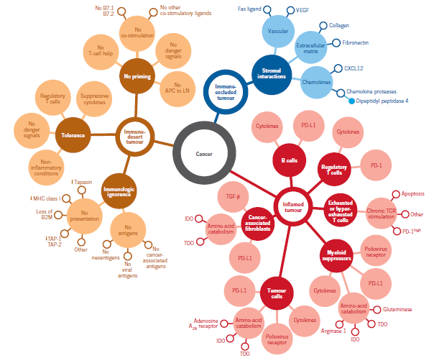
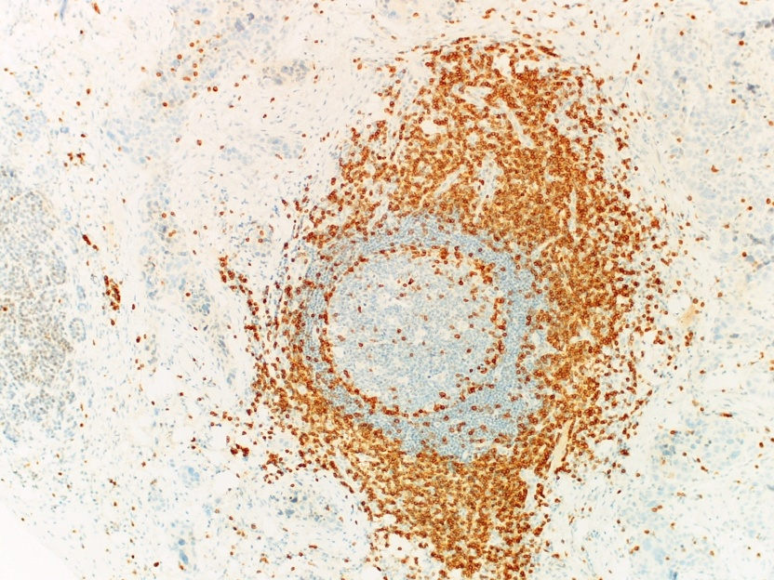
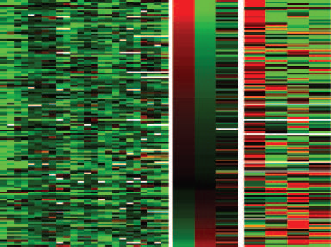
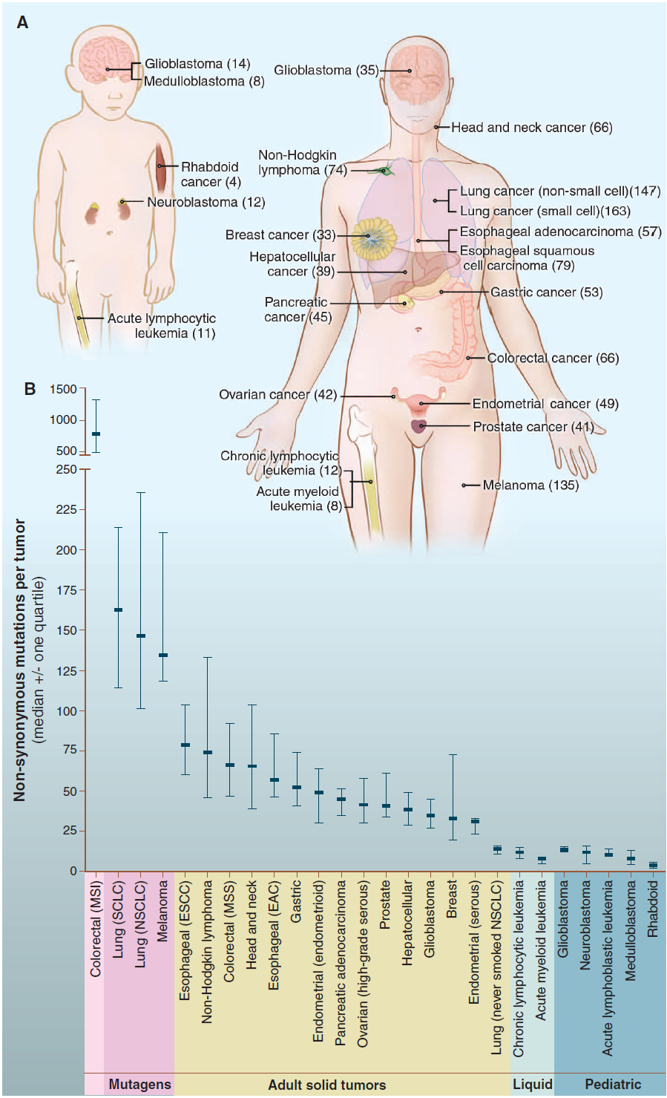
ΑΝΟΣΟΛΟΓΙΑ ΚΑΙ ΚΑΚΟΗΘΗ ΝΕΟΠΛΑΣΜΑΤΑ
Περικλής Γ. Φούκας
B’ Εργαστήριο Παθολογικής Ανατομικής
Ιατρικής Σχολής, ΕΚΠΑ

Slide 2
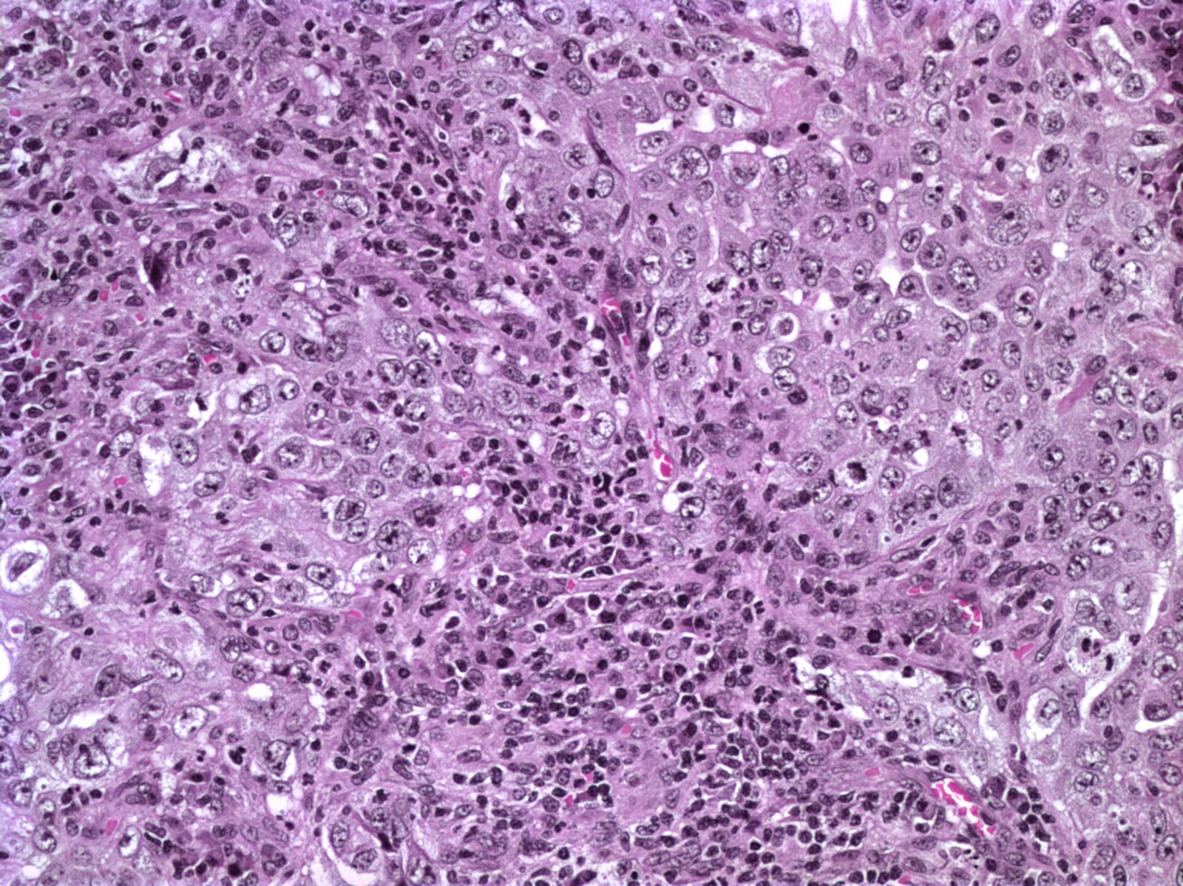
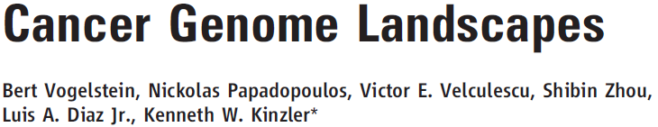
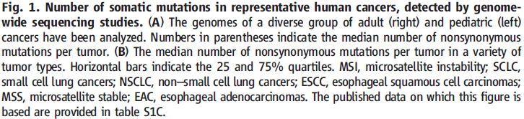
Notes:
Cancer is a genetic disease and the intrinsic genomic instability facilitates the escape from cytotoxic or targeted therapies.

Slide 3
Ca
Ca
TME
Notes:
Tumor tissues are complex structures where malignant cells interact with a variety of different cell types that include cells from the innate and adaptive immune system, blood vessels, lymphatics stromal cells and fibroblasts

Slide 4
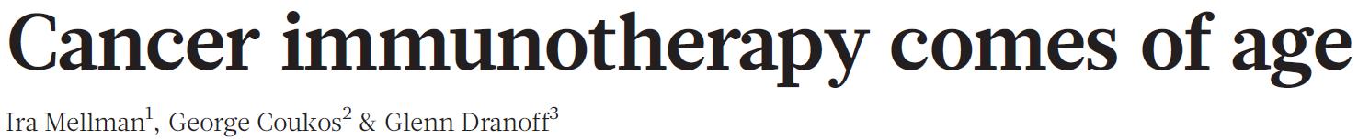
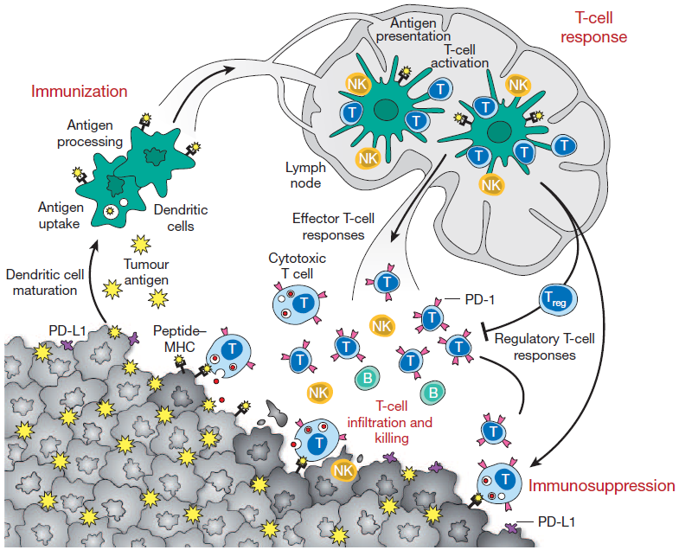
Notes:
The mechanisms that regulate anti-tumor T cell responses are nicely depicted in cancer-immunity cycle

Slide 5
Φορτίο μεταλλάξεων και νεοαντιγόνων
Notes:
The release of tumor antigens constitutes a central part of the cycle

Slide 6
Δενδριτικά
κύτταρα
Notes:
Antigens are captured by DCs and transfered to LN

Slide 7
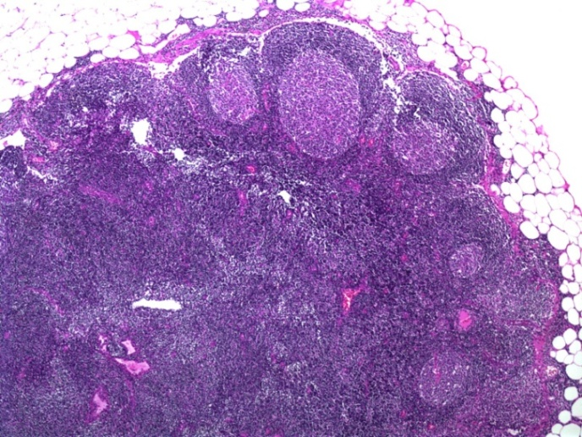
Secondary Lymphoid Organs
(=Επιχώριοι λεμφαδένες)
Notes:
For the priming and activation of peripheral immune cells

Slide 8
Tumor immune microenvironment (TIME)
Notes:
Which traffic back and infiltrate the tumor compartment and after tumor cell recognition they mediate tumor cell death

Slide 9
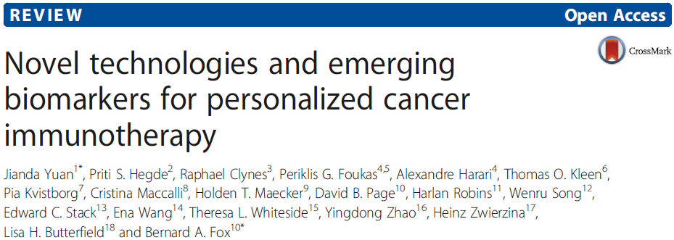
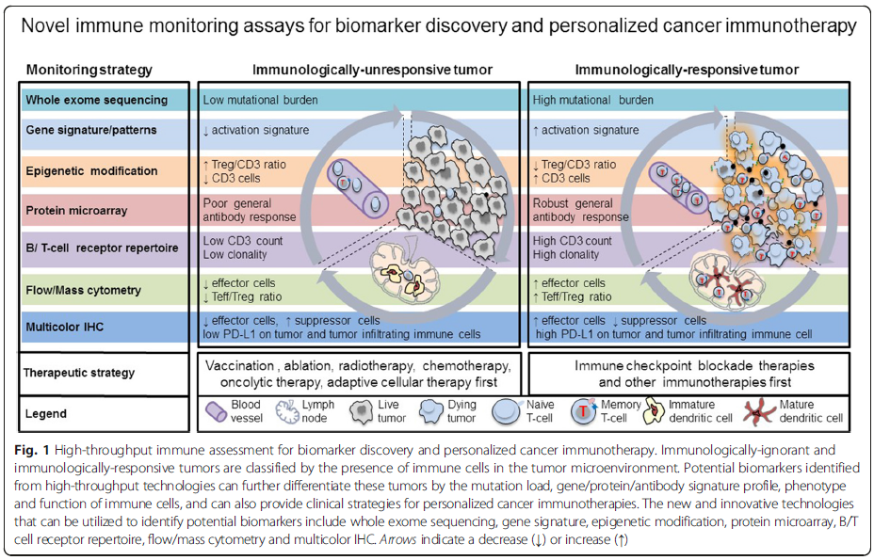
Notes:
In nowadays, there are many platforms in hand to characterize in depth the different steps of the cancer-immunity cycle. Genomic and transcriptomic analyses are part of routine clinical practice whereas proteomic and metabolomic approaches are currently considered rather experimental

Slide 10
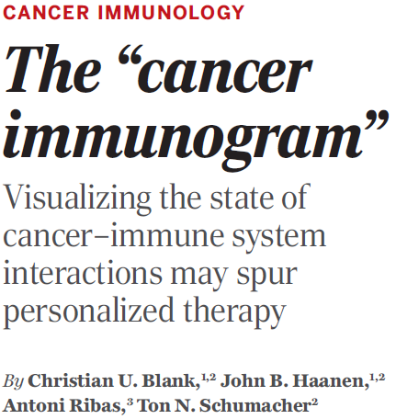
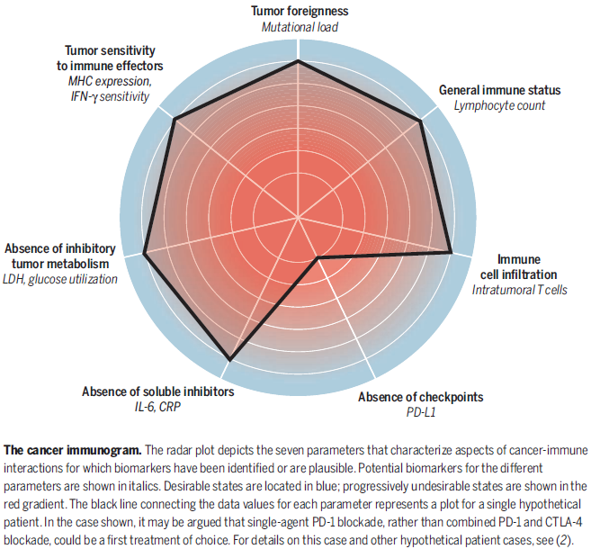

Slide 11
Secondary Lymphoid Organs
Peripheral blood
Tumor mutational and neoantigen
landscape
Tumor immune microenvironment (TIME)
Notes:
Among the different steps of the cancer-immunity cycle….

Slide 12
Secondary Lymphoid Organs
Peripheral blood
Tumor mutational and neoantigen
landscape
Tumor immune microenvironment (TIME)
Notes:
Among the different steps of the cancer-immunity cycle….

Slide 13
Tumor mutational and neoantigen
landscape
Notes:
Among the different steps of the cancer-immunity cycle….

Slide 14
1. Το φορτίο των μεταλλάξεων και των νεοαντιγόνων έχει θετική προγνωστική αξία
2. Το φορτίο των μεταλλάξεων και των νεοαντιγόνων έχει θετική προβλεπτική αξία
3. Το φορτίο των μεταλλάξεων και των νεοαντιγόνων σχετίζεται με το TIME
Tumor mutational and neoantigen
landscape
Notes:
From the step number 1, data from these studies provide evidence that …..
PROVIDES ALSO further support for the idea that mutation-associated neoantigen recognition is an important component of the endogenous antitumor immune response.

Slide 15
Secondary Lymphoid Organs
Peripheral blood
Tumor mutational and neoantigen
landscape
Tumor microenvironment
immune landscape
Tumor microenvironment
immune landscape

Slide 16
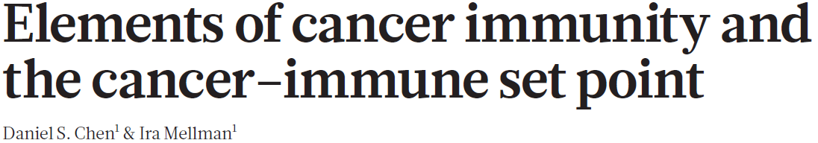
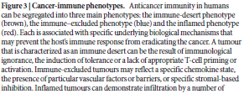
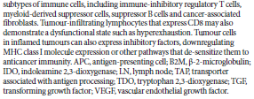
Notes:
We can use these different platforms in order to determine whether a tumor belongs to one of the 3 main cancer-immune phenotypes:

Slide 17
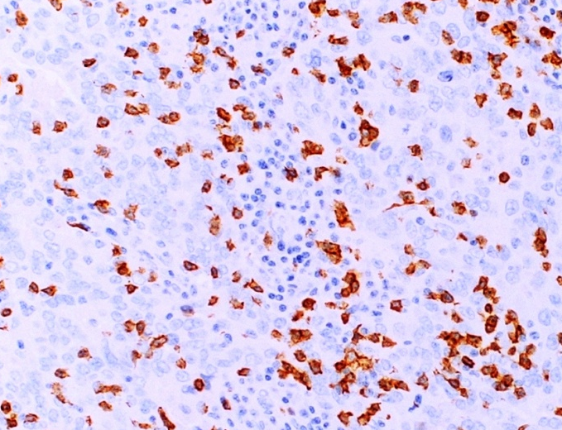
CD8
Notes:
Inflamed tumors with infiltration and expansion of CD8+ T cells, production of chemokines and IFN signaling which induces tolerance through the expression of PD-L1 and IDO

Slide 18
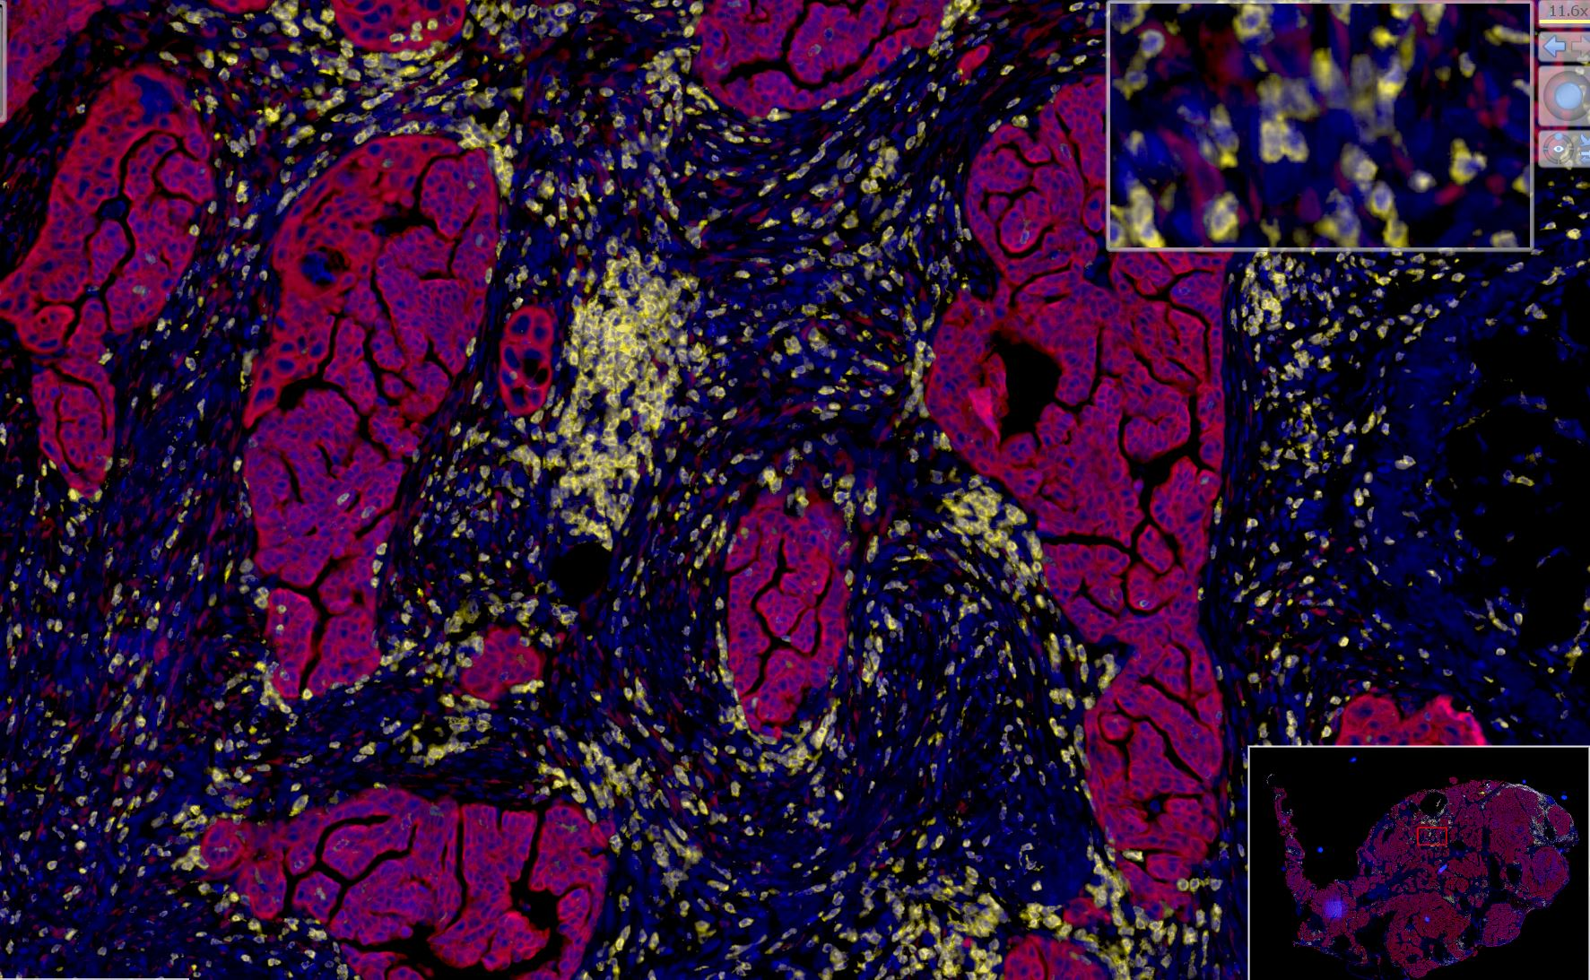
DAPI CD8 Keratin
CD8
Notes:
Immuno-excluded tumors with many CD8+ cells in the tumor stroma but with rare cells infiltrating tumor islands

Slide 19
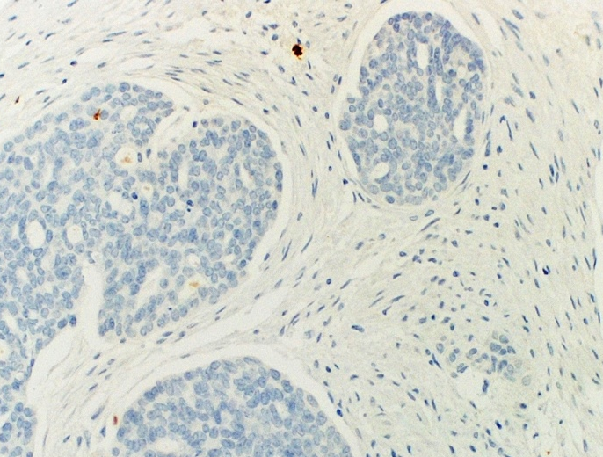
DAPI CD8 Keratin
CD8
CD8
Notes:
Immuno-desert tumors tumors essentialy lymphopenic

Slide 20
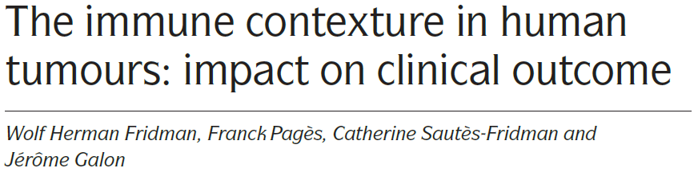
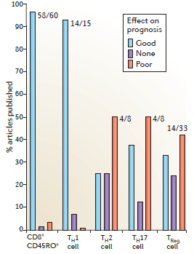
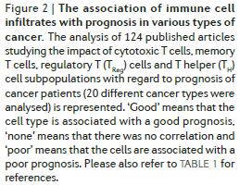
CD4+ T helper cells
Notes:
This Meta-analysis provides the general characteristics of the different tumor-associated immune cell infiltrates. The majority of studies have demonstrated that high densities of CD3, CD8, CD45RO cells and TH1 cells are associated with longer DFS, and / or OS

Slide 21
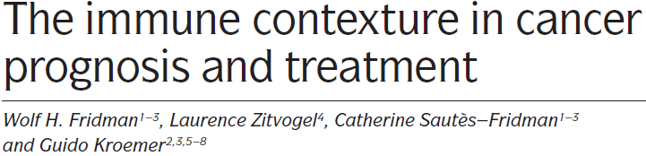
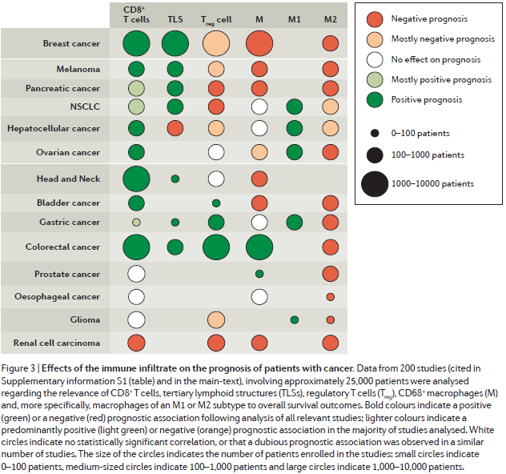
Notes:
M1 macrophages produce tumoricidal molecules such as TNFa, M2 macrophages produce proangiogenic factors like VEGF, cell growth promoting factors like IL-1, IL-6 and immunosuppressive and profibrotic factors such as TGFb

Slide 22
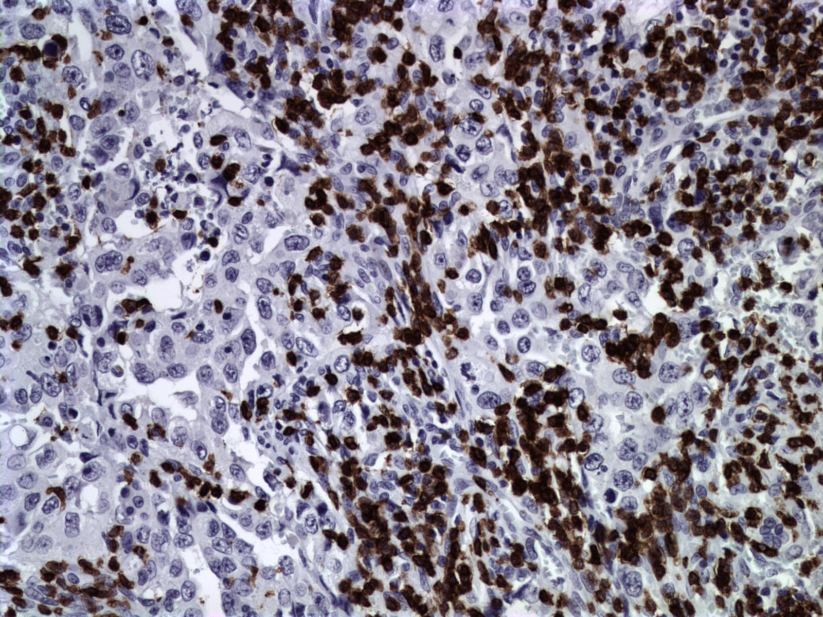
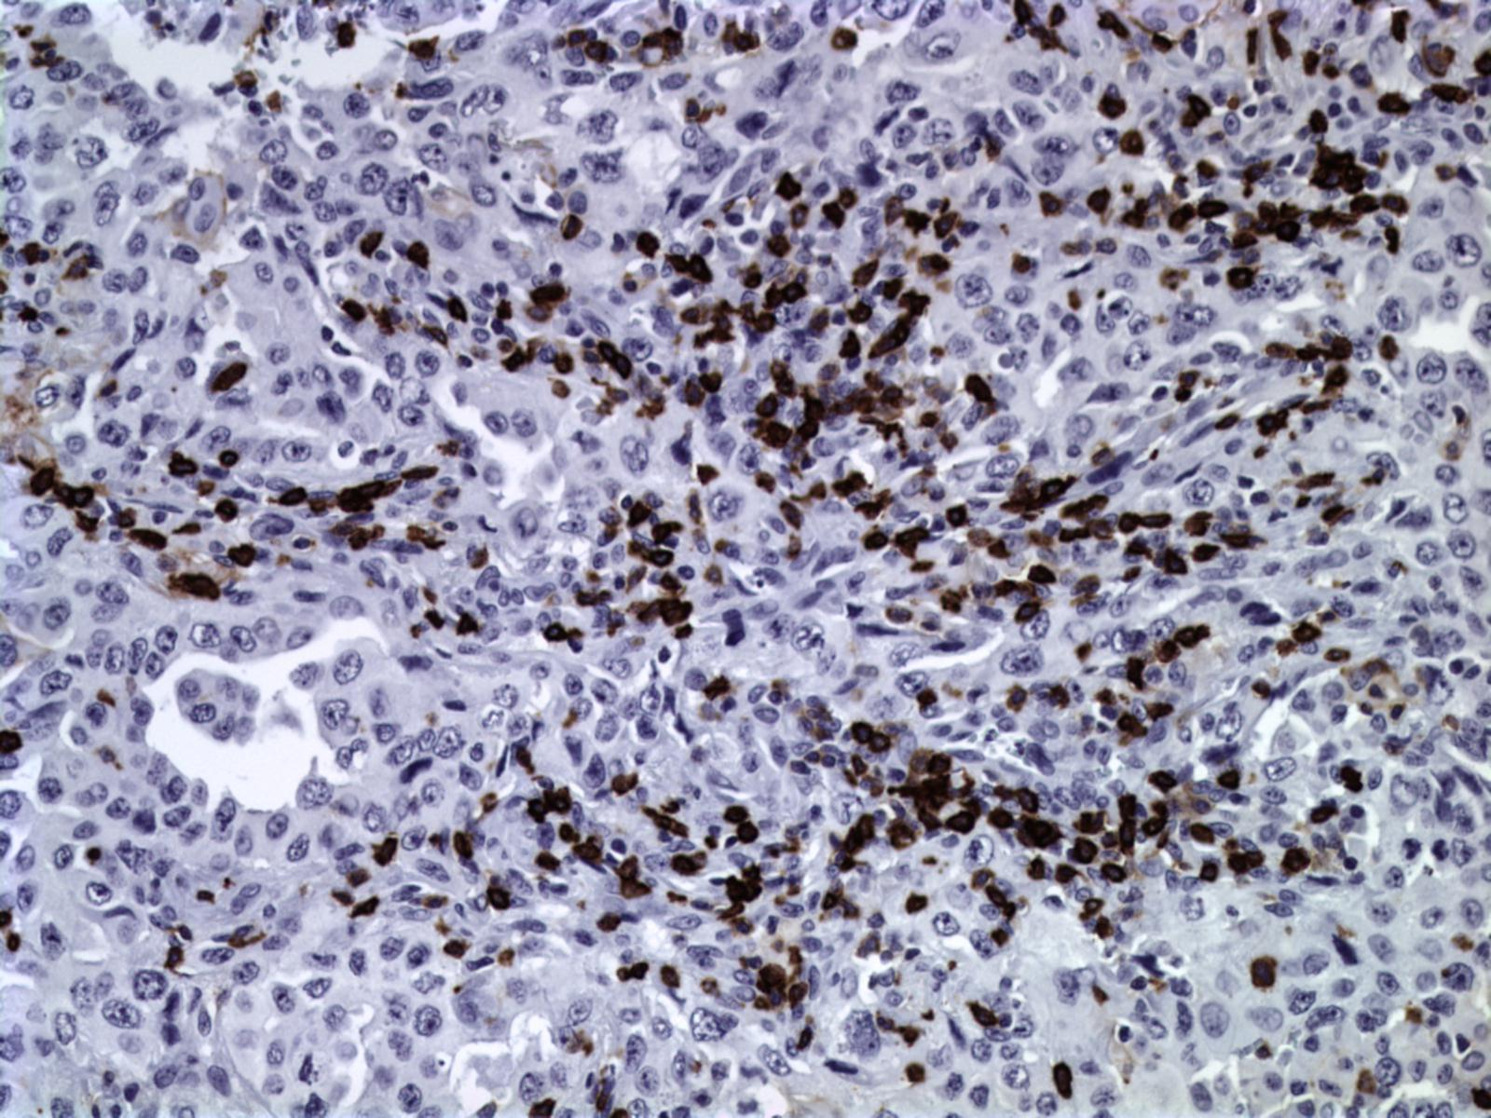
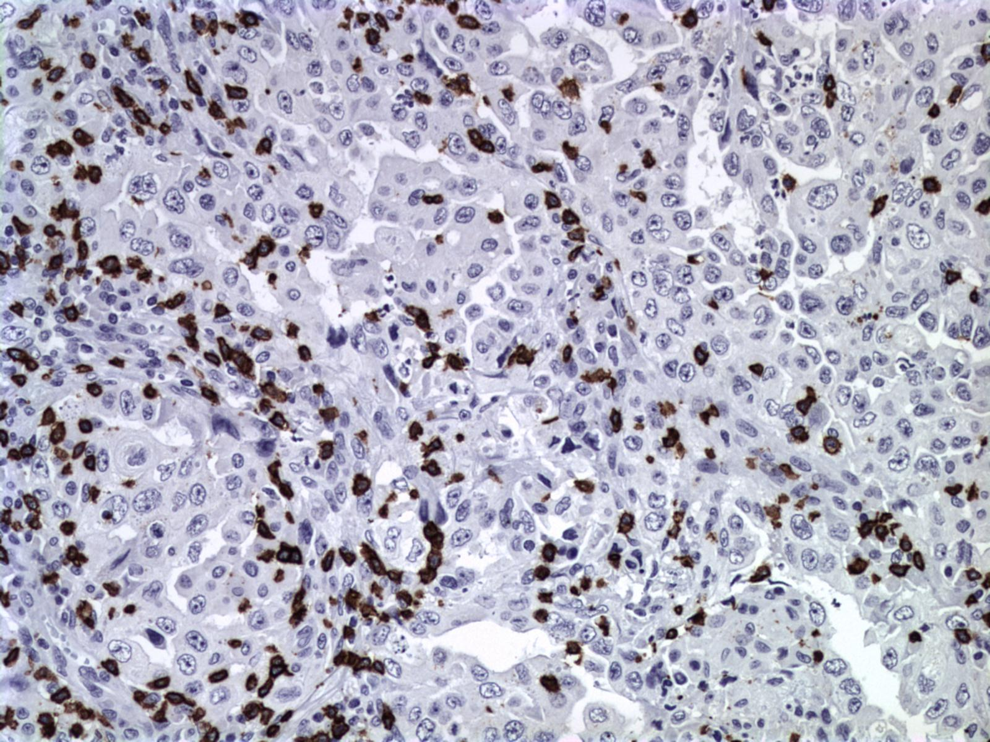
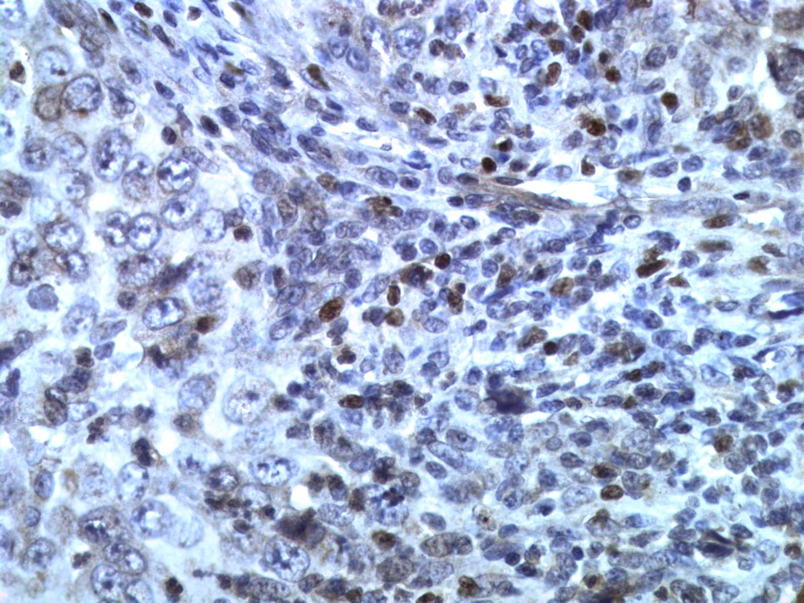
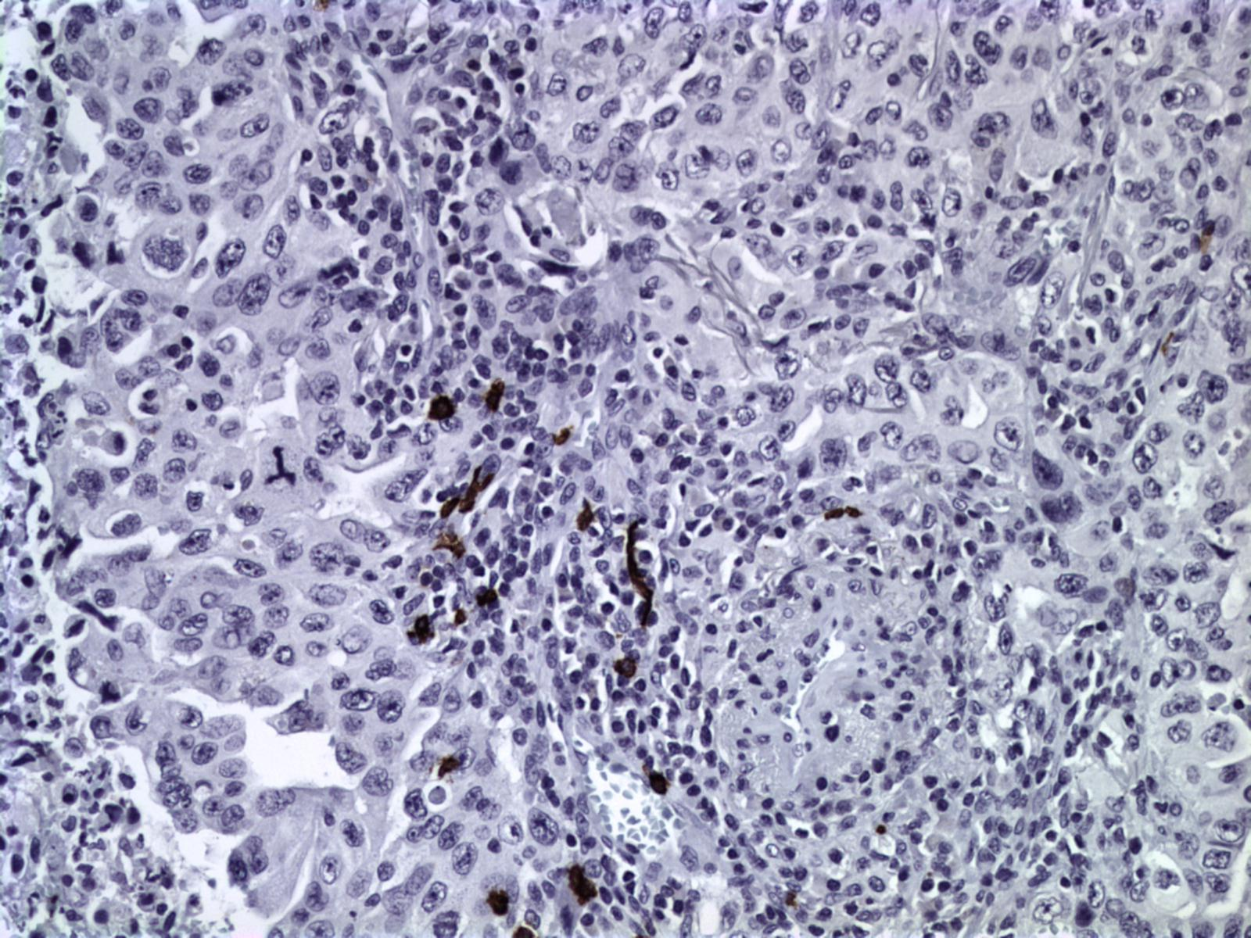
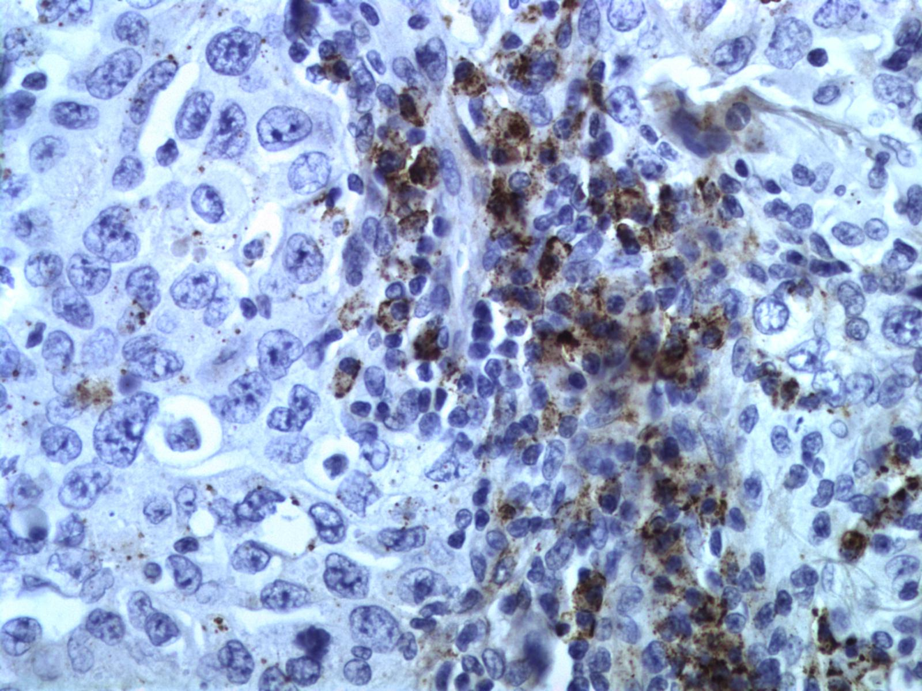
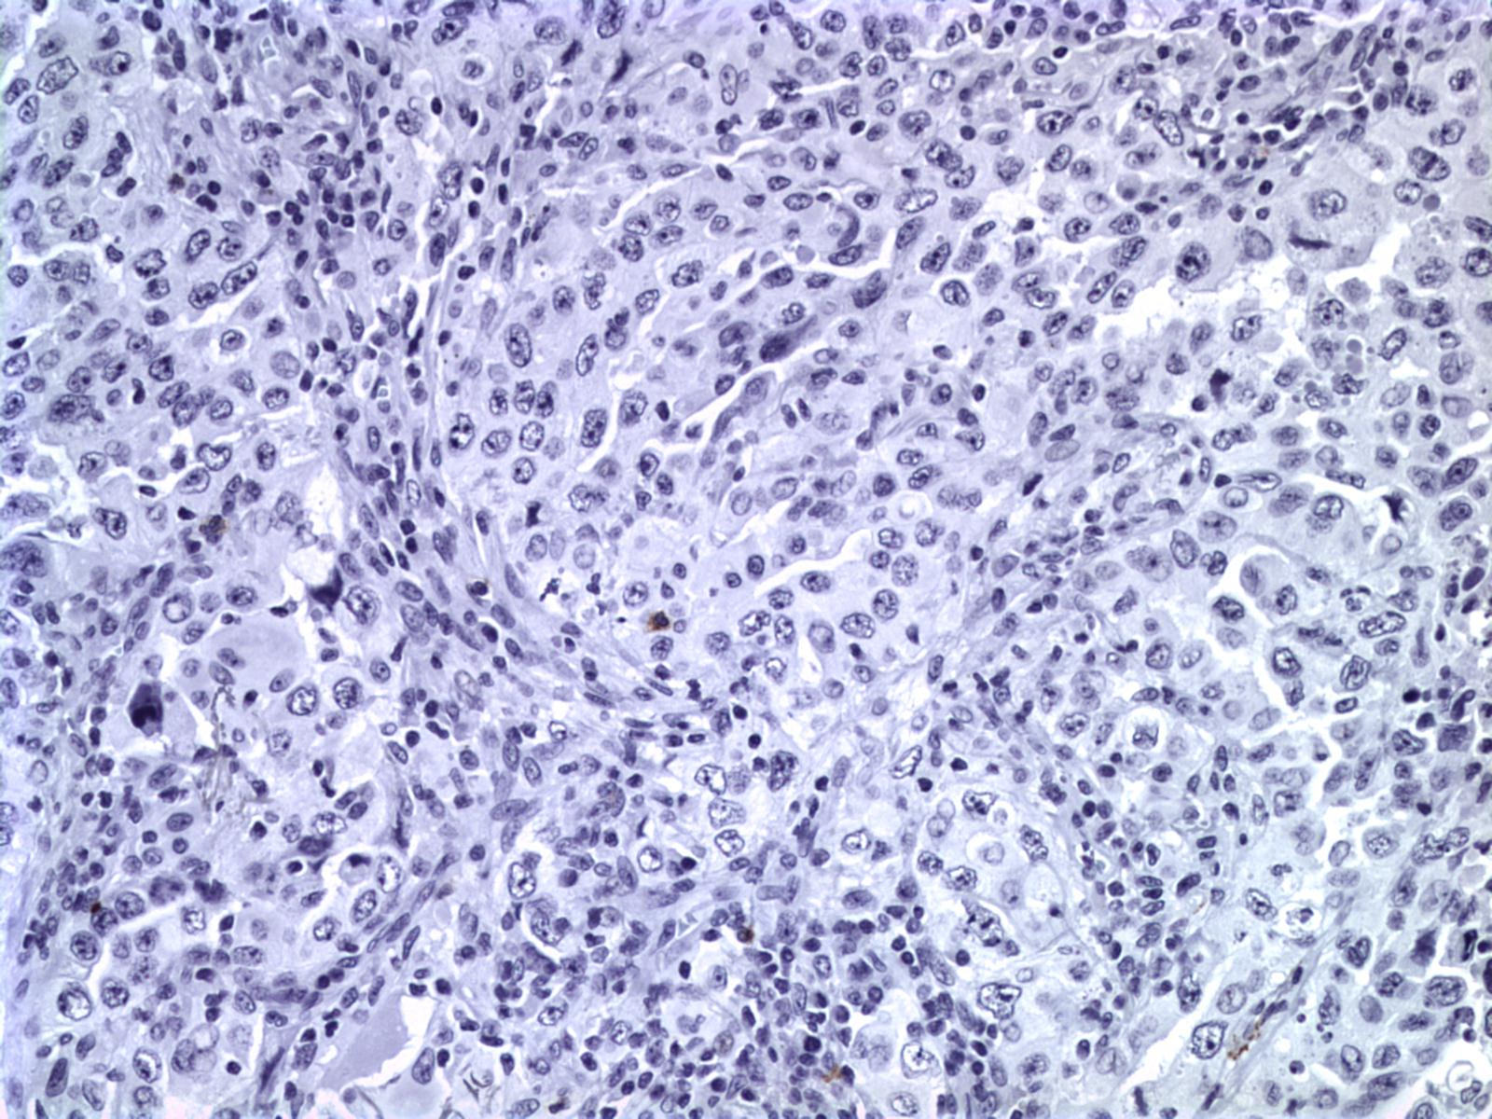
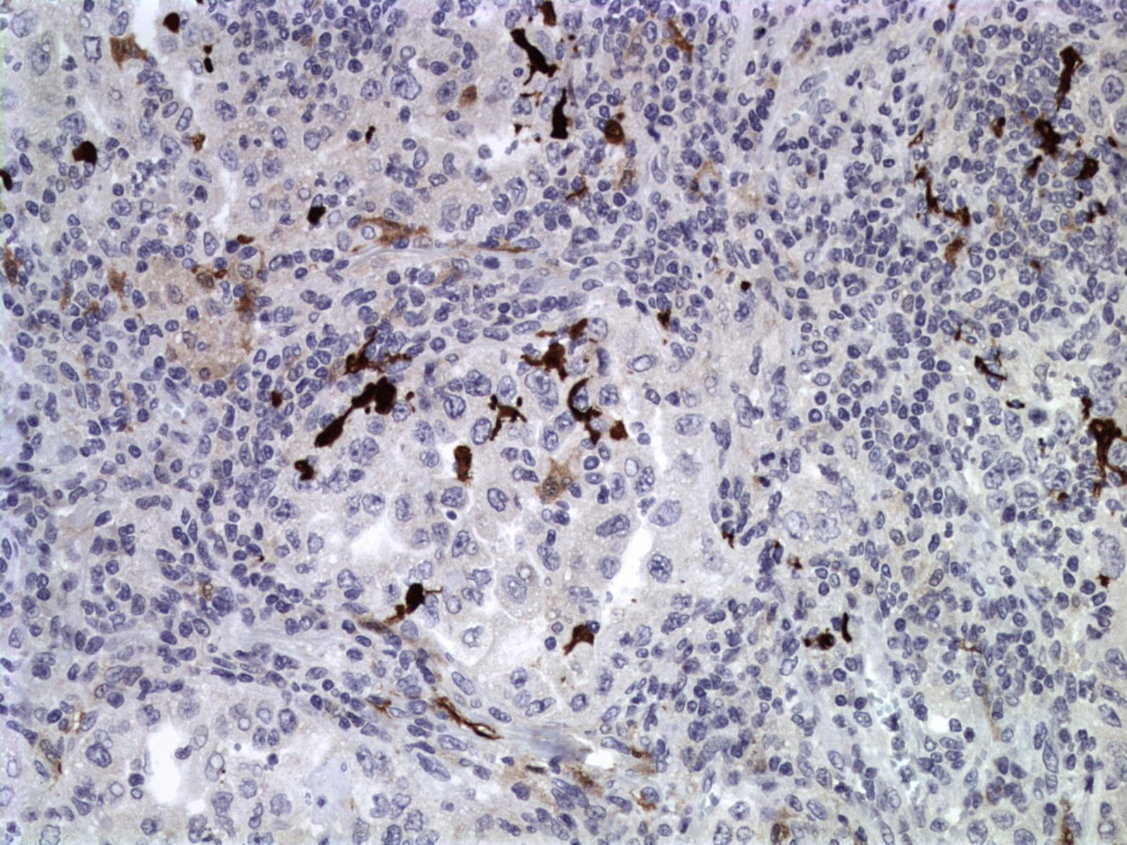
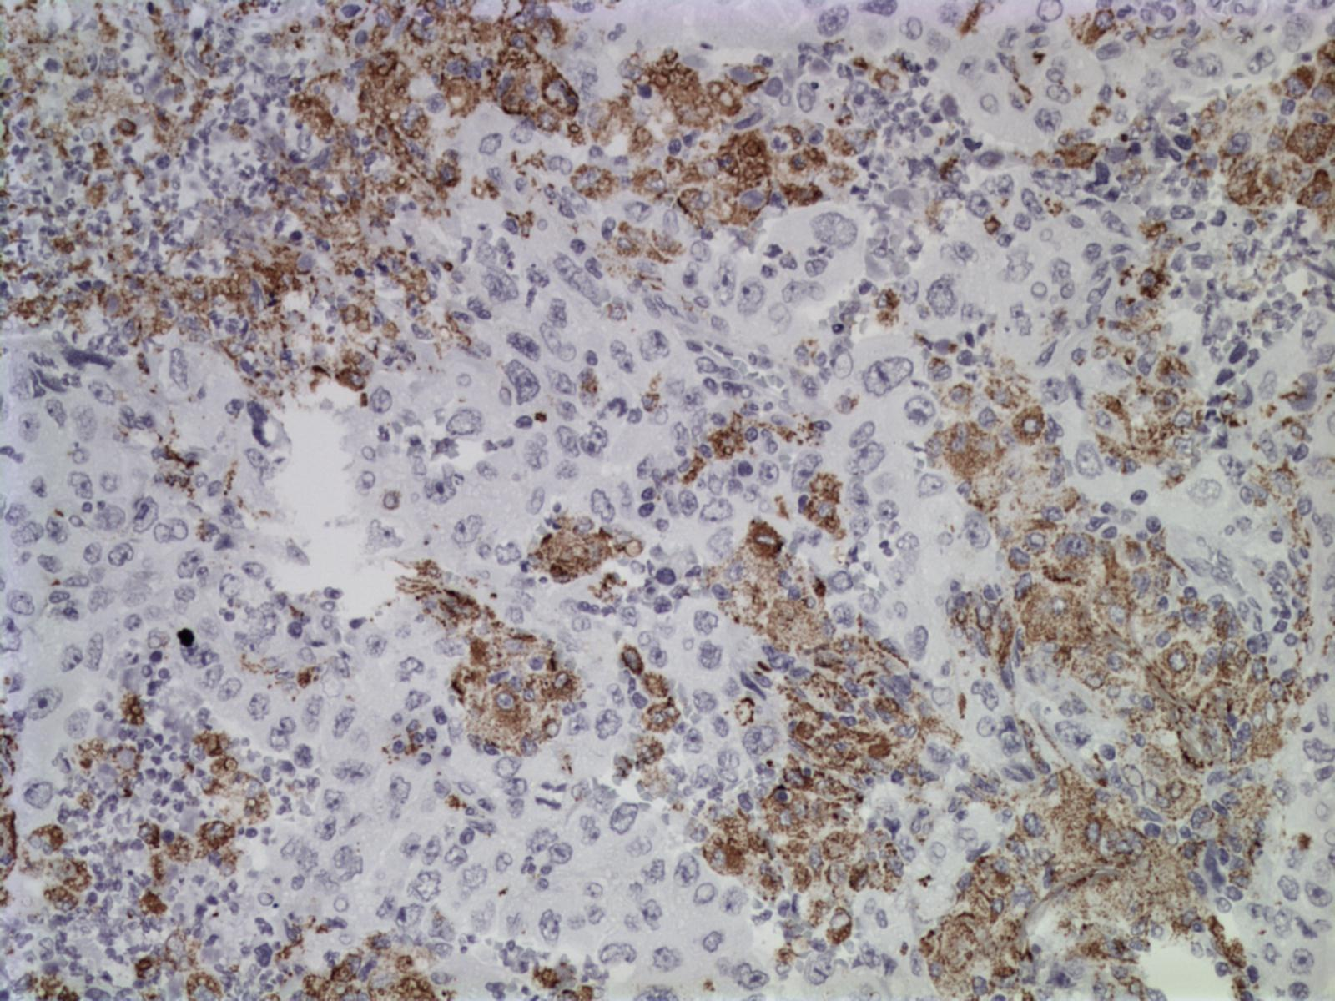
Tumor Immune Microenvironment, ΤΙΜΕ
CD3_T cells
CD4_helper T cells
CD8_cytotoxic T cells
adaptive
Foxp3_regulatory T cells
CD20_B cells
CD138_Plasma cells
innate
CD56_NK cells
S100_dendritic cells
CD68_macrophages

Slide 23
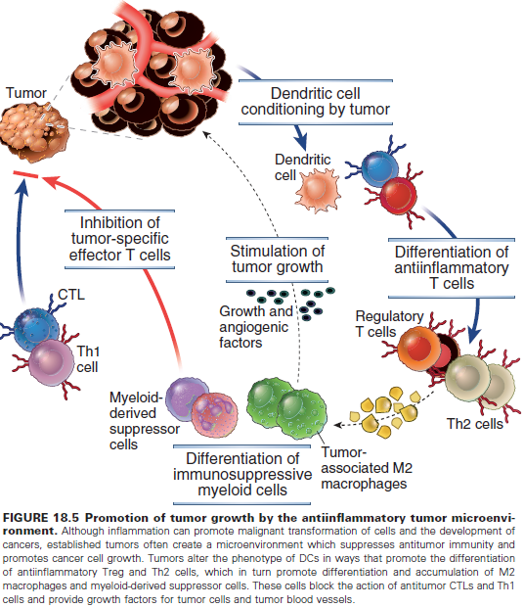
ΤΙΜΕ
Εικόνα από: Cellular and molecular immunology. Abbas & Lichtman

Slide 24
ΤΙΜΕ
Αντινεοπλασματική
δράση
Εικόνα από: Cellular and molecular immunology. Abbas & Lichtman

Slide 25
ΤΙΜΕ
Αντινεοπλασματική
δράση
Νεοπλασματική
δράση
Εικόνα από: Cellular and molecular immunology. Abbas & Lichtman

Slide 26
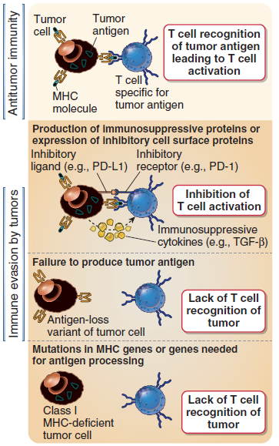
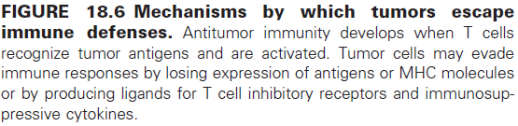
ΤΙΜΕ
Εικόνα από: Cellular and molecular immunology. Abbas & Lichtman

Slide 27
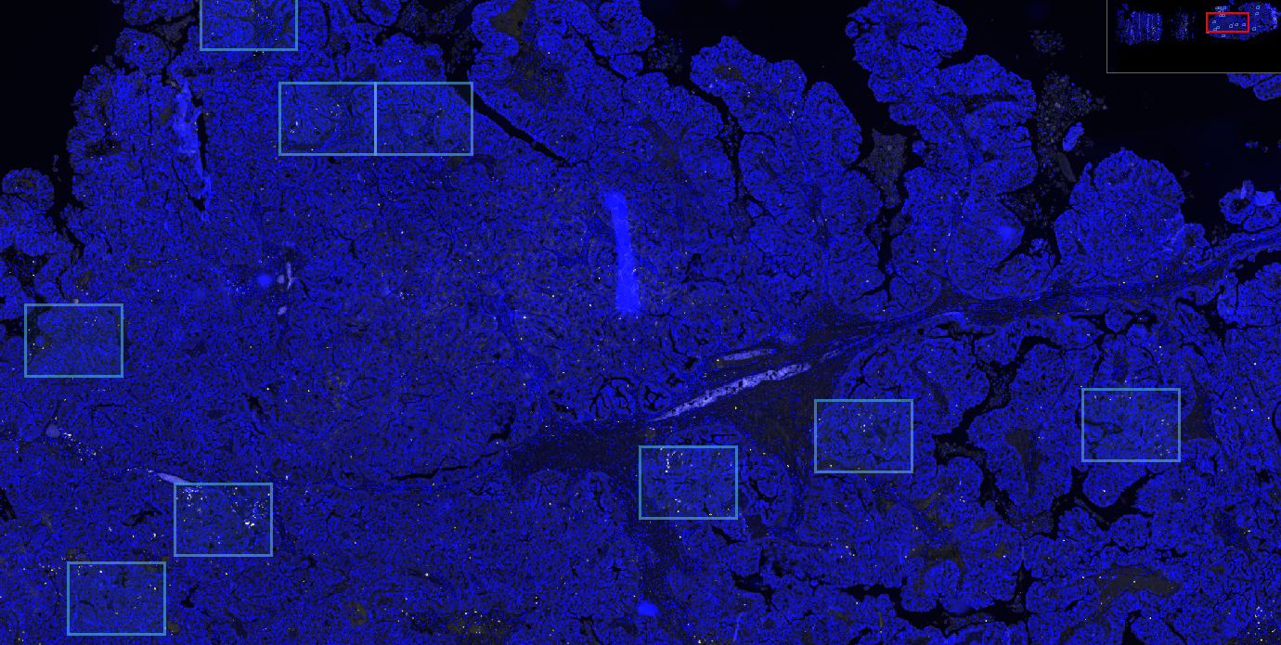
TILs –ve_Case
CD8 DAPI

Slide 28
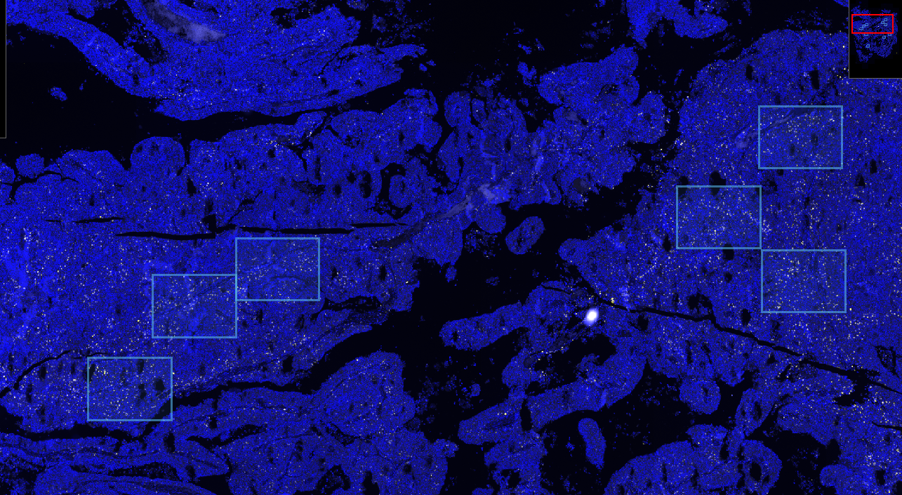
TILs +ve_Case
CD8 DAPI

Slide 29
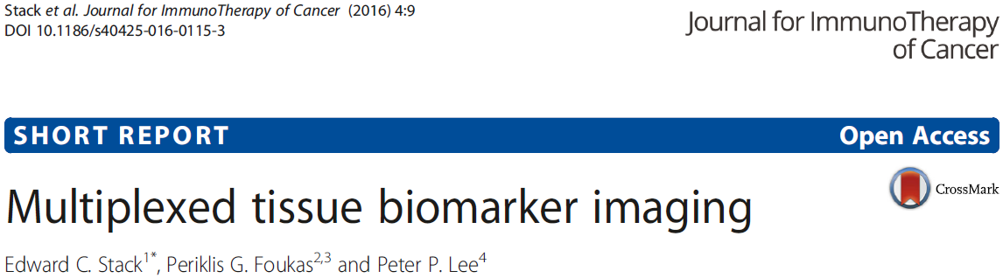
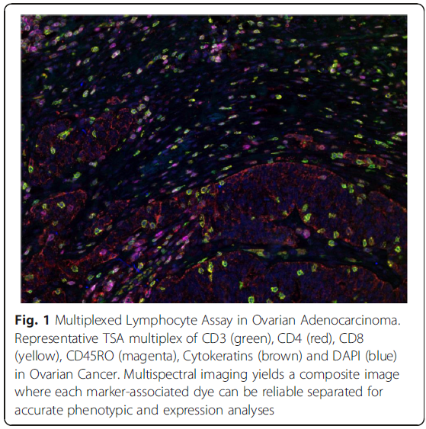
Notes:
In order to assess the presence of both tumor and immune cell phenotypes and their spatial relationships, in situ multiplex immunohistochemistry techniques are important technologies, which provides information that might be complementary or even superior to gene expression profiling.

Slide 30
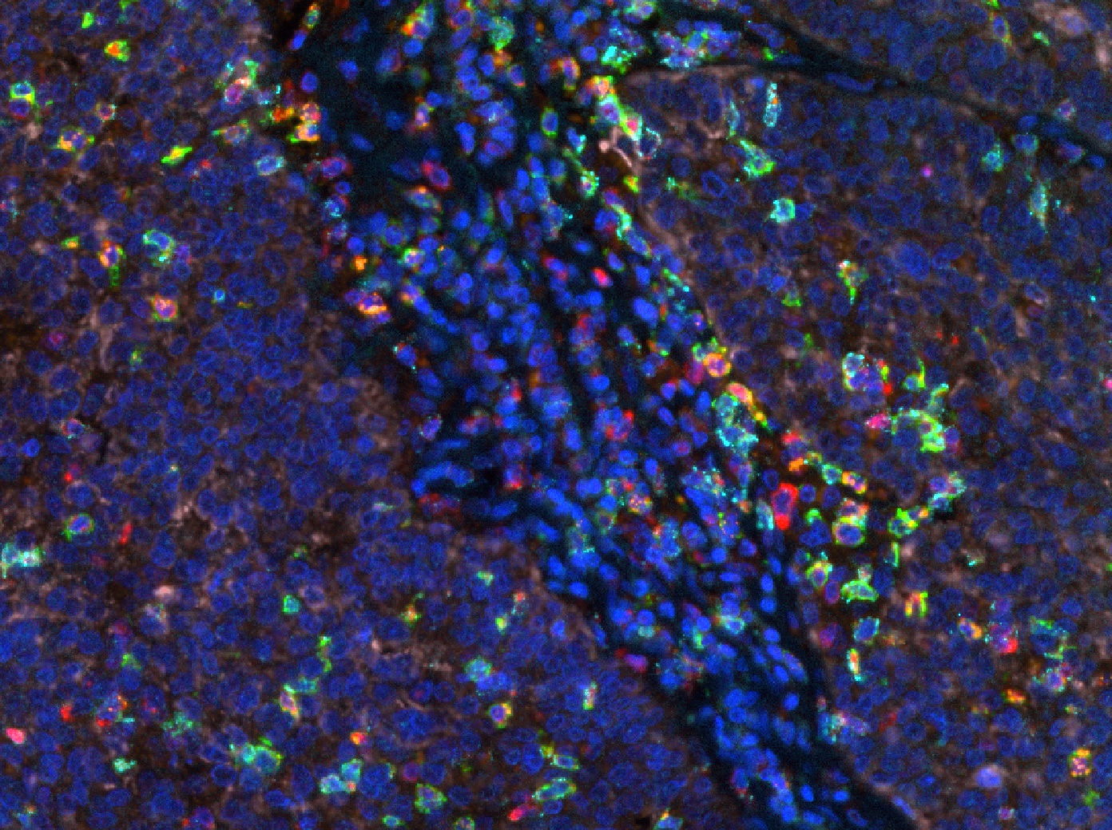
CD8
NFATc2
Keratins
GranzB
Merge / Composite
PD1
OVCA

Slide 31
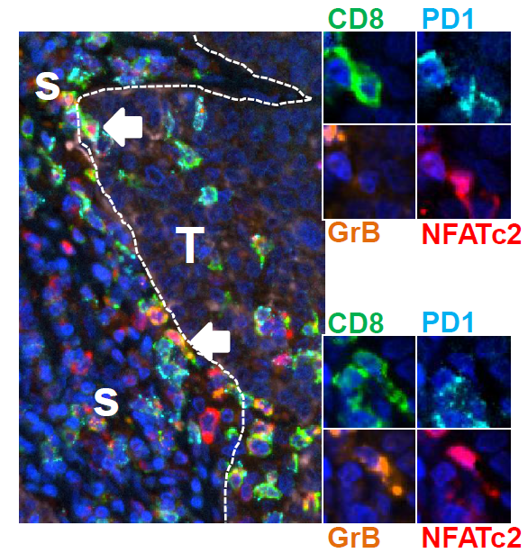

Slide 32
Panel : PD-L1 / CD68 / CD11c / CD8 / Keratins / DAPI

Slide 33
DAPI CD8 Keratin
CD8
CD8
Notes:
Immuno-desert tumors tumors essentialy lymphopenic

Slide 34
Tumor tissue-level studies
High-TILs
Low-TILs
Mechanisms of immune escape and tolerance may differ
↑ checkpoint inhibitor ligands
↑ Tregs, IDO, immunosuppressive factors
↓ DC infiltration, ↓ CD8 T cell infiltration
↑ immunosuppressive oncogenic
pathway signaling
Notes:
The recognition of the cancer immune phenotype is important as the mechanisms of immune escape and tolerance may differ and so the immunotherapeutic strategies

Slide 35
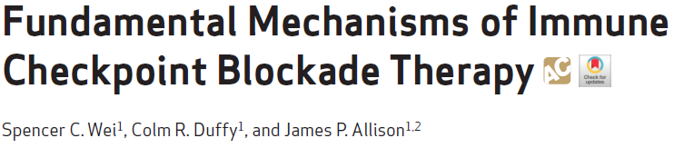
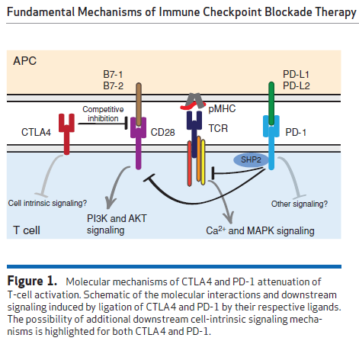
Αντιγονοπαρουσιαστικό
κύτταρο
Τ λεμφοκύτταρο

Slide 36
Αντιγονοπαρουσιαστικό
κύτταρο
Ενεργοποίηση
Τ λεμφοκυττάρου
Τ λεμφοκύτταρο

Slide 37
Αντιγονοπαρουσιαστικό
κύτταρο
Αναστολή
ενεργοποίησης
Τ λεμφοκυττάρου
Τ λεμφοκύτταρο

Slide 38
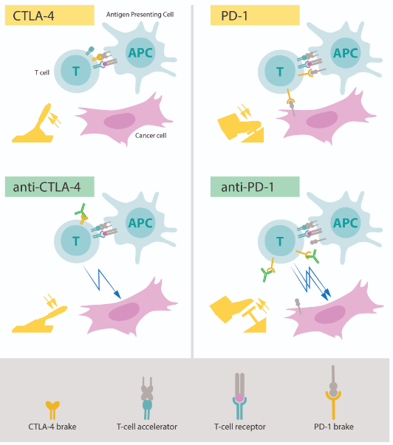
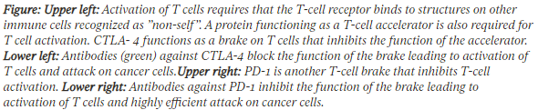
https://www.nobelprize.org/prizes/medicine/2018/press-release/

Slide 39
PD-L1 expression
https://www.nobelprize.org/prizes/medicine/2018/press-release/

Slide 40
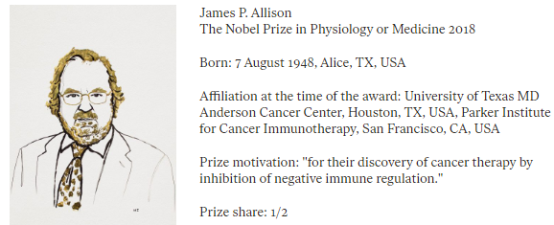
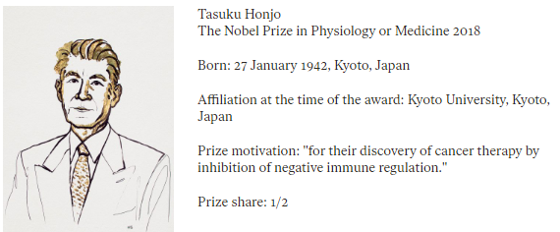
PD-L1 expression
https://www.nobelprize.org/prizes/medicine/2018/press-release/

Slide 41
T
B
TLO or TLS
T
B

Slide 42
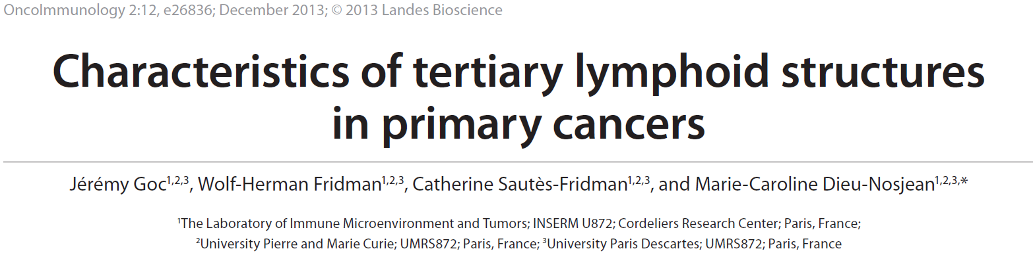


Έκτοποι λεμφικοί σχηματισμοί σε:
χρόνιες λοιμώξεις π.χ. H. pylori,
αυτοάνοσα νοσήματα,
χρόνια απόρριψη μοσχεύματος, και
΄κακοήθη νεοπλάσματα

Slide 43


CD20
T
B
CD3

Slide 44



Ruddle NH. J Clin Invest. 2014; 124(3):953-959
Similarities
Cellular content and organization
Stromal components
Lymphoid chemokines
Vasculature (HEVs, LVs)

Slide 45
Ruddle NH. J Clin Invest. 2014; 124(3):953-959
Differences
Ontogeny, predetermined locations
Ectopic to canonical lymphoid organs.
Arise in response to inflammation
No capsule (free diffusion of antigen?)

Slide 46



Slide 47




Slide 48




Slide 49
Notes:
TLS in HCC might actually constitute a niche that favours the emergence of transformed cells

Slide 50



Slide 51
ΑΝΟΣΟΛΟΓΙΑ ΚΑΙ ΚΑΚΟΗΘΗ ΝΕΟΠΛΑΣΜΑΤΑ
Περικλής Γ. Φούκας
B’ Εργαστήριο Παθολογικής Ανατομικής
Ιατρικής Σχολής, ΕΚΠΑ
ΕΥΧΑΡΙΣΤΩ

