Slide 1
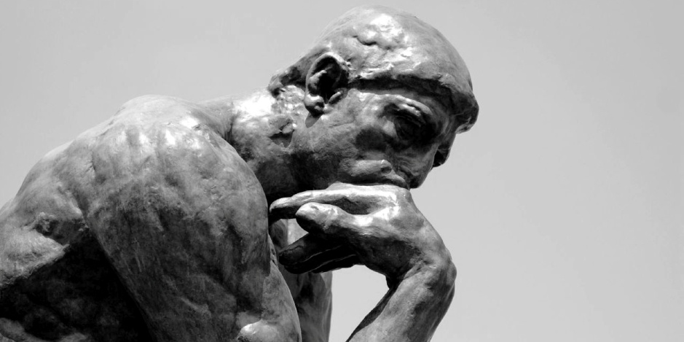
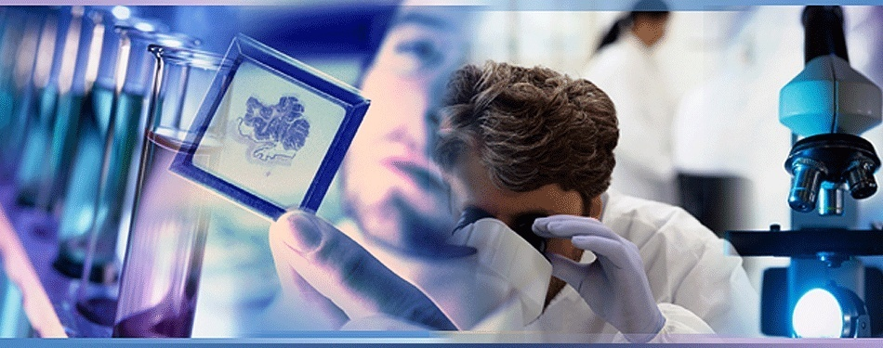
European Society of Pathology Special Session: Pathology and the public. 3.9.2017 The relationship between pathologist and patient as a philosophical stimulus: Personal reflections. Prof. Dr Andreas C. Lazaris, Pathologist

Slide 2
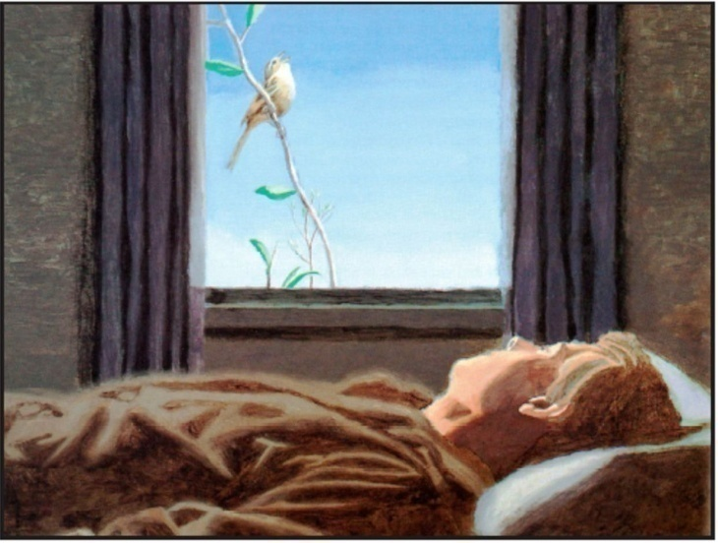
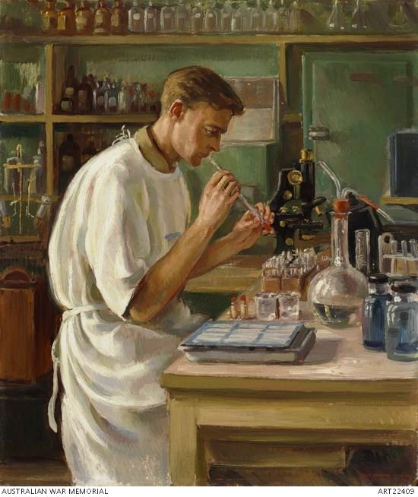
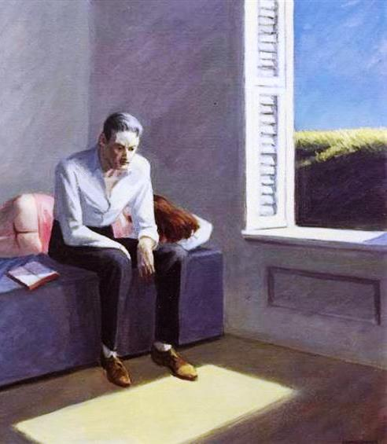
Goals and structure of this presentation
According to ECP2017 hosts,
“ the motto of the congress
– Pathology for Patient Care –
will highlight the added value
of the pathology science and discipline
in providing care
and improving health outcomes
for patients and population.”
In line with the objective of the conference and the principles of “Pathology and Public” group, we will first examine how the pathologist and patient relationship can be of mutual benefit to both parties.
Then, after putting the pathologist with his scientific training in the patient's position, we will attempt to philosophize about the similarity and diversity of people and to extract some balancing messages about our everyday life.
R Pope : Sparrow, 1989.
E Hopper : Excursion into Philosophy, 1959.

Slide 3
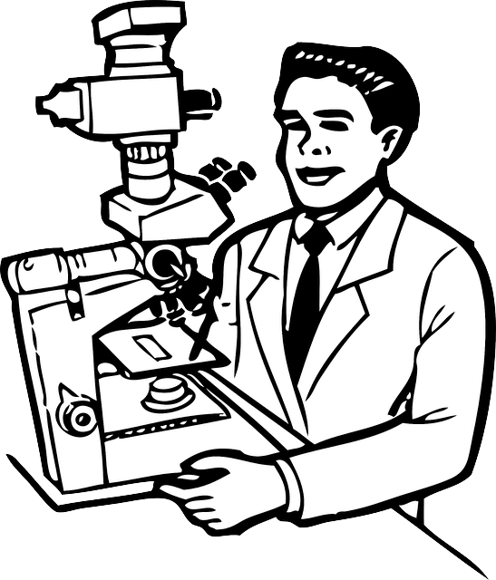
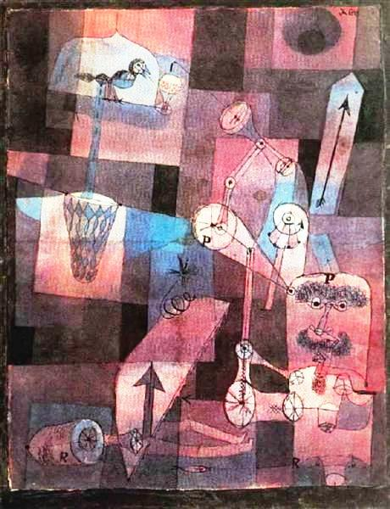
The pathologist is exercised daily to recognize the similarity and diversity of cells, tissues and organs. Physiological elements are organized in order and homogeneity, while abnormal elements clearly differ.
The pathologist deals with both the cell, i.e., the structural unit, the beginning of life, and the autopsy, i.e., the end of life, thus covering the entire spectrum of human life.
By possessing scientific knowledge, the pathologist is required to incorporate ethical reason into biotechnology and to reflect on man and on the quality of his life, on the basis of the modern possibilities of science.
P Klee :
Analysis of diverse perversities,1922.

Slide 4
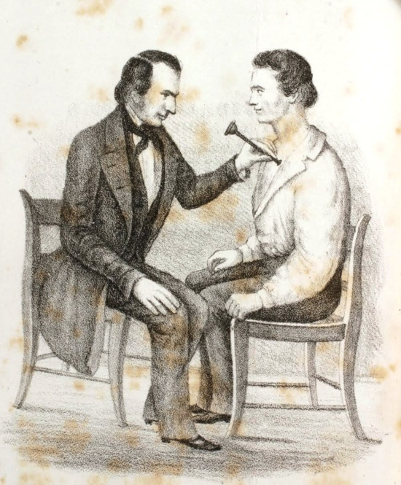
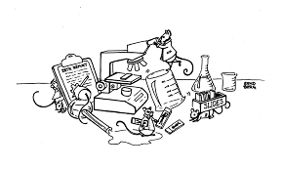
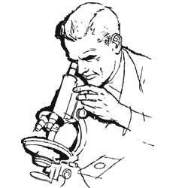
Pathologists are often referred to as the “doctor’s doctor” rather than the “patient’s doctor”, because they interact with clinicians rather than patients.
Design by Sundberg
Picturing the physician–patient encounter
L. M. Lawson, M.D., "Lectures on the Pathology, Diagnosis and Treatment of Diseases of the Chest; … Mode of Auscultation -- Stethoscopes," The Western Lancet Vol XI, No.3 (March, 1850): fig 24 (opp p 137).
The pathologist’s under recognized job.
Part of the problem is the media and its portrayal of the laboratory and the pathologists who work in it as a “ black box” which transforms the sample into diagnosis. How often have you heard the phrase, “We are waiting for the results” ? What you are really waiting for is the pathologist to make the diagnosis.
A clear report, correlating with clinical circumstances and issued by a pathologist whose name is not communicated to patients, is unlikely to generate patients’contact with a pathologist.
Traditionally, pathologists worked behind the scenes, studying specimens and developing diagnoses. A patient would see his primary care physician or specialist, who would provide a specimen to a pathologist. The pathologist would review the specimen and return a diagnosis or recommendation to the physician, who would then transmit that information to the patient. Fierce competition in health care, declining reimbursements, and the implementation of industrial productivity measures conspire to keep pathologists focused on “glass”, not on discussion with the patients whose samples are on it.

Slide 5
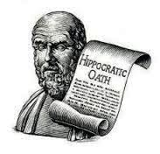
Instead of being the “doctor’s doctor”, the pathologist should be part of a clinical care team.
If there’s no need for a relationship between the pathologist and the patient, then maybe pathologists don’t need to be physicians. Maybe we could be histomorphologists. Or molecular analysts. We could be skilled technicians who are adept at categorizing abnormalities that we detect in patient samples sent to us by physicians caring for the patient.
Pathologists must be physicians because our primary obligation is to the patient. Our obligation is to help the patient first, regardless of insurance pressures, surgeon intimidation, political expediency, or whatever might get in our way. Just like we said we would when we took the Hippocratic Oath.

Slide 6
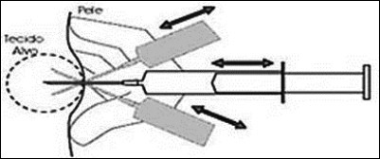
Does the pathologist have direct patient contact?
Pathologists may perform bone marrow biopsies to evaluate blood and bleeding disorders.
We are called upon to perform fine needle aspirations. In many instances, an immediate diagnosis can be rendered, saving the patient a costly and time consuming surgical biopsy.
In transfusion medicine, the administration of blood products is actually a treatment; the pathologist may often manage the patient receiving these products, necessitating bedside monitoring.
Whenever there is a discrepency between the diagnosis on the microscope slide or with a laboratory test, the pathologist may need to examine the patient and review the patient's records to resolve the issue.
Remember, the pathologist is first a physician.

Slide 7
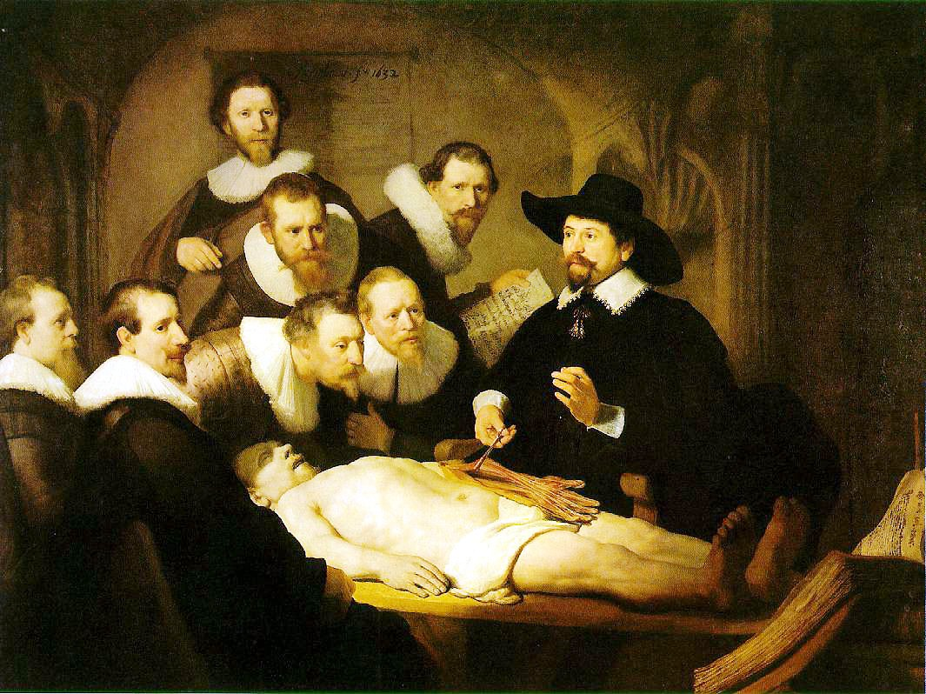
Αnatomy is merely the pathologist’s starting point.
Rembrandt Van Rijn : The Anatomy Lesson of Dr. Nicolaes Tulp, 1632.

Slide 8
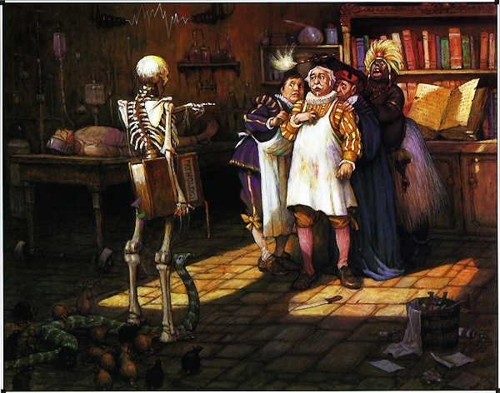
Surgical pathology is the pathology of the living patient! It is ironic that the physician making the patient’s diagnosis, the pathologist, very rarely has communicated with the patient...until now. The doctor's doctor is ready to be the patient’s physician.
With regard to communication,
if you look at the surgeon/dermatologist/gastroenterologist as a surrogate for the patient,
asking for your help
in the patient’s stead,
then the pathologist-patient relationship makes sense
and can serve as a starting point
for looking at new ways
to practice our specialty.
The modern relationship between a clinician, pathologist, and patient should have a triangular structure, ideally with simultaneous encounters of all three parties; in this way, seeing that the person involved in the critical interpretation of their specimens, regularly meets with the clinicians, people will gain a greater understanding of the role of the pathologist on the team of health professionals who provide for patients’ care.
Pathologists should be committed to being accessible for direct consultation not only with clinicians, but also with patients, particularly since nowadays the latter gain increased access to their medical records (including pathology reports) and medical information via the Internet. We might make the public -and clinicians- more aware of our availability to review cases with those patients (or families) who might desire these consultations.
People should realize that pathologists do not only work
with dead people.

Slide 9
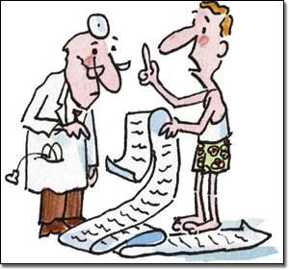
Patients generally decide to speak to a pathologist because they seek information about the pathologic report typically communicated to them by the clinician.
They may ask to discuss a specific facet of their report, how the pathologist arrived at a diagnostic interpretation, if there is any uncertainty about the diagnosis or whether a second opinion is warranted, the feasibility of performing additional special studies on tumors for new treatments, the results of autopsies on family members.

Slide 10
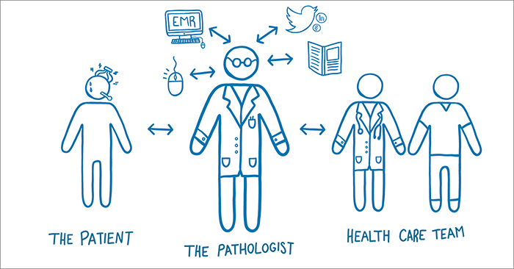
The pathologist, as an integral member of the health care team,
advises on test selection, evaluates results, and can explain outcomes
both to the rest of the multidisciplinary team and to patients directly.
In the face of serious illness, patients may be experiencing marked distress and,
in these circumstances, their request for information involves an attempt
to objectify, or gain control over a situation, rather than deal with it solely emotionally.
The author of the diagnostic pathology report is better equipped to explain it
than a clinician, its usual translator, who may lack in his/her comprehension of pathology reports. Of course, the pathologist should promote good communication
with the patient’s primary clinician and inform him/her
about the tenor of the pathologist-patient consultation meeting.
.

Slide 11
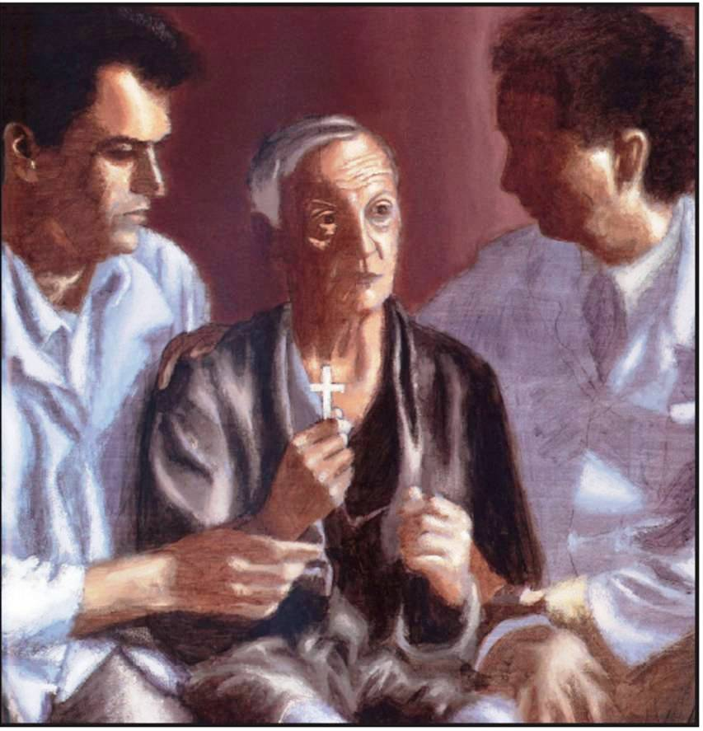
Pathologists should be available to discuss the results of patients’ tests with them and address their concerns.
The most difficult part in this process is to determine where to draw the line between explaining the technical aspects of their reports versus providing clinical advice which is more appropriate for an oncologist and surgeon to explain.
The pathologist should be empathetic toward the patient, a careful listener and a careful speaker using appropriate language (after assessing the patient’s level of sophistication), truthful about the pathologic interpretation, and certain that any therapeutic recommendations that he or she might make, are indeed appropriate.
R Pope : Mr S is told he will die, 1989.
In addition to the cognitive and emotional benefits that may accrue to patients, such encounters can bring pathologists closer to the source of their daily work i.e., the patients, since helping patients may come into gratifyingly clear focus when sitting across from them at the microscope.

Slide 12
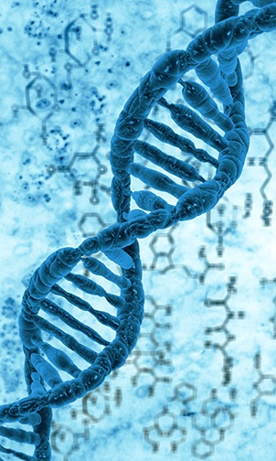
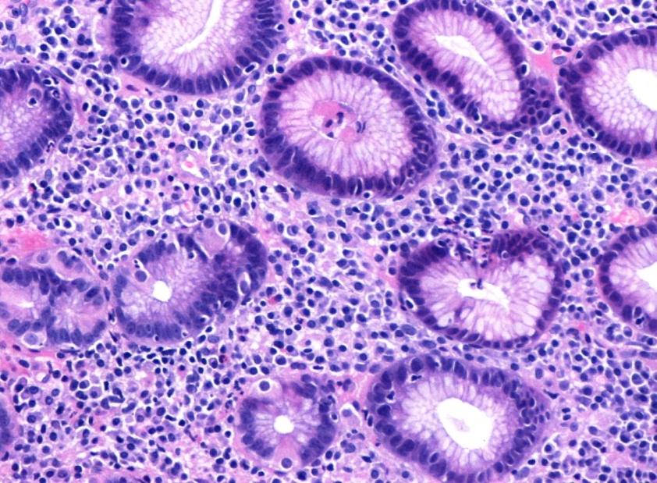
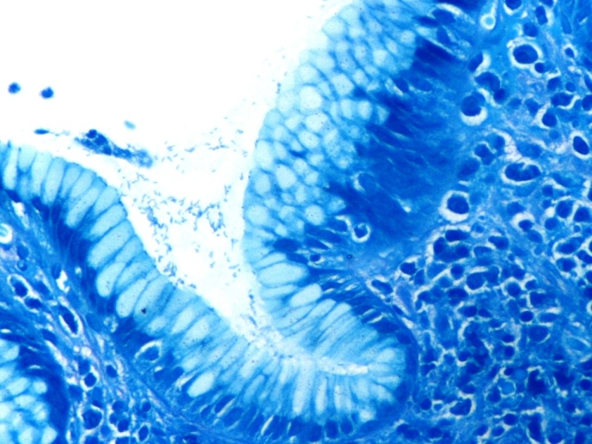
Specimen number: 23984.16 Specimen type: Gastric biopsies Patient’s name: Andreas C. Lazaris Diagnosis: Chronic active HP gastritis Pathologist: Andreas C. Lazaris
The doctor-patient relationship so far requires two distinct, different roles, with some doctors sometimes feeling in a position of power as the patient's illness is safely outside their "ego" and outside the egos of their beloved ones. Ιt is, however, certain that at some point the doctor will find himself/herself in the patient's position. In case the doctor is a pathologist, he/she will probably have to examine samples from his/her own organs, tissues and cells. Then, he/she will realize before his/her eyes, in the most tangible way, how much he/she looks like his/her patients and, at the level of morphology, that he/she can completely be identical with them.
The tissues of humans (but also of animals) are impressively identical at a morphological level but due to differences in tiny parts of the genome, the corresponding beings become definitely unique and can thus be regarded as so different from each other. All human genetic variation falls in 0.1% of the DNA of two modern humans. Ιn my personal view, traditional Pathology stresses the physical resemblance, while Molecular Pathology underlines the individuality.
Which will support the center of gravity of our existence, our similarity or our diversity? Does attachment to similarity always lead to leveling? Does commitment to diversity necessarily lead to individualism?

Slide 13
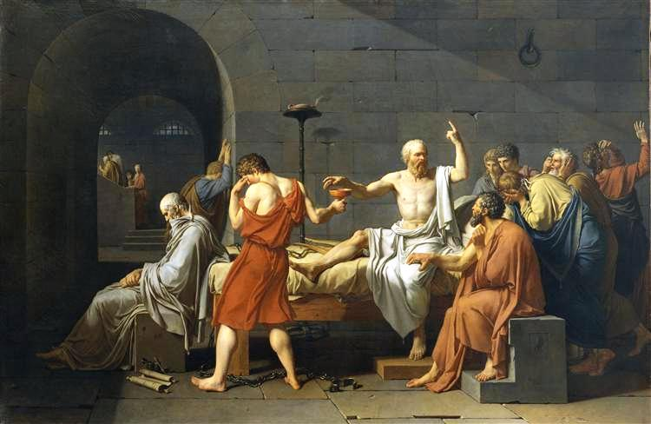
The Hellenic Idea of Philosophy as a Way of Life.
Philosophy should not be thought of primarily either as an attempt to investigate and understand the self or the world, or as a special occupation that concerns only a few. Rather, philosophy must be thought of as fully integrated within life. To be sure, there may need to be professional philosophers, who develop an elaborate set of methods and concepts, but life can be lived philosophically without a technical knowledge of philosophy.
Later in the 19th century, Marx famously criticized previous philosophy by saying that the point of philosophy is not to know things – even to know things about activity – but to change them.
For Kierkegaard, the truths of existence are immediately lived, felt and acted.
Most existentialists
also understand
philosophy as praxis:
involved action in the world and participation in the course of history.
J – L David : The death of Socrates, 1787.
This idea of philosophy was exemplified in the person of Socrates who did not write treatises, but who died for his ideas.
Philosophical concepts
are valuable
insofar as they serve a flourishing life, not as academic exercises.

Slide 14
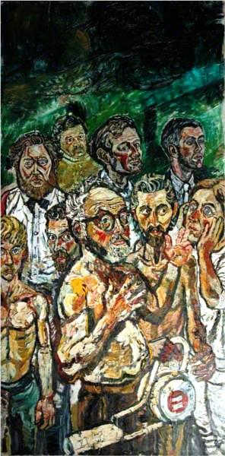
Μe and the others
The Hegelian movement remains one of the most fascinating moments in the history of philosophy since it is for the first time that the constitution of the self does not take place from within the self (as happens with Descartes, for whom the only truth is the truth of my existence; or Leibniz, for whom the monads are ‘windowless’; or Fichte, for whom the ‘I’ is absolutely self-constitutive) but from the outside. It is, Hegel tells us, only because someone else recognizes me as a subject that I can be constituted as such. Outside the moment of recognition
there is no self-consciousness. Heidegger was probably right in seeing being with others as an essential element of being human.
J Bratby : Self portrait with others, 1959.

Slide 15
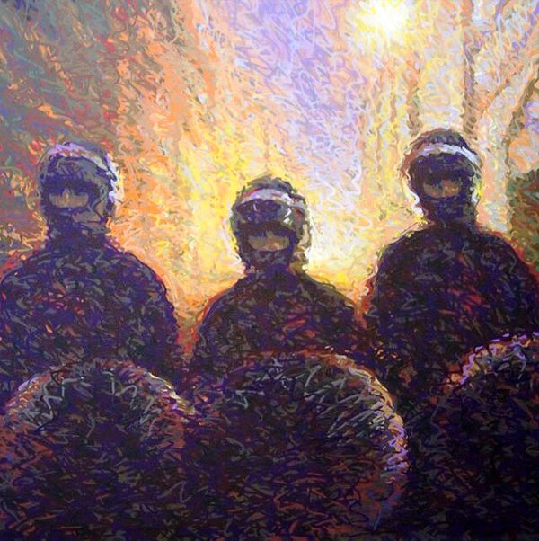
SIMILARITY OR DIVERSITY?
My ego is my individuality, what makes me different, unique and irreplaceable, what makes me have a name, a particular appearance, taste, emotions, personality and way of thinking that belong exclusively to me. The "other" is the person who is not me, who owns a body and a spirit that is not mine. And he/she, like me, has a name, specific look, tastes, emotions, personality and way of thinking that belong to him/her alone. So the following philosophical opposition arises: Is every one of us a unique ego or an ego that resembles all the other egos? What impact each one of these two considerations may have on our everyday life?
Sally Jasmin Sarma on Twitter:
“Must decide whether to walk
in light of creative altruism
or darkness destructive selfishness.” Martin Luther King Jr

Slide 16
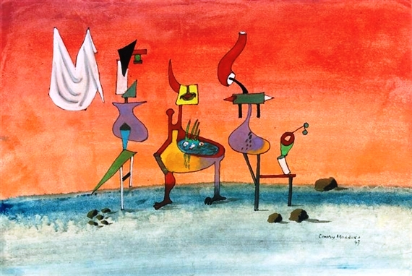
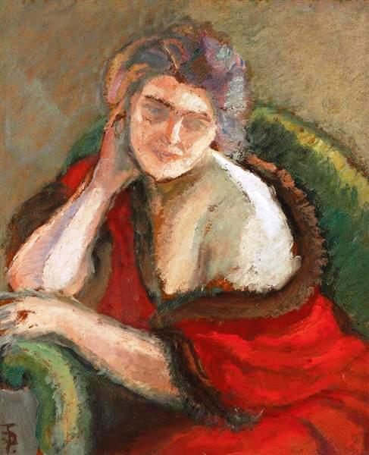
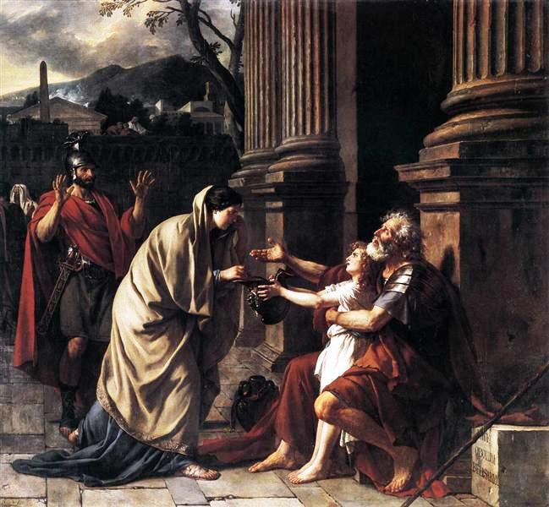
Each one of us is unique and we must recognize and respect the individuality of each one of us.
Nevertheless, because we are all human, because we all consist of morphologically similar tissues and cells, because we live in a family and in a society, we have a lot in common with each other. Many similarities between individuals are caused by shared culture. We are bound to each other. No one can exist on his/her own, because man is by nature a social being.
Often, however, others do not understand us. It is also a fact that even we cannot understand ourselves and even ourselves may surprise us, either negatively or positively.
On the other hand, we happen to recognize ourselves in others, when the others attract us, when the others suffer or when they think like us.
C Maddox : Natural attraction,1943.
T Pallady (1871-1956) : Thinking woman.
J-L David : Belisarius begging for alms,1781.

Slide 17
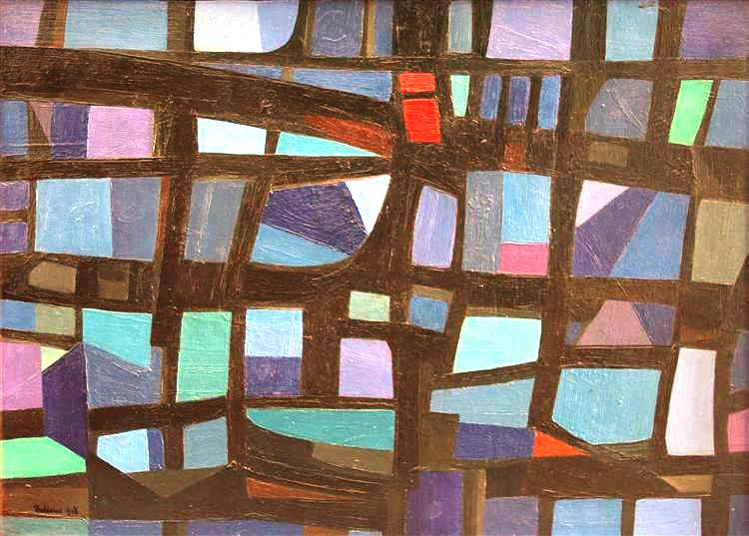
How is diversity defined?
Differences among groups of people and individuals based on:
ethnicity, race, gender, geographical area, age, sexual orientation, socioeconomic status, educational, professional and personal background, interests, cultures, world and life viewpoints, life experiences, skills, career interests, aptitude, perspectives, hobbies, exceptionalities, language, political leanings, religion etc.
Life is plurality, death is uniformity.
Maintaining diversity is not always fair. Ιn the same manner that the promotion of poverty in underdeveloped nations as "cultural diversity" is unethical, it is unethical to promote all religious practices simply because they are seen to contribute to cultural diversity. Particular religious practices are recognized by the WHO and UN as unethical, including female genital mutilation, polygamy, child brides, and human sacrifice.
M Ballocco : Reticolo nero diversi blu rosso verso destra, 1948.
Αlthough considering the above reservations,
diversity should generally not necessitate
just respect and tolerance for difference , i.e., a kind of positive acceptance of a belief that for some reason you still find is not as attractive as the one you hold,
but also inclusion of those who are not the majority,
as they are, without seeking to absorb the 'other‘
into the horizons of one's own self-understanding.
( unity in diversity, not in similarity ).

Slide 18
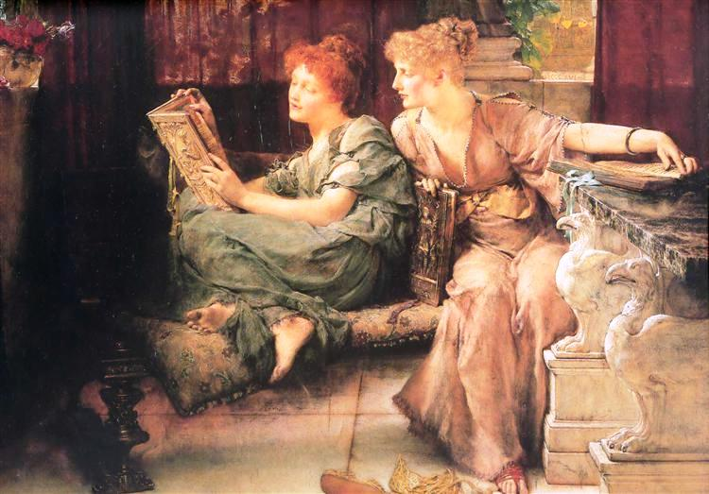
By comparing ourselves with others, we perceive what we look like and what we differ from them, so we manage to better understand who we are. However, when social comparison becomes a dominant mode of functioning, we are more likely to harm ourselves with it than help ourselves. Chronic 'comparing' starts to be detrimental when it leaves us constantly feeling that we lack what everybody else seems to have.
Differences
easily trigger comparisons.
More than two thousand years ago the Greek philosophers Plato and Aristotle were already writing about how people compare themselves to others. Looking to other people to get a sense of our own 'worth' has been going on a long time.
Sir L Alma-Tadema : Comparisons,1892.
Stoic and contemporary philosophy, psychological research, and religion explain how to escape, or at least tame, insidious social comparison and make space for a more considered life.

Slide 19
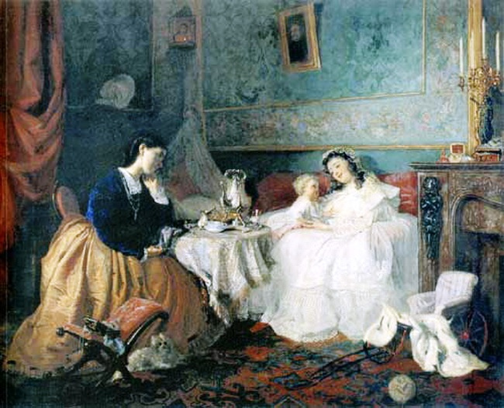
The theory of 'social comparisons' basically states that there is a natural drive within people to evaluate their own attributes (looks, wealth, capabilities) by looking to others. It's hardly an objective view, of course, but our view of how favorably (or unfavorably) we compare to others is often a contributory factor in our level of self esteem.
When you look hard enough, there is always someone bigger, stronger, richer, more beautiful/handsome, cleverer, happier (at least outwardly) than you think you are. Some people over-estimate the attributes of others while under-estimating their own talents.
G Myasoyedov (1834-1911) :
By happiness of others (Two fates)

Slide 20
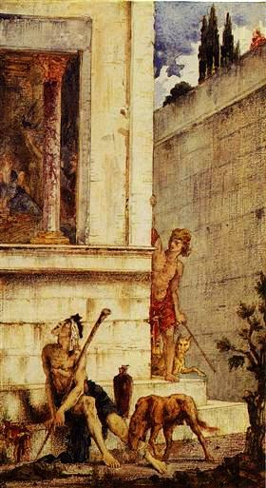
Economic studies have shown, for example, that once they make a certain amount of money to cover basics, most people care more about relative, rather than absolute, income.
That is, most of us feel better if we make, say, $100,000 if the majority of our neighbors make $75,000 than if we earn $150,000 when most of our friends bring in $200,000.
G Moreau : The Wicked Rich
and the Poor Lazarus, 1875-78.

Slide 21
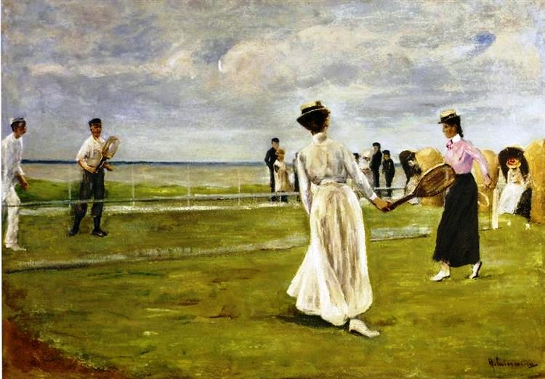
According to H. G. Halvorson, upward comparison can be punishing and make you feel terrible, but you can also look upward to learn.
If we feel bad, for example, about how well we just played in a game of tennis, we can check out those who play worse to make ourselves feel better, and avoid watching the semi-pros on the other court.
Or, if we believe that we can improve and learn by looking at others — and not just feel inferior about playing worse — then we can watch the better players.
M Liebermann :
Tennis Game by the Sea, 1901.
There are also pros and cons to comparing ourselves with people worse off than ourselves. It’s not good if we’re just trying to gain a sense of superiority or avoiding challenging ourselves to do better.
But such downward comparisons can remind us of our own fortune. They can also help us when we think about the things we regret but we cannot change.

Slide 22
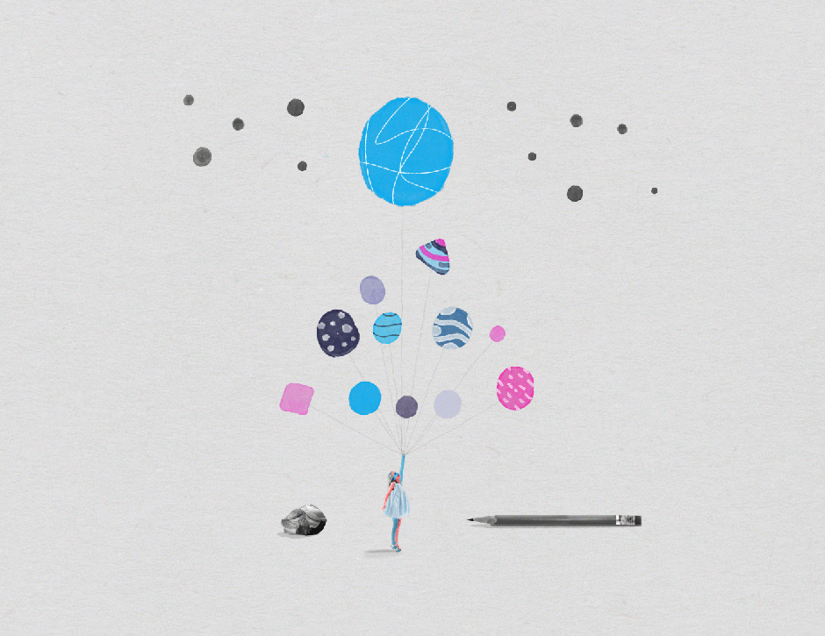
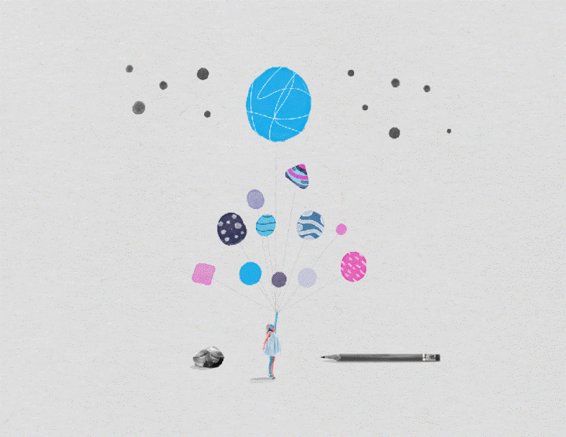
In the “social hierarchy game” we compare ourselves to those around us to make sure we’re doing okay or better than our peers, or use self-promotion as a tool to climb the social ladder. Nevertheless, our job, for example, shouldn’t define us or anyone else by itself, and neither should some jobs be more valued than others. What we do in our job has value, not our job in itself.
We all seize opportunities to look cleverer, funnier, better-read, or more loyal or cynical—whatever is prized in our circle. However, even those who appear as high achieving usually compare themselves unfavorably to others in their field.
Occasionally, envy can be motivating. But obsessively comparing is never a good idea.
The original Stoics who believed in egalitarianism as a virtue, didn’t talk a lot about happiness, per se, but they aspired to live in a state of tranquility, and they recognized that for many people, the social hierarchy game was a hindrance to it. The tendency to compare fortunately wanes with age.
According to Irvine, one of the tricks to having a good life is realizing that there are some people whose opinion you should care about, but there’s a whole bunch who don’t matter. When you face veiled insults from those looking to gain an upper hand, disarm their barbs by criticizing yourself even more harshly, or ignore the comment entirely.
Hierarchy. Art by A Costa.
The best strategies
for self-assessment
Observe yourself,
then follow the quitters regarding
what most other people
think of you.
Change your framing.
Remind yourself of what
you appreciate about yourself.

Slide 23
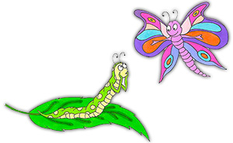
How to Stop Discouraging Comparing Yourself to Others Ιf you want to cut down on your self comparisons and free yourself to be the individual you were meant to be, here's what to do:
Remember social comparison is just a tool. Useful sometimes. Watch yourself and be aware when you're doing it. Also remember that we all have a duty to be ourselves in life. The day you stop finding differences between yourself and others is the day you stop being unique. Limit the amount of time you are exposed to 'groupthink' situations such as watching TV or reading magazines or newspapers. We can all be brainwashed through exposure to stereotypes. Be wary of perfectionism. High standards are great, but you may have constructed an inner perfectionist phantom. Constantly comparing yourself to this perfect inner construct will always leave you feeling wanting. You are human, thank goodness! | Distinguish between quantifiable attributes such as height, wealth, weight, and so on and vaguer, less quantifiable ones such as charm, humor and even beauty. Notice times in your day when you relax and find it easier to just be yourself. Remember this feeling and rehearse having this feeling more often. Strongly and repeatedly imagine being freer for more of your time. Lastly, remember you owe it to the world to be your individual self. It's a waste of time and energy to attempt to live what is essentially someone else's life.
“I ‘ll never be
as beautiful as you!”
Young ballerinas at the Lincoln Center, comparing height.
Seeing how you measure up
to others
in material goods
and achievements
can be a good way
to challenge yourself
and learn,
but it can be disheartening.

Slide 24
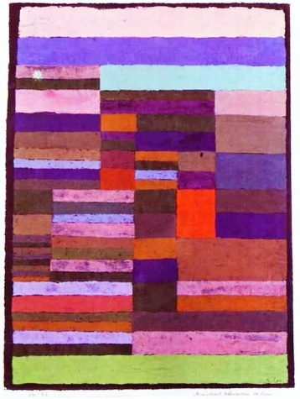
Existentialism is the work of certain late-19th- and 20th-century European philosophers who, despite profound doctrinal differences, shared the belief that philosophical thinking begins with the human subject—not merely the thinking subject, but the acting, feeling, living human individual. While the predominant value of existentialist thought is commonly acknowledged to be freedom, its primary virtue is authenticity. Many existentialists have also regarded traditional systematic or academic philosophies, in both style and content, as too abstract and remote from concrete human experience.
Kierkegaard is generally considered to have been the first existentialist philosopher. He proposed that each individual - not society or religion - is solely responsible for giving meaning to life and living it passionately and sincerely, or “ authentically”.
P Klee :
Individualized altimetry of tripes,
1930.

Slide 25
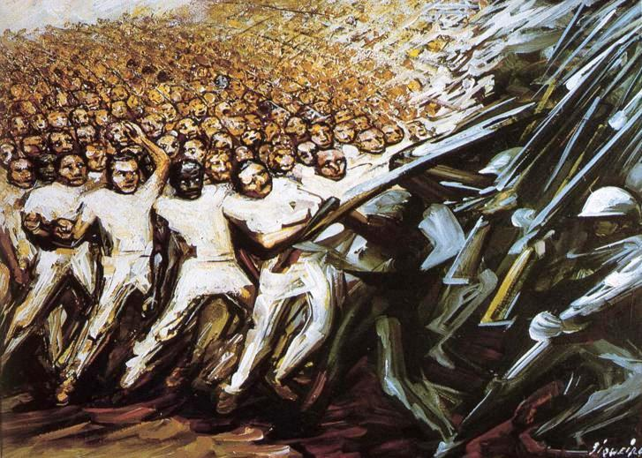
Authenticity as a key theme of existentialism.
The concept of authenticity constitutes the existentialist spin on the Greek notion of 'the good life'. The authentic being does not recognize the nature of existence as an intellectual fact, disengaged from life, but rather, the authentic being lives in accordance with this nature. For many existentialists, the conditions of the modern world make authenticity especially difficult. The 19th and 20th century presented a number of mass political ideologies which might be seen as posing a particularly challenging environment for authentic and free existence.
David Alfaro Siqueiros :
Struggle for emancipation, 1961.

Slide 26
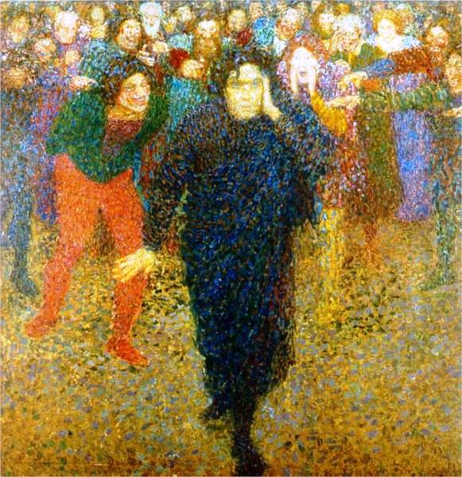
The notion of authenticity is sometimes seen as connected to individualism. This is only reinforced by the contrast with the theme of the ‘ crowd’. Certainly, if authenticity involves 'being on one's own', then there would seem to be some kind of value in celebrating and sustaining one's difference and independence from others. Inauthenticity manifests itself as de-individuated or faceless. Instead of being formed authentically in freedom, values are just accepted from others because ‘that is what everybody does’. However, many existentialists see individualism as a historical and cultural trend (for example Nietzsche), or dubious political value (Camus), rather than a necessary component of authentic existence. Individualism tends to obscure the particular types of collectivity that various existentialists deem important.
For Heidegger, living inauthentically is being absorbed in a way of life produced by others. Inauthenticity, however, may be inscribed into the mode of being; in this case it does not come from the outside as a bad influence which could be erased.
Y Tadevosyan : The genius and the crowd,1909.

Slide 27
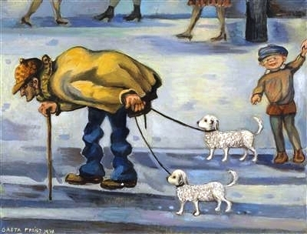
G Freist : An ordinary man walking with his dogs, 1978.
Many existentialists, in their attempt to differentiate the value of individual existence from the alienating effects of the masses, formed an uneasy relation with the value of the ‘everyday man’. The ‘common’ man was thought to be lacking in will, taste in matter of aesthetics, and individuality in the sense that the assertion of his existence comes exclusively from his participation in larger groups and from the ‘herd’ mentality with which these groups infuse their members.
Nietzsche believed that men in society are divided and ordered according to their willingness and capacity to participate in a life of spiritual and cultural transformation. Certainly not everyone wishes this participation and Nietzsche’s condemnation of those unwilling to challenge their fundamental beliefs is harsh; however, it would be a mistake to suggest that Nietzsche thought their presence dispensable. In various aphorisms he stresses the importance of the ‘common’ as a necessary prerequisite for both the growth and the value of the ‘exceptional’.

Slide 28
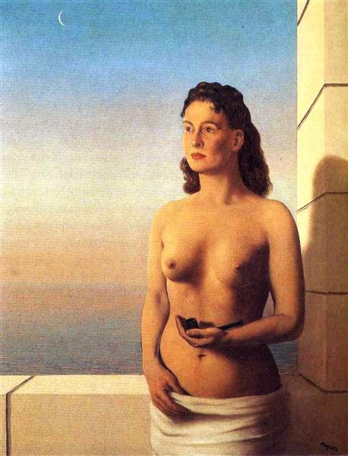
There is some minimal level of content to any authentic project: whatever else my project is, it must also be a project of freedom, for myself and for others.
While Nietzsche and Heidegger both suggest the possibility of an authentic being with others, both leave it seriously under-developed.
One of the key ideas in Sartre’s “Notebooks for an Ethics” is that my projects can be realized only with the cooperation of others; however, that cooperation presupposes their freedom, and their judgement about me must concern me to some extent.
Therefore, permitting and nurturing the freedom of others must be a central part of all my projects.
R Magritte: Freedom of mind, 1948.

Slide 29
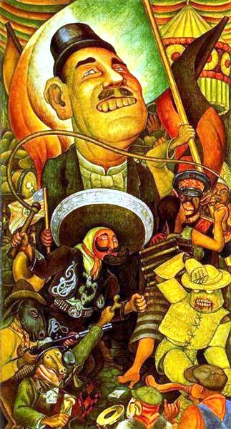
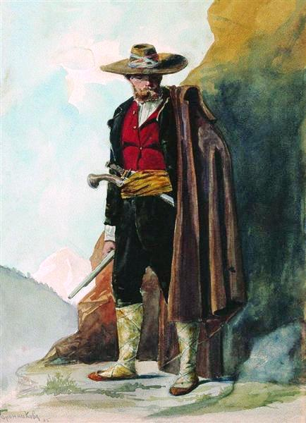
In Camus’ “The Rebel”, the slave starts by begging for justice and ends by wanting to wear a crown. He too wants to dominate.”
The problem is that while man genuinely rebels against both unfair social conditions and, as Camus says, against the whole of creation, nevertheless in the practical administration of such revolution, man comes to deny the humanity and the freedom of the other in an attempt to impose his own individuality.
F Bronnikov : Rebel, 1885.
D Rivera : Carnival of Mexican Life. Dictatorship,1936.

Slide 30
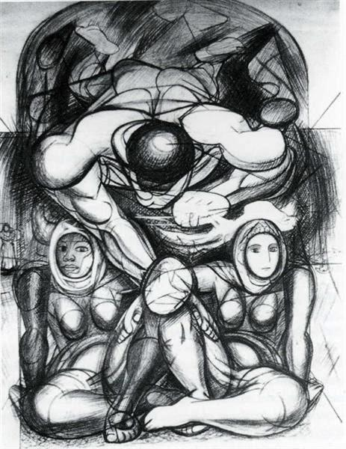
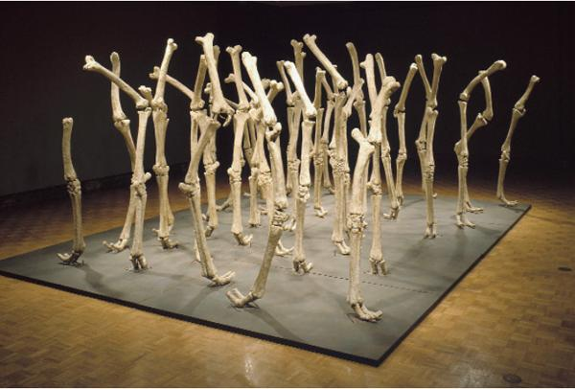
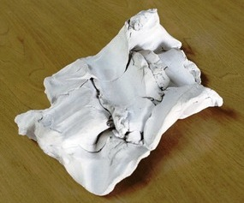
Τo say e.g. that men are equal is not to say that they are identical. Equality implies similarity rather than sameness. People should be treated as equals, should treat one another as equals, should relate as equals, or enjoy an equality of social status of some sort. Egalitarian doctrines tend to rest on a background idea that all human persons are equal in fundamental worth or moral status.
N Graves : Variability of similar forms,1970.
In my opinion, this sculptural composition
is a perfect example of harmonious coexistence of diversity and similarity.
T Jorjadze : All men are equal but some men are more equal than others (Orwell), 2008.
D A Siqueirow : Allegory of racial equality, 1943.

Slide 31
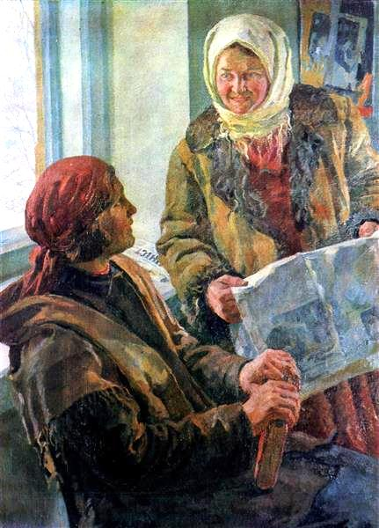
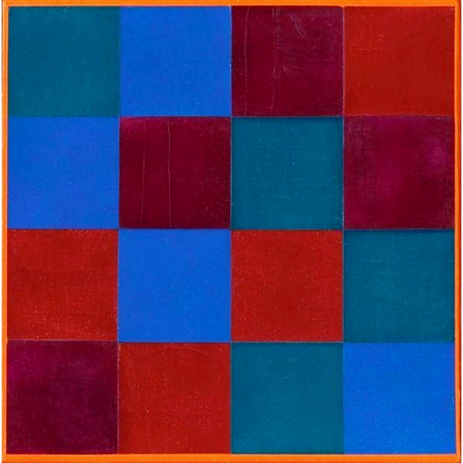
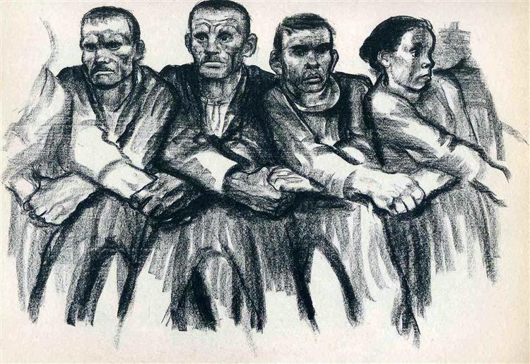
Personally,
I understand equality primarily
in its social dimension,
as providing
equal opportunities
for education, healthcare, culture,
and well-being
to all members of society,
without exception.
Similarity favors collegiality ( a term I prefer to the rather impersonal term “collectivity” ) which is directly linked with solidarity.
Solidarity, however, must not deprive people of the possibilities and their mood for creation, making them expect everything from others.
People’s freedom to achieve well-being is to be understood in terms of people's capabilities, that is, their real opportunities to do and be what they have reason to value.
K Trokhymenko :
In the collective farm club,1936.
M Bill : Four equal groups of four, 1970.
K Kollwitz : Solidarity, 1932.

Slide 32
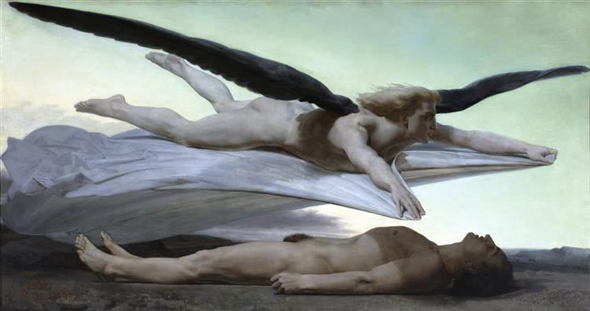
The most indisputable equality among people is that in the face of the event of death.
( Death is, of course, part of the pathologist’s work. )
W-A Bouguereau : Equality before death, 1848.
Bouguereau created this spectacular, large format painting of an angel of death covering the body of a young man with a shroud. The image would move anyone with its evocation of the inevitability of death. This sombre vision serves as a warning, as this note on a preparatory drawing demonstrates: “Equality. When the angel of death covers you with its shroud, your life will have been meaningless if you have not done some good on earth”. But the equality in question is not exactly the same as that which Liberals all over Europe aspired to achieve in 1848. Bouguereau is keeping to a deeply religious idea, where equality, far from being a social or political objective (as we’ve previously discussed) only exists in the afterlife.
Νow listening to
“Requiem aeternam” from “Libera me”, last section of
G. Verdi’s Messa da Requiem.

Slide 33
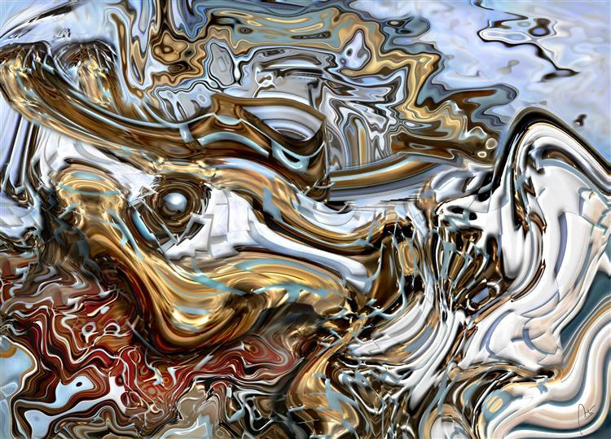
"Corpse of
a self-crowned subject
as the best
and most outstanding individual
on the planet."
Chicote CFC : Bones
of a victim of selfishness, 2014.
Going through life feeling protagonist and chosen unique with the added quality of arrogance, is to let oneself die in life of vainglory and by excess of petulance and narcissism, doses of which nowadays are more than enough among a majority of individuals. We strive to be cocky to ratify our worth, despite the fact that it will certainly close many of the doors to which we intend.

Slide 34
S LeWitt : Irregular horizontal bands of equal width starting at bottom,1991.
YES TO SIMILARITIES
We all suffer the pangs of old age, disease, the loss of loved ones, and impermanence, including the perishing of good things when they pass away. We all seek social recognition, satisfaction or happiness, too; we seek a fullness of life in community with others that so often eludes our grasp. The desires to avoid suffering and to be happy: we share these desires with one another. As we travel through life, we experience common emotions, too: joy and sadness, trust and disgust, fear and anger, surprise and anticipation. Whenever differences are divisive, the need is to affirm similarities.
A better world begins with this recognition of common experiential bonds.

Slide 35
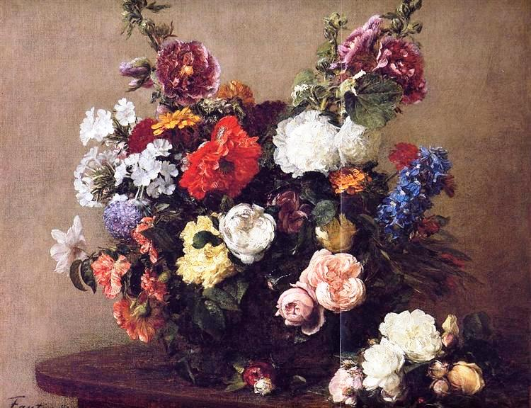
H Fantin-Latour : Bouquet of diverse flowers,1881.
H Hiary : Differences - Art Book
YES TO DIFFERENCES
Similarities, however, should not be overemphasized. Sometimes similarities are real but not what is most important to the people at issue, because their desire is to enjoy the dignity of being different.
We should bare in mind that divine oneness is akin to a field of wildflowers, each containing a different tone and hue.
Love rightly begins not with imposing one's perspective on others, but in listening to other people on their own terms and for their own sake, with sensitivity to what is most important to them, which may be different from what is most important to you.

Slide 36
The journey of life
Rembrandt Van Rijn (1606-1669) : Self portraits
Common affiliation to the laws of nature brings people together in the journey of life. Similarities such as those highlighted by traditional Pathology, can unite people and warm their hearts irrespective of their origins from the North, South, East or West…
Regardless of racial, ethnic, socio-economic and cultural differences, the peculiarities of each of our personalities are those that count on our self-esteem and our autonomy over other people.

Slide 37
To a happy, full life
Researchers
often seem to identify happiness
with subjective well-being,
sometimes with life satisfaction,
and perhaps most commonly
with emotional or hedonic state.
G Klimt : The Beethoven Frieze:
The Longing for Happiness. Left wall, 1902.
Create rejuvenating moments in your everyday life and keep a positive mood. The beauty, tenderness, poetry and joy of life are often beside you; practice to experience them on a daily basis. Discover the genuine, sincere feelings of at least some people in your everyday life and respond accordingly. These feelings are more likely to come from non-highly-educated people, as education often involves a false self-discipline covering true feelings. Common people should not be downgraded in any way; engaging with genuine, otherwise common people, offers life the rare gift of immediacy.
Selflessly offering to others will continue your existence after the end of your life on Earth and sweet memories will overwhelm the people you've been communicating, including your beloved ones.
Going through the path of your life authentically, i.e., according to your personal existential identity, which is largely genetically defined, is a prerequisite for your happiness. Αvoid criticizing others because they are moving on the basis of their own existential identity; if you do not fit with them, keep a safe distance, but also keep in mind that an egocentric life filled with the deceptive feeling of superiority over the inferior, leads to the depression of isolation.

Slide 38
From my point of view,
by encouraging others
and giving them hope, you may begin to feel hopeful and energetic yourself.
The more effort you make for other people’s happiness,
the happier you feel!
T Murakami : Open Your Hands Wide,
Embrace Happiness, 2010.
Νow listening to Fantasia from :
J. S. Bach’s Fantasia & Fugue
in a minor BWV 944.

Slide 39
Key points
There should be opportunities for pathologists to discuss what they do, explain diagnoses, and provide their medical opinions to the patients they serve. This is the best way to demystify the profession, highlight the central role that pathology plays in healthcare, and raise pathologists’ public profile.
Similarities are not necessarily identical, differences are not necessarily divisive, but rather beautiful. Similarities are shared experiences and differences are different ways of seeking satisfaction in life, of seeking beauty. Differences should never be the source of hatred or conflict.
Comparisons can serve as a reality check, but constant comparison really is a one way ticket to misery.
Individuals should live in accordance with their existential identity and their thinking. Prove yourself to yourself and not to others.
Authentic act is one that is in accordance with one’s freedom and with the freedom of others. You cannot make the others like you, love you or think like you; they are free to do so or not.

Slide 40
REFERENCES
Gutmann EJ (2003) Pathologists and patients: can we talk? Mod Pathol 16 (5): 515-518.
Arneson R "Egalitarianism", The Stanford Encyclopedia of Philosophy (Summer 2013 Edition), Zalta ΕΝ (ed.), URL = <https://plato.stanford.edu/archives/sum2013/entries/egalitarianism/>.
Forst, Rainer, "Toleration", The Stanford Encyclopedia of Philosophy (Fall 2017 Edition), Edward N. Zalta (ed.), forthcoming URL = <https://plato.stanford.edu/archives/fall2017/entries/toleration/>.
Robeyns, Ingrid, "The Capability Approach", The Stanford Encyclopedia of Philosophy (Winter 2016 Edition), Edward N. Zalta (ed.), URL = <https://plato.stanford.edu/archives/win2016/entries/capability-approach/>.
Haybron, Dan, "Happiness", The Stanford Encyclopedia of Philosophy (Fall 2011 Edition), Edward N. Zalta (ed.), URL = <https://plato.stanford.edu/archives/fall2011/entries/happiness/>.
https://qz.com/961808/how-do-i-stop-comparing-myself-to-others-strategies-from-buddhist-and-stoic-philosophy/
https://philosophynow.org/issues/84/Who_Or_What_Am_I
http://www.jesusjazzbuddhism.org/yes-to-similarities-and-differences-a-whiteheadian-appreciation-of-cultural-diversity.html
http://humancond.org/analysis/nature/0main
http://www.self-confidence.co.uk/articles/stop-comparing-yourself-to-others/
ΑCKNOWLEDGEMENT
Thanks to the National and Kapodistrian University of Athens
Special Account for Research Grants
for its support.

Slide 41
The city of Amsterdam through the ages.
May the lecture
you attended
in this city
offer you something
of practical value
that will help you
live your life
being….
This entire presentation is available, among other presentations, to any interested party, for further study, via the links below:
https://www.facebook.com/HIPON-Project-504573706265856
http://eclass.uoa.gr/modules/document/index.php?course=MED409&openDir=/4f8e670fkcr8
A van de Velde :
View of Οudezijds Voorburgwal
with the Oude Kerk in Amsterdam, 1670.
Cornelis Springer (1817-1891) :
View on Herengracht in Amsterdam-Sun.
C Monet : Zuiderkerk in Amsterdam, 1874.
O Kokoschka : Amsterdam, 1925.
P Werner : View on the waterfront Oosterdok-Winter, Amsterdam, 2005.

Slide 42
W. Collins : Happy as a King(!?), 1860.

