Slide 1

ΠΡΟΓΡΑΜΜΑ ΜΕΤΑΠΤΥΧΙΑΚΩΝ ΣΠΟΥΔΩΝ
ΚΑΡΔΙΑΓΓΕΙΑΚΗ ΑΠΕΙΚΟΝΙΣΗ
Επιλογή καταλλήλου πρωτοκόλλου stress. Ενδείξεις, αντενδείξεις, επιπλοκές.
Αναστασία Κίτσιου, MD, PhD, FESC Καρδιολόγος, Διευθύντρια Καρδιολογικού Τμήματος ΓΝΑ Σισμανόγλειο Chair, Nuclear Cardiology and Cardiac CT Section, EACVI, ESC, 2012-2014
22/05/2026

Slide 2
Disclosures
No conflict of interest regarding the topics of this talk

Slide 3
Stress methods
Exercise test
  Treadmill
  Bicycle
Pharmacologic stress tests
  Vasodilator agents: dipyridamole, adenosine and regadenoson
  Sympathomimetic agent: dobutamine (used rarely and almost exclusively in patients with bronchospastic pulmonary disease)
  Vasodilatos may be combined with low-level exercise, except for patients with LBBB (HR related artefacts)

Slide 4
Cascade of Ischemia
angina
Treadmill stress test
ischemic ST depression
regional myocardial dysfunction
Rate Pressure Product
flow heterogeneity
Stress SPECT & PET MPI
Rest
Exercise
Treadmill Time

Slide 5
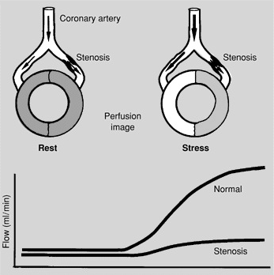
Pathophysiology of perfusion defects on myocardial perfusion scintigraphy
Imaging of MBF heterogeneity

Slide 6
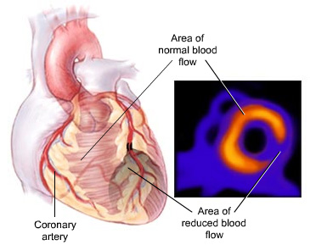
Stress MPI
Reduction in myocardial blood flow produces a proportional decrease in the uptake of myocardial perfusion tracers.

Slide 7
Preparation before stress test
Fasting for at least 3 hours before the test
Withholding methylxanthines (i.e. caffeine, theophylline) prior to stress test with vasodilators
A brief history and physical examination should be performed to rule out contraindications to testing or to detect important clinical signs such as a cardiac murmur, gallop sounds, pulmonary bronchospasm, or rales
Medications (stop or continue)
Detailed explanation of the testing procedure
Fletcher GF, et al. Circulation 1995;91:580-615. Henzlova MJ, et al. J Nucl Cardiol. 2006;13:e80-90.

Slide 8
Safety requirements
Main safety-related points are:
Indications and contraindications for stress studies
Stress test supervision by trained personnel
Knowledge of indications for termination of stress studies
Presence of appropriate emergency equipment and drugs

Slide 9
Procedural and safety aspects of stress nuclear test
Continuous ECG monitoring
ECG recording for 12-lead ECG
Blood pressure recording
IV cannula(s)
Defibrillator
Dietary restrictions
Myers J, et al. Circulation. 2009;119:3144 –3161. Henzlova MJ, et al. J Nucl Cardiol. 2006;13:e80-90.

Slide 10
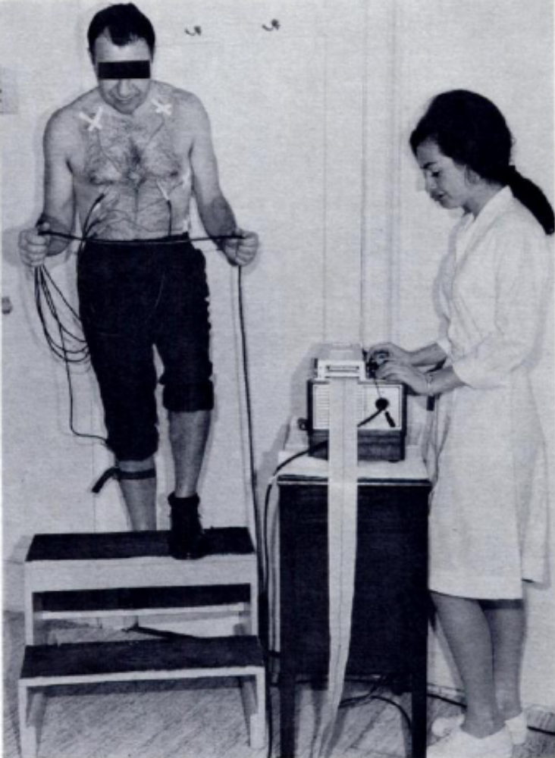
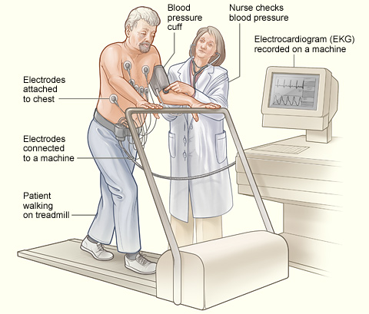
Evolution of equipment and protocols
www.nhlbi.nih.hov
Master AM, Rosenfeld I. Dis Chest 1967;51;347-383
Notes:
Master’s: 1941, ecg added

Slide 11

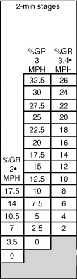
Treadmill stress protocols
Bruce
Naughton
Modified Bruce

Slide 12
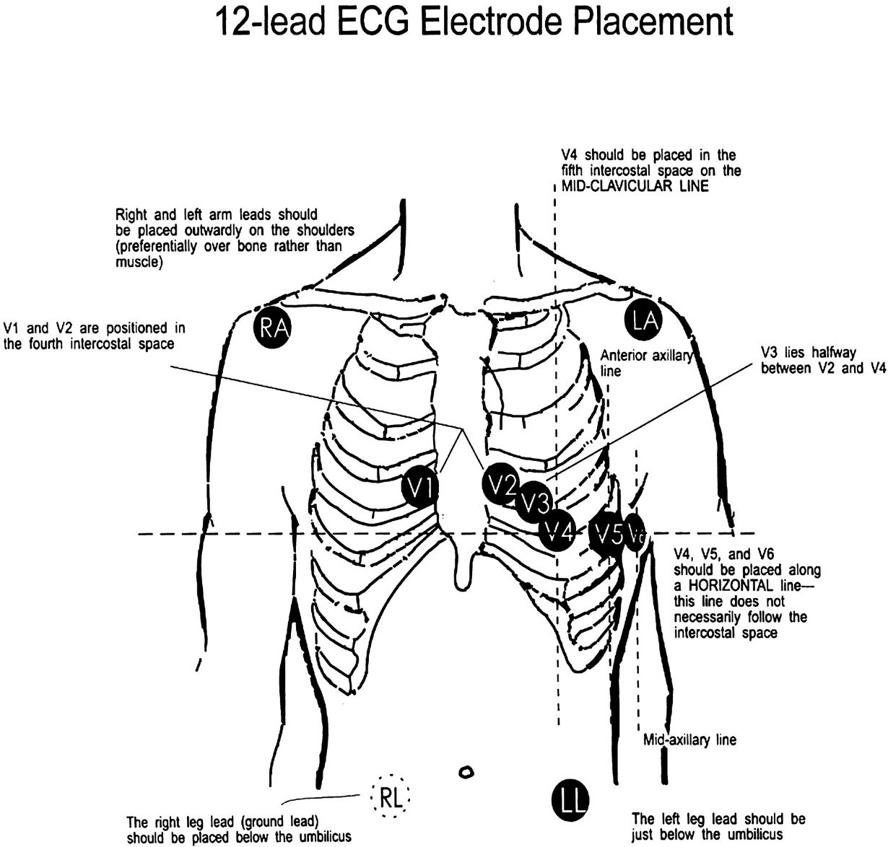
Placement of 12-lead ECG electrodes

Slide 13
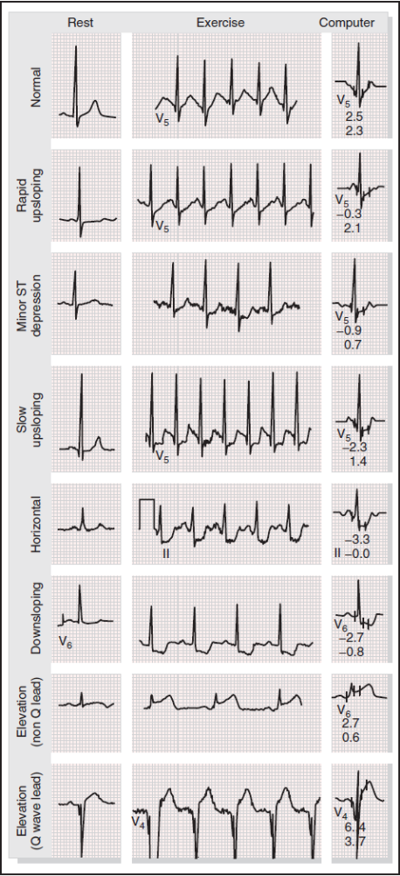
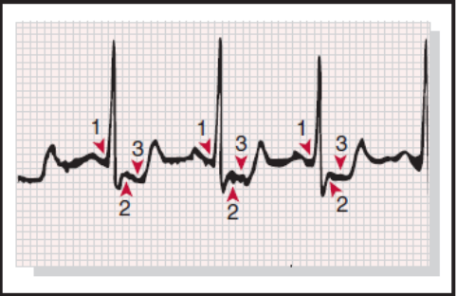
Eight typical exercise electrocardiographic patterns at rest and at peak exertion
Magnified ischemic exercise-induced electrocardiographic pattern.
Three consecutive complexes with a relatively stable baseline are selected. The PQ junction (1) and J point (2) are determined; the ST80 (3) is determined 80 milliseconds after the J point.
In this example, average J point displacement is 0.2 mV (2 mm) and ST80 is 0.24 mV (24 mm). The average slope measurement from the J point to ST80 is −1.1 mV/sec.
Braunwald, Heart Disease, 2012, p 174

Slide 14
What are METS?
Metabolic equivalents
Measure of how hard the body is working
  1 MET = 3.5mL O₂ consumption/kg/min
Target METS
  Men: 14.7 – (0.11 x age)
  Women: 14.7 – (0.13 x age)
Why is this important?
  Women who achieved <85% of their age-predicted METS were twice as likely to die from all causes over 8.4 years compared to women who achieved at least 85%
Gulati, M, et al. NEJM 2005; 353: 468-475.

Slide 15
Exercise Test: Protocols
Exercise stress test
Tracer injection
(Peak stress or evidence of ischemia)
Stop effort
(1 min after tracer injection)
Notes:
The exercise may be performed on a treadmill or a bicycle ergometer.
All clinically used protocols consist of increasing multi-level workload stages.
Evidence of ischaemia (symptoms and/or ECG changes)
Target heart rate: > (220 – age) x 0,85
or
Rate pressure product (heart rate x systolic blood pressure)

Slide 16
Main characteristics of pharmacologic stressors
 | Mechanism of action | Half-life | Intravenous dose
Dobutamine | potent agonist of β₁ and β₂ receptors (β₁>>>β₂) | ~2 min | continuous infusion, starting at 5 mcg/kg/min increasing in 3-min intervals up to 40 mcg/kg/min
Dipyridamole | increases interstitial fluid adenosine concentration by blocking its cellular uptake and subsequent degradation | 3-12 min, 33-62 min, 11.6-15 hours (triexponential elimination) | continuous infusion, 0.56 mg/kg over 4 min
Adenosine | non-specific agonist of A₁, A_{2A}, A_{2B}, A₃ receptors | <10 seconds | continuous infusion, 140 mcg/kg/min over 6 min
Regadenoson | relatively selective agonist of A_{2A} receptor; weak agonist of A₁ receptor | 2-4 min (initial phase), 30 min (intermediate phase), 2 hrs (terminal phase) | rapid injection, 0.4 mg over 10 sec
Dilsizian V, et al. J Nucl Cardiol 2015;22:1198-213.

Slide 17
Adenosine receptors
Adenosine directly interacts with all 4 known adenosine receptor subtypes (A₁, A_{2A}, A_{2B}, and A₃)
Activation of the A_{2A} receptor results in the desired effect of coronary vasodilation (this results in a 3.5- to 4-fold increase in MBF)
Activation of the A₁ receptor can cause AV block and bradycardia
Activation of the A_{2B} receptors can cause peripheral vasodilation
Activation of the A_{2B} and/or A₃ receptors can cause bronchoconstriction

Slide 18
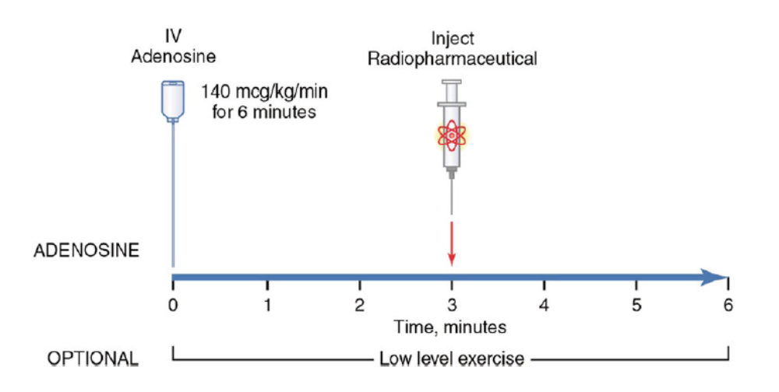
Adenosine protocol
Henzlova MJ, et al. J Nucl Cardiol. 2016;23:606-39.

Slide 19
Adenosine stress – Key point for infusion
An accurate pump system should be used
Adenosine should be infused at a constant rate during the pharmacologic stress test.
Rapid injection and flushing of the radiopharmaceutical agent through the intravenous tubing being used for the adenosine infusion should be avoided, because this high infusion rate will cause high blood levels and increase the risk of AV block.
Cerqueira MD, et al. J Am Coll Cardiol 1994;23:384-9.

Slide 20
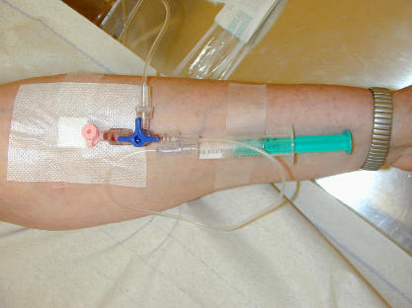
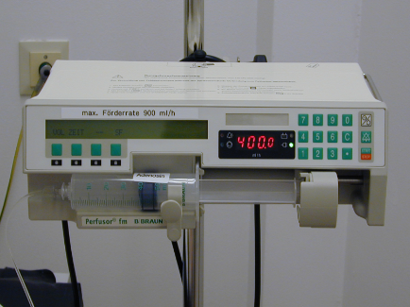
Adenosine Protocol (0.14 mg/kg/min)
Start infusion
Tracer injection
(3 min)
End infusion
(6 min)
Notes:
6 min infusion of 0.14 mg/kg/min, injection after 3 min
Alternative: 4 min infusion is also feasible, injection after 2 min
For example:
fill the syringe with NaCl to 40 ml, then infusion rate is always 400 ml/h

Slide 21
Complications during adenosine stress
The safety profile of adenosine stress myocardial perfusion imaging was examined in the Adenoscan Multicenter Trial Registry involving 9,256 patients. There were no deaths, one myocardial infarction, seven episodes of severe bronchospasm and one episode of pulmonary edema.
Transient AV block occurred in 706 patients, approximately 7.6%, (first-degree in 256, second-degree in 378 and third degree in 72) and resolved spontaneously in most patients (n = 508) without alteration in the adenosine infusion.
There were no sustained episodes of AV block. Patients >70 years of age had an increased risk of developing AV block.
Cerqueira MD, et al. J Am Coll Cardiol 1994;23:384-9.

Slide 22
Selective adenosine A_{2A} receptor agonists
Regadenoson
Regadenoson-COPD (RegCOPD) trial showed the overall safety of regadenoson in 49 outpatients with clinically stable moderate and severe COPD
In a pilot safety study of 48 patients with mild or moderate asthma regadenoson was safe and well tolerated.
  Dyspnea occurred in 34% of patients after treatment with regadenoson (16/48) and none after treatment with placebo. The dyspnea events had a mean duration of 3 minutes 53 seconds (range, 0 to 7 minutes), and the onset was between 0 and 15 seconds after dosing. No episodes of dyspnea were treated.
Thomas GS, et al. J Nucl Cardiol 2008;15:319-28 Leaker BR, et al. J Nucl Cardiol 2008;15:329-36

Slide 23
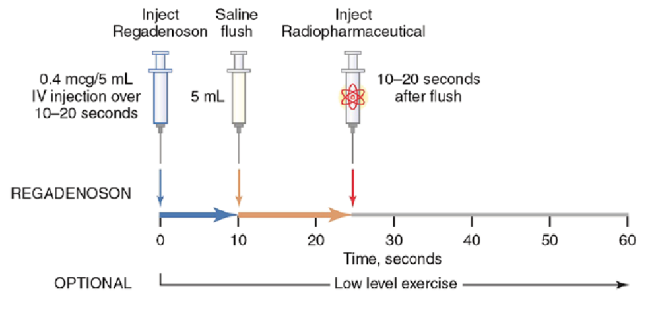
Regadenoson protocol
Henzlova MJ, et al. J Nucl Cardiol. 2016;23:606-39.

Slide 24
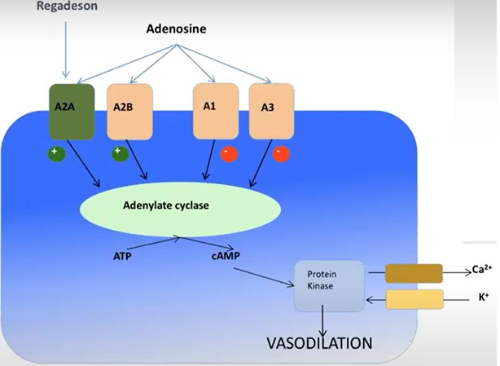
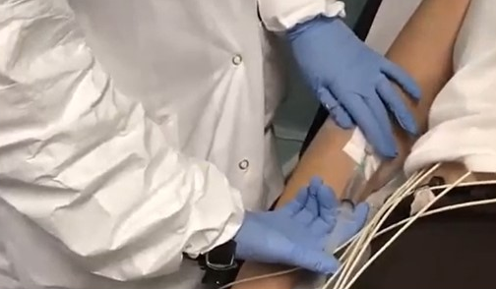
Regadenoson Protocol
Injection of Regadenoson (10 sec)
Flush of Saline 10 mL
(10 Sec)
10 to 20 sec delay
Tracer Injection
Optional Injection of Aminophilline

Slide 25
Complications during regadenoson stress
Regadenoson, a relatively selective A_{2A} adenosine receptor agonist is increasingly used as a vasodilator stress agent.
In a study comparing regadenoson with adenosine, first-degree AV block was noted in 2.8% regadenoson patients and 7.0% adenosine patients and second-degree AV block in 1(0.1%) regadenoson patient and 9 (1.5%) adenosine patients (p <0.001).
In a recent European report of over 1,581 consecutive patients receiving regadenoson as a stress agent, two patients were reported to have developed transient asystole.
Cerqueira MD, et al. J Am Coll Cardiol Img 2008;1:307-16.
Brinkert M, et al. Eur J Nucl Med Mol Imaging 2014;41:511-21.

Slide 26
Complications during regadenoson stress
In other reports, a small number of cases with asystole and cases developing seizures post-regadenoson administration have been reported.
Regadenoson should be used with caution in patients with a history of seizures, as it appears that the risk of a regadenoson-induced seizure may be higher in this patient population. However, seizures may occur even in the absence of a seizure history.
In case of seizures during regadenoson stress, anticonvulsants (e.g., benzodiazepines) should be administered, if needed, when the episode is prolonged.
Rosenblatt J, et al. J Nucl Cardiol 2014;21:862–8
Page RL 2nd, et al. J Nucl Cardiol 2012;19:389-91.
Hage FG, et al. J Nucl Cardiol. 2014;21:877-9.

Slide 27
Aminophylline
Aminophylline is a non-selective adenosine receptor antagonist.
Aminophylline may be administered to attenuate severe and/or persistent adverse reactions to vasodilator stress tests, most often when dipirydamole or regadenoson is used.
Because of the very short half life of adenosine, most side effects subside after termination or decrease of rate of adenosine infusion and aminophylline is rarely needed.
In the rare occasion of seizures following regadenoson injection, aminophylline is not recommended, as it may increase the risk of seizures associated with regadenoson.
Aminophylline may be administered in doses ranging from 50 to 250 mg by slow intravenous injection (50-100 mg over 30-60 seconds).
Henzlova MJ, et al. J Nucl Cardiol. 2006;13:e80-90.

Slide 28
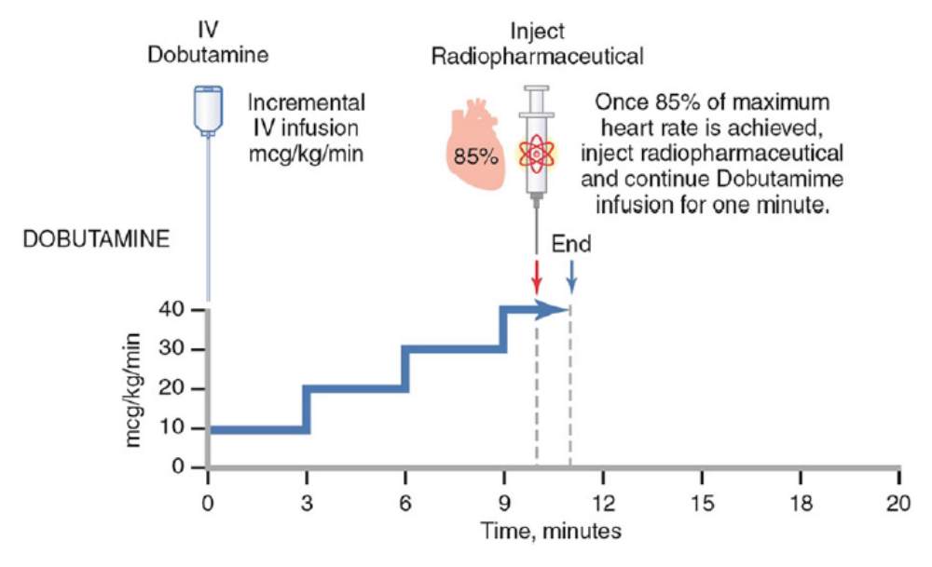
Dobutamine protocol
Henzlova MJ, et al. J Nucl Cardiol. 2016;23:606-39.

Slide 29
Stress studies - Safety
All types of the above mentioned stress tests are considered to be safe with a low rate of serious and life-threatening complications.
Nevertheless, every stress-nuclear cardiology laboratory should be prepared to effectively address any serious stress-related complication and emergency.

Slide 30
Cardiovasular complications due to stress studies
Bradyarrhythmias (most revere form: asystole)
Tachyarrhythmias (most severe forms: sustained VT, VF)
Acute coronary syndromes
Hypotension
Severe bronchospasm
Cerebrovascular accident
Death

Slide 31
Complications during exercise test
A report on a very large number of 518,448 exercise stress tests examined the incidence of serious complications during exercise testing. There were 3.58 myocardial infarctions, 4.78 serious arrhythmias, and 0.5 deaths per 10,000 tests.
In another report, the frequency of major complications was 0.8 complications per 10,000 tests, in a population with a low prevalence of known coronary heart disease.
Risk of complications is higher in patients being evaluated for malignant ventricular arrhythmias and in the unrevascularized post-MI patient.
Stuart RJ Jr, Ellestad MH. Chest. 1980;77:94 –97.
Gibbons L, et al. Circulation. 1989;80:846-52.
Myers J, et al. J Cardiopulm Rehabil. 2000;20:251–258.
Notes:
Good clinical judgment should therefore be used in deciding which patients should undergo exercise testing.

Slide 32
Contraindications to exercise testing
Absolute
• Acute myocardial infarction (within 2 d)
• High-risk unstable angina
• Uncontrolled cardiac arrhythmias causing symptoms or
hemodynamic compromise
• Symptomatic severe aortic stenosis
• Uncontrolled symptomatic heart failure
• Acute pulmonary embolus or pulmonary infarction
• Acute myocarditis or pericarditis
• Acute aortic dissection
Fletcher GF, et al. Circulation 1995;91:580-615 Gibbons RJ, et al. ACC/AHA 2002 guideline update for exercise testing

Slide 33
Contraindications to exercise testing
Relative
• Left main coronary stenosis
• Moderate stenotic valvular heart disease
• Electrolyte abnormalities
• Severe arterial hypertension (SBP >200 mm Hg and/or DBP >110 mm Hg)
• Tachyarrhythmias or bradyarrhythmias
• HCM and other forms of outflow tract obstruction
• Mental or physical impairment leading to inability to exercise adequately
• High-degree atrioventricular block
Fletcher GF, et al. Circulation 1995;91:580-615 Gibbons RJ, et al. ACC/AHA 2002 guideline update for exercise testing

Slide 34
Indications for termination of exercise test
Absolute indications
• Drop in SBP of >10 mm Hg from baseline blood pressure despite an increase in workload, when accompanied by other evidence of ischemia
• Moderate to severe angina
• Increasing nervous system symptoms (eg, ataxia, dizziness, or near-syncope)
• Signs of poor perfusion (cyanosis or pallor)
• Technical difficulties in monitoring ECG or systolic blood pressure
• Subject’s desire to stop
• Sustained ventricular tachycardia
• ST elevation (≥1.0 mm) in leads without diagnostic Q-waves (other than V₁ or aVR)
Gibbons RJ, et al. ACC/AHA 2002 guideline update for exercise testing

Slide 35
Indications for termination of exercise test
Relative indications
• Drop in SBP of (≥10 mm Hg from baseline blood pressure despite an increase in workload, in the absence of other evidence of ischemia
• ST or QRS changes such as excessive ST depression (>2 mm of
horizontal or downsloping ST-segment depression) or marked axis shift
• Arrhythmias other than sustained VT, including multifocal PVCs, triplets of PVCs, supraventricular tachycardia, heart block, or bradyarrhythmias
• Fatigue, shortness of breath, wheezing, leg cramps, or claudication
• Development of bundle-branch block or IVCD that cannot be distinguished from ventricular tachycardia
• Increasing chest pain
• Hypertensive response (SBP >250 mm Hg and/or DBP >115 mm Hg)
Gibbons RJ, et al. ACC/AHA 2002 guideline update for exercise testing

Slide 36
Common medical conditions in which potential complications may occur with vasodilator stress testing
Severe aortic stenosis
Hemodynamically severe carotid artery disease
Critical left main coronary artery disease
Severe proximal multivessel coronary artery disease
Autonomic dysfunction
Baseline hypotension
Hypovolemia
Dilsizian V, et al. J Nucl Cardiol 2015; in press

Slide 37
Indications for early termination of dipyridamole, adenosine, and regadenoson infusion
Severe hypotension (systolic blood pressure <80 mm Hg)
Development of symptomatic, persistent second degree or complete AV block
Wheezing
Severe chest pain associated with ST depression of ≥2 mm
Signs of poor perfusion (pallor, cyanosis, cold skin)
Technical problems with the monitoring equipment
Patient’s request to stop
Henzlova MJ, et al. J Nucl Cardiol. 2006;13:e80-90.

Slide 38
Complications during dobutamine stress
Among the pharmacologic stress tests, dobutamine stress is the least commonly used in conjunction with nuclear myocardial perfusion imaging. The following serious complications during dobutamine stress have been reported:
Cardiac rupture (incidence <0.01%)
Myocardial infarction (0.02%)
Cerebrovascular accident (<0.01%)
Cardiac asystole (<0.01%)
Ventricular fibrillation (0.04%)
Sustained ventricular tachycardia (0.15%)
Supraventricular arrhythmias are frequent, but they rarely result in hemodynamic instability requiring cardioversion.
The incidence of hypotension (decrease of SBP > 20 mmHg) is 20%.
Geleijnse ML, et al. Circulation. 2010;121:1756-67.

Slide 39
Post-stress period
After termination of either exercise or pharmacologic stress studies, additional monitoring of the patient is required.
The patient should be monitored for several minutes after stress test.
If symptoms have been reported or ECG-ST segment deviation, rhythm disturbances or abnormal blood pressure responses have been noted, longer monitoring is needed until resolution of symptoms and until ECG and blood pressure return to pre-test status.
It is important for the supervising healthcare personnel to know that abnormal ECG and blood pressure responses may, some times, occur only in the post-stress recovery period.
Fletcher GF, et al. Circulation. 2013;128:873–934.
Henzlova MJ, et al. J Nucl Cardiol. 2006;13:e80-90.

Slide 40
Written, well-rehearsed plan
In every stress-nuclear laboratory, standardized procedures and test termination criteria should exist and a written, well-rehearsed plan for effective management of complications should be in place.
Fletcher GF, et al. Circulation. 2013;128:873–934.

Slide 41
Effective management of serious and life-threatening stress studies complications
Serious and life-threatening stress studies complications
Risk
stratification of
patients to be
tested
Well-rehearsed
emergency
plan
Emergency
equipment
Emergency
drugs
Trained stress-
nuclear lab
healthcare
personnel
Effective and successful management

Slide 42
Conclusion
The choice of appropriate stress protocol (exercise or pharmacologic stress), should always be individualized based on the patient’s clinical condition, functional capacity and comorbidities.
Careful screening for contraindications, continuous monitoring during stress testing, preparedness for emergency management, and awareness of potential adverse reactions to pharmacologic agents are essential to minimizing risk and ensuring patient safety.
Thank you!

