Slide 1

Βασικές αρχές PET, Ραδιοφάρμακα, PET κάμερες
Dr med Γεώργιος Ν. Μπενέτος, MD, MSc, PhD
Ακαδημαϊκός Υπότροφος Α’ Πανεπιστημιακή Καρδιολογική Κλινική
Cardiac CT Κλινική Λευκός Σταυρός
EACVI and SCCT Level 3 certified in Cardiac CT

Slide 2
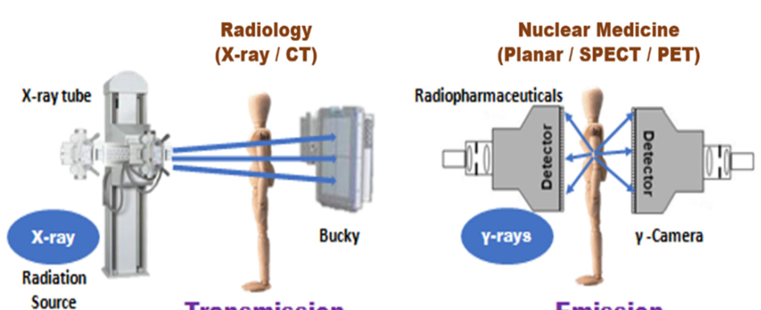
Nuclearmedicine vs. Radiology
Transmission
Emission

Slide 3
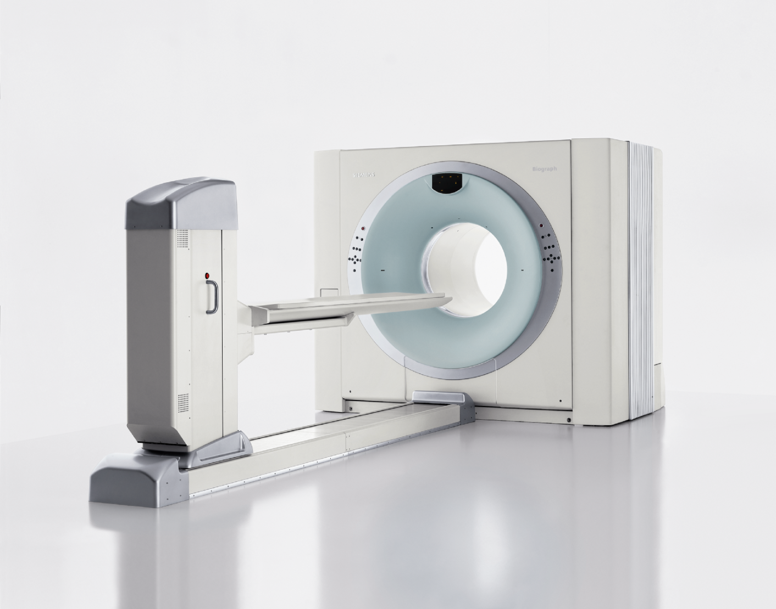
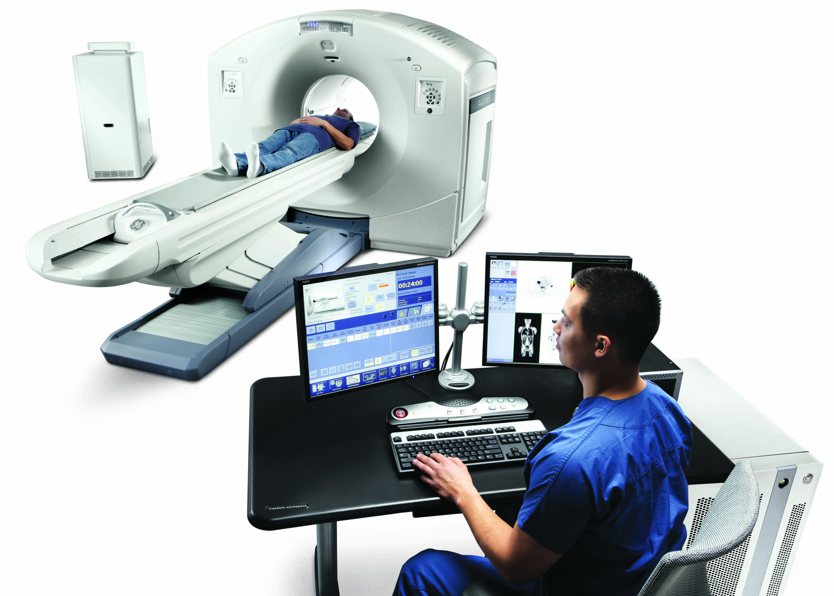
PET-CT cameras
Siemens PET-CT camera
GE PET-CT camera

Slide 4
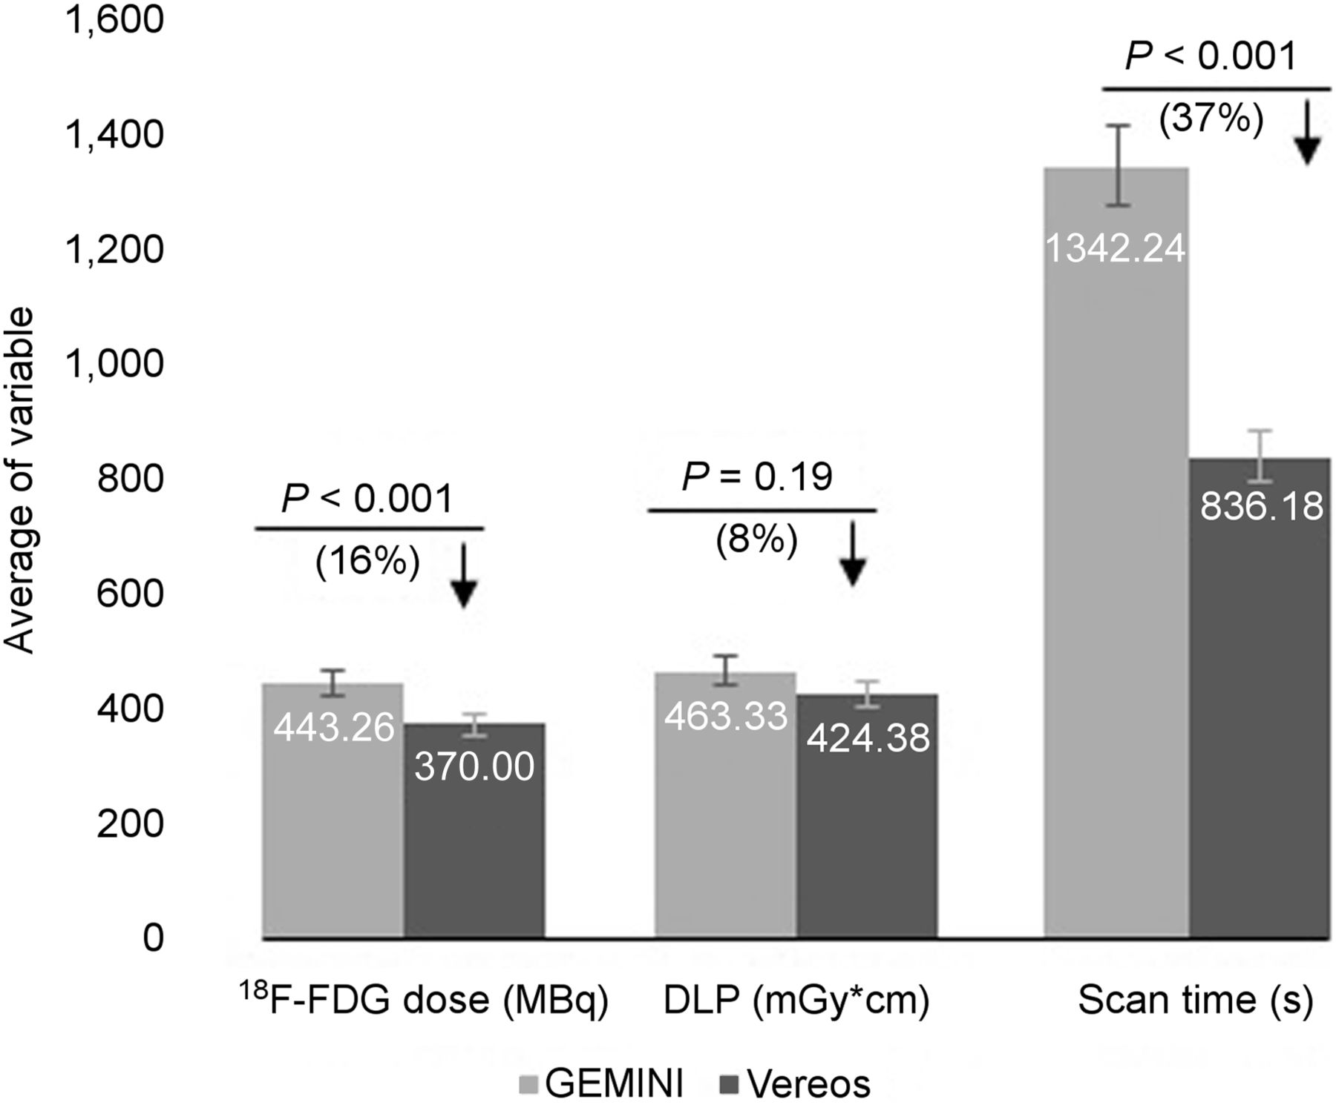
Digital vs analog PET cameras
Digital (Vereos) vs analog (GEMINI) PET camera
With Digital camera shorter scan times, less FDG (radiation dose), less noisy images
Hatami et al, J Nucl Med Technol 2020

Slide 5
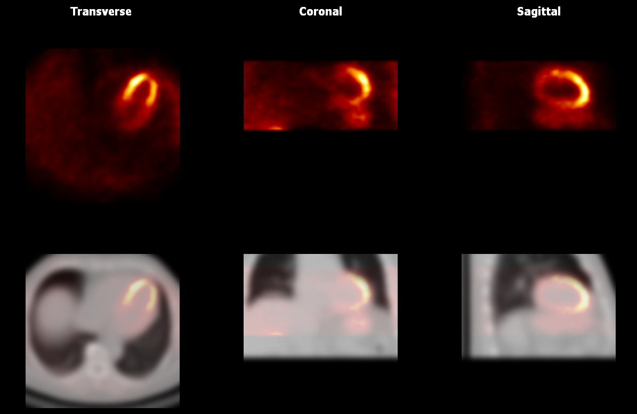
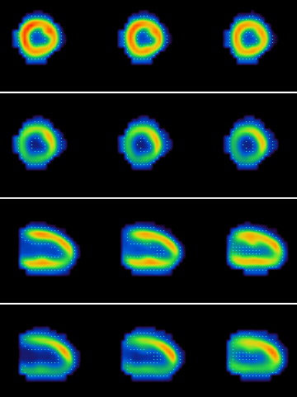
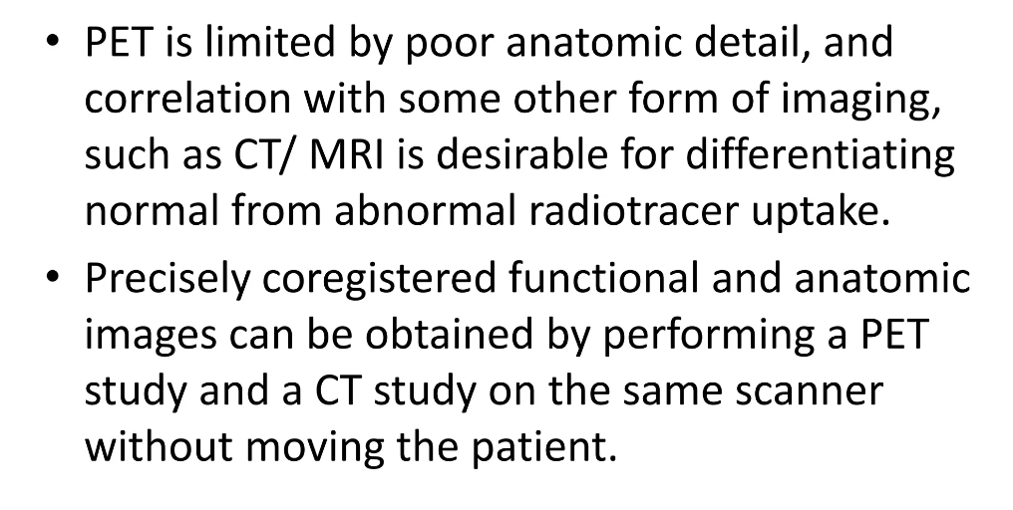
CT-AC for PET is mandatory
AC
NAC
AC
NAC

Slide 6
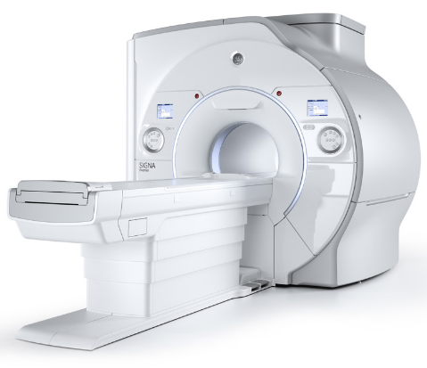
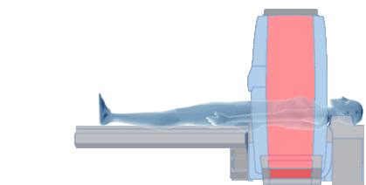
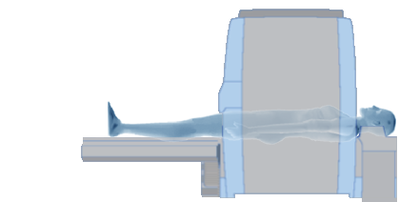
Hybrid-PET/MR
PET/MR
PET
MRI
PET
Metabolism imaging
Coronary flow reserve
Cardiac MRI
Anatomic and morphological information
Functional information
Notes:
What if we could combine both methods in a one-stop shop examination in one hybrid machine?

Slide 7
Hybrid-PET/MR
PET
MRI
Conditions:
MR compatible PET detectors
MR attenuation correction

Slide 8
What is a positron?
A positron is an anti-matter electron, it is identical in mass but has a positive charge of +1
Positron can come from different number of sources but for PET they are produced by nuclear decay
Nuclear decay is basically when unstable nuclea are produced in a cyclotron by bombarding the target material with protons and as a result a neutron is released
E.g 18-0 enriched water +proton = 18-F + neutron

Slide 9
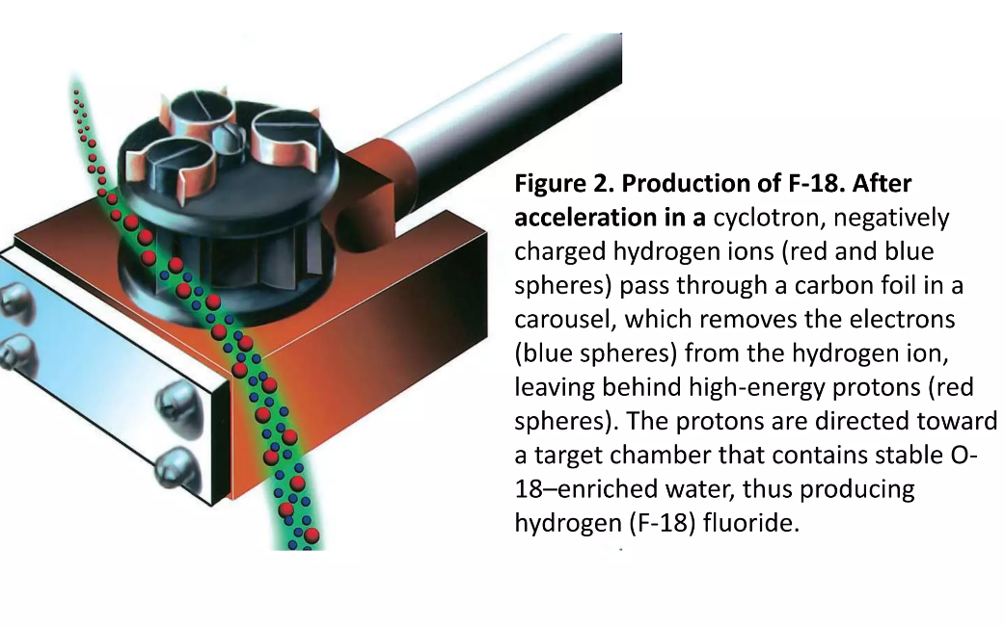
How are tracers produced?

Slide 10
Basic principles
In PET the product of the bombardment decays to a more stable state isotope by emitting a positron, for instance 18-F has too many protons, so one of these protons decays to a neutron emitting in the process a positron and a neutrino
Positron begins its activity by colliding with other particles and gradually losing its kinetic energy

Slide 11
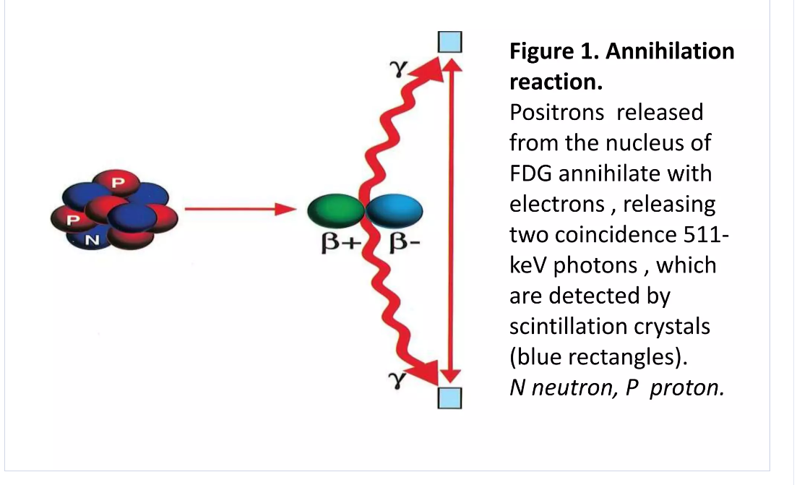
Annihilation reaction
Notes:
ΑΝΤΙΔΡΑΣΗ ΕΞΟΥΔΕΤΕΡΩΣΗΣ

Slide 12
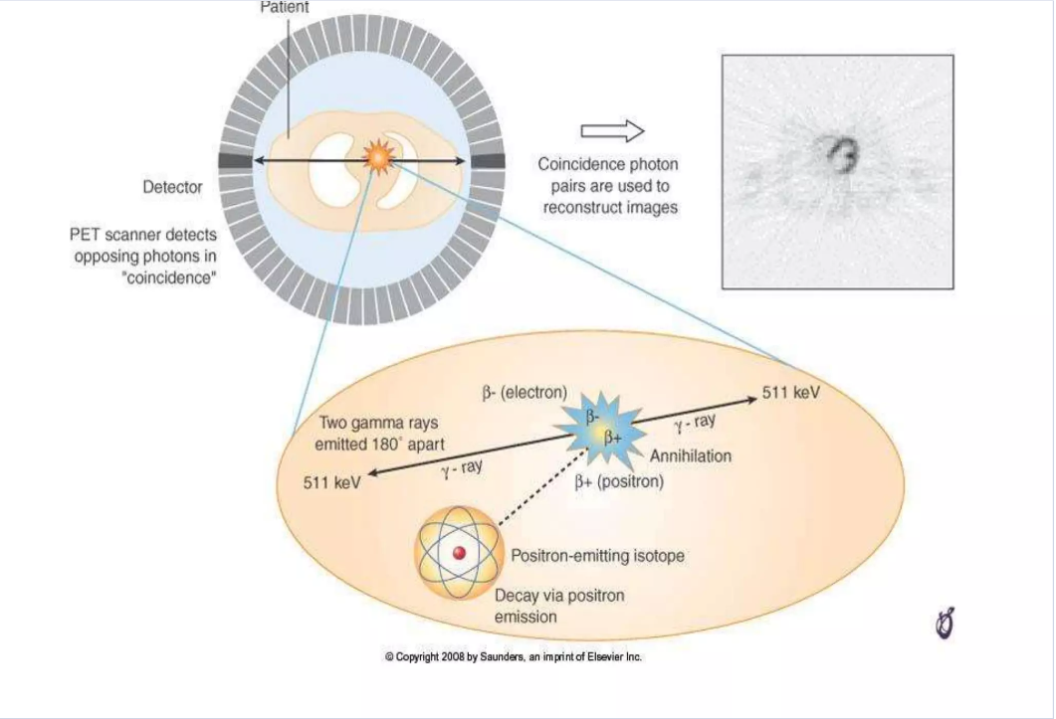
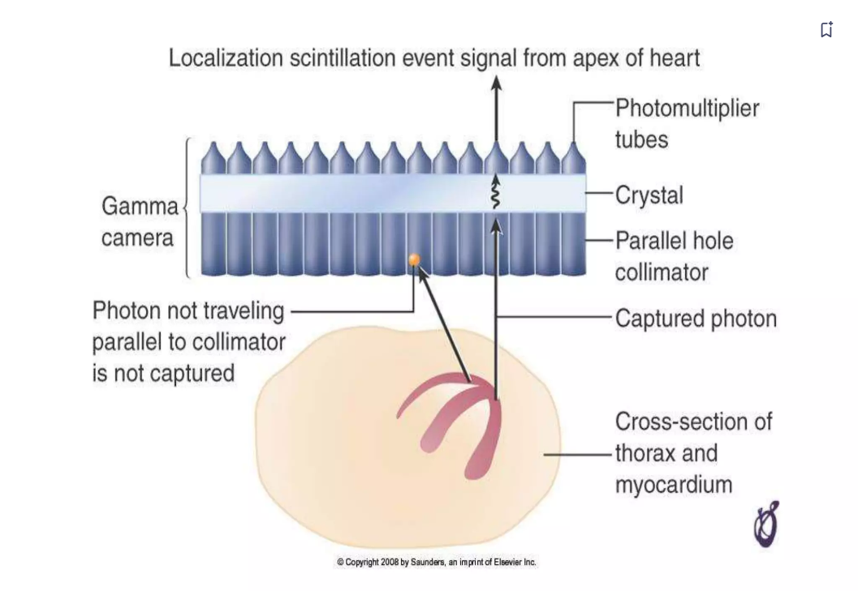
Annihilation reaction and photon detection
The positron will encounter an electron and completely annihilate each other resulting in converting all their masses into energy. Because of conservation of mass and momentum each photon has energy of 511 kEV and head in an almost 180 degrees from each other
Notes:
The positron will encounter an electron and completely annihilate each other resulting in converting all their masses into energy. Because of conservation of mass and momentum each photon has energy of 511 kEV and head in an almost 180 degrees from each other

Slide 13
PET tracers used in cardiology
Myocardial perfusion tracers: ¹⁵O-water, ¹³N-ammonia, ⁸²Rubidium and ¹⁸F-Flurpiridaz
Myocardial metabolism and viability tracer: ¹⁸F-Fluorodeoxyglycose
Microcalcification tracer (vulnerable atherosclerotic plaque): ¹⁸F-sodium floride

Slide 14
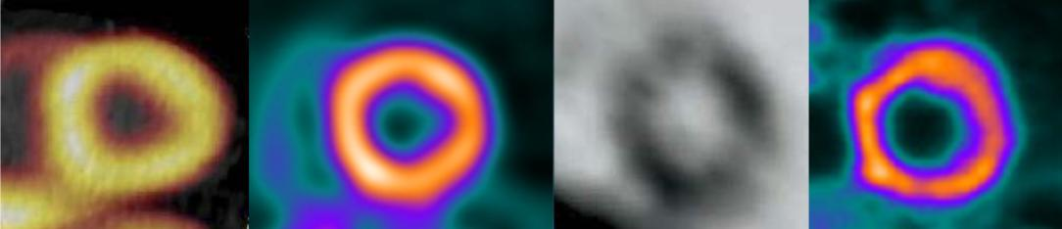
PET Myocardperfusions-Tracer
Tracer Production Half-life
¹⁵O-Water Cyclotron 2 min
¹³N-Ammonia Cyclotron 10 min
⁸²Rubidium Generator 1 min
¹⁸F-Flurpiridaz* Cyclotron 110 min
* currently in phase III study
⁸²Rb
¹³N-NH₃
¹⁵O-H₂O
¹⁸F-Flurpiridaz
modified from Schindler et al. JACC Cardiovasc Imaging. 2010 Jun;3(6):623-40

Slide 15
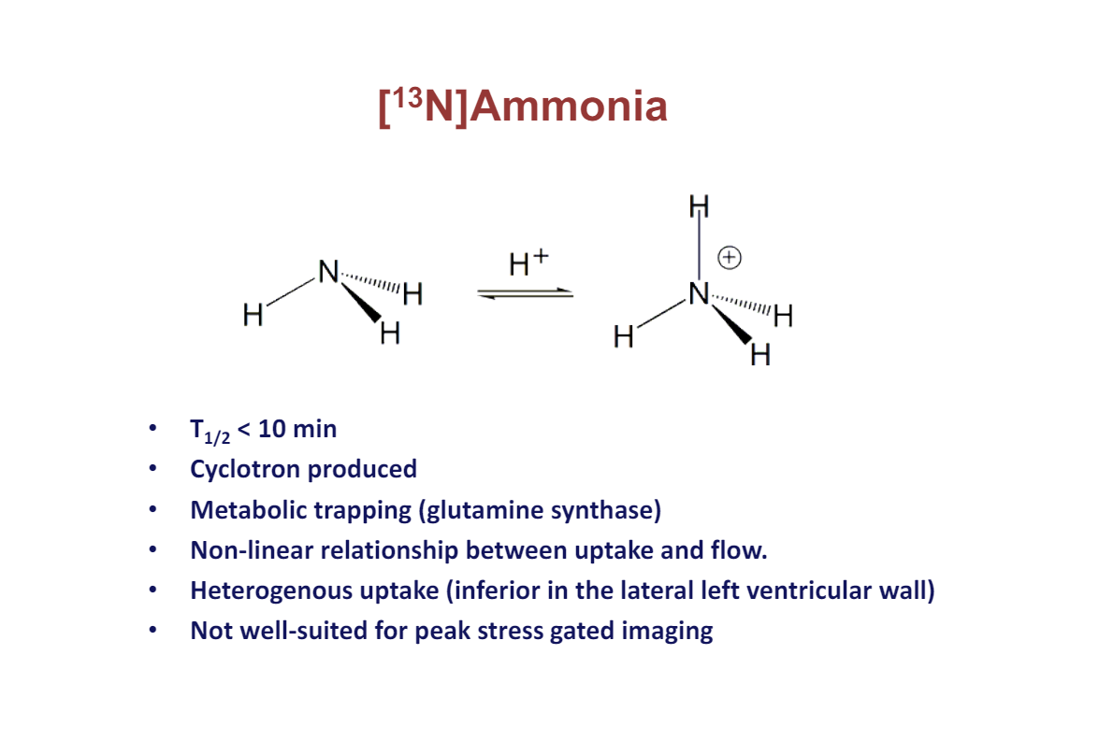
¹³N-ammonia

Slide 16
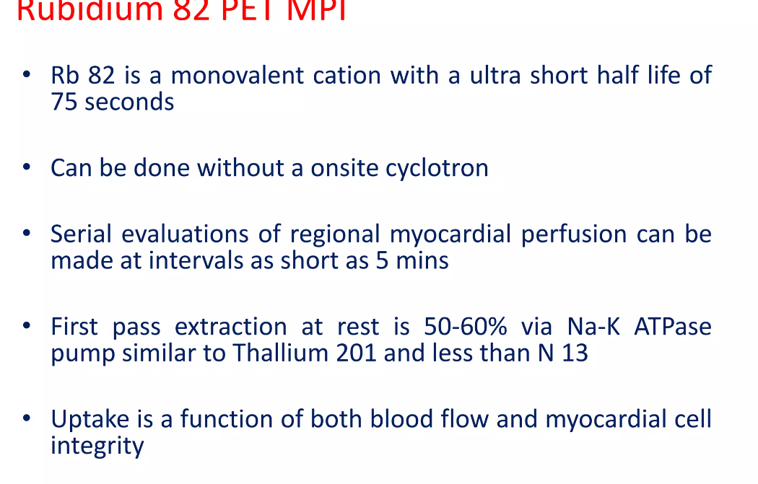
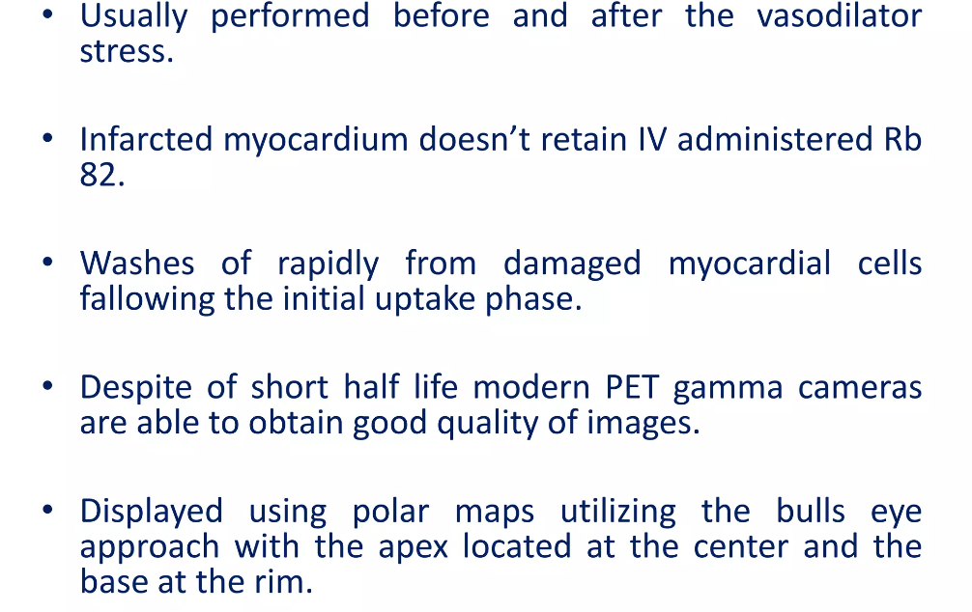
Rubidium 82 PET MPI

Slide 17
Oxygen-15 water
Oxygen-15 has a short half-life of 2 minutes that is well-matched to the short biological half-life, resulting in a very low radiation dose of 1-2 mSv
It is freely diffusible across capillary and cell membranes with extraction fraction close to 100%
very robust and versatile for the quantification of MBF under many different disease conditions
The washout rate of H2 15O correlates tightly with MBF23 and is considered the gold-standard for quantification of blood flow in the myocardium and other perfused organs.
It is not metabolically retained in tissues, that is RF = 0
Seminars in Nuclear medicine 2020

Slide 18
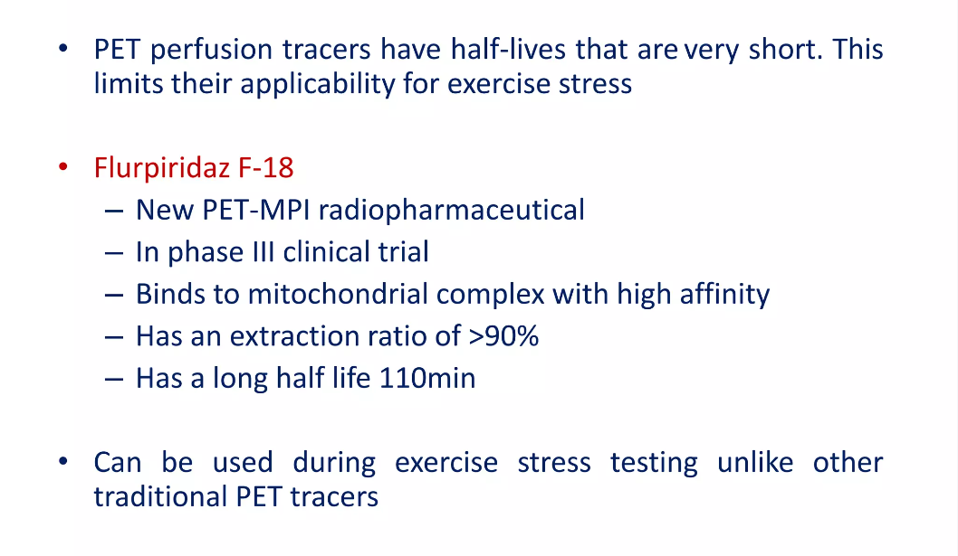
18-F Flurpiridaz
Notes:
FDA APPROVAL 09/2024

Slide 19
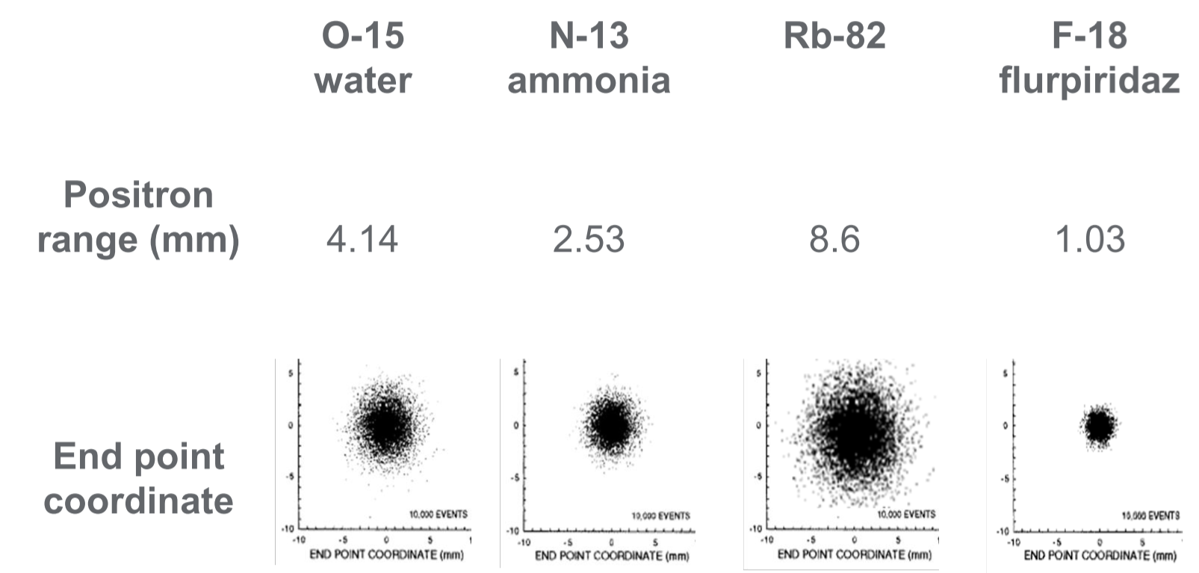
PET - Perfusion Tracers
Maddahi et al. Semin Nucl Med. 2014 Sep;44(5):333-43.

Slide 20
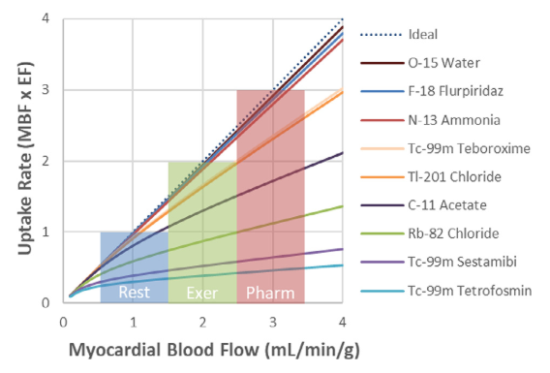
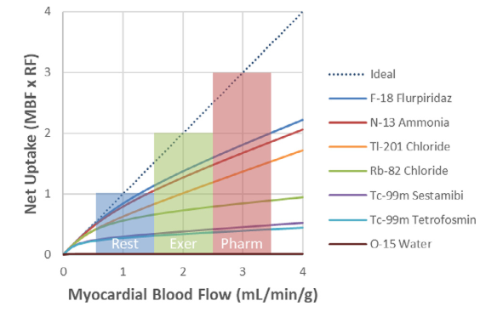
Uptake rate and net uptake
Uptake rate (EF=extraction fraction)
Retention rate (retention fraction)
Seminars in Nuclear medicine 2020

Slide 21
Coronary Flow and Stress Tests
N-13 Ammonia
Coronary Flow
5
4
3
Coronary Flow
(ml/min/g)
2
1
0
Rest
Exercise
Dipyridamole
Adenosine
Condition
Chan. JACC 1992;116:53-58

Slide 22
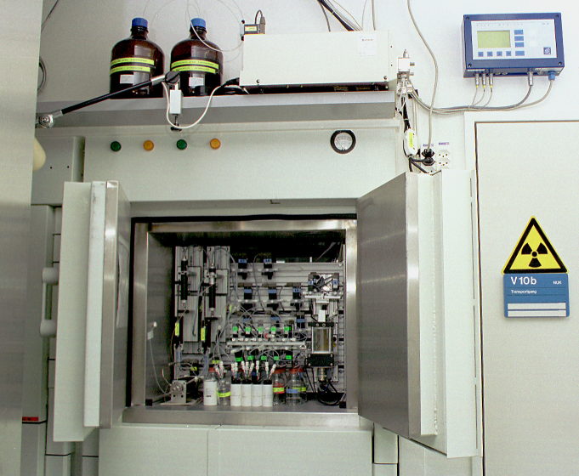
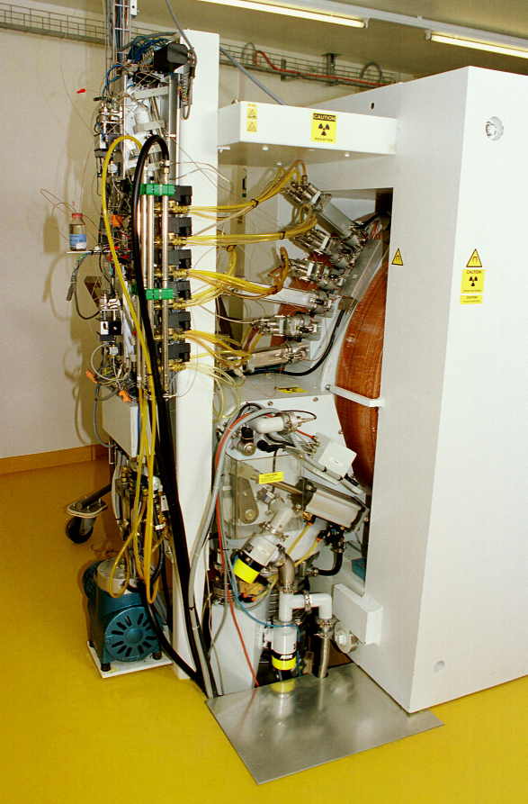
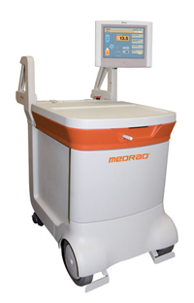
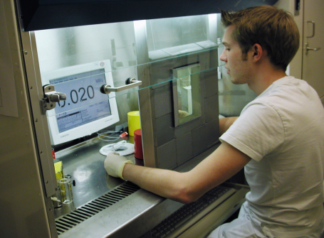
Production of PET Tracer - cyclotron
Radiopharmazie ist ein zertifizierter Pharmabetrieb
Herstellung Positronen-
emittierender Nuklide (¹⁸F,¹¹C, ¹³N…)
Hotcells/Module
Nuclide | Halftime | FWHM Diameter
¹⁵O | 2.04 min | 1.05 mm
¹³N | 9.96 min | 0.39 mm
¹¹C | 20.4 min | 0.28 mm
¹⁸F | 109.7 min | 0.22 mm
Cyclotron
Dosierung für
Patienten (GCP, GLP, GMP…)

Slide 23
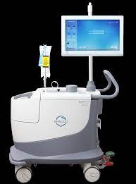
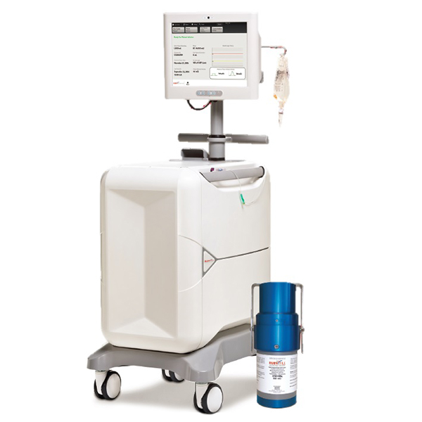
Production of PET Tracer - generator

Slide 24
Types of stress
Exercise stress test (treadmill) (target: at least 85% of maximal HR and continue exercise 1 min after the injection)
Pharmacologic vasodilator stress
  Adenosin
  Regadenoson
  Dipyridamol
Pharmacologic synthetic cathecholamin stress
  Dobutamin
Vasodilat.
β₁-stim.

Slide 25
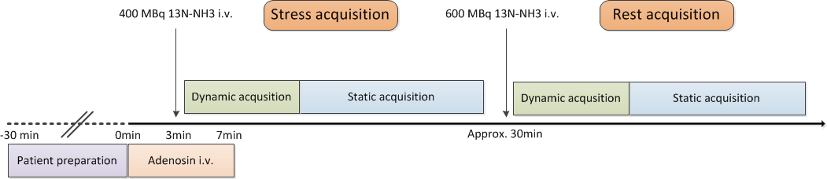
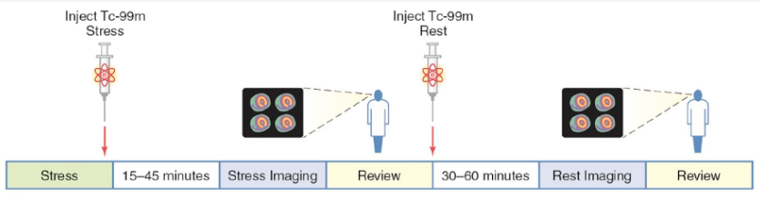
Acquisition Protocol
CTAC

Slide 26
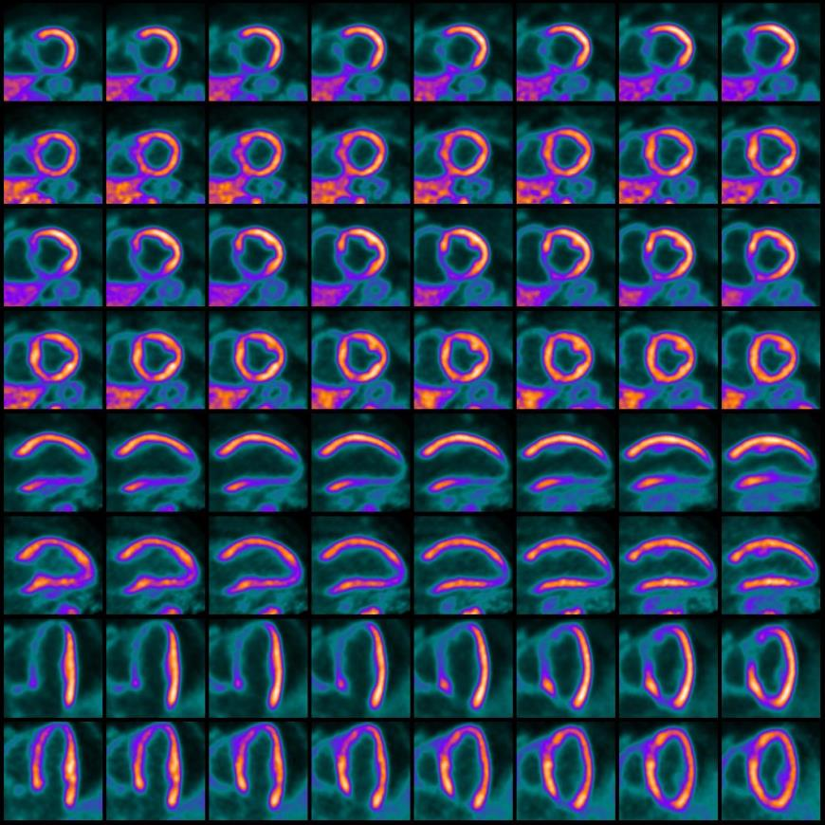
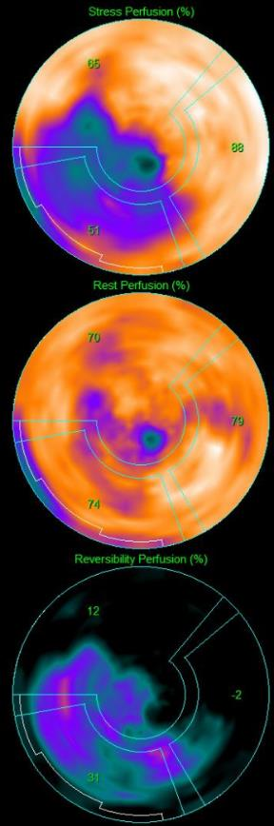
Myocardperfusions-PET - Semiquantitative
Superior image quality
Common reconstructions as SPECT
Axial
Horizontal long and
vertical long axis view

Slide 27
Semiquantitative perfusion imaging
But in comparison with myocardial perfusion SPECT:
- with high spatial resolution (4-7mm).
- with high contrast resolution (target to background ratio)
- with accurate attenuation correction
- with very high diagnostic accuracy
- at a low radiation dose exposure (1-2mSv)
Sampson et al. J Am Coll Cardiol 2007;49:1052–8
Bateman et al. J Nucl Cardiol 2006;13:24–33
Di Carli et al. J Nucl Cardiol 2004;11:719 –32
Stewart et al. Am J Cardiol 1991;67:1303–10
Go et al. J Nucl Med 1990;31:1899–1905

Slide 28
Acquisition Protocol
CTAC

Slide 29
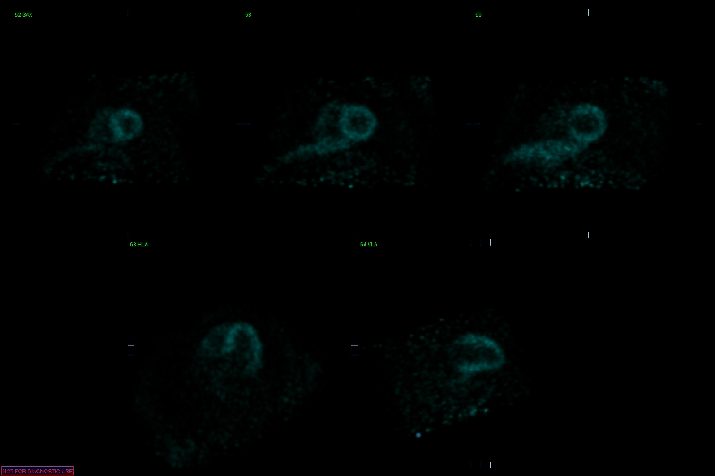
Dynamic acquisition

Slide 30
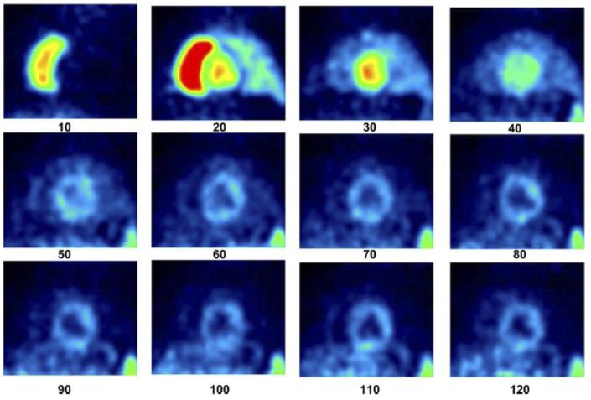
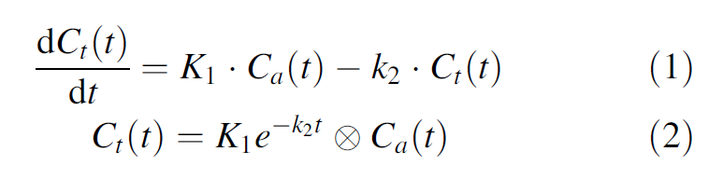
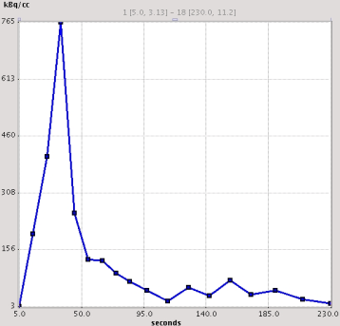
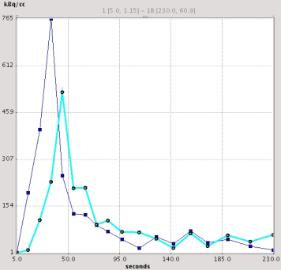
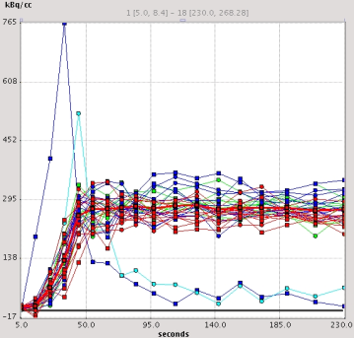
Quantitative Imaging
Akquisition von Zeitaktivitätskurven
RV
LV
myocardium

Slide 31
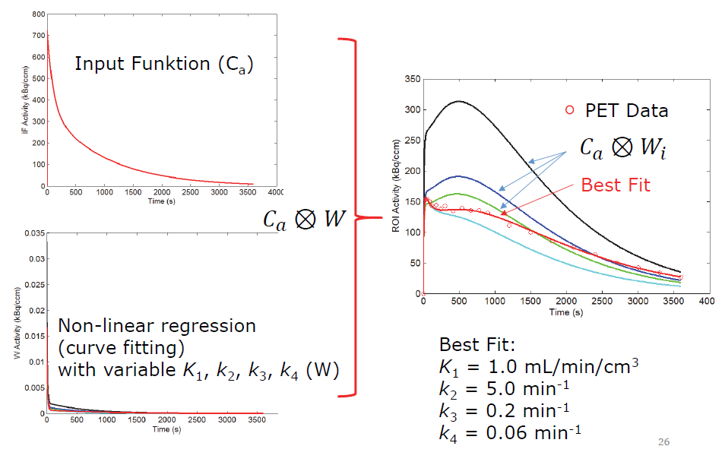
Quantitative Imaging
MFR normal > 2.5
MFR pathologic < 2.0
rest MBF (ml/min/g)
stress MBF (ml/min/g)
MFR (stress:rest)

Slide 32
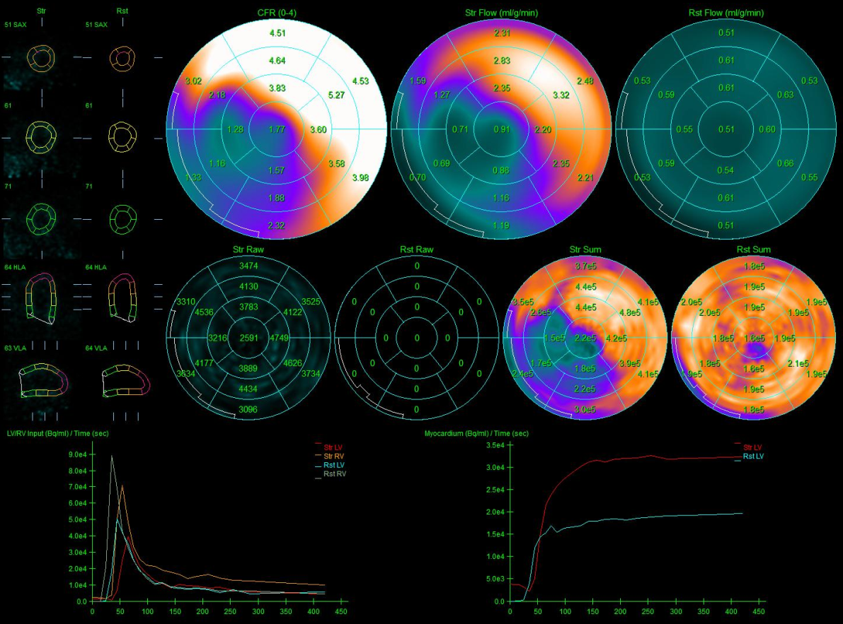
Myocardperfusions-PET - Quantitative
MFR
Hyperemic Flow
Rest Flow

Slide 33
Why/when is quantitation useful?
Problem of MPI:
Evaluation of relative tracer uptake may lead to underestimation of the extent of CAD and even uniform tracer uptake despite
  1) extensive (three-vessel) CAD or in the case of
  2) endothelial dysfunction or microvascular disease
Balanced CAD patterns in as much as 5-10% of patients with suspected CAD
Kajander et al. Circulation. 2008;118:S_1010-S_1011

Slide 34
PET and MFR – Prognostic Value
254 patients with ischemic heart failure undergoing PET MPI and viability testing identified from Zurich PET Registry
MFR independent predictor of events in this patient category
Benz D., …Benetos G…Buechel R. JACC Img 2020
Notes:
Objectives: The aim of this study was to investigate the prognostic and clinical value of quantitative positron emission tomographic (PET) metrics in patients with ischemic heart failure.
Background: Although myocardial flow reserve (MFR) is a strong predictor of cardiac risk in patients without heart failure, it is unknown whether quantitative PET metrics improve risk stratification in patients with ischemic heart failure.
Methods: The study included 254 patients referred for stress and rest myocardial perfusion imaging and viability testing using PET. Major adverse cardiac event(s) (MACE) consisted of death, resuscitated sudden cardiac death, heart transplantation, acute coronary syndrome, hospitalization for heart failure, and late revascularization.
Results: MACE occurred in 170 patients (67%) during a median follow-up of 3.3 years. In a multivariate Cox proportional hazards model including multiple quantitative PET metrics, only MFR predicted MACE significantly (p = 0.013). Beyond age, symptom severity, diabetes mellitus, previous myocardial infarction or revascularization, 3-vessel disease, renal insufficiency, ejection fraction, as well as presence and burden of ischemia, scar, and hibernating myocardium, MFR was strongly associated with MACE (adjusted hazard ratio per increase in MFR by 1: 0.63; 95% confidence interval: 0.45 to 0.91). Incorporation of MFR into a risk assessment model incrementally improved the prediction of MACE (likelihood ratio chi-square test [16] = 48.61 vs. chi-square test [15] = 39.20; p = 0.002).
Conclusions: In this retrospective analysis of a single-center cohort, quantitative PET metrics of myocardial blood flow all improved risk stratification in patients with ischemic heart failure. However, in a hypothesis-generating analysis, MFR appears modestly superior to the other metrics as a prognostic index

Slide 35
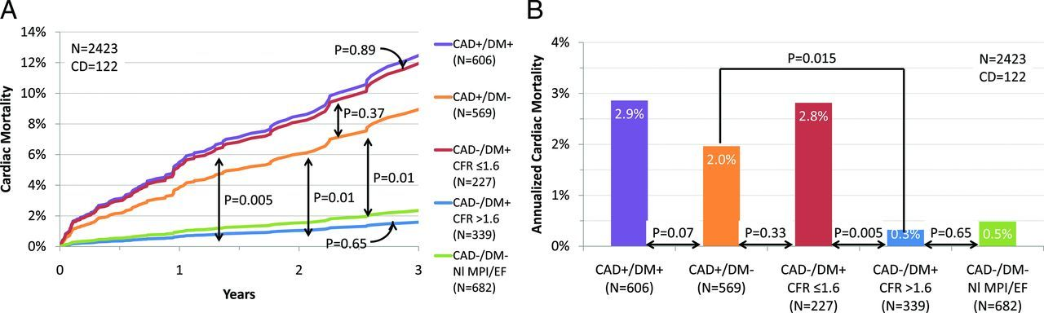
Prognostic value of MFR in DM
Patients without CAD and DM and abnormal MFR have the same prognosis with patients with DM and known CAD
Patients with DM and normal MFR have the same prognosis with patients without DM and without CAD
Venkatesh et al. Circulation 2012

Slide 36
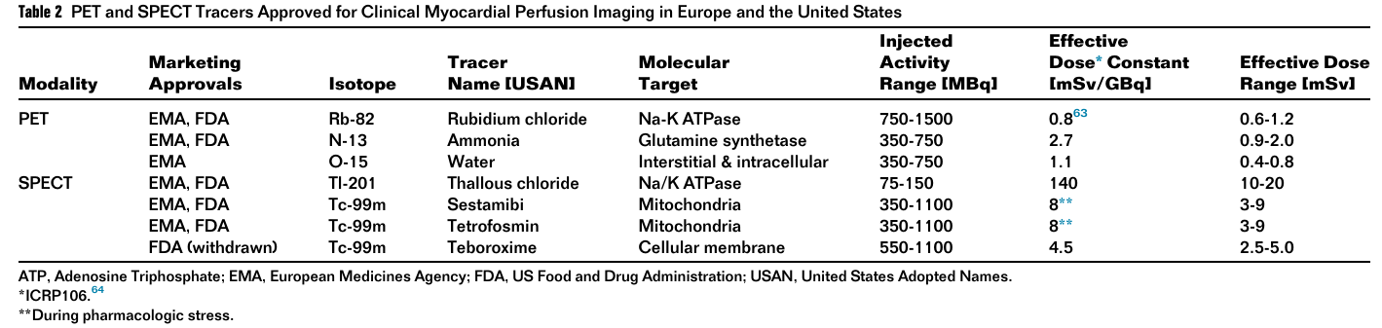
Radiation Dose– PET

Slide 37
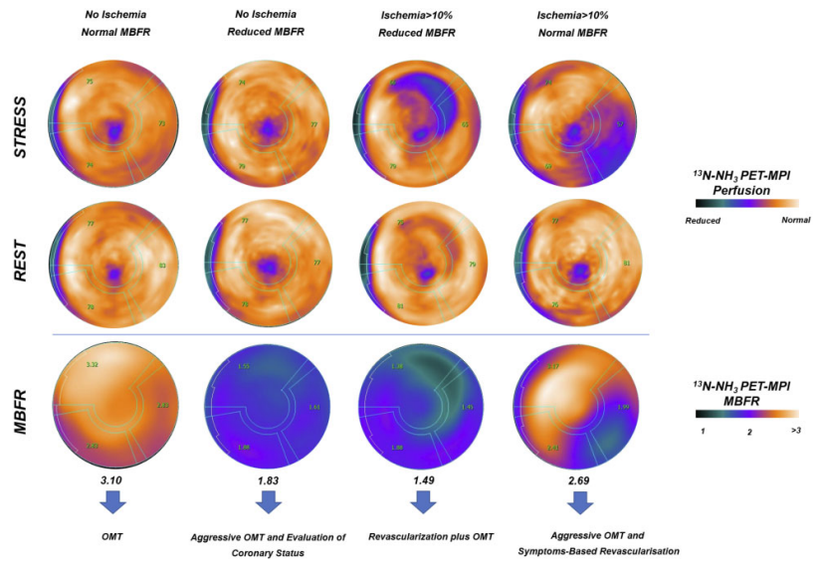
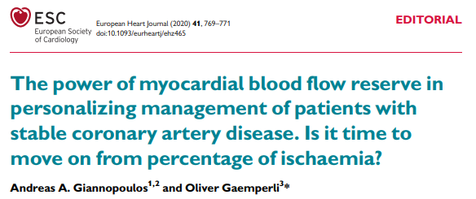
Value of PET
Normal relative stress perfusion images and normal MBFR are associated with a very low risk of cardiac death (<0.5% per year)
Myocardial perfusion alone does not exclude:
  a. 50% left main disease,
  b. extensive CAD,
  c. balanced MBF reduction,
  d. extensive microvascular disease,
  e. non-response to vasodilation
Normal MBFR in addition to normal perfusion establishes physiologic normality of the epicardial arteries and the microvasculature.
Knowledge of the total atherosclerotic burden with CACS

Slide 38
PET tracer used for metabolism - inflammation
18-F FDG
Produced by cyclotron
Half life of 110 minutes
Compound: deoxyglycose

Slide 39
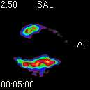
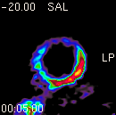
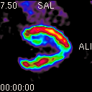
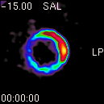
Hibernating Myocardium in PET
Normal myocytes under fasting conditions consume fatty acids
Postprandial they consume glycose
The chronic reduction of MBF levels that occur with myocardial hibernation leads to an overdependence on glucose metabolism by the cardiac myocyte
Adaptive metabolic change
13N-NH3
MISMATCH
18F-FDG
Notes:
The effective dose for a 10- mCi dose of 18F-FDG administered intravenously is 7 mSv.

Slide 40
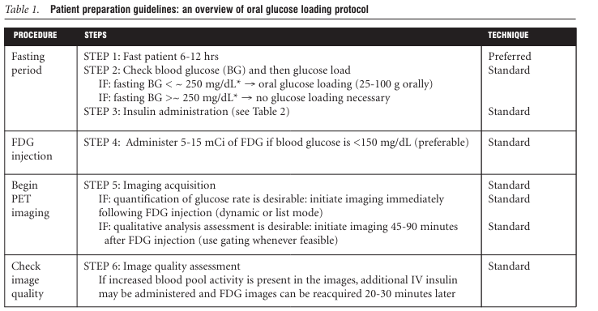
Hibernating Myocardium in PET – glycose protocol

Slide 41
FDG-PET – Basics (inflammation)
Accumulation FDG ~ glucose uptake
Reflects metabolic activity of cells
FDG
Glucose
¹⁸F-FDG: half life of 110 min
Photons energy 511 kEV
GLUT
FDG
Glucose
Hexokinase
FDG-6-Phosphate
FDG-6-Phosphate
FDG-6-Phosphate
Glucose-6-Phosphate
Glucose-6-phosphate isomerase
Krebs cycle
High uptake in inflammatory cells … but also in any cells that are metabolically very active (sterile inflammation, infection, cancer, physiologically etc.)
Notes:
Different from glucose, the phosphorylated radiotracer,
18F-FDG-6-phosphate does not proceed into glycogen
synthesis or aerobic glycolysis with only minimal dephosphorylation
and return of radiotracer to blood; it is
thus metabolically trapped in tissue. Consequently, its
uptake is reflective of overall glucose uptake

Slide 42
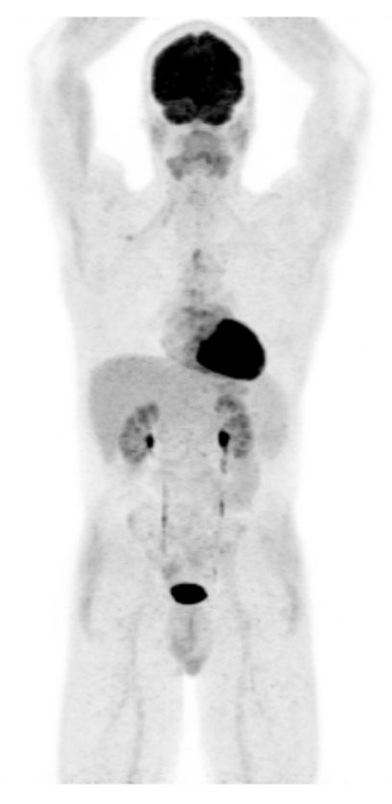




FDG-PET - Basics
Suppression of myocardial FDG uptake
12 hours fasting
No carb / high fat diet
60 mins
uptake
18F-FDG
±Heparin
2.5-5MBq/kg
Whole-body PET/CT acquisition
Duration of acquisition approx. 20 minutes
+/- CTA
Notes:
5-15 mCi (185-555 MBq)
10 MCI=7MSV

Slide 44
Hibernating Myocardium in PET
Normal myocytes under fasting conditions consume fatty acids
Postprandial they consume glycose
The chronic reduction of MBF levels that occur with myocardial hibernation leads to an overdependence on glucose metabolism by the cardiac myocyte
Adaptive metabolic change
13N-NH3
MISMATCH
18F-FDG
Notes:
The effective dose for a 10- mCi dose of 18F-FDG administered intravenously is 7 mSv.

Slide 45



PET-FDG Myocardial Viability - Case
CTO RCA and EF=40%
Source USZ

Slide 46



PET-FDG Myocardial Viability - Case
Anterior MI and CTO LAD
Source USZ

Slide 47

Radiation Dose– PET
Case et al. J Nucl Cardiol. 2017 Aug;24(4):1427-1439
USZ:
n = 1341 pts
Median: 1.3mSv

Slide 48
Pros and Cons of SPECT and PET
Advantages
  Availability (SPECT)
  Exercise test (SPECT)
  Claustrophobia (SPECT)
  Renal and liver function not relevant
  No allergic reactions
  Devices do not alter the quality of the examination
  Quantification of myocardial flow (PET)
  Low radiation (PET)
Disadvantages
  Availability (PET)
  High radiation (SPECT)
  Claustrophobia (PET)
  Balanced ischemia (SPECT)

Slide 50

Tracer uptake increases proportionally to MBF
Myocardial uptake of ²⁰¹Tl increases proportionately with perfusion when perfusion increases up to 2–2.5 times above resting levels before reaching a plateau in myocardial uptake.
The ^{99m}Tc-labelled tracers reach a plateau in myocardial uptake at a myocardial perfusion around twice resting levels

Slide 51
Myocardperfusions-PET – Flow quantification
rest MBF (ml/min/g)
stress MBF (ml/min/g)
MFR (stress:rest)
MFR normal > 2.5
MFR pathologic < 2.0
Notes:
By drawing activity time curves (by placing specific ROIs) we can calculate myocardial blood flow both in stress and rest

Slide 52



Nuclear Cardiology – Myocardperfusion PET
LOR
„Single“
event
Annihilation
γ
γ
„Single“
event
Notes:
Annihilation of a proton with an electron to two high energy photons (511kEV)

Slide 53

PET - Perfusion Tracers
Dewey M et al. Nat Rev Cardiol. 2020.

Slide 54

Prognostic value of MFR in DM
Retrospective study of 2783 pts (1172 DM and 1611 without) who underwent RB PET perfusion imaging. Median FU of 1.4 years
Venkatesh et al. Circulation 2012
Notes:
Background—
Diabetes mellitus increases the risk of adverse cardiac outcomes and is considered a coronary artery disease (CAD) equivalent. We examined whether coronary vascular dysfunction, an early manifestation of CAD, accounts for increased risk among diabetics compared with nondiabetics.
Methods and Results—
A total of 2783 consecutive patients (1172 diabetics and 1611 nondiabetics) underwent quantification of coronary flow reserve (CFR; CFR=stress divided by rest myocardial blood flow) by positron emission tomography and were followed up for a median of 1.4 years (quartile 1–3, 0.7–3.2 years). The primary end point was cardiac death. Impaired CFR (below the median) was associated with an adjusted 3.2- and 4.9-fold increase in the rate of cardiac death for diabetics and nondiabetics, respectively (P=0.0004). Addition of CFR to clinical and imaging risk models improved risk discrimination for both diabetics and nondiabetics (c index, 0.77–0.79, P=0.04; 0.82–0.85, P=0.03, respectively). Diabetic patients without known CAD with impaired CFR experienced a rate of cardiac death comparable to that for nondiabetic patients with known CAD (2.8%/y versus 2.0%/y; P=0.33). Conversely, diabetics without known CAD and preserved CFR had very low annualized cardiac mortality, which was similar to patients without known CAD or diabetes mellitus and normal stress perfusion and systolic function (0.3%/y versus 0.5%/y; P=0.65).
Conclusions—
Coronary vasodilator dysfunction is a powerful, independent correlate of cardiac mortality among both diabetics and nondiabetics and provides meaningful incremental risk stratification. Among diabetic patients without CAD, those with impaired CFR have event rates comparable to those of patients with prior CAD, whereas those with preserved CFR have event rates comparable to those of nondiabetics.

Slide 55


Prognostic value of CFR
Herzog et al. J Am Coll Cardiol. 2009 Jul 7;54(2):150-6

Slide 56

Head-to-head diagnostic performance
n = 208
PACIFIC trial. Danad I et al. JAMA Cardiol. 2017 Oct 1;2(10):1100-1107.

Slide 57
Myocardial compartment model
Myocardium C_{m}(t)
K₁
k₃
Blood compartment
C_{a}(t)
Extravascular
compartment
Metabolic
compartment
k₂
k₄
Tissue C_{t}(t)
¹⁵O-water
¹⁸F-flurpiridaz
¹³N-ammonia
⁸²Rb
modified from Schelbert et al. Circ 1981

