Slide 1

Έλεγχος ισχαιμίας-βιωσιμότητας. Παραδείγματα
Dr med Γεώργιος Ν. Μπενέτος, MD, MSc, PhD
Ακαδημαϊκός Υπότροφος Α’ Πανεπιστημιακή Καρδιολογική Κλινική
Cardiac CT Κλινική Λευκός Σταυρός
EACVI and SCCT Level 3 certified in Cardiac CT

Slide 2
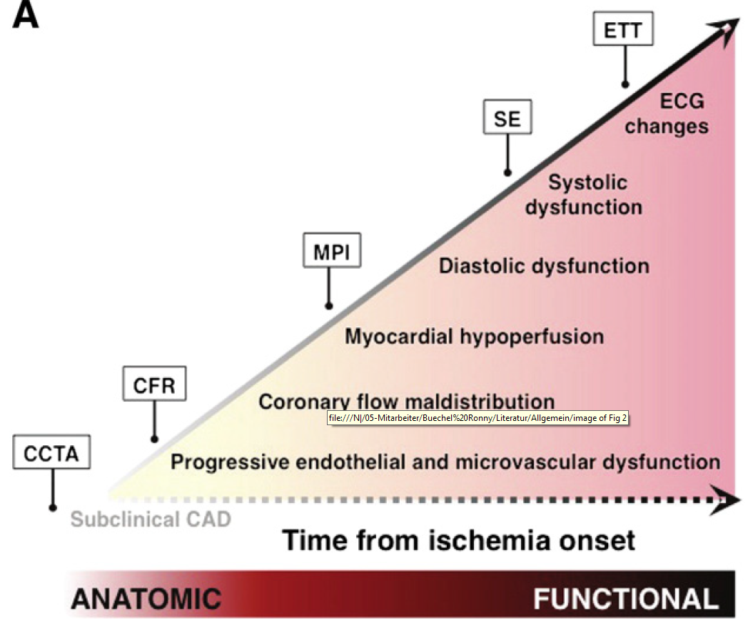
CAD diagnosis
Stress-ECG
Stress Echo
SPECT
MRI
PET
CCTA
Invasive Coro

Slide 3
CAD diagnosis
Stress-ECG
Stress Echo
SPECT
MRI
PET
CCTA
Invasive Coro

Slide 4
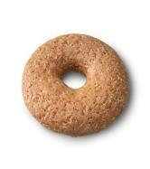
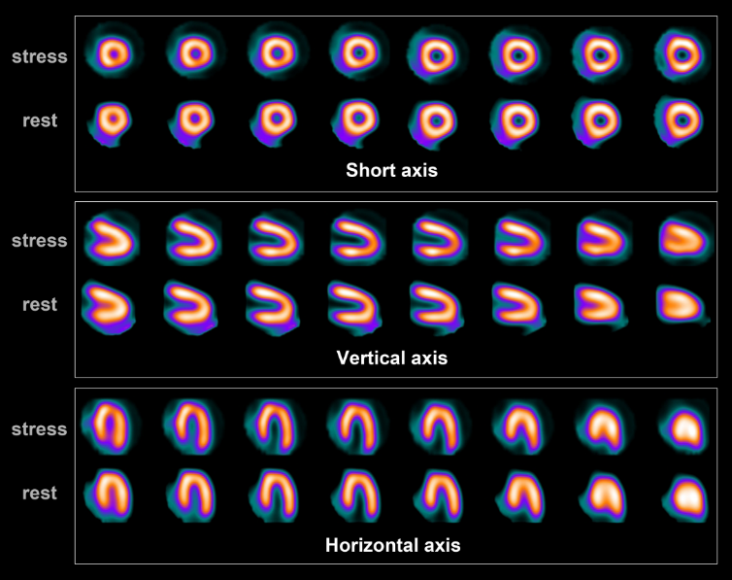
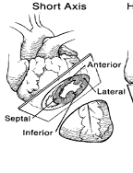
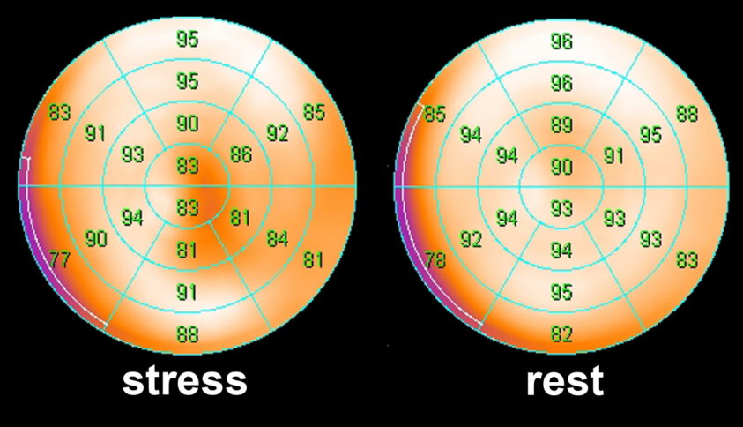

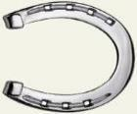
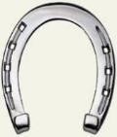

Myocardperfusion-SPECT
ΚΟΡΥΦΗ
ΒΑΣΗ
ΠΛΑΓΙΟ
ΜΚΔ
ΠΡΟΣΘΙΟ
ΟΠΙΣΘΙΟ
Buechel RR and Kaufmann PA. Protocols and data analysis: normal scans and pitfalls in PET and SPECT.
In von Schulthess GK (Ed.), Clinical Molecular Anatomic Imaging PET/CT, SPECT/CT and PET/MR. Philadelphia, USA: Lippincott Williams & Wilkins. 2015 Jun 16.
Notes:
Higher spatial resolution compared to conventional cameras

Slide 5
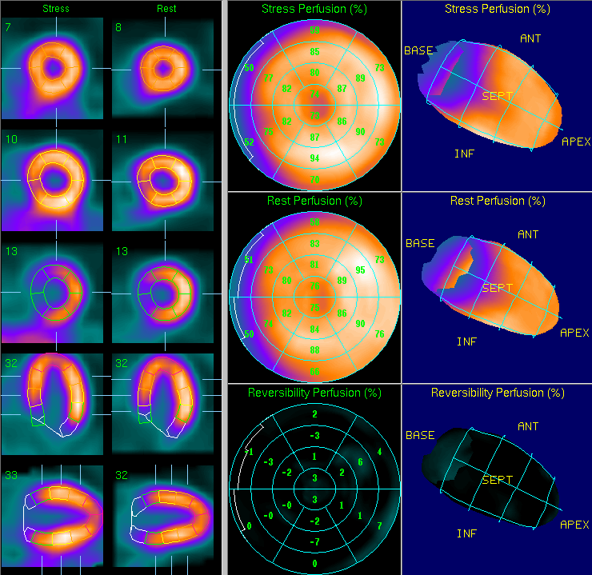
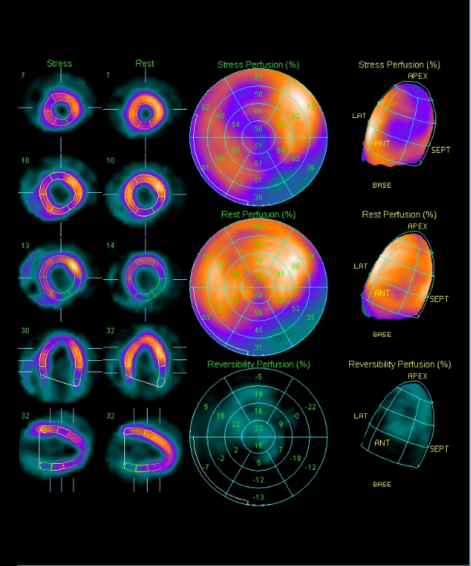
How does ischemia and scar look like?
Ischemia
Scar
Scar

Slide 6
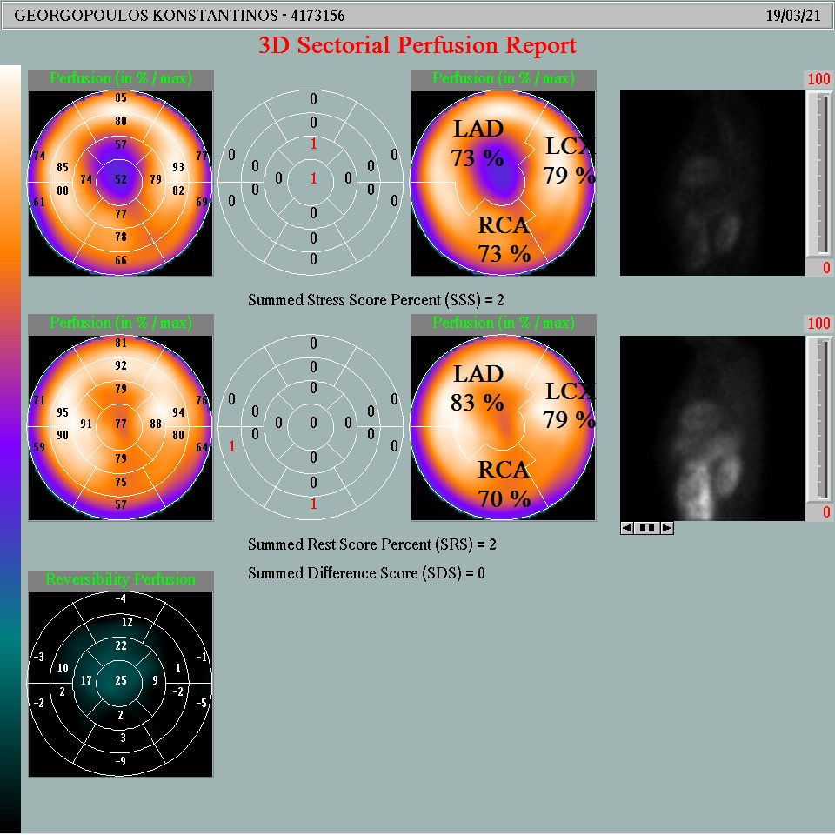
Semiquantification of perfusion defects in SPECT
Normal: ≥70%
Mildly reduced: 50-69%
Moderately reduced: 30-49%
Severely reduced: 10-29%
Absent: <10%
17 segments (basal and mid segments divided in 6 segments and apical in 4)
Score 0-4, 0 (normal uptake) to 4 (uptake absent) for each segment
SSS: summed stress score
SRS: summed rest score
SDS: summed difference score
Each segment corresponds to ~5% of LV myocardium

Slide 7
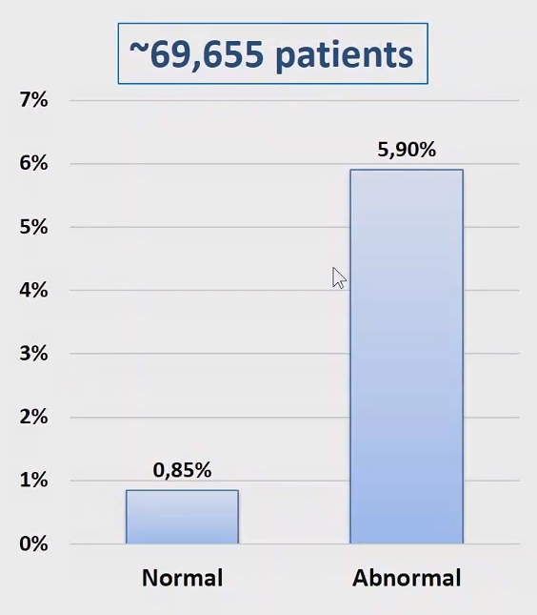
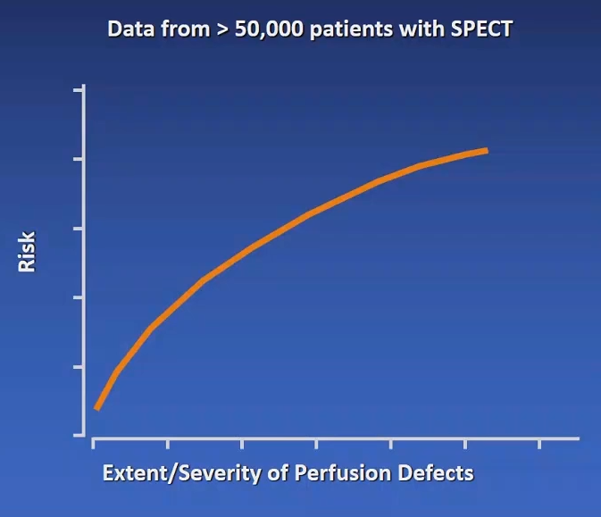
Prognostic value of a normal SPECT
Power of Normal Perfusion
Normal SPECT MPI is associated with an excellent prognosis
with annual cardiac event rates <1%
Revascularization for Ischemia>10-15% associated with survival benefit
Dorbala S et al JACC 2014
Courtesy of Dr. Hachamovitch, Cleveland Clinic

Slide 8
Extent of ischemia and survival benefit with Revascularization
N>10.000 patients
Without prior CAD undergoing MPS
Revascularization compared with MT had greater survival benefit in patients with moderate to large amounts of inducible ischemia
Hachamovitch R. et al. Circulation 2003

Slide 9
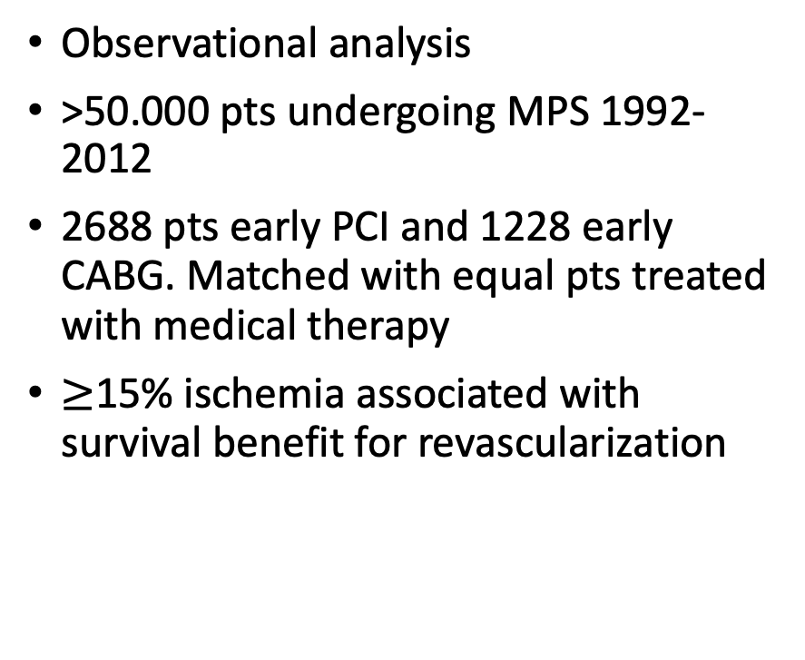
Extent of ischemia and survival benefit with Revascularization
Observational analysis
>50.000 pts undergoing MPS 1992-2012
2688 pts early PCI and 1228 early CABG. Matched with equal pts treated with medical therapy
$≥$15% ischemia associated with survival benefit for revascularization
Miller et al. Eur Heart J CVI 2020

Slide 10
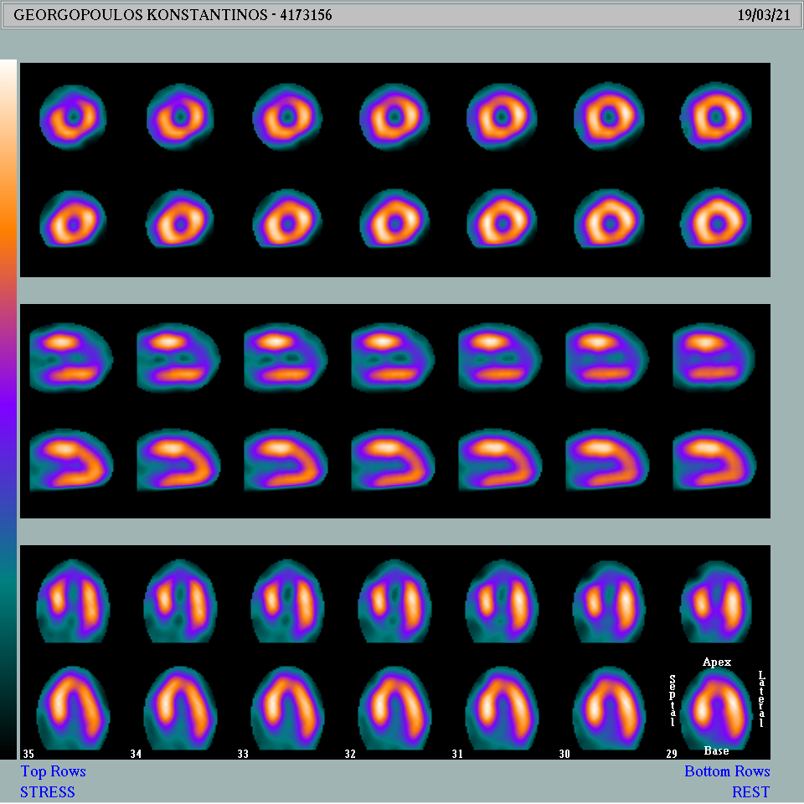

Case 1

Slide 11
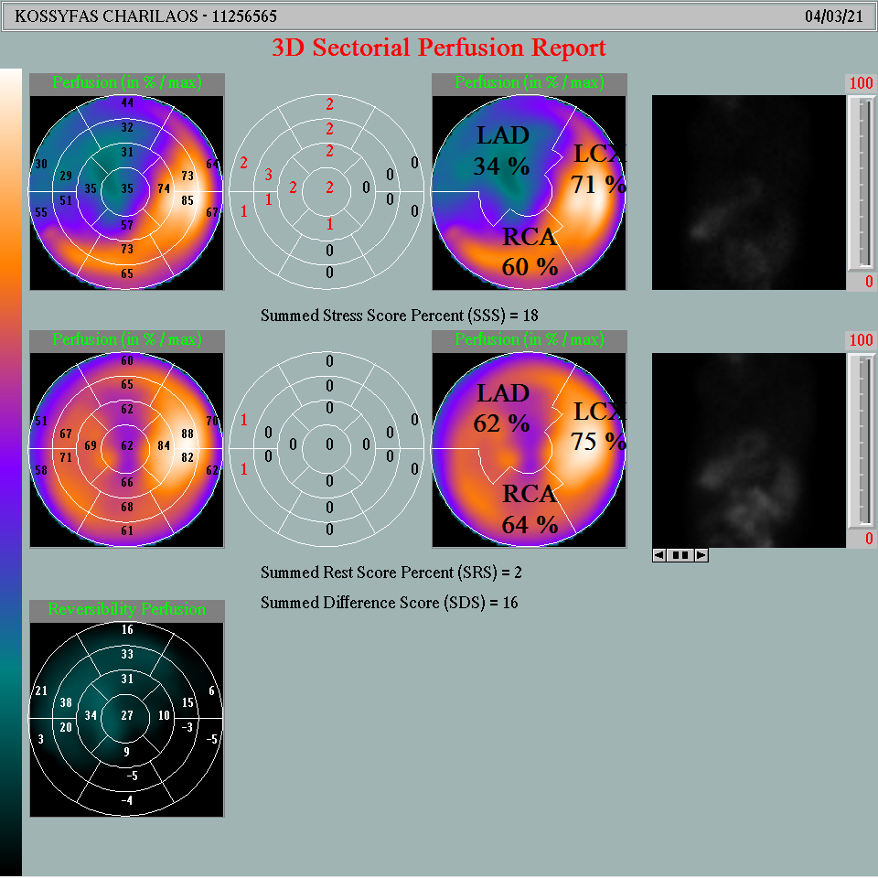
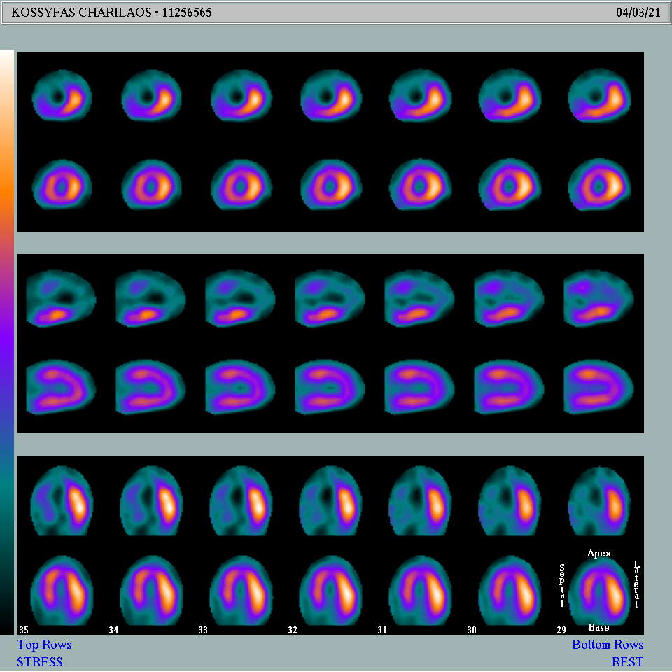
Case 2

Slide 12
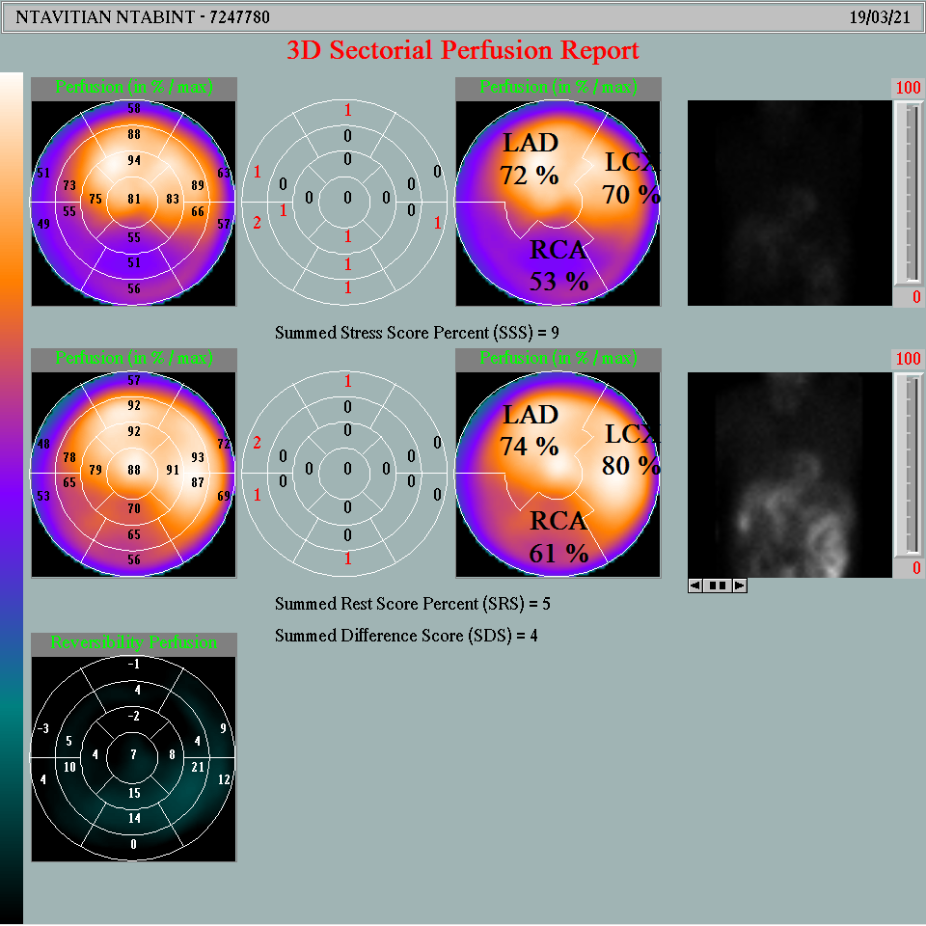
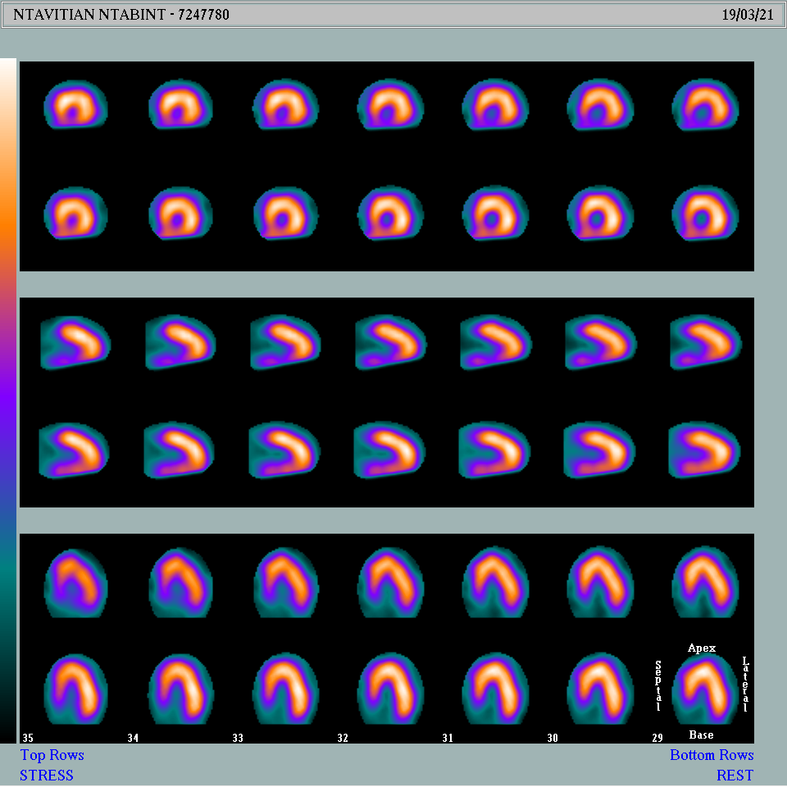
Case 3

Slide 13
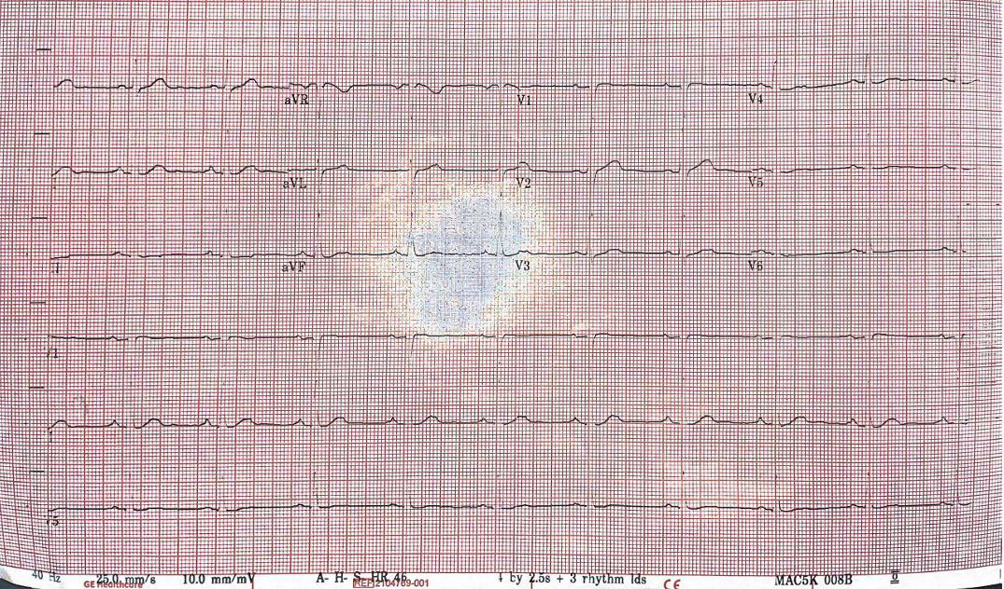
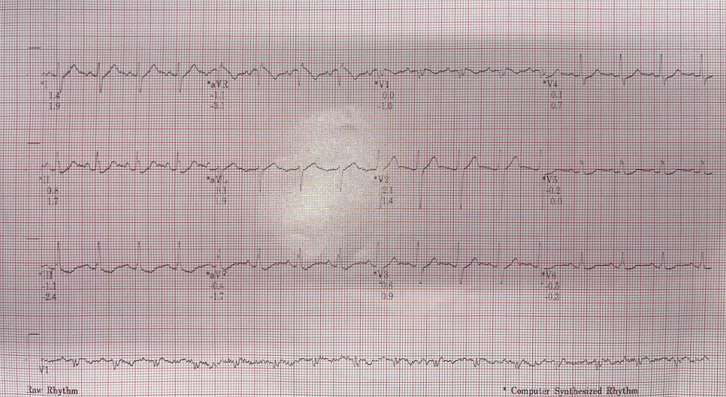
Case 4
60 years old patient.
CVRf:Smoking .Dyslipidemia.
Fatigue
Rest
Stage 1

Slide 14
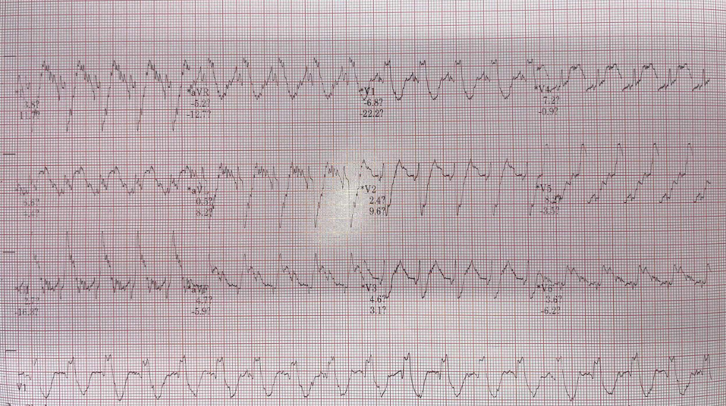
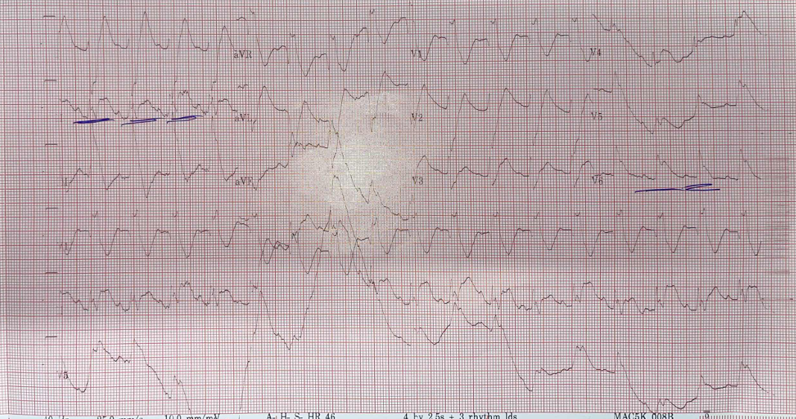
Case 4
Stage 2
Recovery

Slide 15
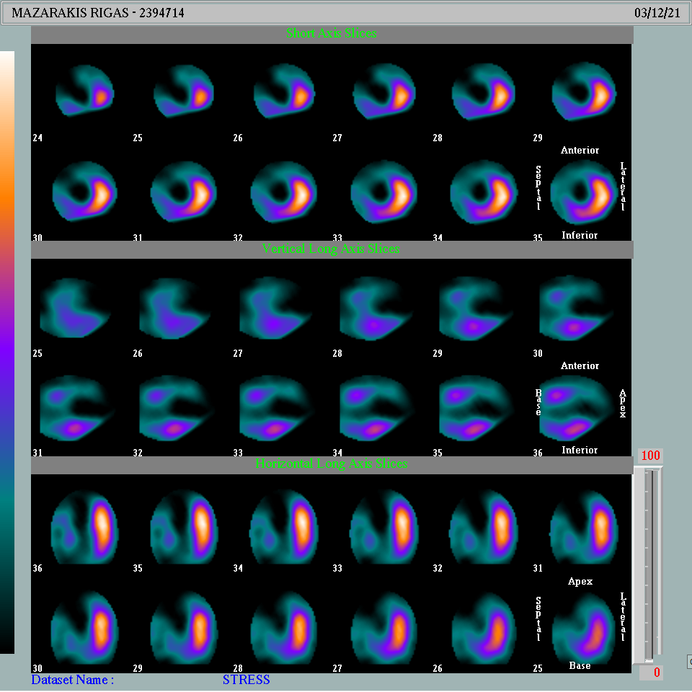
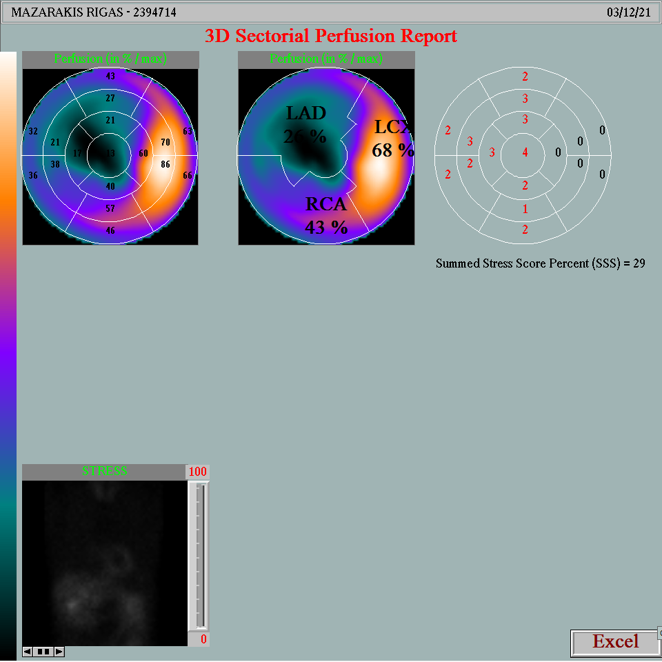
Case 4
Stress only… the ambulance arrived before the rest acquisition!

Slide 16
Case 5 presentation
55 years old male
Asymptomatic
Very active – 10km running every day
Pilot
No known CV risk factors
Underwent CCTA

Slide 17
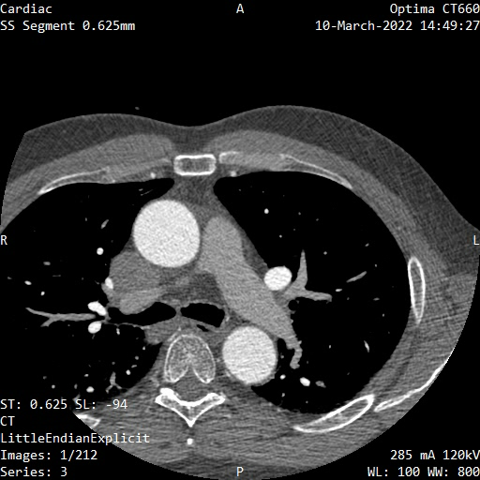
CCTA (03/2022)
CCTA under suboptimal conditions (mean HR~71/min)

Slide 18
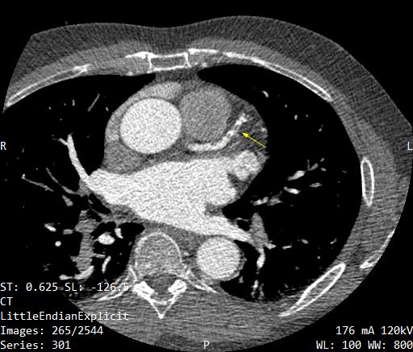
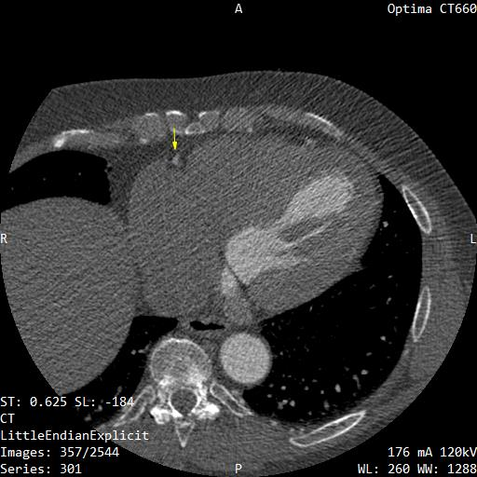
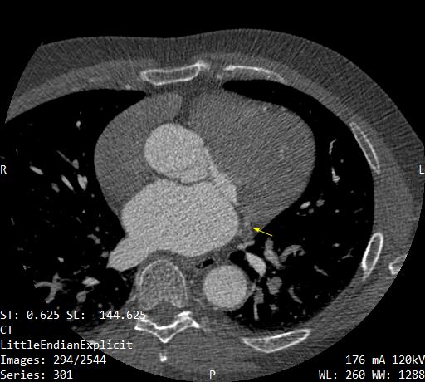
CCTA (03/2022)
Calcium score=1213 (90th percentile)
LAD~50-69%
3rd diagonal ~70%
RCA<50%
LCX<50%
CAD-RADS: 4/N

Slide 19
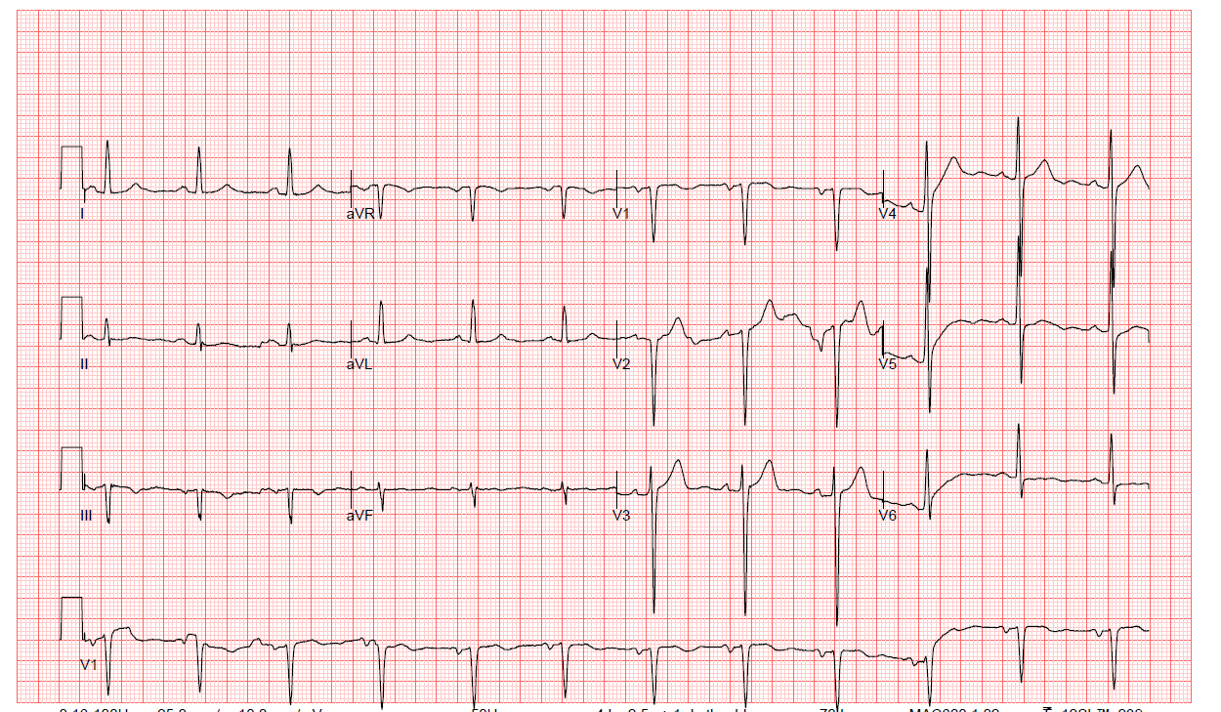
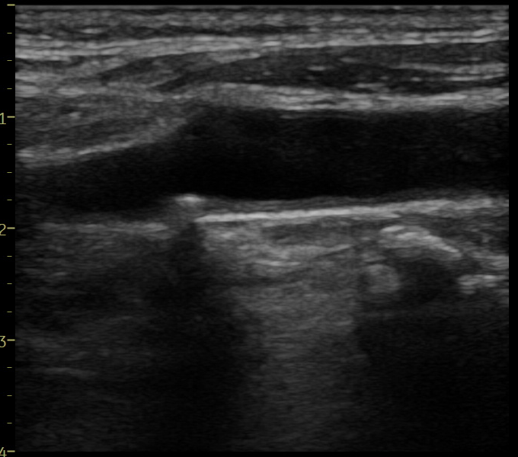
Office 1st visit
BP: 240/140mmHg
Rest clinical examination normal
Echo: normal LVEF without wall motion abnormalities
Carotid arteries: minimal atherosclerosis right carotid bulb
Tchol=220mg/dl, LDL=140mg/dl

Slide 20
Further management
Patient already under aspirin 100mg and rosuvastatin 20mg (due to CCTA results)
Initiation of antihypertensive therapy
1st step: Valsartan 160mg/HCT 12.5mg
2nd step: valsartan 160mg/HCT 12.5mg/amlodipine 10mg
Successful blood pressure control

Slide 21
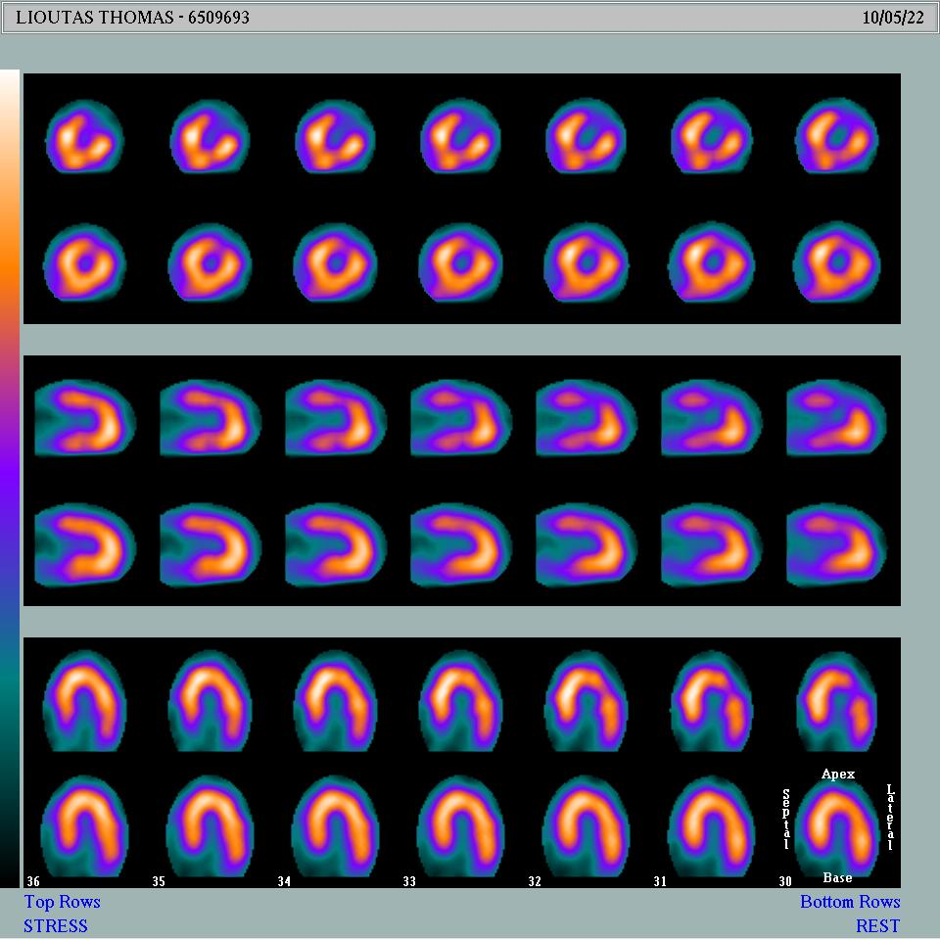
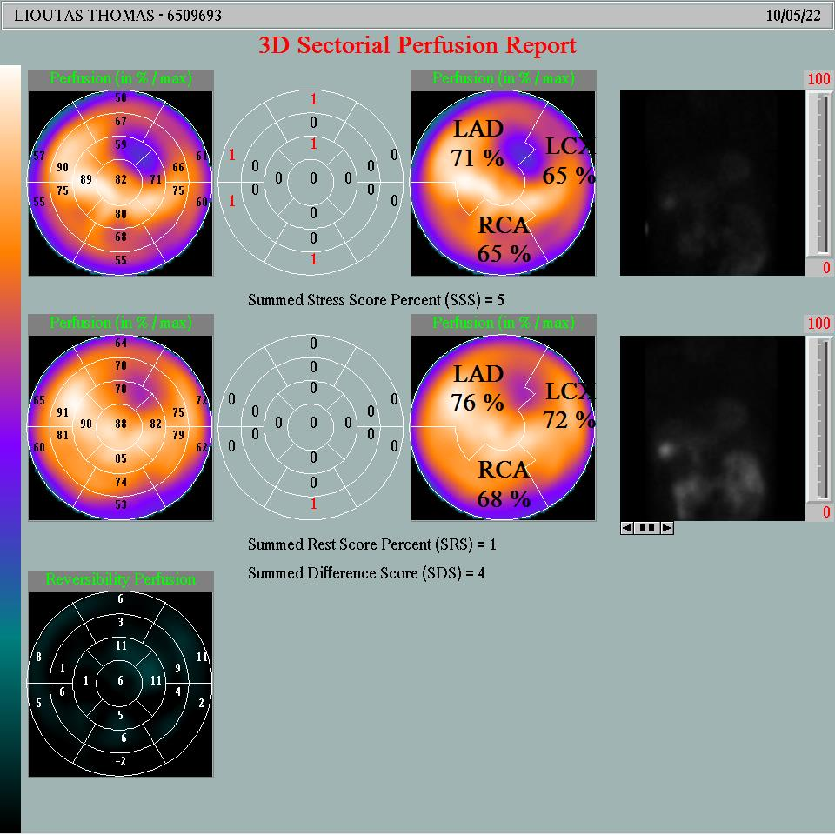
SPECT (05/2022)
Patient underwent SPECT with treadmill stress test
12 min treadmill test with no ECG signs of ischemia

Slide 22
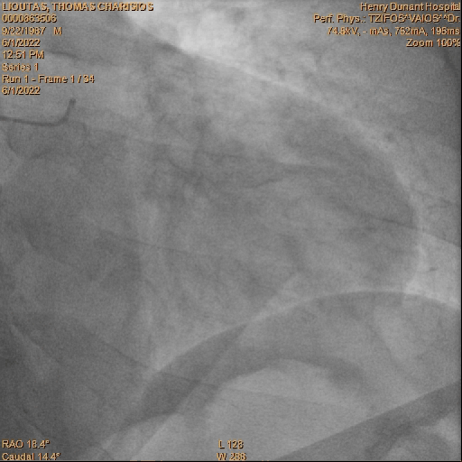
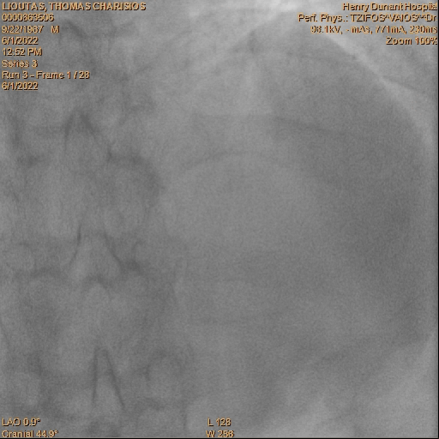
Coronary angiography 1st – 06/2022

Slide 23
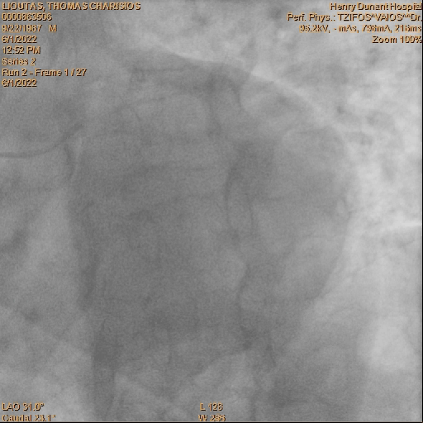
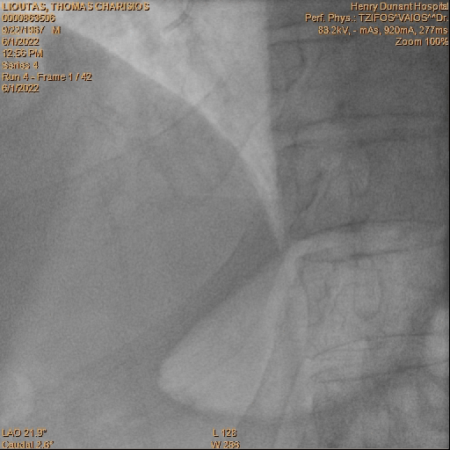
Coronary angiography 1st – 06/2022

Slide 24
Coronary angiography 1st – 06/2022
Patient refused the option of surgery….

Slide 25
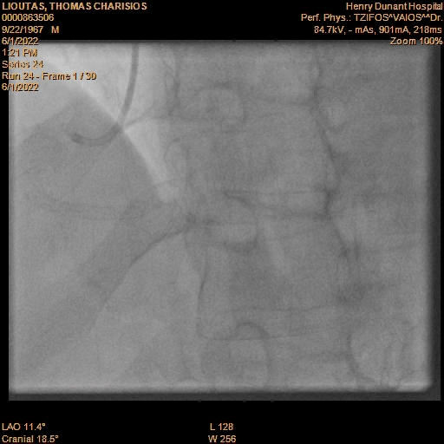
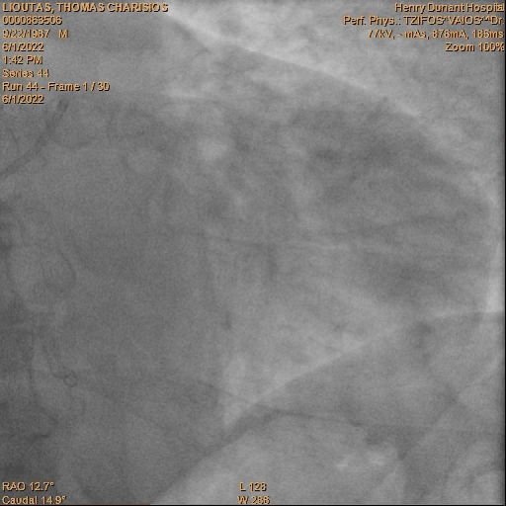
Coronary angiography 1st – 06/2022

Slide 26
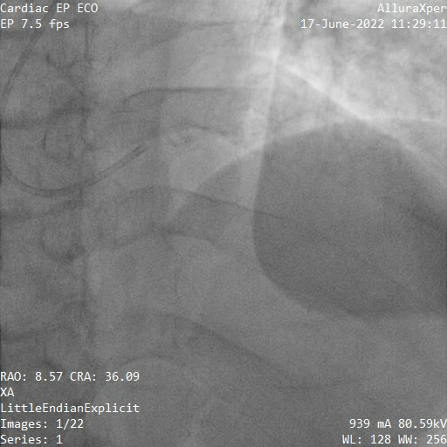
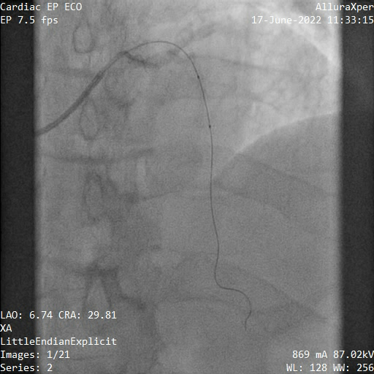
Coronary angiography 2nd – 07/2022

Slide 27
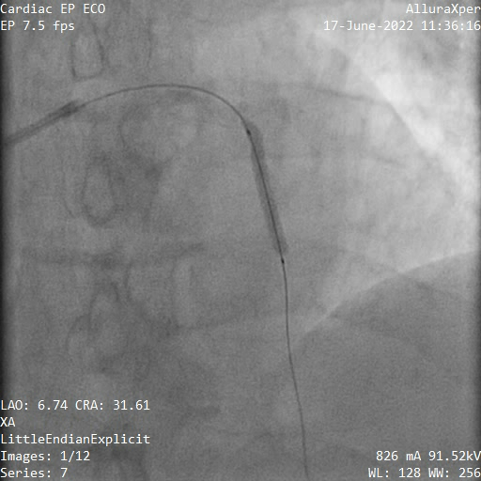
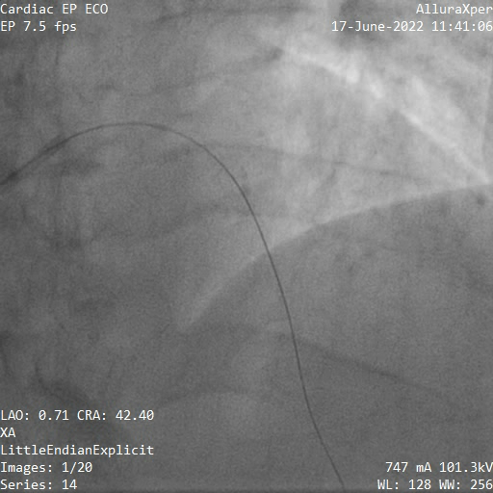
Coronary angiography 2nd – 07/2022

Slide 28
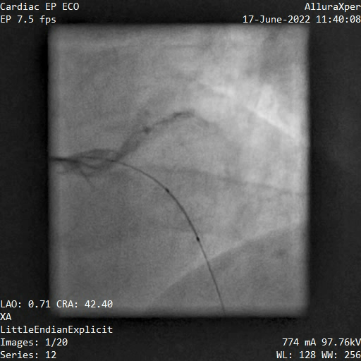
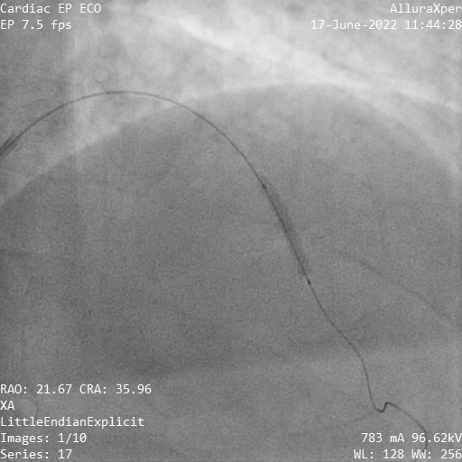
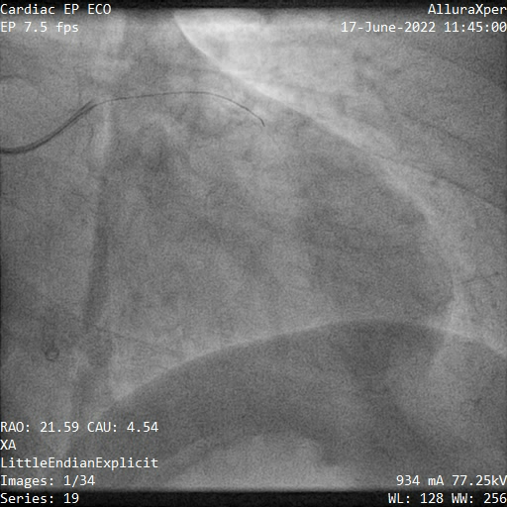
Coronary angiography 2nd – 07/2022

Slide 29
PET cases

Slide 30
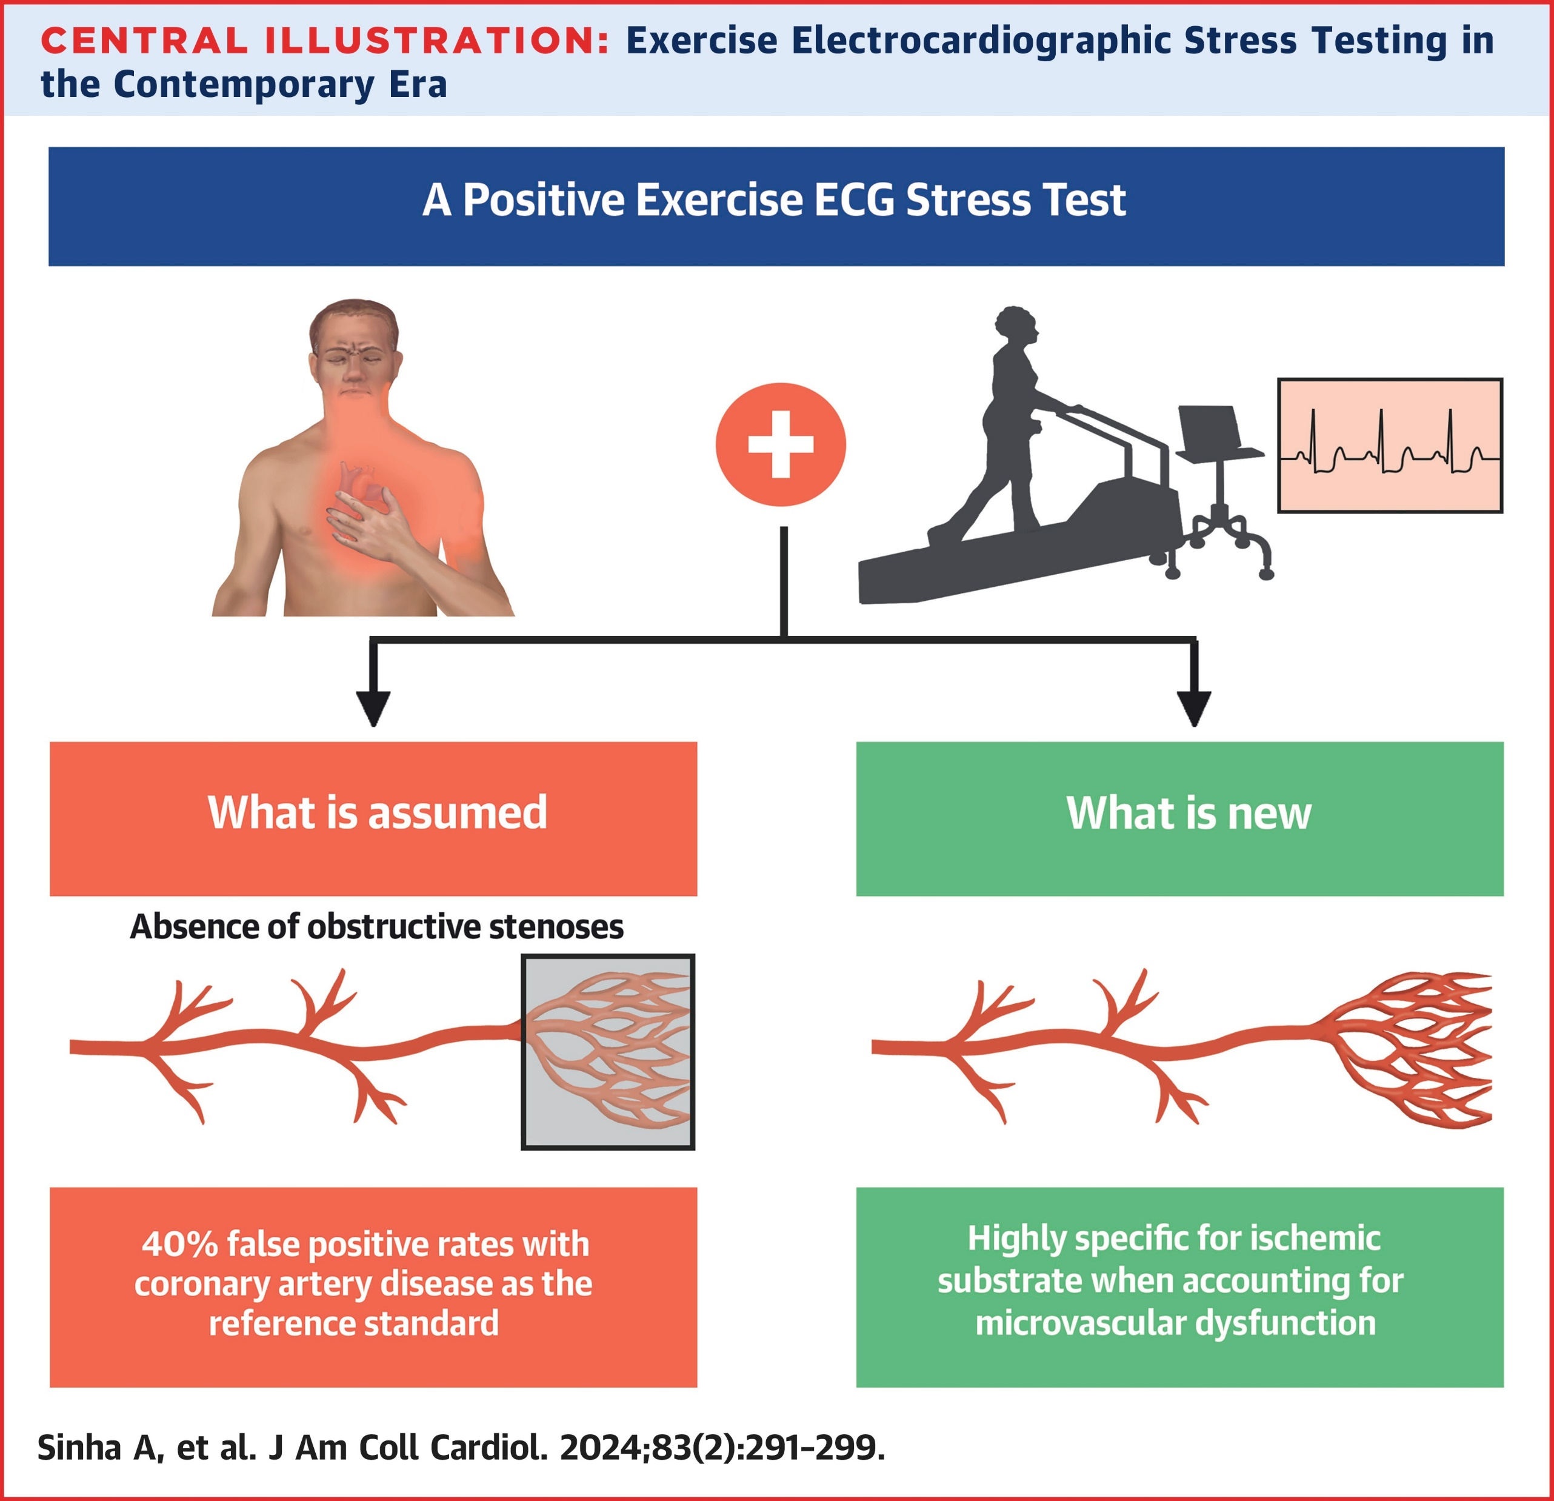
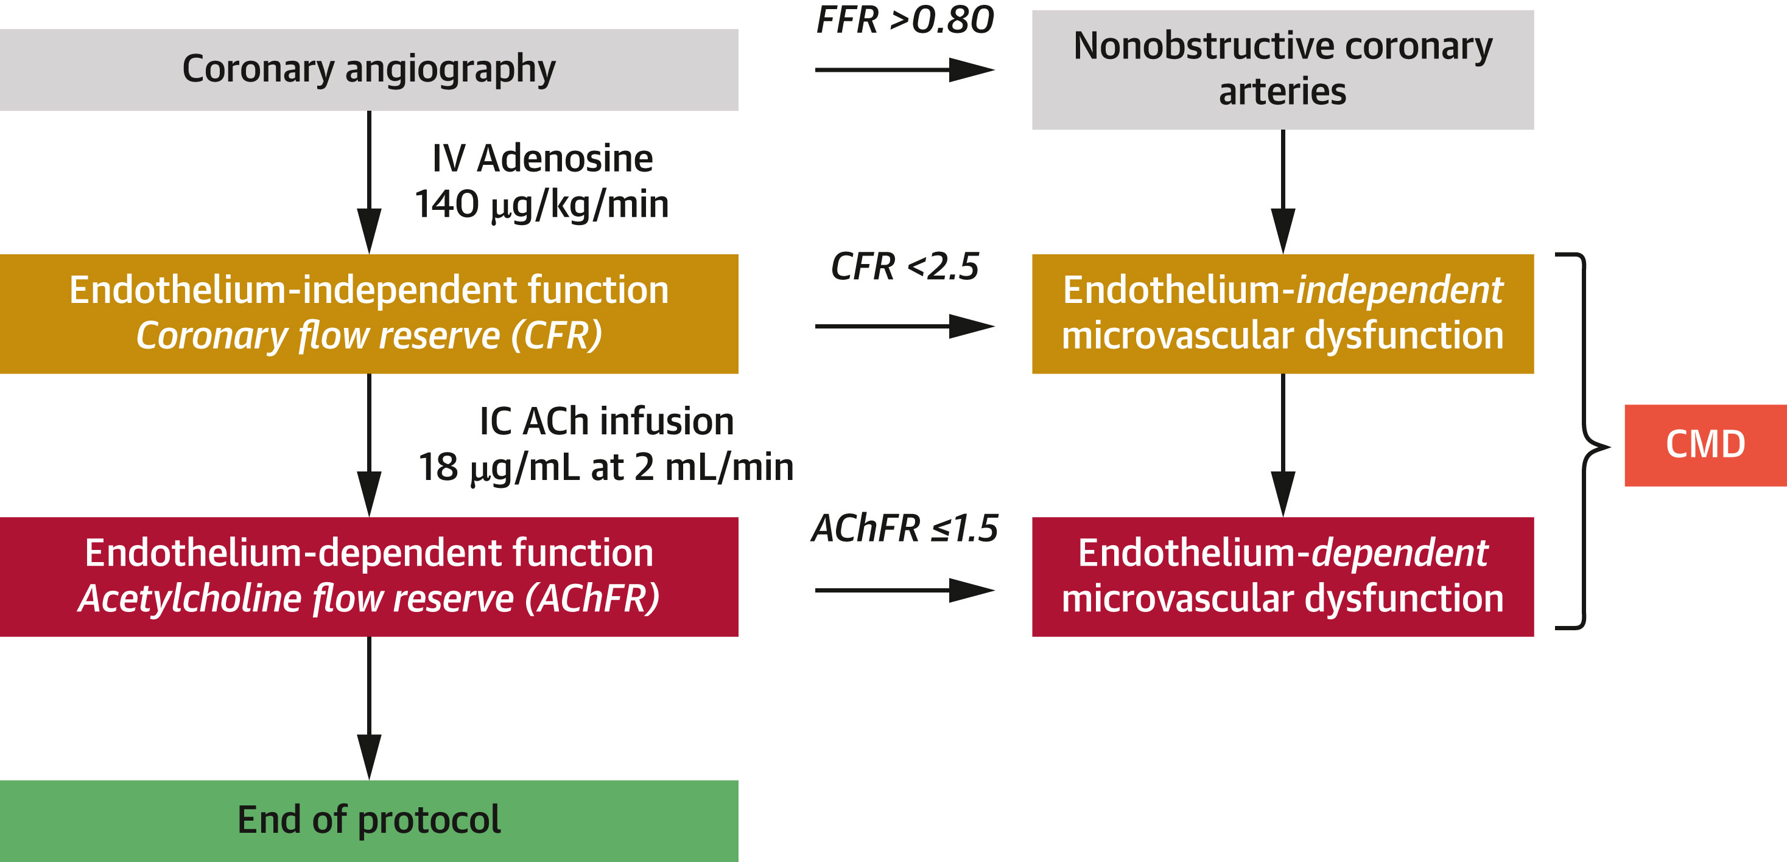
Rethink about false positive exercise test!
Patients with ANOCA and positive stress test underwent invasive physiological coronary assessment. Positive exercise test 100% specificity of CMD!
There is still MINOCA and INOCA!
Sinha A. et al, J Am Coll Cardiol 2024

Slide 31
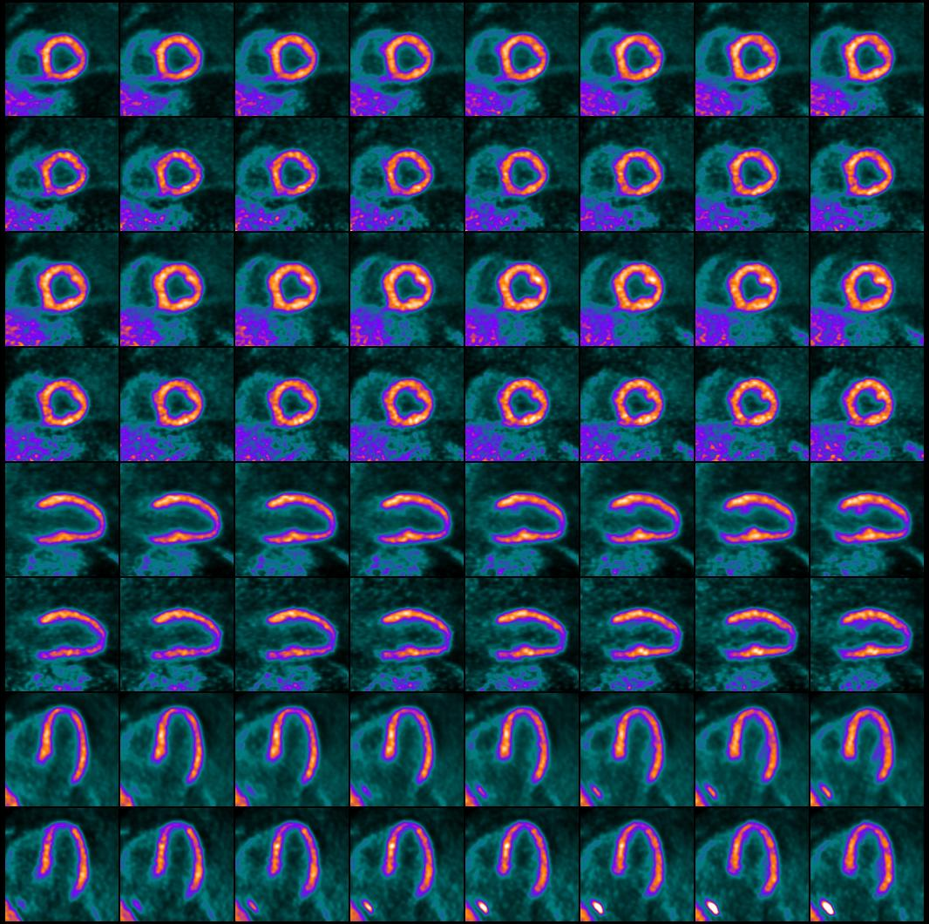
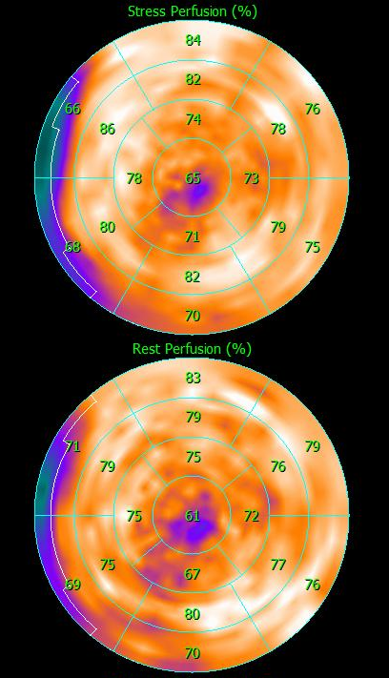
Patient with a BMI of 60

Slide 32
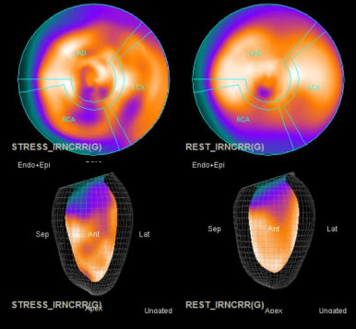
Patient with a BMI of 60
PET
SPECT

Slide 33




PET in DM - Case
62 years old patient with DM under insulin therapy
Typical anginal episodes
Non stenotic CAD in ICA
Abnormal MFR values depicting severe microvascular dysfunction

Slide 34


Case apical HCM
Apical HCM, perfusion
Courtesy Dr Giannopoulos USZ

Slide 35

Case apical HCM
Apical HCM, Flow quantification
Courtesy Dr Giannopoulos USZ

Slide 36


Case - HCM
Perfusion

Slide 37

Case - HCM
Flow quantification

Slide 38
Goals of viability diagnosis
Identification of viable myocytes in akinetic regions
Identification of viable segments that theoretically may improve function after coronary revascularisation
Identification of patients with global
functional improvement capacity
Identification of patients with prognostic benefit

Slide 39
Comparison of methods
Gold standard: functional recovery
100%
90%
80%
70%
60%
50%
LD Dobutamine
Echo
Specificity
MRI
Tc^{99m}
FDG PET
Tl²⁰¹
60% | 70% | 80% | 90% | 100%
Sensitivity
Schinkel et al. Curr Probl Cardiol 2007

Slide 40





Hibernating Myocardium in PET
13N-NH3
18F-FDG

Slide 41

Case 1
NH3 Stress
NH3 Rest
FDG
NH3 Stress
NH3 Rest
FDG
NH3 Stress
NH3 Rest
FDG

Slide 42



Case 1
NH3 Stress
NH3 Rest
NH3 Rest
FDG

Slide 43

Case 2
NH3 Stress
NH3 Rest
FDG
NH3 Stress
NH3 Rest
FDG
NH3 Stress
NH3 Rest
FDG

Slide 44



Case 2
NH3 Stress
NH3 Rest
NH3 Rest
FDG

Slide 45



PET-FDG Myocardial Viability – Case 3
CTO RCA and EF=40%
Source USZ

Slide 46



PET-FDG Myocardial Viability – Case 4
Anterior MI and CTO LAD
Source USZ

Slide 48





Case 2

Slide 49
STICH Viability Sub-study
SPECT protocols:
• Thallium-201 stress-redistribution-reinjection
• Thallium-201 rest-redistribution
• Nitrate-enhanced Tc-99m perfusion imaging
Dobutamine echo protocols:
• Staged increase in dobutamine starting at
5 μg/kg/min
Substudy failed to show association between myocardial viability and benefit from revascvularization
Notes:
this sub-study failed to show an association between myocardial viability on imaging and additional beneﬁt from revascularization. Again, the study was underpowered for this analysis.

Slide 50


PET-FDG Μυοκαρδιακή Βιωσιμότητα
Προγνωστική αξία
Follow-up: 5 years
N = 195 in each arm
p= n.s.
Mission impossible if clinicians do not follow recommendations from scan results.
p < 0.05
PARR-2 long-term follow up, Circ Imaging 2016
Notes:
Background—
Whether viability imaging can impact long-term patient outcomes is uncertain. The PARR-2 study (Positron Emission Tomography and Recovery Following Revascularization) showed a nonsignificant trend toward improved outcomes at 1 year using an F-18-fluorodeoxyglucose positron emission tomography (PET)–assisted strategy in patients with suspected ischemic cardiomyopathy. When patients adhered to F-18-fluorodeoxyglucose PET recommendations, outcome benefit was observed. Long-term outcomes of viability imaging–assisted management have not previously been evaluated in a randomized controlled trial.
Methods and Results—
PARR-2 randomized patients with severe left ventricular dysfunction and suspected CAD being considered for revascularization or transplantation to standard care (n= 195) versus PET-assisted management (n=197) at sites participating in long-term follow-up. The predefined primary outcome was time to composite event (cardiac death, myocardial infarction, or cardiac hospitalization). After 5 years, 105 (53%) patients in the PET arm and 111 (57%) in the standard care arm experienced the composite event (hazard ratio for time to composite event =0.82 [95% confidence interval 0.62–1.07]; P=0.15). When only patients who adhered to PET recommendations were included, the hazard ratio for the time to primary outcome was 0.73 (95% confidence interval 0.54–0.99; P=0.042).
Conclusions—
After a 5-year follow-up in patients with left ventricular dysfunction and suspected CAD, overall, PET-assisted management did not significantly reduce cardiac events compared with standard care. However, significant benefits were observed when there was adherence to PET recommendations. PET viability imaging may be best applied when there is likely to be adherence to imaging-based recommendations.

Slide 51



Thalium –Reinjection Myocardial Viability - Case
CTO LAD, RCA 70%, LBBB, EF~30%

Slide 52
Hibernating Myocardium in PET
Normal myocytes under fasting conditions consume fatty acids
Postprandial they consume glycose
The chronic reduction of MBF levels that occur with myocardial hibernation leads to an overdependence on glucose metabolism by the cardiac myocyte
Adaptive metabolic change
13N-NH3
MISMATCH
18F-FDG
Notes:
The effective dose for a 10- mCi dose of 18F-FDG administered intravenously is 7 mSv.

Slide 53


Case 6

Slide 54


Case 7

Slide 55


Case 8

Slide 56


Case 9

Slide 57

Diagnostic techniques for evaluation of myocardial viability

