Slide 1



Stress and
Cardiometabolic Medicine
George P Chrousos, MACP, MACE, FRCP
Biomedical Research Foundation, Academy of Athens
University Research Institute on Maternal and
Child Health and Precision Medicine, UNESCO Chair on Adolescent Health Care, National and Kapodistrian University of Athens
Hellenic Pasteur Institute

Slide 2
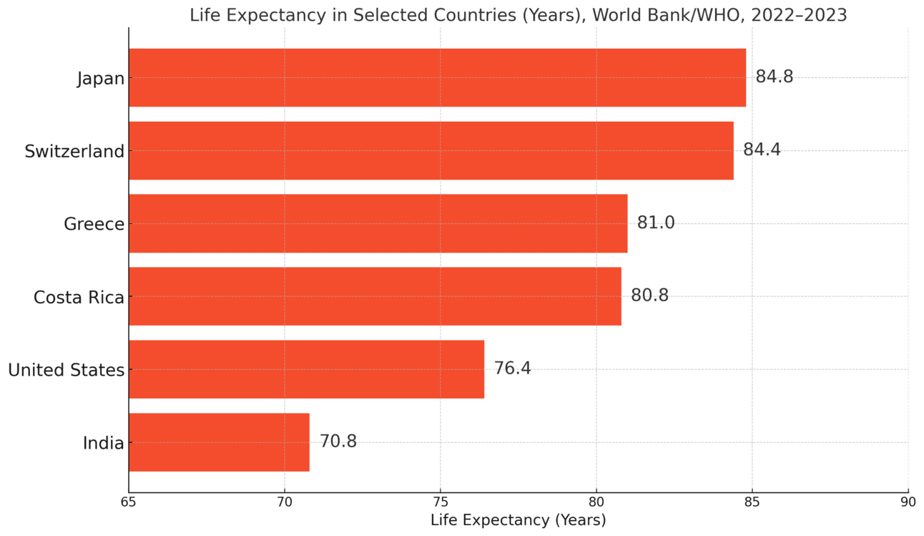
Life Expectancy by Country = Lifespan

Slide 3
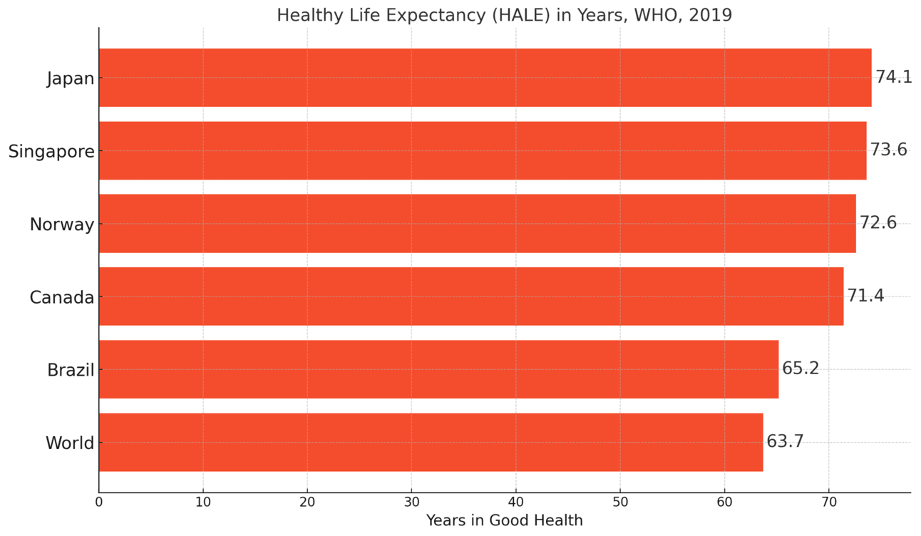
Healthy Life Expectancy (HALE) =Healthspan

Slide 4
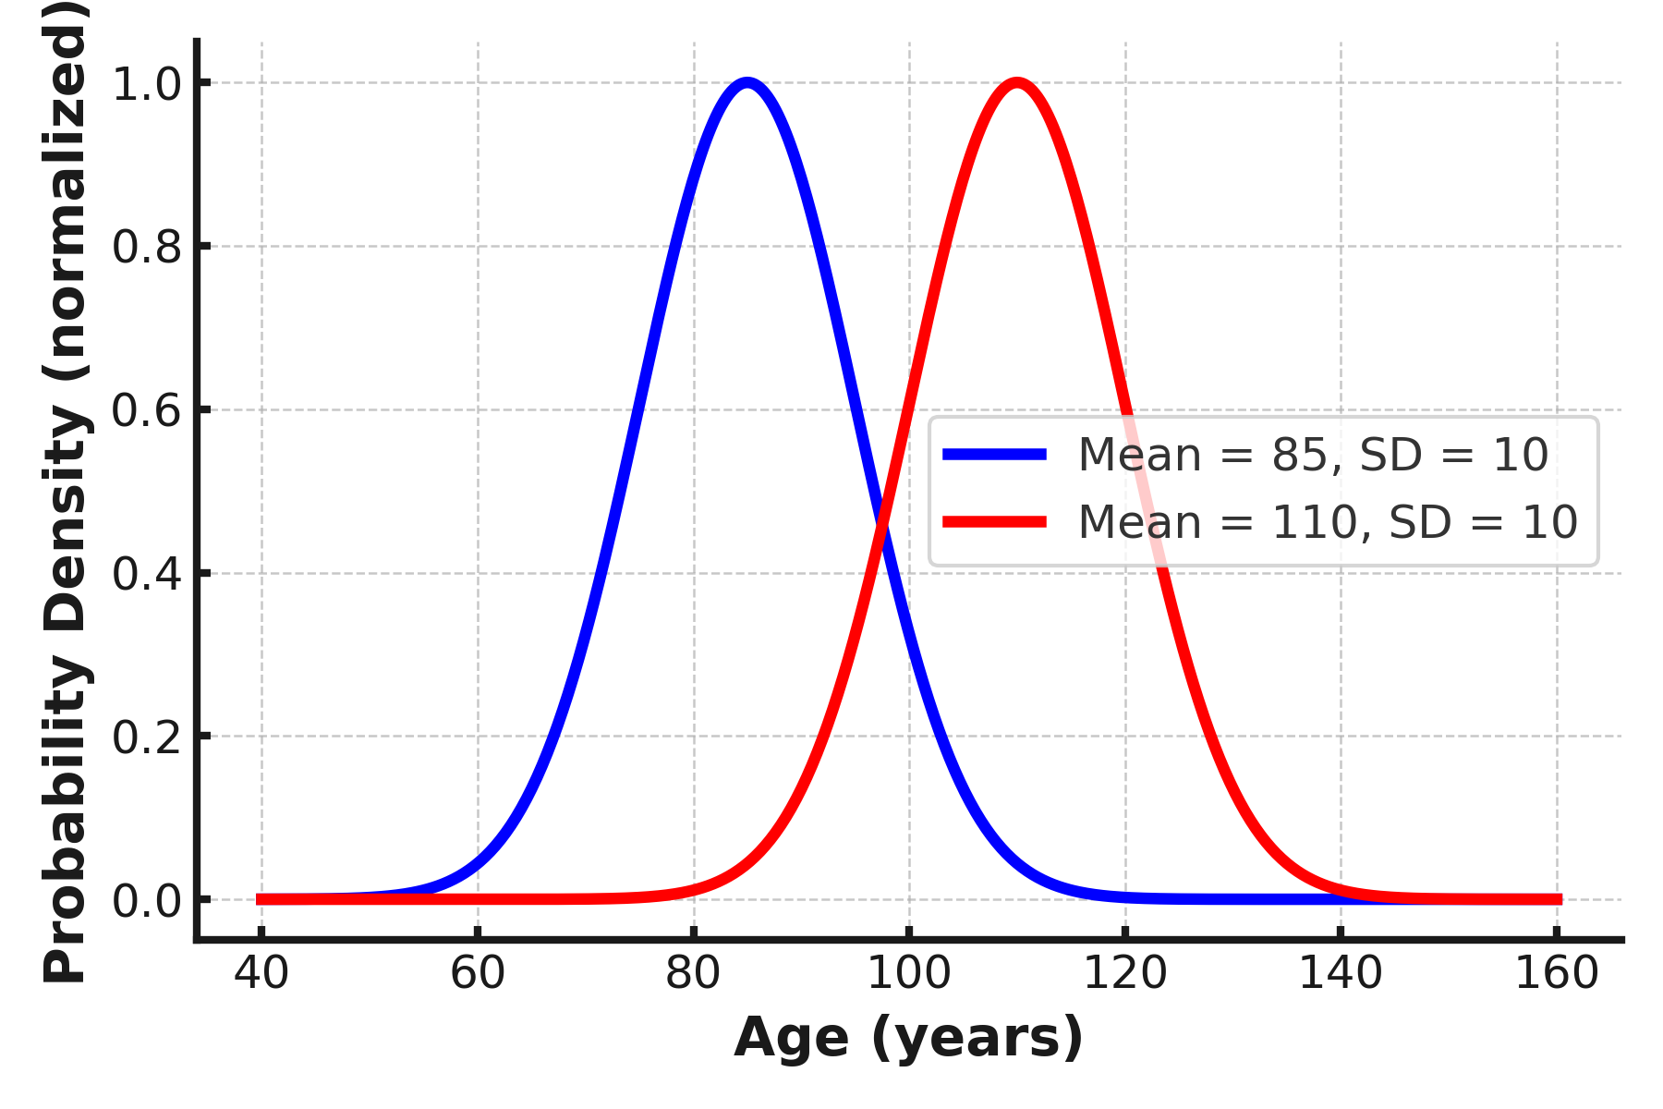
Comparison of Life Expectancy Distributions
(SD = 10, Equal Peak Height)
Real Japan
Ideal Hypothetical

Slide 5
Health Changes in the last 70 Years
Life expectancy has increased
Psycho-socio-economic, ecologic and environmental stress is ubiquitous and starts early in life
Overweight/Obesity and ensuing co-morbidities are ubiquitous and start early in life
Co-morbidities are seen in lean adult subjects (“paradoxic” obesity)
Aging markers appear earlier in life, showing acceleration of senescence
Cancers appear earlier in life
Decreased fertility and fecundity
Increased incidence of neurodevelopmental disorders

Slide 6
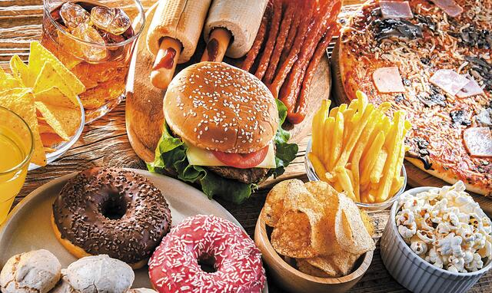

Slide 7
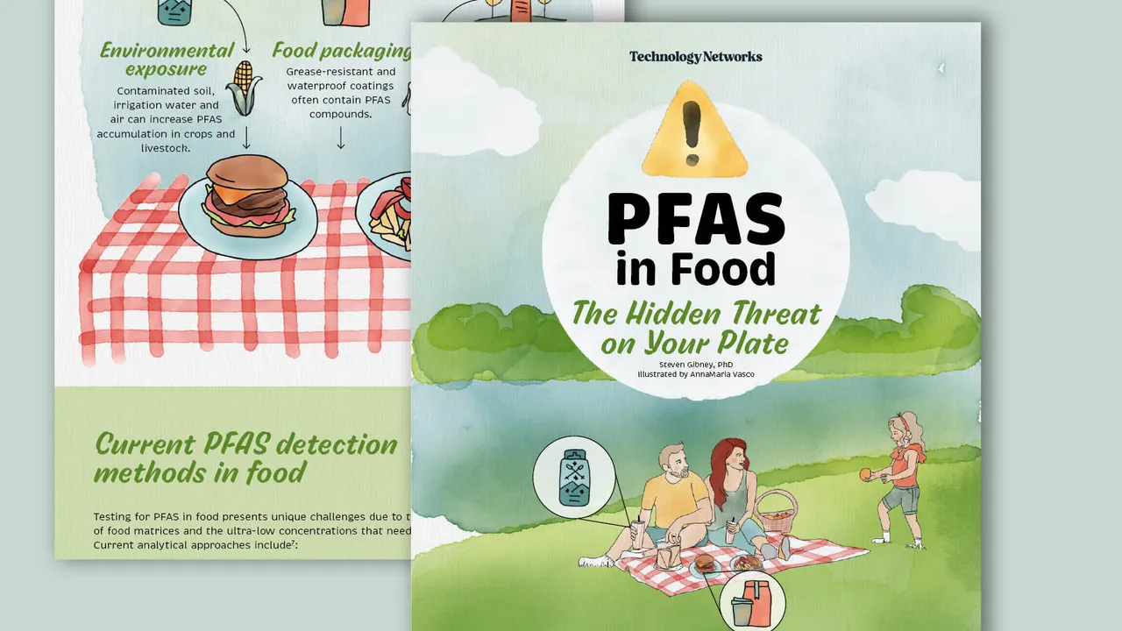

Slide 8
Western Lifestyle
Dominance of ultra-processed foods high in sugar, salt, and saturated fats
Sedentary lifestyle and lack of physical activity
High pace, work pressure, and insecurity (chronic psychosocial stress)
Advanced technology and real-life social isolation
Sleep disruption, artificial light (ΑLΑΝ) and overstimulation
Environmental (pollution: chemical and digital) and ecological
(climate change) stress (“Exposome”)

Slide 9
Western lifestyle has led to:
A surge in non-communicable diseases
A surge of neurodevelopmental disorders
A mental health crisis
A weakening of social bonds
Novel medicines improving life expectancy

Slide 10
Healthy (Eu)Longevity
Stress, Homeostasis, Resilience
Neuro-Endocrine Mechanisms of the Stress Response
Adverse Effects of Chronic Stress- Pathology & Aging
Evaluation of a Stressed Human Subject- Aging
Stress Management – Therapy- Healthy Aging
Life extension-Rejuvenation
Notes:
10

Slide 11
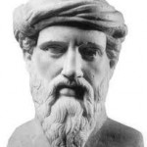
Pythagoras.
6th cent BCE
Notes:
11

Slide 12
Complex Systems Theory
“Harmony”
Equilibrium
Balance
Counteracting
Reestablishing
Forces
Disturbing
Forces
II
II
II
Homeostasis
(Range)
Adaptive
Response
Stressors
(Physical,
Emotional)
Pythagoras= Harmony
Alcmaeon=Iso-nomia
Hippocrates=Eucrasia
Epicurus= Eustatheia
Walter Cannon= Homeostasis
G.P. Chrousos
Notes:
12

Slide 13
Stress is the State of Threatened (or Perceived as Threatened) Homeostasis
Notes:
13

Slide 14
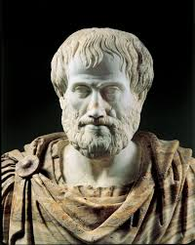
Aristotle.
384-322 BCE

Slide 15
“Mesotes” in the inverse U Curve of Virtues
“Is thus virtue a voluntary habit, being in the middle from our point, defined by logic and practical wisdom. The good is in the middle, between two evils, too much or too little”
Aristotle, Nicomacheian Ethics

Slide 16
Eustasis
(Range)
Allostasis
Caco-
Allostasis
Caco-
Optimum
Homeostatic Effect
Deficiency
Excess
Homeostatic System Activity

Slide 17

Eustress Distress

Slide 18
Eustasis
(Range)
Allostasis
Allostasis
Cacostasis
Cacostasis
Optimum
Homeostatic Effect
“Eustress”
“Effectance”
(Hormesis)
Learning
“Conatus”
Self-stim
Deficiency
Excess
Homeostatic System Activity

Slide 19
Human Stressors
Daily hassles
Life transitions: Early life, puberty, adolescence, menopause, retirement
Natural and unnatural catastrophies
Starvation, Excessive nutrition, Western diet, Deficient exercise, Excessive exercise,
Socioeconomic status, Minority status, Loneliness (Dignity)
Work stress (Effort Reward Imbalance, ERI), Unemployment (Dignity)
Job loss, Downsizing, Loss of control (Dignity)
Social Inequality (Dignity), Social Restriction (Dignity)
Bereavement, Caretaking/ Pathologic empathy vs. principled compassion
Addictions/ Toxic substances
Trauma, Surgery
Chronic diseases, Treatments
Inflammations (Traumatic, Infectious, Autoimmune, Allergic, Para-inflammation)
Anxiety, Depression, Personality disorders, Phobias
Sleep deficiency, Sleep excess
Uncoupling of the Clock: Jet-lag, “Social-jetlag”, “Work jet lag”
Behavioral addictions: Digital technology-“Meta-modern stress”, “Cyborg stress”, Hikikomori s., NEET, Nomophobia (Nomo[bile]phobia)
G.P. Chrousos
Notes:
19

Slide 20
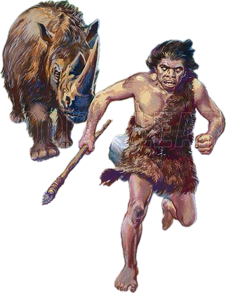

Acute vs. Chronic Stress
4Fs acute
4Fs chronic
Chronic Psycho-socio-economic Stress
(Chronically activated Fight, Flight, Freeze, Fawn
Reaction = chronic, smoldering, waxing and waning
of an Anger, Fear (anxiety), Paralysis and Subservient
state) (pathologic)
Fight, Flight, Freeze, (Fawn) Reaction
(physiologic)
G.P. Chrousos
20

Slide 21
Homeostasis over Time
Improved Homeostasis=Hyperstasis
Elevated mood
Healthy Baseline Homeostasis
Baseline Homeostasis=Eustasis
Constitutional mood
Constitutional mood
Deteriorated Homeostasis=Cacostasis
Catabasis
Suppressed mood
Tissue damage
Curtailed life
Anabasis
Distress (Eustress)
G.P. Chrousos
21

Slide 22
Homeostasis over Time
Adaptation ↑
Psychosomatic Resilience = “Ataraxia”+ “Aponia”
-Small disturbance
-Quick recovery
Improved Homeostasis=Hyperstasis
Elevated mood, eu-longevity
Healthy Baseline Homeostasis
Baseline Homeostasis=Eustasis
 ⬅➔
Constitutional mood
Constitutional mood
Deteriorated Homeostasis=Cacostasis
Catabasis
Suppressed mood,
Chronic disease
Curtailed life
⬆
Anabasis
Psychosomatic Vulnerability
Frailty
Distress/Eustress
Adaptation ↓
G.P. Chrousos

Slide 23
Resilience is the Ability of any Organism to Resist to Stressors and Return Rapidly to Homeostasis

Slide 24
Healthy (Eu)Longevity
Stress, Homeostasis, Resilience
Neuro-Endocrine Mechanisms of the Stress Response
Adverse Effects of Chronic Stress – Pathology-Aging
Evaluation of a Stressed Human Subject- Aging
Stress Management-Therapy- Eu-longevity
Life Extension-Rejuvenation
Notes:
24

Slide 25
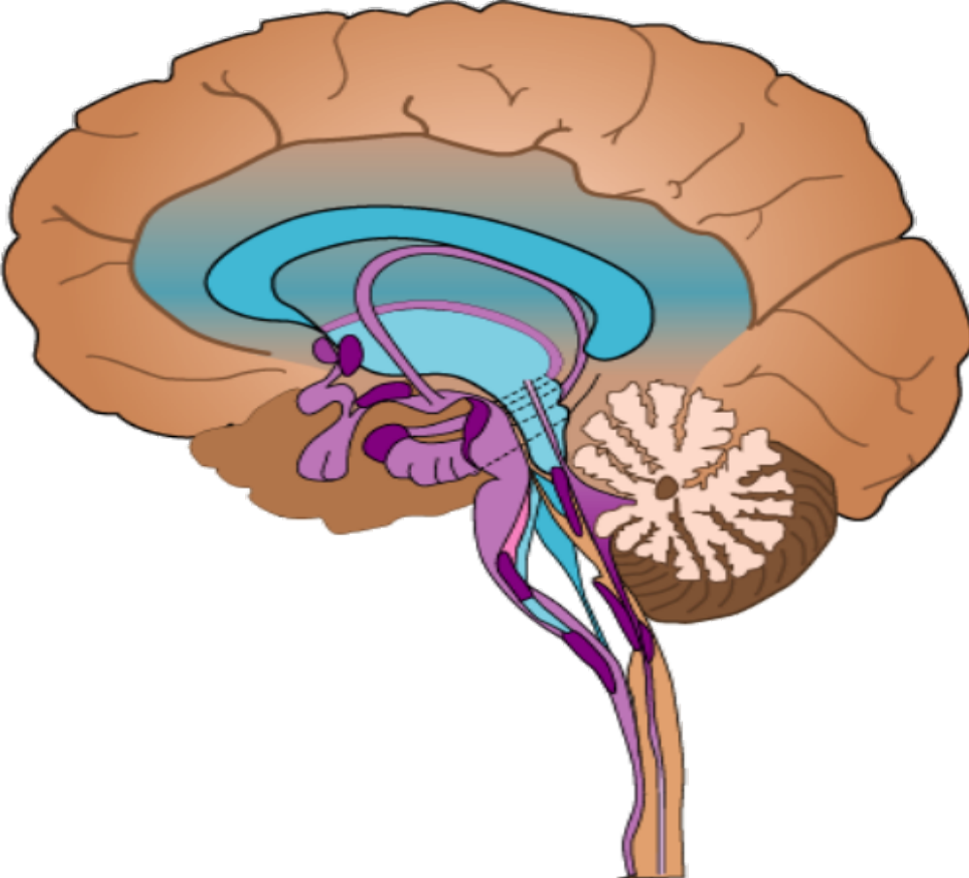
Stress System
Reward System
Circadian clock
HPA Axis
LC-NE
System
Norepinephrine
Epinephrine, iCRH, Interleukin-6 (IL-6)
Cortisoll
Notes:
25

Slide 26
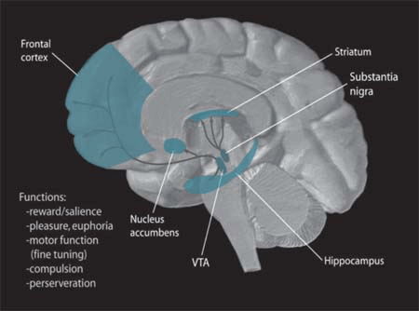
MC/ML “Reward” System
ML
MC

Slide 27
MC/ML “Reward” System Tone
Stress System Tone
+ acute
- chronic
-
G.P. Chrousos
27
Notes:
27

Slide 28
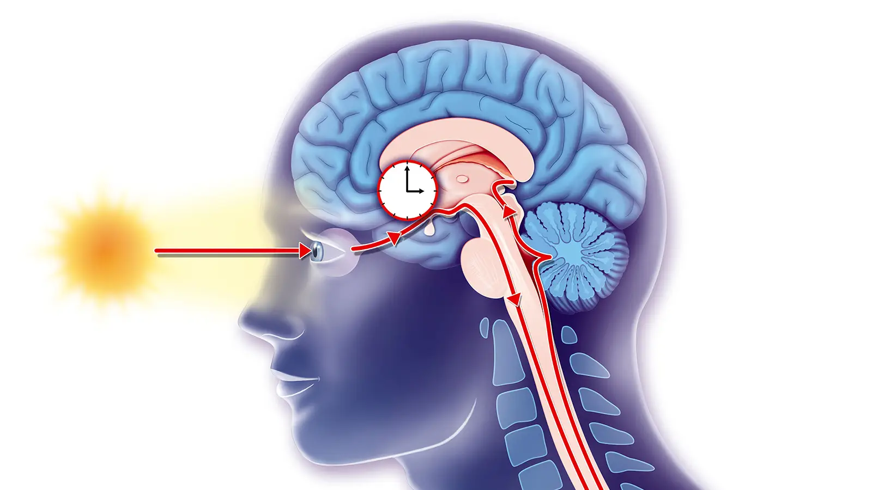
The Retino-hypothalamic Track

Slide 29
A.
24 H SAMPLING
OVERNIGHT
DEXAMETHASONE TEST
24 H CORTISOL
-D
PLASMA CORTISOL
-D
NS
CS
+D
+D
DARK
NS
CS
8 am
8 pm
8 am
B.
TARGET TISSUE SENSITIVITY
TARGET TISSUE RESPONSE
HS
N
R
THRESHOLD
FOR HARMFULNESS
Chrousos JCEM 1998
CORTISOL CONCENTRATION

Slide 30
Uncoupling between Circadian Rhythm of SeCortisol and Tissue Glucocorticoid Sensitivity
OVERNIGHT
DEXAMETHASONE TEST
24 H SAMPLING
Normal
Stress
Shift
-D
Serum Cortisol
-D
+D
+D
8 am
8 pm
Dark
8 am
NS
SS
CIRCADIAN TISSUE GLUCOCORTICOID SENSITIVITY/GR ACETYLATION
GR Acetylation
Functional Glucocorticoid Hypersensitivity
Target Tissue
Glucocorticoid Sensitivity
GR Acetylation
αt Target Tissues
Target Tissue
Glucocorticoid Sensitivity
Pathologic Consequences
8 am
8 pm
Dark
8 am

Slide 31
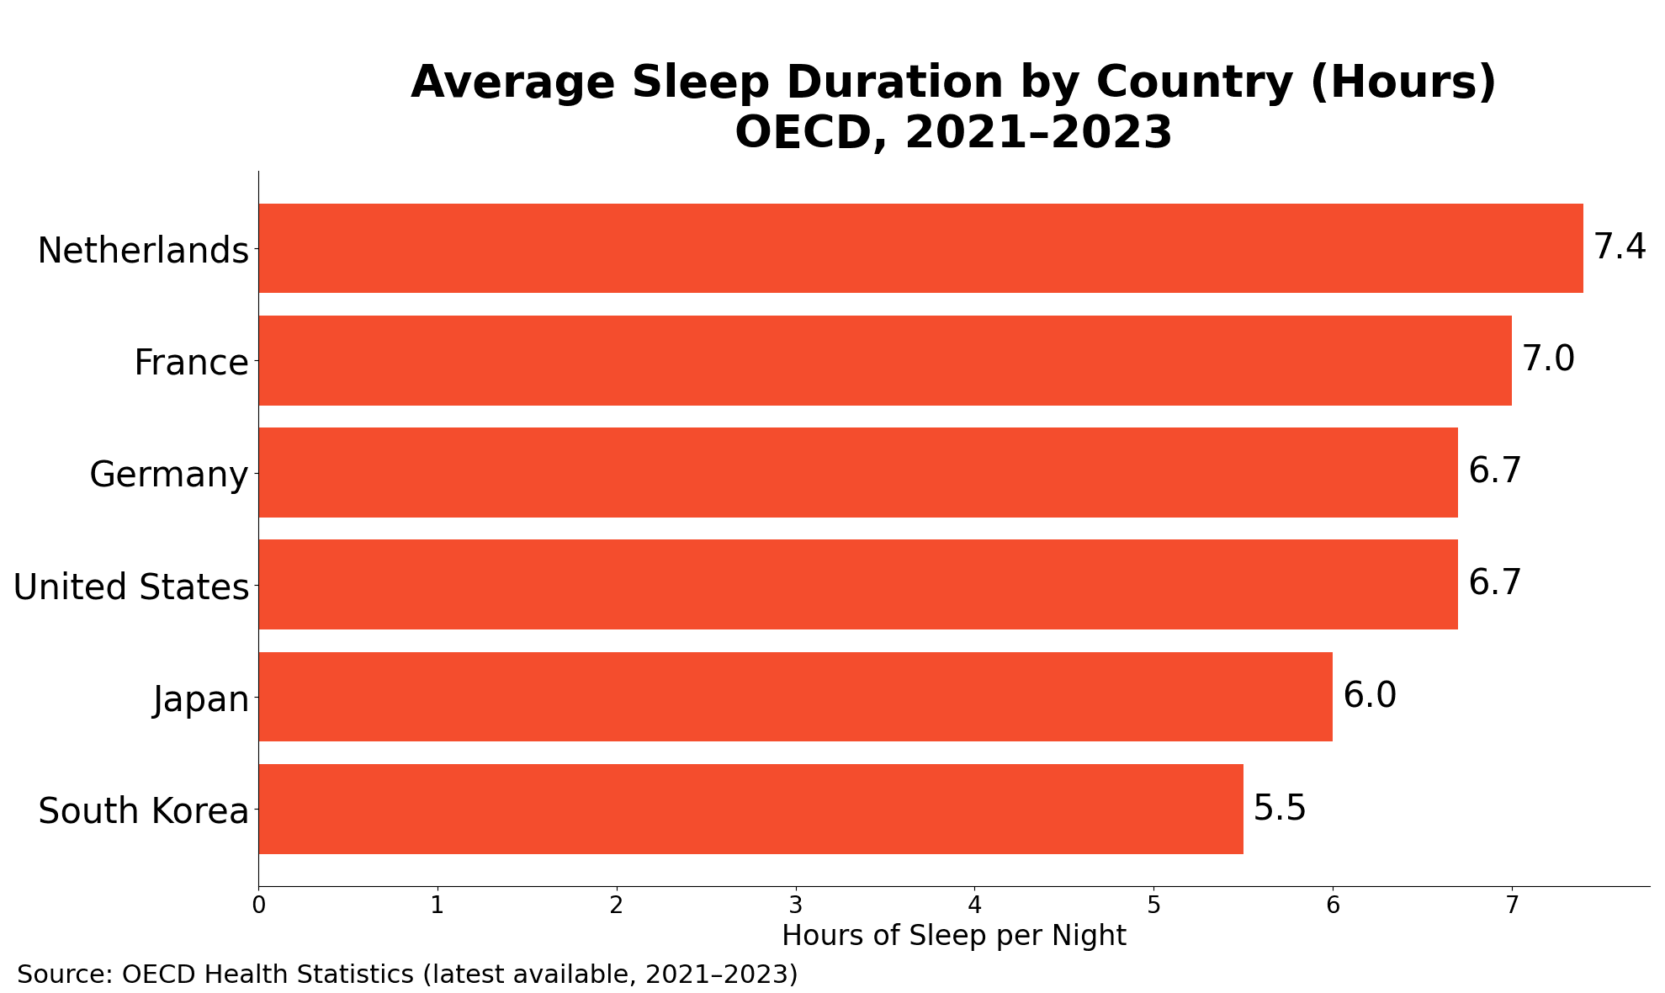

Slide 32
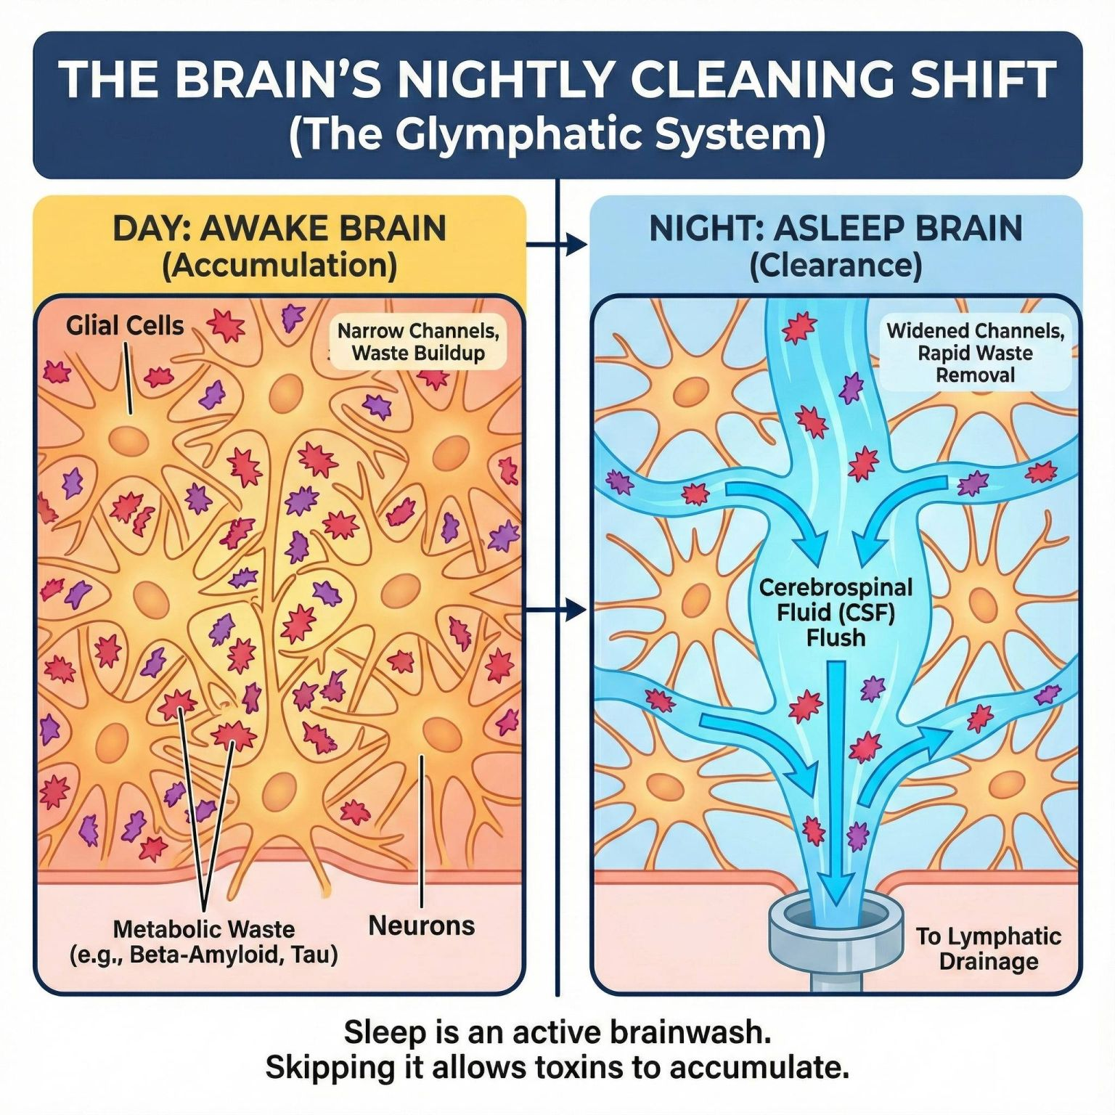

Slide 33
Healthy Aging (Eu)Longevity
Stress, Homeostasis, Resilence
Neuro-Endocrine Mechanisms of the Stress Response
Adverse Effects of Chronic Stress – Pathology-Aging
Evaluation of a Stressed Human Subject- Aging
Stress Management-Therapy-Eu-Longevity
Life extension-Rejuvenation
Notes:
33

Slide 34
CHRONIC STRESS SYSTEM ACTIVATION Pathophysiology
• Anxiety, depression, addiction, anti-social behavior, psychosomatic disorders, loss of libido, fatigue, pain
• Overweight, obesity, metabolic syndrome, T2DM, para-inflammation, inflammaging, immune dysfunction, autoimmunity/allergy, hypo-fertility, ED, atherosclerosis, CVD, dementia
• Osteopenia/Sarcopenia/Osteoporosis
• Premature aging of all vulnerable organs, including the brain (neurodegeneration) and the skin
• Vulnerability to certain cancers [to certain infections] *
⬆
CHRONIC NONCOMMUNICABLE DISEASES, + COMMUNICABLE*

Slide 35
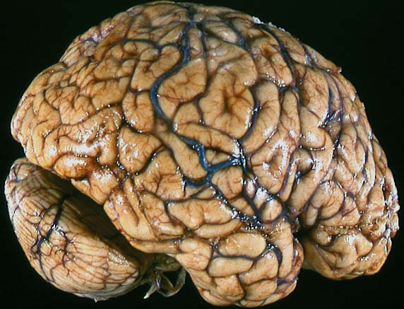
DEVELOPMENTAL HISTORY
STRESS
Real or perceived
GENETIC VARIATION
NUTRITION
AGING
Stress system
CRH/AVP-LC/NE
HPA axis
Systemic Sympathetic
Adrenomedullary Systems
GH/IGF-1
LH, T, E2
TSH, T₃
Cortisol
Target Tissues
NE, E, IL-6
Insulin resistance
Visceral Obesity/Sarcopenia
=Metabolic
Syndrome, DM type2
TG
LDL
HDL
ABP
MAFLD
Sickness
Syndrome
Manifestations
APR
Cytokines
Dyscoagulation
Sleep Apnea
Osteopenia
Osteoporosis
PCOS
Endothelial Dysfunction/Inflammation
Atherosclerosis
Cardiovascular Disease
35
G.P. Chrousos

Slide 36
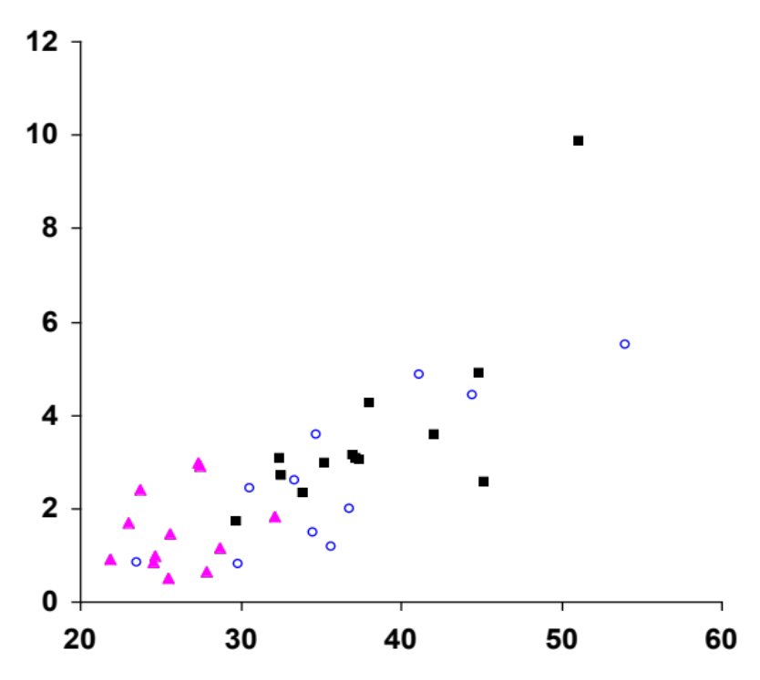
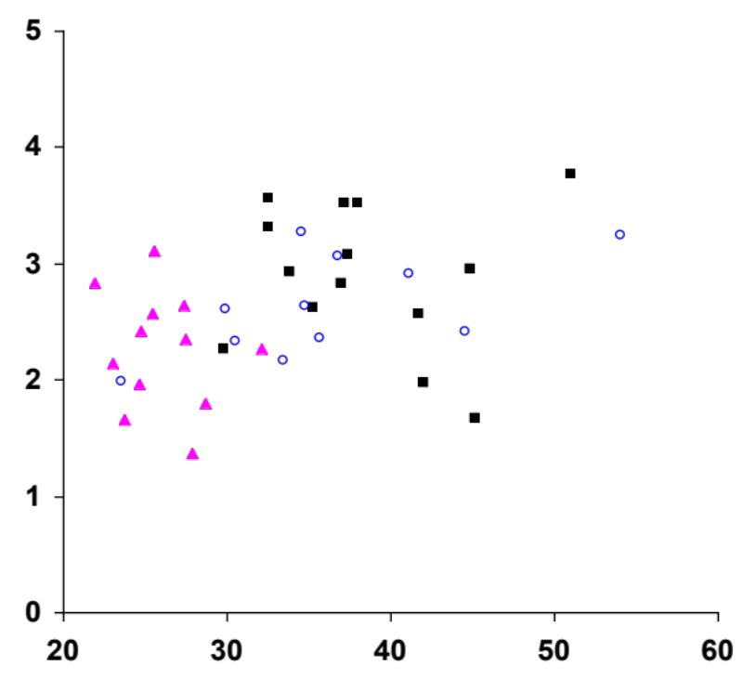
Both IL-6 and TNFα correlate with BMI
IL-6 (pg/ml)
TNFα (pg/ml)
r = .790
p = .000
r = .400
p = .014
BMI
Vgontzas et al. JCEM 1997
Notes:
36

Slide 37
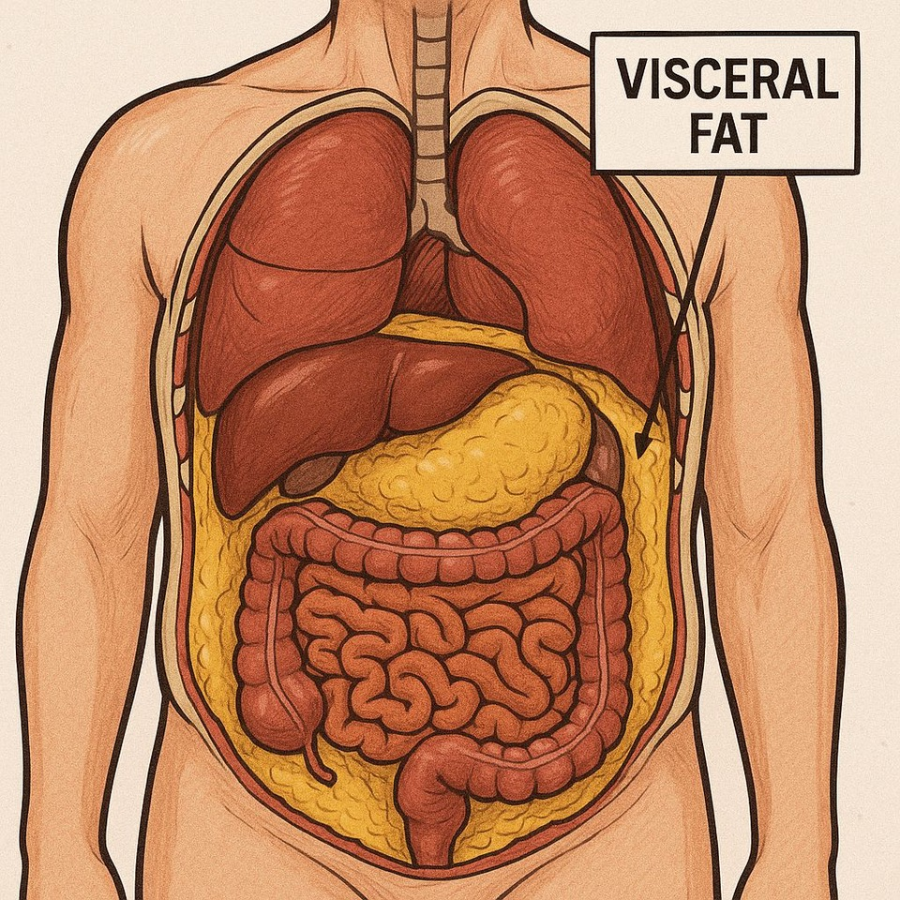

Slide 38
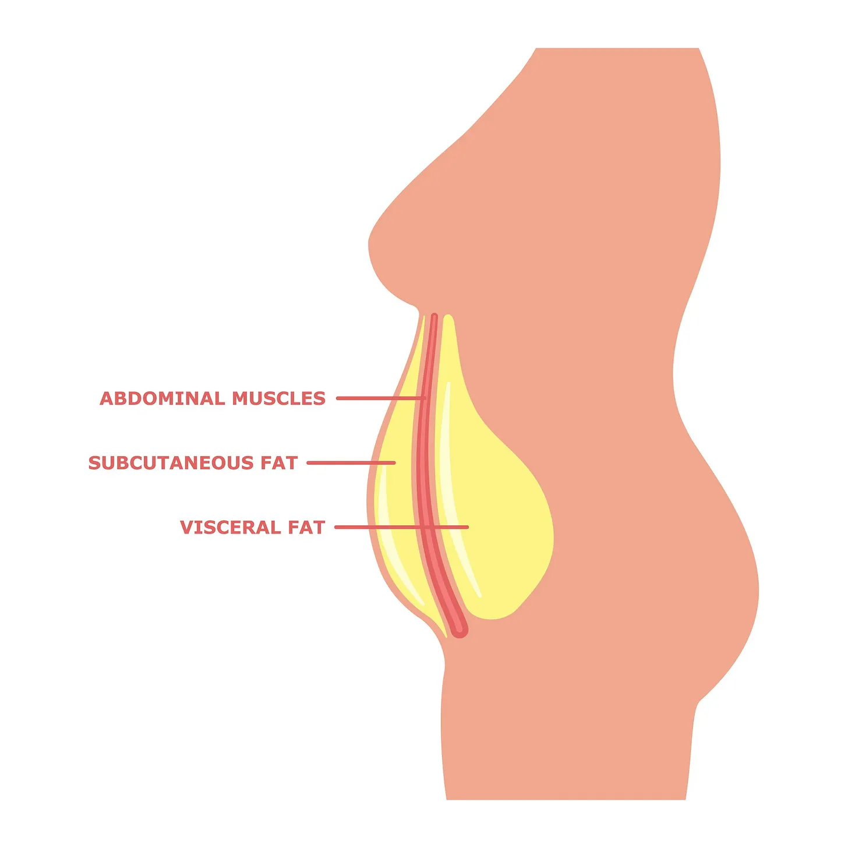

Slide 39
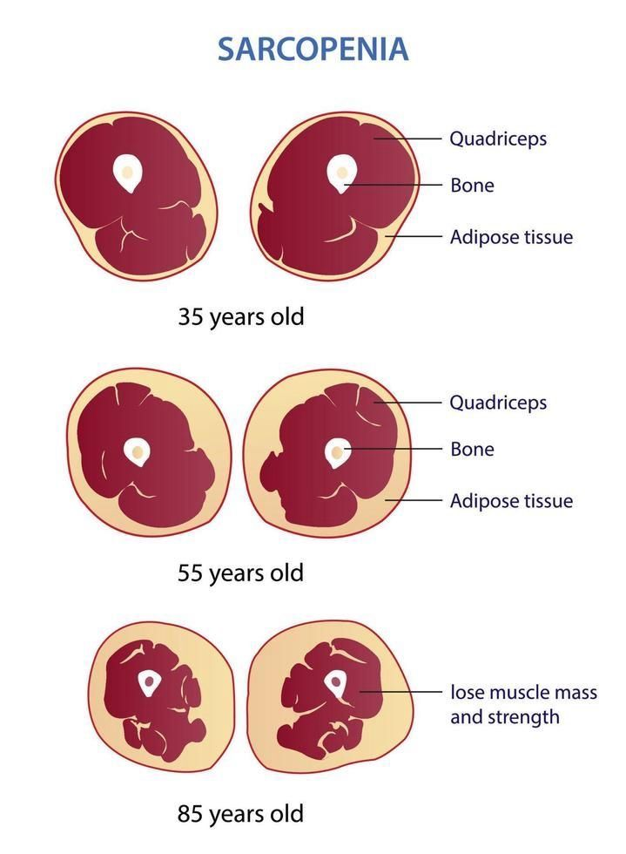

Slide 40
Cellular Stress
Nutritional
Inflammatory
Oxidative

Slide 41
Cellular Stress
Integrated Cell Stress Response
Nutritional
IR
Inflammatory
NF-kB
NFAT5
Oxidative
Mitochondria
Keap1 (SH sensor)-Nrf2-ΑRΕ

Slide 42
Integrated Cell Stress Response
4 Sensor Enzymes ( stress phosphokinases)
Protein folding
(UPR-RES)
Food
Viruses
Mitochondria
Translation factor elF2α +
HSPs
Autophagy, Cleaning
Protein synthesis -
ATF-4 +
Antioxidation proteins
Negative feedback
Apoptosis+/-
GDF-15

Slide 43
The Biological Fork: Salvation or Death
Outcome depends on intensity, duration and cellular reserve
Persistent ICSR / ATF4
Decision point
ALLOSTATIC OUTCOME
Moderate / resolvable stress
Repair • adaptation • restored homeostasis
Cell survival
GDG-15
CACOSTATIC OUTCOME
Intense / persistent stress
ATF4 → CHOP (DDIT3)
Growth arrest • apoptosis
GDF-15
The same stress machinery can be protective early and destructive when stress cannot be resolved.
7

Slide 44
Fasting
Fed
Eustatic Milieu
(Range)
Allostatic
Cacostatic
Milieu
Allostatic
Cacostatic
Milieu
Optimum
Caloric
Deficiency
NAD+/Sirtuin 1
(HDAC) up
AMPK up, mTOR down
FOXO up, PPARs up
P53 up
-Cancer
- Aging
Homeostatic Effect
Caloric Balance
Sirtuin 1 vs. GCN5
PGC-1alpha
Mitochondria
PPARγ, ACSL1,
Ferroptosis, FOXO
Tumor resistance
Normal aging
Caloric Excess
Acetyl-coA-/GCN5(HAT) up
mTOR up + storage
+Oxidation
+Inflammation
+Cancer
+Aging
+ Cancer
+ Aging
Metabolic System Activity
Notes:
Acyl coA synthase long chain 1

Slide 45
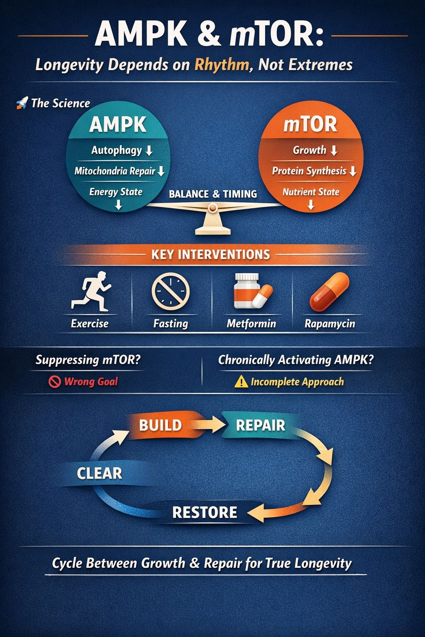

Slide 46
The Integrated Cell Stress Response
FASTING STATE
FED STATE
Eustatic Milieu
(Range)
Allostatic
Cacostatic
Milieu
Allostatic
Cacostatic
Milieu
Optimum
Caloric
Deficiency
NAD+/Sirtuin 1
(HDAC) up
AMPK up, mTOR down
FOXO up, PPARs up
P53 up
-Cancer
Homeostatic Effect
Caloric Balance
Sirtuin 1 vs. GCN5
PGC-1alpha
Mitochondria
PPARγ, ACSL1,
Ferroptosis, FOXO
Tumor resistance
Normal aging
Caloric Excess
Acetyl-coA-/GCN5(HAT) up
mTOR up + storage
+Oxidation
+Inflammation
+Cancer
+Aging
UPR and ER stress
GDF-15
UPR and ER stress
GDF-15
Metabolic System Activity
Notes:
Acyl coA synthase long chain 1

Slide 47
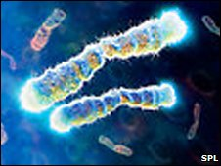
TELOMERES

Slide 48
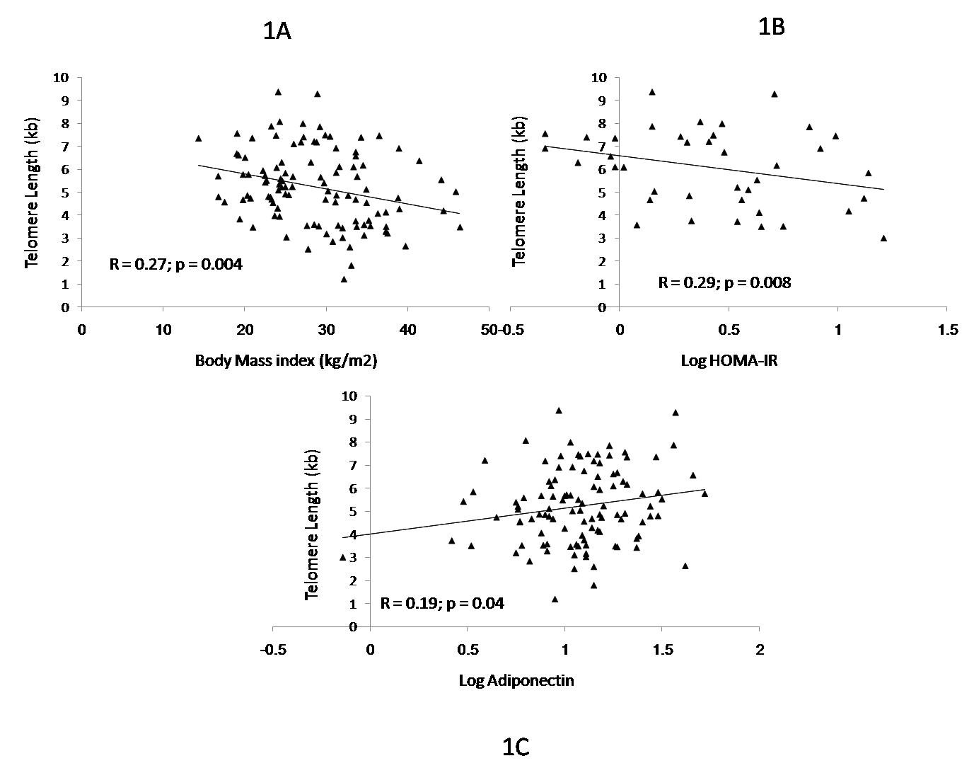
TELOMERE SHORTENING
Al-Attas et al. 2010

Slide 49
Molecular Aging: Insights from Nature Aging (2024)
• Large-scale multi-omics data reveal nonlinear aging
• Two major acceleration phases around the mid-40s and early 60s
• Affects proteins, metabolites, RNA, and microbiome composition
• Parallels functional physiological markers

Slide 50
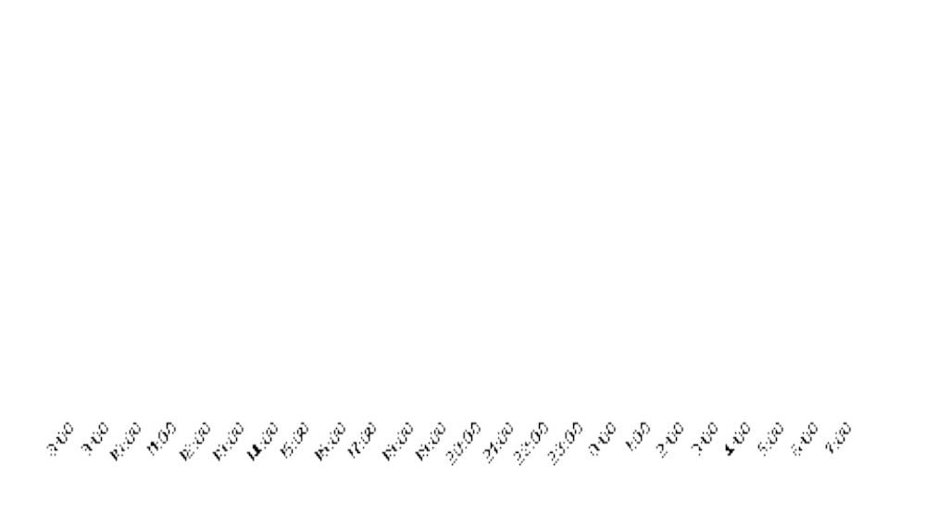
HPA axis and older age
Mean age 73 yy
Cortisol (nmol/L)
Mean age 63 y
Time (Clock Hours)
Vgontzas et al. JCEM 2003
Notes:
Cortisol is in SI units

Slide 51
Cytokines and older age
Mean age 73 yy
Mean age 63 y
Time (Clock Hours)
Vgontzas et al. JCEM 2003
Notes:
Cortisol is in SI units

Slide 52
Cumulative Acceleration of Aging in Human Life
(Increases at 44 & 60 y)
Aging Index
☨
☨
Age (years)

Slide 53
Implications for Healthy Longevity
• Aging is not linear, but punctuated by transition phases
• Midlife represents a key opportunity for prevention
• Lifestyle, stress modulation, and resilience are central targets
• Functional biomarkers can guide personalized interventions

Slide 54
Stress System
/Inflammation Activation
Chronic Psycho-
socio-economic Stress
Sleep disorders,
Accelerated aging,
Increased cancer risk,
Increased risk for
Infections*
Ecologic or
exposomic stress
Environ. Pollution
Western diet (UPFs)
Climate change
Polarized EMF
Infections
“Chronic Stress and Inflammation
Syndrome” (CSI Syndrome)
Psychologic and Physical Manifestations, Overweight/obesity
Dysphoria, Medically Unexplained Symptoms (MUS), Autoimmunity/Allergy, Hypochondriasis, Osteosarcopenia, Aging
= “Chronic Noncommunicable Diseases” +*
Notes:
54

Slide 55

Last 70 years
Epigenetic changes:
↑ Overweight/Obesity
↑ CSI Syndromes

Slide 56
MUSCLE MASS
Best predictor of morbidity and life expectancy

Slide 57
Known anti-stress, anti-inflammatory and nutritional and other potential life extenders
ANTI-STRESS- Beta-blockers, Anti-depressants, CEI, AT2-blockers
ANTI-INFLAMMATION- ω3 Fatty Acids, Unsaturated Fatty Acids, Statins,
PPAR-γ agonists
ANTI-OXIDATION- Phytoestrogens, sulforafane, ...
INSULIN SENSITIZATION- Diet, Exercise, Μetformin, PPAR-γ agonists, GLP-1 agonists
ANTI-COAGULATION- Anti-platelet agents

Slide 58
GLP1 Agonists
Allostastic
Cacostatic
Milieu
Catabolism
Eustatic Milieu
(Range)
Allostatic
Cacostatic
Milieu
Anabolism
Optimum
Caloric
Deficiency
NAD+/Sirtuin 1
(HDAC)
AMPK
FOXO
PPARs
P53
-Cancer
Homeostatic Effect
Caloric Balance
Sirtuin 1 vs. GCN5
PGC-1alpha
Mitochondria
PPARγ, ACSL1,
Ferroptosis
Tumor resistance
Normal aging
Caloric Excess
Acetyl-coA-/GCN5(HAT)
mTOR + storage
UPR and ER stress
Oxidation
Inflammation
+Cancer
+Aging
Metabolic System Activity
Notes:
Acyl coA synthase long chain 1

Slide 59
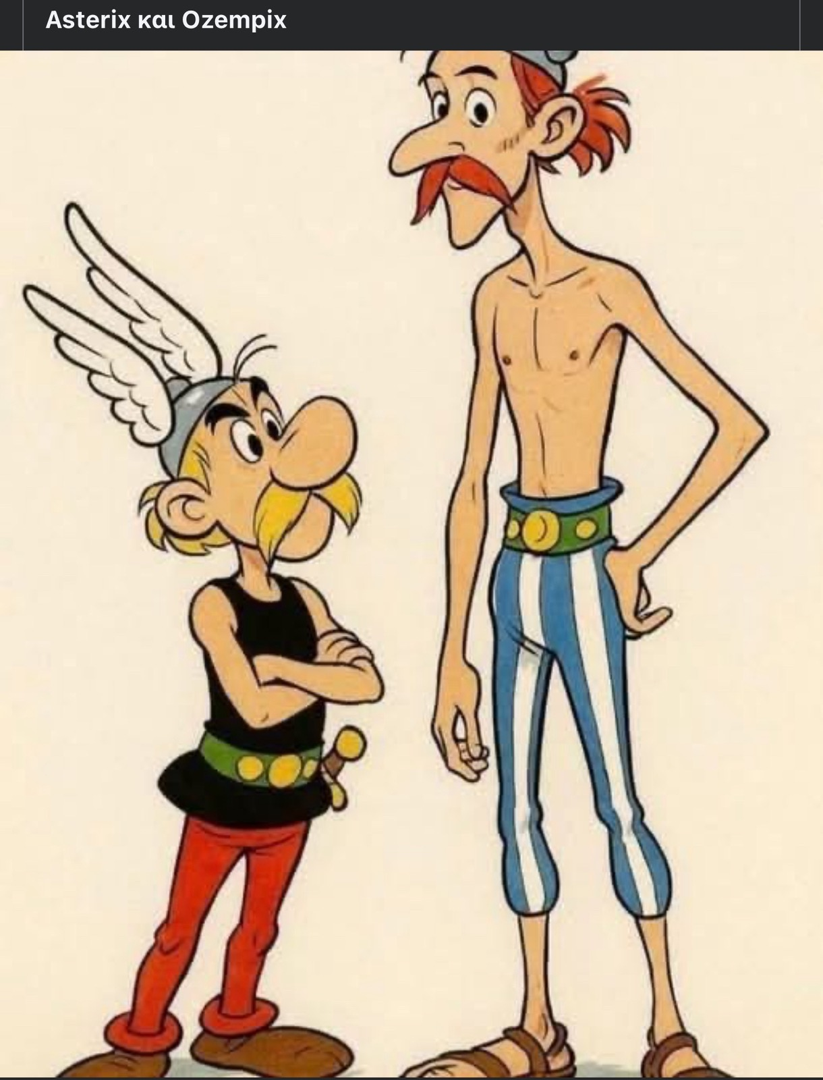
Notes:
Asterix and Obelix

Slide 60
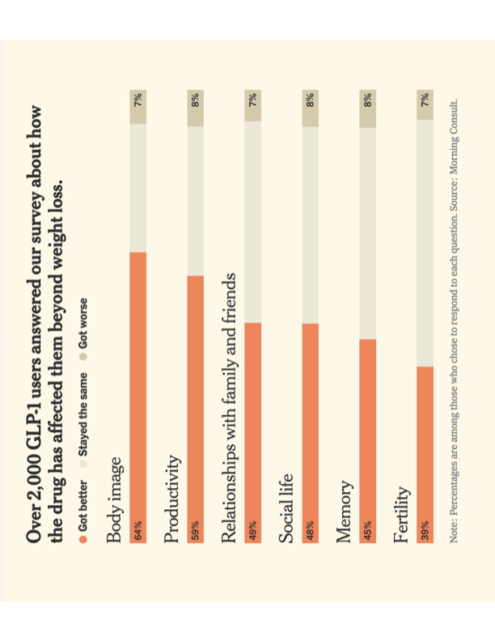

Slide 61
Healthy (Eu)Longevity
Concepts of Complexity vs. Endocrinology
Neuro-Endocrine Mechanisms of the Stress Response
Adverse Effects of Chronic Stress – Pathology-Aging
Evaluation of a Stressed Human Subject - Aging
Stress Management-Therapy- Eu-longevity
Life extension-Rejuvenation
Notes:
61

Slide 62
Evaluation/Monitoring of a Stressed Subject
History, MUS, Physical examination
Appropriate questionnaires (PST, Anxiety, Depression, QOL, etc.)
Heart Rate Variability measures (Autonomic nervous system)
Body Composition (Sarcopenia, Visceral fat, IMAT, Bone density)
Biochemical tests (Stress, Inflammation, Metabolic and Aging Markers)
Sleep study
Research tools (EEG, Loreta EEG, HEG (NIRS), Functional Imaging, etc.)
Notes:
62

Slide 63
Geroscience
Gerogenes
Geromedicine
Gerotherapeutics vs. Geriatrics

Slide 64
Intrinsic Capacity vs. Predictive Health Index
Intrinsic Capacity (IC, WHO)
Composite of physical & mental capacities
Domains: mobility, cognition, psychological health,
sensory functions
Represents individual’s internal reserves
Decline predicts vulnerability & dependency
Focus: maintaining independence & healthy longevity
Predictive Health Index (PHI)
Composite score from biomarkers, clinical & lifestyle data
Includes genetics, metabolic, proteomic, and clinical
indicators
Estimates biological age & resilience beyond
chronological age
Predicts risk of frailty, multimorbidity, mortality
Guides personalized preventive & therapeutic strategies

Slide 65
Population - Methods
Data: 35,405 individuals monitored over ~5 years
Metrics: body composition via BIA-ACC®, HRV via photoplethysmography
Artificial intelligence: Random Forest machine learning algorithm
Integration of non-invasive diagnostic tests

Slide 66
Results
PHI achieved highly significant predictive performance (p < 0.0001)
Successfully distinguished healthy subjects vs. high-risk individuals
Fast, non-invasive, easy-to-use, highly accurate tool
Supports early detection & personalized interventions

Slide 67
Endocrine–Metabolic Implications
Dysregulation precedes overt disease
Integration of stress, inflammation, and metabolism
Supports preventive and precision endocrinology

Slide 68
Molecular Aspects of Aging
(All influenced by chronic stress)
Programmed Organismal Senescence (gerogenes)
Programmed Cellular Senescence (gerogenes)
Genomic Instability
Epigenetic Alterations
Mitochondrial Decrease/Dysfunction
Proteostasis Decline
Deregulated Nutrient Sensing (mTOR system)
Stem Cell Exhaustion
Parainflammation-Inflammaging
Autophagy and Lysosomal Dysfunction

Slide 69
Biological Age Biomarkers
  Main primary composite biomarkers:
  - Composite blood biomarker indices
  - Physical function measures (muscle strength, power; HRV)
  - Body composition measures (muscle mass, visceral fat, MASH)
  - DNA methylation clocks/signatures
  - DNA Stability (telomere length)
  - Proteomic clocks (proteasomes, proteomic signatures)
  Often used together for robust, sensitive aging endpoints

Slide 70
Healthy (Eu)Longevity
Concepts of Complexity vs. Endocrinology
Neuro-Endocrine Mechanisms of the Stress Response
Adverse Effects of Chronic Stress – Pathology-Aging
Evaluation of a Stressed Human Subject- Aging
Stress Management-Therapy-Eu-longevity
Life extension-Rejuvenation
Notes:
70

Slide 71
The 5 Classic Lifestyle “Musts” for Hyperstatic Resilience
Healthy Nutrition (2nd)
Moderate Exercise (3rd)
Proper Sleep (1st)
Circadian Regularity
Stress Management
}
G.P. Chrousos

Slide 72


Slide 73
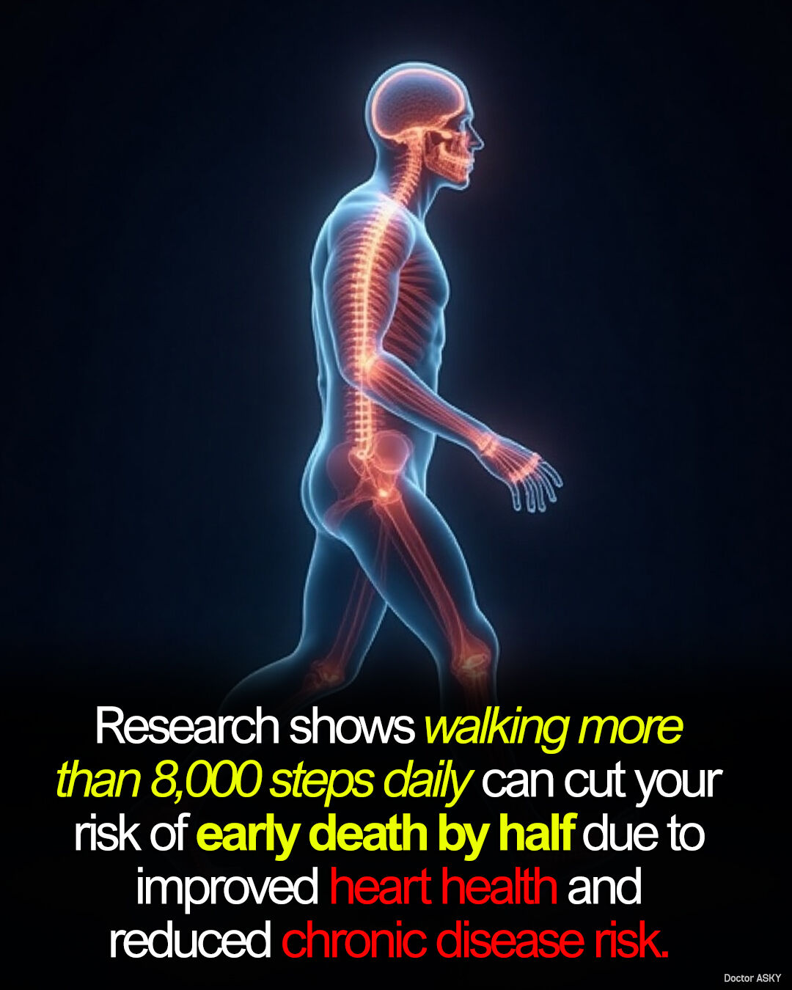

Slide 74
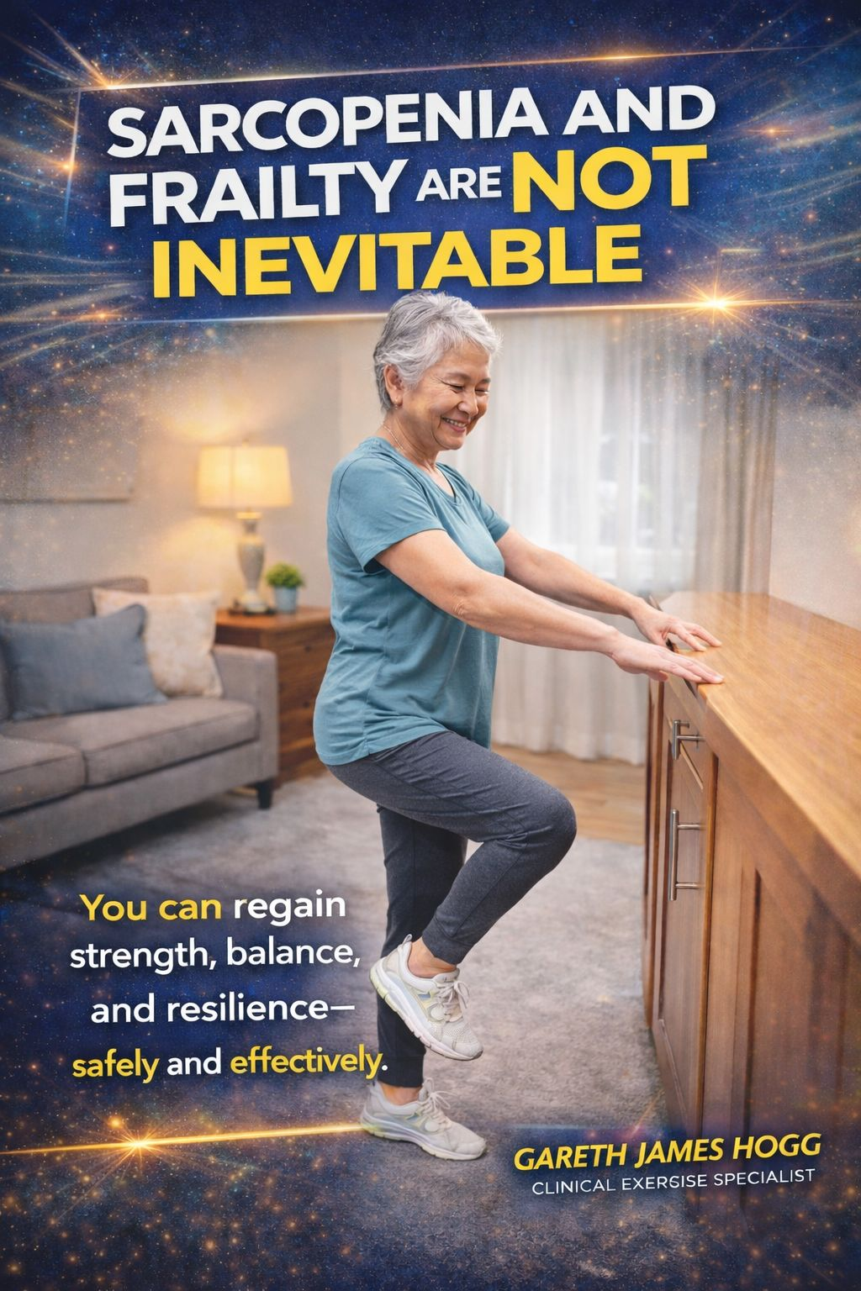

Slide 75
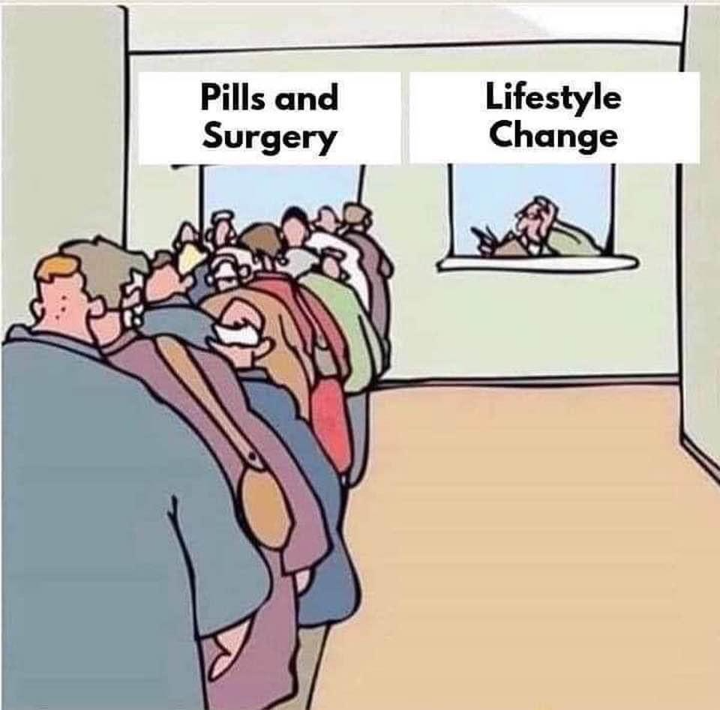
A Herculean
Dilemma
Vice vs. Virtue
Disease vs. Health
Primary and Secondary
Prevention
and Reversal

Slide 76
What can we do about stress?
Social prerequisites
Nutrition
Exercise
Sleep
Circadian regularity
Stress Management
Eustress-Effectance-Learning
Experiencing “Flow”
“Noopedia” methods, SEL skills
Environment, Arts
“Meaning- in-life”
G.P. Chrousos

Slide 77
Basic Social Prerequisites
Safety, Security
Social Integration
Competence
Authenticity
Autonomy
G.P. Chrousos
77

Slide 78
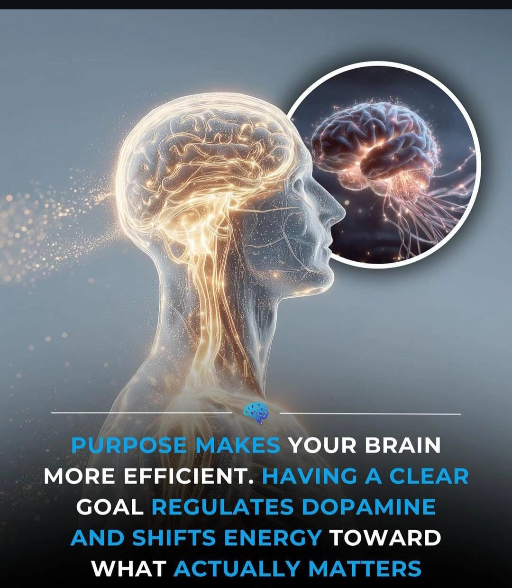

Slide 79
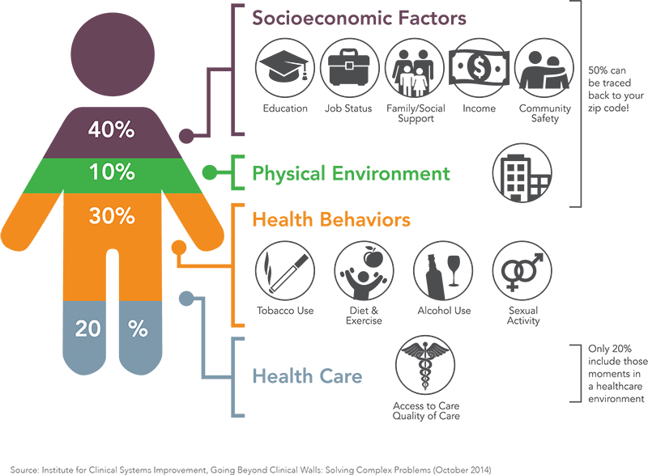

Slide 80
Holistic Approach to Stress Management
Lifestyle changes (Daily routine, nutrition, exercise, sleep, social support)
Life skills training/SEL (Problem solving, emotion management, resilience, coping with change, communication skills, etc.)
Relaxation techniques training (Breathing, PMR, TM, Mindfullness, EFT, etc.)
Professional support* (Councelling, PSM, CBT, DBT, ACT, EMDR, etc.)
*Psychology, Psychiatry
Notes:
ACT= Acceptance and Commitmemt Therapy PMR= Progressive Muscular Relaxation SEL= Social Emotional Learning Primordial Sound Meditation, Eye Movement esensitization Reprocessing

Slide 81
Techniques that Stimulate the
Parasympathetic Nervous System (PNS)
Enhancing Calm, Resilience, and Long-term Health

Slide 82
Behavioral Techniques
Diaphragmatic breathing (slow deep breaths)
Biofeedback (PPG, Regmatex, ANS)
Mindfulness meditation, yoga, tai chi
Visualization, mantras, guided imagery
Gentle stretching, progressive relaxation
Positive sensory/social activities: nature, massage,
pets

Slide 83
Neuromodulation Techniques
Heart rate variability (HRV) biofeedback — trains vagal tone
Transcutaneous auricular vagus nerve stimulation (ta-VNS)
Invasive vagus nerve stimulation (VNS) — FDA-approved for
epilepsy & depression
Experimental: ultrasound vagus nerve stimulation
Transcranial direct current stimulation (tDCS) & repetitive transcranial
magnetic stimulation (rTMS)

Slide 84
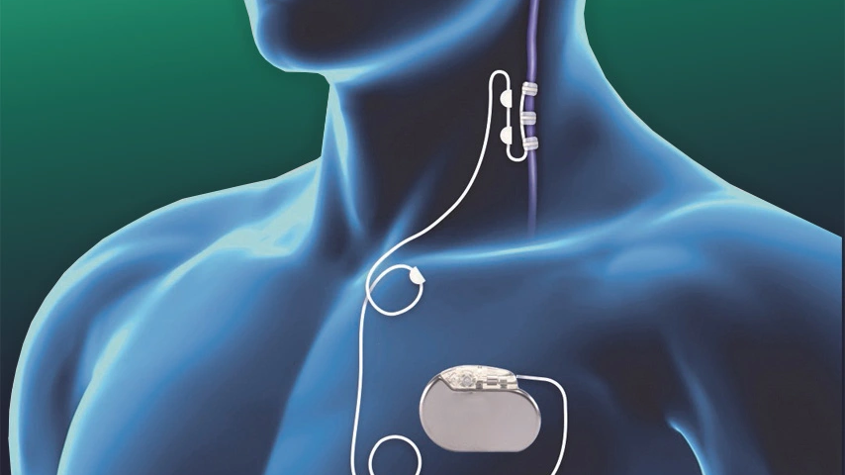

Slide 85
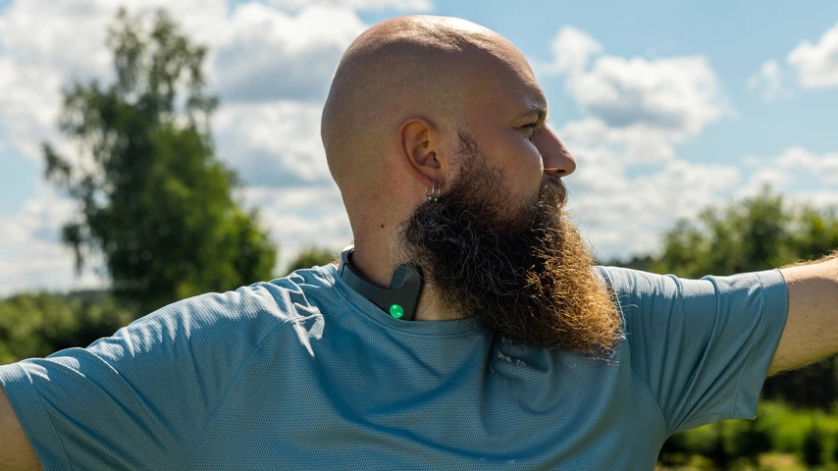

Slide 86
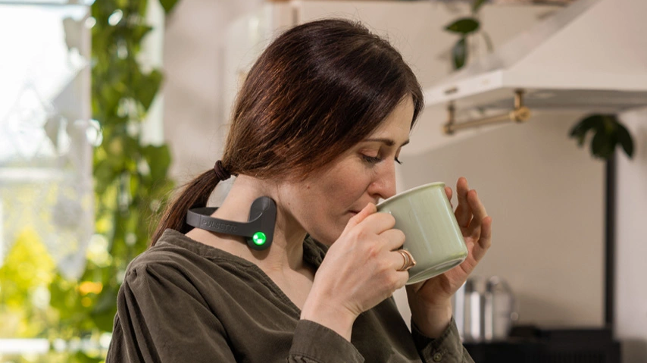

Slide 87
Study of 400 Greek Centenarians:
Female: Male 1.7:1, Key Features
No Hx of Obesity, Maintained Good BMI
No Hx of Depression, No Loneliness
Little or No Hx of Smoking
Stable Daily Activity Schedule
Resilience to Stress
High Optimism, Adaptability
Spirituality/Religiosity
(Underachievement ?)

Slide 88
Healthy (Eu)Longevity
Concepts of Complexity vs. Endocrinology
Neuro-Endocrine Mechanisms of the Stress Response
Adverse Effects of Chronic Stress – Pathology-Aging
Evaluation of a Stressed Human Subject- Aging
Stress Management-Therapy-Eu-longevity
Life extension-Rejuvenation
Notes:
88

Slide 89
Is Slowing of Aging Possible?
Animal examples provide distinct mechanisms
for life prolongation :
Bats (anti-viral, anticancer, apoptosis, immunity)
Greenland whales (DNA repair)
Elephants (anti-cancer, apoptosis)

Slide 90
Is Anti-aging Possible?
Processes that provide distinct mechanisms
for both rejuvenation and immortality:
Gamete and blastocyst rejuvenation
Nature experiments (Hydra, Axolotl)
Creation of induced pluripotent cells (iPS cells)

Slide 91


Slide 92
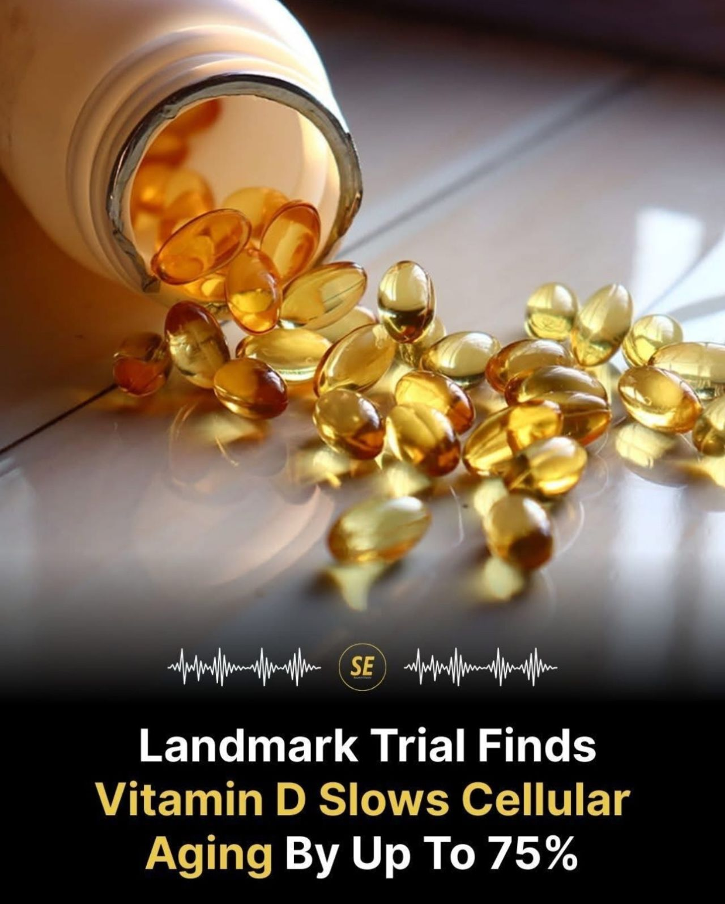

Slide 93
Extension of Life and Rejuvenation
of Cells, Organs and Organisms using Molecular Techniques
are Possible and under Intense Study

Slide 94
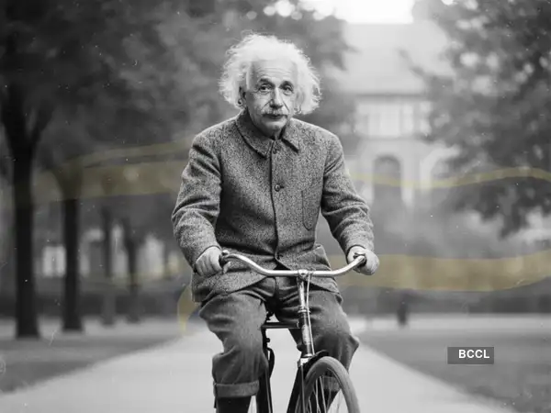
“Life is like riding a bicycle. To keep your balance, you must keep moving.” Albert Einstein

