Slide 1

Χειρουργική Θεραπεία Στεφανιαίας Νόσου
ΠΜΣ ΚΑΡΔΙΟΜΕΤΑΒΟΛΙΚΗ ΙΑΤΡΙΚΗ
Δημήτριος Χρ. Ηλιόπουλος
Καρδιοχειρουργός
Καθηγητής Καρδιοχειρουργικής ΕΚΠΑ
Διευθ/ντής Δ’ Καρδιοχειρουργικής Κλινικής
Θεραπευτηρίου ΥΓΕΙΑ

Slide 2

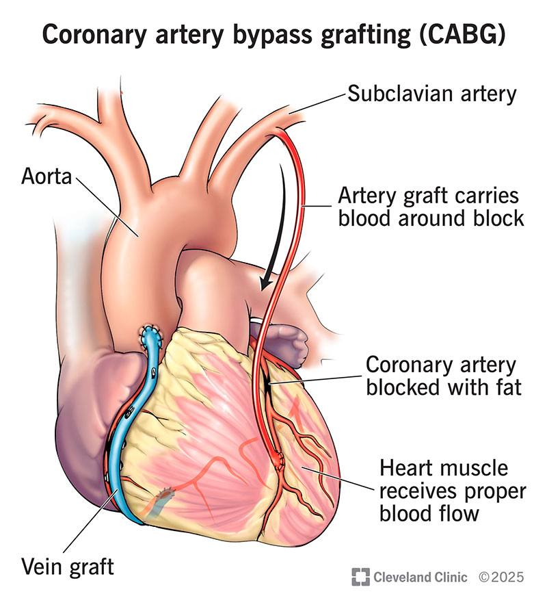
Figure of CABG as an introduction

Slide 3
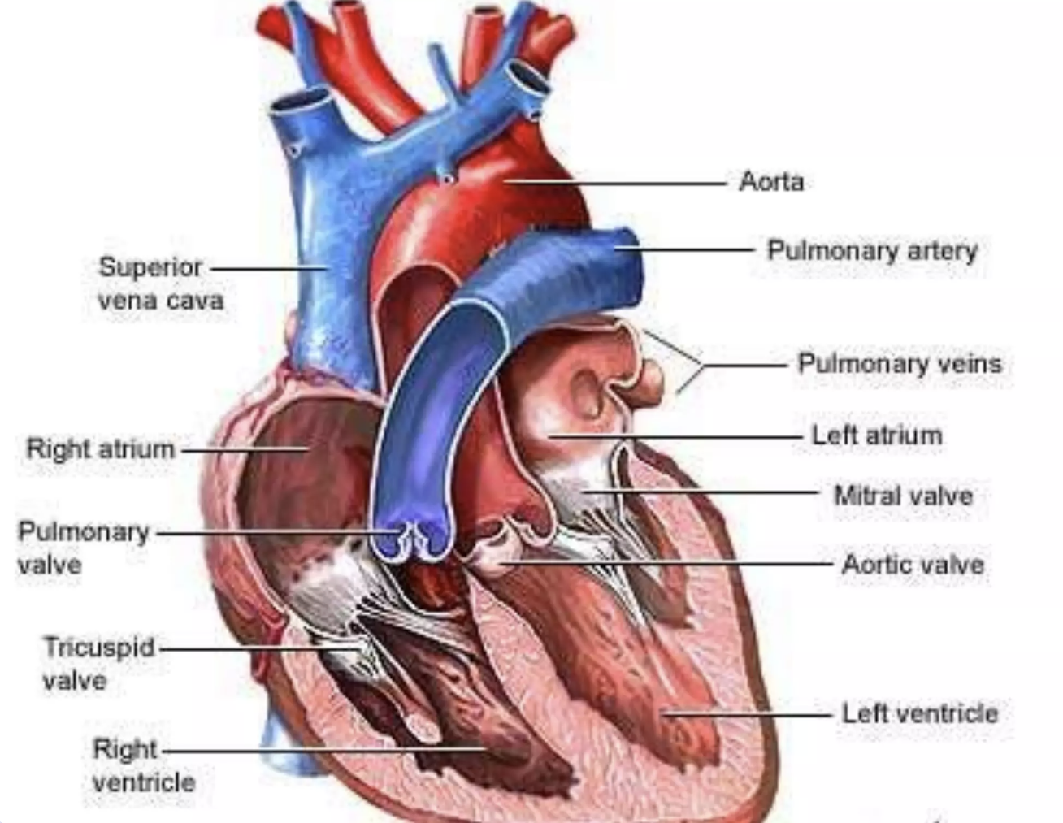
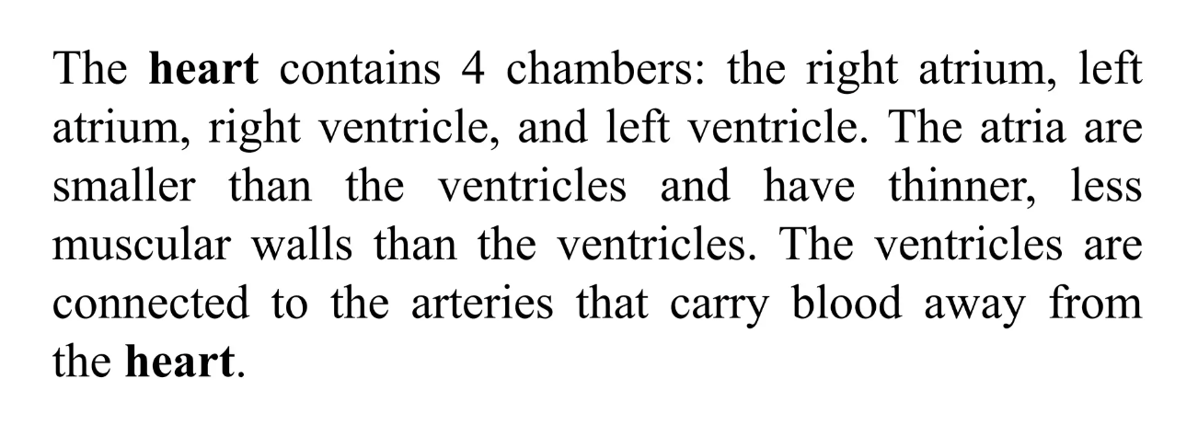
Anatomy of the heart

Slide 4
Definition of CABG
Bypass surgery create new routes of blood flow in coronary arteries that are narrowed or occluded.
Increases blood flow in the heart muscle with oxygenated blood full of nutrients.
This is the most common operation in cardiac surgery with its incidence up to 70% in total.

Slide 5

Purpose of CABG
Restore blood flow to the heart muscle.
Relieve chest pain and ischemia.
Improves the patient’s quality of life.
Lower risk of heart attack and heart failure.

Slide 6
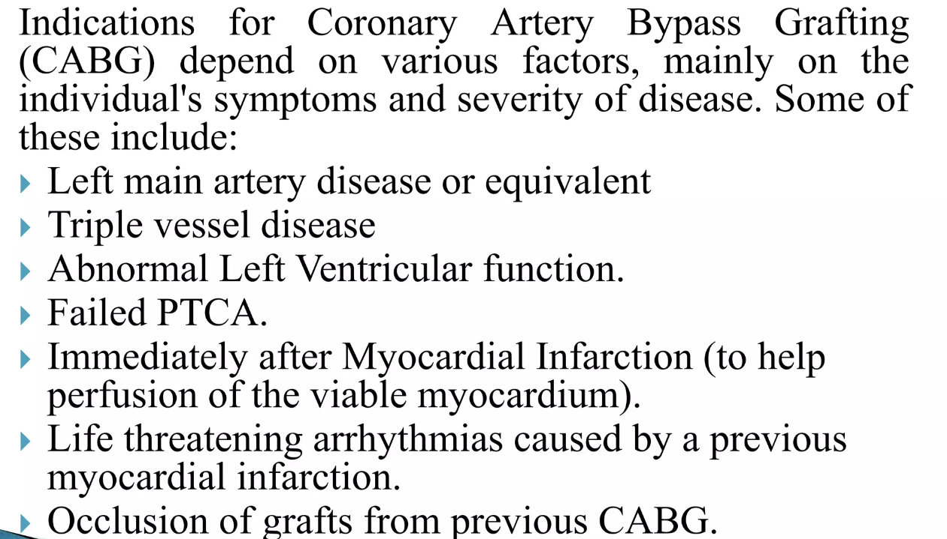
Indication for CABG

Slide 7
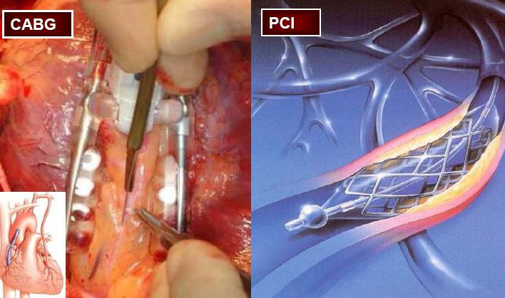
How and when to revascularize ??

Slide 8

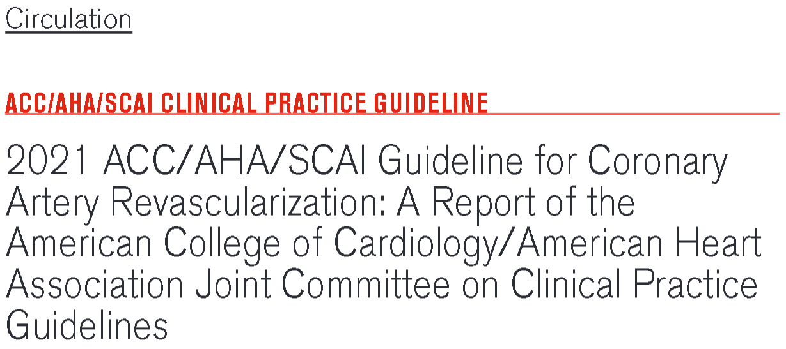
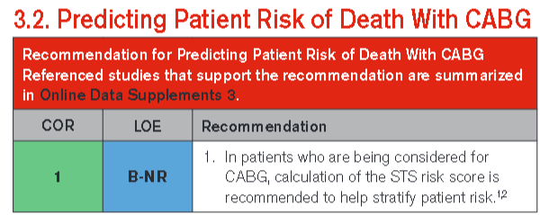

Slide 9


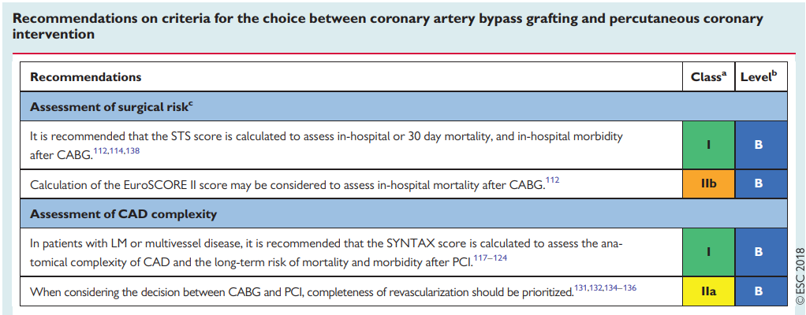

Slide 10
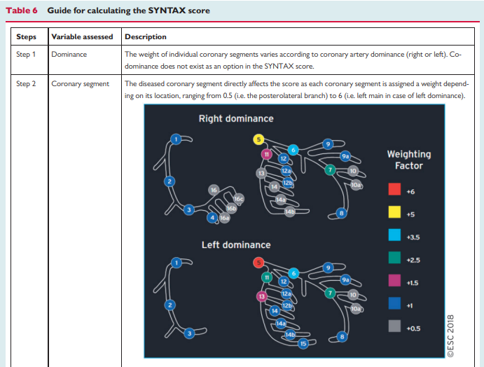
SYNTAX score
Significant tool in decision making

Slide 11
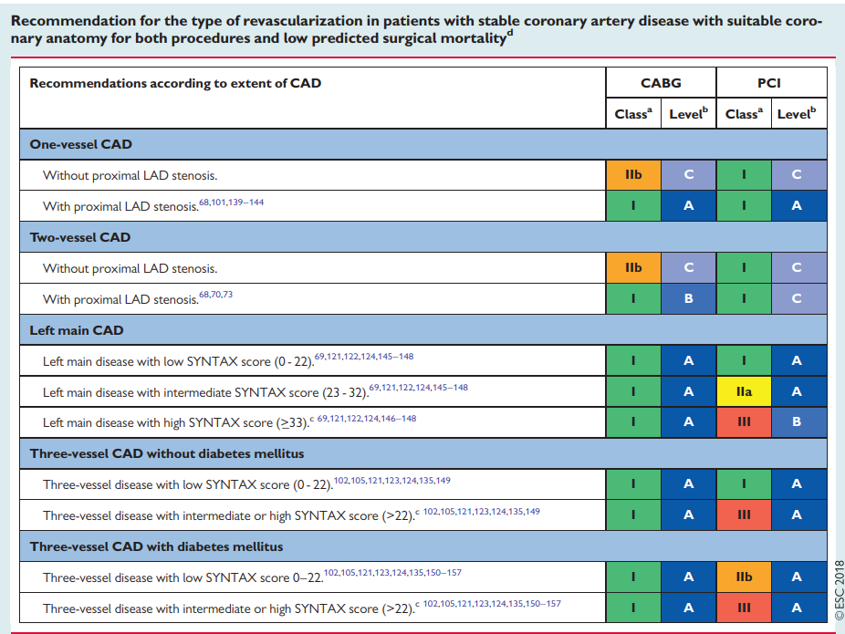



Slide 12
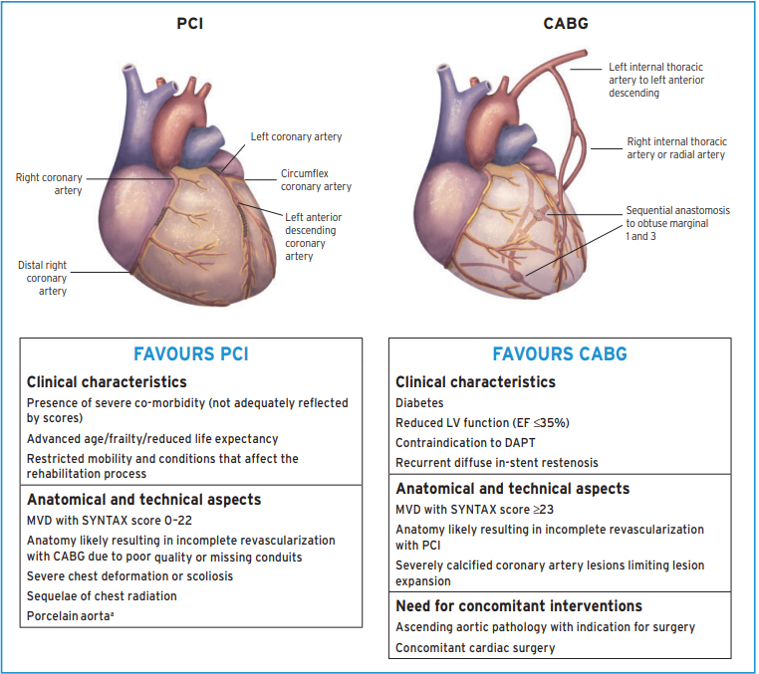



Slide 13
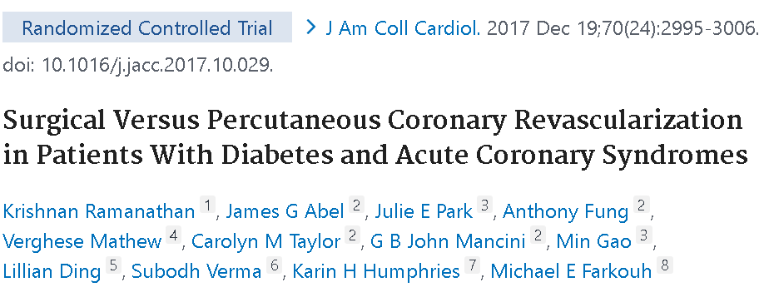
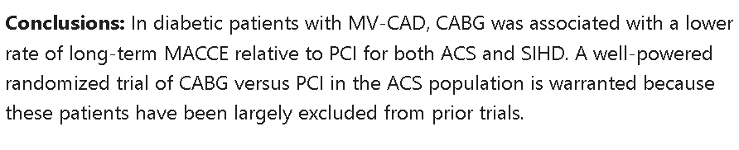
Διαβητικοί ασθενείς

Slide 14
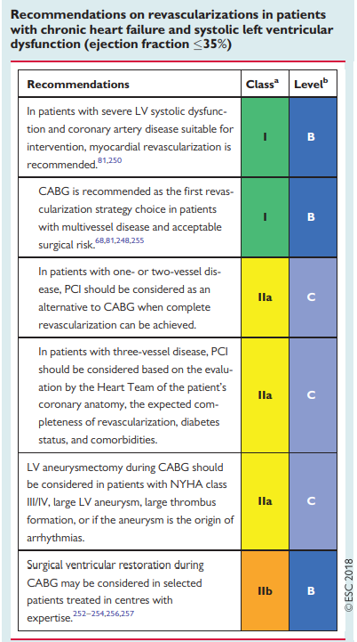
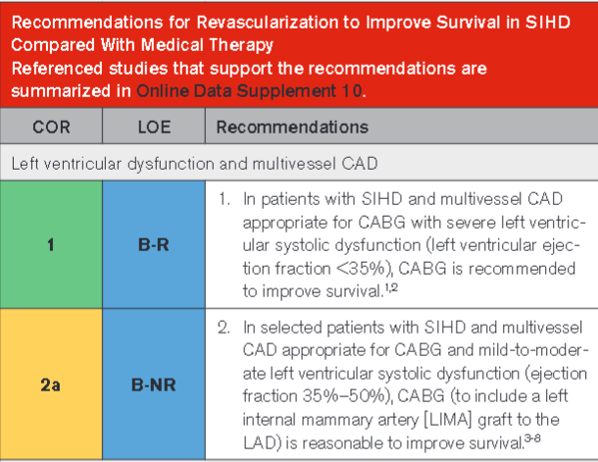

Επαναιμάτωση σε ασθενείς με καρδιακή ανεπάρκεια
Πρέπει να είναι πλήρης
PCI: Σε ηλικιωμένους, μη διαβητικούς και εφόσον μπορεί να επιτευχθεί πλήρης επαναιμάτωση.
CABG: Σε νεότερους ασθενείς με εκτεταμένη αθηρωματική νόσο και σε διαβητικούς.
Σε ασθενείς με μέτρια ή σοβαρή δυσλειτουργία της ΑΡ κοιλίας, (EF<50%), υπερτερεί η χειρουργική επαναιμάτωση.
Όμως…

Slide 15
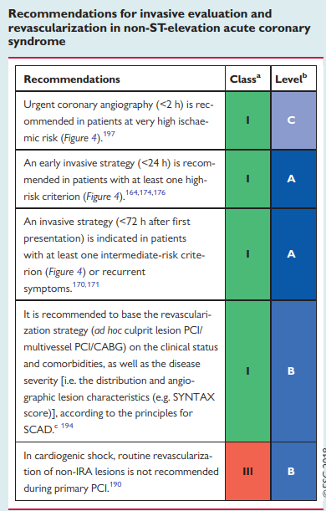
Οξύ στεφανιαίο σύνδρομο
5 – 10 % των ασθενών θα χρειαστούν CABG.
Σε περιστατικά που δεν απαιτείται επειγόντως επέμβαση, ο χρόνος αναμονής πρέπει να αποφασίζεται ανάλογα με τον κάθε ασθενή.
Σε ασθενείς με αιμοδυναμική αστάθεια ή συνεχιζόμενη ισχαιμία, η αορτοστεφανιαία παράκαμψη πρέπει να πραγματοποιείται επειγόντως και ανεξάρτητα από τη λήψη αντιαιμοπεταλιακών σκευασμάτων.

Slide 16
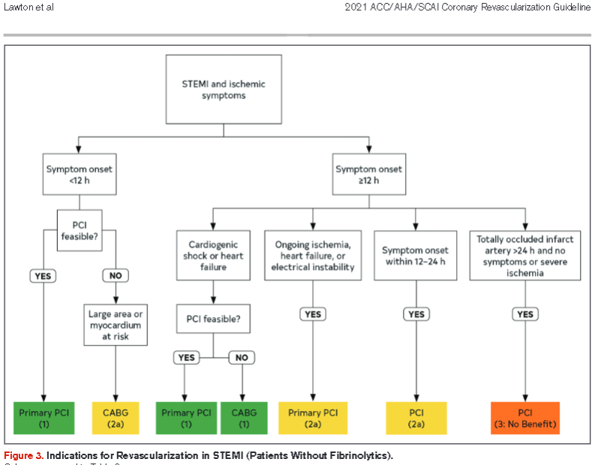


Slide 17
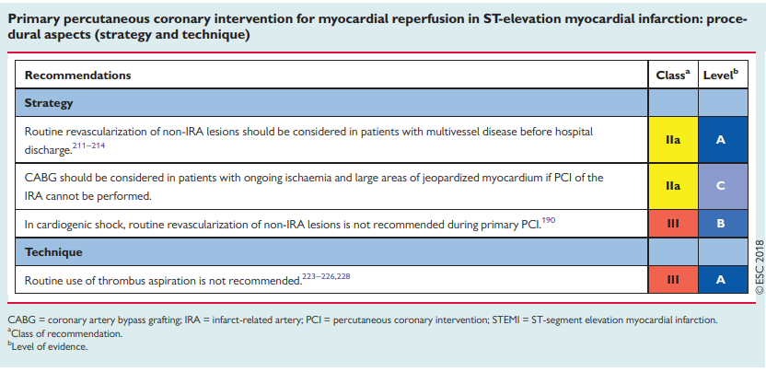

Slide 18
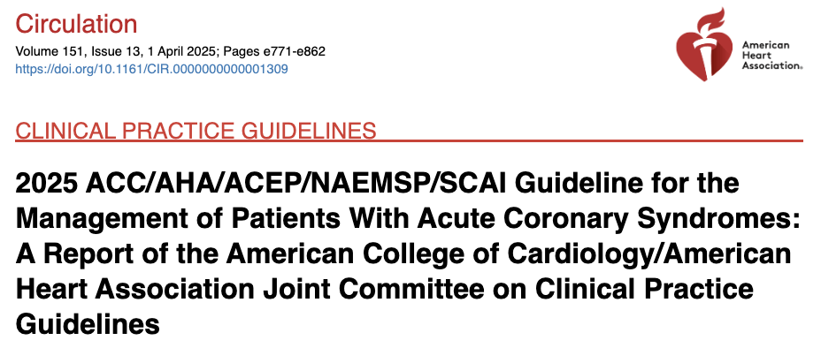
Recent guidelines on Acute Coronary Syndrome (2025)

Slide 19
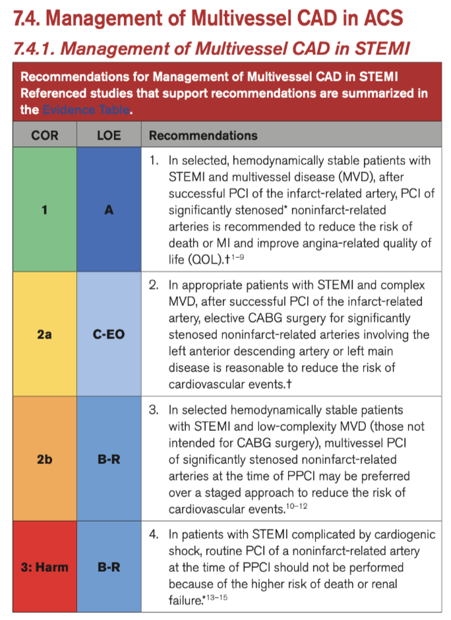
CABG in ACS
Elective CABG after primary PCI for STEMI is indicated to:
Reduce death of MI (Class I)
To reduce risk of cardiovascular events for significant stenosis in LAD or LM. (Class Iia)

Slide 20
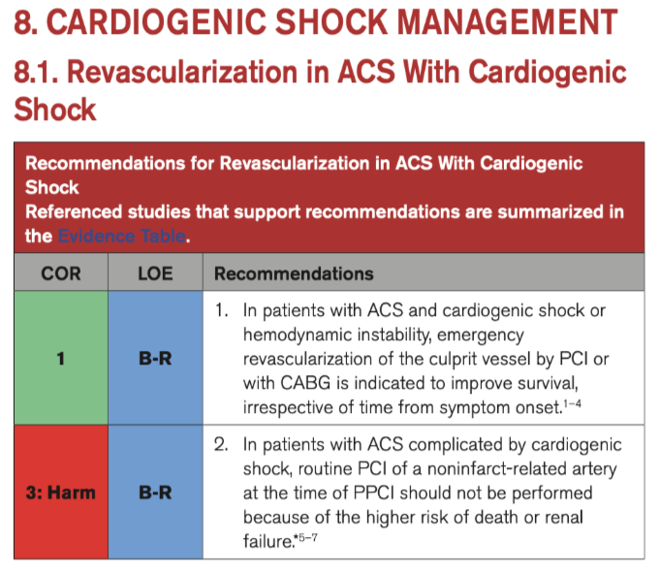
CABG in STEMI and Cardiogenic Shock?
CABG after failed PCI even on cardiogenic shock

Slide 21
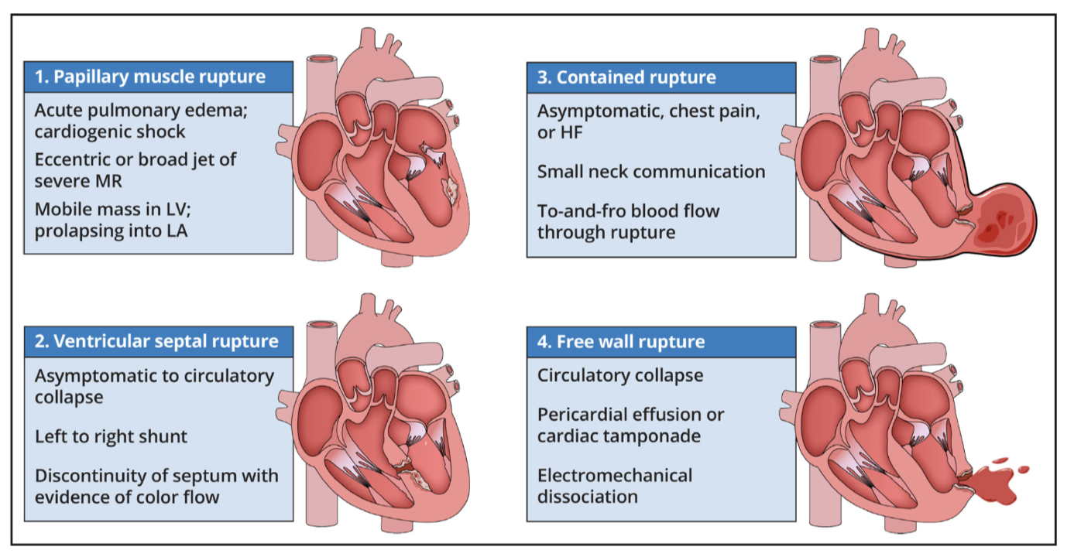
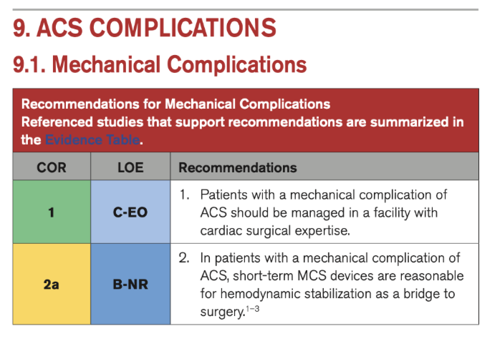
Mechanical complications after STEMI
CABG is indicated in STEMI complications.
Challenging procedures with high mortality rate.

Slide 22
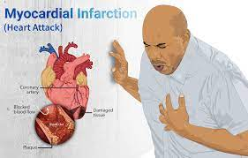
ST-Segment Elevation MI (STEMI)
Emergency or urgent CABG indication:
  Failed angioplasty (PTCA)
  Ventricular septal rupture or mitral valve insufficiency
  In the early hours(6~12 hrs) of evolving STEMI (class IIa)
  Persistent or recurrent ischemia refractory to medical therapy
  Cardiogenic shock in <75 y/o, LBBB
  Life-threatening ventricular arrhythmias with 50% left main stenosis and/or 3-vessels disease

Slide 23
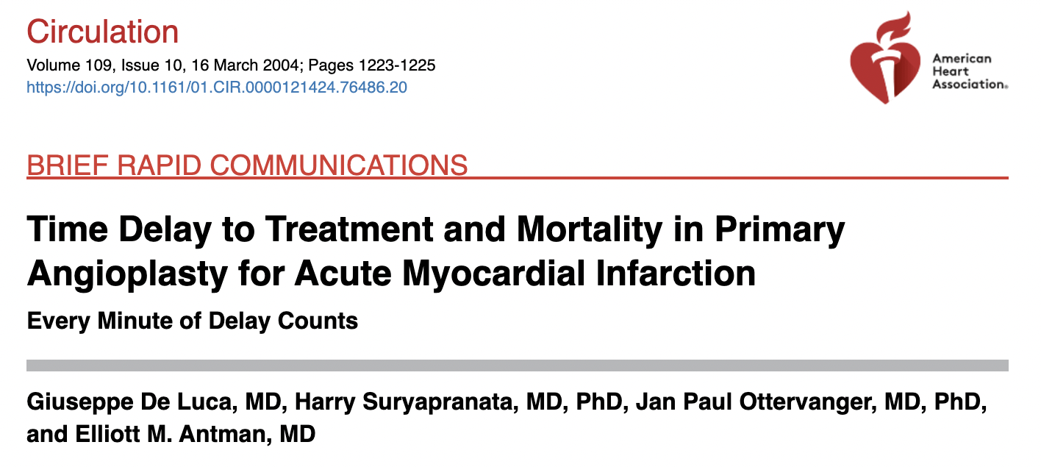
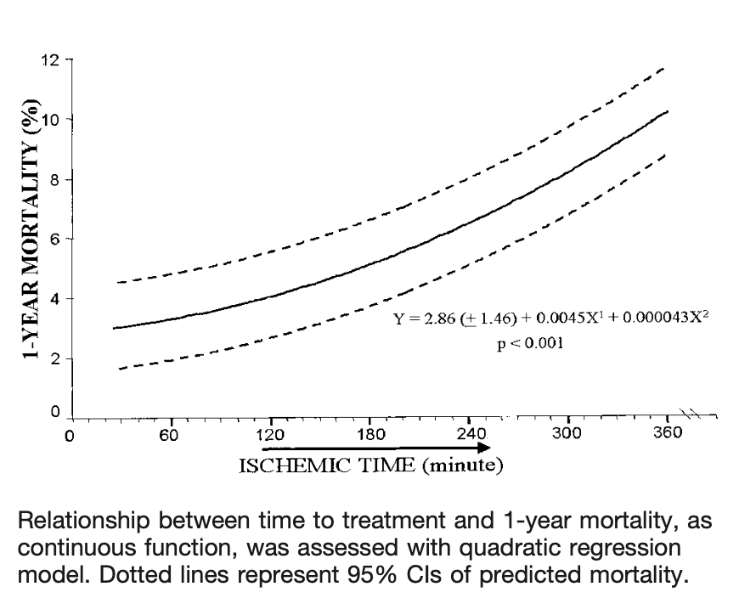

Slide 24
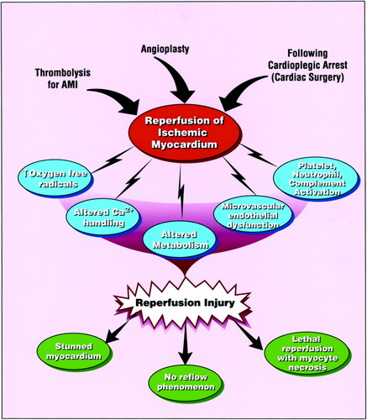
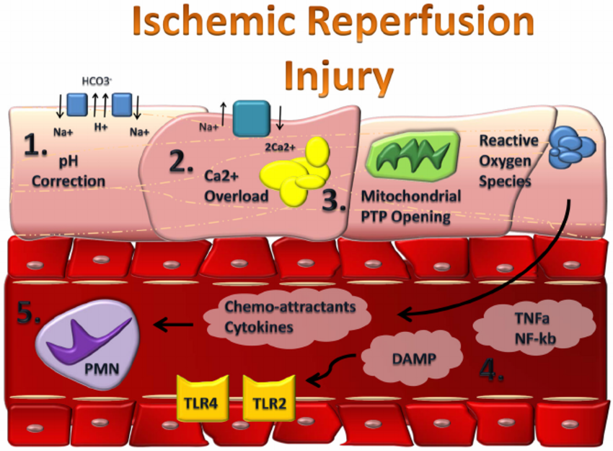
Reperfusion injury

Slide 25
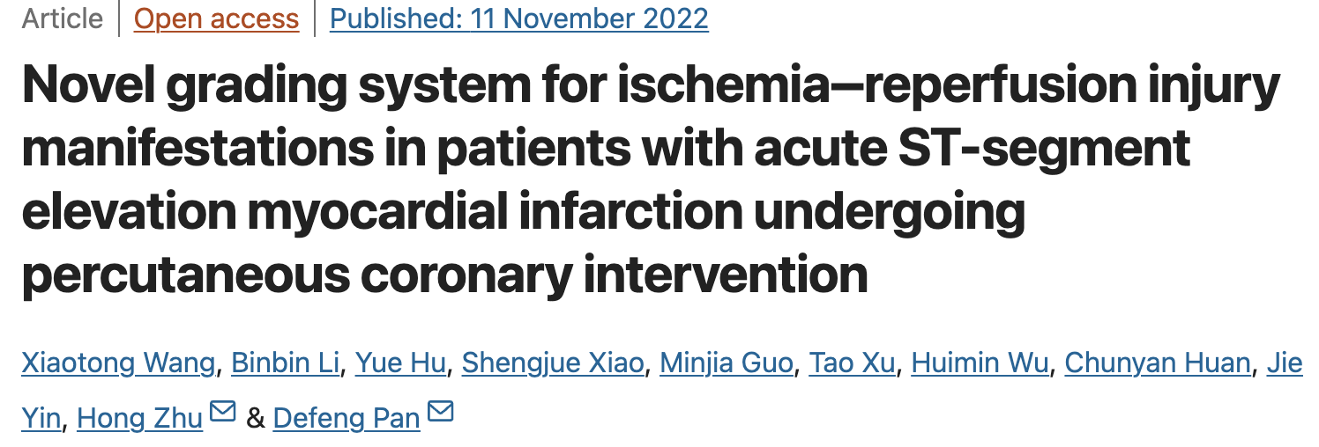
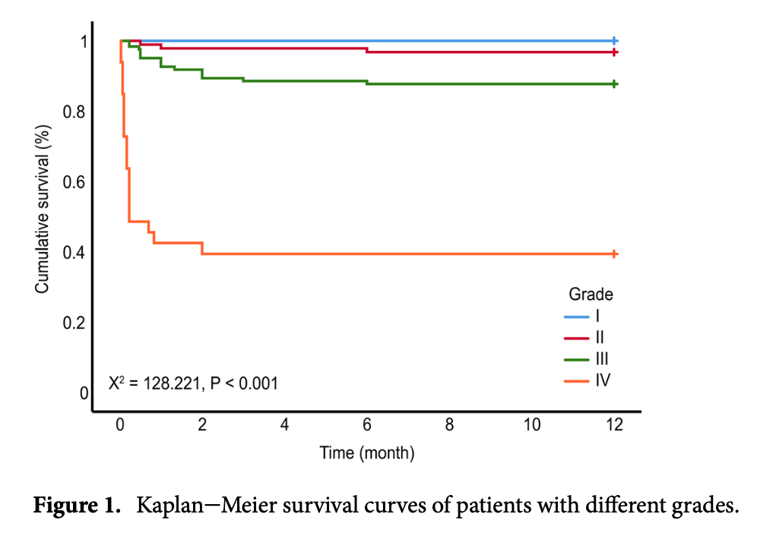
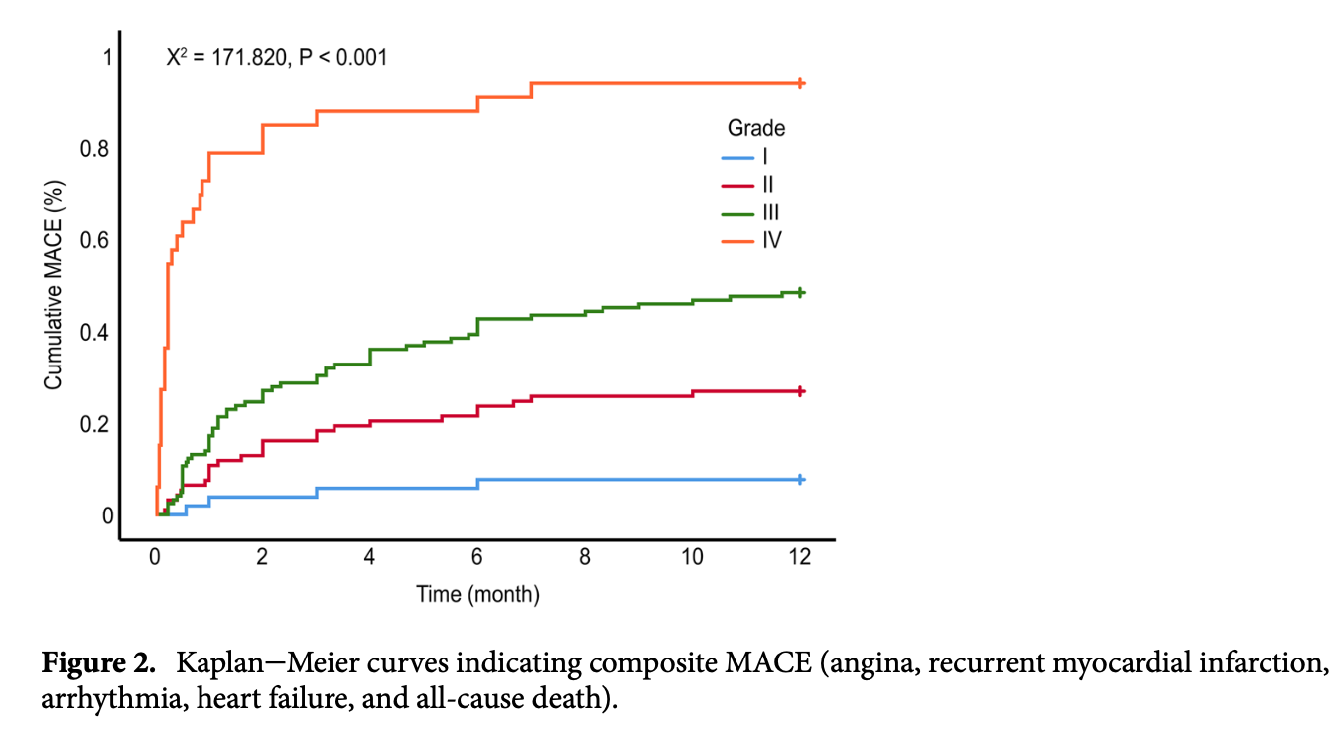
The MIRI manifestation grade criteria were as follows.
Grade I: The patient’s vital signs were stable, and the blood pressure and heart rate remained unchanged
Grade II: Transient hypotension (less than 90/60 mmHg or SBP and/or DBP decrease≤30%) and/or reperfusion arrhythmia that was not treated; TIMI 3, MBG 3
Grade III: persistent hypotension (lower than 90/60 mmHg, or SBP and/or DBP decrease > 30% or need for drug treat- ment) and/or reperfusion arrhythmia and need for drug treatment; transient TIMI: 2, MBG: 2
Grade IV: cardio- genic shock or malignant arrhythmia; TIMI ≤ 2, MBG: 0 or 1

Slide 26
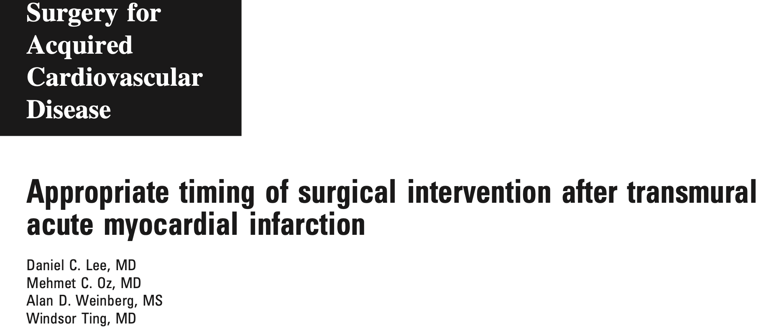
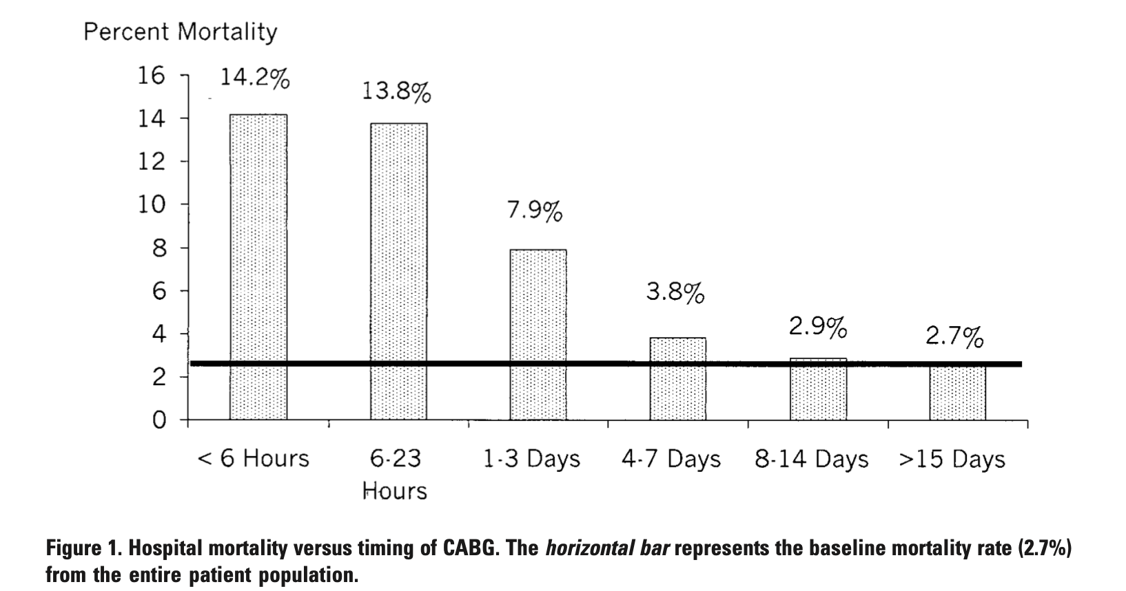
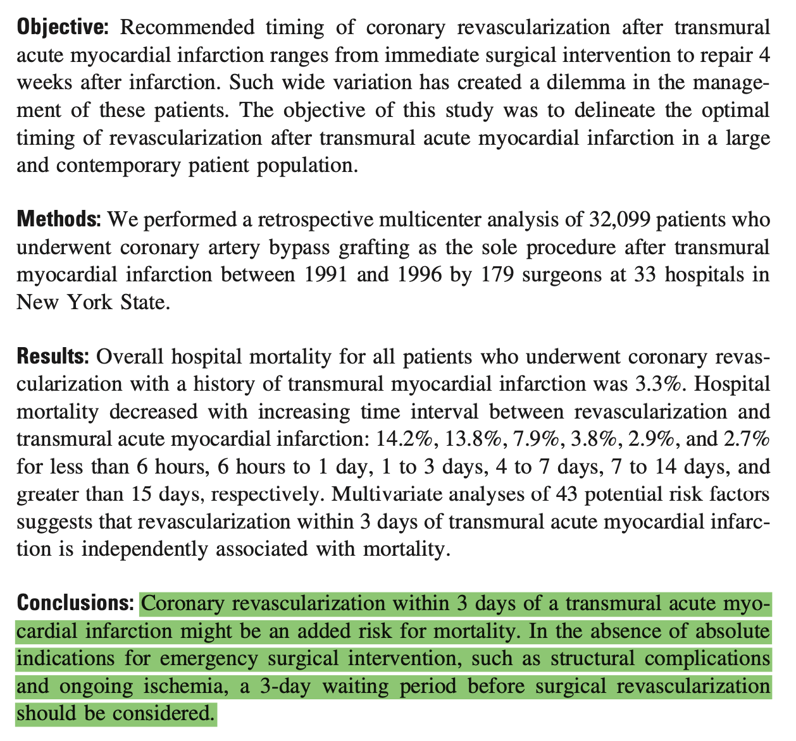

Slide 27
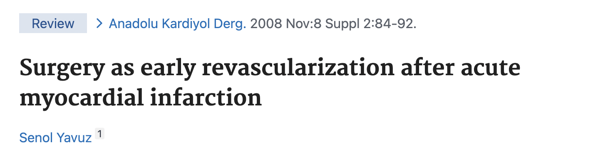
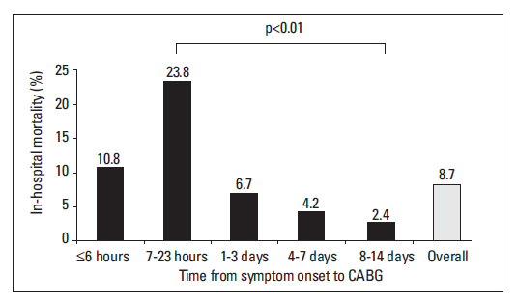

Slide 28
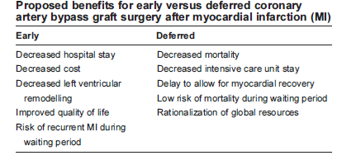
Early vs. Delayed CABG
Raghavan R et al, Can J Cardiol 2007;23 (12): 976-982

Slide 29
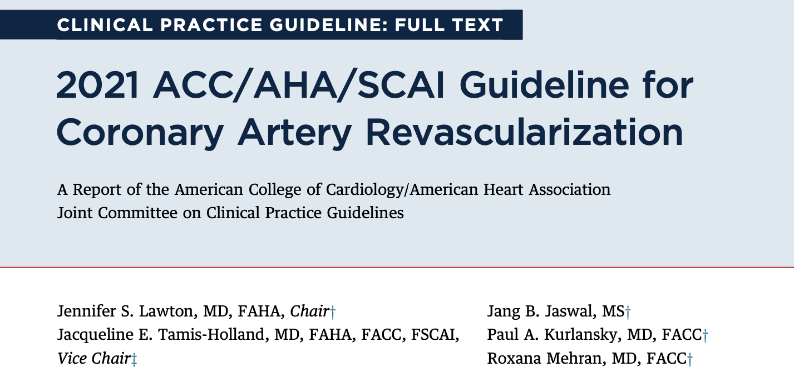
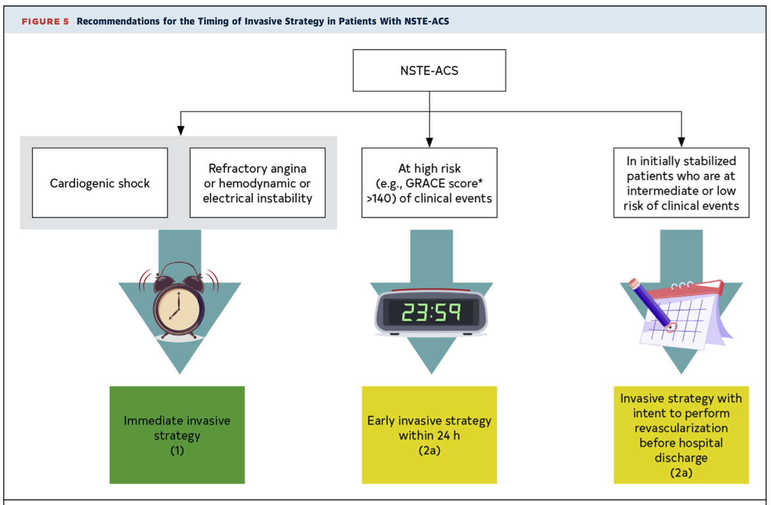

Slide 30
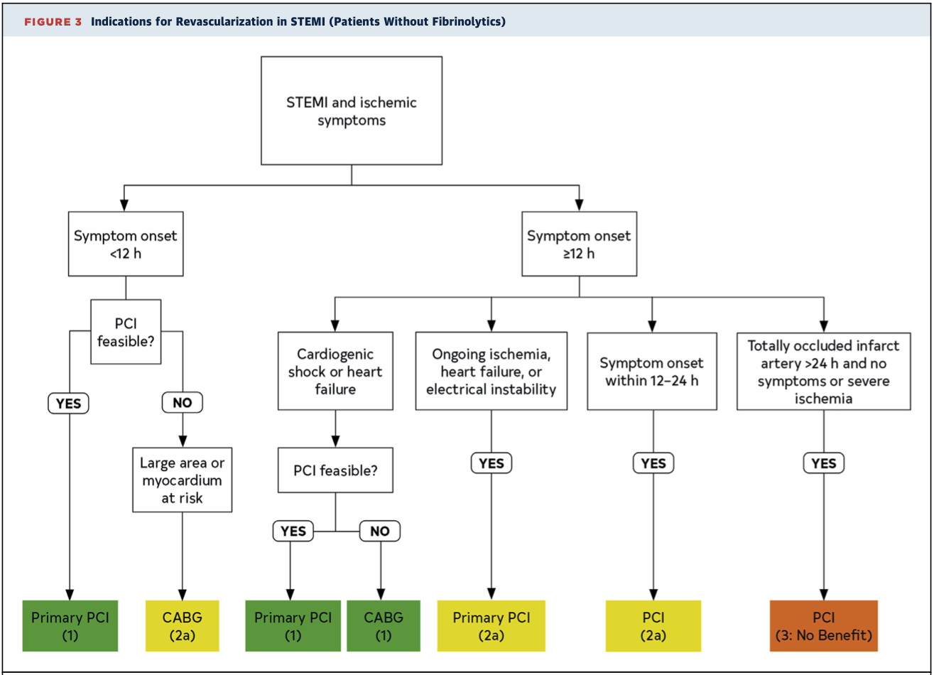

Slide 31
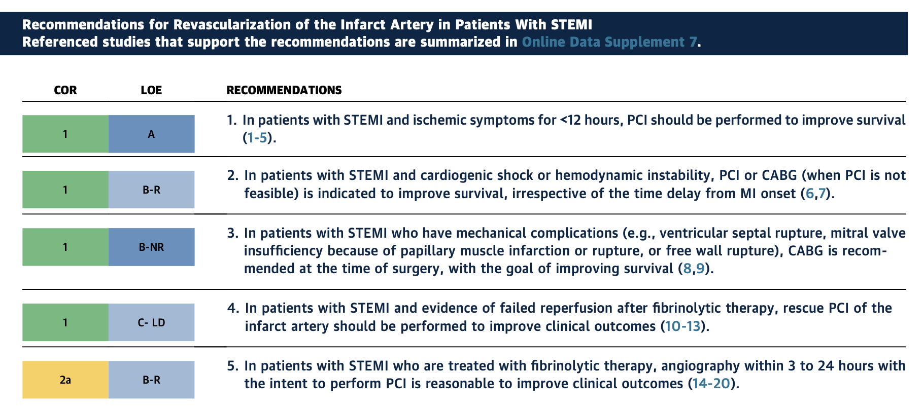

Slide 32
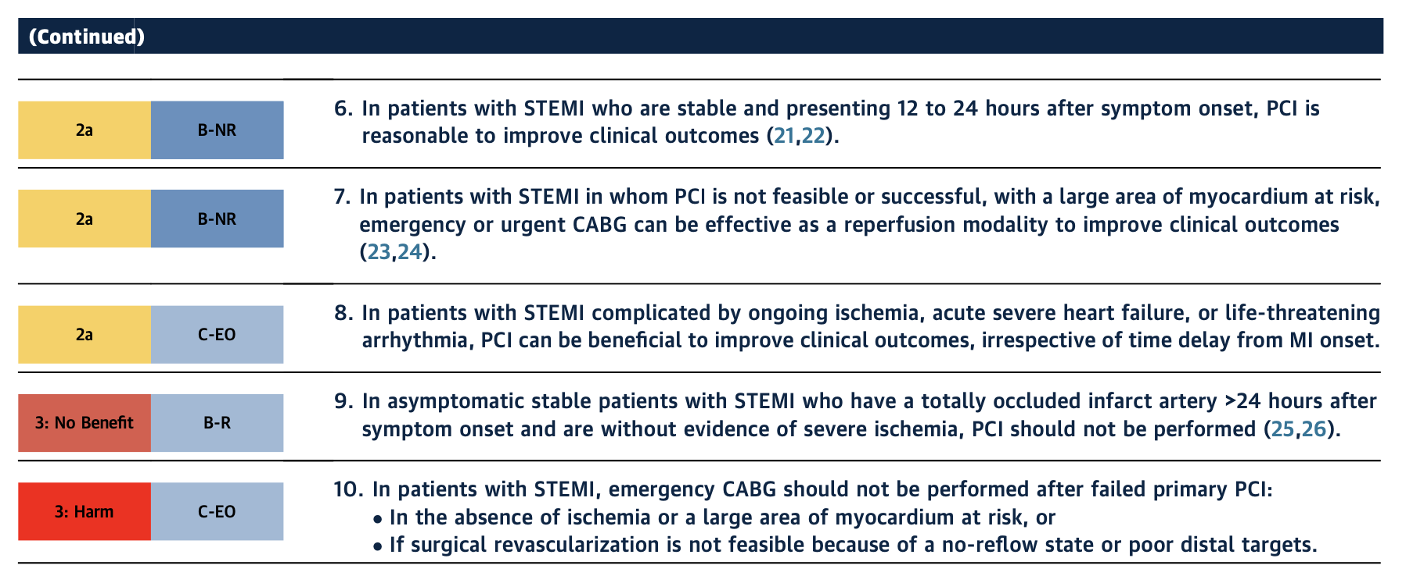

Slide 33
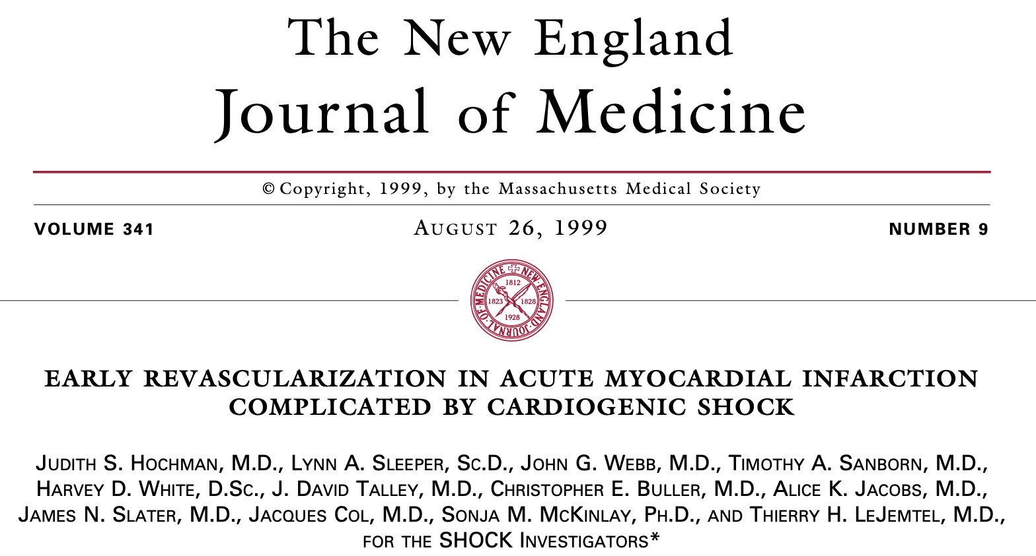
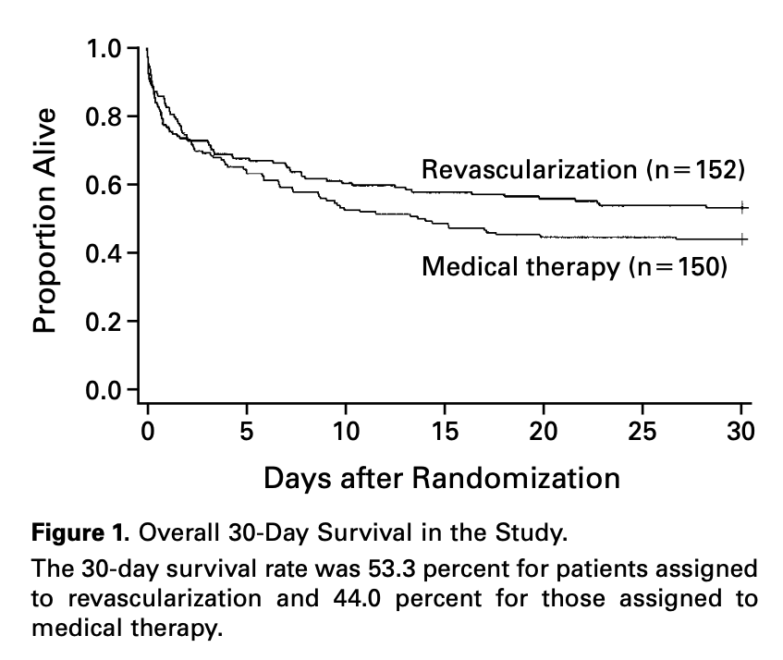
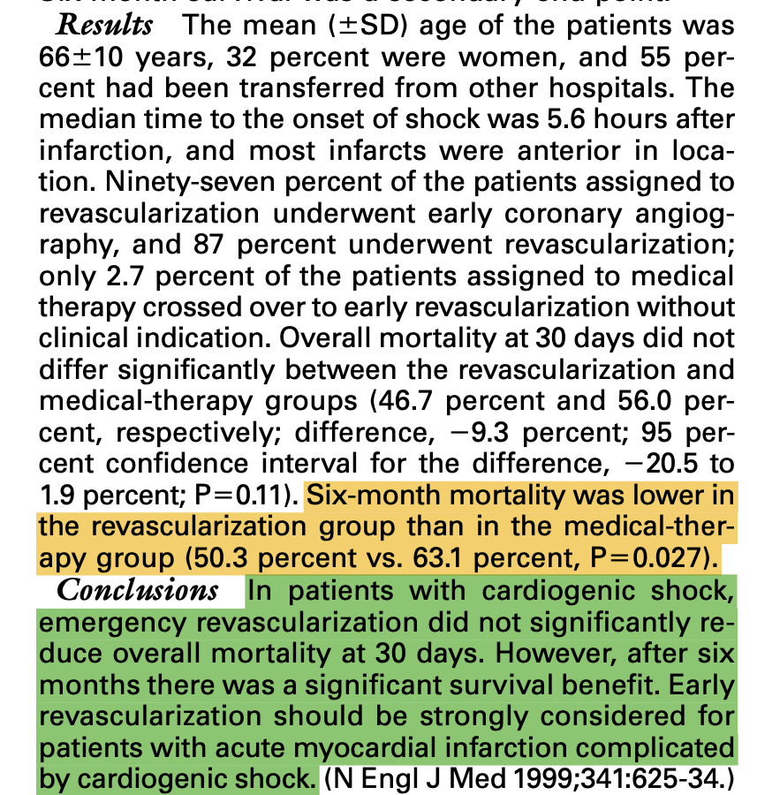
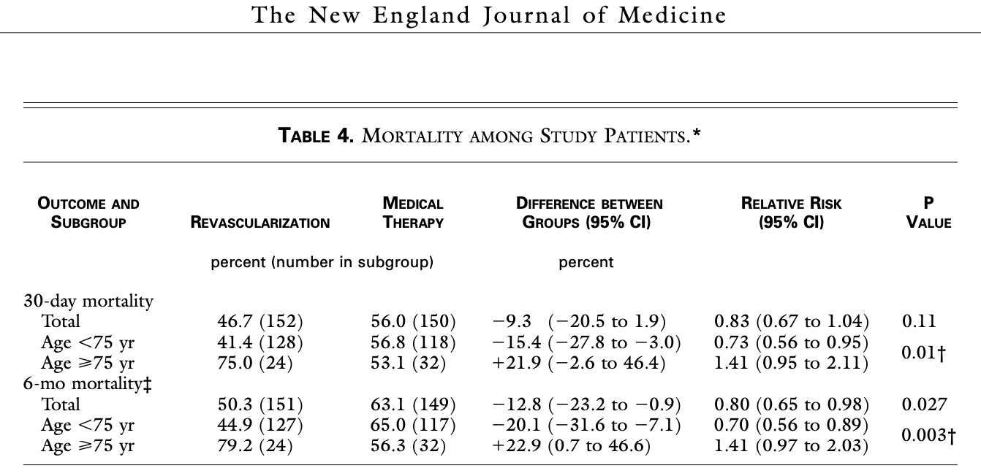

Slide 34
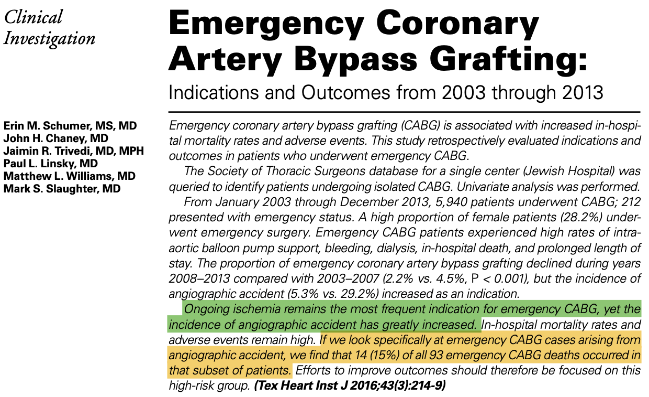
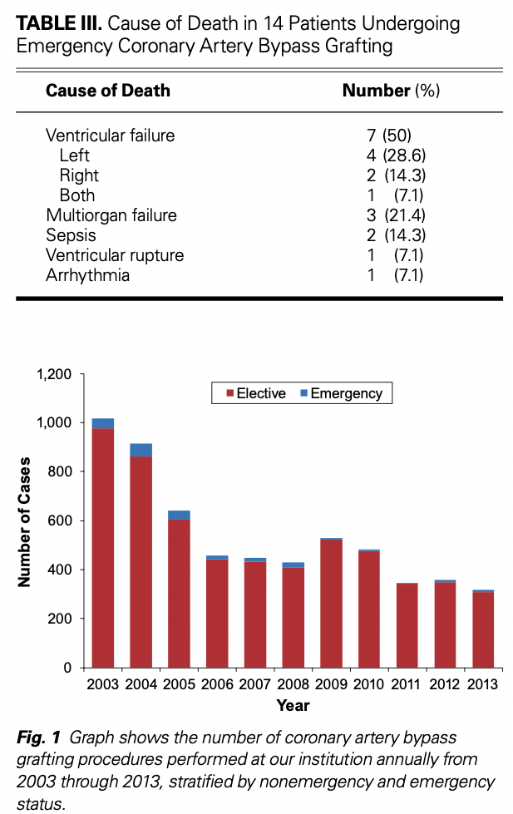
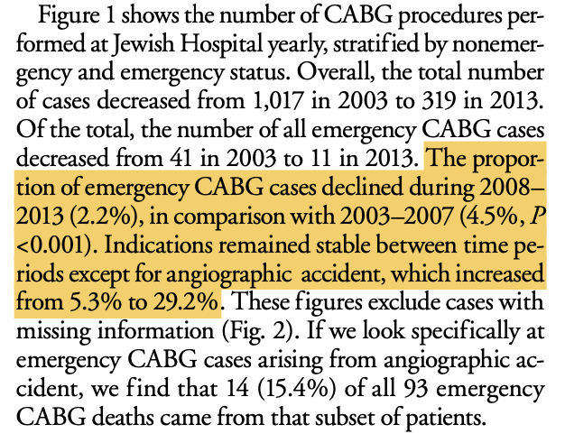
Emergency CABG cases decreased

Slide 35

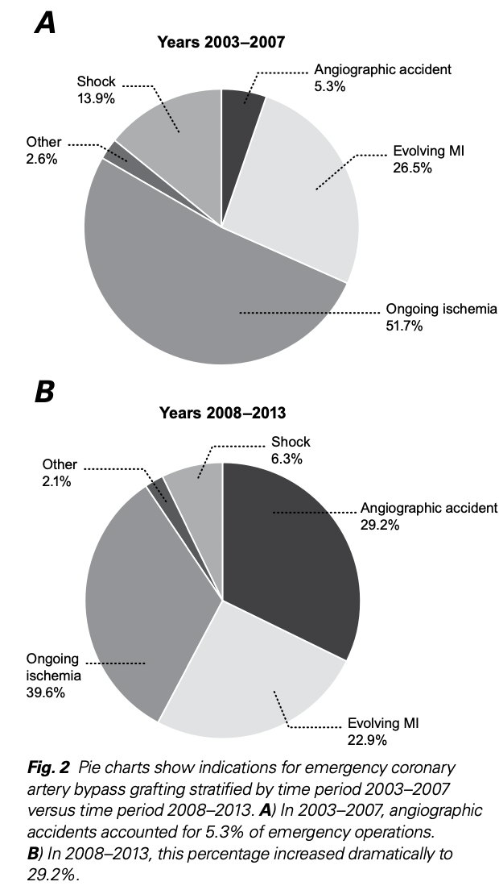
Increase in angiographic accidents from 5.3% to 29.2%

Slide 36





Slide 37



Mechanical complications rate 0,27% after STEMI
with mortality rate 42.4%!!

Slide 38



Intervention in patients post-infraction mitral regurgitation is associated with improved survival

Slide 39



When Papillary Muscle Rupture is restored, the long term clinical outcomes are similar to those treated only for MI.

Slide 40

Recent guidelines on Chronic Coronary Syndromes (2024)

Slide 41

Revascularization in patients with Heart failure (LVEF<35% evaluation of HEART TEAM required

Slide 42

CABG for Left main artery disease
PCI only as an alternative in low complexity stenosis (SYNTAX score <22%

Slide 43

Prognosis After CABG
CABG is one of the most effective long-term treatments for advanced coronary artery disease. Prognosis depends on several factors, but overall outcomes are good, especially with modern surgical techniques.
Survival Rates
Operative mortality: ~1–3% in low-risk patients; higher in elderly or those with multiple comorbidities
5-year survival: ~85–90%
10-year survival: ~70–75%
15-year survival: ~55–60%
Survival is highest in patients:
<70 years old
With good left ventricular function
With isolated left main or multivessel disease
Who do not have severe comorbidities (renal failure, COPD, advanced diabetes)

Slide 44


Recent study on CABG long term outcomes
Mortality :1,62% 30-day
rate 2,94%. 5-year
22,79% 10-year
36,60% 15-year
Renal failure the worst predictor
Increased EUROSCORE, BMI, age and diabetes also associated with high mortality rate

Slide 45
Symptom Relief and Quality of Life
CABG provides:
Significant reduction in angina (80–90% become angina-free initially)
Improved exercise tolerance
Better quality of life than PCI in multivessel disease
Improvement may decrease over time due to graft occlusion or progression of native disease.

Slide 46

CABG (description of procedure)

Slide 47


CABG (description of procedure)
Saphenous vein harvesting

Slide 48
CABG (description of procedure)
Saphenous vein harvesting

Slide 49



CABG (description of procedure)
Sternotomy – Internal Mammary Harvesting

Slide 50

CABG (description of procedure)
Cannulation

Slide 51


CABG (description of procedure)
Choice of target vessels - Anastomosis

Slide 52


CABG (description of procedure)
Decannulation – Sternal closure

Slide 53
Expected Recovery Timeline
Hospital stay: 4–7 days
Full recovery: 6–12 weeks
In sternotomy 6-8 weeks avoidance of weight lifting, sleeping on the back and in general minimize pressure on the chest.
Return to work: ~6 weeks (varies)
Cardiac rehab strongly improves recovery and long-term outcomes

Slide 54
Factors That Improve Prognosis
Optimal risk-factor control
Adherence to medications
Cardiac rehabilitation
Avoiding smoking
Good management of diabetes, hypertension, and lipids
Regular follow-up with a cardiologist

Slide 55
Post-CABG Recommendations to Improve Prognosis
Lifelong antiplatelet therapy (aspirin ± P2Y12 inhibitor)
Statin therapy
BP and sugar control
Cardiac rehabilitation
Smoking cessation
Walking/exercise program

Slide 56

Arterial or vein grafts for CABG??

Slide 57

Mechanisms of vein graft failure..
Day 0- 1 week: Surgical preparation leads to endothelial denudation which precipitates platelet adhesion and thrombus formation
1 week - 1 month: Medial thickening due to vascular smooth muscle cells migration – Neointima formation
1 month – 3 years : Atheromatous lesions rich in foam cells lead to development of early intimal atherosclerotic changes.
Shukla N, Jeremy JY. Pathophysiology of saphenous vein graft failure: a brief overview of interventions. Curr Opin Pharmacol. 2012 Apr;12(2):114-20.

Slide 58

How vein grafts fail over time..
Harik L, Perezgrovas-Olaria R, Soletti G Jr, Dimagli A, Alzghari T, An KR, Cancelli G, Gaudino M, Sandner S. Graft thrombosis after coronary artery bypass surgery and current practice for prevention. Front Cardiovasc Med. 2023 Mar 8;10:1125126. doi: 10.3389/fcvm.2023.1125126

Slide 59

Gharibeh L, Ferrari G, Ouimet M, Grau JB. Conduits' Biology Regulates the Outcomes of Coronary Artery Bypass Grafting. JACC Basic Transl Sci. 2021 Apr 27;6(4):388-396.

Slide 60




Slide 61





Slide 62




Radial over Saphenous Vein Graft…

Slide 63





Slide 64




Slide 65



Slide 66


Slide 67




Slide 68



Slide 69




Slide 70


Reasons of limited usage of Total Arterial Revascularization

Slide 71





Slide 72


How about Multiple Arterial Grafting in women??

Slide 73



Slide 74



Slide 75


Slide 76


Slide 77


Slide 78

CABG VS MIDCAB

Slide 79

DESCRIPTION OF MIDCAB
Thoracoscopic harvesting of Left Internal Mammary.
Left anterior thoracomy (usually 5th intercostal).
Placement of stabilizer on target vessel.
Anastomosis of LIMA to LAD off pump.

Slide 80


Shorter ventilation time and length of stay in favor of Minimal Invasive

Slide 81

Higher Cross-clamp time and CPB time for Minimal Invasive

Slide 82


Slide 83
Conclusions
CABG is a safe, effective and well-documented procedure for the treatment of coronary artery disease.
CABG is the gold standard for left main disease and three vessel disease.
Emergent CABG is indicated after failed PCI , ongoing ischemia and mechanical complications of MI.
Total arterial revascularization is associated with improved long term outcomes.
Minimal invasive is rapidly expanding and constitutes a promising approach.

