Slide 1

Οξέα στεφανιαία σύνδρομα. Έμφραγμα μυοκαρδίου με ανάσπαση του ST διαστήματος
ΠΜΣ: ΚΑΡΔΙΟΜΕΤΑΒΟΛΙΚΗ ΙΑΤΡΙΚΗ
Καλογεράς Κων/νος, MD, FESC
Επίκουρος Καθ. Καρδιολογίας
Γ’ Πανεπ. Καρδιολ. Κλινική
ΓΝΝΘΑ ’Η Σωτηρία’

Slide 2
ΟΞΕΑ ΣΤΕΦΑΝΙΑΙΑ ΣΥΝΔΡΟΜΑ
STEMI
NSTEMI
Ασταθής στηθάγχη (unstable angina)

Slide 4
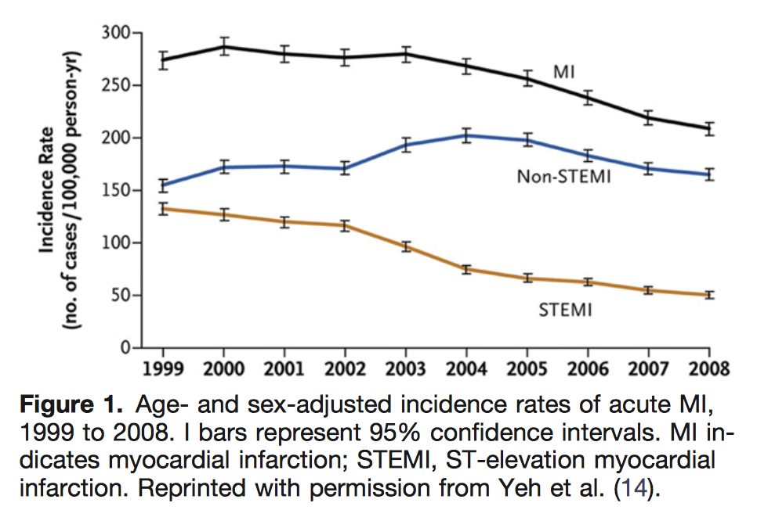

Slide 5
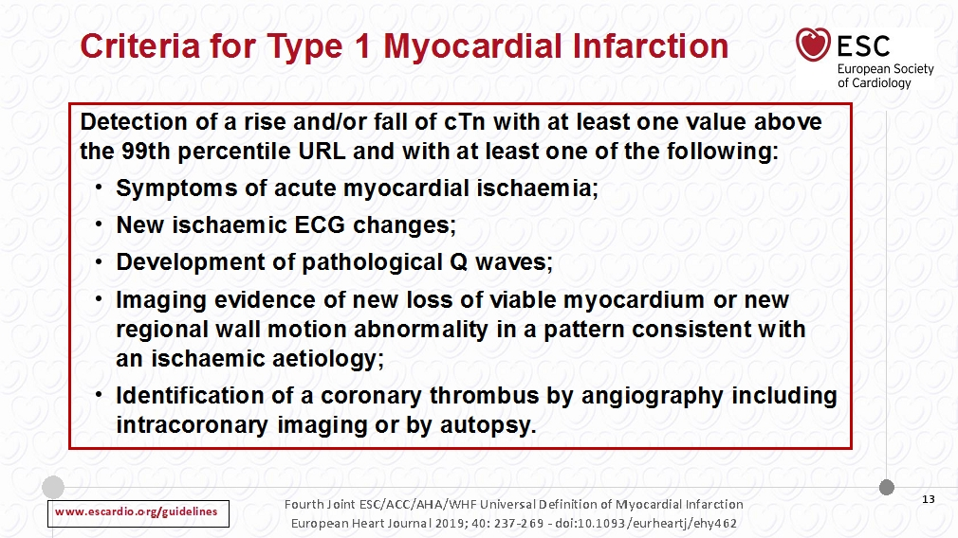

Slide 6
What is STEMI?
ST-segment Elevation Myocardial Infarction
STEMI is a type of AMI defined by characteristic
symptoms of myocardial ischaemia in association with
persistent ECG ST-segment elevation
AMI is a leading cause of death and disability worldwide
AMI, acute myocardial infarction
Thygesen K et al. J Am Coll Cardiol 2012;60:1581–98

Slide 7
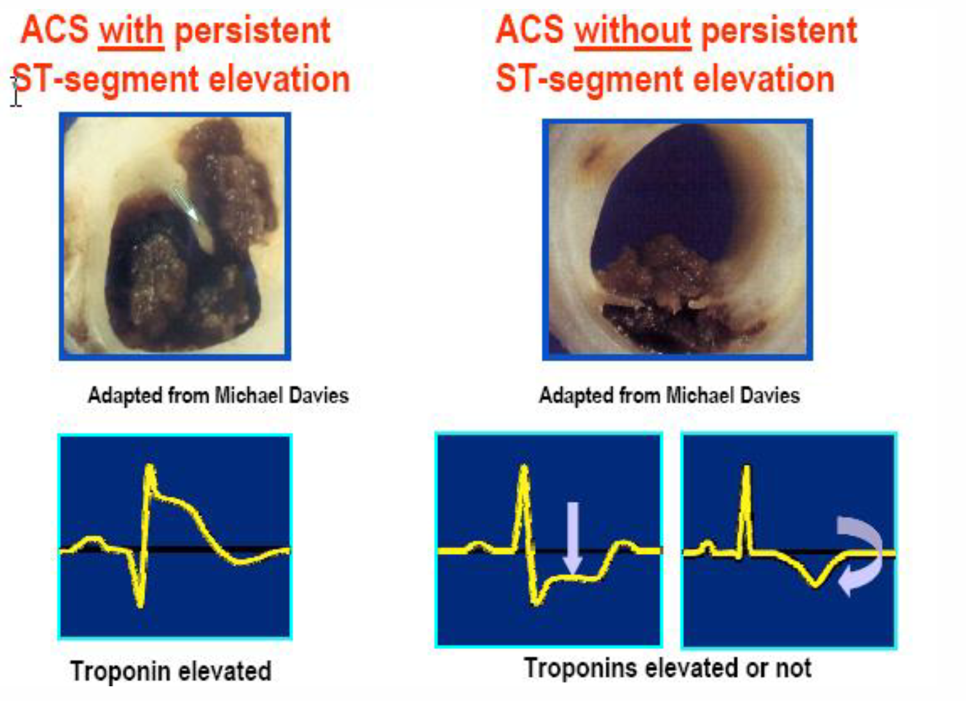
Pathophysiology of ACC

Slide 8
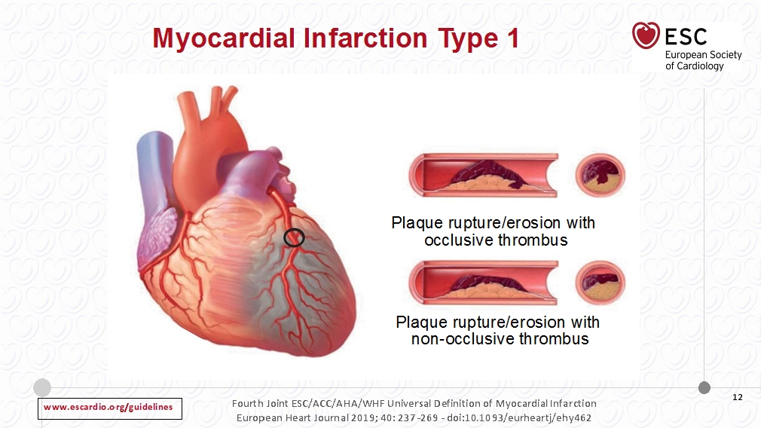

Slide 9
Diagnosis of STEMI

Slide 10
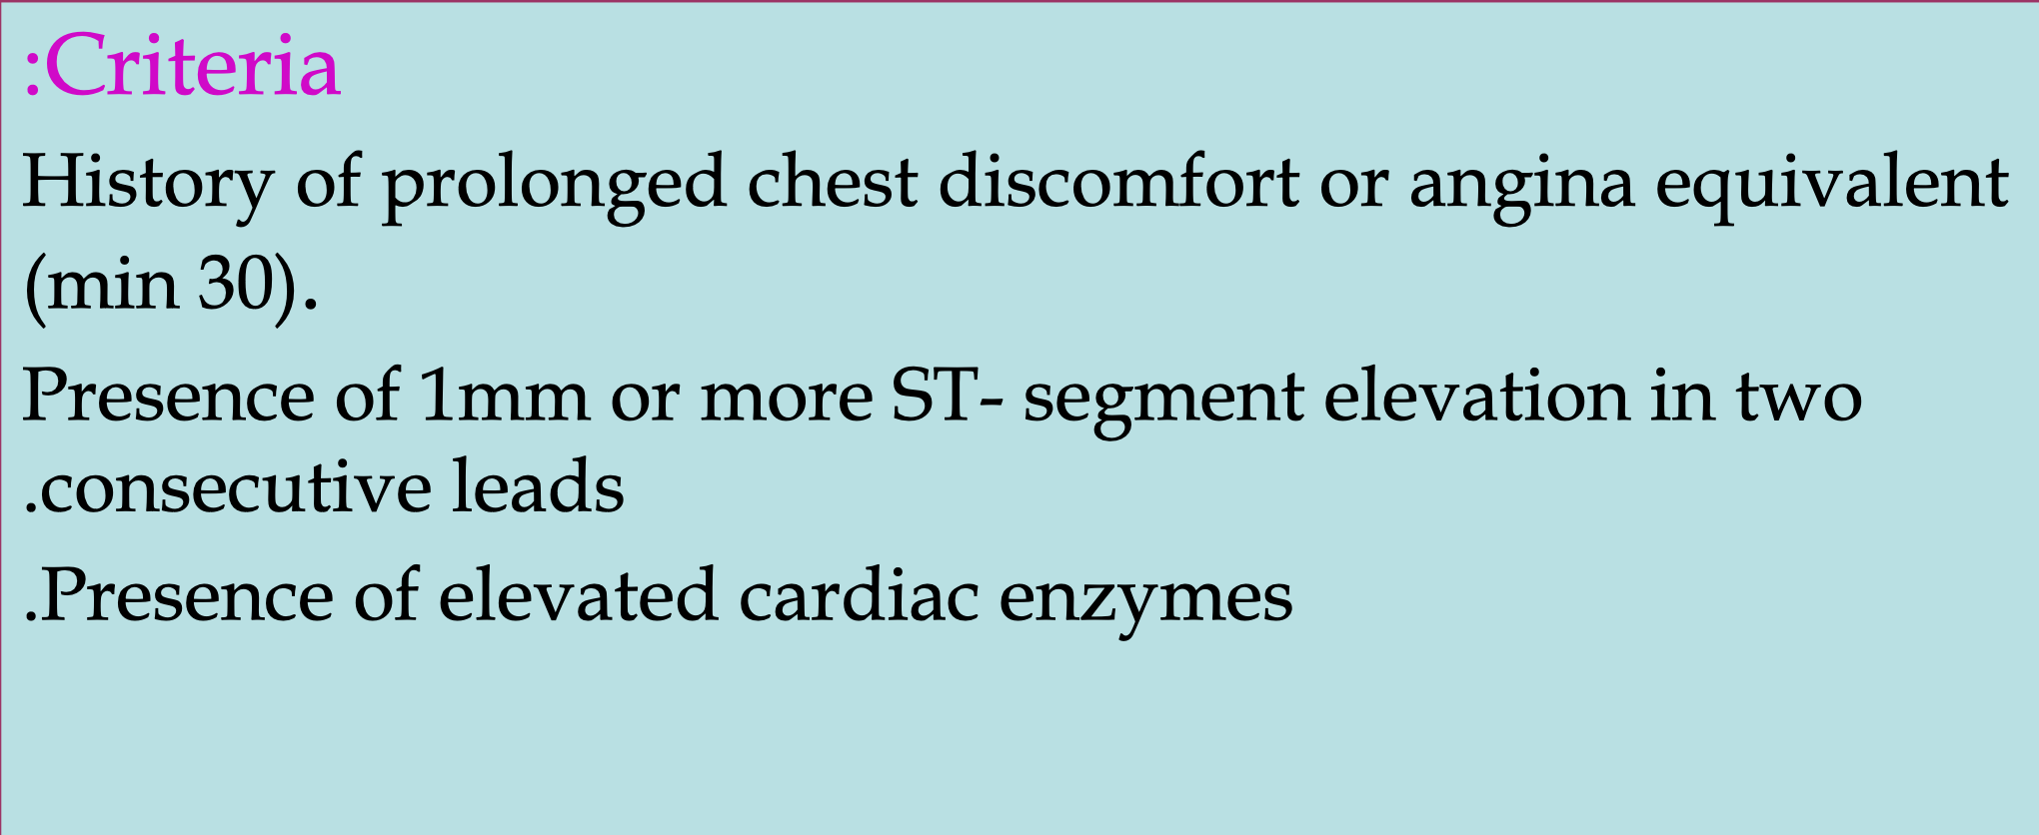
How to diagnose STEMI

Slide 11
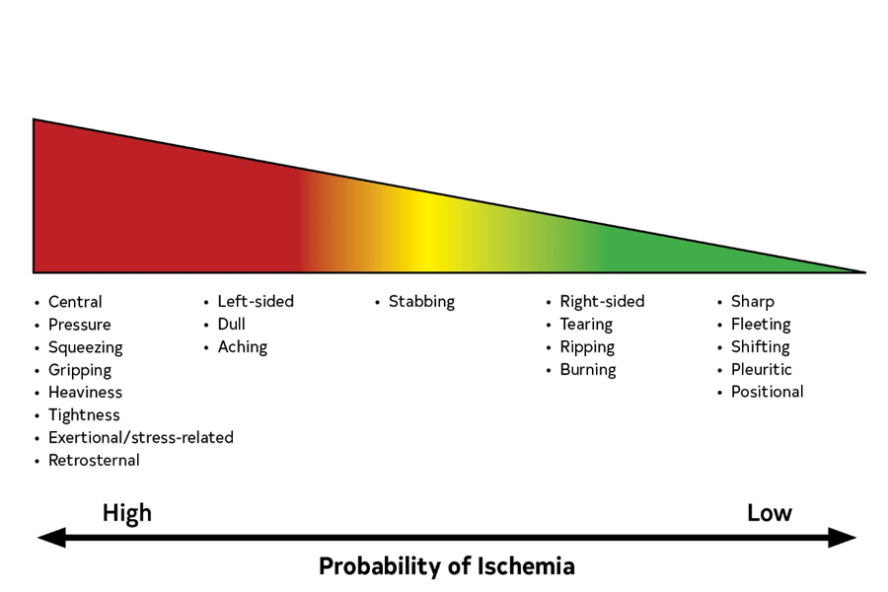
Index of Suspicion That Chest “Pain” Is Ischemic in Origin on the Basis of Commonly Used Descriptors.

Slide 12
Clinical Syndrome | Findings
Emergency
ACS | Diaphoresis, tachypnea, tachycardia, hypotension, crackles, S3, MR murmur; examination may be normal in uncomplicated cases
PE | Tachycardia + dyspnea—>90% of patients; pain with inspiration
Aortic dissection | Connective tissue disorders (e.g., Marfan syndrome), extremity pulse differential (30% of patients, type A>B) Severe pain, abrupt onset + pulse differential + widened mediastinum on CXR >80% probability of dissection Frequency of syncope >10% (8), AR 40%–75% (type A)
Esophageal rupture | Emesis, subcutaneous emphysema, pneumothorax (20% patients), unilateral decreased or absent breath sounds
Physical Examination in Patients With Chest Pain
ACS indicates acute coronary syndrome; AR, aortic regurgitation; AS, aortic stenosis; CXR, chest x-ray; LR, likelihood ratio; HCM, hypertrophic cardiomyopathy; MR, mitral regurgitation; PE, pulmonary embolism; and PUD, peptic ulcer disease.

Slide 13
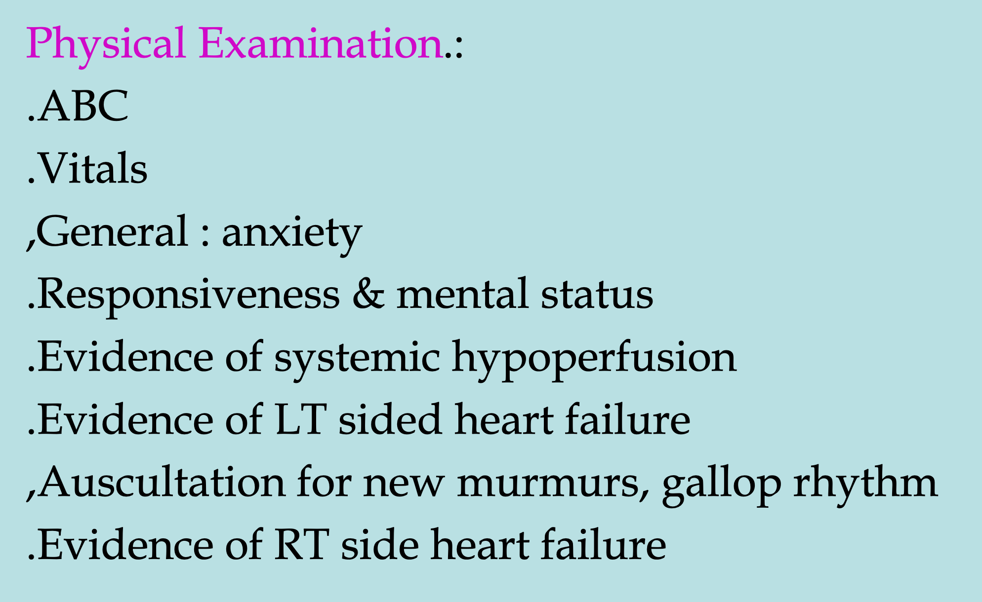
How to diagnose STEMI

Slide 14
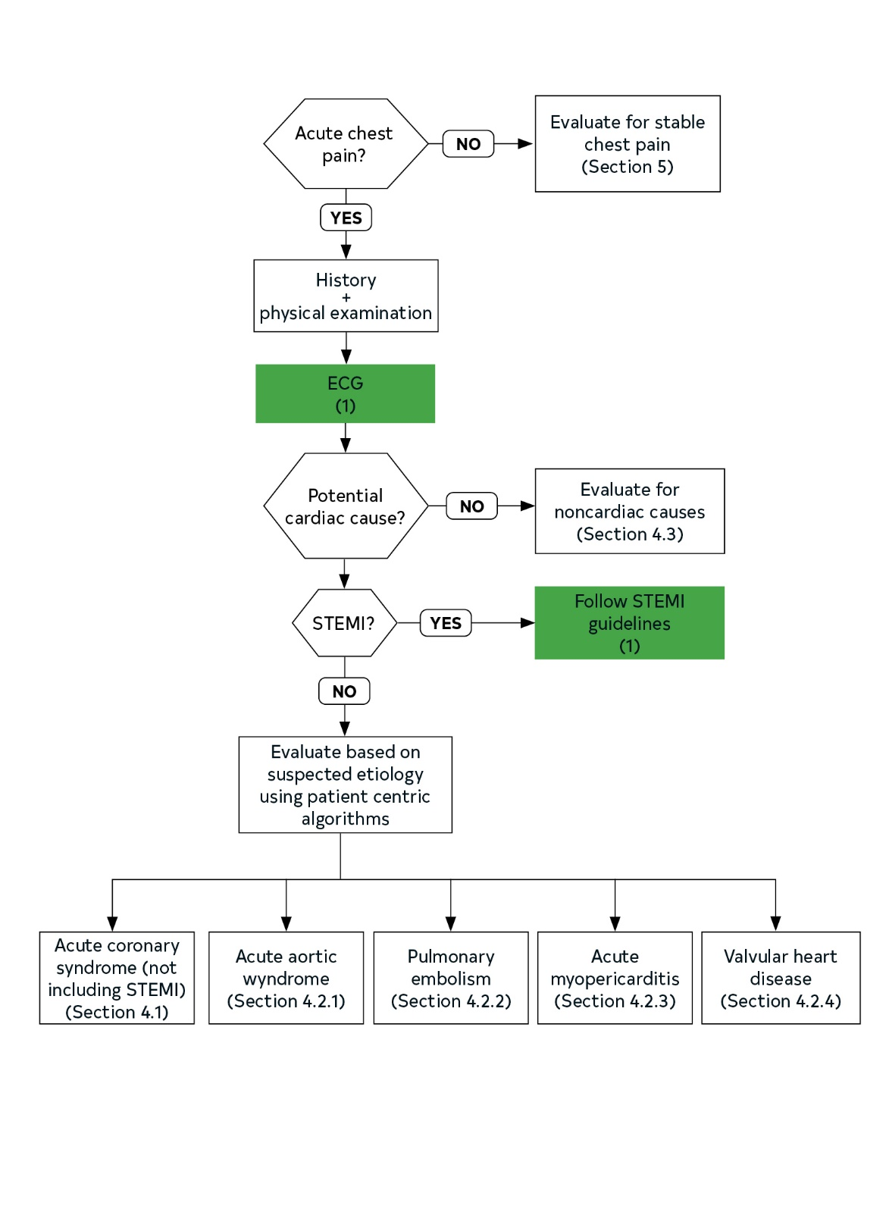
Patient-Centric Algorithms for Acute Chest Pain.
Colors correspond to the Class of Recommendation in Table 1.
ECG indicates electrocardiogram; and STEMI, ST-segment–elevation myocardial infarction.

Slide 15
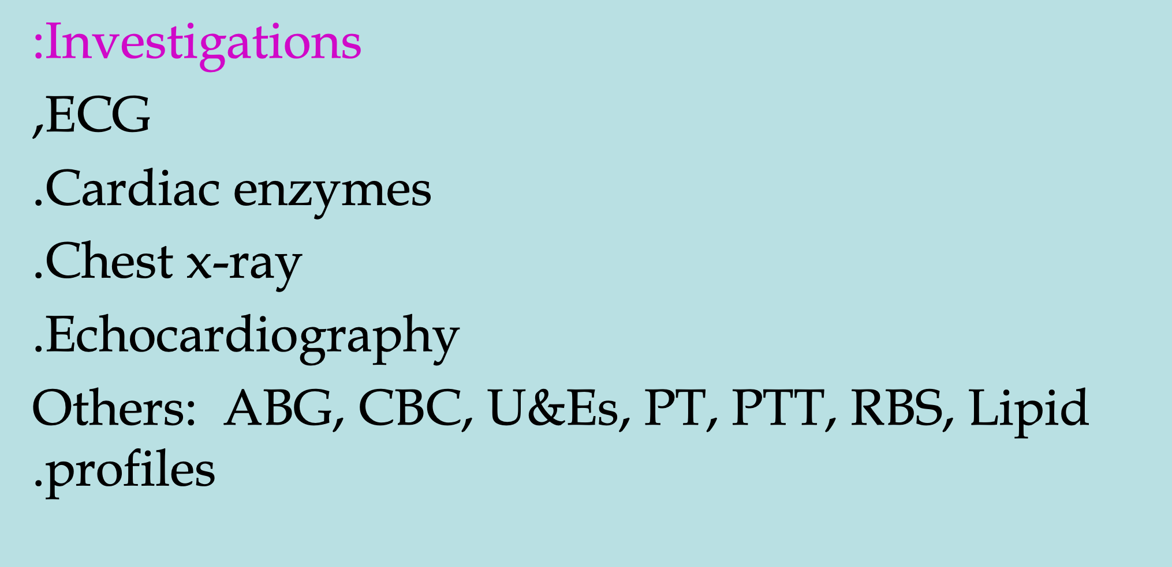
How to diagnose STEMI

Slide 16
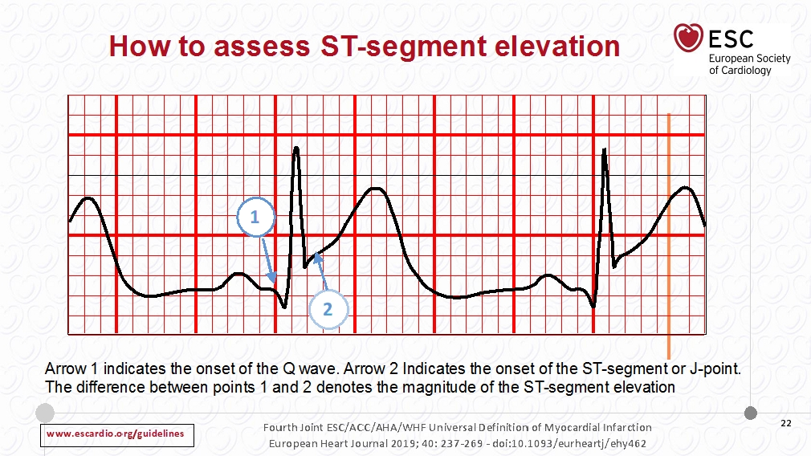

Slide 17
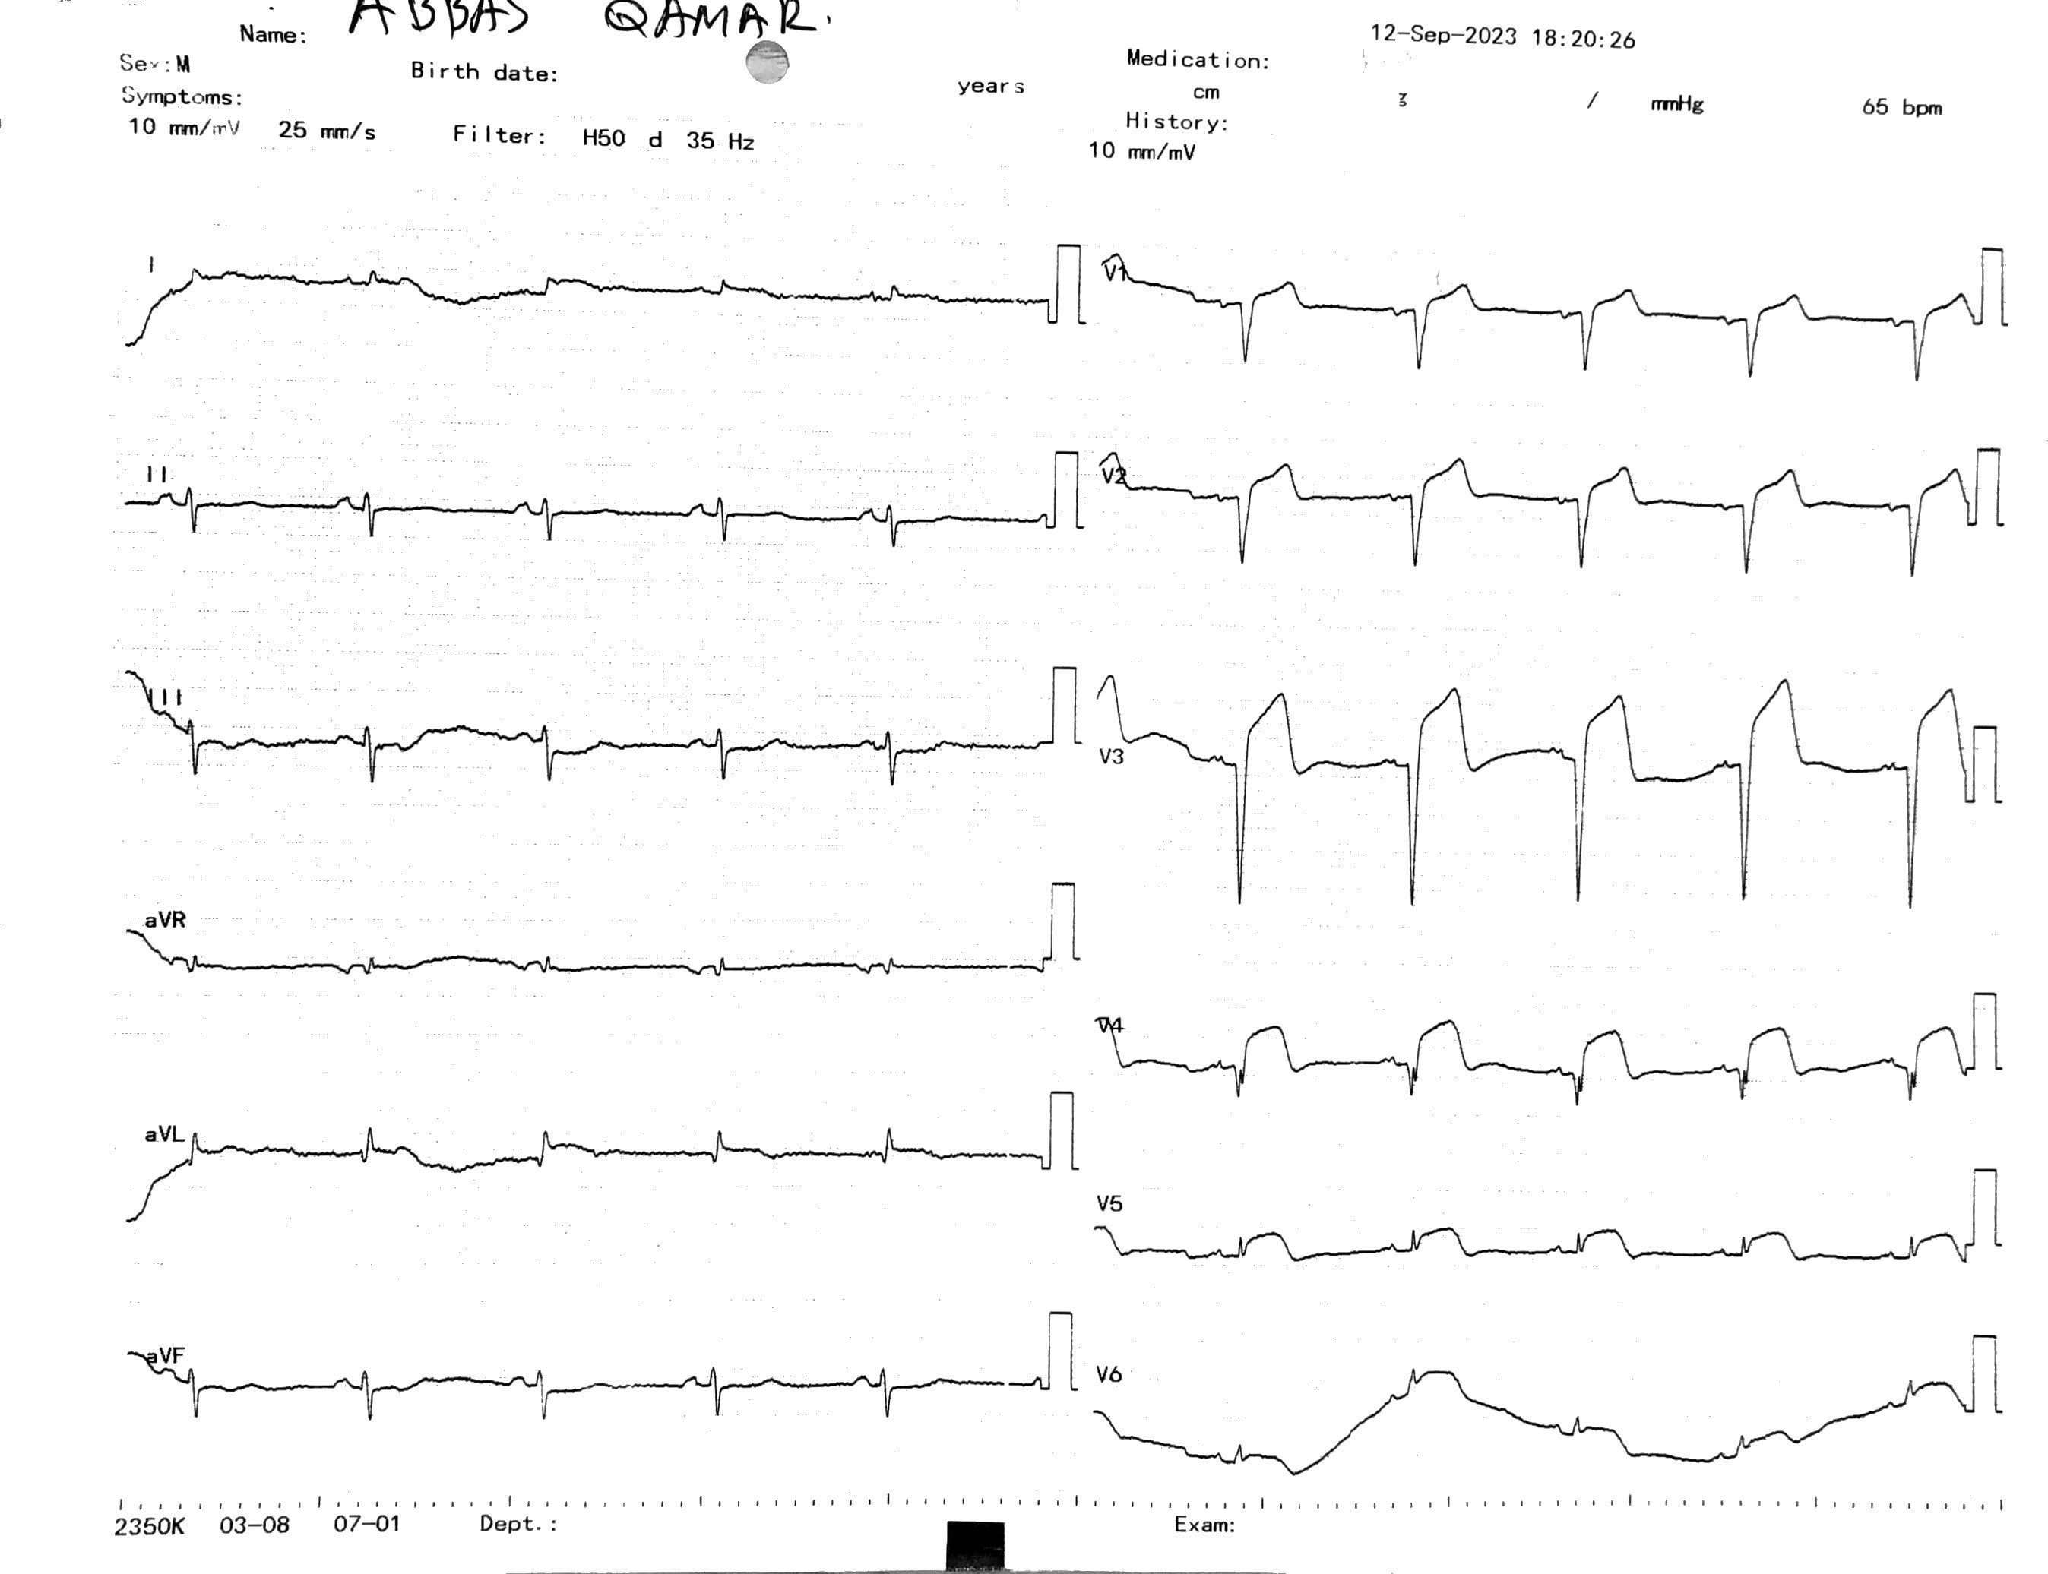

Slide 18
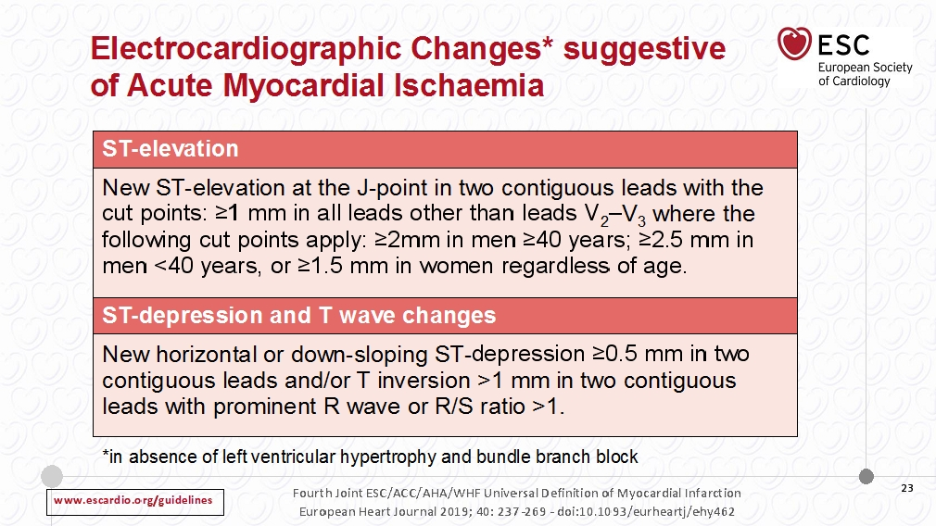

Slide 19
Diagnosis of STEMI
  STEMI is defined as persistent chest discomfort or other symptoms suggestive
  of ischaemia and ST-segment elevation in ≥2 contiguous leads
Key recommendations for initial diagnosis
At FMC*
  ECG monitoring with defibrillator capacity as soon as possible in all patients with suspected STEMI (IB)
  12-lead ECG as soon as possible (target delay ≤10 min) (IB)
  Routine sampling for serum markers as soon as possible in the acute phase, but should not delay reperfusion (IC)
*First medical contact (FMC) is defined as the time when the patient is initially assessed by a physician, paramedic, nurse or other trained EMS personnel who can obtain and interpret the ECG and deliver initial interventions, either in the pre-hospital setting or upon arrival at the hospital
Ibanez B et al. Eur Heart J 2018;39:119–77
Notes:
Some factors may hinder ECG diagnosis:
Bundle branch block
Ventricular pacing
Non-diagnostic ECG
Isolated posterior MI
Left main coronary obstruction
Additional leads may aid in the diagnosis of STEMI in some cases:
The use of additional posterior chest wall leads (V₇–V₉) in patients with high suspicion of posterior MI (circumflex occlusion) should be considered (IIa/B)
The use of additional right precordial leads (V₃R and V₄R) in patients with inferior MI should be considered to identify concomitant RV infarction (IIa/B)
Reference
Ibanez B et al. Eur Heart J 2018;39:119–77

Slide 20
Management of STEMI

Slide 21
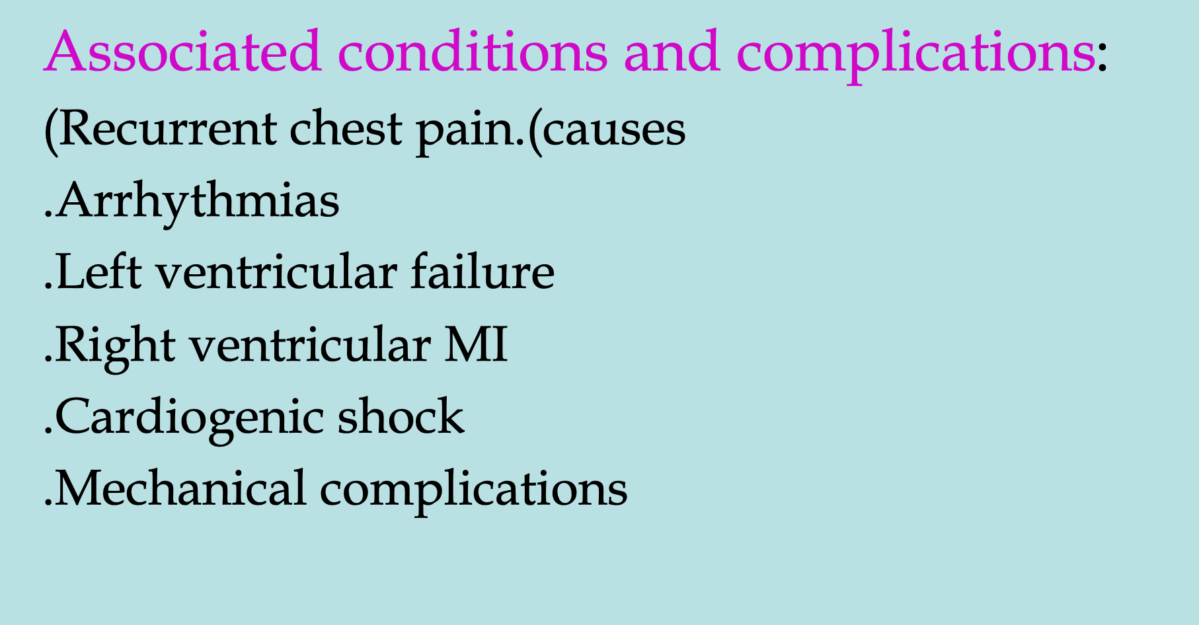
Management of STEMI

Slide 24
Reperfusion strategies in STEMI
Invasive
primary PCI
Pharmacological
induction of thrombolysis
by thrombolytic agent
Pharmaco-invasive
a combination of both approaches
Early reperfusion aims to limit the extent of myocardial damage and lead to better outcomes in patients with STEMI
PCI, percutaneous coronary intervention
Steg PG et al. Eur Heart J 2012;33:2569–619
Notes:
Reperfusion may be achieved using pharmacological or mechanical (invasive) approaches, or by a combination of both¹
In patients with suspected myocardial ischaemia and STEMI, reperfusion therapy should be started as soon as possible in order to improve the patient’s outcome¹
The European Society of Cardiology (ESC) recently published updated clinical guidelines on the management of AMI in patients presenting with ST-elevation; these 2017 guidelines include several new/revised concepts treatment strategies²
References
Steg PG et al. Eur Heart J 2012;33:2569–619
Ibanez B et al. Eur Heart J 2018;39:119–77

Slide 25

What is the impact of delayed reperfusion?
Absolute 35-day mortality reduction vs treatment delay
80
‘Golden hour’
65 lives are saved for every 1000 patients treated when the treatment is initiated within the first hour of symptom onset
60
Absolute benefit
(per 1000 treated patients)
40
20
0
0
3
6
9
12
15
18
21
24
Treatment delay (h)
Reprinted from The Lancet, Vol. 21, Boersma E, Maas AC, Deckers JW, Simoons ML, Early thrombolytic treatment in acute myocardial infarction: reappraisal of the golden hour, Pages 771–5, Copyright 1996, with permission from Elsevier.
Notes:
Time-to-treatment and mortality reduction are related
The amount of tissue salvageable in myocardial infarction is inversely related to the duration of coronary artery occlusion up to about 5 h, when myocardial ischaemia becomes irreversible
Very substantial myocardial salvage, and therefore saving of life, is possible if reperfusion therapy is started within 2 h of the onset of symptoms, and especially within the first ‘golden’ hour
During the first 2–3 h after symptom onset, time to treatment is a critical determinant of the extent of salvage and reduction in mortality. Subsequently, a benefit persists but the ‘flattening of the curve’ emphasises that time to treatment is less of a factor and the major priority is opening of the infarct-related artery
Reference
Boersma E et al. Lancet 1996;348:771–75

Slide 26
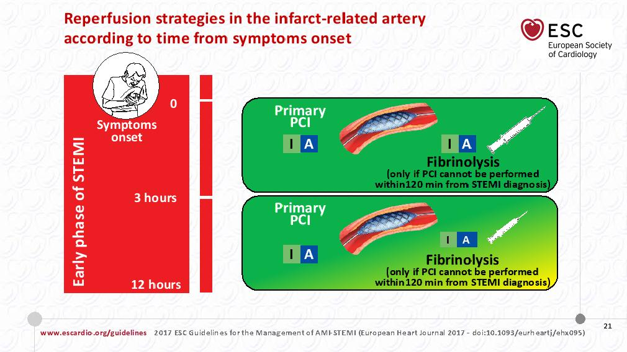

Slide 27
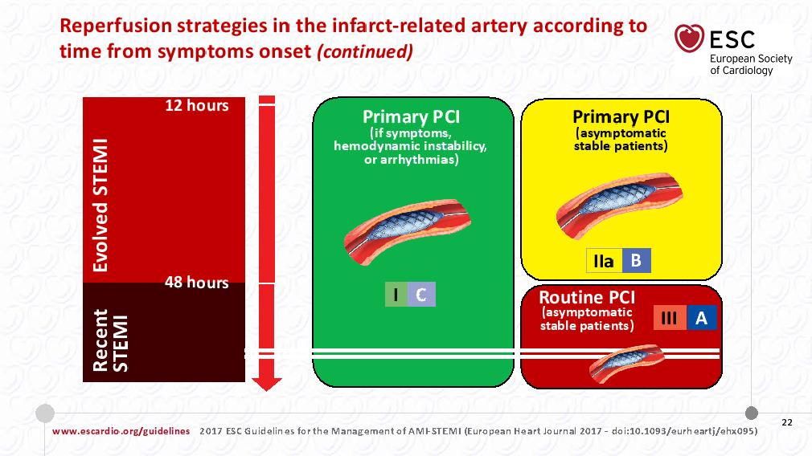

Slide 28
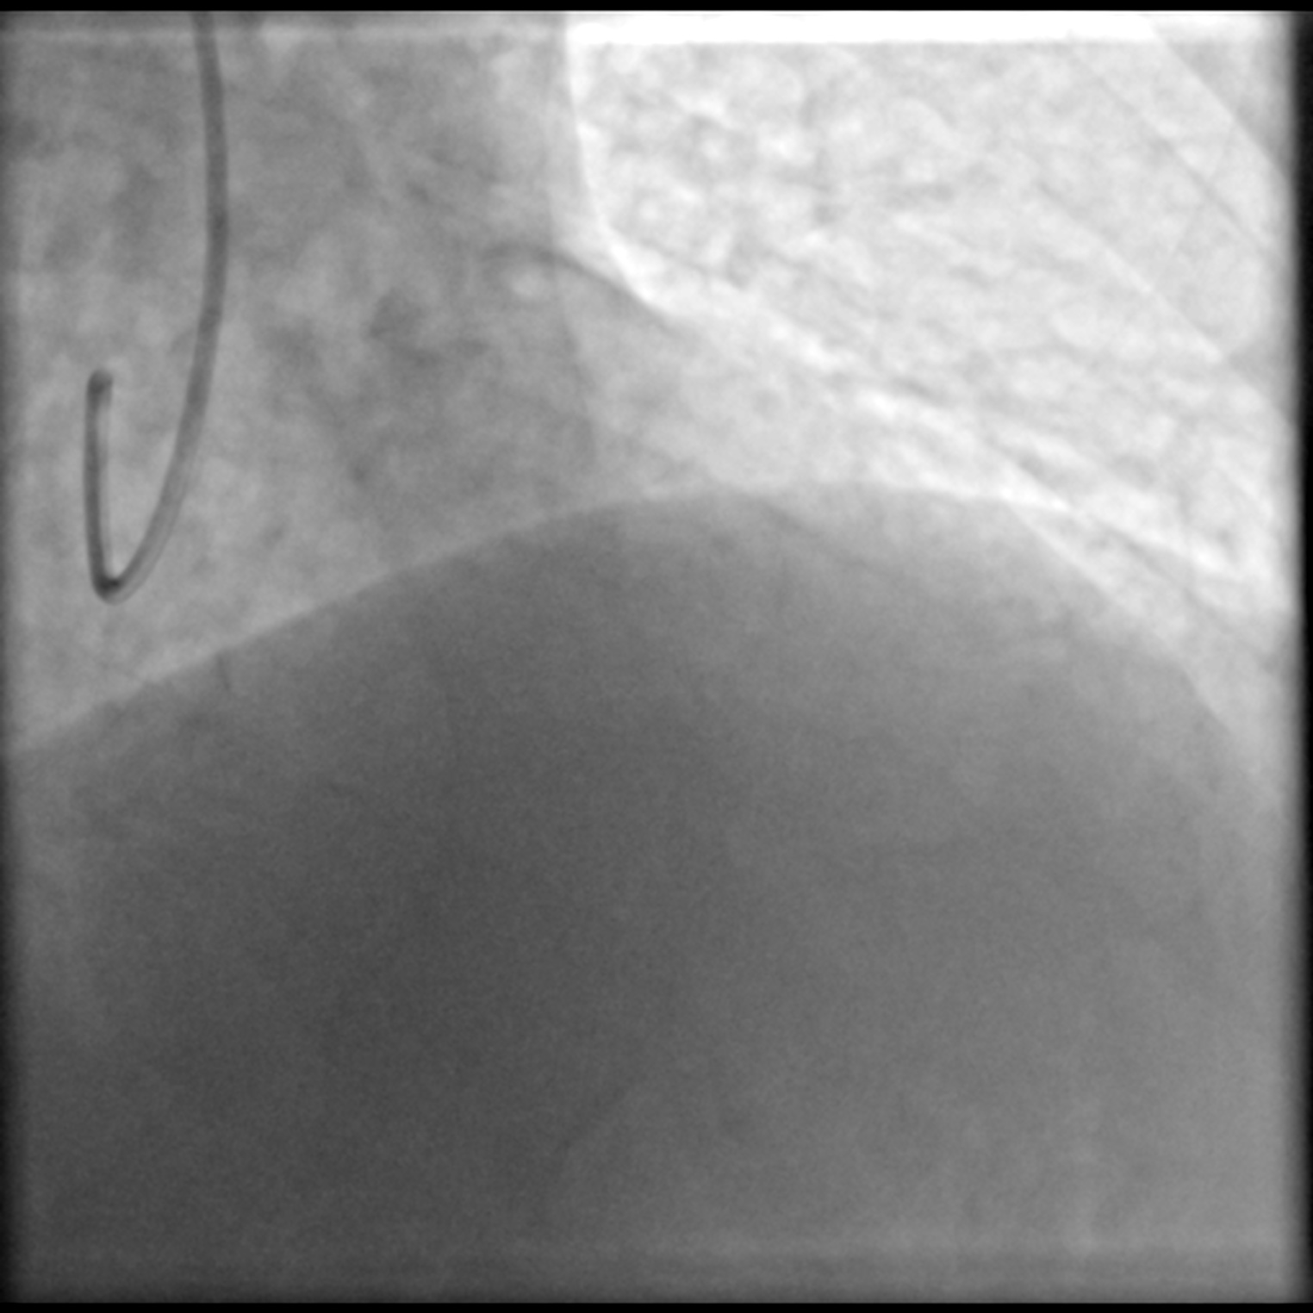
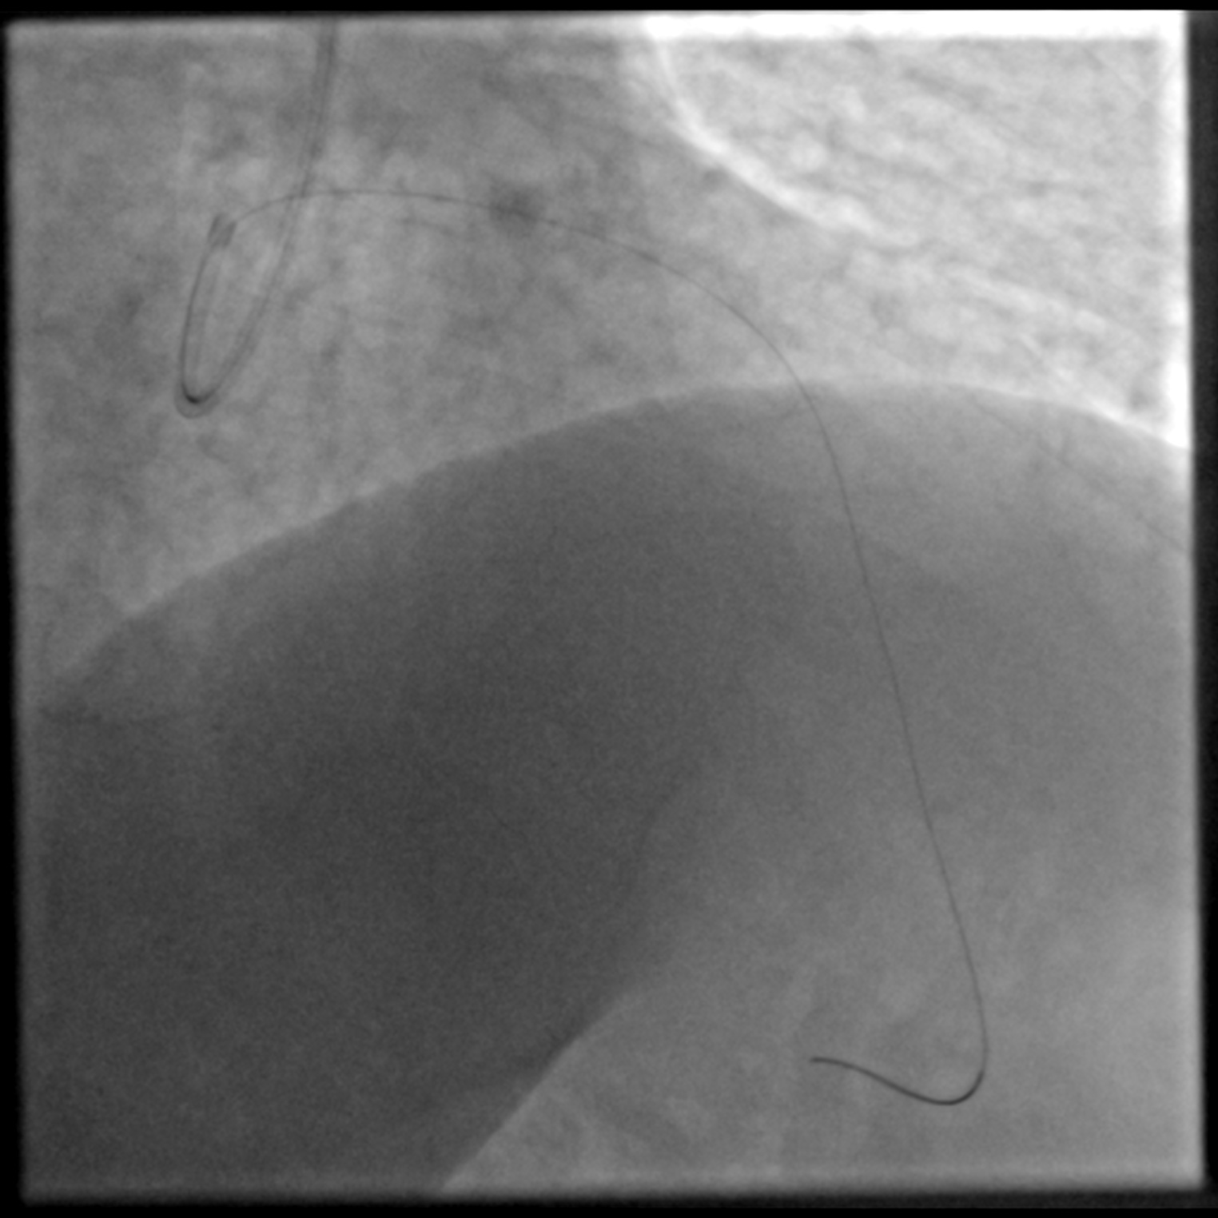
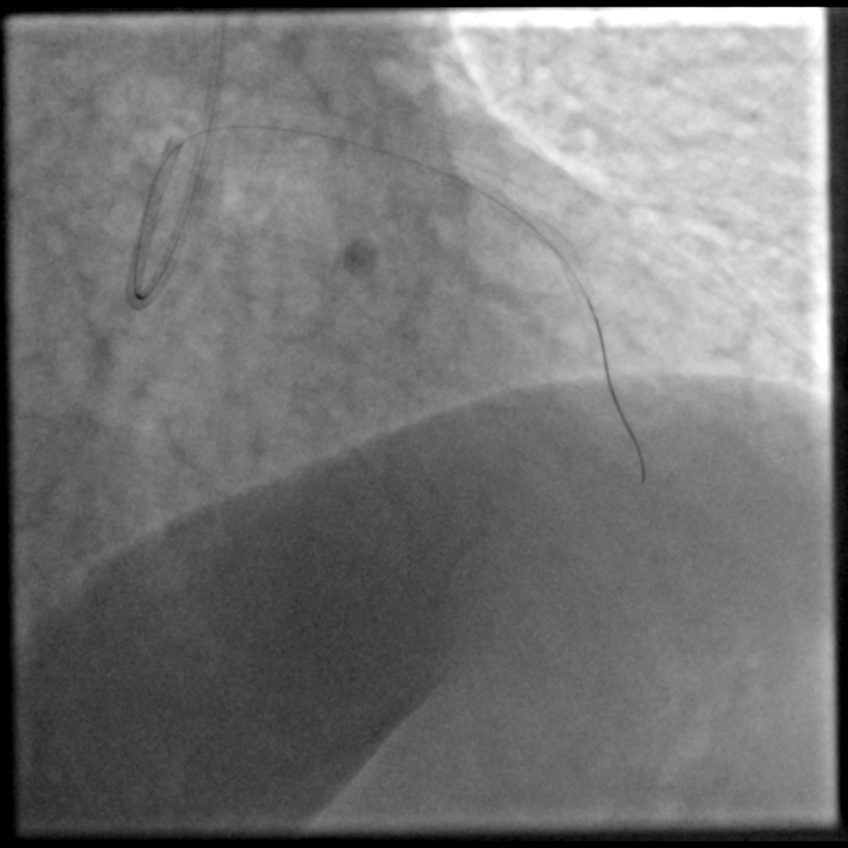
67 years old lady presenting with ongoing chest pain the last 2hours
ECG: Anterior wall ST elevation

Slide 29

What factors lead to delayed reperfusion and greater ischaemic time?
FMC
STEMI diagnosis
Strategy
Reperfusion
<90
min
≤120 min
Primary PCI
Systems are required to ensure rapid fibrinolysis before transfer to PCI centre if PCI cannot be performed within 120 min
≤10
min
Wire crossing
EMS
<10
min
Time to PCI?
>120 min
Fibrinolysis
Non-PCI centre
Lytic bolus*
≤10
min
<60
min
Primary PCI
PCI centre
Wire crossing
Patient delay
EMS/system delay
Total ischaemic time
*Patients with fibrinolysis should be transferred to a PCI centre immediately after administration of the lytic bolus
Ibanez B et al. Eur Heart J 2018;39:119–77. Adapted and reproduced with permission of Oxford University Press on behalf of the European Society of Cardiology. Please see slide notes for full reference information
Notes:
The total ischaemic time is defined as the time from onset of symptoms to successful reperfusion via PCI and/or fibrinolysis
The total ischaemic time is affected by
Patient factors (eg time taken for the patient to seek medical assistance
EMS factors (time taken for first responders to attend patient; time to transport the patient to hospital)
EMS/hospital factors (transfer from a non-PCI centre to a PCI centre)
STEMI diagnosis
Treatment
Reference
Ibanez B, et al. 2017 ESC Guidelines for the management of acute myocardial infarction in patients presenting with ST-segment elevation: The Task Force for the management of acute myocardial infarction in patients presenting with ST-segment elevation of the European Society of Cardiology (ESC), European Heart Journal (2017) 00, 1–66 doi:10.1093/eurheartj/ehx393. Adapted and reproduced with permission of Oxford University Press on behalf of the European Society of Cardiology. Oxford University Press and the ESC are not responsible or in any way liable for the accuracy of the adaptation, for any errors, omissions or inaccuracies, or for any consequences arising therefore. Boehringer Ingelheim is solely responsible for the adapted material in this work. Please visit: www.escardio.org/Guidelines/Clinical-Practice-Guidelines/Acute-Myocardial-Infarction-in-patients-presenting-with-ST-segment-elevation-Ma. Boehringer Ingelheim was not involved in the development of this ESC Guidelines article and in no way influenced its content.

Slide 33
PCI may be indicated or necessary after fibrinolysis
  All patients should be transferred to a PCI-capable centre immediately after fibrinolysis (IA)
  Emergency angiography and PCI in patients with heart failure or shock (IA)
Fibrinolysis successful?
Yes
No
  Angiography and PCI of the IRA, if indicated, at 2–24 h (IA)
  Rescue PCI is indicated immediately when fibrinolysis has failed (<50% ST‑segment resolution at 60–90 min) or at any time in the presence of haemodynamic or electrical instability, or worsening ischaemia (IA)
  Emergency angiography and PCI in case of recurrent ischaemia or re-occlusion (IB)
Ibanez B et al. Eur Heart J 2018;39:119–77
Notes:
This slide summarizes the recommendations for post-fibrinolytic management of STEMI patients
It is particularly important that all patients are immediately transferred to a PCI centre after fibrinolysis
If fibrinolysis is successful, PCI should be performed if indicated and in patients with recurrent ischaemia or re-occlusion
Rescue PCI should be performed promptly if fibrinolysis was unsuccessful
Emergency PCI may be necessary/indicated in patients with heart failure/shock
Reference
Ibanez B et al. Eur Heart J 2018;39:119–77

Slide 34
Seeking to minimize delayed reperfusion in pre-hospital settings
Key recommendations
Any reperfusion strategy
Pre-hospital management should be based on regional networks to deliver reperfusion quickly and effectively, and to make primary PCI available to as many patients as possible (IB)
Ambulance teams should transfer STEMI patients to a PCI-capable centre, bypassing non-PCI centres (IC)
Patients should be transferred directly to the catheterization lab (IB)
Primary PCI centres should deliver a 24/7 service (IB)
Pharmaco-invasive strategy
Pre-hospital fibrinolysis is recommended if primary PCI cannot be performed within 120 min from STEMI diagnosis*(1A)
Ambulance teams should be equipped to identify STEMI and administer fibrinolysis where applicable (IC)
*Within 12 h of symptom onset
Ibanez B et al. Eur Heart J 2018;39:119–77

Slide 35
Summary of important time targets
in acute STEMI
Maximum delay/intervals | Time targets
FMC to ECG and diagnosis | ≤10 min
STEMI diagnosis to primary PCI (wire crossing) – if this cannot be met, consider fibrinolysis | ≤120 min
STEMI diagnosis to wire crossing in patients presenting at primary PCI hospitals | ≤60 min
STEMI diagnosis to wire crossing in transferred patients | ≤90 min
STEMI diagnosis to fibrinolysis in patients for whom primary PCI target time cannot be met | ≤10 min
Start of fibrinolysis to evaluation of its efficacy (success or failure) | 60–90 min
Start of fibrinolysis to angiography (if fibrinolysis is successful) | 2─24 h
Ibanez B et al. Eur Heart J 2018;39:119–77. Adapted and reproduced with permission of Oxford University Press on behalf of the European Society of Cardiology. Please see slide notes for full reference information
Notes:
Key target times for the diagnosis and initiation of reperfusion therapy in STEMI patients
If performed, fibrinolysis should be started ≤10 min after the diagnosis of STEMI and its efficacy should be determined
60–90 min later
If fibrinolysis was successful, angiography should be performed
2–24 h later
Reference
Ibanez B, et al. 2017 ESC Guidelines for the management of acute myocardial infarction in patients presenting with ST-segment elevation: The Task Force for the management of acute myocardial infarction in patients presenting with ST-segment elevation of the European Society of Cardiology (ESC), European Heart Journal (2017) 00, 1–66 doi:10.1093/eurheartj/ehx393. Adapted and reproduced with permission of Oxford University Press on behalf of the European Society of Cardiology. Oxford University Press and the ESC are not responsible or in any way liable for the accuracy of the adaptation, for any errors, omissions or inaccuracies, or for any consequences arising therefore. Boehringer Ingelheim is solely responsible for the adapted material in this work. Please visit: www.escardio.org/Guidelines/Clinical-Practice-Guidelines/Acute-Myocardial-Infarction-in-patients-presenting-with-ST-segment-elevation-Ma. Boehringer Ingelheim was not involved in the development of this ESC Guidelines article and in no way influenced its content.

Slide 36
Primary PCI procedures
Infarct-related artery (IRA)
Non-IRA
Strategy
Primary PCI of the IRA
is indicated (IA)
For patients with signs
of recurrent/remaining ischaemia after primary PCI, new coronary angiography is recommended (IC)
Technique
Stenting recommended over balloon angioplasty (IA)
DES recommended over BMS (IA)
Radial access recommended over femoral access (IA)
Strategy
Revascularization of non-IRA should be considered in STEMI patients with multivessel disease (IIa/A)
BMS, bare-metal stent; DES, drug-eluting stent
Ibanez B et al. Eur Heart J 2018;39:119–77
Notes:
Recommendations for primary PCI encompass the strategy and technique for treating the IRA, as well as the strategy for managing non-IRAs in patients with STEMI
IRA strategies include:
Primary PCI of the IRA (IA)
New coronary angiography with PCI in patients with symptoms or signs of recurrent/remaining ischaemia after primary PCI (IC)
Recommended IRA techniques include:
Stenting (instead of balloon angioplasty) for primary PCI (IA)
Stenting with a new-generation DES (rather than a BMS) for primary PCI (IA)
Radial access (rather than femoral access) (IA)
Routine thrombus aspiration (IIIA) and deferred stenting (IIIB) are not recommended IRA techniques
Non-IRA strategies include
Routine revascularization of non-IRA lesions in STEMI patients with multivessel disease before hospital discharge (IIa/A)
Non-IRA PCI should be considered during the index procedure in patients with cardiogenic shock (IIa/C)
Coronary artery bypass graft surgery should be considered in patients with ongoing ischaemia and large areas of jeopardized myocardium if PCI of the IRA cannot be performed (IIa/C)
Reference
Ibanez B et al. Eur Heart J 2018;39:119–77

Slide 38
Fibrinolysis and pharmaco-invasive strategy
Key recommendations
  Fibrinolysis should be initiated as soon as possible after STEMI diagnosis, preferably in the pre-hospital setting (IA)
  A fibrin-specific agent (ie alteplase, reteplase or tenecteplase) is recommended (IB)
  The fibrinolytic bolus should be administered within 10 min of STEMI diagnosis*
  A half-dose of tenecteplase should be considered in patients ≥75 years old (IIa/B)
*Alteplase is injected as an initial bolus over 1 min followed by infusion over 60 min, reteplase is injected as two boluses 30 min apart, and tenecteplase is injected as a single bolus over ~10 s
Ibanez B et al. Eur Heart J 2018;39:119–77
Notes:
This slide summarizes the key recommendations for fibrinolysis and the pharmaco-invasive strategy
Of particular note, if fibrinolysis is the chosen strategy, it should be initiated as soon as possible (ideally within 10 min) after STEMI diagnosis
The fibrinolytic bolus may need to be administered in pre-hospital settings by the first medical contact (eg ambulance staff)
Reference
Ibanez B et al. Eur Heart J 2018;39:119–77

Slide 39
Contraindications to fibrinolysis
Absolute contraindications
Relative contraindications
Prior intracranial haemorrhage or stroke
of unknown origin at anytime
Ischaemic stroke previous 6 months
CNS damage or neoplasms or arteriovenous malformation
GI bleeding within the past month
Known bleeding disorder (except menses)
Aortic dissection
Non-compressible punctures in past 24 h
(eg liver biopsy, lumbar puncture)
TIA in previous 6 months
Oral anticoagulant therapy
Pregnancy or 1 week postpartum
Refractory hypertension (SBP >180 mmHg and/or DBP >110 mmHg)
Advanced liver disease
Infective endocarditis
Active peptic ulcer
Prolonged or traumatic resuscitation
Ibanez B et al. Eur Heart J 2018;39:119–77. Adapted and reproduced with permission of Oxford University Press on behalf of the European Society of Cardiology. Please see slide notes for full reference information
Notes:
Reference
Ibanez B, et al. 2017 ESC Guidelines for the management of acute myocardial infarction in patients presenting with ST-segment elevation: The Task Force for the management of acute myocardial infarction in patients presenting with ST-segment elevation of the European Society of Cardiology (ESC), European Heart Journal (2017) 00, 1–66 doi:10.1093/eurheartj/ehx393. Adapted and reproduced with permission of Oxford University Press on behalf of the European Society of Cardiology. Oxford University Press and the ESC are not responsible or in any way liable for the accuracy of the adaptation, for any errors, omissions or inaccuracies, or for any consequences arising therefore. Boehringer Ingelheim is solely responsible for the adapted material in this work. Please visit: www.escardio.org/Guidelines/Clinical-Practice-Guidelines/Acute-Myocardial-Infarction-in-patients-presenting-with-ST-segment-elevation-Ma. Boehringer Ingelheim was not involved in the development of this ESC Guidelines article and in no way influenced its content.

Slide 41
Peri- and post-procedural antithrombotic therapy in PCI
Key recommendations: antiplatelet therapy
Potent P2Y₁₂ inhibitor before PCI and maintained over 12 months (IA)
ASA as soon as possible (IB)
GP IIb/IIIa inhibitors considered for ‘bailout’ if no-reflow or thrombotic complications (IIa/C)
Key recommendations: anticoagulant therapy
Anticoagulation for all patients in addition to antiplatelet therapy during primary PCI (IC)
Routine use of UFH is recommended (IC)
ASA, acetylsalicylic acid (aspirin); GP IIb/IIIa, glycoprotein IIb/IIIa inhibitors; UFH, unfractionated heparin
Ibanez B et al. Eur Heart J 2018;39:119–77
Notes:
Peri-procedural and post-procedural antithrombotic therapy is an integral part of the management of STEMI patients, and should include antiplatelet and/or anticoagulant therapy
Dose adjustments may be necessary for antiplatelet and anticoagulant therapies in patients undergoing fibrinolysis
Reference
Ibanez B et al. Eur Heart J 2018;39:119–77

Slide 42
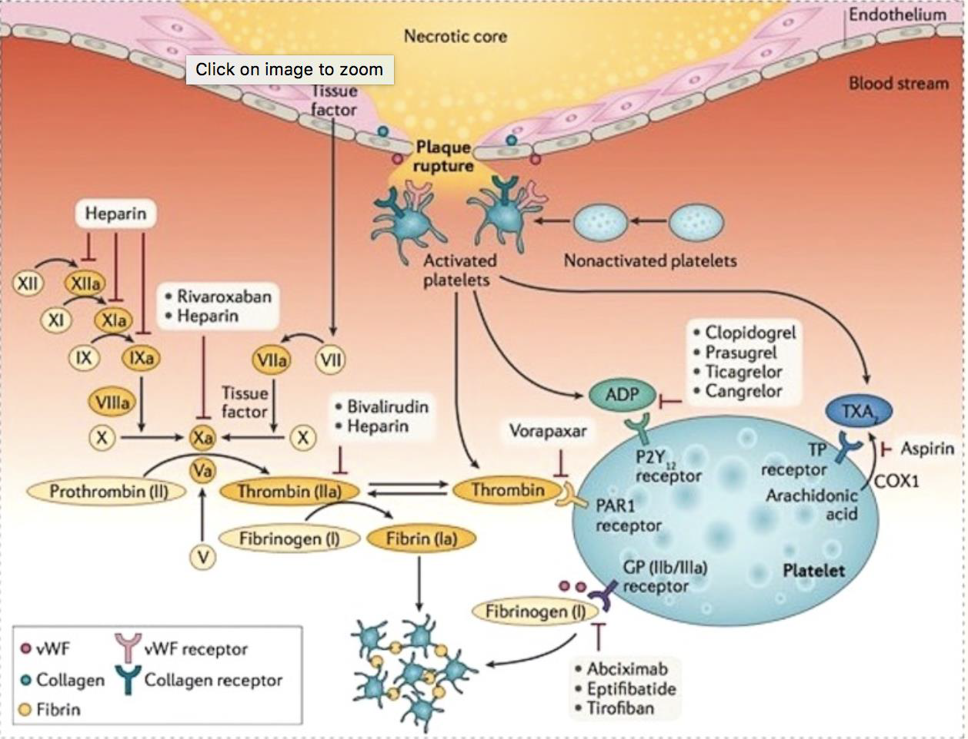

Slide 43
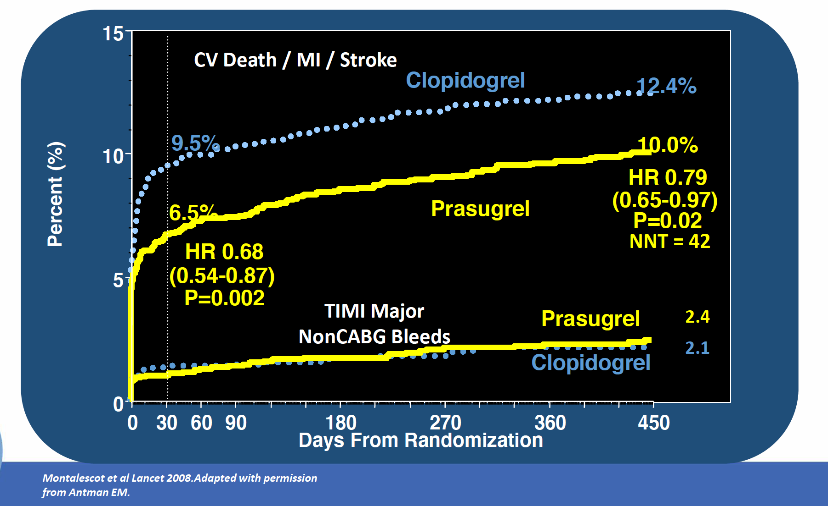
Prasugrel – TRITON TIMI 38

Slide 44
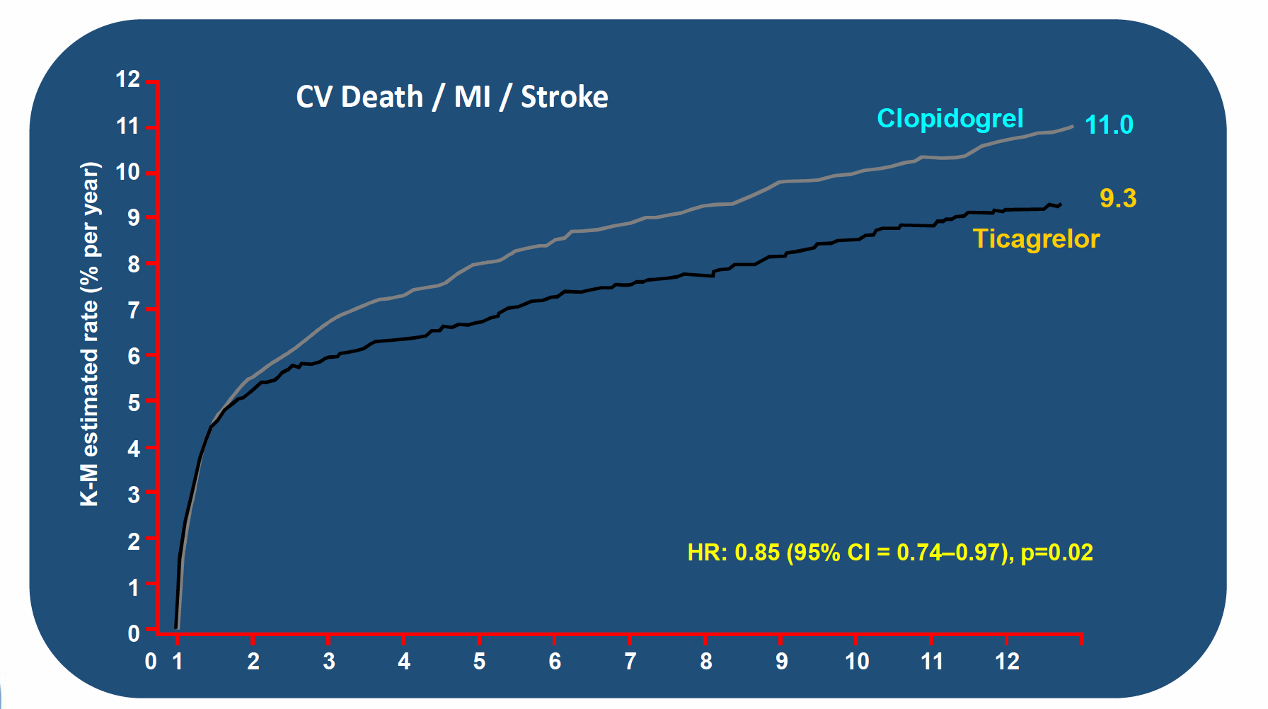
Ticagrelor – PLATO

Slide 50
What about long-term…?

Slide 53
Supplemental Therapies
• Bed rest
• Continuous ECG Monitoring
• Supplemental O2 to maintain SaO2 >90%
• NTG (IV or PO as dictated clinically)
• Beta-blockers (PO and/or IV) (Class I, LOE B)
• IV Morphine (May impair absorption of P2Y12 inhibitors)
• ACEI for persistent hypertension in patients with LV systolic
dysfunction or CHF (Class I, LOE A)
• Aldosterone antagonist for LV dysfunction and HF or DM
• High intensity statin therapy (Class I, LOE B)

Slide 56
Thank you!

