Slide 1


ΠΡΟΓΡΑΜΜΑ ΜΕΤΑΠΤΥΧΙΑΚΩΝ ΣΠΟΥΔωΝ
"ΚΑΡΔΙΟΜΕΤΑΒΟΛΙΚΗ ΙΑΤΡΙΚΗ"
Μεταβολeς στο ενεργειακo υπoστρωμα των κυττaρων στηn καρδιακη ανεπαρκεια
Georgios Georgiopoulos
Αssist. Professor, Second Department of Cardiology, School of Medicine, National and Kapodistrian University of Athens
Clinical Lecturer (hon), Institute of Cardiovascular Sciences, UCL, UK
Lecturer (vis.), School of Biomedical Engineering and Imaging Sciences, King’s College London, UK

Slide 2
CONTENTS
Energy metabolism in the healthy heart
Energy metabolism in heart failure
Energy metabolism in heart failure with reduced ejection fraction
Energy metabolism in heart failure with preserved ejection fraction
Lipotoxicity
Insulin Resistance
Therapeutic opportunities
Conclusions

Slide 3
Nonstandard Abbreviations and Acronyms
LIVCS branched chain amino acid\cation sym-porter family
LV left ventricle
LVAD LV assist device
LVH LV hypertrophy
MCAD medium chain acyl CoA dehydrogenase
MCD malonyl CoA decarboxylase
MCT1 monocarboxylate transporter 1
ME1 malic enzyme 1
Mfn1 mitofusin 1
Mfn2 mitofusin 2
MPC mitochondrial pyruvate carrier
mTOR mammalian target of rapamycin
NAD nicotinamide adenine dinucleotide
NADPH nicotinamide adenine dinucleotide
phosphate
NAMPT nicotinamide phosphoribosyl transferase
NMNAT nicotinic acid mononucleotide
adenyltransferase
NRF-1 nuclear respiratory factor-1
NRF-2 nuclear respiratory factor-2
NRK nicotinamide riboside kinase
PARP poly (ADP-ribose) polymerase
PDH pyruvate dehydrogenase
PDK4 PDH kinase 4
PFK-1 phosphofructokinase 1
PFK-2 phosphofructokinase 2
PKM pyruvate kinase
PPARγ peroxisome proliferator activator receptor γ
PPC2m protein phosphatase C2m
ROS reactive oxygen species
SCOT succinyl-CoA:3 oxoacid-CoA transferase
SGLT2 sodium/glucose co-transporter 2
Sirt3 sirtuin 3
SLC16A1 monocarboxylate ketone transporter
T2D type 2 diabetes
TAC transverse aortic constriction
TCA tricarboxylic acid
VLDL very low-density lipoprotein
βOHB β-hydroxybutyrate
ACC acetyl CoA carboxylase
Akt protein kinase B
AMPK AMP-activated protein kinase
BCAA branched chain amino acid
BCATm mitochondrial branched chain aminotransferase
BCKA branched chain α-keto-acids
BCKDH branched chain α-keto acid dehydrogenase
BDH1 β-hydroxybutyrate dehydrogenase 1
BDK BCKDH kinase
CD36 cluster of differentiation 36
CD38 cluster of differentiation 38
CK creatine kinase
CoA coenzyme
CPT-1 carnitine palmitoyl transferase-1
DNMT3A DNA methyltransferase 3A
Drp1 dynamin-related protein 1
ERK extracellular signal-regulated kinase
FADH2 flavin adenine dinucleotide
FATP-1 fatty acid transport protein-1
Fis1 mitochondrial fission 1 protein
FOXM1 forkhead box protein M1
G6P glucose 6-phosphate
GCGR glucagon receptor
GLUT1 glucose transporter 1
GLUT4 glucose transporter 4
HBP hexosamine biosynthetic pathway
HDAC histone deacetylase
HF heart failure
HFpEF heart failure with preserved ejection
fraction
HFrEF heart failure with reduced ejection
fraction
IRS insulin receptor substrate
LDH lactate dehydrogenase

Slide 4
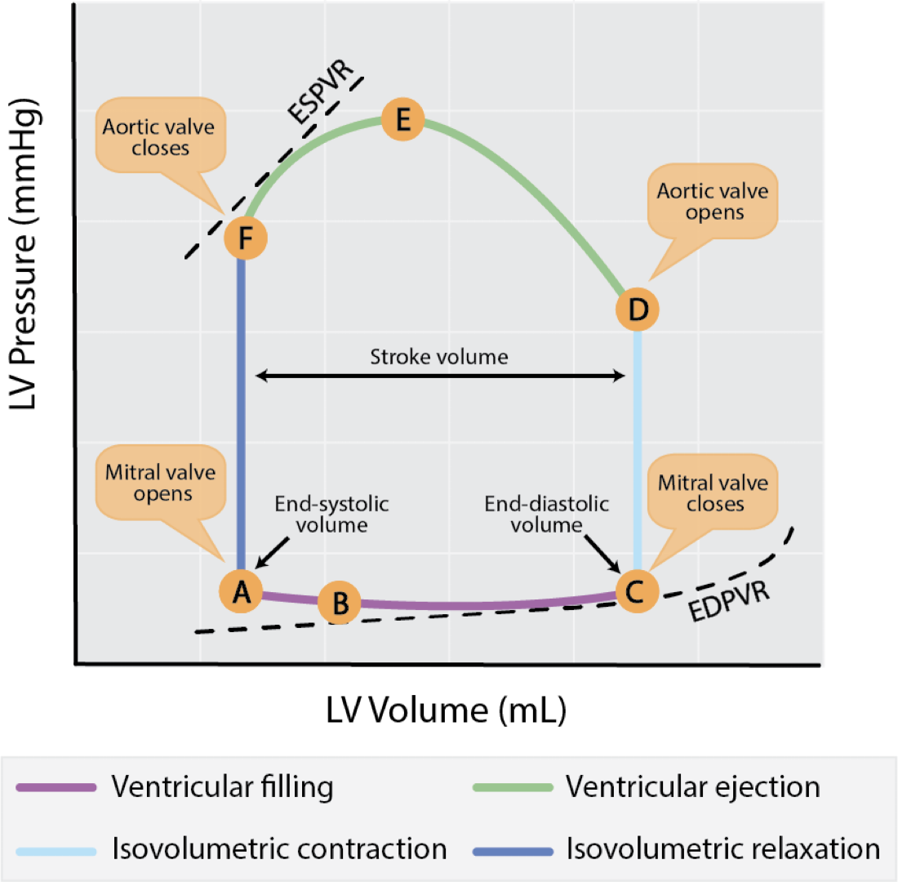
HUMAN PHYSIOLOGY: From cells to death (Ninth edition), Lauralee Sherwood

Slide 5
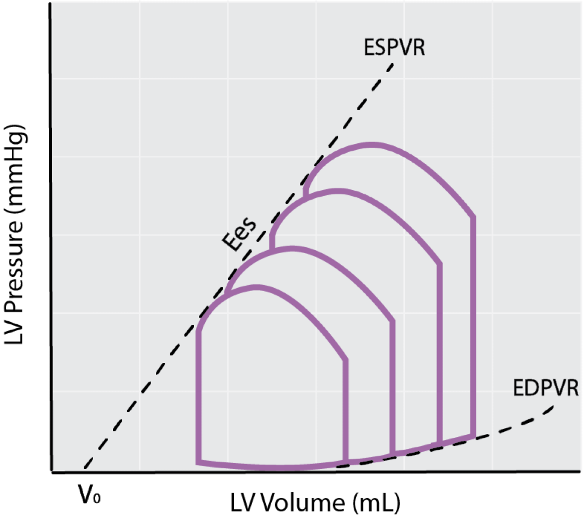
HUMAN PHYSIOLOGY: From cells to death (Ninth edition), Lauralee Sherwood
Notes:
This implies that the PV loop cannot cross over the line defining ESPVR for any given contractile state. The slope of ESPVR (Ees) represents the end-systolic elastance, which provides an index of myocardial contractility.

Slide 6
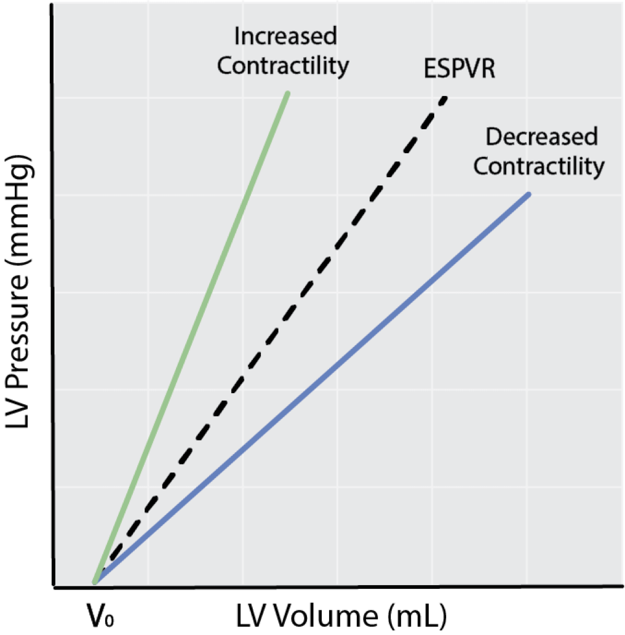
HUMAN PHYSIOLOGY: From cells to death (Ninth edition), Lauralee Sherwood

Slide 7
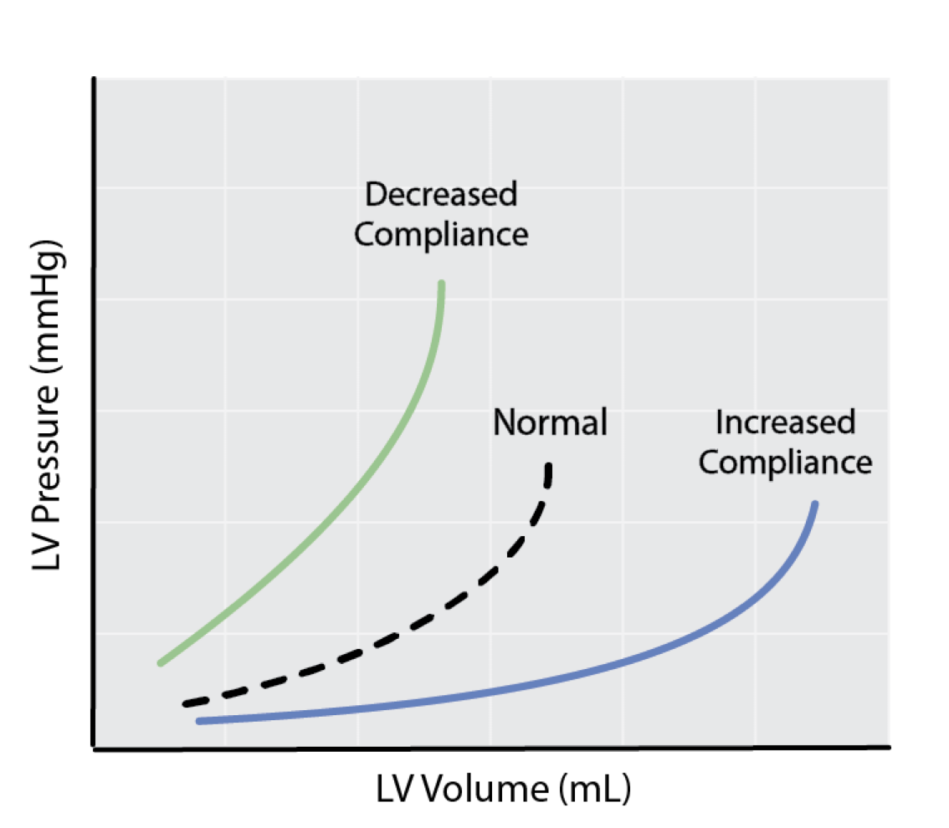
HUMAN PHYSIOLOGY: From cells to death (Ninth edition), Lauralee Sherwood

Slide 8
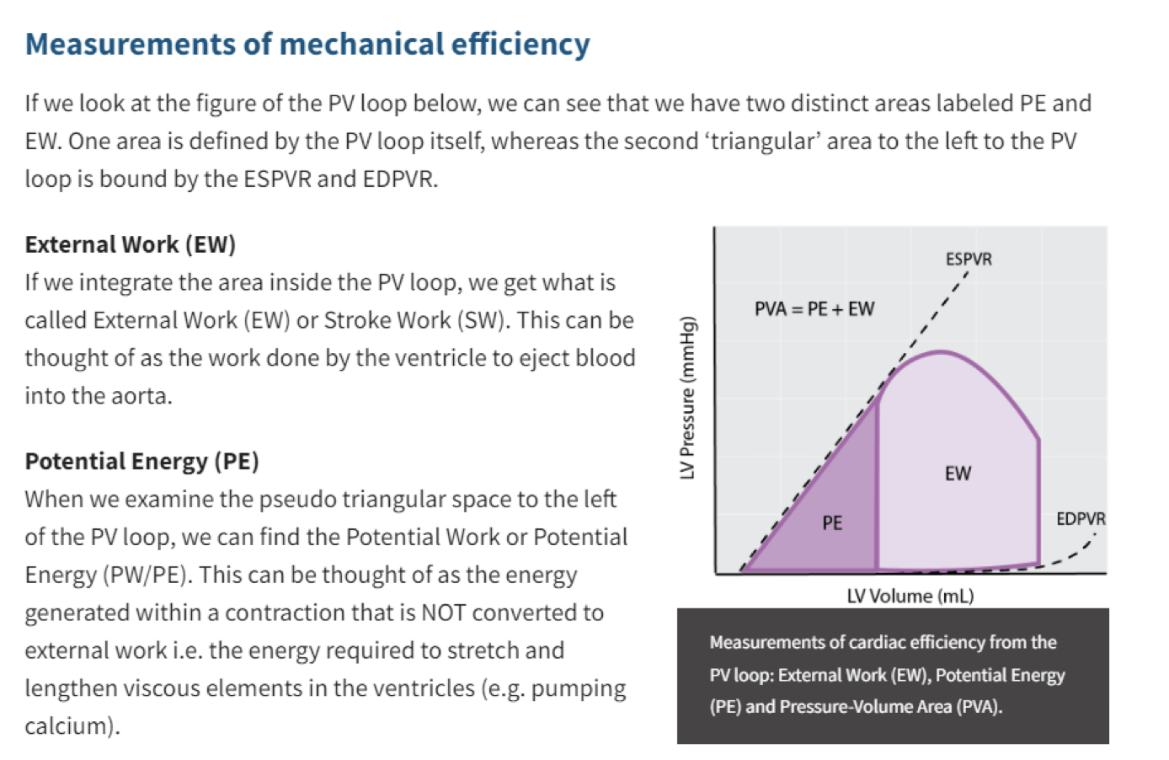
HUMAN PHYSIOLOGY: From cells to death (Ninth edition), Lauralee Sherwood

Slide 9
Cardiac action potential
Ca2+ enters cell during plateau
Ca2+-induced Ca2+ release from SR
Ca2+ binds to troponin C
Cross-bridge cycling
TENSION
1
2
3
Ca2+ reaccumulated in SR
4
RELAXATION
5
PHYSIOLOGY: (Fourth edition), Linda S. Constanzo

Slide 10
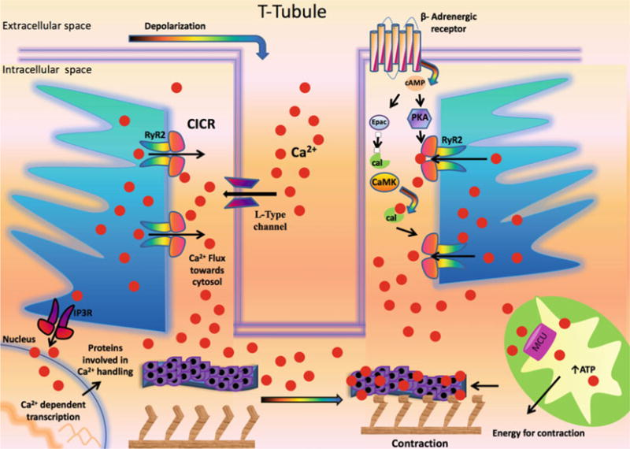
Ca2+: calcium; cal: calmodulin; CaMK: Ca2+/calmodulin-dependent protein kinase; CICR: Ca2+-induced Ca2+ release; Epac: exchange protein directly
activated by cAMP; IP3R: inositol 1,4,5-trisphosphate receptor; MCU: mitochondrial Ca2+ uniporter; PKA: Protein Kinase A; RyR2: Type 2 ryanodine receptor Ca2+ release channel
Role of Ca2+ in excitation-contraction coupling in cardiomyocyte
Gambardella J, Trimarco B, Iaccarino
G, Santulli G. New Insights in Cardiac
Calcium Handling and Excitation-
Contraction Coupling. Adv Exp Med Biol. 2018;1067:373-385. doi: 10.1007/5584_2017_106. PMID: 28956314; PMCID: PMC5889357.

Slide 11
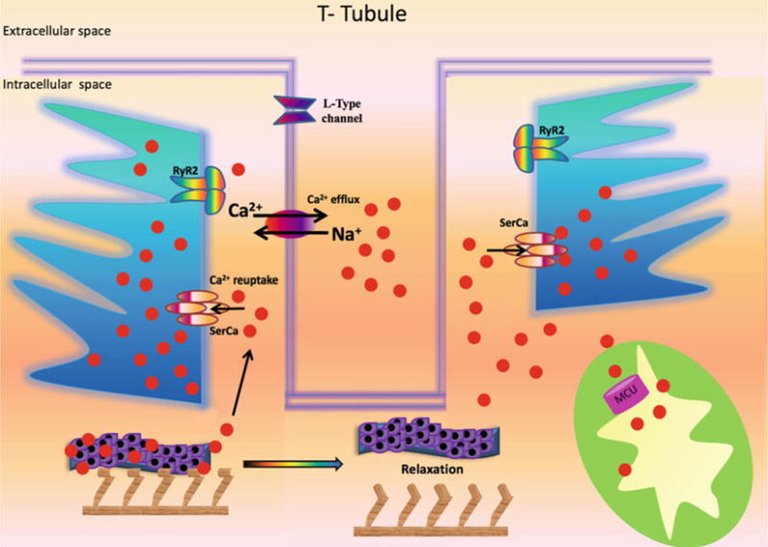
Ca2+: calcium; MCU: mitochondrial Ca2+ uniporter; Na+: sodium; RyR2: Type 2 ryanodine receptor Ca2+ release channel; SERCA: sarco/endoplasmic reticulum Ca2+-ATPase
Mechanistic role of Ca2+ in the relaxation phase
Gambardella J, Trimarco B, Iaccarino
G, Santulli G. New Insights in Cardiac
Calcium Handling and Excitation-
Contraction Coupling. Adv Exp Med Biol. 2018;1067:373-385. doi: 10.1007/5584_2017_106. PMID: 28956314; PMCID: PMC5889357.

Slide 12
The ATP-dependent processes that allow restoration of resting
tension are the following:
(i)Dissociation of calcium from tropomyosin C. This is determined by the relative affinity of calcium for its tropomyosin binding site.
(ii) Lysis of actin–myosin tension bonds and release of cross-bridges.
(iii) Phosphorylation of phospholamban: this myocyte protein regulates the activity of sarcoplasmic reticulum ATPase
pumps. Its phosphorylation increases the rate of calcium sequestration.
(iv) Clearance of calcium from the cytosol by sarcoplasmic reticulum and sarcolemmal ATPases, which transport calcium into the sarcoplasmic reticulum and across the sarcolemma, respectively.
(v) Sodium/calcium exchange by secondary active transport.
(vi) Restoration of sarcomere resting length.
In DD, the calcium transient is prolonged as a result of dysfunction of any of the processes mentioned above. A decrease in ATP levels below a critical level, as is seen in myocardial ischaemia, can lead to both incomplete sequestration of calcium and incomplete actin–myosin dissociation, leading to a state of ‘partial persistent systole’.
A small depletion in ATP tends to effect diastole more than systole, because the myosin heads have a higher ATP affinity and so dissociation requires greater ATP availability.

Slide 13
ENERGY METABOLISM IN HEALTHY HEART
Very high energy demands (ATP) for contrile function
No energy reserves in the heart If not replaced, the entire ATP content of the heart would be used in 2-10 seconds
Constant and large production of ATP by metabolism of different energy substrates depending on availability
Lopaschuk GD, Karwi QG, Tian R, Wende AR, Abel ED. Cardiac Energy Metabolism in Heart Failure. Circ Res. 2021 May 14;128(10):1487-1513. doi: 10.1161/CIRCRESAHA.121.318241. Epub 2021 May 13. PMID: 33983836; PMCID: PMC8136750.
Cardiovascular Endocrinology and Metabolism (Theory and Practise of Cardiometabolic Medicine), Chapter 7, Gary D.Lopachuk, Kim L.Ho

Slide 14
40% of heart's ATP needs are obtained by metabolism of glucose, lactate, ketones, amino acids
60% are obtained by metabolism of fatty acids
95% of ATP's production is a result of mitochondrial oxidative metabolism
5% is produced from glycolysis
Lopaschuk GD, Karwi QG, Tian R, Wende AR, Abel ED. Cardiac Energy Metabolism in Heart Failure. Circ Res. 2021 May 14;128(10):1487-1513. doi: 10.1161/CIRCRESAHA.121.318241. Epub 2021 May 13. PMID: 33983836; PMCID: PMC8136750.​
Cardiovascular Endocrinology and Metabolism (Theory and Practise of Cardiometabolic Medicine), Chapter 7, Gary D.Lopachuk, Kim L.Ho

Slide 15
40% of heart's ATP needs are obtained by metabolism of glucose, lactate, ketones, amino acids
60% are obtained by metabolism of fatty acids
95% of ATP's production is a result of mitochondrial oxidative metabolism
5% is produced from glycolysis
METABOLIC FLEXIBILITY
Lopaschuk GD, Karwi QG, Tian R, Wende AR, Abel ED. Cardiac Energy Metabolism in Heart Failure. Circ Res. 2021 May 14;128(10):1487-1513. doi: 10.1161/CIRCRESAHA.121.318241. Epub 2021 May 13. PMID: 33983836; PMCID: PMC8136750.​
Cardiovascular Endocrinology and Metabolism (Theory and Practise of Cardiometabolic Medicine), Chapter 7, Gary D.Lopachuk, Kim L.Ho

Slide 16
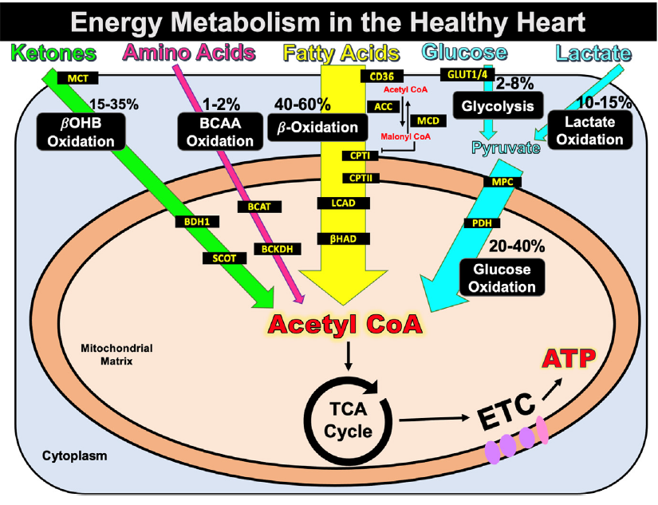
Cardiac energy metabolism in the healthy heart
Cardiovascular Endocrinology and Metabolism (Theory and Practise of Cardiometabolic Medicine), Chapter 7, Gary D.Lopachuk, Kim L.Ho
Notes:
Fatty acids are taken up by the cell via CD36 and are subsequently esterified and transported into the mitochondria via the CPT-I and CPT-II enzymes. Once in the mitochondria, fatty acids are oxidized via
β-oxidation of which two key enzymes in this pathway are LCAD and Βhad [LCAD, long-chain acyl-CoA dehydrogenase; ECH, enoyl CoA hydratase; βHAD, 3-OH-acyl-CoA dehydrogenase]. Glucose is taken up by the cell by GLUT4 or GLUT1 and subsequently converted into pyruvate via glycolysis. Pyruvate can then be converted to lactate or be transported into the mitochondria via MPC. Once in the mitochondria, pyruvate can be converted into acetyl CoA by PDH. Lactate is
taken up into the cell by MCT4 and pyruvate can be converted to lactate via LDH. Ketones are taken up by the cell via SLC16A1 (MCT1) after which they are transported to the
mitochondria for oxidation. Two key enzymes in ketone body oxidation are BDH1 and SCOT. Branched-chain amino acids are first converted to BCKAs by BCATm after which these
BCKAs are decarboxylated by BCKDH. Together these substrates are metabolized to produce energy (ATP) to fuel contractile function. Abbreviations: Glucose transporter 1 and 4 (GLUT1,
GLUT4), mitochondrial pyruvate carrier (MPC), pyruvate dehydrogenase (PDH), monocarboxylate transporter (MCT). Cluster of differentiation 36 (CD36), carnitine
palmitoyltransferase (CPT-1), acetyl CoA carboxylase (ACC), malonyl CoA decarboxylase (MCD), tricarboxylic acid (TCA) cycle, electron transport chain (ETC), adenosine triphosphate
(ATP). β-hydroxybutyrate (βOHβ), monocarboxylate transporter 1 (SLC16A1), β-hydroxybutyrate dehydrogenase 1 (BDH1), succinyl-CoA:3 oxoacid-CoA transferase (SCOT),
branched-chain α-keto-acids (BCKA), branched-chain amino-transaminase (BCAT), and mitochondrial branched-chain α-keto acid dehydrogenase (BCKDH).

Slide 17
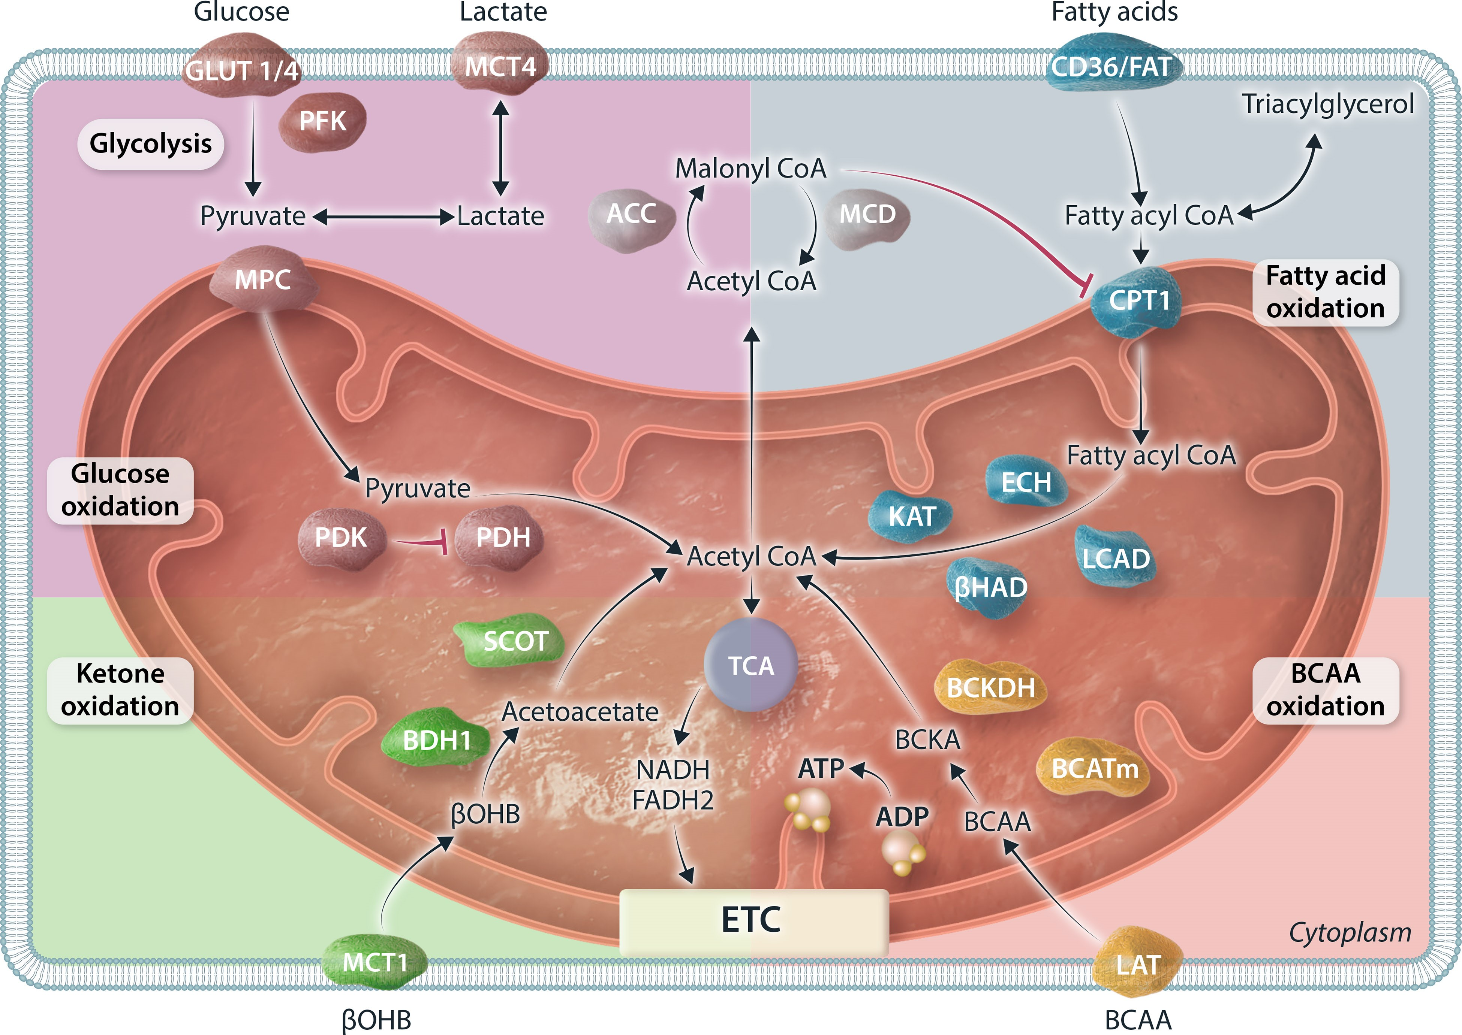

Major metabolic pathways and its associated key enzymes involved in cardiac metabolism
Notes:
Figure 1 Depiction of major metabolic pathways and its associated key enzymes involved in metabolism of glucose, fatty acids, ketones, and BCAA in the heart. Glucose metabolism can be divided as glycolysis and downstream pyruvate metabolism/glucose oxidation. Fatty acid oxidation can be regulated by the endogenous inhibitor malonyl-CoA. Ketone oxidation is depicted using the major form of ketone bodies, βOHB. BCAA oxidation includes oxidation of leucine, isoleucine, and valine. All four metabolic substrates are converted to acetyl-CoA for entering the TCA cycle to generate reduced equivalent NADH and FADH2, which will enter the ETC and generate a proton gradient across the mitochondrial membrane to drive the action of ATP synthase for ATP genesis. GLUT1/4, glucose transporter 1/4; MCT4, monocarboxylate transporter 4; PFK, phosphofructokinase; MPC, mitochondrial pyruvate carrier; PDH, pyruvate dehydrogenase; PDK, PDH kinase; ACC, acetyl-CoA carboxylase; MCD, malonyl-CoA decarboxylase; CD36/FAT, fatty acid transporter; CPT1, carnitine palmitoyltransferase 1; LCAD, long-chain acyl-CoA dehydrogenase; ECH, enoyl CoA hydratase; βHAD, 3-OH-acyl-CoA dehydrogenase; KAT, 3-ketoacyl-CoA thiolase; BCAA, branched-chain amino acids; BCATm, mitochondrial BCAA amimotransferase; BCKDH, branched-chain α-ketoacid dehydrogenase; LAT, L-type amino acid transporters; βOHB, β-hydroxybutyrate; BDH1, βOHB dehydrogenase 1; SCOT, succinyl-CoA:3-ketoacid CoA transferase; TCA, tricarboxylic acid; NADH, nicotinamide adenine dinucleotide; FADH2, flavin adenine dinucleotide; ETC, electron transport chain; ADP, adenosine diphosphate; ATP, adenosine triphosphate.
Unless provided in the caption above, the following copyright applies to the content of this slide: © The Author(s) 2024. Published by Oxford University Press on behalf of the European Society of Cardiology.This is an Open Access article distributed under the terms of the Creative Commons Attribution License (https://creativecommons.org/licenses/by/4.0/), which permits unrestricted reuse, distribution, and reproduction in any medium, provided the original work is properly cited.

Slide 18
Fatty acid β-oxidation
Free fatty acids bound to alboumin or contained in triacylglycerols inside chylomicrons or VLDL are delivered to the heart
Hydrolysis of triacylglycerols via endothelial-bound lipoprotein lipase
Free fatty acids are taken inside the cardiomyocytes via transporters or via passive diffusion
Fatty acids are esterified to form fatty acyl CoA and then are transferred to L-carnitine by CPT-1 to form long-chain acylcarnitine
Lopaschuk GD, Karwi QG, Tian R, Wende AR, Abel ED. Cardiac Energy Metabolism in Heart Failure. Circ Res. 2021 May 14;128(10):1487-1513. doi: 10.1161/CIRCRESAHA.121.318241. Epub 2021 May 13. PMID: 33983836; PMCID: PMC8136750.​​
Cardiovascular Endocrinology and Metabolism (Theory and Practise of Cardiometabolic Medicine), Chapter 7, Gary D.Lopachuk, Kim L.Ho

Slide 19
Long-chain acylcarnitine transported in the mitochondria
Fatty acid transferred back to CoA to form long- chain acyl CoA
Long-chain acyl CoA enters the β-oxidation pathway
Lopaschuk GD, Karwi QG, Tian R, Wende AR, Abel ED. Cardiac Energy Metabolism in Heart Failure. Circ Res. 2021 May 14;128(10):1487-1513. doi: 10.1161/CIRCRESAHA.121.318241. Epub 2021 May 13. PMID: 33983836; PMCID: PMC8136750.​​
Cardiovascular Endocrinology and Metabolism (Theory and Practise of Cardiometabolic Medicine), Chapter 7, Gary D.Lopachuk, Kim L.Ho

Slide 20
Β-oxidation
Each cycle produces acetyl CoA tricarboxylic acid (TCA) cycle
flavin adenine dinucleo- tide (FADH2)
nicotinamide adenine dinucleotide (NADH)
electron transport chain to generate ATP
TCA cycle produces NADH and FADH2 that enter the electron transport chain amd in the presence of oxygen produce ATP
Lopaschuk GD, Karwi QG, Tian R, Wende AR, Abel ED. Cardiac Energy Metabolism in Heart Failure. Circ Res. 2021 May 14;128(10):1487-1513. doi: 10.1161/CIRCRESAHA.121.318241. Epub 2021 May 13. PMID: 33983836; PMCID: PMC8136750.​​
Cardiovascular Endocrinology and Metabolism (Theory and Practise of Cardiometabolic Medicine), Chapter 7, Gary D.Lopachuk, Kim L.Ho

Slide 21
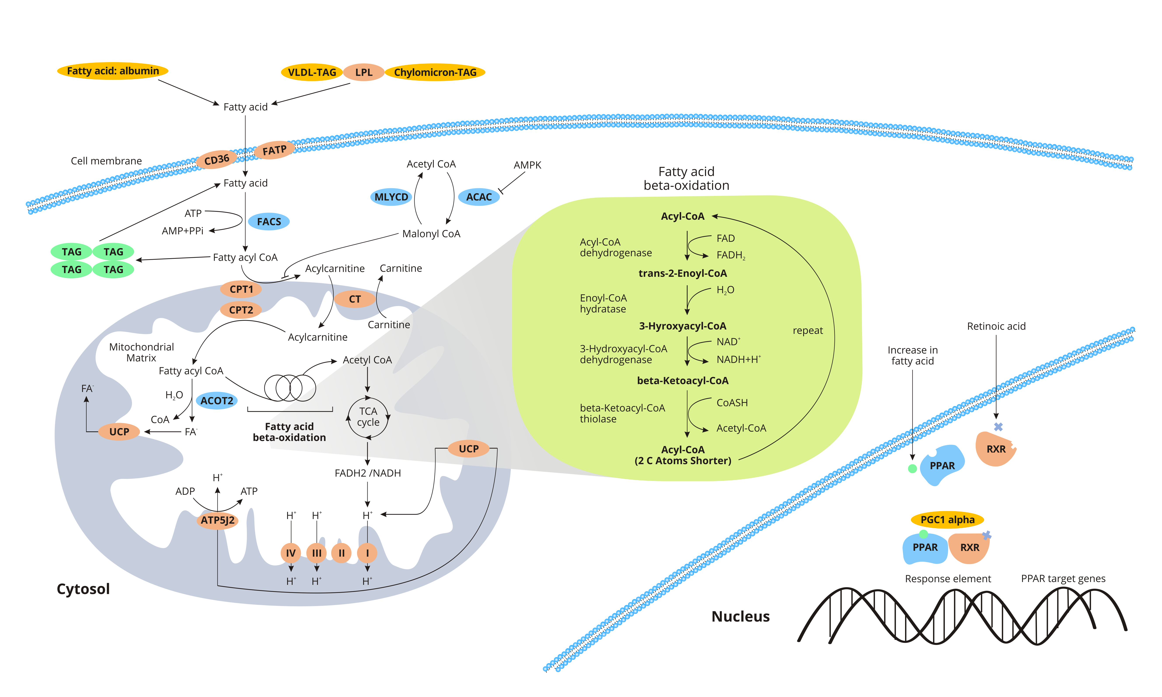
cusabio.com

Slide 22
REGULATION OF CARDIAC FATTY ACID β-OXIDATION
Regulation of fatty acid sypply to the heart
Malonyl CoA-induced CPT-1 inhibition
3) Allosteric regulation by the ratio of FAD/FADH2, NAD1/NADH and
Acetyl CoA/ CoA
(smaller ratio/ less activation oxidation of fatty acids)
4) Post-translational acetylation, succinylation, and malonylation of
fatty acid oxidative enzymes
5) Transcriptional regulation of fatty acid oxidative enzyme expression
Lopaschuk GD, Karwi QG, Tian R, Wende AR, Abel ED. Cardiac Energy Metabolism in Heart Failure. Circ Res. 2021 May 14;128(10):1487-1513. doi: 10.1161/CIRCRESAHA.121.318241. Epub 2021 May 13. PMID: 33983836; PMCID: PMC8136750.​​
Cardiovascular Endocrinology and Metabolism (Theory and Practise of Cardiometabolic Medicine), Chapter 7, Gary D.Lopachuk, Kim L.Ho

Slide 23
Glucose metabolism

Slide 24
Inside the cell
GLUCOSE (transported via GLUT4 and GLUT1)
polyol pathway
hexosamine biosynthetic pathway
pentose phosphate pathway
Glycogen synthesis
Glycolysis
Production pf 2 ATP molecules without the requirment of oxygen
Pyruvate conversion to lactate
Transportation into the mitochondria via MPC MPC
Transported
inside the heart via MCT4
Conversion via LDH
Lopaschuk GD, Karwi QG, Tian R, Wende AR, Abel ED. Cardiac Energy Metabolism in Heart Failure. Circ Res. 2021 May 14;128(10):1487-1513. doi: 10.1161/CIRCRESAHA.121.318241. Epub 2021 May 13. PMID: 33983836; PMCID: PMC8136750.​​
Cardiovascular Endocrinology and Metabolism (Theory and Practise of Cardiometabolic Medicine), Chapter 7, Gary D.Lopachuk, Kim L.Ho
Notes:
LDH: Lactate Dehydrogenase
MCT4: Monocarboxylate transporter 4
MCT4:monocarboxylic anion transporters MCT4
MPC, mitochondrial pyruvate carrier

Slide 25
Pathways of non-oxidative glucose metabolism whose by-products contribute to cardiac remodeling
Lopaschuk GD, Karwi QG, Tian R, Wende AR, Abel ED. Cardiac Energy Metabolism in Heart Failure. Circ Res. 2021 May 14;128(10):1487-1513. doi: 10.1161/CIRCRESAHA.121.318241. Epub 2021 May 13. PMID: 33983836; PMCID: PMC8136750.
Notes:
Schematic summary of glucose uptake via GLUT1 and GLUT4 transporters and entry of glucose into the glycolytic pathway (purple arrows) leading to the generation of pyruvate. In heart failure, impaired entry of pyruvate into mitochondria or decreased mitochondrial pyruvate metabolism leads to accumulation of glycolytic intermediates and increased flux into accessory pathways (blue arrows) such as the polyol pathway, pentose phosphate pathway, hexosamine biosynthetic pathway, mannose and galactosamine synthetic pathways and one carbon metabolism pathways, products of which have been linked to the activation of signaling pathways that may contribute to left ventricular modelling. Regulatory steps in glycolysis that have been implicated in heart failure include phosphofructokinase (PFK), pyruvate kinase (PKM1), the mitochondrial pyruvate carrier (MPC) and pyruvate dehydrogenase (PDH).

Slide 26
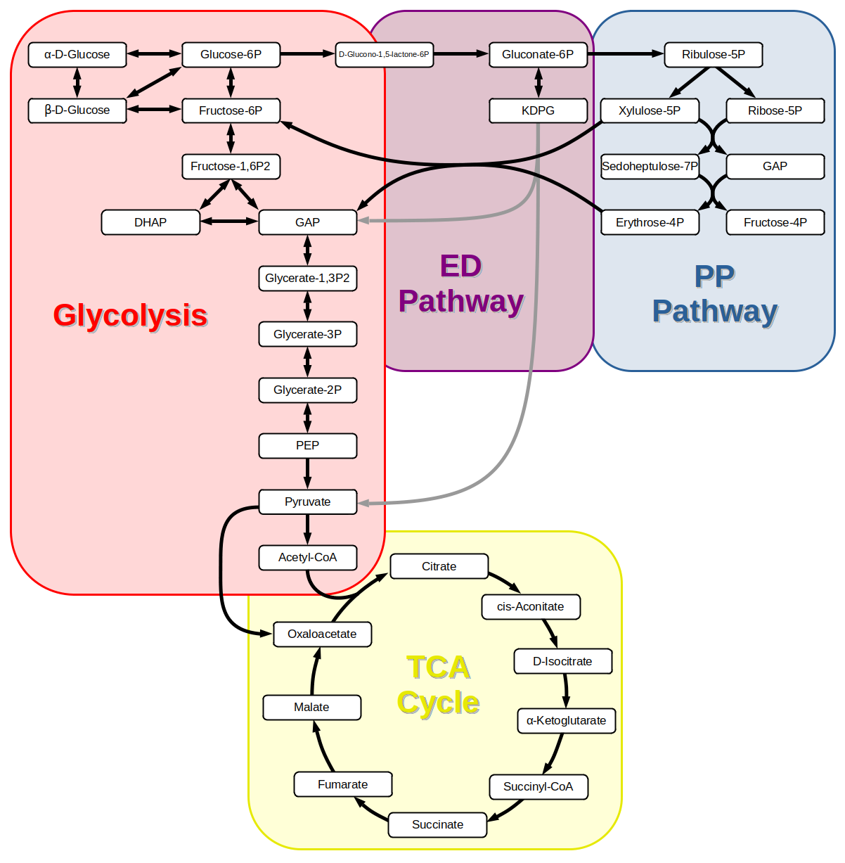
https://www.utmb.edu/msf/home/small-molecules/glycolysis-ppp
Notes:
The Entner–Doudoroff (ED) pathway is a catabolic pathway for glucose.
The ED pathway is an alternative to glycolysis found mainly in bacteria, yielding pyruvate, ATP, NADH, and NADPH. It plays a key role in microbial physiology but is not a major pathway in human glucose metabolism.

Slide 27
Pyruvate inside the mitochondrium is then converted to acetyl
CoA by pyruvate dehydrogenase (PDH)
This acetyl CoA is then further metabolized in the TCA cycle
PDH activated via dephosphorylation by PDH phosphatase and inhibited by PDH kinase (PDK)
Lopaschuk GD, Karwi QG, Tian R, Wende AR, Abel ED. Cardiac Energy Metabolism in Heart Failure. Circ Res. 2021 May 14;128(10):1487-1513. doi: 10.1161/CIRCRESAHA.121.318241. Epub 2021 May 13. PMID: 33983836; PMCID: PMC8136750.​​
Cardiovascular Endocrinology and Metabolism (Theory and Practise of Cardiometabolic Medicine), Chapter 7, Gary D.Lopachuk, Kim L.Ho
Notes:
Pyruvate inside the mitochondrium is then converted to acetyl CoA by pyruvate dehydrogenase (PDH)
This acetyl CoA is then further metabolized in the TCA cycle
PDH is activated via dephosphorylation by PDH phosphatase and inhibited by PDH kinase (PDK)

Slide 28
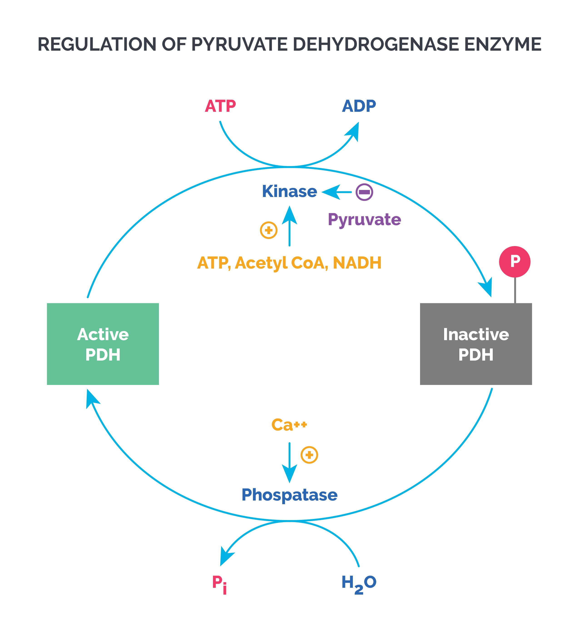
PDK
https://app.achievable.me/study/usmle-step-1/learn/biochemistry-glycolysis-tricarboxylic-acid-cycle

Slide 29
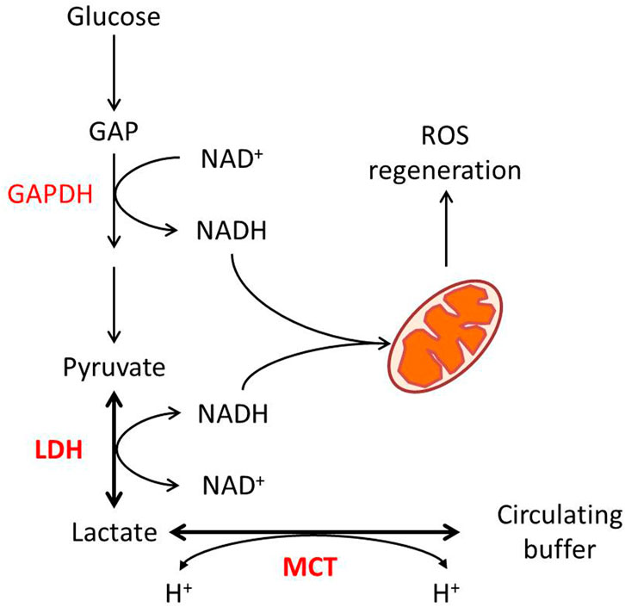
https://doi.org/10.3389/fphys.2022.1038421
Notes:
FIGURE 1. Lactate metabolism and redox homeostasis. Glycolytic flux from glucose to pyruvate generates NADH from NAD at the GAPDH reaction, while LDH-catalyzed pyruvate to lactate consumes NADH. The pyruvate–lactate ratio in some conditions reflects the NAD–NADH ratio. MCT-mediated proton-dependent lactate transport maintains the balance between intracellular and circulated lactate.

Slide 30
Regulation of carbohydrates metabolism in the healthy heart
Insulin stimulates glucose uptake via GLUT4 transporters and directly stimulating glucose oxidation in the heart
Transcriptional control of both glycolytic and glucose oxidative enzymes
When fatty acid ß-oxidation rises, glucose and lactate oxidation decrease, and when carbohydrate oxidation increases, fatty acid ß- oxidation decreases
Reciprocal relationship, called the “Randle Cycle": fatty acid ß-oxidation inhibits PDH and glycolysis and carbohydrate oxidation-induced increases in malonyl CoA, inhibit CPT-1 and mitochondrial fatty acid uptake
Lopaschuk GD, Karwi QG, Tian R, Wende AR, Abel ED. Cardiac Energy Metabolism in Heart Failure. Circ Res. 2021 May 14;128(10):1487-1513. doi: 10.1161/CIRCRESAHA.121.318241. Epub 2021 May 13. PMID: 33983836; PMCID: PMC8136750.​​
Cardiovascular Endocrinology and Metabolism (Theory and Practise of Cardiometabolic Medicine), Chapter 7, Gary D.Lopachuk, Kim L.Ho

Slide 31
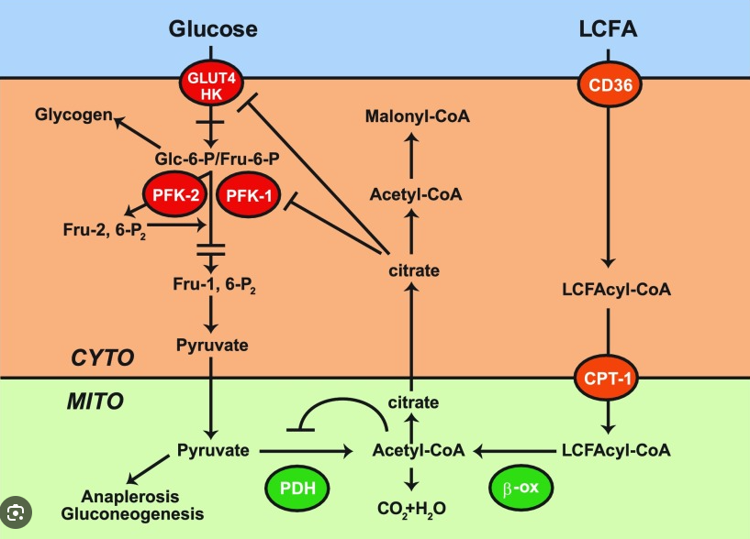
Randle cycle
Glucose-fatty acid cycle->
significant reduction in the uptake and utilization of glucose when fatty acid oxidation is intense.

Slide 32
Ketone metabolism in the healthy heart
Ketones important source of energy for the heart, produced in the liver from acetyl CoA, predominately derived by hepatic fatty acid ß-oxidation
β-hydroxybutyrate (βOHB) is the predominant ketone body oxidized in the heart by BDH1 and is converted to acetoacetate.
Regulation:
-Circulating levels of ketone
-transcriptional regulation of the ketolytic enzymes
-Increased when fasting
Lopaschuk GD, Karwi QG, Tian R, Wende AR, Abel ED. Cardiac Energy Metabolism in Heart Failure. Circ Res. 2021 May 14;128(10):1487-1513. doi: 10.1161/CIRCRESAHA.121.318241. Epub 2021 May 13. PMID: 33983836; PMCID: PMC8136750.​​
Cardiovascular Endocrinology and Metabolism (Theory and Practise of Cardiometabolic Medicine), Chapter 7, Gary D.Lopachuk, Kim L.Ho
BDH1: β-hydroxybutyrate dehydrogenase 1
Notes:
BDH1: D-beta-hydroxybutyrate dehydrogenase
Ketones are also an important source of energy for the heart. Ketone bodies are produced in the liver from acetyl CoA predominately derived by hepatic fatty acid ß-oxidation. β-hydroxybutyrate (βOHB) is the predominant ketone body oxidized in the heart. β-hydroxybutyrate dehydrogenase 1 (BDH1) catalyzes the oxidation of βOHB to acetoacetate (AcAc), which is then becomes acetoacetyl CoA (AcAc CoA). AcAc CoA then undergoes a thiolysis reaction from which acetyl CoA is produced, that then enters the TCA cycle
Ketone metabolism is regulated by the circulating levels of ketone, the transcription rate of ketolytic enzymes and is increased also when fasting.

Slide 33
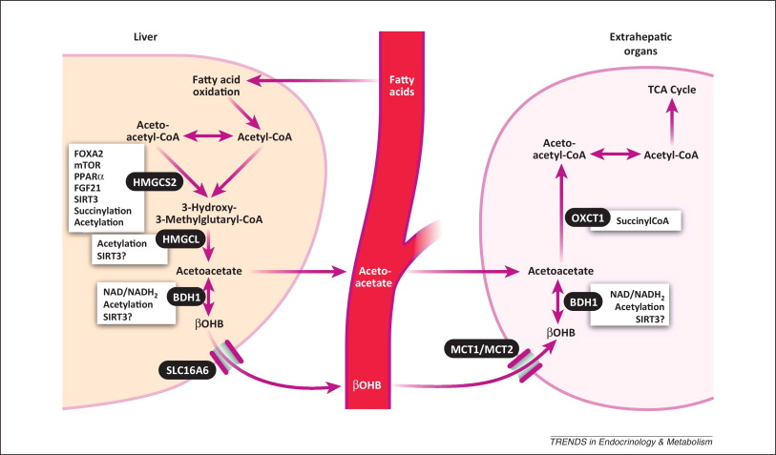
Newman et al. Ketone bodies as signaling metabolites. 2013
Notes:
Figure 1Outline of ketone body metabolism and regulation. The key irreversible step in ketogenesis is synthesis of 3-hydroxy-3-methylglutaryl-CoA by HMGCS2. Conversely, the rate limiting step in ketolysis is conversion of acetoacetate to acetoacetyl-CoA by OXCT1. HMGCS2 transcription is heavily regulated by FOXA2, mTOR, PPARα, and FGF21. HMGCS2 activity is post-translationally regulated by succinylation and acetylation/SIRT3 deacetylation. Other enzymes are regulated by cofactor availability (e.g., NAD/NADH2 ratio for BDH1). All enzymes involved in ketogenesis are acetylated and contain SIRT3 deacetylation targets, but the functional significance of this is unclear other than for HMGCS2. Although ketone bodies are thought to diffuse across most plasma membranes, the transporter SLC16A6 may be required for liver export, whereas several monocarboxylic acid transporters assist with transport across the blood–brain barrier. Abbreviations: BDH1, β-hydroxybutyrate dehydrogenase; FGF21, fibroblast growth factor 21; FOXA2, forkhead box A2; HMGCS2, 3-hydroxy-3-methylglutaryl (HMG)-CoA synthase 2; HMGCL, HMG-CoA lyase; MCT1/2, monocarboxylic acid transporters 1/2; mTOR, mechanistic target of rapamycin; OXCT1, succinyl-CoA:3-ketoacid coenzyme A transferase; PPARα, peroxisome proliferator-activated receptor α; SIRT3, sirtuin 3; SLC16A6, solute carrier family 16 (monocarboxylic acid transporter), member 6; TCA cycle, tricarboxylic acid cycle.

Slide 34
Energy producing efficiency-carbohydrates
oxidation of each glucose molecule → 6 O2 molecules / 31 high-energy phosphate (ATP) molecules
glucose's phosphate/oxygen (P/O) ratio: 2.58
Notes:
The complete oxidation of one glucose molecule (C₆H₁₂O₆) requires 6 molecules of O₂:
$$C_{6}H_{12}O_{6}+6O_{2} → 6CO_{2}+6H_{2}O$$
This is the classical balanced equation for aerobic respiration.
2. ATP yield (31 ATP)
When glucose is oxidized:
Glycolysis, pyruvate oxidation, TCA cycle, and oxidative phosphorylation together produce ~30–32 ATP per glucose (depending on the shuttle system and efficiency).
Here, the assumption is 31 ATP per glucose.
So, we can say:
$$1 \text{glucose} → 31 \text{ATP}$$
3. The P/O ratio
The P/O ratio expresses how many ATP (“phosphates”) are synthesized per oxygen atom reduced in oxidative phosphorylation.
Oxygen is reduced to water in the electron transport chain:
$$O_{2}+4e^{−}+4H^{+} → 2H_{2}O$$
Each O₂ molecule consumes 2 oxygen atoms (O).
4. Calculating P/O ratio for glucose
6 O₂ molecules are used → that means 12 oxygen atoms are reduced.
31 ATP are produced.
So:
$$\text{P}\text{/}\text{O} \text{ratio}=\frac{31 \text{ATP}}{12 O \text{atoms}}≈2.58$$

Slide 35
Energy producing efficiency-fatty acids
oxidation of fatty acid molecule, e.g. palmitate→ 23 O2 molecules / 105 high-energy phosphate (ATP) molecules
glucose's phosphate/oxygen (P/O) ratio: 2.33

Slide 36
Energy producing efficiency- ketones
minor contribution to the total ATP production compared to fatty acids or glucose
myocardial oxidation of ketones increase significantly in response to changes in arterial concentration
ketones phosphate/oxygen (P/O) ratio: 2.5
(ketones less efficient than glucose but more efficient than palmitate)

Slide 37
Branched chain amino acid oxidation
Branched-chain amino acids (BCAAs) (leucine, isoleucine, and valine) can be oxidized by the heart (small contribution to ATP production <2%)
BCAAs inhibit the signaling of cardiac insulin
BCAAs BCKAs (branch-chained α-keto-acids)
Acetyl CoA for TCA cycle succinyl CoA for anaplerosis
BCATm
Lopaschuk GD, Karwi QG, Tian R, Wende AR, Abel ED. Cardiac Energy Metabolism in Heart Failure. Circ Res. 2021 May 14;128(10):1487-1513. doi: 10.1161/CIRCRESAHA.121.318241. Epub 2021 May 13. PMID: 33983836; PMCID: PMC8136750.​​
Cardiovascular Endocrinology and Metabolism (Theory and Practise of Cardiometabolic Medicine), Chapter 7, Gary D.Lopachuk, Kim L.Ho
BCKDH
BCKDH: branched-chain α-keto acid dehydrogenase
BCATm: mitochondrial branched-chain amino-transaminase
Notes:
Branched-chain amino acids (BCAAs) (leucine, isoleucine, and valine) can be oxidized by the heart. The contribution of BCAA oxidation to ATP production in the heart is small (2%). The first step of BCAA metabolism in the heart involves BCAA conversion to branched-chain α-keto- acids (BCKAs) by the mitochondrial branched-chain amino-transaminase (BCATm). These BCKAs are then decarboxylated by a mitochondrial branched-chain α-keto acid dehydrogenase (BCKDH). BCKDH activity is regulated by phosphorylation with BCKDH by a BCKDH kinase (BDK), which inhibits activity, and dephosphorylation by PPC2m, which activates BCKDH. The products of BCKDH either eventually provide acetyl CoA for the TCA cycle or succinyl-CoA for anaplerosis.
Anaplerosis refers to metabolic pathways that replenish the citric acid cycle intermediates, which are essential to energy metabolism; however, our understanding of the role and regulation of this process in the heart, particularly under pathophysiological conditions, is very limited.

Slide 38
.
BCDK Pi
BCDK kinase (BDK)
Phosphorylates BCDK and inactivates it
PPC2m dephosphorylates BCDK and activates it
.
BCDK + Pi
Lopaschuk GD, Karwi QG, Tian R, Wende AR, Abel ED. Cardiac Energy Metabolism in Heart Failure. Circ Res. 2021 May 14;128(10):1487-1513. doi: 10.1161/CIRCRESAHA.121.318241. Epub 2021 May 13. PMID: 33983836; PMCID: PMC8136750.​​
Cardiovascular Endocrinology and Metabolism (Theory and Practise of Cardiometabolic Medicine), Chapter 7, Gary D.Lopachuk, Kim L.Ho
Notes:
ΕΙΚΟΝΑ

Slide 39
BCAA increased muscle mass, improved postexercise recovery, glucose homeostasis
BUT BCAA linked with the development of insulin resistance
+
decrease in insulin-stimulated glucose oxidation
Lopaschuk GD, Karwi QG, Tian R, Wende AR, Abel ED. Cardiac Energy Metabolism in Heart Failure. Circ Res. 2021 May 14;128(10):1487-1513. doi: 10.1161/CIRCRESAHA.121.318241. Epub 2021 May 13. PMID: 33983836; PMCID: PMC8136750.​​
Cardiovascular Endocrinology and Metabolism (Theory and Practise of Cardiometabolic Medicine), Chapter 7, Gary D.Lopachuk, Kim L.Ho

Slide 40
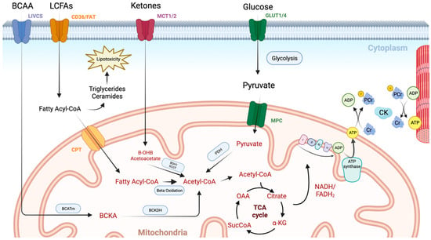
this proton-motive force to phosphorylate adenosine diphosphate (ADP) molecules, generating adenosine triphosphate (ATP). Transport of energy to the myofibril then occurs using the creatine kinase (CK) system. Image created using BioRender.com.
Henry, J.A.; Couch, L.S.; Rider, O.J. Myocardial Metabolism in Heart Failure with Preserved Ejection Fraction. J. Clin. Med. 2024, 13, 1195. https://doi.org/10.3390/jcm13051195
Henry JA, Couch LS, Rider OJ. Myocardial Metabolism in Heart Failure with Preserved Ejection Fraction. Journal of Clinical Medicine. 2024; 13(5):1195. https://doi.org/10.3390/jcm13051195
Chicago/Turabian Style
Henry, John Aaron, Liam S. Couch, and Oliver J. Rider. 2024. "Myocardial Metabolism in Heart Failure with Preserved Ejection Fraction" Journal of Clinical Medicine 13, no. 5: 1195. https://doi.org/10.3390/jcm13051195
Notes:
Figure 1. An overview of cardiac metabolism. Long chain fatty acids (LCFAs) enter the myocardium via CD36 and fatty acid transport protein (FAT). They then undergo esterification to form a fatty acyl coenzyme A (Acyl-CoA), which is either converted to lipotoxic intermediates such as triglycerides and ceramides or enters the mitochondrial via the carnitine palmitoyltransferase (CPT) system. Once inside the mitochondrial matrix, the fatty acyl-CoA undergoes beta oxidation with the resulting acetyl-CoA molecule entering the TCA cycle. Glucose enters the cardiomyocyte through glucose transporters (GLUT1/4). It then undergoes glycolysis producing pyruvate, which enters the mitochondria via the mitochondrial pyruvate carrier (MPC). Pyruvate dehydrogenase (PDH) governs the conversion of pyruvate into acetyl-CoA, and thus controls the balance between fatty acid and glucose use via the Randal cycle. Ketones are taken up via monocarboxylate transporters (MCT1/2) and are then converted to acetyl-CoA in the mitochondria by beta hydroxybutyrate dehydrogenase 1 (BDH1) and succinyl-CoA:3 oxoacid-CoA transferase (SCOT). Branched chain amino acids (BCCA) are taken up via the branched-chain amino acid–cation symporter family (LIVCS). Conversion to branched chain ketoacids (BCKA) occurs via the mitochondrial branched-chain aminotransferase (BCATm) before final conversion to acetyl-CoA via branched chain-alpha-ketoacid dehydrogenase (BCKDH). High-energy electron carriers (NADH and FADH2), produced via the tricarboxylic acid (TCA) cycle, deliver electrons to the electron transport chain, where they are used to generate a proton gradient across the inner mitochondrial membrane. ATP synthase then uses

Slide 41
Energy metabolism in HF

Slide 42
ENERGY METABOLISM IN HF
(1) increased reactive oxygen species (ROS) production
(2) dysregulation of mitochondrial Ca2+ homeostasis
(3) impairments in mitochondrial dynamics, sustained mitophagy, increased autophagic cell death of cardiomyocytes
(4) alterations in transcriptional regulation* of mitochondrial proteins and increases in post-translational protein modification
Reduced mitochondrial oxidative capacity
Lopaschuk GD, Karwi QG, Tian R, Wende AR, Abel ED. Cardiac Energy Metabolism in Heart Failure. Circ Res. 2021 May 14;128(10):1487-1513. doi: 10.1161/CIRCRESAHA.121.318241. Epub 2021 May 13. PMID: 33983836; PMCID: PMC8136750.​​
Cardiovascular Endocrinology and Metabolism (Theory and Practise of Cardiometabolic Medicine), Chapter 7, Gary D.Lopachuk, Kim L.Ho
Energy defficient- 30-40% less ATP content than a healthy heart
* (PPARγ coactivator-1a) PGC1α is repressed
→decreased mitochondrial biogenesis
Notes:
Mitophagy is a specialized type of autophagy in which damaged, dysfunctional, or superfluous mitochondria are selectively degraded and recycled by the cell.

Slide 43
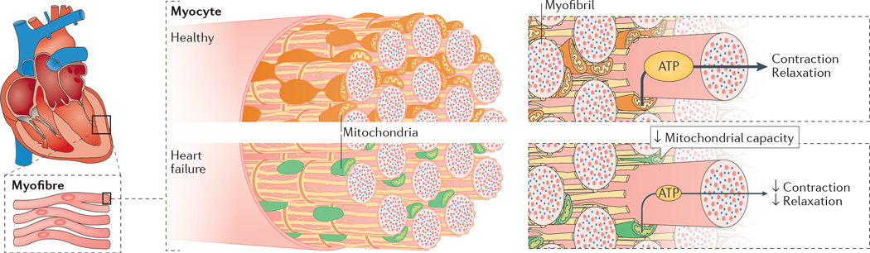
Brown DA, Perry JB, Allen ME, Sabbah HN, Stauffer BL, Shaikh SR, Cleland JG, Colucci WS, Butler J, Voors AA, Anker SD, Pitt B, Pieske B, Filippatos G, Greene SJ, Gheorghiade M. Expert consensus document: Mitochondrial function as a therapeutic target in heart failure. Nat Rev Cardiol. 2017 Apr;14(4):238-250. doi: 10.1038/nrcardio.2016.203. Epub 2016 Dec 22. PMID: 28004807; PMCID: PMC5350035.

Slide 44
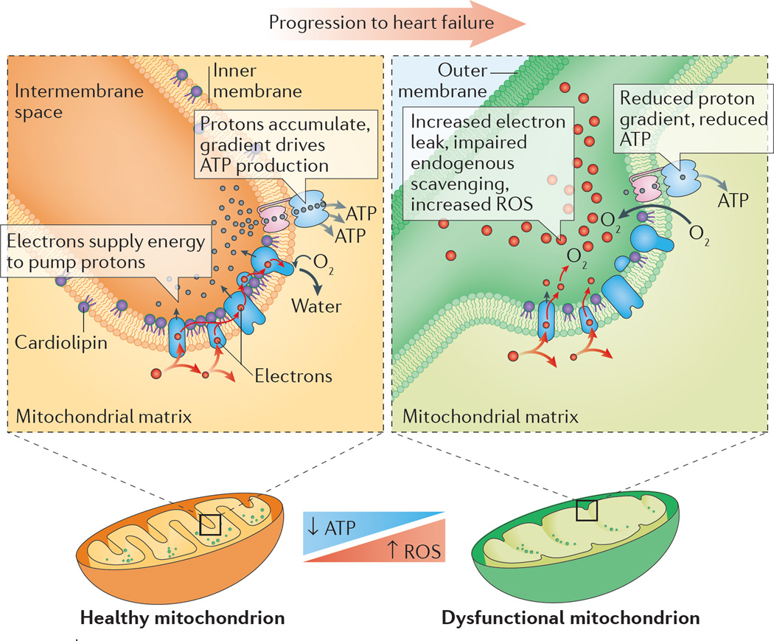
Brown DA, Perry JB, Allen ME, Sabbah HN, Stauffer BL, Shaikh SR, Cleland JG, Colucci WS, Butler J, Voors AA, Anker SD, Pitt B, Pieske B, Filippatos G, Greene SJ, Gheorghiade M. Expert consensus document: Mitochondrial function as a therapeutic target in heart failure. Nat Rev Cardiol. 2017 Apr;14(4):238-250. doi: 10.1038/nrcardio.2016.203. Epub 2016 Dec 22. PMID: 28004807; PMCID: PMC5350035.
Figure 4. Impaired mitochondrial energy production along the inner membrane
Enzyme complexes responsible for energy production are packed into the mitochondrial inner membrane, often with the help of phospholipids such as cardiolipin. Failing mitochondria often display altered morphology, decreased ATP-generating capacity, heightened production of reactive oxygen species (ROS), abnormal cardiolipin levels, and impaired supercomplexes.

Slide 45
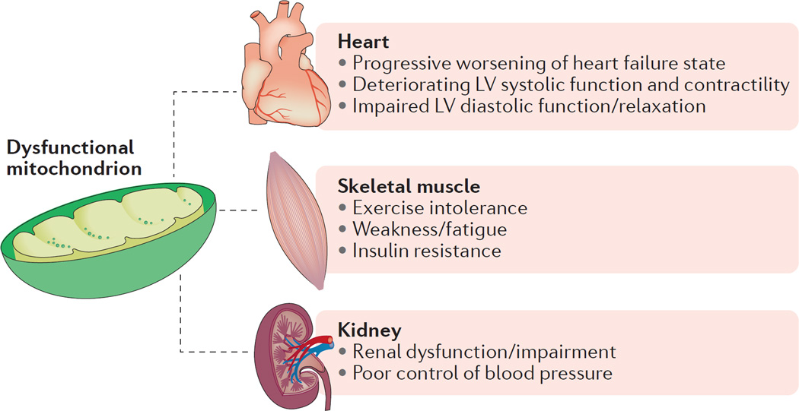
Brown DA, Perry JB, Allen ME, Sabbah HN, Stauffer BL, Shaikh SR, Cleland JG, Colucci WS, Butler J, Voors AA, Anker SD, Pitt B, Pieske B, Filippatos G, Greene SJ, Gheorghiade M. Expert consensus document: Mitochondrial function as a therapeutic target in heart failure. Nat Rev Cardiol. 2017 Apr;14(4):238-250. doi: 10.1038/nrcardio.2016.203. Epub 2016 Dec 22.
Figure 3. Mitochondrial contribution across multifaceted symptoms of heart failure
Aberrant mitochondrial energy production is involved in many symptoms commonly found in patients with heart failure, including skeletal muscle dysfunction and renal pathologies. LV, left ventricular.

Slide 46
ENERGY METABOLISM IN HF
1) increased reactive oxygen species (ROS) production
(2) dysregulation of mitochondrial Ca2+ homeostasis
(3) impairments in mitochondrial dynamics, sustained mitophagy, increased autophagic cell death of cardiomyocytes
(4) alterations in transcriptional regulation* of mitochondrial proteins and increases in posttranslational protein modification
Loss of metabolic flexibility, changing the relative amount of the energy substrates it uses
Reduced mitochondrial oxidative capacity
Lopaschuk GD, Karwi QG, Tian R, Wende AR, Abel ED. Cardiac Energy Metabolism in Heart Failure. Circ Res. 2021 May 14;128(10):1487-1513. doi: 10.1161/CIRCRESAHA.121.318241. Epub 2021 May 13. PMID: 33983836; PMCID: PMC8136750.​​
Cardiovascular Endocrinology and Metabolism (Theory and Practise of Cardiometabolic Medicine), Chapter 7, Gary D.Lopachuk, Kim L.Ho
Energy defficient- 30-40% less ATP content than a healthy heart
* (PPARγ coactivator-1a) PGC1α is repressed
→decreased mitochondrial biogenesis

Slide 47
Metabolic signaling to epigenetic transcriptional control
Lopaschuk GD, Karwi QG, Tian R, Wende AR, Abel ED. Cardiac Energy Metabolism in Heart Failure. Circ Res. 2021 May 14;128(10):1487-1513. doi: 10.1161/CIRCRESAHA.121.318241. Epub 2021 May 13. PMID: 33983836; PMCID: PMC8136750.
Notes:
Primary cardiac metabolites, glucose and fatty acids, directly alter NAD+/(NADH) ratios as well as the acetyl-CoA pool that signal to the nucleus to impact the epigenetic environment. Additionally, glucose can signal through the hexosamine biosynthetic pathway (HBP). Additional metabolic intermediates like à-hydroxybutyrate (àOHB), can also regulate activity of epigenetic regulating enzymes as can singlecarbon metabolism via folate and S-adenosylmethionine (SAM). metabolites and metabolic pathways regulate the activity and/or substrate availability of epigenetic modifiers of histones (eg, HDAC [histone deacetylase], HAT [histone acetyltransferase], HDM [histone demethylase], HMT [histone methyltransferase]), DNA (eg, DNMT [DNA methyltransferase] and ten-eleven translocation TET, ultimately altering gene expression.
Left: Mitochondrial metabolic flux of primary cardiac metabolites, glucose and fatty acids, directly alter NAD+/NADH ratios as well as the Acetyl-CoA pool that signal to the nucleus to impact the epigenetic environment. Additionally, glucose that does not enter oxidative metabolism in the mitochondria can signal through the HBP. Additional metabolic intermediates discussed in the text, βOHB, can also regulate activity of epigenetic regulating enzymes as can single carbon metabolism via folate and SAM. Middle: Metabolites and metabolic pathways regulate the activity and/or substrate availability of epigenetic modifiers of histones (e.g., HDAC, HAT, HDM, HMT) and DNA (e.g., DNMT and TET). Right: A) Histone modifications include inhibitory tri-methylation as well as activating acetylation. B) DNA modifications such as DNA methylation (5mC) at CGI in promoters are associated with gene silencing while CGI demethylation and gene body DNA hydroxymethylation (5hmC) modifications are associated with gene activation. C) Although metabolites are not known to be directly regulated by metabolic intermediates, a number of metabolic genes are regulated by miR and lncRNA expression. Please see references included in the main text for additional details. (Illustration credit: Ben Smith).
Abbreviations: α-ketoglutarate (αKG), β-hydroxybutyrate (βOHB), CpG island (CGI), DNA methyltransferase (DNMT), fatty acid oxidation (FAO), hexosamine biosynthetic pathway (HBP), histones (H2A, H2B, H3, H4), histone acetyltransferase (HAT), histone deacetylase (HDAC), histone demethylase (HDM), histone methyltransferase (HMT), long noncoding RNA (lncRNA), microRNA (miR), oxidative phosphorylation (OXPHOS), pyruvate dehydrogenase (PDH) complex, S-adenosylmethionine (SAM), ten-eleven translocation (TET), and tricarboxylic acid (TCA) cycle.

Slide 48
reduced NAD+/NADH ratio in HF
Lopaschuk GD, Karwi QG, Tian R, Wende AR, Abel ED. Cardiac Energy Metabolism in Heart Failure. Circ Res. 2021 May 14;128(10):1487-1513. doi: 10.1161/CIRCRESAHA.121.318241. Epub 2021 May 13. PMID: 33983836; PMCID: PMC8136750.
Notes:
There is a decrease of NAD+ availability and a reduced NAD+/NADH ratio in HF
Supplementation of NAD precursors improves the outcome of HF
NAD carries electrons generated from substrate catabolism, e.g. TCA cycle or glycolysis, to oxidative phosphorylation for ATP production. The NAD⁺/NADH ratio determines cellular redox and metabolic fluxes. NAD⁺ is consumed by multiple enzymes, e.g. Sirtuins and PARPs, for protein and nucleotide modification thus regulating signal transduction. These reactions generate nicotinamide (NAM), which, through the salvage pathway, is converted into nicotinamide mononucleotide (NMN) by nicotinamide phosphoribosyl transferase (NAMPT). The NMN is converted to NAD⁺ by nicotinamide mononucleotide adenyltransferase (NMNAT). Alternatively, nicotinamide riboside (NR) can be phosphorylated by nicotinamide riboside kinase (NRK) 1 or 2 to form NMN. NAD⁺ can also be synthesized from nicotinic acid (NA) in the Preiss-Handler pathway or from tryptophan in the de novo pathway. Both pathways generate nicotinic acid mononucleotide (NaMN). NMNAT then converts NaMN to nicotinic acid adenine dinucleotide (NaAD) which is further metabolized into NAD⁺ by NAD synthase (NADS).

Slide 49
Energy metabolism in HFrEF

Slide 50
Type of HF |  | HFrEF | HFmrEF | HFpEF
CRITERIA | 1 | Symptoms ± Signsª | Symptoms ± Signsª | Symptoms ± Signsª
 | 2 | LVEF ≤40% | LVEF 41–49%^{b} | LVEF ≥50%
 | 3 | – | – | Objective evidence of cardiac structural and/or functional abnormalities consistent with the presence of LV diastolic dysfunction/raised LV filling pressures, including raised natriuretic peptides^{c}
HF = heart failure; HFmrEF = heart failure with mildly reduced ejection fraction; HFpEF = heart failure with preserved ejection fraction; HFrEF = heart failure with reduced ejection fraction; LV = left ventricle; LVEF = left ventricular ejection fraction.
a Signs may not be present in the early stages of HF (especially in HFpEF) and in optimally treated patients.
b For the diagnosis of HFmrEF, the presence of other evidence of structural heart disease (e.g. increased left atrial size, LV hypertrophy or echocardiographic measures of impaired LV filling) makes the diagnosis more likely.
c For the diagnosis of HFpEF, the greater the number of abnormalities present, the higher the likelihood of HFpEF.
2021 ESC Guidelines for the diagnosis and treatment of acute and chronic heart failure: Developed by the Task Force for the diagnosis and treatment of acute and chronic heart failure of the European Society of Cardiology (ESC) With the special contribution of the Heart Failure Association (HFA) of the ESC, European Heart Journal, Volume 42, Issue 36, 21 September 2021, Pages 3599–3726, https://doi.org/10.1093/eurheartj/ehab368
Notes:
New therapeutic strategies -> cardiac energy metabolism optimizatio

Slide 51
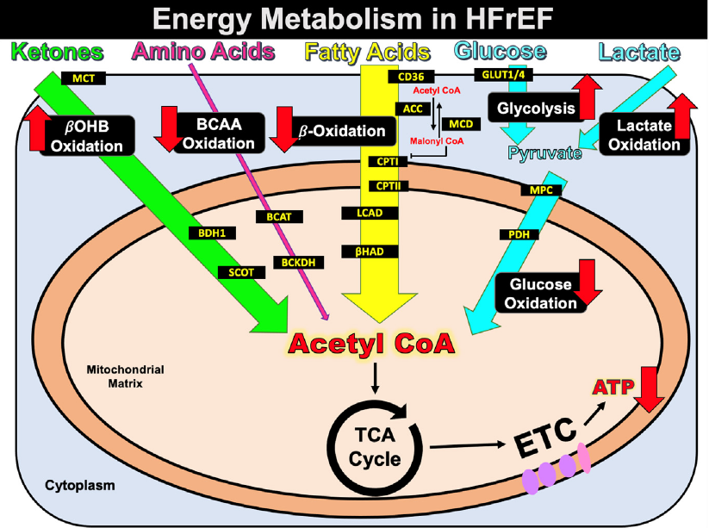
Cardiac energy metabolism in HFrEF
Notes:
Several energy metabolic changes occur in HFrEF, which include a decrease in cardiac
fatty acid ß-oxidation, a decrease in glucose oxidation, an increase in glycolysis, an
increase in ketone body oxidation, and a decrease in branched-chain amino acid
oxidation. Overall, these perturbations in overall cardiac energy metabolism contribute to
decreased energy (ATP) production. HFrEF, Heart failure with reduced ejection fraction.

Slide 52
LIPID METABOLISM IN HFrEF
Inconsistencies in fatty acid utilization in HF, likely attributable to differences in severity (16-48% range of EF) and comorbidities like diabetes or obesity (HFpEF).
although fatty acid oxidation reduced in HFrEF,
fatty acid ATP generation> glucose ATP generation
Lopaschuk GD, Karwi QG, Tian R, Wende AR, Abel ED. Cardiac Energy Metabolism in Heart Failure. Circ Res. 2021 May 14;128(10):1487-1513. doi: 10.1161/CIRCRESAHA.121.318241. Epub 2021 May 13. PMID: 33983836; PMCID: PMC8136750.​​
Cardiovascular Endocrinology and Metabolism (Theory and Practise of Cardiometabolic Medicine), Chapter 7, Gary D.Lopachuk, Kim L.Ho

Slide 53
Lopaschuk GD, Karwi QG, Tian R, Wende AR, Abel ED. Cardiac Energy Metabolism in Heart Failure. Circ Res. 2021 May 14;128(10):1487-1513. doi: 10.1161/CIRCRESAHA.121.318241. Epub 2021 May 13. PMID: 33983836; PMCID: PMC8136750.
Notes:
GLUT1 (glucose transporter 1)
GLUT4 (glucose transporter 4)

Slide 54
GLUCOSE METABOLISM IN HFrEF
Lopaschuk GD, Karwi QG, Tian R, Wende AR, Abel ED. Cardiac Energy Metabolism in Heart Failure. Circ Res. 2021 May 14;128(10):1487-1513. doi: 10.1161/CIRCRESAHA.121.318241. Epub 2021 May 13. PMID: 33983836; PMCID: PMC8136750.​​
Cardiovascular Endocrinology and Metabolism (Theory and Practise of Cardiometabolic Medicine), Chapter 7, Gary D.Lopachuk, Kim L.Ho
INCREASED:
-Glucose uptake (GLUT1* expression)
-Glycolysis, insufficient compensation
1 Glu->2 ATP
1 Glu->1 Pyruvate->31 ATP
-anaplerosis (pyruvate carboxylation)
DECREASED:
-Glucose oxidation
-Transport and metabolism of pyruvate
(reduced MPC* expression)
Nonoxidative metabolism of glycolytic metabolites into pathways below
*mitochondrial pyruvate carrier
*glucose transporter 1
LV remodeling cardiomyocyte hypertrophy

Slide 55
accumulation of O-GlcNAc -> LV remodeling
Lopaschuk GD, Karwi QG, Tian R, Wende AR, Abel ED. Cardiac Energy Metabolism in Heart Failure. Circ Res. 2021 May 14;128(10):1487-1513. doi: 10.1161/CIRCRESAHA.121.318241. Epub 2021 May 13. PMID: 33983836; PMCID: PMC8136750.
Notes:
The reduction in pyruvate utilization is not likely to contribute to energy starvation in heart failure but rather in adverse LV remodeling by nonoxidative metabolism of glycolytic metabolites into pathways such as the polyol pathway, the hexosamine biosynthetic pathway (altered flux through HBP leads to accumulation of O-GlcNAc modifications),the pentose phosphate pathway, and one carbon cycle pathways.
-One potential mechanism for LVH (in animals) is oxidative stress arising in the cytosol and not the mitochondria, supporting the concept that increased availability of glycolytic intermediates could be maladaptive
O-GlcNAc ---post translationation modification (glycosiliosis) N-Acetylglucosamine (

Slide 56
KETONE BODY METABOLISM In HFrEF
Fasting-induced increase in circulating ketones exacerbated
Ketone body oxidation increased*, reciprocally regulated with inhibited fatty acid oxidation
*Whether adaptive or maladaptive not established
Reliance on ketone bodies in HFrEF > HFpEF
Lopaschuk GD, Karwi QG, Tian R, Wende AR, Abel ED. Cardiac Energy Metabolism in Heart Failure. Circ Res. 2021 May 14;128(10):1487-1513. doi: 10.1161/CIRCRESAHA.121.318241. Epub 2021 May 13. PMID: 33983836; PMCID: PMC8136750.​​
Cardiovascular Endocrinology and Metabolism (Theory and Practise of Cardiometabolic Medicine), Chapter 7, Gary D.Lopachuk, Kim L.Ho

Slide 57
BCAA METABOLISM IN HFrEF
Increases in plasma BCAA (branched-chain amino acids), in part due to
Impaired BCAA oxidation
Accumulated BCAAs -> activated mTOR* signaling -> cardiac hypertrophy
*(mammalian target of rapamycin)
Lopaschuk GD, Karwi QG, Tian R, Wende AR, Abel ED. Cardiac Energy Metabolism in Heart Failure. Circ Res. 2021 May 14;128(10):1487-1513. doi: 10.1161/CIRCRESAHA.121.318241. Epub 2021 May 13. PMID: 33983836; PMCID: PMC8136750.​​
Cardiovascular Endocrinology and Metabolism (Theory and Practise of Cardiometabolic Medicine), Chapter 7, Gary D.Lopachuk, Kim L.Ho

Slide 58
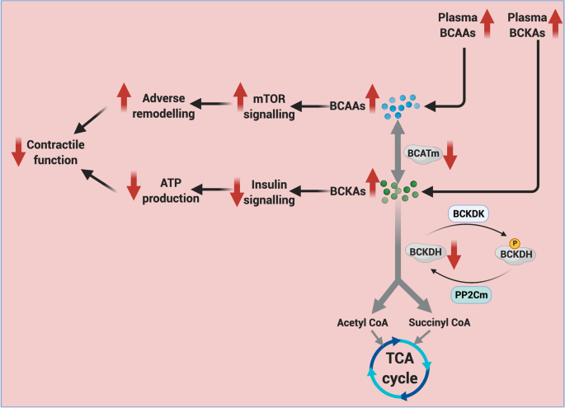
Karwi, Q.G., Lopaschuk, G.D. Branched-Chain Amino Acid Metabolism in the Failing Heart.Cardiovasc Drugs Ther 37, 413–420 (2023). https://doi.org/10.1007/s10557-022-07320-4
Branched-Chain Amino Acid Metabolism in the Failing Heart
Notes:
Increases in plasma BCAA levels, which occur in heart failure, may be due in part to impaired BCAA oxidation. The accumulation of BCAAs in heart failure may activate cardiac mTOR signaling, thereby promoting cardiac hypertrophy. There are also increases in BCKAs, which also lead to contractile dysfunction.
*The first step of BCAA metabolism in the heart involves BCAA conversion to branched-chain α-keto- acids (BCKAs) by the mitochondrial branched-chain amino-transaminase (BCATm). These BCKAs are then decarboxylated by a mitochondrial branched-chain α-keto acid dehydrogenase (BCKDH). BCKDH activity is regulated by phosphorylation with BCKDH by a BCKDH kinase (BDK), which inhibits activity, and dephosphorylation by PPC2m, which activates BCKDH. The products of BCKDH either eventually provide acetyl CoA for the TCA cycle or succinyl-CoA for anaplerosis.

Slide 59
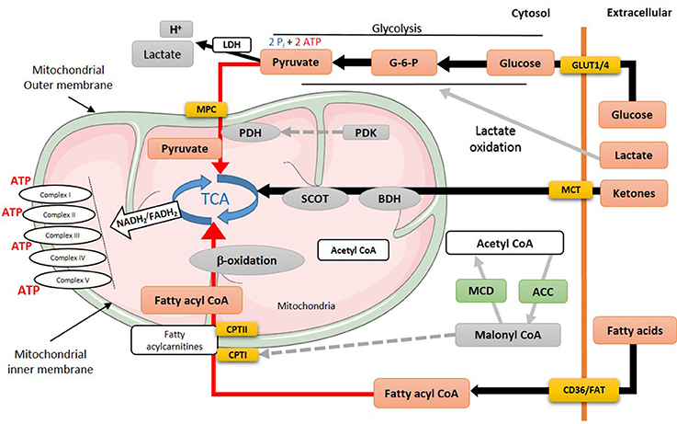
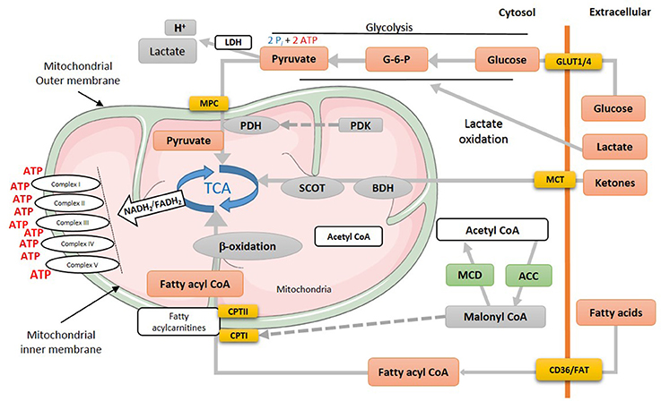
HF: black lines->increased
Red lines->impaired utilization
Healthy heart
https://doi.org/10.3389/fcvm.2018.00068

Slide 60
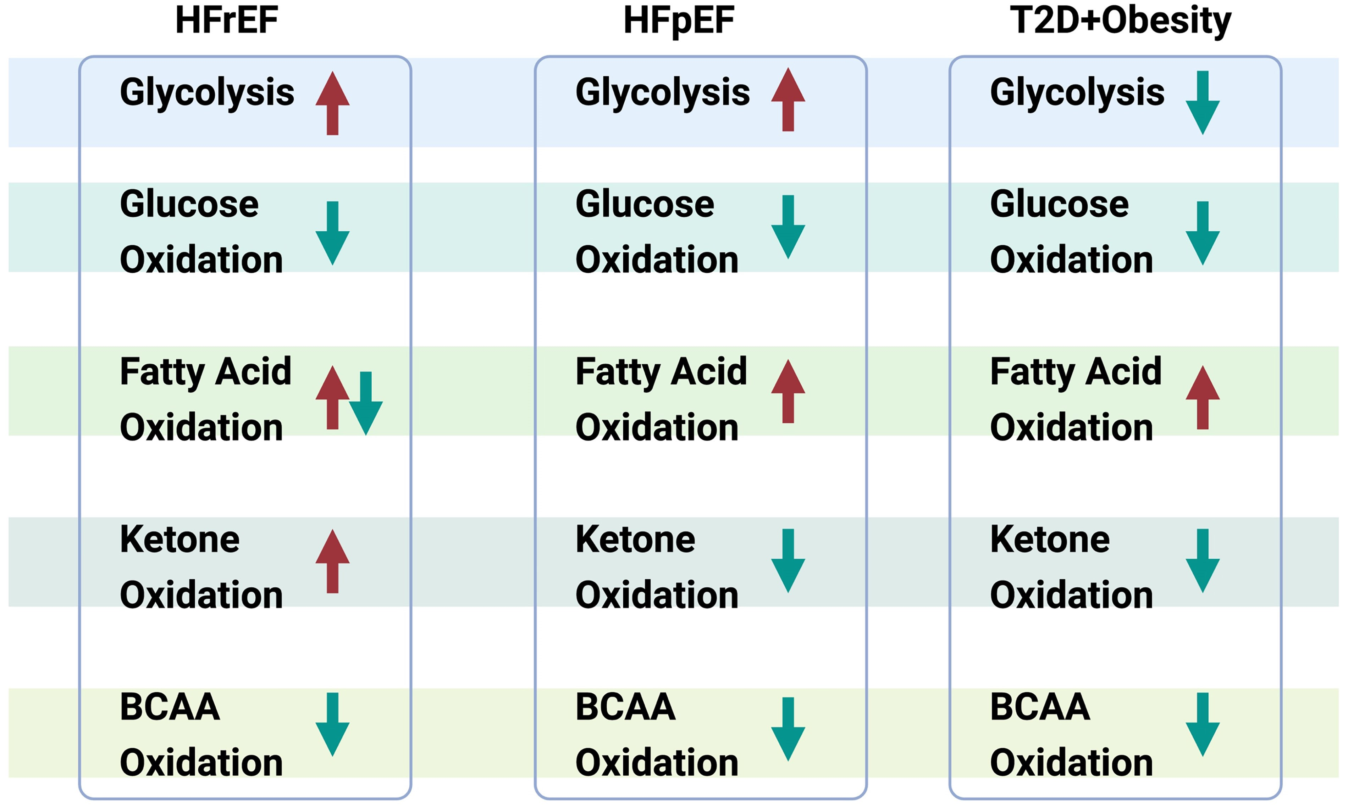
Alterations of myocardial energy metabolism in heart failure
Notes:
Figure 2 Alterations of myocardial energy metabolism in heart failure. Summary chart showing the alterations of five major energy metabolic pathways, including glycolysis, glucose oxidation, fatty acid oxidation, ketone oxidation, branched-chain amino acid (BCAA) oxidation in three different types of HFrEF, HFpEF, heart failure associated with obesity, and T2D. Arrow pointing upward indicates the corresponding pathway is stimulated, and arrow pointing downward indicates the corresponding pathway is suppressed.
Unless provided in the caption above, the following copyright applies to the content of this slide: © The Author(s) 2024. Published by Oxford University Press on behalf of the European Society of Cardiology.This is an Open Access article distributed under the terms of the Creative Commons Attribution License (https://creativecommons.org/licenses/by/4.0/), which permits unrestricted reuse, distribution, and reproduction in any medium, provided the original work is properly cited.

Slide 61
Energy metabolism in HFpEF

Slide 62
Cardiac energy metabolism in heart failure with preserved ejection fraction (HFpEF)
Limited studies due to the lack of appropriate experimental models
Recent models of HFpEF with increased blood pressure and obesity to produce an HFpEF phenotype new research opportunities
increased stiffness, increased LVED pressure, and normal systolic function
Lopaschuk GD, Karwi QG, Tian R, Wende AR, Abel ED. Cardiac Energy Metabolism in Heart Failure. Circ Res. 2021 May 14;128(10):1487-1513. doi: 10.1161/CIRCRESAHA.121.318241. Epub 2021 May 13. PMID: 33983836; PMCID: PMC8136750.​​
Cardiovascular Endocrinology and Metabolism (Theory and Practise of Cardiometabolic Medicine), Chapter 7, Gary D.Lopachuk, Kim L.Ho

Slide 63
Mitochondrial function compromised in HFpEF
increased ROS production
impaired mitofission
sustained mitophagy
increased autophagic cell death of cardiomyocytes
transcription factor PPARα activated in forms of HFpEF associated with diabetes and obesity upregulation of fatty acid oxidation (in contrast with HFrEF)
Lopaschuk GD, Karwi QG, Tian R, Wende AR, Abel ED. Cardiac Energy Metabolism in Heart Failure. Circ Res. 2021 May 14;128(10):1487-1513. doi: 10.1161/CIRCRESAHA.121.318241. Epub 2021 May 13. PMID: 33983836; PMCID: PMC8136750.​​
Cardiovascular Endocrinology and Metabolism (Theory and Practise of Cardiometabolic Medicine), Chapter 7, Gary D.Lopachuk, Kim L.Ho

Slide 64
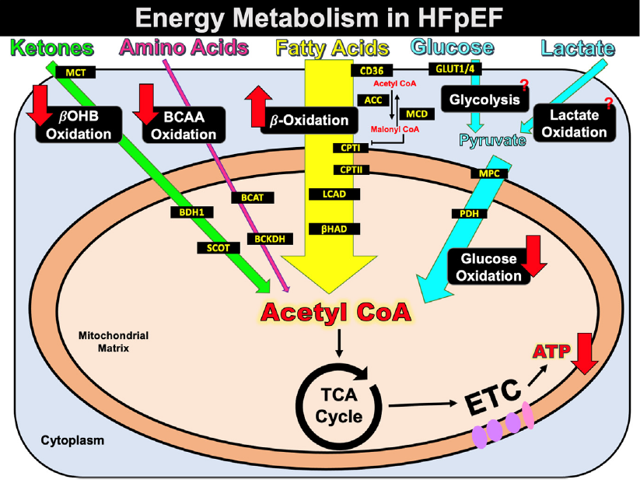
Cardiac energy metabolism in HFpEF
Notes:
Several energy metabolic changes occur in HFpEF, which include an increase in cardiac
fatty acid ß-oxidation, a decrease in glucose oxidation, a decrease in ketone body
oxidation, and a decrease in branched-chain amino acid oxidation. Overall, these
perturbations in overall cardiac energy metabolism contribute to decreased energy (ATP)
production. HFpEF, Heart failure with preserved ejection fraction.

Slide 65
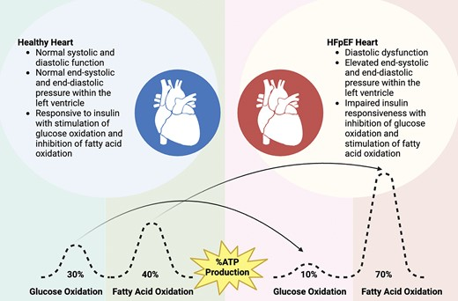
Qiuyu Sun, Berna Güven, Cory S Wagg, Amanda Almeida de Oliveira, Heidi Silver, Liyan Zhang, Brandon Chen, Kaleigh Wei, Ezra B Ketema, Qutuba G Karwi, Kaya L Persad, Jennie Vu, Faqi Wang, Jason R B Dyck, Gavin Y Oudit, Gary D Lopaschuk, Mitochondrial fatty acid oxidation is the major source of cardiac adenosine triphosphate production in heart failure with preserved ejection fraction, Cardiovascular Research, 2024;, cvae006, https://doi.org/10.1093/cvr/cvae006

Slide 66
Fatty acid oxidation in HFpEF
Increased myocardial fatty acid β-oxidation in response to conditions such as type 2 diabetes, obesity, insulin resistance (prevalent in patients with HFpEF)
Obese women with LV hypertrophy, HFpEF and reduced cardiac efficiency
increased myocardial fatty acid uptake and oxidation with the severity of their insulin resistance correlating with higher rates of fatty acid oxidation
Men with type 2 diabetes and cardiomyopathy similar to HFpEF
increased fatty acid uptake and ß-oxidation
Lopaschuk GD, Karwi QG, Tian R, Wende AR, Abel ED. Cardiac Energy Metabolism in Heart Failure. Circ Res. 2021 May 14;128(10):1487-1513. doi: 10.1161/CIRCRESAHA.121.318241. Epub 2021 May 13. PMID: 33983836; PMCID: PMC8136750.​​
Cardiovascular Endocrinology and Metabolism (Theory and Practise of Cardiometabolic Medicine), Chapter 7, Gary D.Lopachuk, Kim L.Ho

Slide 67
Increases in plasma concentrations of fatty acids have been associated with increased risk for developing heart failure
Despite the close association, a causal role for increased fatty acid oxidation rates in cardiac dysfunction of obesity or diabetes is less certain
Lopaschuk GD, Karwi QG, Tian R, Wende AR, Abel ED. Cardiac Energy Metabolism in Heart Failure. Circ Res. 2021 May 14;128(10):1487-1513. doi: 10.1161/CIRCRESAHA.121.318241. Epub 2021 May 13. PMID: 33983836; PMCID: PMC8136750.​​
Cardiovascular Endocrinology and Metabolism (Theory and Practise of Cardiometabolic Medicine), Chapter 7, Gary D.Lopachuk, Kim L.Ho

Slide 68
Glucose metabolism in heart failure with preserved ejection fraction
Glucose uptake and glycolysis decreased in HFpEF (increased in HFrEF)
Decreases in myocardial glucose oxidation in experimental models
Decreases in glucose oxidation promote HFpEF
required for normal cardiac metabolism and for coping with heart failure-promoting stresses
Lopaschuk GD, Karwi QG, Tian R, Wende AR, Abel ED. Cardiac Energy Metabolism in Heart Failure. Circ Res. 2021 May 14;128(10):1487-1513. doi: 10.1161/CIRCRESAHA.121.318241. Epub 2021 May 13. PMID: 33983836; PMCID: PMC8136750.​​
Cardiovascular Endocrinology and Metabolism (Theory and Practise of Cardiometabolic Medicine), Chapter 7, Gary D.Lopachuk, Kim L.Ho

Slide 69
Ketone body oxidation in heart failure with preserved ejection fraction
Limited studies
Ketone oxidation decreased compared to HFrEF patients
Plasma concentration of ketone bodies increased in insulin resistance and type 2 diabetes unclear if myocardial uptake and oxidation is increased
Ketone oxidation in db/db mice with HFpEF decreased
Decreased hydroxybutyrate dehydrogenase 1 (BDH1) expression
Lopaschuk GD, Karwi QG, Tian R, Wende AR, Abel ED. Cardiac Energy Metabolism in Heart Failure. Circ Res. 2021 May 14;128(10):1487-1513. doi: 10.1161/CIRCRESAHA.121.318241. Epub 2021 May 13. PMID: 33983836; PMCID: PMC8136750.​​
Cardiovascular Endocrinology and Metabolism (Theory and Practise of Cardiometabolic Medicine), Chapter 7, Gary D.Lopachuk, Kim L.Ho

Slide 70
Branched-chain amino acid oxidation in heart failure with preserved ejection fraction
prevalent in HFpEF, whether this is due to alterations in BCAA oxidation is not known
Impaired BCAA oxidation
accumulation of BCAAs and BCKAs
cardiac insulin resistance
and contractile dysfunction
Overall amino acid oxidation decreased compared to patients with HFrEF, but not clear if BCAA oxidation is decreased
Lopaschuk GD, Karwi QG, Tian R, Wende AR, Abel ED. Cardiac Energy Metabolism in Heart Failure. Circ Res. 2021 May 14;128(10):1487-1513. doi: 10.1161/CIRCRESAHA.121.318241. Epub 2021 May 13. PMID: 33983836; PMCID: PMC8136750.​​
Cardiovascular Endocrinology and Metabolism (Theory and Practise of Cardiometabolic Medicine), Chapter 7, Gary D.Lopachuk, Kim L.Ho

Slide 71
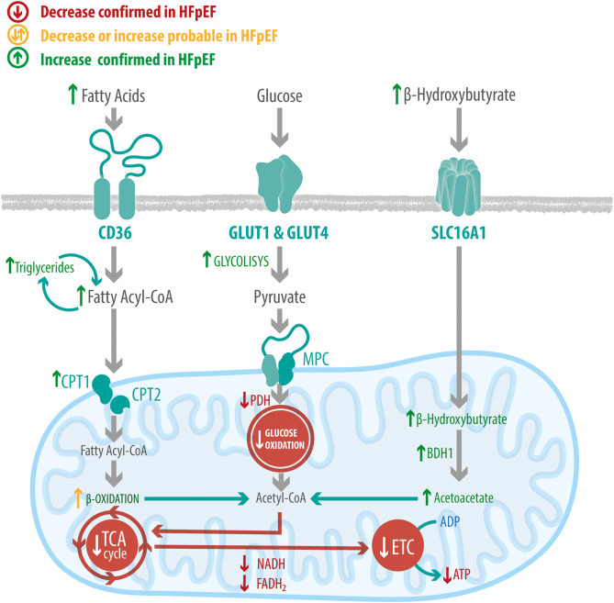

Slide 72
Alterations of myocardial energy metabolism in heart failure
Notes:
Figure 2 Alterations of myocardial energy metabolism in heart failure. Summary chart showing the alterations of five major energy metabolic pathways, including glycolysis, glucose oxidation, fatty acid oxidation, ketone oxidation, branched-chain amino acid (BCAA) oxidation in three different types of HFrEF, HFpEF, heart failure associated with obesity, and T2D. Arrow pointing upward indicates the corresponding pathway is stimulated, and arrow pointing downward indicates the corresponding pathway is suppressed.
Unless provided in the caption above, the following copyright applies to the content of this slide: © The Author(s) 2024. Published by Oxford University Press on behalf of the European Society of Cardiology.This is an Open Access article distributed under the terms of the Creative Commons Attribution License (https://creativecommons.org/licenses/by/4.0/), which permits unrestricted reuse, distribution, and reproduction in any medium, provided the original work is properly cited.

Slide 73
alterations in transcription, redox state and metabolite signaling contributing to post-translational/epigenetic changes
HFrEF | CARDIAC | HFpEF
+ | decreased ATP production from mitochondrial oxidative metabolism | +
 | increased fatty acid oxidation (decrease in cardiac efficiency) | +
+ | insulin resistance | + (+)
+ | decreased glucose oxidation | +
+ | Decreased BCAA oxidation | +
+ | increased ketone oxidation
 | decreased ketone oxidation | +
+ | DECREASED EFFICIENCY | +

Slide 74
LIPOTOXICITY
Mechanisms link lipotoxicity and HF
- oxidative stress
-suppressed autophagy
- mitochondrial uncoupling
-altered mitochondrial dynamics
-accumulation of toxic lipid intermediates
such as ceramide or diacylglycerol
- endoplasmic reticulum stress
- inflammation
->activates signaling pathways
->impaired cardiac function
Mitochondrial oxidative capacity unable to adapt to lipid overload
(obesity or diabetes)
Increases heart failure risk in diabetes

Slide 75
INSULIN RESISTANCE IN HEART FAILURE
Cardiac insuline resistance (early metabolic perturbations):
-in insulin-mediated glucose uptake and direct (AKT* in signaling pathway) glucose oxidation
→decrease in contractile function
-insulin fatty acid oxidation inhibition
-potentially not only a marker of HF severity but also mediates contractile dysfunction
-whole body insulin resistance: -> aggravated by HF
->risk factor for HF *protein kinase b

Slide 76
Glucose and fatty acid metabolism are tightly controlled by insulin signaling in the heart
Patients with insulin resistance have high rates of lipolysis in adipose tissue with increases in TAG hydrolysis.
insulin resistance-induces shifts in favor of fatty acid oxidation and is associated with attenuation of glucose uptake by the heart.
Impairment in insulin signaling primarily has a direct inhibitory effect on fatty acid oxidation by increasing the malonyl CoA levels and secondarily inhibiting glucose oxidation through a negative feedback effect of the Randle cycle.
Notes:
In insulin resistanceAdipocytes become less responsive to insulin’s antilipolytic effect.→ HSL activity remains high, so triacylglycerols (TAGs) in adipose tissue undergo excessive hydrolysis.→ Increased release of FFAs and glycerol into the circulation.ConsequencesElevated plasma FFA levels → hepatic uptake → promote gluconeogenesis and hepatic TAG synthesis.Increased VLDL secretion → dyslipidemia (↑TG, ↓HDL, small dense LDL).FFAs impair insulin signaling in muscle and liver → further worsening of insulin resistance.Chronic FFA excess contributes to ectopic fat deposition (liver, heart, skeletal muscle) and lipotoxicity.🔑 Key teaching phrase:“In insulin resistance, failure of insulin to suppress adipose tissue lipolysis leads to increased hydrolysis of triglycerides, elevated free fatty acid flux, and metabolic consequences in liver and muscle.

Slide 77
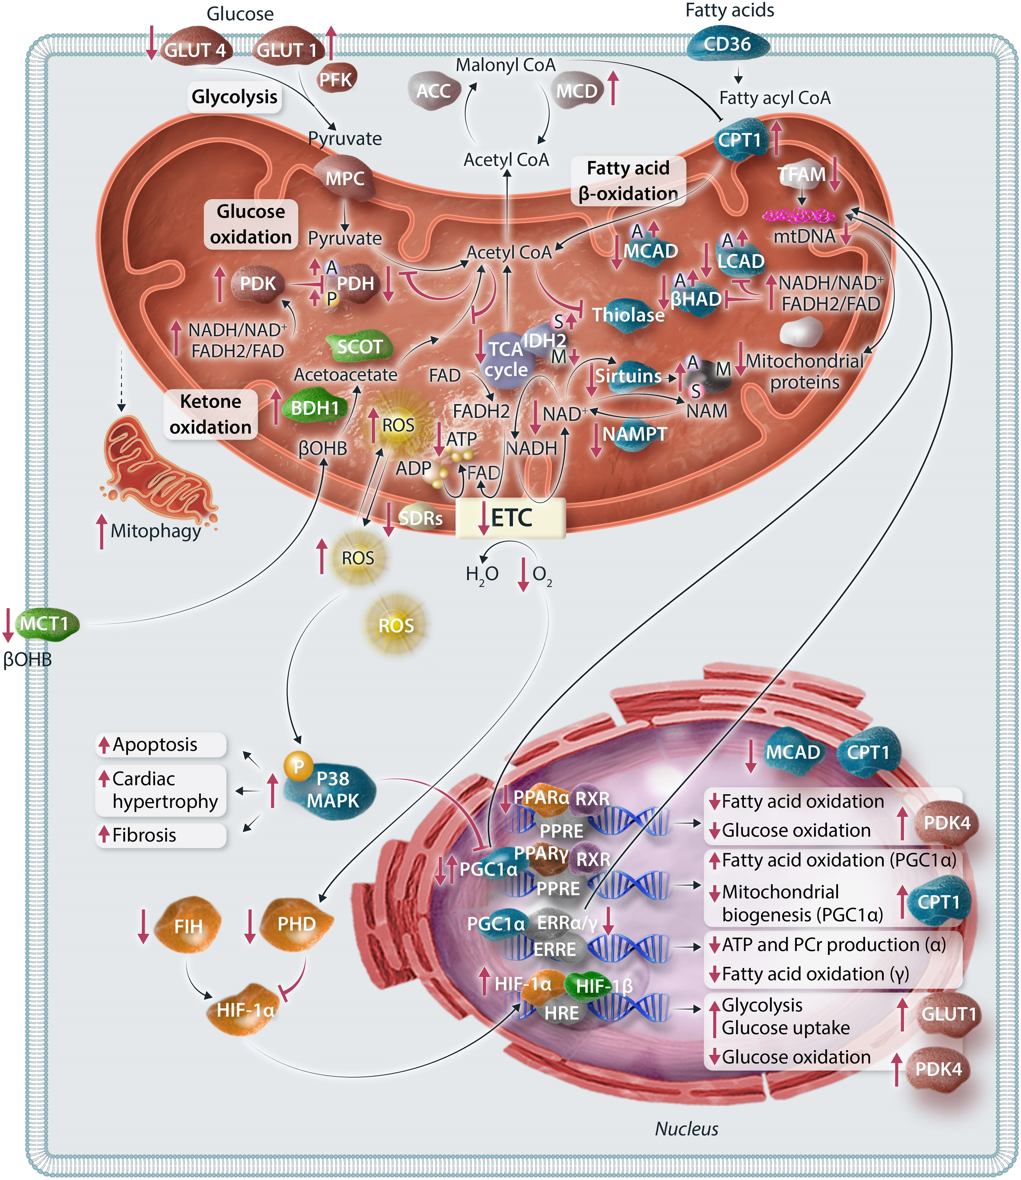
Molecular mechanisms contributing to altered energy metabolism in heart failure
Notes:
Figure 3 Molecular mechanisms contributing to altered energy metabolism in heart failure. Changes and disruptions in energy metabolism in heart failure are governed by four distinct molecular mechanisms: mitochondrial function, substrate control, transcriptional control, and post-translational modifications. (i) Mitochondrial dysfunction in heart failure encompasses reduced transcriptional regulation of mitochondrial biogenesis, increased ROS production, impaired mitofission, sustained mitophagy, and enhanced autophagic cell death of cardiomyocytes. (ii) Regulation of carbon flux through metabolic pathways in the heart relies on tight control of CoA and its derivatives. In heart failure, the acetyl-CoA pool resulting from fatty acid oxidation can allosterically inhibit metabolic pathways through enzymes like PDH, thiolase, and ACAT. (iii) Transcriptional regulation in cardiac metabolism involves PPARs, ERRs, PGC-1α, and HIF-1α. (iv) PTMs play a crucial role in modulating the activities of mitochondrial enzymes and are implicated in heart failure progression. The small bubbles attached to specific proteins with letters P, A, S, M are representing PTMs. The representation of each letter are phosphorylation, P; acetylation, A; succinylation, S; malonylation, M. GLUT1/4, glucose transporter 1/4; PFK, phosphofructokinase; MPC, mitochondrial pyruvate carrier; PDH, pyruvate dehydrogenase; PDK, PDH kinase; CD36/FAT, fatty acid transporter; CPT1, carnitine palmitoyltransferase 1; LCAD, long-chain acyl-CoA dehydrogenase; βHAD, 3-OH-acyl-CoA dehydrogenase; MCAD, medium chain acyl-CoA dehydrogenase; βOHB, β-hydroxybutyrate; BDH1, βOHB dehydrogenase 1; SCOT, succinyl-CoA:3-ketoacid CoA transferase; MCT1, monocarboxylate transporter 1; ROS, reactive oxygen species; TCA, tricarboxylic acid; NADH, nicotinamide adenine dinucleotide; FADH2, flavin adenine dinucleotide; ETC, electron transport chain; ADP, adenosine diphosphate; ATP, adenosine triphosphate; SDR, short chain dehydrogenase; IDH2, isocitrate dehydrogenase; NAMPT, nicotinamide phosphoribosyltransferase; NAM, nicotinamide; TFAM, transcription factor A, mitochondrial; PGC-1α, peroxisome proliferator-activated receptor-gamma coactivator (PGC)-1α; MAPK, mitogen-activated protein kinase; PPAR, peroxisome proliferator-activated receptors; RXR, the retinoid X receptor; ERR, oestrogen-related receptor; HIF1, hypoxia-induced factor-1; HRE, hypoxia-response element.

Slide 78
Therapeutic opportunities

Slide 79
Therapeutic opportunities
Optimizing energy metabolism is a potential therapeutic approach to treating both HFrEF and HFpEF
Presently no FDA approved therapies that specifically target cardiac energy metabolism
Potential future approaches
Lopaschuk GD, Karwi QG, Tian R, Wende AR, Abel ED. Cardiac Energy Metabolism in Heart Failure. Circ Res. 2021 May 14;128(10):1487-1513. doi: 10.1161/CIRCRESAHA.121.318241. Epub 2021 May 13. PMID: 33983836; PMCID: PMC8136750.​​
Cardiovascular Endocrinology and Metabolism (Theory and Practise of Cardiometabolic Medicine), Chapter 7, Gary D.Lopachuk, Kim L.Ho

Slide 80
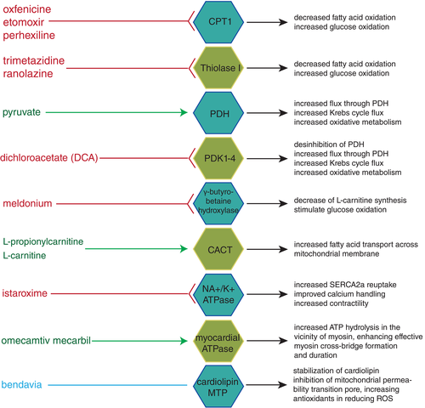
Metabolic support for the heart: complementary therapy for heart failure?
Ward A. Heggermont, et al. 2016

Slide 81
Inhibiting fatty acid oxidation
Improved heart function in patients with both HFrEF and HFpEF
Inhibition of malonyl CoA decarboxylase→ increased malonyl CoA → inhibition of fatty acid oxidation
Inhibitors of fatty acid oxidation such as trimetazidine, etomoxir, and perhexiline (MCD inhibitors)increase glucose oxidation
Lopaschuk GD, Karwi QG, Tian R, Wende AR, Abel ED. Cardiac Energy Metabolism in Heart Failure. Circ Res. 2021 May 14;128(10):1487-1513. doi: 10.1161/CIRCRESAHA.121.318241. Epub 2021 May 13. PMID: 33983836; PMCID: PMC8136750.​​
Cardiovascular Endocrinology and Metabolism (Theory and Practise of Cardiometabolic Medicine), Chapter 7, Gary D.Lopachuk, Kim L.Ho
Notes:
), malonyl CoA decarboxylase
(MCD),

Slide 82
Stimulating glucose oxidation
Dichloroacetate (DCA), a direct inhibitor of PDH kinase stimulation of PDH complex activity
improved cardiac function, decreased lactate production,
Improved cardiac efficiency
In postischemic HF, DCA improved recovery, contractile function and cardiac efficiency
In congestive HF, DCA improved LV mechanical efficiency and enhanced cardiac work
Potency and pharmacokinetics limited clinical usefulness
Lopaschuk GD, Karwi QG, Tian R, Wende AR, Abel ED. Cardiac Energy Metabolism in Heart Failure. Circ Res. 2021 May 14;128(10):1487-1513. doi: 10.1161/CIRCRESAHA.121.318241. Epub 2021 May 13. PMID: 33983836; PMCID: PMC8136750.​​
Cardiovascular Endocrinology and Metabolism (Theory and Practise of Cardiometabolic Medicine), Chapter 7, Gary D.Lopachuk, Kim L.Ho

Slide 83
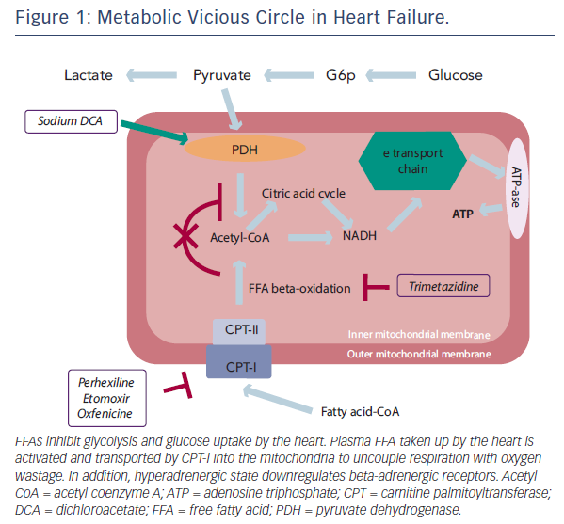
Gabriele Fragasso , Deranged Cardiac Metabolism and the Pathogenesis of Heart Failure, Cardiac Failure Review 2016;2(1):8–13
https://doi.org/10.15420/cfr.2016:5:2

Slide 84
Paradoxical common benefits of opposite therapeutic approaches
Inhibition of malonyl CoA decarboxylase
increased malonyl CoA (MCD inhibitor)
(endogenous fatty acid oxidation inhibitor)r)
Inhibition of malonyl CoA synthesis
(ACC inhibitor)
+
stimulation of β-oxidation
improved coupling of glycolysis to glucose oxidation, suggesting a decrease in proton production from uncoupled glucose metabolism
Improved heart function and efficiency
Improved mitochondrial function
Lopaschuk GD, Karwi QG, Tian R, Wende AR, Abel ED. Cardiac Energy Metabolism in Heart Failure. Circ Res. 2021 May 14;128(10):1487-1513. doi: 10.1161/CIRCRESAHA.121.318241. Epub 2021 May 13. PMID: 33983836; PMCID: PMC8136750.​​
Cardiovascular Endocrinology and Metabolism (Theory and Practise of Cardiometabolic Medicine), Chapter 7, Gary D.Lopachuk, Kim L.Ho

Slide 85
Enhancing cardiac insulin signaling
antagonizing glucagon, using human monoclonal antibody (mAb A) against GC
GR (glucagon receptor)
Akt aktivators
improved cardiac insulin sensitivity, glucose oxidation, and cardiac function
postmyocardial infarction
weight loss (in obesity) -> dietary interventions
improved cardiac function
Lopaschuk GD, Karwi QG, Tian R, Wende AR, Abel ED. Cardiac Energy Metabolism in Heart Failure. Circ Res. 2021 May 14;128(10):1487-1513. doi: 10.1161/CIRCRESAHA.121.318241. Epub 2021 May 13. PMID: 33983836; PMCID: PMC8136750.​​
Cardiovascular Endocrinology and Metabolism (Theory and Practise of Cardiometabolic Medicine), Chapter 7, Gary D.Lopachuk, Kim L.Ho

Slide 86
Stimulating ketone oxidation
Adaptive in the failing heart improved heart function in both HFrEF and HFpEF
Achieved by increasing circulating ketone body levels with the following:
Lopaschuk GD, Karwi QG, Tian R, Wende AR, Abel ED. Cardiac Energy Metabolism in Heart Failure. Circ Res. 2021 May 14;128(10):1487-1513. doi: 10.1161/CIRCRESAHA.121.318241. Epub 2021 May 13. PMID: 33983836; PMCID: PMC8136750.​​
Cardiovascular Endocrinology and Metabolism (Theory and Practise of Cardiometabolic Medicine), Chapter 7, Gary D.Lopachuk, Kim L.Ho

Slide 87
Ketone infusions (ß-hydroxybutyrate) improved contractile function in HFrEF
Ketone ester infusions (R- 3-hydroxybutyral(R)-3-hydroxybutyrate)
Difficult to chronically maintain elevated circulating ketone levels with
either ketone or ketone ester infusions
3) Ketogenic diet very modest improvements in experimental models
4) SGLT2 increased circulated ketone bodies levels and energy supply
Beneficial for both HFrEF and HFpEF
Lopaschuk GD, Karwi QG, Tian R, Wende AR, Abel ED. Cardiac Energy Metabolism in Heart Failure. Circ Res. 2021 May 14;128(10):1487-1513. doi: 10.1161/CIRCRESAHA.121.318241. Epub 2021 May 13. PMID: 33983836; PMCID: PMC8136750.​​
Cardiovascular Endocrinology and Metabolism (Theory and Practise of Cardiometabolic Medicine), Chapter 7, Gary D.Lopachuk, Kim L.Ho

Slide 88
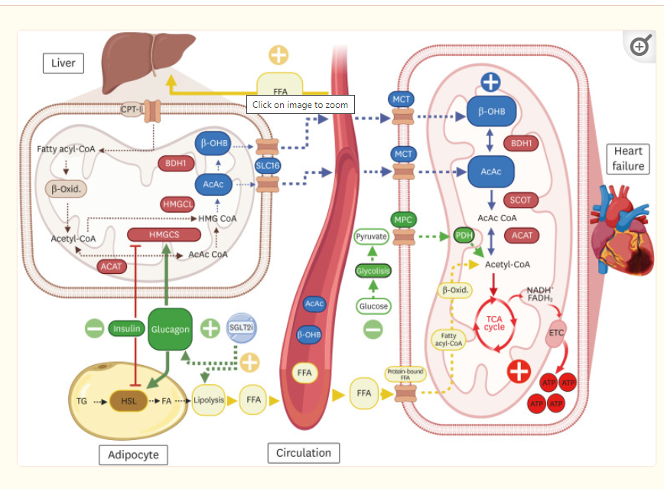

Slide 89
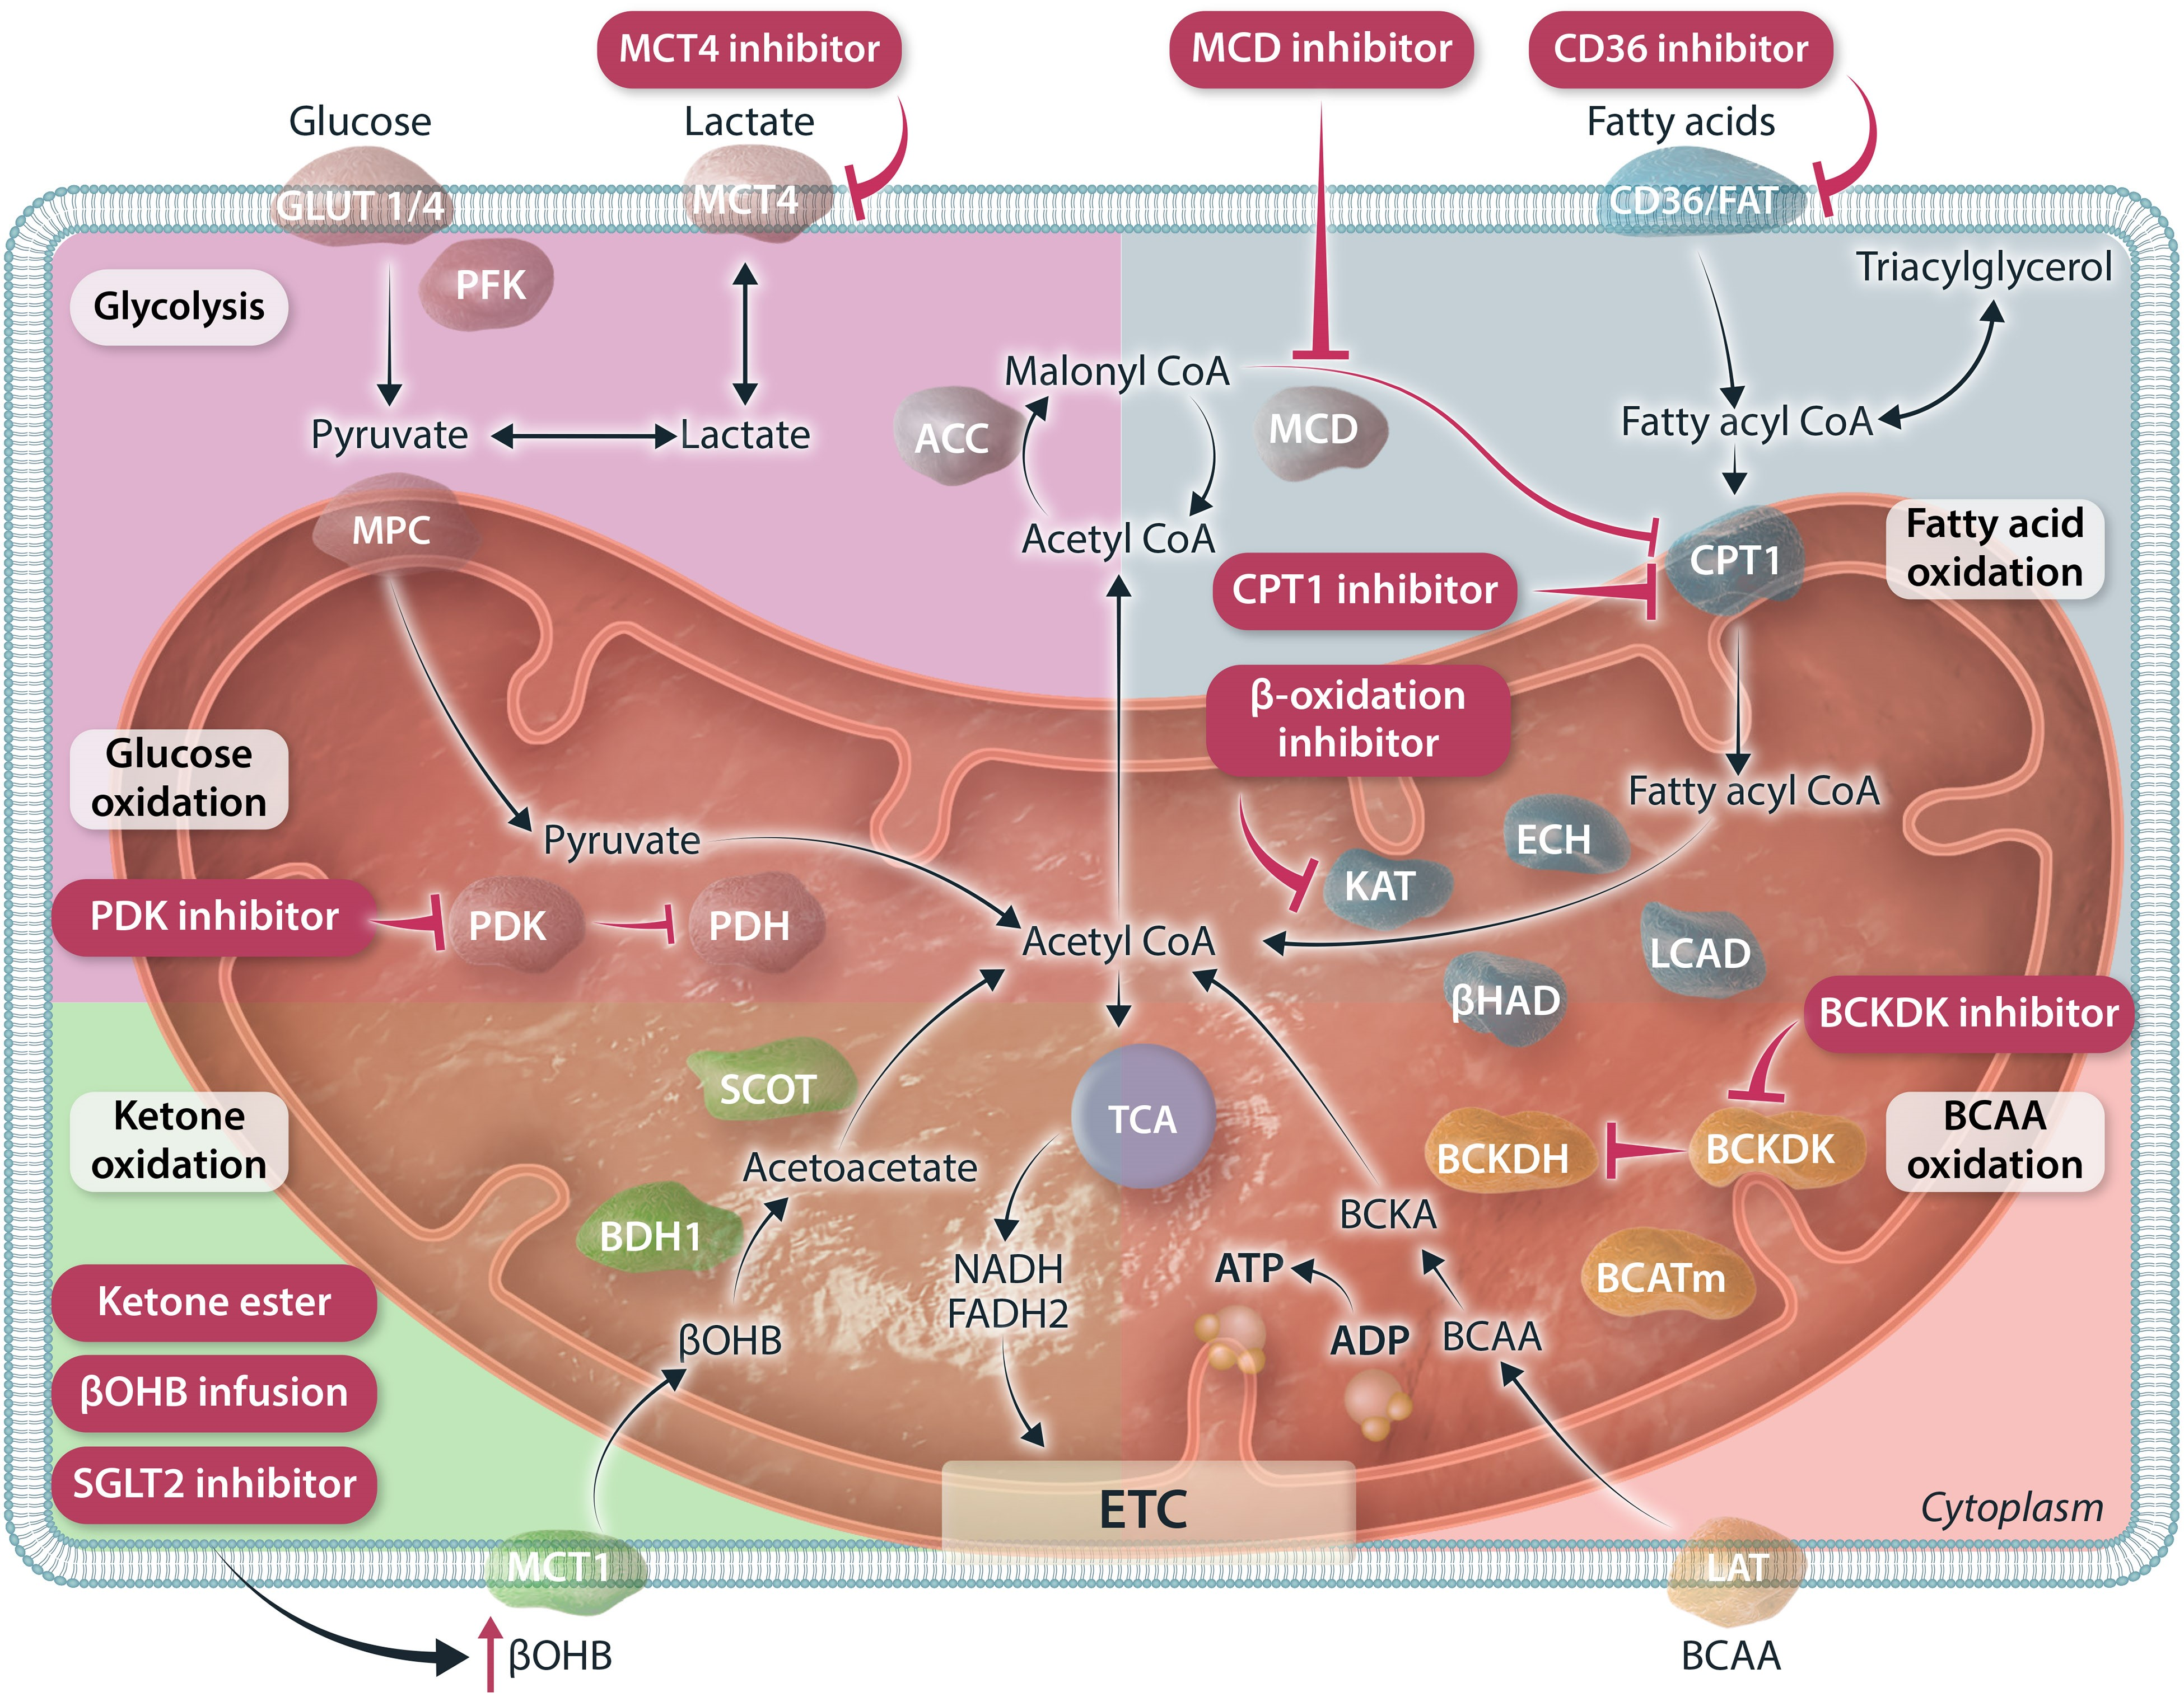
Current available pharmacological therapies that target cardiac energy metabolism
Cardiovasc Res, Volume 120, Issue 16, November 2024, Pages 1996–2016
Notes:
Figure 4 Current available pharmacological therapies that target cardiac energy metabolism. Collection of drugs that target different metabolic pathways through modifying the action of key enzymes involved. PDK inhibitor alleviates the inhibitory action of PDK on PDH, thus can stimulate glucose oxidation. MCT4 inhibition decreases lactate efflux, which can redirect glycolytic carbon flux into mitochondrial pyruvate oxidation/glucose oxidation. CD36 inhibition decrease fatty acid uptake into myocardium. Both CPT1 inhibitors and MCD inhibitors decrease the action of CPT1 for uptake of fatty acids into mitochondria. β-oxidation inhibitors interferes with the action of KAT, one of the major β-oxidation enzymes. Ketone therapy includes, ketone ester, βOHB infusion, SGLT2 inhibitor all which increases circulating βOHB levels, thus elevated accessibility of βOHB for further uptake and oxidation by the heart. BCKDK inhibitors alleviate the inhibitory action of BCKDK, thus stimulating the action of BCKDH and inducing the flux of BCAA oxidation. GLUT1/4, glucose transporter 1/4; MCT4, monocarboxylate transporter 4; PFK, phosphofructokinase; MPC, mitochondrial pyruvate carrier; PDH, pyruvate dehydrogenase; PDK, PDH kinase; ACC, acetyl-CoA carboxylase; MCD, malonyl-CoA decarboxylase; CD36/FAT, fatty acid transporter; CPT1, carnitine palmitoyltransferase 1; LCAD, long-chain acyl-CoA dehydrogenase; ECH, enoyl CoA hydratase; βHAD, 3-OH-acyl-CoA dehydrogenase; KAT, 3-ketoacyl-CoA thiolase; BCAA, branched-chain amino acids; BCATm, mitochondrial BCAA amimotransferase; BCKDH, branched-chain α-ketoacid dehydrogenase; BCKDK, BCKDH kinase; LAT, L-type amino acid transporters; βOHB, β-hydroxybutyrate; BDH1, βOHB dehydrogenase 1; SCOT, succinyl-CoA:3-ketoacid CoA transferase; SGLT2, sodium-glucose co-transporter 2; TCA, tricarboxylic acid; NADH; nicotinamide adenine dinucleotide; FADH2, flavin adenine dinucleotide; ETC, electron transport chain; ADP, adenosine diphosphate; ATP, adenosine triphosphate.
Unless provided in the caption above, the following copyright applies to the content of this slide: © The Author(s) 2024. Published by Oxford University Press on behalf of the European Society of Cardiology.This is an Open Access article distributed under the terms of the Creative Commons Attribution License (https://creativecommons.org/licenses/by/4.0/), which permits unrestricted reuse, distribution, and reproduction in any medium, provided the original work is properly cited.

Slide 90
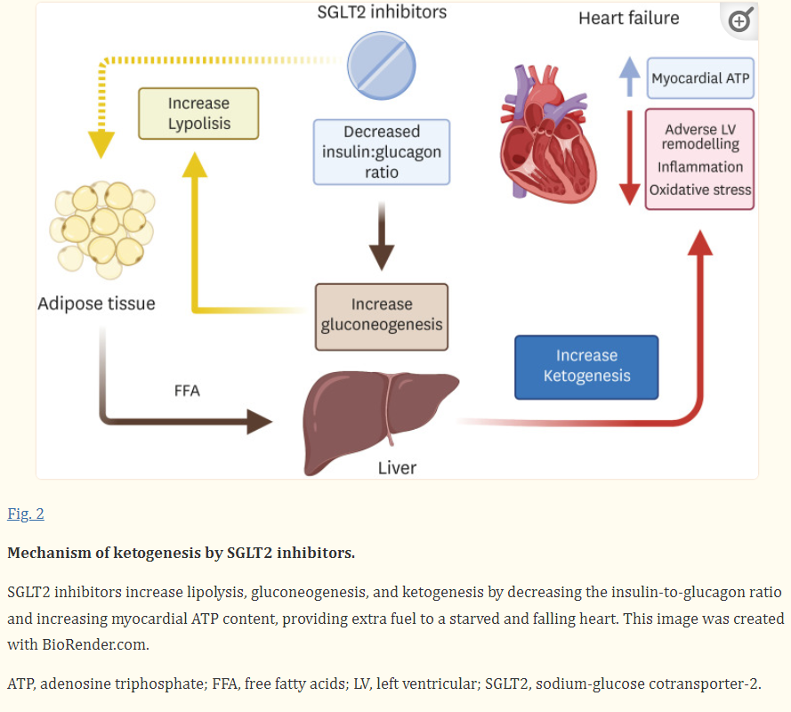

Slide 91
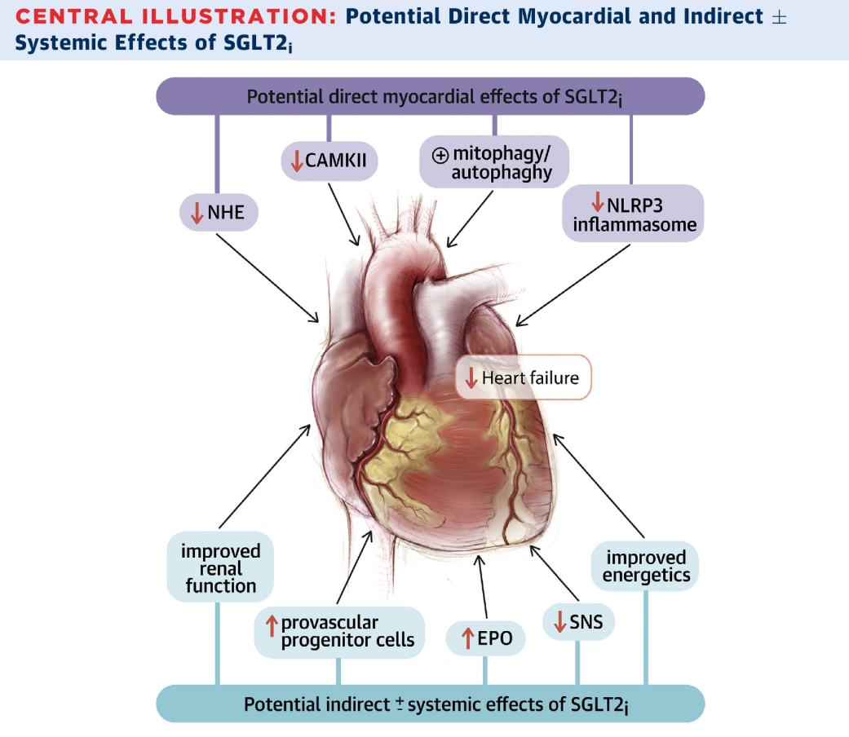
Gary D. Lopaschuk et al. J Am Coll Cardiol Basic Trans Science 2020; 5:632-644.
Notes:
CAMKII = calmodulin-dependent protein kinase II; EPO = erythropoietin; NHE = sodium/hydrogen exchanger; NLRP3 = nucleotide-binding oligomerization domain, leucine-rich repeat, and pyrin domain-containing 3; SGLT2_{i} = sodium glucose co-transporter 1(2) inhibitor; SNS = sympathetic nervous system.

Slide 92
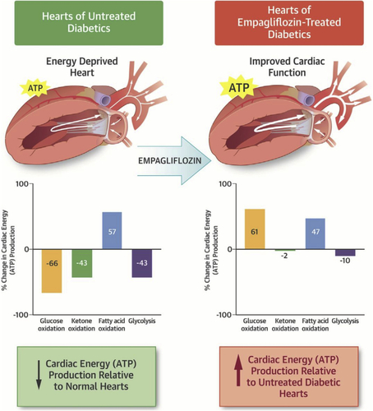
Gary D. Lopaschuk et al. J Am Coll Cardiol Basic Trans Science 2020; 5:632-644.
Notes:
CAMKII = calmodulin-dependent protein kinase II; EPO = erythropoietin; NHE = sodium/hydrogen exchanger; NLRP3 = nucleotide-binding oligomerization domain, leucine-rich repeat, and pyrin domain-containing 3; SGLT2_{i} = sodium glucose co-transporter 1(2) inhibitor; SNS = sympathetic nervous system.

Slide 93
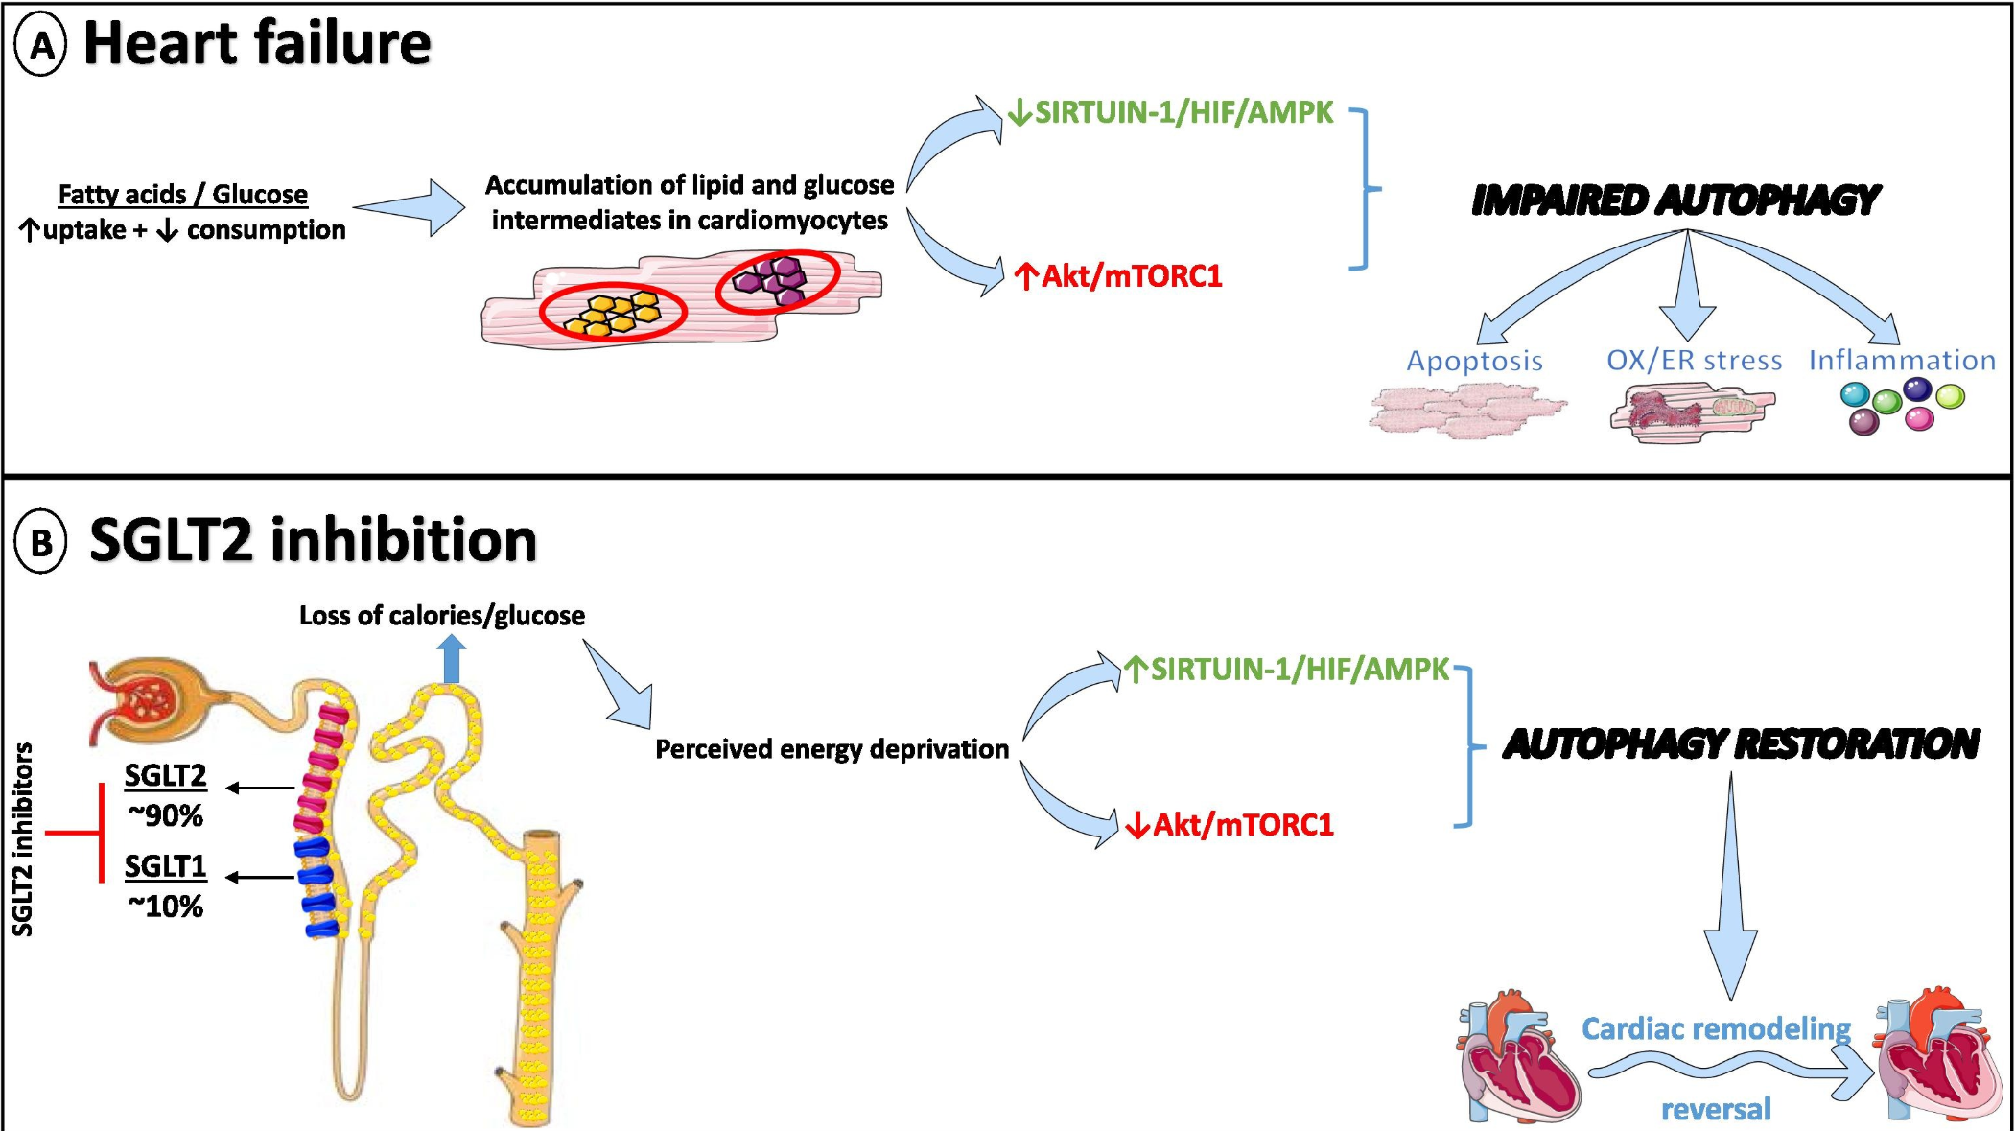
Diabetes Research and Clinical Practice Volume 188, June 2022, 109927
Notes:
Impaired autophagy in heart failure and the potential role of SGLT2 inhibition. A) Heart failure is a condition of nutrient excess leading to the accumulation of lipid and glucose intermediates in cardiomyocytes, ultimately resulting in impaired autophagy with ensuing apoptosis, oxidative (OX) and endoplasmic reticulum (ER) stress, and inflammation. B) SGLT2 inhibitors promote a state of perceived nutritional deprivation with an altered balance between the Sirtuin-1/Hypoxia-inducible factor (HIF)/ 5′ AMP-activated protein kinase (AMPK) pathway and the Akt/mammalian target of rapamycin complex 1 (mTORC1) pathway. Consequently, the restoration of autophagy aids the reversal of adverse cardiac remodeling.
nsulin binding to its receptor → autophosphorylation of the receptor → recruitment of IRS (insulin receptor substrates).
IRS activates PI3K → PIP3 → Akt (protein kinase B).
Akt phosphorylates multiple targets, including TSC2 (tuberous sclerosis complex), releasing inhibition of Rheb.
Rheb activates mTORC1 (mammalian target of rapamycin complex 1).
mTORC1 promotes:
Protein synthesis (via S6K1, 4E-BP1).
Lipogenesis (via SREBP1c).
Cell growth and survival.
Nutrient sensing and anabolic metabolism
In insulin resistance, the Akt → mTORC1 pathway is paradoxically overstimulated by nutrient excess, and instead of promoting healthy growth and metabolism, it generates feedback inhibition of insulin signaling, fueling a vicious cycle of hyperinsulinemia and metabolic dysfunction.

Slide 94
Stimulation of BCAA oxidation
Decreased circulating BCAA levels cardioprotective in HFrEF
Achieved by using the branched-chain keto acid dehydrogenase kinase inhibitor (BT2), which reduces BCAA and BCKA accumulation
improved heart function
Not yet clear how it effects HFpEF
Lopaschuk GD, Karwi QG, Tian R, Wende AR, Abel ED. Cardiac Energy Metabolism in Heart Failure. Circ Res. 2021 May 14;128(10):1487-1513. doi: 10.1161/CIRCRESAHA.121.318241. Epub 2021 May 13. PMID: 33983836; PMCID: PMC8136750.​​
Cardiovascular Endocrinology and Metabolism (Theory and Practise of Cardiometabolic Medicine), Chapter 7, Gary D.Lopachuk, Kim L.Ho

Slide 95
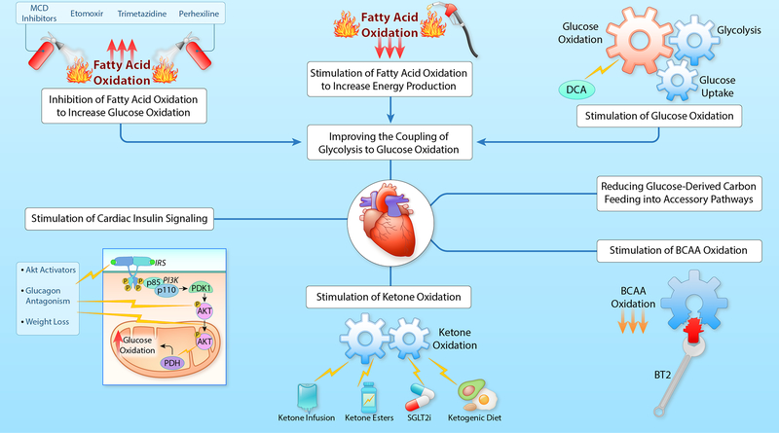
Targeting cardiac metabolism to protect the failing heart
Lopaschuk GD, Karwi QG, Tian R, Wende AR, Abel ED. Cardiac Energy Metabolism in Heart Failure. Circ Res. 2021 May 14;128(10):1487-1513. doi: 10.1161/CIRCRESAHA.121.318241. Epub 2021 May 13. PMID: 33983836; PMCID: PMC8136750.
Notes:
MCD, malonyl CoA decarboxylase; DCA, dichloroacetate; IRS, insulin receptor substrate; PI3K, phosphatidylinositol 3-kinase; PDK1, 3-phosphoinositide-dependent protein kinase-1; Akt, protein kinase B; PDH, pyruvate dehydrogenase; BCAA, branched chain amino acids; BT2, branched chain keto acid dehydrogenase kinase inhibitor; SGLT2i, sodium/glucose cotransporter-2 inhibitors. (Illustration credit: Ben Smith).

Slide 96
Therapeutic target | HFrEF | HFpEF
Sodium glucose cotransporter 2 | Inhibition • Empagliflozin • Dapagliflozin • Canagliflozin | Inhibition • Empagliflozin
Fatty acid oxidation | Inhibition • Trimetazidine • Etomoxir • Perhexiline • MCD inhibitor | Inhibition • Trimetazidine • Etomoxir • Perhexiline • MCD inhibitor
 | Stimulation • ACC inhibition
Glucose oxidation | Stimulation • Dichloroacetate • New PDK inhibitors | Stimulation • Dichloroacetate • New PDK inhibitors
Ketone body oxidation | Stimulation • Ketone infusion • Ketone ester • Ketogenic diet • SGLT2 inhibition | Stimulation • Ketone infusion • Ketone ester • Ketogenic diet • SGLT2 inhibition
Branched-chain amino acid oxidation | Stimulation • BCKDK inhibitor (BT2) | Stimulation • BCKDK inhibitor (BT2)
Cardiovascular Endocrinology and Metabolism (Theory and Practise of Cardiometabolic Medicine), Chapter 7, Gary D.Lopachuk, Kim L.Ho​

Slide 97
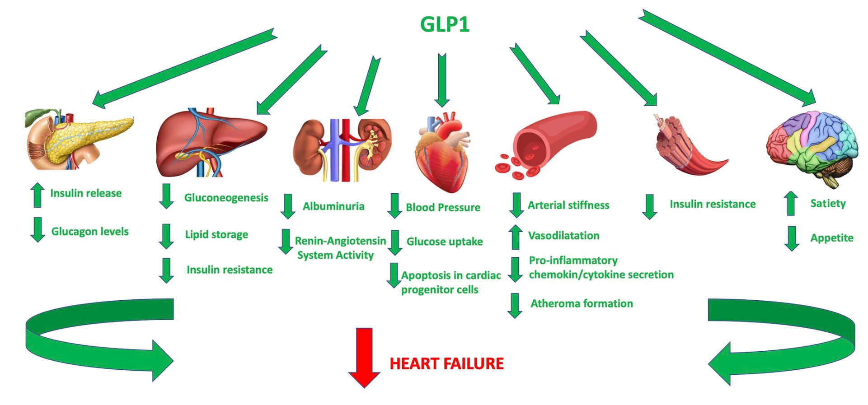
Vascular and metabolic effects of GLP-1 in heart failure patients
Heart Fail Rev 28, 733–744 (2023)

Slide 98
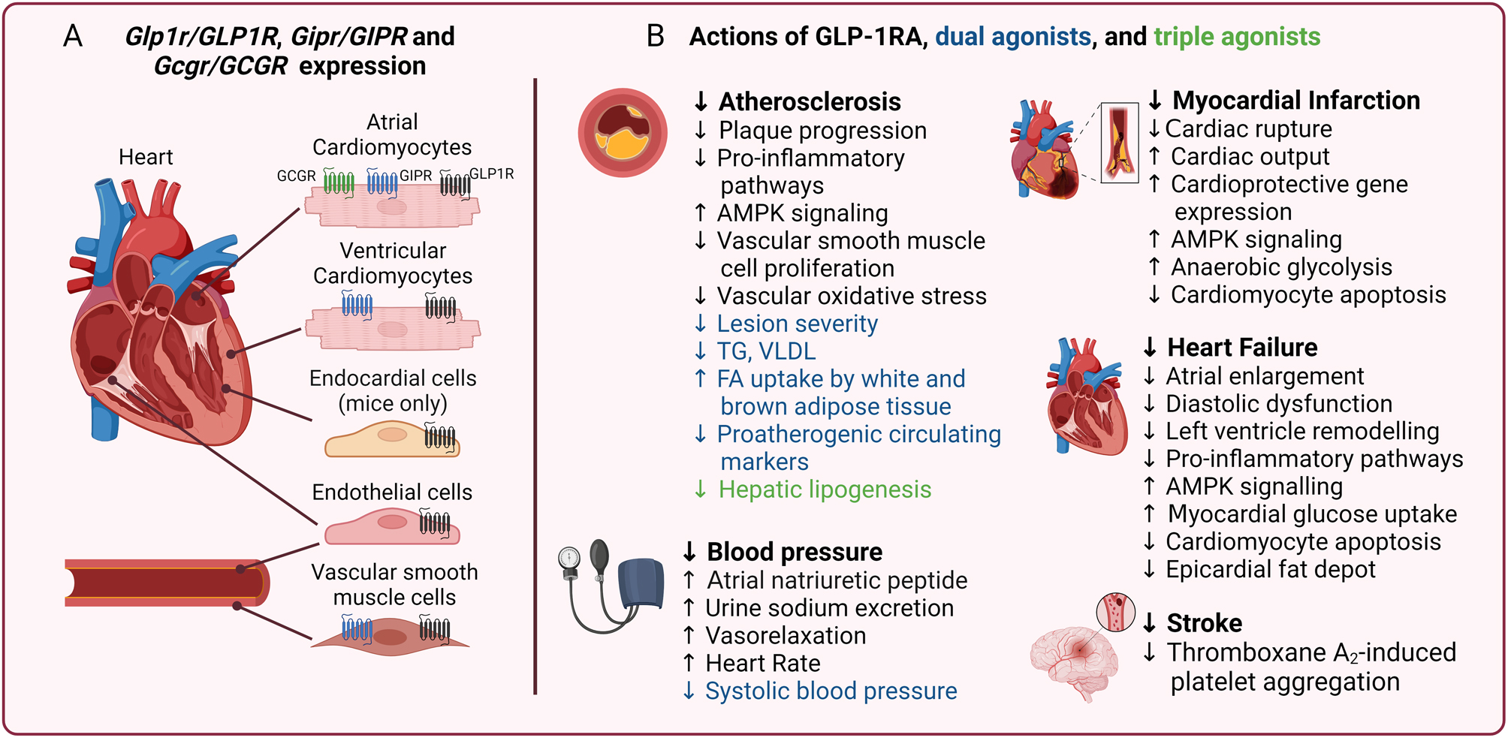
https://doi.org/10.1530/JOE-24-0046
Notes:
Figure 1 Cardiovascular benefits of GLP-1RA, dual, or triple agonists. (A) Distribution of Glp1r or GLP1R (in black), Gipr or GIPR (in blue), and Gcgr or GCGR (in green) mRNA in the heart of humans and mice. (B) Mechanisms of action by which GLP-1RA (black), dual (blue), or triple agonists (green) improve cardiovascular outcomes. GLP-1RA, glucagon-like peptide 1 receptor agonist; GIPR, glucose-dependent insulinotropic peptide receptor; GCGR, glucagon receptor; TG, triglycerides; VLDL, very low-density lipoproteins; AMPK, 5' adenosine monophosphate-activated protein kinase.

Slide 99
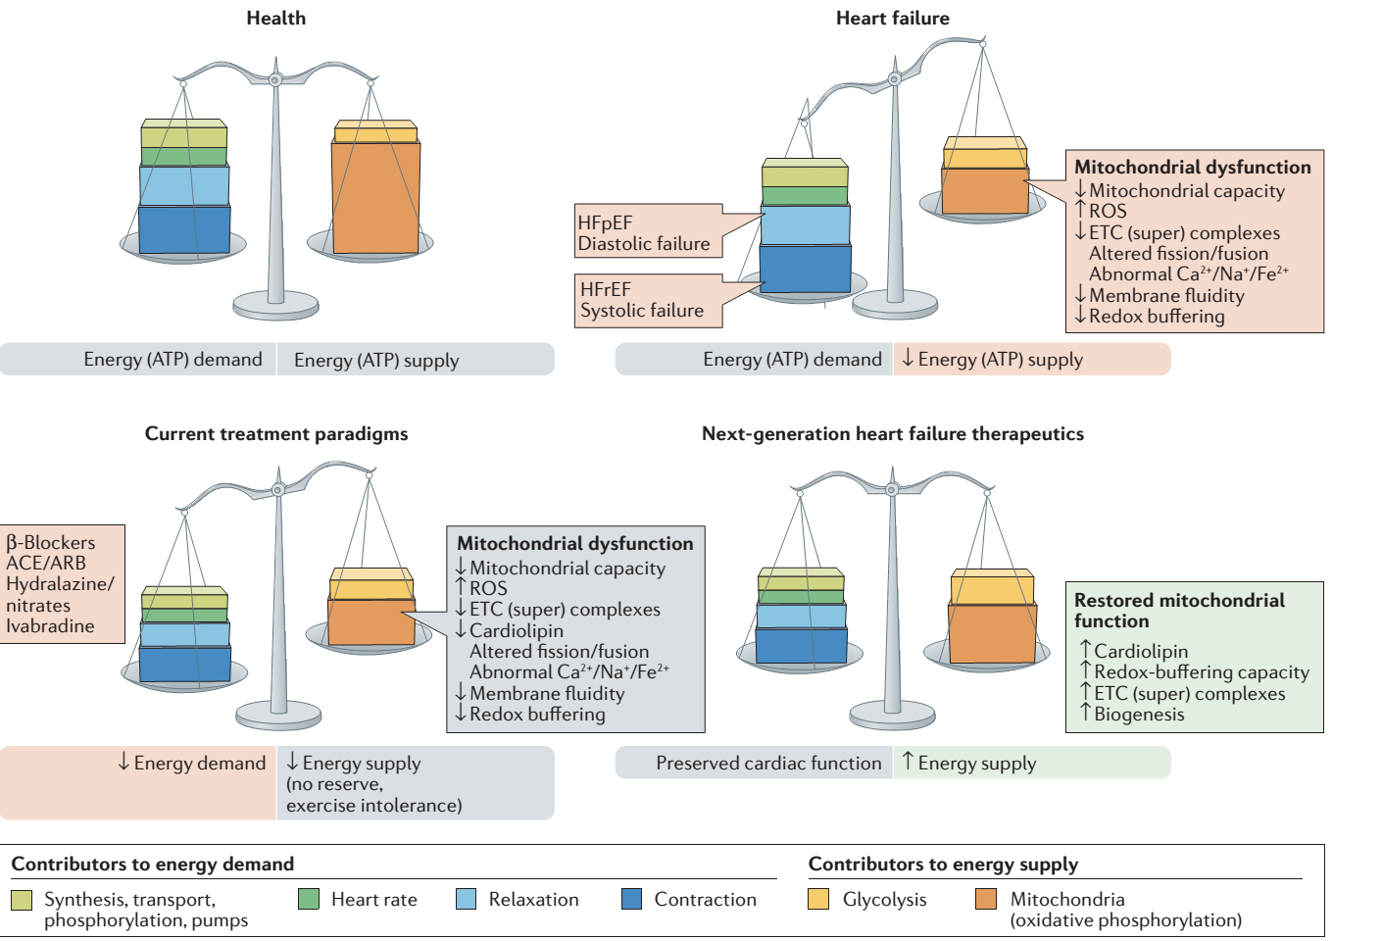
ACE, angiotensin-converting enzyme; ARB, angiotensin II-receptor blocker; ETC, electron transport chain; HFpEF, heart failure with preserved ejection fraction; HFrEF, heart failure with reduced ejection fraction; ROS, reactive oxygen species.
Brown DA, Perry JB, Allen ME, Sabbah HN, Stauffer BL, Shaikh SR, Cleland JG, Colucci WS, Butler J, Voors AA, Anker SD, Pitt B, Pieske B, Filippatos G, Greene SJ, Gheorghiade M. Expert consensus document: Mitochondrial function as a therapeutic target in heart failure. Nat Rev Cardiol. 2017 Apr;14(4):238-250. doi: 10.1038/nrcardio.2016.203. Epub 2016 Dec 22. PMID: 28004807; PMCID: PMC5350035.

Slide 100
Conclusions
Decreased generation and transfer of energy influences all processes that require energy in heart cells, most notably
contraction and relaxation
Changes in cardiac energy metabolism both in HFrEF and HFpEF.
In both, decreased ATP production from mitochondrial oxidative metabolism, to which a number of mitochondrial
abnormalities contribute
y
HFpEF is associated with increased fatty acid oxidation, while ketone oxidation is increased in HFrEF and appears to
be decreased in HFpEF
Both HFrEF and HFpEF are associated with the development of cardiac insulin resistance, a decrease in glucose oxidation rates, a decrease in BCAA oxidation, and a decrease in cardiac efficiency
Potential therapeutic strategies to treat energy pertubations in HF by bolstering mitochondrial energy production would improve existing standard-of-care therapies

Slide 101
THANK YOU
Σας ευχαριστώ
Γεώργιος Γεωργιόπουλος
georgiopoulosgeorgios@gmail.com

