Slide 1


Υπογλυκαιμία και Καρδιαγγειακός Κίνδυνος
"ΠΜΣ Καρδιομεταβολική Ιατρική"
Nικολέτα Καραμπέτσου,ΜD, PhD
Γεώργιος Γεωργιόπουλος
Επίκουρος Καθηγητής Καρδιολογίας
Β’ Παν. Καρδιολογική Κλινική, ΕΚΠΑ

Slide 2
Hypoglycaemia
and Cardiovascular Risk
ECG + CGM
Trigger, marker, or both?
70 mg/dL
54 mg/dL
A low glucose value may be the moment when a vulnerable heart is exposed to sympathetic, electrical, inflammatory and thrombotic stress.
Refs: ADA Standards of Care 2026; IHSG, Diabetologia/Diabetes Care 2017; Frier et al. Diabetes Care 2011.
1
Notes:
Opening: frame hypoglycaemia as a cardiometabolic stressor, not just a diabetes side-effect.

Slide 3
Hypoglycaemia and cardiovascular risk: a cardiometabolic issue
Not just “low sugar”
Risk marker
Therapeutic signal
Hypoglycaemia activates a survival response: catecholamines, haemodynamic stress, altered repolarization, inflammation and thrombosis.
Severe events identify patients with frailty, CKD, autonomic neuropathy, advanced diabetes, comorbidity and overtreatment.
A severe event should trigger review of targets, insulin/sulfonylureas, renal function, meal patterns and CGM need.
Severe hypoglycaemia should be interpreted as a cardiovascular warning sign — whether it is a causal trigger, a vulnerability marker, or both.
Low glucose
Stress response
Vulnerable heart
Event risk
Refs: ADA Standards of Care 2026; ESC Guidelines for CVD in Diabetes 2023; Frier et al. Diabetes Care 2011.
2
Notes:
Emphasize that the cardiologist often sees the high-risk phenotype: ASCVD, HF, CKD and older insulin-treated patients.

Slide 4
Definitions: what counts as clinically important?
Level 1
<70 and ≥54 mg/dL
(<3.9 and ≥3.0 mmol/L)
Alert value: recognize and prevent further fall
Level 2
<54 mg/dL
(<3.0 mmol/L)
Clinically important: neuroglycopenia and higher risk physiology
Level 3
Severe event requiring external assistance
Defined by functional impairment, not a glucose threshold
A “clinically important” biochemical value (<54 mg/dL) and a “severe” event are not the same construct. One is a threshold; the other is a clinical syndrome requiring help.
Refs: IHSG, Diabetologia 2017; ADA Standards of Care 2026; Battelino et al. Diabetes Care 2019.
4
Notes:
Teach thresholds in mg/dL and mmol/L; severe hypoglycaemia is defined clinically, not by a number.

Slide 5
Epidemiology: most events are invisible to clinicians
Visible: reported severe events
Three reasons hypoglycaemia is underestimated
• Non-severe episodes are often not reported
• Nocturnal episodes may be prolonged and asymptomatic
• HbA1c cannot reveal time below range or glycaemic variability
Hidden: unreported, nocturnal, asymptomatic
biochemical hypoglycaemia
CGM changes the denominator
Refs: Frier Nat Rev Endocrinol 2014; Chow et al. Diabetes 2014; ADA Standards of Care 2026.
5
Notes:
Highlight that HbA1c misses time below range and nocturnal/asymptomatic events.

Slide 6
Physiology: the counter-regulatory cascade
↓ Plasma
glucose
↓ Endogenous
insulin
↑ Glucagon +
epinephrine
Symptoms +
behaviour
Recovery
or failure
Why it matters for CV risk
The same physiological rescue response that protects the brain also raises heart rate, blood pressure, myocardial oxygen demand, platelet activation and repolarization instability.
Graduate-level framing
• Hypoglycaemia is a systemic stressor, not only a glucose disorder.
• Risk emerges when compensatory physiology meets vulnerable myocardium/vasculature.
Refs: Cryer PE, Diabetes 2008; Frier et al. Diabetes Care 2011; ADA Standards 2026.
6
Notes:
Describe the fall in insulin and rise in glucagon, epinephrine and symptoms.

Slide 7
Mechanistic map: five cardiovascular stress pathways
Sympathetic
surge
HYPOGLYCAEMIA
Endothelial
dysfunction
QT prolongation
+ arrhythmia
Inflammation +
thrombosis
Ischaemia /
demand mismatch
Outcome phenotype depends on substrate: CAD, LVH, HF, CKD, autonomic neuropathy, age/frailty and medications.
Refs: Frier et al. Diabetes Care 2011; Christou et al. Cardiovasc Diabetol 2023; Chow et al. Diabetes 2014.
7
Notes:
Use this slide as a roadmap for mechanism slides.

Slide 8
Electrophysiology: why QT and potassium matter
During hypoglycaemia
ECG schematic: repolarization becomes the vulnerable interval
↑ Catecholamines, ↑ insulin-mediated cellular potassium shift, possible hypokalaemia, altered autonomic tone and delayed repolarization.
QT interval
• QTc prolongation is common in experimental hypoglycaemia
• Risk is amplified by baseline QTc, QT-prolonging drugs, CKD, ischaemia and electrolyte disturbance
• Nocturnal hypoglycaemia may be prolonged and less symptomatic
Refs: Kacheva et al. Diabetes Res Clin Pract 2017; Lee et al. Diabetes Res Clin Pract 2016; Christou et al. Cardiovasc Diabetol 2023.
8
Notes:
Explain QT prolongation as repolarization vulnerability, not an automatic arrhythmia diagnosis.

Slide 9
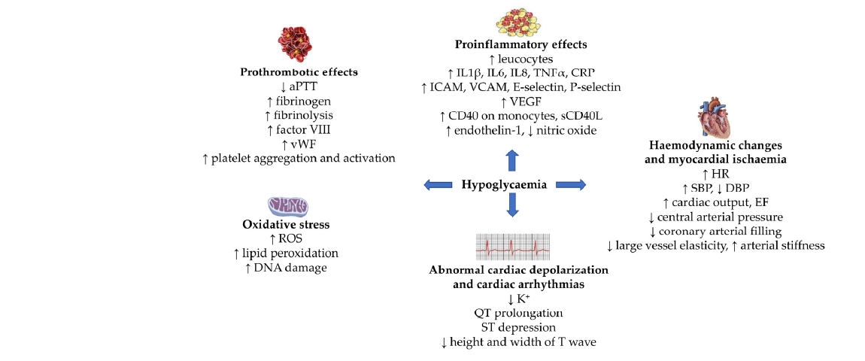
Mechanistic map: hypoglycaemia as a multisystem CV stressor
Inflammation
Thrombosis
Oxidative stress
Repolarization
Ischaemia
One glucose event can activate several CV stress pathways simultaneously.
Mechanistic plausibility is strongest for short-term triggers: arrhythmia, supply-demand ischaemia, thrombosis.
“Low glucose” is not metabolically isolated from the heart.
Ηypoglycaemia is a sympathetic, electrophysiological, inflammatory and thrombotic stressor.
Reference: Christou MA et al. Effects of Hypoglycemia on Cardiovascular Function in Patients with Diabetes. Int J Mol Sci. 2023;24:9357. Figure 2.

Slide 10
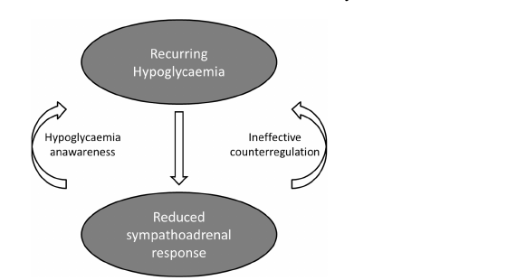
Hypoglycaemia-associated autonomic failure: why recurrent episodes matter
Antecedent hypoglycaemia blunts autonomic warning symptoms.
Glucose thresholds for symptoms and counter-regulation shift downward.
This creates the clinical phenotype: “hypoglycaemia without warning”.
High-risk settings: sleep, exercise, long diabetes duration, autonomic neuropathy.
Clinically important in insulin-treated T1D and long-standing insulin-treated T2D.
CGM can identify unrecognized nocturnal burden.
Recurrent hypoglycaemia can make future hypoglycaemia less symptomatic - and therefore more dangerous.
Reference: Christou MA et al. Int J Mol Sci. 2023;24:9357. Figure 1 and section on impaired hypoglycaemia awareness/HAAF.

Slide 11
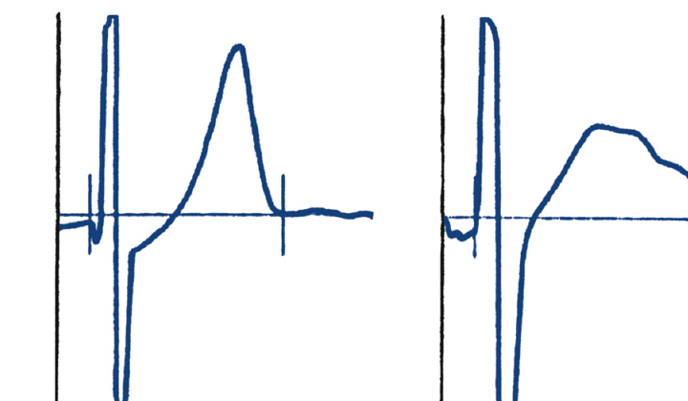
Hypoglycaemia can prolong repolarization
Experimental hypoglycaemia is associated with QT/QTc prolongation and T-wave changes.
Mechanistic drivers include catecholamine surge, insulin/catecholamine-mediated hypokalaemia, and ion-channel effects.
The highest-risk patient is not the healthy volunteer - it is the patient with CAD, LVH, HF, CKD, or autonomic neuropathy.
Practical cardiology link: ask about nocturnal symptoms, syncope, palpitations and falls after “unexplained” arrhythmic episodes.
5.0 mmol/L
2.5 mmol/L
Hypoglycaemia converts metabolic stress into electrical instability.
Reference: Frier BM, Schernthaner G, Heller SR. Hypoglycemia and Cardiovascular Risks. Diabetes Care. 2011;34 Suppl 2:S132-S135. Figure 1.

Slide 12
Arrhythmia phenotypes: day and night may differ
Daytime
Nocturnal
Sympathetic symptoms → tachycardia, palpitations, increased ectopy; patients may recognize and treat the episode.
Longer asymptomatic events → altered vagal/sympathetic balance, bradyarrhythmias or repolarization abnormalities may be observed.
Hypo → symptoms → treatment
Hypo → sleep → prolonged exposure
Νot every hypoglycaemic episode causes arrhythmia; it is that hypoglycaemia can create a pro-arrhythmic milieu in the wrong substrate.
Refs: Chow et al. Diabetes 2014; Novodvorsky et al. Diabetes Care 2017; International Hypoglycaemia Study Group 2017.
9
Notes:
Teach that arrhythmia response is context-specific and the nocturnal physiology may be bradycardic.

Slide 13
Ischaemia: supply–demand mismatch under metabolic stress
Catecholamines
↑ HR, ↑ BP, ↑ contractility
Ischaemia
if supply limited
Hypoglycaemia
↑ Myocardial
oxygen demand
Supply limitation substrates
Clinical clues
Obstructive CAD, diffuse atherosclerosis, coronary microvascular dysfunction, LVH, anaemia, hypoxaemia, tachyarrhythmia, hypotension or acute illness.
Chest discomfort, dynamic ST/T changes, troponin rise, arrhythmias, hypotension, recurrent episodes around meals/insulin peaks or overnight.
Do not over-attribute: hypoglycaemia can trigger demand ischaemia, but coexisting ACS must be considered when the clinical picture fits.
Refs: Desouza et al. Diabetes Care 2010; Frier et al. Diabetes Care 2011; ESC CCS Guidelines 2024.
10
Notes:
Use a cardiology lens: demand up, supply limited by CAD or CMD.

Slide 14
Vascular biology: inflammation, coagulation and endothelial function
Platelets
↑ activation
Coagulation
↑ factor VIII / vWF
Inflammation
↑ cytokines / leukocytes
Endothelium
↓ NO bioavailability
These pathways connect an acute metabolic event to plaque instability, microvascular dysfunction and thrombotic potential — but direct proof of event causation in humans remains challenging.
Mechanistic plausibility ≠ proof of causality
Refs: Wright & Frier, Diabetes Metab Res Rev 2008; Frier et al. Diabetes Care 2011; Joy et al. Diabetes Care 2016.
11
Notes:
Mechanisms are plausible but heterogeneous; avoid overclaiming.

Slide 15
Hypoglycaemia unawareness and autonomic failure
Recurrent
hypoglycaemia
Blunted
adrenergic warning
Reduced
awareness
More severe /
nocturnal events
Clinical consequence
Patients at greatest cardiovascular risk may have the least warning before prolonged hypoglycaemia. This is especially relevant in long-standing diabetes, autonomic neuropathy and CKD.
Refs: Cryer PE, Diabetes 2008; Frier Nat Rev Endocrinol 2014; ADA Standards of Care 2026.
12
Notes:
Explain how recurrent hypoglycaemia shifts awareness lower and increases future risk.

Slide 16
04 | Evidence
The central evidence problem: trigger vs marker
Trigger hypothesis
Marker hypothesis
Acute hypoglycaemia directly provokes arrhythmia, ischaemia, thrombosis or haemodynamic collapse.
Severe hypoglycaemia identifies sicker patients: CKD, frailty, autonomic dysfunction, malnutrition, polypharmacy.
Most defensible conclusion: severe hypoglycaemia is both a potential trigger and a high-risk phenotype marker.
Refs: Zoungas et al. NEJM 2010; Bonds et al. BMJ 2010; Frier et al. Diabetes Care 2011.
13
Notes:
Key methodological teaching: do not infer simple causality from severe hypoglycaemia associations.

Slide 17
Trial timeline: how the field learned the safety lesson
2008
2008
2010
2012
2017
ACCORD
ADVANCE
ADVANCE hypo
ORIGIN
DEVOTE
Intensive glycaemia
arm stopped early
Intensive strategy
less dramatic HbA1c target
Severe hypo predicts
vascular events/death
Basal insulin neutral
CV outcomes
Insulin choice affects
severe hypo profile
The lesson
The modern question is not only “how low can HbA1c go?” but “which strategy reduces cardiovascular and renal risk without exposing vulnerable patients to hypoglycaemic stress?”
Refs: ACCORD NEJM 2008; ADVANCE NEJM 2008/2010; ORIGIN NEJM 2012; DEVOTE NEJM 2017.
14
Notes:
Introduce the major trials before going into individual lessons.

Slide 18
ACCORD: intensive glucose lowering in high-risk T2D
Population
Main finding
Hypoglycaemia signal
High-risk type 2 diabetes; intensive HbA1c target <6.0% vs standard strategy.
Intensive arm stopped early because of excess mortality; primary CV endpoint not significantly reduced.
Severe hypoglycaemia was more common in intensive therapy, but did not fully explain excess mortality.
ACCORD teaches therapeutic humility: in high-risk patients, intensity without safety can be harmful.
Danger of a single-number target
Aggressive HbA1c pursuit
+ complex regimens
+ high-risk substrate
Refs: ACCORD Study Group, NEJM 2008; Bonds et al. BMJ 2010; Riddle et al. Diabetes Care 2010.
15
Notes:
Avoid simplistic narrative that hypoglycaemia alone explains ACCORD mortality.

Slide 19
04 | Evidence
ADVANCE: severe hypoglycaemia as a high-risk signal
In ADVANCE, severe hypoglycaemia was associated with higher risk of:
Macrovascular
events
Microvascular
events
CV death
All-cause
death
Interpretation
The association is strong and consistent, but the event may also mark an already vulnerable patient. Severe hypoglycaemia should therefore prompt both risk stratification and treatment review.
Clinical action: reassess targets + regimen + comorbidities
Refs: Zoungas et al. NEJM 2010; ADVANCE Collaborative Group, NEJM 2008; Davis et al. Diabetes Care 2019.
16
Notes:
Use ADVANCE as the clearest association between severe hypoglycaemia and outcomes.

Slide 20
ORIGIN and VADT: context modifies the signal
ORIGIN
VADT
Basal insulin glargine targeting fasting glucose had neutral CV outcomes over long follow-up, but more hypoglycaemia and modest weight gain.
In analyses of high-risk T2D veterans, recent severe hypoglycaemia was associated with serious CV events and CV mortality.
Evidence synthesis for students
• Basal insulin can be CV-neutral at the trial level, yet still produce hypoglycaemia in individuals.
• The danger is highest when hypoglycaemia meets advanced comorbidity and limited physiological reserve.
• Trial average effects do not remove the need for individual safety assessment.
Refs: ORIGIN Trial Investigators, NEJM 2012; Davis et al. Diabetes Care 2019; Duckworth et al. NEJM 2009.
17
Notes:
Show why not all insulin or intensive therapy evidence maps onto the same patient risk.

Slide 21
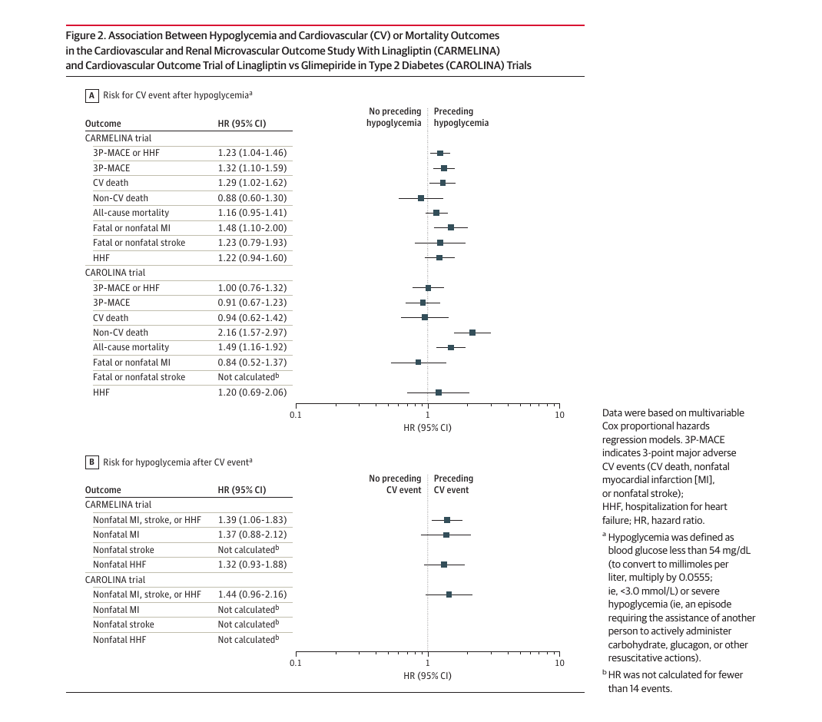
Vulnerable phenotype, not simple causality
CARMELINA: hypoglycaemia was associated with later 3P-MACE/HHF, CV death and MI.
The reverse direction also appeared: nonfatal CV events were associated with later hypoglycaemia.
CAROLINA did not show the same CV association pattern.
Interpretation: bidirectionality weakens a simple causal claim and supports “shared vulnerability” - CKD, frailty, longer diabetes duration and insulin exposure.
Severe hypoglycaemia is both a possible acute trigger and a strong marker of a high-risk phenotype.
Reference: Marx N et al. Hypoglycemia and Cardiovascular Outcomes in CARMELINA and CAROLINA. JAMA Cardiol. 2024;9:134-143. Figure 2.

Slide 22
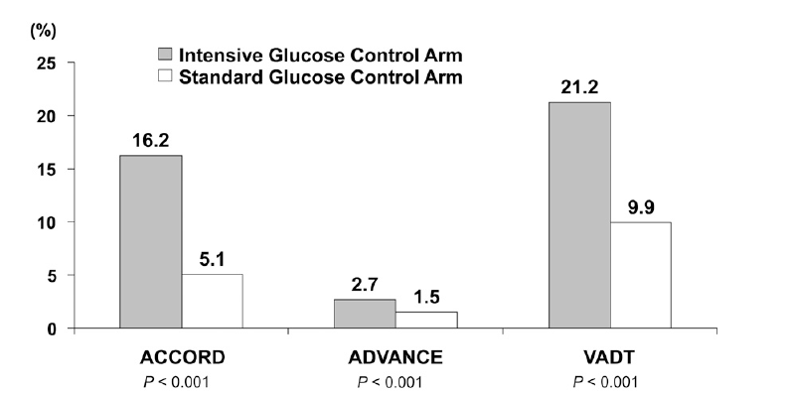
Classic trial lesson: intensive glucose lowering increased severe hypoglycaemia
ACCORD, ADVANCE and VADT taught that “lower HbA1c” is not automatically safer in high-risk T2D.
Severe hypoglycaemia was consistently more frequent in intensive arms, but event causality remained complex.
The clinical lesson is individualization, not therapeutic nihilism.
Trial harm often reflects the combination of aggressive targets + hypoglycaemia-prone therapy + vulnerable patients.
Reference: Frier BM et al. Diabetes Care. 2011;34 Suppl 2:S132-S135. Figure 2 and discussion of ACCORD/ADVANCE/VADT.

Slide 23
DEVOTE: CV safety is not the same as hypoglycaemia safety
Insulin degludec
High CV-risk T2D; noninferiority design for MACE
Insulin glargine U100
Main CV result
Safety result
Degludec was noninferior to glargine U100 for major adverse cardiovascular events.
Degludec reduced severe hypoglycaemia compared with glargine U100.
For insulin-treated high-risk patients, “which insulin?” can be a cardiovascular safety question because hypoglycaemia is part of the safety phenotype.
Refs: Marso et al. NEJM 2017; Pieber et al. Diabetologia 2018; ADA Standards of Care 2026.
18
Notes:
Key lesson: two drugs may be similar for MACE but different for severe hypoglycaemia.

Slide 24
Modern cardiometabolic therapy: reducing risk without hypoglycaemia
SGLT2 inhibitors
GLP-1 receptor agonists
Cardiorenal benefit; low intrinsic hypoglycaemia risk unless combined with insulin/sulfonylurea.
ASCVD/weight benefit in appropriate patients; low intrinsic hypoglycaemia risk unless combined with insulin/sulfonylurea.
Cardiovascular + renal benefit
Glycaemic efficacy with low hypoglycaemia risk
Avoid overtreatment in vulnerable patients
Refs: ESC Guidelines for CVD in Diabetes 2023; ADA Standards of Care 2026; EMPA-REG OUTCOME NEJM 2015; LEADER NEJM 2016.
19
Notes:
Teach why SGLT2 inhibitors and GLP-1 receptor agonists transformed the risk-benefit calculus.

Slide 25
05 | Clinical translation
Who is most vulnerable to hypoglycaemia-related CV harm?
ASCVD / prior MI
Heart failure
CKD
Older age / frailty
Autonomic neuropathy
Long diabetes duration
Insulin or sulfonylurea
Impaired awareness
The highest-risk phenotype is often familiar to cardiology: older patient, established CVD, CKD, insulin exposure and limited reserve.
Action after any severe event: review medication, kidney function, nutrition, targets and monitoring
Refs: ADA Standards of Care 2026; ESC Guidelines for CVD in Diabetes 2023; Frier Nat Rev Endocrinol 2014.
20
Notes:
This is a clinical risk recognition slide.

Slide 26
Drug class lens: where hypoglycaemia risk enters treatment choice
Class
Intrinsic hypoglycaemia risk
Cardiovascular teaching point
Insulin
High
Necessary for many patients; choose safer regimens and avoid excessive targets
Sulfonylureas
Moderate–high
Cheap/effective, but hypoglycaemia liability matters in CVD/CKD/frailty
SGLT2 inhibitors
Low
Cardiorenal benefit; monitor volume/renal issues rather than hypoglycaemia
GLP-1 receptor agonists
Low
ASCVD/weight benefit; hypoglycaemia mainly when combined with insulin/SU
Practical rule
When adding SGLT2i/GLP-1 RA to insulin or sulfonylurea, anticipate the need for dose de-escalation if glucose levels are already near target or hypoglycaemia occurs.
Refs: ADA Standards of Care 2026; ESC Guidelines for CVD in Diabetes 2023; DEVOTE NEJM 2017.
21
Notes:
Use this as a teaching table, not a full pharmacology lecture.

Slide 27
CGM: moving beyond HbA1c
HbA1c answers
CGM answers
Average glycaemic exposure over weeks to months — useful, but blind to timing, variability and lows.
How much time is spent in range, below range, overnight, and with high variability.
Core CGM safety metrics
TIR 70–180
TBR <70
TBR <54
TAR >180
Targets vary by population; in older/high-risk patients, reducing time below range may be the safest first objective.
Refs: Battelino et al. Diabetes Care 2019; ADA Standards of Care 2026; International Consensus on Time in Range 2019.
22
Notes:
Teach TBR as a safety metric.

Slide 28
After severe hypoglycaemia: what should the cardiologist ask?
1
Was there cardiac injury?
2
Why did it happen?
Symptoms, ECG, QTc, troponin pattern, arrhythmia, HF decompensation.
Insulin/SU dose, missed meal, alcohol, renal decline, weight loss, infection, exercise.
3
Is the target too tight?
4
How do we prevent recurrence?
HbA1c, CGM time below range, frailty, life expectancy, comorbidity burden.
Regimen simplification, dose reduction, CGM, education, glucagon, caregiver plan.
Treat the event + investigate the substrate + change the plan
Refs: ADA Standards of Care 2026; ESC Guidelines for CVD in Diabetes 2023; Frier et al. Diabetes Care 2011.
23
Notes:
This slide is practical and designed for bedside teaching.

Slide 29
05 | Clinical translation
A simple management algorithm after severe hypoglycaemia
1. Stabilize
carbohydrate / glucagon
identify precipitant
2. Check CV
ECG/QTc, troponin
arrhythmia/HF
3. Review meds
insulin/SU, renal
function, meals
4. De-intensify
or switch safer
therapy
6. Follow-up
reassess targets and
recurrence
5. Monitor
CGM/TBR, education
rescue plan
The goal after a severe event is not just correction — it is recurrence prevention and cardiovascular risk reassessment.
Refs: ADA Standards of Care 2026; Battelino et al. Diabetes Care 2019; ESC Guidelines for CVD in Diabetes 2023.
24
Notes:
Walk through immediate care, risk review, medication deintensification and monitoring.

Slide 30
Special settings: ACS, HF, CKD and hospital care
ACS / ischaemia
Heart failure
Avoid prolonged fasting + insulin mismatch; monitor QTc/electrolytes; do not dismiss chest pain/troponin as “just hypo”.
Reduced intake, renal dysfunction, diuretics and frailty increase risk; SGLT2i decisions depend on acute stability.
CKD
Hospital
Lower insulin clearance and sulfonylurea accumulation; dose reassessment after any eGFR change is essential.
Protocolized glucose management should prevent level 2/3 hypoglycaemia; nutrition–insulin coordination is a safety intervention.
Ιn acute cardiovascular illness, “tight control” can become dangerous when intake, renal function and haemodynamics are changing rapidly.
Refs: ADA Standards of Care in Hospital 2026; ESC Guidelines for CVD in Diabetes 2023; KDIGO Diabetes in CKD guideline 2022.
25
Notes:
Hospitalized patients have higher risk; avoid both severe hyperglycaemia and hypoglycaemia.

Slide 31
Society recommendations after hypoglycaemia
Society / guideline | Core recommendation(s) | Main patient group | Teaching points
ADA Standards of Care 2026 | Standardize event levels; Level 2 (<54 mg/dL) or Level 3 severe hypoglycaemia should prompt reassessment of goals and therapy. Use CGM/glucagon and de-intensify hypoglycaemia-prone treatment in high-risk adults. | Insulin / sulfonylurea users; older adults; CKD; frailty; impaired awareness | Hypoglycaemia is a safety endpoint, not a nuisance value.
ESC diabetes–CVD guidelines 2023 | In T2D with ASCVD, HF or CKD, prioritize SGLT2 inhibitors and/or GLP-1 receptor agonists with proven CV/renal benefit, independent of baseline or target HbA1c when indicated. | T2D plus ASCVD, HF, CKD or very high CV risk | Move from HbA1c-only care to outcome-based, low hypoglycaemia-risk therapy.
Endocrine Society 2022 | For people at high risk for hypoglycaemia: prefer CGM in insulin-treated patients; use long-acting analogues rather than NPH; use rapid-acting analogues rather than regular insulin; provide structured education. | T1D/T2D treated with insulin and high hypoglycaemia risk | Prevention strategy for recurrent/nocturnal episodes and arrhythmogenic stress.
AHA / HFSA cardiology statements | Cardiology guidance emphasizes systematic CV/HF risk reduction in diabetes and adoption of therapies with proven CV benefit. Specific hypoglycaemia-prevention steps mainly come from ADA/Endocrine guidance. | Diabetes with ASCVD and/or HF | Coordinate cardiology–diabetes care; avoid glucose strategies that destabilize vulnerable hearts.
Clinical action: after severe or recurrent hypoglycaemia, reassess target, agents, renal function, frailty, awareness, and cardiac vulnerability.
Refs: ADA Standards of Care in Diabetes—2026 (Sections 6, 9, 13); 2023 ESC Guidelines for CVD in diabetes; Endocrine Society CPG for high hypoglycaemia risk, 2022; AHA/HFSA Scientific Statement on T2D and HF, Circulation 2019.
Notes:
translate a low glucose event into a treatment-safety and cardiovascular-risk signal.

Slide 32
Teaching case: applying the framework
Case
78-year-old with T2D, prior MI, HFpEF, CKD stage 3b, basal insulin + gliclazide. HbA1c 6.4%. Found confused at 03:00; capillary glucose 42 mg/dL. ECG: QTc 510 ms; K+ 3.3 mmol/L.
What made this patient vulnerable?
What cardiac complications should be excluded?
Which treatment changes reduce recurrence?
What monitoring would you choose?
Αnswer: severe event + vulnerable substrate + overtreatment → de-intensify, monitor, protect the heart
Refs: ADA Standards of Care 2026; ESC Guidelines for CVD in Diabetes 2023; Zoungas et al. NEJM 2010.
26

Slide 33
Synthesis: a defensible causal model
Background vulnerability: age, ASCVD, HF, CKD, autonomic neuropathy, frailty, polypharmacy
Treatment exposure: insulin, sulfonylurea, tight HbA1c targets, missed meals, renal decline
Acute event: level 2/3 hypoglycaemia with counter-regulatory stress
Pathways: arrhythmia, ischaemia, thrombosis, inflammation, haemodynamics
Outcomes: events, death, falls, fear, therapeutic inertia
Refs: Frier et al. Diabetes Care 2011; Zoungas et al. NEJM 2010; Christou et al. Cardiovasc Diabetol 2023.
27

Slide 34
Take-home messages
1
Severe hypoglycaemia is a cardiovascular warning sign.
2
Mechanisms are plausible: sympathetic, electrical, haemodynamic, inflammatory and thrombotic.
3
Causality is complex: hypoglycaemia is both potential trigger and vulnerability marker.
4
High-risk patients are common in cardiology: ASCVD, HF, CKD, older age, insulin/SU exposure.
5
Modern therapy should reduce CV risk without increasing hypoglycaemic risk.
Final clinical rule: after a severe hypoglycaemic event, do not simply treat the glucose — treat the risk.
Refs: ADA Standards of Care 2026; ESC Guidelines for CVD in Diabetes 2023; IHSG 2017; ACCORD/ADVANCE/DEVOTE/ORIGIN trials.
28

