Slide 1


ΠΜΣ ΚΑΡΔΙΟΜΕΤΑΒΟΛΙΚΗ ΙΑΤΡΙΚΗΣ
Τρίτη 12 Μαΐου 2026
Τεχνητή Νοημοσύνη στη Διάγνωση και Διαχείριση της Υπέρτασης
Κωνσταντίνος Μπακογιάννης, MD PhD
Reader, Γ’ Πανεπιστημιακή Καρδιολογική Κλινική ΑΠΘ.
Ειδικό Ιατρείο Προσωποποιημένης Καρδιαγγειακής Φροντίδας & Πρόληψης
2026

Slide 2

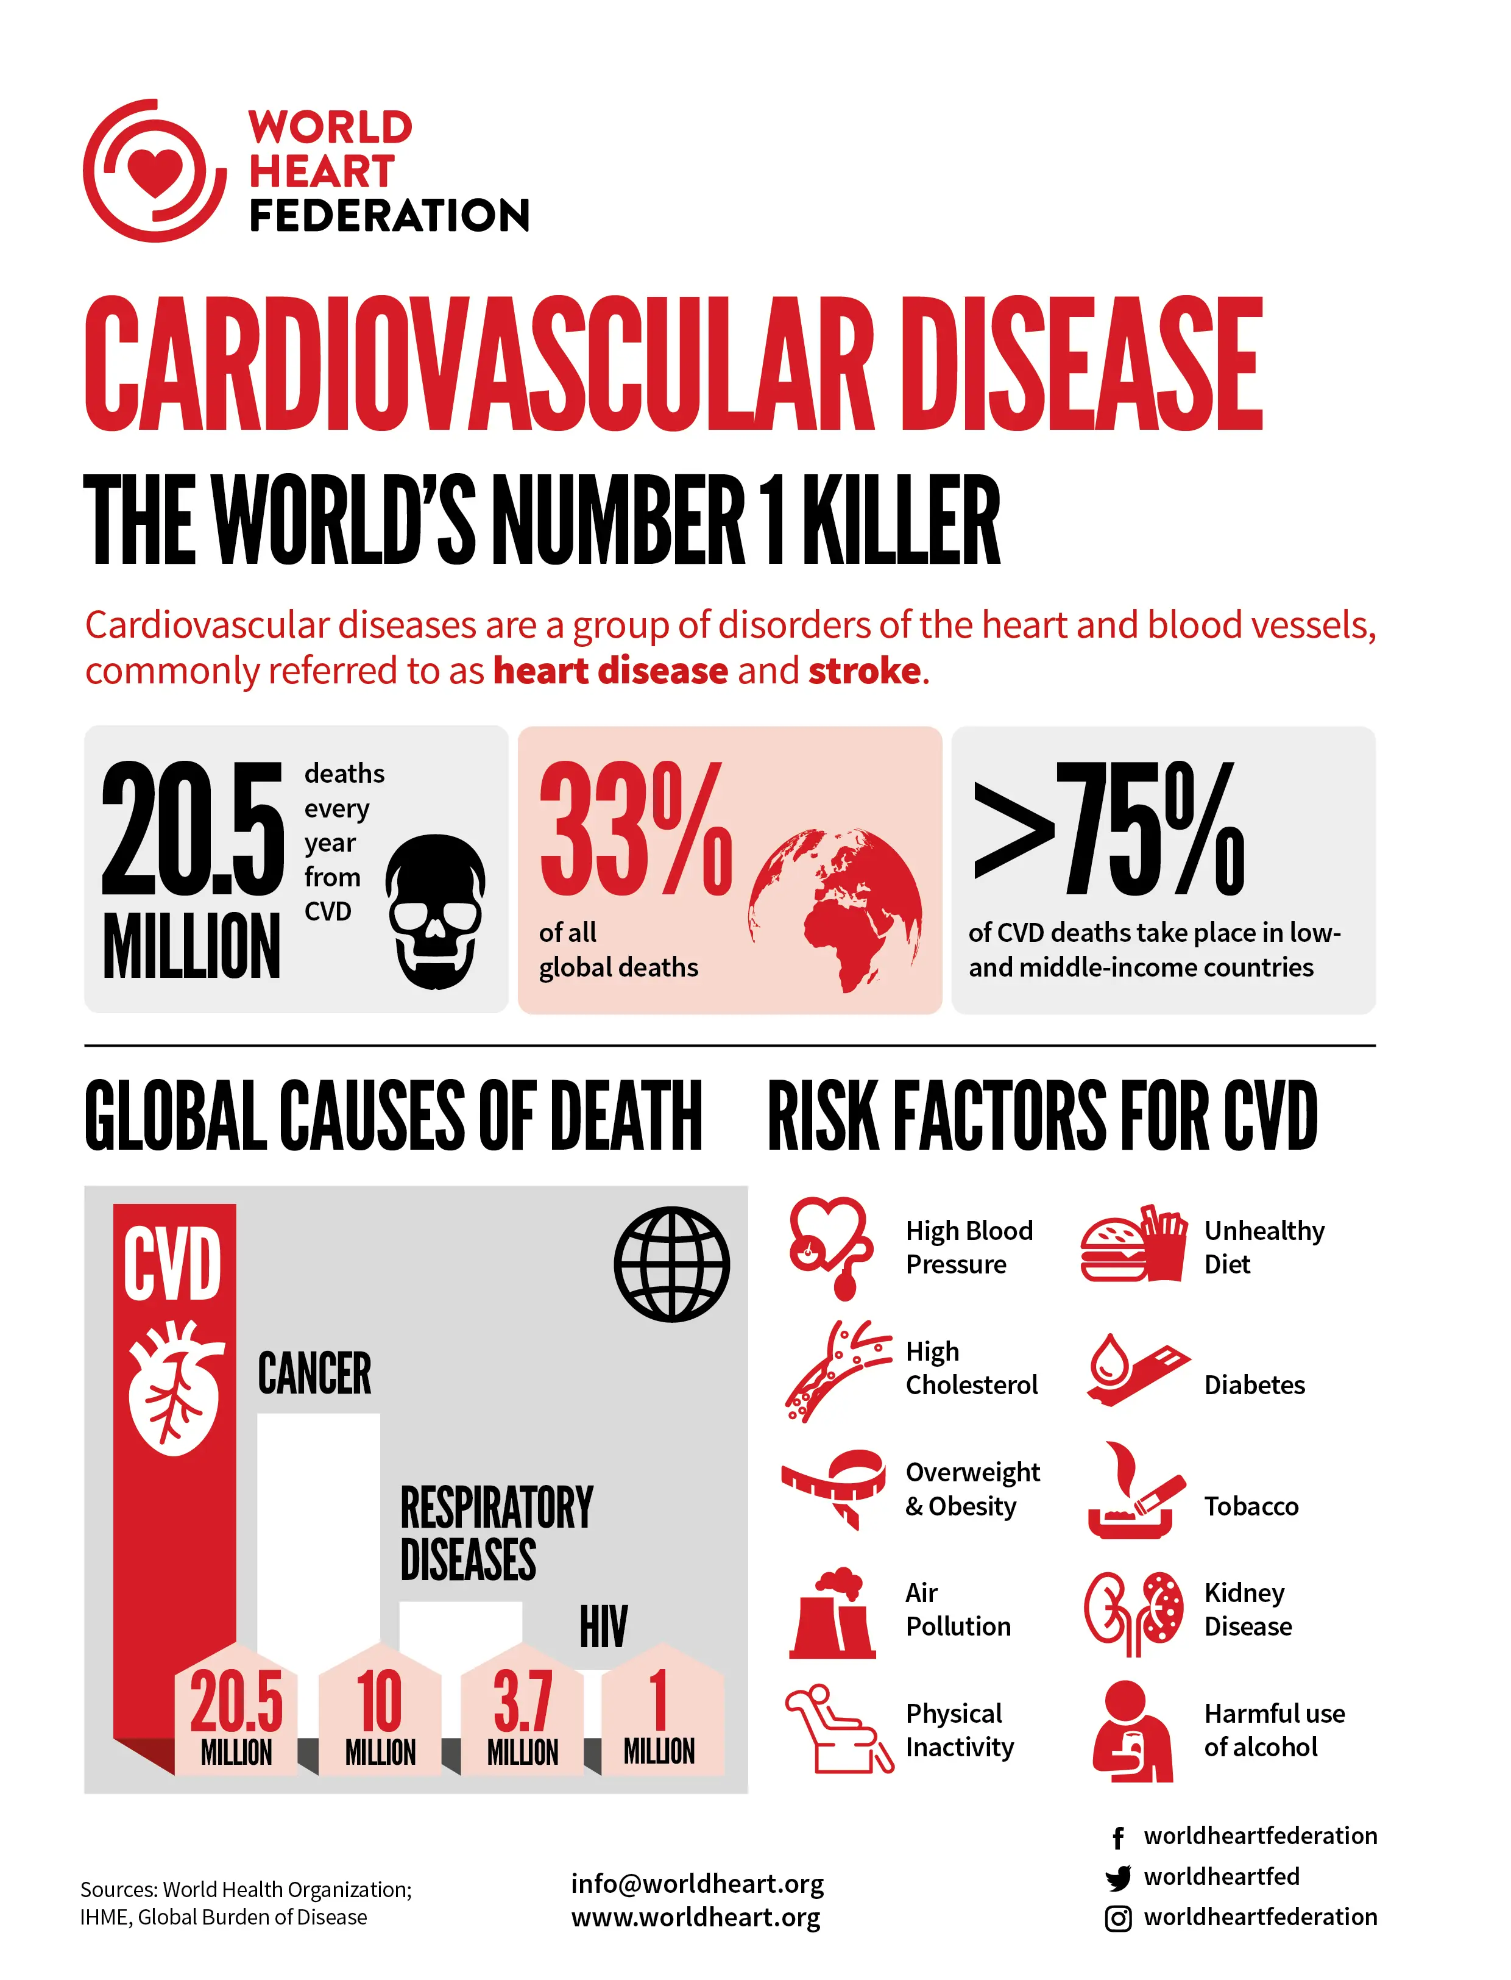

CVD remains the 1st cause of mortality and morbidity
C. Bakogiannis

Slide 3
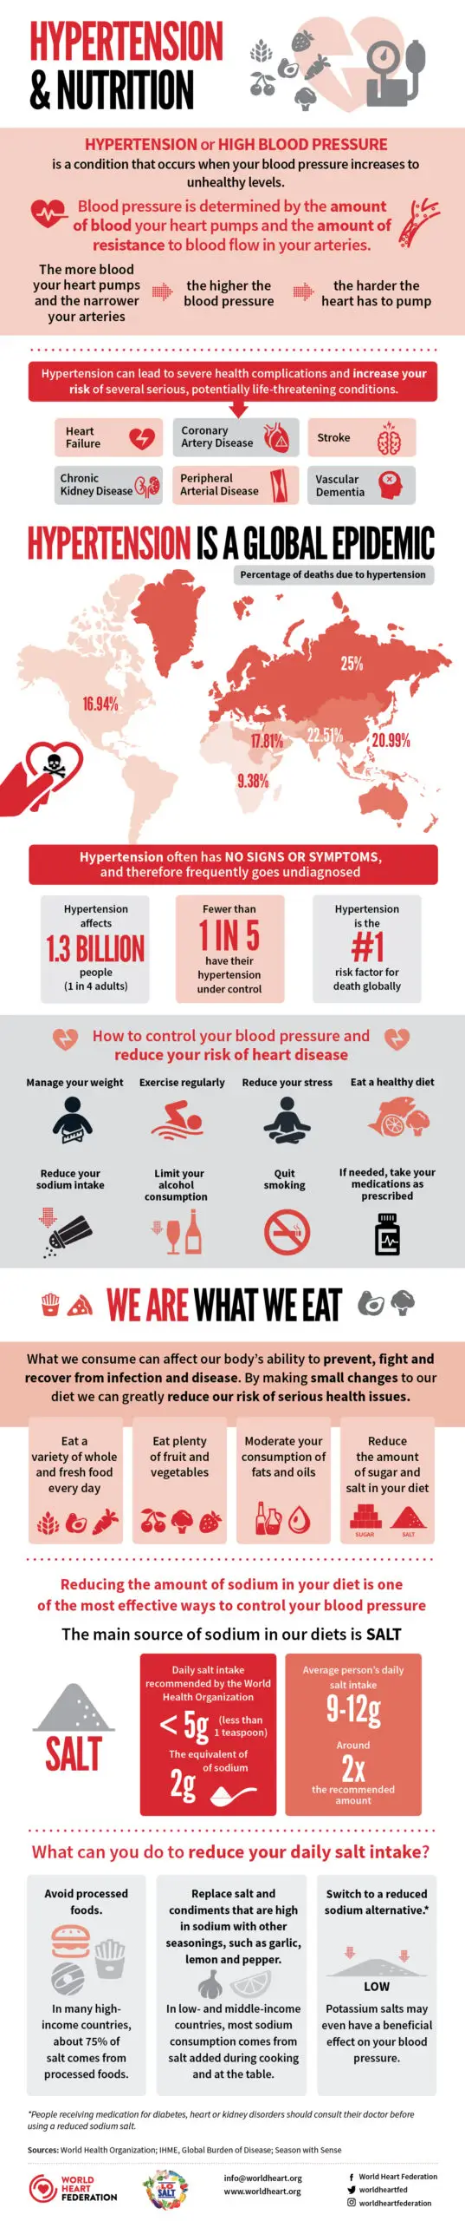
Hypertension
A global epidemic
C. Bakogiannis

Slide 4
UNdetected
UNdertreated
UNcontrolled
C. Bakogiannis

Slide 5




Person-centered Cardiovascular Care & Prevention
Cellular Pathways
Genetic Variations
Lifestyle
Cardiac Function
Stem cells
Gene expression
Behavioral
Transcriptomics
Proteomics
Pharmacogenomics
Phenomics
Metabolomics
Interventional Cardio
Environment/
Exposomics
Cardiac Imaging
C. Bakogiannis
Images powered by DALL-E

Slide 6
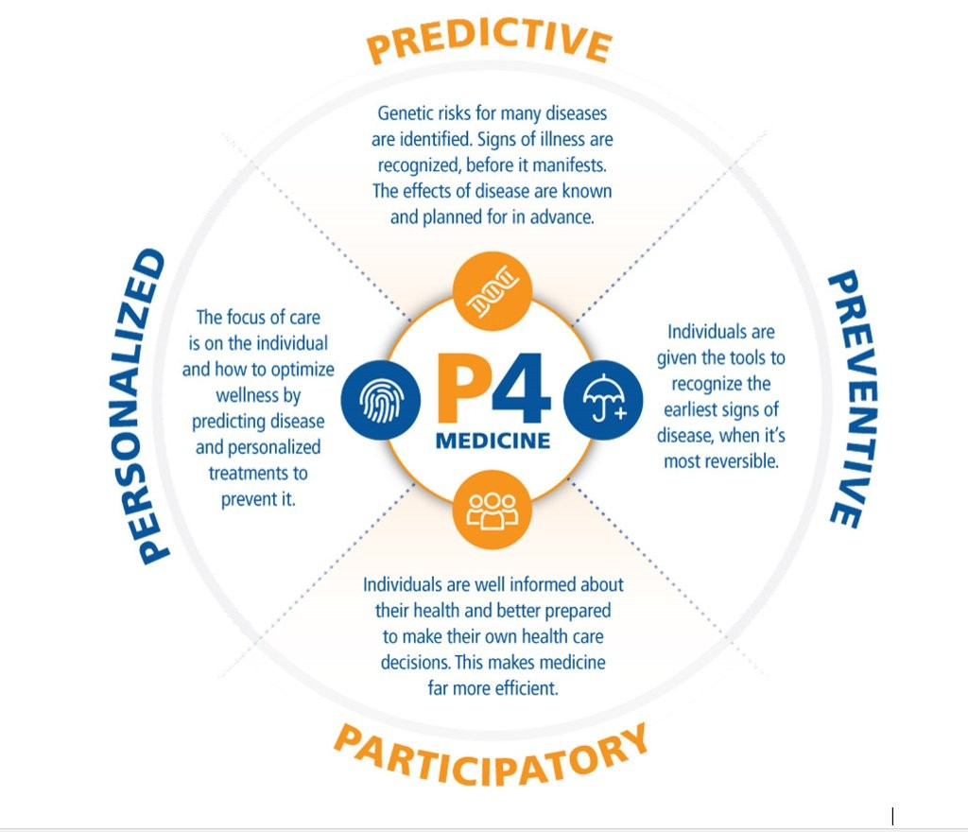
P4 Medicine
C. Bakogiannis

Slide 7
/ˈdɪd͡ʒɪtəɫ/
/helθ/
“…the convergence of digital technologies with health, healthcare, living and society to enhance the efficiency of healthcare delivery and make medicines more personalized and precise”
O’Donoghue et al., BMJ Open 2019

Slide 8
Big Data &
Artificial Intelligence (AI)
Remote assessment &
Telemonitoring
Social Media
Wearables &
mHealth Apps

Slide 9

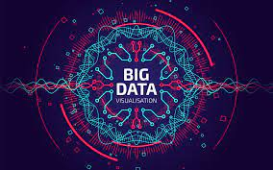

Big data
large, fast & complex datasets that could not be processed using traditional methods
370 TB of digital data produced daily
~150MB/ person/ day
Breakthroughs in Information Technology
Digitization of machinery & daily social activities
Popularization of the Internet
C. Bakogiannis

Slide 10
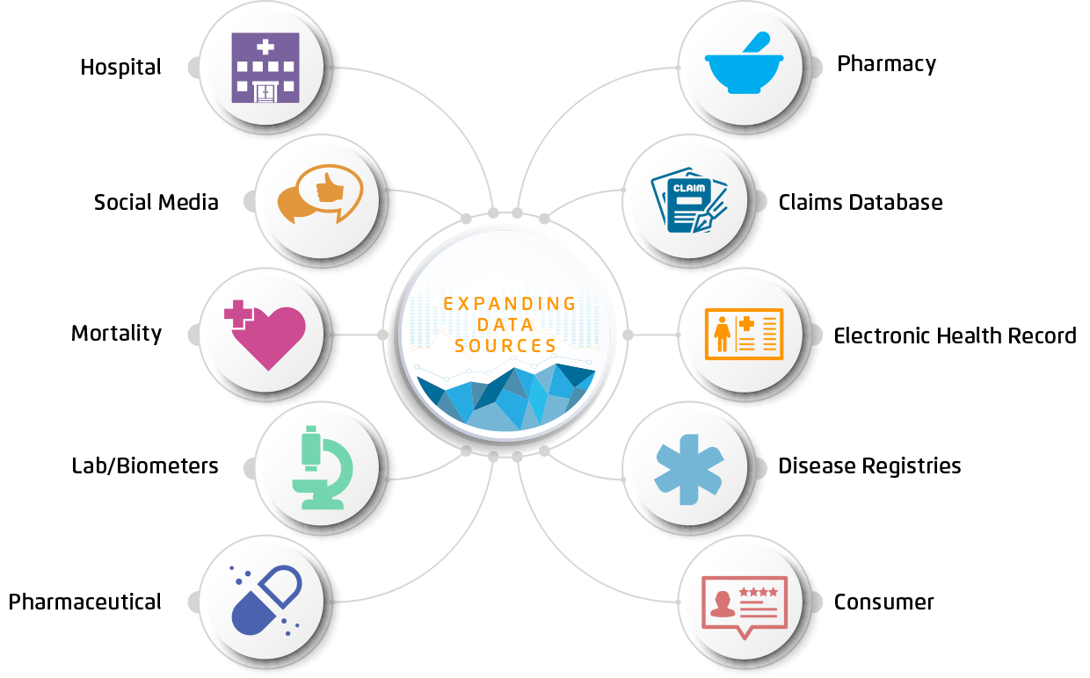
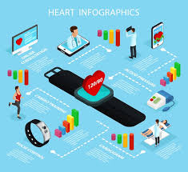
Digital Sources of Data in Cardiology

Slide 11


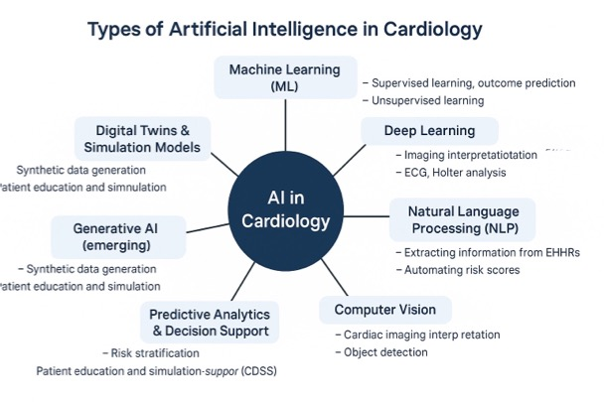
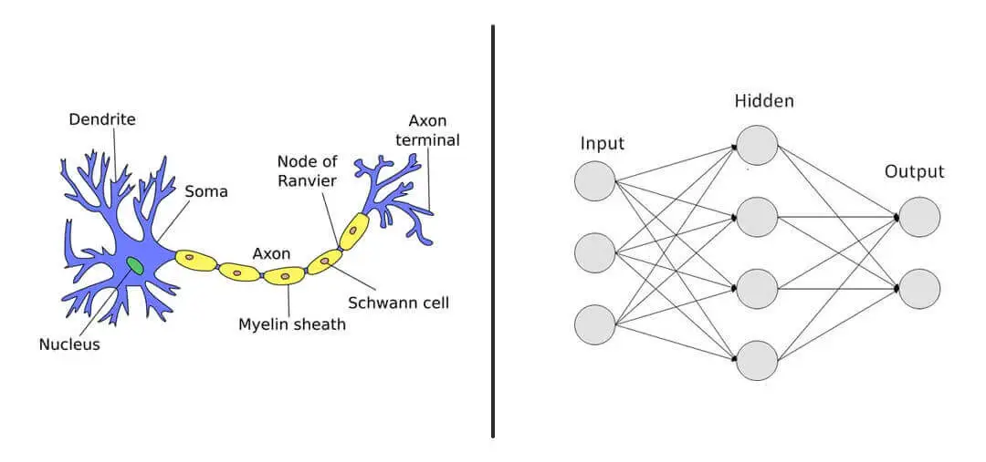
AI in simple words…
Hypothesis
Algorithms
Data
Probability
C. Bakogiannis
https://clevertap.com/blog/neural-networks/

Slide 12


Human Learning
C. Bakogiannis

Slide 13



Human Learning
C. Bakogiannis

Slide 14


Human Learning
Dog or Wolf?
C. Bakogiannis

Slide 15


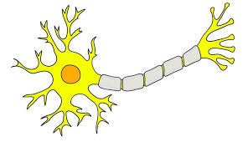
Human NN
Signals
Dog or Wolf?
Parameters
∼86 billion neurons
∼100 trillion synapses
C. Bakogiannis

Slide 16
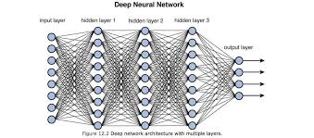
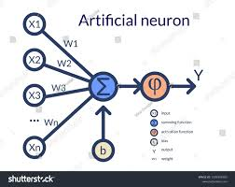
Artificial NN
Pixels
Dog or Wolf?
Features
Example: 8 layers
659.000 units (65mio parameters)
C. Bakogiannis

Slide 17
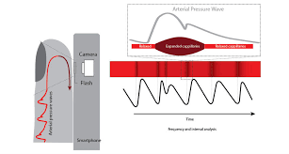
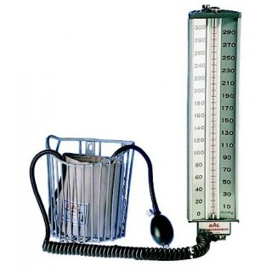
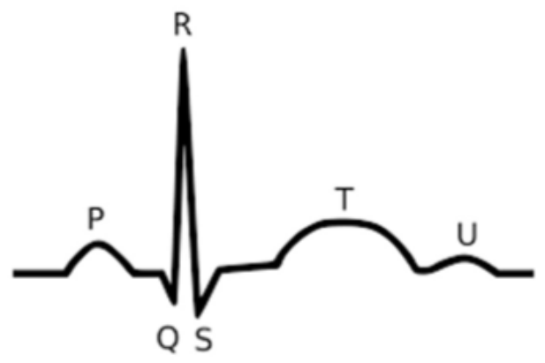
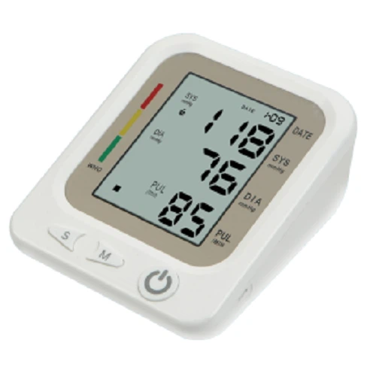
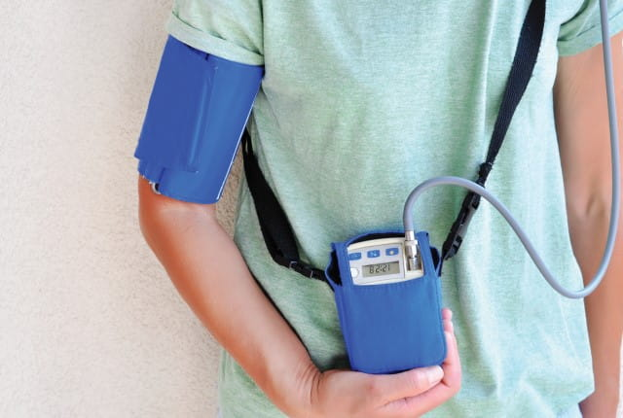
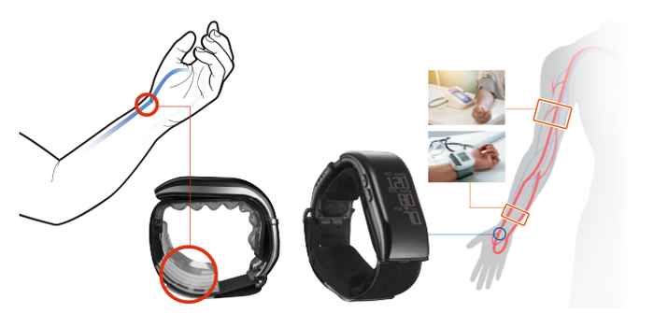
Innovating BP monitoring
PPG
ECG
Smart BP
Wearable
C. Bakogiannis

Slide 18
AI in the DIAGNOSIS of Hypertension
C. Bakogiannis

Slide 19
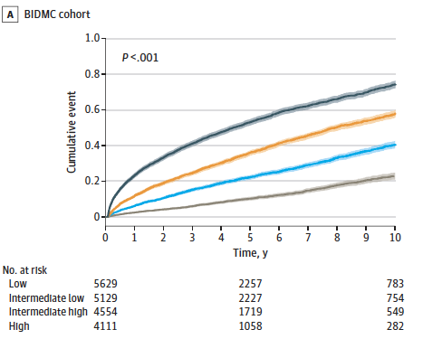
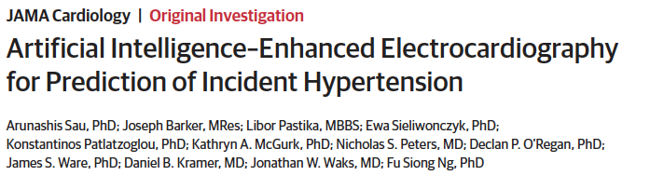
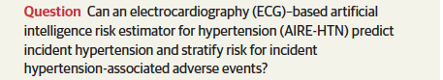
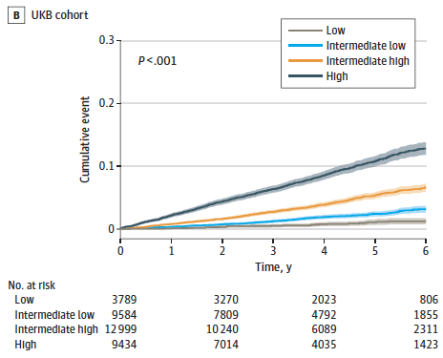
AI-Enhanced ECG for Hypertension Prediction
AIRE-HTN was trained on 1163401 ECGs from 189539 patients (BIDMC)
The algorithm was tested on 65610 ECGs (UKB) for external validation
C. Bakogiannis
Sau A., et al. JAMA Cardiology 2026

Slide 20
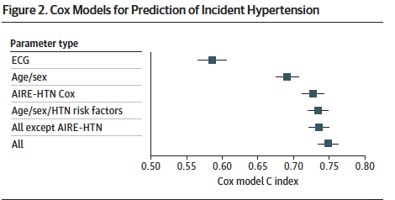
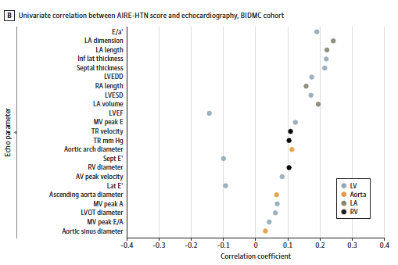
AIRE-HTN Cox model alone performs at least as well as, or better than models with only age/sex or only ECG
AIRE-HTN AI-ECG appear to correlate with subclinical cardiac and vascular remodeling (LA enlargement, aortic dilation, impaired diastolic ind.
AIRE-HTN, an AI-ECG model, can predict incident hypertension and identify patients at risk of hypertension-related adverse events, beyond conventional clinical risk factors
C. Bakogiannis
Sau A., et al. JAMA Cardiology 2026

Slide 21
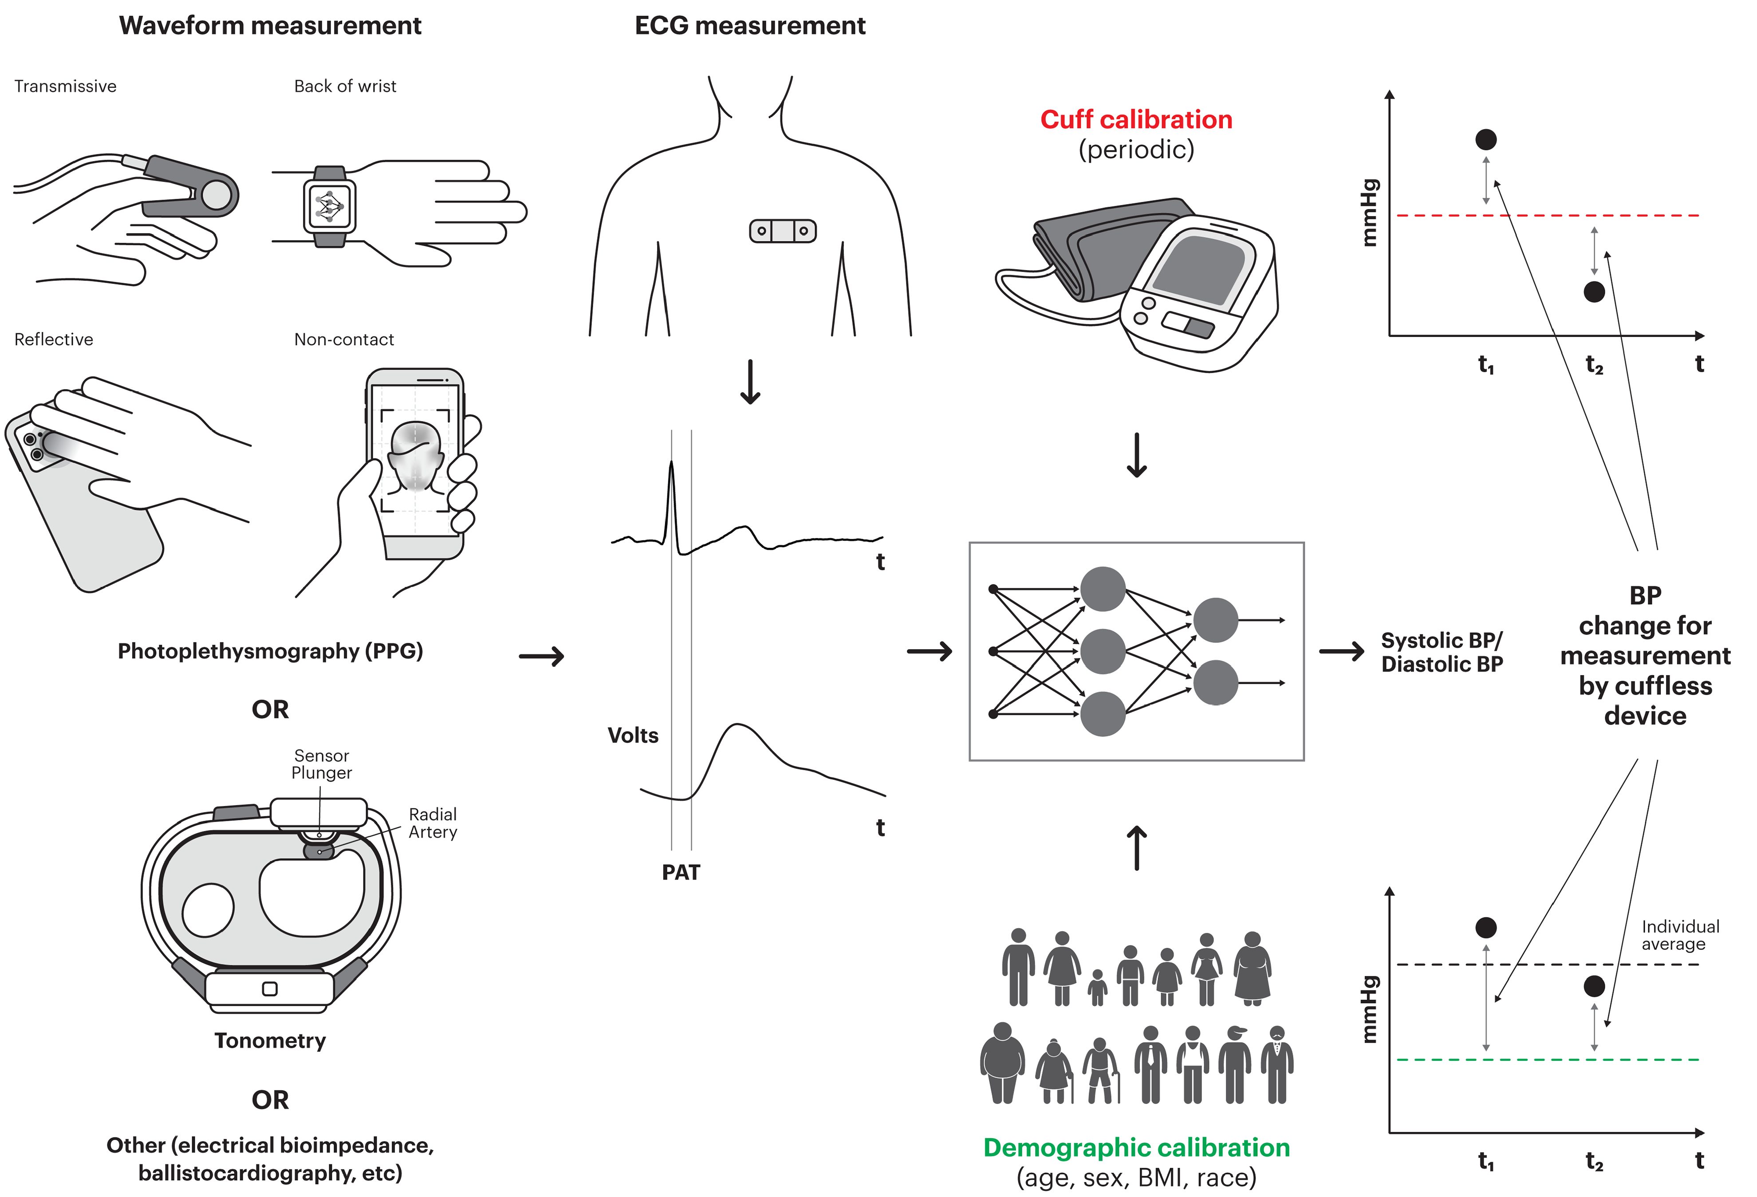
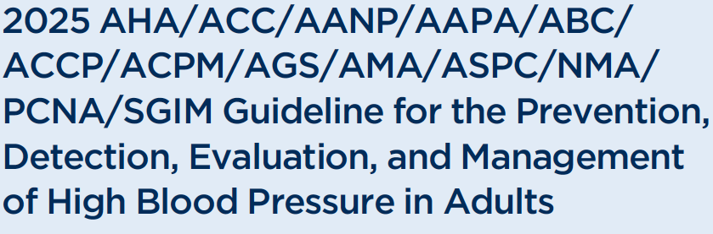
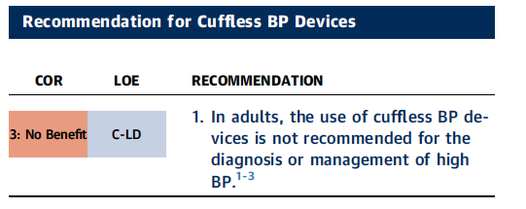
Cuffless Blood Pressure Monitoring
Cuffless technology options, often embedded in wearable, or smartphone devices, estimate BP through various approaches.
PPG, Pulse Wave Analysis, Pulse Arrival Time, Tonometry etc.
C. Bakogiannis
2025 AHA Guidelines for Hypetension

Slide 22
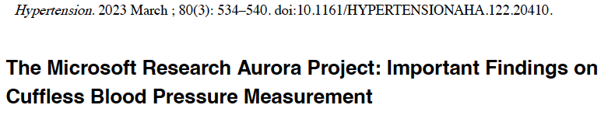
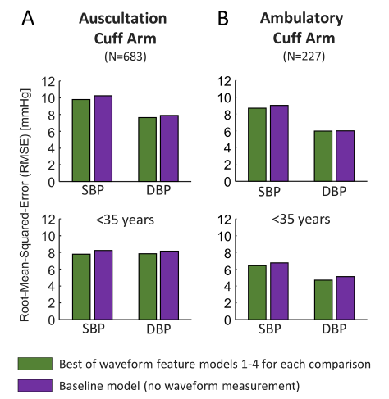
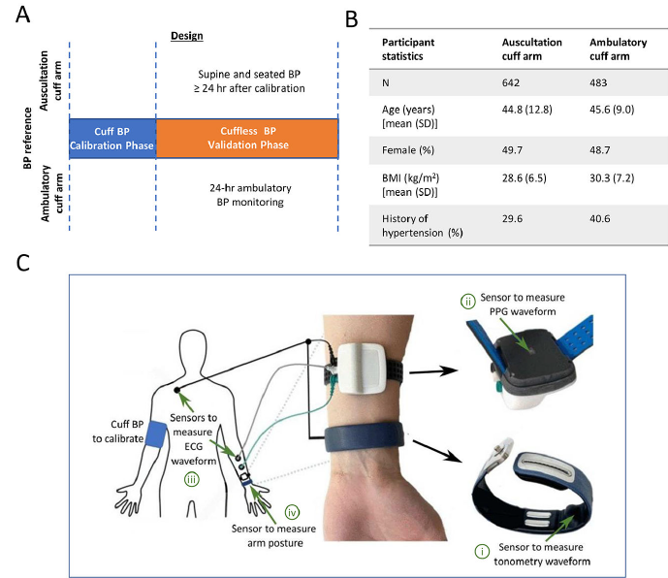
Cuffless BP devices based on PWA were of no additional value in measuring resting auscultatory or 24-hour ambulatory cuff BP as compared to baseline model in which BP was predicted without an actual measurement
C. Bakogiannis
Mukkamala R., et al. Hypertension 2023

Slide 23

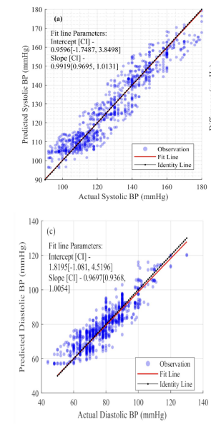
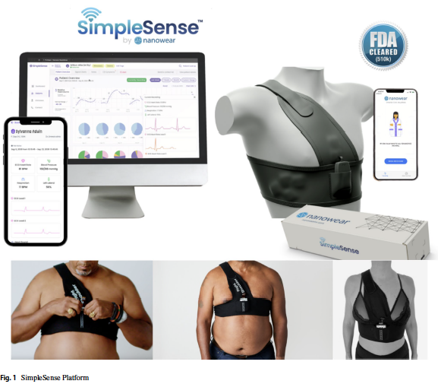
303 subjects included
Clinical validation was promising
External & further validation needed
Mutlimodal Approach
Demographic data, historical BP data, ECG and Respiration Rate
C. Bakogiannis
Lopez-Himenej F., et al. J of Card Transl Res 2025

Slide 24
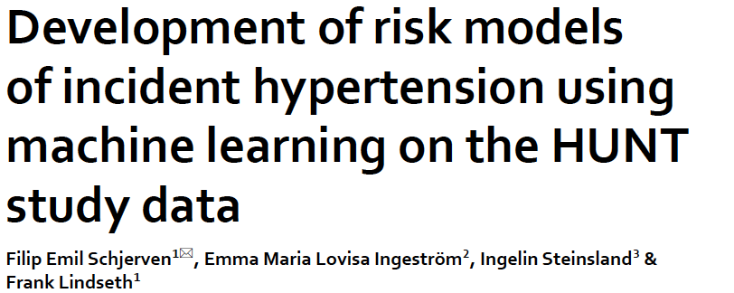
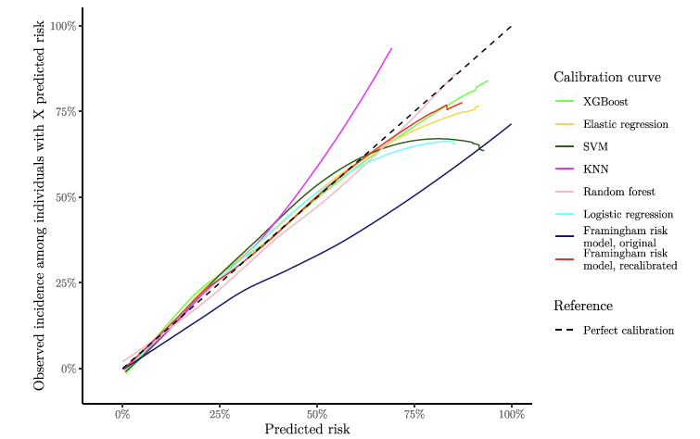
Aimed to create a 11-year hypertension risk model using data from the HUNT study
Based on features and data such as age, systolic and diastolic BP, body mass index, height, family history and others.
Comparison of various BP model to predict hypertension risk retrospectively in a Norwegian population
C. Bakogiannis
Schjerven FE., et al. Sci Rep 2024

Slide 25
AI in the MANAGEMENT of Hypertension
C. Bakogiannis

Slide 26
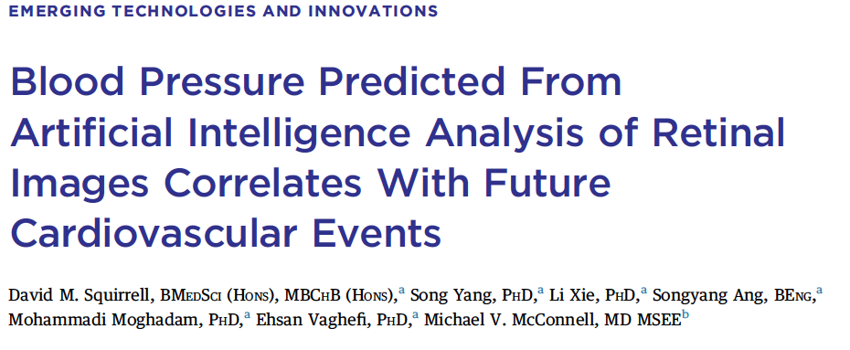
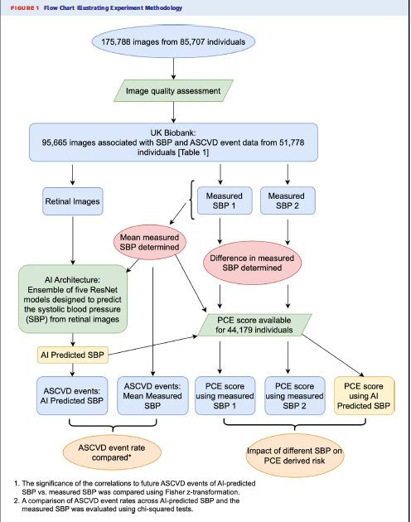
95,665 macula-centered retinal images from 51,778 individuals from the UK Biobank with no ASCVD
AI model to predict SBP
Correlation with ASCVD?
C. Bakogiannis
Squirell DM., et al. JACC Adv 2024

Slide 27
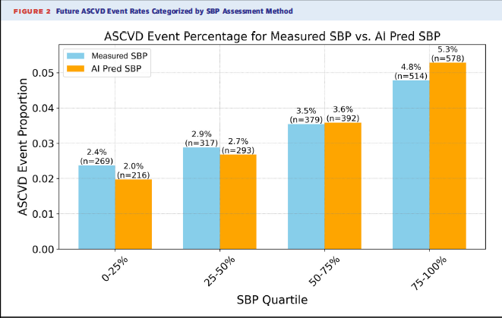
AI analysis of retinal images may provide a more reliable and accurate biomarker for predicting future ASCVD events
C. Bakogiannis
Squirell DM., et al. JACC Adv 2024

Slide 28
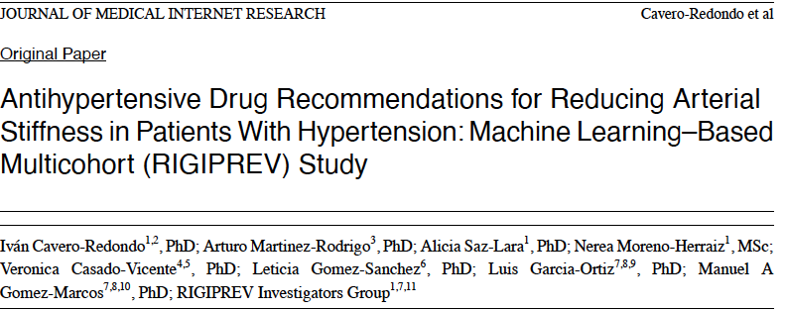
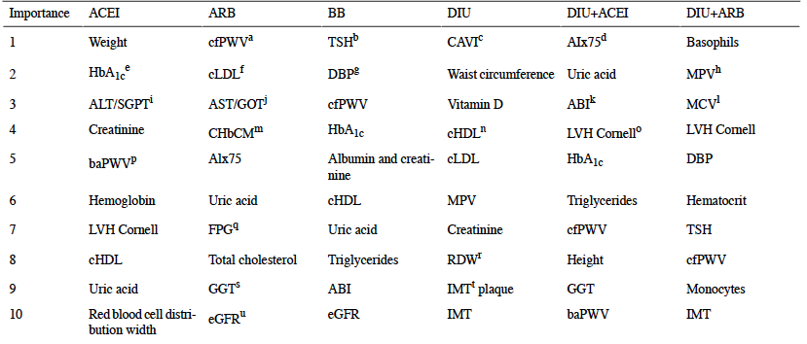
C. Bakogiannis
Cavero-Redondo I., et al. JMIR 2024

Slide 29
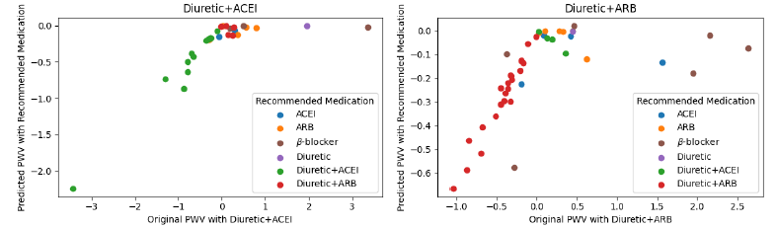
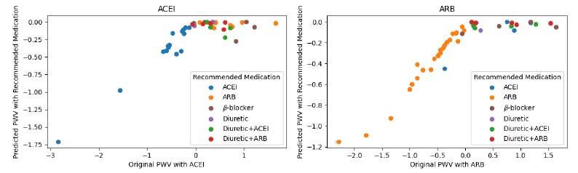
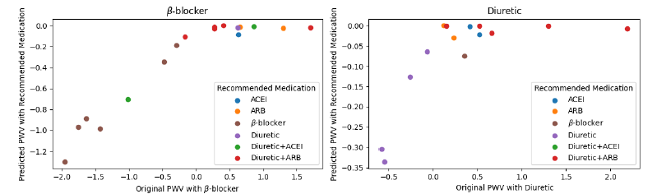
The study demonstrates the utility of ML in providing personalized treatment recommendations for antihypertensive treatment.
Further studies are needed!
C. Bakogiannis
Cavero-Redondo I., et al. JMIR 2024

Slide 30
Challenges, Ethics & Limitations
C. Bakogiannis

Slide 31
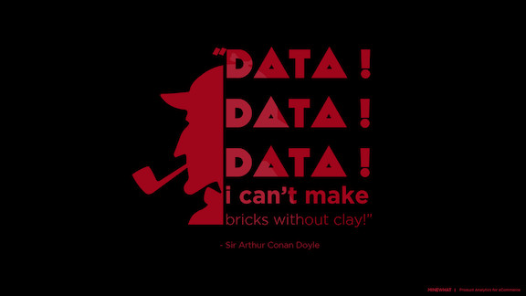

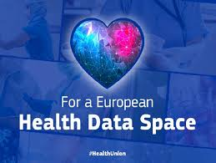

Data quality/
Data Harmonization
The quality of the data used for AI/ ML training
Balance/ Bias
C. Bakogiannis

Slide 32

BlackBox/Explainable AI
AI algorithms have inherent restrictions and limitations
Foundation models can potentially smooth out some of these challenges
C. Bakogiannis

Slide 33
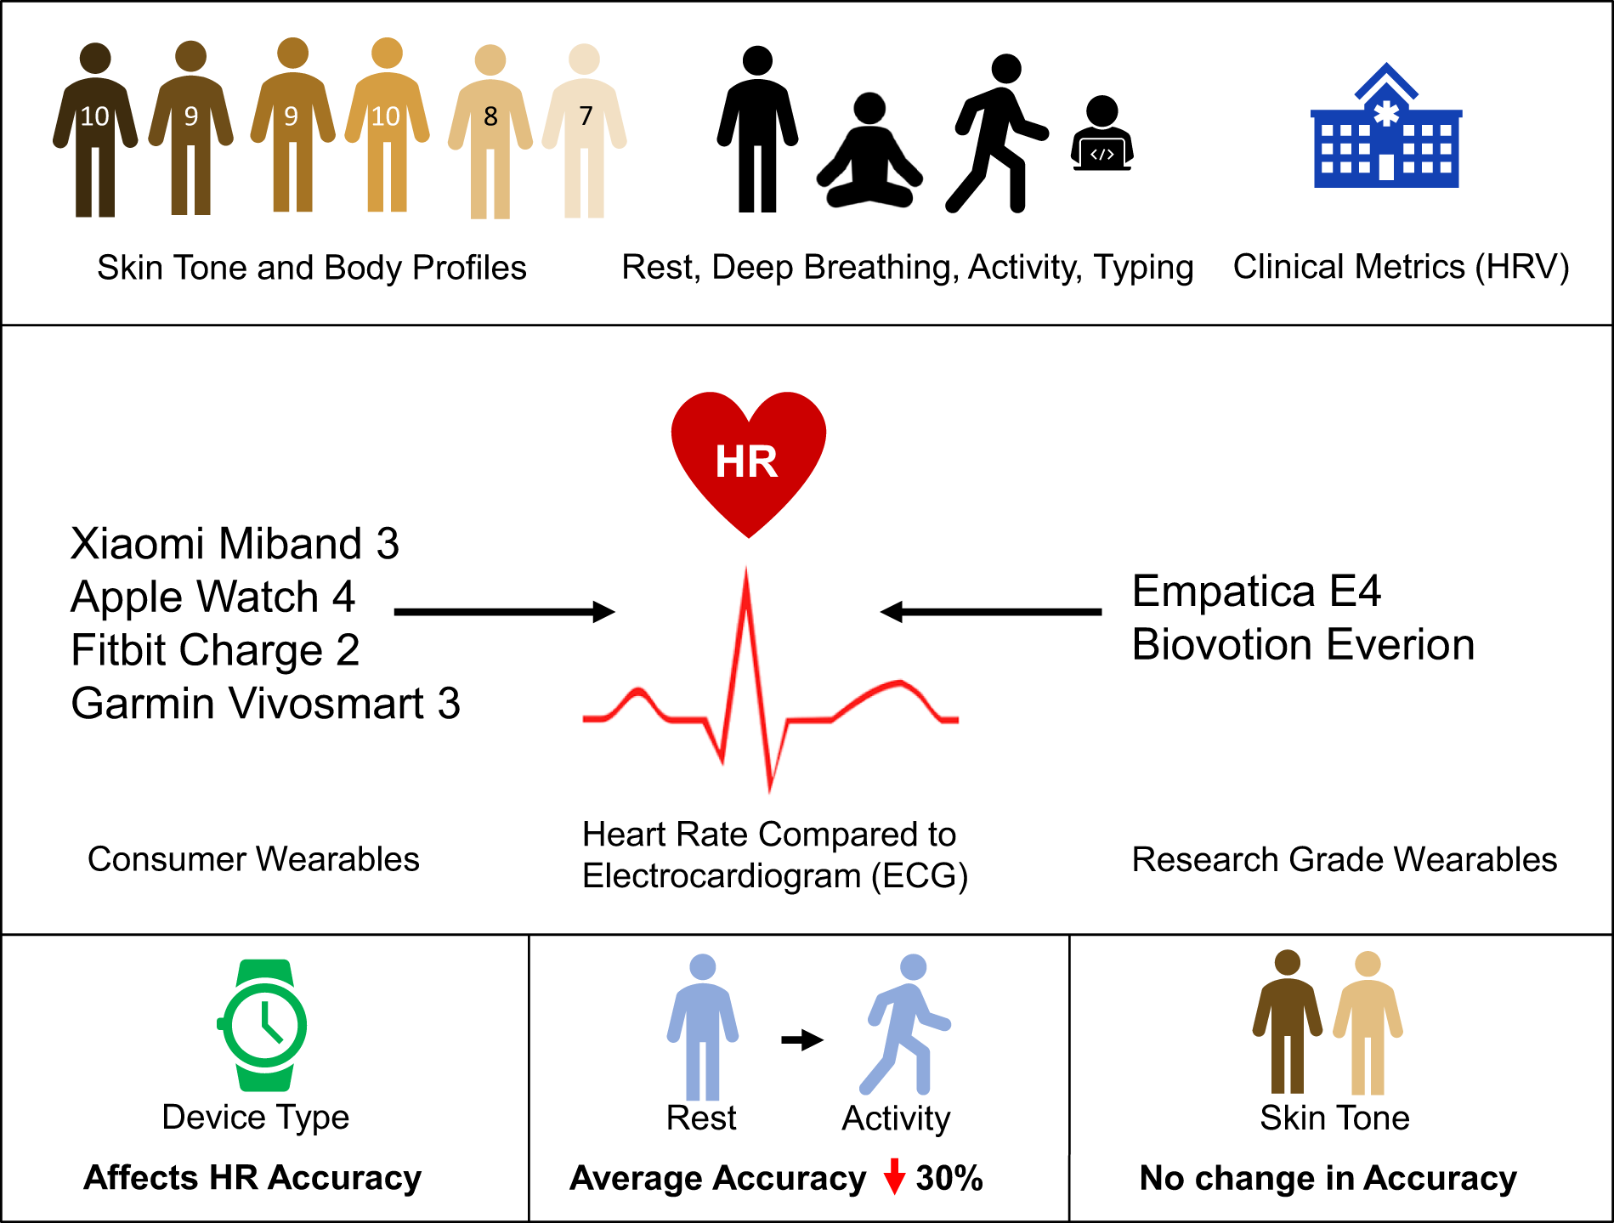
Technological Challenges
Skin tone
Movement
Harmonious application
Etc.
Data from Sensors/IoTs/ Wearables add significant value towards the personalized approach
However, there are still challenges to be addressed
C. Bakogiannis
Bent B., et al. NPJ Dig Med 2020

Slide 34

Implementation & key utility aspects
The use of all these tools in daily clinical life is of outmost importance, as restructuring of existing processes is needed
Aspects, such as safety, cost-effectiveness and others should be tested
C. Bakogiannis
Bent B., et al. NPJ Dig Med 2020

Slide 35

Evaluation Frameworks
Health Technology Assessment
There is a high unmet need for establishing valid, clear, and efficient frameworks to evaluate all the aspects of AI tools in clinical environments and healthcare ecosystems
Legal, ethical, and regulatory issues should be part of the evaluation and licensing process
C. Bakogiannis

Slide 36
Take home messages
AI changes existing status quo in diagnosis and management of arterial hypertension
Cuffless monitoring is promising but not yet clinically ready
AI’s greatest near-term clinical impact is in management, especially with regard to a more personalize & precise approach
However, real-world, quality evidence for blood pressure outcomes remain scarce
We should always keep in mind that ethical, equitable, and regulatory dimensions are non-negotiable
C. Bakogiannis

Slide 37
Further resources
1. Sau A, Barker J, Pastika L, et al. Artificial intelligence-enhanced electrocardiography for prediction of incident hypertension (AIRE-HTN): a large, multicentre development and external validation study. JAMA Cardiology. 2025;10(3):214–223.
2. Armoundas AA, Ahmad FS, Attia ZI, Doudesis D, Khera R, Kyriakoulis KG, Stergiou GS, Tang WHW. Controversy in Hypertension: Pro-Side of the Argument Using Artificial Intelligence for Hypertension Diagnosis and Management. Hypertension. 2025;82(6):929–944.
3. Dunn J, Kibbe MR, Klonoff DC, et al. Brief Review and Primer of Key Terminology for Artificial Intelligence in Hypertension. Hypertension. 2025;82(1):26–35.
4. Shimbo D, Shah RU, Abdalla M, et al. Transforming Hypertension Diagnosis and Management in the Era of Artificial Intelligence: A 2023 National Heart, Lung, and Blood Institute (NHLBI) Workshop Report. Hypertension. 2025;82(1):36–45.
5. Lu Y, Spatz ES, Krumholz HM. Navigating the 2024 ESC Hypertension Guidelines: What Is New, Context, and Future Directions. Journal of the American College of Cardiology. 2025;85(5):556–559.
6. 2025 AHA/ACC/AANP/AAPA/ABC/ACCP/ACPM/AGS/AMA/ASPC/NMA/PCNA/SGIM Guideline for the Prevention, Detection, Evaluation, and Management of High Blood Pressure in Adults. Journal of the American College of Cardiology. 2025.
7. Controversy in Hypertension: Con-Side of the Argument Using Artificial Intelligence for Hypertension Diagnosis and Management. Hypertension. 2025.
8. Maeda T, Sakamoto Y, Hosoki S, et al. Does clinical practice supported by artificial intelligence improve hypertension care management? A pilot systematic review. Hypertension Research. 2024;47(9):2312–2316.
9. Chaikijurajai T, Laffin LJ, Tang WHW. Artificial Intelligence and Hypertension: Recent Advances and Future Outlook. American Journal of Hypertension. 2020;33(11):967–974.
10. Padmanabhan S, Dominiczak AF. Genomics of hypertension: the road to precision medicine. Nature Reviews Genetics. 2021;22(4):235–250.
11. Stergiou GS, Avolio AP, Palatini P, et al. European Society of Hypertension recommendations for the validation of cuffless blood pressure measuring devices. Journal of Hypertension. 2023;41(11):2074–2087.
12. Sjoding MW, Dickson RP, Iwashyna TJ, Gay SE, Valley TS. Racial Bias in Pulse Oximetry Measurement. New England Journal of Medicine. 2021;385(25):2496–2497.
13. Kankrale R, Kokare M. Artificial Intelligence in Retinal Image Analysis for Hypertensive Retinopathy Diagnosis: A Comprehensive Review and Perspective. Visual Computing for Industry, Biomedicine, and Art. 2025;8:11.
14. Hua J, Su M, Wu J, et al. Wearable cuffless blood pressure monitoring: From flexible electronics to machine learning. Wearable Electronics. 2024;1:78–90.
C. Bakogiannis

Slide 38
Σας ευχαριστώ πολύ!
Constantinos Bakogiannis, MD PhD
Reader, 3rd Cardiology Clinic, AUTH
Personalized Cardiovascular Care & Prevention dept.
cbakogiannis@auth.gr
www.3rdcardio.com
www.cardio-school.com
C. Bakogiannis

