Slide 1

Καρδιομεταβολική Ιατρική, Πρόγραμμα Μεταπτυχιακών Σπουδών
Εθνικό και Καποδιστριακό Πανεπιστήμιο Αθηνών
Ο ρόλος της στεφανιαίας ενδοθηλιακής δυσλειτουργίας και διατμητικής τάσης στην εξέλιξη της στεφανιαίας νόσου.
Dr Marina Zaromytidou, MSc, PhD
Cardiologist, Inherited Cardiac Diseases,
St Bartholomew’s Hospital,
BARTS Trust, London

Slide 2
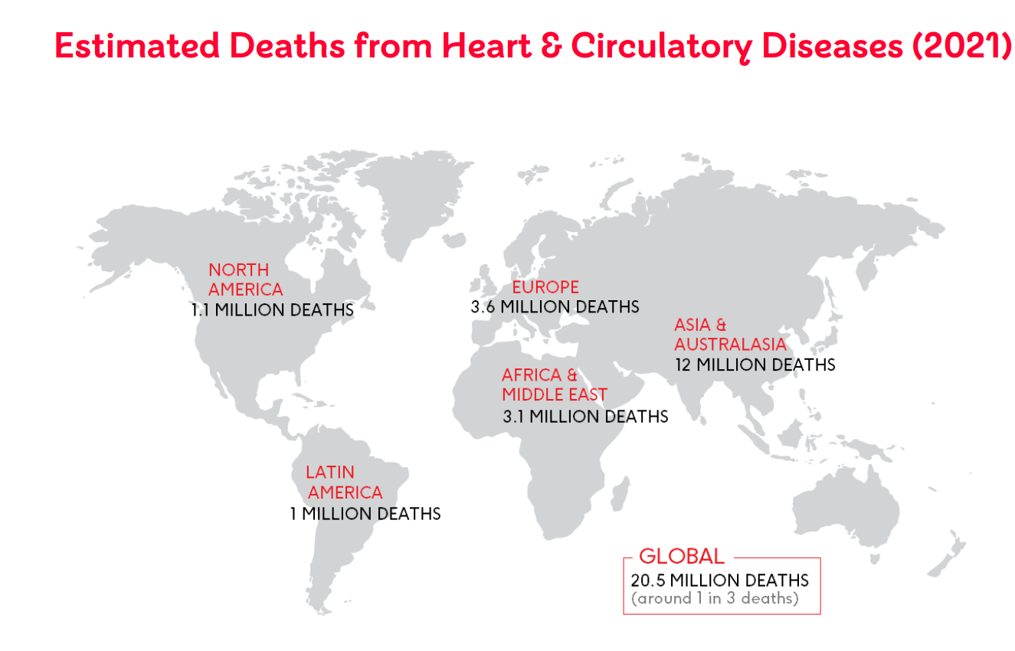
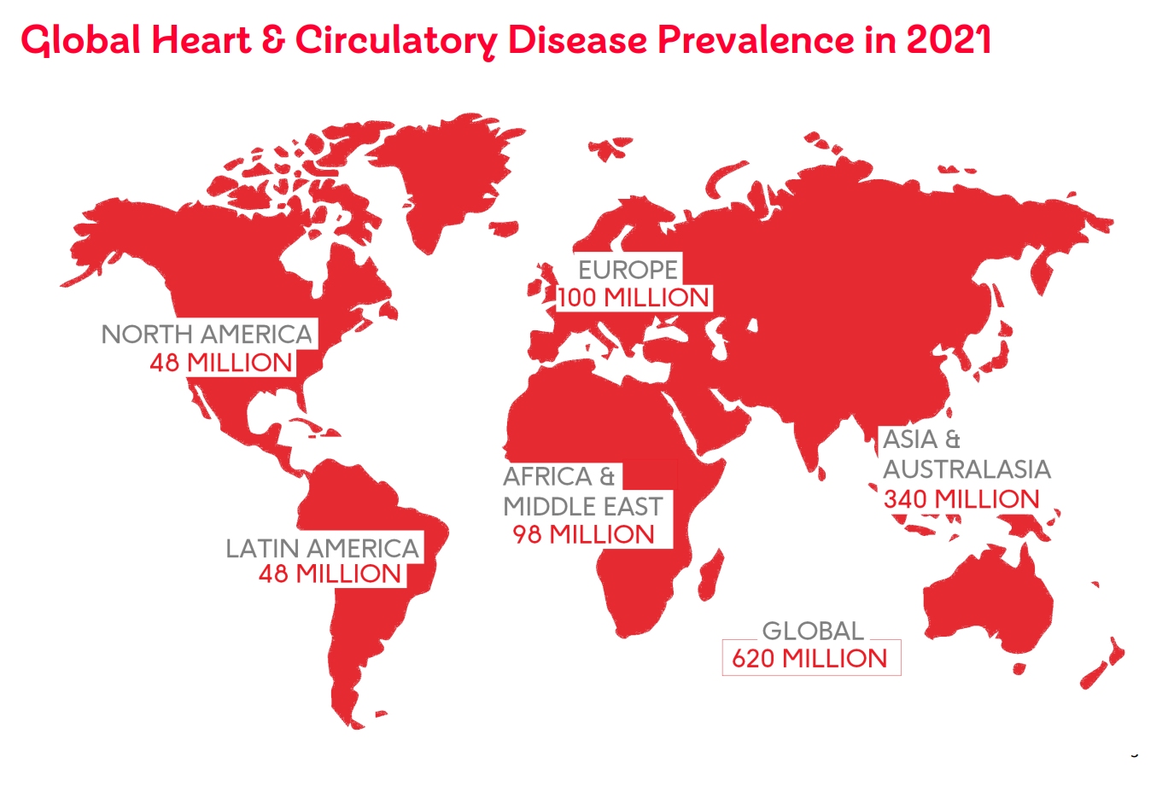
The Heart and Circulatory Diseases Burden on Public Health
Lindstrom et al (2022) Global Burden of Cardiovascular Diseases and Risks Collaboration, 1990-2021, JACC
World Health Organization (2020) Global Health Estimates for 2019
British Heart Foundation

Slide 3
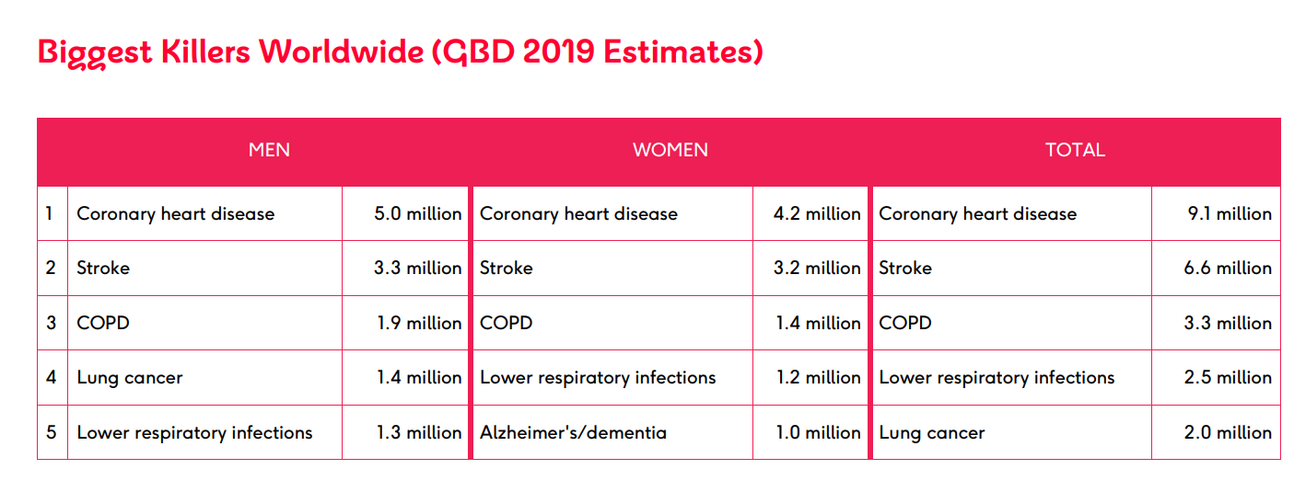
The Heart and Circulatory Diseases Burden on Public Health
Coronary heart disease is the most diagnosed heart disease worldwide
Coronary heart disease kills an estimated nine million people each year – in 2019 it was the world’s single biggest killer.
Lindstrom et al (2022) Global Burden of Cardiovascular Diseases and Risks Collaboration, 1990-2021, JACC
World Health Organization (2020) Global Health Estimates for 2019
British Heart Foundation

Slide 4

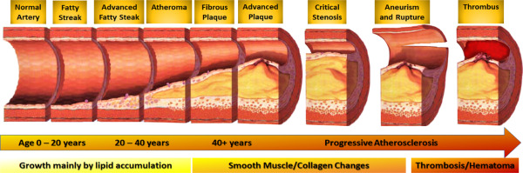
What causes Coronary artery Disease
Atherosclerosis
Coronary Artery Disease
Atherosclerosis Chaya Gopalan Ph.D., FAPS, Erik Kirk Ph.D., in Biology of Cardiovascular and Metabolic Diseases, 2022

Slide 5
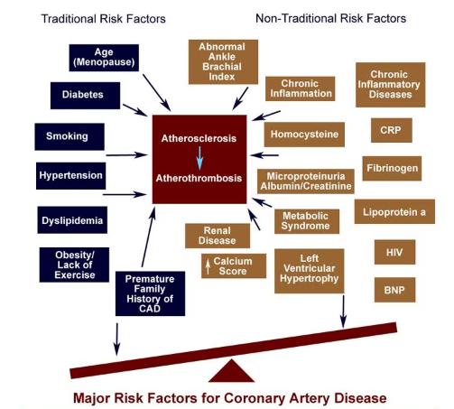
What causes Coronary artery Disease
Risk factors
Coronary Artery Disease
Atherosclerosis
Medscape, theheart.org

Slide 6
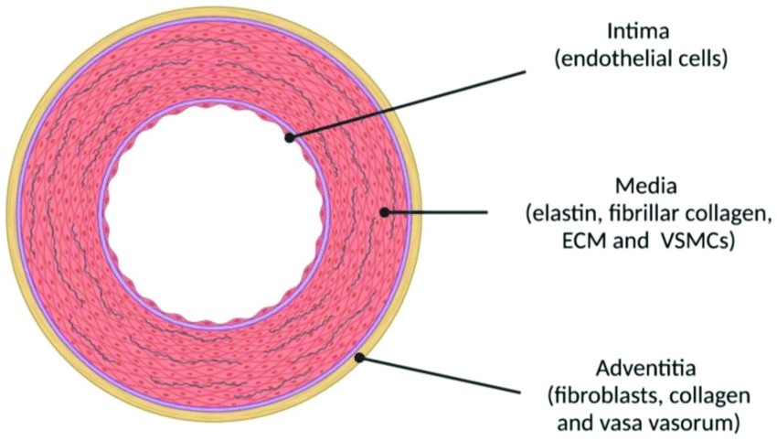
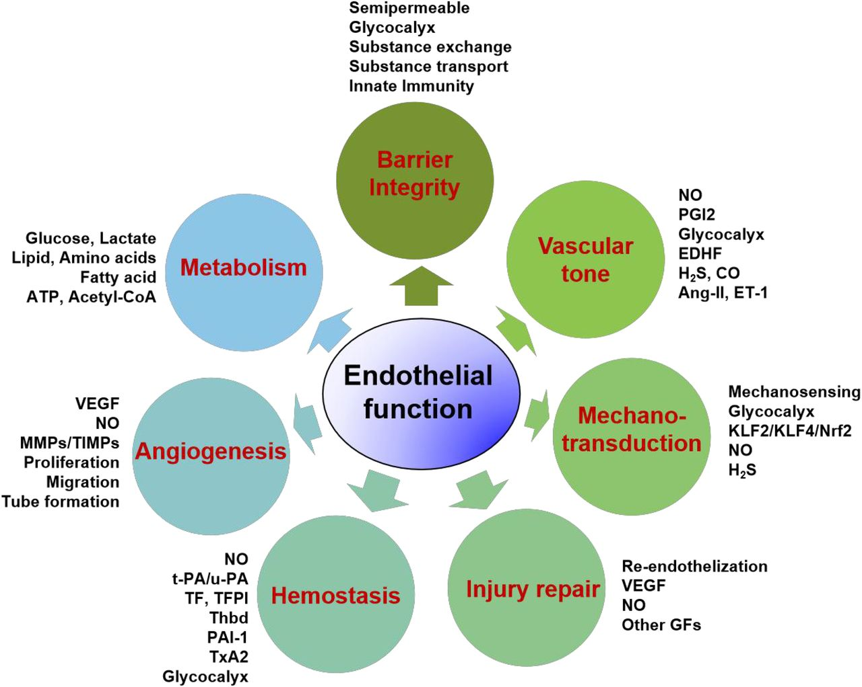
Meet the endothelium
Gonzalez-Clemente et al. (2021). Journal of Clinical Medicine. 10. 3616.10.3390/jcm10163616.

Slide 7
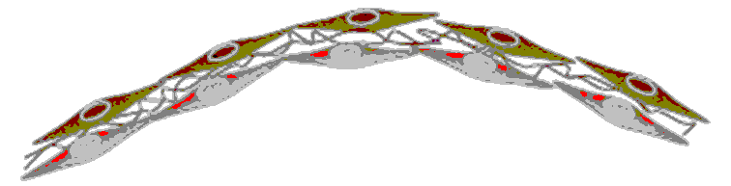






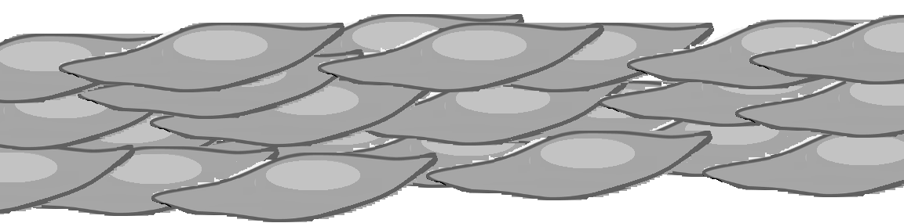
?
Monocytes
Low ESS
LDL
Lumen
Endothelial dysfunction
Monocytes differentiate
into macrophages
Necrotic lipid core
RISK FACTORS
Defective efferocytosis
Binding LDL to scavenger receptor
Intima
Oxidized LDL
Apoptosis
Foam cell
Smooth muscle cells migration and proliferation
Macrophages
Media
Vascular Smooth Muscle Cells

Slide 8
Monocytes
Low ESS
LDL
Lumen
Endothelial dysfunction
Monocytes differentiate
into macrophages
Necrotic lipid core
RISK FACTORS
Defective efferocytosis
Binding LDL to scavenger receptor
Intima
Oxidized LDL
Apoptosis
Foam cell
Smooth muscle cells migration and proliferation
Macrophages
Media
Vascular Smooth Muscle Cells

Slide 9
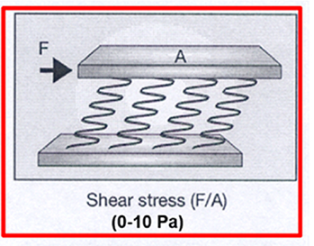
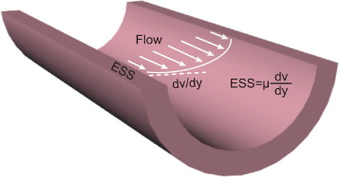
Meet Endothelial shear stress
Endothelial shear stress is the tangential stress derived from the friction of the flowing blood on the endothelial surface of the arterial wall and is expressed in units of force / unit area (N/m2or Pascal [Pa] or dyne/cm2; 1 N/m2= 1 Pa = 10 dyne/cm2) (26, 27) (Table 1).
Endothelial shear stress is proportional to the product of the blood viscosity (μ) and the spatial gradient of blood velocity at the wall

Slide 10
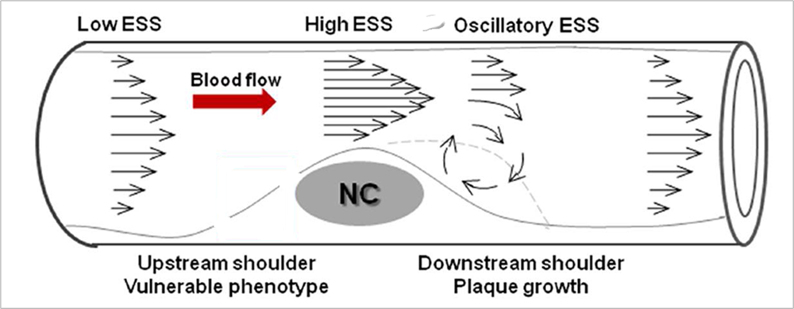
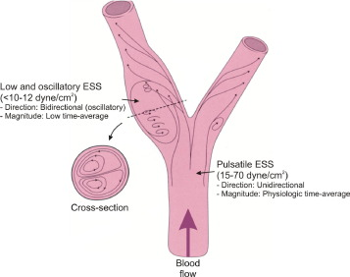
Endothelial shear stress and blood flow
Branch points, curvatures or bifurcations exhibit disturbed flow and low ESS in contrary to laminar, undisturbed flow.

Slide 11
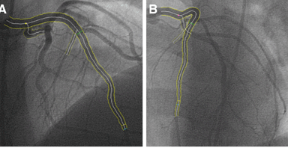
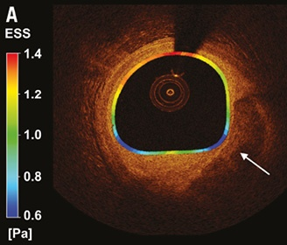
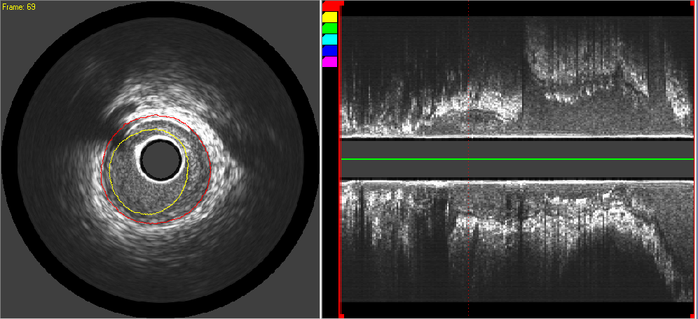
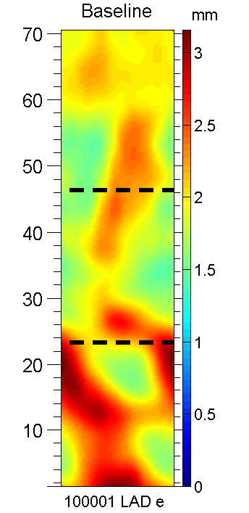
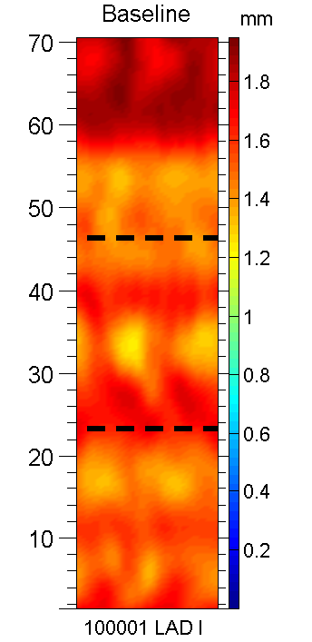
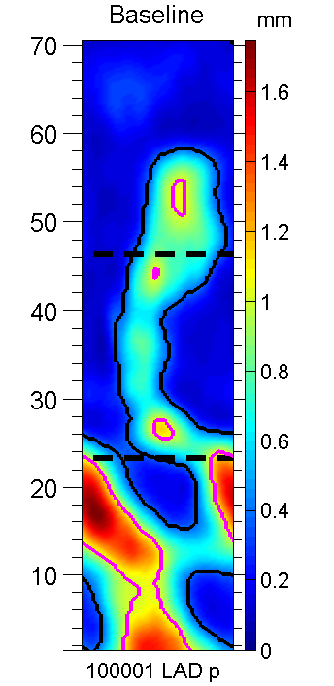
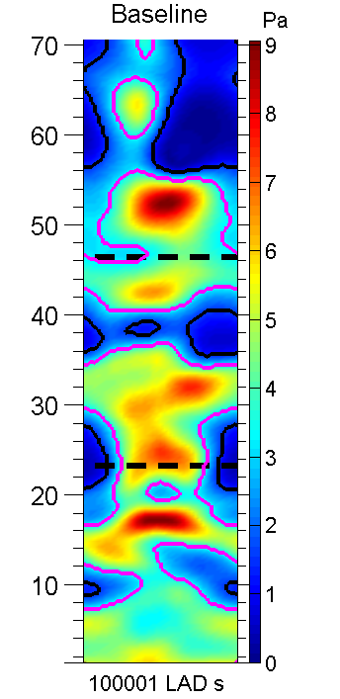
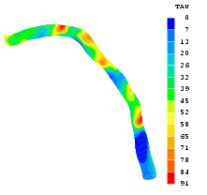
How to calculate Endothelial shear tress
A. Two angiographic planes
B
Lumen
Plaque
B. OCT/ IVUS segmentation
Plaque
EEM
EEM
Radius
Lumen
Radius
Plaque
Thickness
ESS
Reconstructed LAD
with ESS “profile”
proximal
C. Computational fluid dynamics (CFD)
and 3D reconstruction and ESS maps
distal

Slide 12
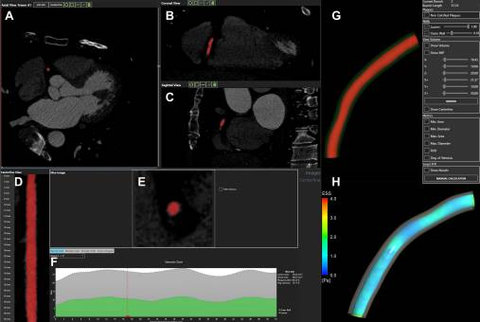
Endothelial shear stress calculation with Computed tomography coronary angiography
Pros | Cons
Non-invasive | Resolution (Artifacts, including calcium)
Assessment of entire coronary tree | Pending validation
Schultz et al, International Journal of Cardiovascular Imaging 2023

Slide 13
Endothelial shear stress: what to look for
Levels of shear stress and its effects on atherosclerosis
 |  | Effects in:
Label | Range (Pa) | Early atherosclerosis | Advanced atherosclerosis | Stented segments
Oscillatory Low | 0±0.5 0-1 | Athero-prone | Athero-prone | Neoathero-prone
Normal/ high | 1-7 | Atheroprotective | No consensus | Neoathero-protective
Elevated | >7 | NA | Erosion/ Rupture | NA
ESSG (ESS gradient):
quantitative measure of the non-uniformity in ESS
Types of flow
Laminar
Oscillatory
Unidirectional
Bidirectional
Gijsen, F… Serruys, P., 2019.. European Heart Journal 40, 3421–3433.https://doi.org/10.1093/eurheartj/ehz551

Slide 14
Monocytes
Low ESS
LDL
Lumen
Endothelial dysfunction
Monocytes differentiate
into macrophages
Necrotic lipid core
RISK FACTORS
Defective efferocytosis
Binding LDL to scavenger receptor
Intima
Oxidized LDL
Apoptosis
Foam cell
Smooth muscle cells migration and proliferation
Macrophages
Media
Vascular Smooth Muscle Cells

Slide 15
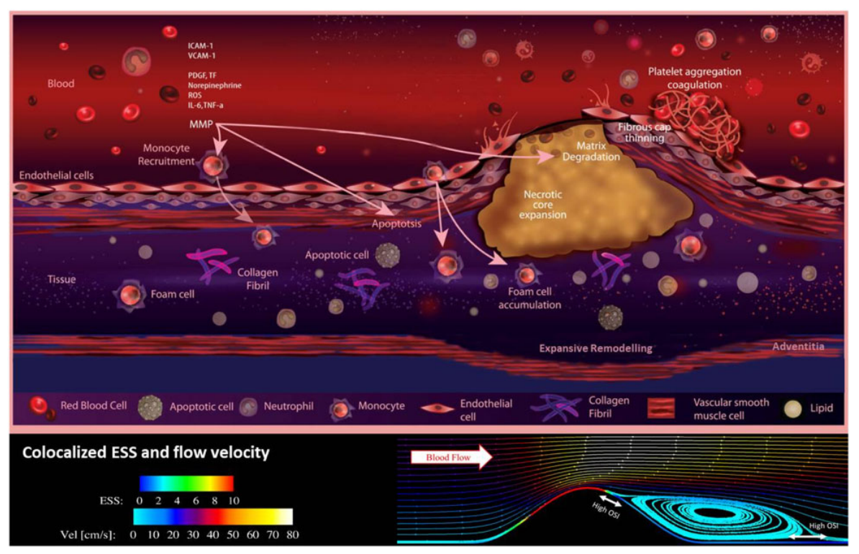
Gijsen, F… Serruys, P., 2019.. European Heart Journal 40, 3421–3433.https://doi.org/10.1093/eurheartj/ehz551

Slide 16
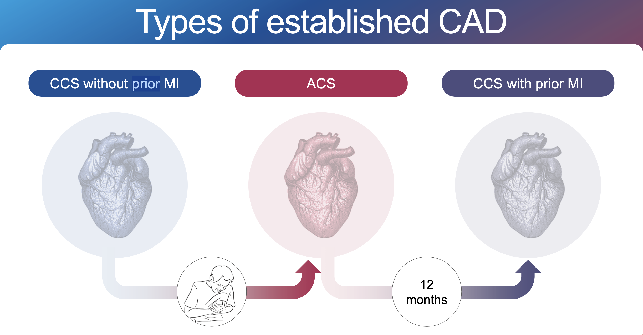
Endothelial shear stress and types of CAD: Clinical studies

Slide 17
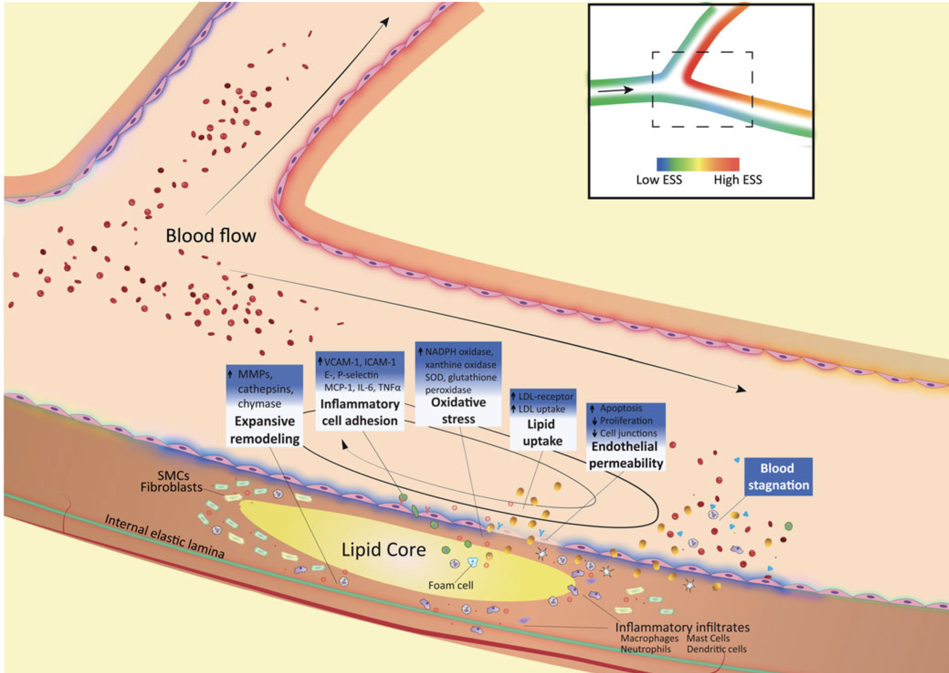
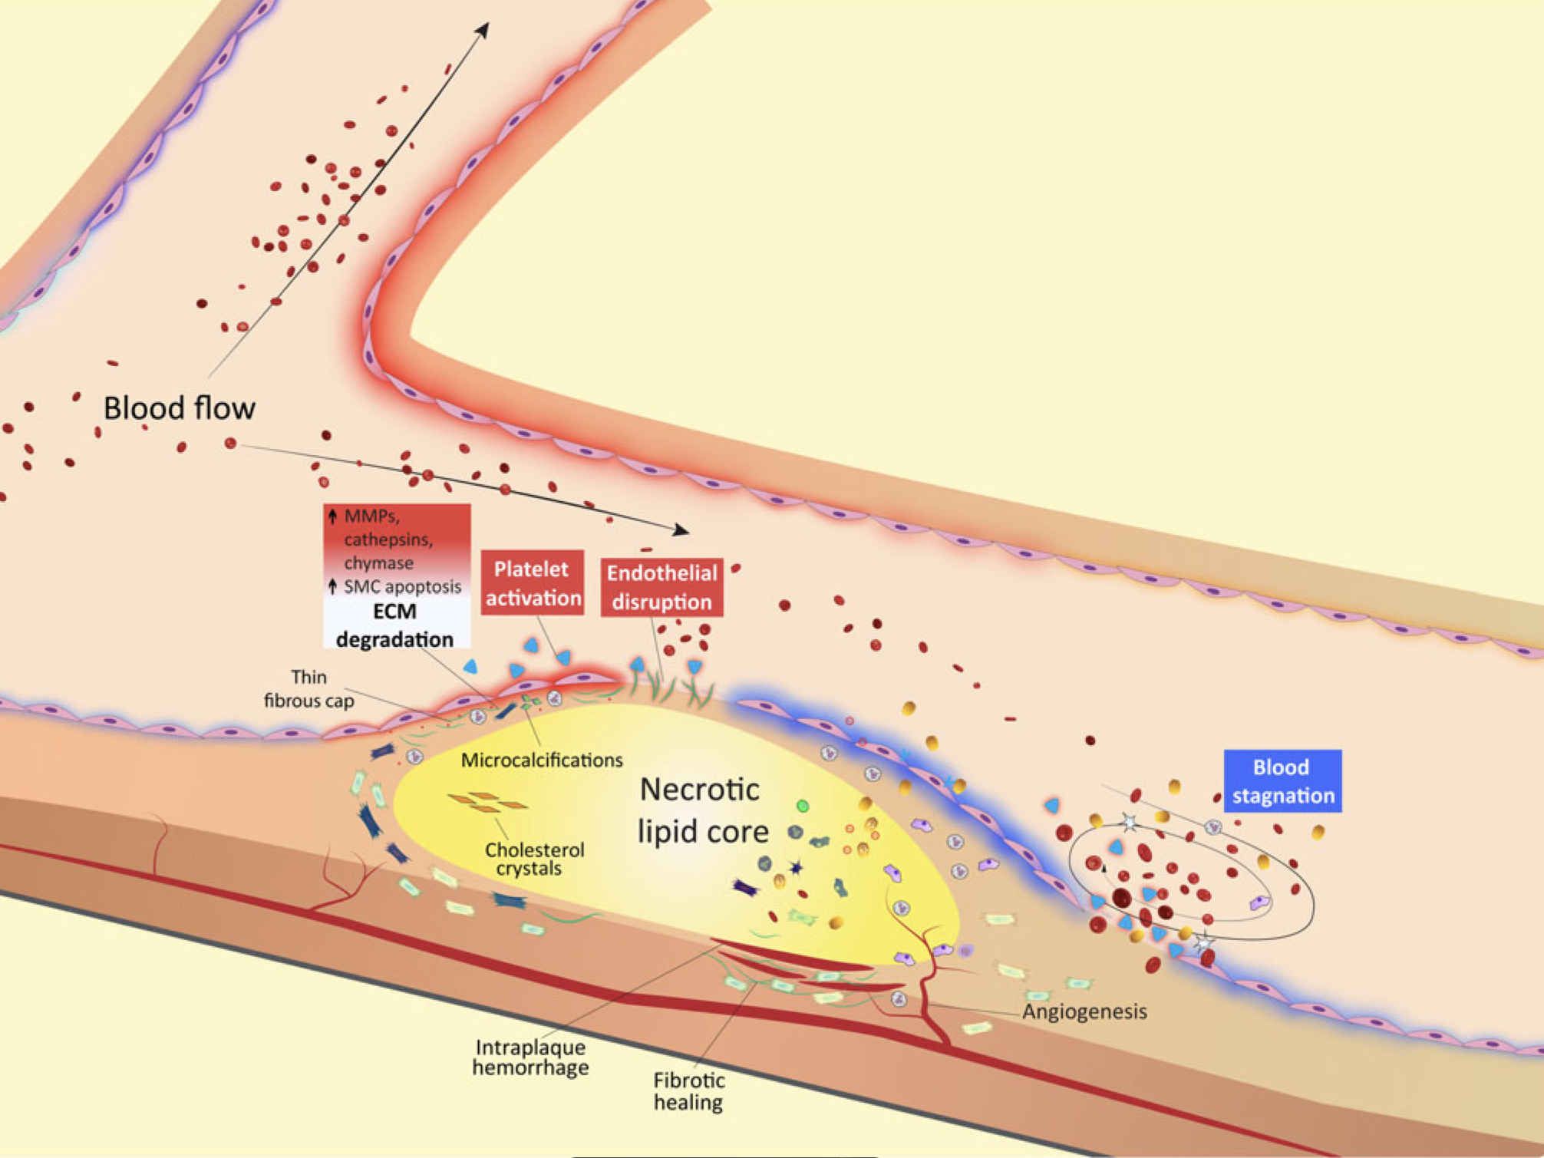
Chronic Coronary Syndromes
Low ESS linked to plaque progression and outward remodeling
Stone et al, Circulation 2003
Stone et al, EHJ 200
Samady et al, Circulation 2011
Stone et al, Circulation 2012
Vergallo et al, Circulation Cardiovasc Imaging 2014
Hung et al, JAHA 2016
Thondapu et al.Biomechanical stress in coronary atherosclerosis: emerging insights from computational modelling EHJ 2017

Slide 18
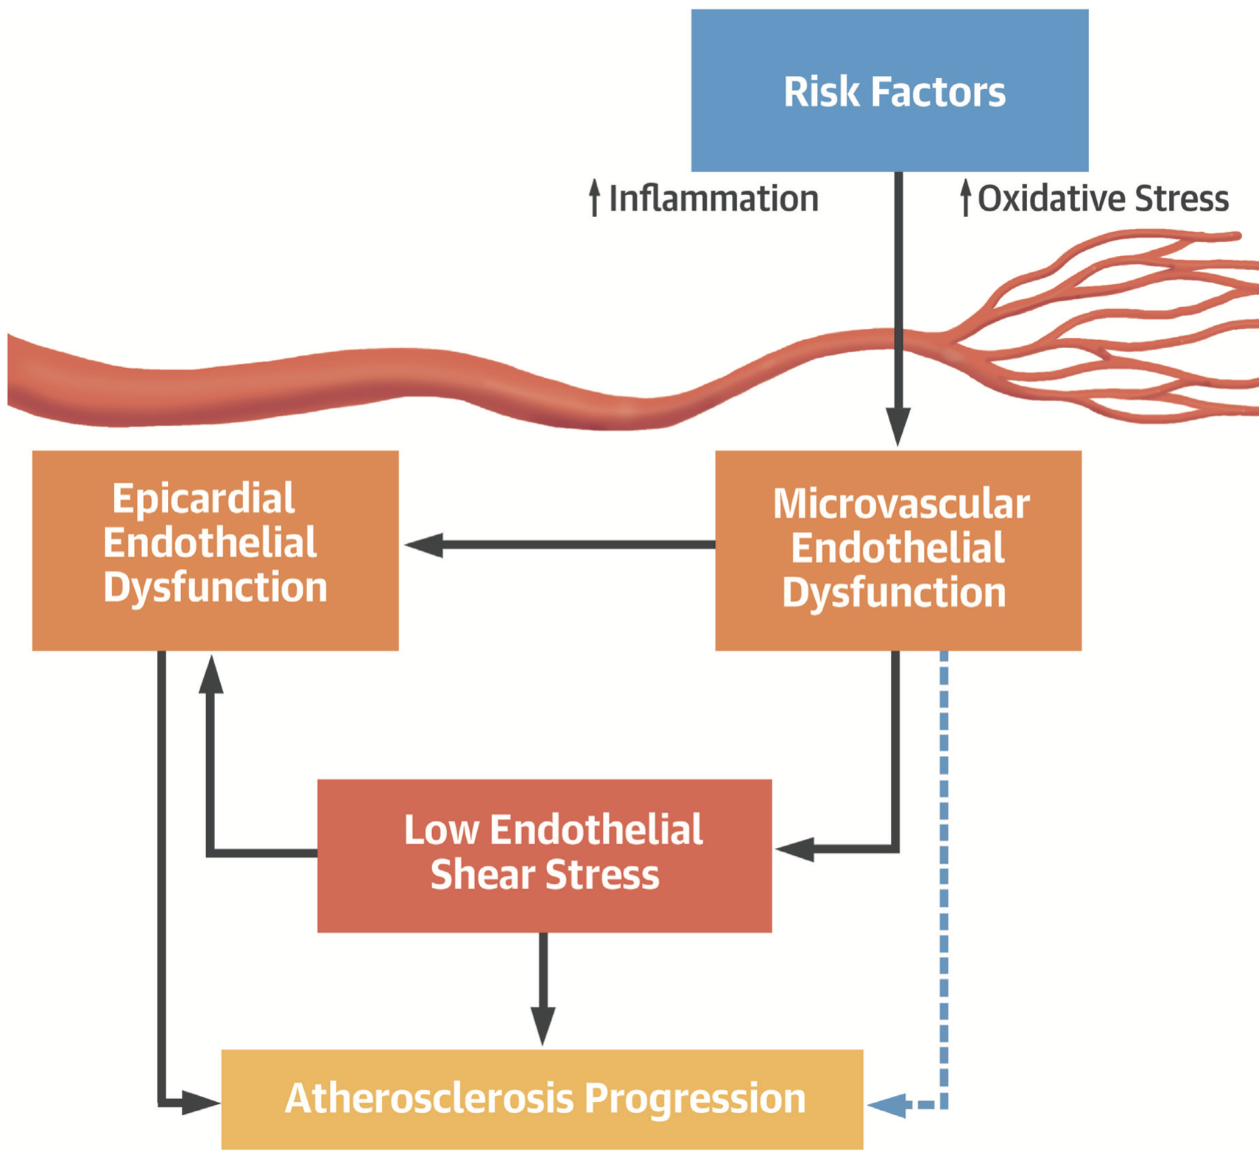
Local Low Shear Stress and Endothelial Dysfunction in Patients
With Nonobstructive Coronary Atherosclerosis
Siasos G…Peter H. Stone, JACC 2018
65 patients with nonobstructive coronary atherosclerosis (luminal diameter stenosis <30%).
Microvascular and epicardial coronary endothelial function was assessed by using intracoronary acetylcholine infusion.
ESS was calculated with coronary angiogram/IVUS/CFD
Microvascular endothelial dysfunction was associated with low ESS and more adverse epicardial plaque characteristics compared with patients with normal microvascular function.

Slide 19

Acute coronary syndromes (ACS)

Slide 20
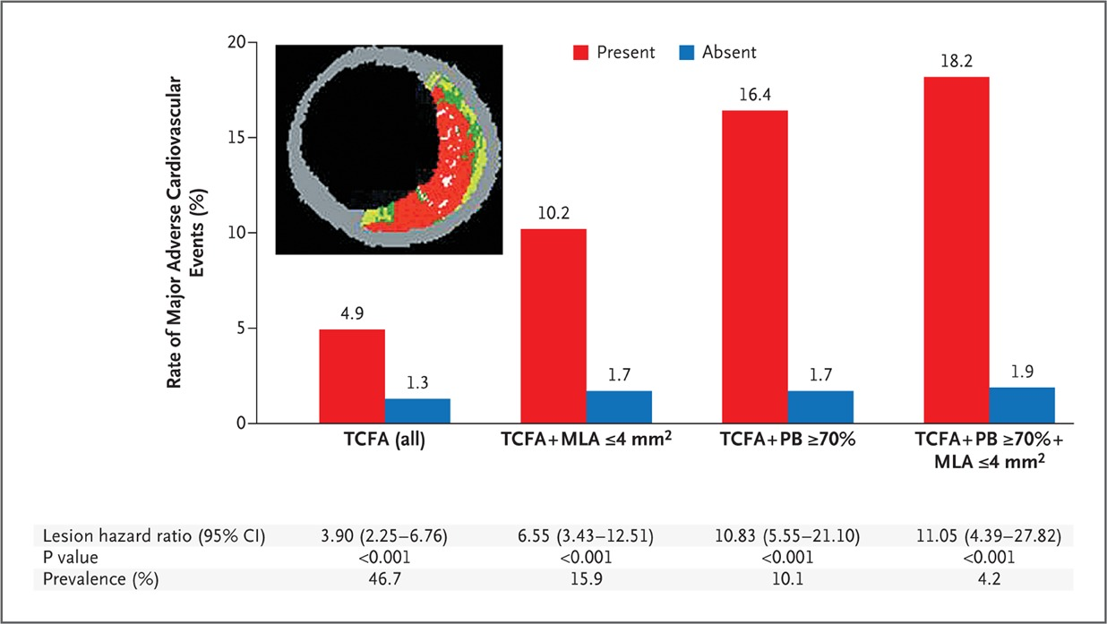
A Prospective Natural-History Study of
Coronary Atherosclerosis
Gregg W. Stone et al, NEJM 2011
Prospective study in 697 patients with PCI treated ACS
3.4 year follow up, 149 events (20%), mostly unstable/ progressive angina
50% of events attributed to non culprit lesions

Slide 21
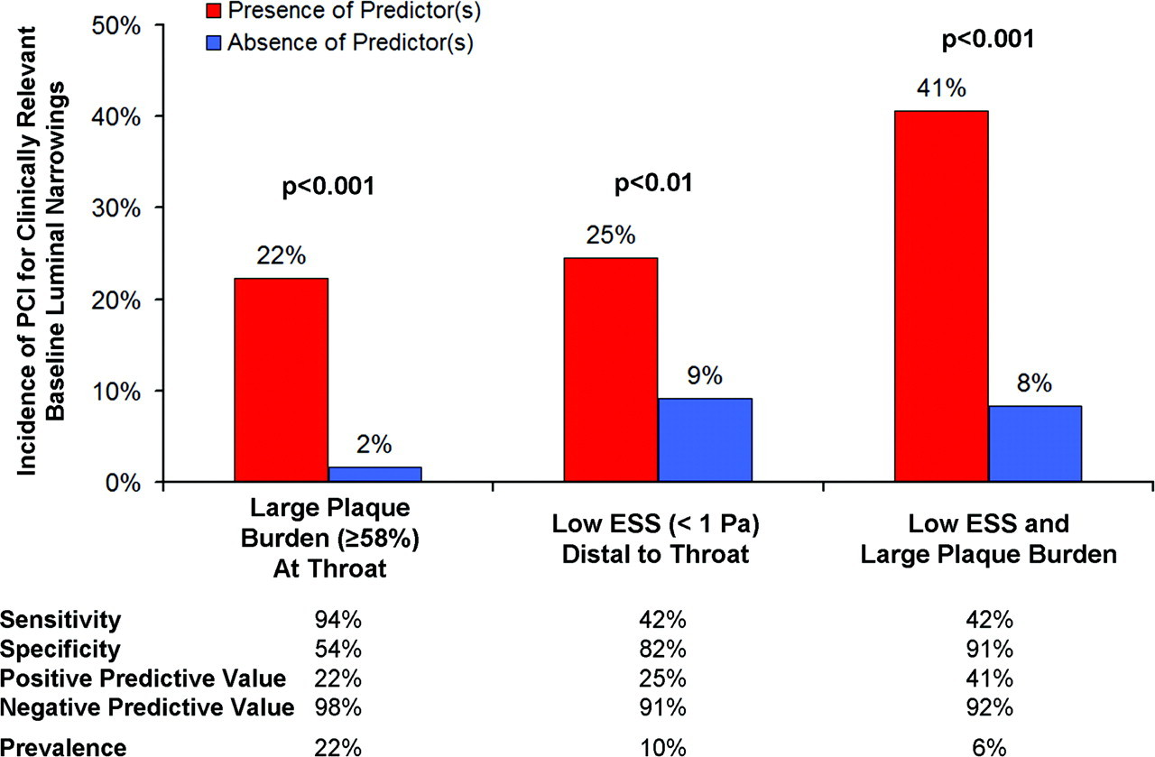
Prediction of Progression of Coronary Artery Disease and Clinical Outcomes Using Vascular Profiling of Endothelial Shear Stress and Arterial Plaque Characteristics
The PREDICTION Study
Peter H. Stone… Charles L. Feldman Circulation 2012
Outcome:
Plaque burden is the most powerful predictor of plaque progression and luminal obstruction
Low ESS provides substantial additive independent prognostication. 41% positive and 92% negative predictive value-Clinical significance limited by infrequent clinical events
(20 events, 1 year follow up)
506 patients with PCI treated ACS
374 (74%) had repeat vascular profiling after
6-10months

Slide 22
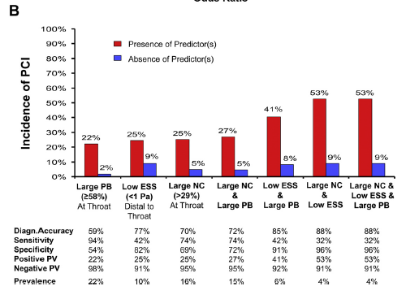
Role of Low Endothelial Shear Stress and Plaque Characteristics in the Prediction of Nonculprit Major Adverse Cardiac Events: The PROSPECT Study
Stone PH..Stone GW, Jacc Cardiovascular Imaging 2018
Outcome:
Low local ESS (<1.3 Pa) was strongly associated with subsequent nc-MACE compared with physiological/high ESS
No lesion without low ESS led to nc-MACE during follow-up, regardless of PB, MLA, or lesion phenotype at baseline.
145 lesions in 97 patients:
23 nc-MACE lesions (13 TCFAs, 10 thick-cap
fibroatheromas [ThCFAs])
122 nc-non-MACE lesions (63 TCFAs, 59 ThCFAs)

Slide 23
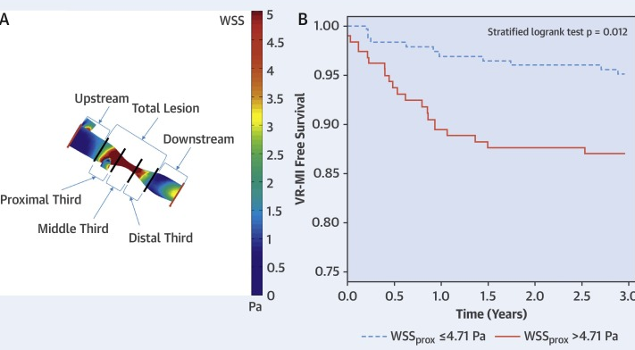
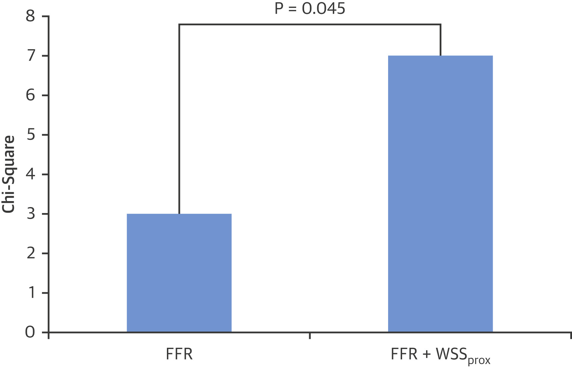
High Coronary Shear Stress in Patients With Coronary Artery Disease Predicts Myocardial Infarction
Kumar A…Samady H. JACC 2018
FAME II population (stable angina and FFR ≤0.80, randomized PCI+OMT vs OMT)
29 culprit vessels with MI vs 29 vessels from non-MI control patients
Outcome
Higher ESS had the highest prognostic value to predict MI at 3 years.
ESS had an incremental prognostic value over FFR in predicting MI.

Slide 24
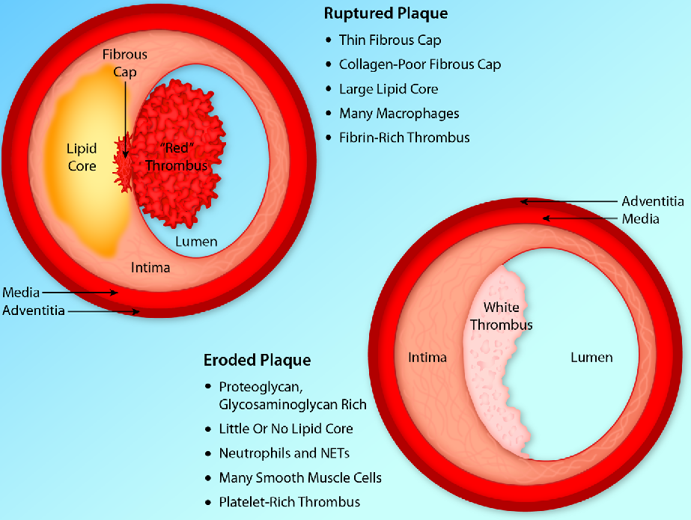
Acute coronary syndromes: rupture vs erosion
Is ESS a factor?

Slide 25
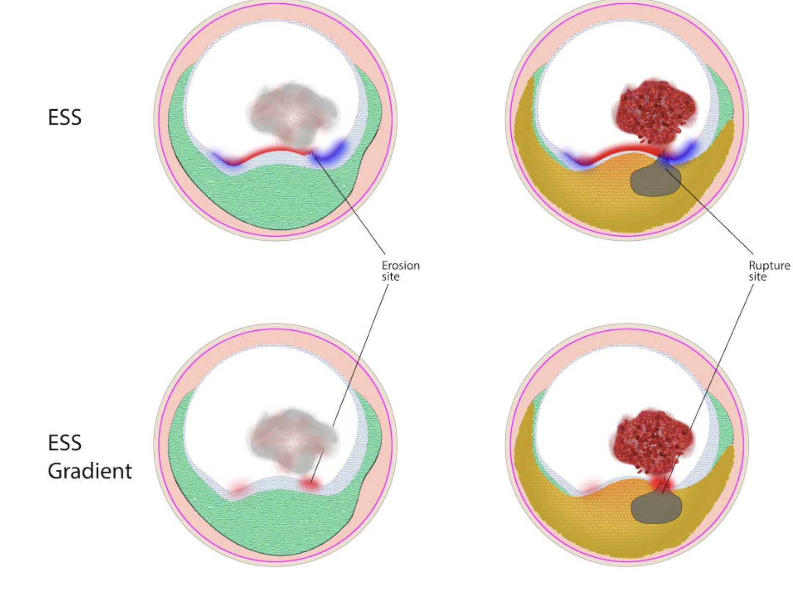
High spatial endothelial shear stress gradient independently predicts site of acute coronary plaque rupture and erosion
Thondapu et al, Cardiovascular Research 2021
Outcome:
Rupture: high ESSG, layered plaque, and lipid
Erosion: moderate/high ESSG, high oscillatory shear index (OSI)
ESSG is higher at rupture sites
ESS is similar between the two groups
37 STEMI/NSTEMI patients who underwent
vascular profiling with with OCT

Slide 26
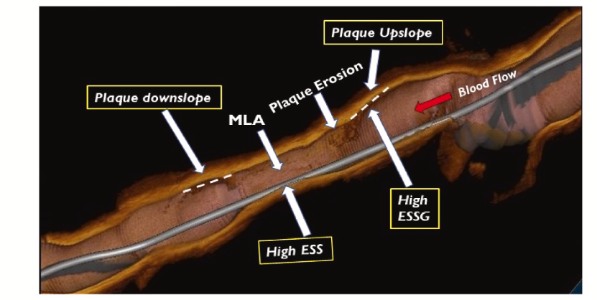
The role of endothelial shear stress, shear stress gradient, and plaque
topography in plaque erosion
Diaa Hakim…Peter H. Stone Atherosclerosis 2023
Outcome
Erosion and thrombus formation were associated with high ESS and ESSG vs. similar plaques without destabilization.
There was no difference in Min ESS between erosion and stable plaques.
ESS and ESSG was compared between plaques with erosion and similar non-culprit control plaques that remained stable in 46 patients

Slide 27
Low vs high ESS in ACS
Plaques exposed to either low or high ESS environments have been associated with plaque destabilization and new major acute cardiovascular events (MACE)
Newer markers such as ESSG, seem to consistently be associated with MACE
 | Low ESS | High ESS | High ESSG
Hakim et al, 2023 |  | ✔️ | ✔️
Thondapu et al, 2021 |  | ✔️ | ✔️
Bourantas et al, 2020 |  | ✔️ | ✔️
Kumar et al, 2018 |  | ✔️
Stone PH et al, 2018 | ✔️

Slide 28
Effects of endothelial shear stress after Stent Implantation
Suboptimal stent implantation affects the local hemodynamic forces and can lead to unfavorable clinical outcomes.
Regions of low ESS after PCI are colocated with neointima and neoatherosclerosis formation.
High shear gradients and flow disturbances have been shown to increase the risk of thrombosis.
Wentzel et al | Circulation 2001
Gijsen et al | Am J Cardiol. 2003
Papafaklis et al | Int J Cardiol. 2009
Bourantas et al | Int J Cardiovasc Imaging. 2014
Bourantas et al | JACC Cardiovasc Interv. 2014
Bourantas et al | Int J Cardiol. 2015
Shishido et al | JAHA 2016
Torii et al | Int J Cardiol 2018
Tenekecioglu et al | Int J Cardiovasc Imaging 2019
Jin et al | Front Cardiovasc Med 2022
Beyene et al | Cardiovasc Revasc Med 2023

Slide 29
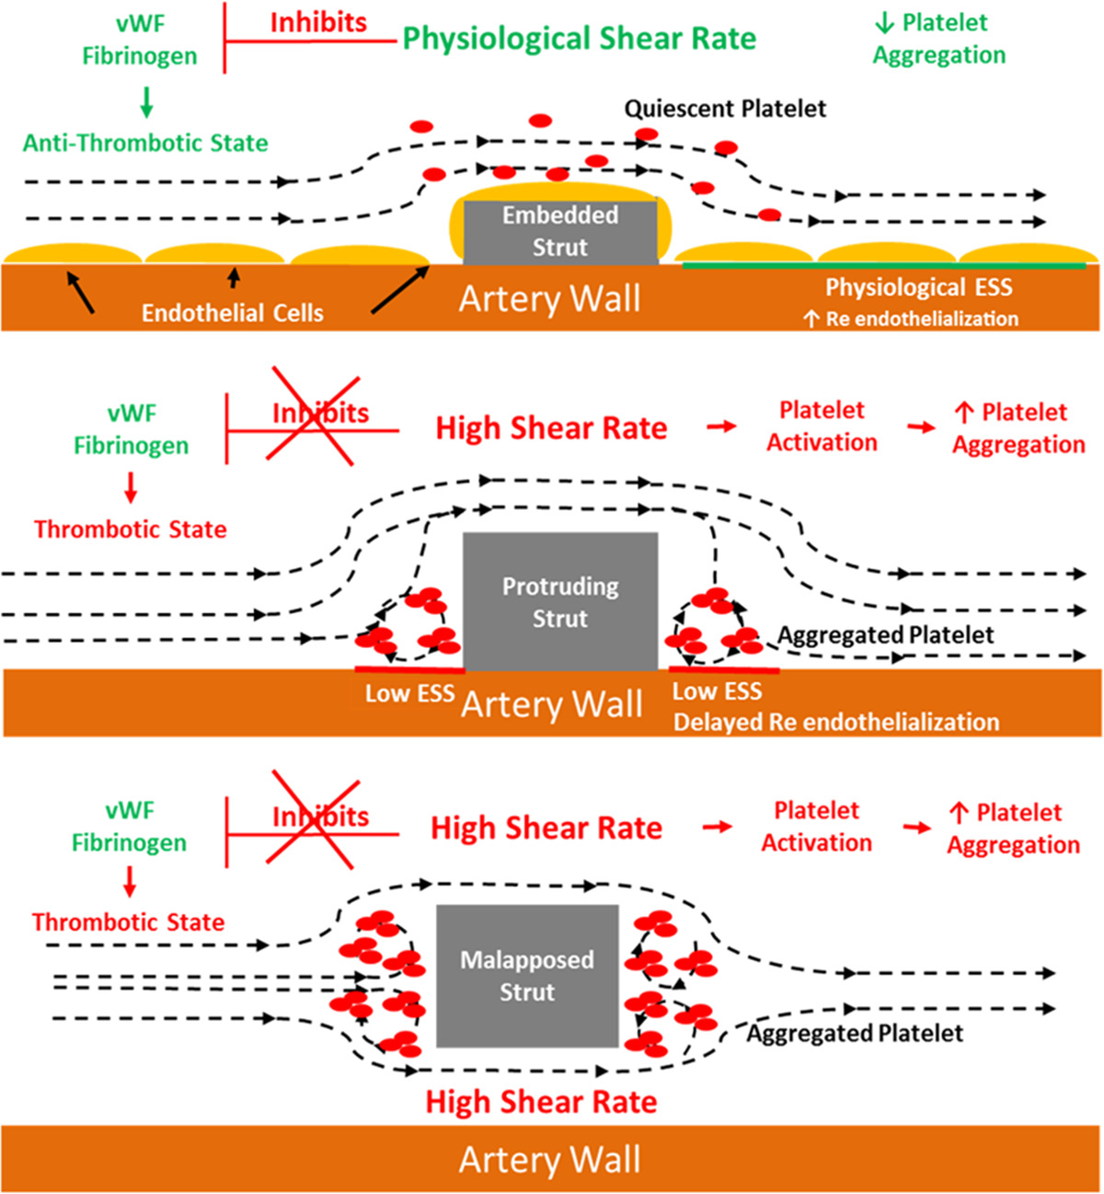
Local Hemodynamic Forces After Stenting Implications on Restenosis and Thrombosis, Jaryl Ng… Nicolas Foin ATVB 2017

Slide 30
Conclusions
Endothelial dysfunction is a prerequisite in initiation of atherosclerotic process
Hemodynamic parameters, such as ESS seem to trigger ED, in certain areas of the coronary tree with flow disturbance/separation (bifurcation, branches)
Data from Coronary angiography (invasive and non-invasive), IVUS/OCT and CFD provide quantification of ESS
Low ESS has been associated with atheromatic plaque progression
Microvascular dysfunction may predispose to low ESS in epicardial arteries
Changes in ESS (Low/High) have been associated with ACS
High ESSG is an emerging marker associated with ACS
Low ESS has been associated with neoatherosclerosis and ISR, high ESSG associated with thrombosis
Advances in imaging modalities may allow less invasive and more accurate atheroma topography and ESS quantification, and implementation in clinical practice

Slide 31
Thank you for your attention

