Slide 1

Εργαλεία εκτίμησης καρδιαγγειακού κινδύνου σε ασθενείς με ΣΔ
ΠΜΣ
Ευάγγελος Οικονόμου
Καρδιολόγος, Επιμελητής Α,
Γ’ Πανεπιστημιακή Καρδιολογική Κλινική, Γ.Ν.Ν.Θ.Α «Η Σωτηρία»

Slide 2
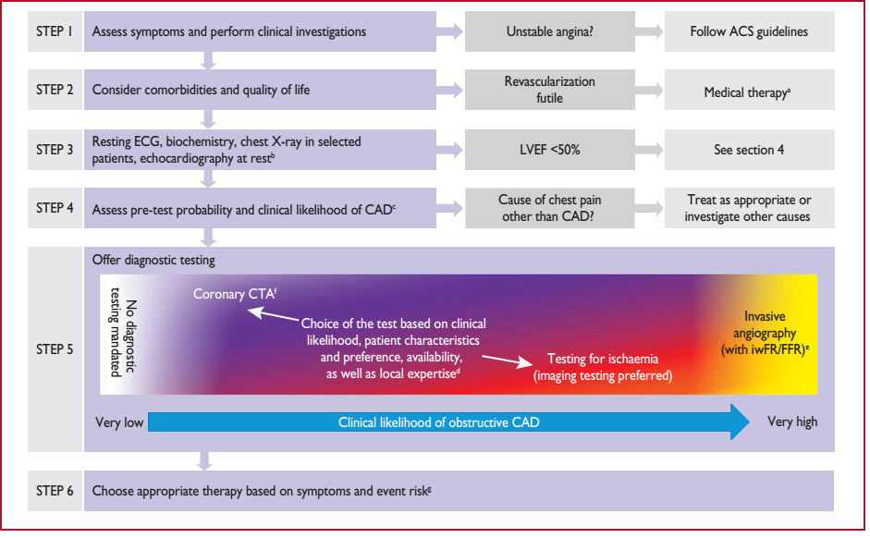

Slide 3
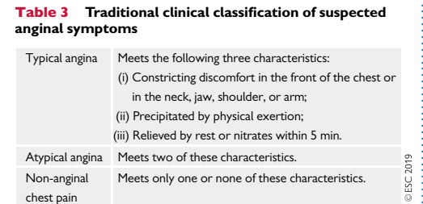

Slide 4

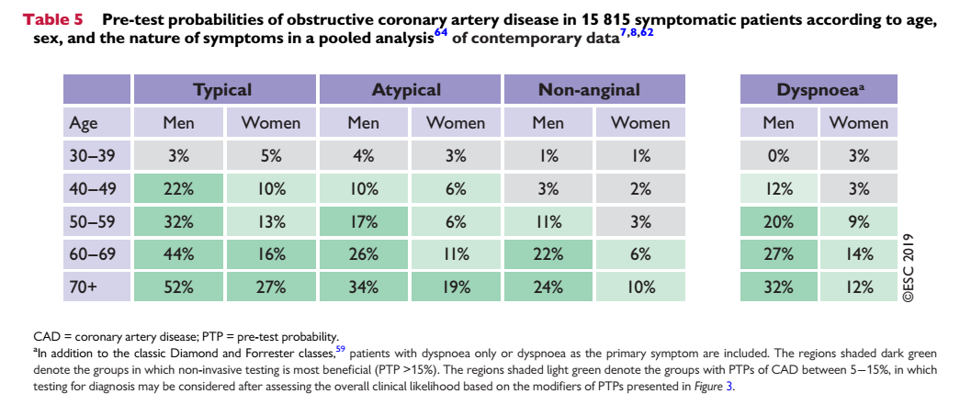

Slide 5
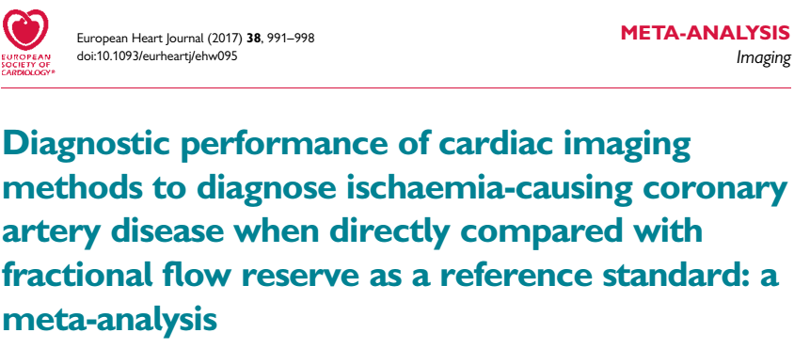
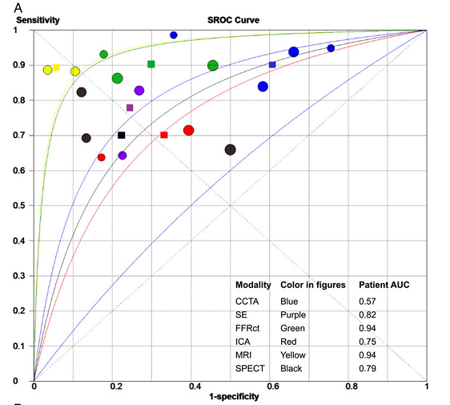
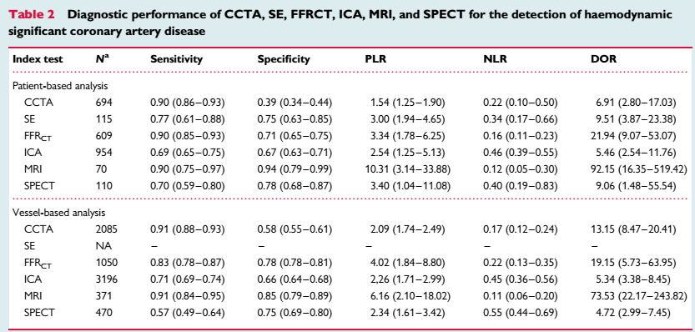

Slide 6
Sensitivity is the percentage of true positives (e.g. 90% sensitivity = 90% of people who have the target disease will test positive).
Specificity is the percentage of true negatives (e.g. 90% specificity = 90% of people who do not have the target disease will test negative).
Sensitivity and specificity are characteristics of a test.
Positive predictive value (PPV) and negative predictive value (NPV) are best thought of as the clinical relevance of a test.
The significant difference is that PPV and NPV use the prevalence of a condition to determine the likelihood of a test diagnosing that specific disease. Whereas sensitivity and specificity are independent of prevalence.
For any given test (i.e. sensitivity and specificity remain the same) as prevalence decreases, the PPV decreases because there will be more false positives for every true positive.

Slide 7
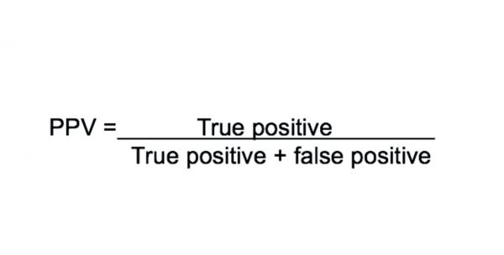
The positive predictive value is the probability that following a positive test result, that individual will truly have that specific disease.

Slide 8
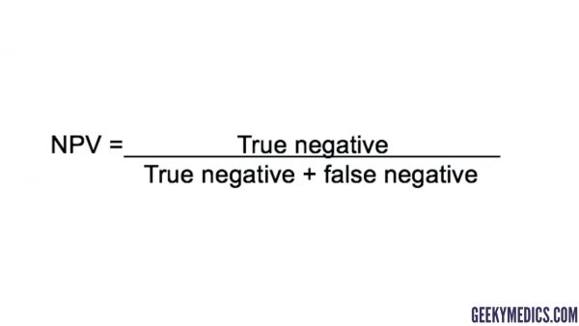
The negative predictive value is the probability that following a negative test result, that individual will truly not have that specific disease.

Slide 9
For a mathematical explanation of this phenomenon, we can calculate the positive predictive value (PPV) as follows: PPV = (sensitivity x prevalence) / [ (sensitivity x prevalence) + ((1 – specificity) x (1 – prevalence)) ]

Slide 10
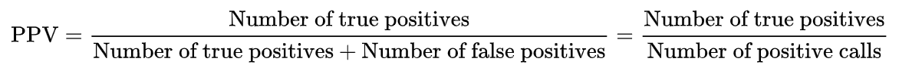
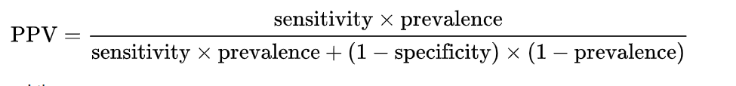
Stress Echo:
Sensitivity: 80%
Specificity: 89%
Pre-Test Probability = 5%
PPV= 27%
0.8x0.05 / ((0.8x0.05) + ((1-0.89)x(1-0.05)))

Slide 11
Stress Echo:
Sensitivity: 80%
Specificity: 89%
Pre-Test Probability = 80%
NPV= 63%
0.89x 0.2 / (0.89 * (1-0.8) + (1-0.8)x0.8)

Slide 12
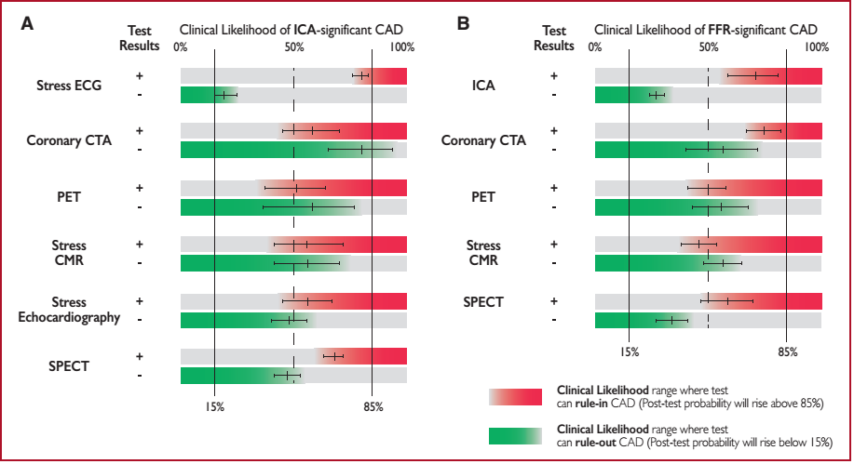

Slide 13
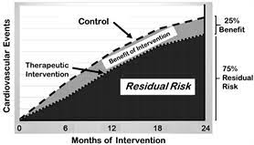

Slide 14
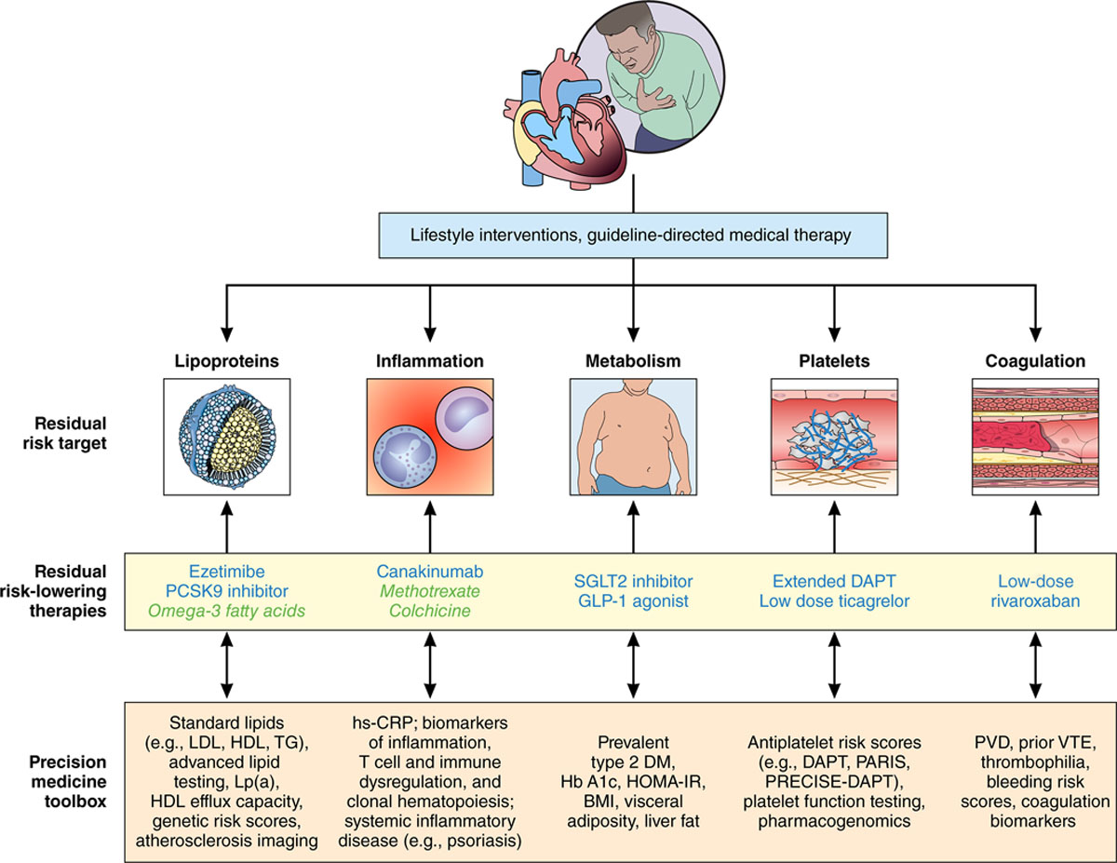

Slide 15
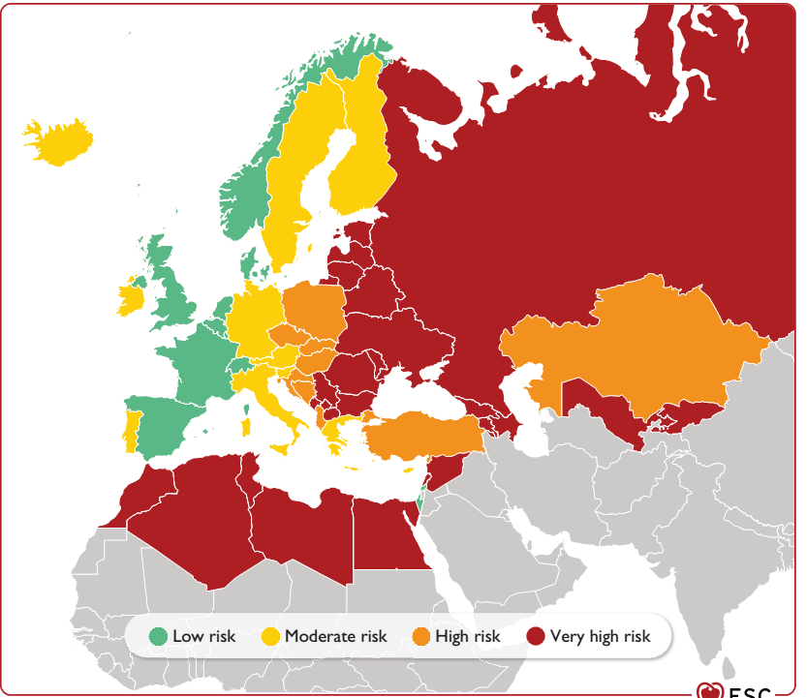

Slide 16
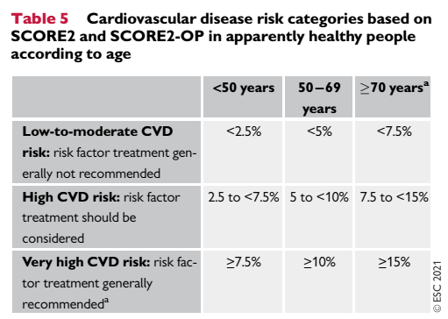

Slide 17
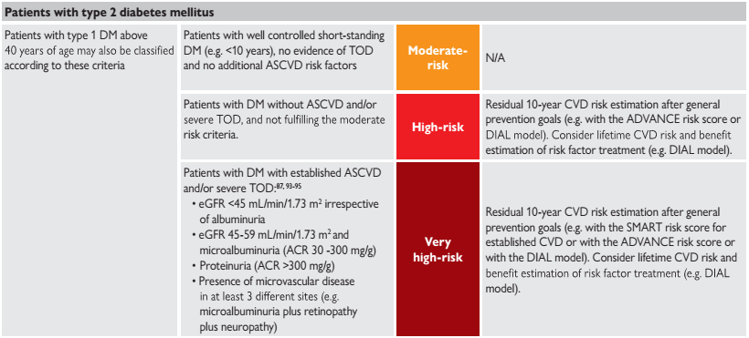

Slide 18
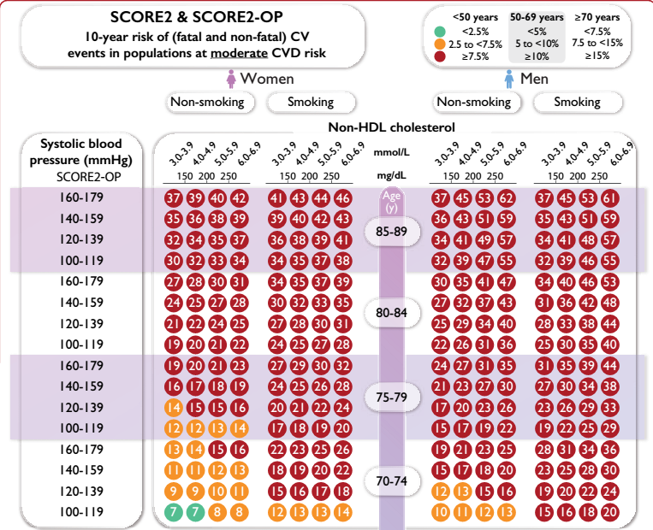

Slide 19
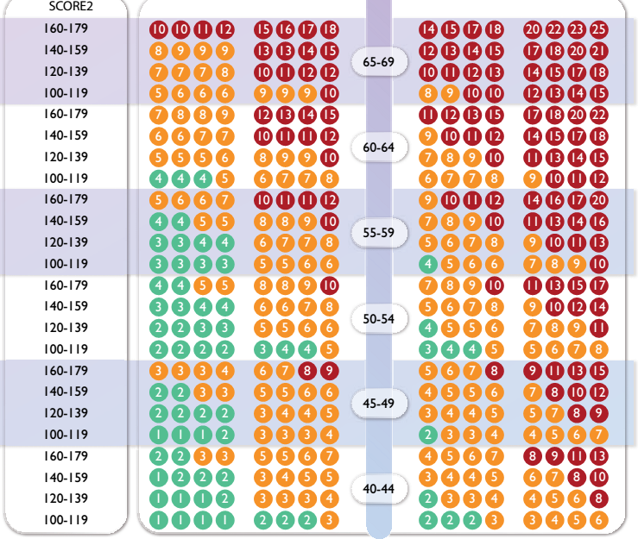

Slide 20
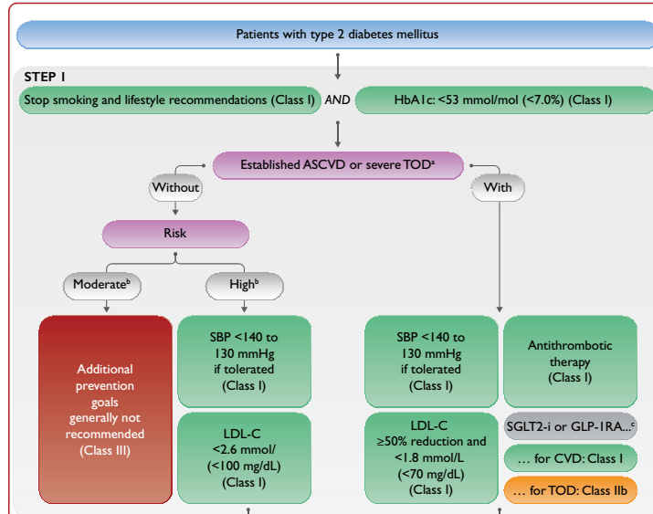

Slide 21
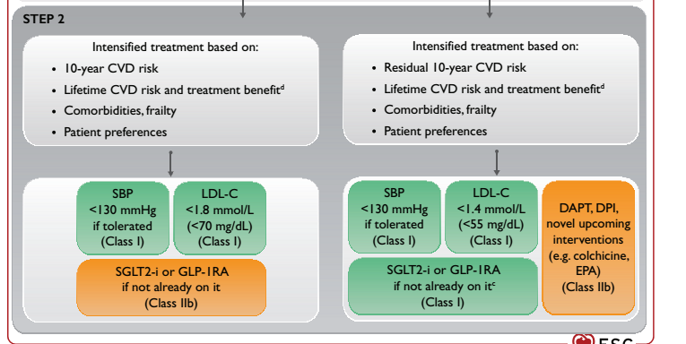

Slide 22
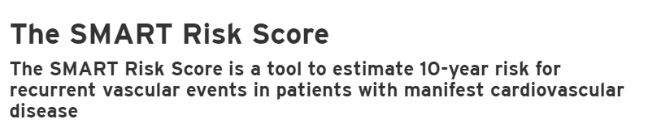
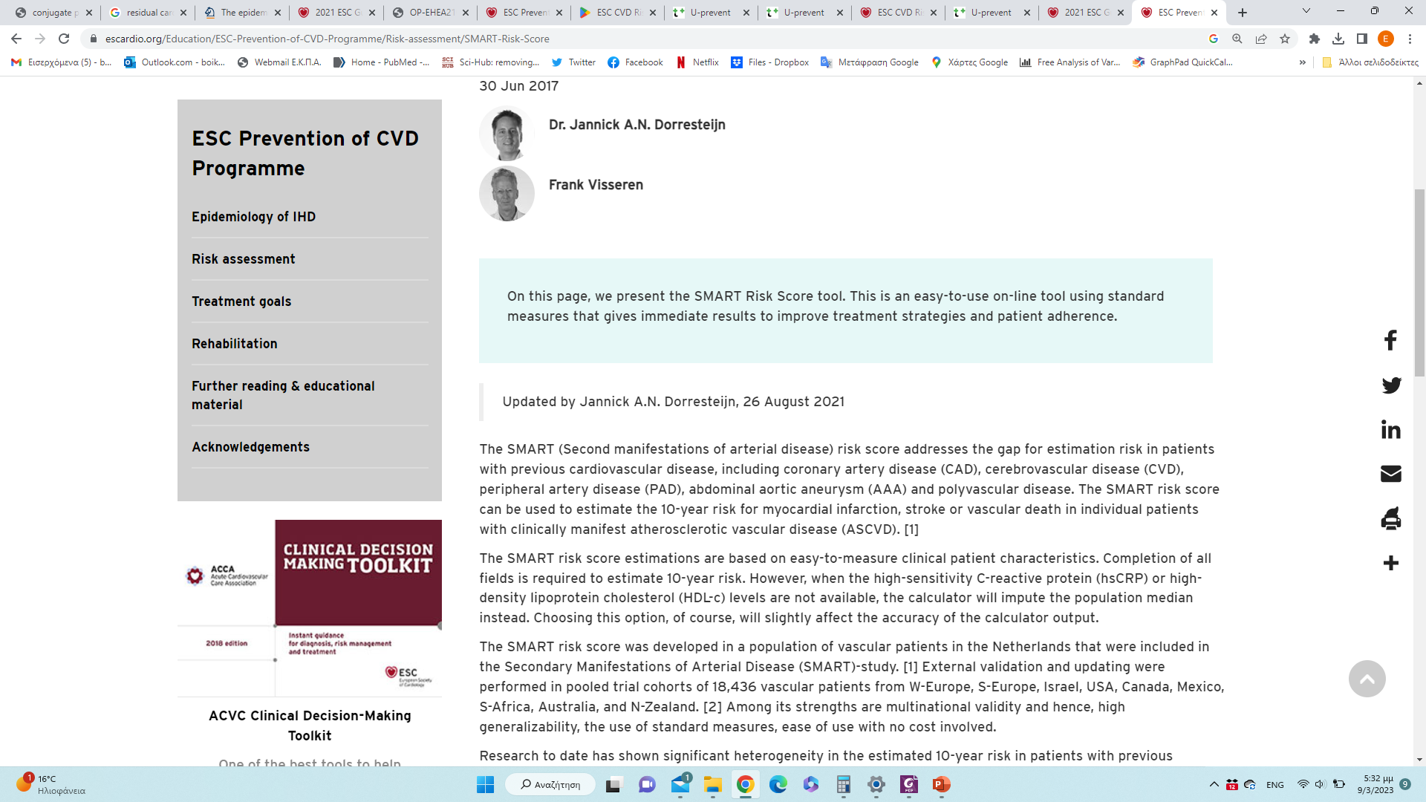

Slide 23
https://u-prevent.com/?redirect=true

Slide 24
https://u-prevent.com/

