Slide 1
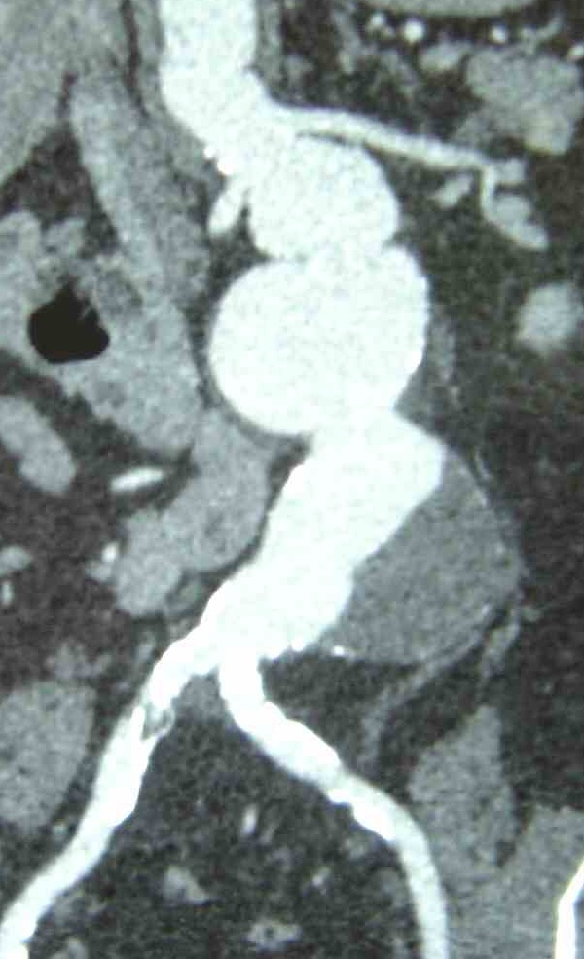
ANEURYSMS
Thanos Katsargyris, MD, PhD
Ass. Professor of Vascular Surgery
2nd Department of Vascular Surgery, Athens University Medical School, LAIKO Hospital

Slide 2
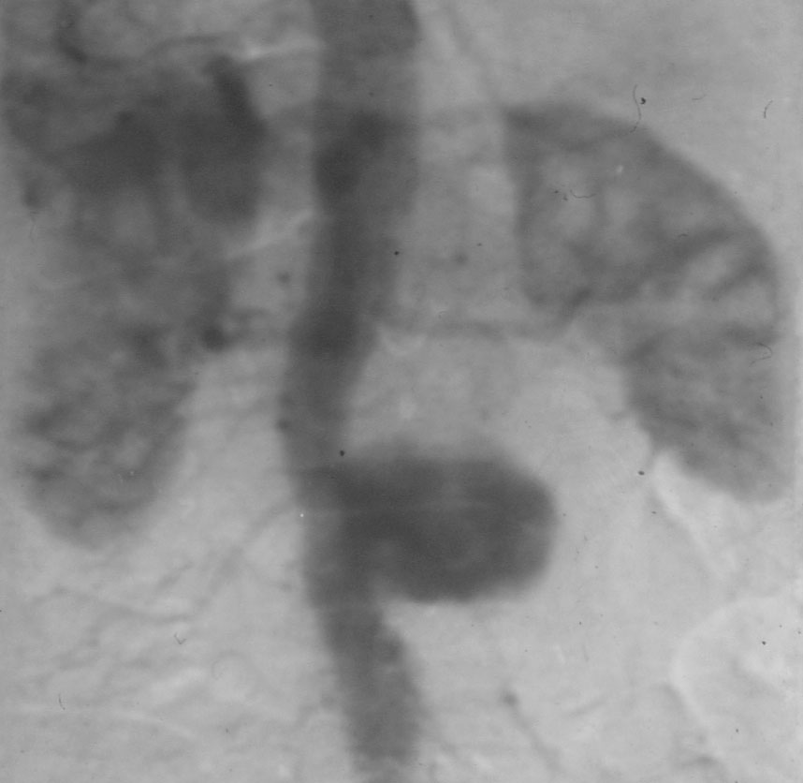
Definition: abnormal dilatation…

Slide 3
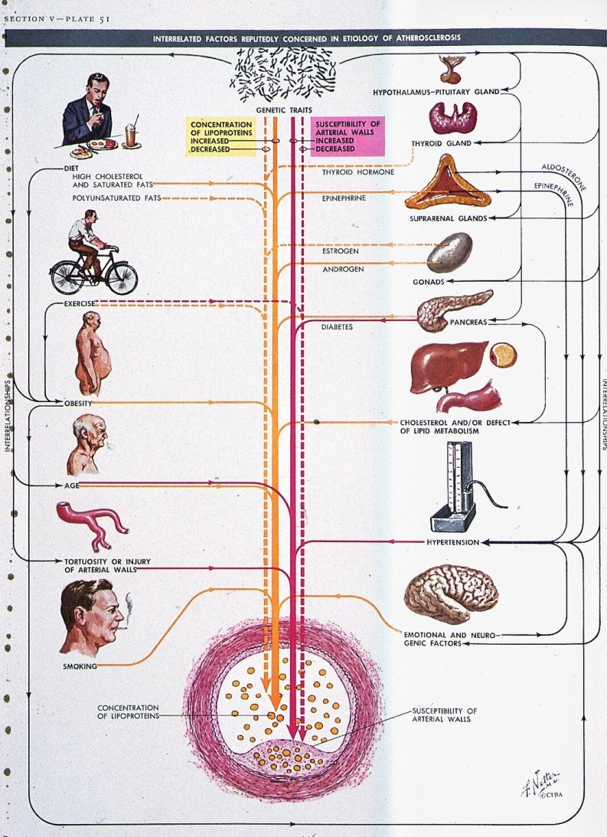
Pathophysiology
Genetic factors
◆
Dilatation of the Aorta
◆
Aneurysm (AAA)
◆
Arteriosclerotic AAA

Slide 4
Aneurysms: increase of incidence
We all get older
More aneurysms detected
Germany:
20000 AAA’s per year
(1/4 acute)

Slide 5
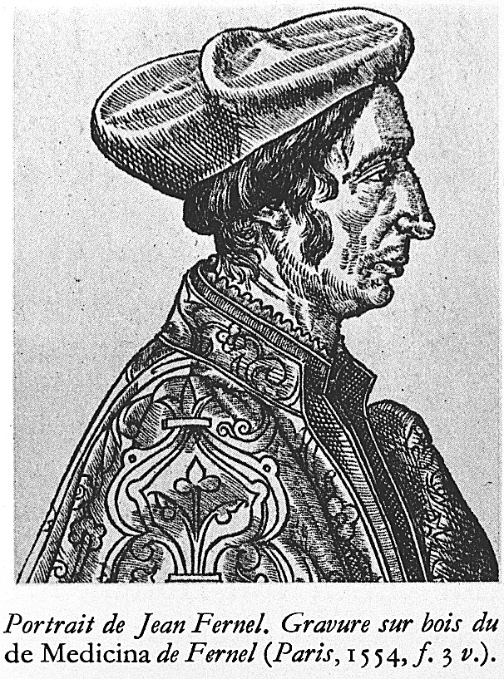
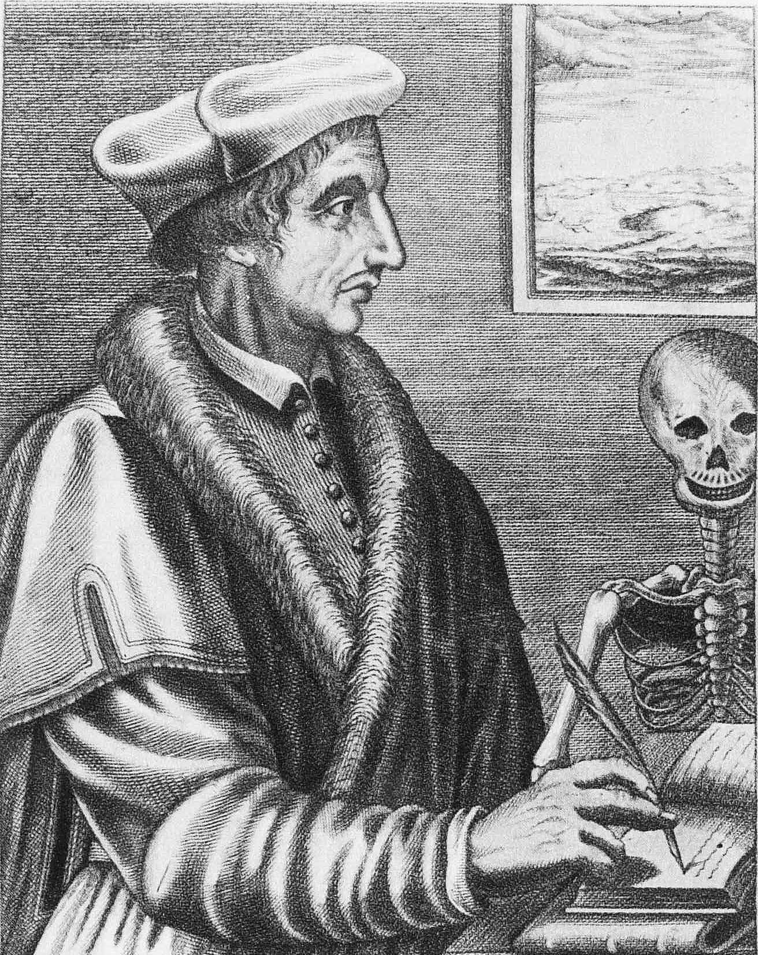
“An aneurysm sometimes occurs in the INTERNAL ARTERIES,
especially in the Chest.” Jean Fernel (1554)

Slide 6
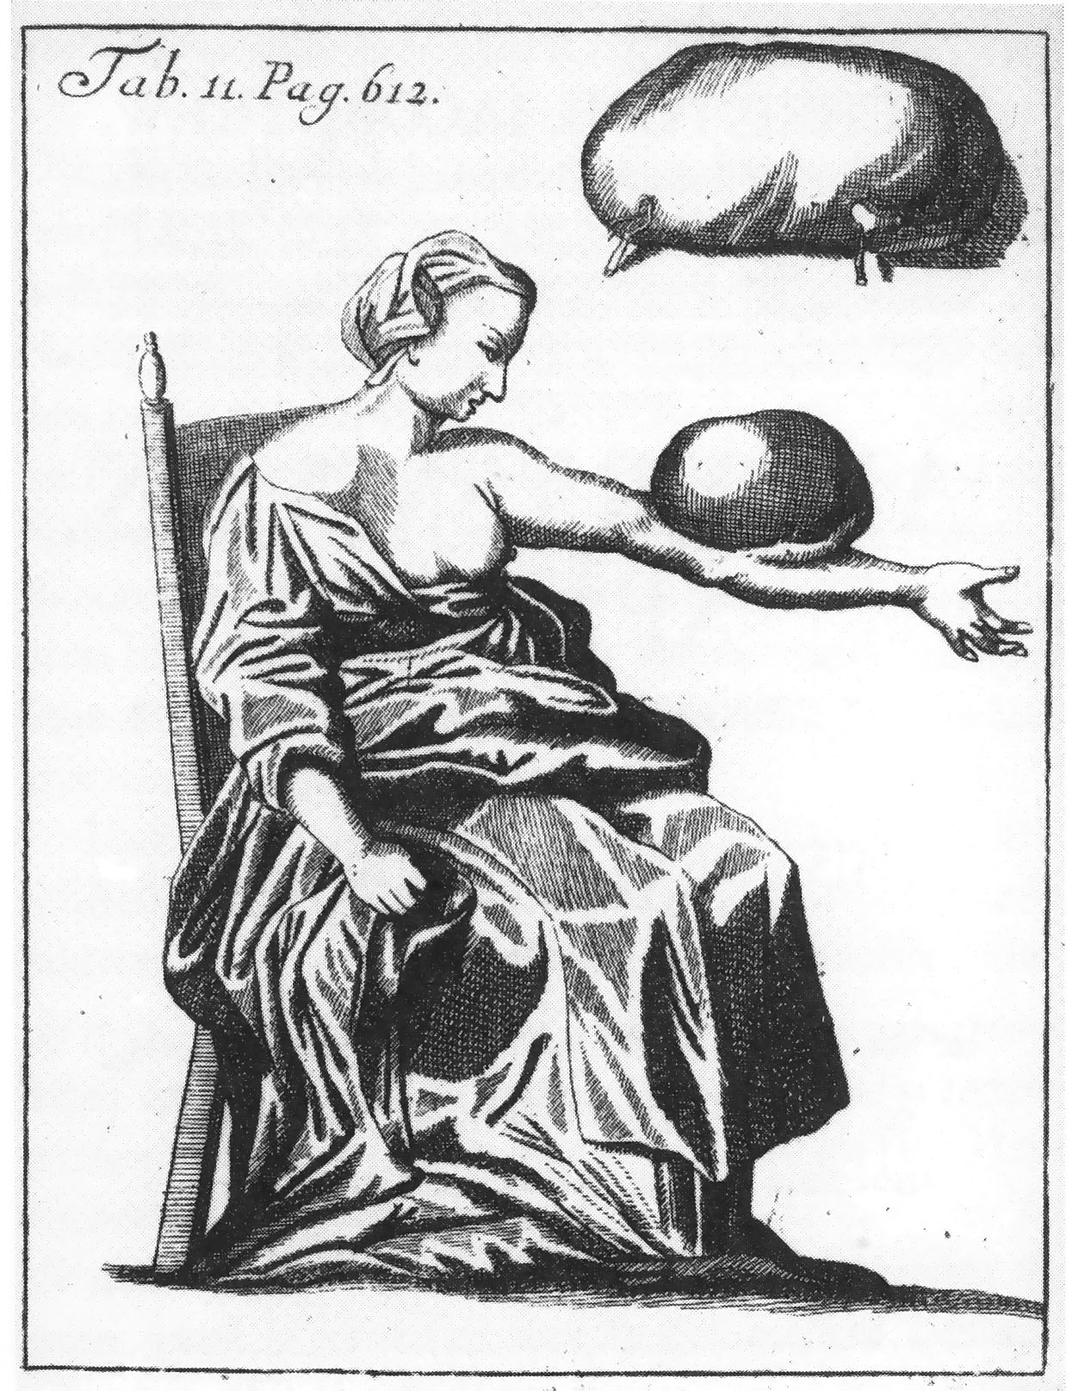
First illustration of
External Aneurysm
Purmann 1699

Slide 7
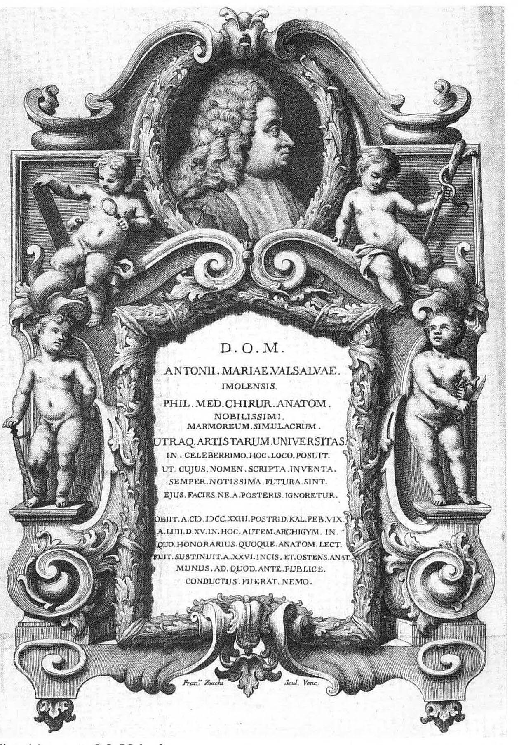
Conservative treatment
Valsalva (1666-1723)
-Ruhe in der Dunkelheit
-Fasten
-Aderlass
A happy few survived this regimen with a thrombosed aneurysm

Slide 8
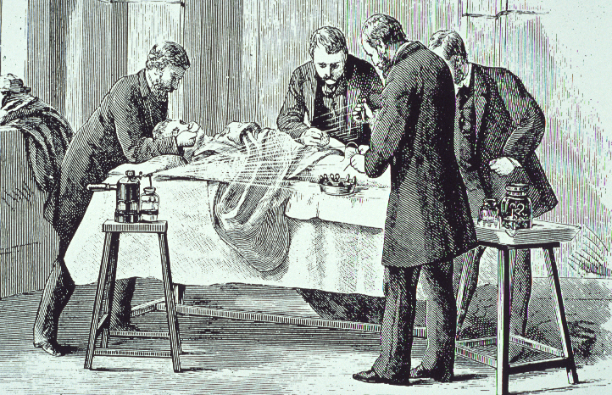
1850 - 1870
Era of Introduction of Antisepsis and Anesthesia.

Slide 9
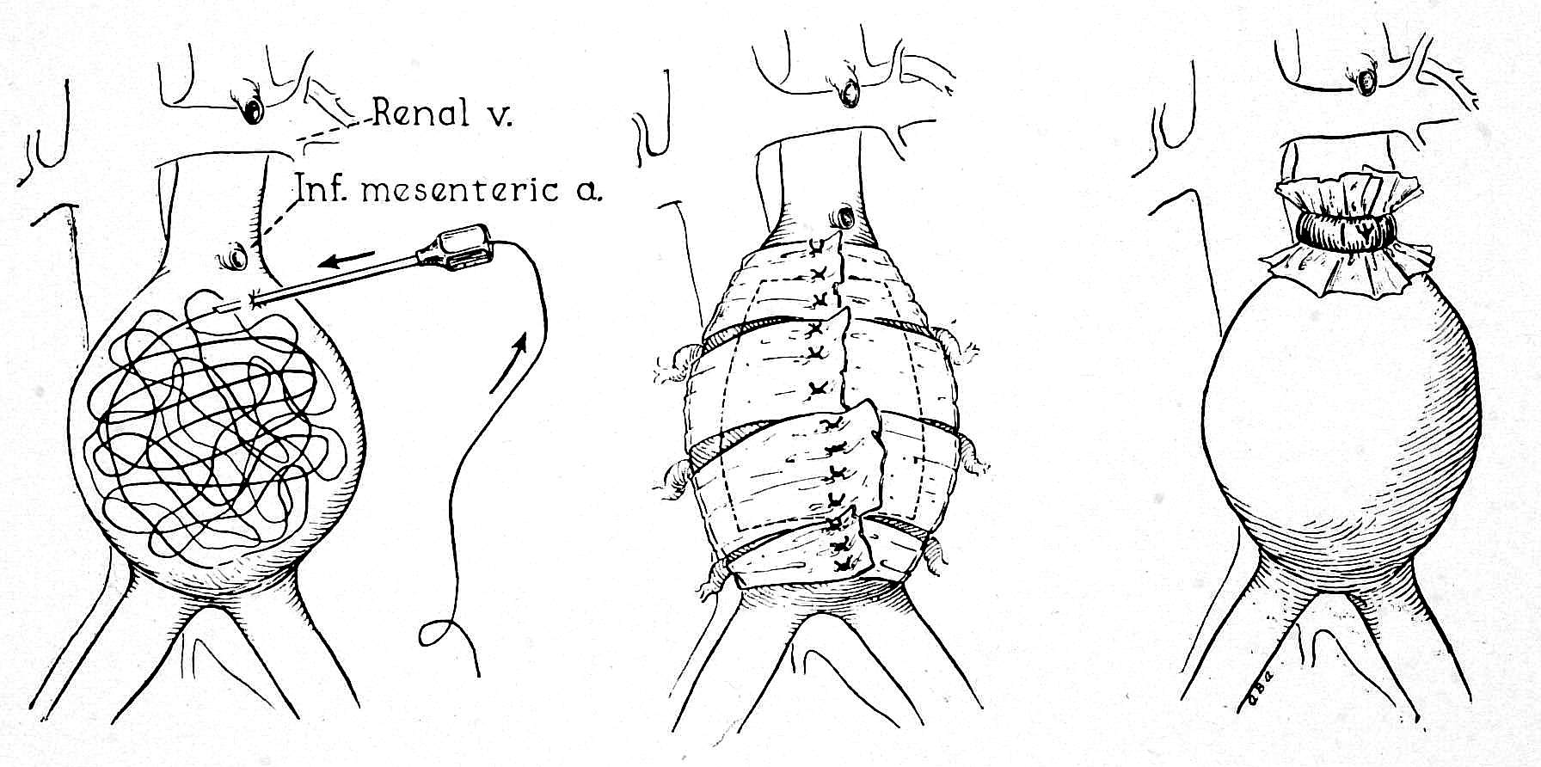
Wiring Wrapping Ligation
Surgical techniques 1900-1950

Slide 10
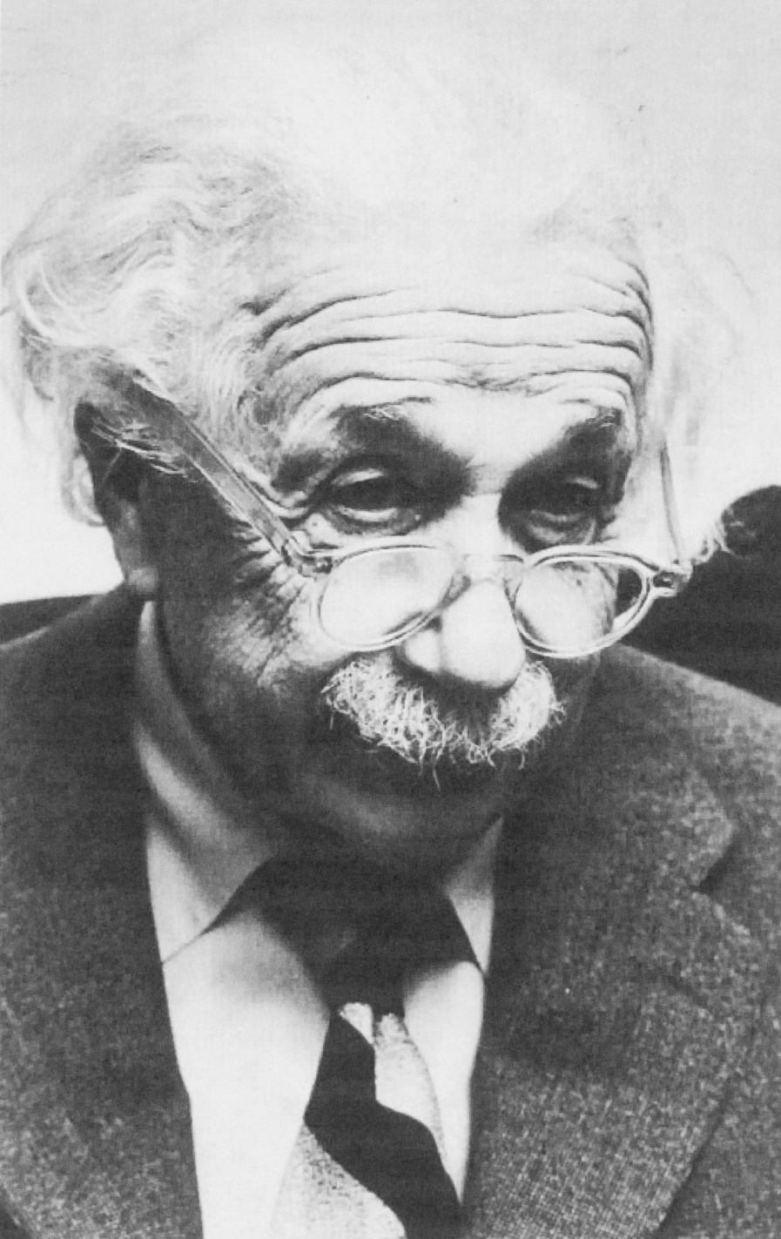
Albert EINSTEIN
(1879 - 1955 )
AAA
wrapping 1948
rupture 1955
(refused aortic surgery)

Slide 11
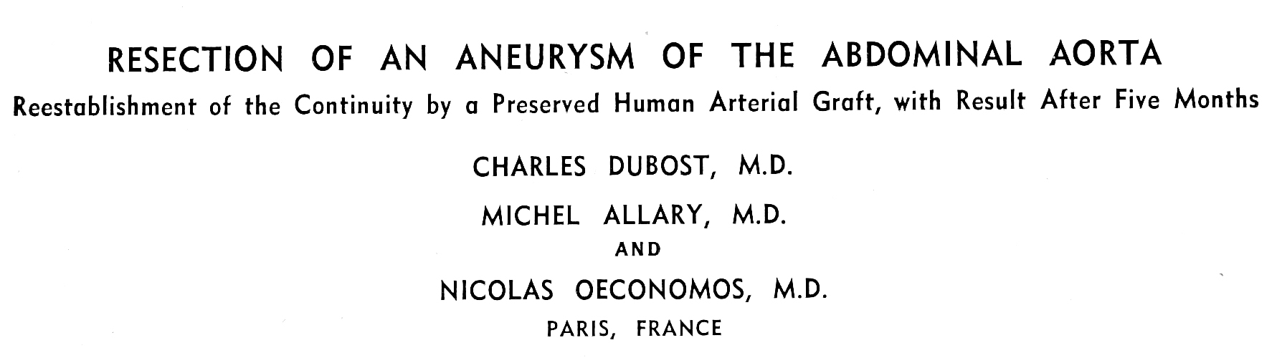
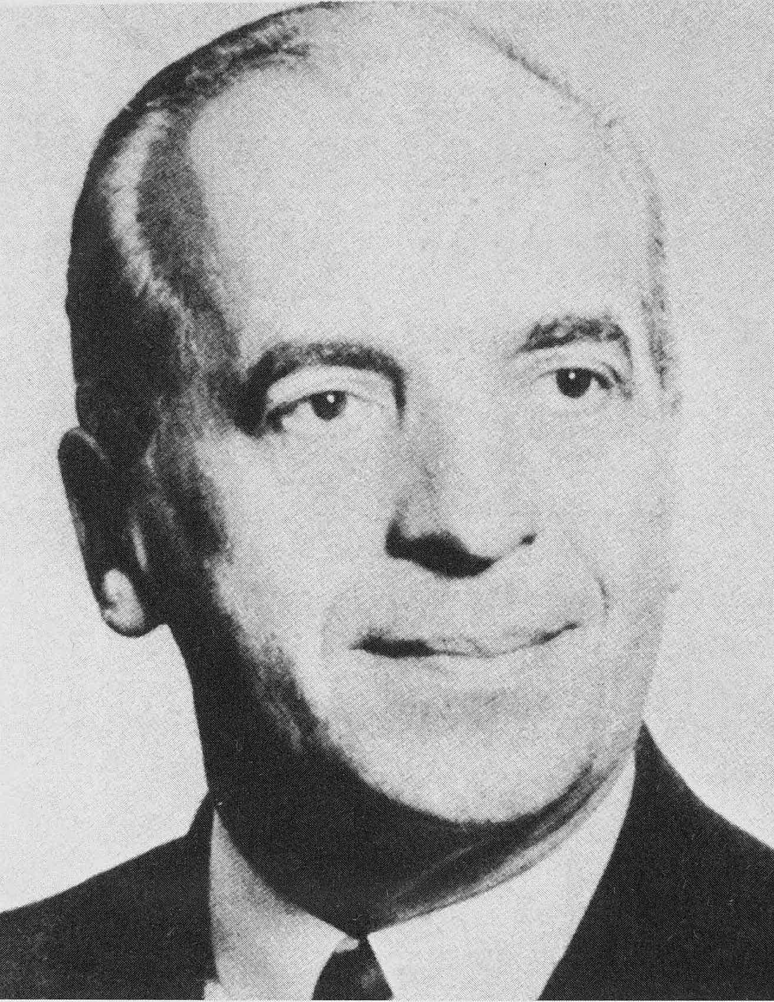
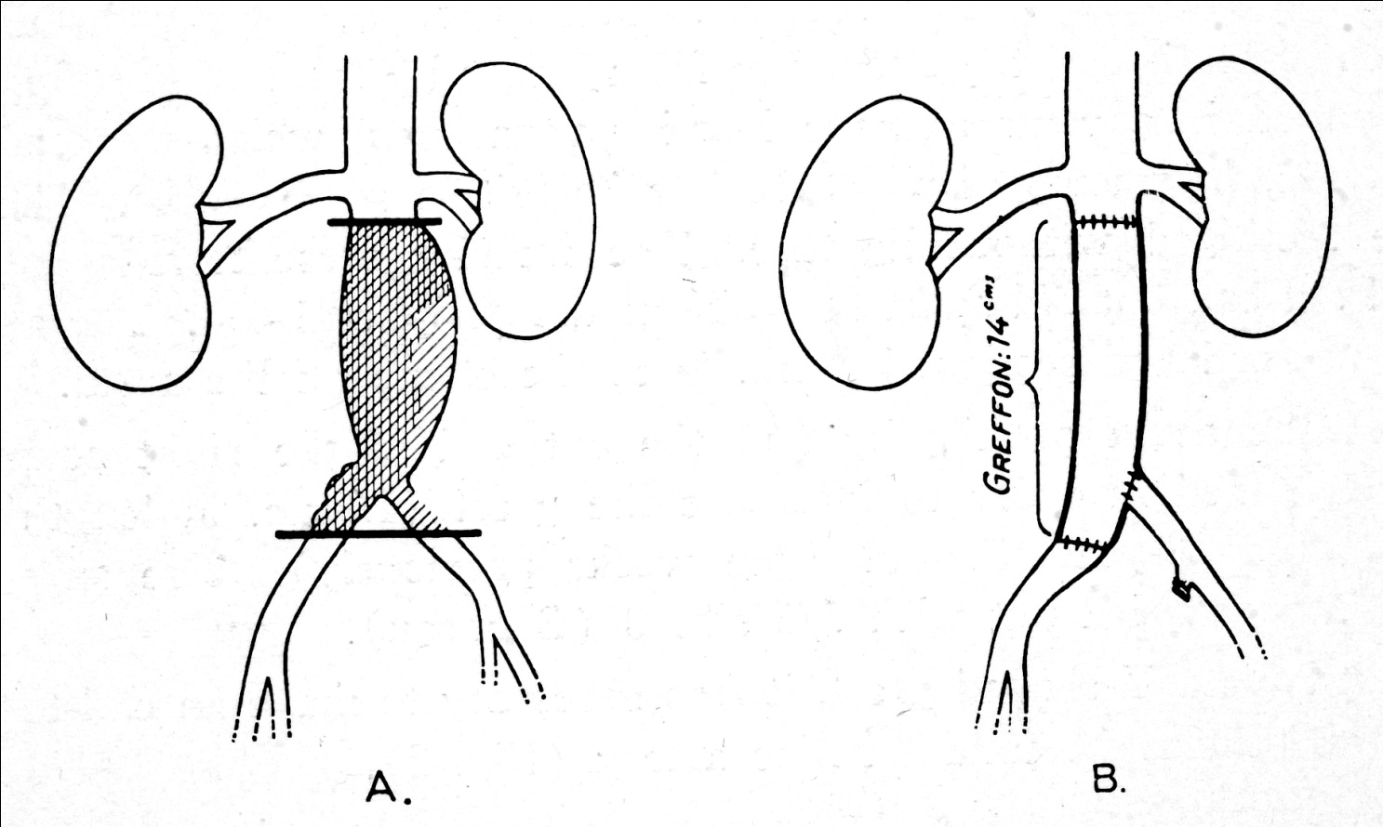
Mem. acad. chir., 1951.
Arch. Surg., 1952.

Slide 12
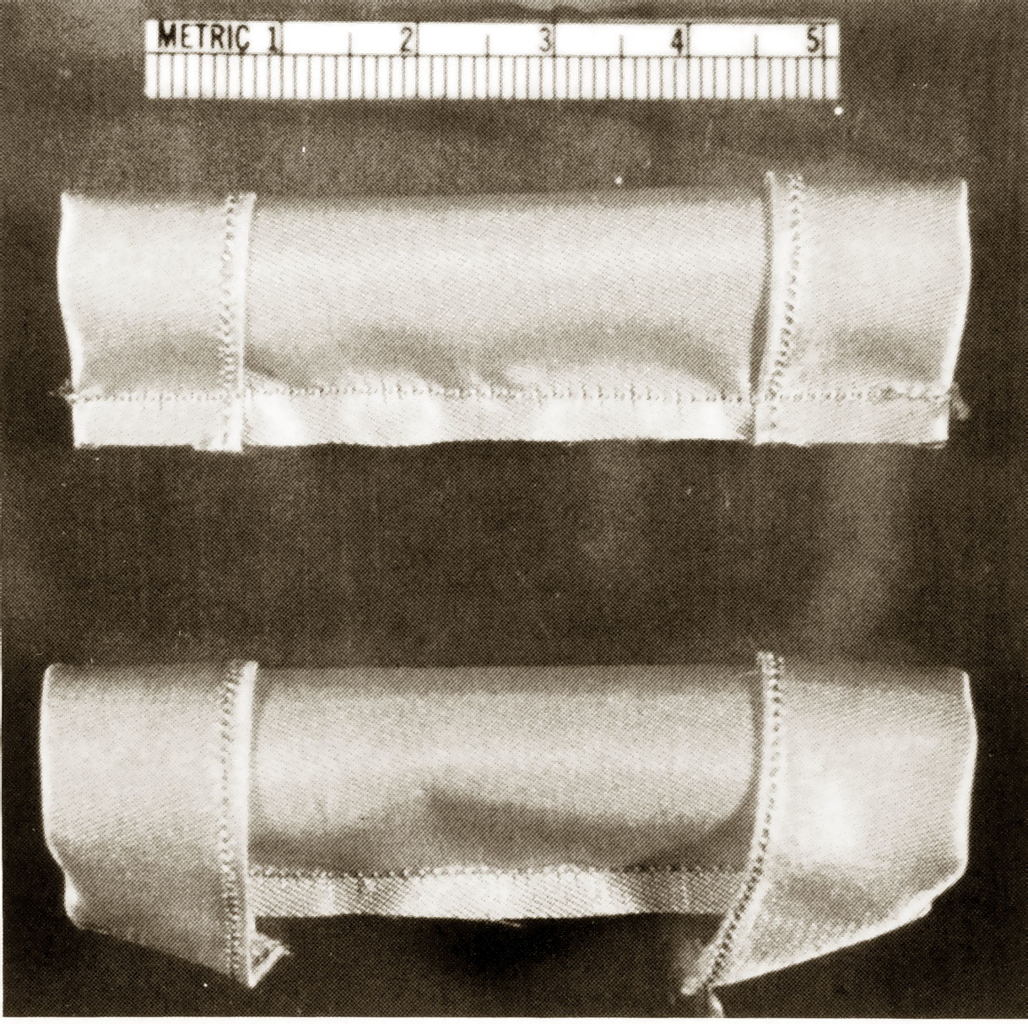
The first
Synthetic
Nylon-graft
Voorhees
New york
1951
Smith R.B. J. Vasc. Surg., 1993

Slide 13
Localisation
AAA
Thoracoabdominal aneurysm
Femoral
Popliteal
Cerebral
Internal Iliac artery
Branches aorta

Slide 14
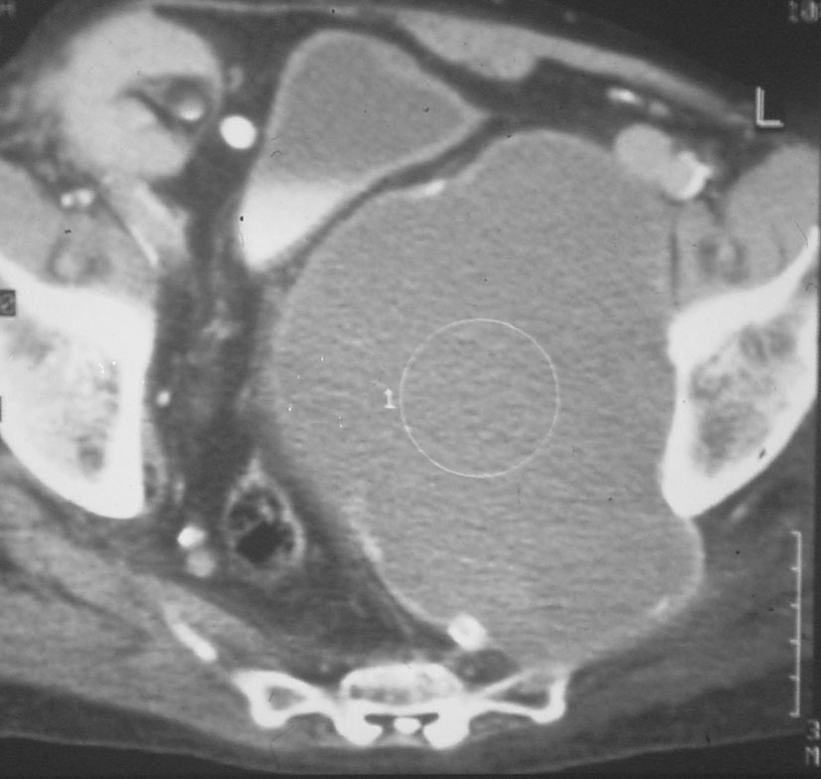
Symptomatology
None!!!!!
Expansion > Pain > Rupture
Local problem
Knee
Internal iliac artery: Hydronephrosis

Slide 15
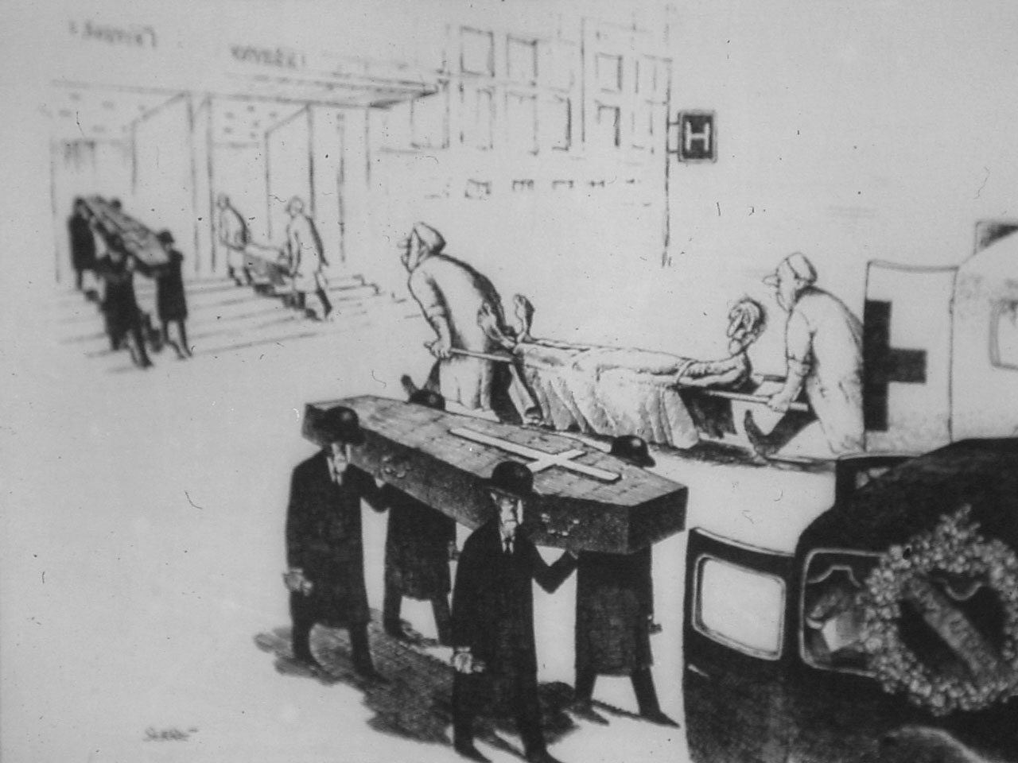
Dangers!!
Rupture
Thrombo-embolisation

Slide 16
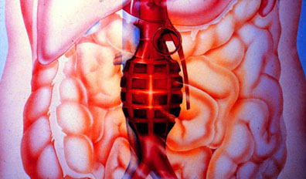
Mortality of RAAA 40-90%
Notes:
And with a mortality of 48% it is not surprising that we are looking for a different treatment modality

Slide 17
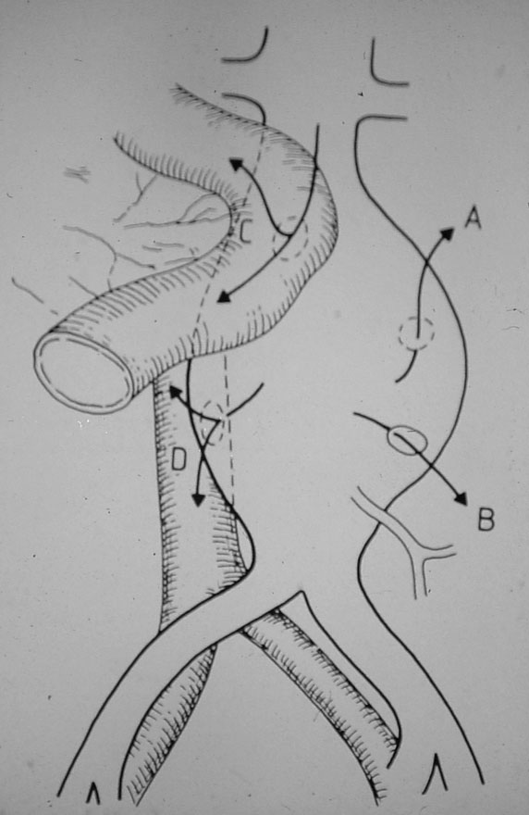
Rupture to…
A. Retroperitoneal
B. Transperitoneal
C. Aortoduodenal fistula
D. Aortocaval fistula

Slide 18
Symptoms acute/ruptured AAA
Acute onset of back pain
Abdominal pain
Shock
(Hemoptoe)
(Right sided heart failure)
Suspicion:
Palpabele pulsating mass in abdomen
Elderly man

Slide 19
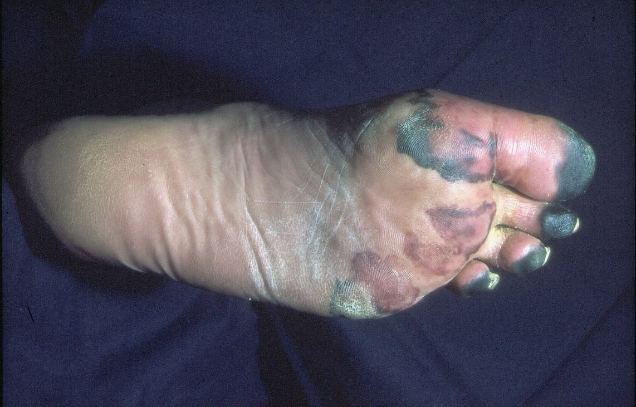
Dangers!!
Rupture
Thrombo-embolisation

Slide 20
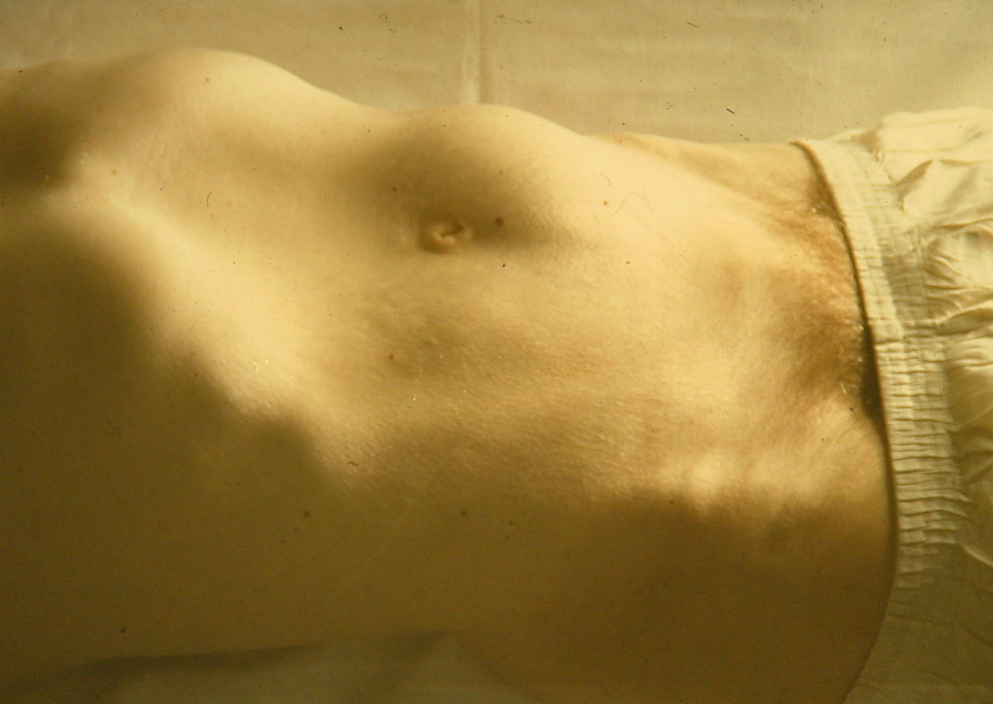
Diagnosis
Clinical examination
Co-incidental:
Urology
Internal Medicine

Slide 21
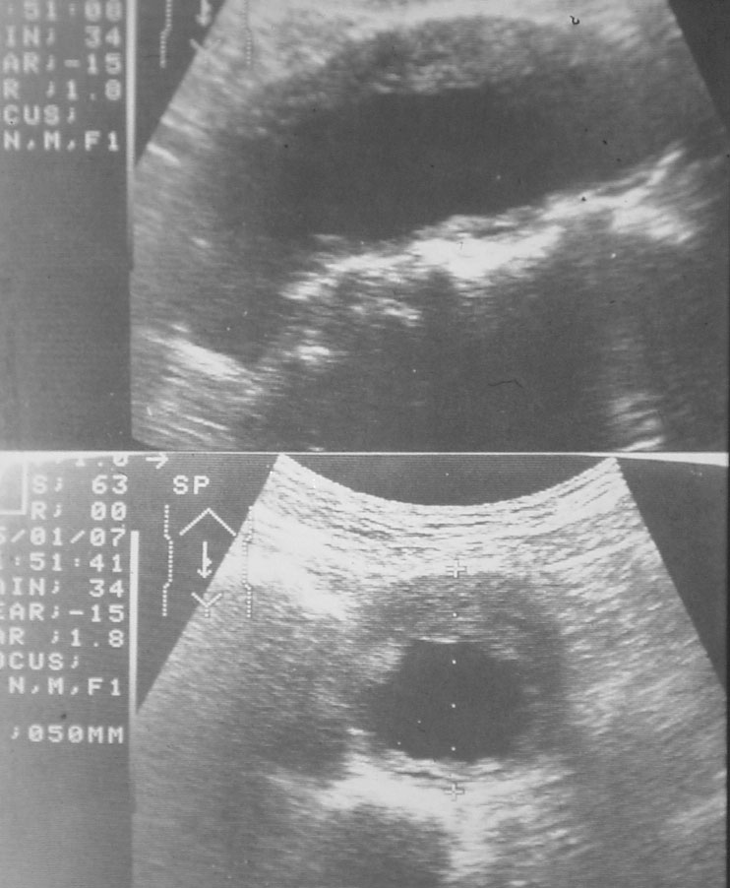
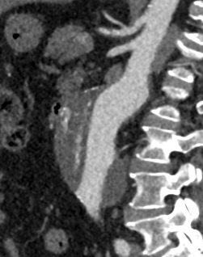
Utrasound/CTscan

Slide 22
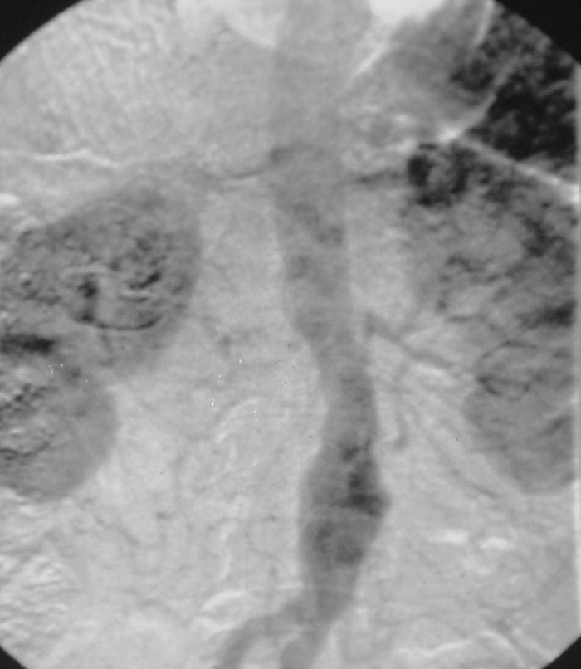
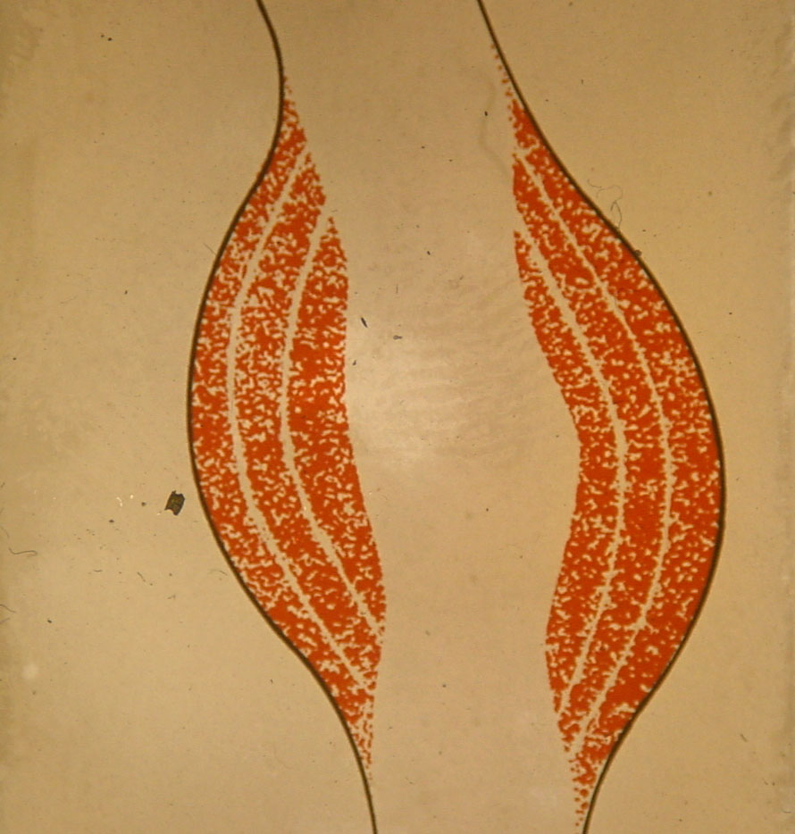
Angiography: NO!

Slide 23
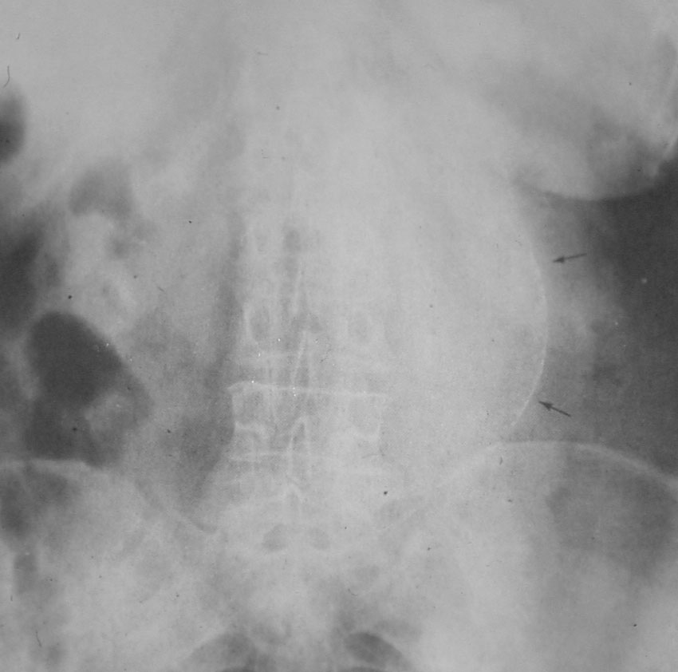
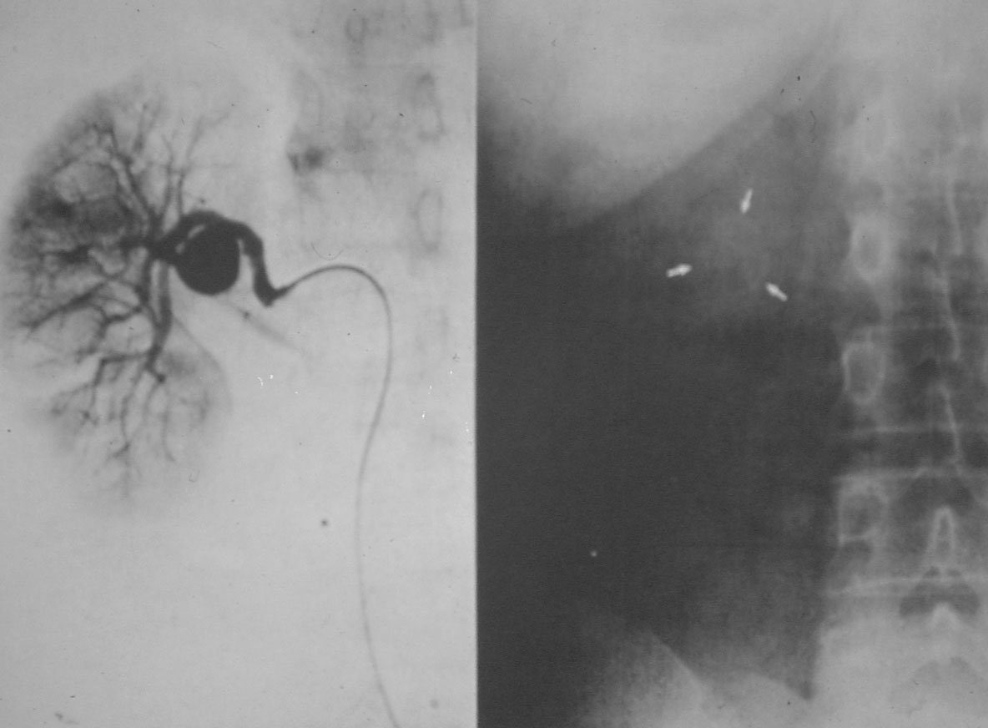
X-Ray

Slide 24
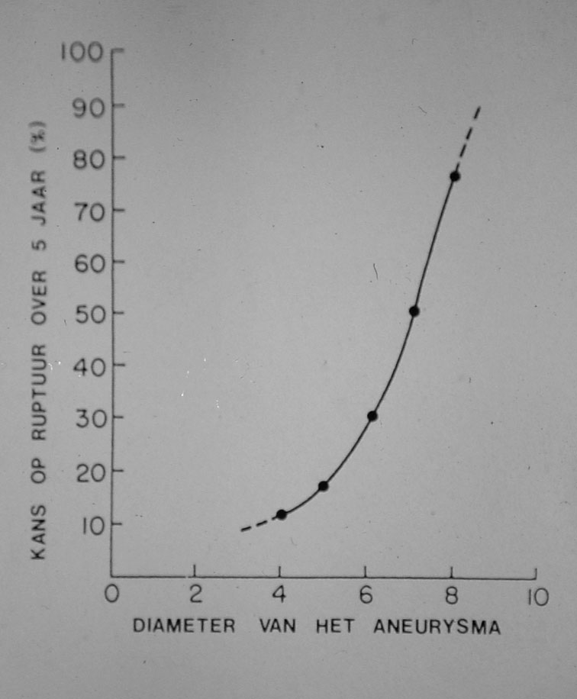
Treatment
Preventive
Exclusion of the aneurysm
Balance: risk of the procedure vs. risk of rupture

Slide 25
Treatment
General rule of thumb:
Man: > 5,5 cm
Female: > 5 cm
Based (amongst other literature) on English “Small Aneurysm Trial”

Slide 26
Open Treatment
Big procedure
Mortality: 5-7 %
Morbidity
Cardiac
Pulmonal
Renal
Sexual

Slide 27
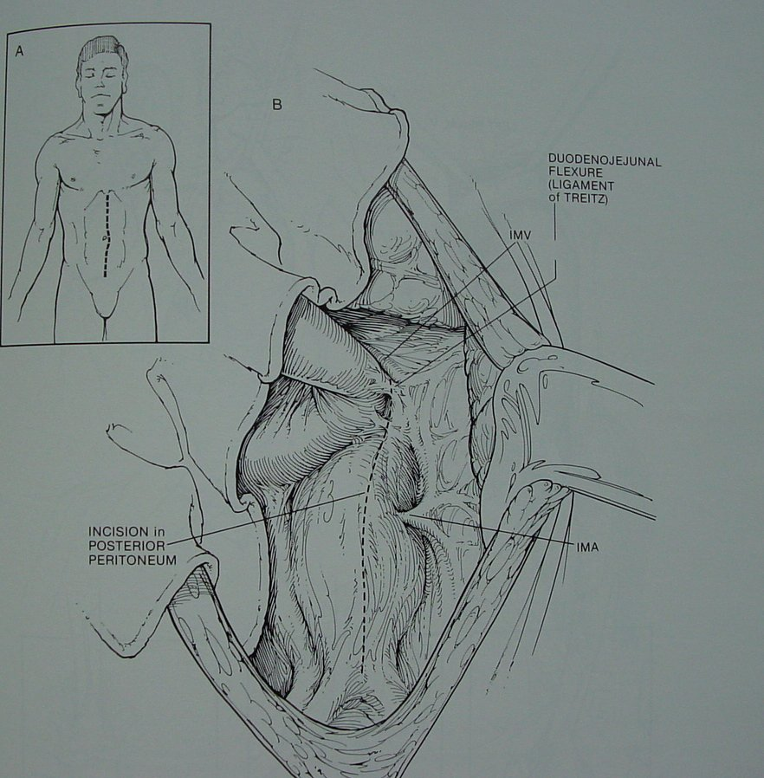
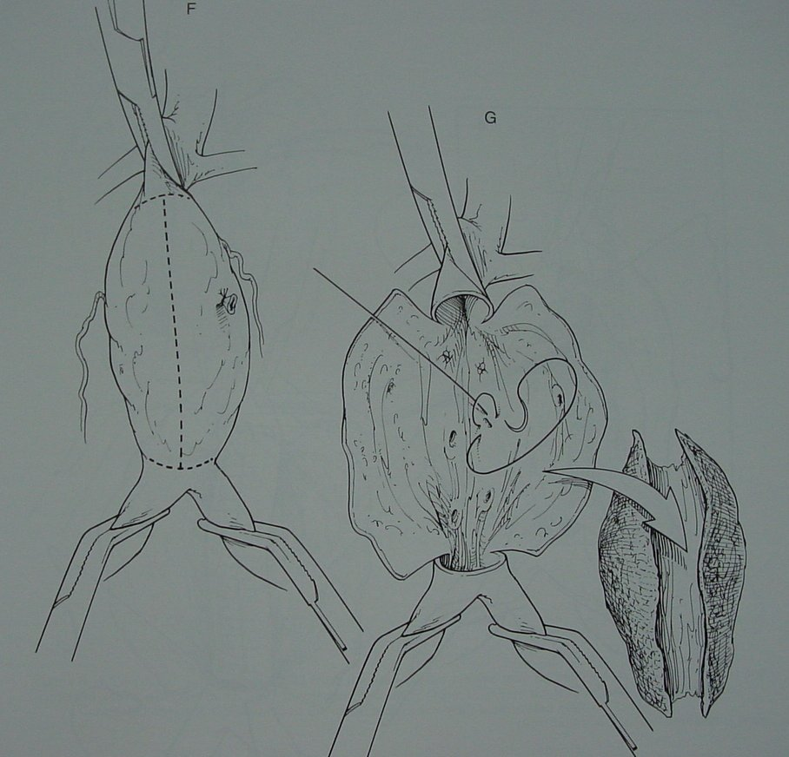
Open Surgery

Slide 28
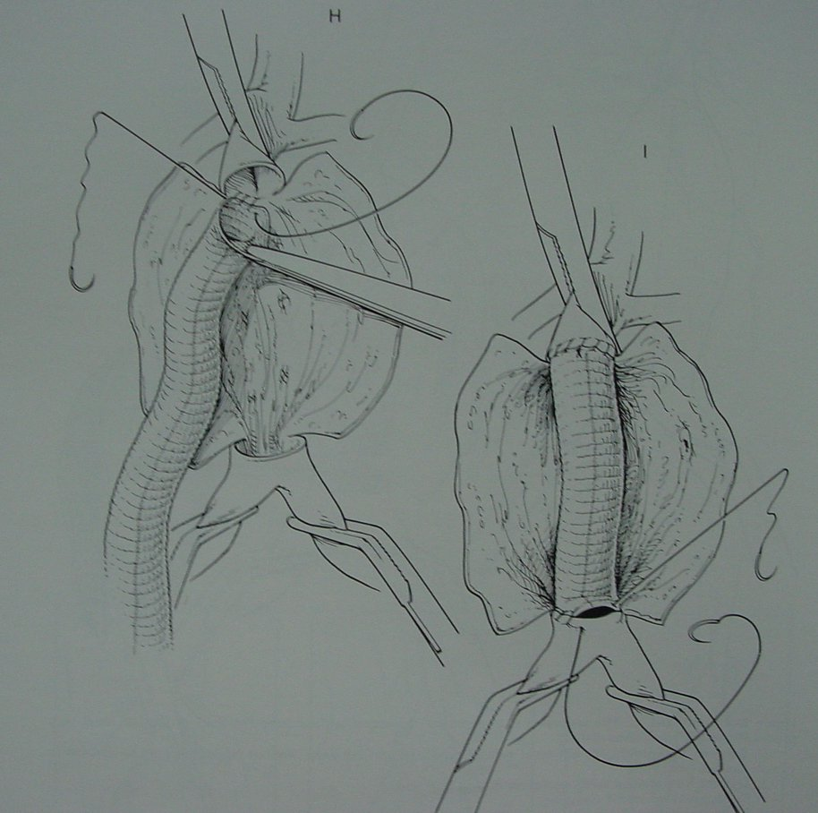
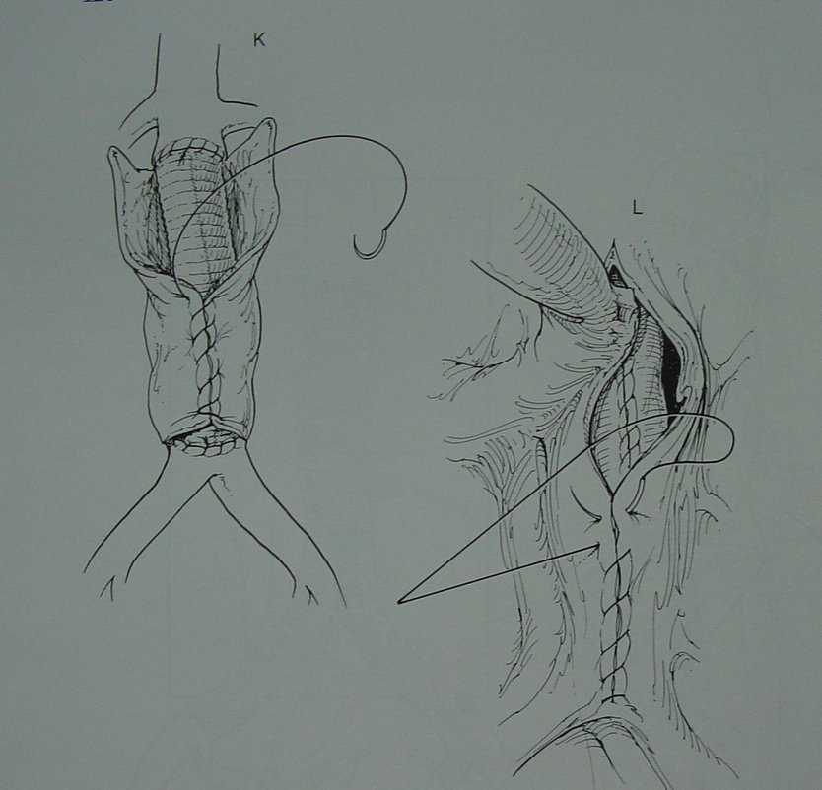
Open Surgery

Slide 29
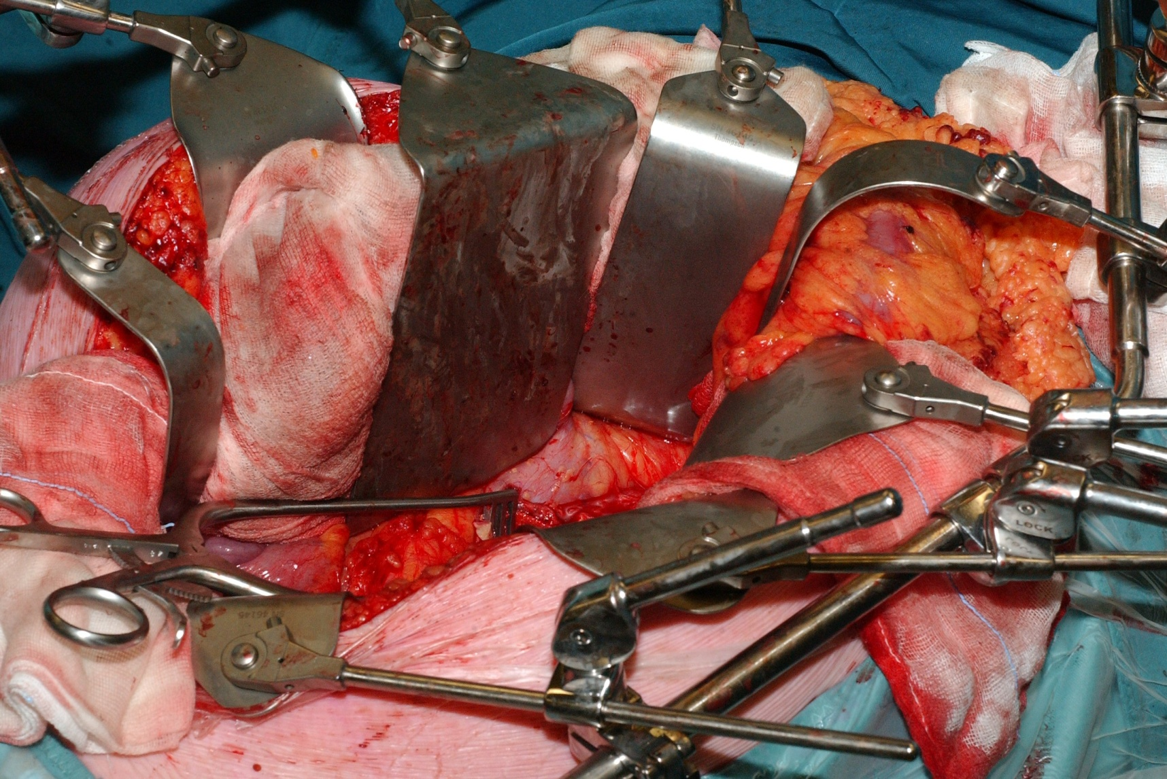
Open Surgery

Slide 30
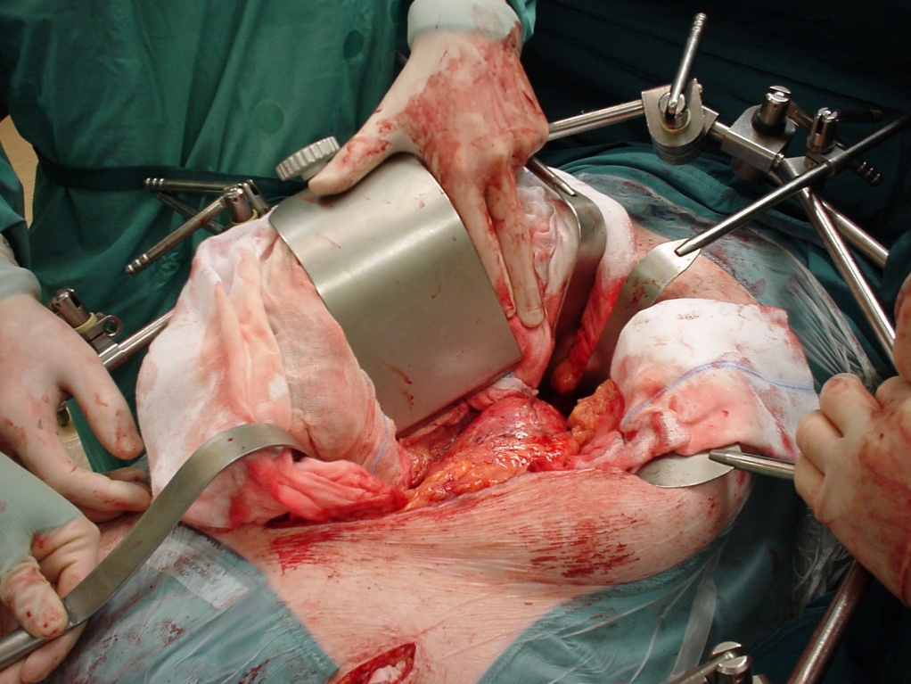
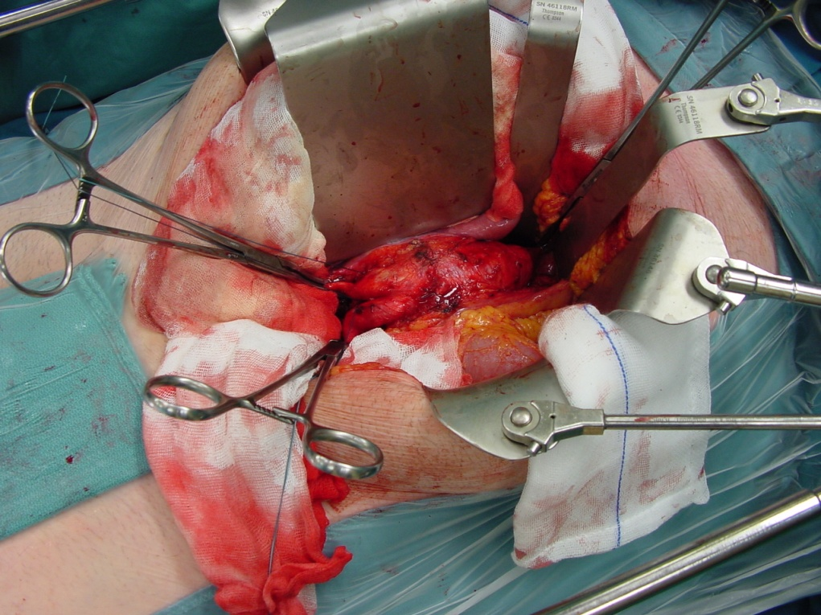
Open Surgery

Slide 31
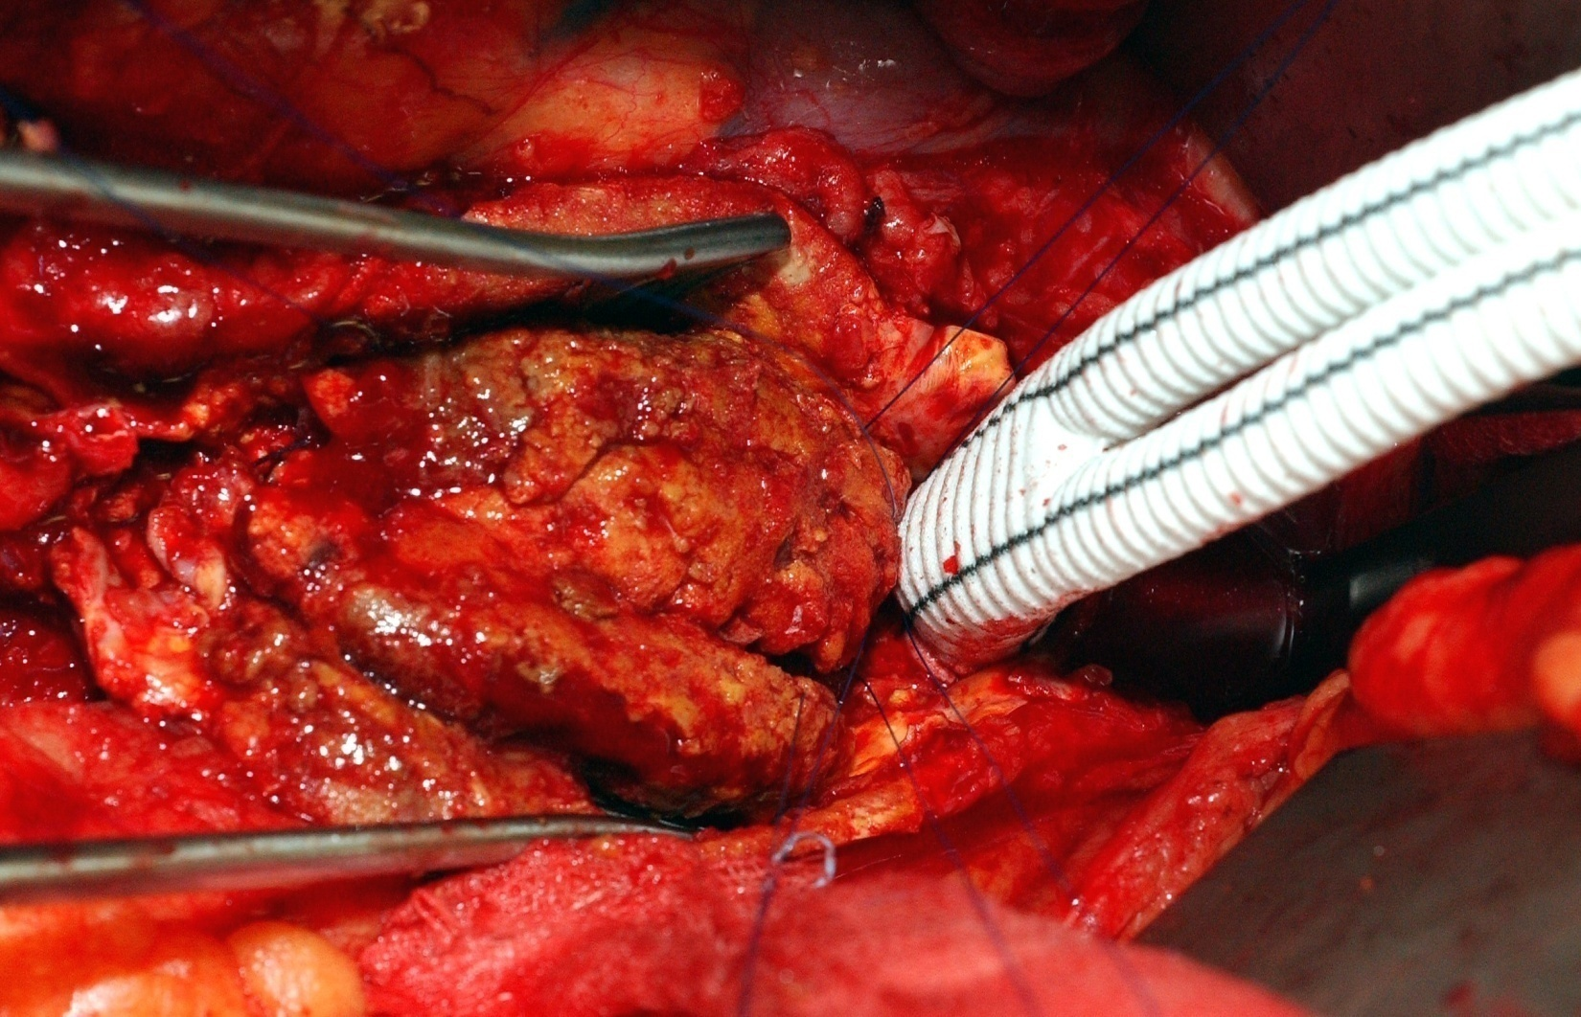
Open Surgery

Slide 32
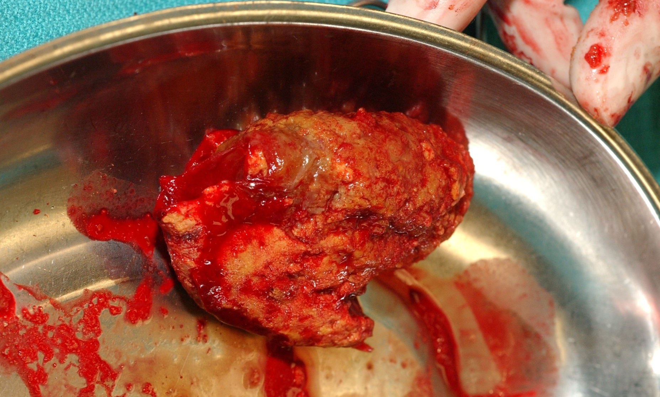
Open Surgery

Slide 33
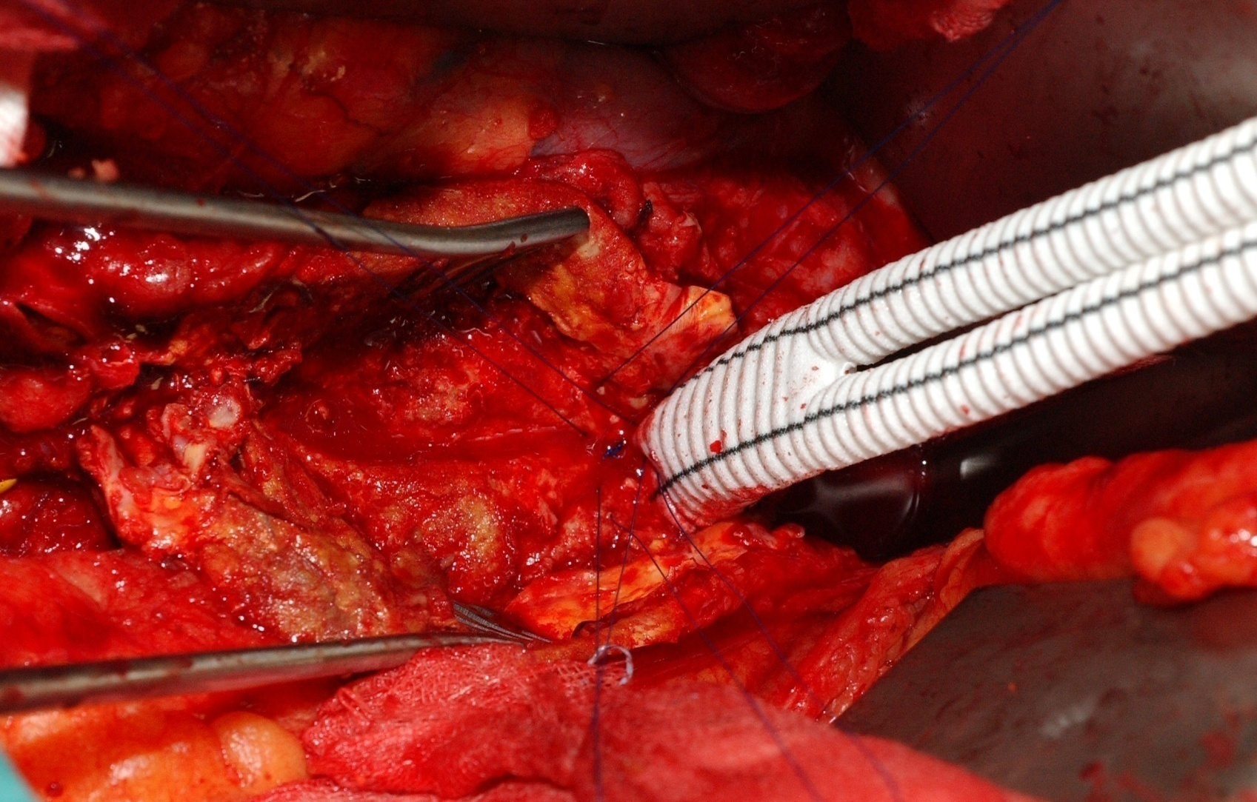
Open Surgery

Slide 34
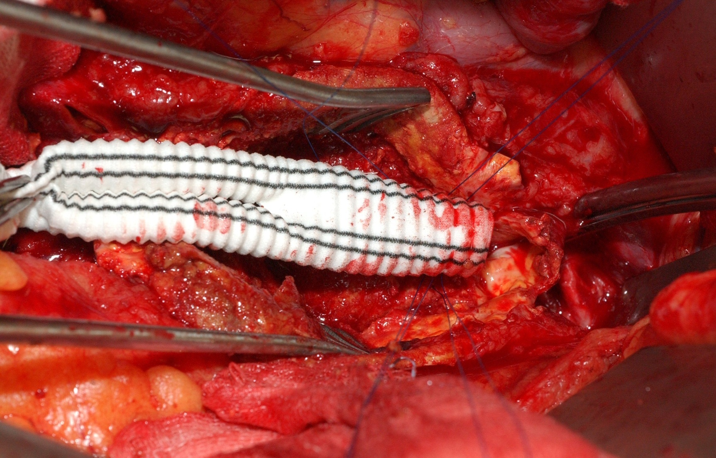
Open Surgery

Slide 35
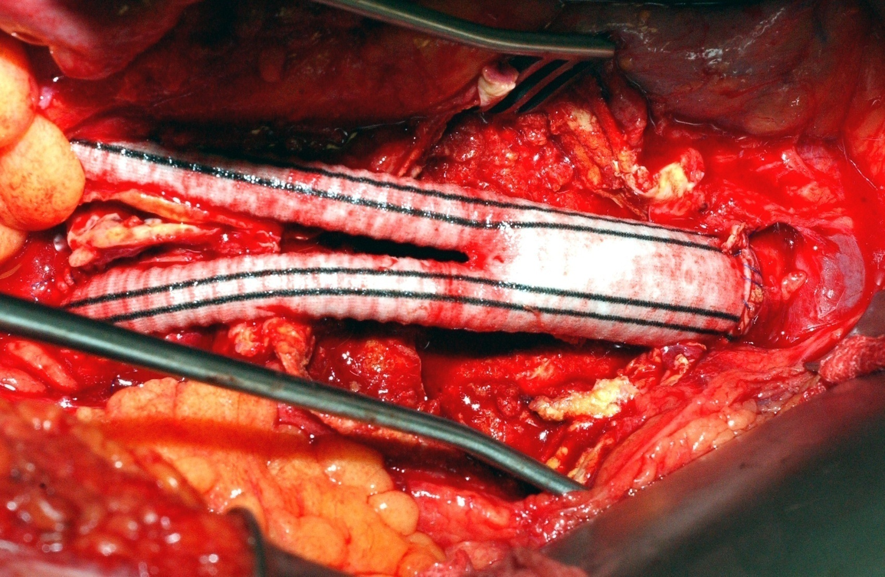
Open Surgery

Slide 36
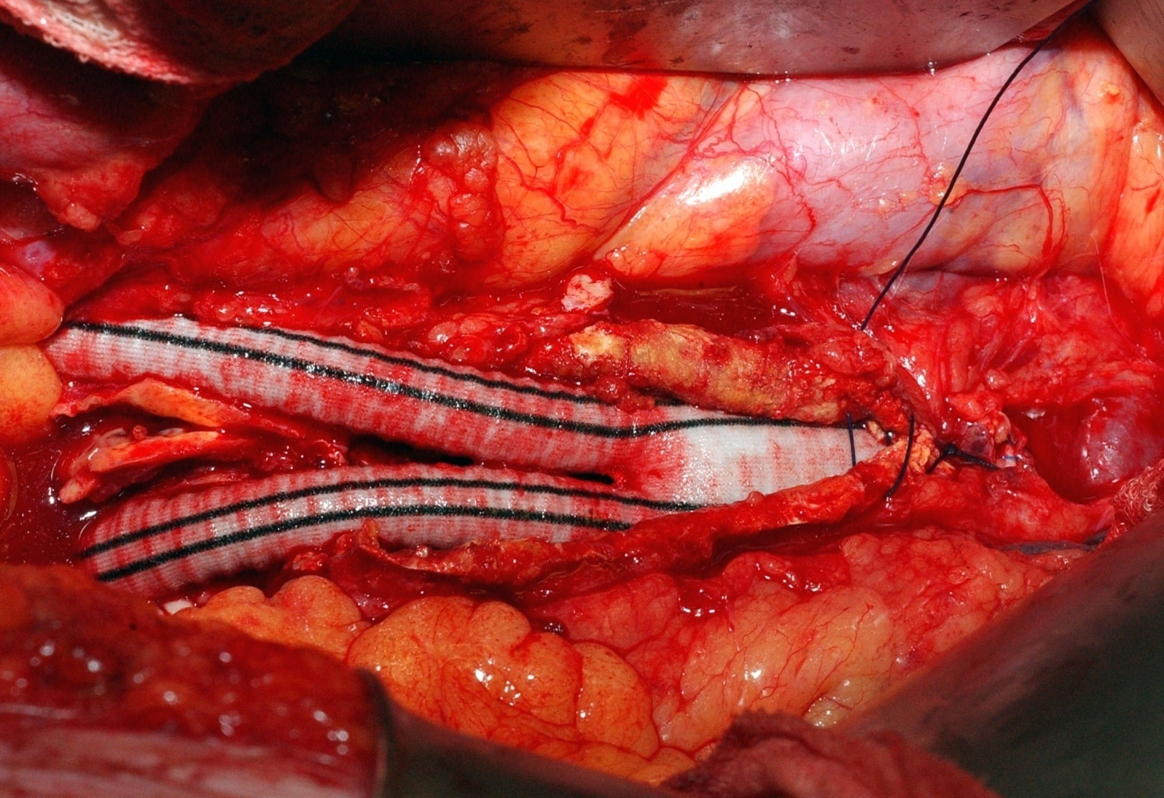
Open Surgery

Slide 37
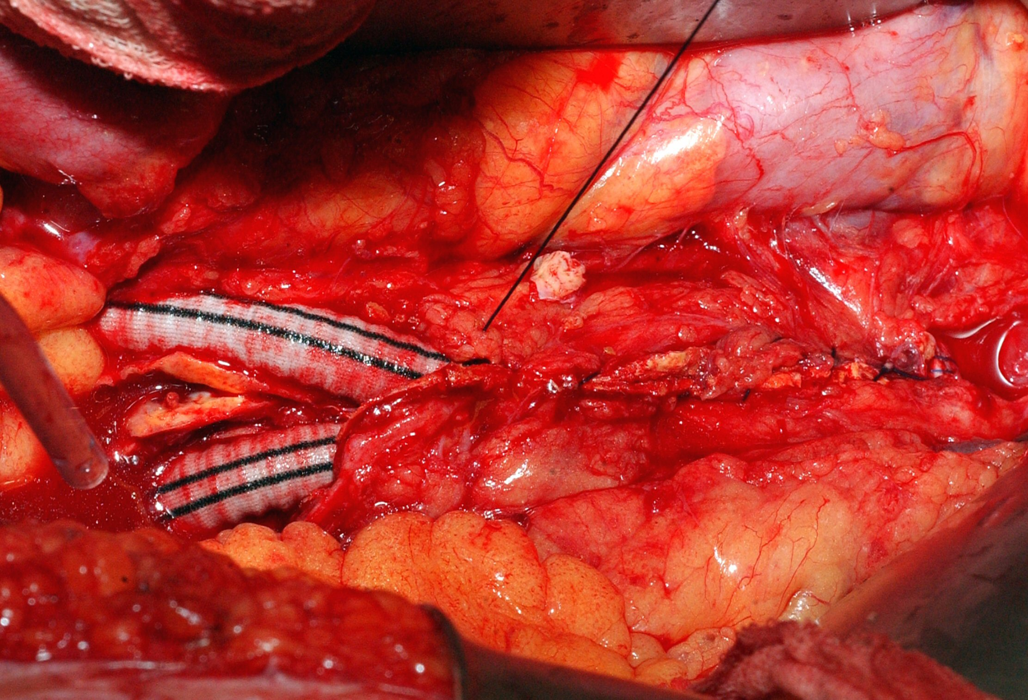
Open Surgery

Slide 38
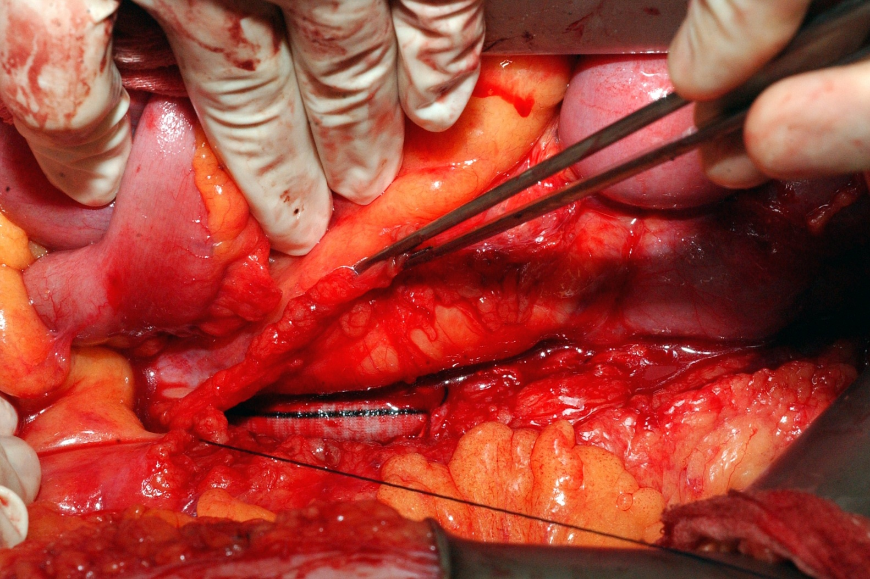
Open Surgery

Slide 39
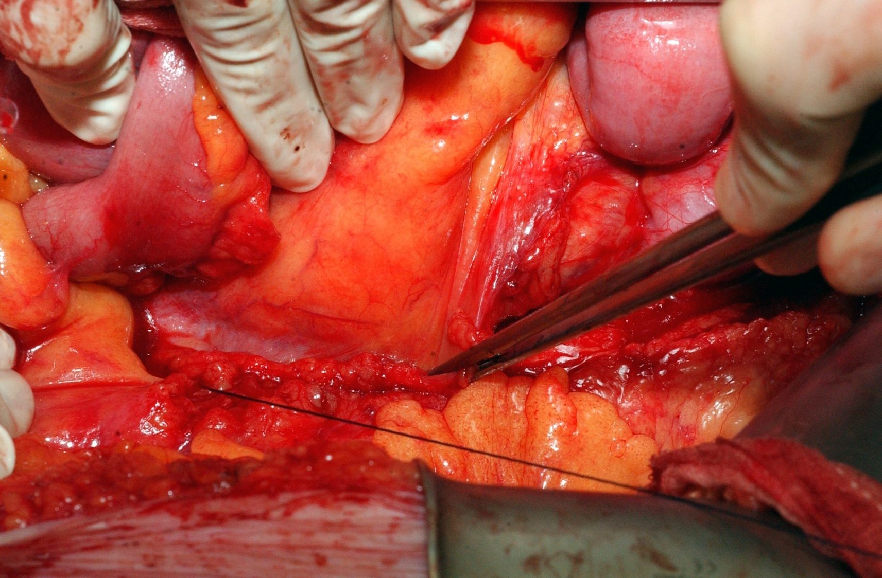
Open Surgery

Slide 40
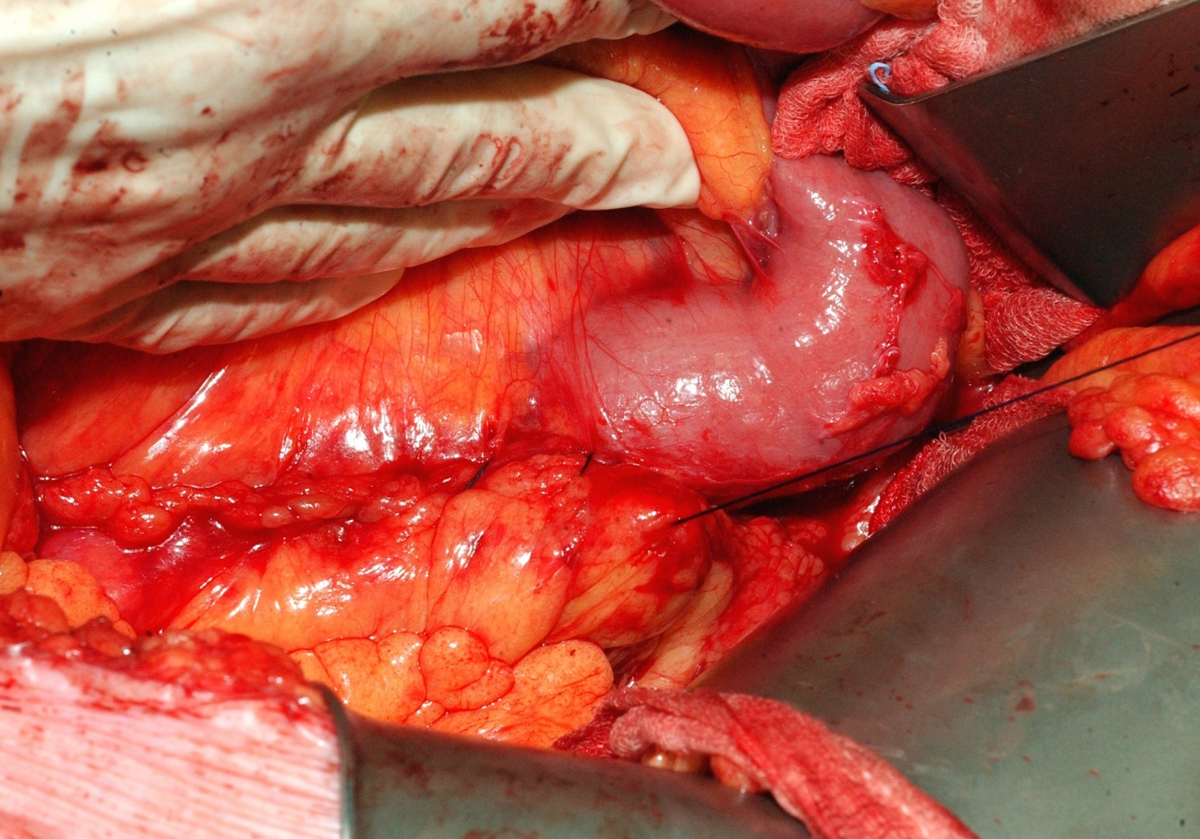
Open Surgery

Slide 41
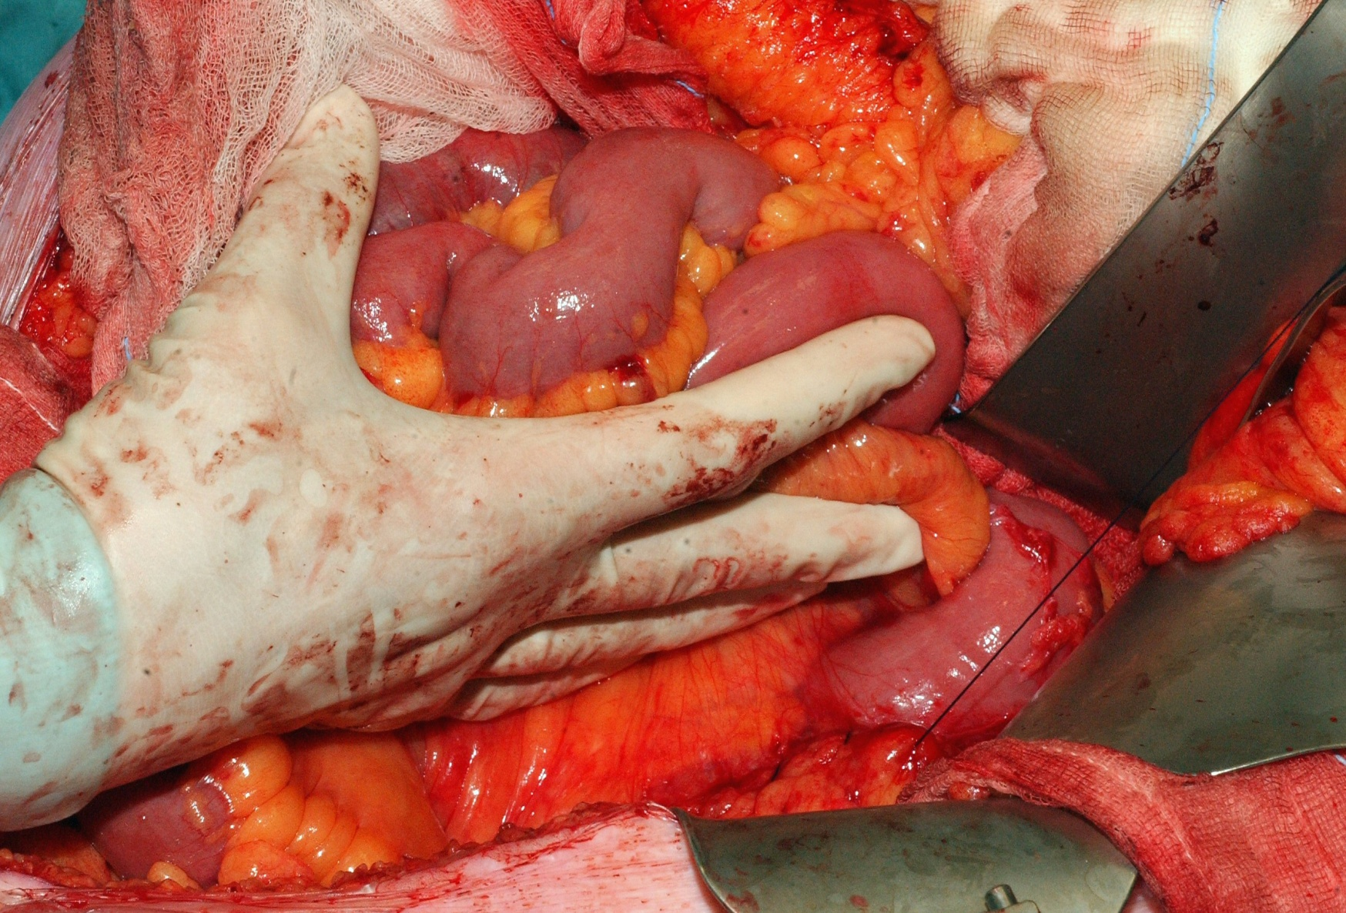
Open Surgery

Slide 42
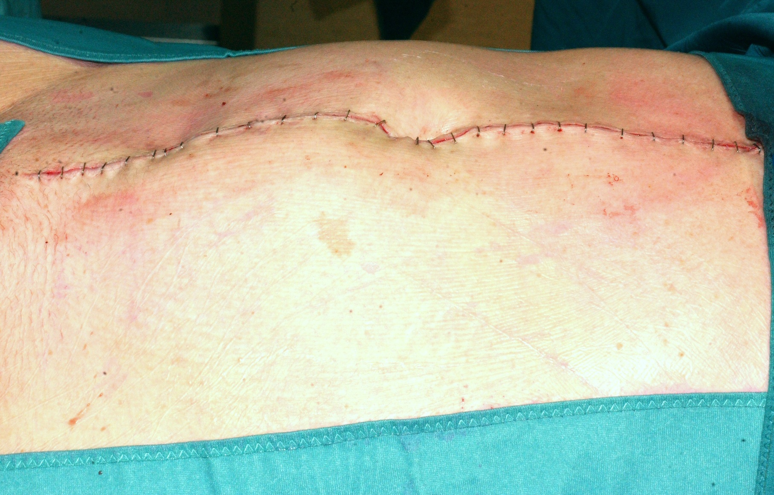
Open Surgery

Slide 43
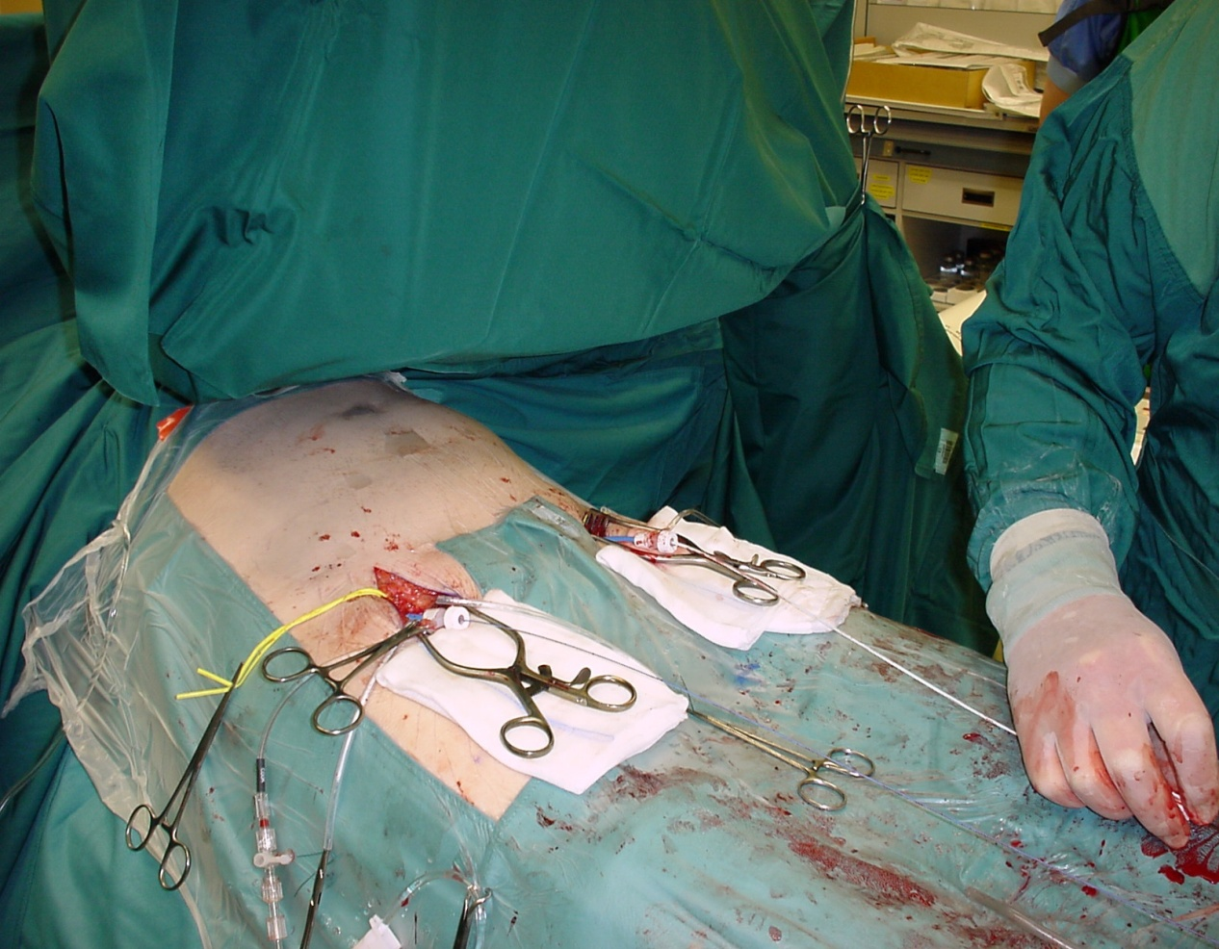
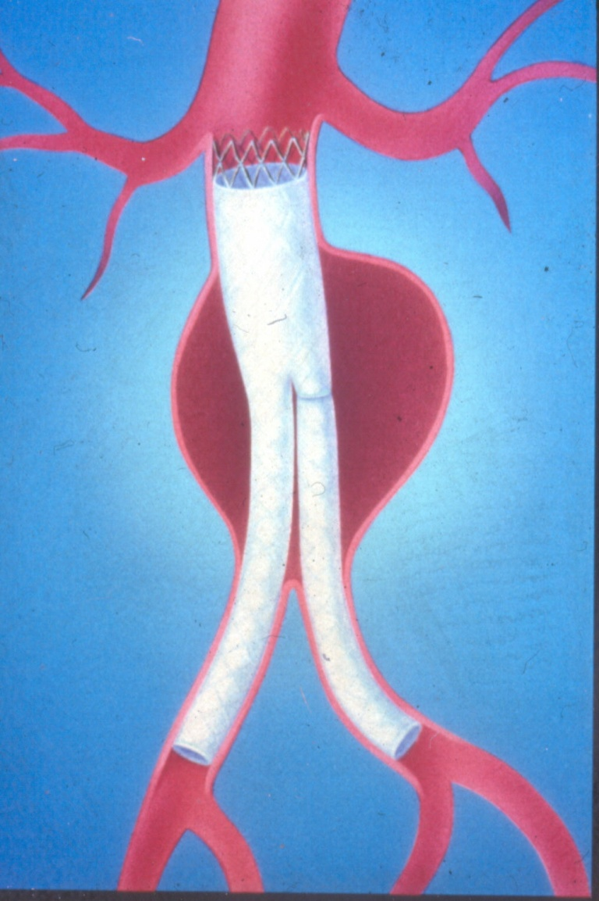
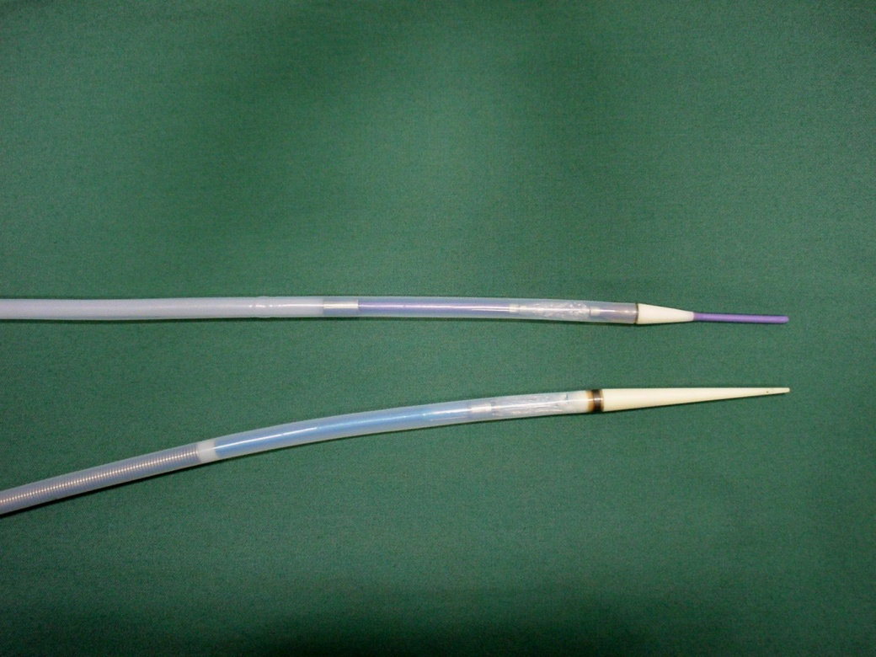
Endovascular Treatment

Slide 44
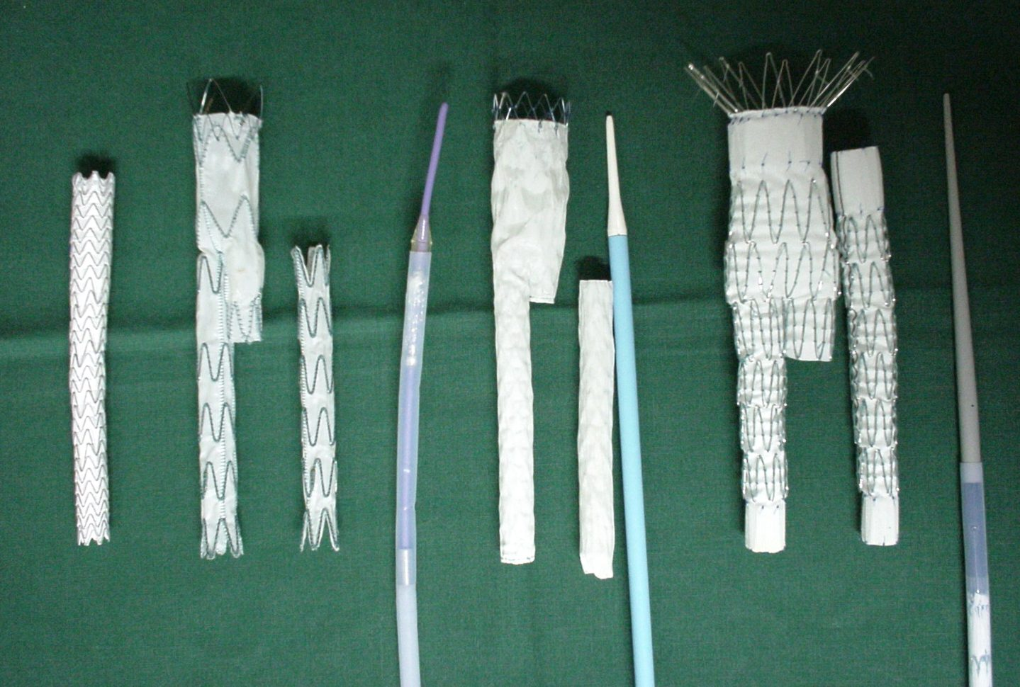
Endovascular Treatment

Slide 45


Slide 46

Indication
Same as open surgery:
Based on diameter
Landing zone
proximal
distal
Access

Slide 47

Advantages
Smaller procedure
No blood transfusion
No I.C.U
Quicker recovery
Lower mortality
Lower morbidity

Slide 48
Complications?
Occlusions
Endoleaks
Migrations
Material failure

Slide 49



Occlusion

Slide 50


Endoleaks

Slide 51



Migration

Slide 52
Material failure
Metal
Stent fractures
Desintegration
Prosthesis
Tearing

Slide 53

Stent fracture

Slide 54

Tear in graft material

Slide 55
Endovascular treatment
Much smaller procedure
Mortality: < 1 %?
Option for about 50%
Strict follow-up needed
Longer term results?

Slide 56
EVAR: Risk Benefit Analysis
Reduced magnitude
Reduced morbidity / mortality
Patient preference
Reduced hospital stay
_
+
Reduced technical success
Reduced durability
Increased procedure cost

Slide 57
EVAR versus Open Repair
Indication for treatment
Information to the patient
Logistics
Measuring & Ordering
Bail-out (plan B/reserve material)
Surgery-Radiology-Industry

Slide 58

Most problems ….. ……. Bad planning!

Slide 59
Fenestrated and branched stent-grafting

Slide 60

Fenestrated Grafts (FEVAR)
Created Neck

Slide 61


Slide 62


Slide 63


Slide 64

Branched Grafts (BEVAR)
Start sealing in the thoracic aorta
Connect visceral vessels with branches

Slide 65



Slide 66

Thoraco-abdominal Aneurysms (TAAA)

Slide 67



Slide 68


Slide 69


Slide 70
Treatment options AAA patients
Conservative...
Open
Endovascular treatment
Fenestrated/Branched
~ age
~ co-morbidity
~ diameter
~ anatomy
~ choice patient

Slide 71
Bullit Points
Abnormal enlargement of a blood vessel
AAA most prevalent (Men above 65…)
Diagnosis: Clinical Examination, US, CT
Risk: Rupture
Shock & acute back pain in elderly men
Preventive operation
Balance Risk and Benefit
Indication: > 5cm

