Slide 1



Stress and the Cardiometabolic Syndrome
George P Chrousos, MACP, MACE, FRCP
Biomedical Research Foundation, Academy of Athens
University Research Institute on Maternal and
Child Health and Precision Medicine,
UNESCO Chair on Adolescent Health Care,
National and Kapodistrian University of Athens,
Hellenic Pasteur Institute

Slide 2
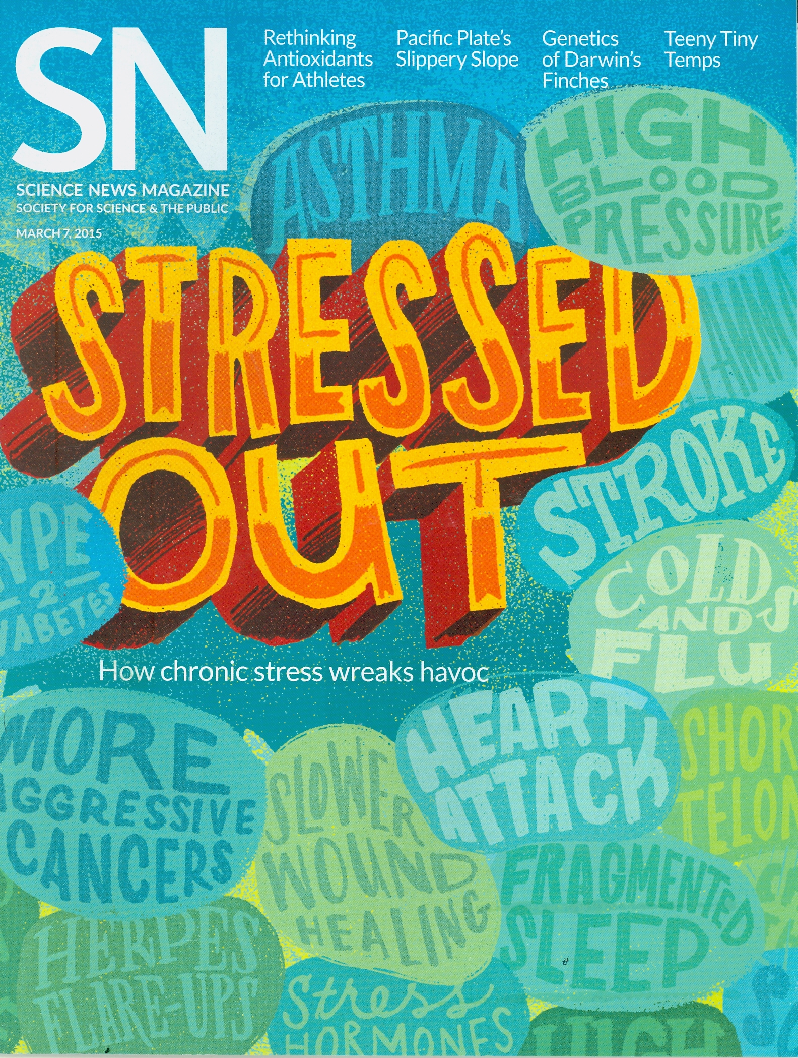
“ANXIOUS”
“BURNED OUT”
“DEPRESSED”
“STRESSED”
“STRESSED OUT”
G.P. Chrousos
2

Slide 3
Stressology vs. Endocrinology
Stressology
Endocrinology
Overlap?
Cardiometabolic Syndrome?
3
Notes:
3

Slide 4
The Endocrine Basis of Stress
Concepts of Complexity vs. Endocrinology
Neuro-Endocrine Mechanisms of the Stress Response
Adverse Effects of Chronic Stress- Pathology
Evaluation of a Stressed Human Subject
Stress Management - Therapy
Notes:
4

Slide 5
HUMAN COMPLEXITY: POST(EPI)GENOMIC ERA
Human genome:
About 3+3 billion bases (“Non-junk” or “dark” DNA 98 vs. 2 %;
retroviral origin 50-60%; 15-25K retrotransposons)
About 20 thousand protein-coding genes
About 24 thousand ncRNA-coding genes
About 200 thousand transcripts
(mRNA, ncRNA)
About 200-260 thousand proteins
Single nucleotide polymorphisms (snp’s or snv’s),
microsatellites or copy number variants (cnv’s): (0.1% difference)
About >25 million snp’s (snv’s), 1.5 million indels
About 20 million microsatellites
>5000 cnv’s (many million bases)
> 200 k disease-related mutations
>60% of promoters have CpG islands, >1 million reg sequences
EPIGENETICS/EPIMUTATIONS
⬇
Notes:
5

Slide 6
THE HUMAN BRAIN
~ 100 billion neurons (100x10¹²⁾ x >10.000 synapses per neuron = >10¹⁷ synapses)
~ 100.000 km of fibers
~ 1 trillion or more glial cells
> 4.25 terabytes
~ 15 Watt lamp (2% of BW uses 20% of the energy)
Plasticity
⬇
Notes:
6

Slide 7
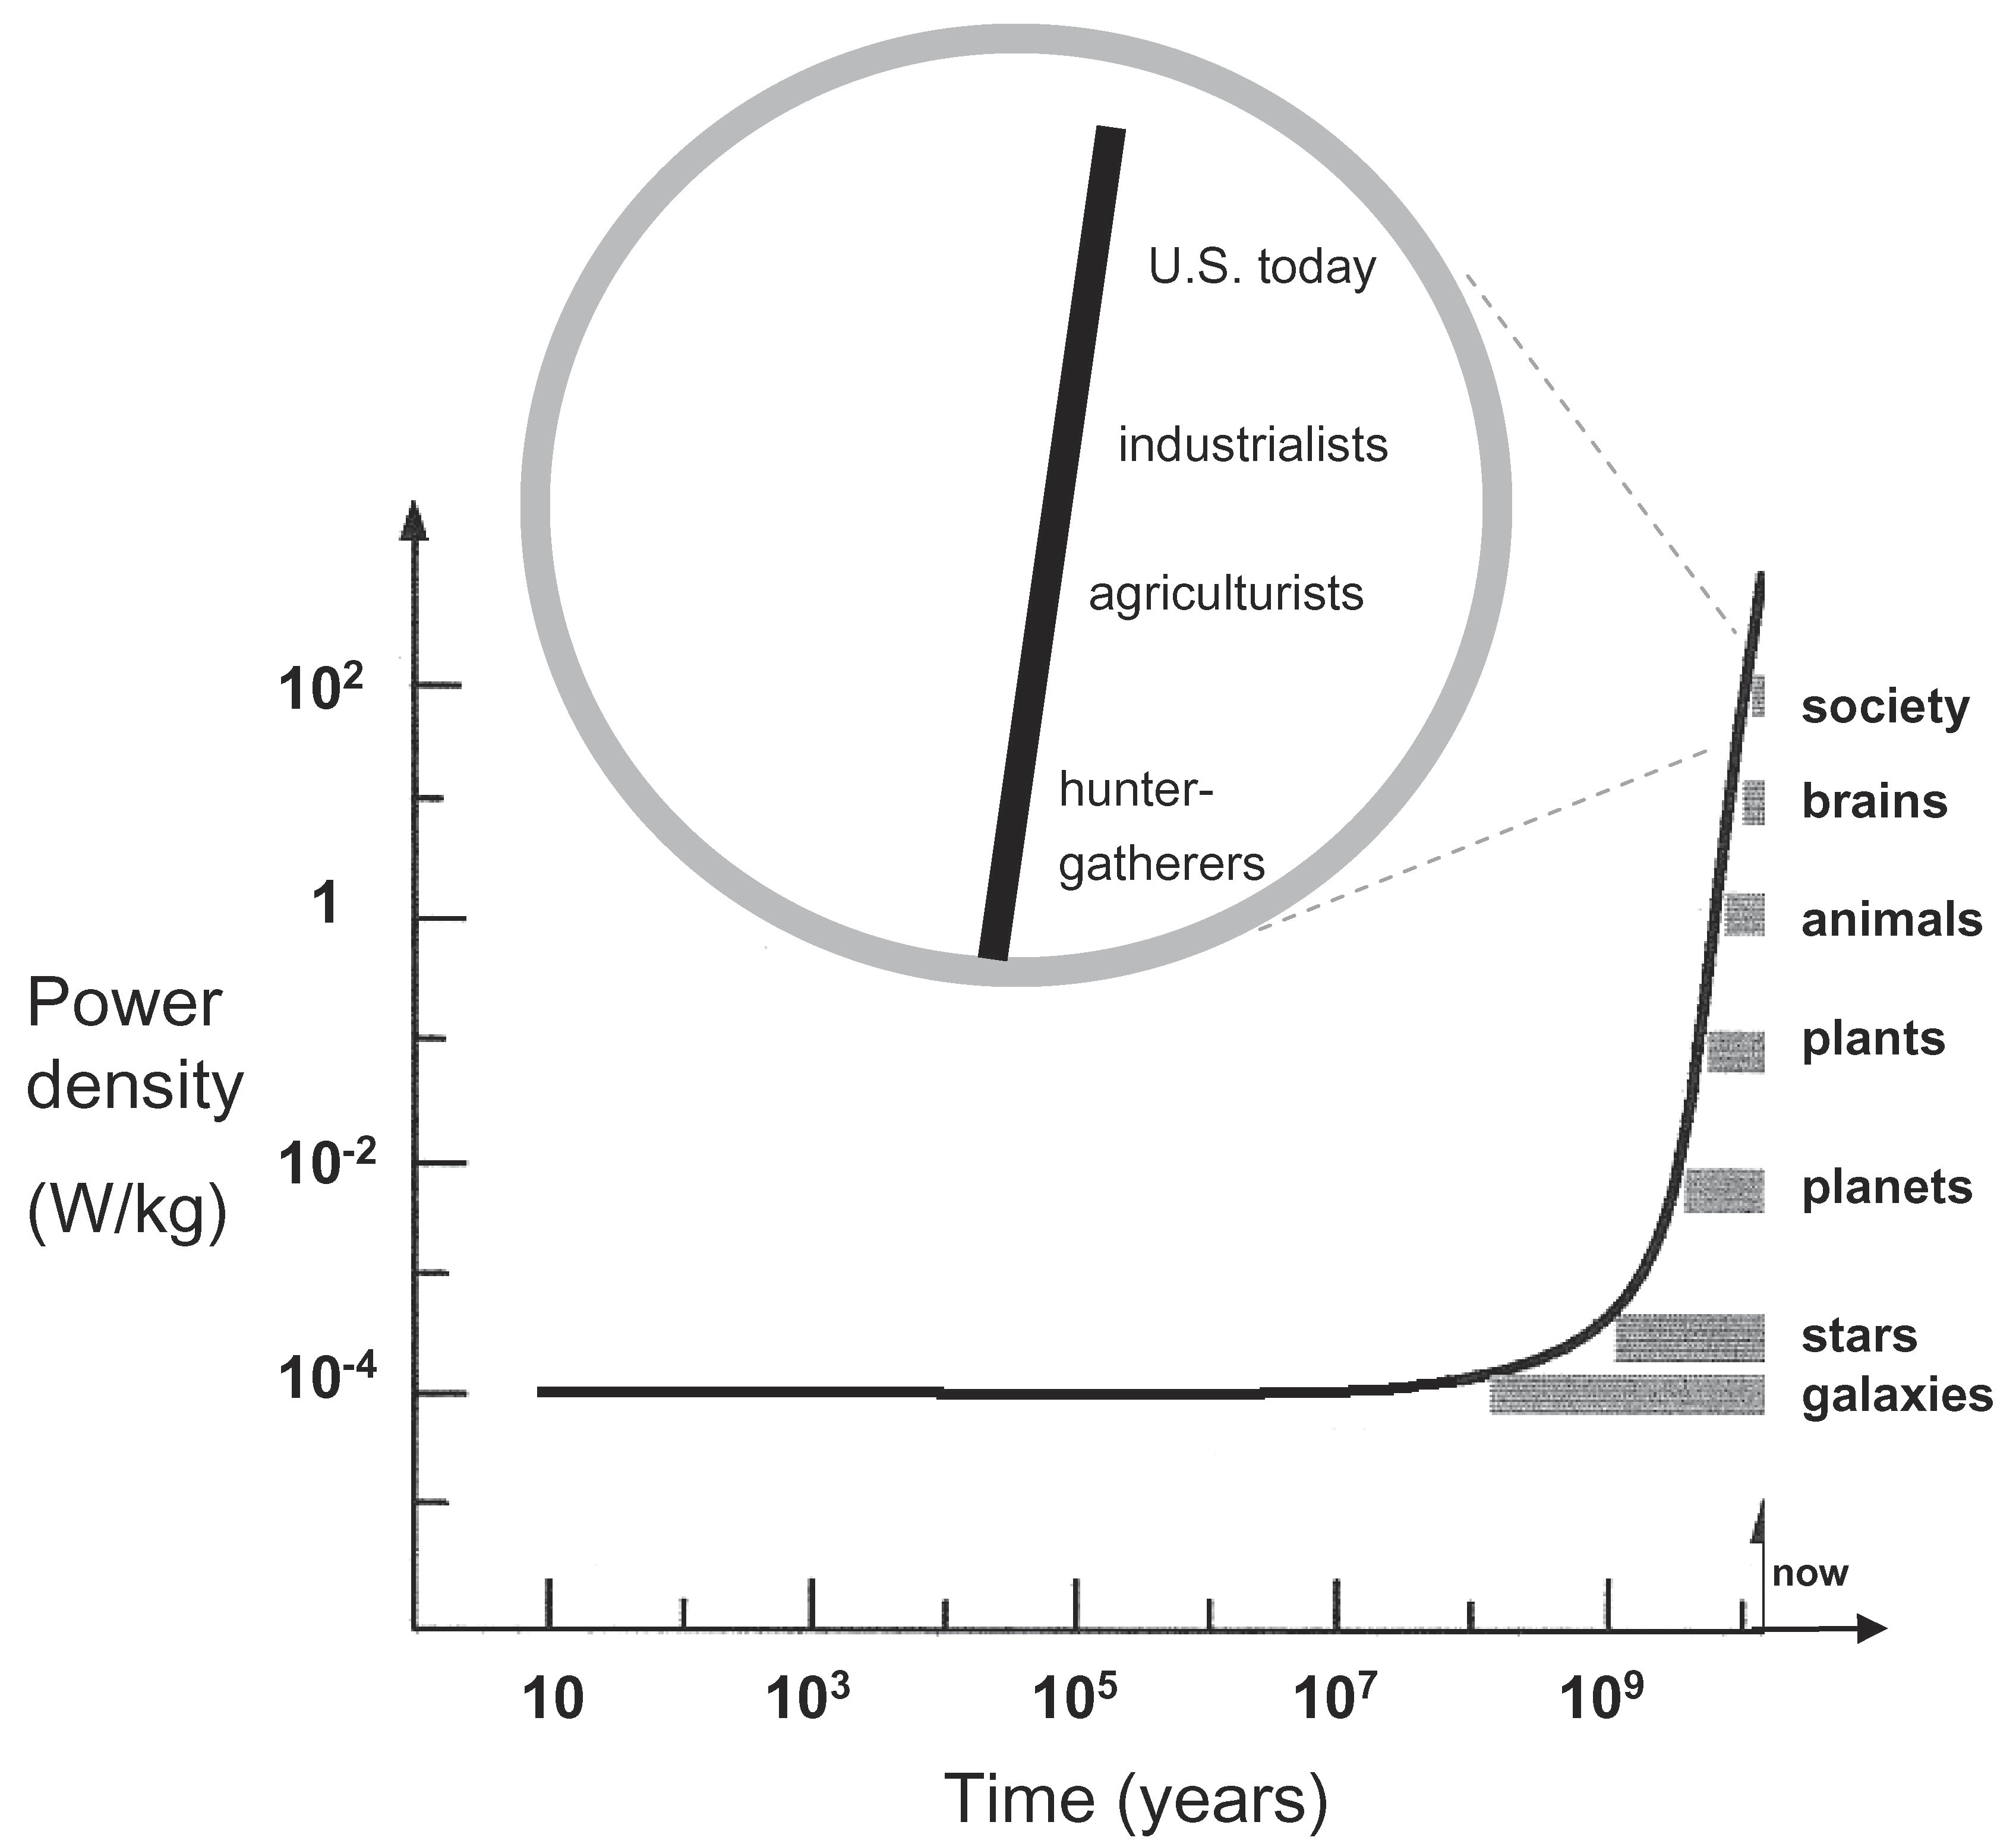
Ever Increasing Universal Complexityy
Info
density
Negentropy
Chaisson E, New Scientist 2009

Slide 8
Man and his/her civilization are of unique complexity in the known universe.
Complex systems, including humans, are in a dynamic disequilibrium that requires energy to be sustained.
Complex systems have organizing principles and follow mathematic rules (“Chaos theory = Complexity theory”).
Hormones -including pheromones- are the cybernetic signals of living organisms that subserve complexity (intracrine, autocrine, paracrine, endocrine functions).
            ⬇
SYSTEMS BIOLOGY, SYSTEMS MEDICINE
NARRATIVE AND PRECISION MEDICINE
P4 MEDICINE (predictive, personalized, preventive, participatory)

Slide 9
Complex Systems Theory
“Harmony”
Equilibrium
Balance
Counteracting
Reestablishing
Forces
Disturbing
Forces
II
II
II
Homeostasis
(Range)
Adaptive
Response
Stressors
(Physical,
Emotional)
Pythagoras= Harmony
Alcmaeon=Iso-nomia
Hippocrates=Eucrasia
Epicurus= Eustatheia
Walter Cannon= Homeostasis
G.P. Chrousos
9
Notes:
9

Slide 10
Επικούρεια Ευστάθεια Epicurean “Eustatheia”
“ευστάθεια” : “σαρκός και ψυχής ευσταθές κατάστημα”
eustatheia: “the balanced state of the flesh and the soul”

Slide 11
Stress is the State of Threatened (or Perceived as Threatened) Homeostasis
Notes:
11

Slide 12
«Εστιν άρα η αρετή έξις προαιρετική, εν μεσότητι ούσα τη προς ημάς, ωρισμένη λόγω και ω αν φρόνιμος ορίσειεν. Μεσότης δε δύο κακιών, της μεν καθ’ υπερβολήν της δε κατ’ έλλειψιν»
“Mesotis” in the inverse U Curve of Virtues
“Is thus virtue a voluntary habit, being in the middle from our point, defined by logic and practical wisdom. The good is in the middle, between two evils, too much or too little”
Αριστοτέλης, Ηθικά Νικομάχεια
Aristotle, Nicomacheian Ethics

Slide 13
Eustasis
(Range)
Allostasis
Caco-
Allostasis
Caco-
Optimum
Homeostatic Effect
Deficiency
Excess
Homeostatic System Activity

Slide 14

Eustress Distress

Slide 15
Eustasis
(Range)
Allostasis
Caco-
Allostasis
Caco-
Optimum
Homeostatic Effect
“Eustress”
“Effectance”
Hormesis
Learning
“Conatus”
Self-stim
Deficiency
Excess
Homeostatic System Activity

Slide 16
Human Stressors
Daily hassles
Life transitions: Early life, puberty, adolescence, menopause, retirement
Natural and unnatural catastrophies
Starvation, Excessive nutrition, Deficient exercise, Excessive exercise, Obesity
Socioeconomic status, Minority status, Loneliness (Dignity)
Work stress (Effort Reward Imbalance, ERI), Unemployment (Dignity)
Job loss, Downsizing, Loss of control (Dignity)
Social Inequality (Dignity), Social Restriction (Dignity)
Bereavement
Caretaking/ Pathologic empathy vs. principled compassion
Addictions/ Toxic substances
Chronic diseases, Treatments
Inflammations (Traumatic, Infectious, Autoimmune, Allergic, Para-inflammation)
Anxiety, Depression, Personality disorders, Phobias
Sleep deficiency, Sleep excess
Uncoupling of the Clock: Jet-lag, “Social-jetlag”
Behavioral addictions: Digital technology-“Meta-modern stress”, “Cyborg stress”, Hikikomori s., NEET, Nomophobia (Nomo[bile]phobia)
G.P. Chrousos
Notes:
16

Slide 17
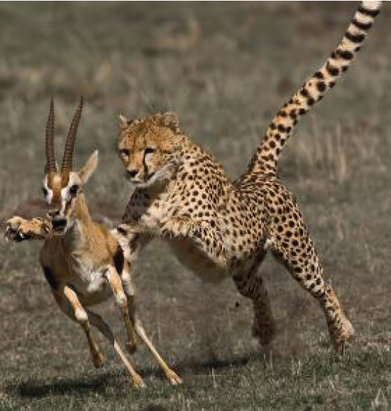
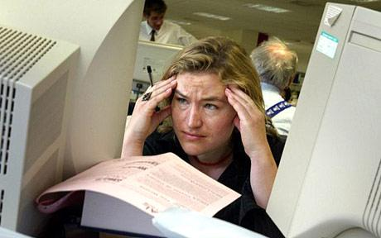
Acute vs. Chronic Stress
Chronic Psycho-socio-economic Stress
(Chronically activated Fight, Flight, Freeze, Faun Reaction =
chronic, smoldering, waxing and waning of Anger, Fear,
“Paralysis”, Subservience state) (pathologic)
Fight, Flight, Freeze, Faun Reaction
(physiologic)
G.P. Chrousos
17

Slide 18
Homeostasis over Time
Improved Homeostasis=Hyperstasis
Elevated mood
Healthy Baseline Homeostasis
Baseline Homeostasis=Eustasis
Constitutional mood
Constitutional mood
Deteriorated Homeostasis=Cacostasis
Catabasis
Suppressed mood
Anabasis
Distress (Eustress)
G.P. Chrousos
18

Slide 19
Homeostasis over Time
Psychosomatic Resilience = “Ataraxia”+ “Aponia”
-Small disturbance
-Quick recovery
Improved Homeostasis=Hyperstasis
Elevated mood
Healthy Baseline Homeostasis
Baseline Homeostasis=Eustasis
 ⬅➔
Constitutional mood
Constitutional mood
Deteriorated Homeostasis=Cacostasis
Catabasis
Suppressed mood
⬆
Anabasis
Distress/Eustress
G.P. Chrousos
19

Slide 20
Resilience is the Ability of any Organism to Resist to Stressors and Return Rapidly to Homeostasis

Slide 21
SEX-related Roles
Speech/Logos
Shared Intentionality
900-700kya
Encephalization
2.0mya
Modern
Culture
>300kya
Modern Behavior
50kya
Bipedalism
4.0mya
Stone Artifact Manufacture
2.2mya
SRGAP2
Epiregulin
FoxP2
2 Million
1 Million
100k
50k
5 Million
4 Million
3 Million
300k
25k
150k
Years Ago
↑
↑
↑
ARHGAP11
Duplication
ARHGAP11B
Mutation
Frontal
neocortex H sapiens sapiens
TKT L1
Mutation
Brain ~380 g
Brain from 380 to 1300- 1600g
over 2 million years
↑
Near extinction “bottleneck”
900-700kya
H. erectus= H heidelbergensis? Ancestor X

Slide 22
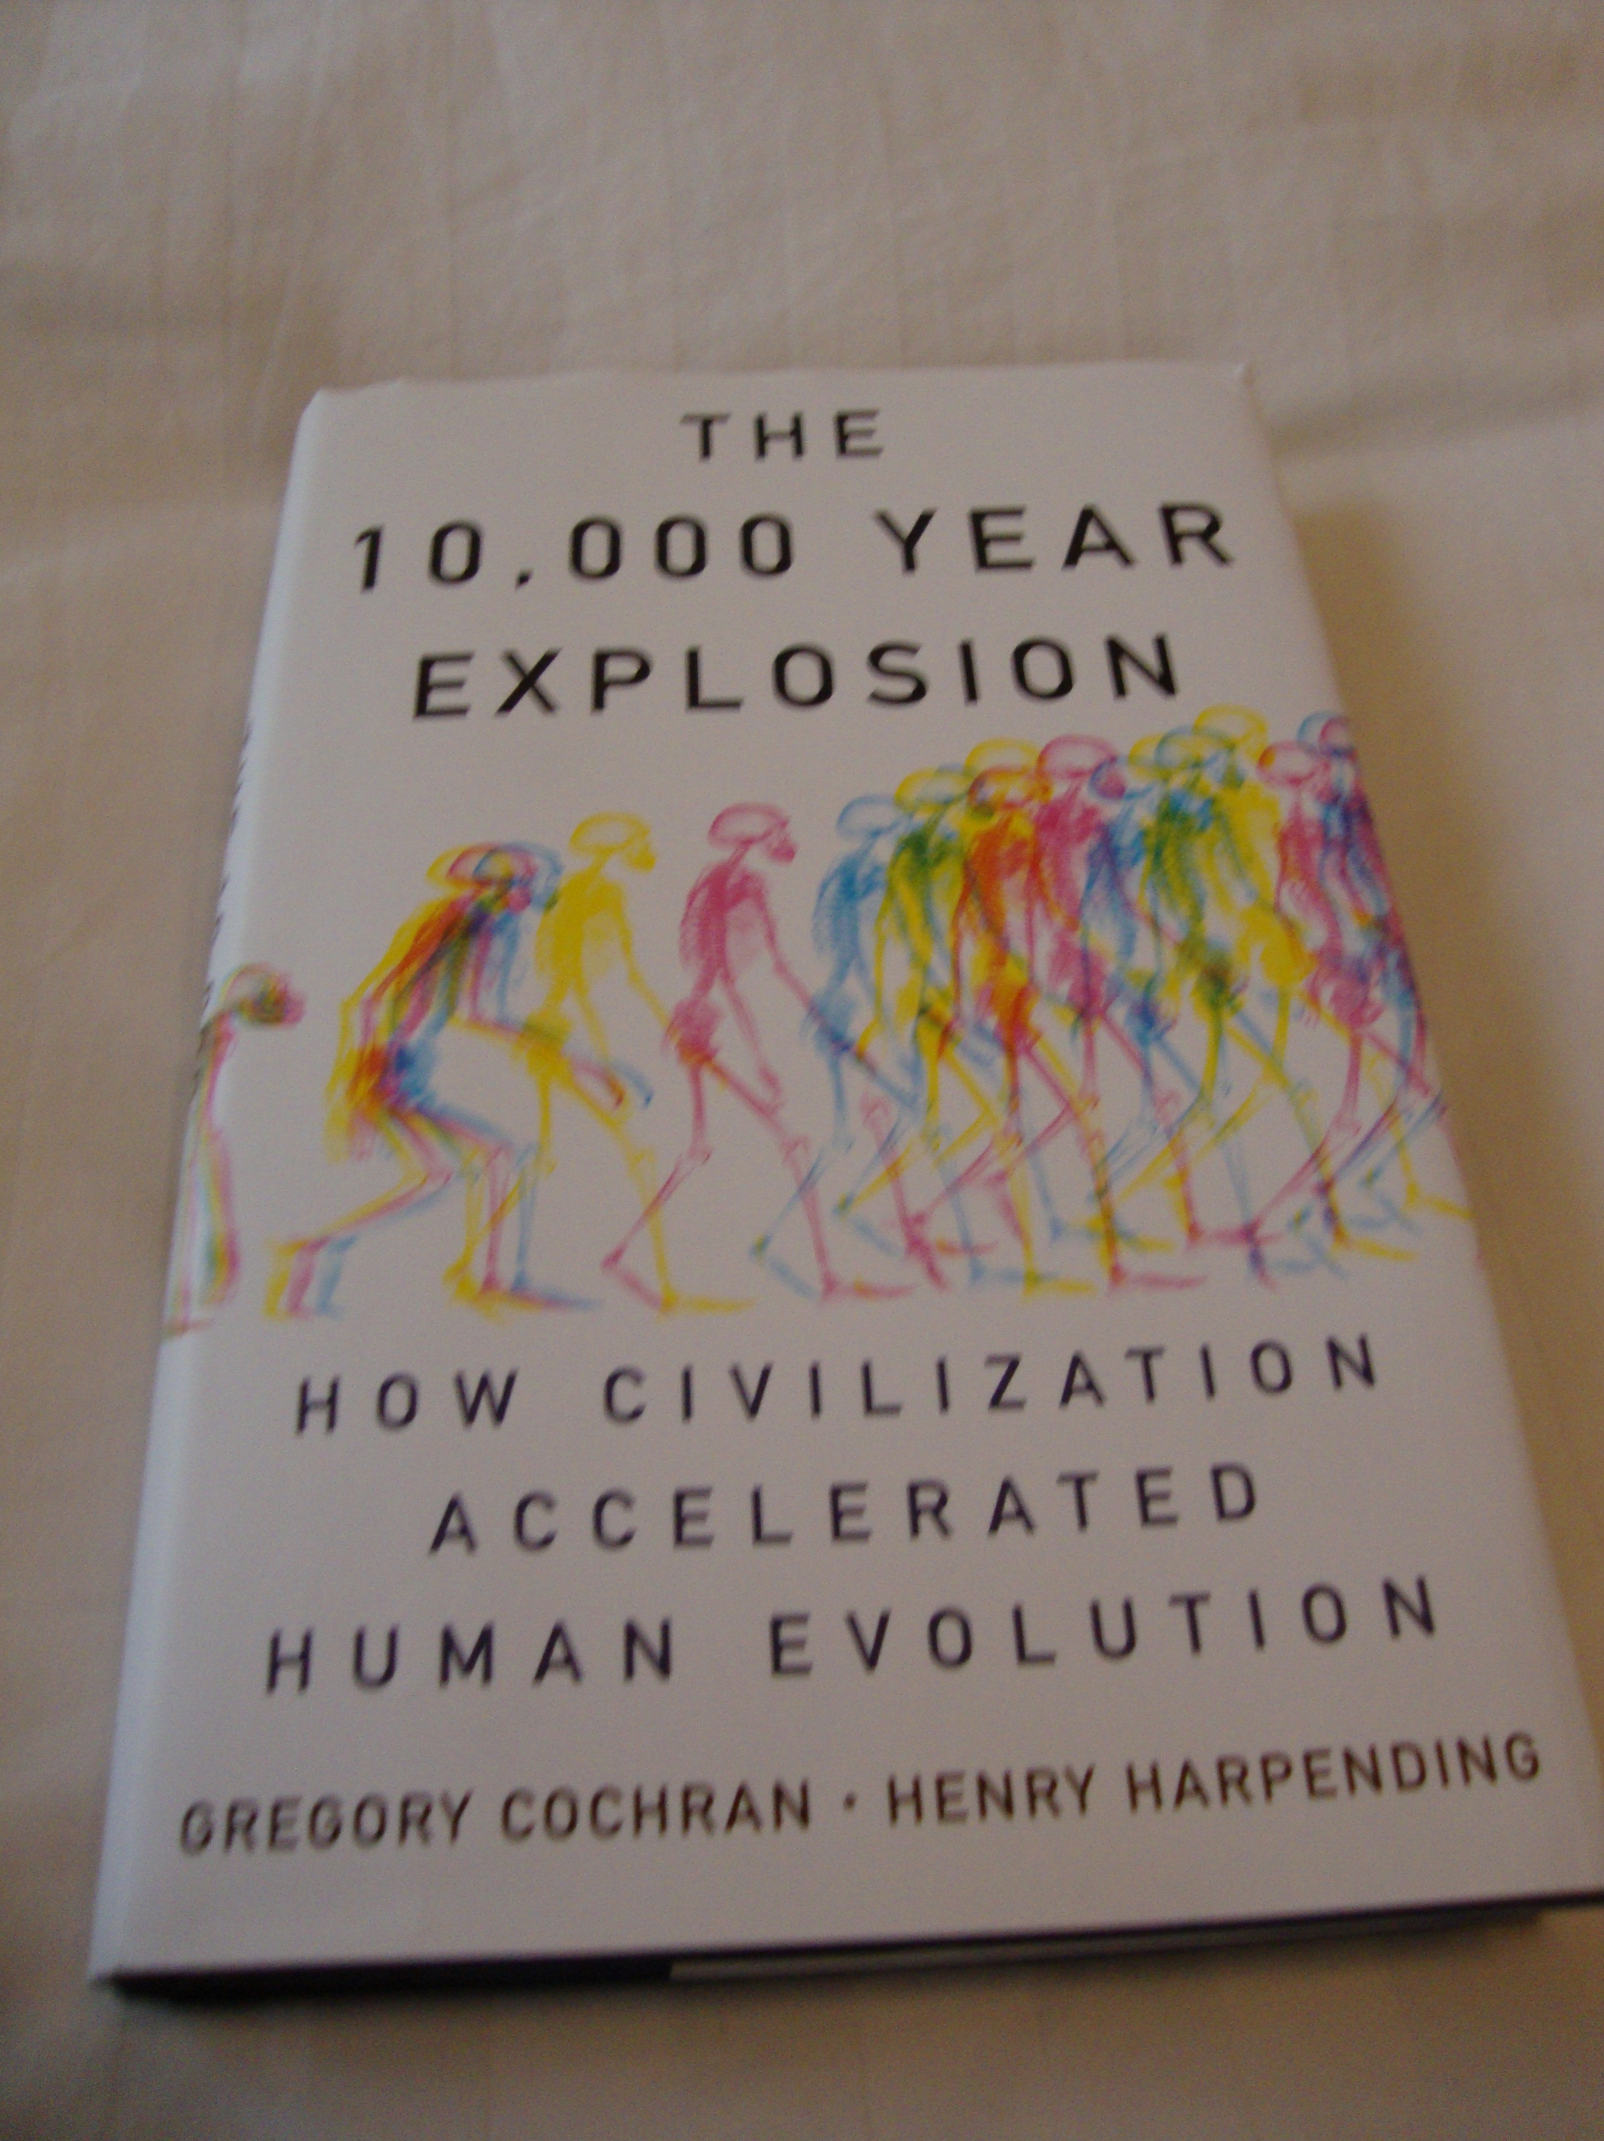
Acceleration of Human
Genetic Evolution as a
function of Cultural
Evolution
A “Virtuous Cycle”
between Human
Genetic Evolution
and Culture

Slide 23
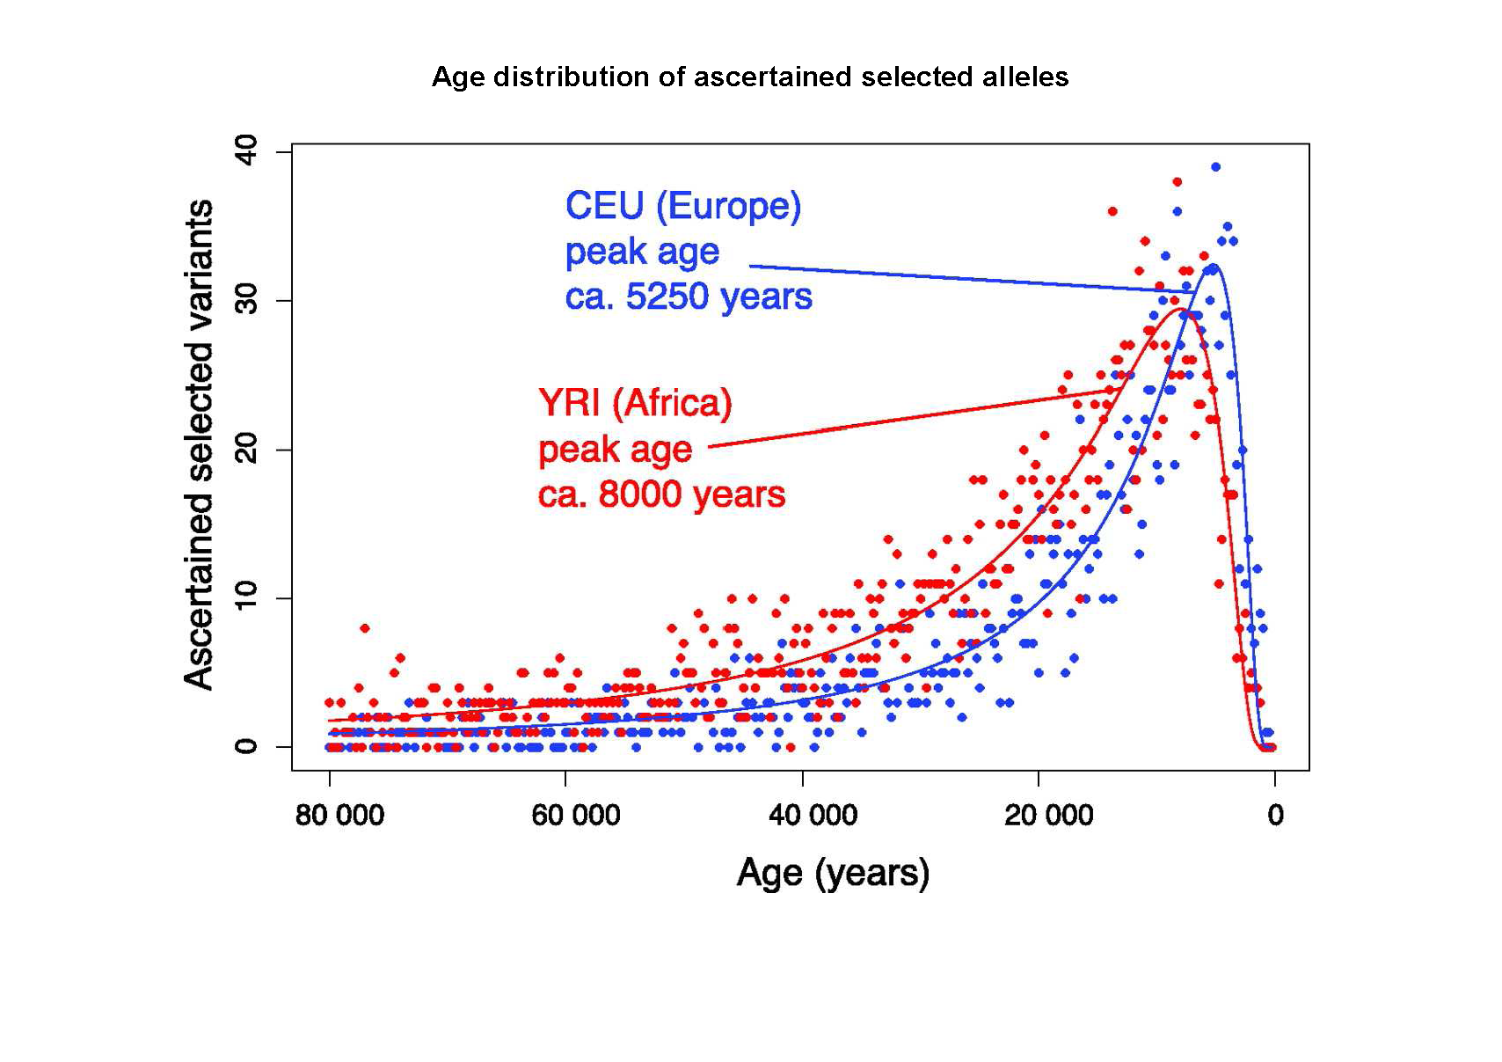
Hawks et al. PNAS 2007

Slide 24
Human Brain Properties
Speech/Logical thinking
Volition (Free will)
Imagination (Space- and time-travel, Metarepresentations)
Effectance, Hormesis (Eustress)
Shared intentionality
Delayed gratification
Empathy/Caring/Morality
✲
✲
✲
✲
✲
✲
✲

Slide 25
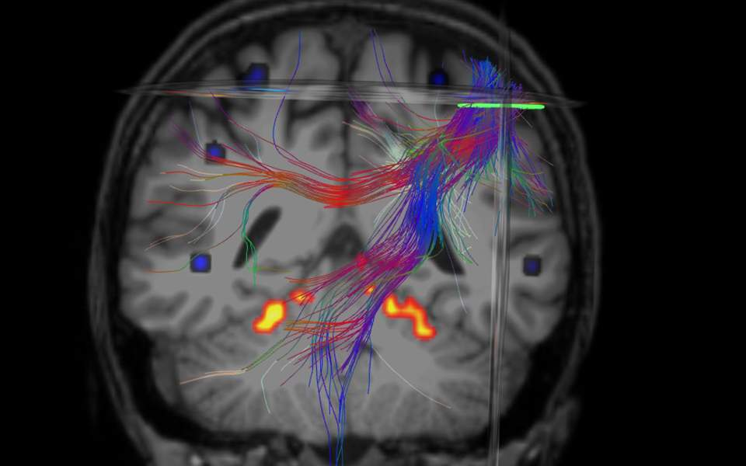
Intra vs. Inter- Network Connectivity
Many Neuronal Networks
fMRI, DTI, etc.

Slide 26
The Endocrine Basis of Stress
Concepts of Complexity vs. Endocrinology
Neuro-Endocrine Mechanisms of the Stress Response
Adverse Effects of Chronic Stress - Pathology
Evaluation of a Stressed Human Subject
Stress Management-Therapy
Notes:
26

Slide 27
Stress System
HPA Axis
LC-NE
System
Norepinephrine
Epinephrine, iCRH, Interleukin-6 (IL-6)
Cortisoll
Notes:
27

Slide 28
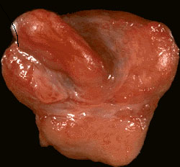
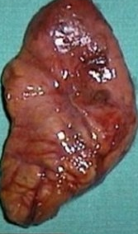
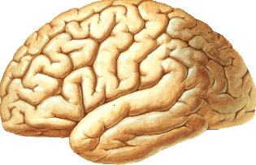
STRESS SYSTEM
Amygdala CRH
HIPPOCAMPUS
CRH/AVP
LC/NE
ACTH
F
NE/E
iCRH
GH/IGF-1
LH/T
TSH/T₃
Mast cellss
+
Interleukin-6
Inflammation
+/-
G.P. Chrousos
Notes:
28

Slide 29
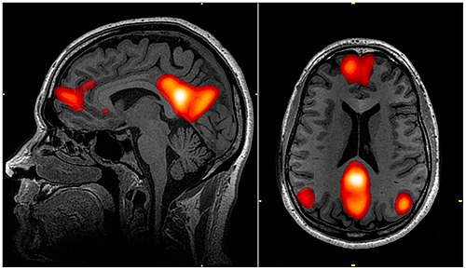
The Default Mode Neural Network (10% of the body energy), Self/Autobiography

Slide 30
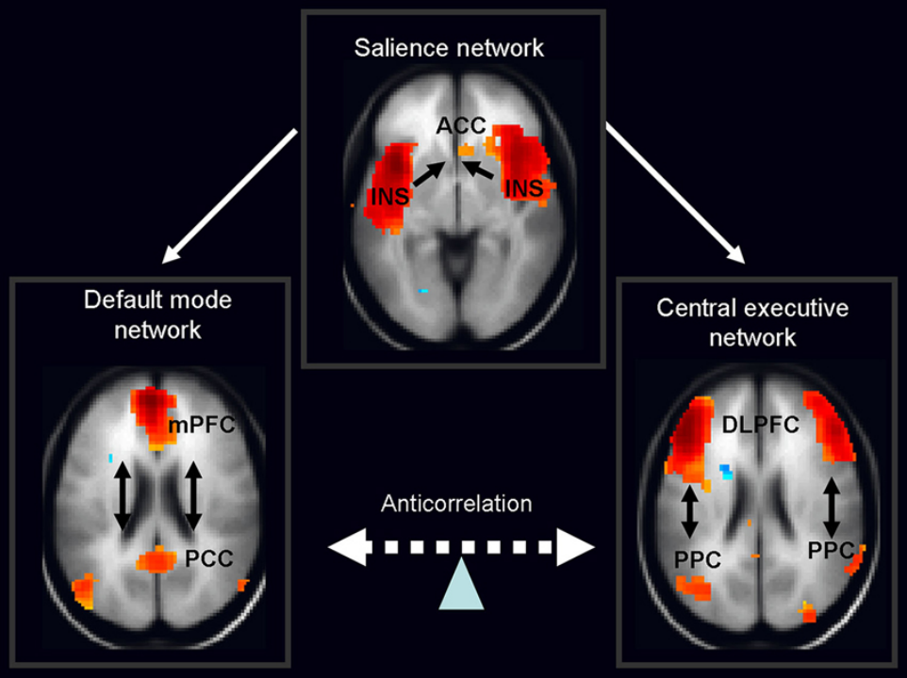
Stress System ↑↓
+
+
Stress System ↑↓
-
-
+

Slide 31
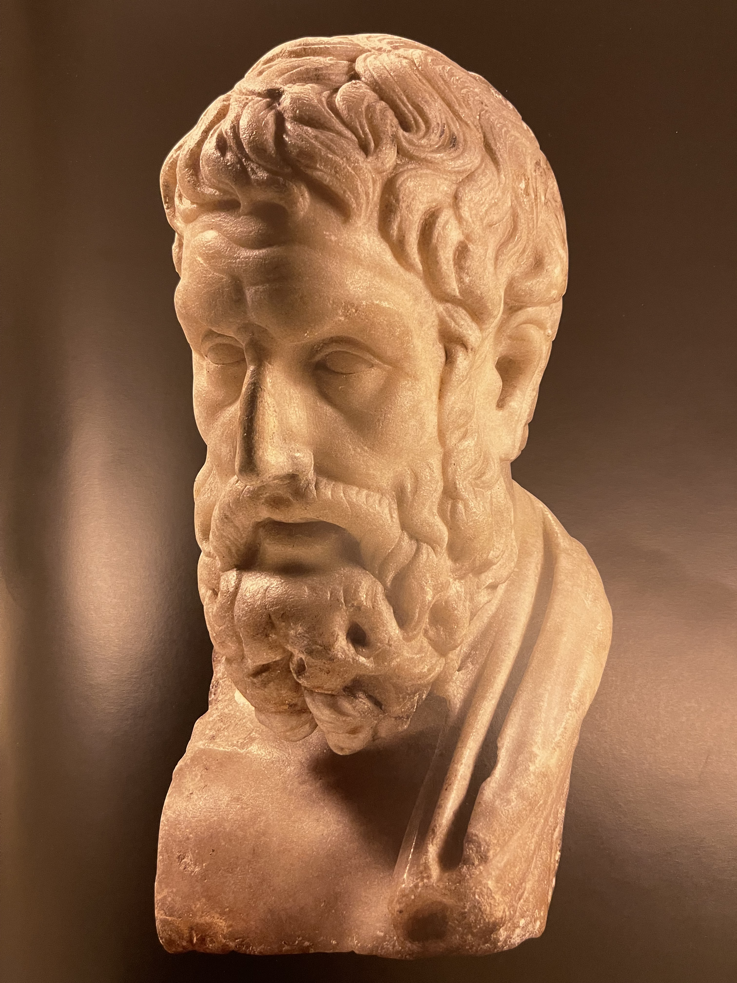
«ΤΗΝ ΗΔΟΝΗΝ ΑΡΧΗΝ ΚΑΙ ΤΕΛΟΣ ΛΕΓΟΜΕΝ ΕΙΝΑΙ ΤΟΥ
ΜΑΚΑΡΙΩΣ ΖΗΝ»
“WE CALL HEDONE THE BEGINNING AND THE END OF
LIVING EUDAIMONICALLY”
Επίκουρος
Epicurus

Slide 32
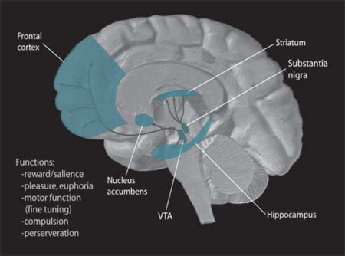
MC/ML “Reward” System
ML
MC

Slide 33
MC/ML “Reward” System Tone
Stress System Tone
+ acute
- chronic
-
G.P. Chrousos
33
Notes:
33

Slide 34
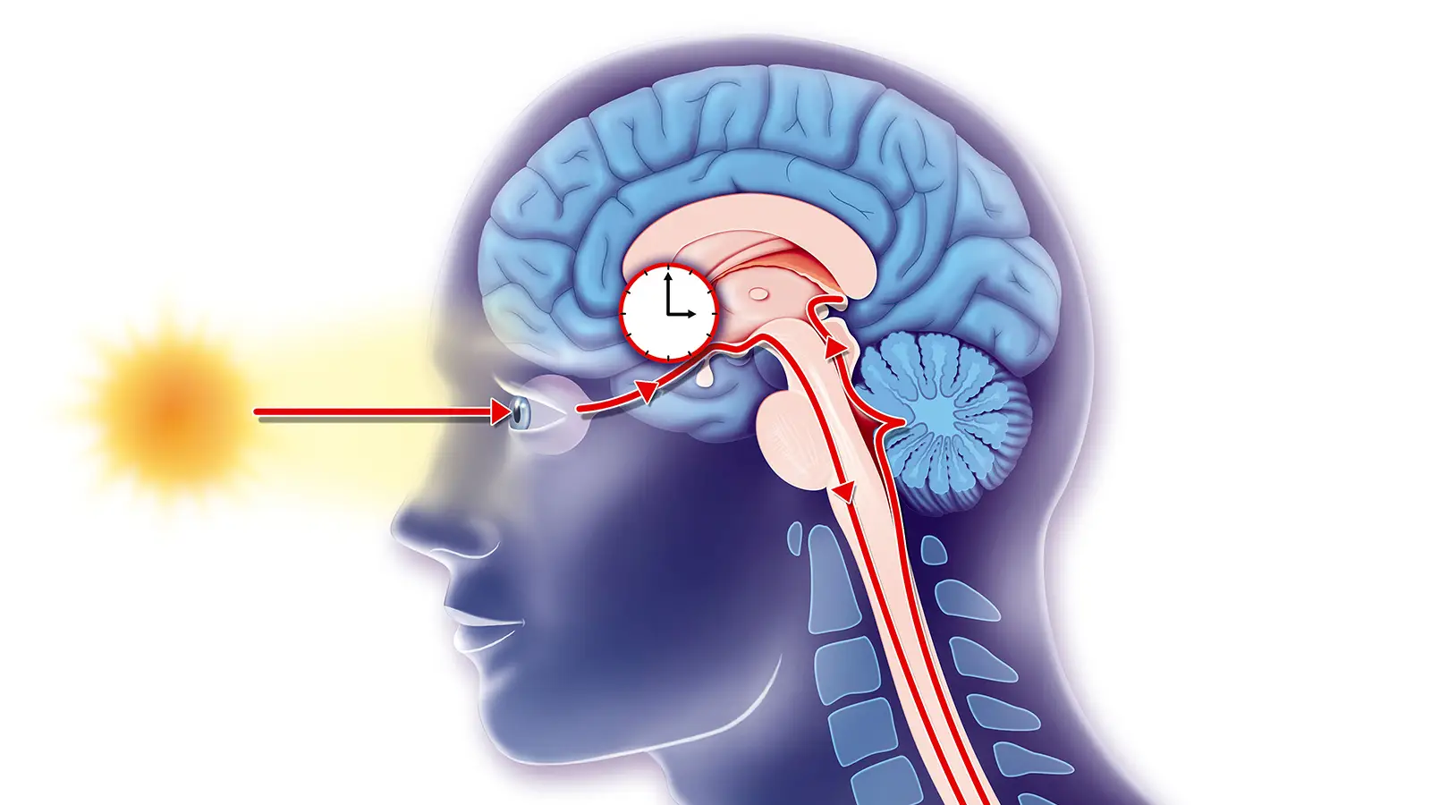
The Retino-hypothalamic Track

Slide 35
Clock/Bmal1 Represses GR Transcriptional Activity through Acetylation
In the Absence of
Acetylation by CLOCK
In the Presence of
Acetylation by CLOCK
Bmal1
GR
Clock
Acetylation
A
A
GRE Binding↓
A
A
GREs
GREs
GR-induced Transcriptional Activity↓
GR-induced Transcriptional Activity
NTD
DBD
HR
LBD
GR
1
420
480
520
777
Nader et al. FASEB J. 2009
Charmandari et al. PLoS One. 2011
K480
K492
K494
K495
Acetylation Sites
Interaction with Clock
Notes:
35
In this slide you see how Clock/Bmal1 represses GR transcriptional activity. Glucocorticoid-bound GR stimulates transcription of its responsive genes through binding to GREs located in their promoter region. Once Clock/Bmal1 acetylates GR, it reduces binding activity of GR to GREs, thus clock /Bmal1 can suppresses GR transcriptional activity.
Clock finds GR by physically interacting with its LBD and acetylates lysines 480, 492, 494 and 495 located in the hinge region of the human GR.

Slide 36
A.
24 H SAMPLING
OVERNIGHT
DEXAMETHASONE TEST
24 H CORTISOL
-D
PLASMA CORTISOL
-D
NS
CS
+D
+D
DARK
NS
CS
8 am
8 pm
8 am
B.
TARGET TISSUE SENSITIVITY
TARGET TISSUE RESPONSE
HS
N
R
THRESHOLD
FOR HARMFULNESS
Chrousos JCEM 1998
CORTISOL CONCENTRATION

Slide 37
Uncoupling between Circadian Rhythm of SeCortisol and Tissue Glucocorticoid Sensitivity
OVERNIGHT
DEXAMETHASONE TEST
24 H SAMPLING
Normal
Stress
Shift
-D
Serum Cortisol
-D
+D
+D
8 am
8 pm
Dark
8 am
NS
SS
CIRCADIAN TISSUE GLUCOCORTICOID SENSITIVITY/GR ACETYLATION
GR Acetylation
Functional Glucocorticoid Hypersensitivity
Target Tissue
Glucocorticoid Sensitivity
GR Acetylation
αt Target Tissues
Target Tissue
Glucocorticoid Sensitivity
Pathologic Consequences
8 am
8 pm
Dark
8 am

Slide 38
The Endocrine Basis of Stress
Concepts of Complexity vs. Endocrinology
Neuro-Endocrine Mechanisms of the Stress Response
Adverse Effects of Chronic Stress - Pathology
Evaluation of a Stressed Human Subject
Beneficial Effects of Stress Management
Notes:
38

Slide 39
CHRONIC STRESS SYSTEM ACTIVATION Pathophysiology
• Anxiety, depression, addiction, anti-social behavior, psychosomatic disorders, loss of libido, fatigue, pain
• Loss of weight, poor growth, obesity, metabolic syndrome, smoldering inflammation, immune dysfunction, autoimmunity/allergy, hypo-fertility, ED, atherosclerosis, CVD, dementia
• Osteopenia/Osteoporosis
• Premature aging of all vulnerable organs, including the brain (neurodegeneration) and the skin
• Vulnerability to certain cancers [to certain infections]
⬆
CHRONIC NONCOMMUNICABLE DISEASES, + COMMUNICABLE

Slide 40
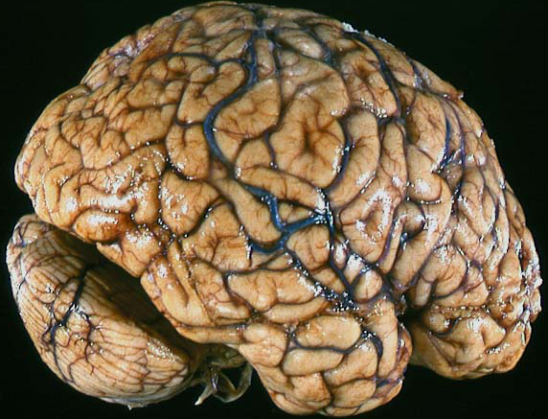
DEVELOPMENTAL HISTORY
STRESS
Real or perceived
GENETIC VARIATION
NUTRITION
AGING
Stress system
CRH/AVP-LC/NE
HPA axis
Systemic Sympathetic
Adrenomedullary Systems
GH/IGF-1
LH, T, E2
TSH, T₃
Cortisol
Target Tissues
NE, E, IL-6
Insulin resistance
Visceral Obesity/Sarcopenia
=Metabolic
Syndrome, DM type2
TG
LDL
HDL
ABP
MAFLD
Sickness
Syndrome”
Manifestations
APR
Cytokines
Dyscoagulation
Sleep Apnea
Osteopenia
Osteoporosis
PCOS
Endothelial Dysfunction/Inflammation
Atherosclerosis
Cardiovascular Disease
40
G.P. Chrousos

Slide 41
Both IL-6 and TNFα correlate with BMI
IL-6 (pg/ml)
TNFα (pg/ml)
r = .790
p = .000
r = .400
p = .014
BMI
Vgontzas et al. JCEM 1997
Notes:
41

Slide 42
HYPERCYTOKINEMIA
TRAUMA/ BURNS
INFECTIOUS ILLNESSES
AUTOIMMUNE INFLAMMATORY DISEASES
ALLERGIC INFLAMMATIONS
CNS INFLAMMATIONS
NONINFLAMMATORY STRESS !
OBESITY/VISCERAL OBESITY
AGING (SARCOPENIA, VISCERAL OBESITY)
G.P. Chrousos
42
Notes:
42

Slide 43
Stress System
/Inflammation Activation
Chronic Psycho-
socio-economic Stress
Sleep disorders,
Accelerated aging,
Increased cancer risk,
Increased risk for
infections
Infections,
Environmental toxins
“Chronic Stress and Inflammation
Syndrome” (CSI Syndrome)
Psychologic and Physical Manifestations, Overweight/obesity
Dysphoria, Medically Unexplained Symptoms (MUS), Autoimmunity/Allergy, Hypochondriasis, Osteosarcopenia
= “Chronic Noncommunicable Diseases” +
Notes:
43

Slide 44

Last 70 years
Epigenetic changes:
↑ Overweight/Obesity
↑ CSI Syndromes

Slide 45
Evolutionary and Developmental Stressors=
Species and Individual Selective Pressures
• Starvation
• Dehydration/hemorrhage (gastroenteritis, trauma)
• Injurious agents ( infections, toxic substances)
• Adversaries (anticipation, minimization of exposure)
Tissue injury (fatigue and pain)
Social bonding disruption (empathy/morality)
Wrong decisions (pragmatic logic)
Notes:
45

Slide 46
Selections of Genetic and Epigenetic Gene Networks Participating in Functions Important for Human Species and Individual Survival
RESPONSE TO SURVIVAL THREAT SELECTIVE ADVANTAGE CONTEMPORARY DISEASE
Combat starvation Energy conservation Obesity/cardiometabolic syndtome
Combat dehydration Fluid and electrolyte conservation Hypertension
Combat infectious diseases Potent immune reaction Autoimmunity/Allergy
Anticipate adversaries Arousal/fear Anxiety/insomnia
Minimize exposure to danger Withdrawal Depression
Prevent tissue strain/damage Retain tissue integrity Pain and fatigue syndromes
Prevent social disruption Retain social integrity (morality) “Evil” behaviors (psychopathy, tribalism,
fanaticism, sexism, etc “Emotional Contagion”
Prevent wrong decisions Making correct decisions (pragmatic logic) “Stupidity”, “Massive Stupidity”
Chrousos, Amer J Med 2004, mod.

Slide 47
Origins of Evil:
Material gain
Threatened egotism (insecurity)
Radical belief (fanaticism)
Sadistic enjoyment (pure evil)
Empathy Lack or Erosion:
Objectifying others
Denying relatedness
Numbing own emotions
Impaired ability to self-reflect

Slide 48
ENVIRONMENTAL STRESSORS
▪ Starvation
▪ Dehydration
▪ Injurious agents-inflammations
▪ Adversaries-anticipation
-avoidance
▪ Injury-minimization
▪ Social bonding disruption
▪ Wrong decisions
Embryogenesis
▪ Maternal Stress
▪ Perinatal Stress
Species
vs.
Individual
Evolution
Genetics
CNS complexity
Development
Epigenetics
CNS plasticity
Genotype
Epigenotype
Phenotype

Slide 49
MUSCLE MASS
Best predictor of morbidity and life expectancy

Slide 50
DEFINITIONS
Osteosarcopenia vs. Overweight/Obesity vs. “Paradoxic”-(non)Obesity
Decreased bone mass:
Osteopenia vs. Osteoporosis
T-scores from -1 to -2.5 vs. <2.5
Decreased muscle mass:
Sarcopenia vs. Sarcasthenia +/- lipoatrophy (cachexia, frailty)

Slide 51
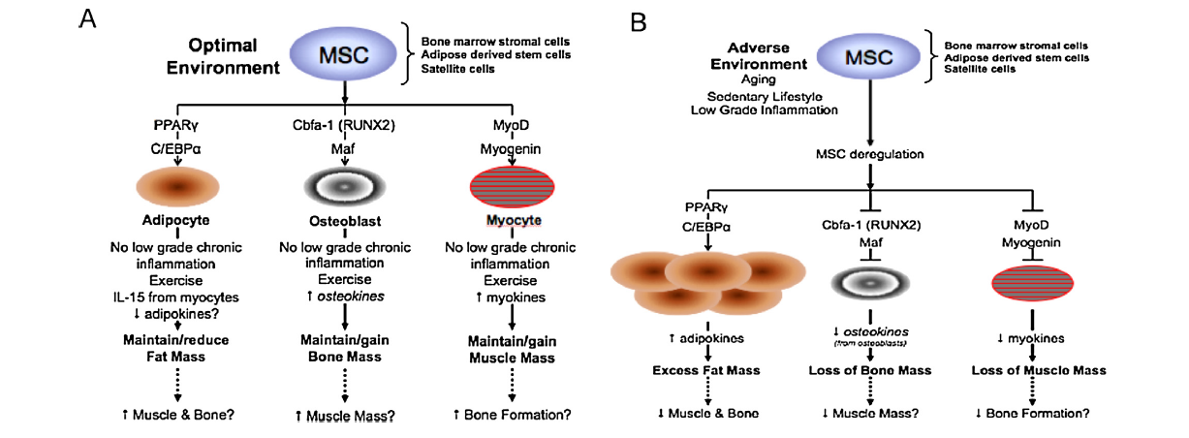
Notes:
To understand these concepts, it is necessary to revisit MSC commitment into adipogenic, osteoblastogenic and myogenic lineages and causes of their deregulation. Although MSC for bone, fat and muscle tissue may not behave identically in their own physiological environments, in this manuscript they are used interchangeably. The MSC lines give rise to various cell types including myocytes, adipocytes, and osteoblasts depending on the growth factors and overall conditions in the microenvironment. The crucial molecule for osteoblastogenic lineage is a core-binding factor alpha-1 (Cbfa-1), also known as runt-related transcriptor factor 2 (RUNX2), the osteoblast-specific transcription factor essential for driving the differentiation toward osteoblasts at the expense of adipocytes (Isenmann et al., 2007; Jeong et al., 2010;McCarthy et al., 2003; Yu and Reddy, 2007; Zahorska-Markiewiczet al., 2000; Zaidi et al., 2007). Peroxisome proliferator-activated receptor gamma (PPAR) is the adipocyte-specific factor essential for adipocyte differentiation (Ackert-Bicknell and Rosen, 2006;Stables and Gilroy, 2011), whereas MyoD, a member of the myogenic regulatory factor family of proteins (Bentzinger et al., 2012)and myogenin (Luo et al., 2009) are considered to be the key myogenic signaling molecules. Fig. 4 depicts a simplified stem cell lineage commitment. Under normal-homeostatic conditions, the MSC seem to slightly favor adipogenic differentiation but the trans-differentiation ofMSC to bone lineage could be triggered and enhanced by various local and systemic factors, as well as environmental (e.g. nutritional) (Cao, 2011; Kim et al., 2013), or by new compounds such as PPAR inhibitors (Duque et al., 2013). However, in less optimal conditions involving low-grade chronic inflammation (aging, obesity, sarcopenia) (Pratesi et al., 2013), outlined in Table 1, there sulting increased synthesis of pro-inflammatory lipid media-tors, prostaglandin E2(PGE2), leukotriene B4(LTB4), TNF, (all mediated by n-6/n-3 PUFA ratios (Kelly et al., 2013), as well as the presence of reactive oxygen species, stimulate adipogenesis and suppress osteoblastogenesis by inhibiting musculoaponeurotic fibrosarcoma (Maf, or c-Maf), necessary for osteoblastogenesis(Nishikawa et al., 2010) and upregulating PPAR. PPAR activa-tion in conjunction with CCAAT/enhancer binding protein-alpha(C/EBP) ensures the MSC is committed to the adipocyte. In addition, PPAR suppresses RUNX2, a master osteoblastogenic factor while TNF enhances osteoclastogenesis. Chronic higher circulating levels of inflammatory markers (IL-6, C-reactive protein and TNF) are associated with lower muscle mass in older people(Beyer et al., 2012). Furthermore, muscle satellite cells from obeseindividuals with type 2 diabetes mellitus, may exhibit a type of “IL-6 resistance” (Scheele et al., 2012). Muscle atrophy F-box (MAFbx)and muscle new gene finger-1 (MuRF-1) are part of the ubiquitin proteosome pathway. MAFbx and MuRF-1 are elevated in animal and human models of wasting, as well as disease and immobilization states. MAFbx seems to target MyoD and myogenin, whereasMuRF-1 targets structural proteins in the muscle (Foletta et al.,2011). However, MAFbx and MuRF1 may have more complex roles as muscle atrophy can be inhibited without a reduction in MAFbxand MuRF1 levels (Foletta et al., 2011).Thus, excess adiposity increases inflammation and enhances adipogenic signals. The net result is bone loss, possibly muscle loss, and increase in adipocytes, along with the maintenance of low-grade chronic inflammation. There is the possibility that sarcopenia, sarcopenic obesity, osteosarcopenic obesity, or other combinations (see Fig. 5) are the same disease at different points of evolvement and development. Furthermore, if muscle and bone mass/strength decline with age, but fat mass increases with age in adipose and other tissue compartments, it suggests that an age-related MCS lineage commitment dysfunction may be occurring, perhaps mediated by inflammation and ultimately being the root cause of sarcopenia and osteopenia.
51

Slide 52
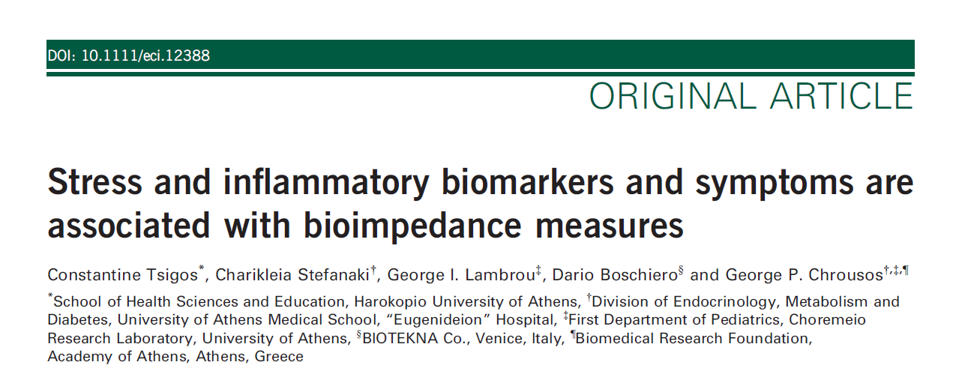
EJCI 2015

Slide 53
Participants were 99571 adult Caucasians (29624 males and 60047 females), ages 18-90 y, grouped by:
• BMI: Lean, Overweight, Obese
• Presence of Medically Unexplained Symptoms = MUS

Slide 54
The Medically Unexplained Symptoms (MUS) Examined*:
(i) persistent tiredness or fatigue,
(ii) depressive symptomatology,
(iii) persistent insomnia or night awakenings,
(iv) persistent drowsiness during the day,
(v) anxiety,
(vi) apathy,
(vii) panic attacks,
(viii) changes in heart rate (arrhythmias/tachycardia) at rest,
(ix) changes in appetite (appetite loss or excessive hunger),
(x) night binge eating,
(xi) stomach cramps, bloating or gastro-esophageal reflux disease (GORD),
(xii) presence of irritable bowel syndrome (IBS) symptoms,
(xiii) cold hands and feet,
(xiv) sweating during sleep.
*Presence of MUS was defined as a positive answer to more than 3 of the above 14 questions.

Slide 55
Evaluation included:
• Advanced Body Composition Analysis by BIA-ACC
• Indices of Inflammation: am hsCRP, Interleukin-6
• Indices of Stress: am and pm Salivary Cortisol, Delta-Cortisol (am-pm) or am/pm cortisol ratio

Slide 56
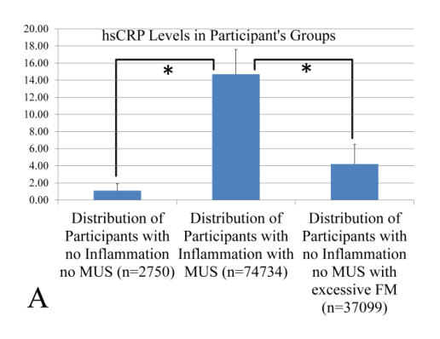

Slide 57
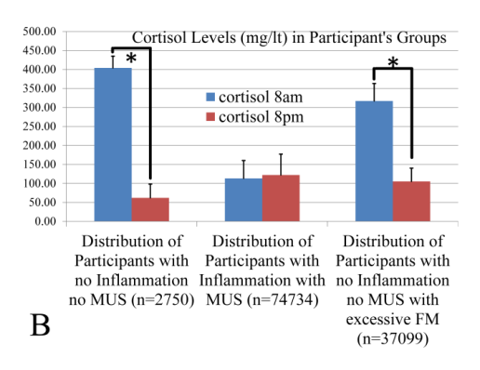

Slide 58
Healthy Overweight/Obese Youth: Early Osteosarcopenic
Obesity Features.
Stefanaki C, Peppa M, Boschiero D, Chrousos GP.
Eur J Clin Invest. 2016 Jul 19. doi: 10.1111/eci.12659.
[Epub ahead of print]

Slide 59
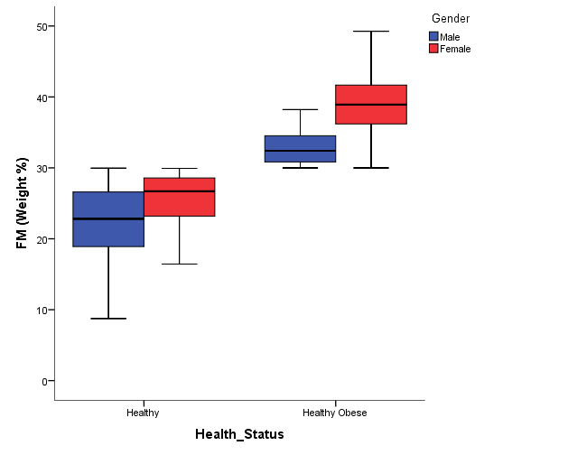
∗∗
∗∗
F(3,2547)= 2824.545, p<0.001,
Eta squared =0.76

Slide 60
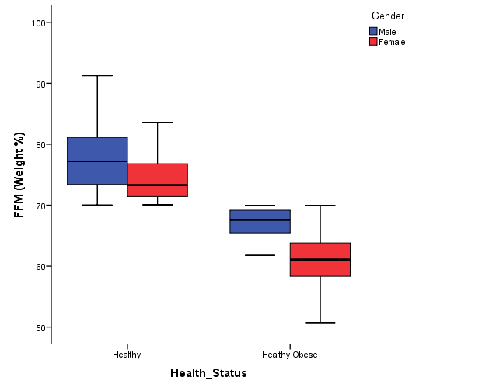
F(3,2547)= 2824.545, p<0.001,
Eta squared =0.76
∗∗
∗∗

Slide 61
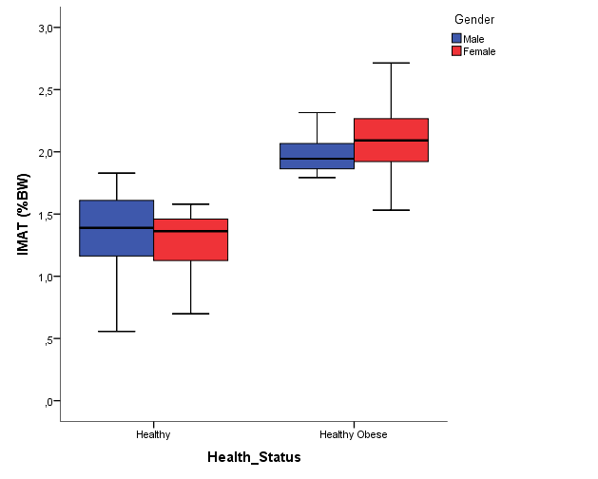
∗∗
∗∗
F(3,2547)= 1679.870, p<0.001,
Eta squared =0.66

Slide 62
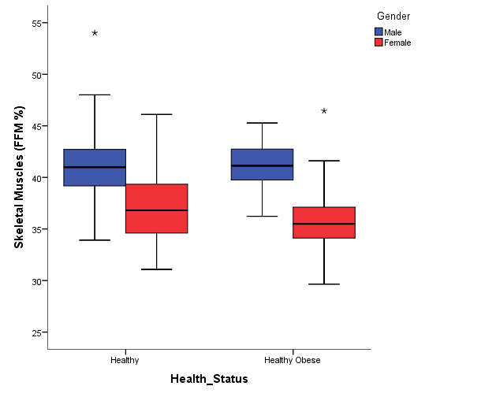
p =0.99
F(3,2547)= 793.640, p<0.001,
Eta squared =0.48
∗∗

Slide 63
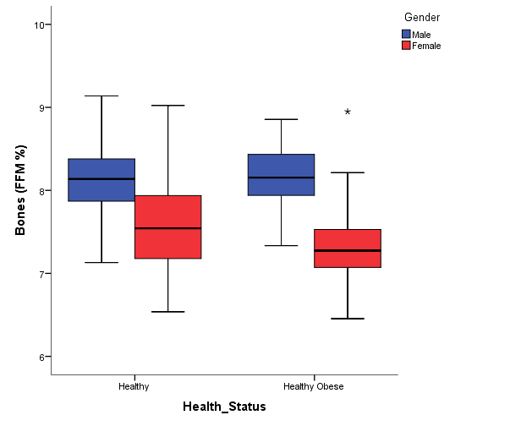
p =0.99
F(3,2547)=
892.223,
p<0.001,
Eta squared
=0.51
∗∗

Slide 64
CONCLUSIONS
“Osteosarcopenic phenotype” is common and exists even in the young and lean people, suggesting an early start of prevention and treatment: “Paradoxic obesity”
“Healthy” overweight or obese populations demonstrate:
Decreased bone mass;
Decreased muscle mass;
Increased am hsCRP concentrations;
Flattening of cortisol circadian rhythm;
MUS
BIA-ACC is a highly potent device that may detect osteosarcopenic phenotypes, and may be used for early intervention.
Future cohort studies are needed to establish the definite causative factors behind the negative relations between fat, bone & muscle mass.

Slide 65
The capacity-load conceptual model
Early life factors
Undernutrition
Short stature
Obesity
Inflammation
Psychosocial stress
Lifestyle factors
Lipogenic diet
Sedentary behavior
Obesity
Inflammation
Psychosocial stress
CSI Syndrome
Capacity for
homeostasis
Challenges to
homeostasis
Capacity
down
Load
up

Slide 66




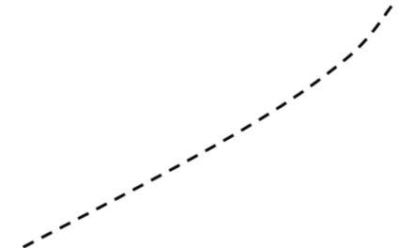


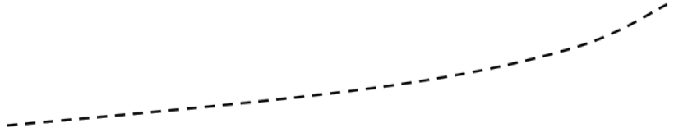



Adulthood
No intervention
Late intervention impactful for
vulnerable groups
Chronic
Noncommunicable
Accumulating
Disease Risk
Childhood &
Adolescence
Late intervention
Mother and Fetus
Earlier intervention improves functional
capacity & responses
to new challenges
Infant
Early intervention
Life course
Developmental epigenetic plasticity
Inadequate response
to stressors

Slide 67
The Endocrine Basis of Stress
Concepts of Complexity vs. Endocrinology
Neuro-Endocrine Mechanisms of the Stress Response
Adverse Effects of Chronic Stress - Pathology
Evaluation of a Stressed Human Subject
Beneficial Effects of Stress Management
Notes:
67

Slide 68
Evaluation/Monitoring of a Stressed Subject
History, MUS, Physical examination
Appropriate questionnaires (PST, Anxiety, Depression, QOL, etc.)
Heart Rate Variability measures (Autonomic nervous system)
Body Composition (Sarcopenia, Visceral fat, IMAT, Bone density)
Biochemical tests (Stress, Inflammation, Metabolic and Aging Markers)
Sleep study
Research tools (EEG, Loreta EEG, HEG (NIRS), Functional Imaging, etc.)
Notes:
68

Slide 69
The Endocrine Basis of Stress
Concepts of Complexity vs. Endocrinology
Neuro-Endocrine Mechanisms of the Stress Response
Adverse Effects of Chronic Stress - Pathology
Evaluation of a Stressed Human Subject
Stress Management-Therapy
Notes:
69

Slide 70
The constituents of Man:
“Φύσις, Εθος, Λόγος”
“Physis, Ethos, Logos”
Genetics, Epigenetics, Reason
(Environment)
Aristotle
4th Century BCE

Slide 71
“Κράτιστον δη προς αλυπίαν φάρμακον ο λόγος και η δια τούτου παρασκευή προς πάσας του βίου μεταβολάς”.
“The best medicine to attain consolation is Logos, and through it the preparation for all the vicissitudes of life”.
Πλούταρχος Plutarch
Notes:
71
Παραμυθητικόν προς Απολλώνιον

Slide 72
The 5 Classic Lifestyle “Musts” for Hyperstatic Resilience
Healthy Nutrition 2
Moderate Exercise 3
Proper Sleep 1
Circadian Regularity
Stress Management
G.P. Chrousos

Slide 73
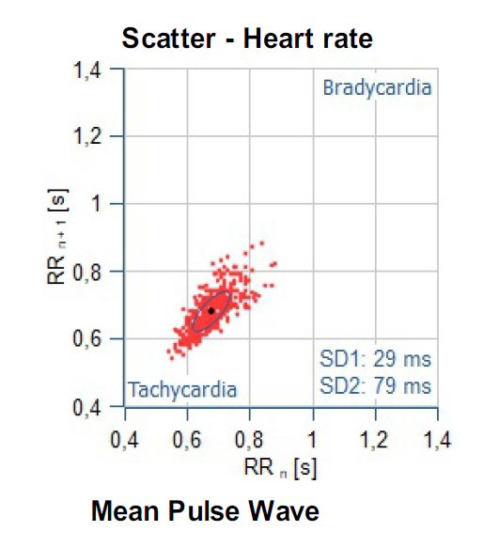
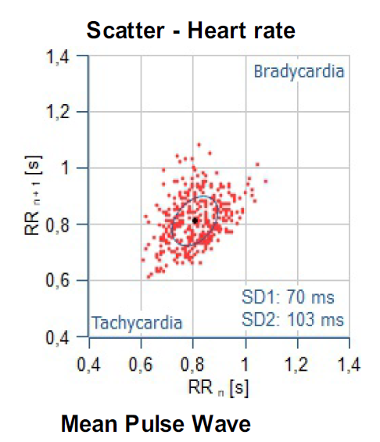
Heart Rate Variability pre- and post stress team management
15/6/2021
9/12/2021

Slide 74
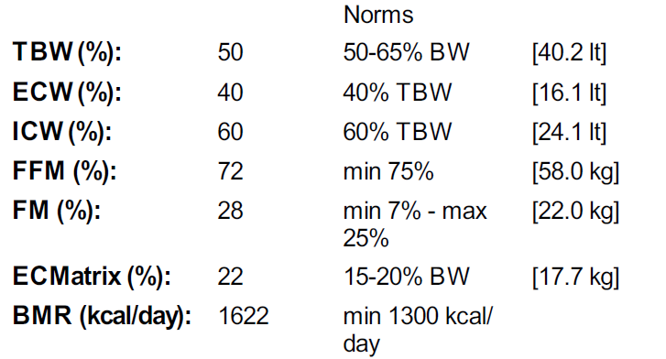
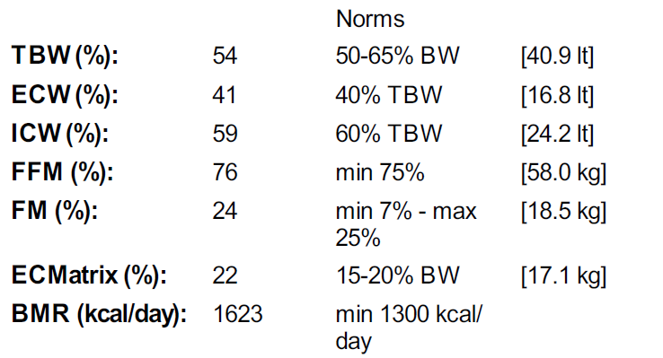
BIA-ACC pre- and post
15/6/2021
9/12/2021

Slide 75
What can we do about stress?
Social prerequisites
Nutrition
Exercise
Sleep
Circadian regularity
Stress Management
Eustress-Effectance-Hormesis-Learning
Environment, Art
Experiencing “Flow”
“Noopedia” methods
“Meaning- in-life”
G.P. Chrousos

Slide 76
Basic Social Prerequisites
Safety, Security
Social Integration
Competence
Authenticity
Autonomy
Environment
G.P. Chrousos
76

Slide 77
Holistic Approach to Stress Management
Lifestyle changes (Daily routine, nutrition, exercise, sleep, social support)
Life skills training/SEL (Problem solving, emotion management, resilience, coping with change, communication skills, etc.)
Relaxation techniques training (Breathing, PMR, TM, Mindfullness, EFT, etc.)
Professional support* (Councelling, PSM, CBT, DBT, ACT, EMDR, etc.)
*Psychology, Psychiatry
Notes:
ACT= Acceptance and Commitmemt Therapy PMR= Progressive Muscular Relaxation SEL= Social Emotional Learning Primordial Sound Meditation, Eye Movement esensitization Reprocessing

