Slide 1
Επείγουσες καταστάσεις στην Ογκολογία
Οικονομοπούλου Παναγιώτα
Παθολόγος-Ογκολόγος
Επιμελήτρια Α’, Β΄Π.Π.Κ
Π.Γ.Ν. «Αττικόν»

Slide 2
Τι είναι επείγουσα κατάσταση στην ογκολογία;
Μια κλινική κατάσταση στην ογκολογία που είναι αποτέλεσμα μιας μεταβολικής, νευρολογικής, καρδαγγειακής, αιματολογικής ή/και λοιμώδους αλλαγής που προκαλείται από τον καρκίνο και η θεραπεία της απαιτεί άμεση παρέμβαση με σκοπό να αποτραπεί ο θάνατος ή η μείωση της ποιότητας ζωής

Slide 3
Σύστημα ή αίτιο | Επείγουσα κατάσταση στην ογκολογία
Καρδαγγειακό σύστημα | Καρδιακός επιπωματισμός Σύνδρομο άνω κοίλης φλέβας
Κεντρικό Νευρικό Σύστημα (ΚΝΣ) | Συμπίεση νωτιαίου μυελού Αυξημένη ενδοκράνια πίεση
Γαστρεντερικό σύστημα | Εντερική απόφραξη Διάτρηση εντέρου Ασκίτης υπό τάση Διάτρηση οισοφάγου
Αιματολογικό σύστημα | Διάχυτη Ενδαγγειακή Πήξη Λευκόσταση
Αναπνευστικό σύστημα | Απόφραξη αεραγωγού Πνευμοθώρακας Μεγάλη πλευριτική συλλογή Πνευμονική εμβολή
Μυοσκελετικό σύστημα | Παθολογικό κάταγμα

Slide 4
Λοιμώδη αίτια | Εμπύρετος ουδετεροπενία
Μεταβολικά αίτια | Υπερασβεστιαιμία Υπογλυκαιμία Σύνδρομο λύσης όγκου
Σχετιζόμενα με ανοσοθεραπεία | Πνευμονίτιδα Κολίτιδα Μυοσίτιδα Ηπατίτιδα
Διάφορα | Αποφρακτική ουροπάθεια Οξύ άλγος ‘Έμετοι Βλεννογονίτιδα

Slide 5
Περιστατικό 1
68 ετών, άνδρας με ιστορικό αρτηριακής υπέρτασης, παρουσιάζεται στον παθολόγο με ιστορικό άλγους οσφύος από μηνός που δεν υφίεται με παρακεταμόλη.
Χαρακτηριστικά άλγους: νυχτερινές αφυπνίσεις, αιμωδίες και ριπές διαξιφιστικού άλγους σε δεξιό κάτω άκρο
Κλινική εξέταση: τοπικό άλγος στον Ο1, άλγος κατά την έγερση του ΔΕ κάτω άκρου
Εργαστ εξετάσεις: εντός φυσιολογικών ορίων

Slide 6
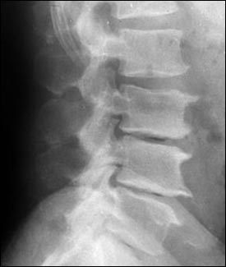
Περιστατικό 1
Διάγνωση:
Οσφυοϊσχιαλγία
Θεραπεία: ΜΣΑΦ, ξεκούραση

Slide 7
Περιστατικό 1
Επιμονή άλγους
Ο ασθενής παρουσιάζει αστάθεια βάδισης και μυϊκή αδυναμία κάτω άκρων
Επισκέπτεται το ΤΕΠ
Κλιν εξέταση: μυϊκή αδυναμία κάτω άκρων άμφω

Slide 8
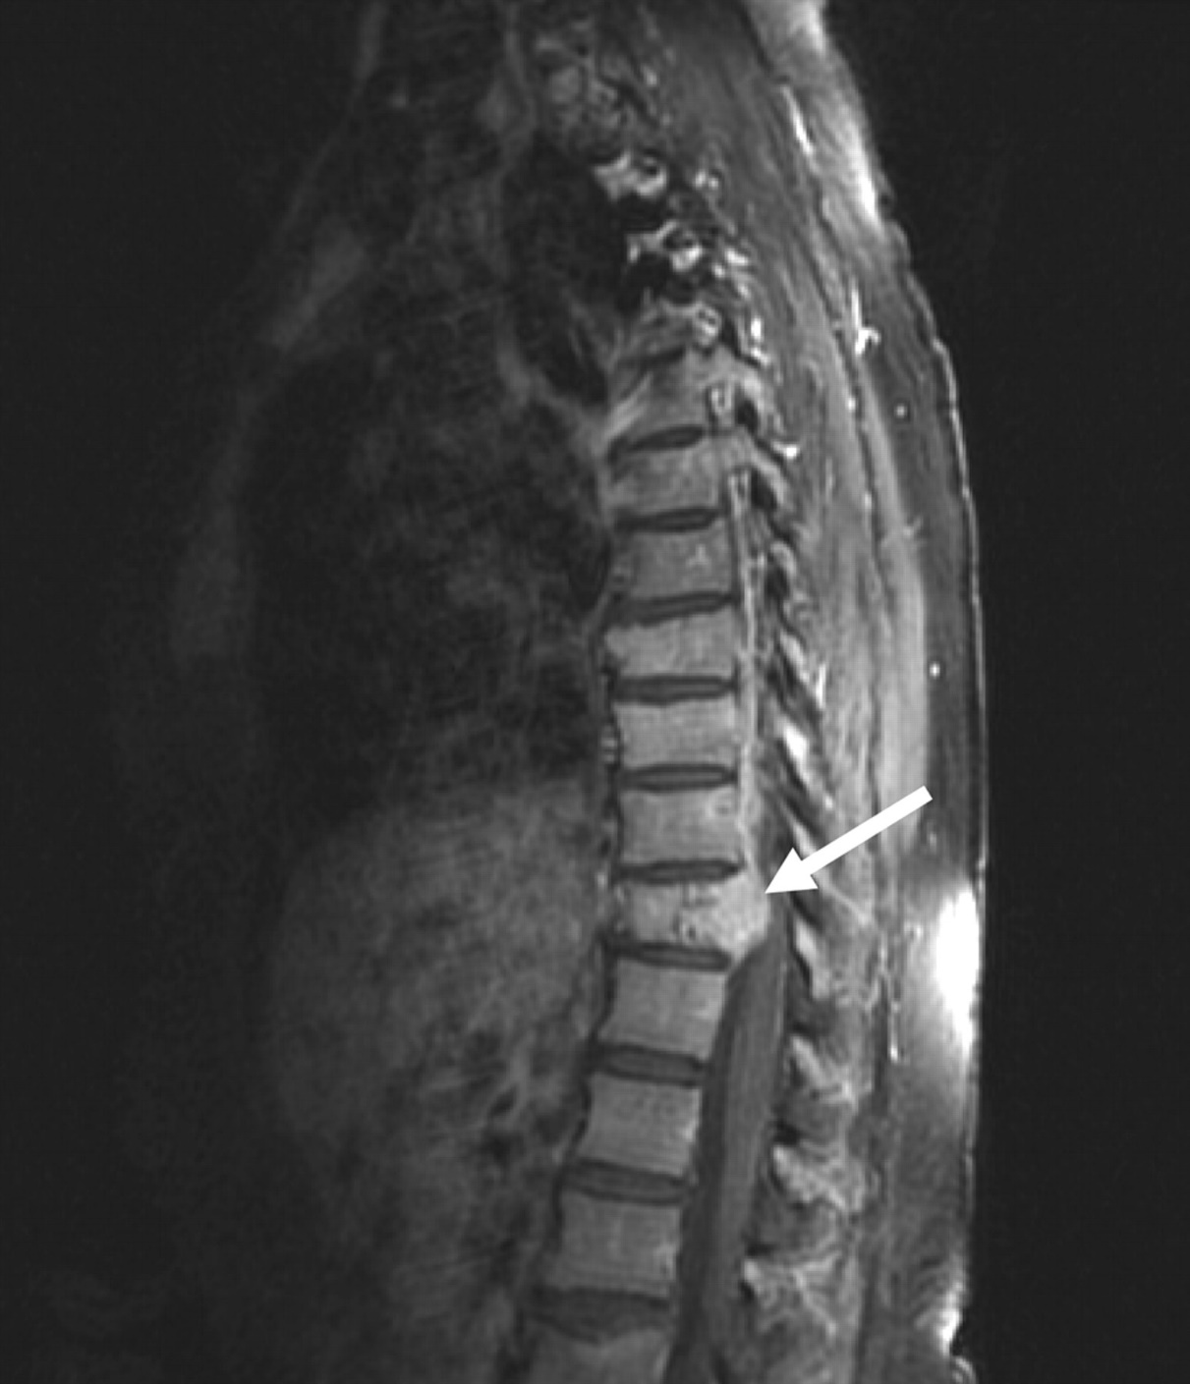

Slide 9
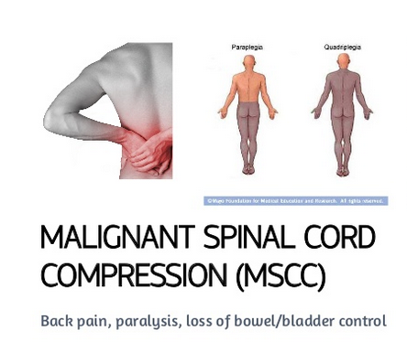

Slide 10
Spinal cord compression is the 2nd most common neurological complication in cancer pts after brain metastases.
Affects approximately 5% of cancer pts.
Haematogenous vertebral corpus metastasis is the most common mechanism in adults.
Differential diagnosis: musculoskeletal diseases, infectious diseases.
MRI is the gold standard method for SCC diagnosis.

Slide 11
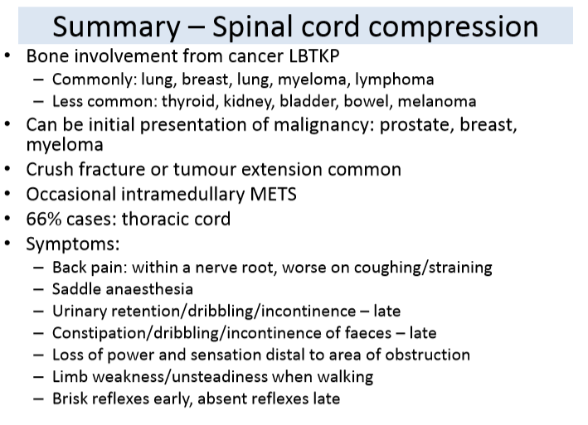
Notes:
Συχνα σε …., 66% θωρακική μοίρα ΣΣ,

Slide 12
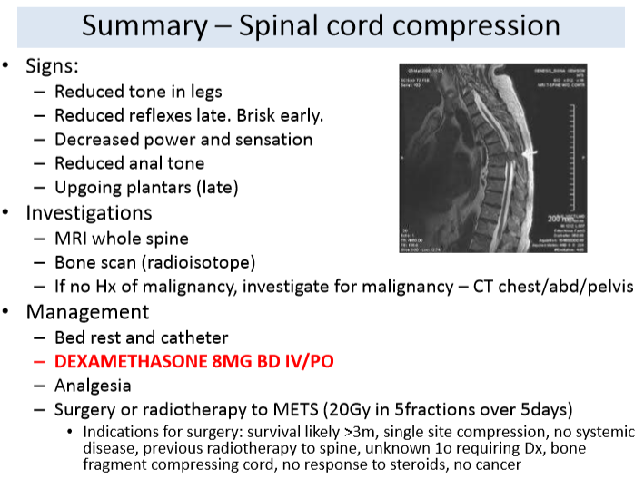

Slide 13
Glucocorticoids
Glucocorticoids are the first-line treatment for most patients with SCC.
GCs reduce inflammation and vasogenic oedema, and also may show antitumoural effects in several types of tumour.
High-dose corticosteroid treatment with 96 mg i.v. dexamethasone, followed by 24 mg qid for 3 days, and then tapered over 10 days is recommended for pts with paraparesis or paraplegia.
For pts with pain but minimal neurological dysfunction, low-dose treatment, with 10mg dexamethasone i.v. bolus, followed by 16mg daily is recommended.

Slide 14
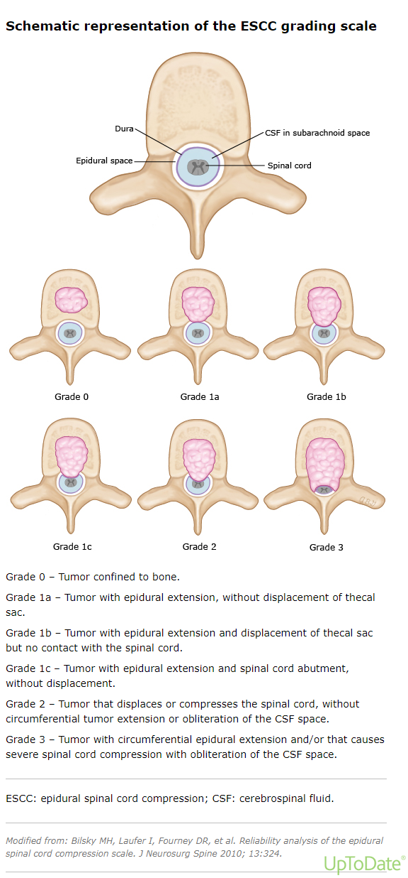

Slide 15
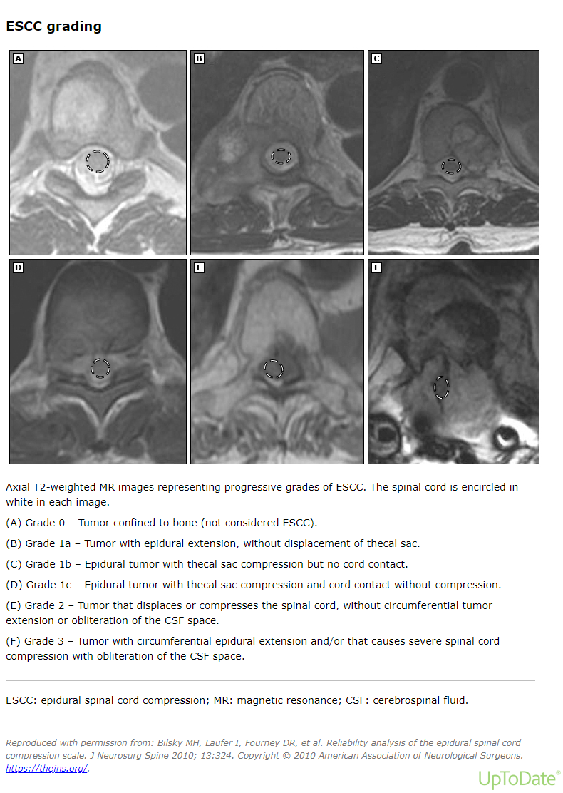

Slide 16
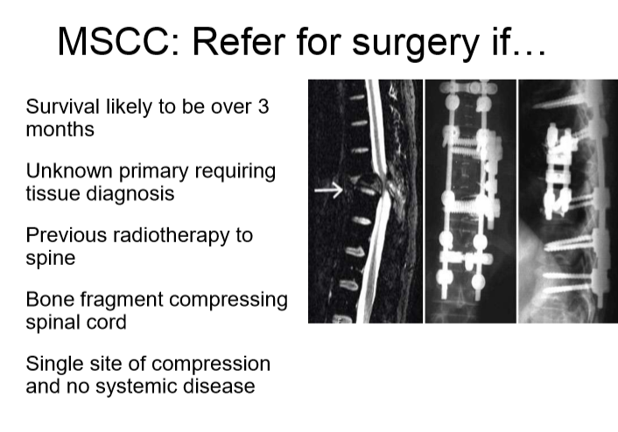

Slide 17
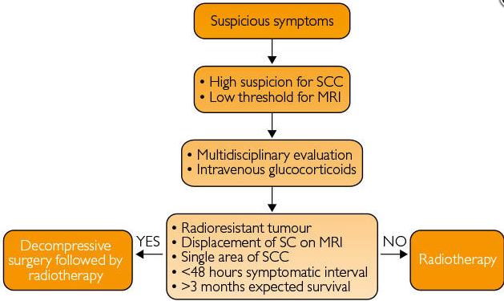
Management

Slide 18
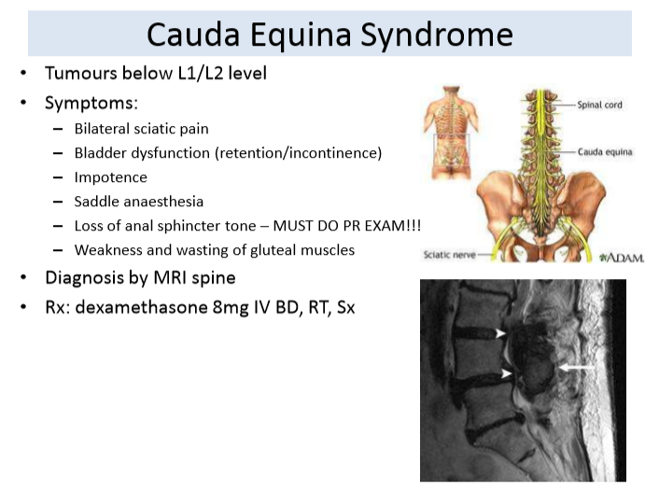

Slide 19
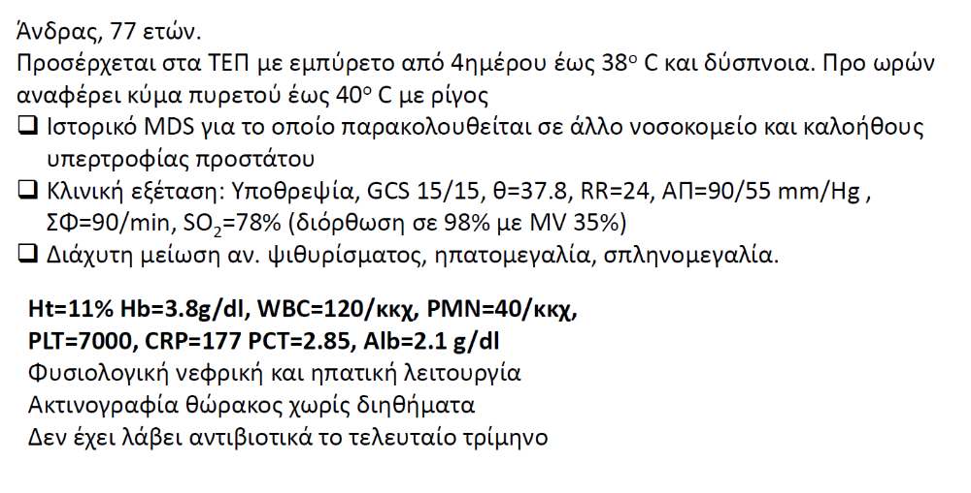
Περιστατικό 2
Hb=7.2 mg/dl, PLts=30000, WBC=500 (neuts=150)

Slide 20
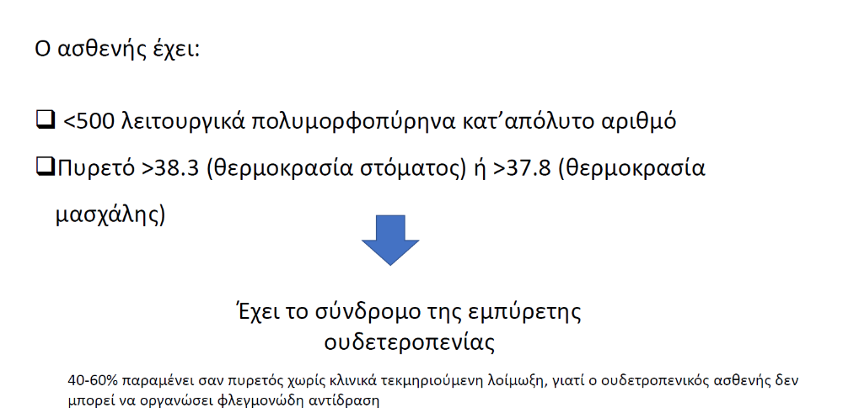

Slide 21
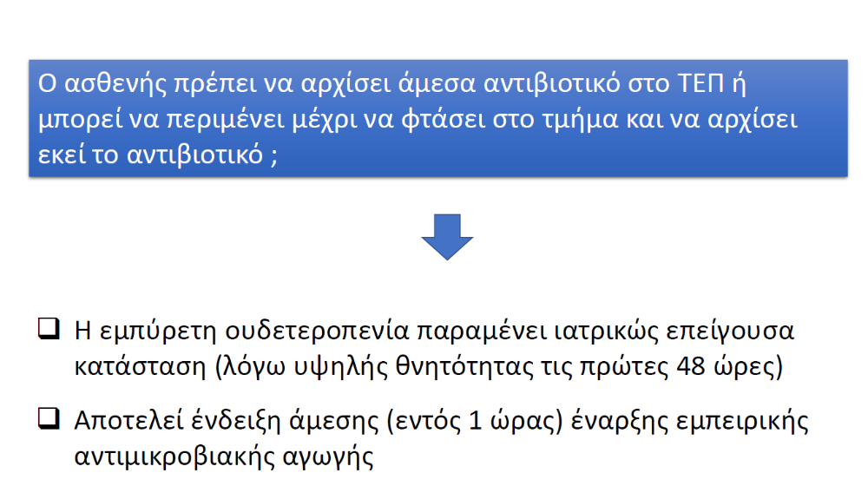

Slide 22
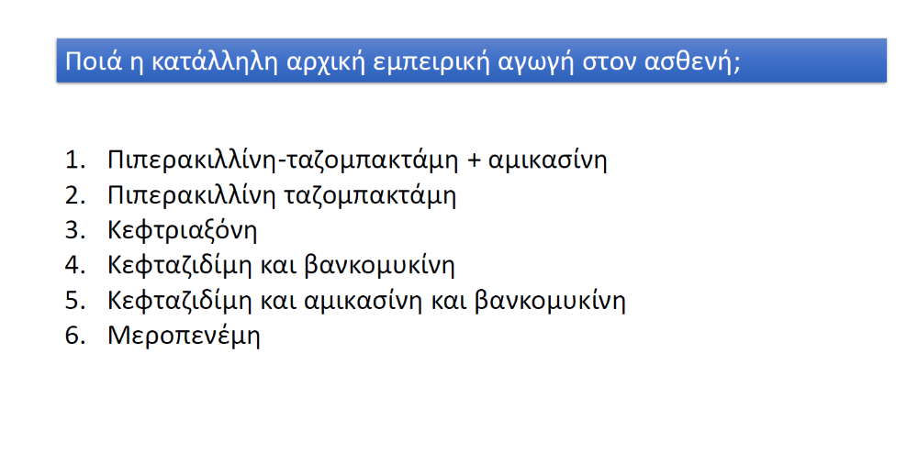

Slide 23
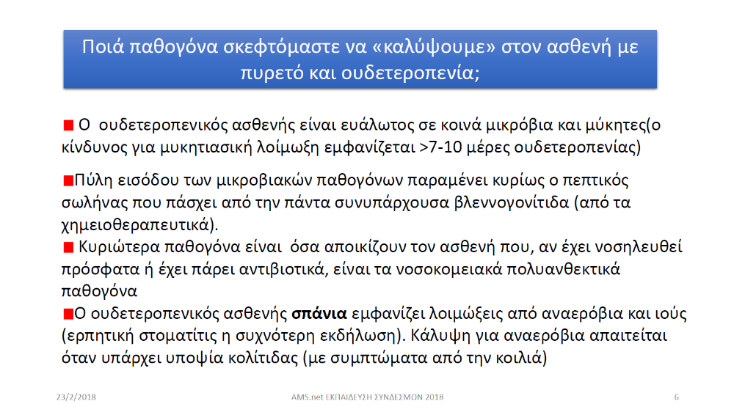

Slide 24
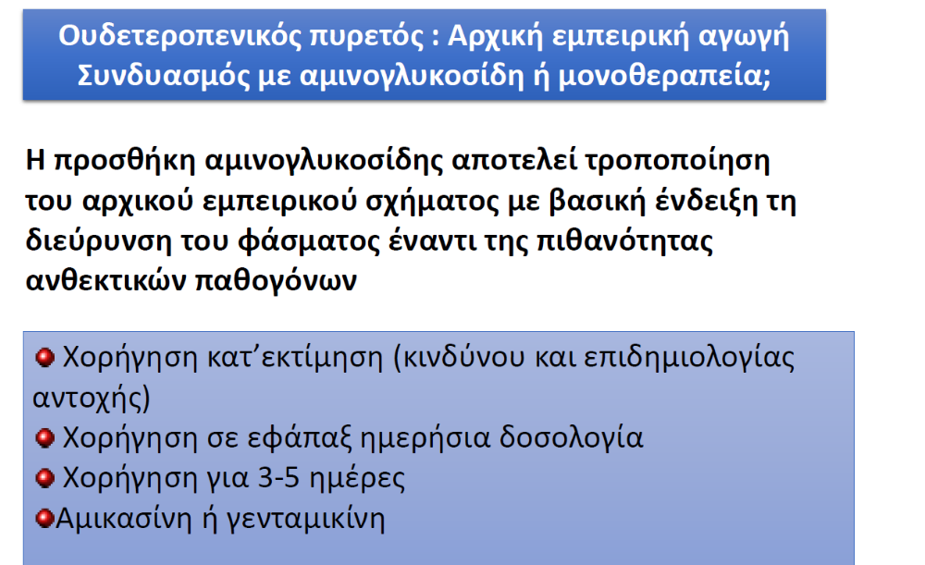

Slide 25
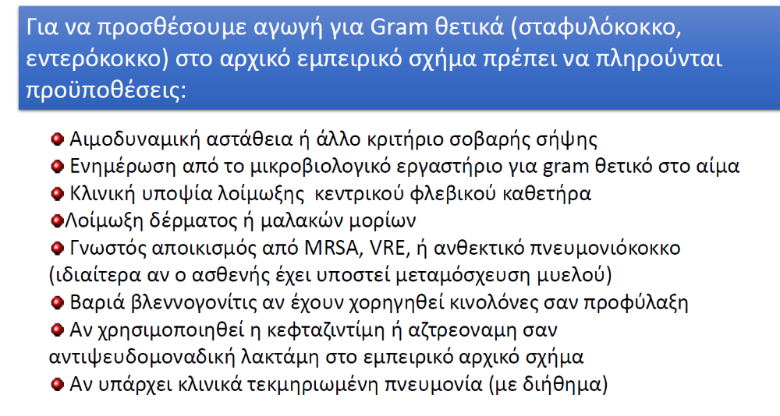

Slide 26
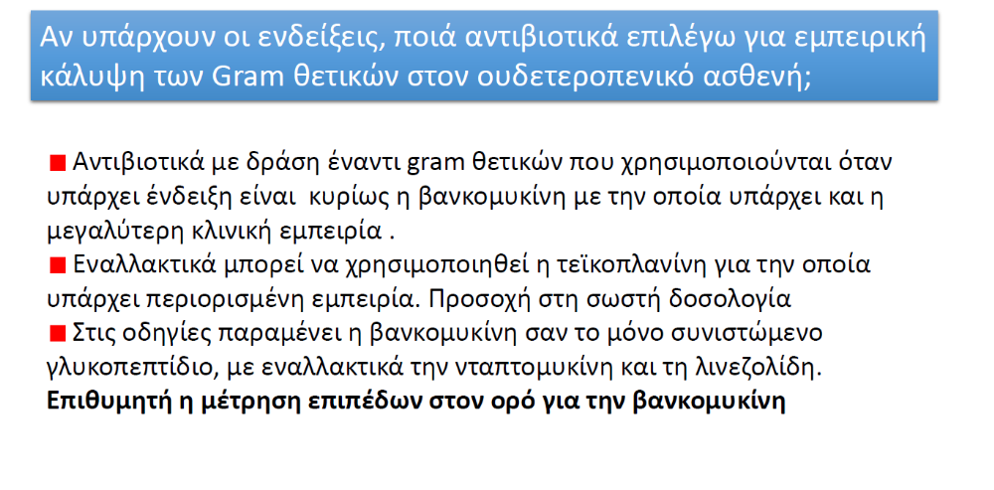

Slide 27
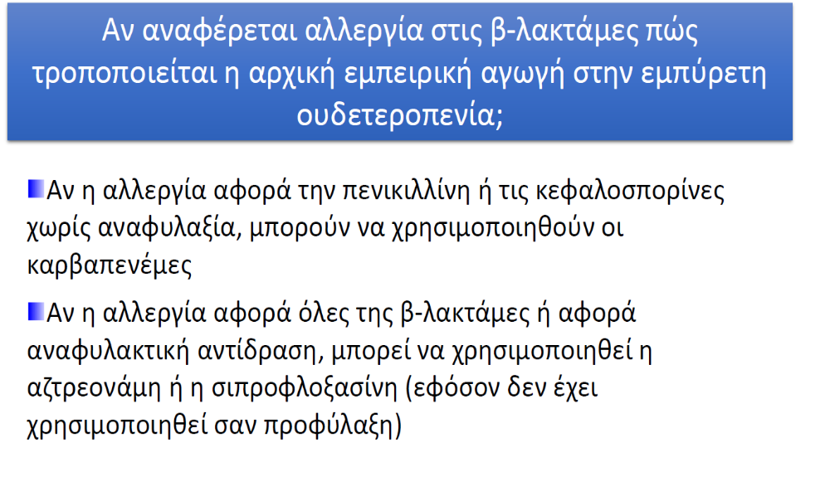

Slide 28
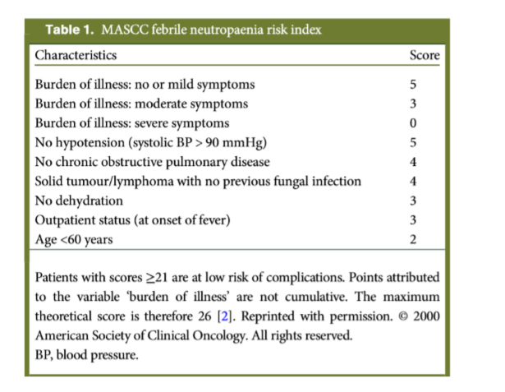
Notes:
Σκόρ κινδύνου να παρουσιάσουν οι ασθενείς επιπλοκές

Slide 29
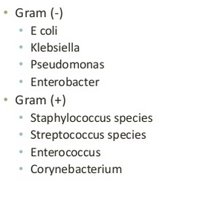
Bacterial infection

Slide 30
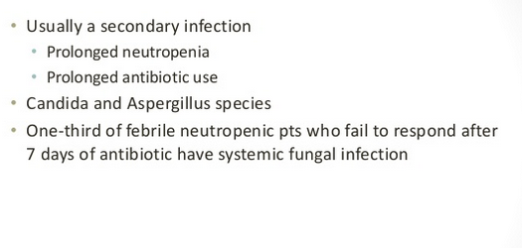
Fungal infection

Slide 31
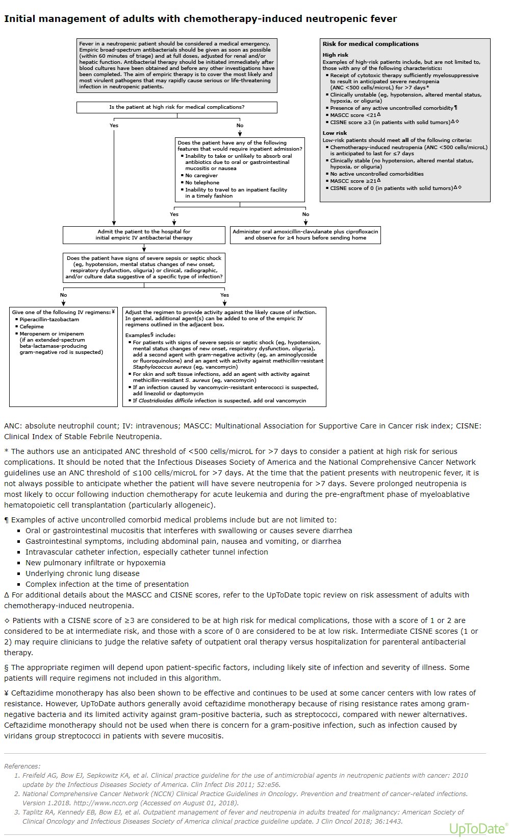

Slide 32
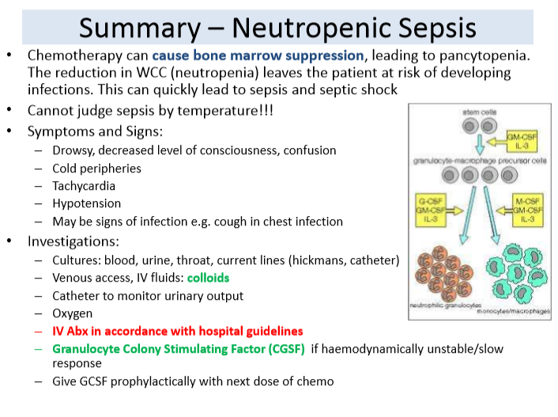

Slide 33
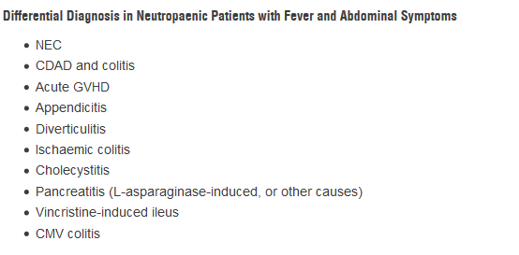
Neutropenic Fever and Abdominal Pain

Slide 34
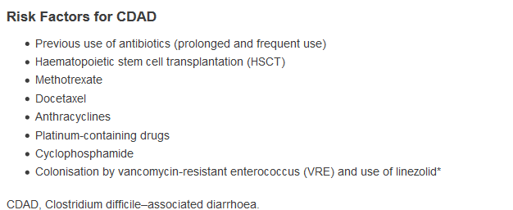
Clostiridium difficile-associated diarrhea

Slide 35
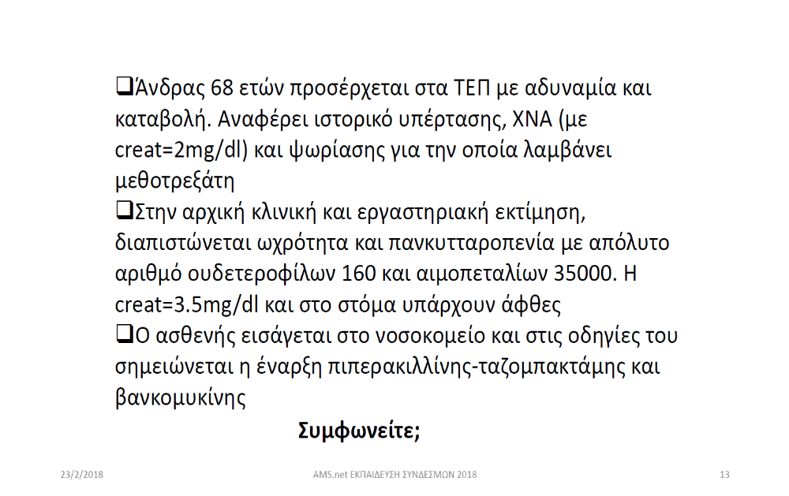

Slide 36
Περιστατικό 3
80 ετών, ζει μόνη της
Παρουσιάζεται με εμέτους, κόπωση, δυσκοιλιότητα, απώλεια ΣΒ, διάχυτο κοιλιακό άλγος
Ιστορικό: καρκίνος μαστού με οστικές β εντοπίσεις υπό αναστραζόλη και διφωσφονικά, Ιστορικό ΠΕ υπό abixaban, ΑΥ υπό Πενιδοπρίλη
Κλινική εξέταση: δακτυλική αρνητική
Λοιπά: δέρμα με ελαττωμένη σπαργή, ΑΠ=110/80, απύρετη
Κοιλιά: διάχυτη ευαισθησία, παρόντες εντερικοί ήχοι

Slide 37
Περιστατικό 3
Γεν αιμ: Hb=13, WBC=10000, Plts=140000
Βιοχ: Ca++=14 mg/dl , Cr=1.8, Mg=1.8, Na=130, K=3.3, CRP=10
Ακτινογραφία κοιλίας: υδραερικά επίπεδα ως επί ειλεού παχέος εντέρου

Slide 38
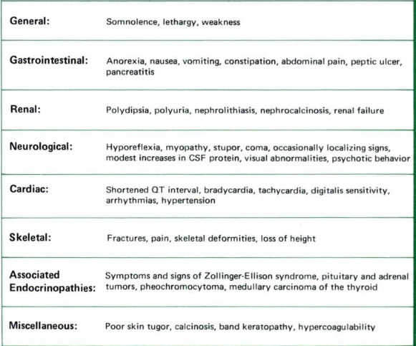
Symptoms-Hypercalcemia

Slide 39
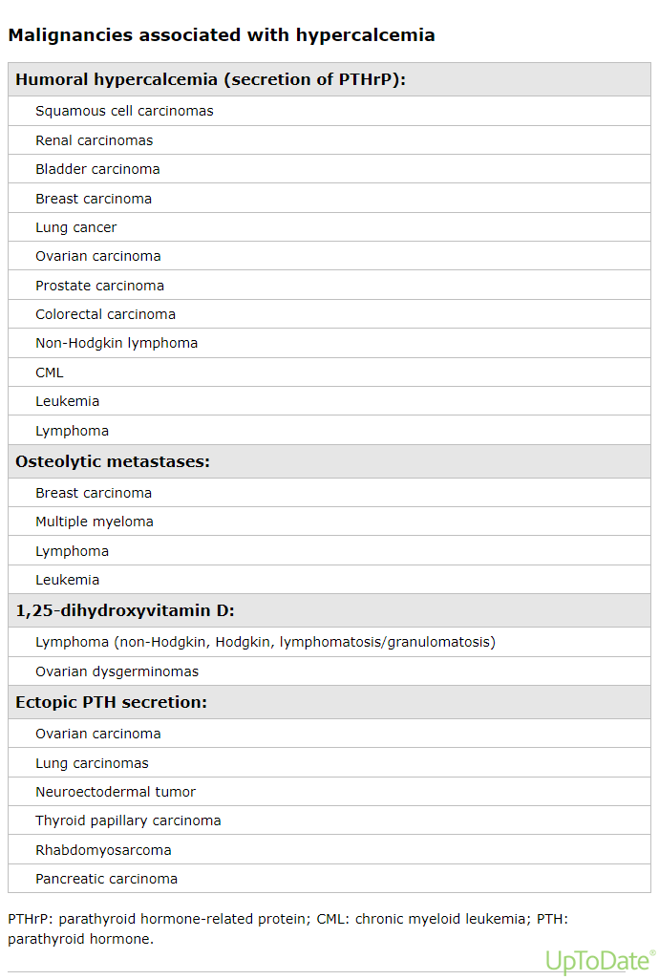

Slide 40
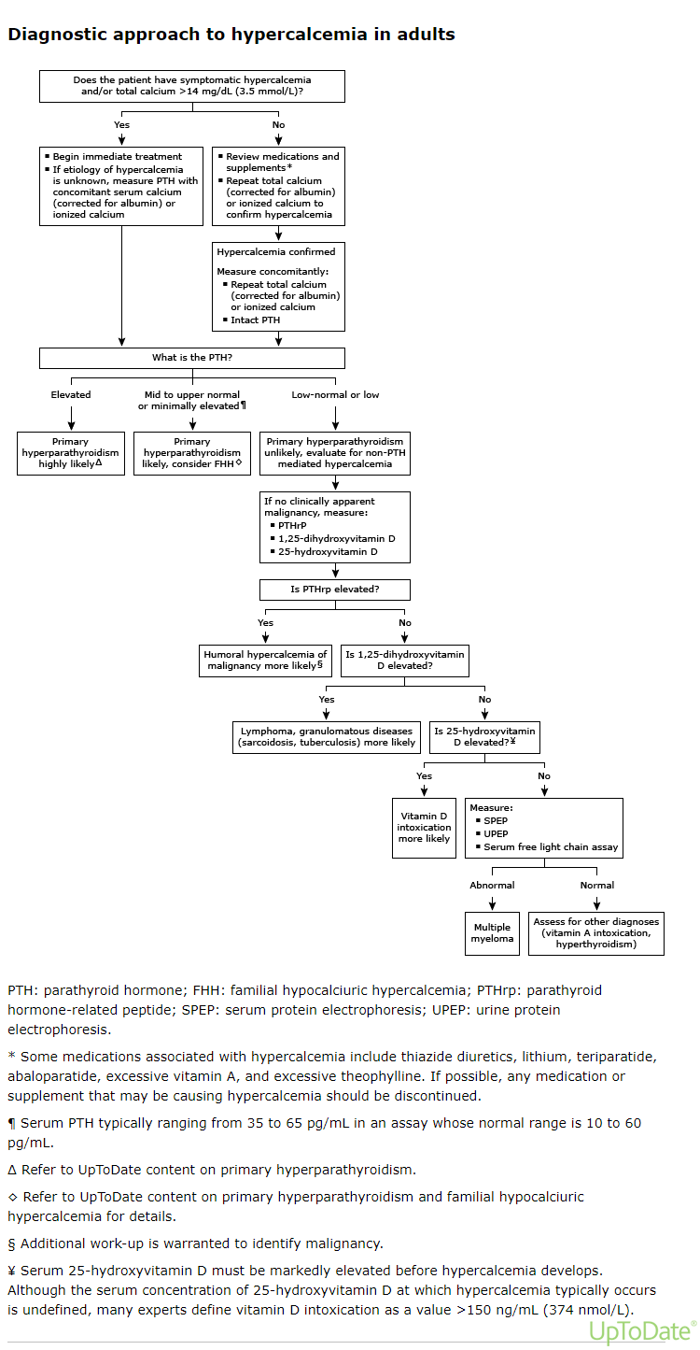

Slide 41
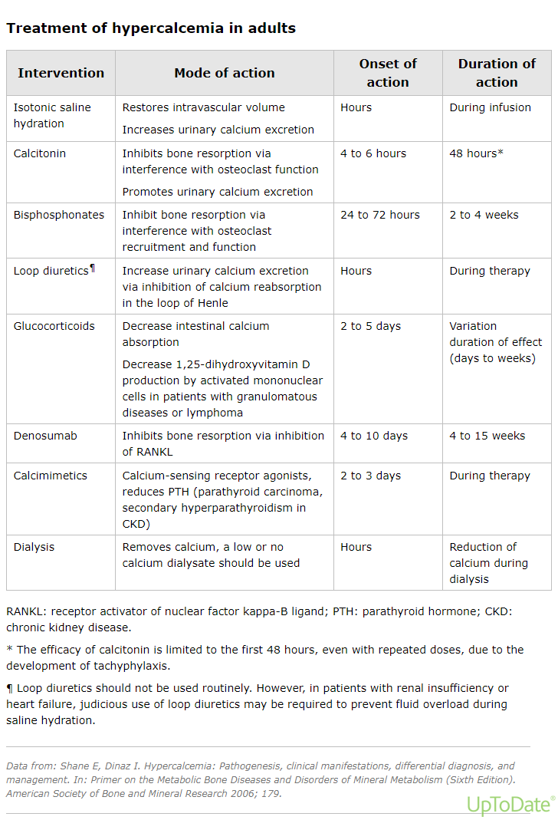

Slide 42


Slide 43
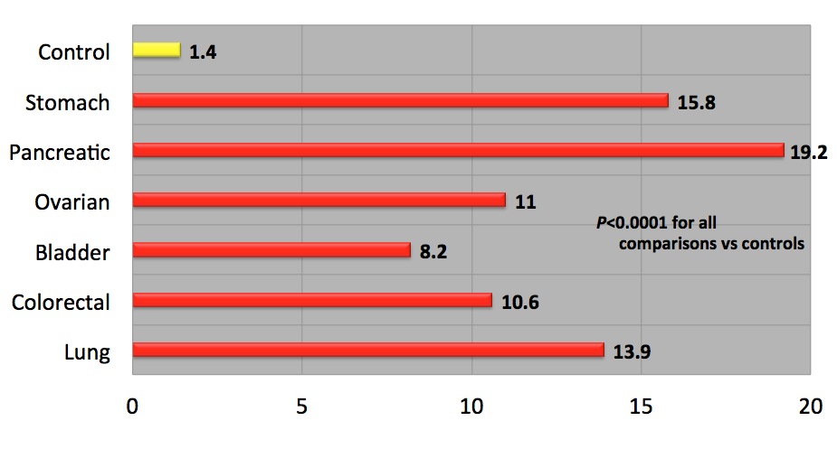
Risk of VTE by Primary Site
Khorana AA et al, Cancer 2012

Slide 44
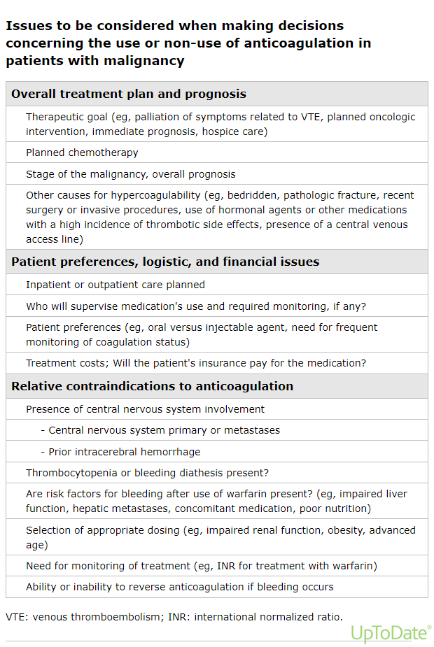

Slide 45
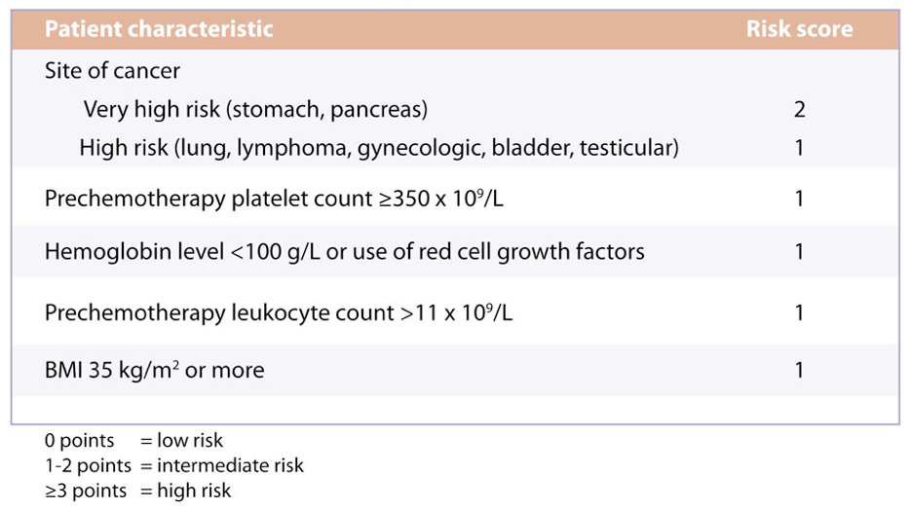
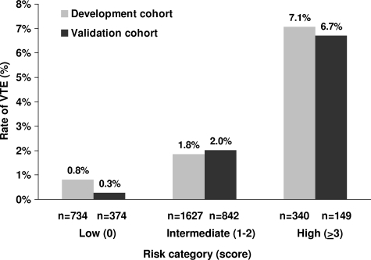
Khorana predictive model for chemotherapy-associated VTE
Risk Score Development and Validation
Developed from a cohort of 2,701 patients initiating chemotherapy in the outpatient setting with a validation cohort of 1,365 patients
Blood. 2008;111:4902-4907
Notes:
Using data from the Awareness of Neutropenia in Chemotherapy (ANC) Study Group Registry, Khorana and colleagues developed a simple model for predicting chemotherapy-associated VTE using baseline clinical and laboratory variables
Five independent risk factors were identified that predicted for symptomatic VTE during the first four cycles of chemotherapy
VTE risk-assessment model has been proposed that can be applied to an individual patient who is receiving chemotherapy in an outpatient setting.
The major advantage of this model is the easy availability of these common clinical markers, while the major limitation is the generalizability of the results
Because the registry contained only a small number of patients with some tumor types (e.g., brain or renal cancers) and the performance status of the patients was excellent, the model may not be predictive of VTE development in some tumor types or in those who have advanced disease and a poor performance status.
the model is also unable to integrate additional risk factors that are subsequently identified, such as new therapies (e.g., bevacizumab or thalidomide).

Slide 46
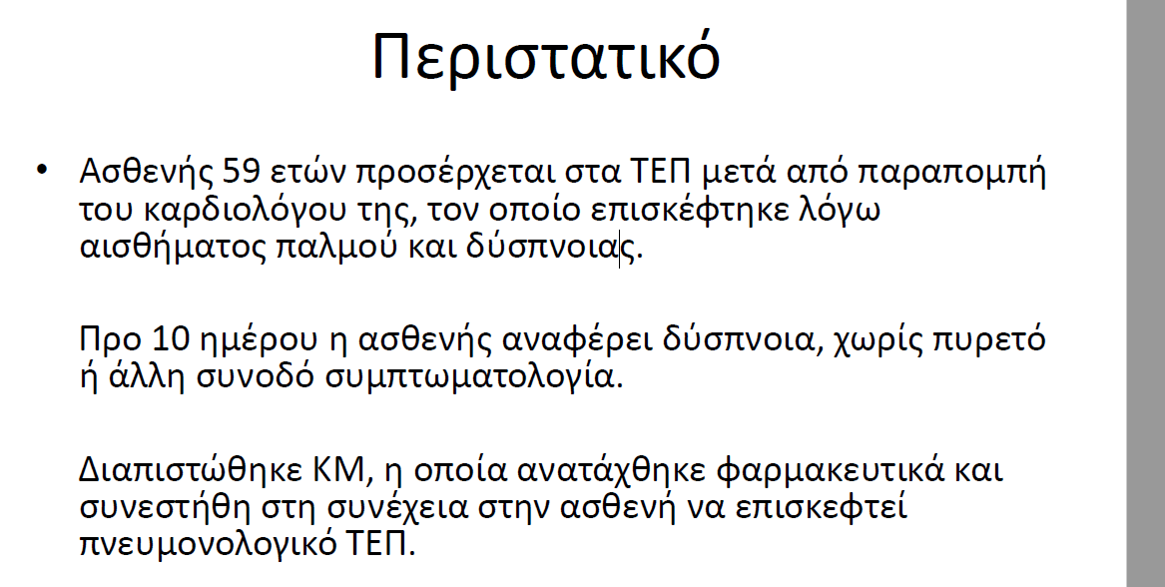
Α/α: AY, πρώην καπνίστρια, Ca παχέος εντέρου υπό ΧΜΘ

Slide 47
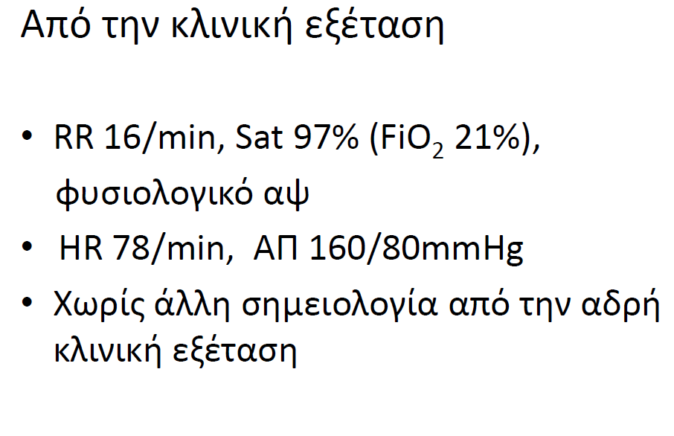

Slide 48
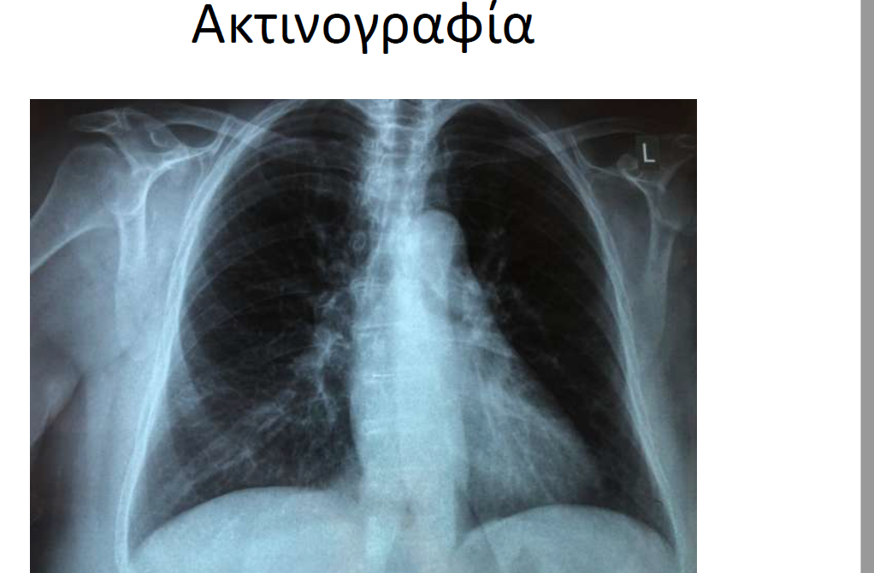

Slide 49
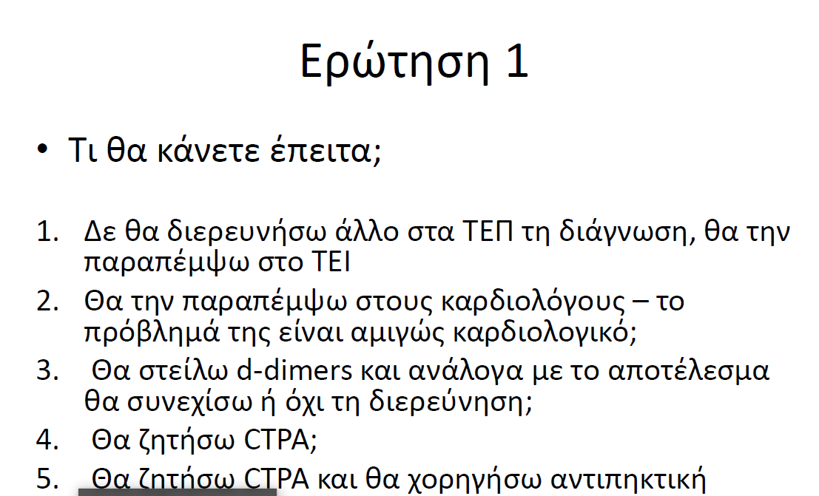

Slide 50
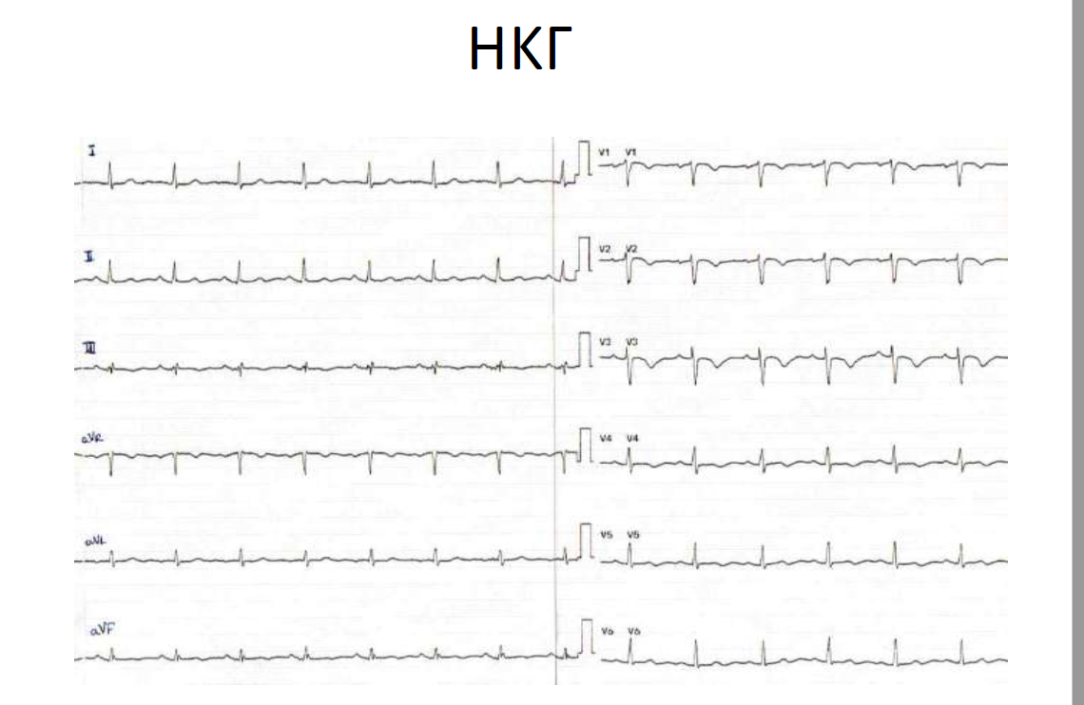

Slide 51
Causes of Dyspnoea
Directly related to cancer
Lung involvement
Carcinomatous lymphangitis
Pleural involvement e.g effusion
Pericardial effusion
Superior vena cava syndrome
Atelectasis
Indirectly related to cancer
Pulmonary embolus
Infection
Electrolyte abnormalities
Related to cancer therapy
RT pneumonitis
chemotherapy or TKIs or IO-induced pneumonitis
Chemotherapy induced cardiomyopathy

Slide 52
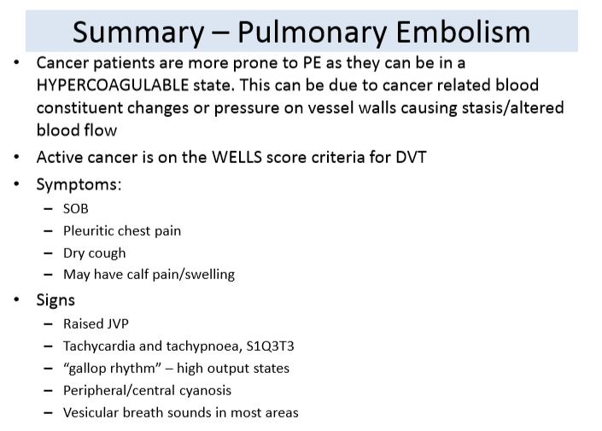

Slide 53
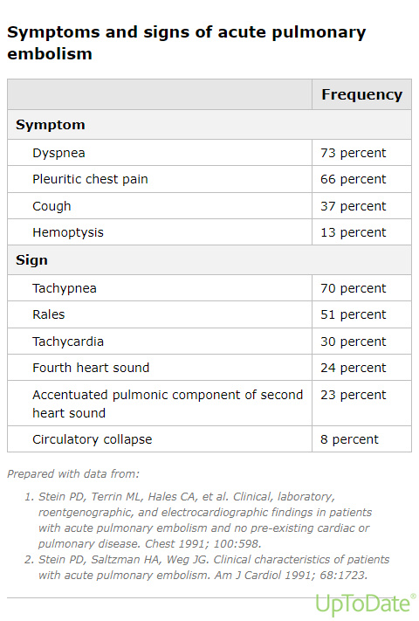

Slide 54
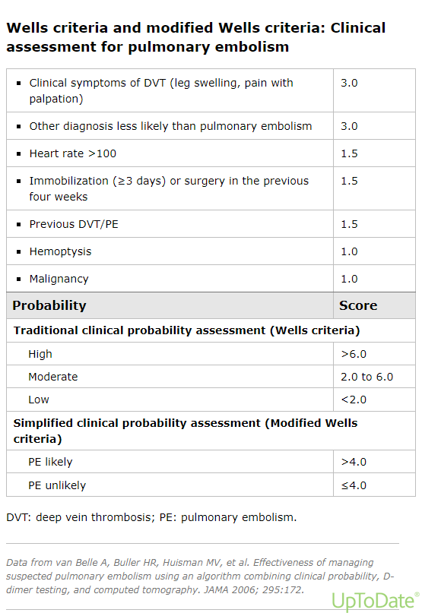

Slide 55
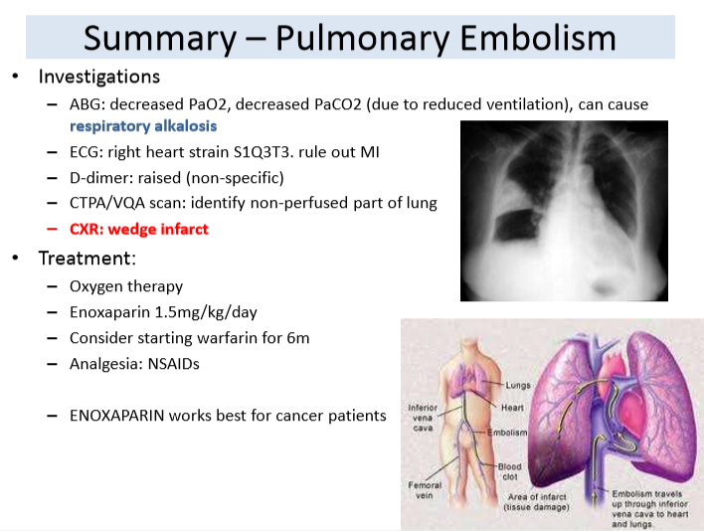

Slide 56
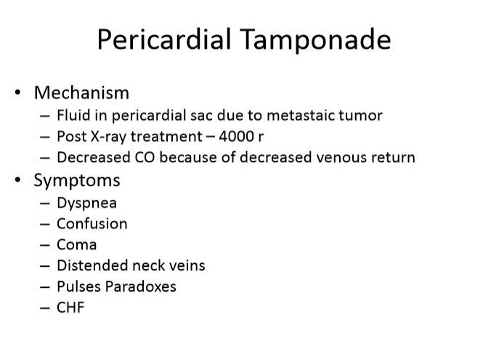

Slide 57
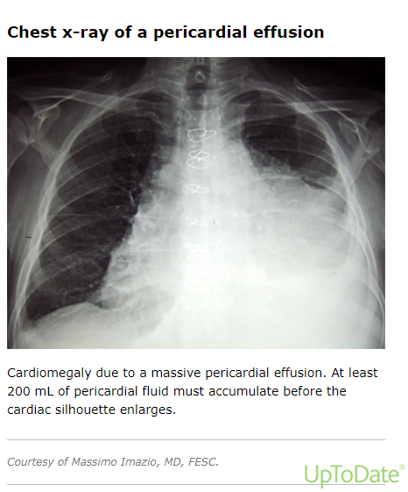

Slide 58
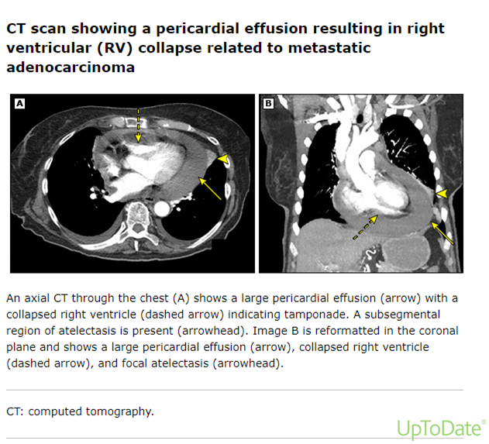

Slide 59
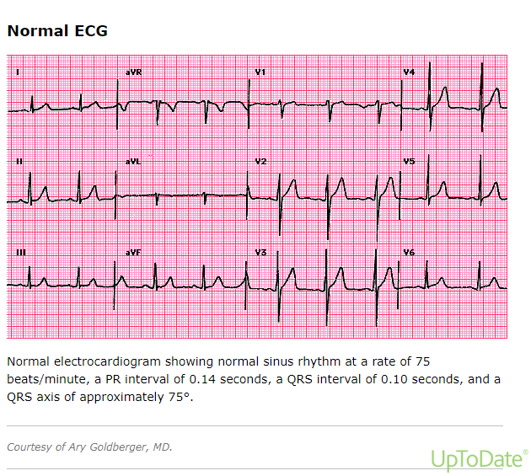

Slide 60
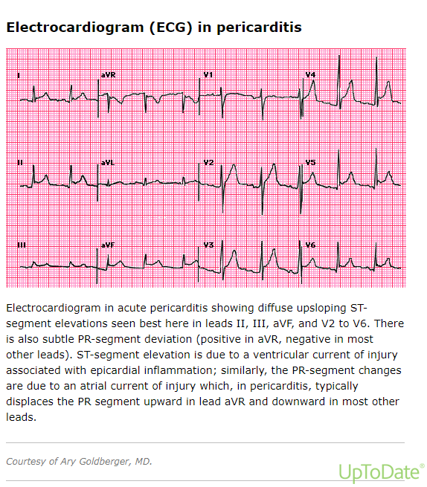

Slide 61
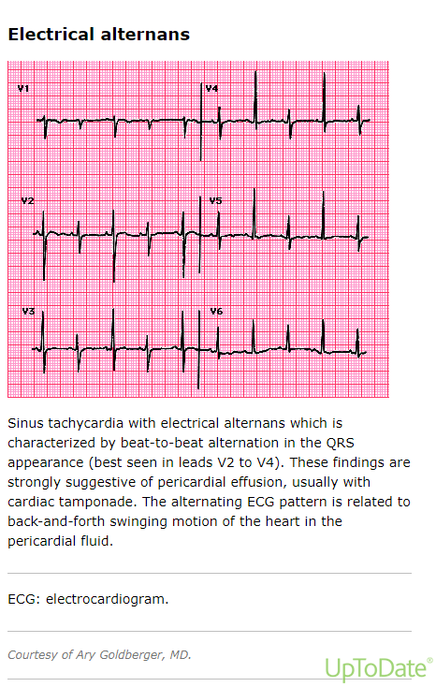

Slide 62


Slide 63


Slide 64


Slide 65


Slide 66


Slide 67


Slide 68


Slide 69

Management Algorithm

Slide 70


Slide 71


Slide 72


Slide 73

Cairo-Bishop criteria

Slide 74

Notes:
Προδιαθεσικοι παραγοντες

Slide 75

Risk Classification of Tumour Types

Slide 76

Prevention

Slide 77
Chemotherapy-related Heart Failure
A decrease in cardiac Left Ventricular ejection, that is either global or more severe in the septum
Symptoms of congestive heart failure
Decline in LVEF of at least 5% bellow 55% with accompanying signs or symptoms of CHF, or a decline in LVEF of at least 10% to below 55% without accompanying signs or symptoms.
Type I cardiac dysfunction, induced by cytotoxic agents due to oxidative stress on the cardiac muscle. It is irreversible and dose-related. e.g. Anthracyclines
Type II, typically induced by biological agents, is associated with reversible myocardial dysfanction and not dose-related.

Slide 78
Antineoplastic Drugs Associated with LVD
Compound | incidence
Type I agents Doxorubicin 400mg/m2 Doxorubicin 550mg/m2 Epirubicin Liposomal anthracyclines Mitoxantrone >150mg/m2 Cyclophosphamide (high dose) Ifosfamide | 7-26% 18-48% 0.9-3.3% 2% 2.6% 7-28% 17%
Type II agents Trastuzumab Lapatinib Sunitinib Bevacizumab Imatinib Trametinib | 2-27% 1.5-2.2% 2-11% 1.7-3% 0.5-1.7% 5-7%

Slide 79


Slide 80
Antidotes
Dexrazoxane has been approved for the treatment of anthracycline extravasation. The first infusion (1000mg/m2) should be started before 6 h following extravasation.
DMSO is an appropriate treatment for the extravasation of cisplatin, dactinomycin, doxorubicin, epirubicin, mitomycin C and mitoxantrone. DMSO is an organic solvent,which acts as a potent radical scavenger by speeding up penetration of the extravasated drug into the adjacent tissue, thus leading to local dilution of the substance.
Hyaluronidase for vinca alkaloid extravasation.
Surgical intervation

Slide 81

Immunotherapy

Slide 82
The blockade of cytotoxic T-lymphocyte antigen 4 (CTLA-4) and programmed cell death protein 1 (PD-1)/programmed death-ligand 1 (PD-L1) is associated with a unique spectrum of immune-related adverse events (irAEs) related to T cell activation. (Haanen et al 2017)

Slide 83


Slide 84

ICP AND irAE

Slide 85

Incidence of irAEs

Slide 86


Slide 87

irAE can be fatal!!

Slide 88
Gastrointestinal irAEs
Diarrhoea
Occurs in 33% of pts treated with ipilimumab.
Colitis
Occurs in 8-22% of pts treated with ipilimumab.
After 6 weeks of treatment (5-10 weeks into treatment)
Affects the descending colon more often than other parts of the bowel. Sigmoidoscopy is generally sufficient to make the diagnosis.
Abdominal pain, cramping, change in bowel habits, mucus or blood in stool, diarrhoea, vomiting, weight loss and fever. Extra-intestinal manifestation are commonly associated.
D/D: infection with Cl. Difficile and other infections
Ulcerative epithelial defect (35.3%), lymphocytic (64.7%), neutrophilic (52.9%) infiltrates, or both(35.3%). Neutrophilic inflammation is predominantly associated with cryptitis and crypt abscesses.
anti-CTLA-4 > anti-PD-1

Slide 89
Gastrointestinal irAEs
Hepatitis
After 8-12 weeks of treatment. Occurs in 5-10% (gr3-4 in 1-2%) of pts treated with monotherapy and in 25-30% (gr 3 in 15%) of pts treated with combination.
Grade 3 hepatitis is more frequently associated with nivolumab or pembrolizumab.
Usually asymptomatic (occasionally fever), elevation in serum levels of ALT, AST. Total BIL is rarely elevated.
Important to evaluate liver function tests for Hy’s Law to rule out potential of drug-induced liver injury.
Viral hepatitis, liver metastasis, alcohol and other drug-specific toxic reactions should be eliminated.
Biopsy: panlobular hepatitis with prominent perivenular infiltrate with endothelialitis
Pancreatitis
1-2%
Anti-pancreas antibodies- IgG4
Asymptomatic increase in the levels of amylase and lipase, negative CT.

Slide 90
Pulmonary irAEs
Pneumonitis
Is the most common pulmonary irAE
Sings and symptoms: Dry cough, progressive shortness of breath, fine inspiratory crakles, tachypnoea, hypoxia, chest pain, fever, radiographic changes on X-ray or CT scan. At an early stage, pneumonitis may be asymptomatic!
Cases have been reported as early as 1 week after drug initiation, but also long after cessation of immunotherapy.
Immune-mediated pneumonitis has been described in<10% of pts receiving anti-PD-1/anti-PD-L1 therapy. With Durvalumab, the incidence rate was 1%.
~ipilimumab < nivolumab, pembrolizumab
Sarcoidosis

Slide 91



Slide 92


Slide 93
Cardiac toxicities
Rare cases of cardiac toxicities have been reported with ICIs. Recent cases of myocarditis and myositis have been reported with combined ICIs.
Rare but potentially fatal complication
Clinical presentations ranging from asymptomatic cardiac biomarker elevation to heart failure, arrhythmia and cardiogenic shock.

Slide 94


Slide 95


