Slide 1



GIST management
Ι.Π.Μπουκοβίνας MD,PhD, PharmaD
Παθολόγος Ογκολόγος
ESMO SARCOMA FACULTY- Πρόεδρος ΕΟΣΣΟ
ibouk@otenet.gr
Notes:
Merhaba
Tünaydın: Good afternoon
İyi akşamlar EE ahk-shahm-LAHR

Slide 2
Overview
The key milestones in management of unresectable or metastatic /adjuvant GIST and updates to the treatment algorithm
Treatment options along the disease continum of care from the first line to fourth line treatments
Discuss the unmet meeds and challenges faced by physicians in the field
Notes:
Today, we will discuss the key milestones in the management of locally advanced unresectable or metastatic GIST, and the new treatment algorithm, particularly what has changed with the new approvals.
In particular, we have focused on the consideration of molecularly-driven, tailored, personal therapies. We will discuss the treatment options along the disease continuum of care, from front-line metastatic disease to treatment of patients in the fourth-line setting

Slide 3
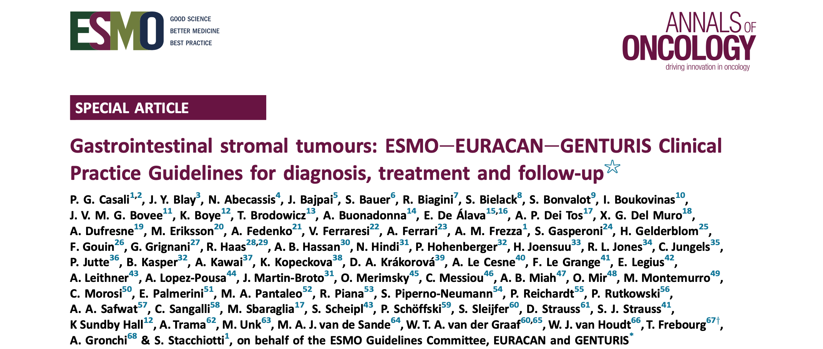
https://doi.org/10.1016/j.annonc.2021.09.005
0923-7534/© 2021 European Society for Medical Oncology

Slide 4
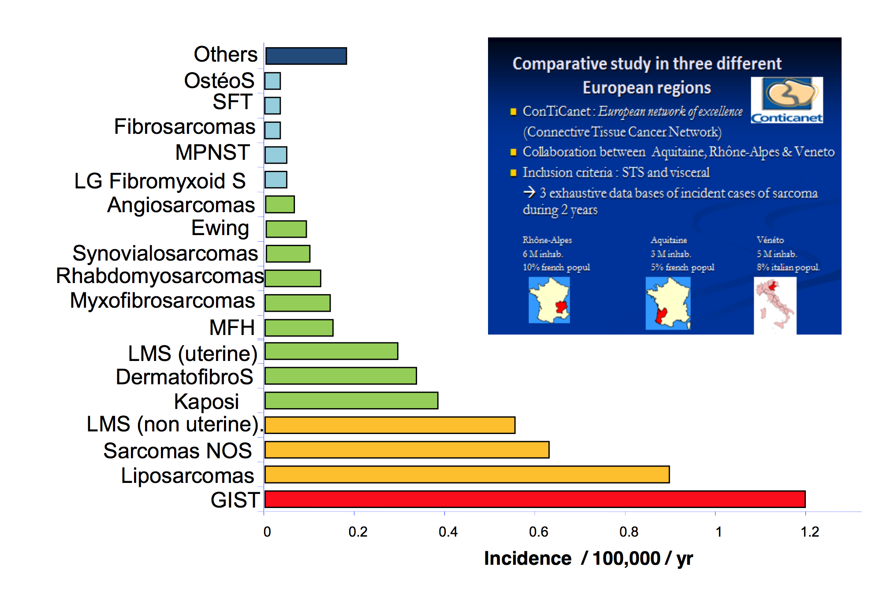
Incidence of sarcomas in 3 EU regions

Slide 5
The Disease is the Medium The Mechanism is the Message
Understanding the basic mechanisms of GIST at the molecular level
Diagnosing patients correctly
Understanding clinically relevant GIST variations
Understanding resistance to overcome barriers to cure
Notes:
During the past decade, GISTs have served as an important model in the emerging field of molecularly targeted therapies for solid tumors
The nearly simultaneous discovery of oncogenic kinase mutations in GISTs and the introduction of kinase inhibitor therapies has led to a rapid evolution in our understanding of these tumors and the biology that defines them.

Slide 6
GIST
Πριν από τον 21^{ο} αιώνα, η υποτροπή ήταν κατά κανόνα μοιραία
1.0
.8
.6
Fraction Surviving
N=80
.4
5 yr 54%
.2
0.0
0
2
4
6
8
10
12
14
16
Years
DeMatteo RP et al. Ann Surg 2000; 231:51

Slide 7

GIST: Διάμεσα κύτταρα του Cajal
Αρχικά περιγράφηκαν από τον Cajal
KIT-θετικά ινοβλαστικά κύτταρα
Βηματοδότες του εντέρου
Εντοπισμένα μεταξύ ενδοτοιχωματικών νευρώνων και λείων μυικών ινών
Παράγουν ηλεκτρικά κύματα
Απώλεια της λειτουργίας των ICC βρίσκεται στη διαβητική γαστρο-εντεροπάθεια, νόσο του Hirschsprung
Takayama et al. Arch Histol Cytol. 2002;65:1.
Notes:
The ICC were originally described by Cajal in 1889 as structures intercalated between intramural neurons and smooth muscle cells of the gut. While historically there has been much debate about whether these cells are distinct cells of mesenchymal origin or networks of Schwann cells of the peripheral autonomic nervous system, ultrastructural studies with electron microscopy in the 1970s have established the mesenchymal origin of these structures. Currently, ICC are thought to be specialized fibroblast-like cells with specific adaptations for propagating the slow electrical waves that are critical for their role as pacemaker cells in the gut.
The morphologic characteristics of ICC vary between species and location along the gut, but include many mitochondria, high levels of intermediate fiber, and large gap junctions connecting the ICC to other ICC and smooth muscle cells. These latter gap junctions are thought to be a key adaptation by the ICC for filling their role of generating the slow electrical signals required for gut pacemaking.
The loss of ICC function (through abnormal ICC or loss of ICC) has been implicated or observed in many diseases in both animal models and humans, including:
Infantile hypertropic pyloric stenosis
Chronic idiopathic intestinal pseudo-obstruction
Aganglionosis and hypoganglionosis
Anorectal malformation
Slow-transit constipation
Diabetes mellitus
Hirschsprung’s disease
Other candidate diseases include ulcerative colitis, Crohn’s disease, and Chagas’s disease.
Takayama I, Horiguchi K, Daigo Y, Mine T, Fujino MA, Ohno S. The interstitial cells of cajal and a gastroenteric pacemaker system. Arch Histol Cytol. 2002;65:1-26.

Slide 8
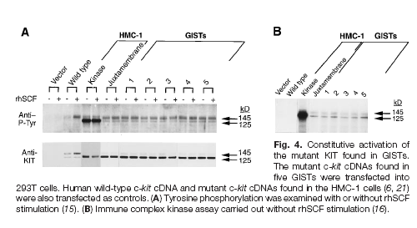
Ανακάλυψη των KIT μεταλλάξεων στα GIST
Hirota S, et al. Science, 1998

Slide 9


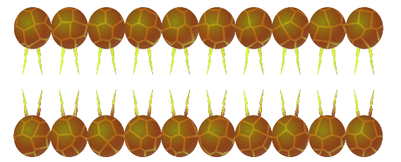

Μεταλλάξεις KIT και PDGFRA
Συχνότητα εμφάνισης (συνολικά): ≥ 86%
KIT (78.5%)
PDGFRA (7.5% )
Exon 9 (9%)
Exon 11 (67%)
Exon 12 (2%)
Exon 13 (1%)
Exon 14 (?)
Exon 17 (1%)
Exon 18 (5.5%)
Corless & Heinrich. Annu Rev Pathol. 2008;3:557-586.

Slide 10
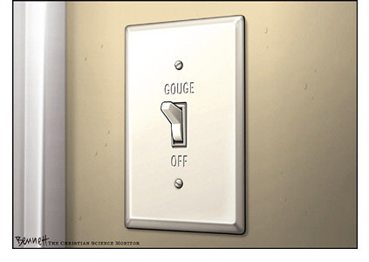
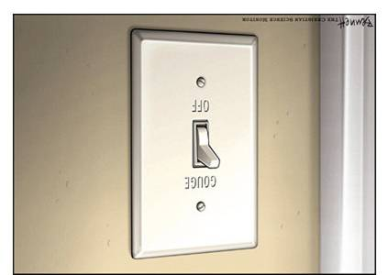
Ψάχνοντας τον κριτικό διακόπτη στον καρκίνο
Επιβίωση και
πολλαπλασιασμός
κυττάρων όγκου
ON
Θάνατος κυττάρων
όγκου
OFF

Slide 11

Για κάποια καρκινικά κύτταρα,μεταλλάξεις στην κινάση οδηγούν στην ενεργοποίηση του διακόπτη σε θέση “ON”
Τα κύτταρα του όγκου δέχονται ένα συνεχές σήμα από την μεταλλαγμένη κινάση που τους δίνει εντολή να επιβιώσουν, να πολλαπλασιασθούν και να συσσωρευτούν
Η ΒΑΣΙΚΗ ΥΠΟΘΕΣΗ: Θα μπορούσαμε να ελέγξουμε τον καρκίνο αν κλείναμε τον διακόπτη της μεταλλαγμένης κινάσης;

Slide 12




Σηματοδότηση KIT
Υπόστρωμα
Τελεστής
Kinase
domains
ADP
P
P
P
P
P
ATP
P
P
P
ADP, adenosine diphosphate; ATP, adenosine triphosphate.
Savage et al. N Engl J Med. 2002;346:683-693.
Scheijen et al. Oncogene. 2002;21:3314-3333.
SIGNALING

Slide 13

Αναστολή της σηματοδότησης ΚΙΤ
Η θέση πρόσδεσης του ATP καταλαμβάνεται από το imatinib
Αποτρέπεται η φωσφορυλίωση του υποστρώματος
Με τη διακοπή της σηματοδότησης αναστέλλεται ο πολλαπλασιασμός και προάγεται η απόπτωση των καρκινικών κυττάρων
Kinase
domains
P
ATP
P
P
P
Imatinib mesylate
SIGNALING
Savage et al. N Engl J Med. 2002;346:683-693.
Scheijen et al. Oncogene. 2002;21:3314-3333.

Slide 14
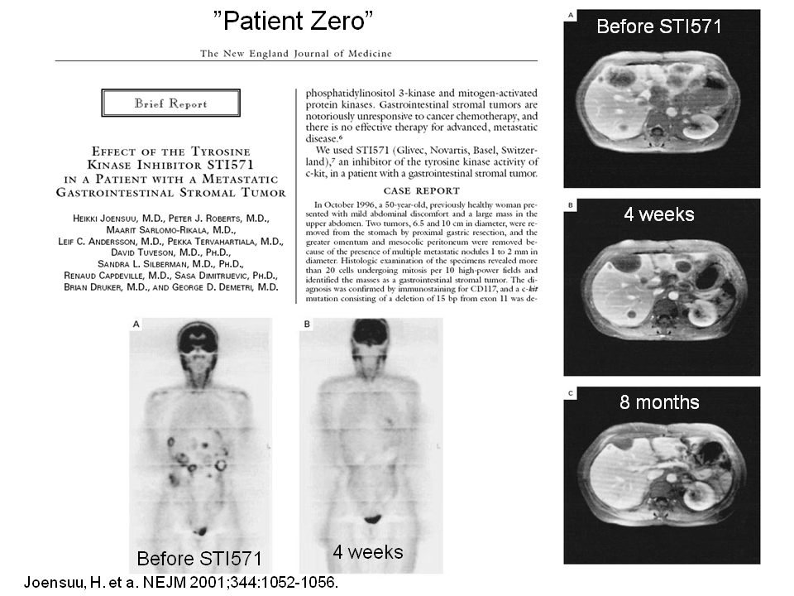

Slide 15
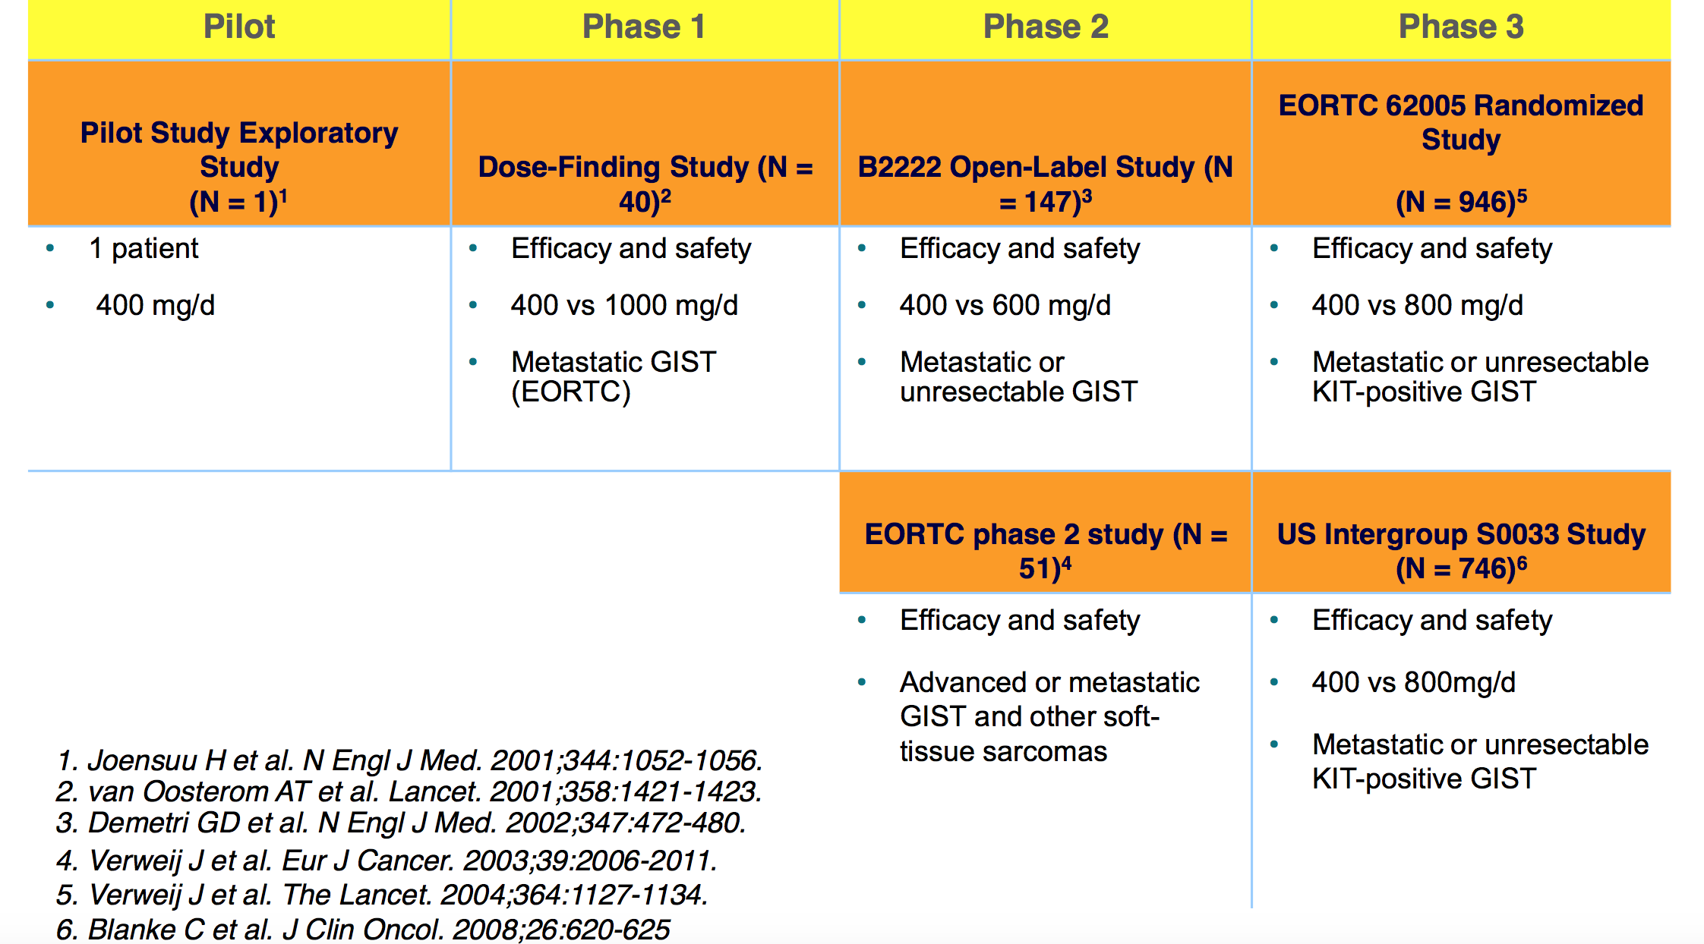
Studies of imatinib therapy in GISTs

Slide 16
Localized phase: ESMO guidelines 2021
Biopsy first
- debate on transparietal
Complete en-bloc resection of the primary tumor
- R0 margins on the gut/gastric wall
- Often R1 in the peritoneal space
- Resection of the adjacent invaded organs
- Neo-adjuvant treatment?
Pathology review
Molecular characterization

Slide 17
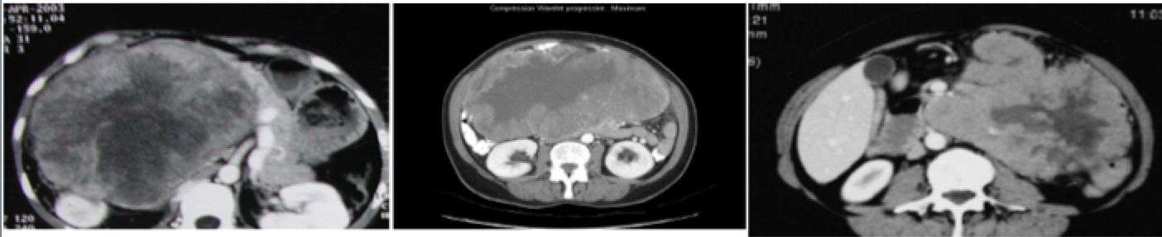
To plan a biopsy before any «unplanned» surgery or any systemic treatment

Slide 18
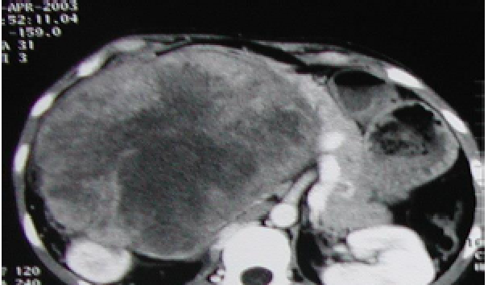
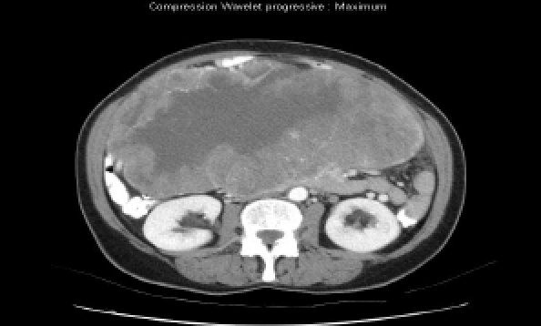
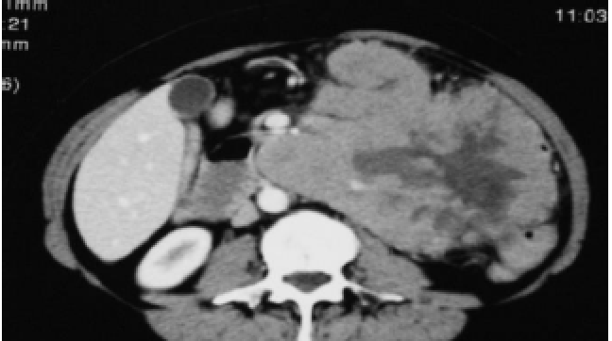
To plan a biopsy before any «unplanned» surgery or any systemic treatment
pNET
GIST
NHL

Slide 19
To plan a biopsy before any «unplanned» surgery or any systemic treatment
pNET
GIST
NHL

Slide 20
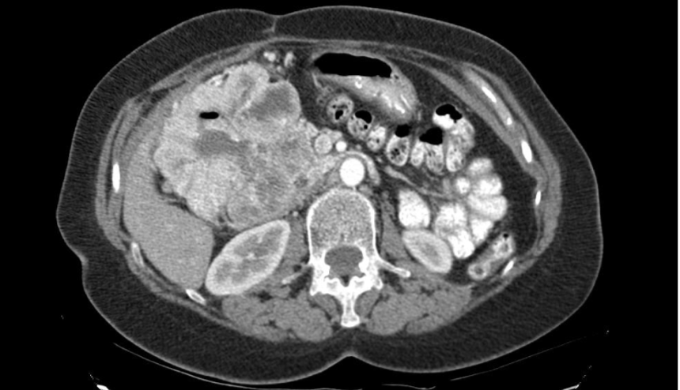
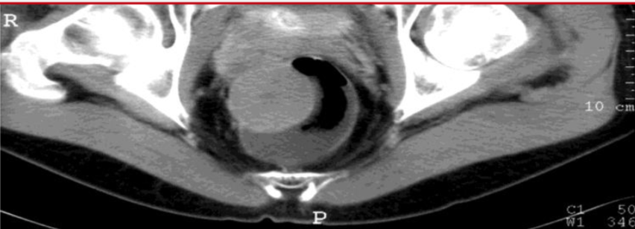
The optimal strategy
Case per case discussion in MTB
If no surgical down-staging
- Surgery first
- Discussion of adjuvant imatinib
- Surgery 6 to 12 months later
- Adjuvant imatinib (3 yrs in total)

Slide 21
The optimal strategy
Case per case discussion in MTB
If no surgical down-staging
- Surgery first
- Discussion of adjuvant imatinib
- Surgery 6 to 12 months later
- Adjuvant imatinib (3 yrs in total)

Slide 22
Adjuvant imatinib
Adjuvant treatment: Z9001, SSGXVIII and EORTC
How long to treat with adjuvant imatinib?
Whom to treat with adjuvant imatinib?
Impact on mutational analysis on treatment decision
What to do after 3-years of adjuvant imatinib treatment: follow-up or continued treatment?
Imatinib reintroduction in case of relapse

Slide 23
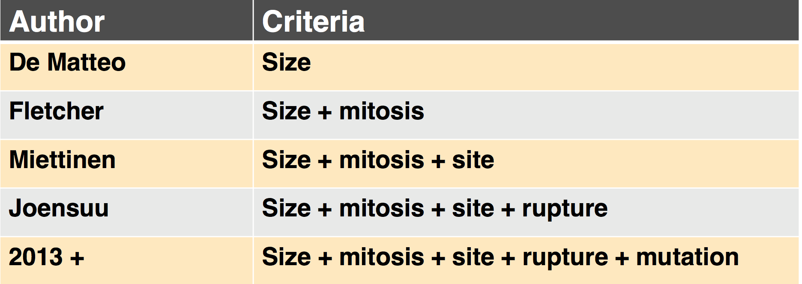
Evolution of histo-prognostic classifications

Slide 24
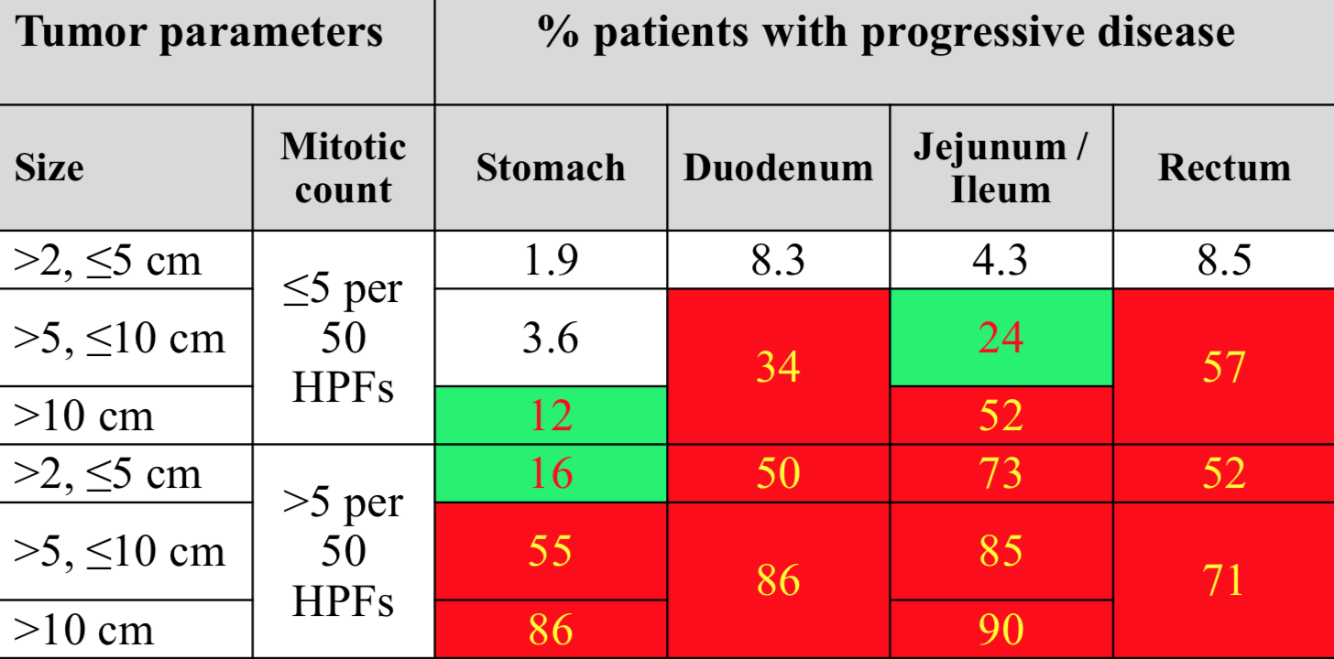
Risk Stratification of Primary GIST: Miettinen (AFIP)
Data are based on long-term follow-up of 1055 gastric, 629 small intestinal, 144 duodenal, and 111 rectal GISTs.
† Denotes small numbers of cases.
≈ Tumour size categories combined for both duodenal and rectal GISTs because of small numbers.
∂ No tumours of such category were included in this study.
Original source: Miettinen M, Lasota J. Semin Diagn Pathol. 2006;23:70-83.
Notes:
24
tumour size, mitotic index, and anatomic location are used in the NCCN consensus approach to risk stratification of primary GIST^{1,2}
Risk stratification for primary GIST in the imatinib era was initiated with the Fletcher/NIH 2002 consensus criteria. However, in 2006, Miettinen and Lasota, pathologists at AFIP, compiled the largest series of GIST in the medical literature
The Fletcher/NIH risk assessment system was based on consensus of professional opinion, but the risk stratification system formulated by Miettinen and Lasota in 2006 is based on data for more than 1900 GIST patients (based on tumour location, size, and mitotic rate) who actually did develop recurrence or metastasis^{1–3}
tumour size and mitotic index are the foundation of the 2007 NCCN consensus approach to risk stratification of primary GIST. In addition, data have confirmed results from earlier, small studies showing that tumour location affects risk of disease recurrence and progression^{1,2,4}
Thus, small-intestinal GIST are seen as having greater malignant potential than gastric GIST of equal size⁴
Demetri GD, Benjamin RS, Blanke CD, et al. NCCN Task Force report: management of patients with gastrointestinal stromal tumour (GIST)—update of the NCCN Clinical Practice Guidelines. J Natl Compr Cancer Netw. 2007;5(suppl 2):S1-29.
Miettinen M, Sobin LH, Lasota J. Gastrointestinal stromal tumours of the stomach: a clinicopathologic, immunohistochemical, and molecular genetic study of 1765 cases with long-term follow-up. Am J Surg Pathol. 2005;29:52-68.
Fletcher CD, Berman JJ, Corless C, et al. Diagnosis of gastrointestinal stromal tumours: a consensus approach. Hum Pathol. 2002;33:459-465.
Miettinen M, Lasota J. Gastrointestinal stromal tumours: pathology and prognosis at different sites. Semin Diagn Pathol. 2006;23:70-83.

Slide 25
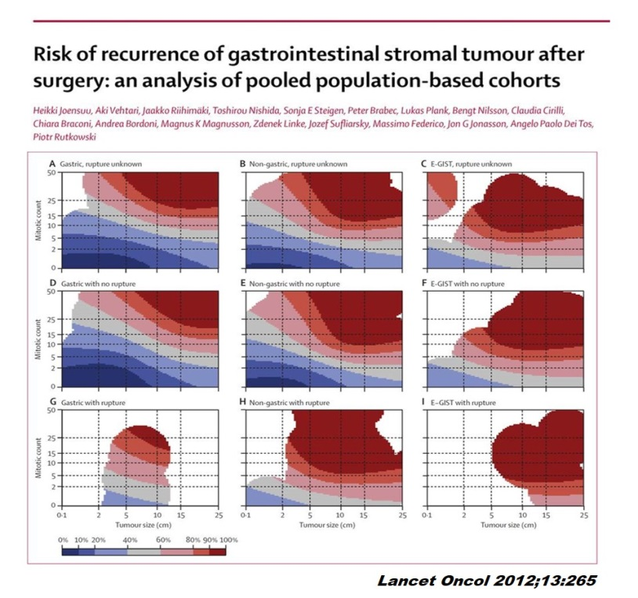
Risk Group Classifications ”Significant risk of relapse”
Decrease of risk with
« Joensuu » classification
Tumor parameters |  | % patients with progressive disease
Size | Mitotic count | Stomach | Duodenum | Jejunum / Ileum | Rectum
>2, ≤5 cm | ≤5 per 50 HPFs | 1.9 | 8.3 | 4.3 | 8.5
>5, ≤10 cm |  | 3.6 | 34 | 24 | 57
>10 cm |  | 12 |  | 52
>2, ≤5 cm | >5 per 50 HPFs | 16 | 50 | 73 | 52
>5, ≤10 cm |  | 55 | 86 | 85 | 71
>10 cm |  | 86 |  | 90
Joensuu H, et al. Lancet Oncol 2012
Miettinen M, Lasota J. Sem Diagn Pathol 2006
Around 10% of risk of relapse

Slide 26
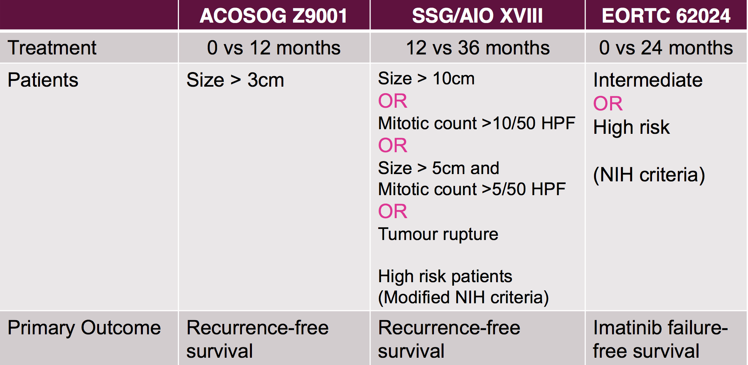
Overview of adjuvant trials

Slide 27
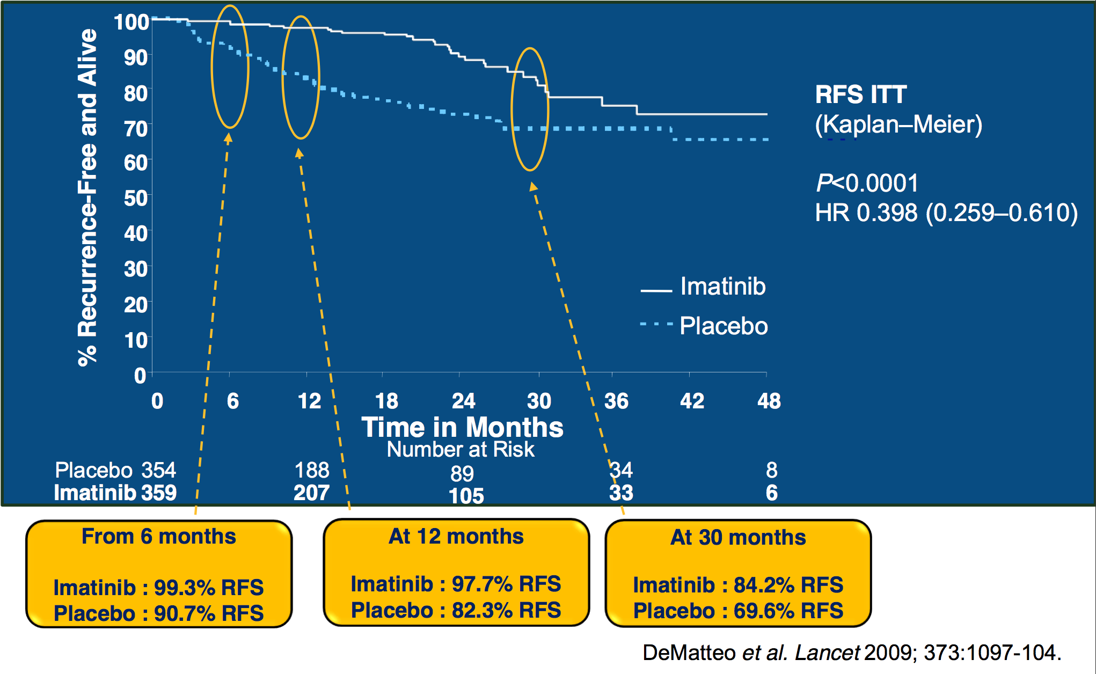
ACOSOG Z9001 Phase III trial : RFS
Notes:
The rate of recurrence on the imatinib arm appeared to increase after approximately 18 months (ie, 6 months after completion of study treatment). This raises the possibility that treatment with adjuvant imatinib for longer periods may further extend RFS

Slide 28
SSGXVIII: Recurrence-Free Survival (ITT)
HR = 0.46 (95% CI = 0.32, 0.65); P < .0001
100
86.6%
80
65.6%
60
60.1%
Recurrence-Free and Alive, %
47.9%
40
36 mo, n = 198
20
12 mo, n = 199
Median follow-up, 54 mo
0
0
1
2
3
4
5
6
Time, y
Joensuu H, et al. JAMA. 2012;307(12):1265-1272.

Slide 29
SSGXVIII: Overall Survival (ITT)
HR = 0.45 (95% CI = 0.22, 0.89); P = .02
100
96.3%
92.0%
94.0%
80
81.7%
60
36 mo
Overall Survival, %
12 mo
40
20
0
0
1
2
3
4
5
6
Time, y
No. at risk (n = 397)
36 mo of imatinib 198 192 184 152 100 56 13
12 mo of imatinib 199 188 176 140 87 46 20
Joensuu H, et al. JAMA. 2012;307(12):1265-1272.

Slide 30

Localized resected GIST
Adjuvant imatinib?
Between 10 to 30%
of risk of relapse according
Miettinen classification
(Relapse rate <10%)
P. Casali et al, JCO 2018
Intermediate risk: Room for shared decision-making in ESMO 2018 guidelines
Follow-up in ESMO 2021 guidelines

Slide 31
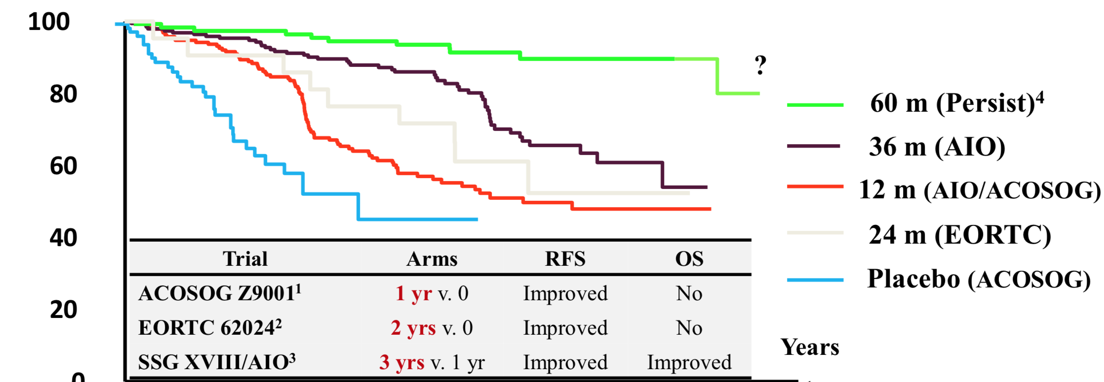
Adjuvant imatinib in high-risk GIST Optimal duration of adjuvant imatinib?
Around 45-50% of pts are cured with surgery alone. Who are there?
1.DeMatteo et al., Lancet 2009 2.Casali et al., JCO 2015 3.Joensuu et al., JAMA 2012 4.Rault C et al. ASCO 2017

Slide 32
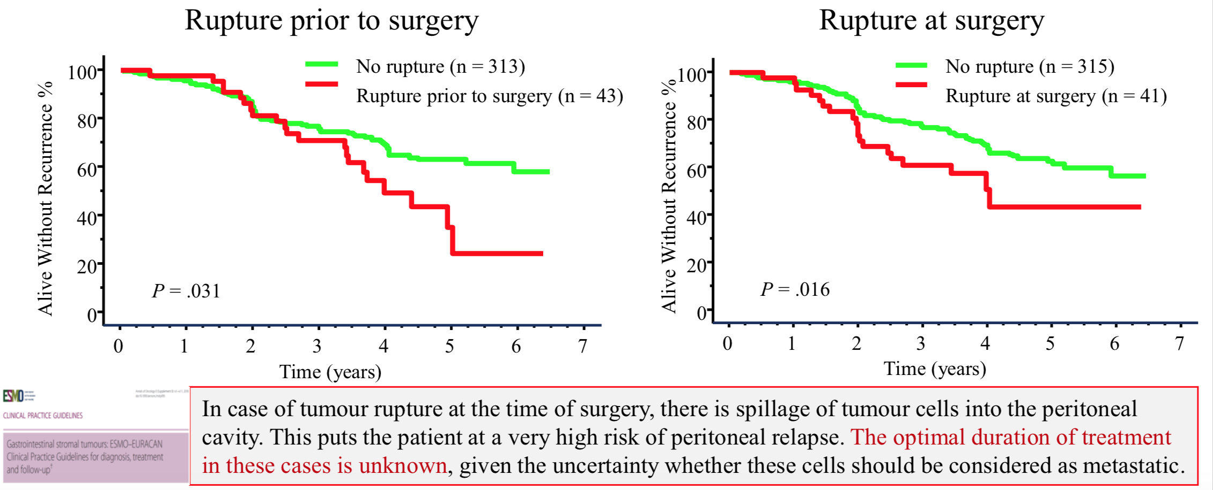
SSGXVIII/AIO - Localized GIST Impact of tumor rupture on PFS (20% of patients)
Toward a better definition of tumor rupture? Major defects, tumor fracture, piecemeal resection, iatrogenic peritoneal laceration.....related also to specific KIT mutations? (Boye K et al, BJS 2018)
Notes:
Gastric GISTs with KIT exon 11 deletions involving codons 557 and 558 are at increased risk of tumour rupture. This high-risk feature can be identified in the diagnostic evaluation and should be included in the assessment when neoadjuvant imatinib treatment is considered.

Slide 33
Molecular Subclassification of GIST (NGS)
Carney-Stratakis Syndrome
Paediatric GIST
Carney Triad
NF1
5-
SDH-
PDGFR
KIT

Slide 34
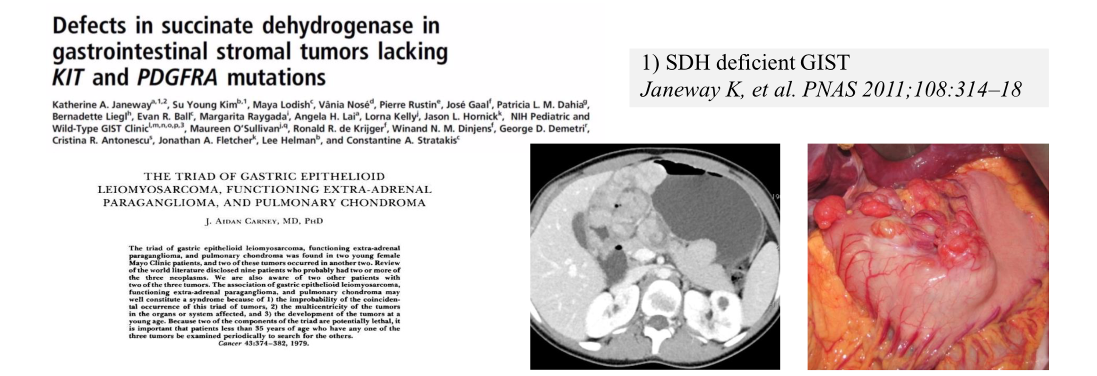
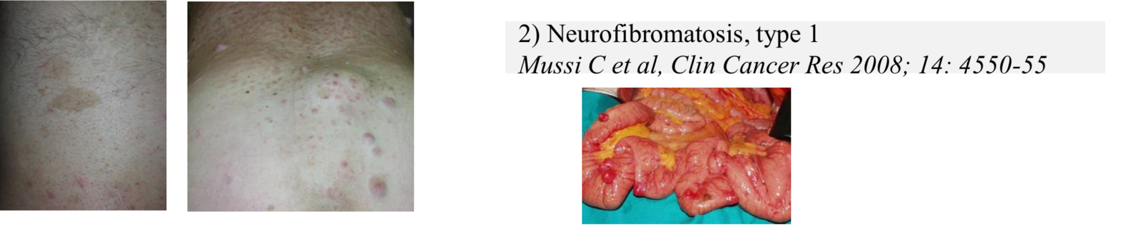
To identity KIT those who do not benefit from adjuvant imatinib

Slide 35
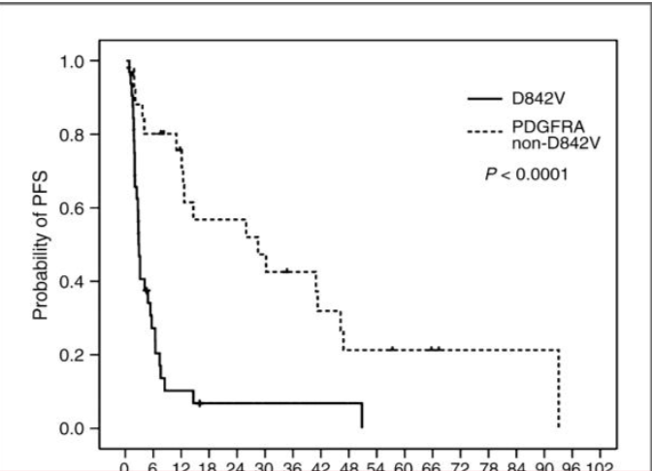
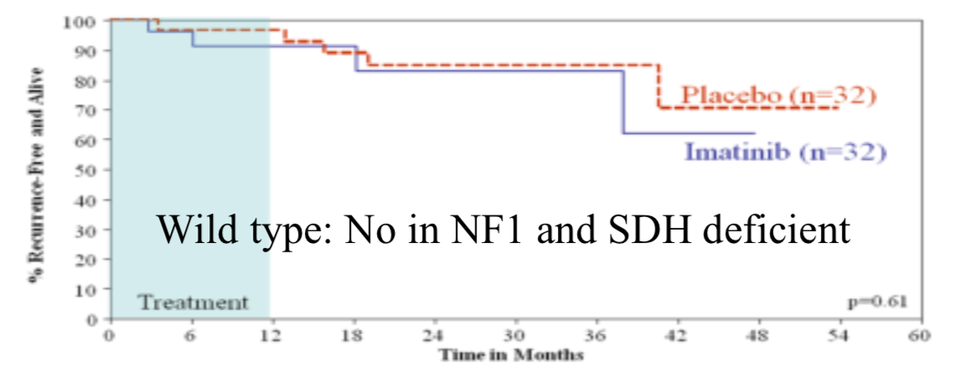
To identity KIT those who do not benefit from adjuvant imatinib (II)
Corless, C.L. et al., JCO 2010
Casali et al, Annals of Oncology 2018
P.A. Cassier et al. Clin Cancer Res 2012

Slide 36
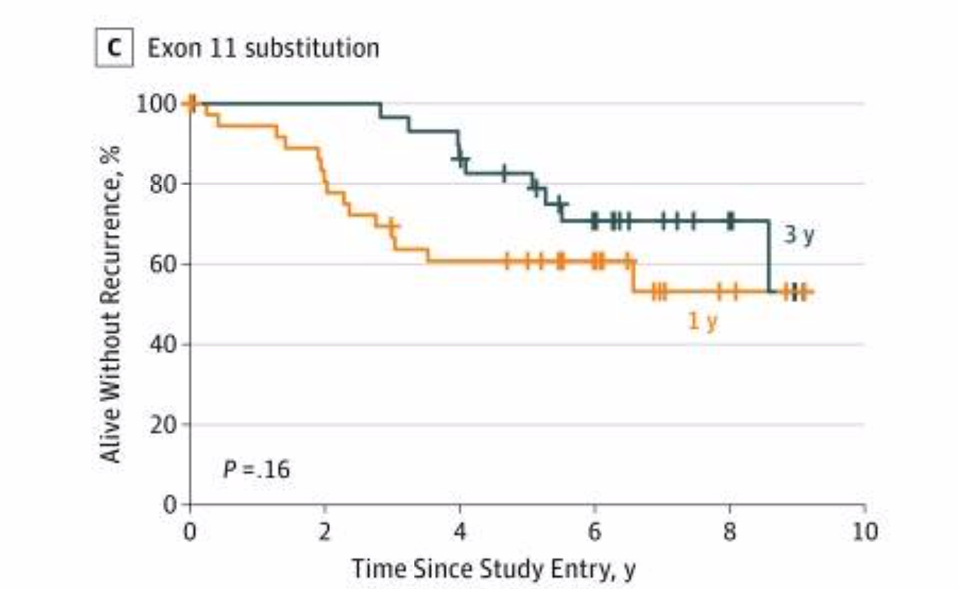
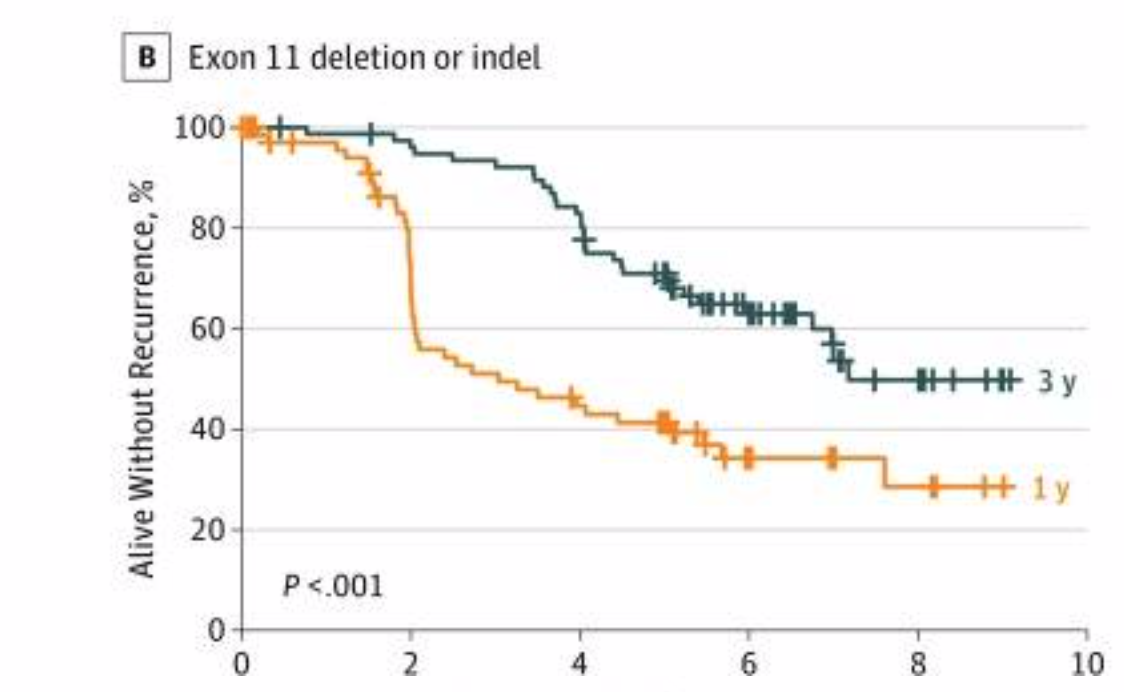
To identity KIT exon 11 those who benefit the most (in terms of duration)
Patients with KIT exon 11 deletion or insert-deletion mutation had better RFS when allocated to the 3-yr group compared with the 1-yr group (5-year RFS, 71.0% vs 41.3%; P < .001)
No significant benefit from the 3-yr treatment was found in the other mutational subgroups examined
Joensuu H, et al. JAMA Oncol 2017

Slide 37
Metastatic phase

Slide 38
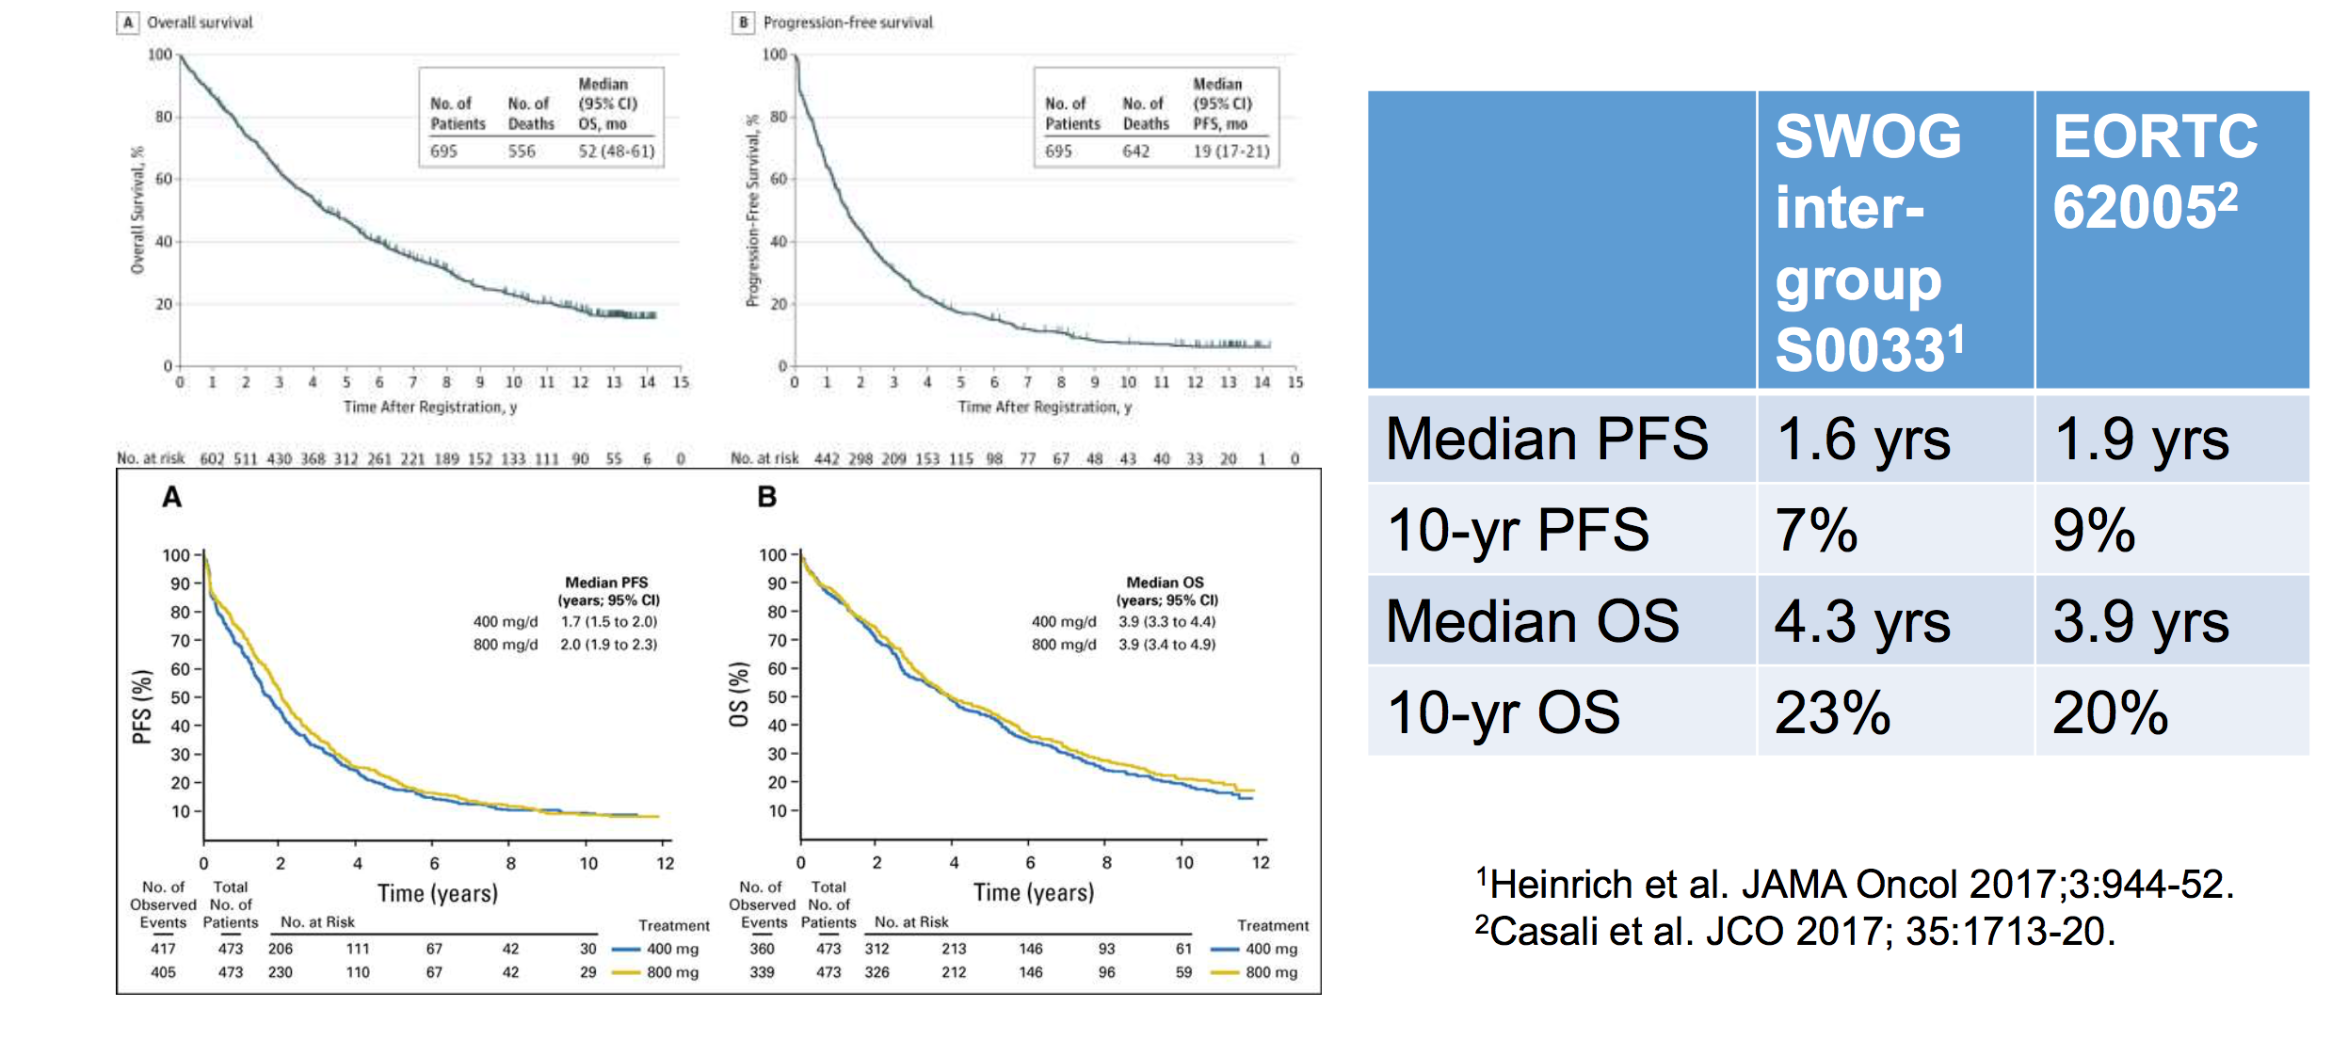
Long-term survival data from 2 trials comparing IM 400 mg/d with 800 mg/d in advanced GIST

Slide 39
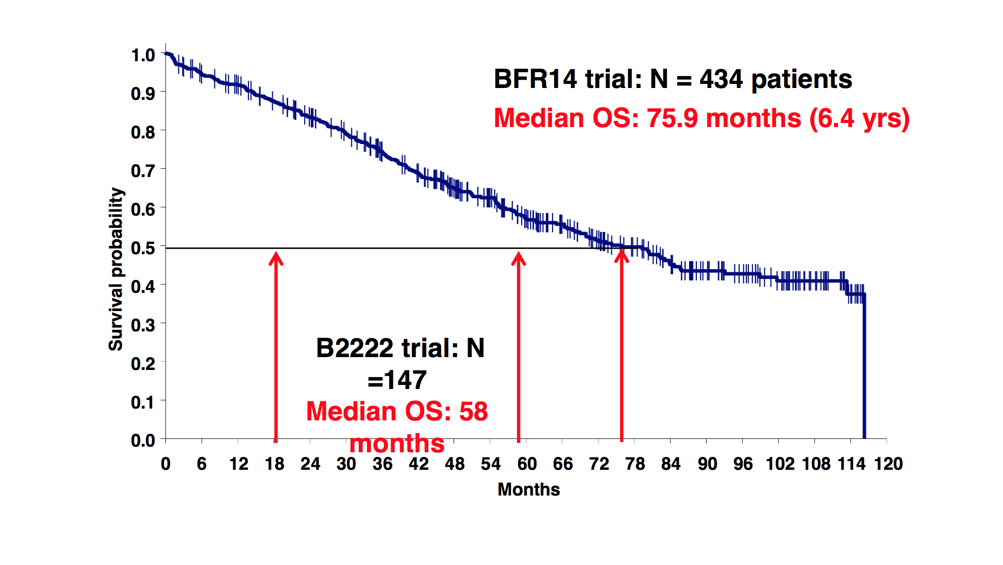
Long-term OS advanced GIST 1st line imatinib

Slide 40
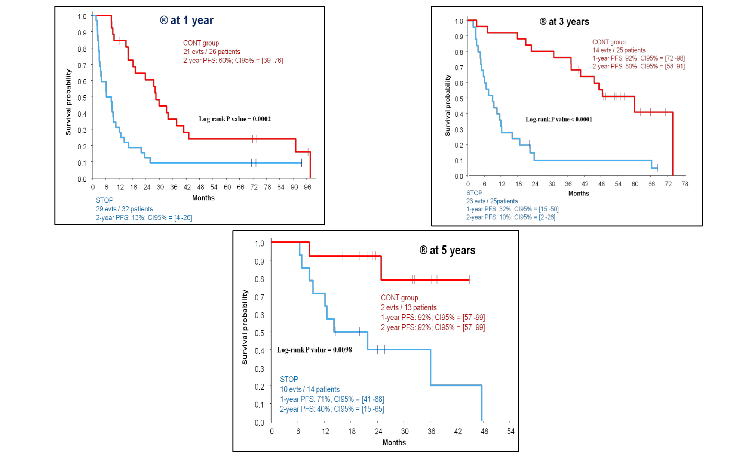
Imatinib interruption in advanced GIST-PFS

Slide 41
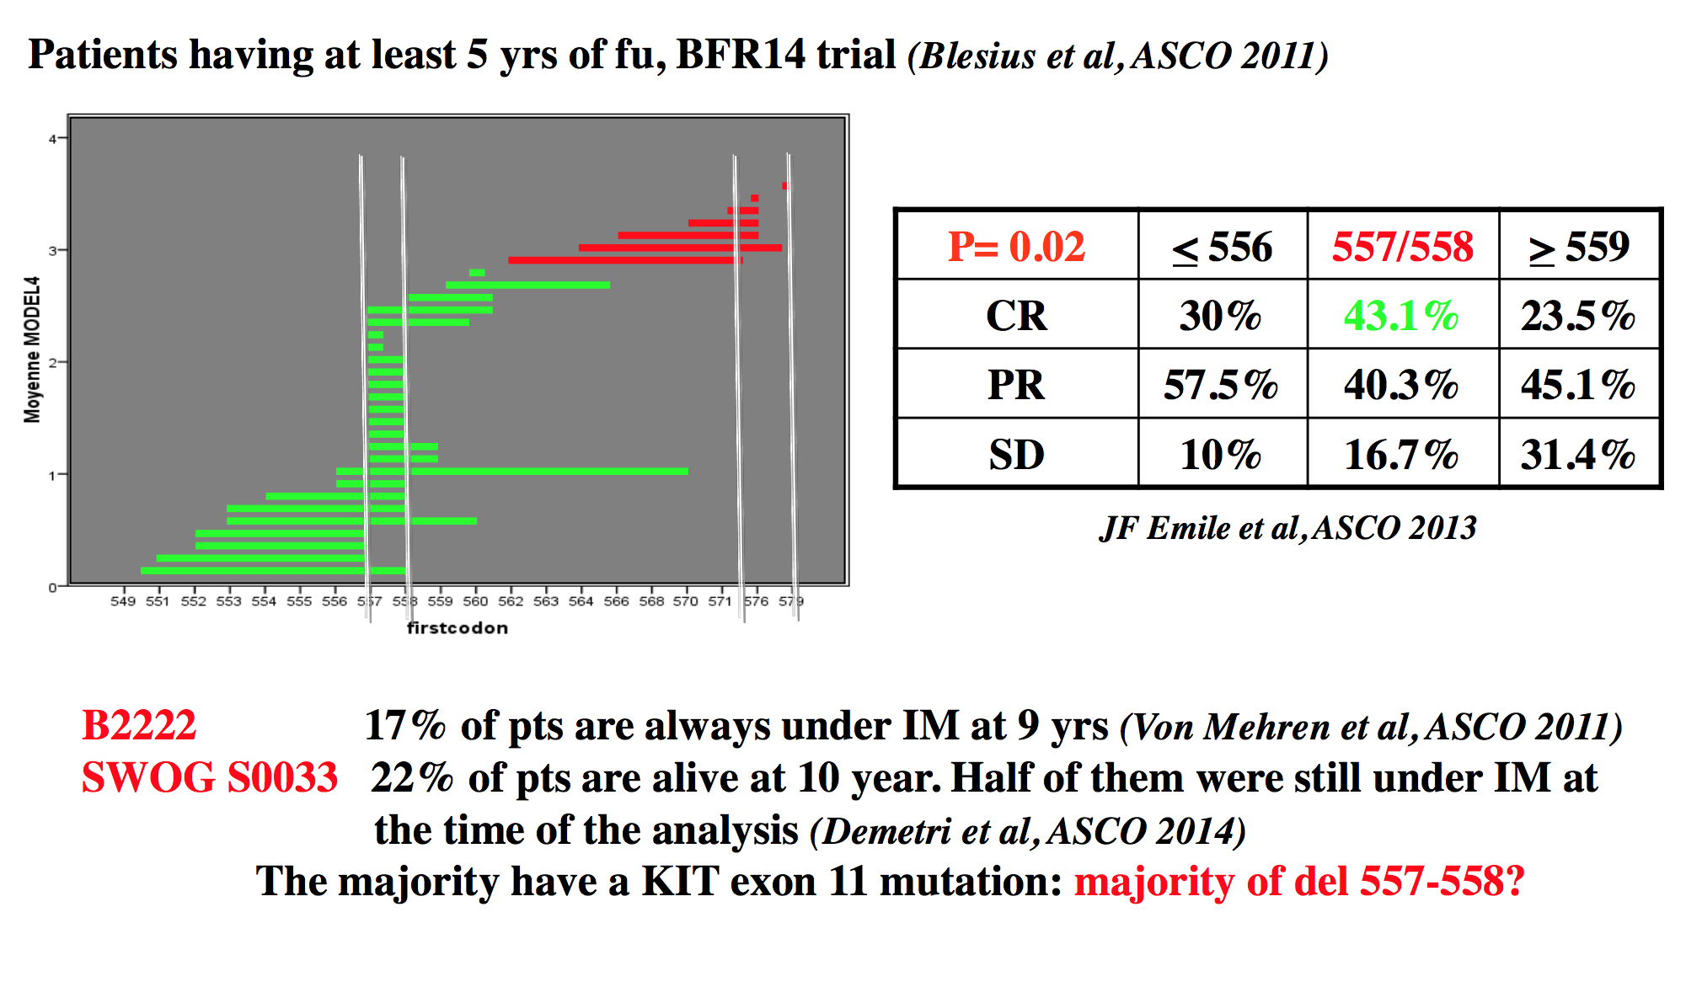
GIST exon 11 kit mutation with del 557-558: Favorable predictive factor?

Slide 42
KIT/PDGFRA mutations are central in GIST
PRIMARY MUTATIONS
Exon 9: 12%
Membrane
Exon 11: 70%
Exon 13: 1%
ATP-binding
Exon 17: 1%
Activation loop
Notes:
KIT and PDGFRA are primary drivers of oncogenic signal in GISTs, and there is a wide variety of KIT and PDGFRA primary mutations across known exonic regions that predict the activity of first-line imatinib.

Slide 43
KIT/PDGFRA mutations are central in GIST
PRIMARY MUTATIONS
SECONDARY MUTATIONS
Exon 13
V654
39.6%
ATP-binding pocket
Exon 14
T670
11.1%
Exon 9: 12%
Membrane
Exon 11: 70%
Exon 13: 1%
ATP-binding
D816
8.3%
Activation
Loop
Exon 17
D820
11.8%
N822
12.5%
Y823
9.0%
Exon 17: 1%
Activation loop
Other KIT mut
7.7%
Notes:
However, resistance to imatinib eventually emerges in most GIST patients.
The main mechanism of imatinib failure is the emergence of KIT secondary mutations, present in up to 90% of GIST patients. THESE SECONDARY MUTATIONS cluster in two regions, the ATP-BP (encoded by exon 13) and the A-loop (encoded by exon 17).

Slide 44
KIT/PDGFRA genotype predicts response to TKIs
PRIMARY MUTATIONS
SECONDARY MUTATIONS
DRUG SENSITIVITY
IM
SU
RE
Exon 13
V654
39.6%
Exon 14
T670
11.1%
Exon 9: 12%
Membrane
Exon 11: 70%
Exon 13: 1%
ATP-binding
D816
8.3%
Exon 17
D820
11.8%
N822
12.5%
Y823
9.0%
Exon 17: 1%
Activation loop
Other KIT mut
Sensitive
7.7%
Resistant
Serrano et al, Br J Cancer 2018
Notes:
Importantly, both in vitro and clinical evidence show that KIT genotype predicts TKI activity in IM-resistant GIST. Thus, sunitinib, the standard second-line, is a very active drug against KIT secondary mutations in the ATP-binding pocket, while regorafenib is generally more active against most common secondary mutations in the activation loop.

Slide 45
Περιορισμοί των παραδοσιακών κριτηρίων (RECIST/SWOG) στην αξιολόγηση της ανταπόκρισης GIST
Τα κριτήρια δεν υπολογίζουν την πυκνότητα του όγκου
Η ανταπόκριση και ο εκφυλισμός της εστίας (νεκρωτική φύση), μπορεί να οδηγήσει σε αύξηση του όγκου και η συρρίκνωση του όγκου μπορεί να εξελιχθεί αργότερα
Υποεκτιμούν το κλινικό όφελος, καθώς δεν συμπεριλαμβάνουν τη σταθεροποίηση νόσου στην αξιολόγηση
Blanke et al. J Clin Oncol. 2008;26:626-632.
Choi et al. Am J Roentgenol. 2004;183:1619-1628

Slide 46
Choi κριτήρια : Αλλαγές στο μέγεθος ή πυκνότητα
Απάντηση στο PET | Ασθενείς με ≥ 10% μείωση του μεγέθους(%) | Ασθενείς με 15% μείωση σε HU (%) | 10% μείωση μεγέθους ή ≥ 15% μείωση σε HU (%)
Καλή (n=33) | 31 (94) | 27 (82) | 32 (97)
Κακή (n=7) | 0 (0) | 0 (0) | 0 (0)
Benjamin et al, ASCO 06
Notes:
Modified CT response criteria (Choi criteria) are a sensitive and specific method for assessing tumor response to imatinib
Decrease in tumor size of ≥10% or a decrease in tumor density (HU) ≥15% on CT predicted TTP and SUVmax
97% sensitivity and 100% specificity in identifying PET responders
Excellent predictor of TTP, detecting significant difference between good and poor PET responders (P = 0.04)

Slide 47
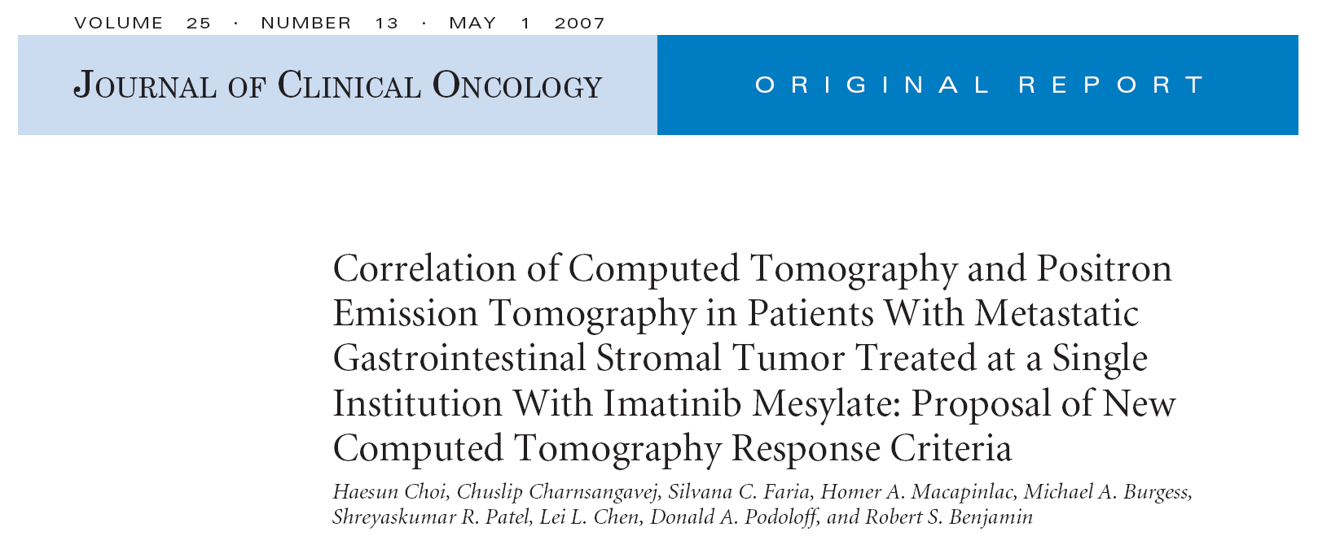
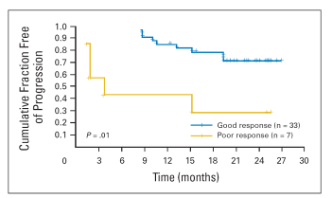
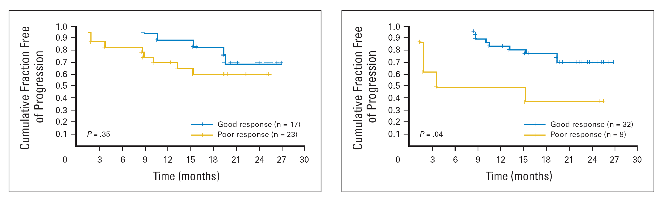
PET
RECIST Choi’s
Choi et al. J Clin Oncol. 2007 May 1;25(13):1753-9.
Notes:
RECIST 1.0 significantly underestimated tumor response
Poor predictor of TTP, failing to detect difference between good and poor PET responders (P = 0.35)

Slide 48
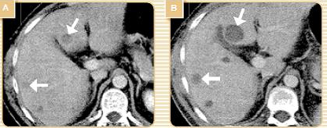
Επιδείνωση ??
Τι θα πρέπει να αξιολογείται πριν από κάποιο θεραπευτικό χειρισμό ?
Adapted from Demetri et al. NCCN Task force report. J.N.C.C.N. 2007;5(S2): S1-S29

Slide 49
Βέλτιστος χειρισμός ασθενών με GIST
Η μεταβολή της πυκνότητας (Choi κριτήρια)
Ο έλεγχος συμμόρφωσης ασθενών για να αποκλειστεί η περίπτωση της ελλιπούς συμμόρφωσης πριν την επιβεβαίωση της επιδείνωσης
Έλεγχος για πιθανή αλληλεπίδραση φαρμάκων, που μπορεί να οδηγεί σε υψηλότερες ή χαμηλότερες συγκεντρώσεις φαρμάκου (Α.Ε., απώλεια ανταπόκρισης)
Η ελλιπής συμμόρφωση ή η αλληλεπίδραση
φαρμάκων μπορεί να είναι αιτία
για λιγότερο ικανοποιητική ανταπόκριση
Blay et al. J Clin Oncol. 2007;25:1107-1113.

Slide 50
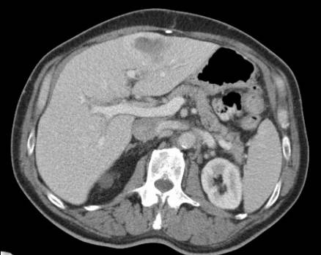
Στην τοπική υποτροπή θα πρέπει να εκτιμηθεί
η εξαιρεσιμότητα/τοπική θεραπεία

Slide 51
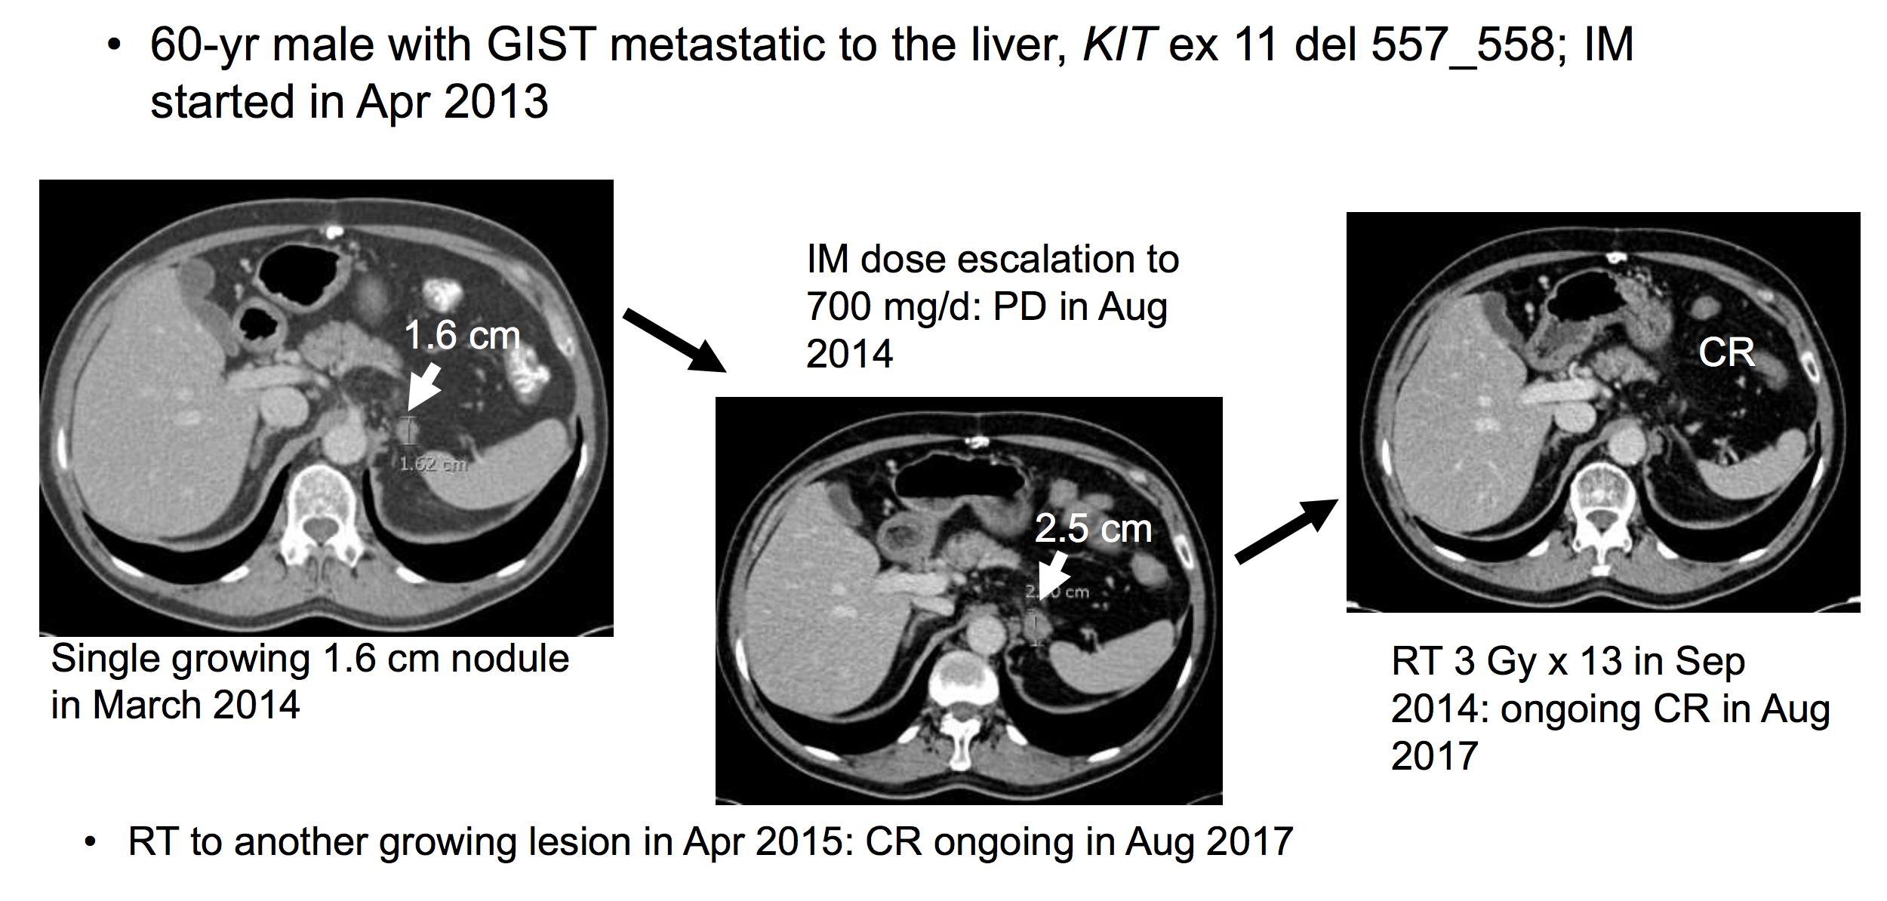
Imatinib dose escalation + local therapy

Slide 52
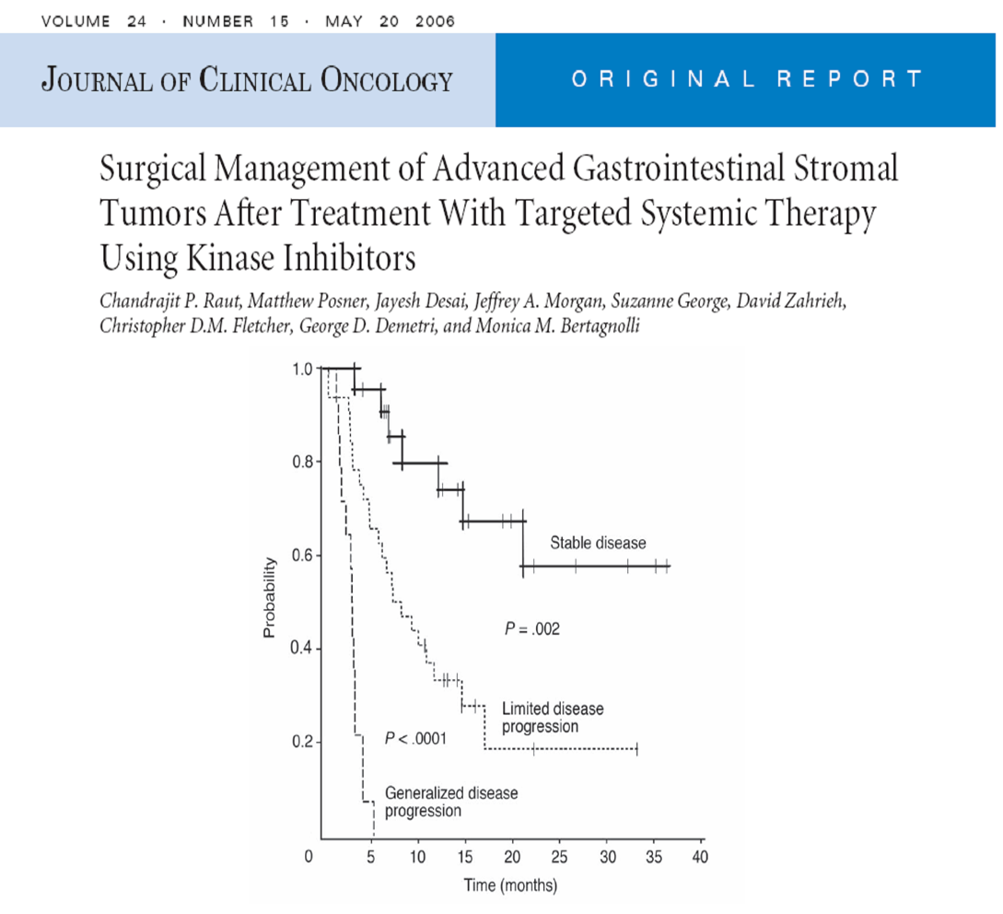
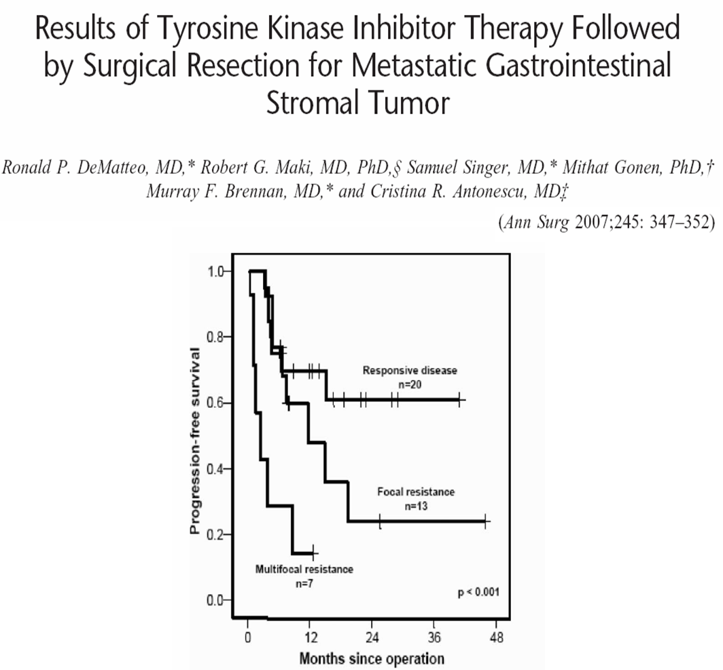
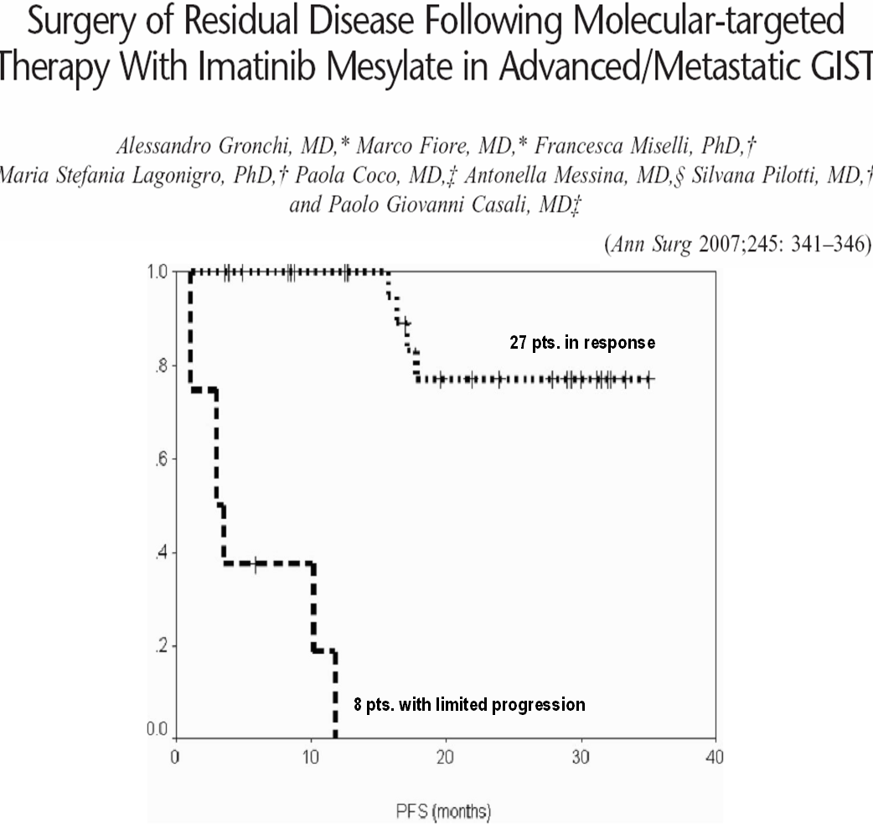
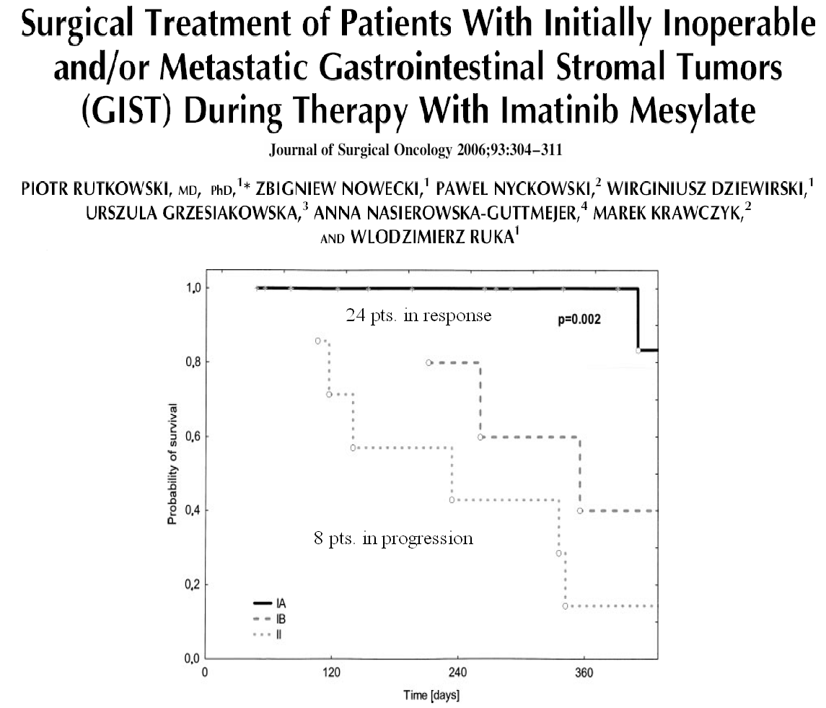
Median time to secondary progression 6-12 months

Slide 53
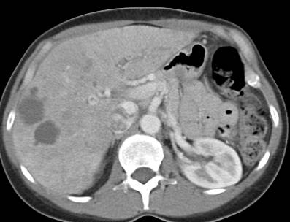
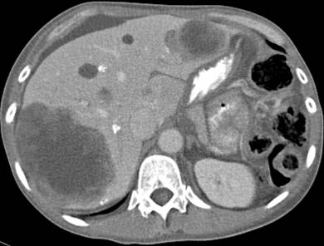
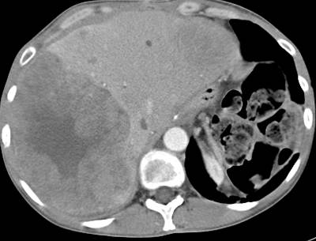
Σε γενικευμένη επιδείνωση το χειρουργείο δε συνιστάται

Slide 54
Ανταπόκριση μετά την αύξηση σε 800 mg imatinib
62005 S0033
66,4
60
70
48
60
50
50
40
38
40
33
% of patients
% of patients
30
30
20
13
20
10
6
10
0
2,5
0
0
0
CR
PR
SD
PD
CR
PR
SD
PD
Assessment
133 ασθενείς που αύξησαν
τη δοσολογία σε 800 mg
136 ασθενείς που αύξησαν
τη δοσολογία σε 800 mg
inadequate
Zalcberg et al. Proc Am Soc Clin Oncol. 2004
Rankin et al. Proc Am Soc Clin Oncol. 2004

Slide 55
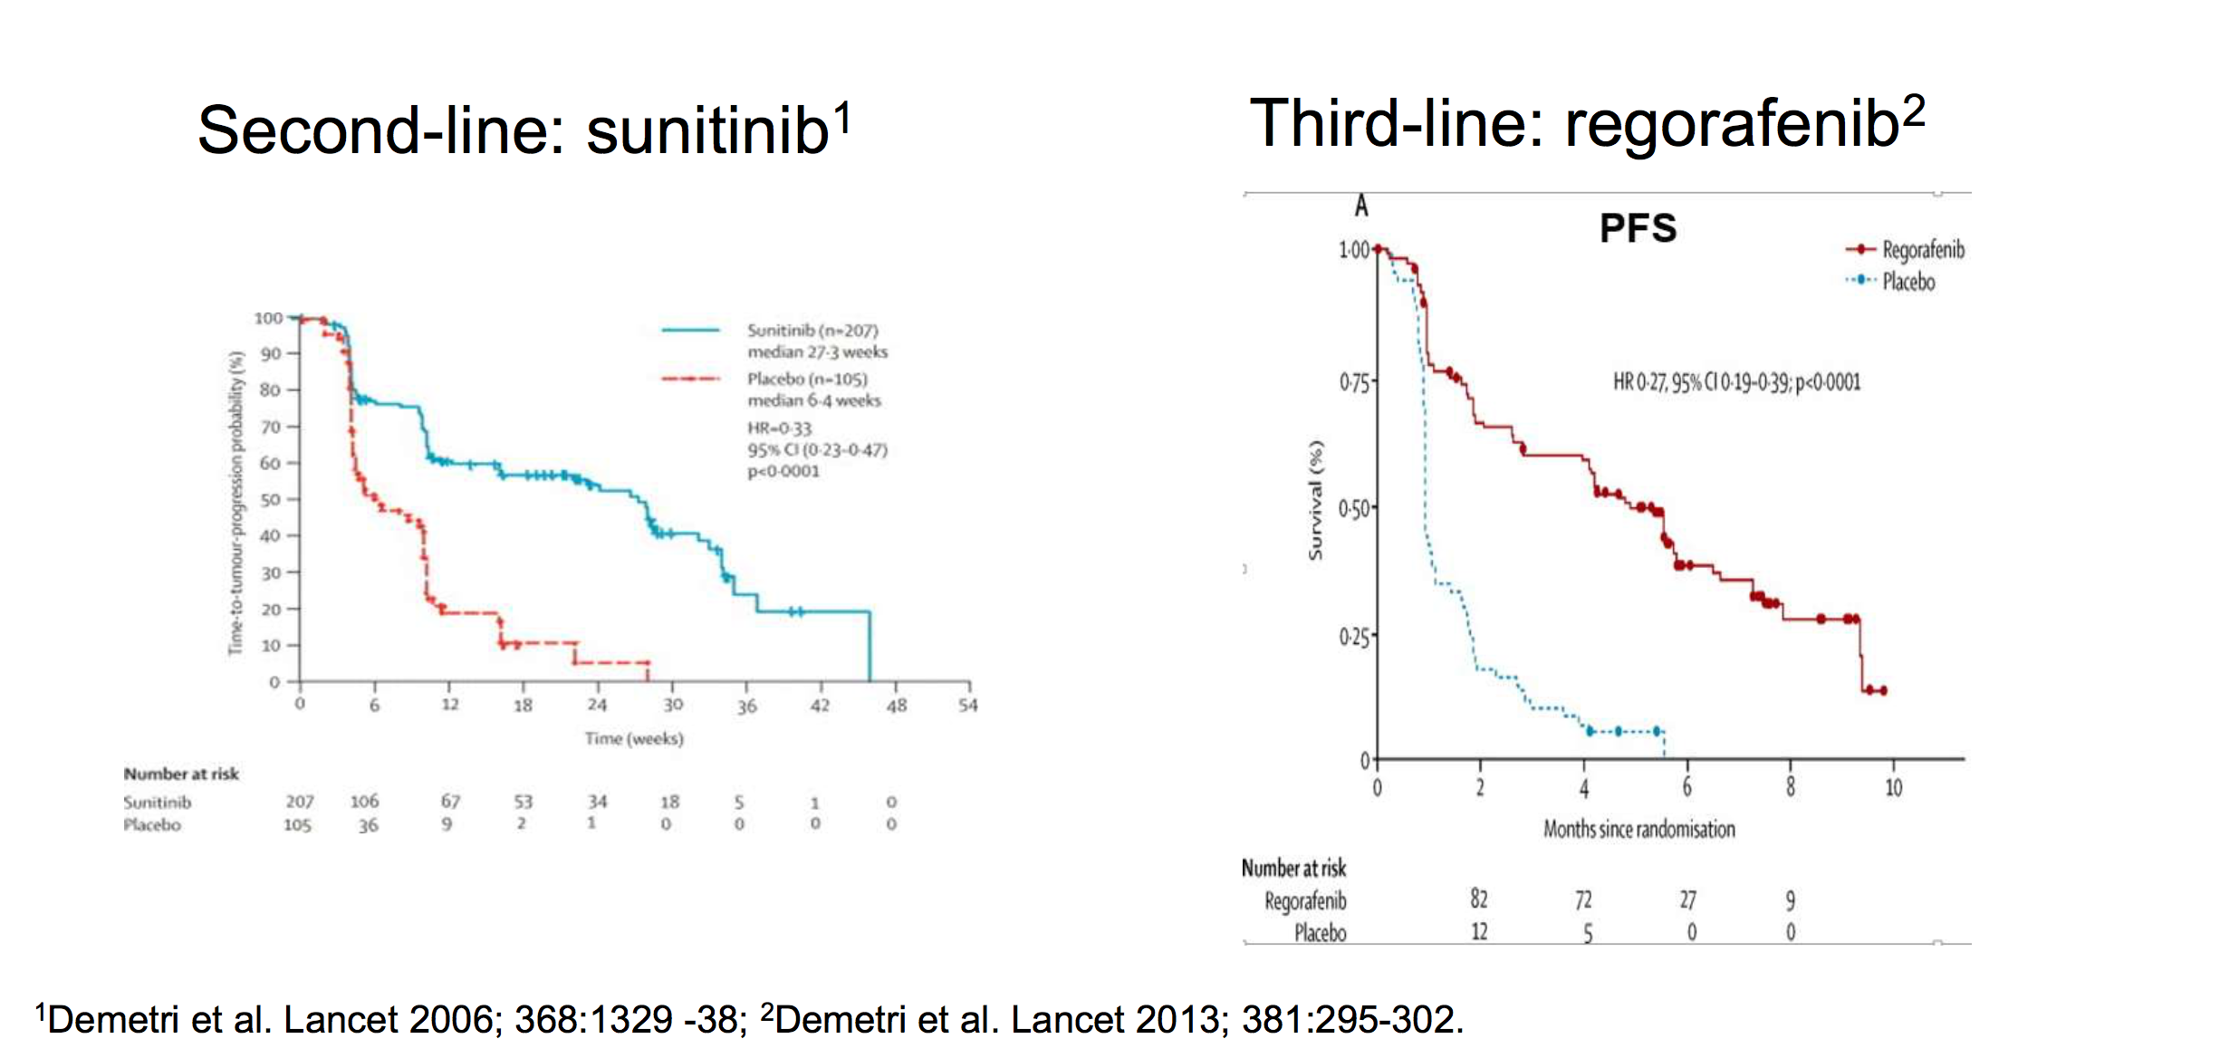
Approved agents after imatinib failure

Slide 56
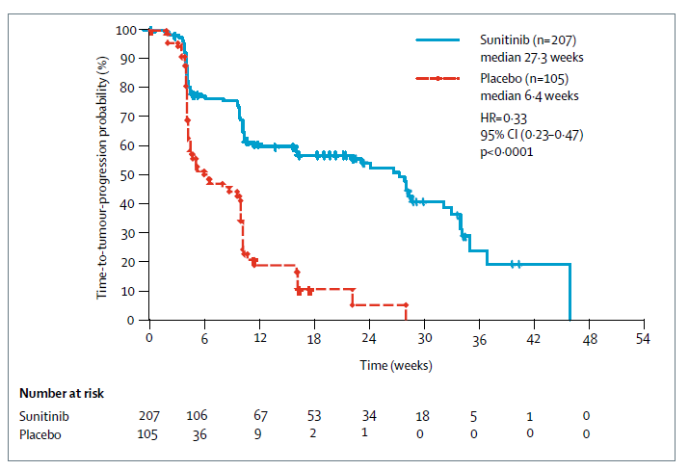
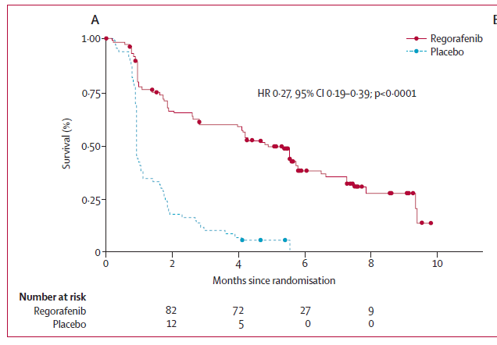
Sunitinib in GIST
2nd line
Active in the ATP-binding pockets mutations
Ripretinib in GIST
4th line
Switch pocket kinase inhibitor
Regorafenib in GIST
3rd line
Active in the activation loop mutations
100
Median PFS 6.3 m vs 1.0 m HR=0.15 P<0.0001
80
60
40
20
Ripretinib 150 mg QD
0
Placebo
N at risk:
0
2
4
6
8
10
12
14
Ripretinib
Placebo
85
44
64
7
52
4
37
1
18
1
8
0
1
0
HR 0.33 mPFS: 5.6 m
Placebo: 1.47 m
RO: 5.1%
HR 0.27 mPFS: 4.8 m
Placebo: 0.9 m
RO: 4.5% (placebo 1.5%)
HR 0.15 mPFS: 6.3 m
Placebo: 1 m
RO: 9.4%
Approval: 2006 Approval: 2014 Approval: 2020
Demetri GD et al. Lancet Oncol 2006
Demetri GD et al. Lancet Oncol 2013
Blay et al. Lancet Oncol 2020

Slide 57
Ripretinib vs Sunitinib (2nd line): phase III Intrigue trial (NCT03673501)
Mutational profile from phase 1
Intrigue trial
2L
GIST
R, 1:1
Ripretinib
Sunitinib
Primary endpoint: PFS
Ripretinib is a novel tyrosine kinase switch control inhibitor by using a unique dual mechanism of action that regulates the kinase switch pocket and activation loop
George S, et al. 2018
November 5, 2021 – The study did not meet the primary endpoint of improved PFS compared with the standard of care sunitinib. Ripretinib demonstrated a mPFS of 8.0 months compared to 8.3 months for the sunitinib arm (HR 1.05, p=0.715).

Slide 58
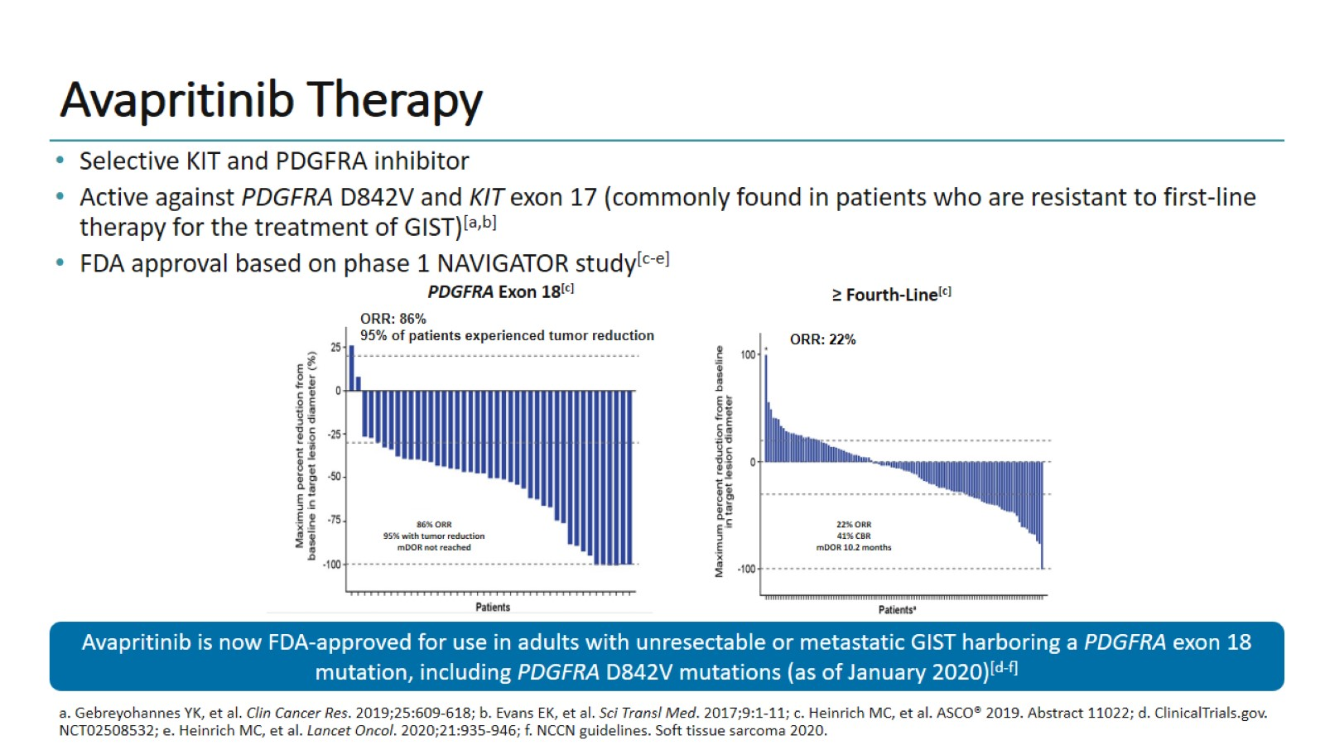
Avapritinib Therapy
Notes:
In this phase 1 study, it demonstrated a significant overall response rate of 86%, and showed 95% of the patients with tumor shrinkage; the medium progression-free survival has not been reached. This really exciting based on this phase 1 results, avapritinib has recently been FDA-approved for the front-line setting in patients with PDGFRA D842V and other exon 18-mutant GIST.

Slide 59

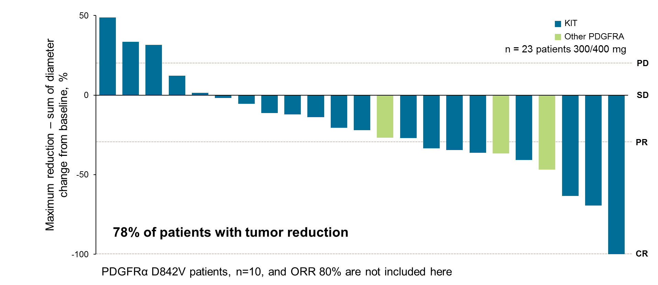
Avapritinib vs Regorafenib (3rd line): phase III Voyager trial
ORR for avapritinib in regonaive pts: 26%
*ORR with Regorafenib: 5%
3L/4L
GIST
R, 1:1
avapritinib
regorafenib
Primary endpoint: PFS
(NCT03465722)
Phase III VOYAGER trial comparing avapritinib to regorafenib failed to meet the primary endpoint (2020) and avapritinib did not received the regulatory authorization fot the treatment of KIT-mutant GIST
Heinrich et al, CTOS 2018
*Demetri G. et al, Lancet, 2012

Slide 60
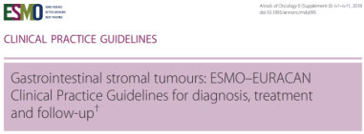

Impact of concomitant medications in pts treated with post-IM TKIs
Anti-acids and sunitinib efficacy in mRCC
When treatment is started, the pt should be alerted to the importance of interactions with concomitant medications and foods, and the best ways to handle side-effects.
Esomeprazole and pazopanib in solid tumors
Ha et al, JOPP 2015
OS
Tan et al, CCP 2013
Bioavailibility
decreasing:
30-50%
Esomeprazole/PPIs and pazopanib in STS
PPIs and sunitinib efficacy in GIST
 | mPFS
PPI=0 | 7,8
PPI=1 | 3
Higher co-medications in elderly
Mir et al, ASCO 2018
Mir et al, Clin Cancer Res 2019

Slide 61
TRK fusion sarcoma patients (n=51): Subtypes*
Inflammatory myofibroblastic
tumor (10%)
NOS (8%)
Peripheral nerve sheath (8%)
NOS (8%)
Myopericytoma (4%)
Spindle cell (14%)
Spindle cell (14%)
Infantile myofibromatosis (2%)
Not determined (2%)
GIST (10%)
GIST (10%)
Spindle, epithelioid (2%)
Small round cell (2%)
Stromal (2%)
Infantile fibrosarcoma (35%)
Lipofibromatosis (2%)
Infantile fibrosarcoma (35%)
*Based on Investigator assessment
GIST, gastrointestinal stromal tumor; NOS, not otherwise specified.

Slide 62

First-generation TRK inhibitors are active in TRK fusion-positive cancers

Slide 63
Novel Therapeutic strategy in GIST
A literature search revealed more
than 300 clinical in trials testing
more than 85 molecules
including 17 trials
with immunotherapeutic agents
Majority are disappointing, other awaited…
Adapted from
C. Vallilas et al, Intern J Molec Science 2021
Role of the receptors in the activation of signaling pathways in GISTs

Slide 64
Overall survival – Advanced GIST
1.0
+ impact of new/old agents (not all on the market):
Avapritinib, Ripretinib, Cabozantinib, pazopanib, nilotinib, larotrectinib, sorafenib, dasatinib….Imatinib, 1 yr more!!
0.9
0.8
0.7
BFR14 trial:
Median OS : 75.9 m (6.4 yrs)
0.6
Survival probability
0.5
B2222 trial
Median OS: 58 m
0.4
0.3
0.2
Historical
Median OS 12 m
0.1
0.0
0
6
12
18
24
30
36
42
48
54
60
66
72
78
84
90
96
102
108
114
120
Months
Until early TKI’s switch based on liquid biopsy datas do not have an impact on OS,
each lines of TKIs have to be optimized!!!
Blanke et al, JCO 2008
Le Cesne et al, Lancet Oncol 2010
Patrikidou et al, EJC 2015

Slide 65
Μαθήματα που πήραμε από τα GIST
Ο στόχος θα πρέπει να είναι βιολογικά σχετικός
KIT/PDGFR είναι οι ογκογενετικοί οδηγοί για τα περισσότερα GIST
Δεν είναι ανάγκη η θεραπεία να είναι κυτταροτοξική για να έχουμε όφελος
Η θεραπεία θα πρέπει να έχει περιορισμένη τοξικότητα λόγω της χρόνιας χορήγησης της
Τα καρκινικά κύτταρα αναπτύσσουν μηχανισμούς επιβίωσης για να υπερκεράσουν τον αναστελλόμενο στόχο
Τα GIST άνοιξαν τον δρόμο ως μοντέλο ανάπτυξης καινοτόμων φαρμάκων

Slide 66

Concluding thoughts for GISTs
Notes:
My personal experience or my personal impression is that over the past 2 decades we have made tremendous progress in a disease that was untreatable until the year 2000. We have transformed this aggressive malignancy by developing and exploring a series of tyrosine kinase inhibitors in the clinic into a chronic disease status; this is really impressive. What is even more impressive is the fact that we added 2 additional lines of treatment options for GIST patients only this year. I of course hope that our treatment results will improve further in the near future by additional clinical testing and clinical trials, leading to development of new treatment strategies for GIST.

