Slide 1
Στρατηγική θεραπείας πρωτοπαθών όγκων των οστών
Anastasios Kyriazoglou MD,PhD
2nd Propaedeutic Department of Medicine, Attikon University Hospital

Slide 2
Καλύτερη έκβαση όταν αντιμετωπίζονται σε εξειδικευμένα κέντρα
OS
PFS
Γαλλική αναδρομική μελέτη
Derbel, PLOS One 2017

Slide 3
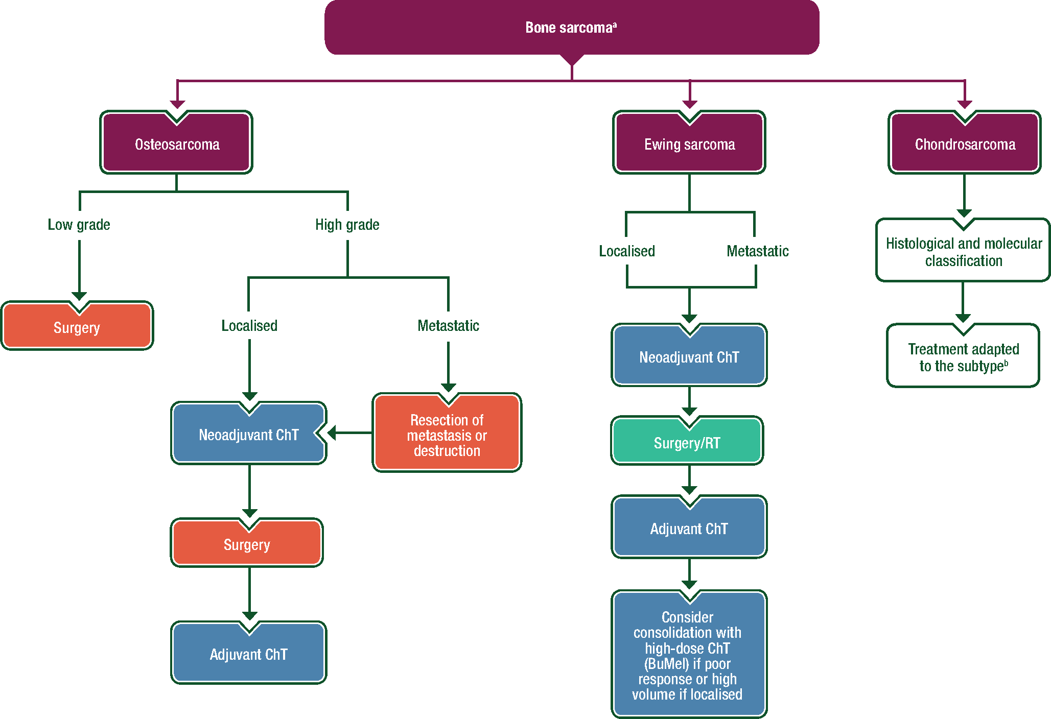

General therapeutic strategy for the three most frequent bone sarcomas.
Notes:
Figure 2. General therapeutic strategy for the three most frequent bone sarcomas. <sup>a</sup>The treatment of primary bone sarcoma must be carried out in a bone sarcoma reference centre. <sup>b</sup>Depending on the chondrosarcoma subtype, treatment can be surgery, neoadjuvant and adjuvant ChT or RT. BuMel, busulfan and melphalan; ChT, chemotherapy; RT, radiotherapy.
Unless provided in the caption above, the following copyright applies to the content of this slide: © The Author(s) 2018. Published by Oxford University Press on behalf of the European Society for Medical Oncology. All rights reserved. For permissions, please email: journals.permissions@oup.com.This article is published and distributed under the terms of the Oxford University Press, Standard Journals Publication Model (https://academic.oup.com/journals/pages/about_us/legal/notices)

Slide 4
osteosarcoma

Slide 5
Prognosis
Tumor size
Site
Mets
Histologic response to chemo (> 90% tumor necrosis)
Surgery + margins
Female sex better

Slide 6
History of osteosarcoma treatment
Before the 1970s patients underwent amputation and no chemotherapy
Long term overall survival was <20%
Introduction of chemotherapy in the early 1970s significantly improved outcomes
By the mid 1980s long term overall survival up to 50-60%
Some studies showed better rates, but overall little significant improvement for over three decades
Anninga JK et al. Eur J Cancer 2011;47(16):2431-45.
Notes:
Before the 1970s when patients underwent amputation with no chemotherapy the long term overall survival was <20%. By the mid 1980s, following the introduction of chemotherapy, long term overall survival was up to 50-60% [Anninga 2011/P2432/Col1/Para 1/L8-12 & Fig1]. Some studies showed better rates, but overall there has little significant improvement for over three decades [Anninga 2011/P2432/Col1/Para 1/L11-12 & Fig1].
A meta-analysis of chemotherapy studies showed a 5 year overall survival of 60% with a 2-drug chemotherapy regimen compared with 66% for 3-drug regimen (p=0.04) [Anninga 2011/P2439/Discussion/Para 2/L5-6]. There was no benefit of adding a fourth drug [Anninga 2011/P2440/Col1/Para 1/L2-6].
Most investigators agree that treatment has reached a plateau [Meyers 2009/P1035/Col2/Para 1/L6-10].
References
Anninga JK, Gelderblom H, Fiocco M et al. Chemotherapeutic adjuvant treatment for osteosarcoma: Where do we stand? Eur J Cancer 2011;47(16):2431-45
Meyers PA. Muramyl tripeptide (mifamurtide) for the treatment of osteosarcoma. Expert Rev Anticancer Ther 2009;9:1035-49.

Slide 7
ΟΣΤΕΟΣΑΡΚΩΜΑ
Δεκαετία του 1980 :
2-ετής επιβίωση
Χωρίς υποτροπή
113 ασθενείς
τυχαιοποίηση = 36
ελεύθερη επιλογή = 77
Παρακολούθηση 17%
R
Επικουρική ΧΜΘ 66%
p<0.001
HD MTX, Cisplatin, Doxorubicin
Bleomycin/Cyclophosphamide/Actinomycin D
Link MP, N Engl J Med 1986 Jun 19;314(25):1600-6.

Slide 8
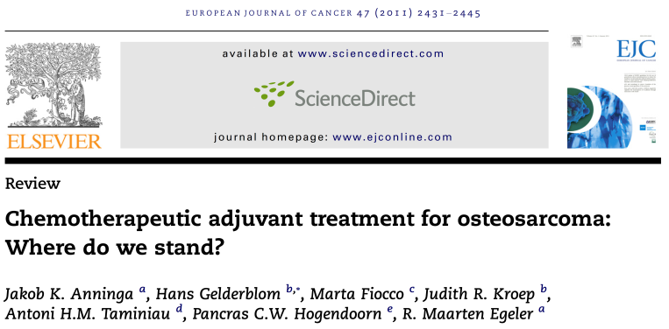
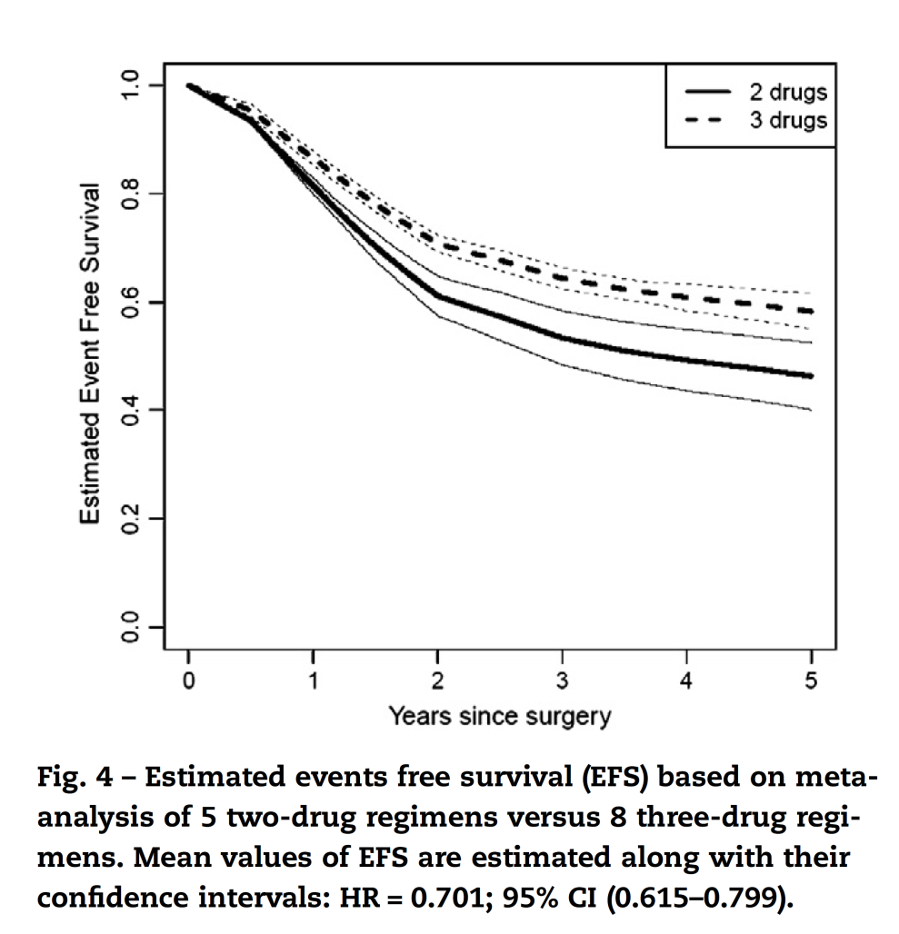
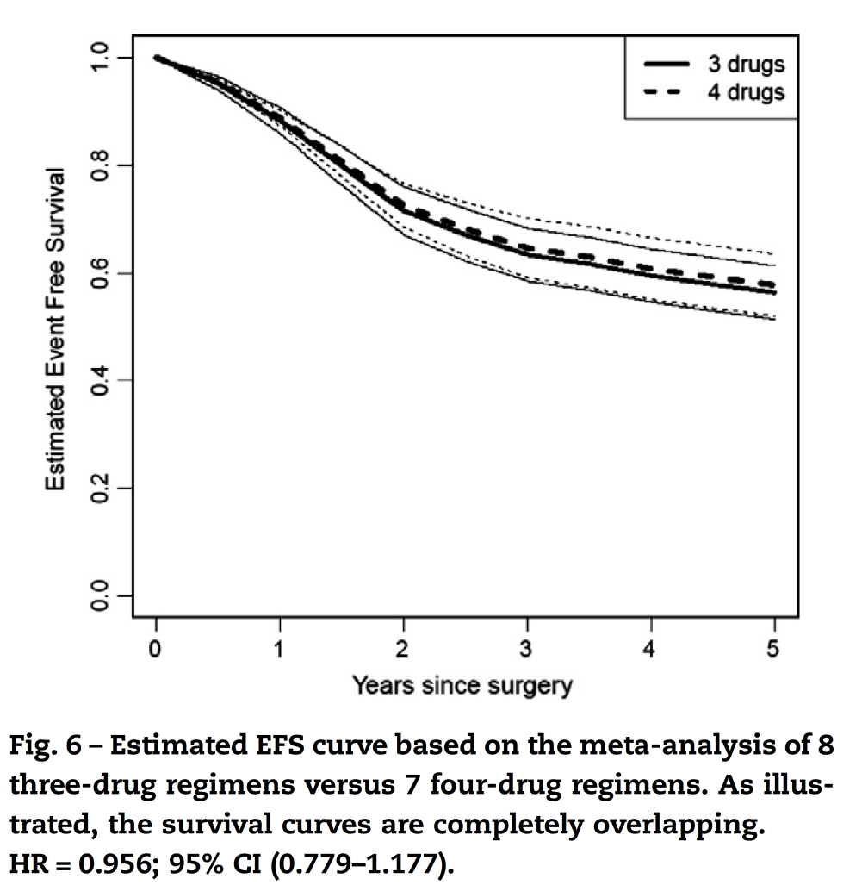
A meta-analysis of chemotherapy studies showed a 5 year overall survival of 60% with a 2-drug chemotherapy regimen compared with 66% for 3-drug regimen (p=0.04)

Slide 9

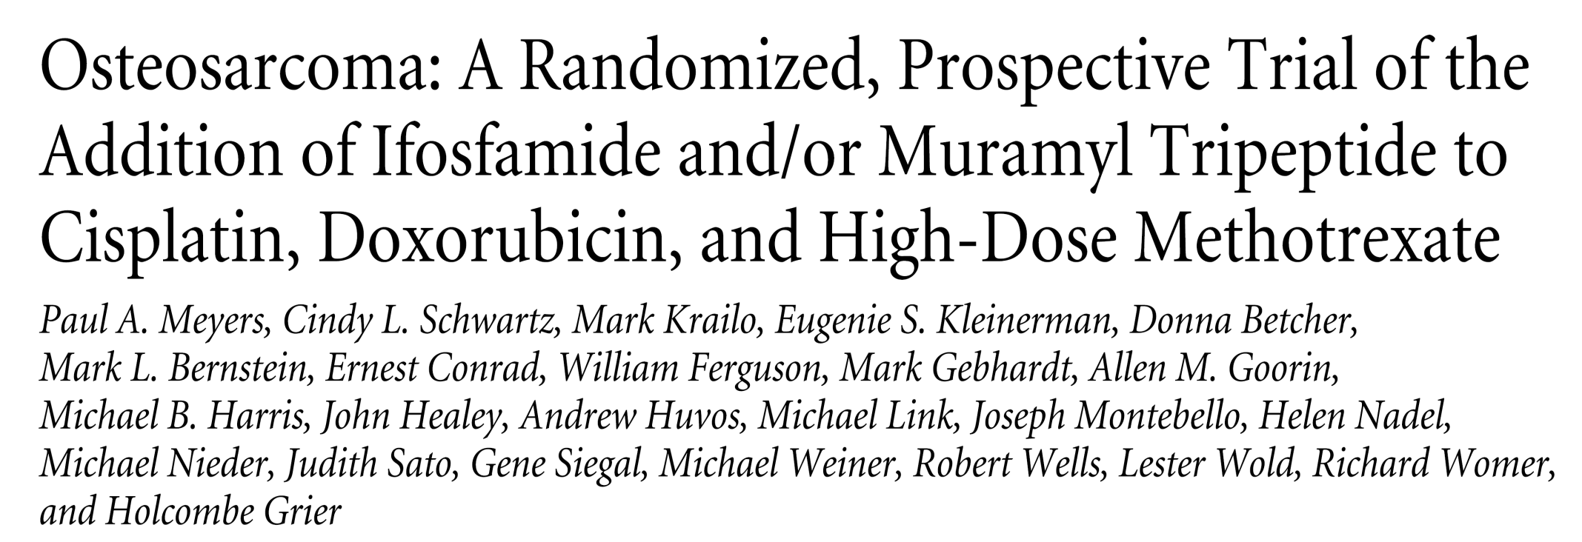

POG/CCG
Meyers et al
2005

Slide 10
Phase III Study Design
RANDOMI
SATION
INDUCTION
D E F I N I T I V E S U R G E R Y
H
I
STOLOG
I
CAL
EVALUAT
I
ON
MAINTENANCE
A
Cisplatin
Doxorubicin
HDMTX
Cisplatin, Doxorubicin, HDMTX
A-
Cisplatin, Doxorubicin, HDMTX, MTP (Mepact)
A+
B
Ifosfamide
Doxorubicin
HDMTX
Ifosfamide, Cisplatin, Doxorubicin, HDMTX
B-
Ifosfamide, Cisplatin, Doxorubicin, HDMTX, MTP (Mepact)
B+
20
27
36
Weeks
Regimens A and B: Doxorubicin x 6 ea (25 mg/m²/day x 3), Cisplatin x 4 ea (120 mg/m²), and Methotrexate x 12 ea (12 g/m²)
Regimen B only: Ifosfamide x 5 ea (1.8 g/m²/day x 5)
HDMTX = High-Dose Methotrexate;
Adapted from:
Meyers PA et al. J Clin Oncol 2005;23:2004-2011
Meyers PA et al. J Clin Oncol 2008;26:633-638
Notes:
10
The first question was a comparison of three drug chemotherapy without ifosfamide to four drug chemotherapy including ifosfamide.
The second question was whether the addition of MTP to the maintenance therapy would improve the outcome.
The objective of this design was to answer each question independently, that is to determine the efficacy of MTP by comparing the patients in both groups assigned to receive MTP (A+ and B+) to the the patients in both groups assigned not to receive MTP (A- and B-). This was the prospective design of the study. In the course of the study we the COG enrolled 662 patients with localized osteosarcoma.

Slide 11
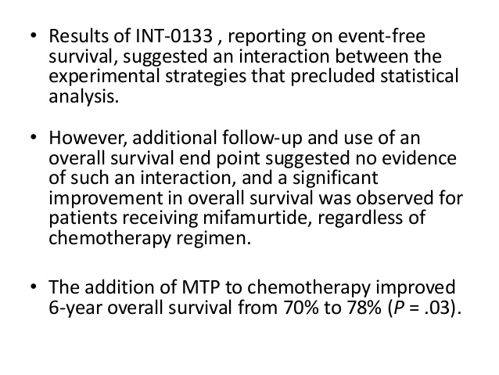

Slide 12
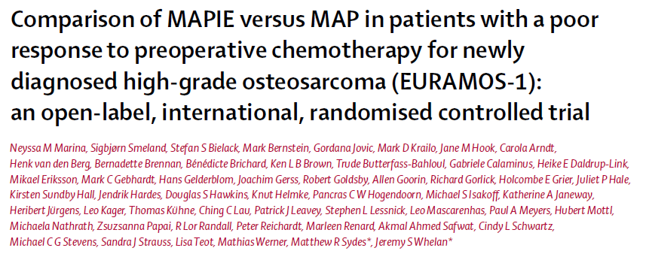


Slide 13
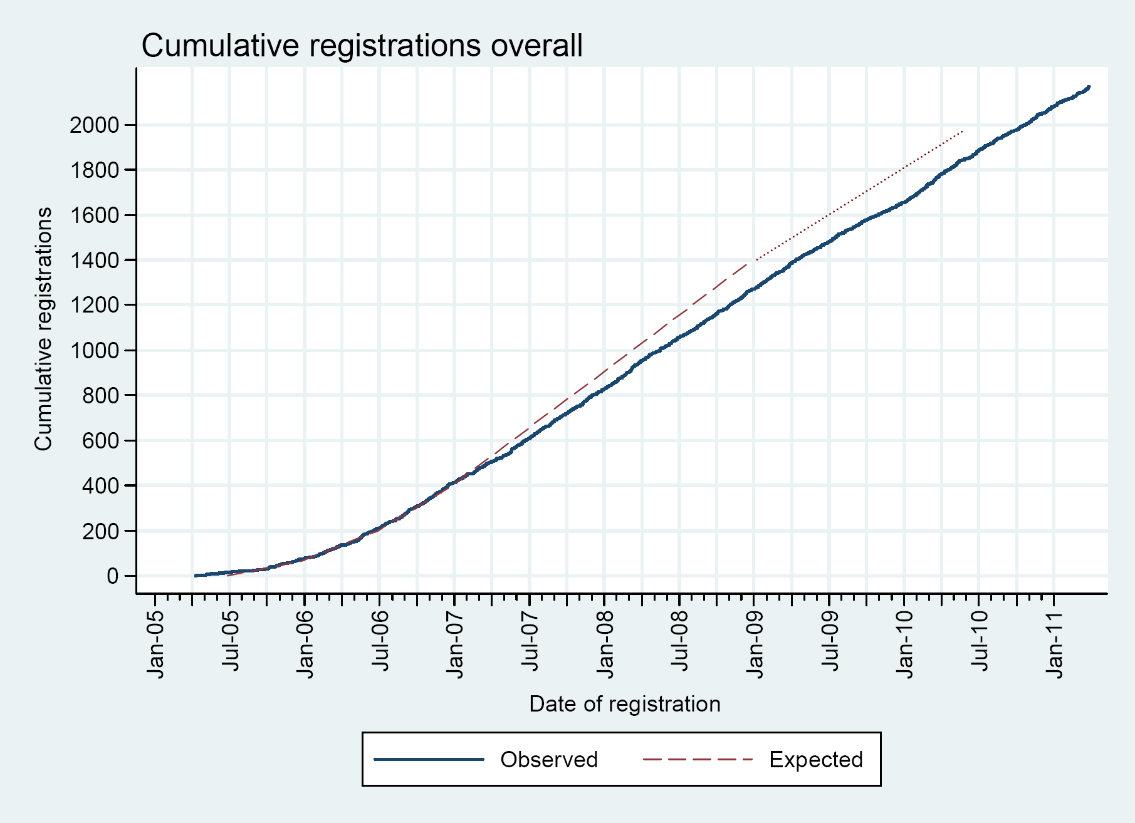
EURAMOS Recruitment 04/05 – 06/11
2.260 patients
from 326 institutions
in 17 countries
Thanks to EURAMOS-CDC,
MRC London

Slide 14
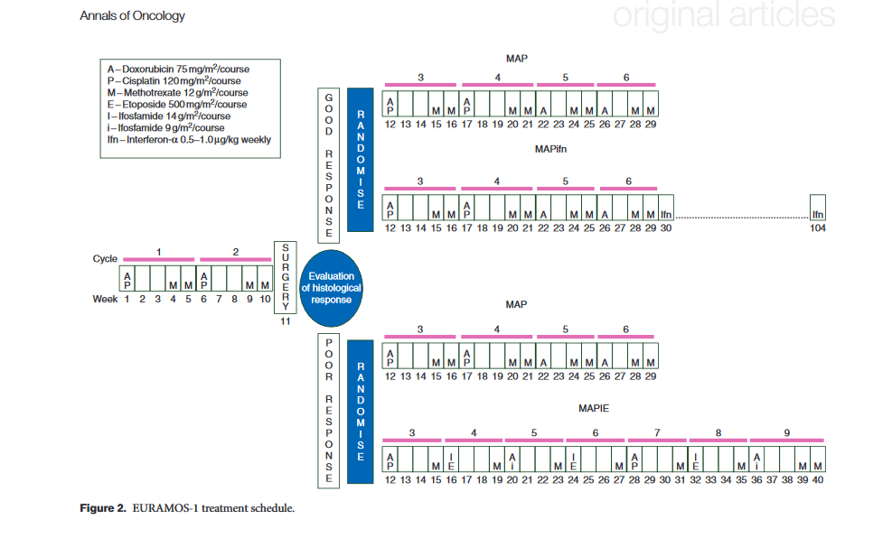

Slide 15
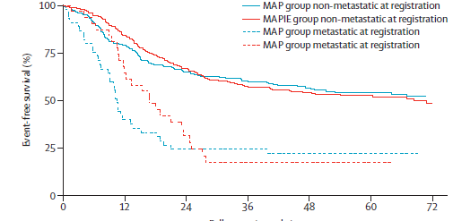
MAPIE vs. MAP in Poor Responders Event-Free Survival
Notes:
---------------Gordana’s notes ---------------
RMST - interpretation of results
Because hazards are not proportional, another summary of difference between the treatments has been used. Difference is expressed in terms of Restricted Mean Survival Time; RMST is an average event-free time over a 5-year period after randomisation.
Time to first event is on average 37.5 month in MAP arm and 38.1 months in MAPIE arm, when time to 5 years from randomisation is considered. The difference in average times to first event is 0.6 months (18 days), in favour of MAPIE arm (time to first event is on average 18 days longer in MAPIE arm). The difference is not statistically significant, therefore we can conclude that there is not enough evidence to suggest that there is EFS difference between the two treatment arms.
---------------------------
Other points:
-lower event rate than predicted (expected/observed 3y EFS 45%/55%)
-target/observed number of events (378/300)
-consequence: need more time to reach target number of events
At the end of the talk, there is an additional slide with event prediction – time to reaching the target number of EFS events

Slide 16
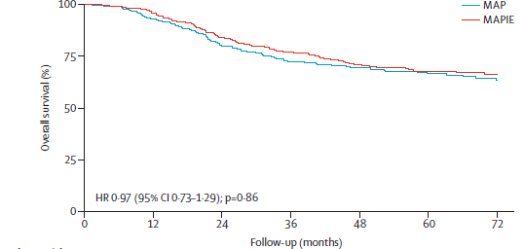
MAPIE vs. MAP in Poor Responders Overall Survival

Slide 17
MAPIE more toxic than MAP
MAPIE: More grade III/IV toxicity (examples)
febrile neutropenia 73% vs. 50%
infection 83% vs. 65%
hypophosphatemia 29% vs. 19%
MAPIE: More secondary leukemias
- MAPIE ≥7/307 vs. MAP 2/308
Notes:
----- Meeting Notes (10/12/14 17:11) -----
In conclusion:
1. We find no evidence of an advantage of MAPIE over MAP in terms of EFS or OS
2. Fewer MAPIE patients received the intended dose
3. MAPIE was associated with greater toxicity and a higher risk of second malignancies.

Slide 18
EURAMOS-1 Conclusions
Poor Response Adding ifosfamide and etoposide to MAP is associated with additional morbidity and has no effect on survival outcomes.
Notes:
----- Meeting Notes (10/12/14 17:11) -----
In conclusion:
1. We find no evidence of an advantage of MAPIE over MAP in terms of EFS or OS
2. Fewer MAPIE patients received the intended dose
3. MAPIE was associated with greater toxicity and a higher risk of second malignancies.

Slide 19
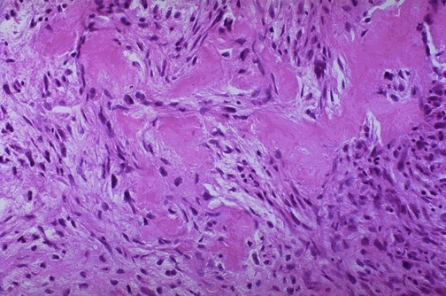
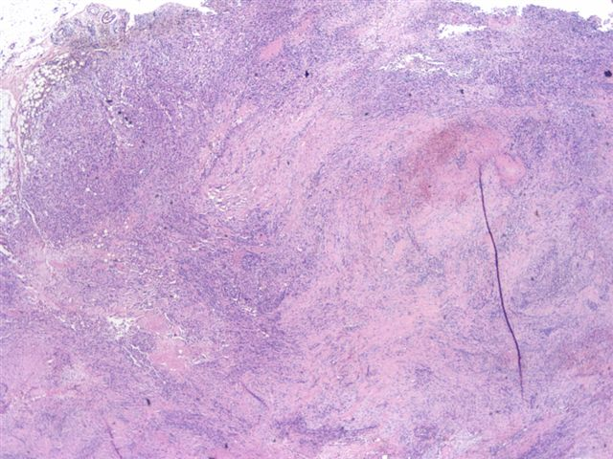
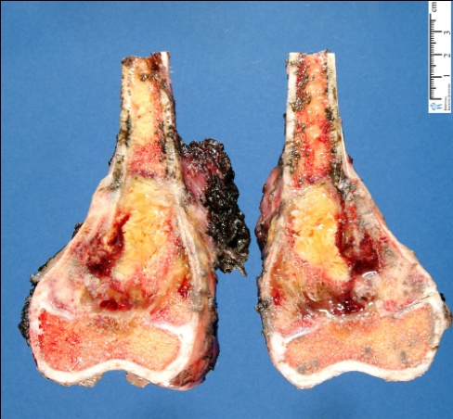
Ιστολογική ανταπόκριση μετά από εισαγωγική χημειοθεραπεία
Η οστική νέκρωση είναι ισχυρός προγνωστικός παράγοντας και σχετίζεται με DFS και OS
Poor responders with tumor necrosis < 90%
Good responders with tumor necrosis > 90%
Rosen G, et al. Cancer 1982;49(6):1221–30
Bielack SS, et al. J Clin Oncol 2002;20:776–90.

Slide 20
Ιστολογική Ανταπόκριση
Πώς αντιμετωπίζονται μετεγχειρητικά οι ασθενείς με πτωχή ανταπόκριση σε εισαγωγική χημειοθεραπεία;
Αλλάζουμε το χημειοθεραπευτικό σχήμα;

Slide 21
Treatment
If postop > 10% viable tumor→ change regimen ?
If <40 y.o→ add methotrexate
If methotrexate intolerant→ ifo
Adj RT if incompletely resected

Slide 22
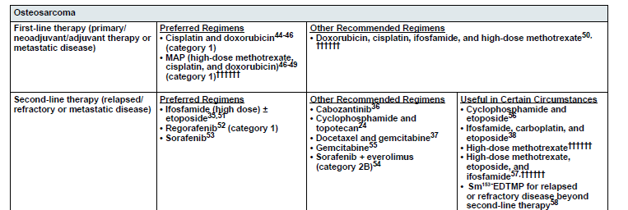

Slide 23
Ewing sarcoma

Slide 24
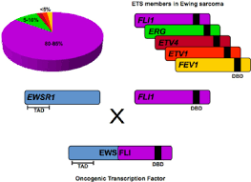
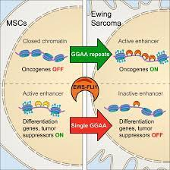
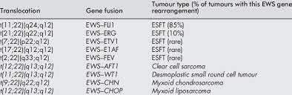
Ewing’s molecular biology

Slide 25
INT-0091 TRIAL
NON METASTATIC
VACD (Doxo, Vincristine, Cycloph/Mesna, actinomycin-D at cycle 11)
Vs VACD-IE (alternative with Ifo/Mesna/Etoposide)
→VACD-IE: Increase of OS 11% (72% vs 61% )
Increase of EFS
decrease of incidence of local failure

Slide 26
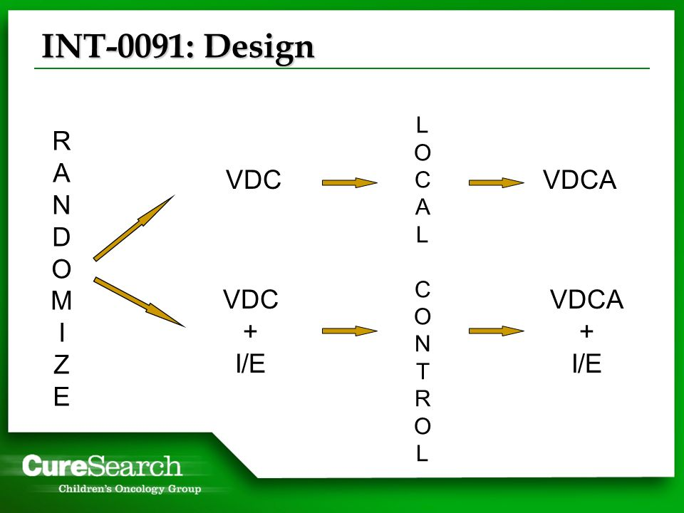

Slide 27
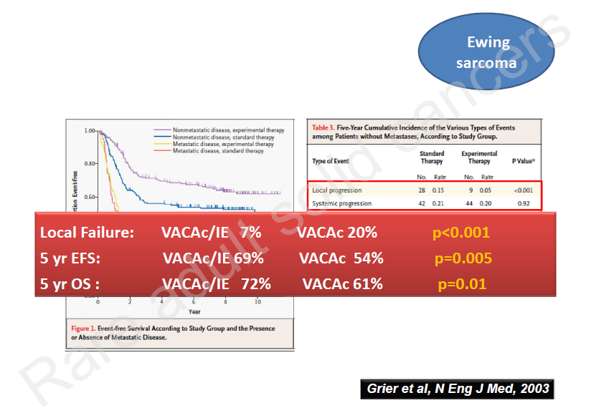

Slide 28
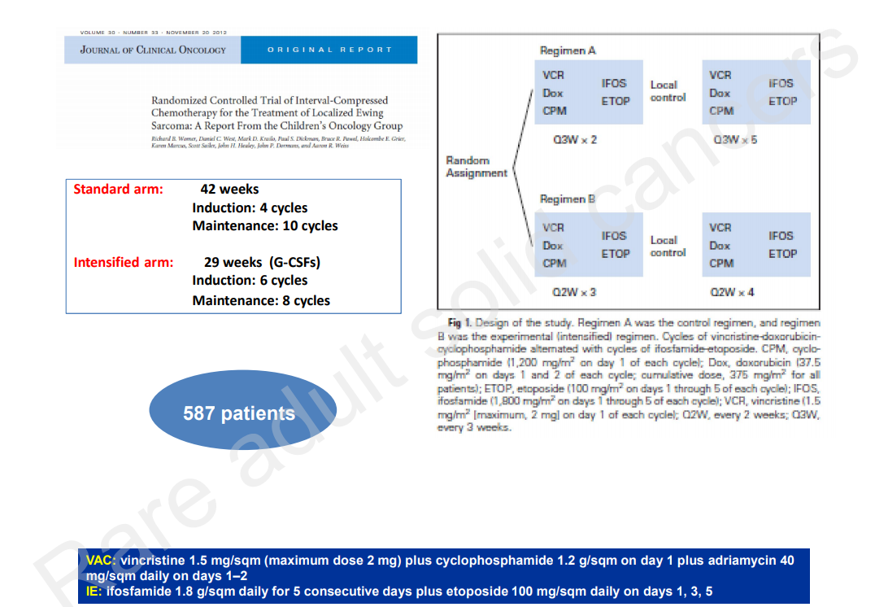

Slide 29
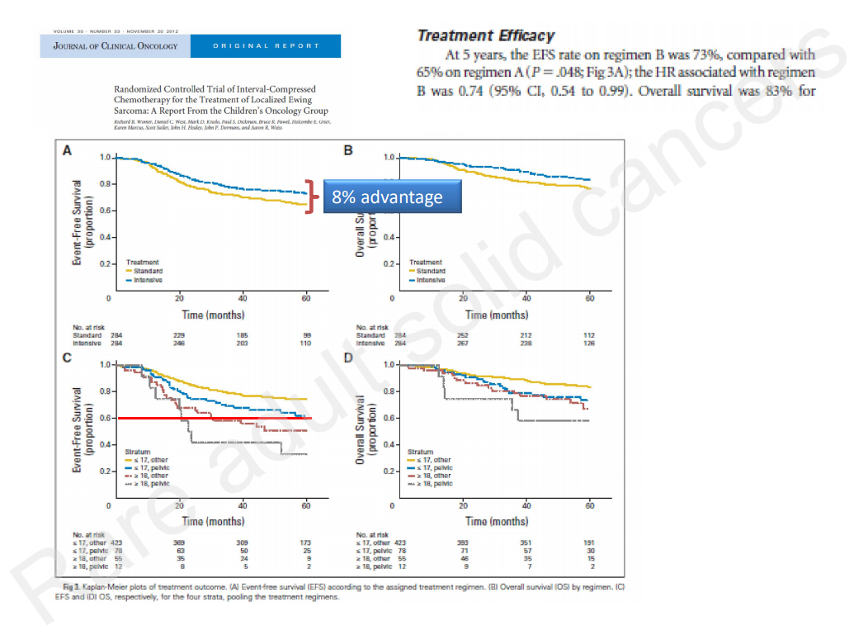

Slide 30
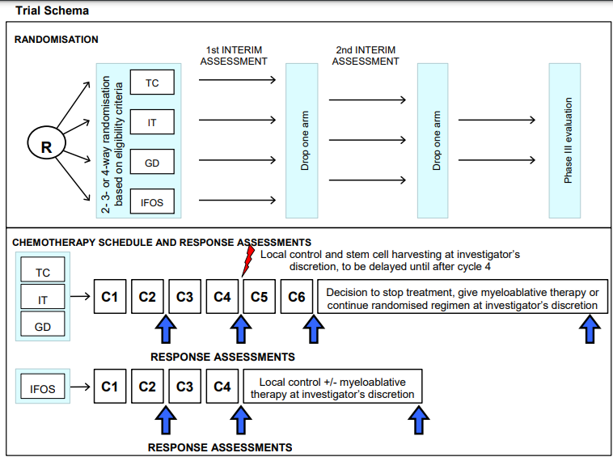
rEECur

Slide 31
rEECur trial
Background: Five-year survival of RR-ES is about 15%. Several chemotherapy regimens are used, but without robust evidence. rEECur, the first randomised controlled trial in this setting, is defining a standard of care, balancing efficacy and toxicity. Methods: Patients aged 4 to 50 with RR-ES and fit to receive chemotherapy were randomised between topotecan & cyclophosphamide (TC), irinotecan & temolozomide (IT), gemcitabine & docetaxel (GD) or high-dose ifosfamide (IFOS). Primary outcome measure was objective response (OR) after 4 cycles by RECIST 1.1. Secondary outcomes included PFS, OS and toxicity. A probability-based Bayesian approach was used with multiple pairwise comparisons. At the first interim analysis patients allocated to GD had worse OR and PFS than the other arms and accrual to the GD arm was halted. The second interim assessment was planned to determine which arm should be closed when at least 75 evaluable patients had been recruited to the remaining arms and evaluated for the primary outcome measure. Results: 366 patients (87% RECIST-evaluable), recruited between 18/12/14 and 17/12/19, were randomised to TC (n=124), IT (118), GD (72) and IFOS (53). Median age was 20 years (range 4-49). Patients had: refractory disease (19%), first recurrence (66%), > first recurrence (14%). Initial disease site was bone in (66%). Sites of progression were: primary site only (16%) pleuropulmonary only (32%), other metastatic (52%). At median follow up of 9.2 months, outcome in the IT arm was: response rate 20%, median PFS 4.7 months (95% CI: 3.4 to 5.7), median OS 13.9 months (95% CI: 10.6 to 18.1). The table shows, for each pairwise comparison of IT with the other open arms (randomly labelled A and B to maintain blinding), the probabilities that OR, PFS and OS were better for X than for each other arm (RR = risk ratio, HR = hazard ratio). For OR, PFS and OS, all comparisons favoured arms A and B. The main grade 3/4 adverse events (% patients with an event) for IT (left hand values) compared with A and B pooled were: vomiting (6% v 1%), nausea (6% v 0%), diarrhoea (17% v 0%), fatigue (3% v 1%) and febrile neutropenia (3% v 24%). Conclusions: The first randomised trial in RR-ES has shown that IT, used as a control arm in planned and ongoing randomised phase II studies in RR-ES, is less effective than A and B in achieving tumour shrinkage or prolonging PFS and OS. The remaining two arms are continuing to recruit patients. Clinical trial information: ISRCTN36453794.
Pairwise comparison OR
Pr(true RR >1) PFS
Pr(true HR <1) OS
Pr(true HR <1)
IT v A 41% 7% 32%
IT v B 44% 33% 38%

Slide 32
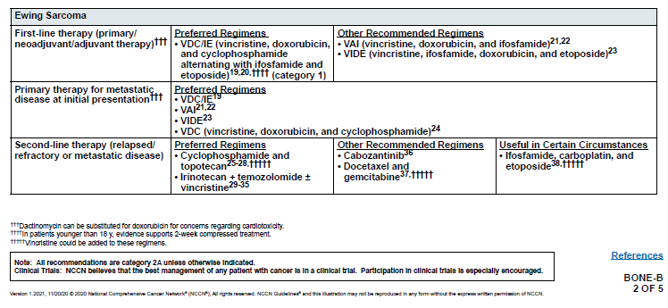
Systemic treatments

Slide 33
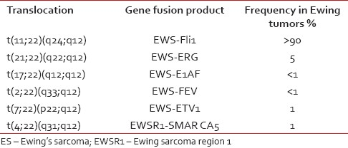
Ewing sarcomas
TK216: Small molecule EWS/FLI1 inhibitor (ets transcription factor inhibitor)
Phase I study of TK216, a novel anti-ETS agent for Ewing sarcoma
Observed efficacy was partial response (PR) 18% (2/11), stable disease 45% (5/11), for an overall clinical benefit rate of 64% (7/11). 3 of the patients experienced PD before reaching C2 evaluation (overall PD 36% (4/11).
Annals of Oncology (2020) 31 (suppl_4): S914-S933. 10.1016/annonc/annonc288, ESMO2020

Slide 34
Nivo-sutent, bone sarcomas
Background: Herein, we present the results of the cohort on advanced bone sarcoma patients of the phase II part of the IMMUNOSARC study (NCT03277924), a European multicentre phase I-II trial aimed at investigating the activity of the combination of sunitinib (SU) and nivolumab (NI) in selected advanced sarcoma subtypes. Methods: Adult, pre-treated, progressing patients, ECOG 0-1, with a diagnosis of osteosarcoma, high-grade bone sarcoma, Ewing sarcoma, chondrosarcoma or dedifferentiated chondrosarcoma were eligible. SU 37.5 mg/day as induction was given days 1-14 and then reduced to 25mg/day continuously. NI was administered at 3 mg/Kg every 2 weeks from week 3. SU-NI was maintained up to progression or intolerance. Primary end-point was progression-free survival rate (PFSR) at 6 months (H1: PFSR 6-months: 15%). Secondary end-points: overall survival (OS), objective response rate (ORR) by RECIST v 1.1 and toxicity. Results: From Nov 2017 to Dec 2018, 40 eligible patients were included: (M/F = 27/13), median age 47 years (range 21-74), ECOG 0 in 11 (27%) cases, 36 (90%) were metastatic, 4 (10%) locally advanced. Histology: 17 osteosarcomas (43%), 14 chondrosarcomas (35%) (4 dedifferentiated), 8 Ewing sarcomas (20%), 1 bone undifferentiated pleomorphic sarcoma (2%). PFSR at 6 months based on local evaluation was 32%. At a median FU of 12.5 months (2-26), median PFS was 3.7 months (95% IC 3.4-4) while median OS was 14.2 months (95%CI: 7.1-21.3). OS rate at 3 and 6 months were 87% and 73%, respectively. ORR by RECIST: 1 CR (2.5%) (1 patient with dedifferentiated chondrosarcoma, lasting 22 months and on going), 1 PR (2.5%) (1 patient with osteosarcoma, lasting 5.7 months), 22 SD (55%, lasting > 6 months in 45% of the cases) and 16 PD (40%). G3/5 toxicities are detailed in Table. Conclusions: The trial met its primary endpoint in the cohort of patients with advanced bone sarcoma, with > 30% of patients free from progression at 6 months. Pre-planned tumor microenvironment genomic, exploratory analysis on pre and post-treatment tumor samples is on going. Clinical trial information: NCT03277924.

Slide 35

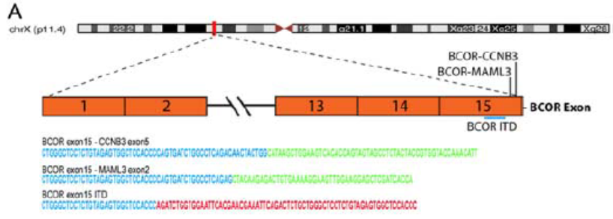
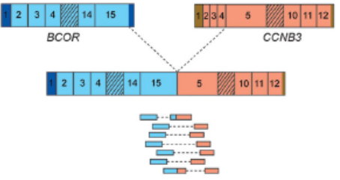
BCOR rearranged sarcomas
Undifferentiated round cell sarcomas (Ewing-like sarcomas) with BCOR genetic alterations
BCOR/CCNB3 and
BCOR/MAML3 fusion genes and
BCOR ITD (internal tandem duplications)

Slide 36

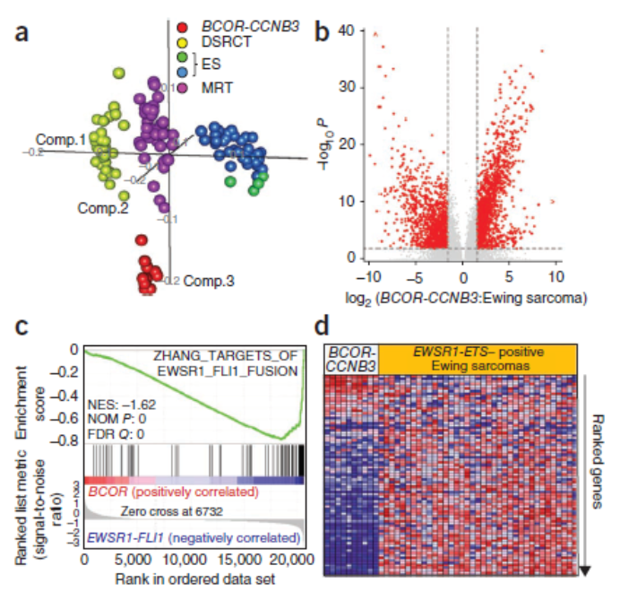
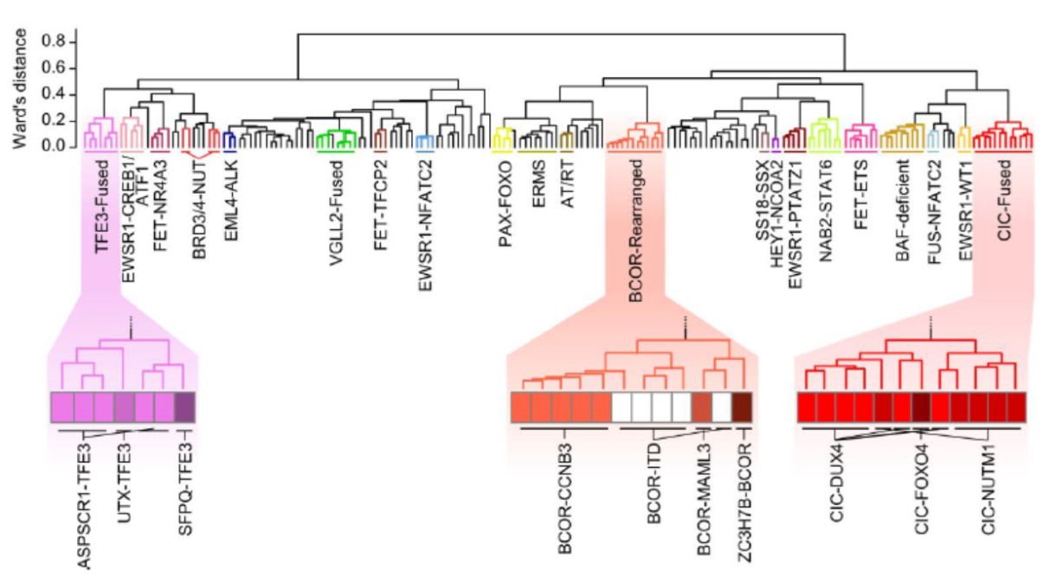
Discussion for treatment options
Expression data from BCOR sarcomas analyses show a different profile from Ewing sarcomas
Morphology and histopathology is distinct from Ewing sarcomas and other undifferentiated round cell sarcomas
Should BCOR rearranged sarcomas be treated like Ewing sarcomas?
Pierron G, et al. A new subtype of bone sarcoma defined by BCOR-CCNB3 gene fusion. Nat Genet. 2012 Mar 4;44(4):461-6
Watson S,et al. Transcriptomic definition of molecular subgroups of small round cell sarcomas. J Pathol. 2018 May;245(1):29-40

Slide 37
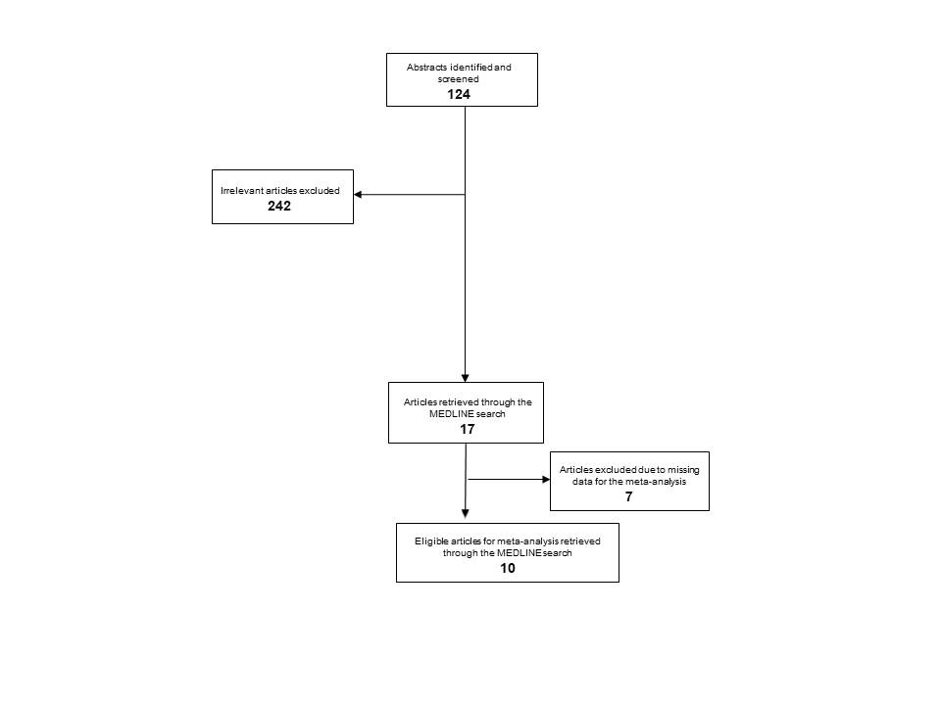
Meta-analysis
Medline search:
BCOR AND (neoplasm OR cancer OR sarcoma) AND (chemotherapy OR systemic therapy OR management OR clinicopathologic OR molecular OR clinical).
Time points: January 1, 2000 up to September 1, 2020
Kyriazoglou A, Bagos P – under review

Slide 38

Studies
Study | Year | Country | Patients | Ewing protocol patients | Non-Ewing protocol patients
Kao et al. (7) | 2017 | USA | 21 | 11 | 10
Yoshida et al. (23) | 2020 | Japan | 7 | 2 | 5
Puls et al. (3) | 2014 | USA | 10 | 8 | 2
Peters et al. (22) | 2014 | USA | 5 | 1 | 4
Kyriazoglou et al. (28) | 2020 | Greece | 5 | 4 | 1
Shibayama et al. (24) | 2015 | Japan | 3 | 3 | 0
Specht et al. (4) | 2016 | Germany-USA | 2 | 1 | 1
Mansor et al. (25) | 2018 | Singapore | 1 | 0 | 1
Han et al. (26) | 2019 | USA | 2 | 2 | 0
Muthukumarana et al. (27) | 2020 | USA | 1 | 0 | 1
Total |  |  | 57 | 32 | 25

Slide 39
Patients’ characteristics
 | Ewing Treatment =1 | Non-Ewing Treatment=0
N (%) | 32 (56.14) | 25 (43.86)
Age in years (sd) | 15.25 (9.28) | 25.08 (19.71)
Male (%) | 28 (87.50) | 19 (76.00)
Bones (%) | 16 (75.00 ) | 24 (64.00 )
Non metastatic at diagnosis (%) | 26 (81%) | 23 (92%)
BCOR-CCNB3 | 31 (97%) | 18 (72%)
Deaths (%) | 7 (21.88) | 5 (20.00)
Exposure in months (sd) | 48.21 (7.94) | 51.85 (8.52)
Personmonths (total ) | 1542.7 | 1296.3
Incidence Rate (death/personmonth) | 0.0045375 | 0.0038571

Slide 40

Ewing treatment when compared to non-Ewing treatment showed similar survival
Incidence Rate Ratio remained larger than one (indicating higher risk for Ewing treatment) but still was far from significance (IRR=1.176, 95% CI: 0.321, 4.700)
Long rank p=0.736
Cox hazards (HR=1.219, 95% CI: 0.284, 3.870, P=0.736)

Slide 41

Extra statistics
After adjusting for de novo metastatic cases results remain unaltered
Sex, age, the site of primary tumor (bone or soft tissue), as well as the type of BCOR fusion, similarly did not influence the result of treatment option to BCOR sarcoma patients

Slide 42
Conclusions
BCOR rearranged sarcomas can be treated with non-Ewing sarcoma protocols
BCOR rearranged sarcomas deserve their independence from Ewing sarcomas and the rest of the undifferentiated round cell sarcomas by limiting the use of the term Ewing-like sarcomas
A prospective clinical trial studying the administration of Ewing protocols to non-Ewing treatment strategy will ideally define the optimal therapeutic option for these tumors.

Slide 43
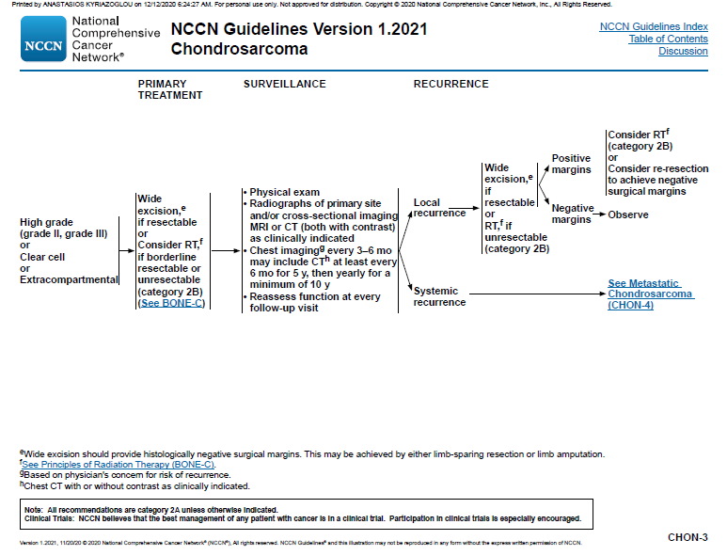
Chondrosarcoma

Slide 44
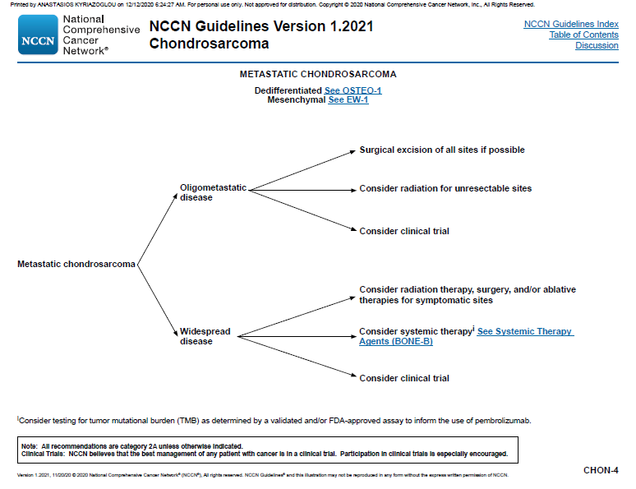

Slide 45
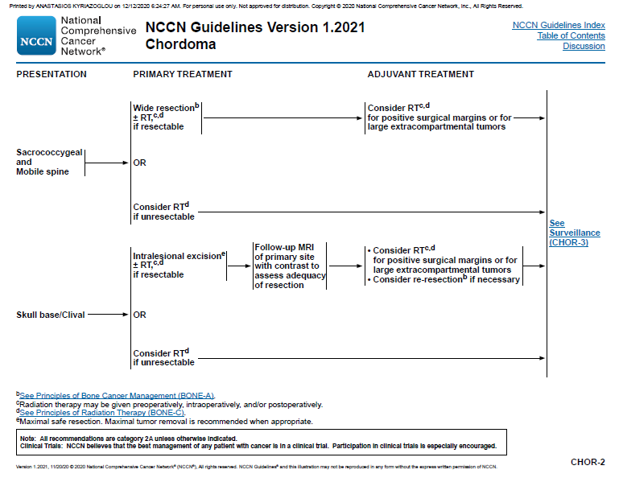
Chordoma

Slide 46
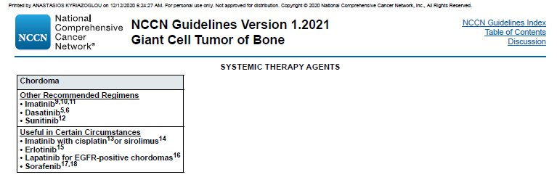

Slide 47
UPS (MFH)
Undifferentiated pleomorphic sarcoma (UPS), previously known as malignant fibrous histiocytoma (MFH), is considered the most common type of soft tissue sarcoma. It has an aggressive biological behavior and a poor prognosis.
As in the majority of the cases, UPS affects the extremities, this article focuses on musculoskeletal involvement.
Terminology
Malignant fibrous histiocytoma (MFH) was removed from the 2013 World Health Organization Classification of Tumors of Soft Tissue and Bone 7.
Epidemiology
Typically, UPS occurs in adults (range 32-80; mean 59 years) with a slight male predilection with an M: F ratio of 1.2:1)
Clinical presentation
The presentation is usually with a painless, enlarging palpable mass.

Slide 48
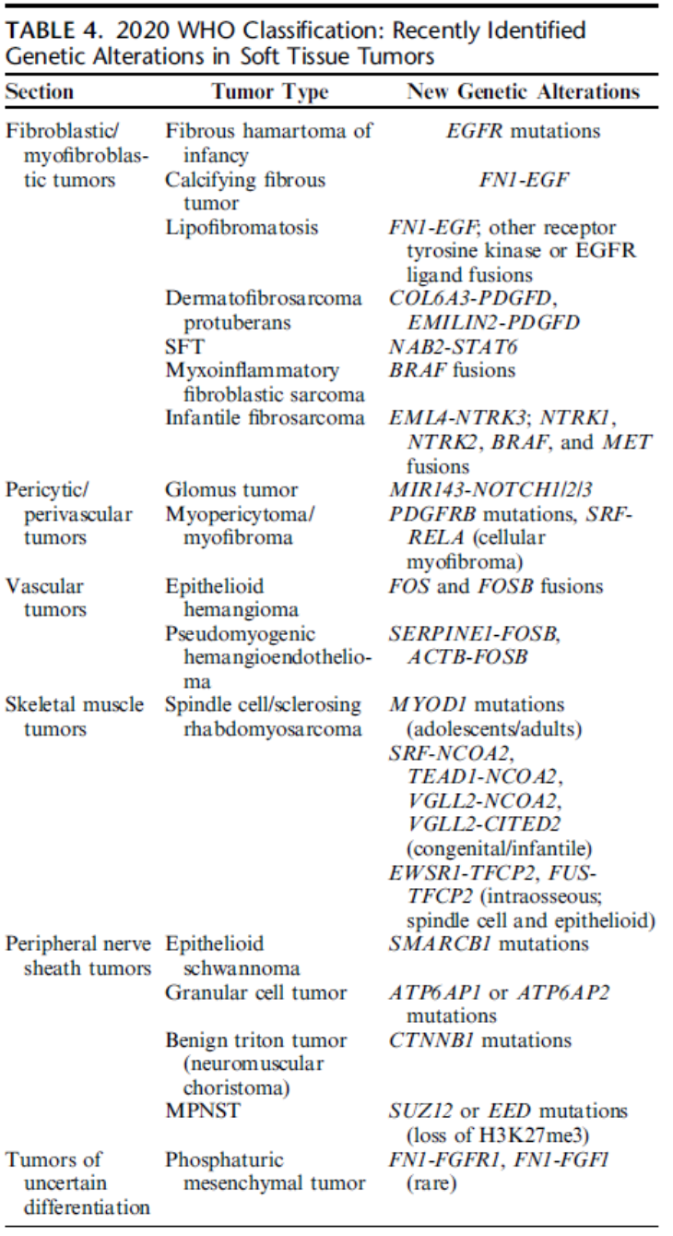
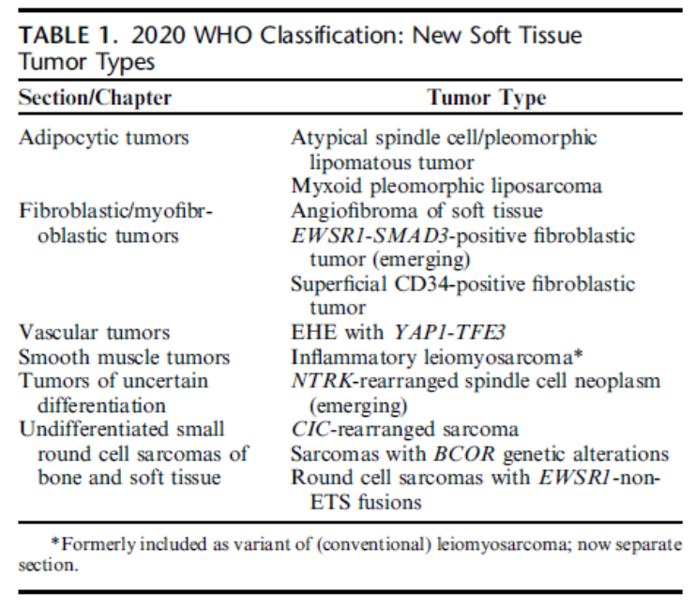
Histopathology
2020 WHO Classification of bone and soft tissue sarcomas identifies 120 tumor entities
New entities based on genetics

Slide 49
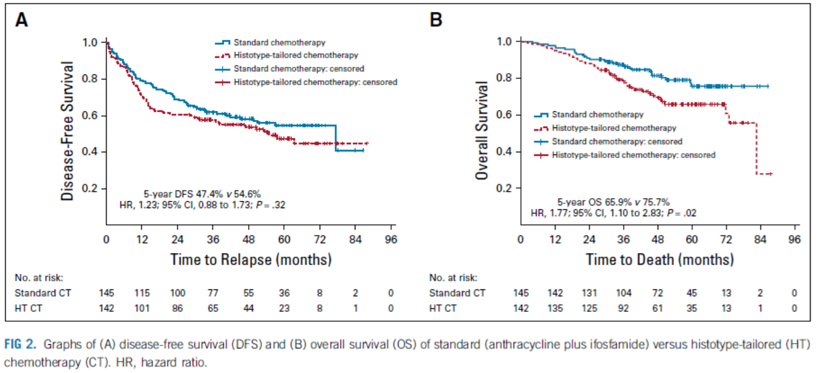
Systemic treatment
Doxorubicin (anthracyclines) is the gold standard!!!
Neoadjuvant Chemotherapy in High-Risk Soft Tissue Sarcomas: Final Results of a Randomized Trial From Italian (ISG), Spanish (GEIS), French (FSG), and Polish (PSG) Sarcoma Groups. Gronchi A, et al. J Clin Oncol. 2020. PMID: 32421444

Slide 50
Antiangiogenic TKIs tested in osteosarcoma
TKI | Type of trial | N | mPFS | Reference
Lenvatinib | Phase 2, single-arm | 31 | 3 m. | Gaspar et al., ASCO 2018
Sorafenib | Phase 2, single arm | 35 | 4 m. | Grignani et al., Lancet Oncol 2015
Regorafenib | Phase 2, placebo-controlled Phase 2, placebo-controlled | 42 43 | 5.3 m. 4.1 m. | Davis et al., JCO 2019 Duffaud et al., Lancet Oncol 2019
Apatinib | Observational | 10 | 7.5 m | Zheng et al., Medicine 2018
Cabozantinib | Phase 2 | 42 | 6.2 m. | Italiano et al., Lancet Oncol 2020

Slide 51
Regobone> osteosarcoma cohort
Double-blind placebo-controlled ph.2 trial
Patients ≥10 y.
1-2 previous lines for metastatic disease
Regorafenib 160 mg/d, 21/28 days
N=43
Cross-over
At 8 w.: 17/26 (65%) non-PD v. 0/12
24% SAE with regorafenib (hypertension, hand-foot skin reaction, fatigue, hypophosphataemia, chest pain)
French Sarcoma Group, Duffaud et al., ASCO 2018

Slide 52
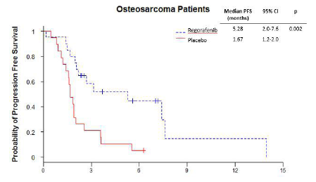
Regorafenib in refractory osteosarcoma / SARC024
USA, similar design (phase 2, placebo-controlled, randomized), 1:1 R, ≥1 prior therapy
N=42
Median PFS 5.3 v. 1.7 m.
Median OS 26.7 m. (regorafenib)
11 patients crossed-over
AE
Davis et al., CTOS 2018 (Paper 041)

Slide 53
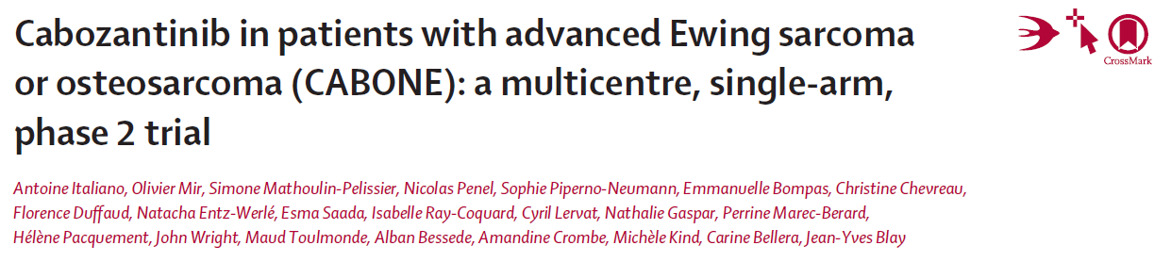
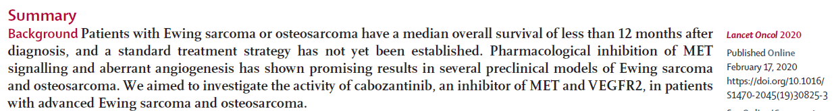
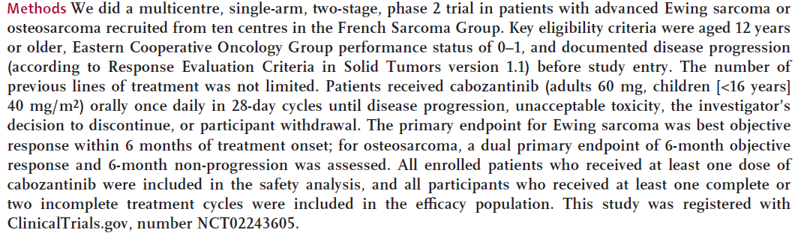

Slide 54
CABONE: Cabozantinib in bone sarcomas
Collaborative French/USA single-arm, phase II study
Ewing Sarcoma, osteosarcoma
Cabozatinib orally: adults 60 mg/d, children 40 mg/m2/d
mF.U. 31.3 m.
N= 81 (42 OS + 39 ES)
10 ES (26%) objective response by 6 months
5 OS (12%) objective response by 6 months & 14 OS (33%) non-PD at 6 months
68% at least 1 SAE
Italiano, CTOS 2018 (paper 042)
Italiano, Lancet Oncol 2020

Slide 55
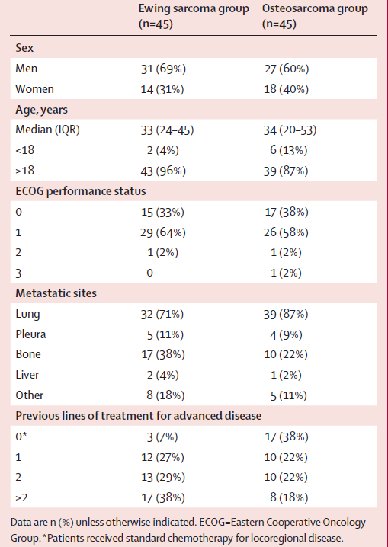
Patients’ characteristics

Slide 56
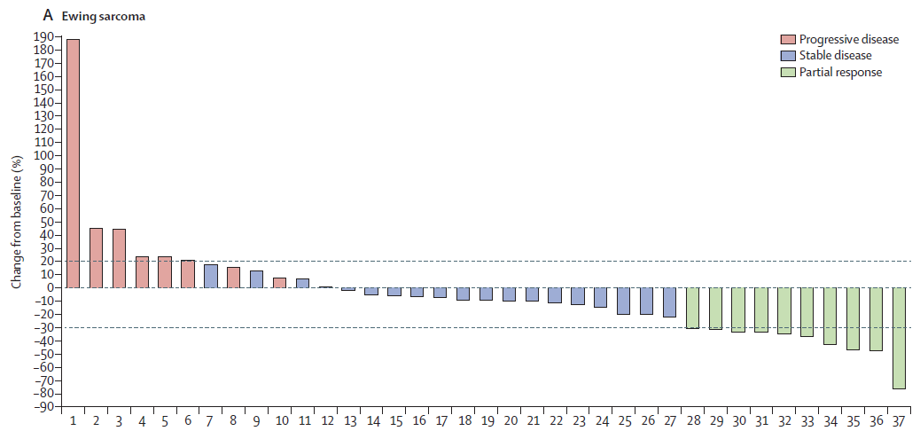
Best overall response in patients with Ewing sarcoma

Slide 57
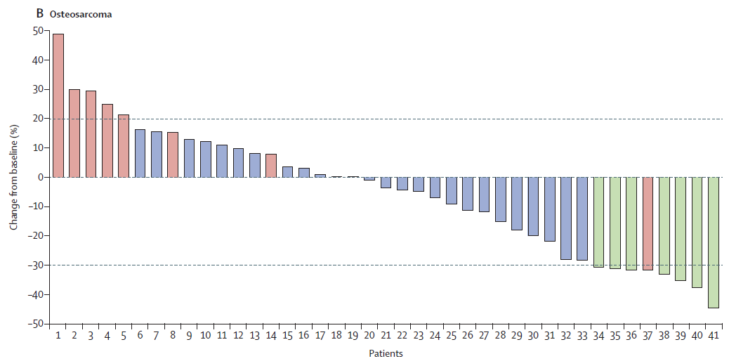
Best overall response in patients with Osteosarcoma

Slide 58
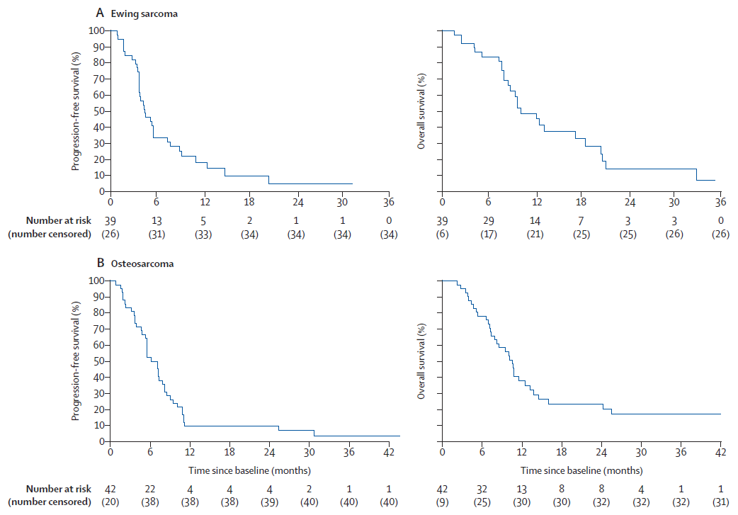
Kaplan Meier curves of PFS and OS

Slide 59
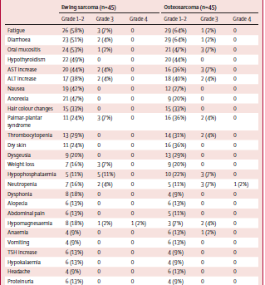
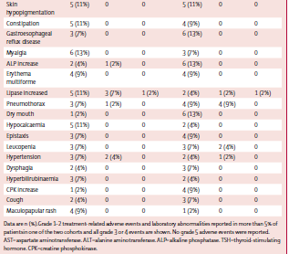
Adverse events

Slide 60


Ευχαριστώ!!!

