Slide 1
Σάρκωμα Ewing σταδιοποίηση και πρόγνωση

Slide 2
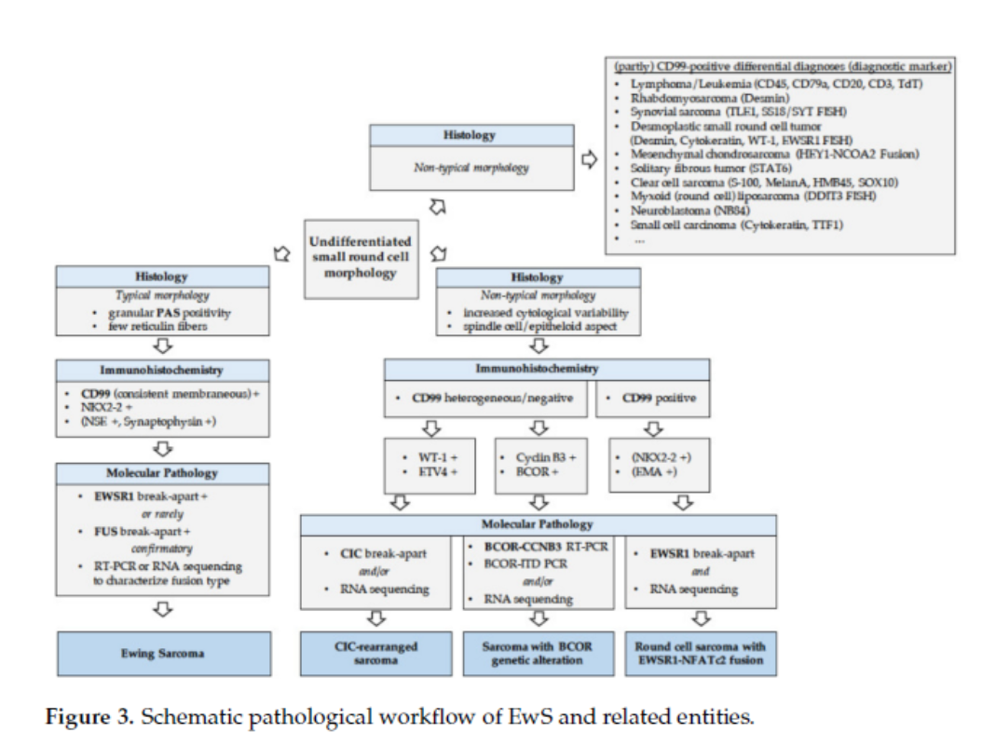

Slide 3
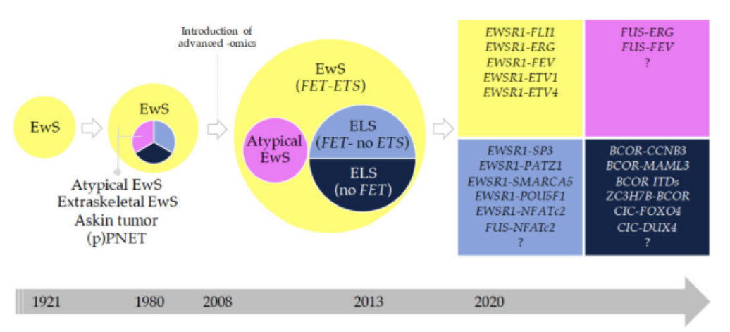

Slide 4
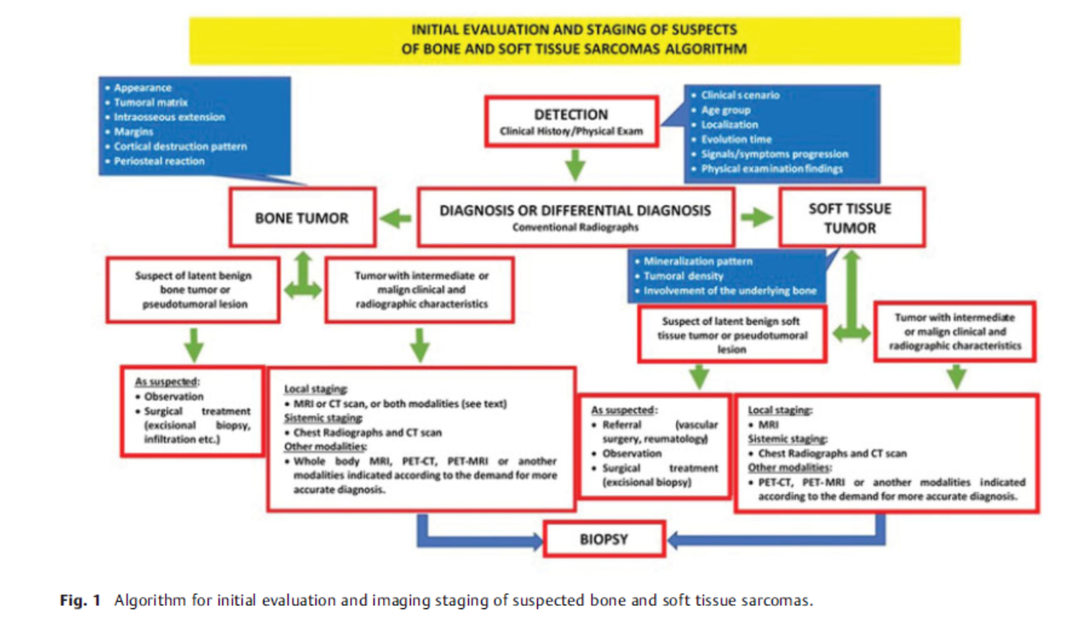

Slide 5
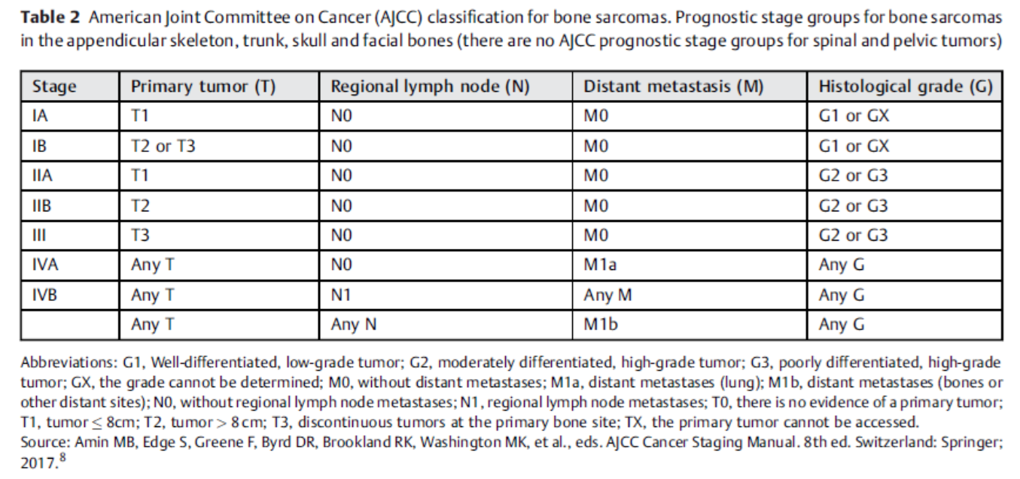

Slide 6
Πρόγνωση
Κλινικά χαρακτηριστικά
Ιστο-παθολογικά χαρακτηριστικά
Γενετικά
Δεδομένα έκφρασης
Επιγενετική
Πρωτεωμική

Slide 7
Tumor burden
Presence of metastases

Slide 8
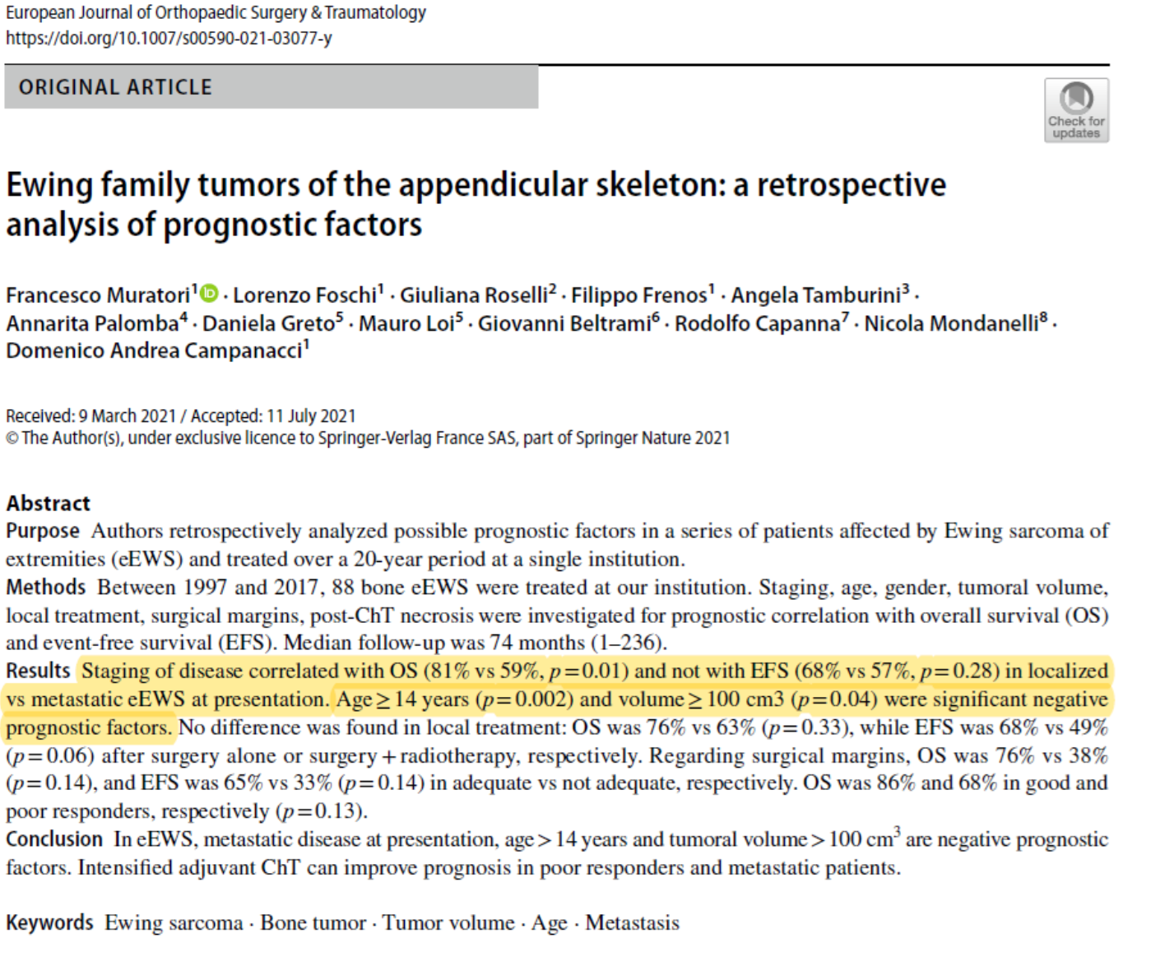

Slide 9
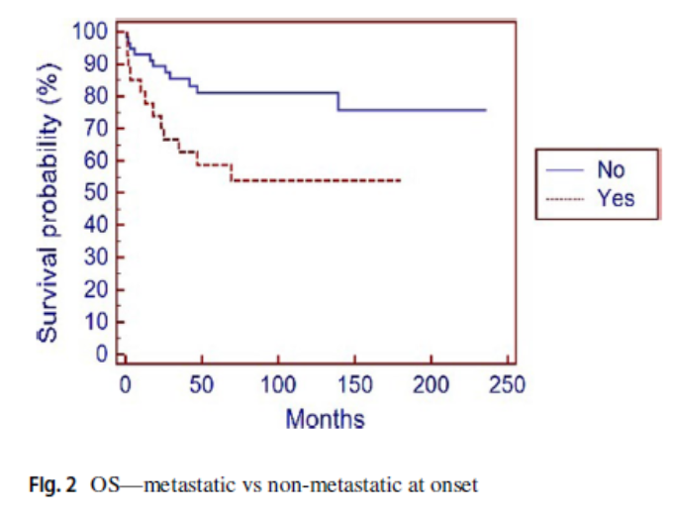
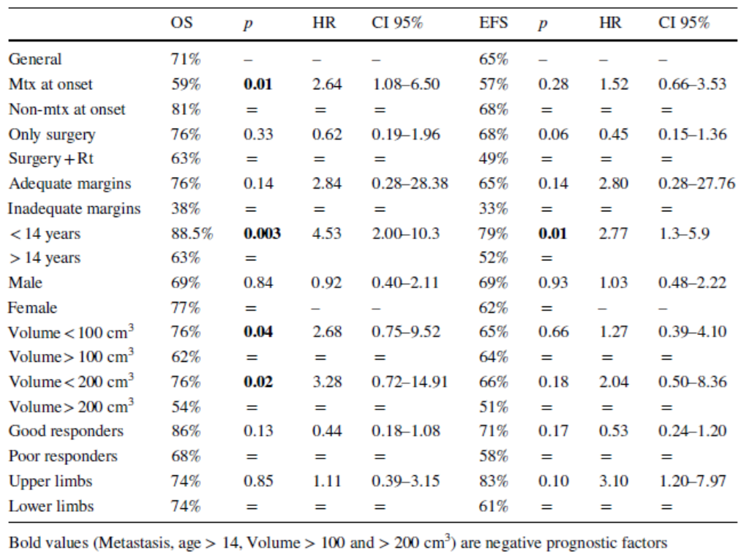

Slide 10
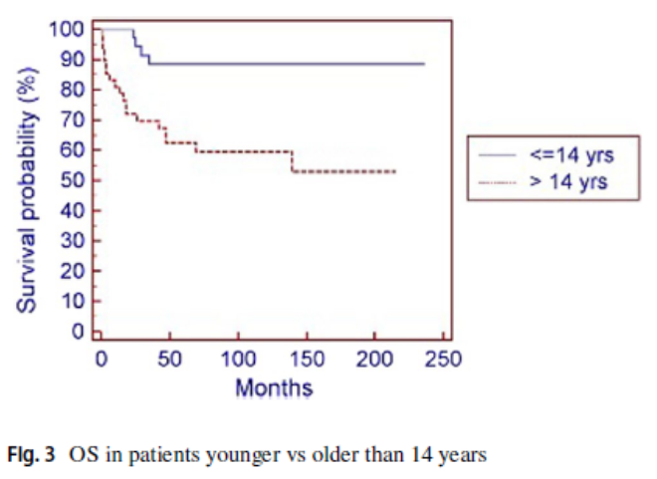
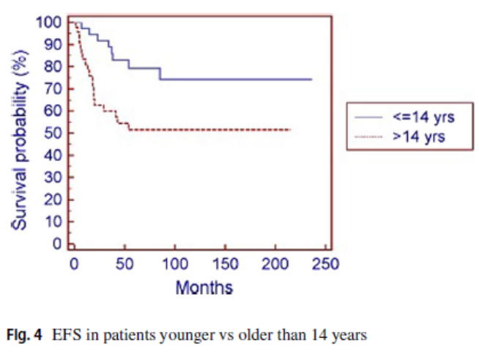
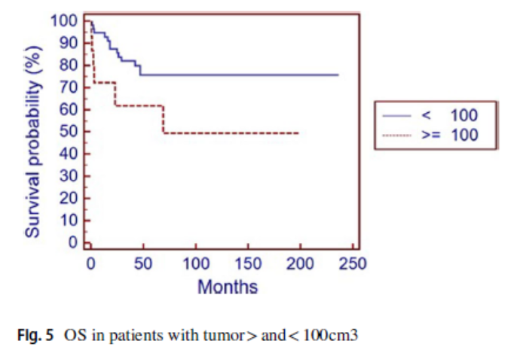

Slide 11

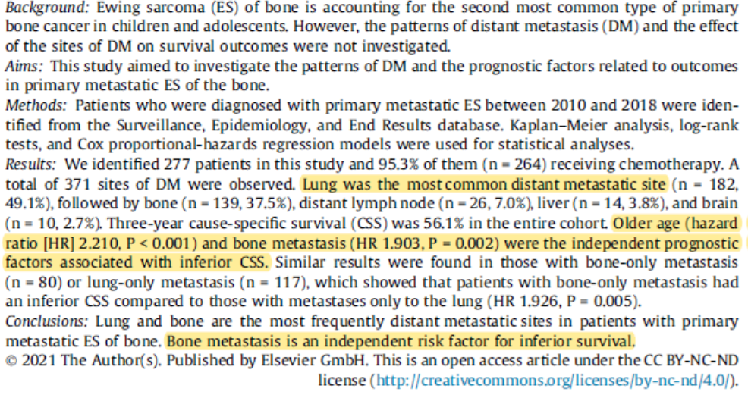

Slide 12
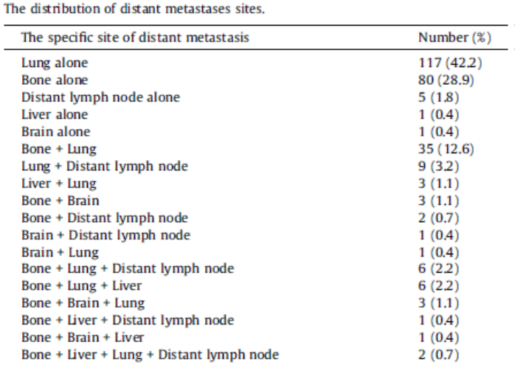

Slide 13
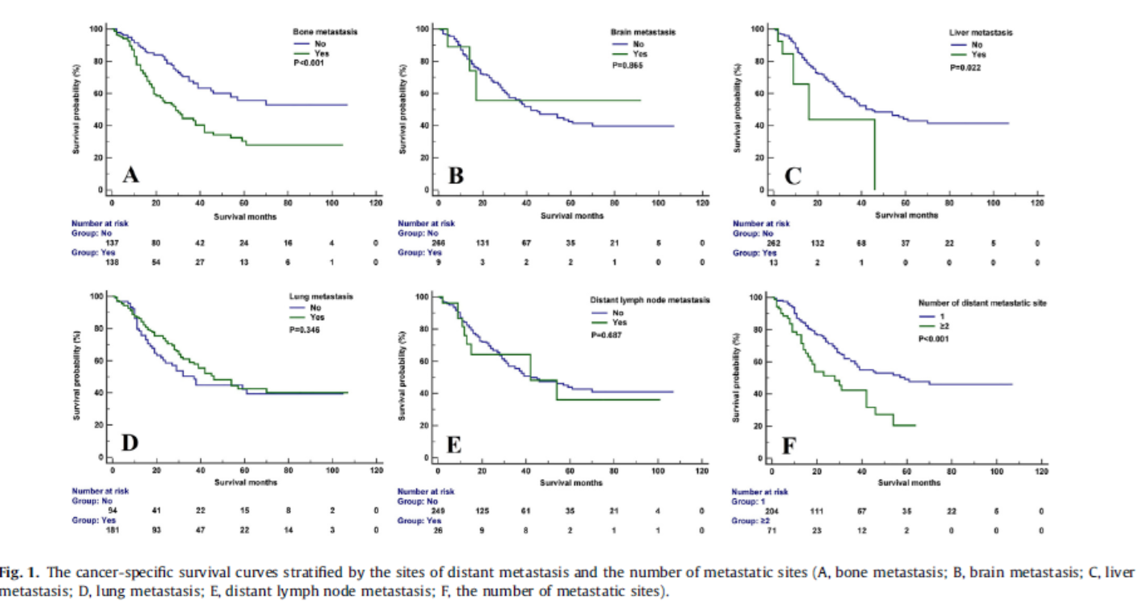

Slide 14
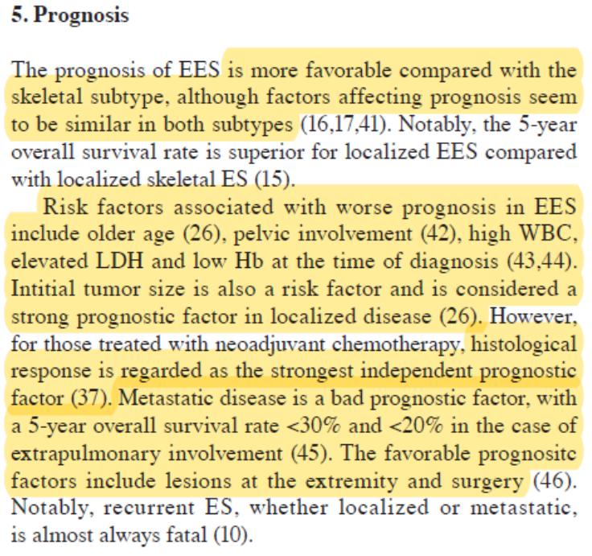

Slide 15
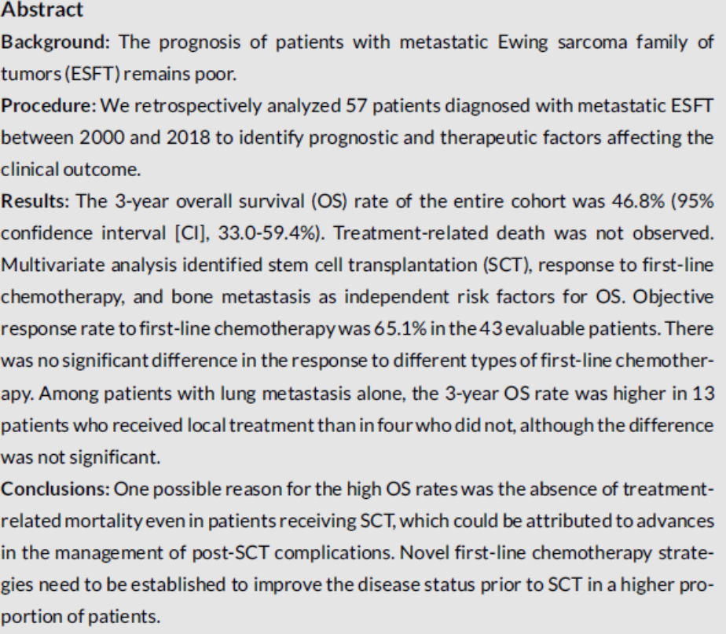

Slide 16
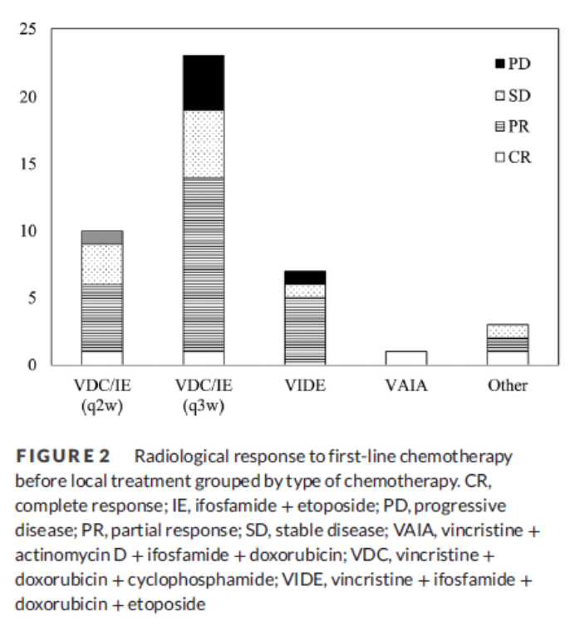
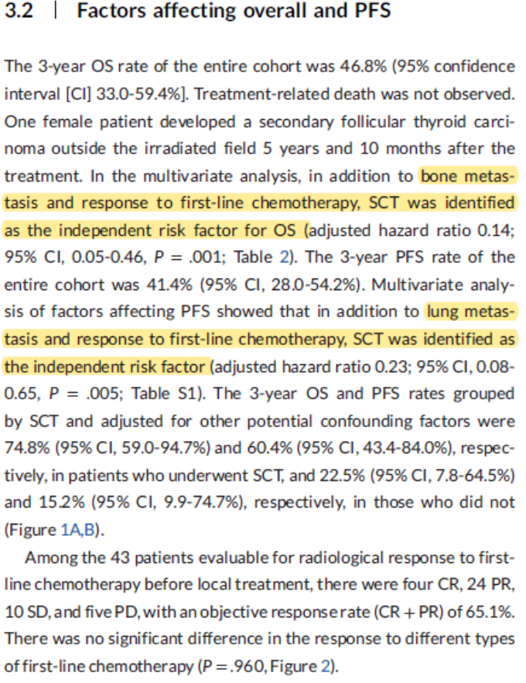

Slide 17
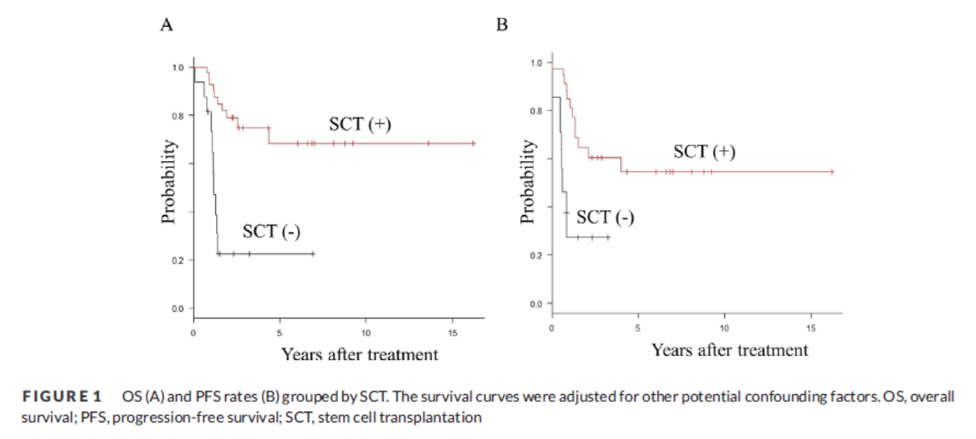

Slide 18
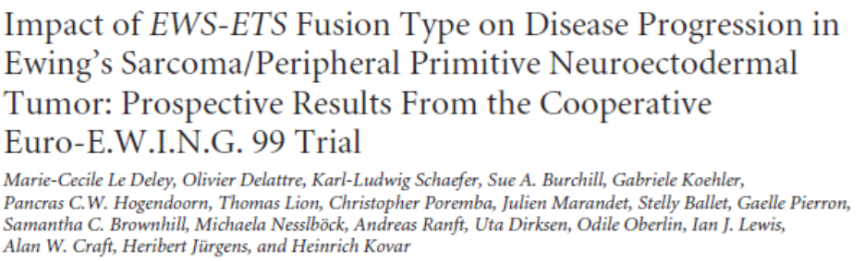
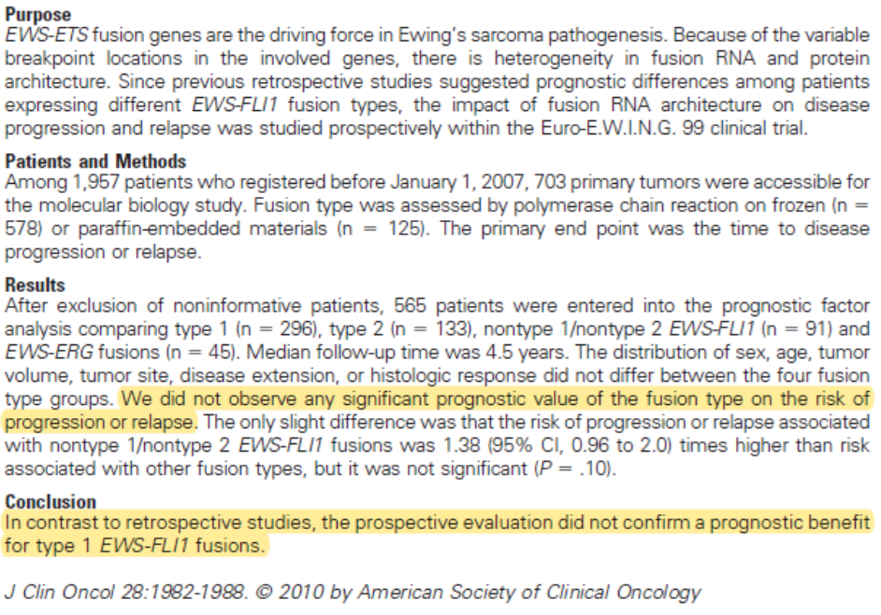

Slide 19
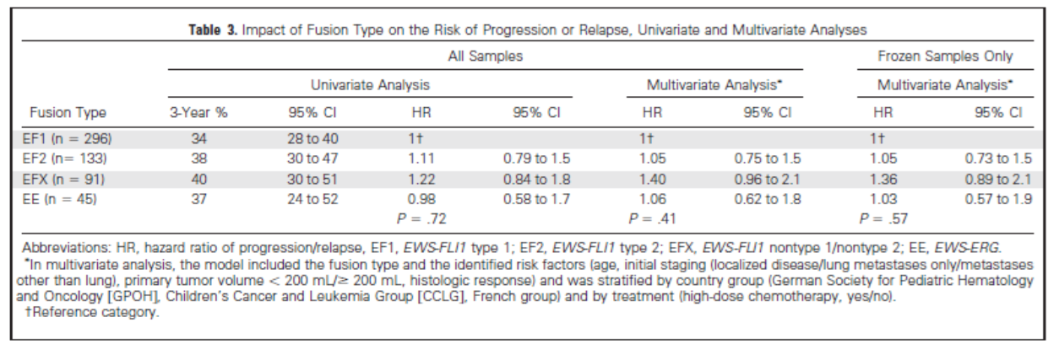

Slide 20
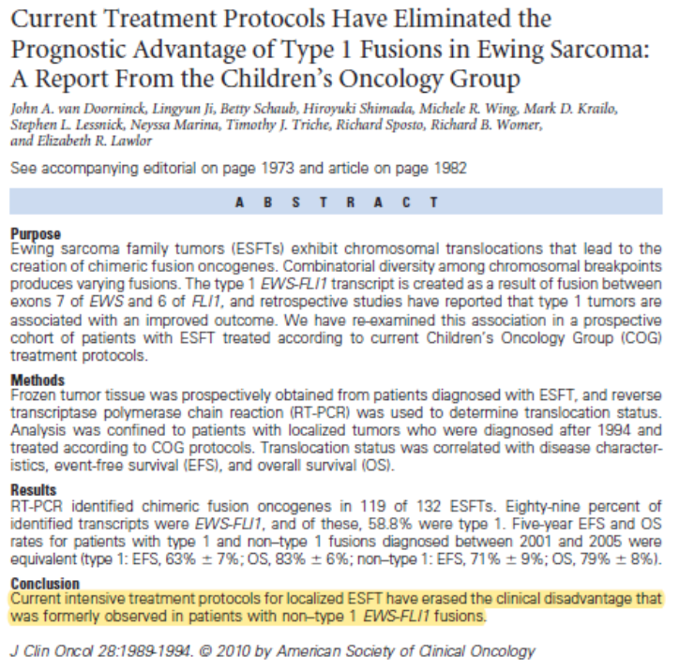

Slide 21
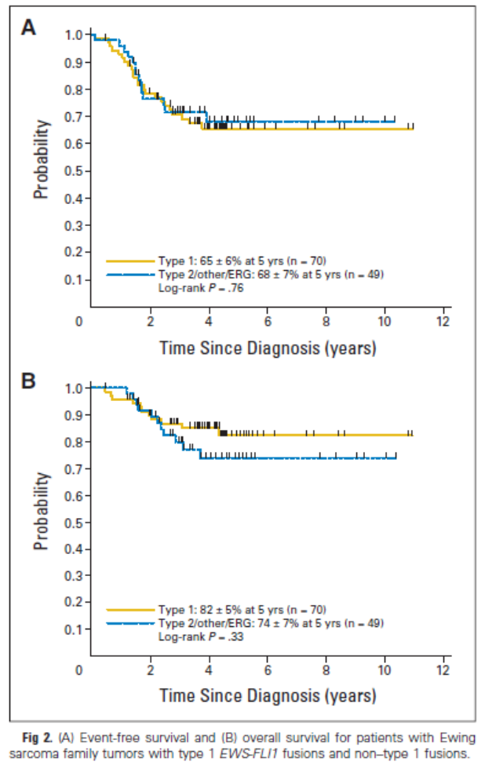
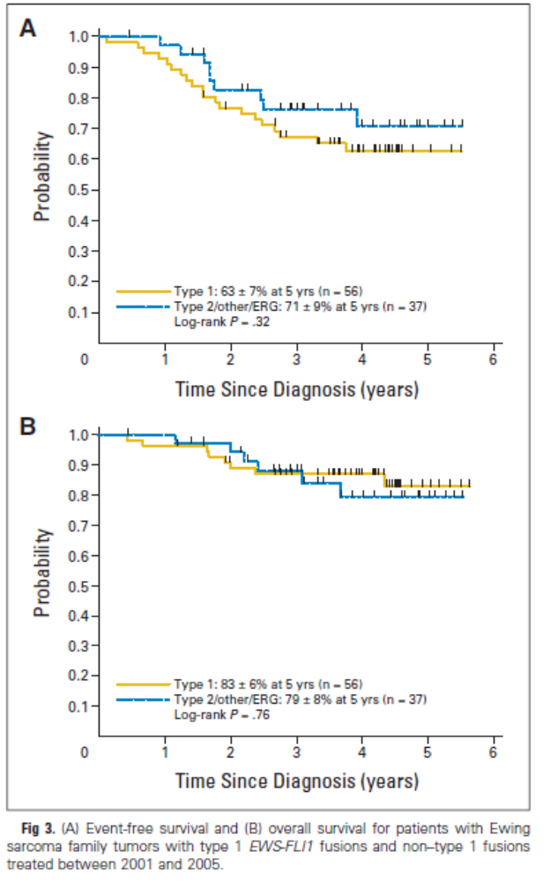

Slide 23
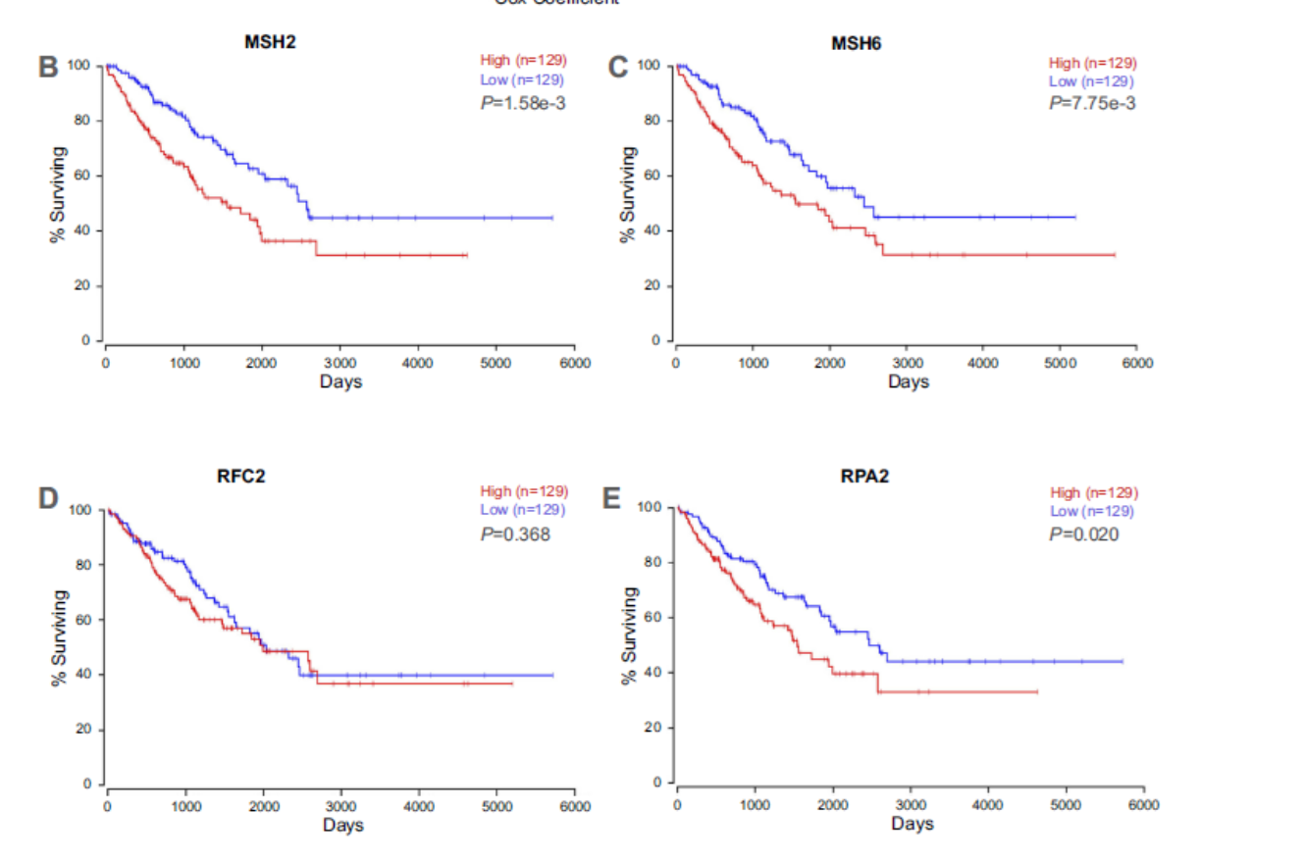
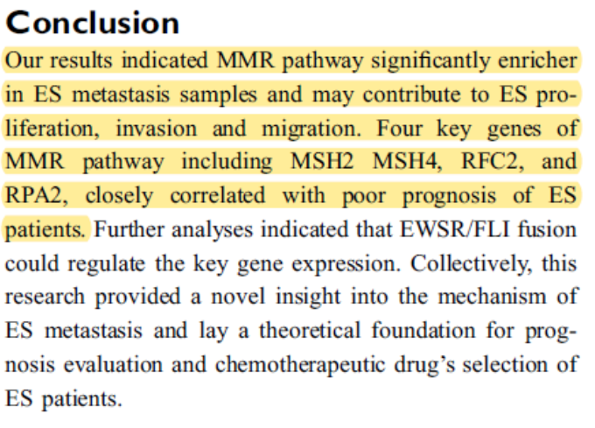

Slide 24
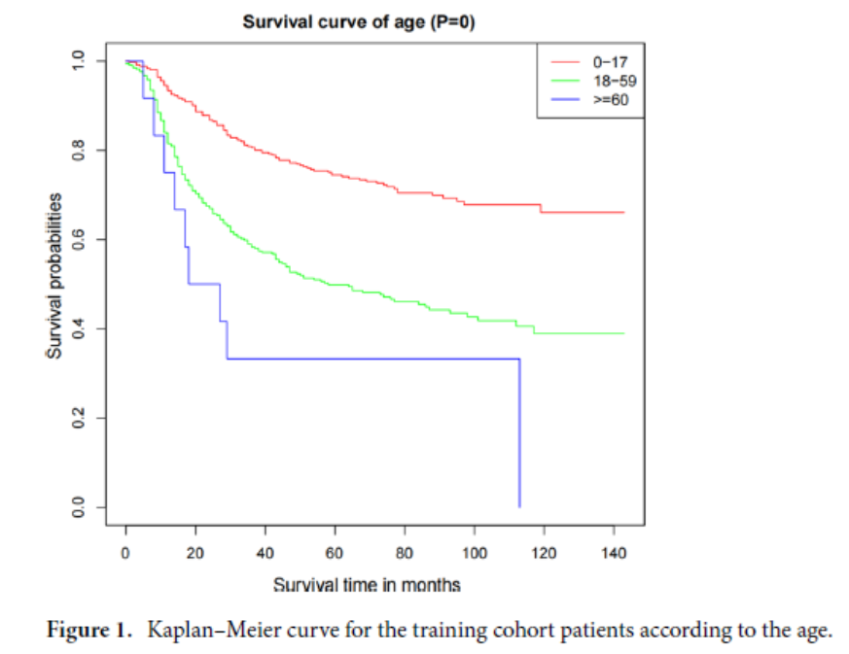

Slide 25
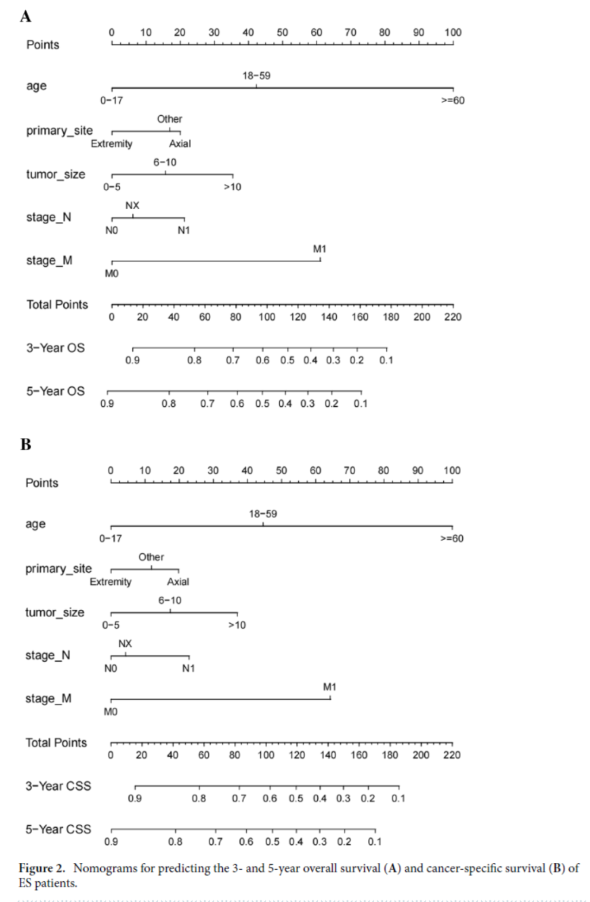

Slide 26
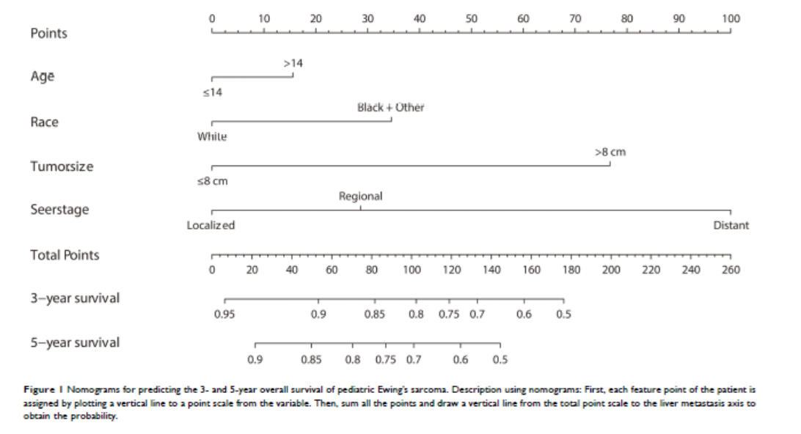

Slide 27
Οστεοσάρκωμα σταδιοποίηση και πρόγνωση

Slide 28
Πρόγνωση
Κλινικά χαρακτηριστικά
Ιστο-παθολογικά χαρακτηριστικά
Γενετικά
Δεδομένα έκφρασης
Επιγενετική
Πρωτεωμική

Slide 29
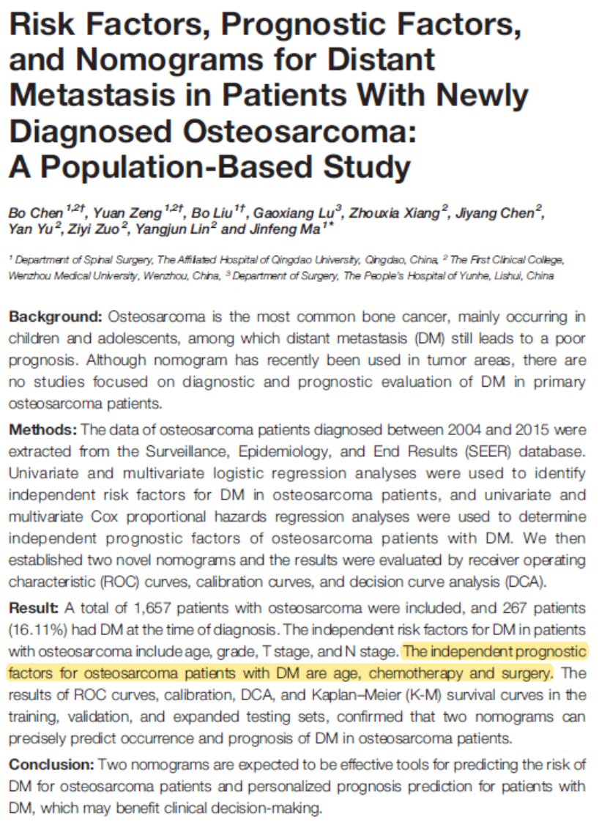

Slide 30
Int J Cancer. 2022 Feb 15;150(4):645-653. doi: 10.1002/ijc.33823. Epub 2021 Oct 5.
Treatment of 120 adult osteosarcoma patients with metachronous and synchronous metastases: A retrospective series of the French Sarcoma Group
Abstract
Treatment options for metastatic osteosarcomas are scarce. Following failure of standard first line therapy, patients who relapse present a challenging treatment dilemma, and have a poor prognosis. Surgical removal of all metastases is essential. A retrospective analysis of patients with metastatic osteosarcomas was conducted in 15 French Sarcoma Group centers. From January 2009 to December 2018, we identified 120 adult patients; 36 with synchronous and 84 with metachronous metastases with 74 males and 46 females. Mean age was 30 years (18-53). Metastatic sites were lung, bone and other in 91, 11 and 24 patients, respectively. Mean time to first metachronous metastases was 22 months (4-97). All patients except 13 (10.8%) with metachronous metastases received a first line systemic treatment for relapse, and 39 patients (32.5%) were included in a clinical trial. Eighty-one patients (67.5%) had local treatment of distant metastases. Median progression free survival (PFS) and overall survival (OS) were 5.5 (95% CI 4.6-6.4) and 20.5 months (95% CI 13.2-27.7) respectively for the overall group. In multivariate analysis, more than five metastases, time to first metastases <24 months, were statistically significant negative prognostic factors for OS and PFS (P = .002, ≤.001 and P = .006, ≤.001, respectively). Surgery of metastases was associated with better prognosis on OS and PFS (P = .001 and .037, respectively). The presence of bone metastases was a negative prognostic factor on OS but not on PFS (P = .021). In reference sarcoma centers, relapsed osteosarcoma patients with more than one metastasis commonly receive more than one line of systemic therapy, and are included in clinical trial if available.

Slide 31
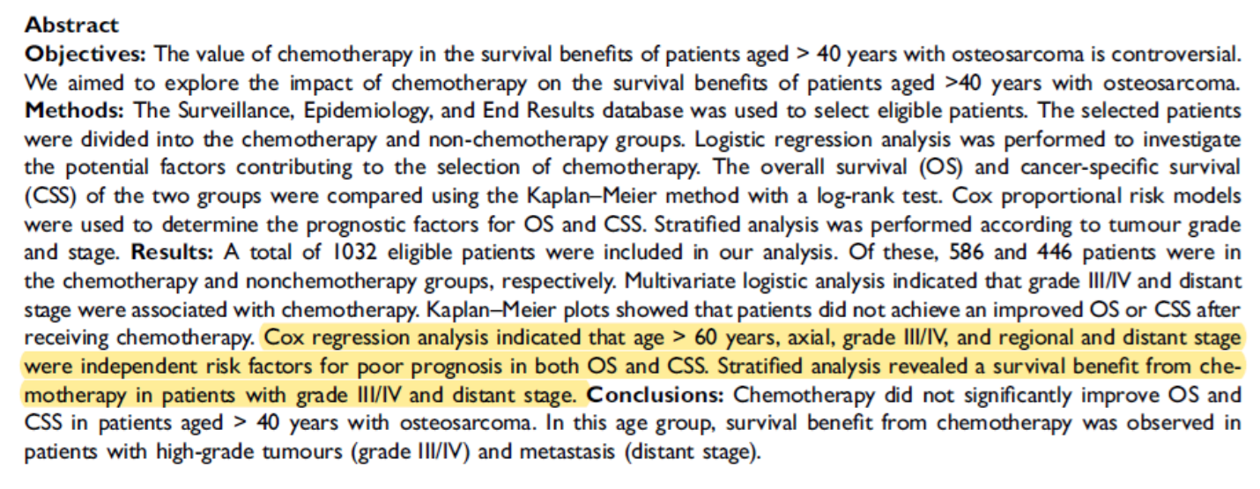

Slide 32
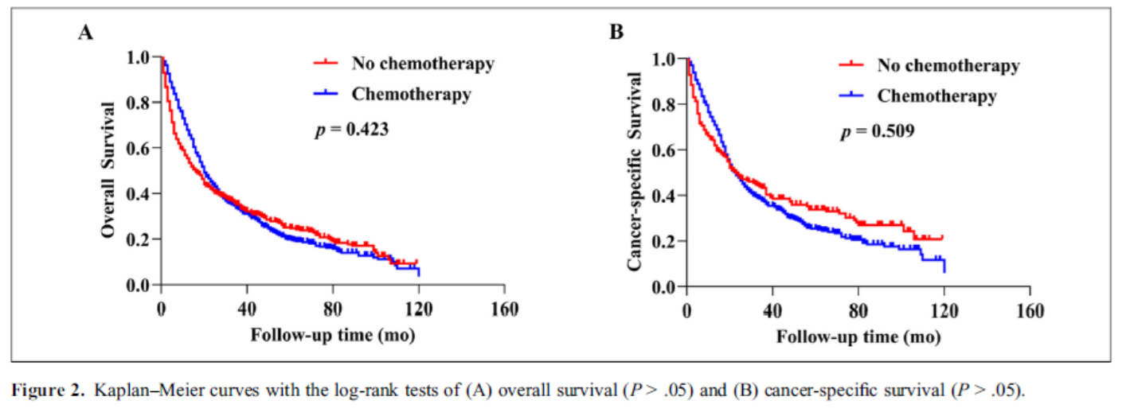

Slide 33
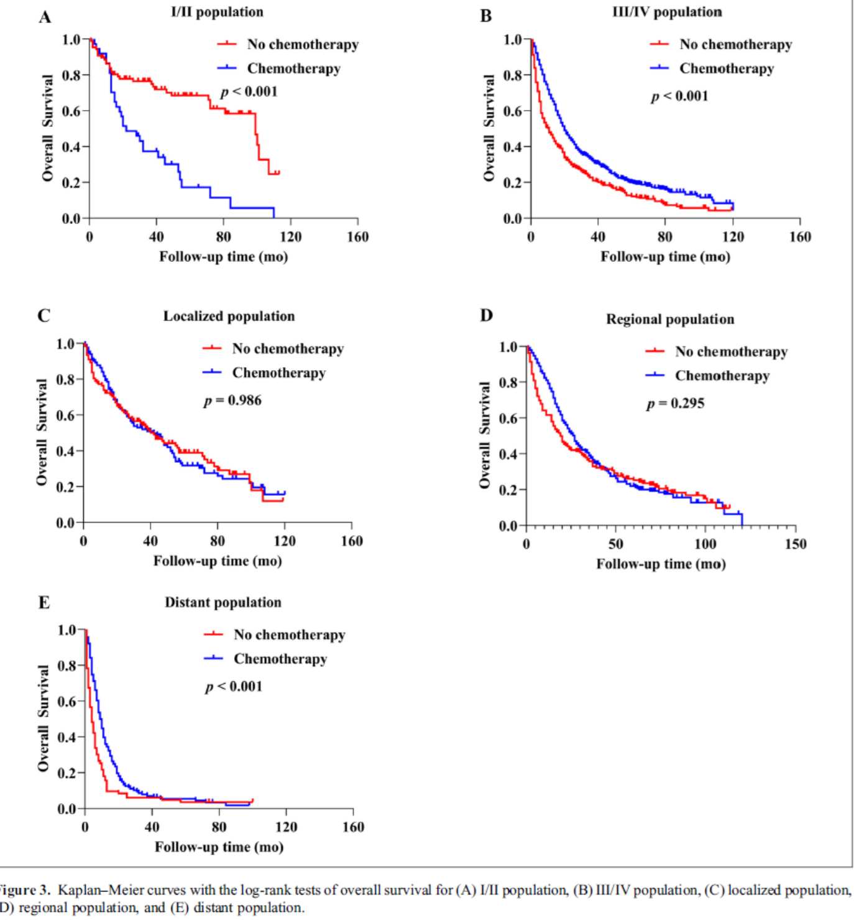

Slide 34
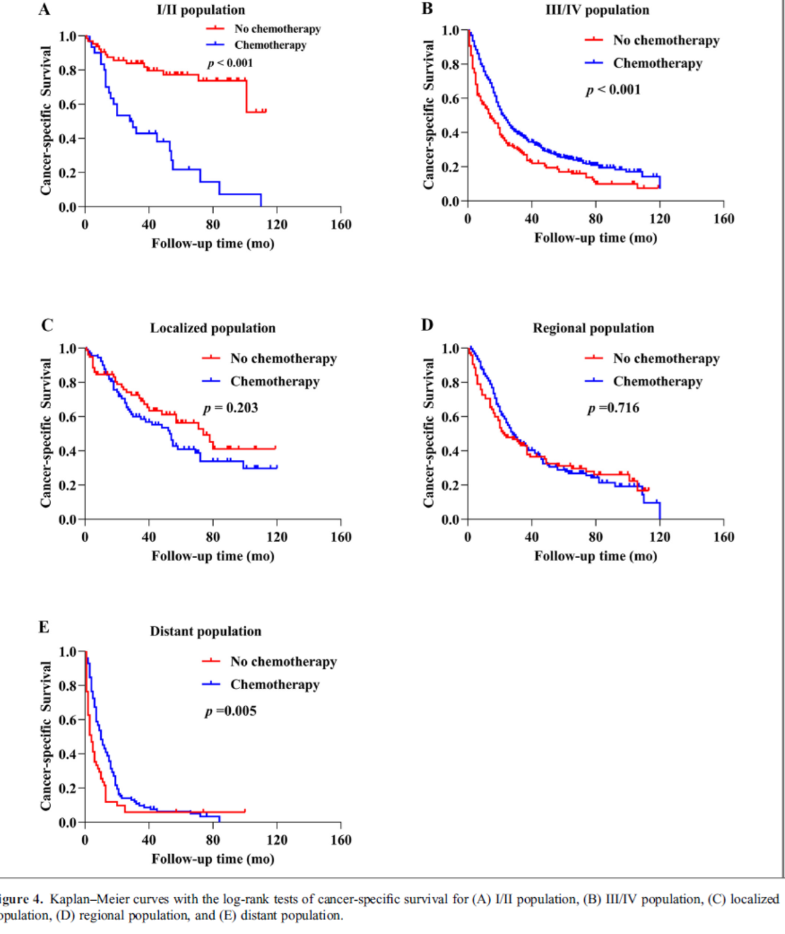

Slide 35
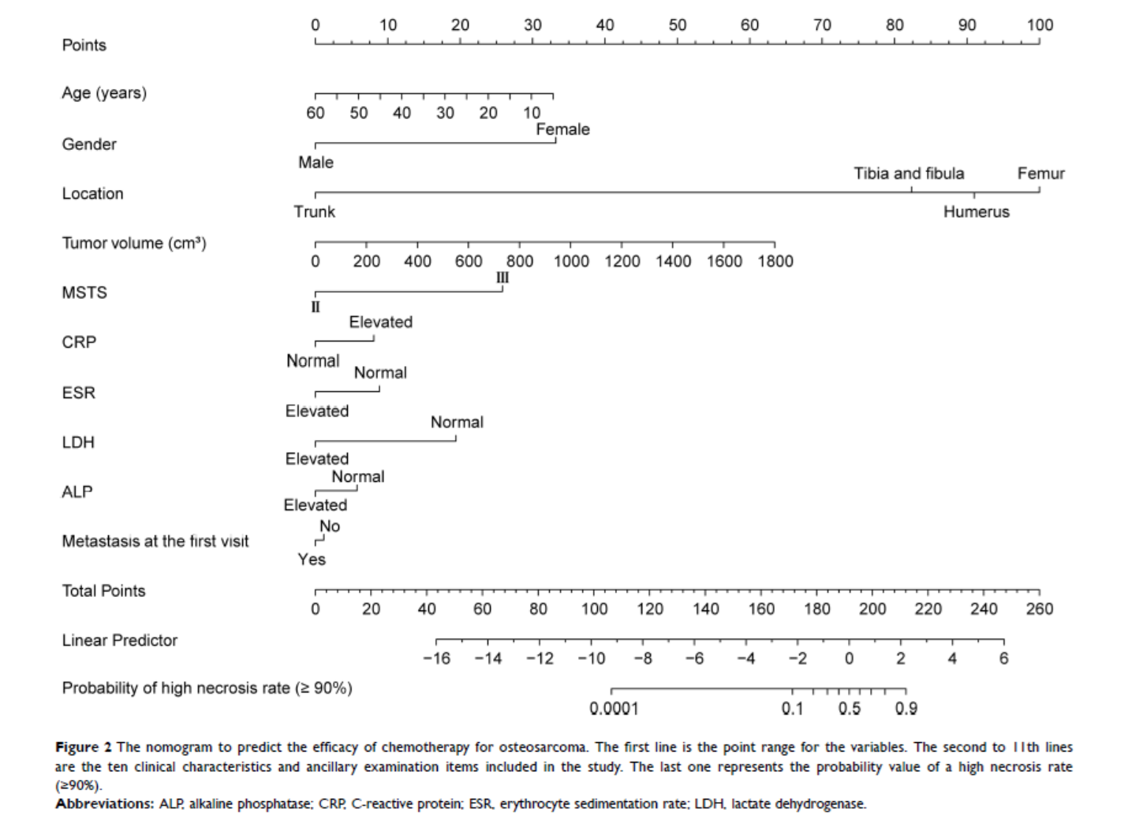

Slide 36
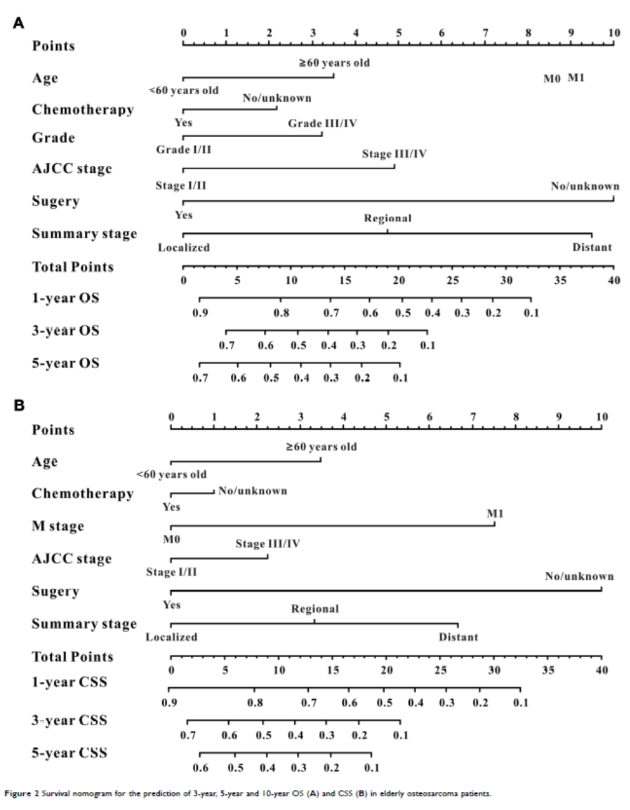

Slide 38
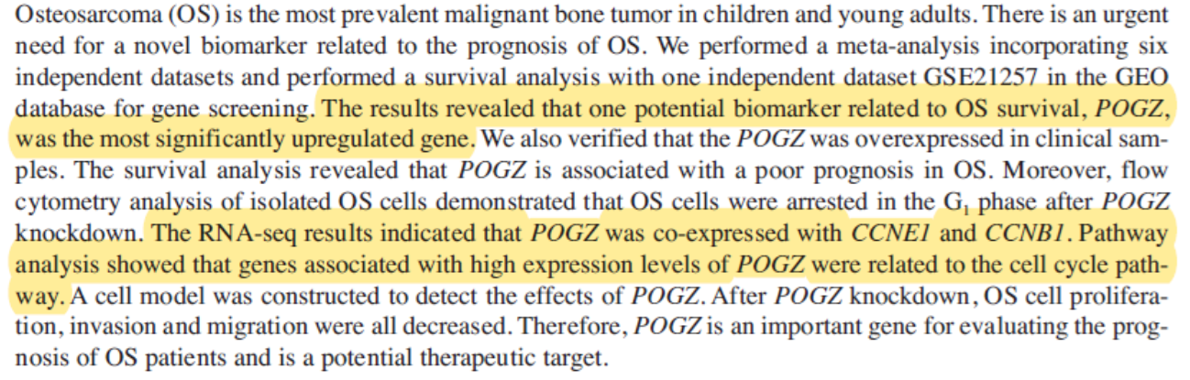

Slide 39
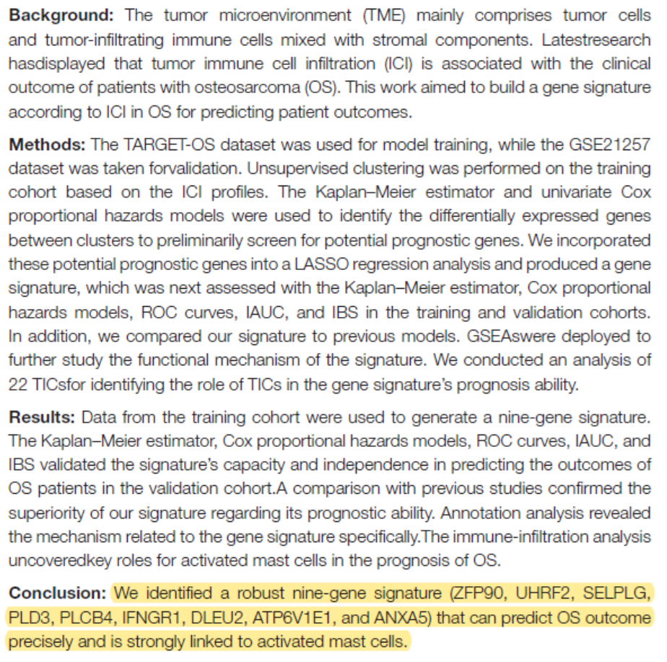

Slide 40
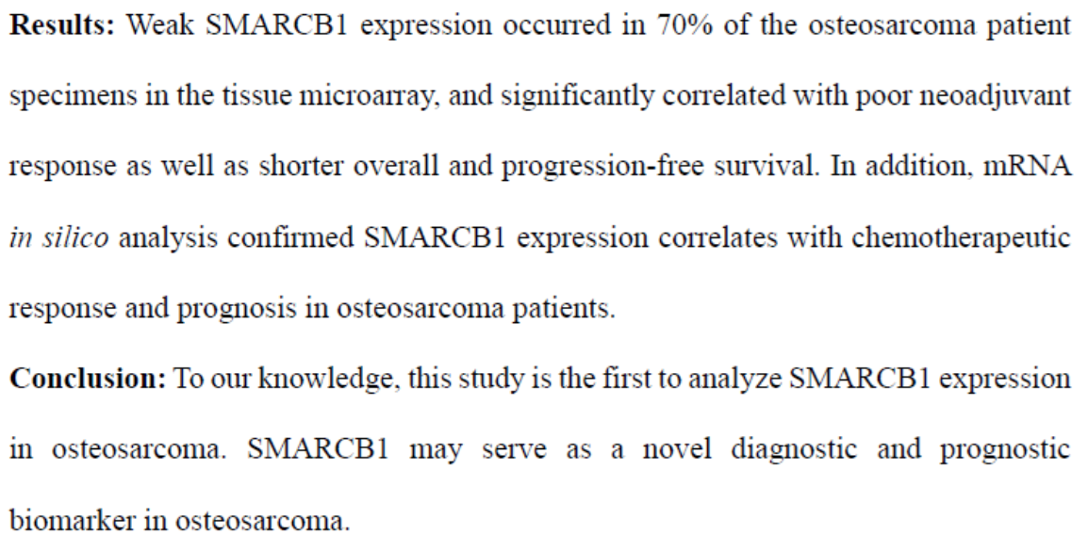

Slide 41
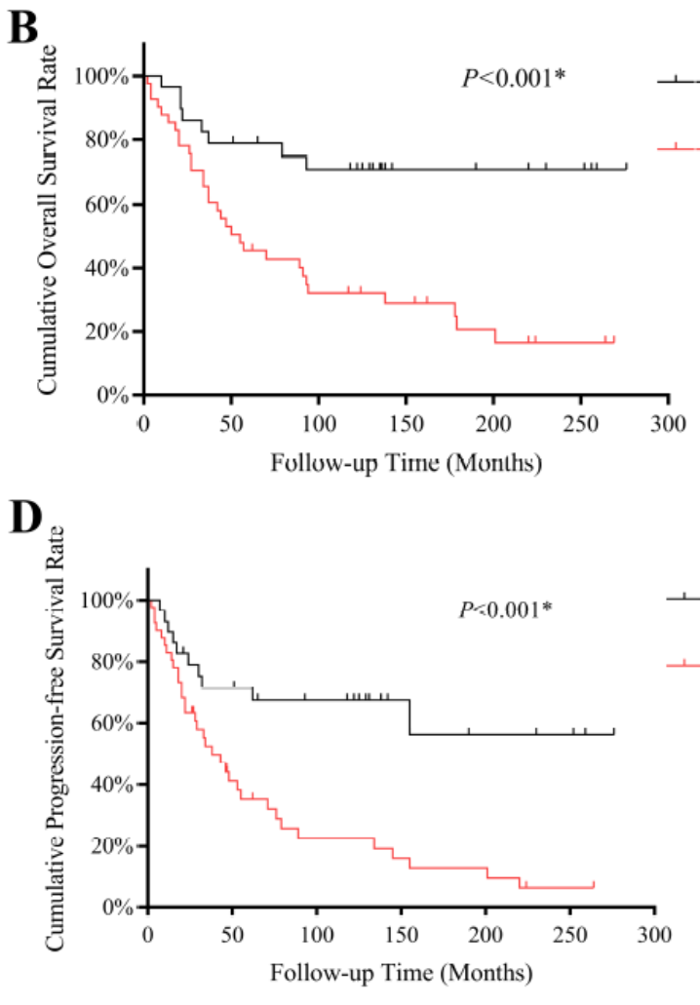
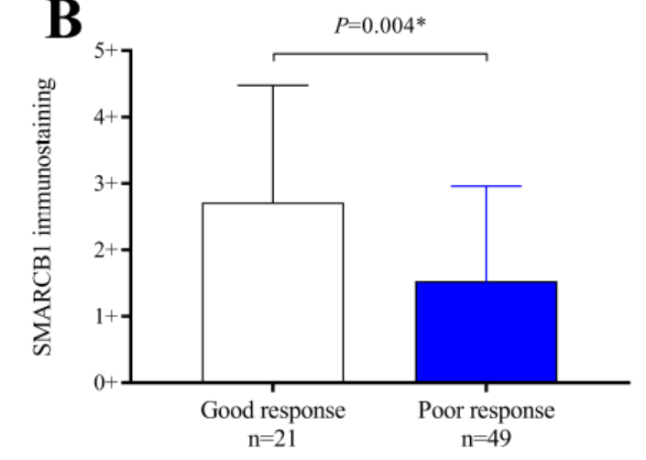

Slide 42
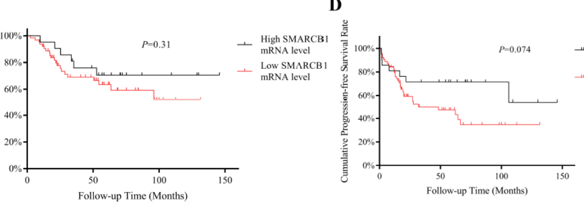

Slide 43
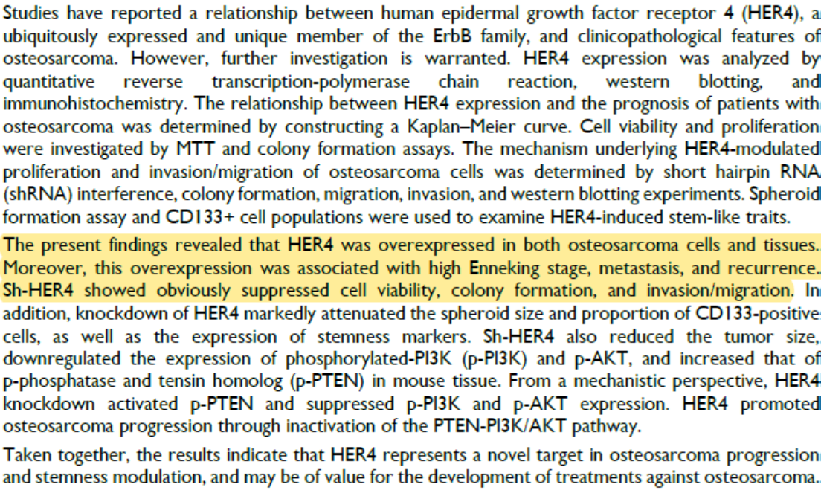

Slide 44
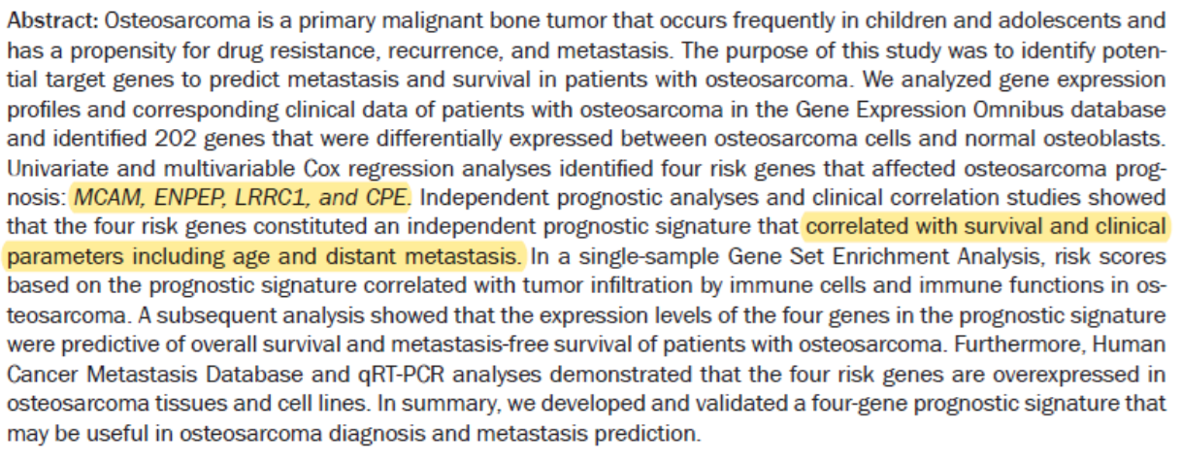

Slide 45
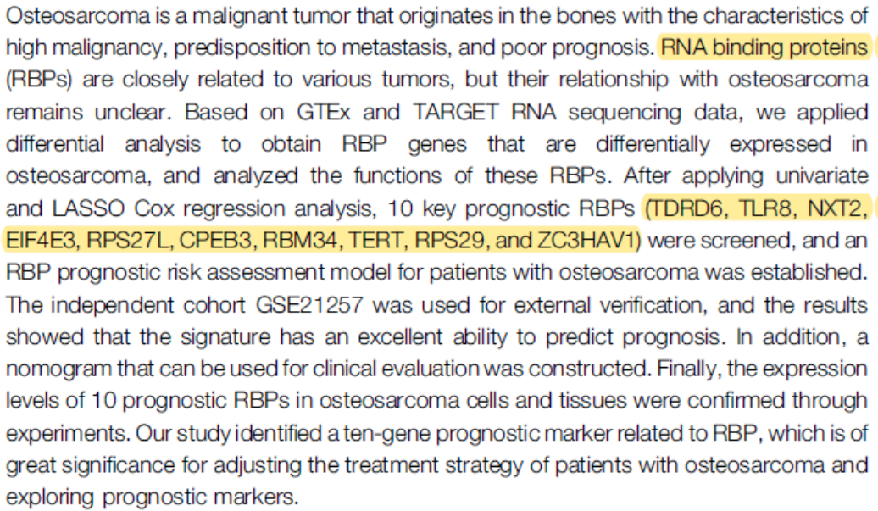

Slide 46
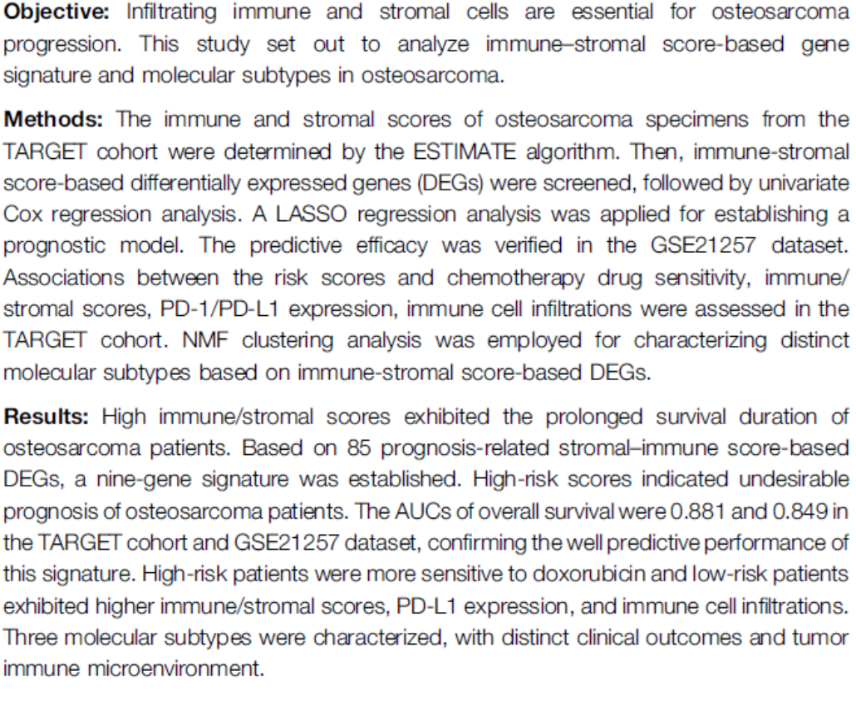

Slide 47
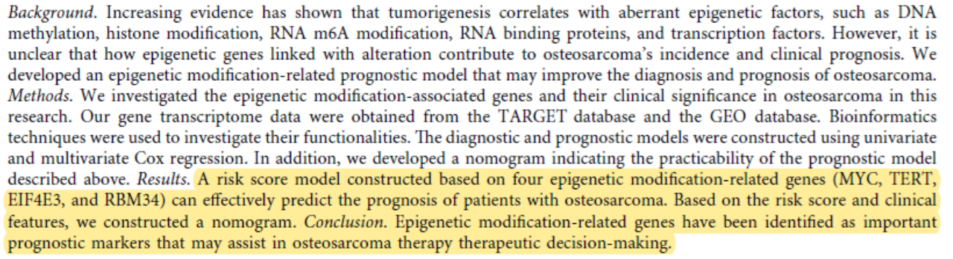

Slide 48
