Slide 1
WHAT’S NEW IN TUMOR ANGIOGENESIS
Stamatios THEOCHARIS

Slide 2
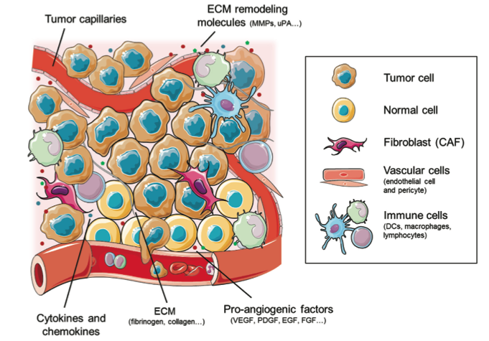
Zuazo-Gaztelu and Casanovas. Front Oncol 2018;8:248

Slide 3
Angiogenesis
Νew blood vessels form from pre-existing vessels
secretion of proteases to cleave the basal membrane of the parental capillary
migration of ECs towards the signal
proliferation of ECs
formation of tubes and diferentiation of the Ecs
endothelial growth factor (VEGF) hypoxia-inducing factor (HIF-1α)
acidic and basic fbroblast growth factor (aFGF, bFGF) platelet-derived growth factor (PDGF)
tumor growth factor-β (TGF-β)
Inhibitors: thrombospondin-1, interferon-α, platelet factor-4, and angiostatin

Slide 4
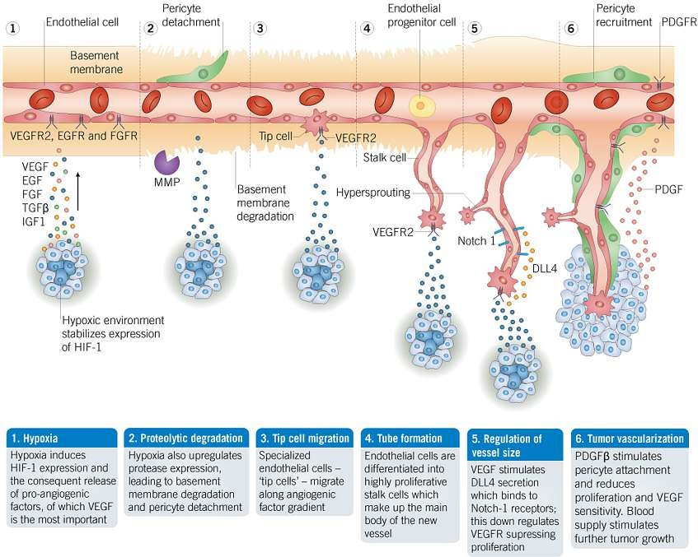
Figure showing angiogenesis steps in tumor vascularization.

Slide 5
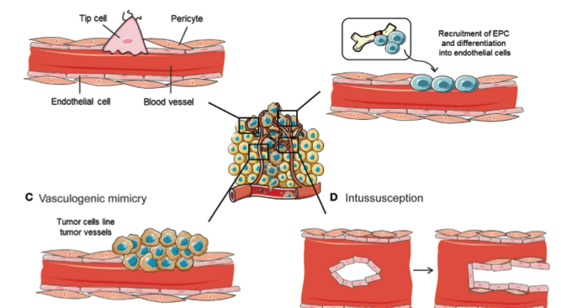
Mechanisms implicated in blood vessel formation
Zuazo-Gaztelu and Casanovas. Front Oncol 2018;8:248

Slide 6

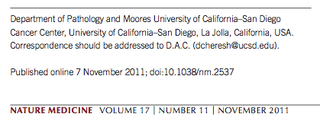

Slide 7
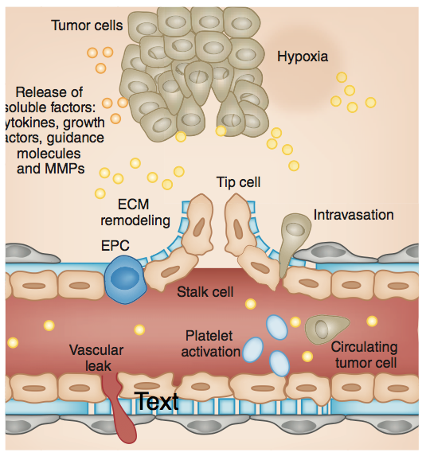
Weis and Cheresh. Nature Medicine 2011;17:1359-1370

Slide 8
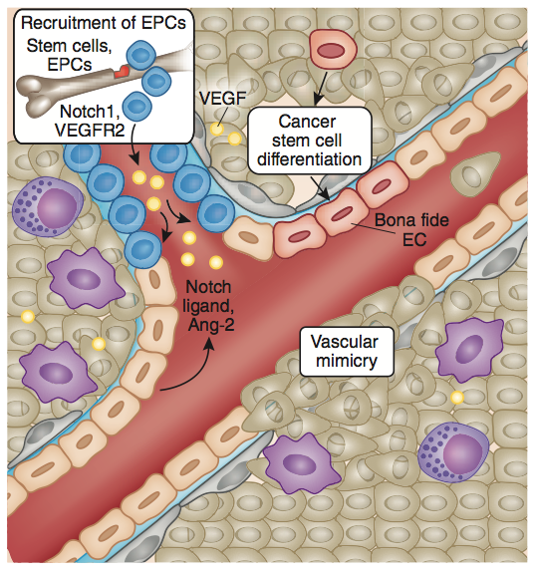
Weis and Cheresh. Nature Medicine 2011;17:1359-1370

Slide 9
The combination of stimulatory signals within the tumor microenvironment prompts changes in multiple cell types:
Perivascular cells detach from the mature blood vessels, compromising their integrity, permitting their remodeling and promoting an activated phenotype
Once the vascular barrier is disrupted, multiple cell types are exposed to angiogenic and inflammatory stimuli to escalate the response

Slide 10
Platelets are recruited to sites of exposed basement membrane, where they become activated and release their stores of stimulatory factors into the tumor microenvironment
Endothelial progenitor cells (EPCs) and myeloid cells from the bone marrow move to the perceived wound, where they release
even more soluble factors locally

Slide 11
Cancer stem cells can differentiate to become bona fide endothelial cells, or tumor cells can physically participate in the formation of new vessels through vascular mimicry

Slide 12
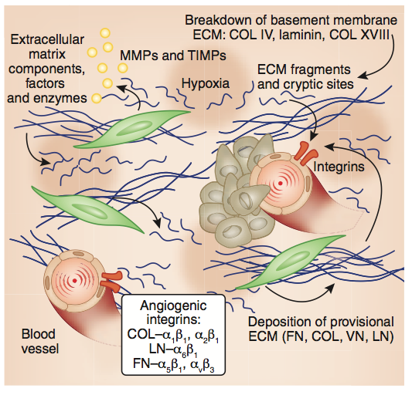
Weis and Cheresh. Nature Medicine 2011;17:1359-1370

Slide 13
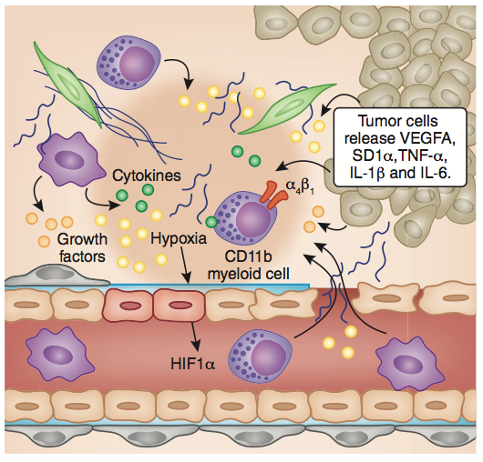
Weis and Cheresh. Nature Medicine 2011;17:1359-1370

Slide 14
Environmental or genetic events transform normal epithelial cells into tumor cells, which grow and divide with little effect on their surroundings until their size exceeds 1–2 mm. At that point, hypoxia and nutrient deprivation trigger the requirement for angiogenesis. Tumor cells release soluble growth factors, chemokines and cytokines, which create a concentration gradient that initiates the sprouting and proliferation of formerly quiescent endothelial cells on nearby blood vessels and lymphatics

Slide 15
These signals also recruit fibroblasts that deposit a repertoire of ECM proteins and enzymes in an attempt to remodel and repair the site
Most tumors elicit an inflammatory response that attracts myeloid cells into the tumor microenvironment, and these cell types release their stores of soluble factors to escalate the angiogenic response

Slide 16
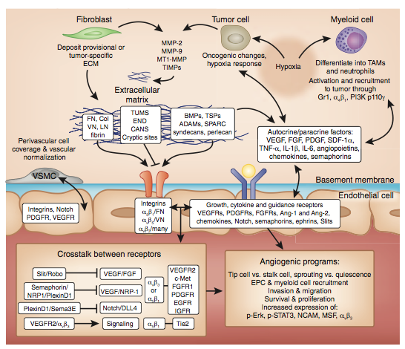
Weis and Cheresh. Nature Medicine 2011;17:1359-1370

Slide 17
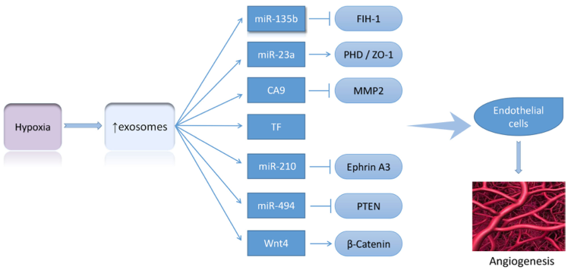
Shao et al. Molecular Cancer (2018) 17:120

Slide 18
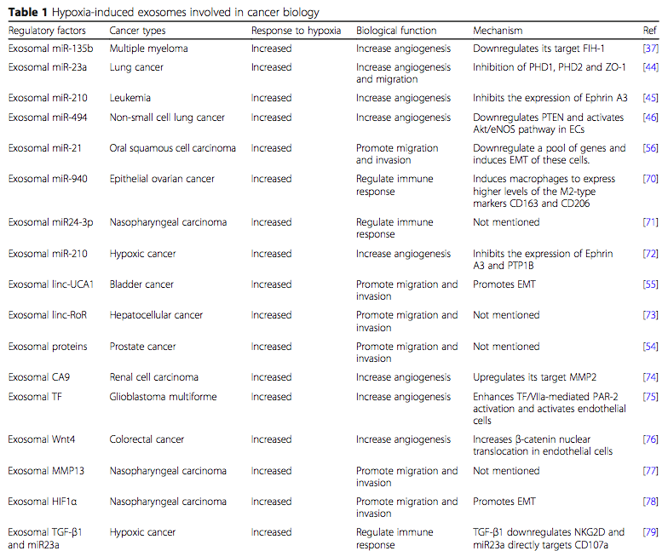
Shao et al. Molecular Cancer (2018) 17:120

Slide 19
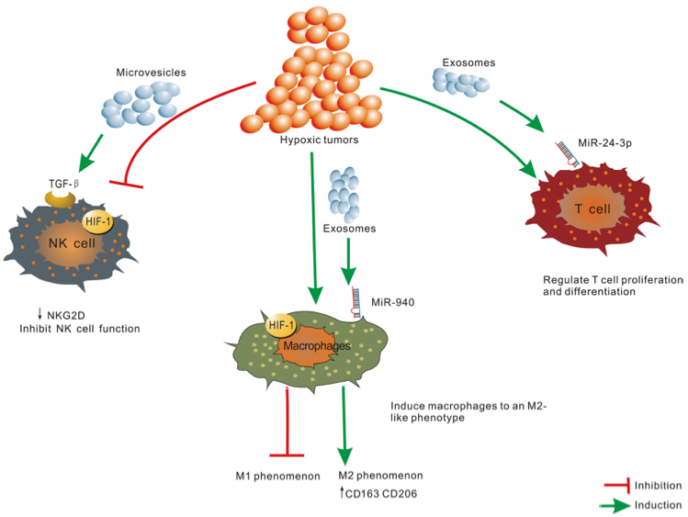
Shao et al. Molecular Cancer (2018) 17:120

Slide 20
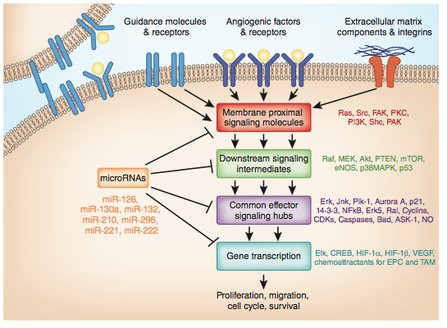
Weis and Cheresh. Nature Medicine 2011;17:1359-1370

Slide 21
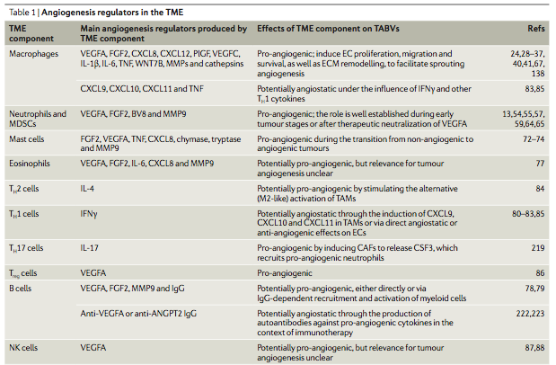
De Palma, et al., Nature Reviews Cancer 2017;17:457-474

Slide 22
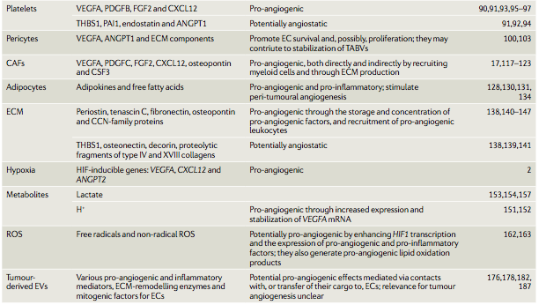
De Palma, et al., Nature Reviews Cancer 2017;17:457-474

Slide 23
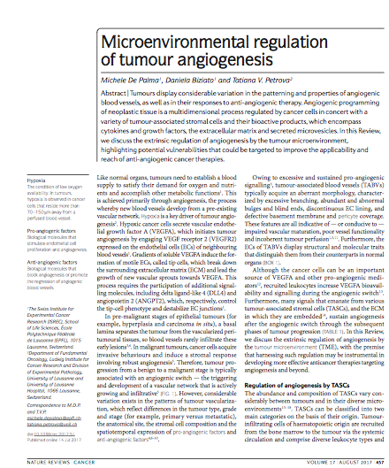

Slide 24
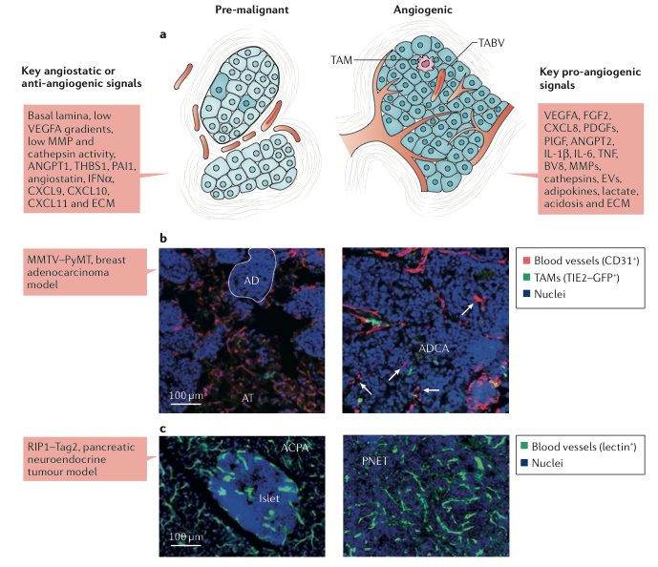
De Palma, et al., Nature Reviews Cancer 2017;17:457-474

Slide 25
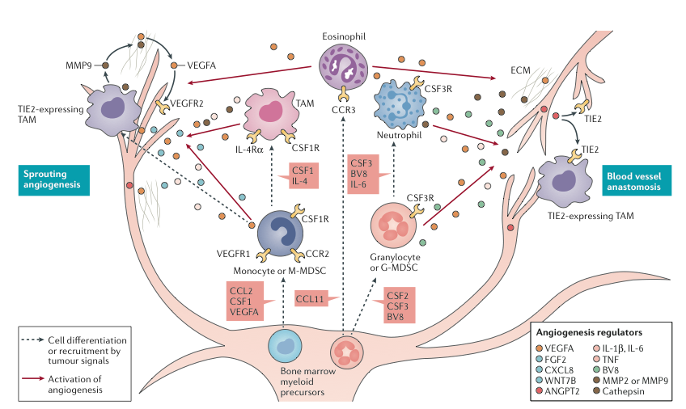
Myeloid cell regulation of tumour angiogenesis
De Palma, et al., Nature Reviews Cancer 2017;17:457-474

Slide 26
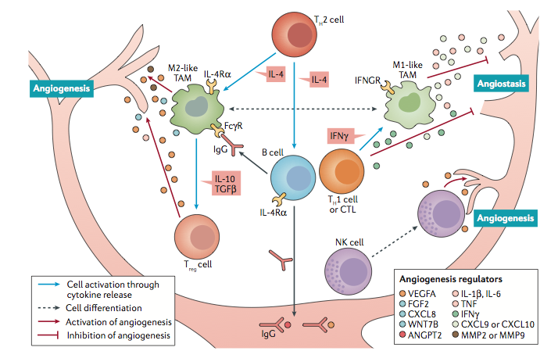
Cross-talk between lymphocytes and myeloid cells regulates tumour angiogenesis
De Palma, et al., Nature Reviews Cancer 2017;17:457-474

Slide 27
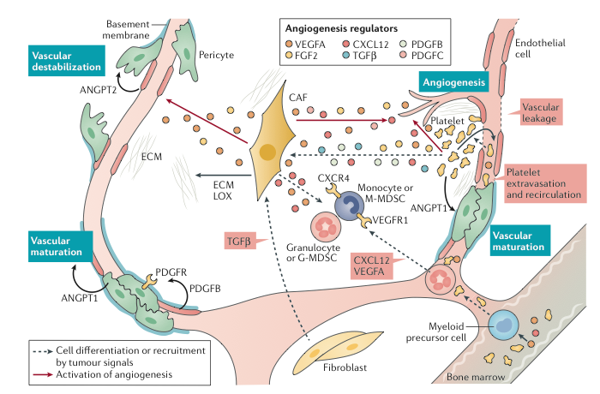
Chronic wound-healing response promotes tumour angiogenesis
De Palma, et al., Nature Reviews Cancer 2017;17:457-474

Slide 28
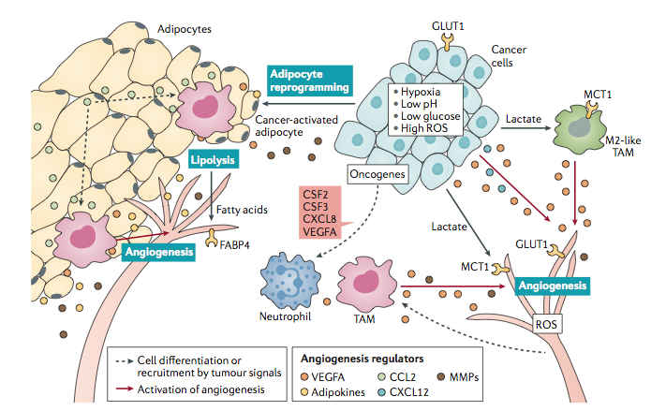
Metabolic regulation of tumour angiogenesis
De Palma, et al., Nature Reviews Cancer 2017;17:457-474

Slide 29
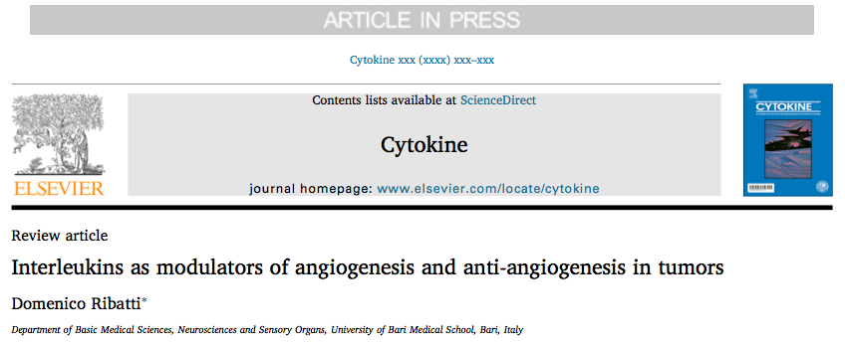
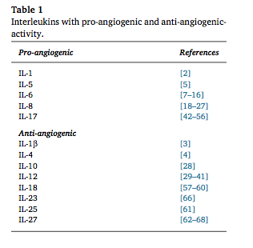

Slide 30
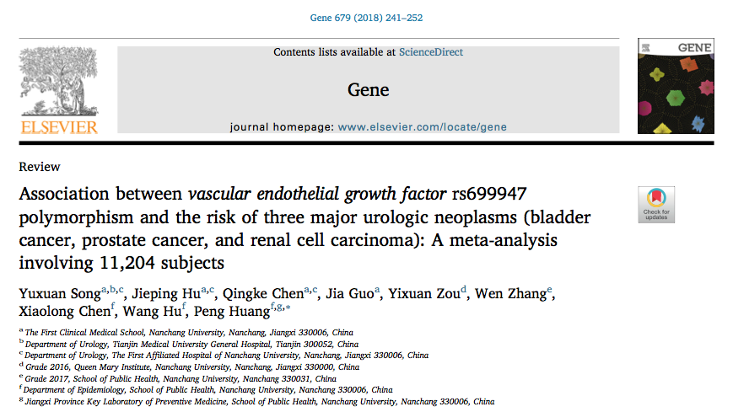

Slide 31
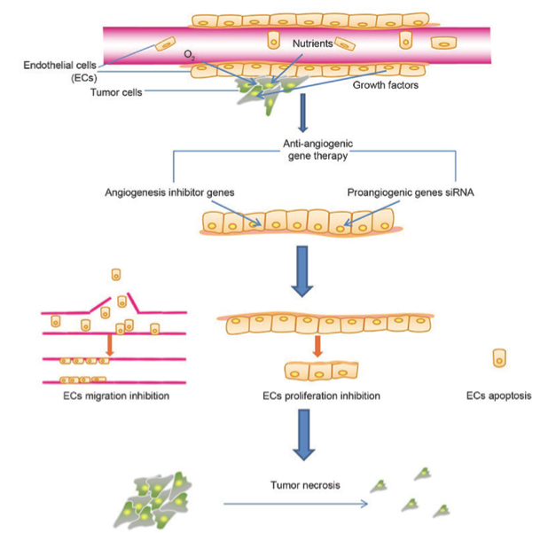
Li T, et al., ONCOLOGY LETTERS 2018; 16: 687-702

Slide 32
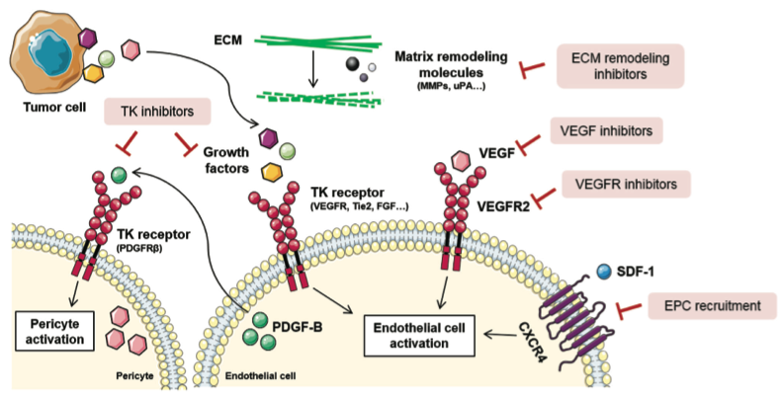
Tumor angiogenesis inhibition strategies
Zuazo-Gaztelu and Casanovas. Front Oncol 2018;8:248

Slide 33
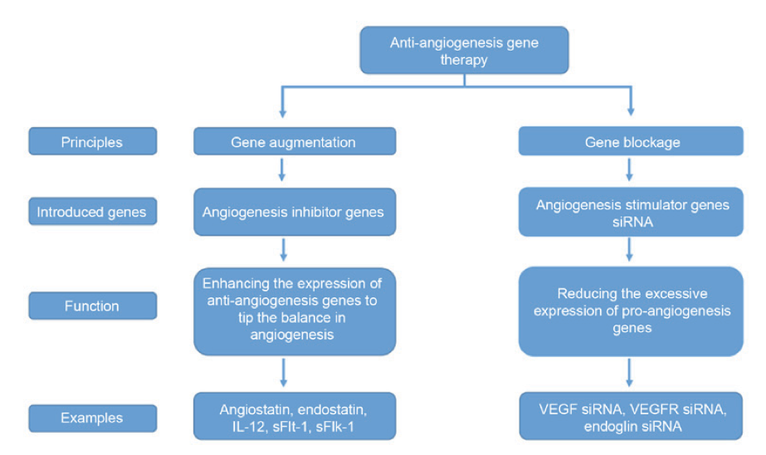
Li T, et al., ONCOLOGY LETTERS 2018; 16: 687-702

Slide 34
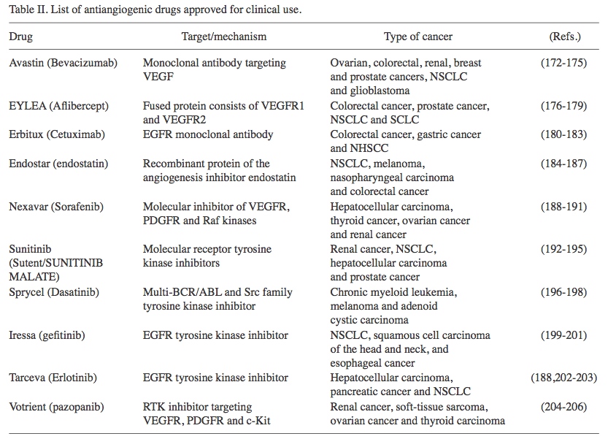
Li T, et al., ONCOLOGY LETTERS 2018; 16: 687-702

Slide 35
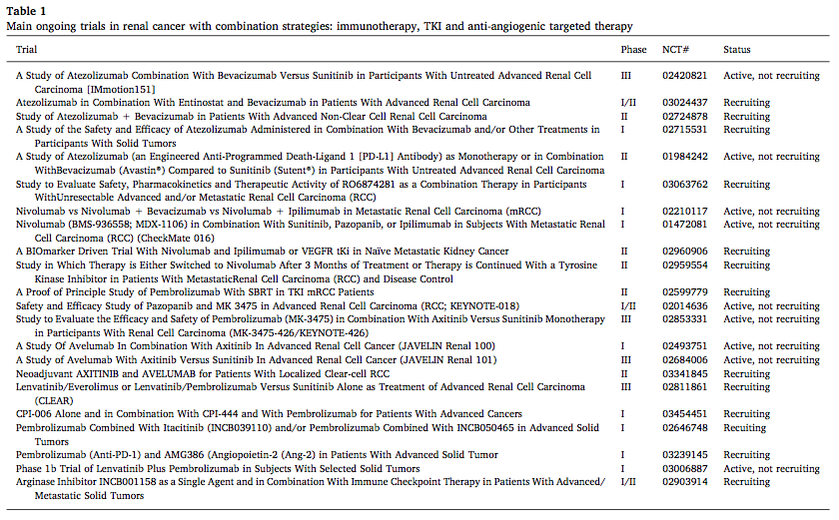
Nuti m, et al., Cancer Treatment Reviews 2018;70:41–46

Slide 36



Role of Eph Receptors and Ephrins in Angiogenesis
•
•
EphB4/ephrinB2 seems to play a key role
1.Vascular borders due to their reciprocal
distribution:
ephrinB2 on arteries and EphB4 on veins
2.Phosphorylation of Akt kinase
3.proliferation and migration of the ECs.
TNF-α induced ephrinA1 expression on ECs.
ECs aggregation and migration
ephrinA1 with EphA2 induced activation of PI3 kinase and Rac1

Slide 37
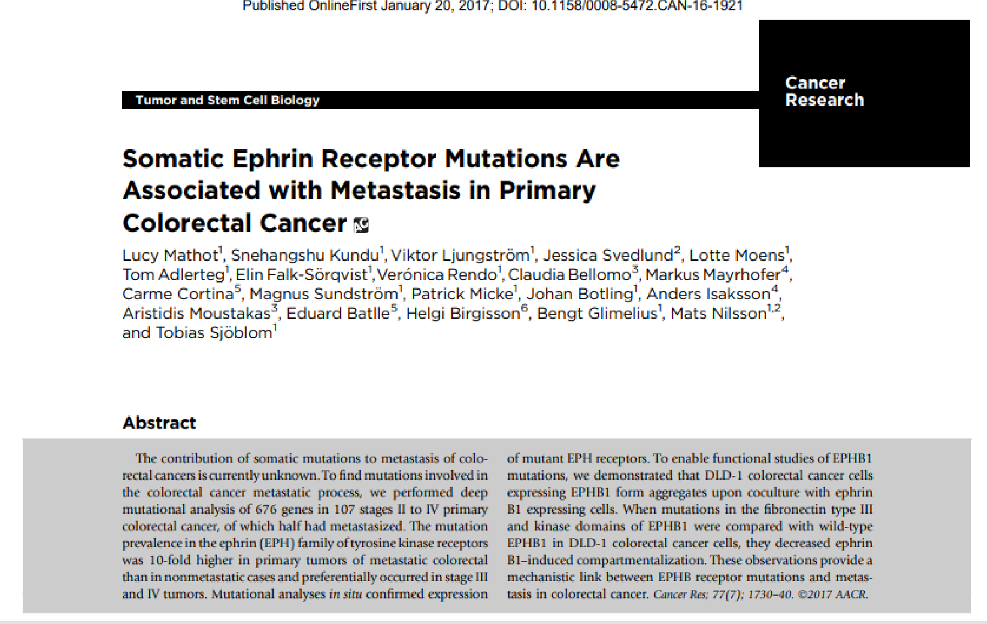

Slide 38
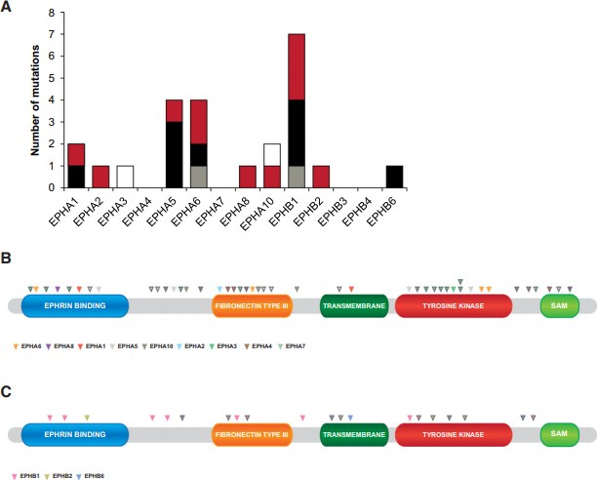

Slide 39
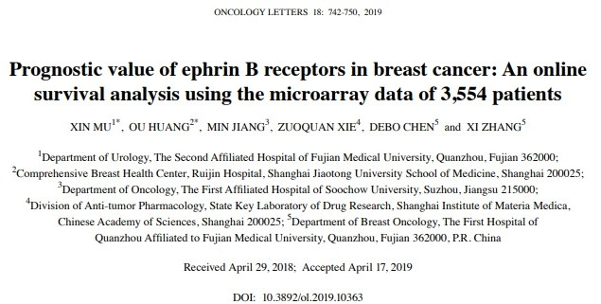
•
•
•
High mRNA expression levels of EphB2,EphB4,and EphB6 →improved survival
High mRNA expression level of EphB3 → worse survival for patients with breast cancer.
High expression levels of all EphB receptors, including EphB1, EphB2, EphB3, EphB4 and EphB6 →
increased risk of mortality in patients with lymph-node-positive breast cancer.
Association between EphB receptors with the clinicopathological features of patients with BC
•

Slide 40
H i g h l i g h t s
EPHA1
down-regulation poor survival outcome in patients with colorectal cancer
upregulation poor survival outcome and the metastasis of gastric cancer.
EPHA2
EFNA1-EPHA2 interaction: tumor angiogenesis
activation of EPHA2 inhibits the Ras/MAPK pathway
EPHA3
No correlation has yet been described
over-expression of EPHA4 shorter survival period and frequent liver metastasis.
EPHA5
no information in human gastrointestinal cancers
Research on EPHA6 in the gastrointestinal tract is sparse. EPHA6 is commonly expressed in the testis and brain
EPHA8 → up-regulation of MAP kinase → tumor cell growth and proliferation
expressed during the fetal period of intestinal morphogenesis and missense mutations in stomach cancer and colon cancer are known
•
•
down-regulation of EPHA7 in colorectal cancer Correlation with gastrointestinal tumors, human lung cancer and prostate cancer.

Slide 41
EPHB1
little information in human clinical cancer.
An EPHB1 mutation was recently identifed in ovarian cancer and missense mutations have also been found in gastric cancer
EPHB2
is the most extensively studied
loss of heterozygosity of the EPHB2 locus in human colorectal cancer
tumor suppressor
EPHB2/EPHRINB1→ important role in cell positioning & developmental migration of intestinal cells
as a therapeutic antibody drug
mutations reported in GII tract cancers
tumors with microsatellite instability
C-terminal EFNB1 →metalloproteinase secretion → phosphorylation of EFNB1 regulates the dissemination of gastric cancer cells in an animal model
over-expression of EPHB3 → cell-cell contact and tumor growth supression
EPHB6
no kinase activity
over-expression in leukemic cells
missense variants have been
reported in familial colorectal cancer

