Slide 1
Hydatic cyst and other liver cysts
Μιχαήλ Βάιλας MD, MSc (HPB), Pharm.D, PhDc
Ακαδημαϊκός Υπότροφος
Α΄ Χειρουργική Κλινική ΕΚΠΑ

Slide 2
Introduction - Epidemiology
Mainly caused by Echinococcus granulosus
parasitic infection
affects the liver (50–70%) and less frequently the lung, the spleen, the kidney, the bones, and the brain
especially in areas where sheep are raised, and is endemic in Asia, North Africa, South and Central America, North America, Canada and the Mediterranean region.

Slide 3
Life cycle
intermediate host usually( a sheep, a cattle, or a swine), and a primary canine host.
an accidental and an intermediate host through contact with infected dogs or by ingesting food or water contaminated with eggs of the parasite
eggs are ingested, they release larvae into the duodenum

Slide 4
migrate through the intestinal mucosa and gain access to mesenteric vessels which carry them to the liver
liver is the site of up to 70%
lung, the site of an additional 15-30% of lesions
The cyst wall contains an outer chitinous layer and an inner germinal layer. The germinal layer may develop internal protrusions and eventually form daughter cysts within the original cyst.

Slide 5
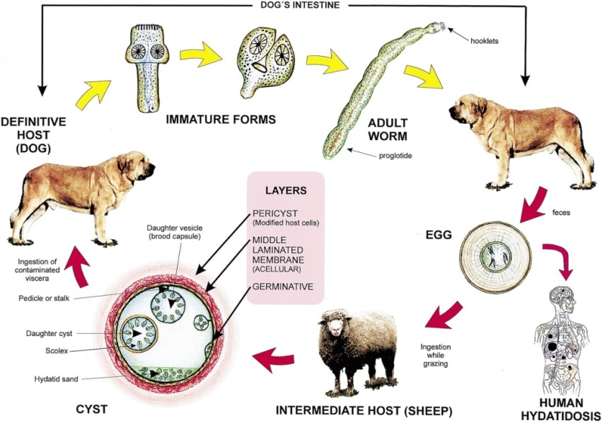

Slide 6
Hydatid cyst structure
Adventitia (pericyst): consisting of compressed liver parenchyma and fibrous tissue induced by the expanding parasitic cyst.
Laminated membrane (ectocyst): is elastic white covering, easily separable from the adventitia.
Germinal epithelium (endocyst) – is a single layer of cells lining the inner aspects of the cyst and is the only living component, being responsible for the formation of the other layers as well as the hydatid fluid and brood capsules within the cyst

Slide 7
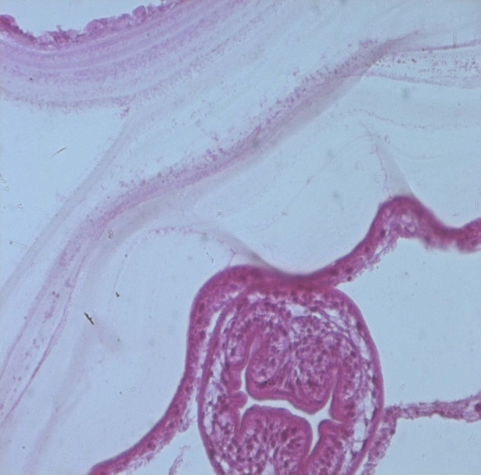

Slide 8
Complications of hydatid cyst of the liver
complications in about 40% of cases. The most common complications in order of frequency are infection, rupture to the biliary tree; rupture to the peritoneal cavity; rupture to the pleural cavity.

Slide 9
Infection
most common complication
pains in the right hypochondrium, hepatomegaly, and fever

Slide 10
Intrabiliary rupture of hydatid cyst
an occult rupture, in which only the cystic fluid drains to the biliary tree and is observed in 10-37% of the patients
frank rupture, which has an overt passage of intracystic material to the biliary tract and is observed in 3-17% of the patients
incidence of rupture into the biliary tree ranges between 3 and 17%

Slide 11
cholangitis, sclerosis odditis, hydatid biliary lithiasis etc.
When ruptured into biliary tree, hydatid cysts commonly manifest with findings of biliary obstruction and cholangitis. Diagnosis of this complication can usually be made by using ultrasound and abdominal CT scan.
The presence of dilated common bile duct, jaundice, or both in addition to a cystic lesion of liver and bile ducts dilatation at CT-scan is strongly suggestive of a hydatid cyst with intrabiliary rupture.

Slide 12
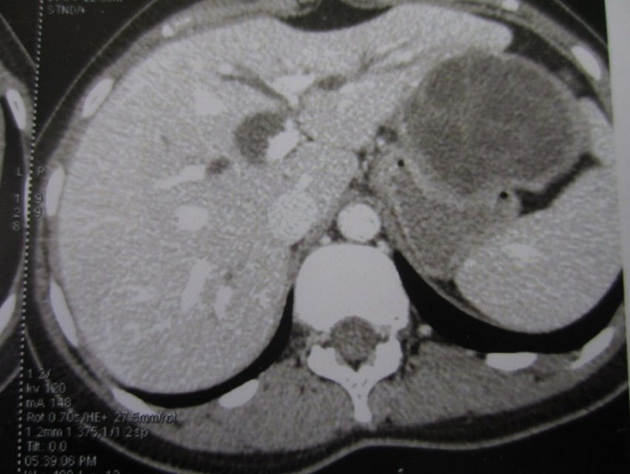

Slide 13
The rupture in the thorax
seen in approximately 0.6% to 16% of cases
The clinical presentation is predominately pulmonary, with abdominal symptoms being less frequent.
Coughs, expectoration, and dyspnea are present in 30% of cases.
Diagnosis of thoracic complications is performed with Thoraco-abdominal CT-scan which shows the liver hydatid cyst, and the thoracic complication and sometimes could show the diaphragmatic fistul

Slide 14
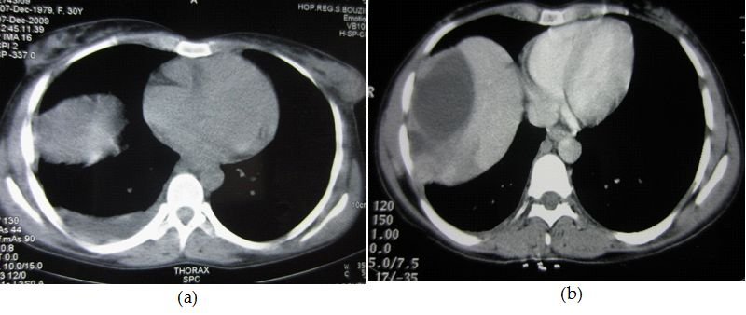
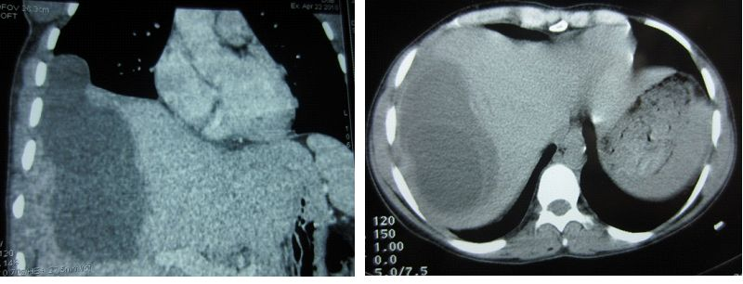

Slide 15
The rupture in the peritoneum
rare and generally followed by anaphylactic reactions.
risk factors for hydatid cyst perforation include younger age, cyst diameter of >10 cm, and superficial cyst location.
Abdominal pain, nausea, vomiting and urticaria are the most common symptoms. Allergic reactions may be seen in 25% of the cases.
if the hydatid cyst contains bile due to associated rupture in the biliary tree, the patient will present peritonitis

Slide 16
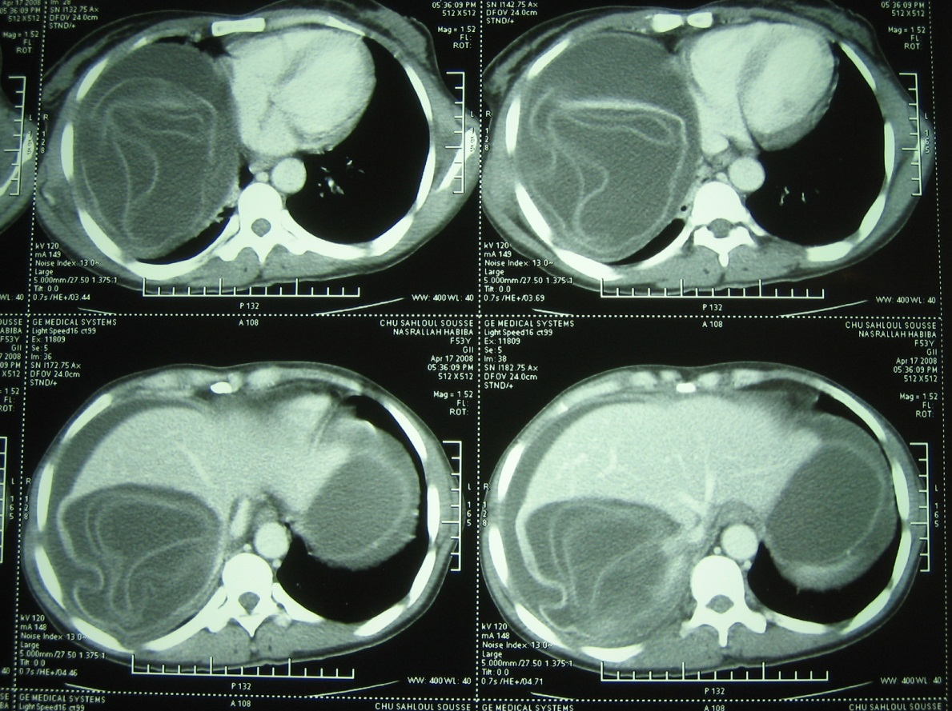

Slide 17
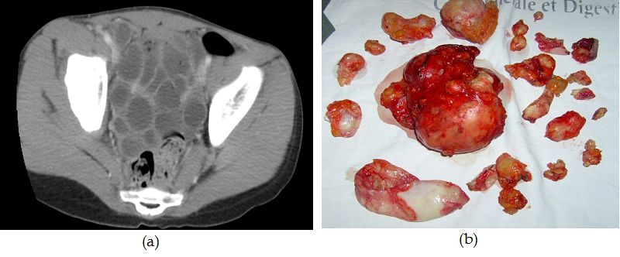

Slide 18
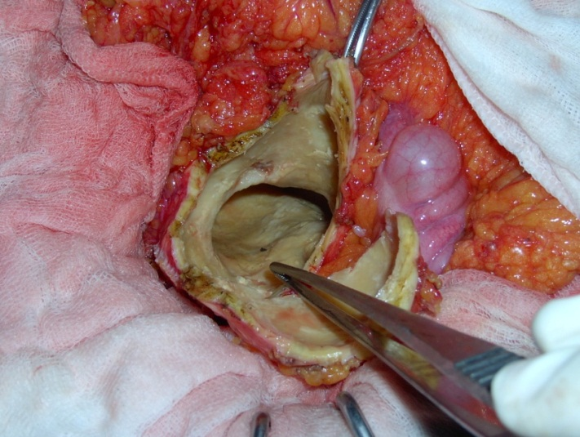

Slide 19
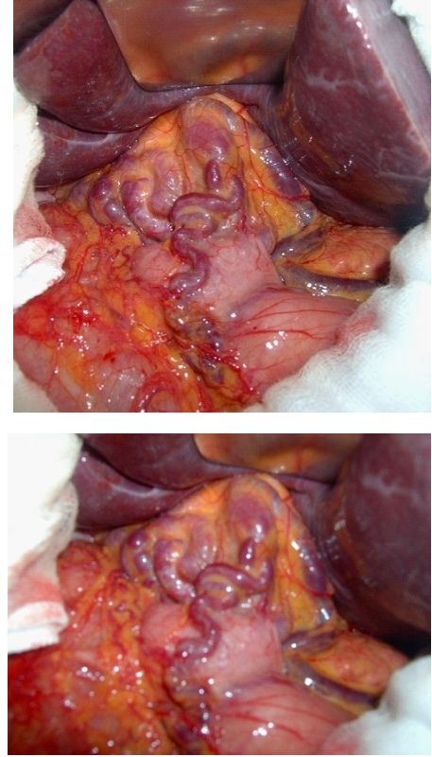
Portal hypertension (pre-hepatic, hepatic, post-hepatic) is a very rare complication of hydatid cyst of liver.The compression of the hepatic veins can be responsible for Budd-Chiari syndrome and portal hypertension

Slide 20
Vascular compression

Slide 21
Diagnosis
humans are usually asymptomatic for a long time.The growth of the cyst in the liver is variable, ranging from 1 mm to 5 mm in diameter per year
symptoms depend not only on the size and number of cysts, but also on the mass effect within the organ and upon surrounding structures

Slide 22
Non complicated cysts
diagnosed incidentally during abdominal investigation for other pathology
The most common symptom, when it occurs, is right upper quadrant or epigastric pain and the most common findings on examination are an enlarged liver and a palpable mass.

Slide 23
Complicated cysts
biliary communication, intraperitoneal rupture (spontaneous or post-traumatic) and, rarely, intrathoracic or intrapericardial rupture
Cyst rupture can be associated with anaphylaxis
secondary infection, tender hepatomegaly, chills, and spiking temperatures occurs. Urticaria and erythema occur in cases of generalized anaphylactic reaction. With biliary rupture the classic triad of jaundice, biliary colic and urticaria occurs.

Slide 24
Complicated cysts
The diagnosis is most easily set by ultrasound or other imaging techniques such as CT-scan or MRI, combined with case history.
Serology tests such as ELISA or immunoblotting can be used in addition, being 80-100% sensitive for liver cysts but only 50-56% for lungs and other organs
The definitive diagnosis of liver echinococcosis requires a combination of imaging, serologic, and immunologic studies.

Slide 25
Detection of IgG antibodies implies exposure to the parasite, while in active infection high titers of specific IgM and IgA antibodies are observed.
ELISA is used most commonly
The counter-immuno-electrophoresis has the highest specificity (100%) and high sensitivity (80 – 90%)

Slide 26
Imaging techniques
Ultrasonography (US) is the screening method of choice - has diagnostic accuracy of 90%
CT scan or MRI scan are important preoperative diagnostic tools to determine vascular,biliary or extra hepatic extension, to recognize complications, such as rupture and infections, and therefore to assess respectability
Plain radiographs of the abdomen and chest may reveal a thin rim of calcification delineating a cyst, or an elevated hemi diaphragm. Both signs are non-specific.

Slide 27
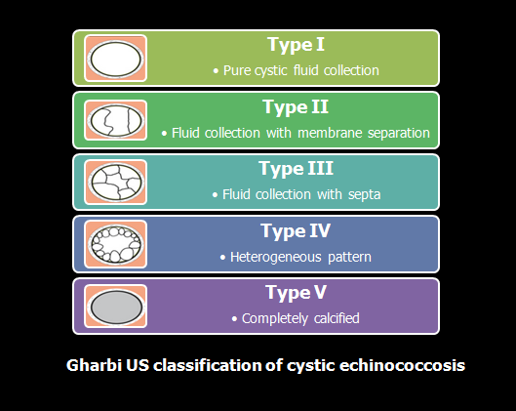

Slide 28
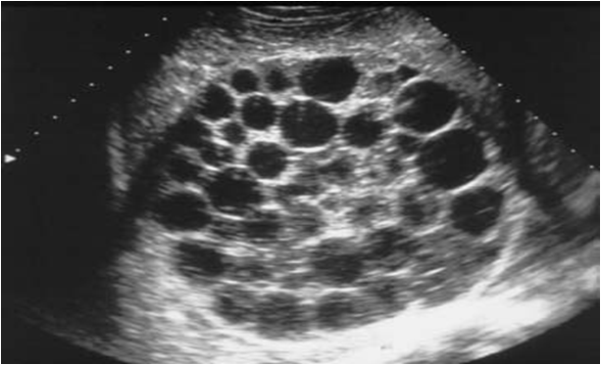

Slide 30
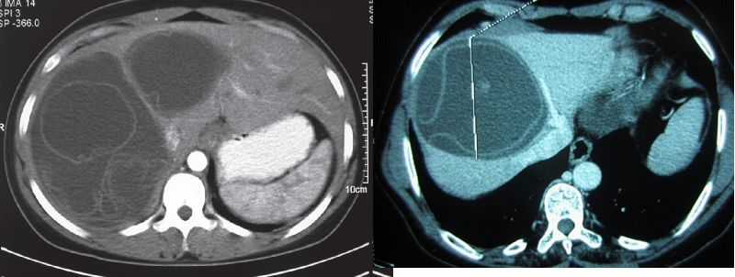
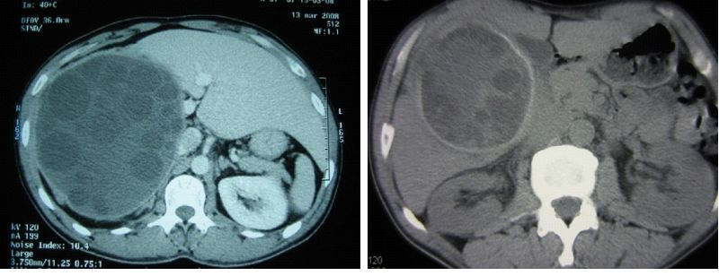
CT scan
Multi detector row computed tomography has the highest sensitivity of imaging of the cyst (100%)

Slide 31
Cholangiography

Slide 32
Treatment
Surgery remains the gold standard treatment for hydatid liver disease.
Cysts with homogeneously calcified cyst walls need, probably, no surgery but only a ‘wait and observe’ approach

Slide 33
principles of hydatid surgery
Total removal of all infective components of the cysts;
the avoidance of spillage of cyst contents at time of surgery;
management of communication between cyst and adjacent structures;
management of the residual cavity;
Minimize risks of operation.

Slide 34
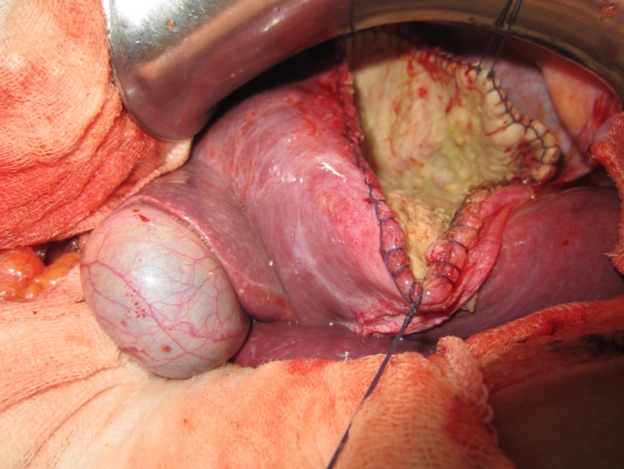
The conservative techniques (Marsupialization )
Radical surgical procedures (cystectomy, pericystectomy, lobectomy and hepatectomy)

Slide 35
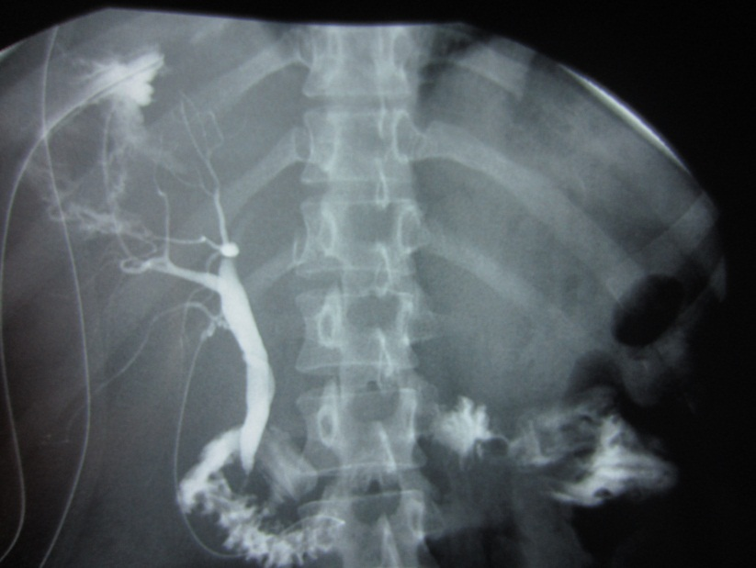
Complications of surgery
Biliary leakage is the most frequent postoperative complication following surgery for hydatid cysts of liver.
Although most of the external biliary fistulas close spontaneously, they may be persistent in 4%-27.5% of the cases

Slide 36
Chemotherapy for hydatid disease of liver
based on benzoimidazole carbamates,such as mebendazole and albendazole
Inoperable cases - as primary treatment - 3 cycles
Pre-operatively – to reduce the risk of recurrence 6 weeks continuous treatment
Post-operatively to prevent recurrence in cases of intraoperative cyst spillage 3 cycles.

Slide 37
Conclusion
a continuous public health problemin endemic countries
(75%of cases), followed by the lungs (15%), the spleen (5%),and other organs (5%)
Ultrasonography and computed tomography.
surgery combined with medical treatment by albendazole is effective in the eradication of hepatic hydatid disease and in the prevention of local recurrences.

Slide 39
Simple cyst
most common pathology of the liver, with a prevalence of 2.5-5%, and a slight female predominance
The majority of simple cysts are congenital and form from biliary ducts
small fraction of patients present with abdominal pain, early satiety, nausea, and vomiting, which arise as a result of a mass effect.

Slide 40
Complications such as hemorrhage, rupture and biliary obstruction
Laboratory findings are usually normal
CA-19-9

Slide 41
Most simple liver cysts are found incidentally during imaging for other reasons.
USG has a sensitivity and specificity of approximately 90% for diagnosing simple cysts, and recent advances in CT and MRI technology might result in even higher sensitivity rates
Treatment of a symptomatic cyst involves either percutaneous aspiration or surgical intervention.

Slide 42
Surgical techniques involve cyst fenestration, subtotal cyst excision, liver resection, and even liver transplantation.
laparoscopic approach is the current standard of care

Slide 43
Biliary cystadenoma (Due to the significant limitations of preoperative imaging and FNA in differentiating BCA from cystadenocarcinoma, all lesions suspected of being BCA should be surgically removed with a negative margin. )
Biliary cystadenocarcinoma

Slide 44
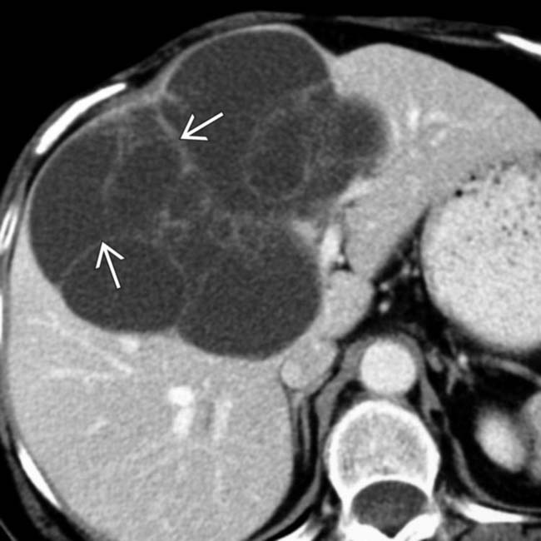

Slide 45
