Slide 1
Acute pancreatitis
Μιχαήλ Βάιλας MD, MSc (HPB), Pharm.D, PhDc
Ακαδημαϊκός Υπότροφος
Α΄ Χειρουργική Κλινική ΕΚΠΑ

Slide 2
Epidemiology
300,000 annually in US
10-20% are severe
Total annual cost of 2 billion $$$
(Biliary + alcoholic) 90%
Even in the west, biliary pancreatitis is the most prevalent type.
Incidence among AIDS patients 4-22%

Slide 3
Pathophysiology
Causes
Biliary tract disease
Alcohol
Hyperlipedemia
Hypercalcemia
Trauma
ERCP
Ischemia
Pancreatic neoplasia
Pancreas divisum
Ampullary lesions
Duodenal lesions
Infections
Venom
Drugs
idiopathic

Slide 4
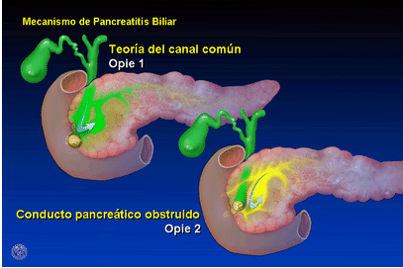
PATHOPHYSIOLOGY
Common channel theory
“Opie 1901”
Detergent effect of bile

Slide 5
Pathophysiology
Theories behind mechanism of biliary pancreatitis
Common channel theory
Incompetent sphincter theory
Co-localization theory

Slide 6
Pathophysiology
Critique of common channel theory
Higher hydrostatic pressure in PD
Introduction of bile into PD in animal models failed to cause AP

Slide 7
Pathophysiology
Incompetent sphincter theory
Incompetent sphincter of Oddi due to stone passage → reflux → AP
Critique
How come papillotomy doesn’t routinely cause AP??

Slide 8
Pathophysiology
Co-localization theory “Steer & Saluja” 1998
Most acceptable
Stones → PD ductal hypertension → ducutle rupture
Ductal pH = 9 …… parynchemal pH = 7
trypsinogen + cathepsin B → trypsin → autodigestion cascade

Slide 9
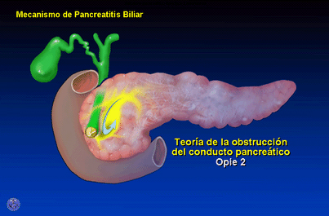
Pathophysiology

Slide 10
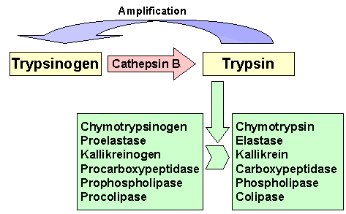
Pathophysiology

Slide 11
Diagnosis
Clinical picture
Investigations
“Acute pancreatitis is a diagnosis of exclusion” Schwartz’s

Slide 12
Diagnosis
Hx:
Epigastric pain
Radiating to back
Nausea, vomitting
Precipitating factor?

Slide 13
Diagnosis
Physical
V/S → variable
Epigastric tenderness
Cullen’s / Grey Turner’s (1%)
Findings of complication(s)

Slide 14
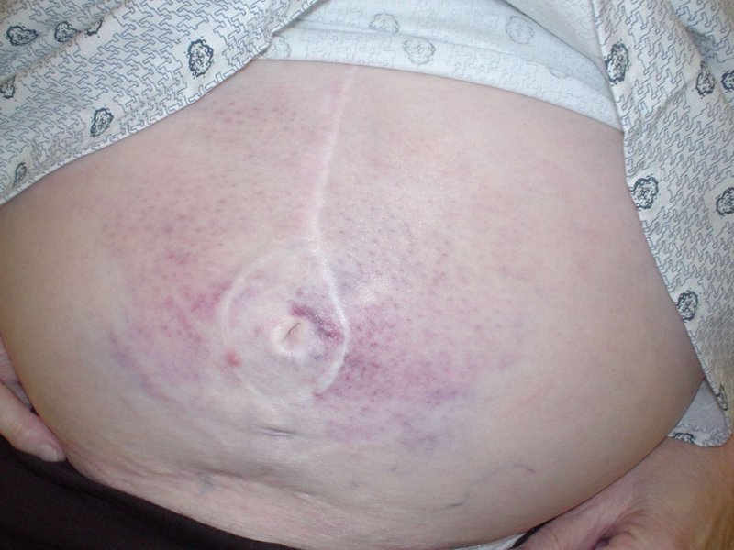
Cullen’s sign

Slide 15
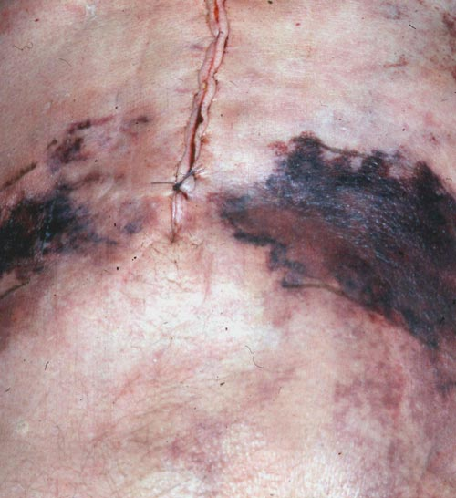
Grey Turner’s sign

Slide 16
Diagnosis
Serum markers
Amylase
Easiest to measure and most widely used
Rises immediately
Peaks in few hours
Remains for 3-5 days
“Three fold rise is diagnostic”
May be normal in severe attacks
May be falsely negative in hyperlipedimic patients
Inverse correlation between severity and serum amylase level
No need to repeat

Slide 17
Diagnosis
Serum markers
Urine amylase
Remains elevated for a few more days
Increase excretion of amylase with attacks of AP
Of great value when dealing with severe pancreatitis

Slide 18
Diagnosis
Serum markers
P/S – amylase
P amylase increases specificity to 93%
Lipase
“the serum marker of highest probability of disease”
Specificity of 96%
Remains elevated for longer time than total amylase

Slide 19
Diagnosis

Slide 20
Causes of hyperamylesemia
Malignancies
Lung CA
Ovarian CA pancreatic CA
Colonic CA
pheochromocytoma;
Thymoma
multiple myeloma
breast cancer
Pancreatitis p
Choledocolethiasis p
Parotitis s
Renal failure s/p
Liver cirrhosis s/p
perforated bowel p
mesenteric infarction p
intestinal obstruction p
Appendicitis p
Peritonitis. P
Gyne disease s

Slide 21
Radiology
Diagnostic role
X-ray
U/S
CE-CT

Slide 22
Radiology
X-ray
Air in the duodenal C loop
Sentinel loop sign
Colon cutoff sign
All these signs are non specific

Slide 23
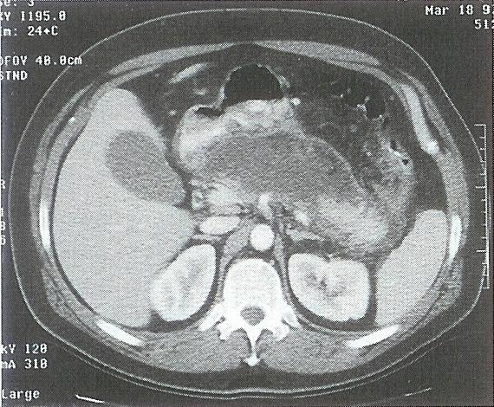
Radiology
CE-CT
Enlargement of the pancreas
(focal/diffuse)
Irregular enhancement
Shaggy Pancreatic contour
Thickening of fascial planes
fluid collections.
Intraperitoneal / retroperitoneal
Retroperitoneal air

Slide 24
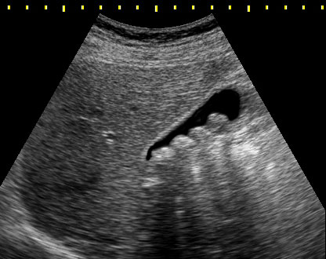
Radiology
U/S
Diagnosis of gallstones
F/U of pseudocysts.

Slide 25
Prognosis
Course either mild or severe
Mild = edematous pancreatitis
Severe = necrotic pancreatitis

Slide 26
Prognosis
Serum markers
CT
Systemic complications
Prognostic scores
Ranson
Apache II
Modified Glasgow
Atlanta
Atlanta Consensus
1992

Slide 27
Prognostic scores
Ranson’s
Predictor of morbidity/mortality
<2 0% mortality
3-5 10-20%
>7 >50% mortality
Critique of Ranson’s
11 parameters
48 hours
No predictor value beyond 48hrs

Slide 29
Prognostic scores
APACHE II
Immediate
Acute and chronic parameters
Complicated
>7 = severe pancreatitis

Slide 30
Prognostic biochemical markers
Biochemical markers of prognosis
Ideally
High sensitivity
High specificity
Discriminate severe from mild
Immediate
Widely available
Amylase & lipase
Highly sens./spec.
Lack prognostic value

Slide 31
Prognostic biochemical markers
Alternatives
CRP
α2 macroglobulin
PMN elastase
α1 antitrypsin
Phospholipase A2
“CRP seems to be the marker of choice in these settings”
CRP >150 is diagnostic of severe pancreatitis

Slide 32
CT scan (prognostic aspect)
“CT scanning with bolus IV contrast has become the gold standard for detecting and assessing the severity of pancreatitis”
“Currently, IV bolus contrast enhanced CT scanning is routinely performed on patients who are suspected of harboring severe pancreatitis, regardless of their Ranson’s or APACHE scores” Schwartz’s

Slide 33
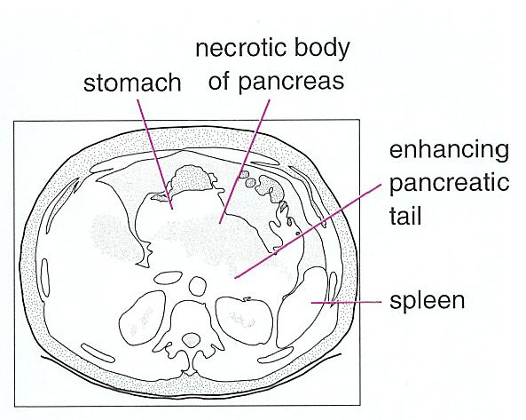
CT scan (prognostic aspect)

Slide 34
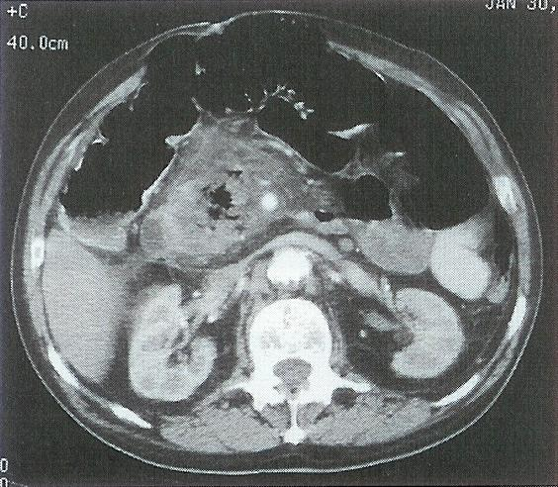
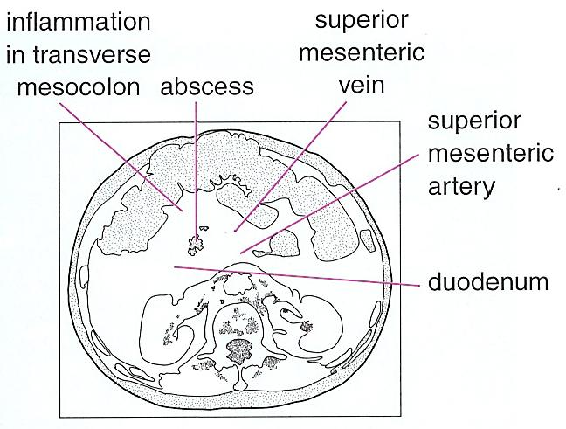
CT scan (prognostic aspect)

Slide 35
CT scan (prognostic role)
Balthazar CT-severity index (CTSI)
CTSI considers degree of necrosis
Also considers the CT grade
A final score is given and correlates with mortality and complication development

Slide 36
CT scan (prognostic role)
Balthazar grading
Grade A - Normal-appearing pancreas 0
Grade B - Enlargement of the pancreas 1
Grade C - Pancreatic gland abnormalities a with peripancreatic fat infiltration 2
Grade D - A single fluid collection 3
Grade E - Two or more fluid collections 4

Slide 37
CT scan (prognostic role)
Grade of necrosis and the points assigned per grade are as follows:
None 0 points
Grade 0.33 2 points
Grade 0.5 4 points
Grade > 0.5 6 points

Slide 38
CT scan (prognostic role)
Overall prognostic outlook:
CTSI | Mortality | Complication
0-3 | 3% | 8%
4-6 | 6% | 35%
7-10 | 17% | 92%

Slide 39
MANAGEMENT
Management depends on severity
We will consider management of edematous pancreatitis separately from necrotizing pancreatitis for purpose of simplification

Slide 40
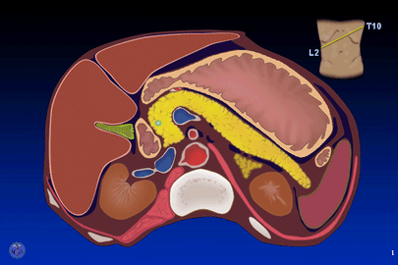
MANAGEMENT OF MILD PANCREATITIS

Slide 41
Management (mild)
Core of treatment based on
Physiological monitoring
Metabolic support
Maintenance of fluids and electrolytes

Slide 42
Management (mild)
Pancreatitis is an autodigestive process
Role of protease inhibitors?
Aprotinin
Gabexate mesylate
Camostate
Phospholipase A2 inhibitors
FFP
No benefit

Slide 43
Management (mild)
Vascular injury is mediated by platelet aggregating factor
What’s the role of PAF inhibitors?
PAF acetylhydrolase
Lexipafant
Great results in models
Great results in small clinical trials
Failed in larger studies
Verdict: useless

Slide 44
Management (mild)
Question to audience:
When dealing with acute pancreatitis, do u start Abx therapy?
“Antibiotic therapy has not proved to be of value in the absence of signs or documented sources of infection”

Slide 45
Management (mild)
Mainstay of management is supportive
NPO
IVF
When to resume oral intake?
Absence of pain
Absence of tenderness
Patient feeling hungry
On average takes about 3-7 days
Sips of water and build up to low protein low fat diet

Slide 46
MANAGEMENT OF SEVERE PANCREATITIS

Slide 47
Management (severe)
Severe pancreatitis:
> Ranson / APACHE
CRP >150
Systemic complications
Necrosis on CE-CT
Hemodynamic compromise

Slide 48
Management (severe)
Complications
Local
Phlegmon
Abcess
Pseudocyst
Ascitis
pseudoanurysm
Adjacent organ envolvment
Systemic
pulmonary
Cardiac
Hematological
GI
Renal
Metabolic
CVS
Fat necrosis

Slide 49
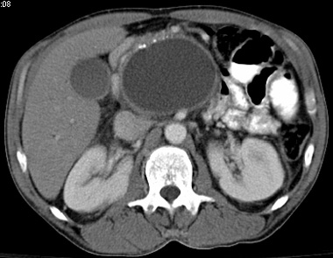
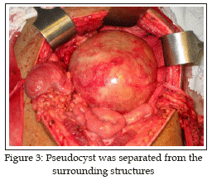
Pseudocyst

Slide 50
Management (severe)
Sterile necrosis
Absence of retroperitoneal air on CT
Prognosis
0% mortality without complications
38% with single sys. complication

Slide 51
Management (severe)
How to approach sterile necrosis?:
No sys. Comp., no infec. (i.e. uncomplicated)
supportive
Sys. Comp. + infection? ( mild complication)
CT guided aspiration → gram stain/culture → Abx
Mult. Sys comp + toxicity/shock (frank complication)
surgical debridment
S
E
V
E
R
I
T
Y

Slide 52
Management (severe)
Role of prophylactic Abx?
Previously thought to have no role in sterile necrosis
Prophylaxis indicated whenever there is necrosis
Drugs with proven benefit
Imipenem
Flagyl
3rd gen. Cephalosporins
Abx prophylaxis reduced:*
Sepsis by 21.1%
Mortality by 12.3%

Slide 53
Management (severe)
Role of Antifungal medication
Candida is a common inhabitant of upper GI tract
Risk of secondary infection
Empiric fluconazole?
Clansy TE “current management of necrotizing pancreatitis”*

Slide 54
Management (severe)
Nutritional support
NPO with resumption of diet when fit
If NPO > 7 days…
TPN vs. Jujenal tube feeding?
TPN: gastric mucosal atrophy → bacterial translocation
Jujenal tube feeding: induces pancreatic secretion
Inconclusive studies:
Jujenal T. feeding is superior*

Slide 55
Management (severe)
Benefit of enteral feeding
Prospective randomized trial
n=34
Severe acute pancreatitis
“enteral feeding modulates the inflamatory and sepsis response in acute pancreatitis”*

Slide 56
Specific considerations of biliary pancreatitis

Slide 57
Management (severe)
Specific consideration of biliary pancreatitis:
Majority of stones will pass within hours
Some might impact
Patient at risk of subsequent stone obst.

Slide 58
Management (severe)
If hyperbilirubinemia is dropping:
Lap chole with surgical duct clearance
<72 hours vs. >72 (within admission)
If patient critical → ERCP stone clearance
Routine ERCP NOT ADVOCATED

Slide 59
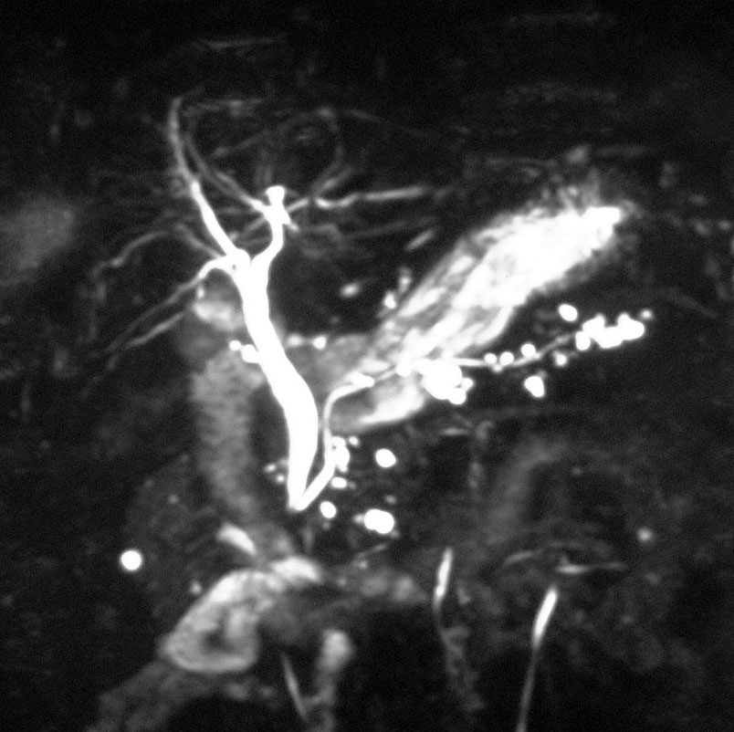
Management (severe)
If hyper bilirubinemia persists:
confirm presence of stone before ERCP (MRCP, EUS)

Slide 60
Conclusion
Acute pancreatitis is a hot area for research
Advances at the cellular level show promise to “halt”pancreatitis
Most patients need just supportive care
No indication for Antibiotics in mild type
Severe pancreatitis needs antibiotics
Surgical management ►gallstones / complications

