Slide 1
My Classification
The optimal management depends on
No classification system is universally
Leaks from cystic duct stump or small ducts in liver bed
Partial CBD/CHD wall injuries
Complete CBD/CHD transection
Right/left hepatic duct or sectoral duct injuries
Bile duct injuries associated with vascular injuries
timing of recognition of injury
the extent of bile duct injury
the patient’s condition
the availability of experienced hepatobiliary surgeons.
Complex bile duct injuries are defined as injuries of the common bile duct or its tributaries that require a circumferential anastomosis as a presumed definitive repair. According to the Strasberg classification , injuries of this type are included in
groups E and D.

Slide 2
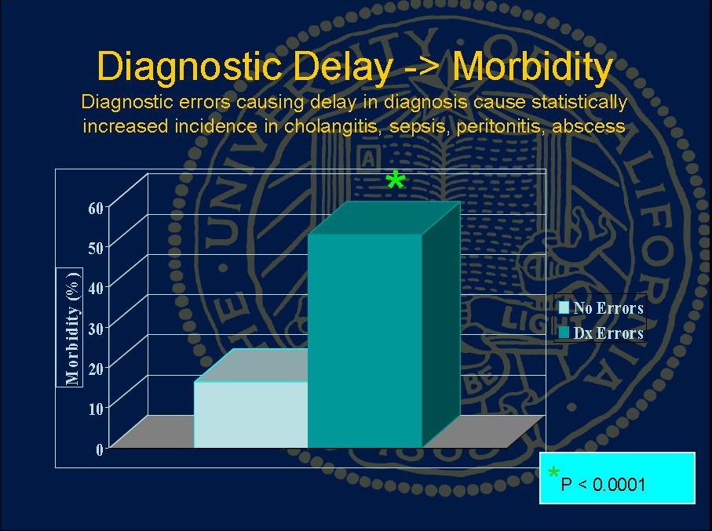

Slide 3
INITIAL GOAL
CONTROL OF SEPSIS
+
CONTROL ONGOING BILE LEAK

Slide 4
Bile Leaks and Sepsis
Drain Now, Fix Later
(delayed repair)

Slide 5
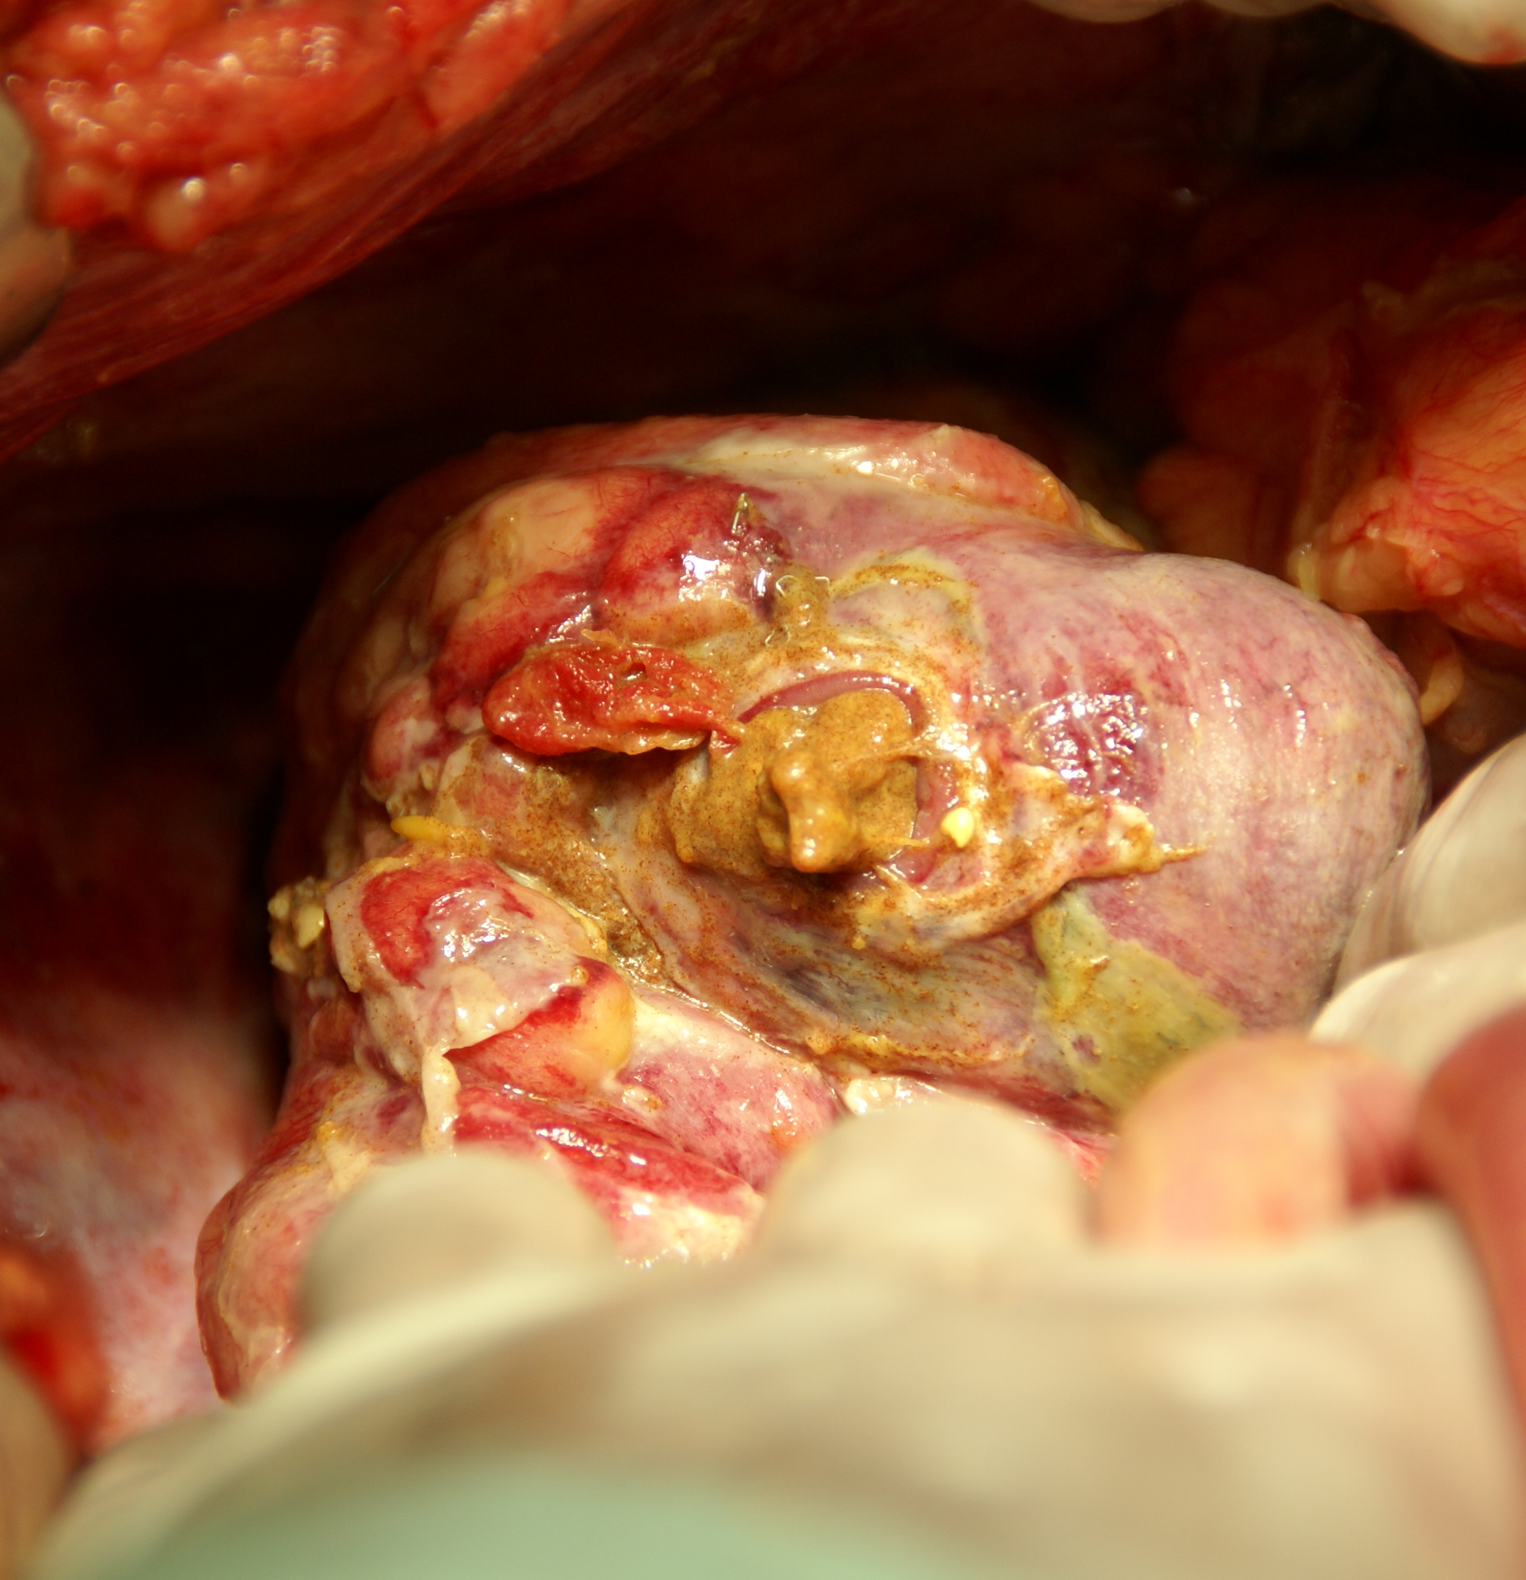
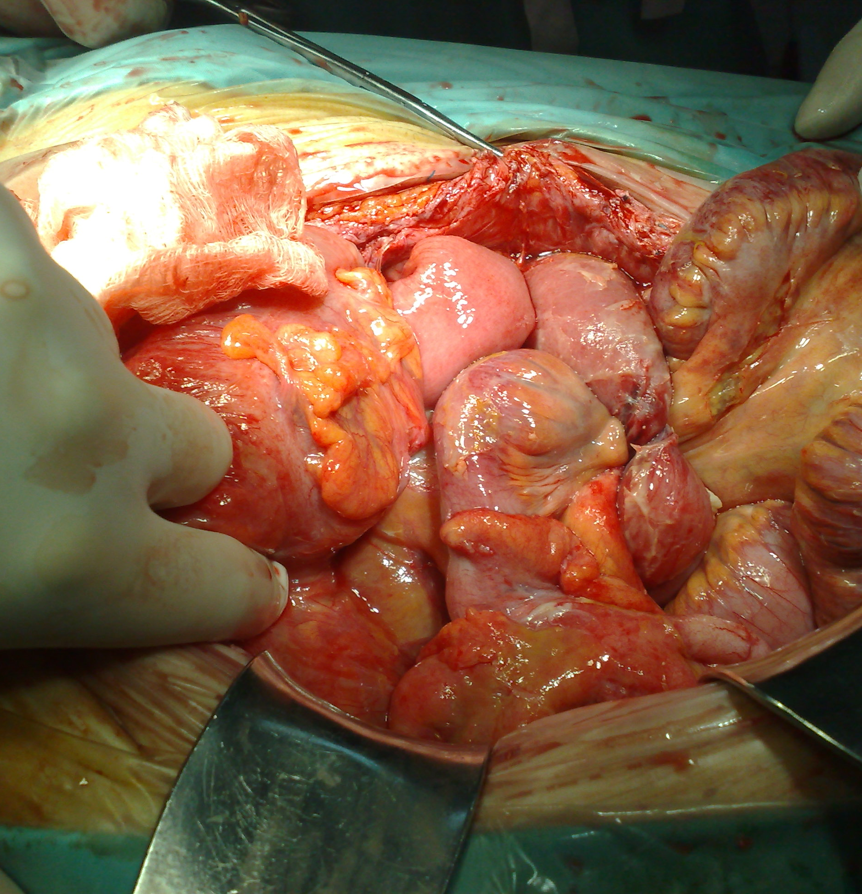
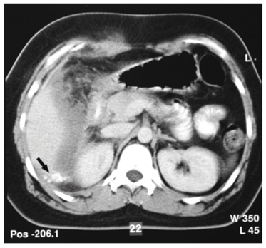
Peritoneal abscess and peritonitis

Slide 6
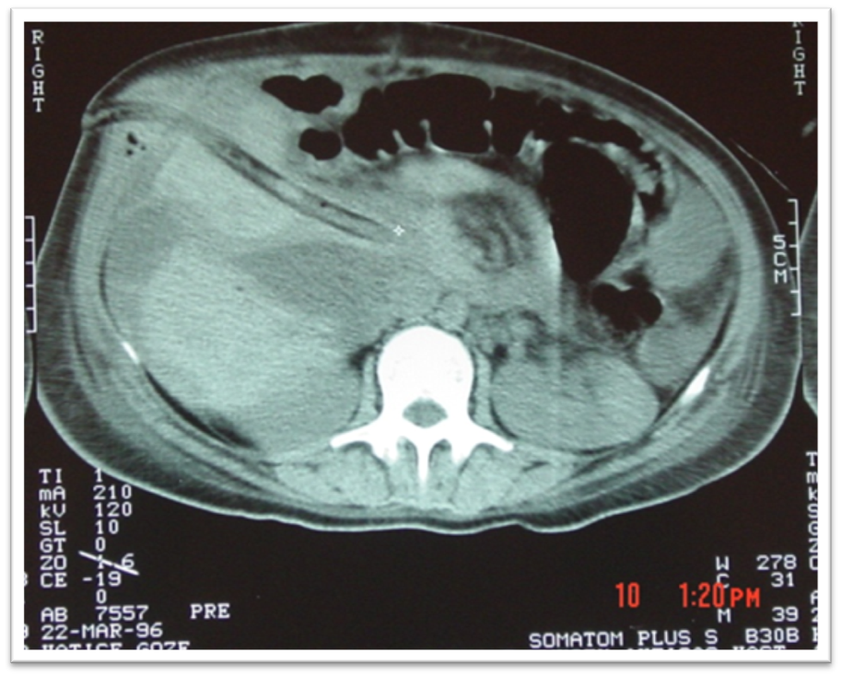

Slide 7
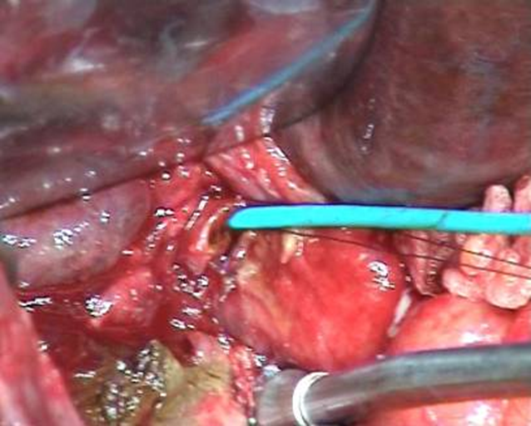
PTCD

Slide 8
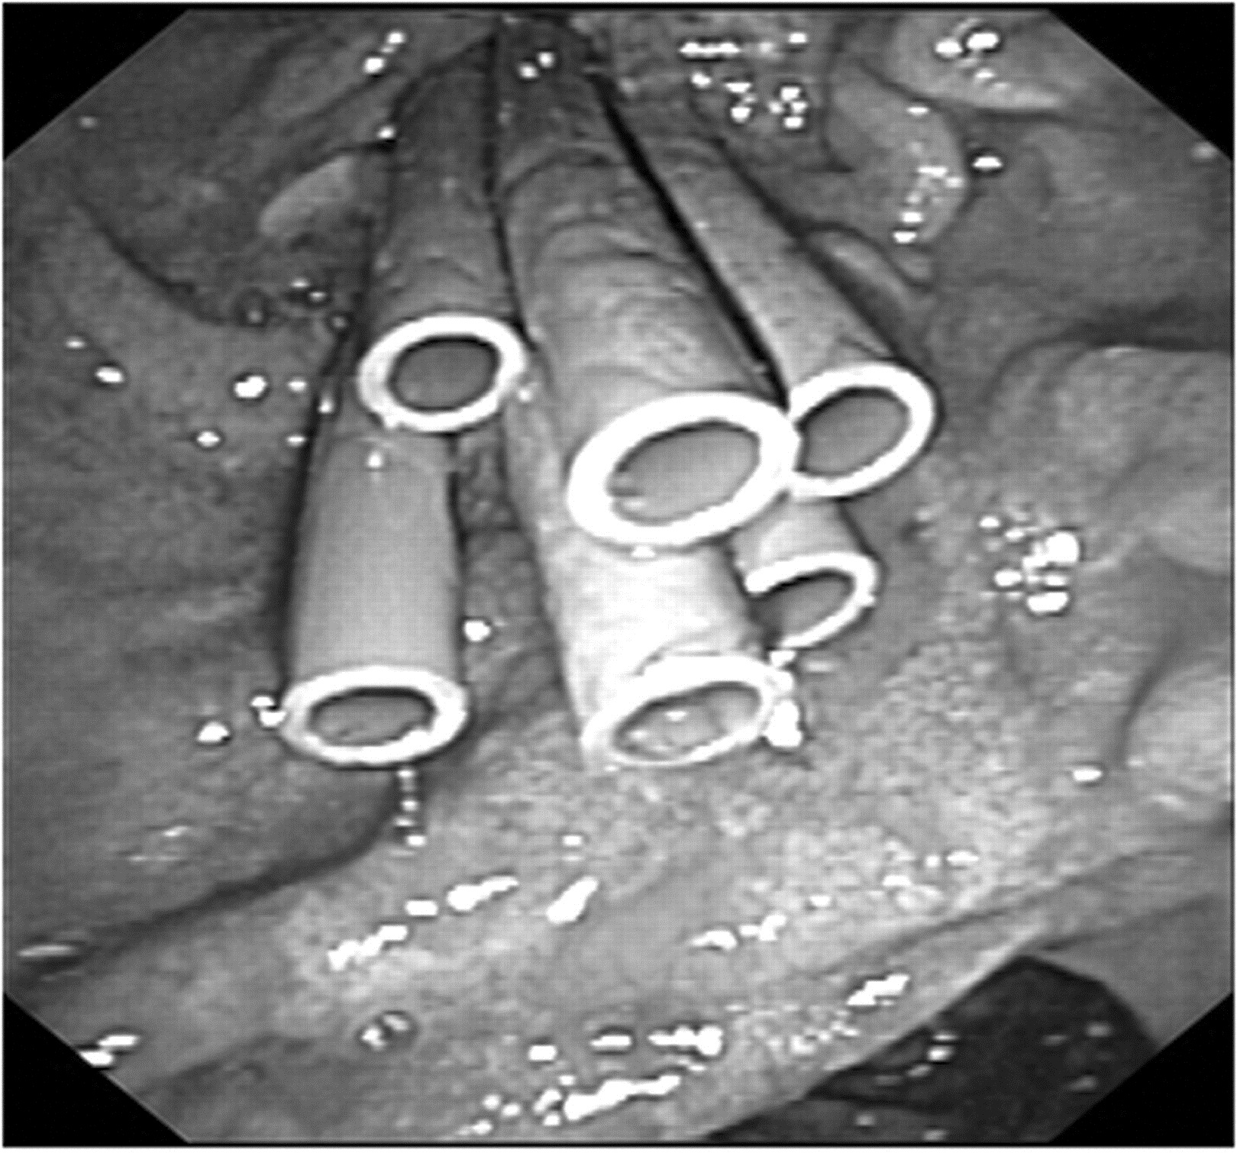
Any suspect of BDI ?
study the biliary anatomy
COLANGIOGRAPHY (PTC / ERCP)
YES
successful repair in 96-98%
NO
unsuccessful repair in 98%
Endoscopic treatment of post-surgical bile duct injuries: long term outcome and predictors of success
Gut 2007;56:11 1599-1605
Wald, Surg Clin N Am 2008
Lillemoe, Br J Surg 2008

Slide 9
MANAGEMENT
LONG-TERM GOAL
RE-ESTABILISHMENT OF BILE FLOW INTO THE GI TRACT
PREVENT STRICTURE
PREVENT LIVER INJURY
PREVENT CHOLANGITIS
PREVENT STONE FORMATION

Slide 10
No prospective, controlled, randomized trial
(evidence level 1) and is not going to be conducted whether an early repair is better than a late one..
The timing of the operative
repair should be individualized
EAES guidelines for BDI. Surg Endosc (2012) 26:3003–3039

Slide 11
IMMEDIATE or
early < 6 weeks
DELAYED
(> 6 weeks )

Slide 12
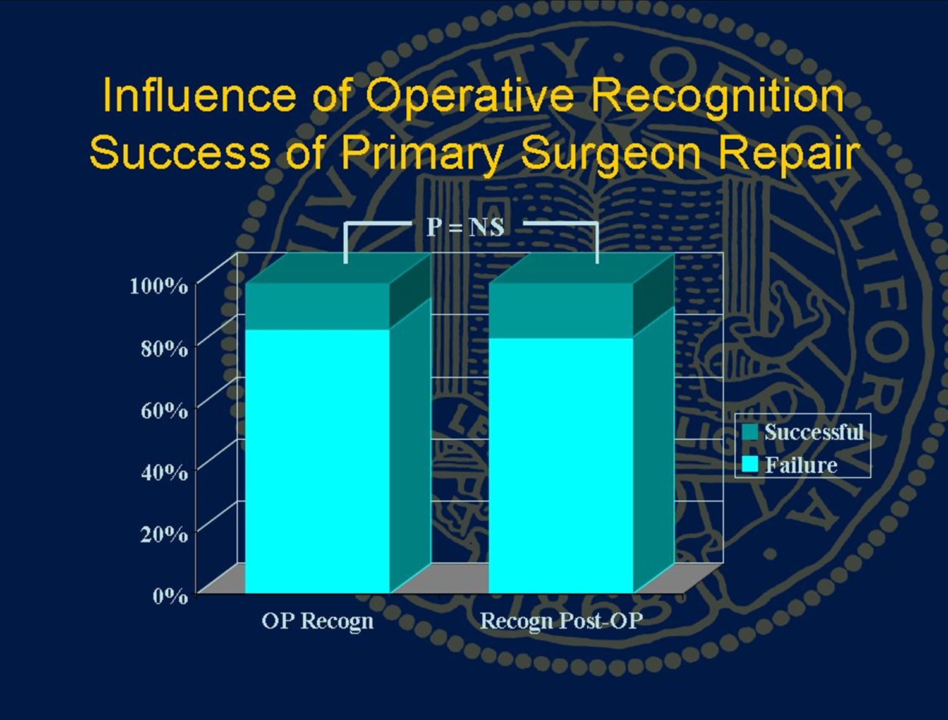
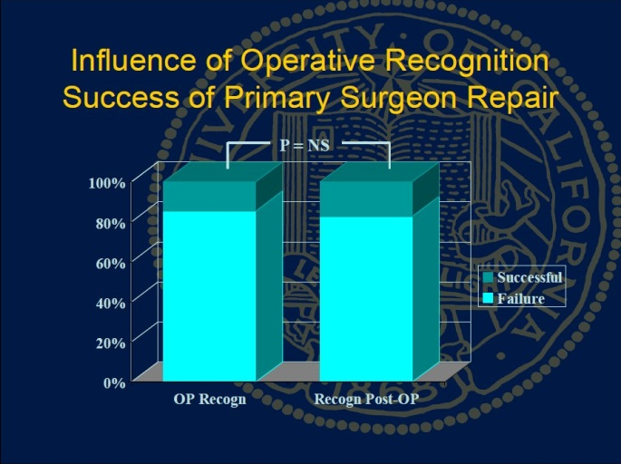
Immediate vs early
Is there a
higher success rate
for injuries
identified at the
index operation(LC) ?
No ???

Slide 13
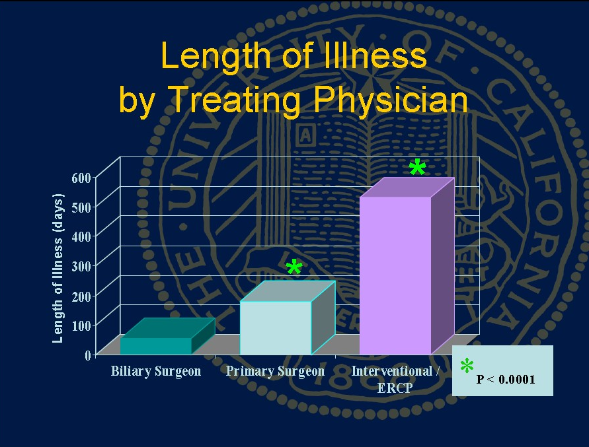

Slide 14
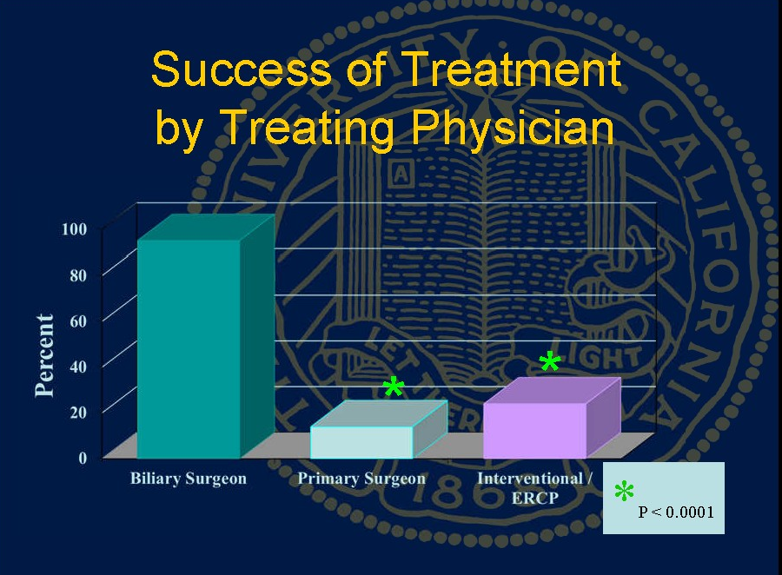

Slide 15
But for expert surgeons
The best chance
  injuries detected during surgery.
Most surgeons unable to do the repair.
  call on a surgeon with the needed expertise for this type of operation.
  the patient should be referred to a capable unit with radiologists, endoscopists, and surgeons.
A successful outcome was achieved in a high proportion of patients (42 of 47) when repair of the bile duct injury was undertaken in a unit experienced in the management of biliary injury.
In selected patients, early repair within the first 2 weeks resulted in a similar outcome to that of delayed repair.
Thomson et al Br J Surg. 2006 Feb;93(2):216-20.

Slide 16
Use It

Slide 17
Algorithm
injury classification
sepsis control and drainage from all parts of the biliary tree
diagnosis for the complete extent of the injury to the biliary tree
patient preparation by insertion of guide stents into each isolated branch of the biliary tree, followed later by surgery.
Strasberg SM et al . J Gastrointest Surg 5: 266–274. 2001

Slide 18

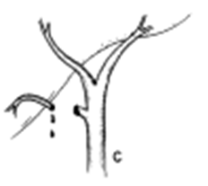



IMMEDIATE SURGICAL REPAIR
EAES guidelines for BDI. Surg Endosc (2012) 26:3003–3039
Simple leak from the cystic duct stump found during LC placement of an additional clip or a suture ligature loop → videolaparoscopy / laparotomy
Complex biliary injuries→ CONVERT TO LAPAROTOMY
STRASBERG CLASSIFICATION

Slide 19
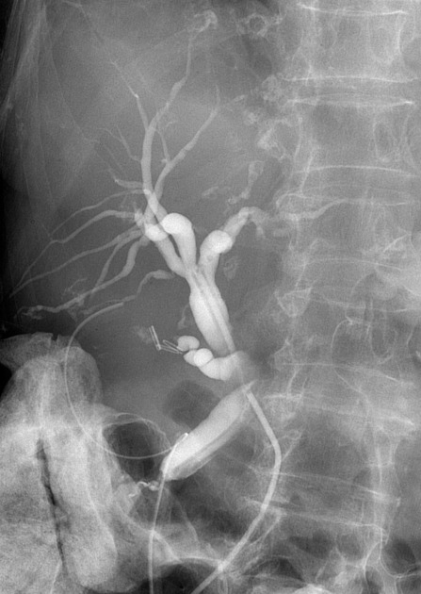

Slide 20
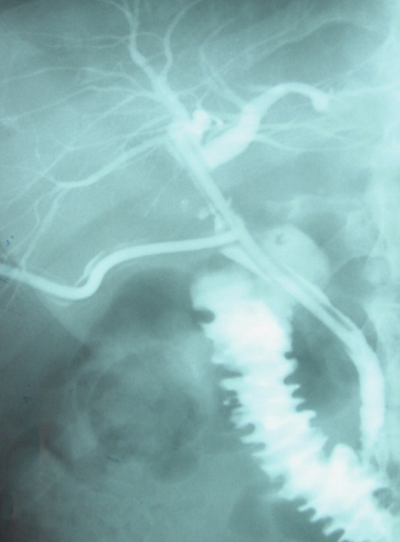
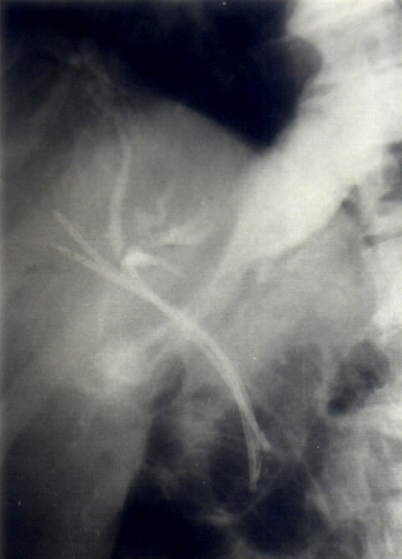

Slide 21
112 (56%) patients were repaired by specialist hepatobiliary surgeons
  timing of repair: immediate, n = 28; early (<21 days), n = 43; and late (>21 days) n = 41
45 (22%) underwent repair by nonspecialist surgeons before specialist referral
  immediate, n = 16; early, n = 26 and late, n = 03.
Outcomes after immediate and early repairs were comparable to late repairs when performed by specialists
  recurrent cholangitis:11%, 12%, and 10%; P = 0.96, NS;
  re-stricture:18%,5%, and 29%; P = 0.01;
  nonsurgical intervention: 14%, 5%, and 24%; P<0.03;
  redo surgery: 4%, 2%, and 5%; P = 0.81, NS;
  overall morbidity: 21%, 14%, and 39%; P<0.02].
On multivariate analysis, immediate and early repairs done by nonspecialist surgeons were independent risk factors (P < 0.05) for
  recurrent cholangitis [50% and 27%],
  re-stricturing (75% and 61%),
  redo reconstructions (31% and 61%), and
  overall morbidity (75% and 84%).
CONCLUSIONS
Early and immediate (< 21 days) repair have an equally good or better long-term outcome when performed at a specialist HBS center compared to injuries that are repaired late.
A delay in referral to a specialist team and the presence of associated vascular injuries contribute to adverse overall morbidity.
Immediate assistance sought from HBS or early referral …….that continues to be the drawback of laparoscopic cholecystectomy.
Perera et al Ann Surg 2011;253:553–560)

Slide 23
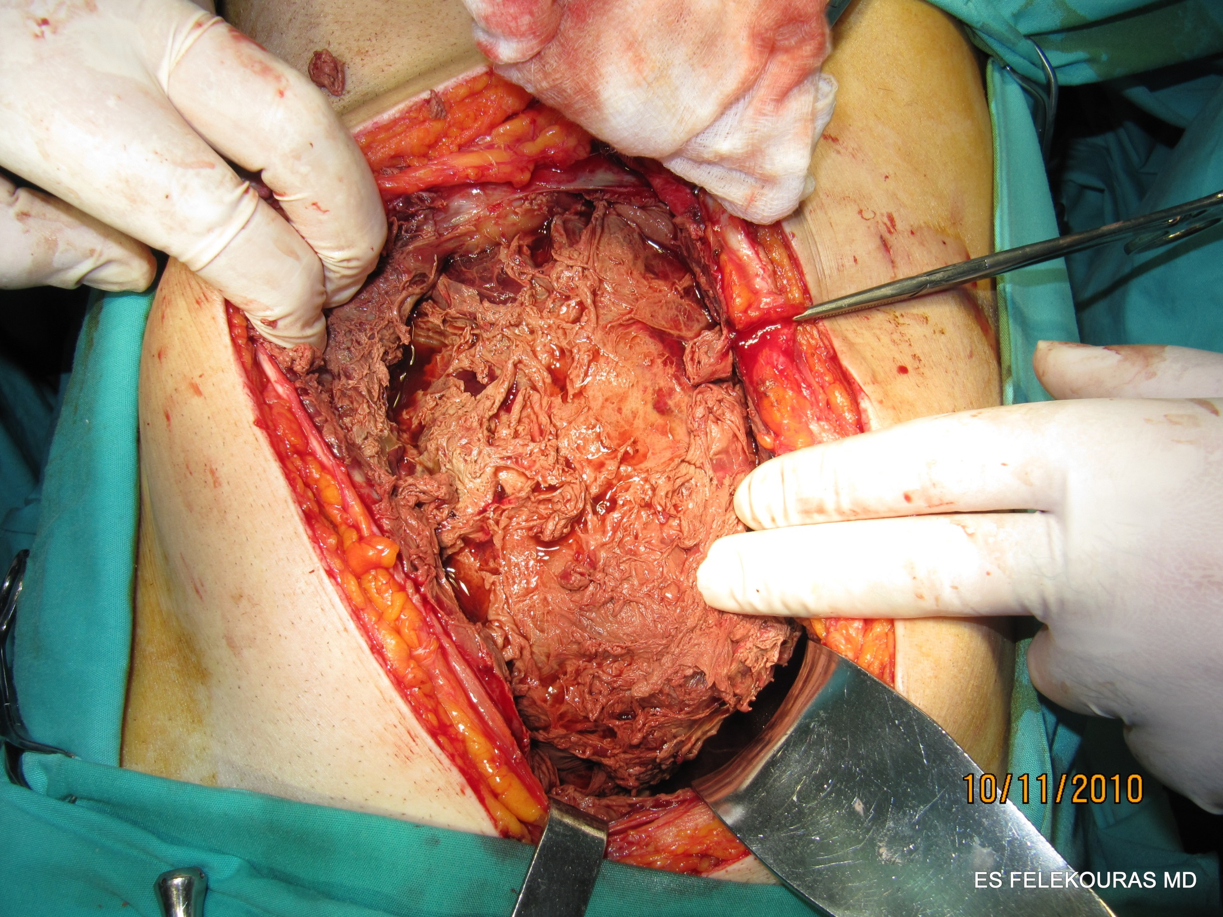
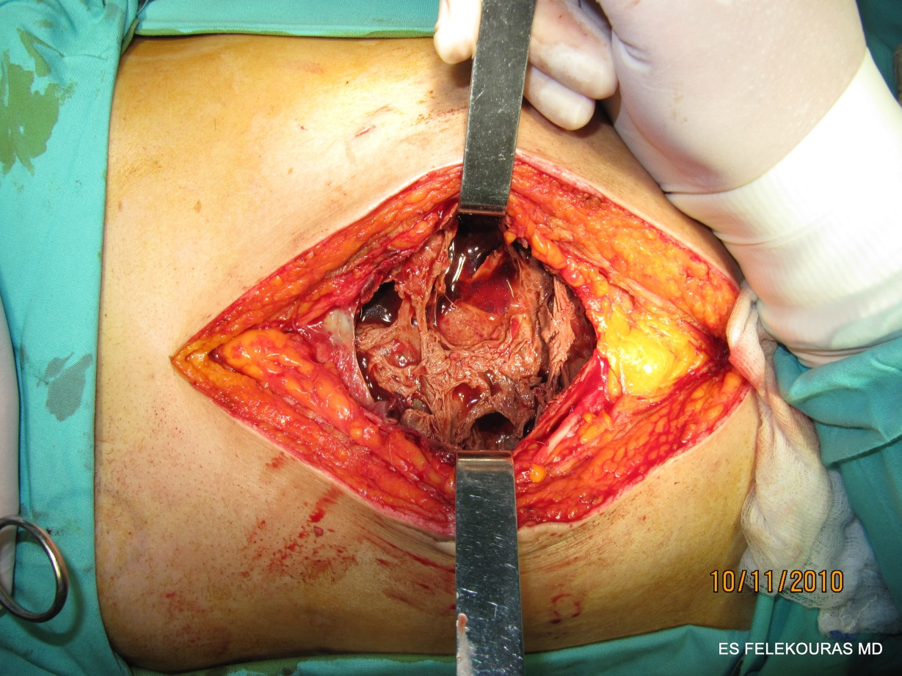
DELAYED SURGICAL REPAIR
unstable patient
  with sepsis
  Water and electrolytic imbalance,
it is wise to postpone the repair until a more stable condition is achieved.

Slide 24
DELAYED SURGICAL REPAIR
Who?
75% of primary surgeon attempt to repair the injury themselves
  17% are successful
If first repair performed in a hepatobiliary third level center
  94% are successful
When?
Some surgeons suggest waiting 4-6 weeks to stabilize patient
Strasberg advises a wait of 3 months.
Other surgeons suggest to repair the injury as soon as possible to avoid formation of adeshions
Schmidt, Br J Surg 2005
Flum, JAMA 2003
McPartland, Surg Clin N Am 2008

Slide 25
DELAYED SURGICAL REPAIR
Injuries repaired in the intermediate period or early (between 72 hours and 6 weeks) were associated with a high rate of biliary strictures (9 of 34 [26%])
compared with
immediate or late repairs
Sahajpal et al Arch Surg. 2010;145(8):757-763

Slide 26
Vasculobiliary injury
is defined as: an injury to both a bile duct and a hepatic artery and/or portal vein
Cut or burn
hepatic ischemia and hepatic infarction in 10%
Right hepatic artery (RHA) vasculobiliary injury (VBI)
  extends the biliary injury to a higher level than the gross observed mechanical injury.
  Repair of the artery is rarely possible and the overall benefit unclear.
Injuries involving the portal vein or common or proper hepatic arteries are much less common, but have more serious effects including rapid infarction of the liver.

Slide 27
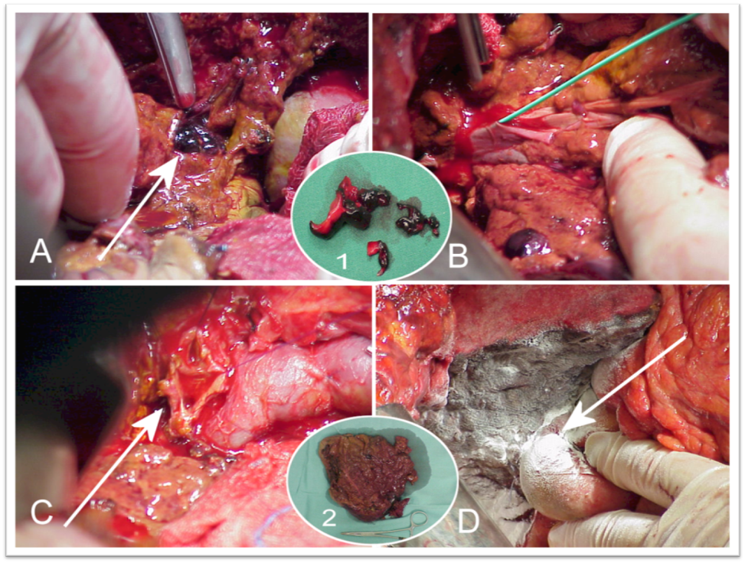
Vasculobiliary injury
Routine arteriography is recommended in patients with a biliary injury if early repair is contemplated ???
Consideration should be given to delaying repair of a biliary injury in patients with occlusion of the RHA.
Patients with injuries to the portal vein or proper or common hepatic should be emergently referred to tertiary care centers.

Slide 28
Early vs. Late repair
No universal recommendations so far
I prefer
early if possible
If not > 3 months
EAES guidelines for BDI. Surg Endosc (2012) 26:3003–3039

Slide 29
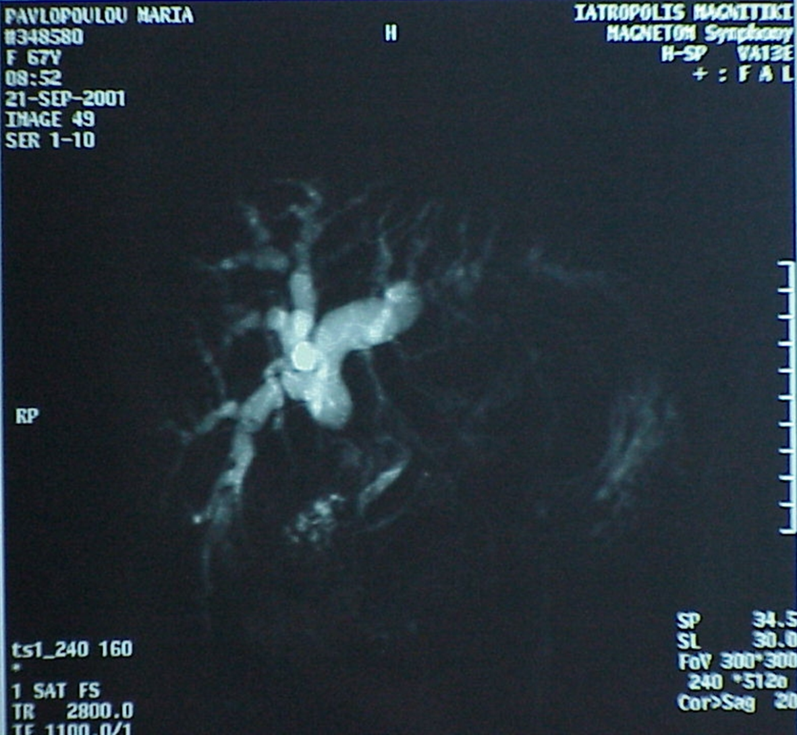

Slide 30
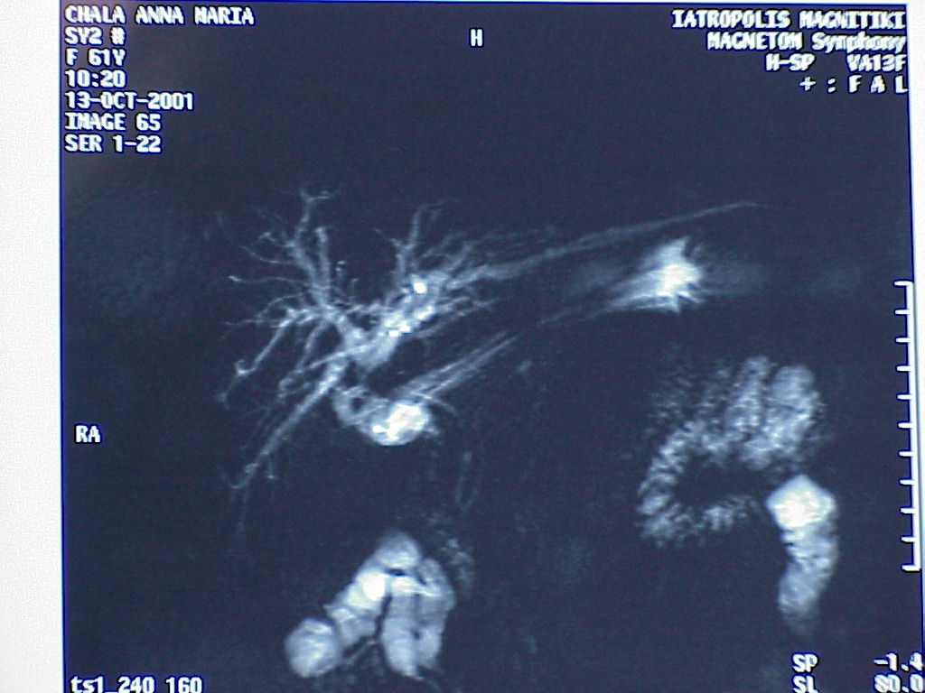

Slide 31
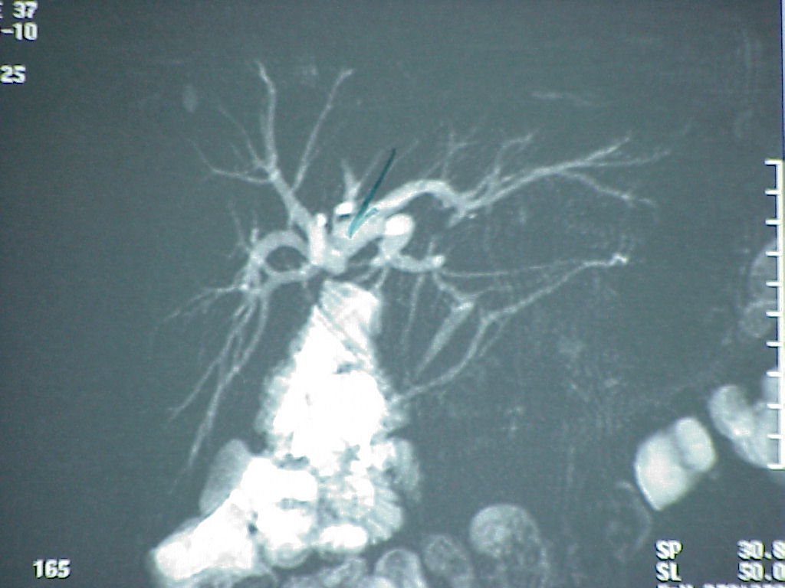

Slide 32
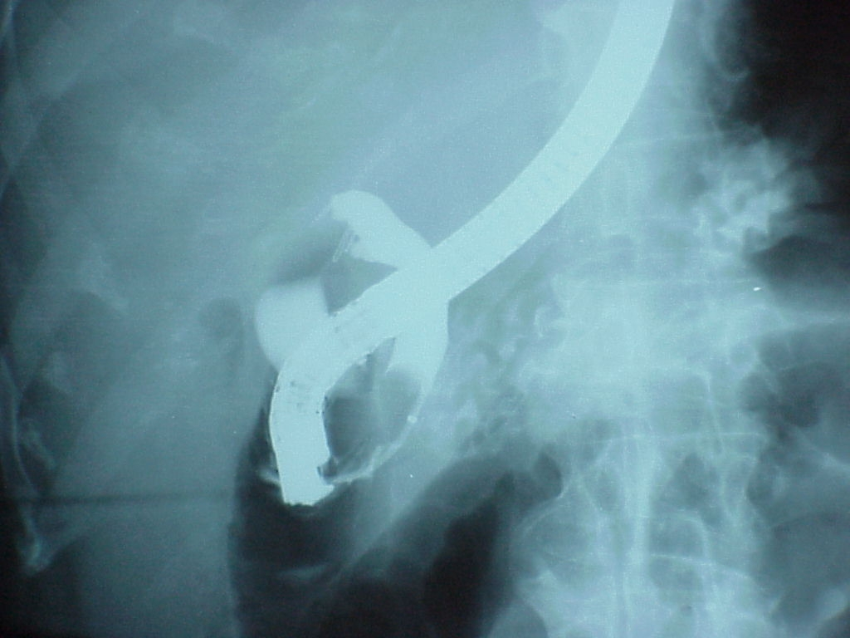

Slide 33
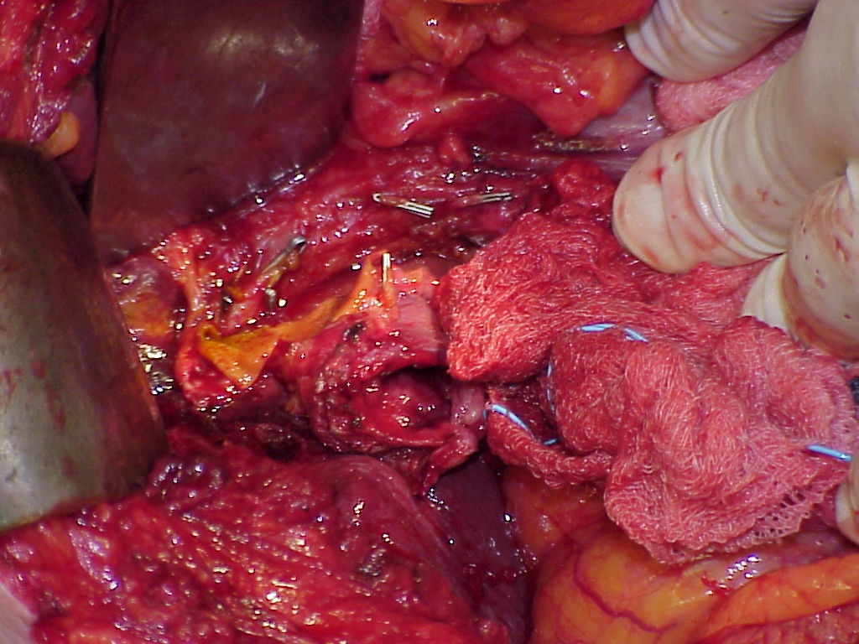

Slide 34
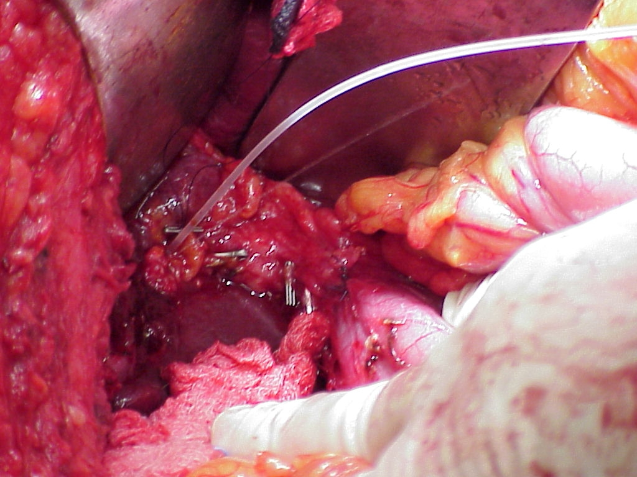

Slide 35
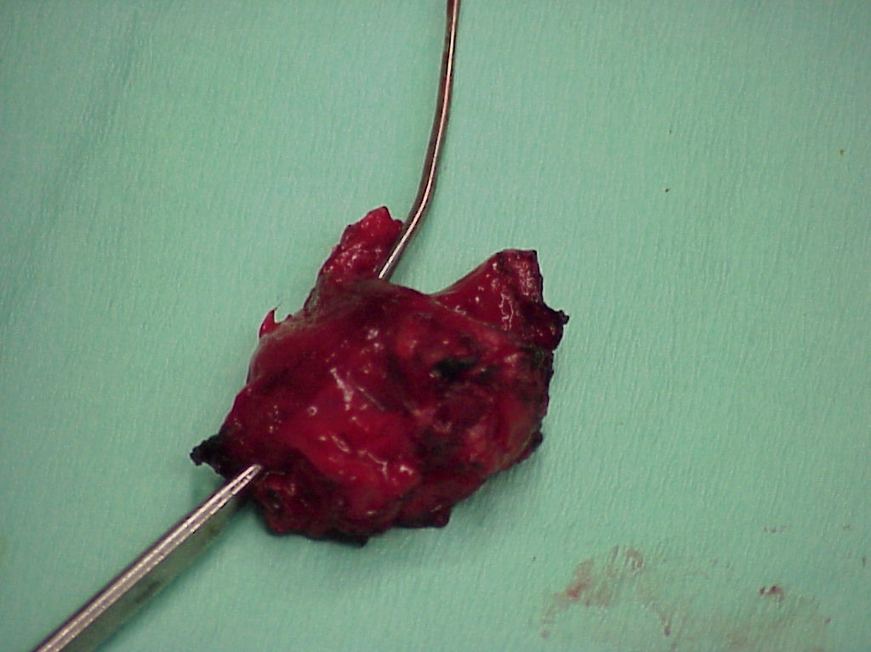

Slide 36
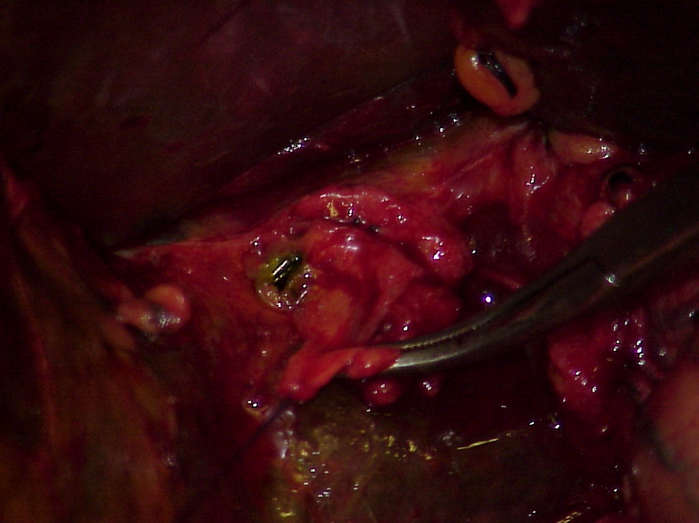

Slide 37
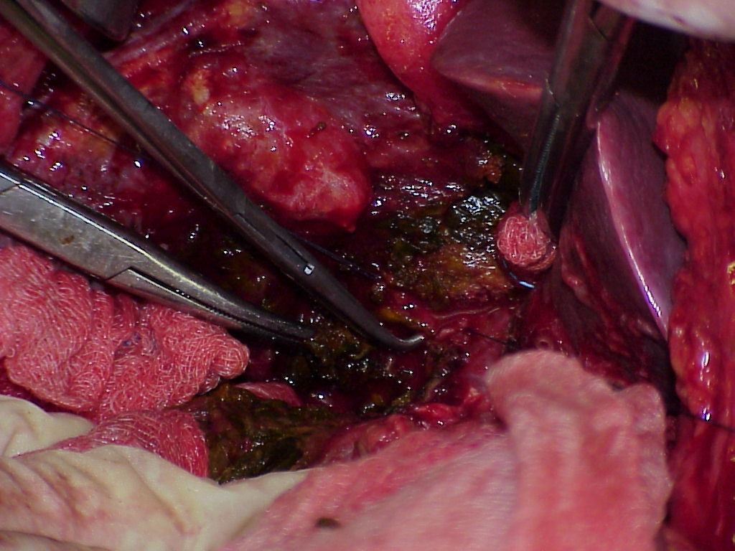

Slide 38
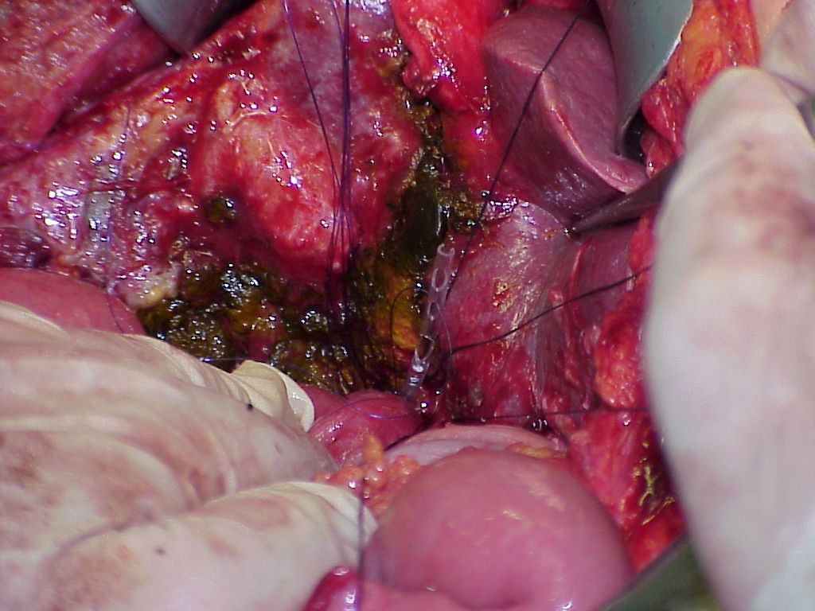

Slide 39
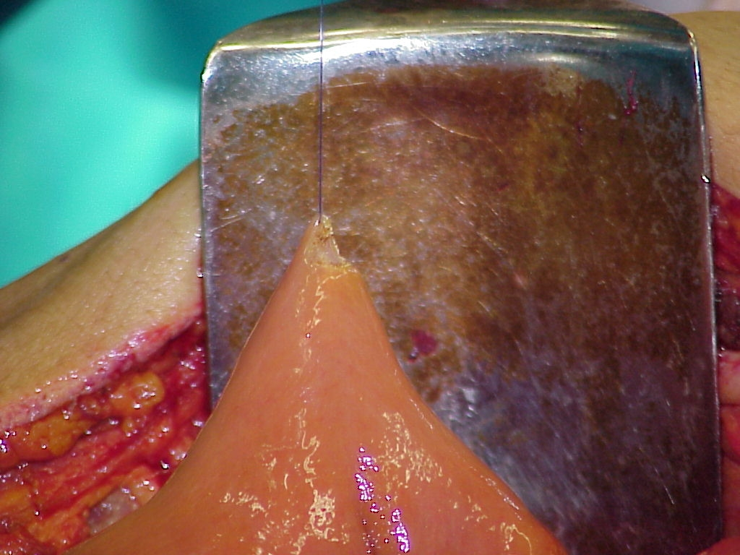

Slide 40
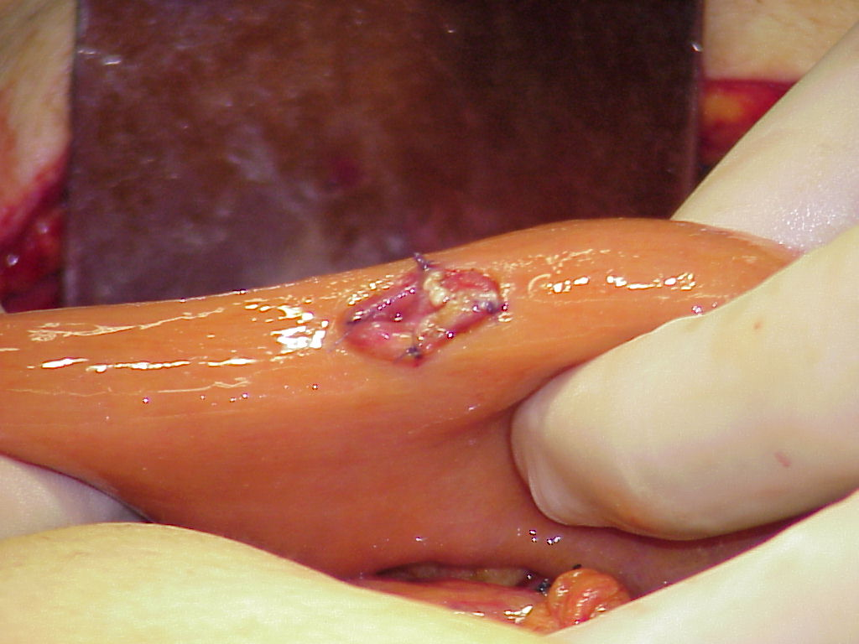
Τεχνική
Δημιουργία της βλεννογόνο-βλεννογόνο εντερικής θέσης

