Slide 1

Στρατηγική αντιμετώπισης των μεταστατικών νευροενδοκρινικών όγκων του παγκρέατος και του λεπτού εντέρου
Ανδρέας Αλεξάνδρου
Αν. Καθ. Χειρουργικής ΕΚΠΑ
Α’ Χειρουργική Κλινική, ΓΝΑ Λαϊκό

Slide 2
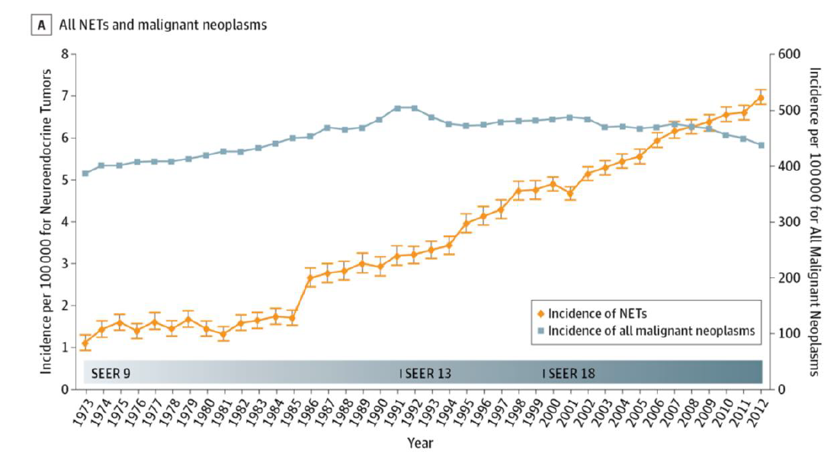

Slide 3
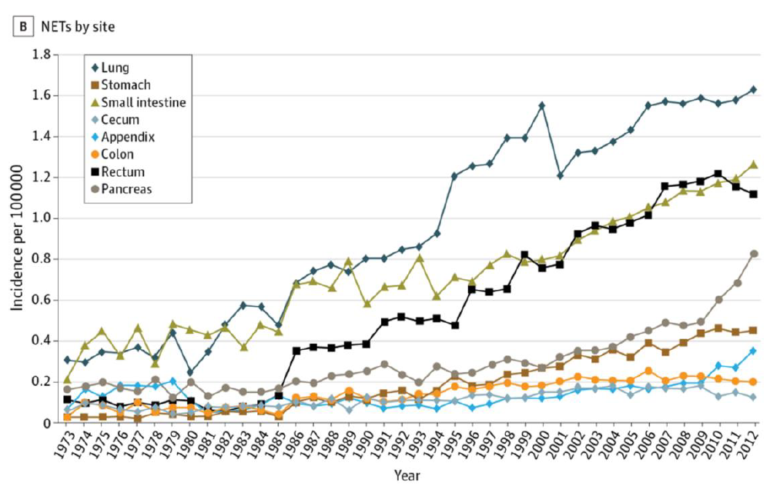

Slide 4
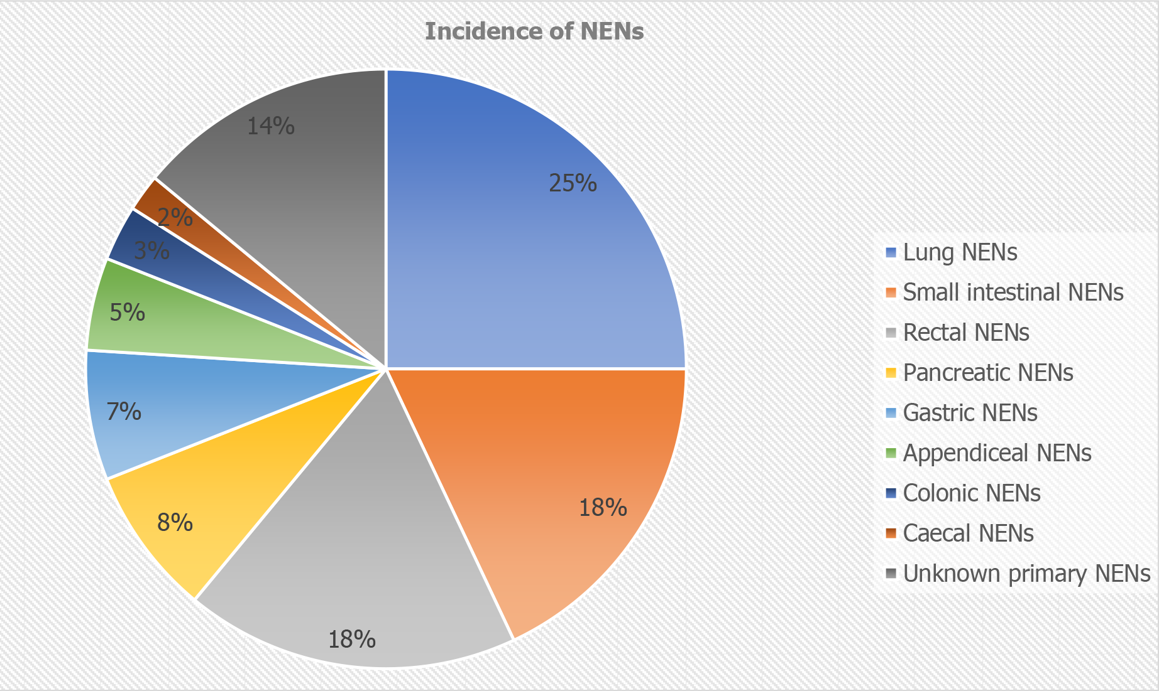
World J Gastrointest Surg 2021 March 27; 13(3): 231-255

Slide 5
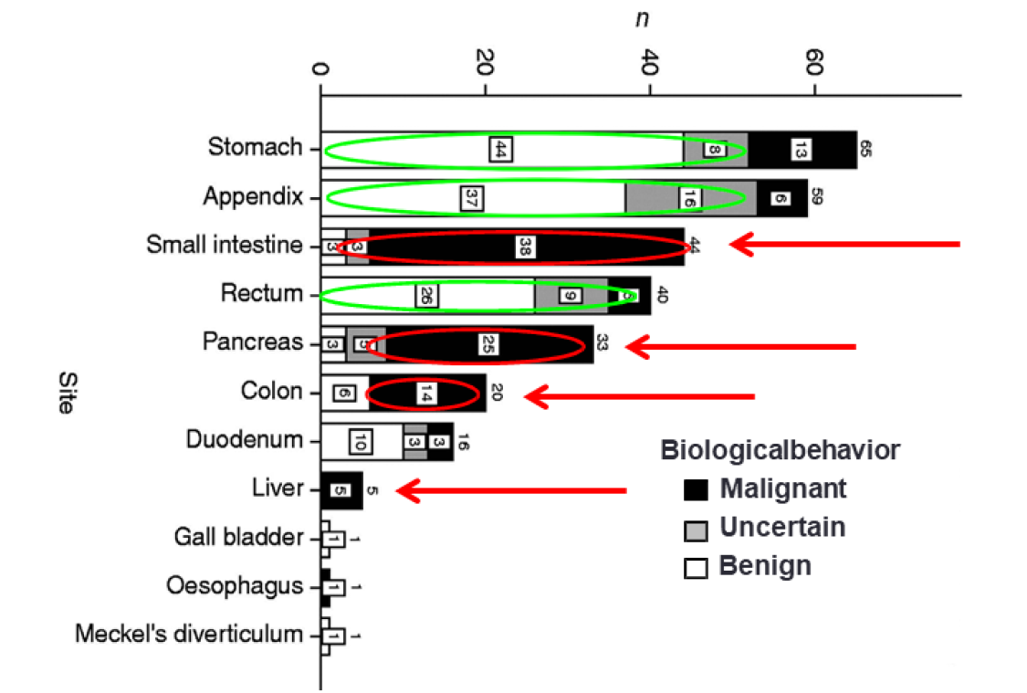

Slide 6
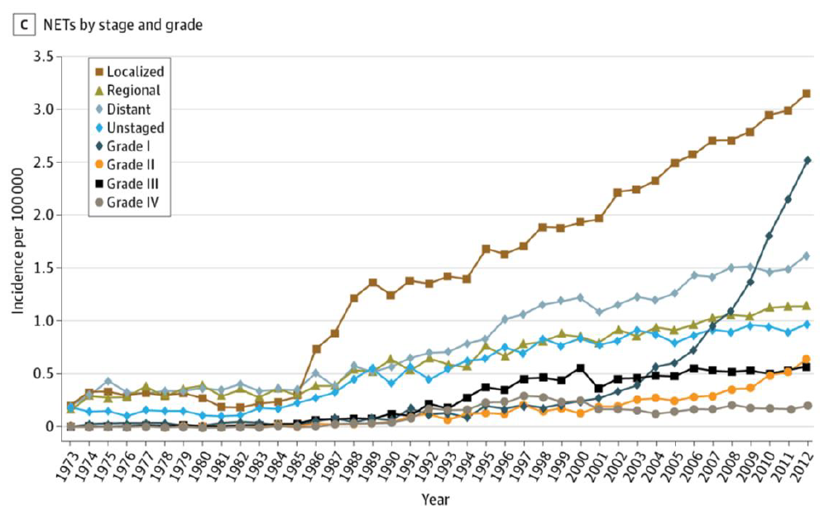

Slide 7
Small Intestinal NETs (Si or SBNETs)
Originating from the EC cells of the base of the crypts in the submucosa of jejunum or ileum
Most common in the terminal 60-100 cm of ileum
Most common tumor of small intestine (approx 1.2/100.000/y)
Usually <1cm, >50% multifocal
NENs of G1 or G2
Despite this: Liver metastasis at 80-90% at first diagnosis, common mesenteric LN metastasis (>50%, approx 90%), >20% “carcinoid syndrome” due to burden
>50% Mesenteric fibrosis (obstruction, ischaemia, vague symptoms ending to malnutrition)
Tsoli et al. Ther Adv Endocrinol Metab 2019;10:
Koumarianou et al. J Clin Med 2020;9

Slide 8
Clinical presentation
Most GEP-NENs non functional
Most present as incidentalomas
Some present with bleeding, anemia, bowel obstruction, ischemia, unexplained weight loss
Standard biomarkers (CgA, NSE, 5-HIAA), CTCs, circulating DNA, micro-RNA, NETest very promising

Slide 9
Imaging
CT delayed venous phase
Mesenteric despoplastic infiltration
Limited uptake of tracer for G1, G2 NENs disadvantage for standard PET
70-90% of GI-NENs express SSTR2 and 5 so SRI useful for diagnosis and therapy progression (Octreoscan or Gallium-DOTA-scan)
Gallium-DOTATATE PET-CT best resolution (false negative for <7mm, false positive for IBD)

Slide 10
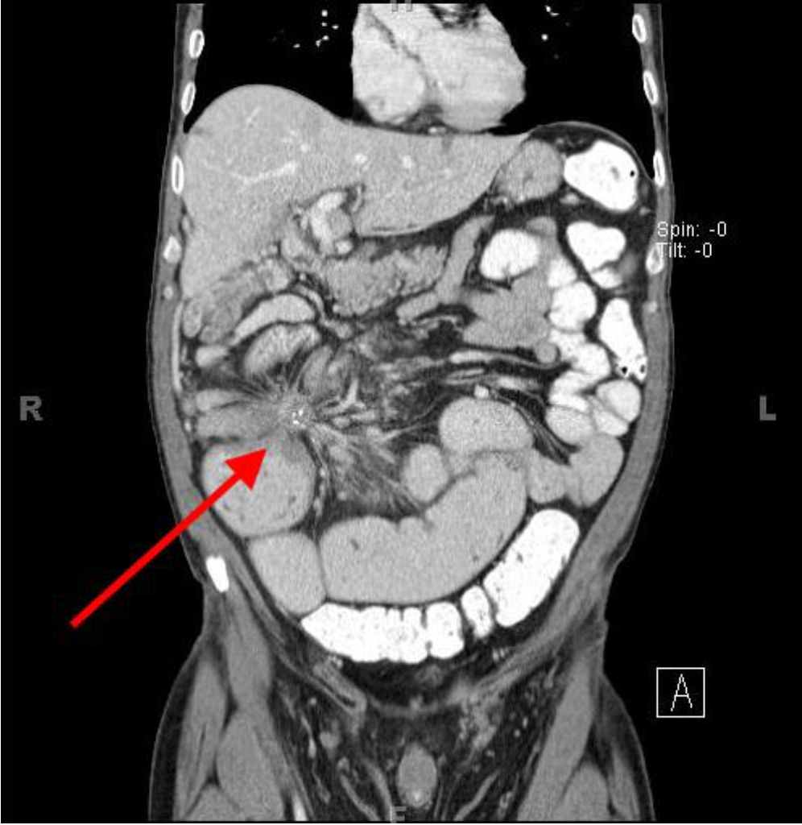

Slide 11
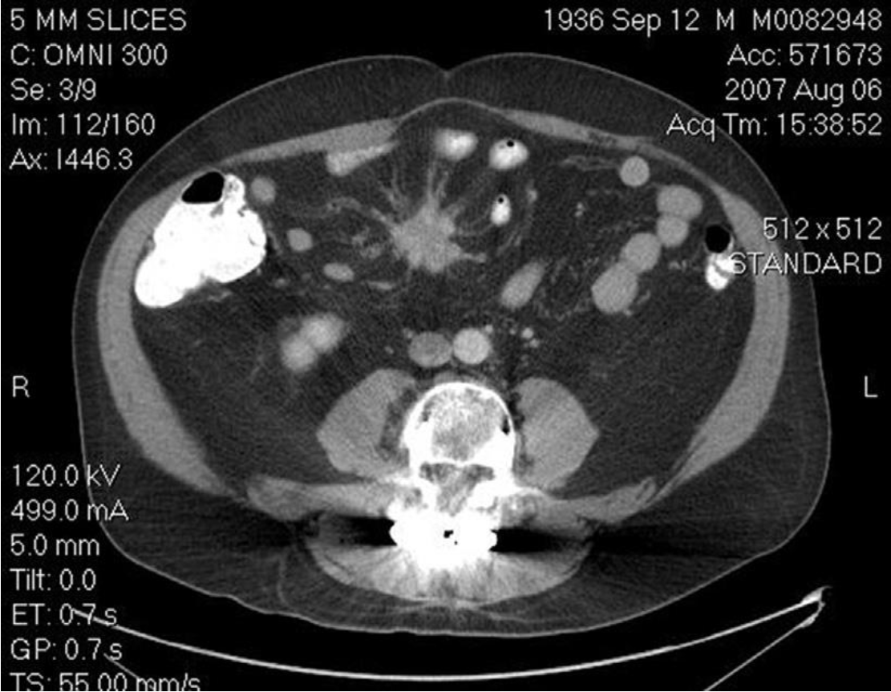

Slide 12
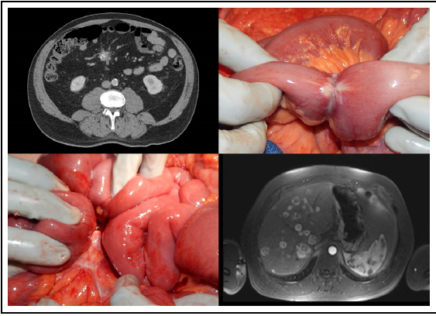

Slide 13
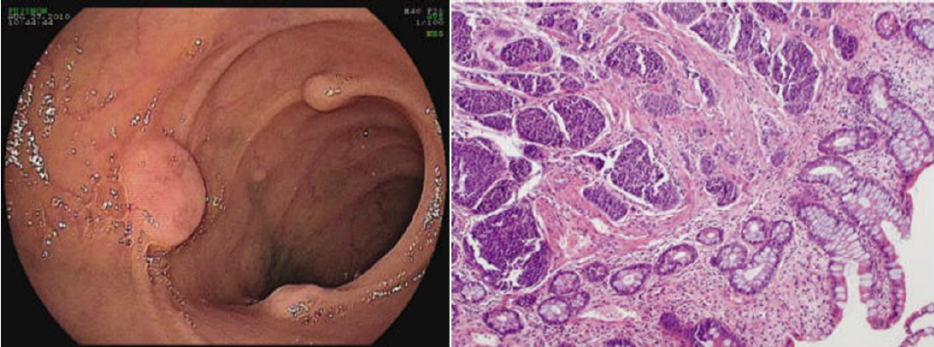

Slide 14
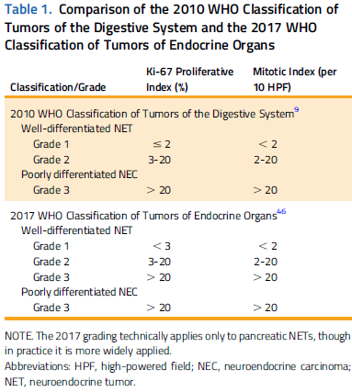

Slide 15
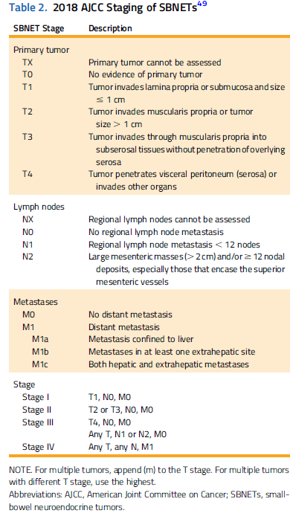

Slide 16
Pre and peri-operative assesment
MRI>CT-scan>Ga-DOTATATE PET scan
Intra-operative U/S above all
Pre-op Administer Octerotide?
Neo-adjuvant chemo?
Adjuvant chemo?

Slide 17
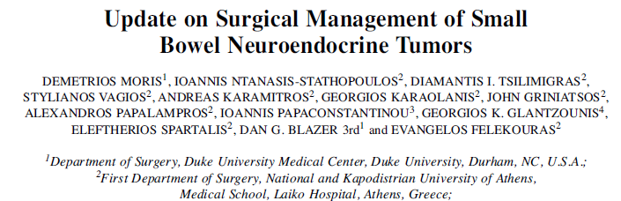
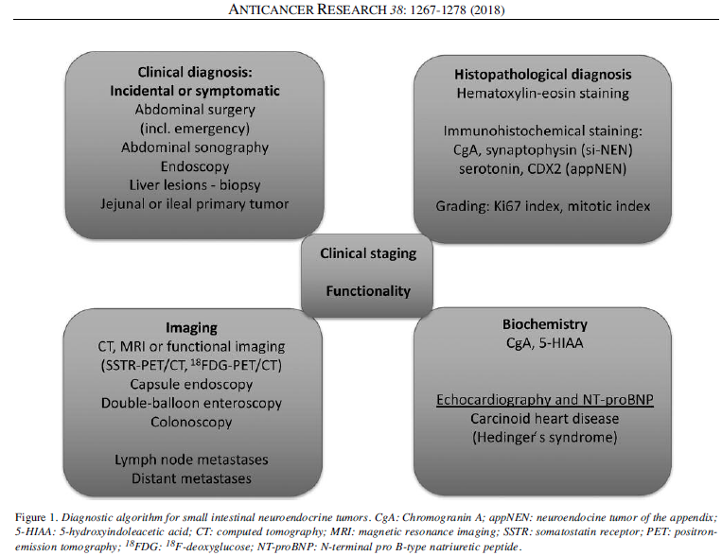

Slide 18
Surgery for small intestinal NENs
All non metastatic tumors should undergo attempt for curative resection irrespective of LN infiltration or infiltration of the root
Careful (open) palpation for multiple foci
Spare the intestine, go deep in the mesentery even for peritoneal carcinomatosis
Resect even in the phase of unresectable liver disease for palliation and prolongation of life (NANETS, ENETS)
Even transplantation can be considered
After resection adjuvant treatment can be more efficient

Slide 19
Intra-op palpation-multifocality (open)
Resection of small intestine or right hemicolectomy
Extensive lymph node dissection (>8 or even >12 LNs)
Better palliation
OS advantage

Slide 20
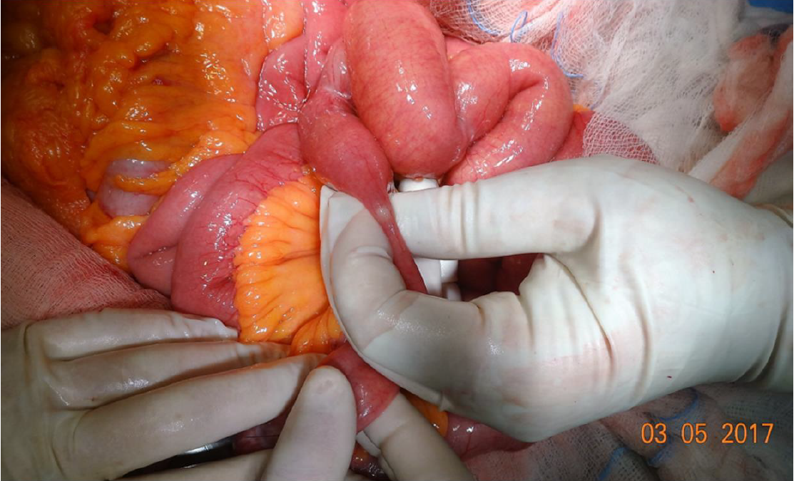

Slide 21
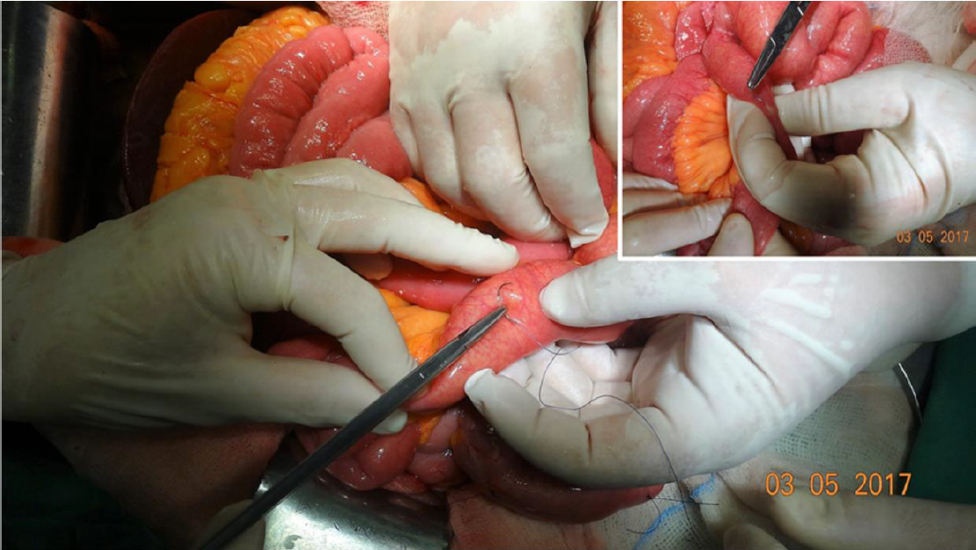

Slide 22
Lymph node resection for SB-NENs
Resection of at least 8 nodes improves survival (HR 0.73, p<0.05)
Positive to negative LN ratio<0.29 improves survival HR 1.65, p<0.0019
Peritoneal disease: debulk-HIPEC not useful
Neuroendocrinology 2016;103(2):125-138
Pancreas 2017;46(6):715-731

Slide 23
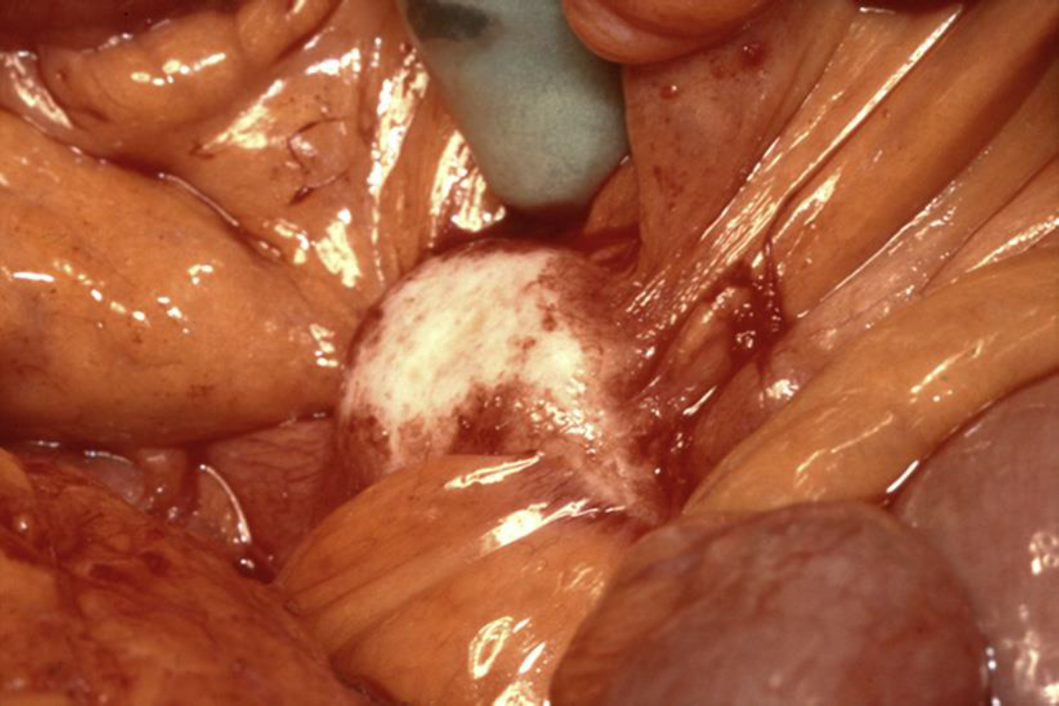

Slide 24
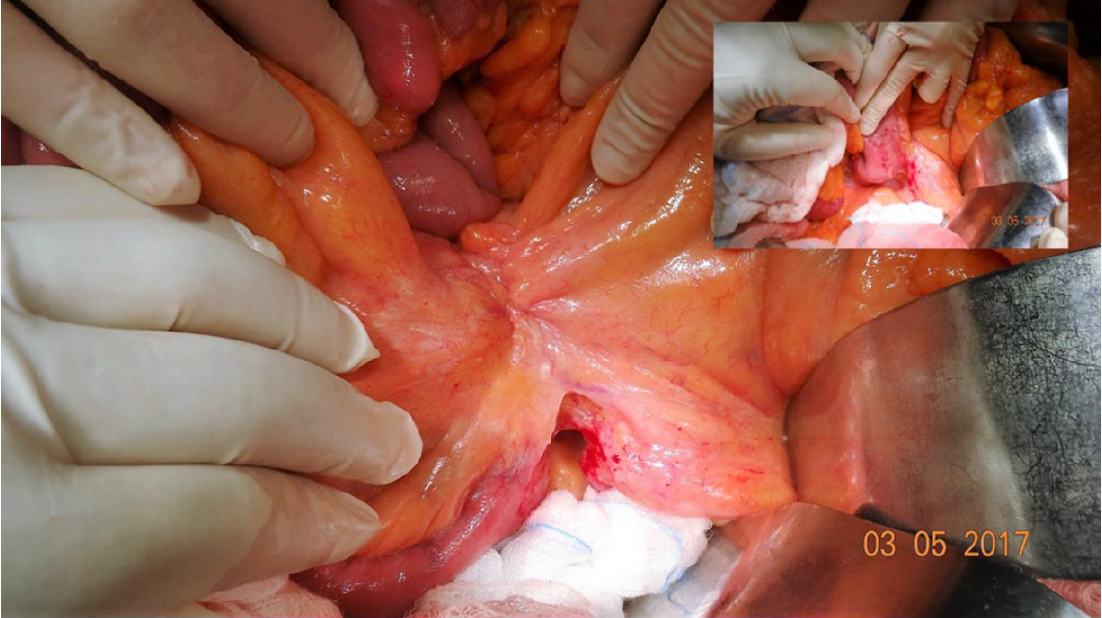

Slide 25
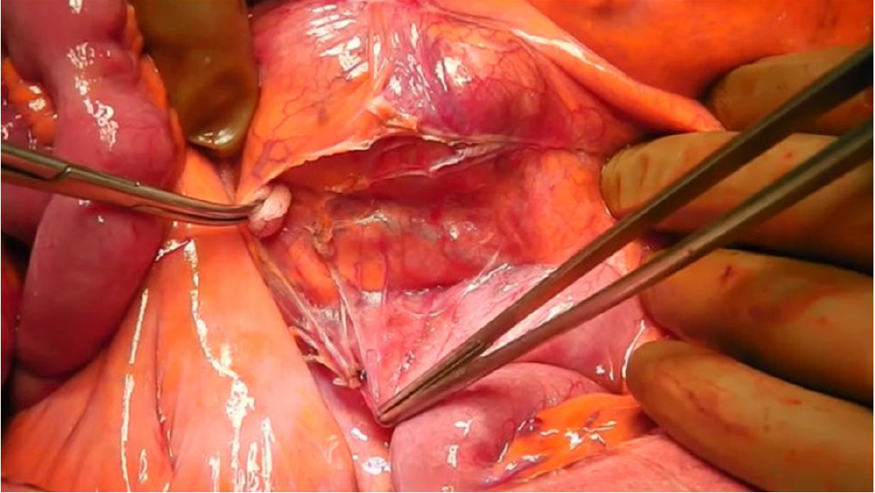

Slide 26
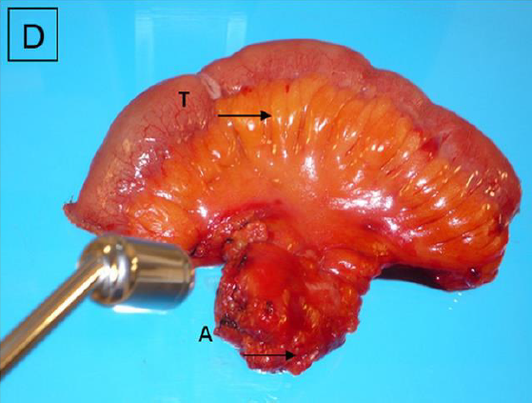

Slide 27
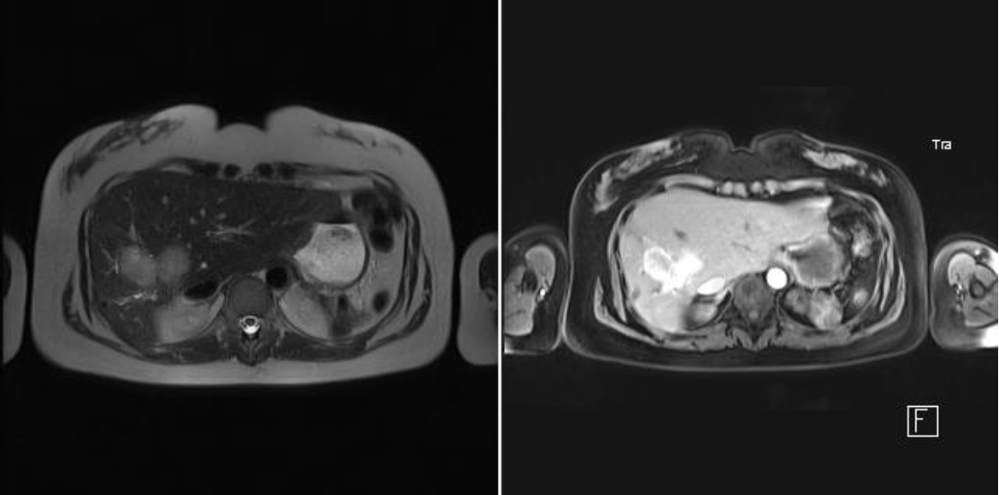

Slide 28
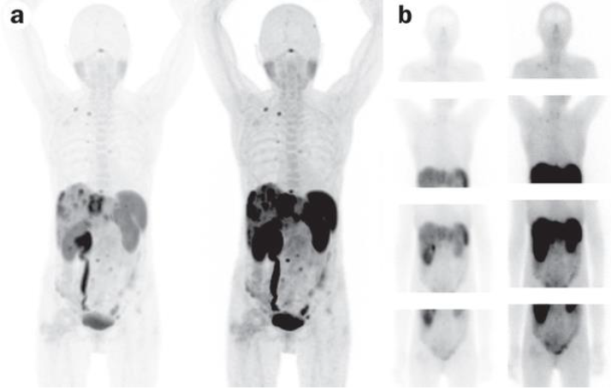

Slide 29
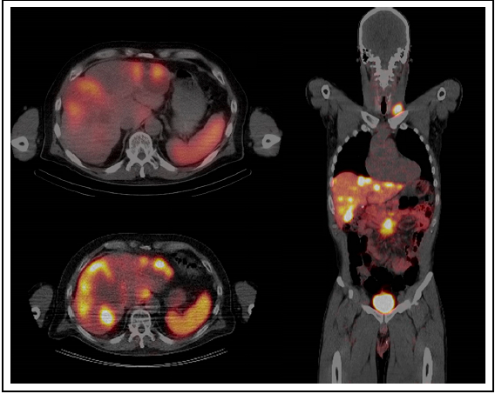

Slide 30
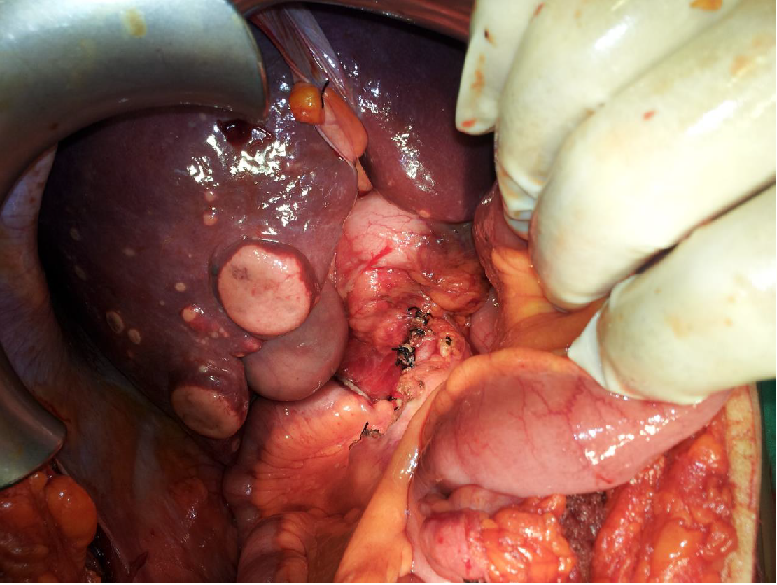

Slide 31
Treatment of hepatic metastasis
Patients with G1, G2 tumors and isolated liver metastasis (type 1 hepatic metastatic burden) and isolated tumor bulk with small satellite metastasis (type 2 burden) undergo parenchyma-sparing or standard hepatectomy
Goal is debulk > 90%, but even >70% is acceptable
Staged resections also
Ablation can be considered for T<5cm with margin >1cm
Even transplantation can be considered

Slide 32
Liver mets of NETs are not infiltrative
Parenchyma sparing techniques
Ablation: RFA, microwave
In the US >30% procedures combine resection with ablation

Slide 33
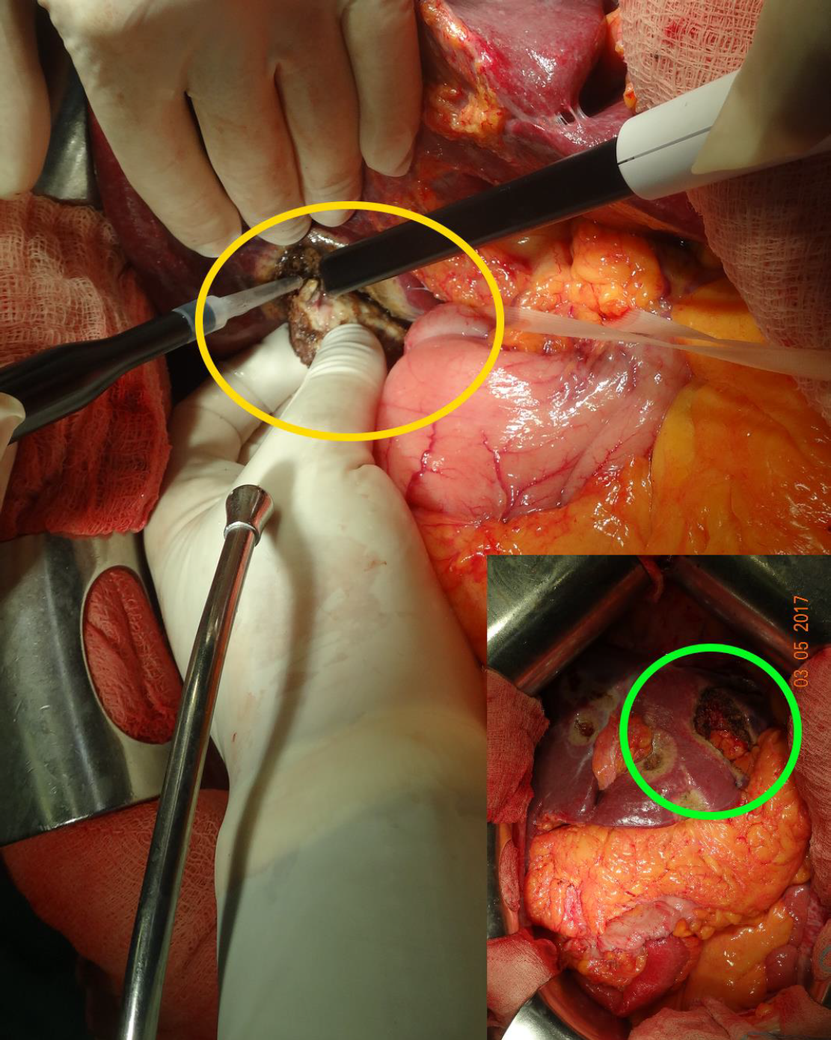

Slide 34
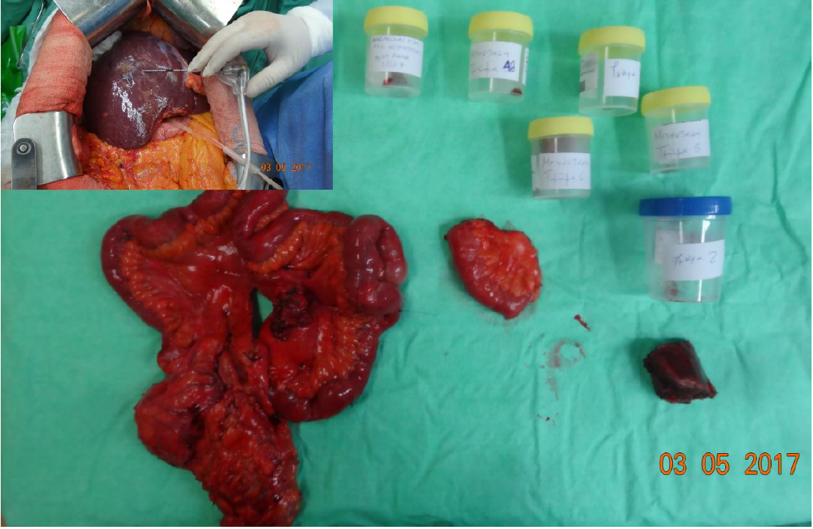

Slide 35
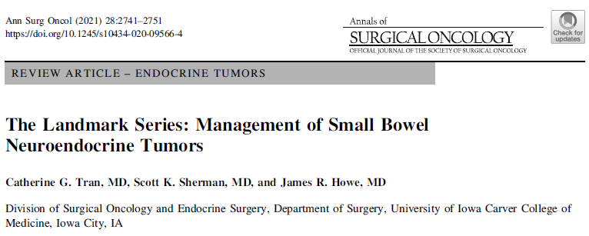
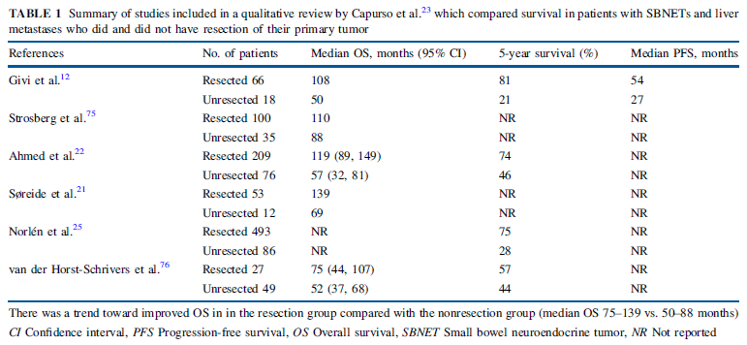

Slide 36
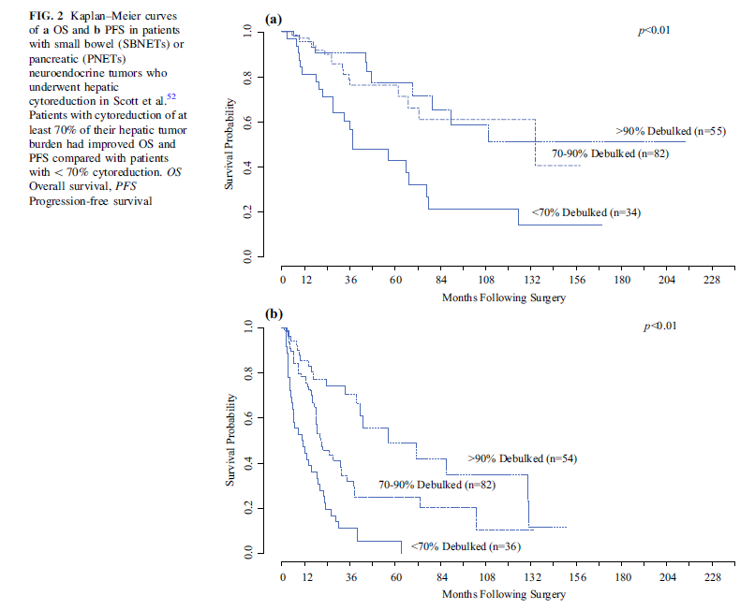

Slide 37
Recurrence after resection common: 50-95%
40% within 1 year, 70% within 3 years
Repeat resection-ablation

Slide 38
Prognostic factors for poor result post resection of liver mets from NETS
Synchronous
Extrahepatic disaese
Non-functional
Grade 3
R is not one of them

Slide 39
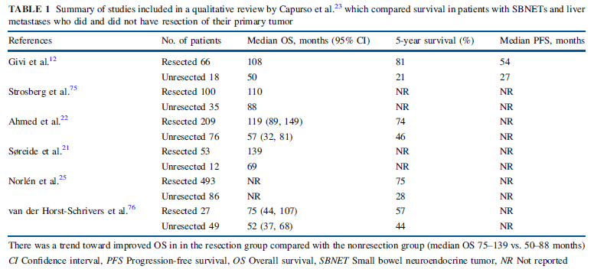
Resectable primary-unresectable mets
For si NETs yes: better palliation, better OS
For p NETs: consideration for some patients

Slide 40
Resectable mets unrestable primary
Most patients die from complications of liver disease
Resect even if primary is unresectable
Xiang et al. Ann Surg Oncol 2018;25:3928-3935

Slide 42
General background data
Approximately 28-77% of p-NETS develop liver mets
834pts underwent 1001 cyto-reductive operations
65% (542pts) si NETs, 154 pNETs, 138 unknown origin (89% defined intra-op)
Intra-op complications 9% (1% carcinoid crisis)
Op time 368+/-146 min, hosp stay 9+/-10 days
Minor morbidity 43%, major 13%, mortality 2%
Woltering et al. J Am Coll Surg 2017;224:434-447.

Slide 43
Woltering et al
Aggressive resection for liver mets of GEP-NETs confers better survival: for pNETs 124 months median OS (16.6 yrs gained), for siNETs 161 m (11.7 yrs gained)

Slide 44
pNETs OS 67%, 51%, 36% for 5, 10 and 20 years respectively, siNETS 84, 67, 31%
Without surgery only 30% make it for 5 years
NANETS, ENETS, JNETS all suggest liver resection for liver mets of pNETs (“should be considered”)

Slide 45
pNET with liver mets
Simultaneous resection if feasible
Resect the primary in the face of unresectable mets if feasible (symptomatic vs asymptomatic)
Definitely resect the mets irrespective of primary for palliation and OS

Slide 46
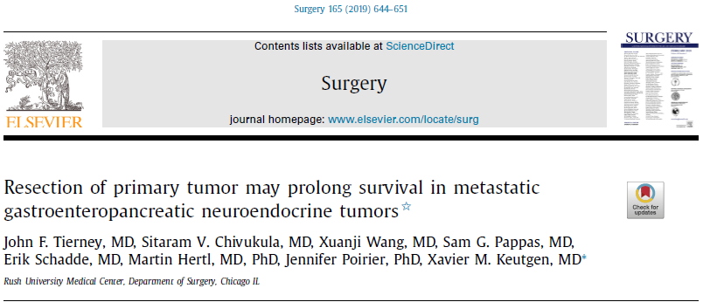

Slide 47
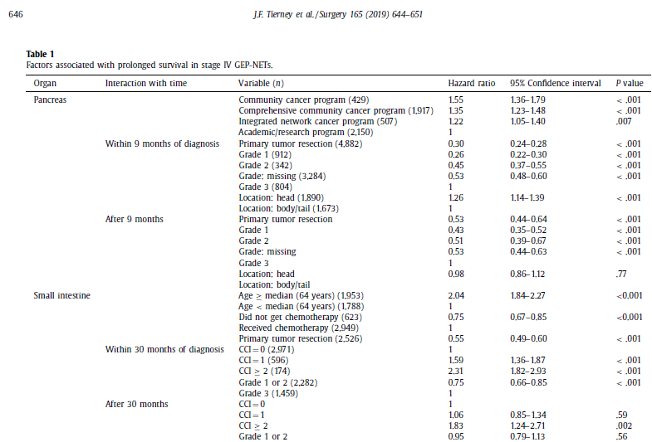

Slide 48
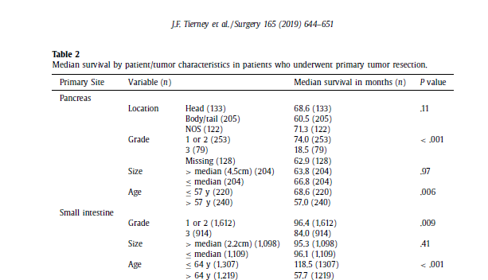

Slide 49
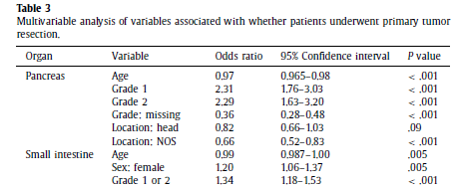



Slide 50
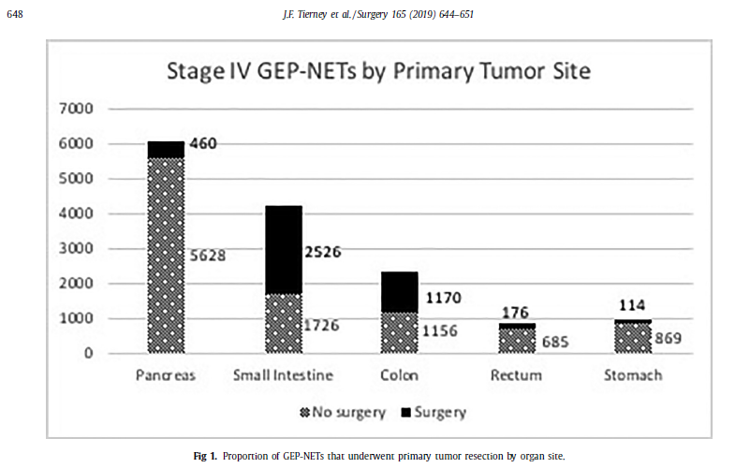

Slide 51
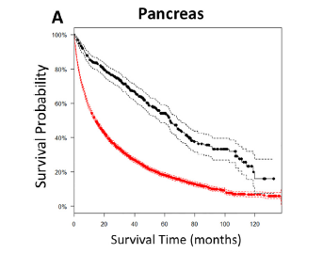
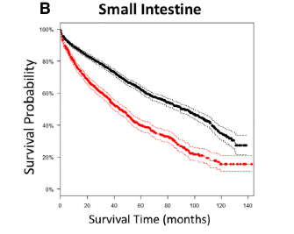




Slide 52
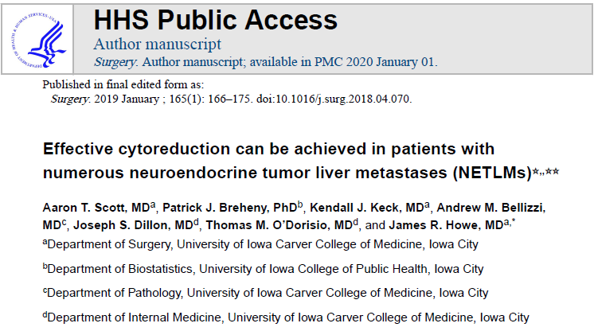

Slide 53
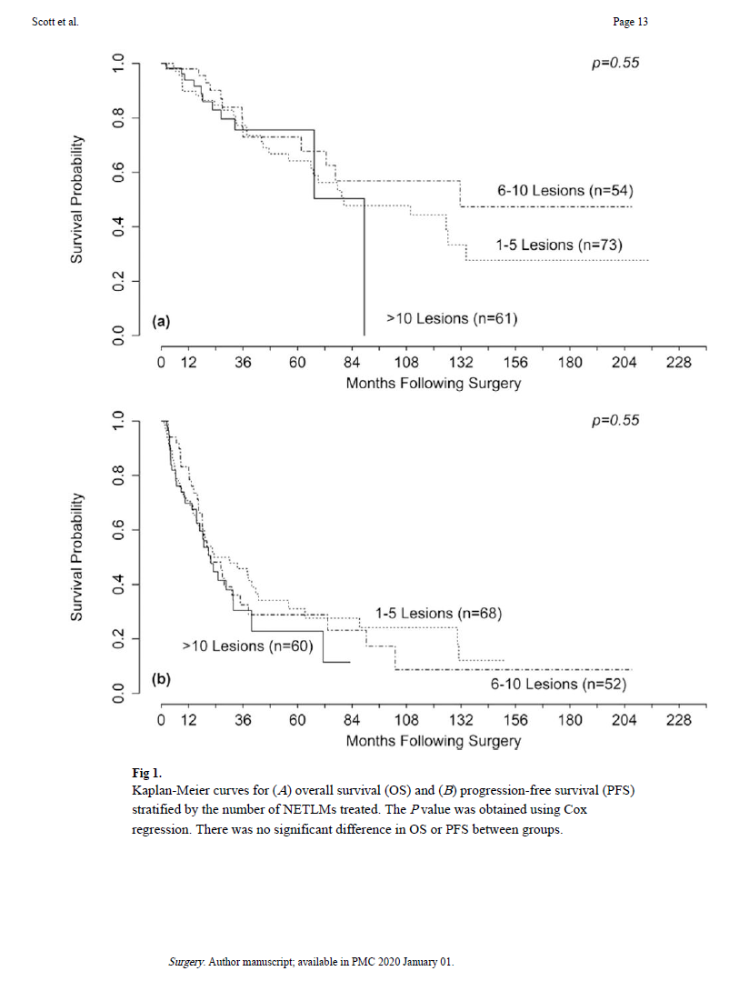

Slide 54
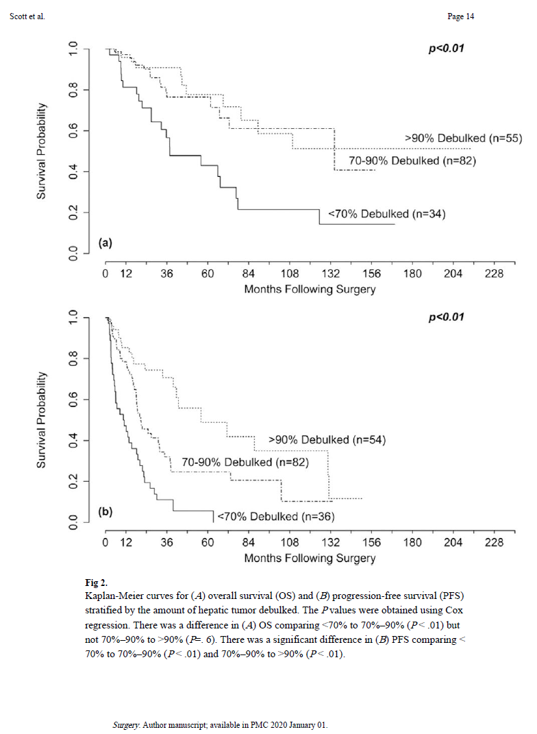

Slide 55
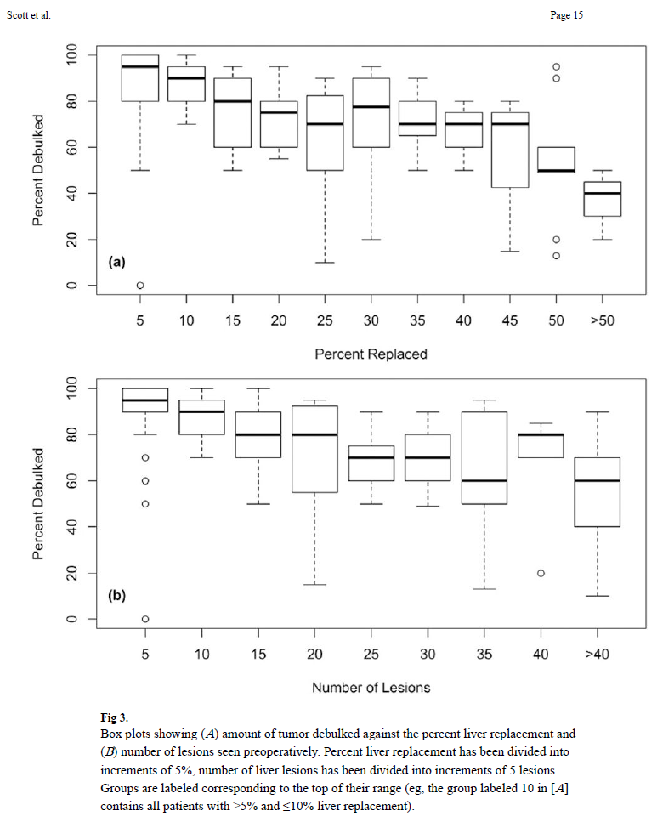

Slide 56
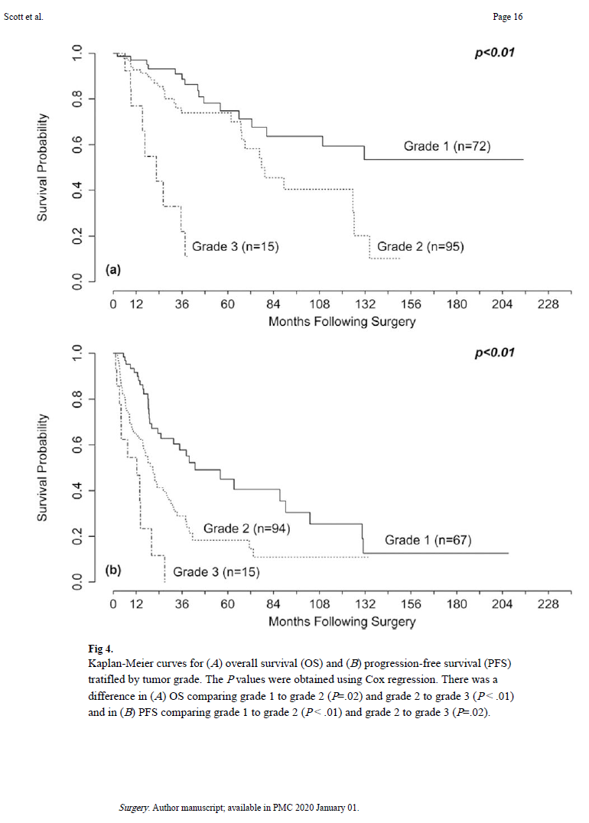

Slide 57
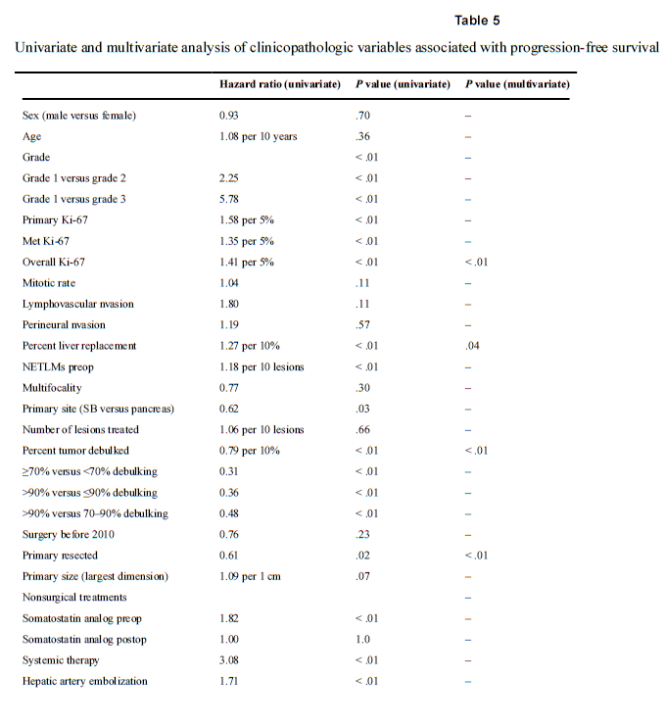

Slide 58
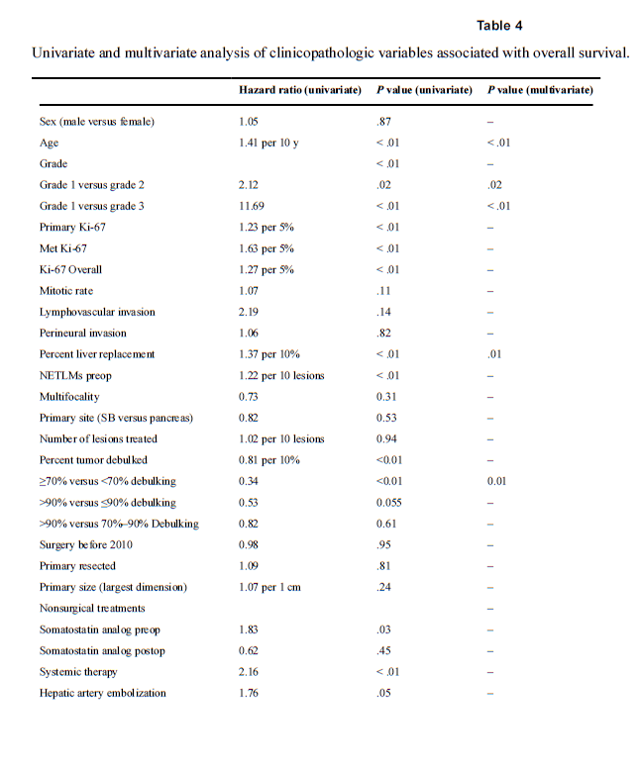

Slide 59
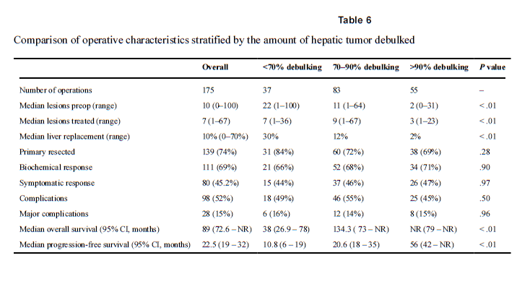

Slide 60
Medical management
SSAs (octreotide, lanreotide) excibit anti-proliferative effect and amelioration of carcinoid syndrome
mTOR inhibitors (everolimus) and angiogenesis inhibitors (sunitinib) second-line treatment
Systemic chemotherapy not efficacious for GI-NETs
PRRTs

Slide 61
Options for the unlucky ones?
Percutaneous ablation (<3 cm, away from vascular structures)
TAE, TACE, TARE
Liver transplantation
Systemic chemo: SSAs, streptozocin, po regimens, sunitinib (TK inhibitor), everolimus (mTOR inhibitor), PRRT (NETTER-1 trial)

Slide 62
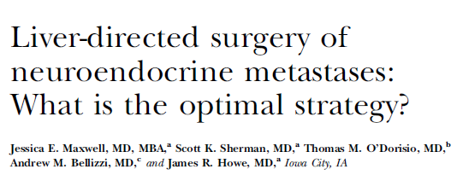
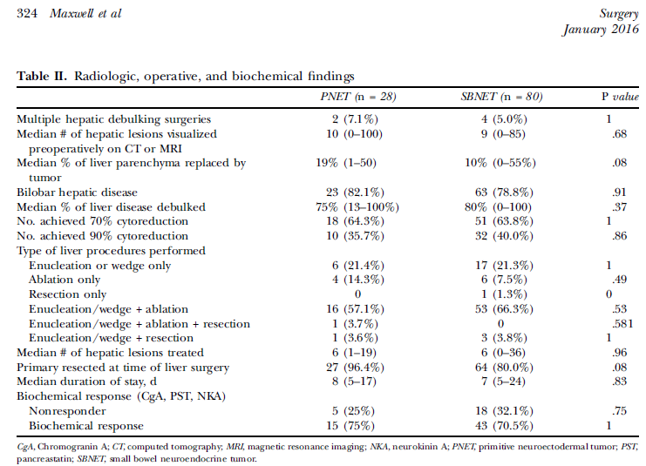

Slide 63
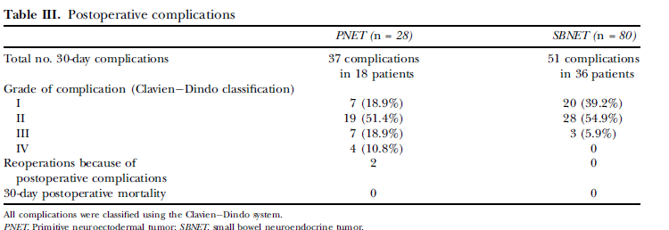

Slide 64
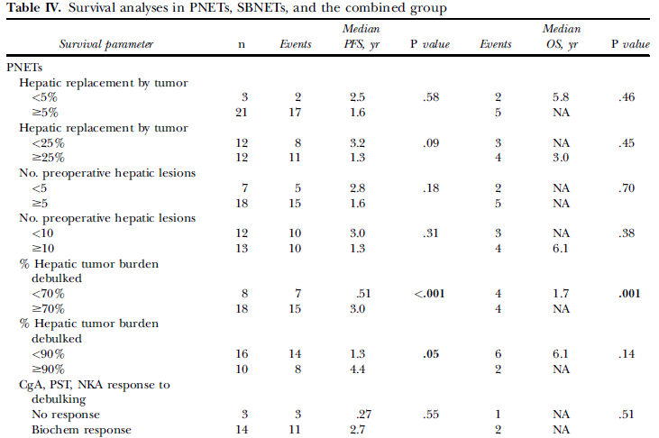

Slide 65
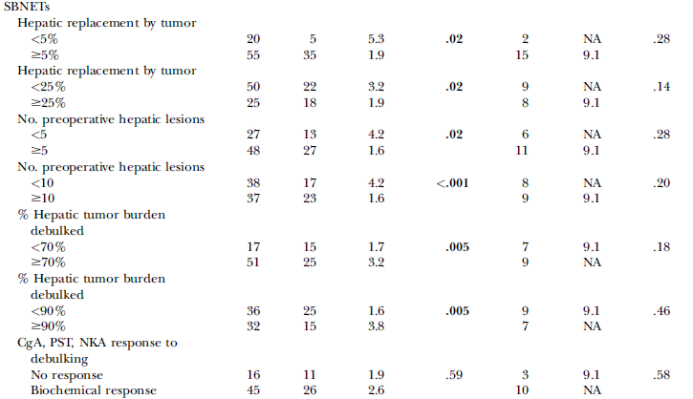

Slide 66
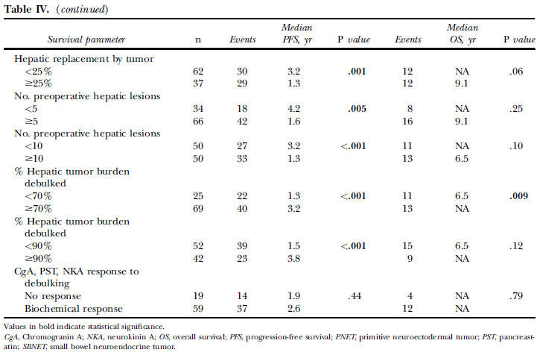

Slide 67


Slide 68


Slide 69


Slide 70


Slide 71


Slide 72


Slide 74


Slide 75


Slide 76


Slide 77


Slide 78
ENETS criteria for liver resection of metastatic pNETs
R0 resection
Grade 1 or 2
Morbidity<30%
Mortality<5%
“Off label”: R1, R2 resections (70% debulking), small extra hepatic disease (amenable to SSAs)

Slide 79

Eligibility criteria for LT

Slide 80


Slide 81
Peritoneal carcinomatosis
Dismall prognosis
HIPEC has been tried
OS not changed
Probably not worthwhile, abandoned
Palliative cytoreduction for symptomatic relief the only option(intestinal obstruction, ureteral obstruction etc)

Slide 82


Slide 83


Slide 84


Slide 85


Slide 86


ΕΥΧΑΡΙΣΤΩ

