Slide 1
Pneumothorax
Spyridon Davakis MD, General Surgeon
Clinical Fellow, First Department of Surgery, National and Kapodistrian University of Athens, Laiko General Hospital

Slide 2
Pneumothorax
-Pneumothorax is the presence of air within the pleural space
-Due to disruption of parietal, visceral or mediastinal pleura
-May also occur from spontaneous rupture of subpleural bleb
-A tension pneumothorax occurs when pleura forms a one-way flap valve
-Tension pneumothorax is a medical emergency

Slide 3
pneumothorax - air leaks into the space between the chest wall and the outer tissues of the lungs.
pneumomediastinum - air leaks into the mediastinum (the space in the thoracic cavity behind the sternum and between the two pleural sacs containing the lungs).
pneumopericardium - air leaks into the sac surrounding the heart.
pulmonary interstitial emphysema (PIE) - air leaks and becomes trapped between the alveoli, the tiny air sacs of the lungs.

Slide 4
Classification
Spontaneous pneumothorax
Primary - no identifiable pathology
Secondary - underlying pulmonary disorder
Catamenial
Traumatic
Blunt or penetrating thoracic trauma
Iatrogenic
Postoperative
Mechanical ventilation
Thoracocentesis
Central venous cannulation

Slide 5
Diseases Associated with Ptx
The following diseases can be associated with pneumothorax: • Chronic obstructive lung disease
• Asthma HIV infection PCP
• Necrotizing pneumonia
• Bronchogenic carcinoma
• Sarcomas metastatic to the lungs
• Tuberculosis
• Cystic fibrosis
• Interstitial lung diseases associated with connective tissue diseases
• Idiopathic pulmonary fibrosis
• Sarcoidosis
• High-risk occupation (eg, diving, flying)

Slide 6
Primary spontaneous pneumothorax
• Usually occurs in young healthy adult men
• 85% patients are less than 40 years old
• Male : female ratio is 6:1
• Bilateral in 10% of cases
• Occurs as result of rupture of an acquired subpleural bleb
• Blebs have no epithelial lining and arise from rupture of the alveolar wall
• Apical blebs found in 85% of patients undergoing thoracotomy
• Frequency of spontaneous pneumothorax increases after each episode
• Most recurrences occur within 2 years of the initial episode

Slide 7
Secondary spontaneous pneumothorax
Accounts for 10-20% of spontaneous pneumothoraces can be due to:
• Chronic obstructive pulmonary disease with bulla formation
• Interstitial lung disease
• Primary and metastatic neoplasms
• Ehlers-Danlos syndrome
• Marfan's syndrome

Slide 8
Traumatic pneumothorax
Can result from either blunt or penetrating trauma
• Tracheobronchial and esophageal injuries can cause both mediastinal emphysema and pneumothorax
• Iatrogenic pneumothorax is common
Occurs after :
• Pneumonectomy
• Thoracocentesis
• High-pressure mechanical ventilation
• Subclavian venous cannulation

Slide 9
Catamenial pneumothorax
Catamenial pneumothorax refers to the development of pneumothorax at the time of menstruation.
• represents 3-6% of spontaneous pneumothorax in women.
• Typically, it occurs in women aged 30-40 years with a history of pelvic endometriosis (20-40%).
• It usually affects the right lung (90-95%) and occurs within 72 hours after the onset of menses.
• The recurrence rate in women receiving hormonal treatment is 50% at 1 year.

Slide 10
Clinical features
Predominant symptom is acute pleuritic chest pain
Dyspnoea results form pulmonary compression
Symptoms are proportional to the size of the pneumothorax
Also depend on the degree of pulmonary reserve
Physical signs include
Tachypnoea
Increased resonance
Absent breath sounds

Slide 11
Clinical features
In a tension pneumothorax
• The patient is hypotensive with acute respiratory distress
• The trachea may be shifted away from the affected side
• Neck veins may be engorged
• Diagnosis can be confirmed with a chest x-ray

Slide 12
Clinical features

Slide 13
Physical Examination

Slide 19
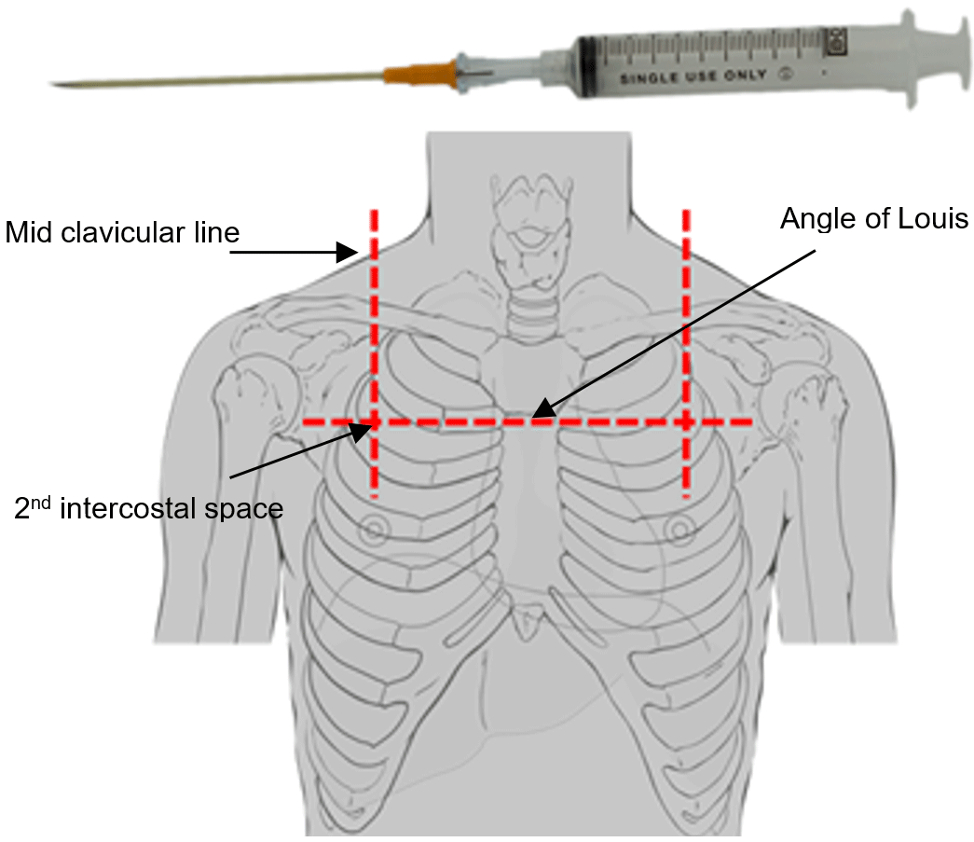

Slide 20
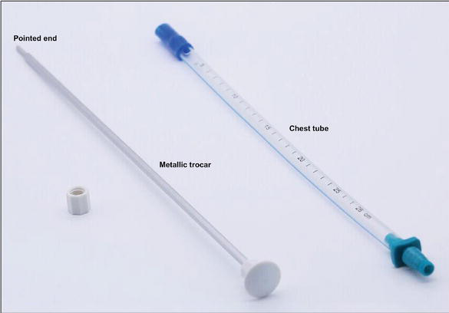

Slide 21
