Slide 1
Επιπλοκές στη Χειρουργική
Επιπλοκές στη Γενική Χειρουργική
Παναγιώτης Σακαρέλλος
Γενικός Χειρουργός
Ακαδημαϊκός Υπότροφος ΕΚΠΑ
Α’ Χειρουργική κλινική
Γ.Ν.Α. Λαϊκό

Slide 2
Complications
Complication (επιπλοκή): any deviation from the normal (ideal) postoperative course
Sequelae (επακόλουθο): cover conditions that are inherent in the procedure, and that thus will inevitably occur Example, scar formation or the inability to walk after an amputation
Failure to cure (αποτυχία της θεραπείας): diseases or conditions that remain unchanged after surgery are not complications, but rather failure to cure Example,
early recurrence of inguinal hernia
incompletely resected malignant tumors
while clearly reflecting a negative outcome, are better covered under the term ‘‘failure to cure.’’
Dindo D, Clavien PA. What is a surgical complication? World J Surg 2008; 32(6):939-41.

Slide 3
Surgical Complication
Dictionaries:
Is an unfavorable evolution or consequence of a disease, a health condition or a therapy (surgery here)
Latest definitions:
‘‘any deviation from the ideal postoperative course that is not inherent in the procedure and does not comprise a failure to cure’’
“οποιαδήποτε απόκλιση από την ιδανική μετεγχειρητική πορεία που δεν είναι εγγενής της επέμβασης και δεν ανήκει στην αποτυχία της θεραπείας”
Dindo D, Clavien PA. What is a surgical complication? World J Surg 2008; 32(6):939-41.

Slide 4
Systemic
Complication
Any deviation from the normal (ideal) postoperative course
Medical mistake (error)
A medical error is a preventable adverse effect of care, whether or not it is evident or harmful to the patient
This might include an inaccurate or incomplete diagnosis or treatment of a disease, injury, syndrome, behavior, infection, or other ailment
By the State
By the Health care system
By the Physician

Slide 5
Medical mistake (error)
Όταν ο ιατρός δεν έχει τηρήσει τους κανόνες της ιατρικής επιστήμης είτε από άγνοια είτε από απειρία είτε από απερισκεψία ή ανεπιτηδειότητα
Όταν έχει υπάρξει μια επιπλοκή είναι πολύ δύσκολο να διακρίνουμε εκ του αποτελέσματος αν ο ιατρός ενήργησε lege artis, σύμφωνα δηλαδή με τους κανόνες της ιατρικής επιστήμης και τέχνης ή υπέπεσε σε σφάλμα

Slide 6
Medical mistake (error)
Causes
Healthcare complexity
System and process design
Competency, education, and training
Human factors and ergonomics
Examples
Errors in diagnosis
Misdiagnosis of psychological disorders
Most common misdiagnoses
Outpatient vs. inpatient
After an error has occurred
Recognizing that mistakes are not isolated
events
Placing the practice of medicine perspective
Disclosing mistakes
To oneself
To patients
To non-physicians
To other physicians
To the physician's institution
Use of rationalization to cover up medical errors
By presence of to the patient
Cause-specific preventive measures
In specific specialties
Legal procedure
Prevention
Reporting requirements
Misconceptions

Slide 7
THE REAL CONTROVERSY
Medical mistake vs. Complication
(key points: Documentation and Witness)

Slide 8
Complications
Όλες οι επεμβάσεις έχουν τον κίνδυνο επιπλοκών.
Μπορεί να είναι 0,1%, μπορεί να είναι και πολύ μεγαλύτερος.
Ο ιατρός γνωρίζει ότι η συγκεκριμένη επέμβαση μπορεί να έχει επιπλοκές,
αλλά δεν γνωρίζει αν θα συμβούν στο συγκεκριμένο ασθενή,
ακόμη και αν ενεργήσει την επέμβαση lege artis

Slide 9
Attributed to
General health of the patient
Preoperative care
Magnitude of the operation
Quality of postoperative care

Slide 10
Complications of major surgery can be broadly classified as those:
Due to anesthesia
Due to surgery

Slide 11
Due to surgery
Perioperative complications
Postoperative complications
Immediate/Early complications
Late complications

Slide 12
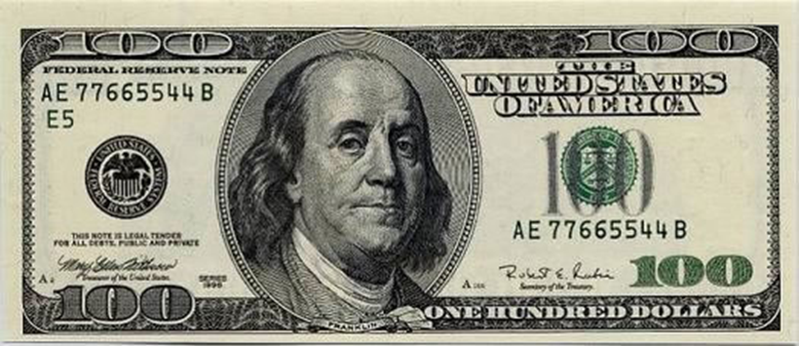
By failing to prepare, you are preparing to fail
Benjamin Franklin

Slide 13
Summary of Preoperative Evaluation
Cardiovascular
History of stable/unstable angina,
arrhythmias,
MI,
CHF,
cardiac surgery,
rheumatic fever,
valvular disease,
endocarditis,
stroke,
claudication

Slide 14
Summary of Preoperative Evaluation
Pulmonary
Recent pneumonia,
exposure to pulmonary irritants,
dyspnea,
productive/non-productive cough,
wheezing,
hemoptysis,
history of pulmonary tuberculosis,
asthma,
bronchitis,
fungal exposure,
smoking history,
cyanosis or aspiration,
availability of previous chest film or CT scans

Slide 15
Summary of Preoperative Evaluation
Renal
Renal insufficiency (recent or in the past),
renal stone,
prostate diseases

Slide 16
Summary of Preoperative Evaluation
Hematologic
History of blood transfusion,
bleeding disorders,
easy bruising,
use of NSAID,
aspirin or antiplatelet medications ,
previous history of DVT or PE,
information regarding blood donation and autologous blood program

Slide 17
Summary of Preoperative Evaluation
Gastrointestinal
History of GI bleeding,
previous operation for ulcers or carcinoma,
GER disease

Slide 18
Summary of Preoperative Evaluation
Endocrine
history of DM,
thyroid disease,
long-term steroid use,
pituitary or adrenal insufficiency

Slide 19
Summary of Preoperative Evaluation
Infection
History of bacterial or viral pneumonia,
chronic bronchitis,
pulmonary TB,
fungal infection,
hepatitis,
CMV or
HIV

Slide 20
Summary of Preoperative Evaluation
Medication
Use of prescription and nonprescription drugs,
previous radiation or chemotherapy.
Previous operation
Especially thoracic and abdominal operations
Nutrition
Note overall appearance of nutritional status, weight loss or gain, obesity and overall eating habit
Patient directives & Health Care
Organ donation, living will, next of kin, privacy request, points of contact perioperatively
logistical and social issues regarding costs, home care, rehabilitation, case cancellation protocols, preoperative counseling

Slide 21
Surgical Basics Preventing injury and error

Slide 22
Blah, Blah, Blah…
“The table was placed in beach chair configuration. Head, neck, trunk and limbs were padded and protected in appropriate fashion.”
“The right lower extremity was prepped and draped in the usual sterile fashion.”
“Bilateral upper extremities were prepped and draped in standard sterile fashion.”

Slide 23
Types of Injuries
Wrong site, wrong procedure
Wrong medication
Skin breakdown/decubiti
Burns
Nerve damage
Ischemia
Eyesight

Slide 24
Pre-operative Preparation
Testing
Determines ability to sustain surgical insult
Determines type of anesthesia delivery
Blood Pressure, Diabetes, EKG, Liver function, CBC, Chest X-ray, UA
Medications
Day before surgery, anti-inflammatory
Day of surgery, antibiotics
Post op pain meds
Smoking cessation?

Slide 25
Patient/Procedure Confirmation
Surgical Consent
Pre-operative marking
“Time Out” in the operating room

Slide 26
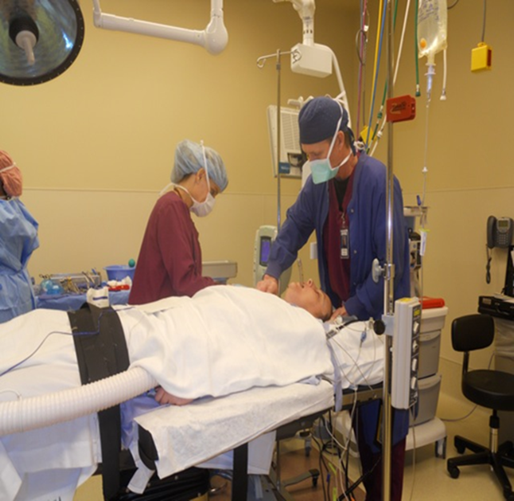
Anesthesia Choices
Goals of anesthesia
Exposure, Relaxation
Keep patient alive
Pain free, unaware, stable
Local Anesthesia
Regional Anesthesia
Conscious Sedation
General Anesthesia
LMA vs. Intubation
Many photos courtesy of John DiPaola, MD

Slide 27
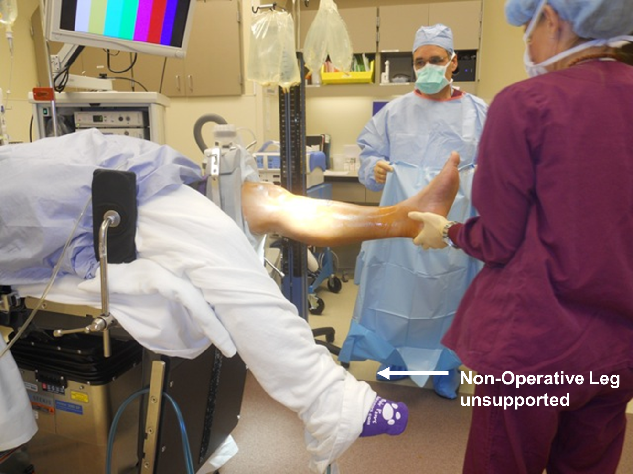
Surgical Positioning
Goals
Exposure for surgeon
Immobilize patient
Injury prevention
Maintain circulation
Maintain anatomic alignment
Prevent pressure points

Slide 28
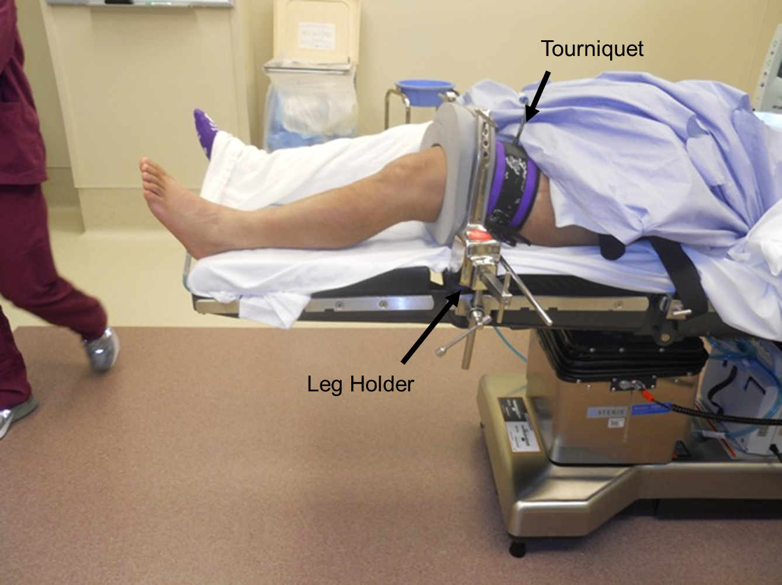
Surgical Positioning
Considerations
No movement for minutes to hours
No ability to identify pain
Sometimes exposure wins out over comfort
Even supine can be injurious

Slide 29
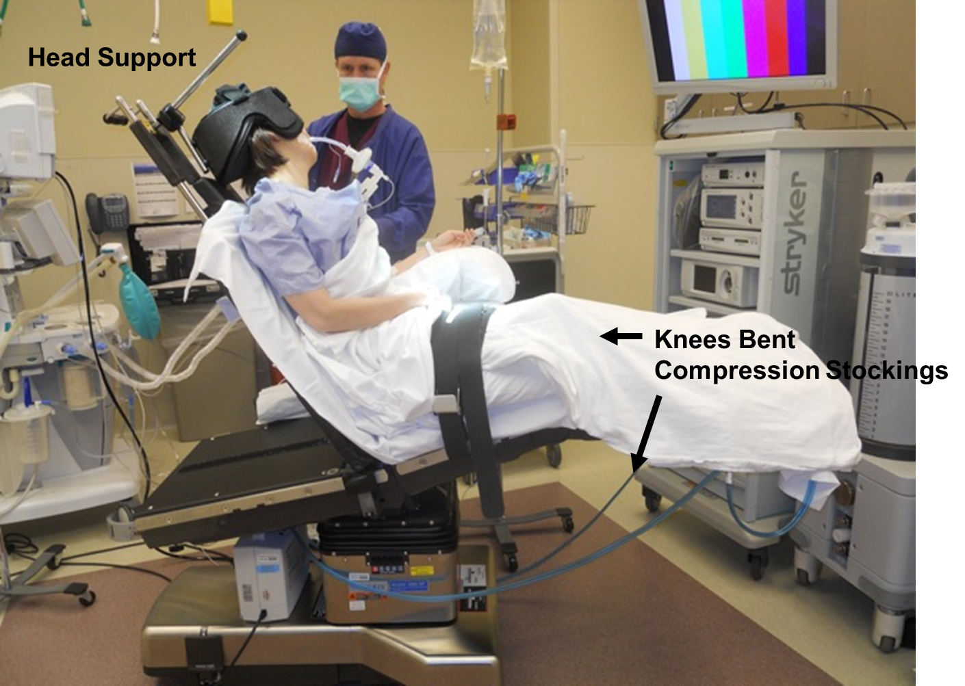

Slide 30
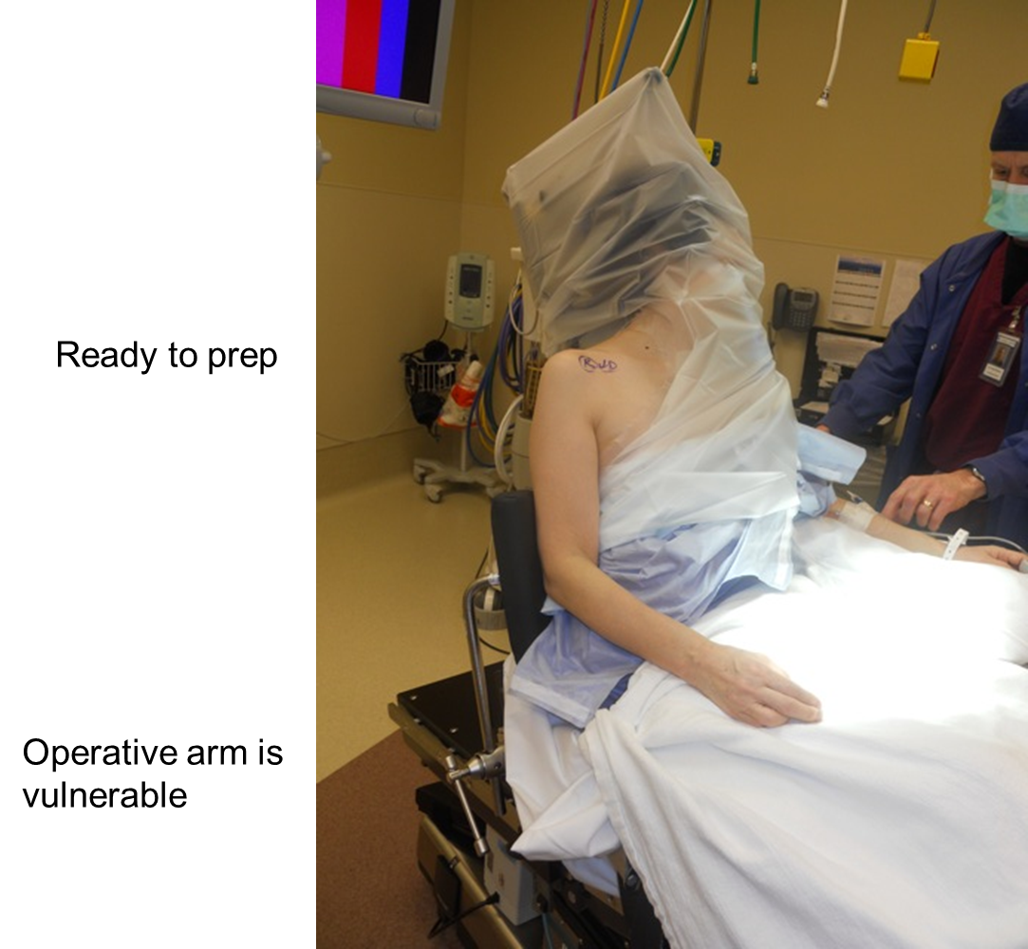

Slide 32
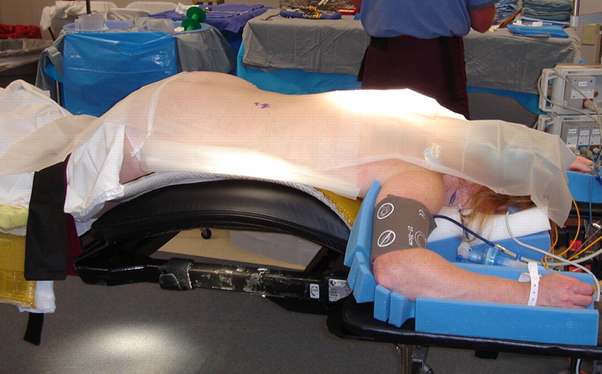
Patient induced on back and then turned. Process reversed at the end of procedure
Arms supported
Face in cradle
Gel pad under
knees

Slide 33
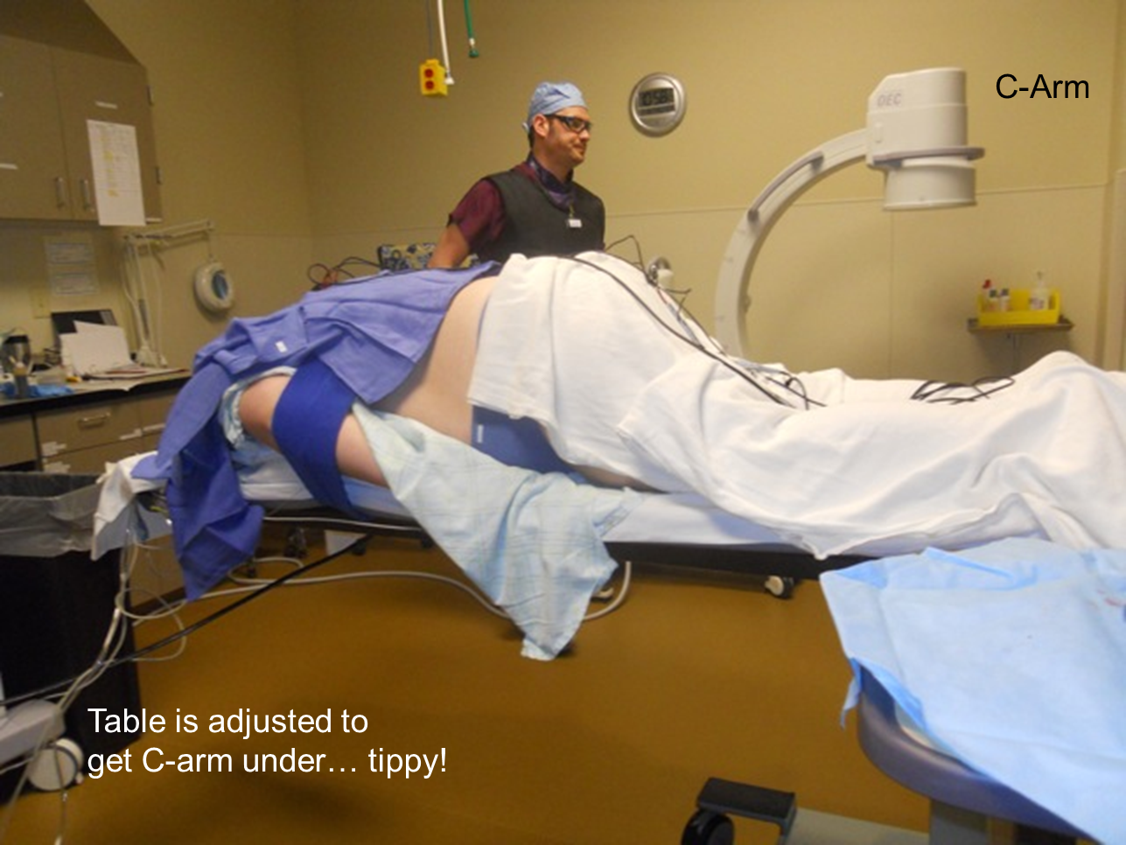
Challenges to positioning
Obesity
Trauma
Pre-existing conditions
Arthritis, amputation, injury
Diabetes
Cardiac/Vascular disease
Smoking

Slide 34
Documentation
“The table was placed in beach chair configuration. Head, neck, trunk and limbs were padded and protected in appropriate fashion.”
“The right lower extremity was prepped and draped in the usual sterile fashion.”
“Bilateral upper extremities were prepped and draped in standard sterile fashion.”

Slide 35
Perioperative complications
Refers to problems arising during surgery, which include:
Hypotension
Blood loss
Mismatched blood transfusion
Vasodilatation from a combination of premedication and anesthetic agents.
Raised blood pressure
Use of ketamine
Phaechromocytoma
Uncontrolled hypertension
Cardiac arrest
Air embolism
Tissue hypoxia
Blood loss
Air embolism
Increase in circulating catecholamine
Use of exogenous adrenaline in the presence of hydrogenated hydrocarbons e.g. Halothane
Hypoxia
Reduced O₂ in inspired air
Inadequate blood flow in myocardial failure
Inadequate alveolar ventilation due to respiratory depression
Insufficient functioning hemoglobin

Slide 36
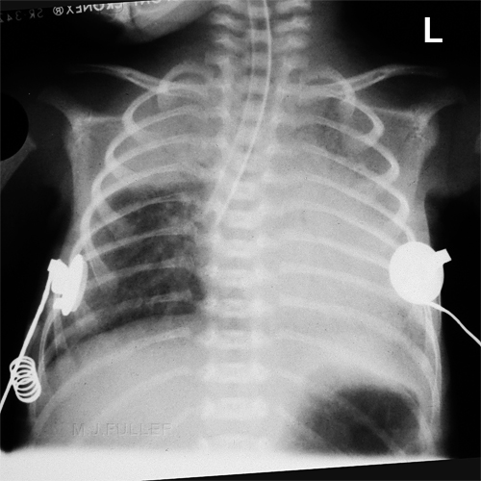
Perioperative complications
Asphyxia
Combination of hypoxia & hypercapnia, caused by respiratory obstruction
SIGNS:-
Noisy breathing during partial obstruction
In the presence of endotracheal tube, difficulty in inflating & deflating the lungs
Cyanosis
CAUSES:- physical & mechanical.
Flexed head in anesthetized px with/without endotracheal tube.
Endotracheal tube blocked by pus, blood, foreign bodies.
Pressure on trachea from without, during operations on large tumors of the neck e.g. thyroidectomy
Chemical causes
Inhalation of intestinal contents (can be due to stimulation of the back of the tongue by foreign)

Slide 37
Post operative complications
Refers to complications arising after surgical operations
Immediate/Early complications
Respiratory,
Cardiovascular,
CNS,
Genito-urinary,
GI and
Wound complications

Slide 38
Respiratory

Slide 39
Respiratory Complications
Respiratory insufficiency
Airway obstruction
Often caused by the tongue which falls back to block the oro- and nasopharynx
Presence of foreign bodies e.g. gastric contents, blood, pus, forgotten throat packs.
Aspiration
Aspiration of gastric contents in px that have recently eaten
Hiccough
Clonic spasm of the diaphragm with reflex closure of the glottis. It may occur soon after operation due to irritation of the mucosa of the esophagus and stomach by anesthetic gases

Slide 40
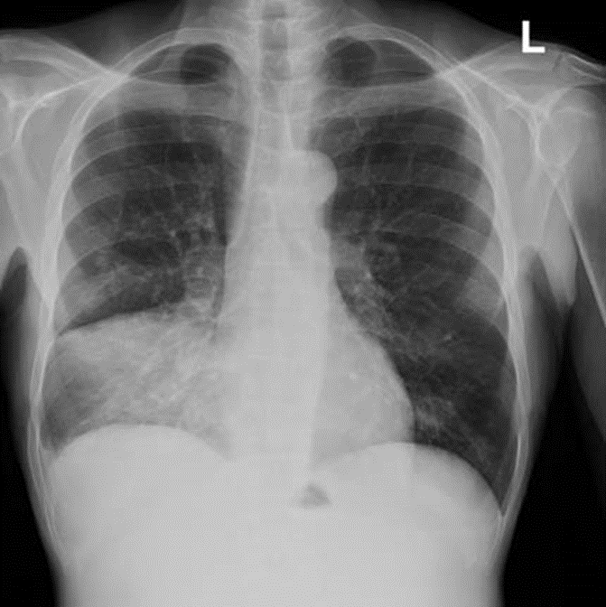
Atelectasis
Atelectasis(pulmonary collapse)
Increased quantity/viscosity of bronchial secretion
Deficiency in mechanism for expelling bronchial secretion
Intubation of respiratory tract
Bronchopneumonia
Infection of Atelectasis

Slide 41
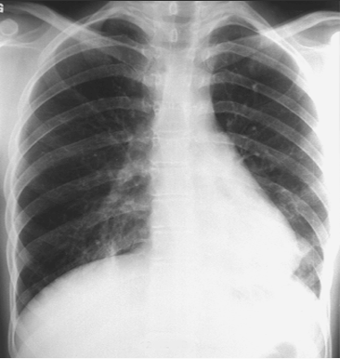
Postoperative Pulmonary Complications
Atelectasis:
90% postoperative pulmonary complications
Etiology:
Obstruction of the tracheobronchial airway
Changes in bronchial secretions
Defects in expulsion mechanism
Reduction in bronchial caliber
Pulmonary insufficiency (hypoventilation)
Decrease surfactant

Slide 42
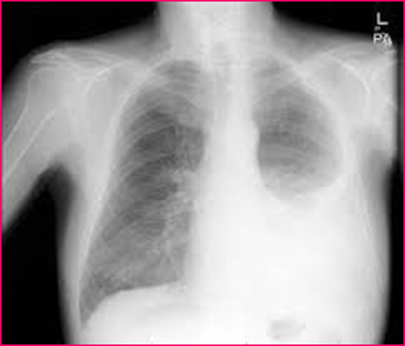
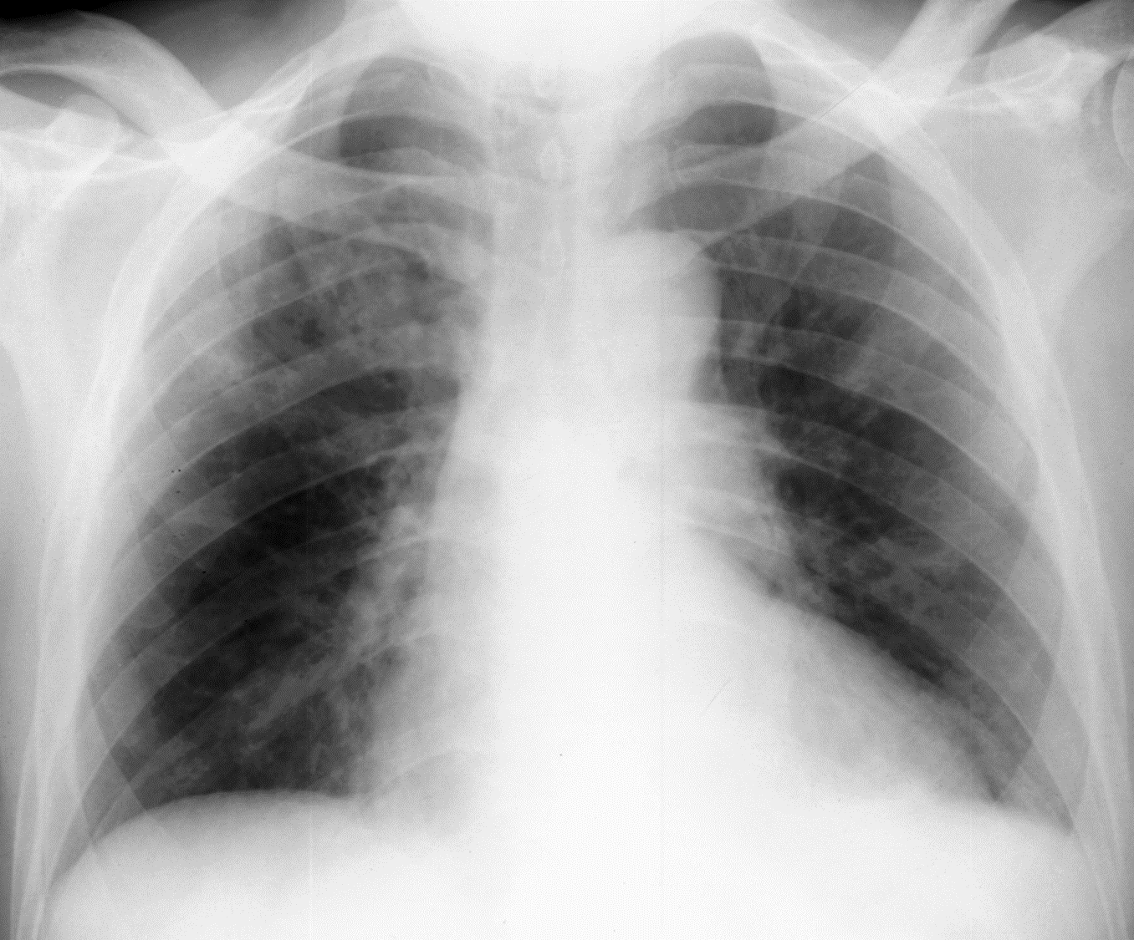
Chest X-ray
Pleural Effusion
Pneumonia
Pulmonary Edema

Slide 43
Risk Factors for Postoperative Pulmonary Complications
Risk Factor
Relative Risk
7,46
4,14
3,90
3,49
3,13
2,29
1,52
Age > 70
Age 50-69
Major abdominal surgery
Emergency surgery
Chronic obstructive pulmonary disease
Age 30-49
General anesthesia > 180 minutes

Slide 44
Common Causes of Postoperative Hypoxemia
Atelectasis
Alveolar infiltrates
Aspiration
Cardiac-associated pulmonary edema
Noncardiac-associated pulmonary edema (e.g. capillary leak, neurogenic, negative pressure)
Pulmonary embolus
Pneumothorax
Bronchospasm
Mucus plugging
Pulmonary contusion/hemorrhage

Slide 45
Common Causes of Postoperative Hypercapnia
Hypothyroidism
Insufflated carbon dioxide (laparoscopic procedures)
Metabolic alkalosis
Malnutrition
Hyper metabolism
Sepsis
Increased physiologic dead space pulmonary edema
Noncardiac-associated pulmonary edema (e.g. capillary leak, neurogenic, negative pressure)
Atelectasis
Alveolar infiltrates
Aspiration
Residual volatile anesthetics
Residual neuromuscular blockade
Narcotic overdose
Sedative overdose
High regional block
Cerebrovascular event
Neuromuscular disorders

Slide 46
CVS

Slide 47
CVS
Hemorrhage
Reactionary (occurring within 24hrs)
Dislodgement of a blood clot/loose ligature at the cut end of a blood vessel
Oozing of blood from an extensive raw area
Platelet deficiency resulting in impaired clotting
Prothrombin deficiency, e.g. in liver dx
Secondary hemorrhage (after 7days)
Bleeding follows necrosis of blood vessels from infection and may be accompanied or preceded by fever
Signs
Pallor, sweating and cool skin
Bleeding from wound
Cardiac arrest
Commonest cause is tissue hypoxia which may result from:
Resp. obstruction
Severe hemorrhage
Shock
Deep venous thrombosis
Venous stasis
Age
Roughening of the endothelium resulting from trauma
Myocardial infarction

Slide 48
Shock
Acute circulatory failure - inability of the cardiovascular system to maintain adequate tissue perfusion
There are three types
hypovolemic
cardiogenic
septic

Slide 49
Deep venous thrombosis (DVT)
Is important cause of morbidity in the surgical patient
Can lead to pulmonary embolism
Its prevalence is up to 40 percent
It can occur in the calf, femoral and iliac veins
Assessing risk
Prevention
Mechanical
Pharmacological

Slide 50
Predisposing factors for DVT
Smoking
Type of surgery
Obesity
Venous stasis
Cancer
Hypercoagulable states
Inactivity after surgery
Oral contraceptive use

Slide 51
Diagnosis and Tx of DVT
History and physical examination
Calf tenderness and swelling
Positive Homan’s sign
Fever
D-dimers
Ultrasound
Anticoagulation
Bed rest early

Slide 52
Pulmonary embolism (PE)
A very serious complication of DVT
10% die within the first hour
90% live longer than one hour-of these patients 70 percent go undiagnosed and of these 30 % die

Slide 53
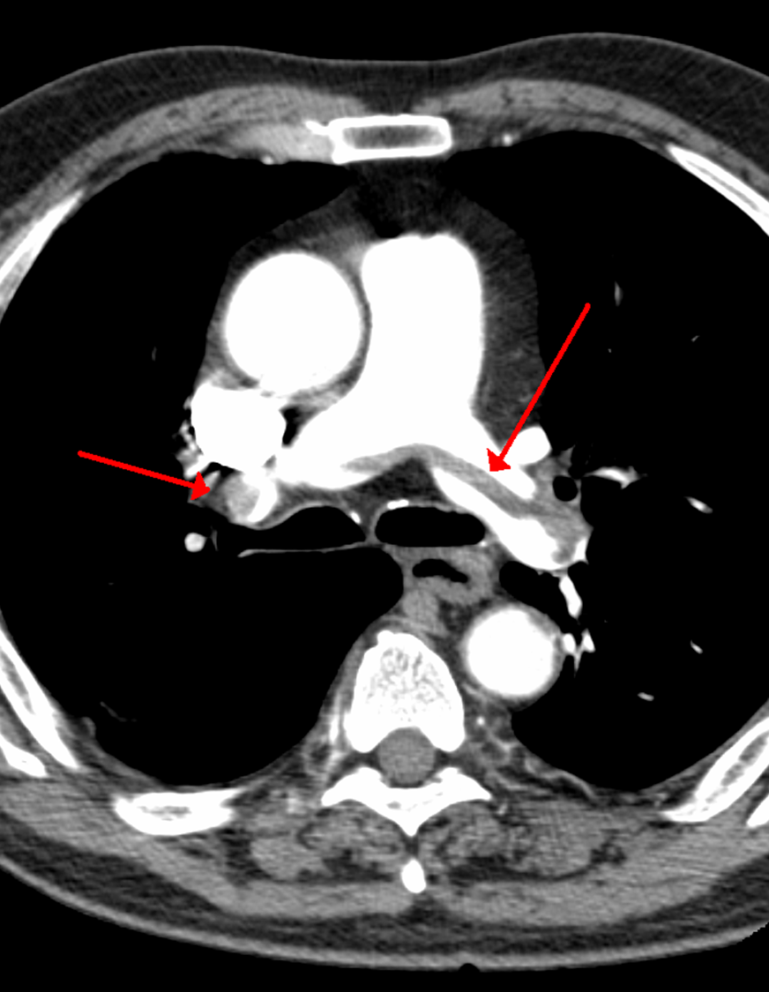
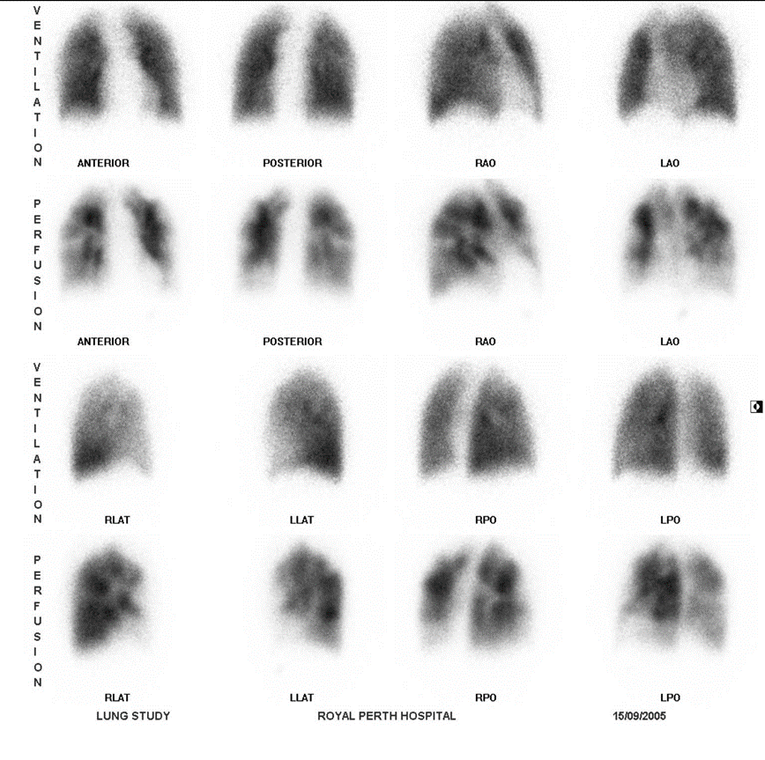
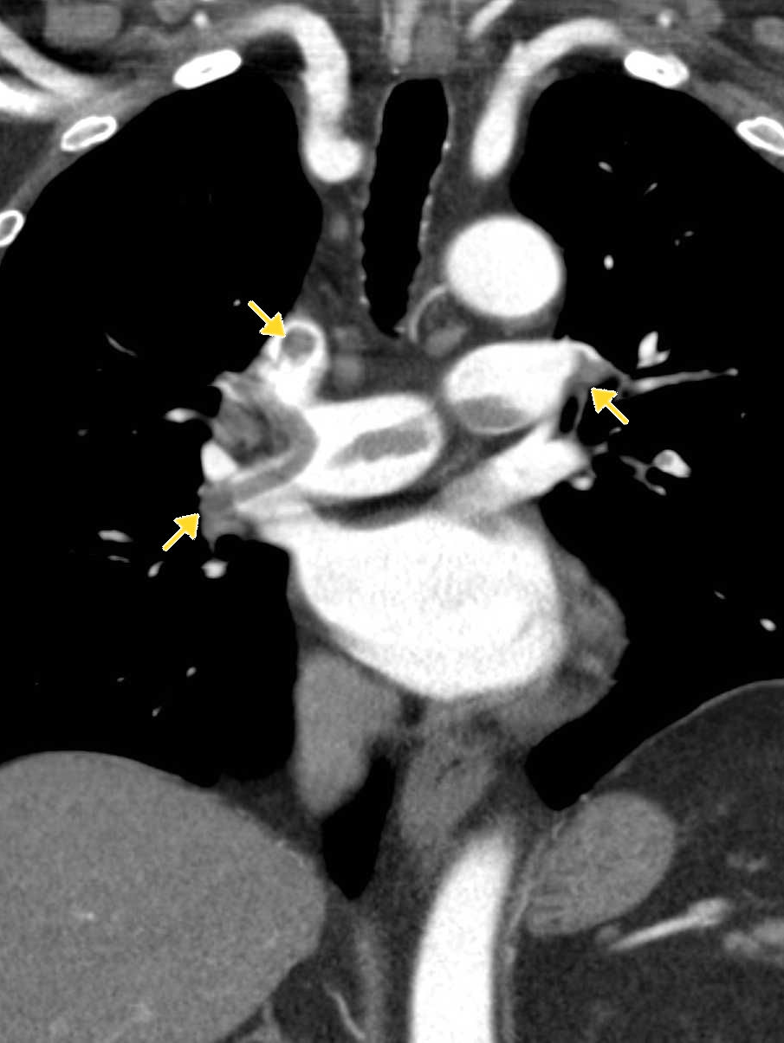
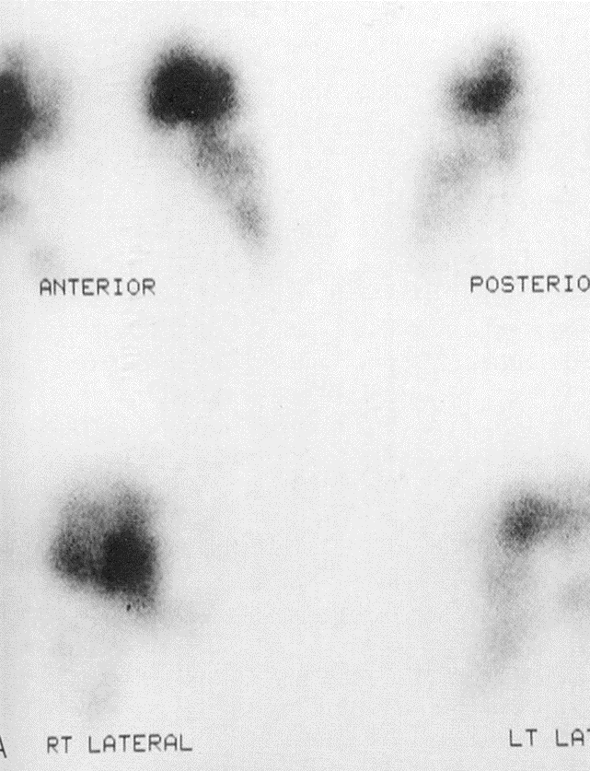
Diagnosis of PE and Tx
Diagnosis
Clinical
dyspnea
chest pain
hypotension
D-dimers
Imaging
CT
Ventilation perfusion scan
Tx
Medical management
supportive care
anticoagulation
thrombolysis
Surgical management

Slide 54
CNS

Slide 55
CNS
Failure to recover consciousness
May be due to cerebral hypoxia as a result of e.g. hypoglycemia
Convulsion
Attacks of involuntary tonic or clonic movements of the trunk, limbs and face with or without loss of consciousness.
Predisposing fx in the post-op period are:
pyrexia
epilepsy
hypocalcaemia

Slide 56
Mental status
Mental changes can include somnolence, coma, confusion, disorientation, agitation and convulsions
Elderly
This could be due to hypoxia, low blood sugar, uremia, ammonia or anesthetic agents
Failure to awaken issue usually due to anesthesia
Consider postoperative stroke in patients with carotid bruits
If the patient is a heavy drinker considered delirium tremens
Disorientation at night

Slide 57
Genito-Urinary

Slide 58
Genito-urinary
Postoperative reduction of urine output to < 0.5 ml / kg / hr.
Early postoperative fluid and sodium retention
Retention of urine
failure to pass urine within 12-24hrs of surgery when bladder is distended.
more common after pelvic and perineal operations.
Due to action of atropine & other cholinergic anesthetic agents (decrease muscle contractility)
Pain in operation site
Urinary tract infections

Slide 59
Prerenal
Implies decreased renal blood flow which is usually due to:
decreased blood volume
decreased cardiac output
medications

Slide 60
Renal
Usually occurs with prolonged or uncorrected pre-renal failure (acute tubular necrosis)
Can also be caused by:
aminoglycosides
intravenous contrast dye
blood transfusions
NSAIDs

Slide 61
Post renal
Usually occurs after the urinary tract has been obstructed
Can be caused by:
enlarged prostate
ligation of the ureter during surgery
foley catheter blockage

Slide 62
GI system

Slide 63
GI
Anorexia
Nausea & vomiting
May be caused by anesthetic agents
Peritonitis & intra-abdominal abscesses
Following operation in septic conditions
Diarrhea
Drugs: oral antibiotics, laxatives, magnesium containing antacids.
Operations: vagotomy & drainage, gut resection.
Upper and lower GI bleeding
Postoperative bowel obstruction
Acute gastric dilatation
Intestinal obstruction (Ileus)
Postoperative fecal impaction
Colitis
Anastomotic leak
Fistula
Peritoneal abscess
Peritonitis
Hepatobiliary complications and jaundice

Slide 64
Postoperative bowel obstruction
Early obstruction
Paralytic ileus
mechanical obstruction
Bowel obstruction should be considered in patients if
the bowel function does not return to normal after about four days

Slide 65
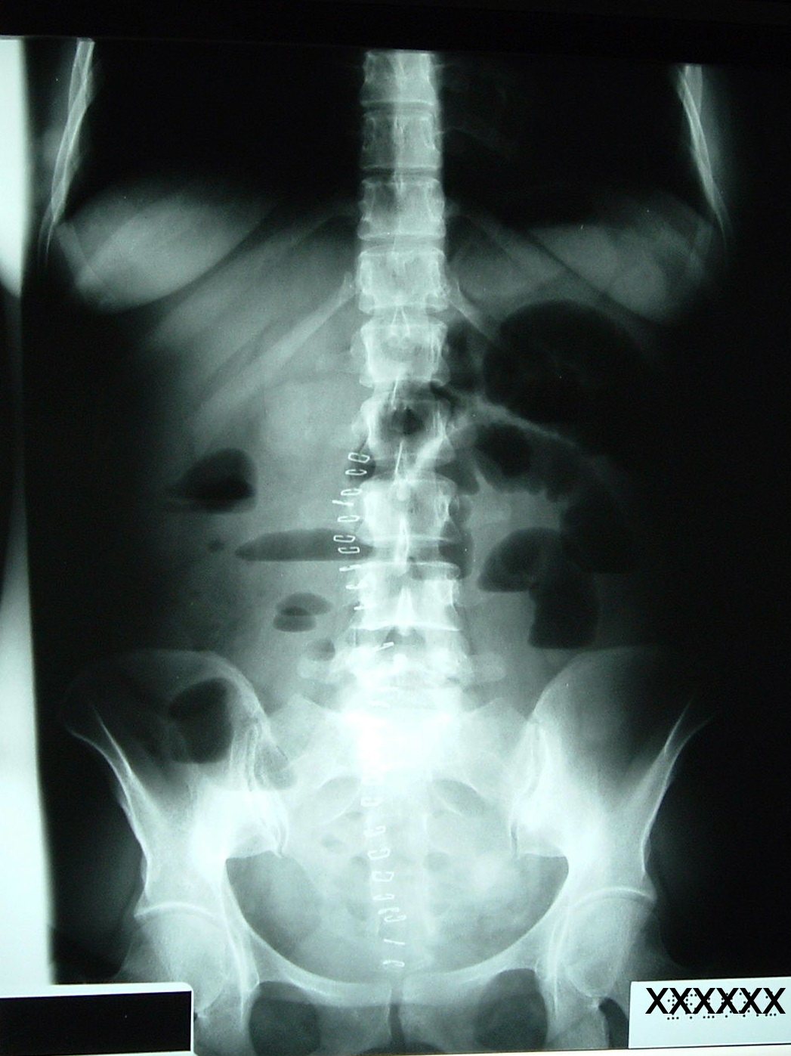
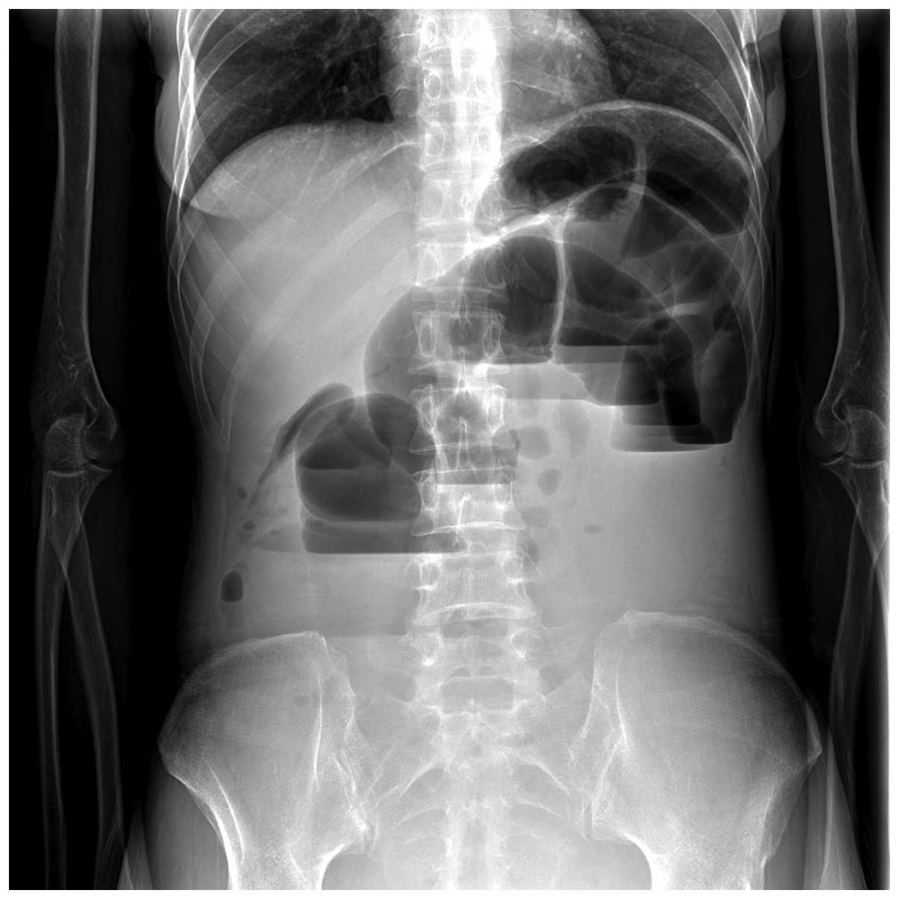
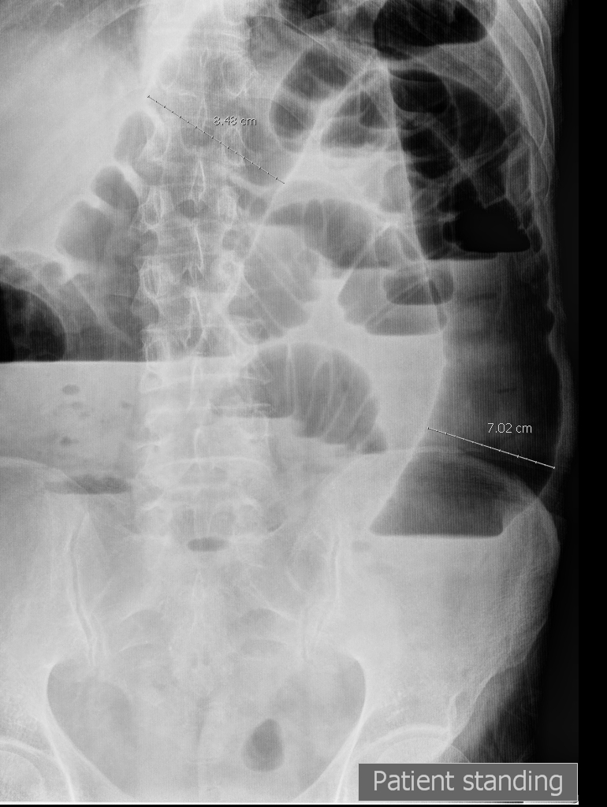
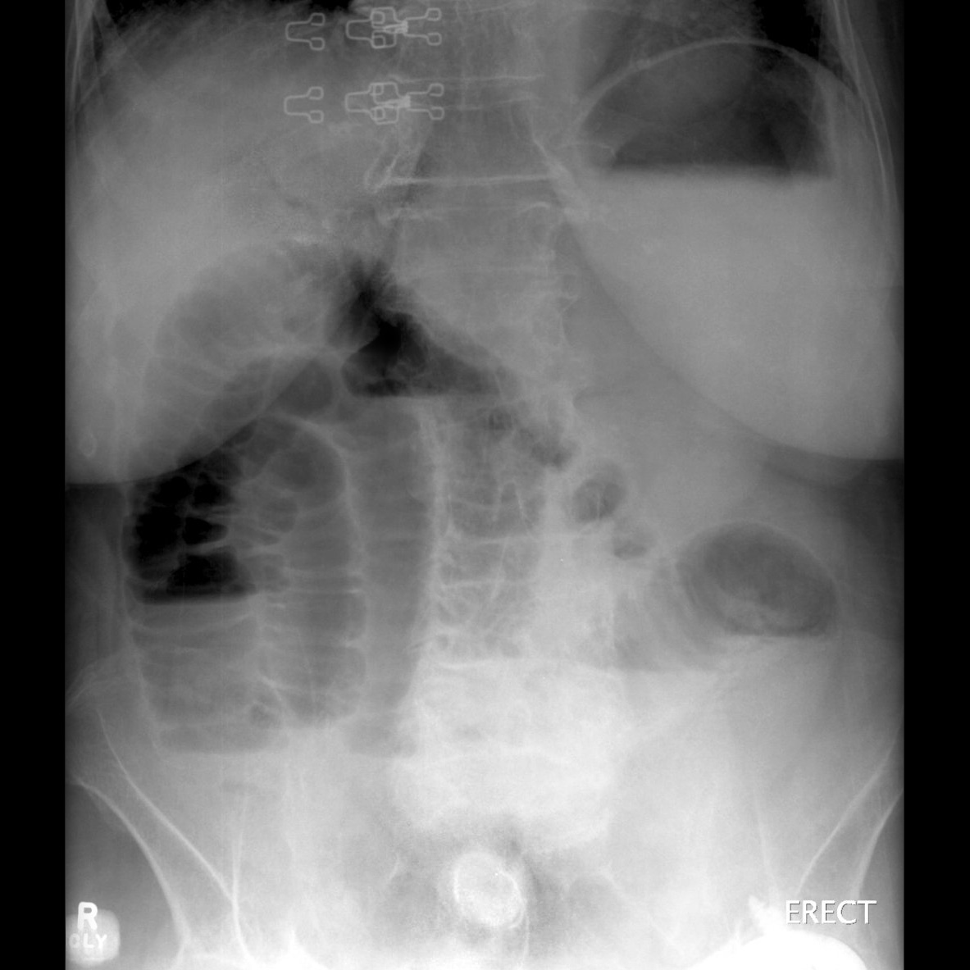
Postoperative bowel obstruction
Commonly caused by
postoperative adhesions
Intussusception
Volvulus
Herniation
Patients usually exhibit normal bowel function for a short while then shows signs of obstruction
S/Sx:
3rd – 4th postop day
Abdominal distention, colicky pain, increase NGT drainage, bilious material
Diagnosis
abdominal x-rays
CT scanning

Slide 66
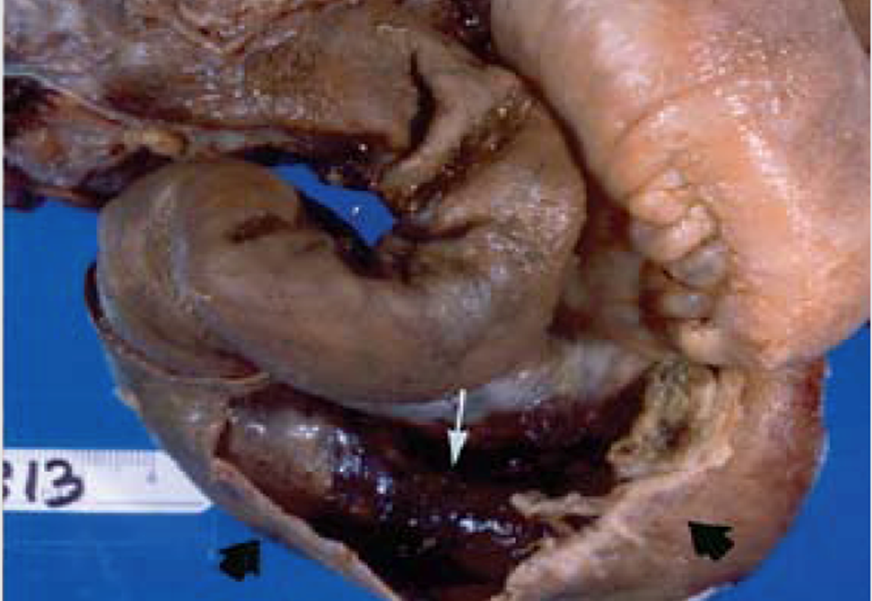
Intussusception

Slide 67
Volvulus

Slide 68
Small bowel volvulus

Slide 69
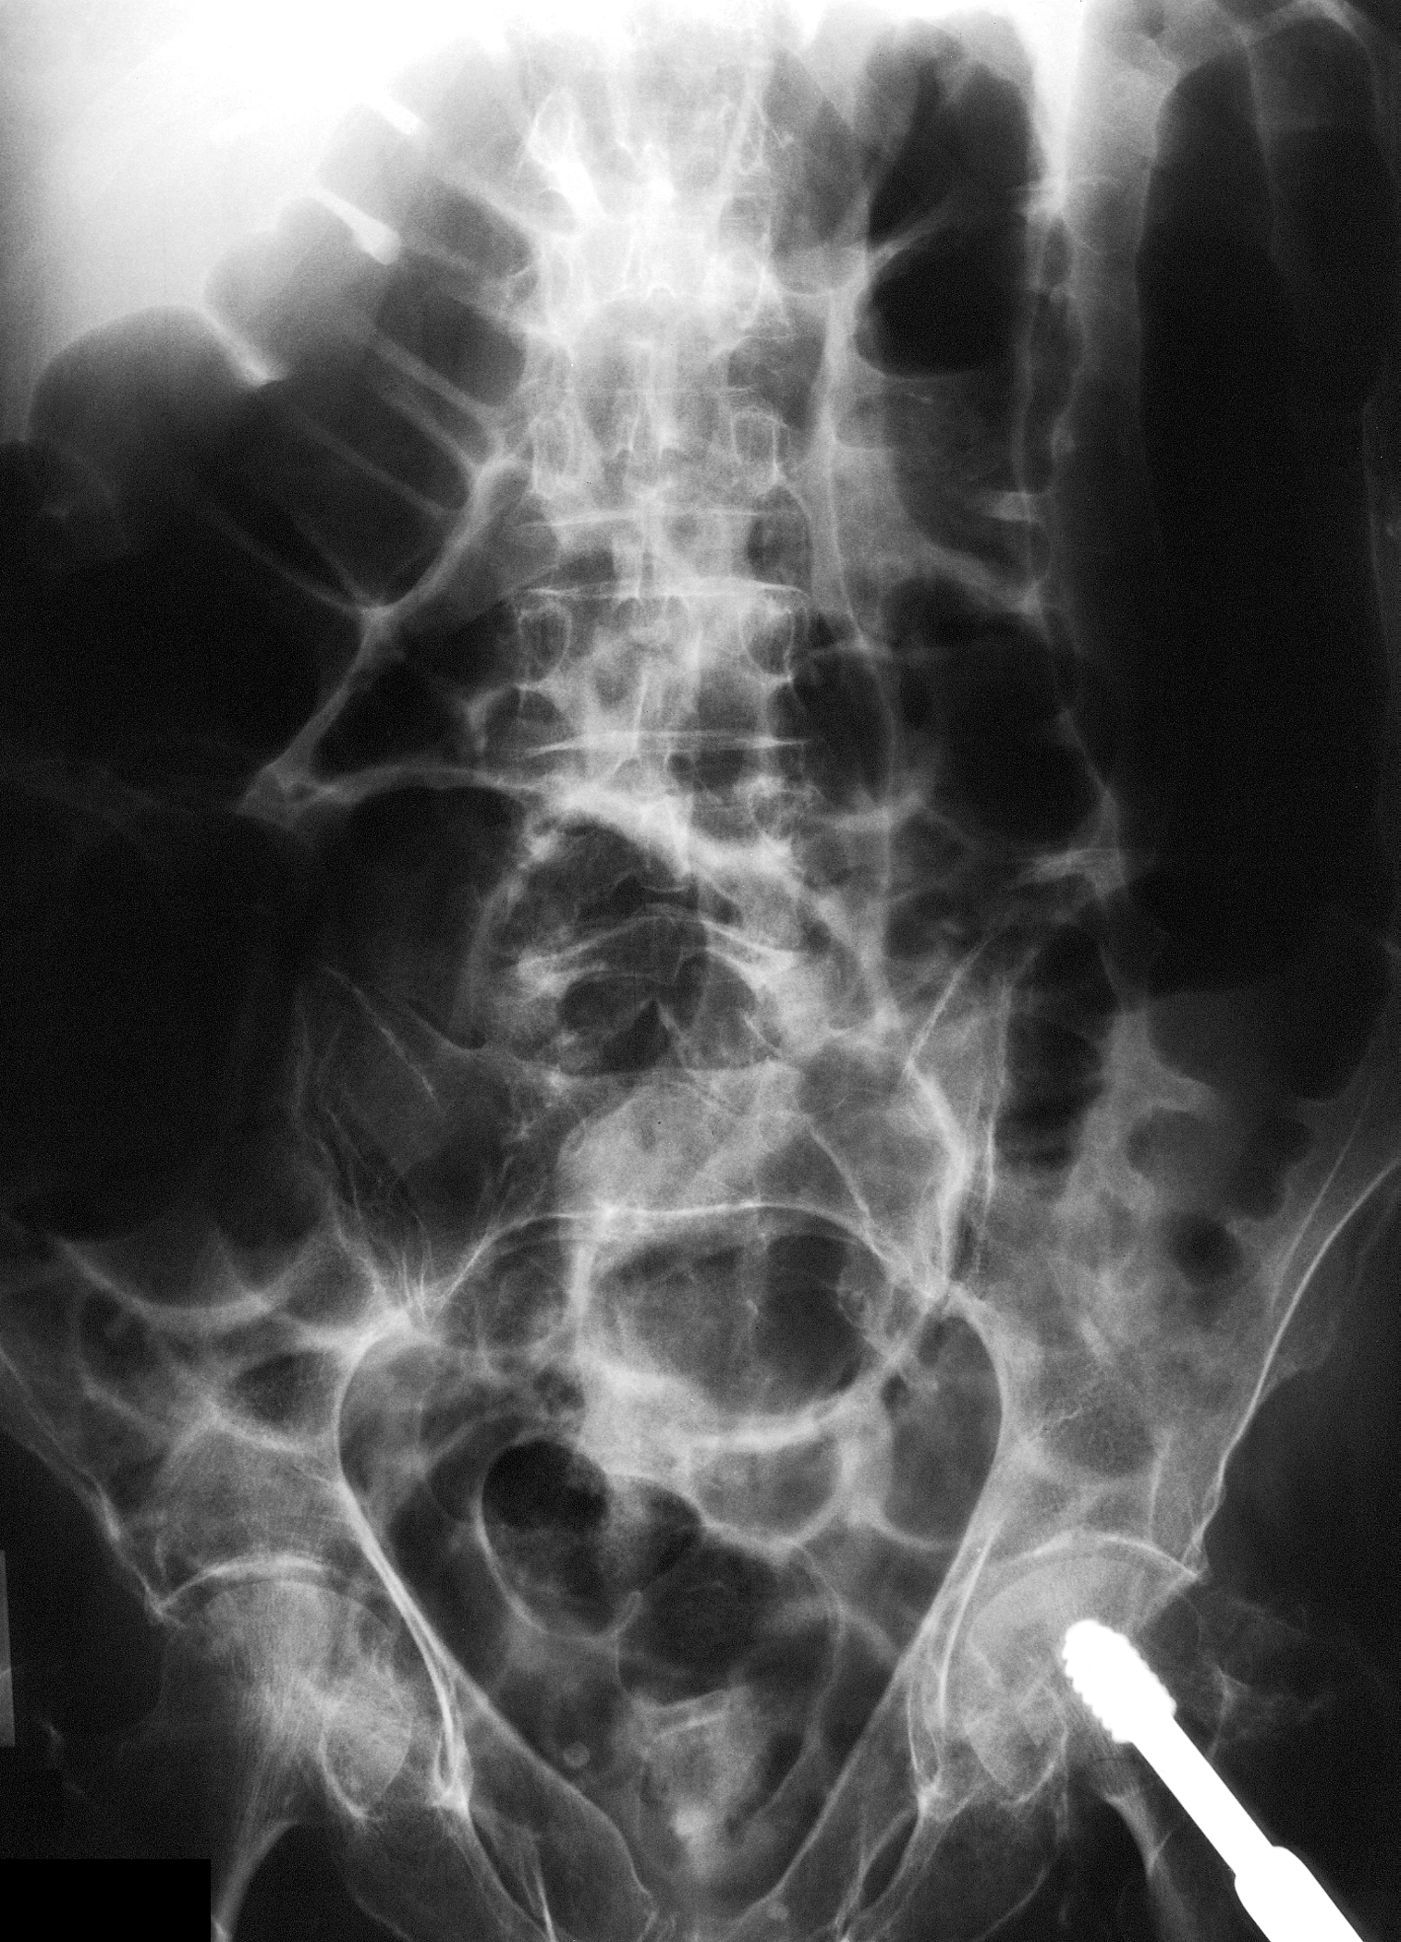
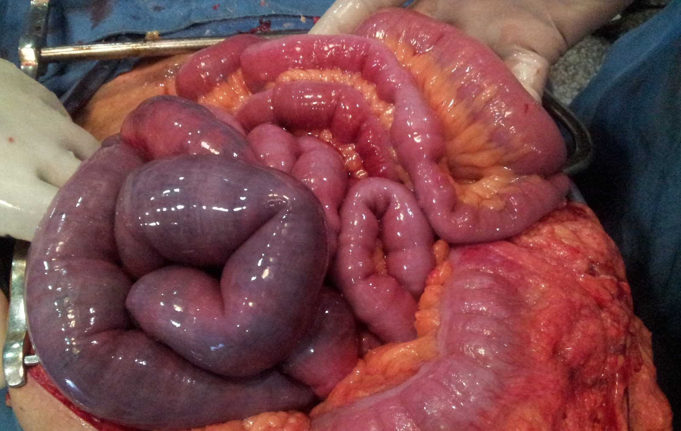
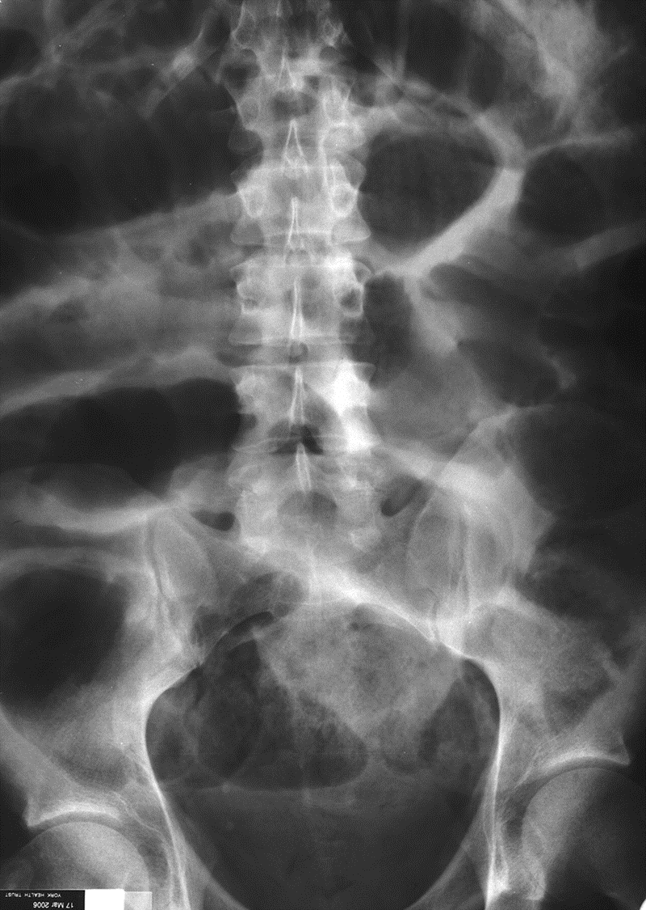
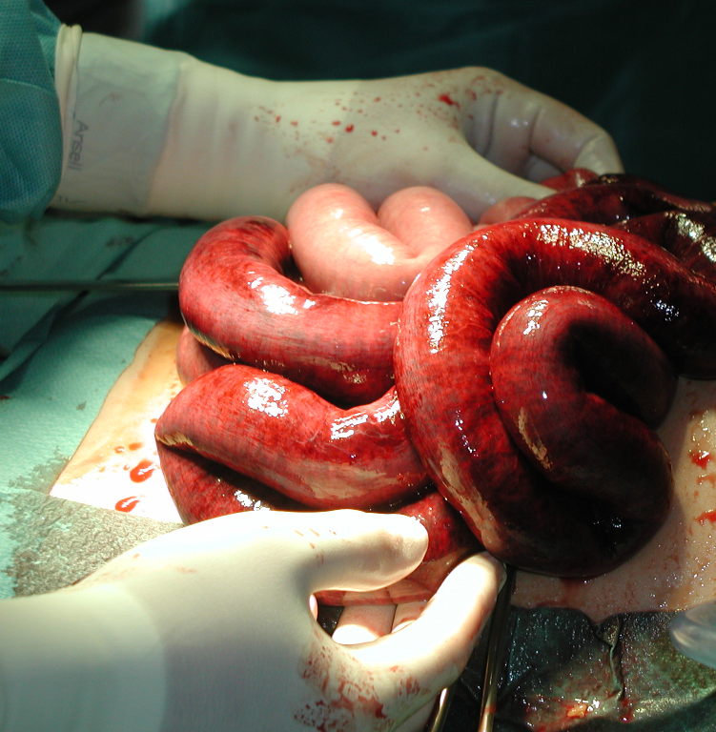
Paralytic ileus
Intra-abdominal inflammation
Drugs

Slide 70
Small bowel internal herniation

Slide 71
Stomal obstruction
Stomal obstruction (due to local edema)
Causes of edema:
Electrolyte imbalance
Incomplete hemostasis
Hypoproteinemia
Leakage from anastomosis
Inadequate proximal decompression
Incorporation of too much tissue in the suture

Slide 72
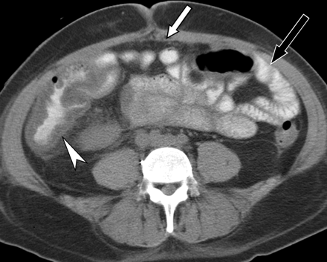
Pseudomembranous colitis-Clostridium difficile

Slide 73
Anastomotic Leak
Fistula
Gastric and duodenal fistula:
Subtotal gastrectomy gastrojejunal and duodenal stump
Due to suture line failure
Bowel
Peritoneal abscess
Peritonitis
Sepsis
Etiologic factor:
Poor surgical technique
Distal obstruction
Inadequate proximal decompression
Can manifest as localized or
generalized peritonitis

Slide 74
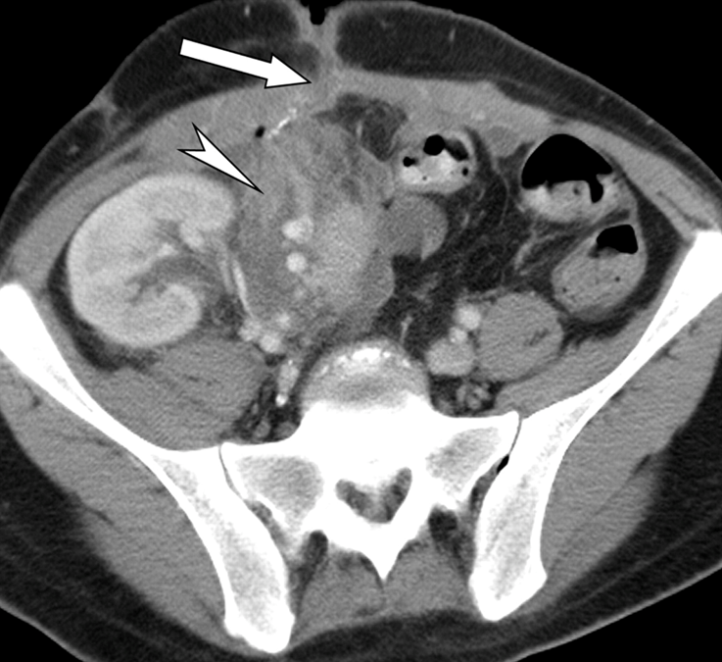
Fistula
Abnormal communication
between two lining epithelium
Etiology:
Anastomotic leak
Poor blood supply
Trauma
Infection
Inadvertent suturing of bowel wall while closing the fascia
Carcinoma
Treatment:
Small leaks:
Conservative, NPO
Proximal decompression
Antibiotic
Large leaks:
Surgical intervention

Slide 75
Fistula
Gastric and duodenal fistula:
Treatment:
NPO / TPN
Place NGT past the leak and give elemental diet
Antibiotic
Majority close spontaneously within 6 weeks.
Failure to close
distal obstruction
large leak
infection
cancer
Surgery: resect the fistula and the bowel segment, then re-anastomosis

Slide 76
Fistula
Small bowel fistula:
Drainage is less effective compared to duodenal fistula
Jejunal fistula have a poorer prognosis than ileal fistula
Treatment:
Supportive:
correct fluid & electrolyte imbalance
give proper nutrition
Proximal jejunal fistula: distal feeding jejunostomy
Distal ileal fistula: low residue diet
Control diarrhea: lomotil / protect the skin

Slide 77
Fistula
Colonic fistula:
Fluid & electrolyte imbalance less common but has higher infection can lead to peritonitis, peritoneal abscess and wound infection
Skin digestion and irrigation are rare
Treatment:
Nutrition (low residue or elemental diet)
Antibiotics
Spontaneous healing of fistula is the rule rather than the exception
Medical management is generally indicated for 6 wks. to permit active inflammation to subside ---> fails ---> surgery
Defunctionalizing colostomies for descending colon
Ileal transverse colostomies for ascending and distal ileal fistulas
If generalized peritonitis do emergency resection

Slide 78
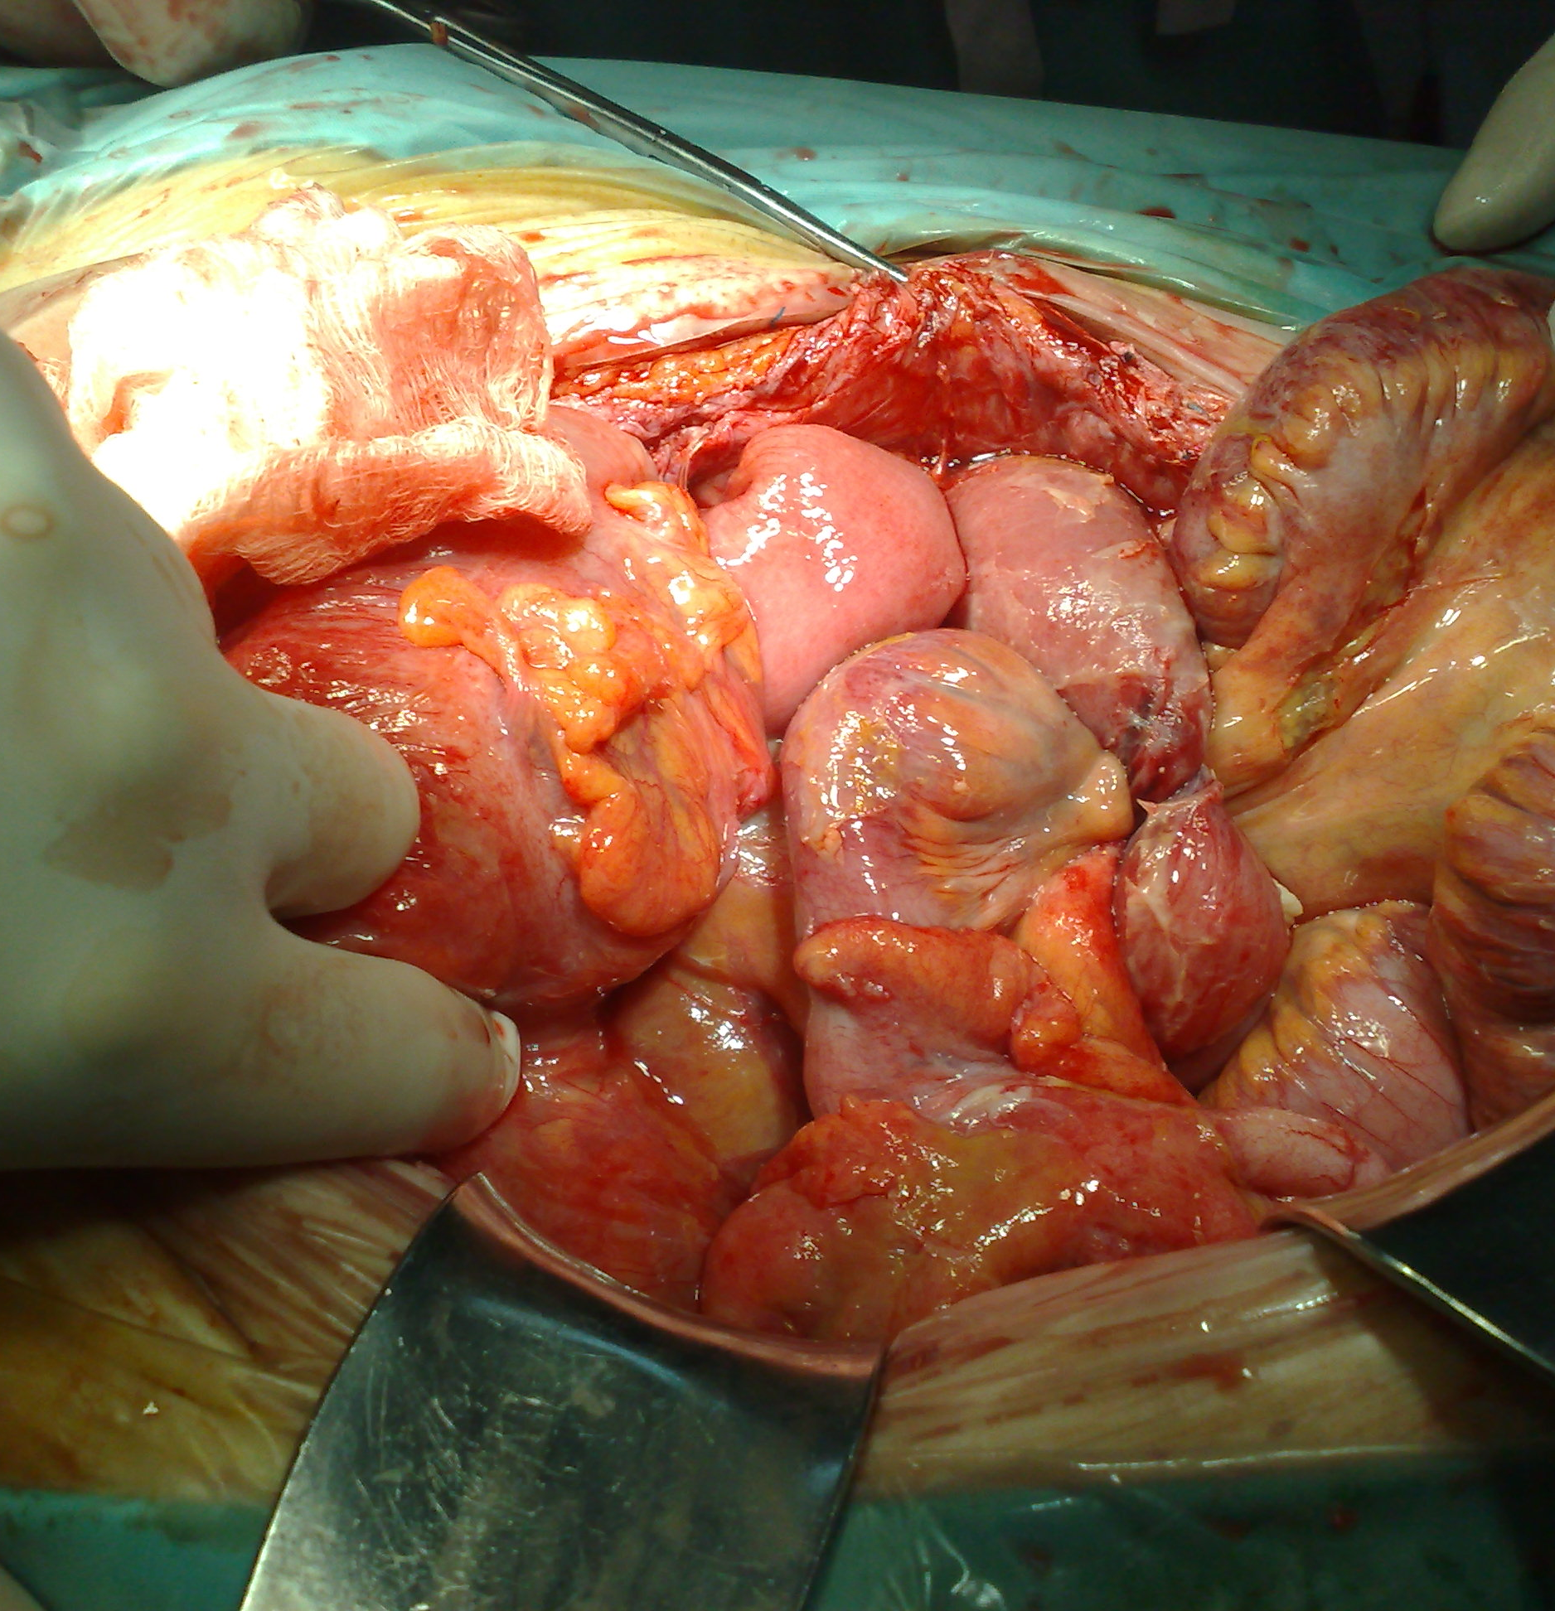
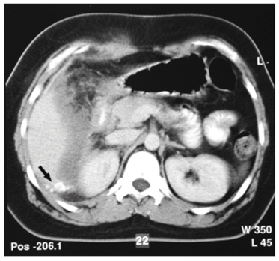
Peritoneal abscess and peritonitis

Slide 79
Late complications
Wound
Hypertrophic scar, keloid, wound sinus.
Adhesions
Strangulation, intestinal obstruction

Slide 80
Wound

Slide 81
Wound complications
Types
Type of operation
Clean
Clean contaminated
Contaminated
Infected
Emergent versus elective
Patients general health
Attributed to
Surgical technique
Wound infection
Postoperative distension
Site of the incision

Slide 82
Wound complications
Hematoma and seromas
Predisposes to infection and delays wound healing
Attribute to
Inadequate hemostasis
Anticoagulants
Intraoperative anticoagulation
Lack of obliteration of dead space
Infection
Usually occurs 5-7days after surgery
Contributing factors:
Longer duration of operation
Age
Poor surgical technique
Measure of ‘good house keeping’ in clean wound
Erythema to pus collection
Primary or secondary
Wound dehiscence
Raised intra-abdominal pressure
Weakness of wound
Partial or complete

Slide 83
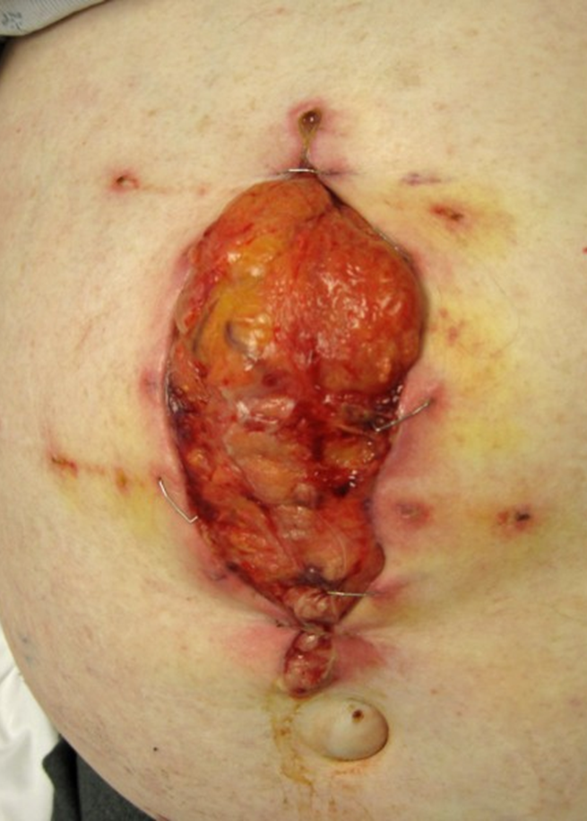
Wound dehiscence
Type
Partial
Complete
Timing
Early
Late
Contributing fx
Malnutrition
Sepsis
Anemia
Steroid therapy
Uremia
Diabetes
Liver failure
Leads to
Incisional hernia

Slide 84
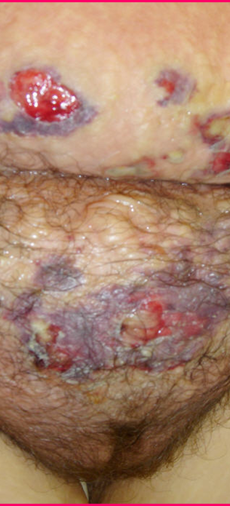
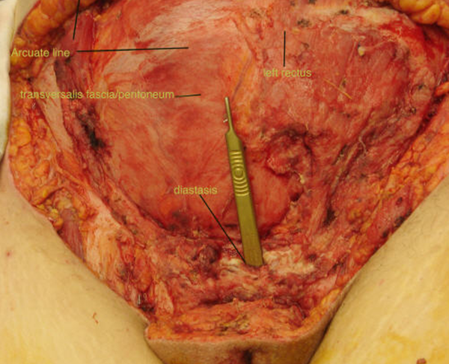
Necrotizing Fasciitis

Slide 85
Postoperative fever
Common problem
Physical exam is important in evaluating postoperative fever
Timing of fever

Slide 86
Postoperative fever
Pyrexia (fever) after operation may be caused by:
Metabolic response to trauma in the first 24hrs
Atelectasis
Alveolar infiltrates
Aspiration
Infection or hematoma of the wound
Laryngo-tracheitis from endotracheal intubation
Peritonitis or intra-abdominal abscess
Complications of blood transfusion: mismatched blood
Drug sensitivity
Injection abscess
Deep venous thrombosis and Pulmonary embolus
Thyroid storm
Malignant hyperthermia

Slide 87
Early postoperative fever
Respiratory: atelectasis
Systemic response to trauma of surgery

Slide 88
Postoperative fever (1-3 days)
Urinary tract infection
IV sites
Phlebitis
Infection

Slide 89
Postoperative fever (after 5 days)
Wound infection
Respiratory tract infection
Abscess
Wound
Intra-abdominal
Urinary tract infection

Slide 90
Common Causes of Elevated Temperature in Surgical Patients
Hyperthermia: temperature greater than 37.5–38.3 °C. as methods for thermoregulation are not as effective. Therefore, the body is absorbing more heat than it is dissipating, also known as overheating of the body
Hyperpyrexia: a fever with an extreme elevation of body temperature greater than or equal to 41.5 °C. Fever/pyrexia is body temperature that is high as a result of bacterial or viral infections
Environmental
Malignant hyperthermia
Neuroleptic malignant syndrome
Thyrotoxicosis
Pheochromocytomatous
Carcinoid syndrome
Iatrogenic
Central/hypothalamic responses
Pulmonary embolism
Adrenal insufficiency
Sepsis
Infection
Drug reaction
Transfusion reaction
Collagen disorders
Factitious syndrome
Neoplastic disorders

Slide 91
Postoperative Care
Pain Control
Pain affects blood pressure, vital signs
Narcotics affect respiration
Pain control is a chemical balance
Challenges in pain control
Surgical procedure, duration
History of prior medication use
Age, co-morbidities
Experience with pain

Slide 92
Complications: Who Knows better ???
What operation did the patient have?
What are the most common complications of this operation?
What is most life-threatening?
What comorbidities does that particular patient have?

Slide 93
Complications: Who Knows better ???
Each surgical procedure has its own set of inherent complications
Surgeon treating the patient usually has the best idea as to what is happening

Slide 94
Common Post Operative Complication post Major Surgery
Post Operative Pain
Bleeding : Hypovolemia
Hypoxia : Hypoventilation
Hemodynamic Unstable
Fluid & Electrolyte imbalance
Wound Complication
Hematoma, infection
Dehiscent, Keloid
Post Operative infection: wound (Site of Operation)
Post Operative Renal Failure
Liver Failure
Hematological disorder: Coagulopathy
Post Operation Sepsis : ARDS
Post Operative Respiratory Failure :
Atelectasis
Pneumonia
MOF
Hematoma, Seroma, Intraabdomina
CVS, arrhythmia, Hypovolemia
Contractility (MI)
Post Op Pulmonary edema, CHF

Slide 95
Surgical safety
The holistic idea of Hippocratic medicine
Only with careful attention to both the individuality of illness and the universality of disease etiology can physicians most effectively care for their patients
Mantri S. Holistic medicine and the Western medical tradition. Virtual Mentor 2008; 10(3):177-80.

Slide 96
Three central problems in Surgical safety
Unrecognized as a public health issue
Lack of data on surgery and outcomes
Failure to use existing safety know-how

Slide 97
Unrecognized as a public health issue
234 million operations are done globally each year Source: Weiser, Lancet 2008.
Known surgical complications of 3-16%
Known death rates of 0,4-0,8%
At least 7 million disabling complications – including 1 million deaths – worldwide each year

Slide 98
Unrecognized as a public health issue (cont.)
Burden of surgical disease is increasing worldwide due to
Cardiovascular disease
Traumatic injuries
Cancer
Longer life expectancies

Slide 99
LACK OF DATA ON SURGERY AND OUTCOMES

Slide 100
Failure to use existing safety know-how
High rates of preventable surgical site infection result from inconsistent timing of antibiotic prophylaxis
Anesthetic complications are 100-1000x higher in countries that do not adhere to monitoring standards
Wrong-patient, wrong-site operations persist despite high publicity of such events

Slide 101
The Safe Surgery Saves Lives: Strategy
Promotion of surgical safety as a public health issue
Creation of a checklist to improve the standards of surgical safety
Collection of “Surgical Vital Statistics”

Slide 102
Surgical safety

Slide 103
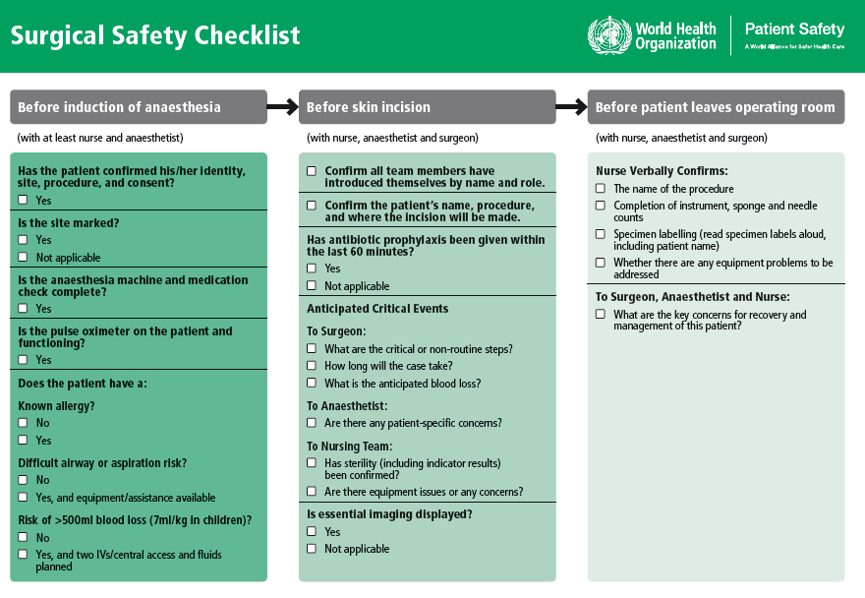
Surgical safety
What is this tool that addresses the 10 objectives?
The team will operate on the correct patient at the correct site.
The team will use methods known to prevent harm from administration of anesthetics, while protecting the patient from pain.
The team will recognize and effectively prepare for life-threatening loss of airway or respiratory function.
The team will recognize and effectively prepare for risk of high blood loss.
The team will avoid inducing an allergic or adverse drug reaction for which the patient is known to be at significant risk.
The team will consistently use methods known to minimize the risk for surgical site infection.
The team will prevent inadvertent retention of instruments or sponges in surgical wounds.
The team will secure and accurately identify all surgical specimens.
The team will effectively communicate and exchange critical information for the safe conduct of the operation.
Hospitals and public health systems will establish routine surveillance of surgical capacity, volume and results.

Slide 104
Reality Check
Currently, hospitals
do MOST of the right things,
on MOST patients,
MOST of the time.
The Checklist helps us
do ALL the right things,
on ALL patients,
ALL the time

Slide 105
Advantages of using a Checklist
Customizable to local setting and needs
Supported by evidence
Evaluated in diverse settings around the world
Promotes adherence to established safety practices
Minimal resources required to implement a far-reaching safety intervention

Slide 106
The Checklist was piloted in 8 cities…

Slide 107
The Checklist was piloted in 8 cities…
...and was found to reduce the rate of postoperative complications and death by more than one third!
Haynes et al. Surgical Safety Checklist to Reduce Morbidity and Mortality in a Global Population. New England Journal of Medicine 360:491-9. (2009)

Slide 108
Change in Death and Complications by Income Classification
Haynes et al.
A Surgical Safety Checklist to Reduce Morbidity and Mortality in a Global Population.
New England Journal of Medicine 360:491-9. (2009)
 | Change in Complications | Change in Death
High Income | 10.3% -> 7.1%* | 0.9% -> 0.6%
Low and Middle Income | 11.7% -> 6.8%* | 2.1% ->1.0%*
* p<0.05

Slide 109
Easy Math
234 million people are operated on each
year, and >1 million of these individual
die from complications
At least ½ are avoidable with the Checklist
500,000 save lives on the line each year

Slide 110
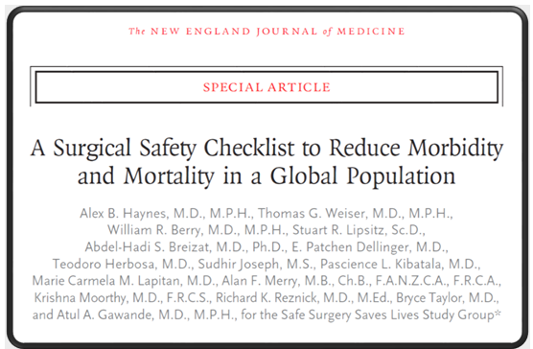
ΥΠΕΡΑΞΙΑ
Results The rate of death was 1.5% before the checklist was introduced and declined to 0.8% afterward (P = 0.003). Inpatient complications occurred in 11.0% of patients at baseline and in 7.0% after introduction of the checklist (P<0.001).

Slide 111
Sir William Osler
“The good physician treats the disease;
The great physician treats the patient who has the disease.”
If there was not bleeding everybody would do surgery
Sir William Osler
The father of Modern (Academic) Medicine

Slide 112
…What ever we do…
…is still the Surgeon that
makes the decisions
and takes the blame
for death and complications.

