Slide 1


WHO: Palliative care is a FUNDAMENTAL HUMAN RIGHT

Slide 2
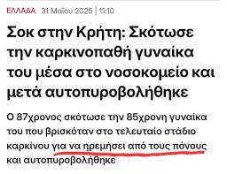
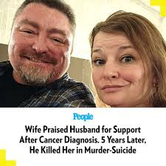

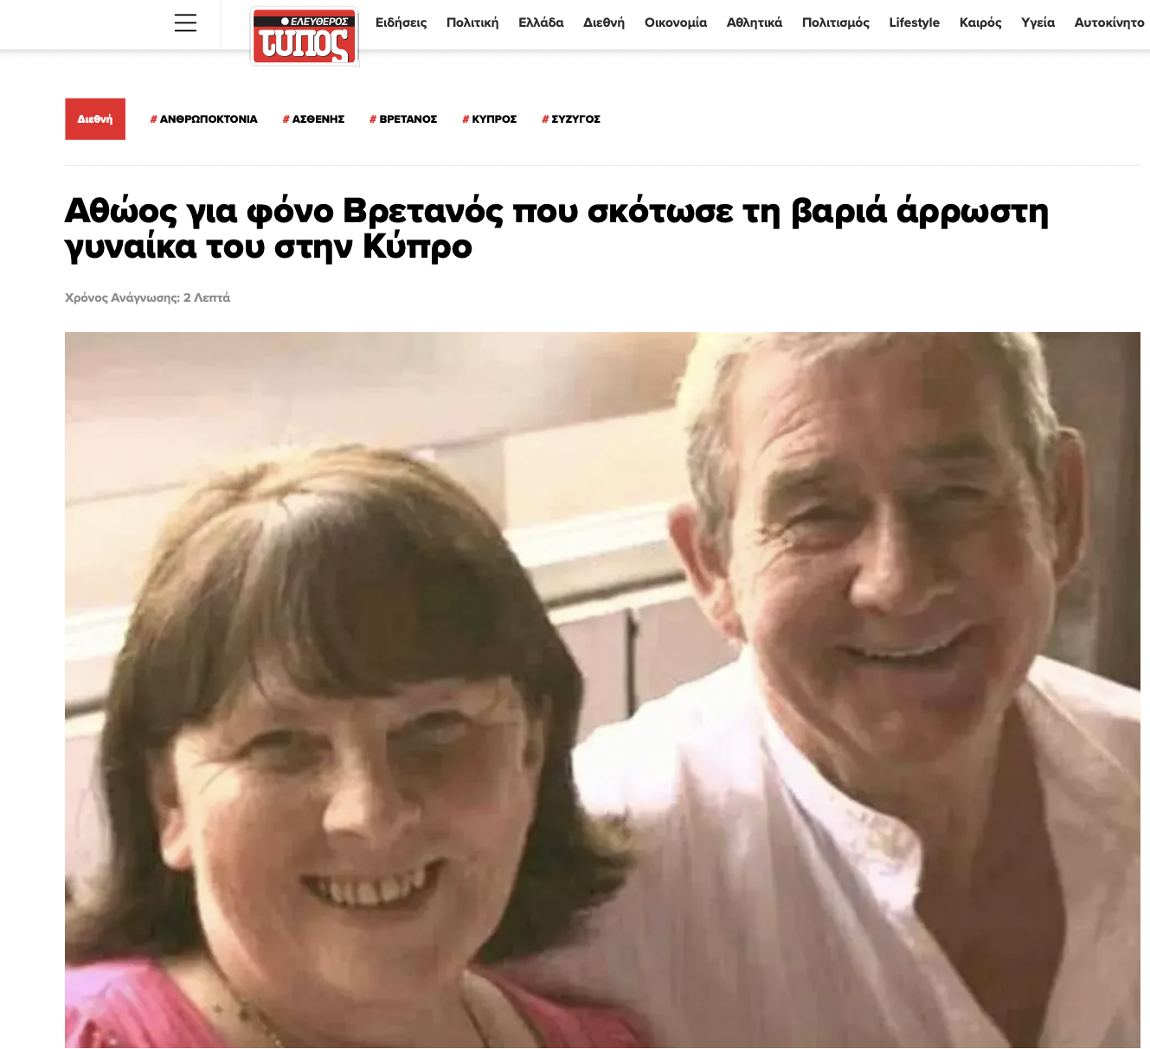
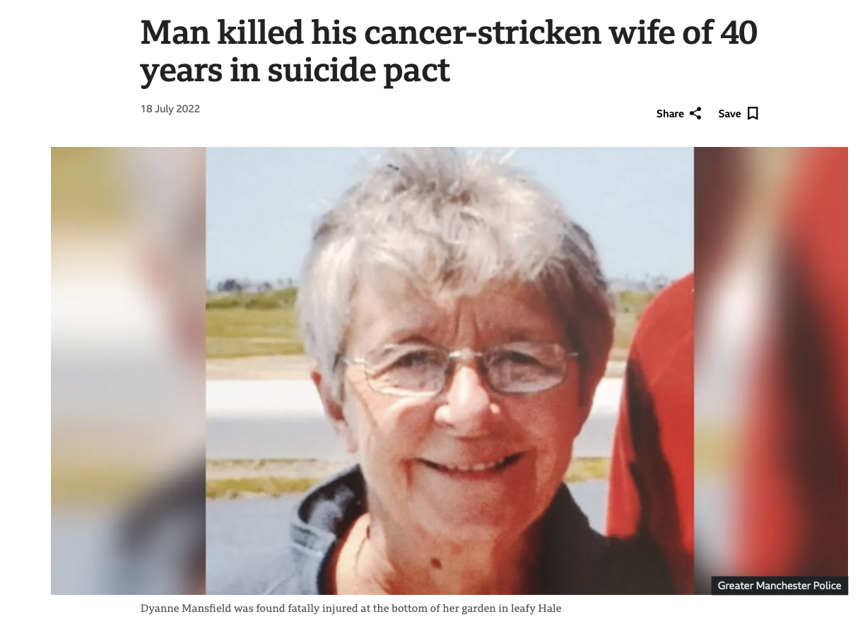

Notes:
Ένα μηνα πριν στη κυπρο κ αι αυτά τα ξερουμε γιατι είναι πυριοβολισμοι….

Slide 3

Palliative protocols
Dr Zinais Kontouli, MD, MSc, PhD, FIP
Anaesthesia / Interventional Pain Medicine
Athens Medical Centre
Imperial College Pain Fellowship
Academic Associate University of Athens

Slide 4

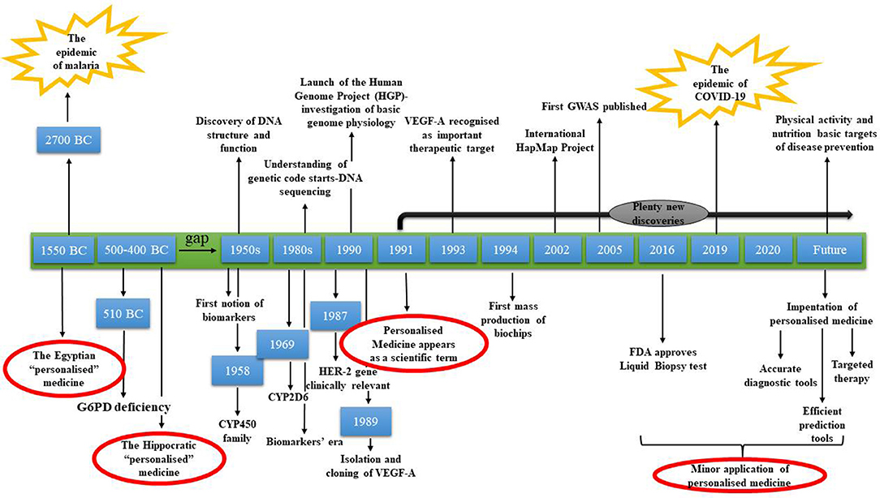
Medical achievements

Slide 5
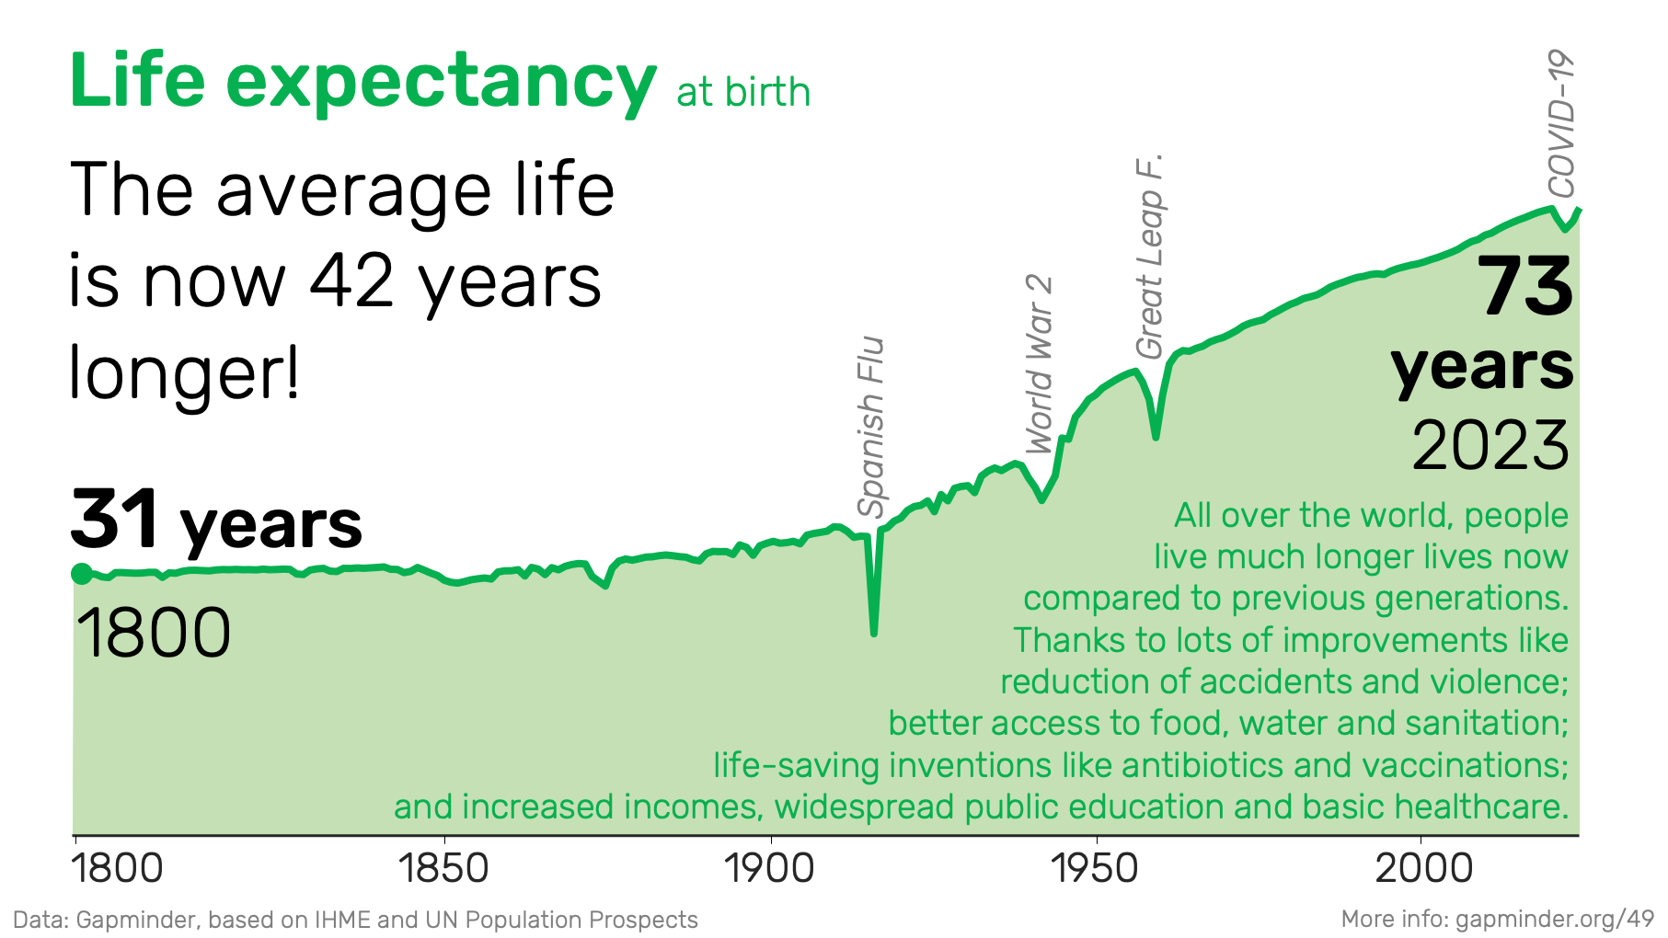

Slide 6







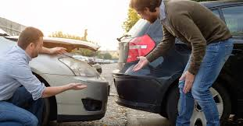
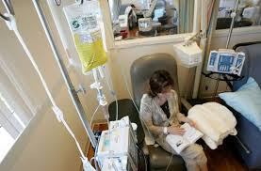

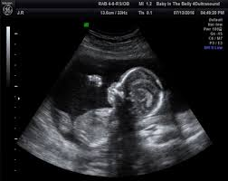









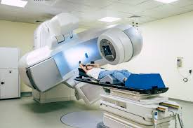
Life line…

Slide 7
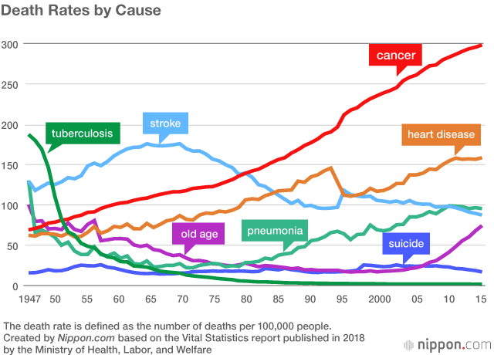

Slide 8
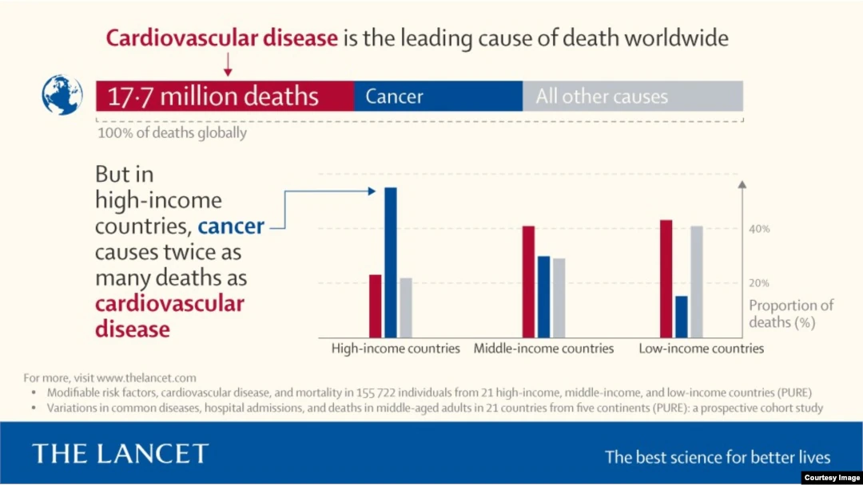
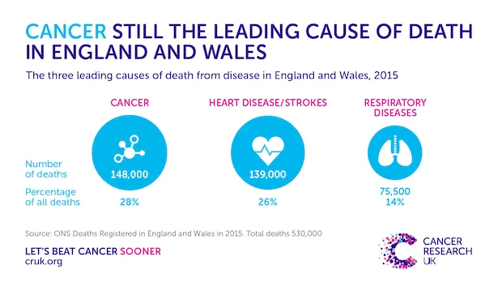
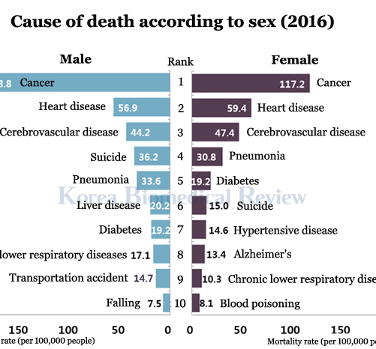
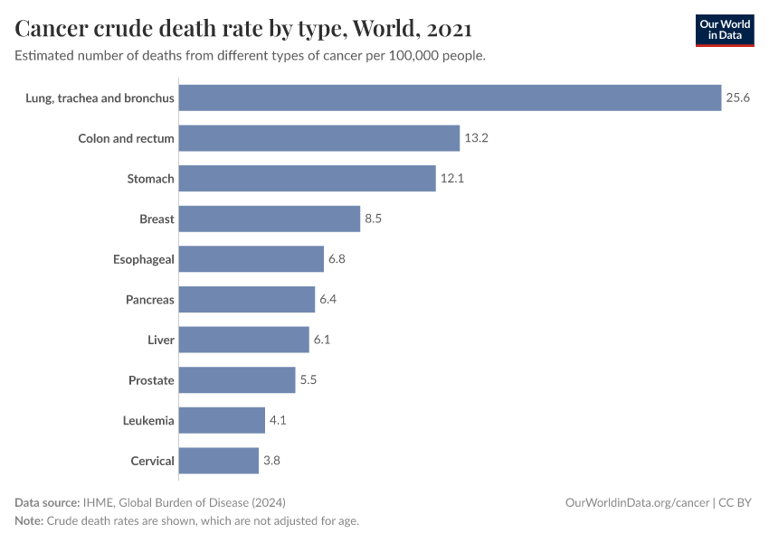

Slide 9
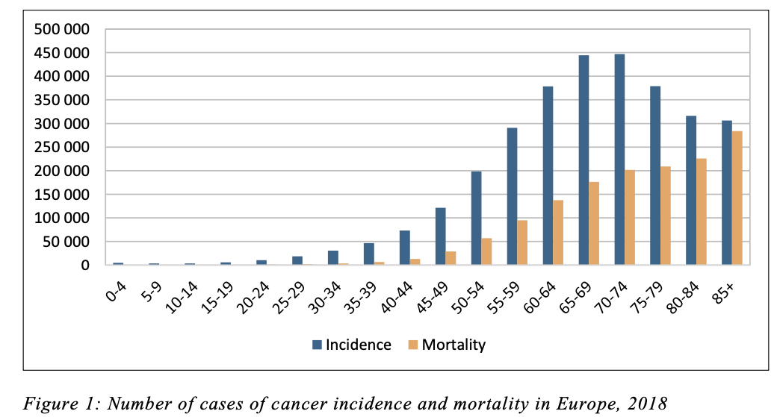
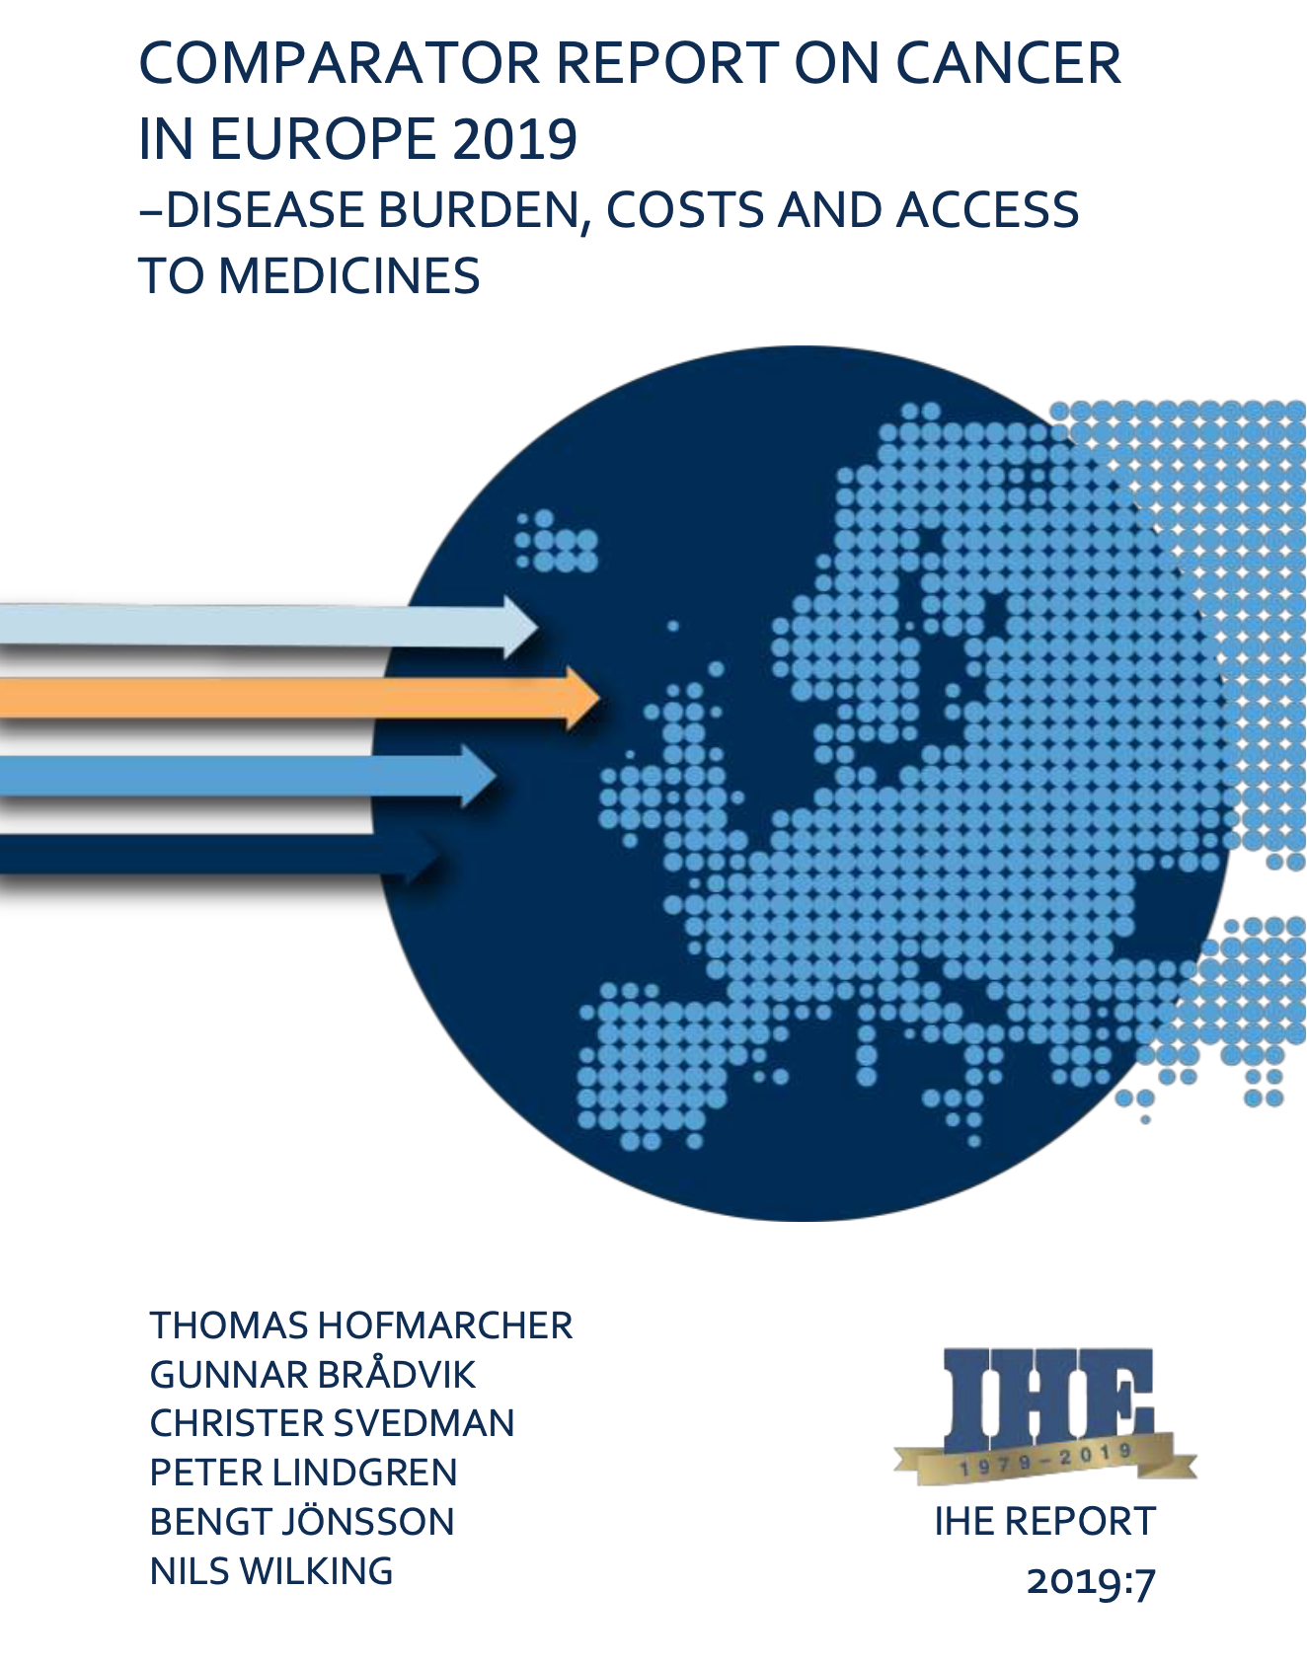
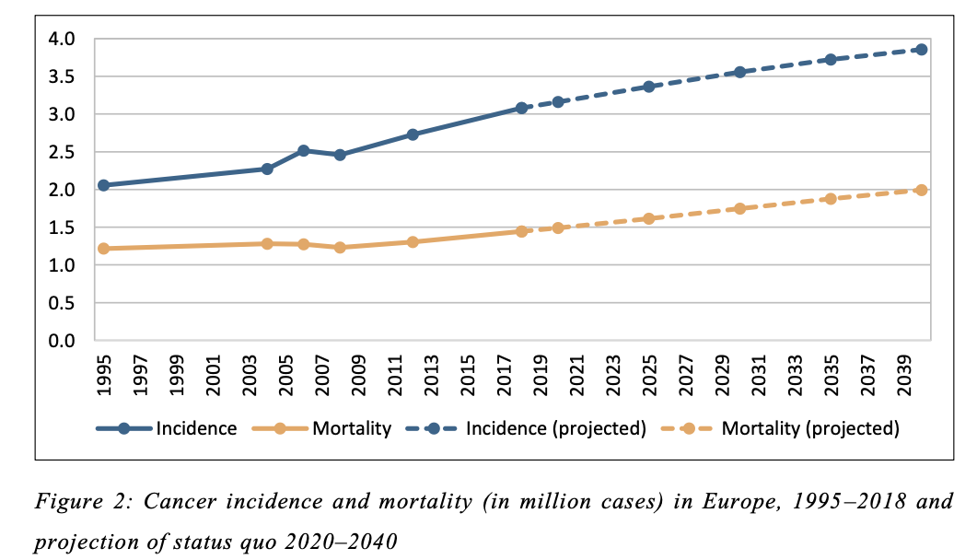

Slide 10
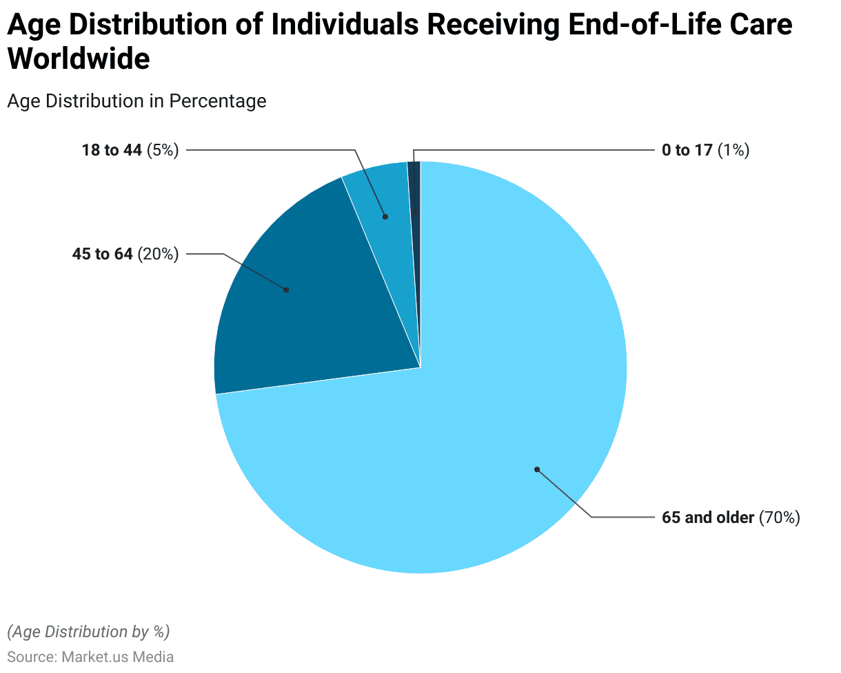
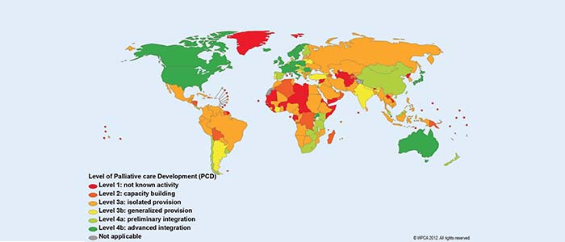

Slide 11
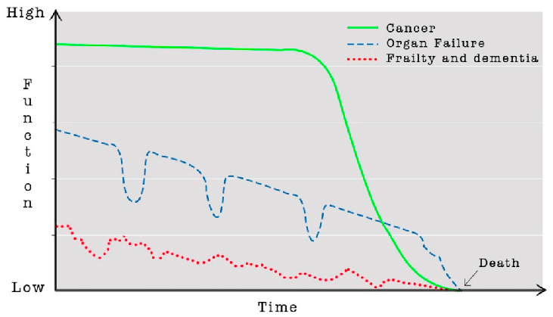
Patients’ life line…

Slide 12
Patients’ life line…
End of life

Slide 13

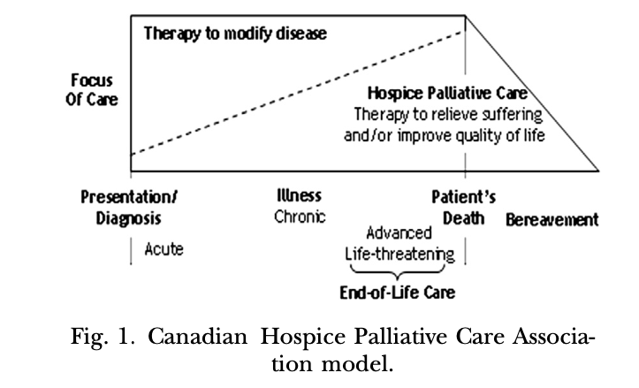


Model of 20th centruty
palliative care
Therapy to
modify disease
Focus of care
Palliative care
Patient s death

Slide 14

The bow tie..

Slide 15
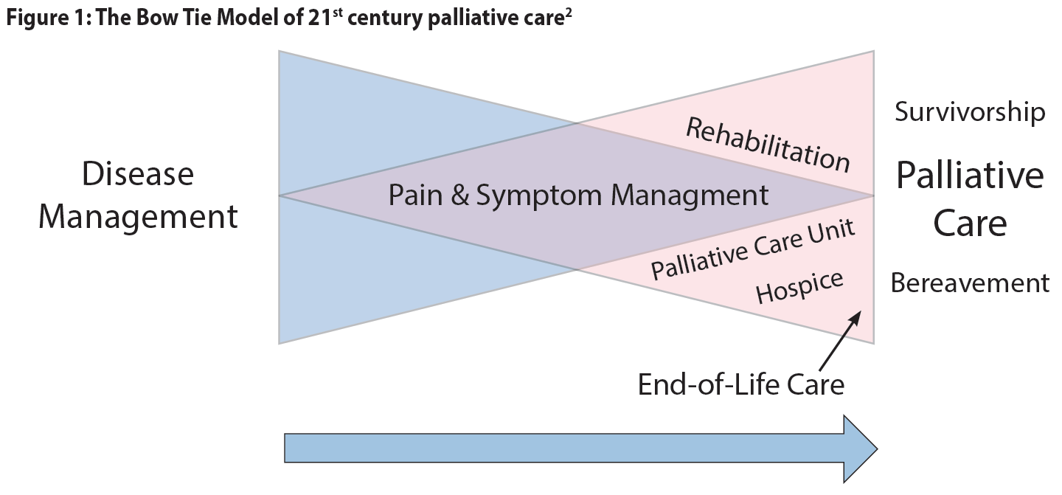

Slide 16
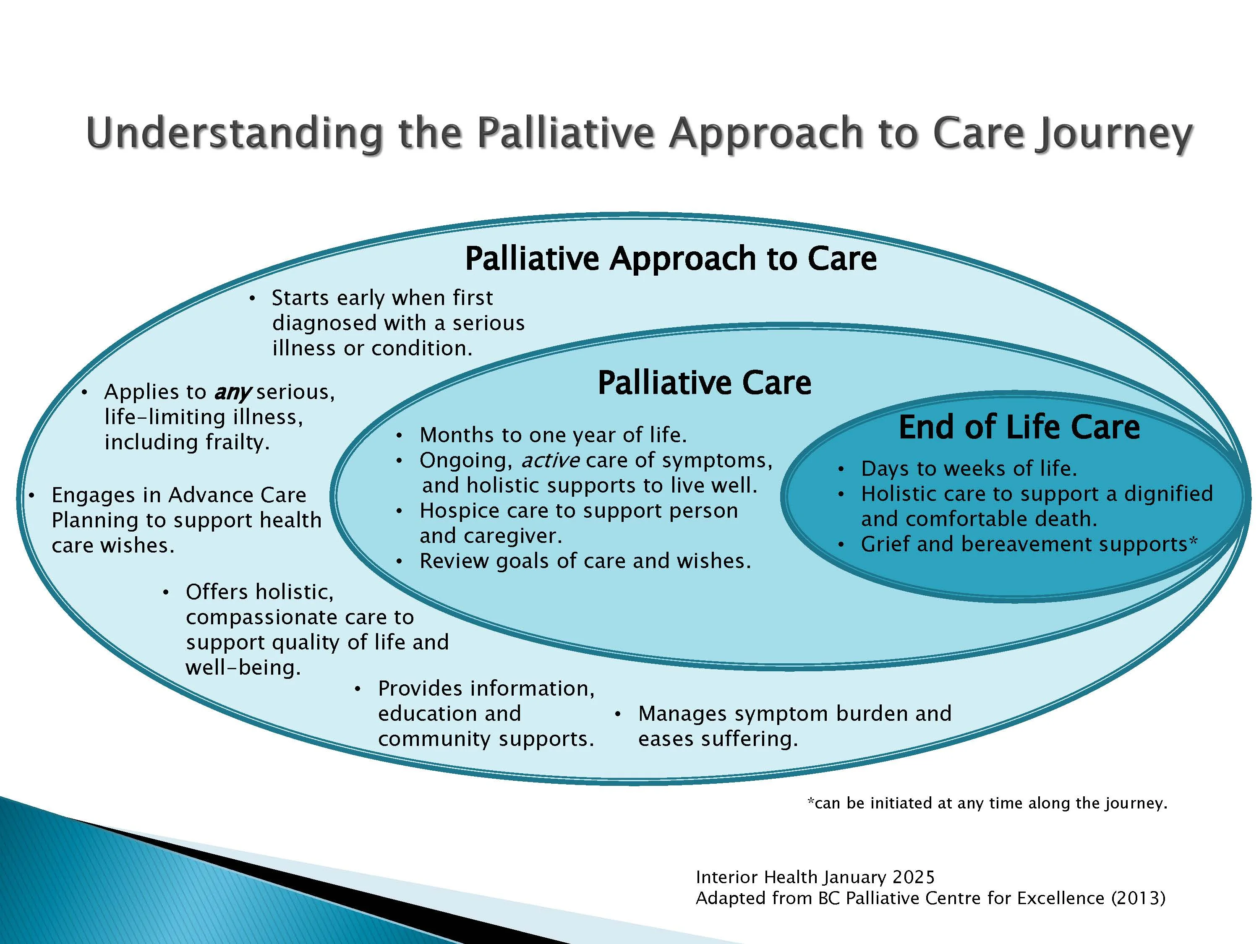

Slide 17

Best Pain Management

Slide 18
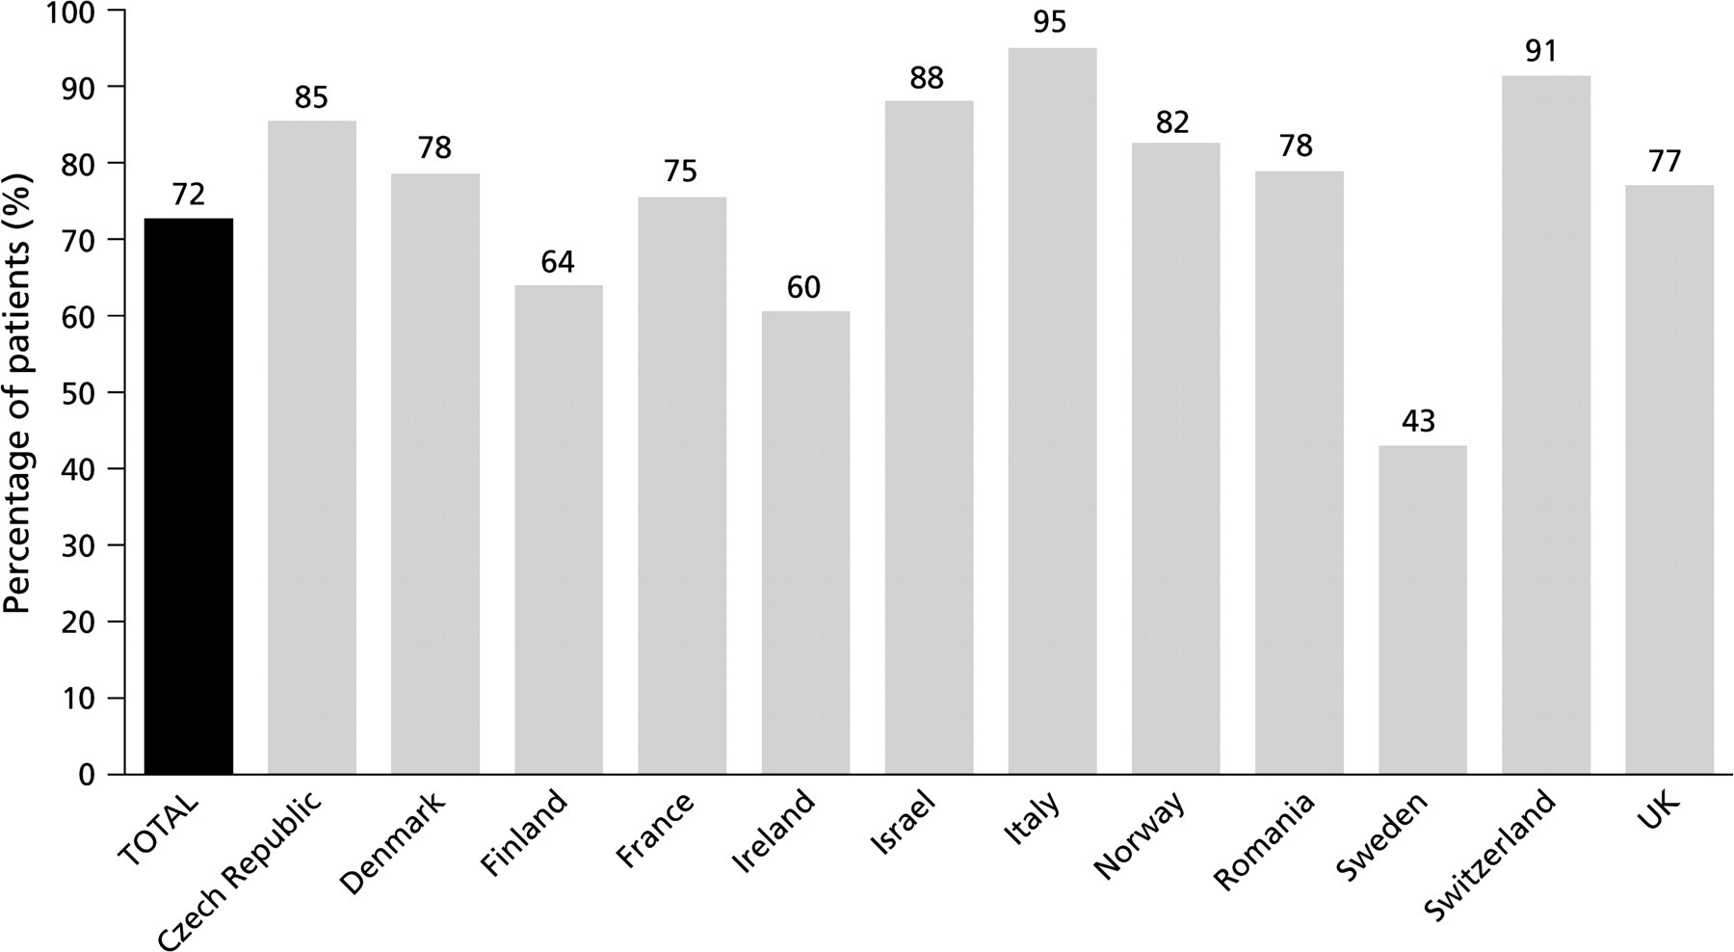

Percentage of patients reporting pain per country during the screening phase.
Breivik H et al. Ann Oncol 2009;20:1420-1433
© The Author 2009. Published by Oxford University Press on behalf of the European Society for Medical Oncology. All rights reserved. For permissions, please email: journals.permissions@oxfordjournals.org
Notes:
Percentage of patients reporting pain per country during the screening phase.

Slide 19
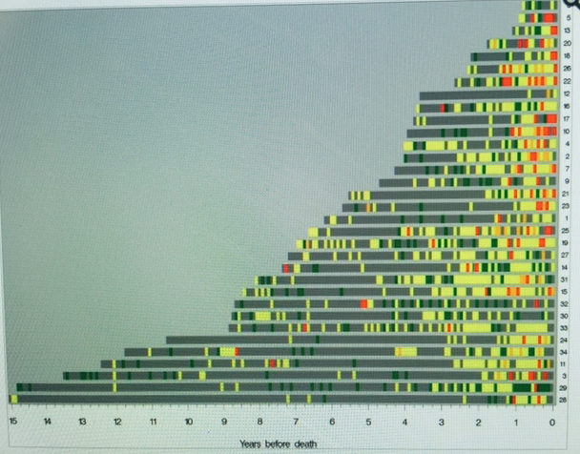
Years of pain before death
Study subject pain ribbons ‘algograph’ display. Maximum pain reported by each subject from prostate cancer diagnosis until time of death from prostate cancer.
Pain data are reported for each month.
Grey, no report; green, no pain; yellow, pain; orange, controlled pain; red, severe pain.
J Am Med Inform Assoc. 2013 Sep; 20(5): 898–905.Published online 2012 Nov 9. doi: 10.1136/amiajnl-2012-001076

Slide 20
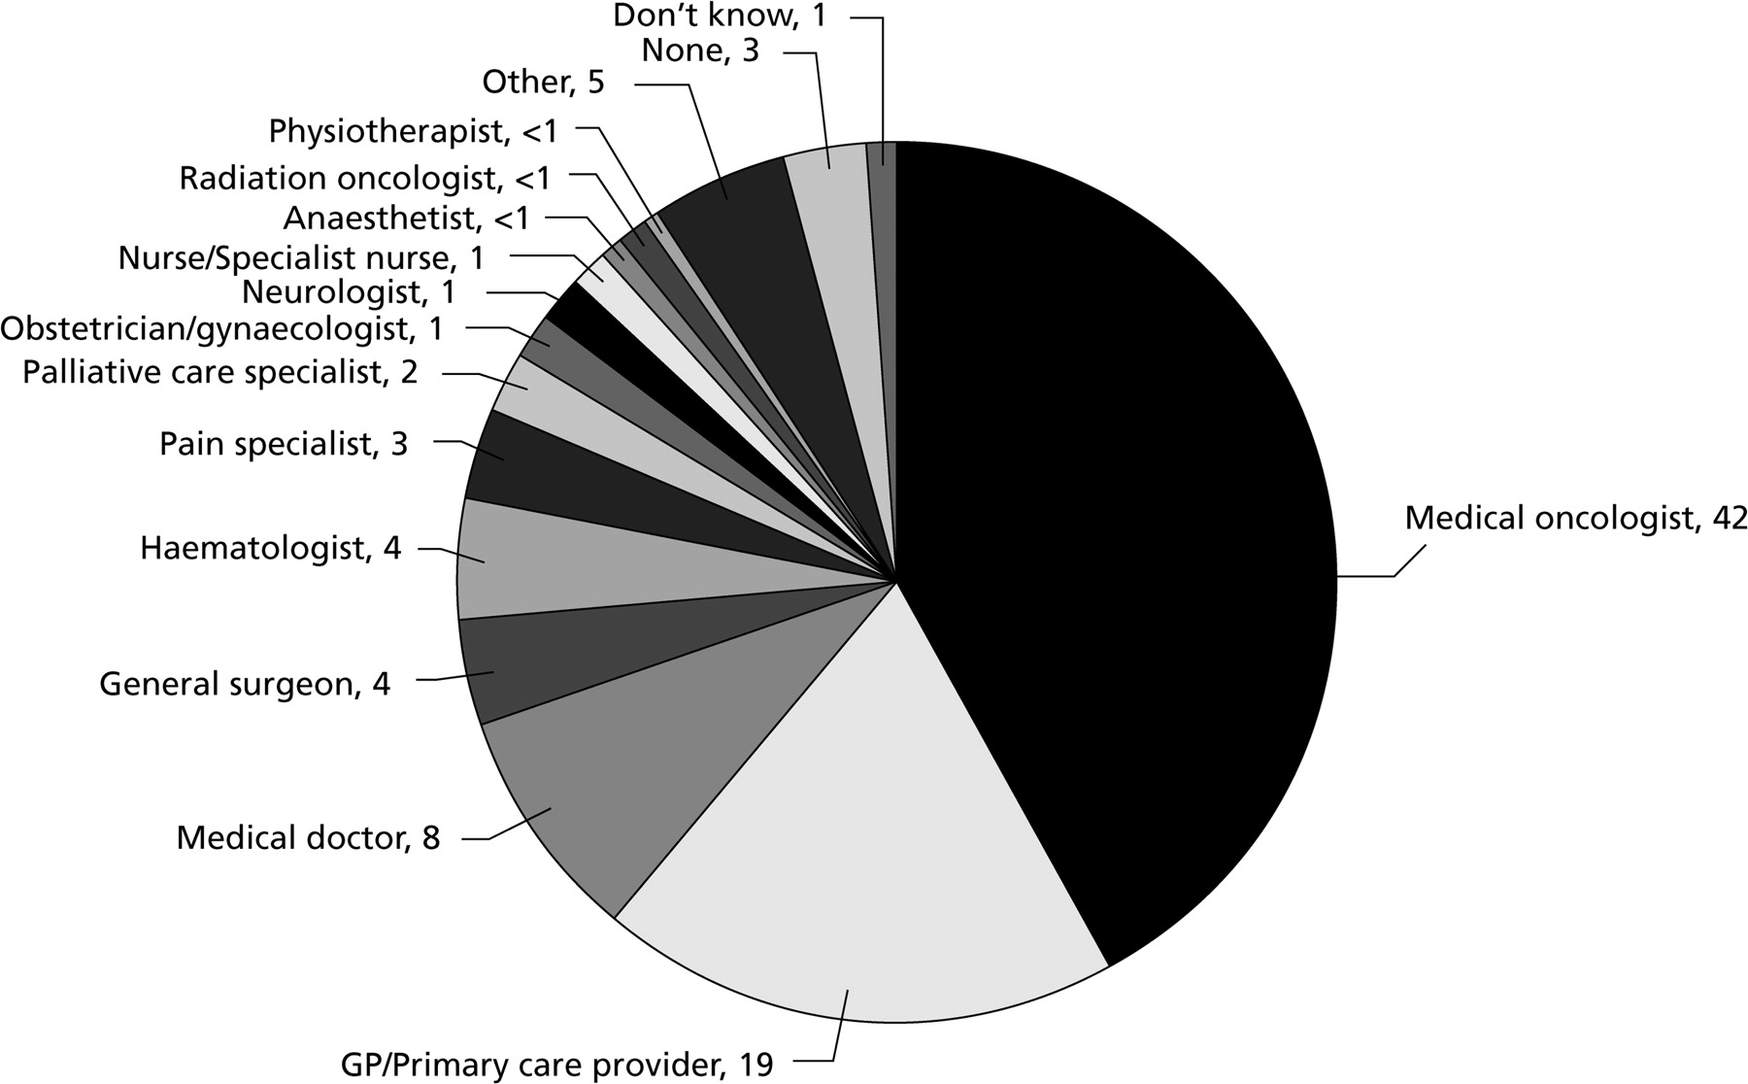
Health care professional responsible for treating or managing patient pain.
Breivik H et al. Ann Oncol 2009;20:1420-1433
© The Author 2009. Published by Oxford University Press on behalf of the European Society for Medical Oncology. All rights reserved. For permissions, please email: journals.permissions@oxfordjournals.org
Notes:
Health care professional responsible for treating or managing patient pain.

Slide 21
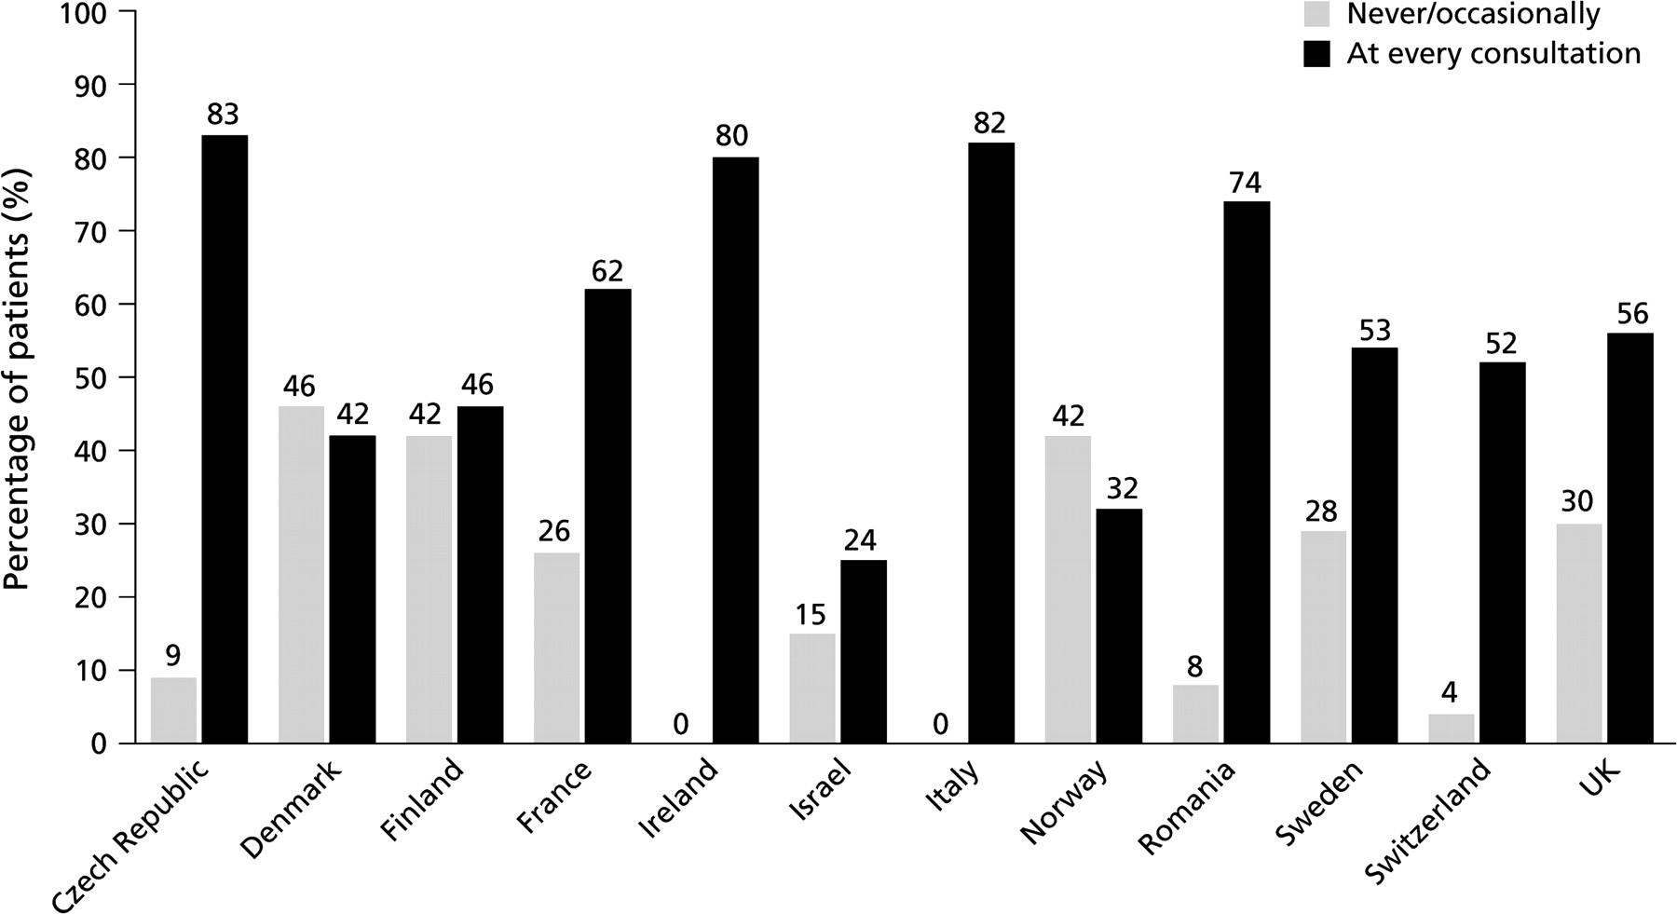
Country comparison of patients who report that their health care professional asked them about their pain.
Breivik H et al. Ann Oncol 2009;20:1420-1433
© The Author 2009. Published by Oxford University Press on behalf of the European Society for Medical Oncology. All rights reserved. For permissions, please email: journals.permissions@oxfordjournals.org
Notes:
Country comparison of patients who report that their health care professional asked them about their pain.

Slide 22
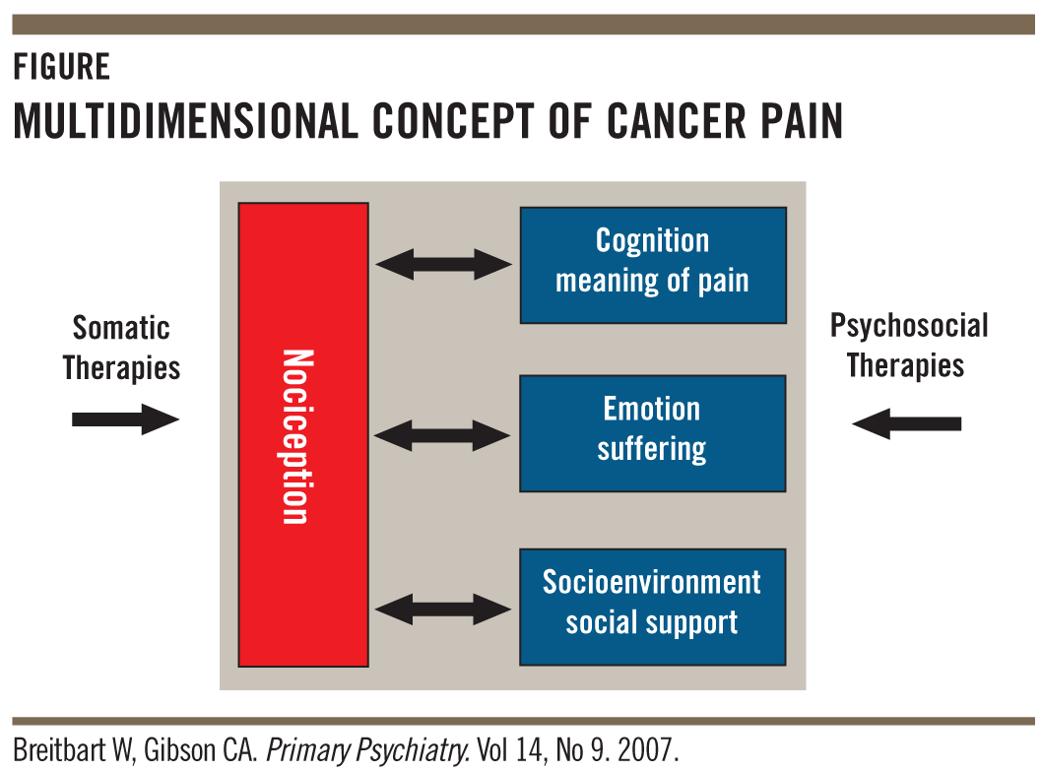

Cancer Pain
Tissue lesion
Tumor
Post surgery
Post Chemo
Post Radio
Bone metastasis
Ascites and other complications
Somatic
Neuropathic
Mixed

Slide 23
NCCN guidelines applied in Greece
Step 4
Step 4
Interventional therapy
Neurolysis
Epidural analgesia
Morphine pump
Step 3
Step 3
Strong opioids
Fentanyl long acting patch
Fentanyl short acting
Morphine patch
Methadone
Oxycodone (40mg/day)
Step 2
Step 2
Weak opioids
Tramadol (400mg/day)
Tapentadol (650mg/day)
Codeine (60mg/day)
Step 1
Step 1
Non opioids
NSAIDs
Paracetamol (4gr/day)
Arcoxia (120mg/day)
BUPRENORPHINE
PALEXIA
DEBALGOS
Adjuvant drugs
Pregabalin (Lyrica 600mg), Gabapentin (Neurontin 3600mg), Amitriptyline (Stelminal 100mg), Duloxetine (Cymbalta 120mg) Biphosphonates, DXM (16mg/day), RT, Antispasmodics

Slide 24
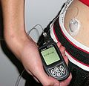
Morphine – Gold standard
s/c
p.o
60-300mg /day
Intrathecal
CANCER J CLIN 2011;61:157-182
As much the patient needs

Slide 25
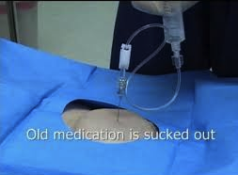
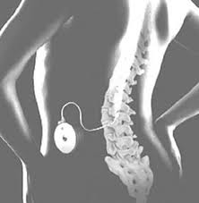
Intrathecal morphine for cancer pain
Intrathecal pump
Intrathecal port
Patent selection and outcome using a low dose intrathecal opioid trialing method for chronic pain. Pain Physician 2011; 14:343-351 • ISSN 1533-3159

Slide 26

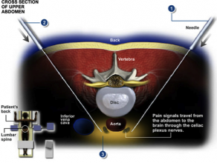
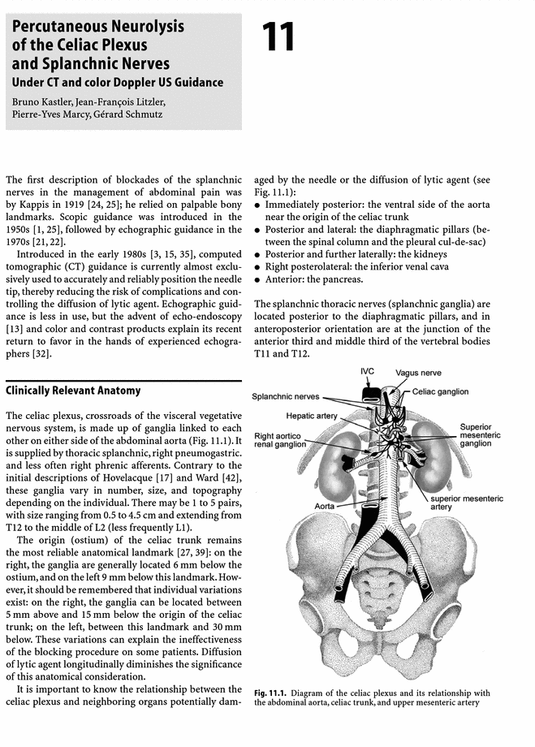
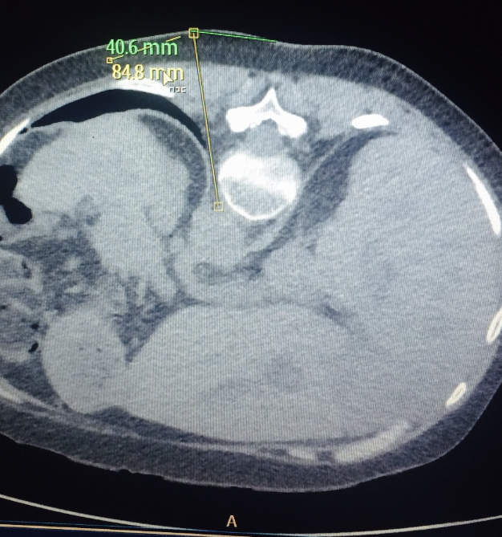
Cancer Pain - Neurolysis

Slide 27
Medical cannabis
Neuropathic pain – cancer pain
Canada
Ann Palliat Med. 2017 Aug 31. pii: apm.2017.08.04. doi: 10.21037/apm.2017.08.04. [Epub ahead of print]
Modulating the endocannabinoid pathway as treatment for peripheral neuropathic pain: a selected review of preclinical studies.
O’earn S1, Diaz P2, Wan BA2, DeAngelis C2, Lao N3, Malek L2, Chow E2, Blake A3.Author informationMedReleaf, Markham, Ontario, Canada. sohearn@medreleaf.com.Odette Cancer Centre, Sunnybrook Health Sciences Centre, University of Toronto, Toronto, Ontario, Canada.MedReleaf, Markham, Ontario, Canada.

Slide 28
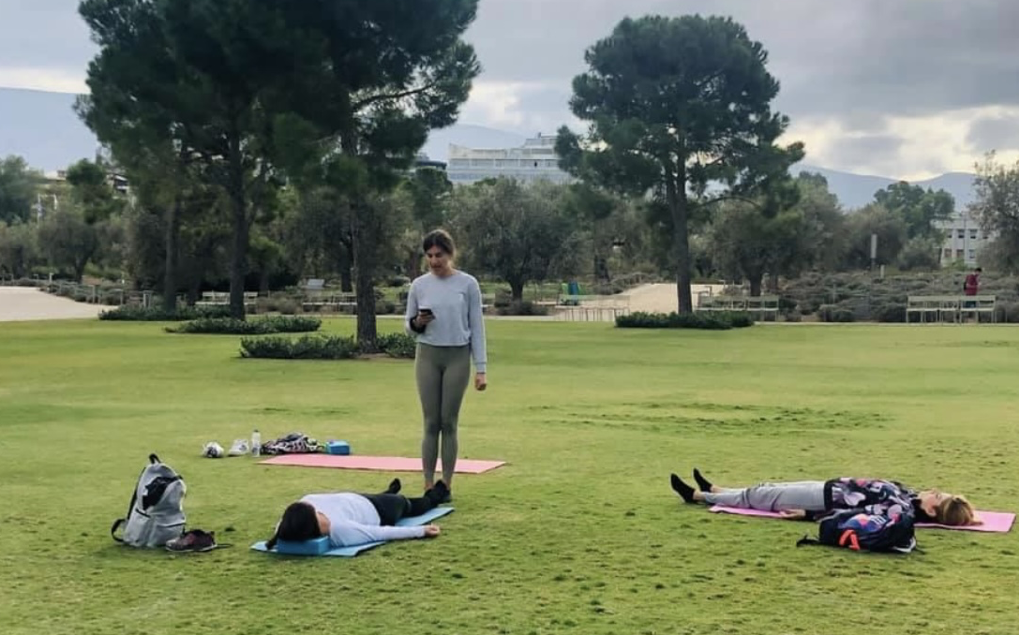
Cancer pain patients yoga – stress reduction

Slide 29
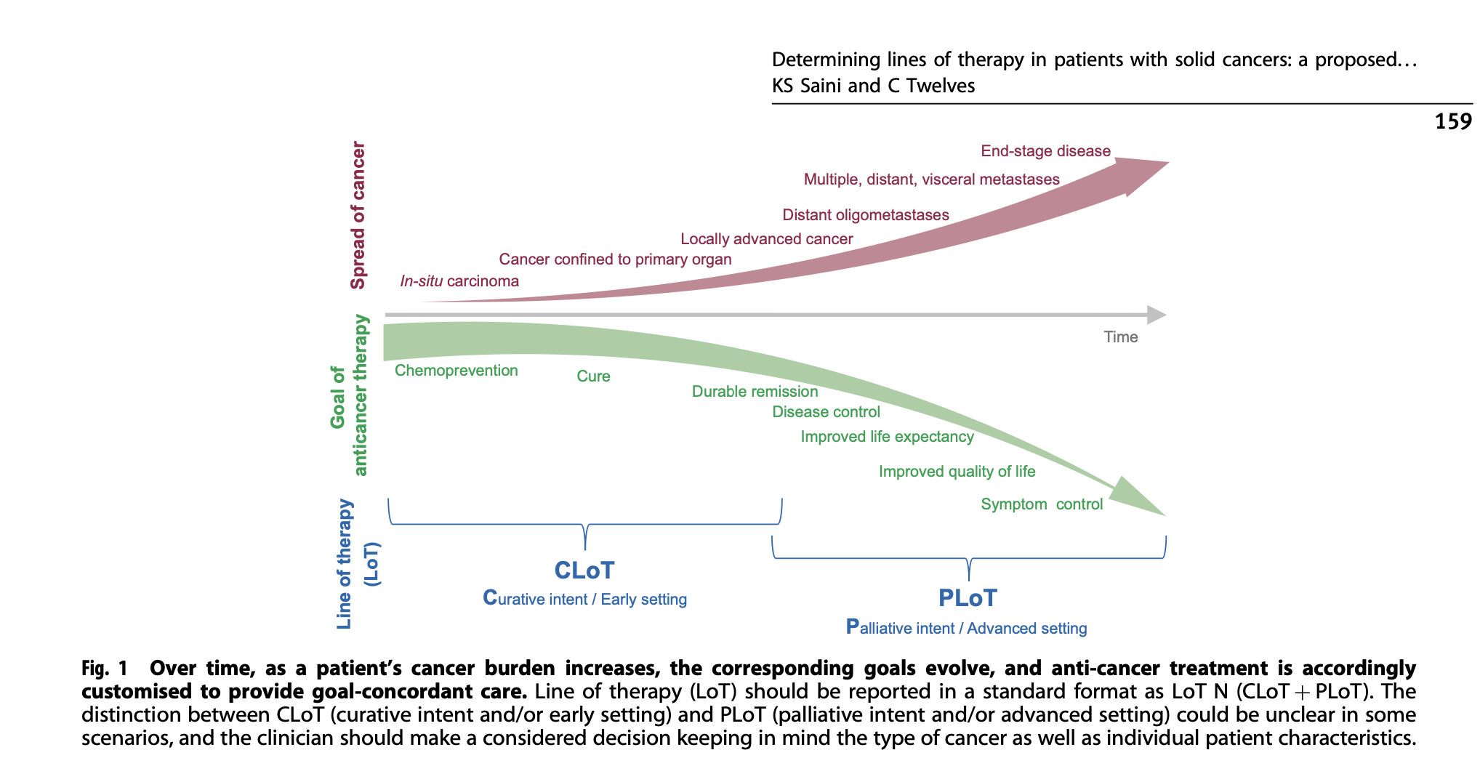
End of life

Slide 30
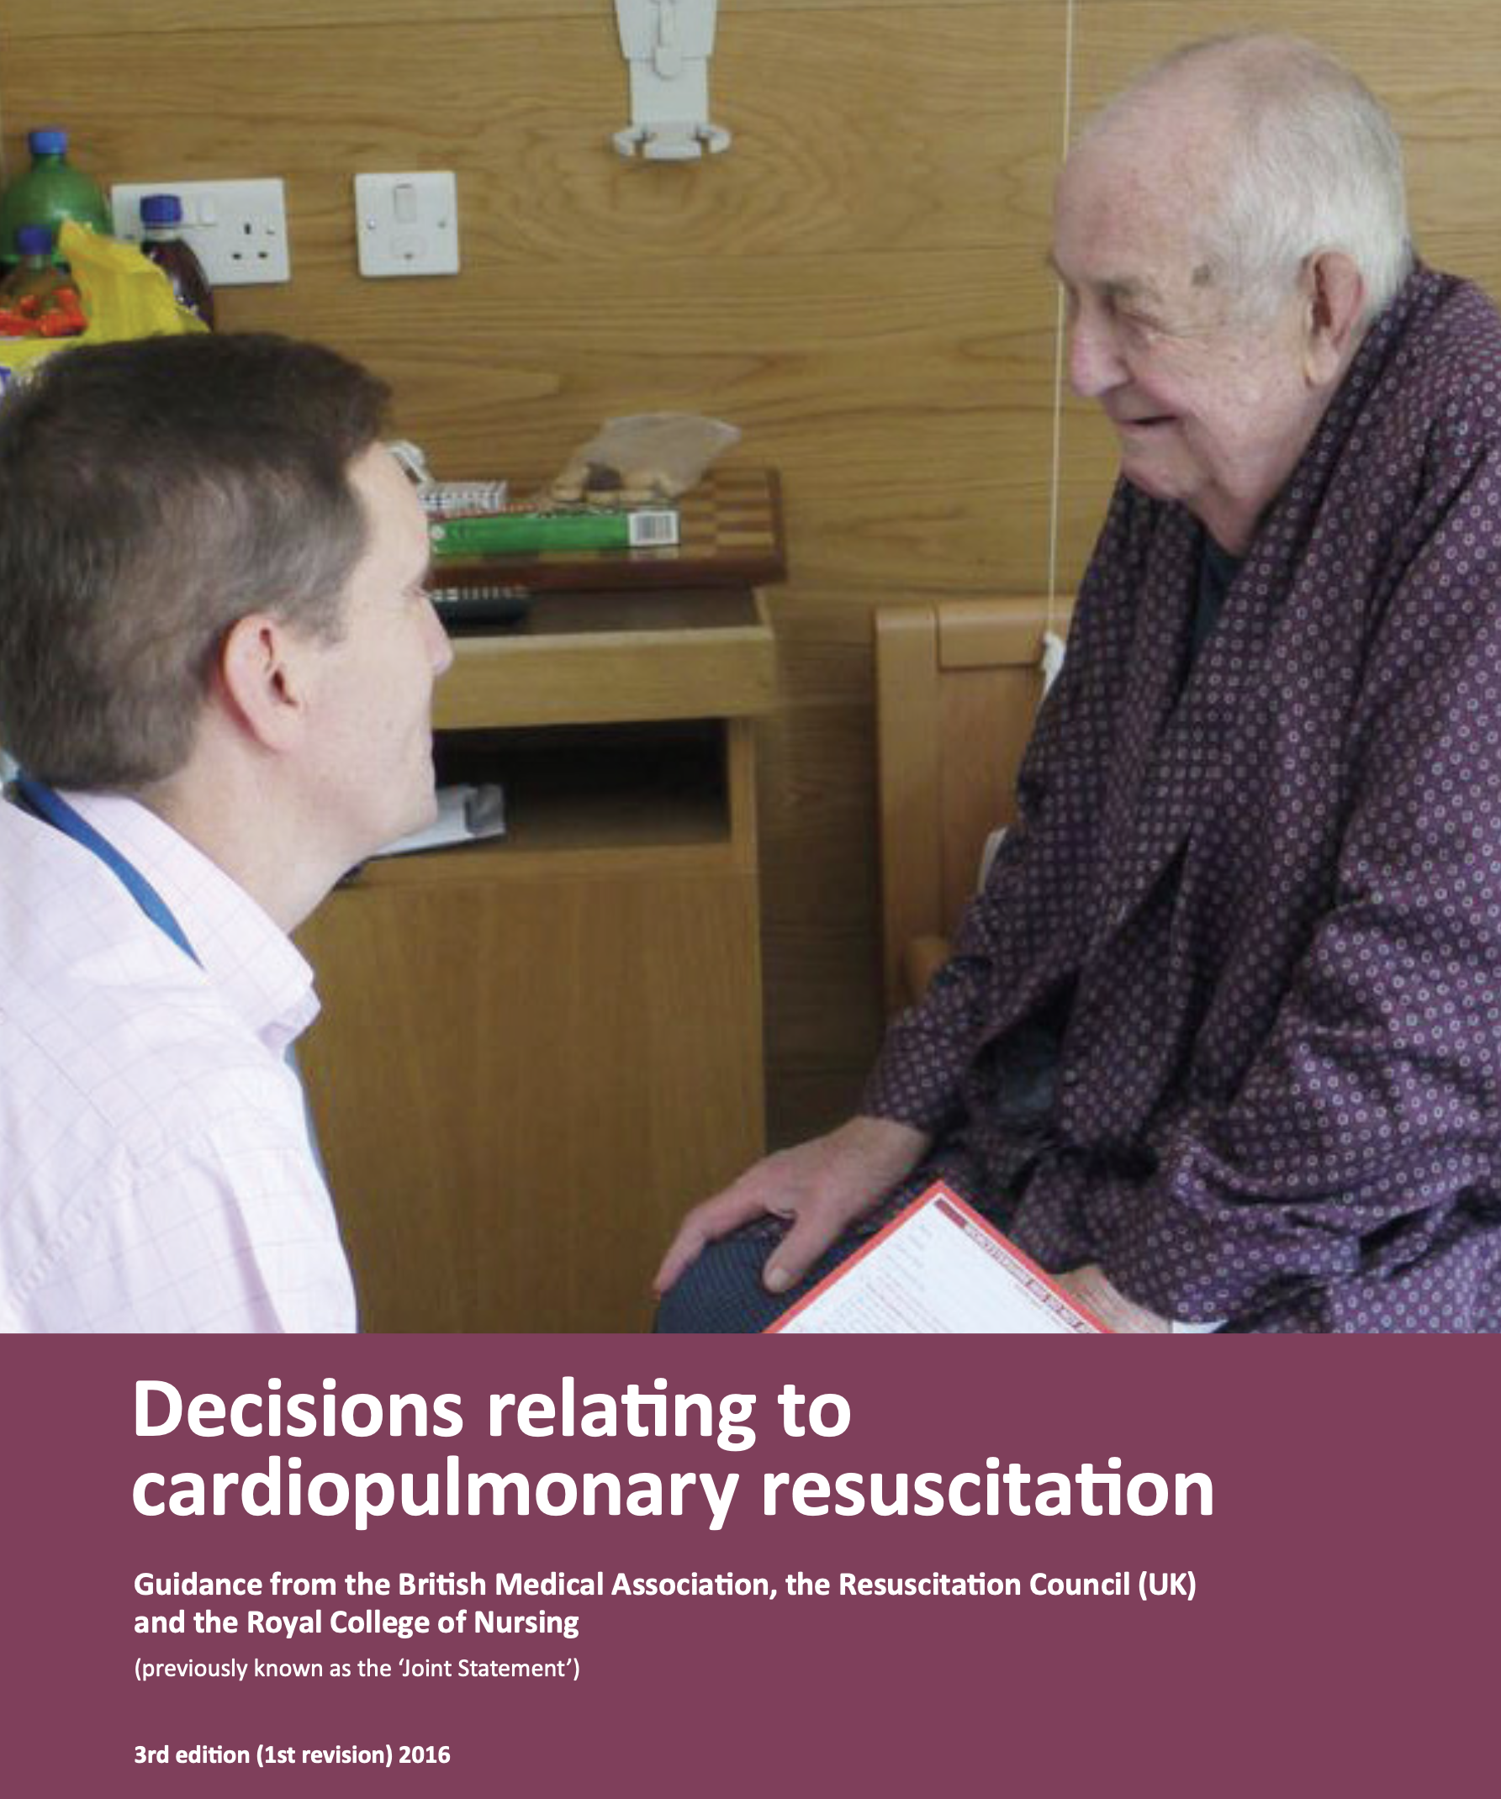
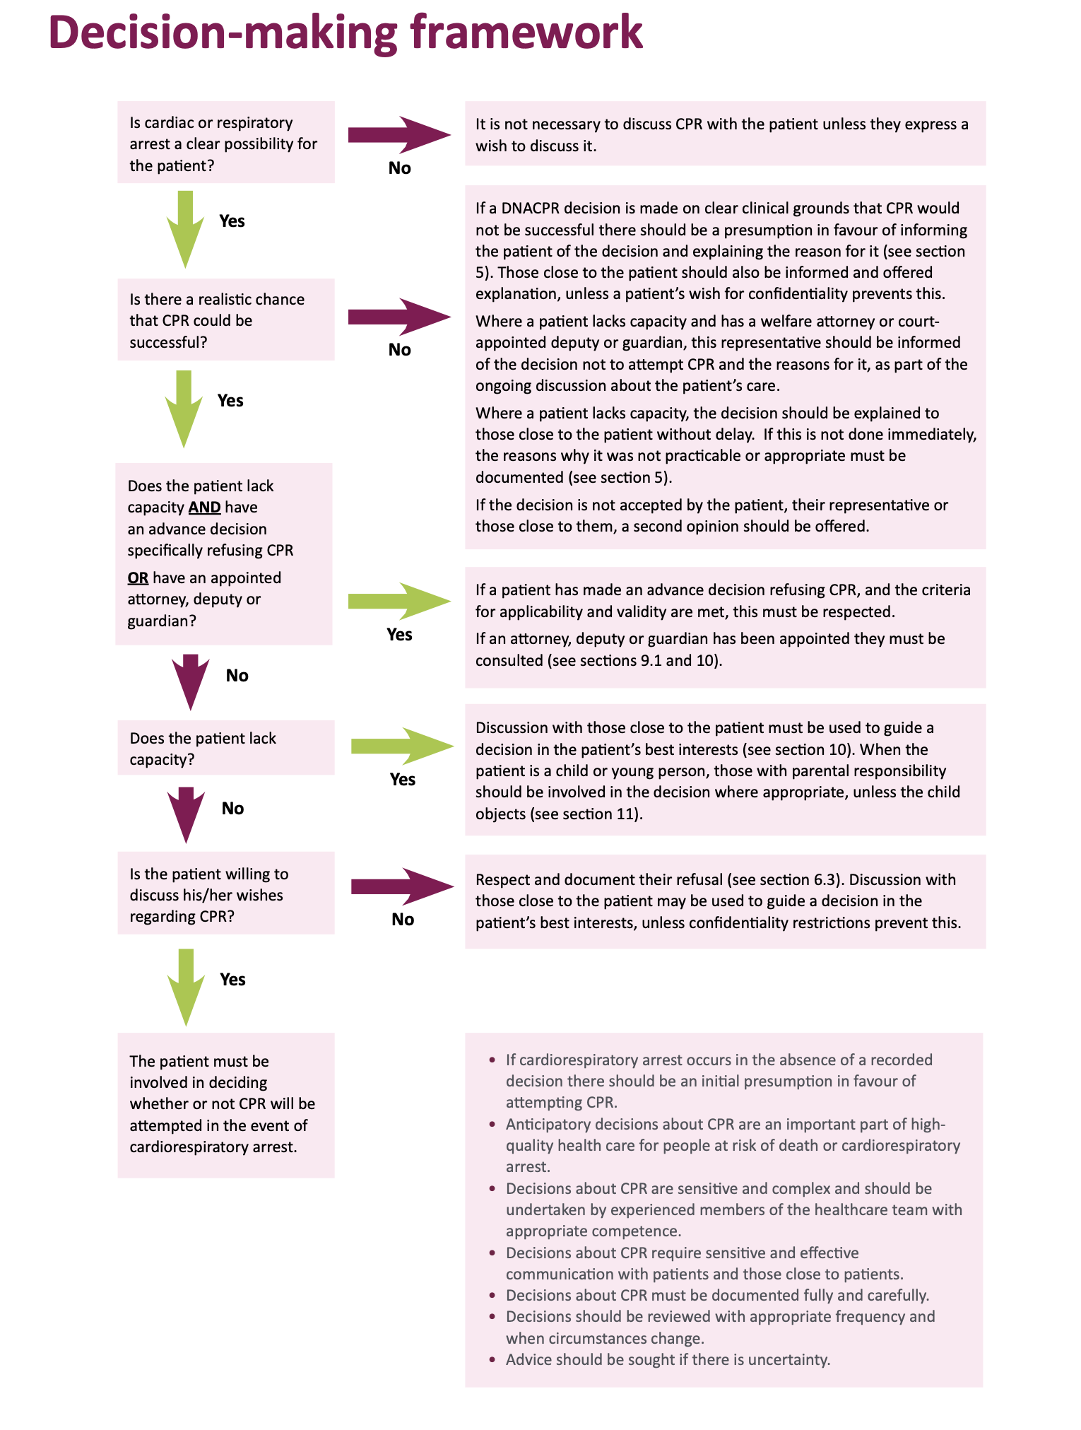

Slide 31
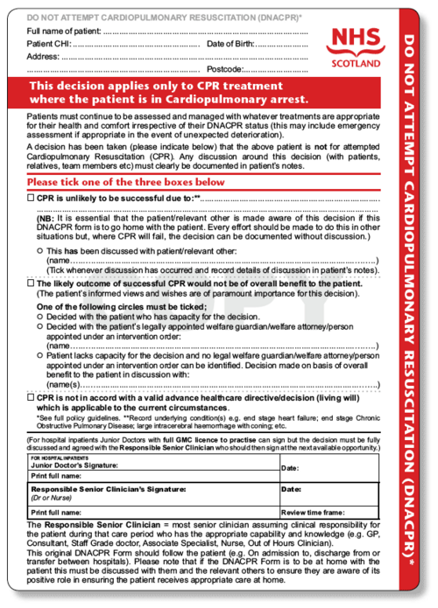
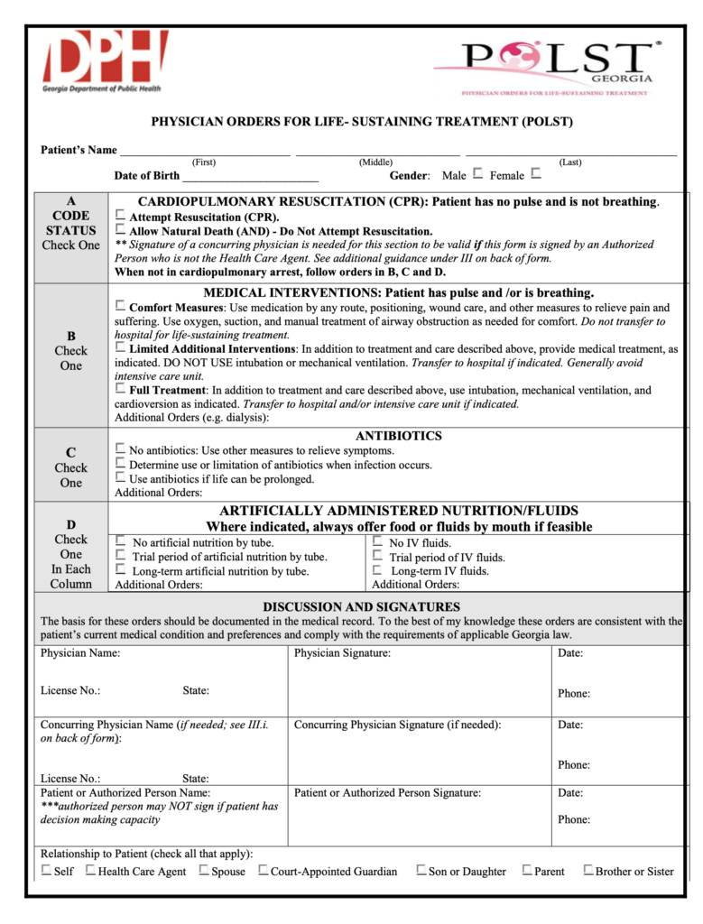
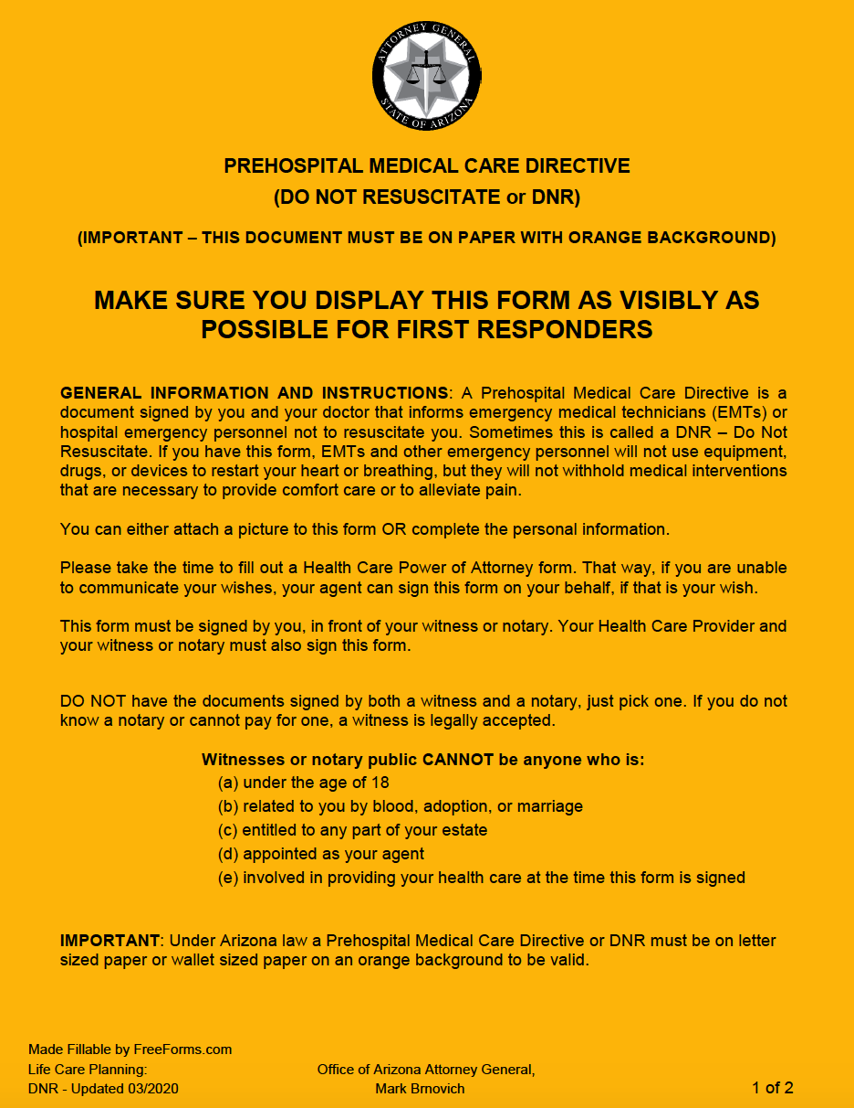
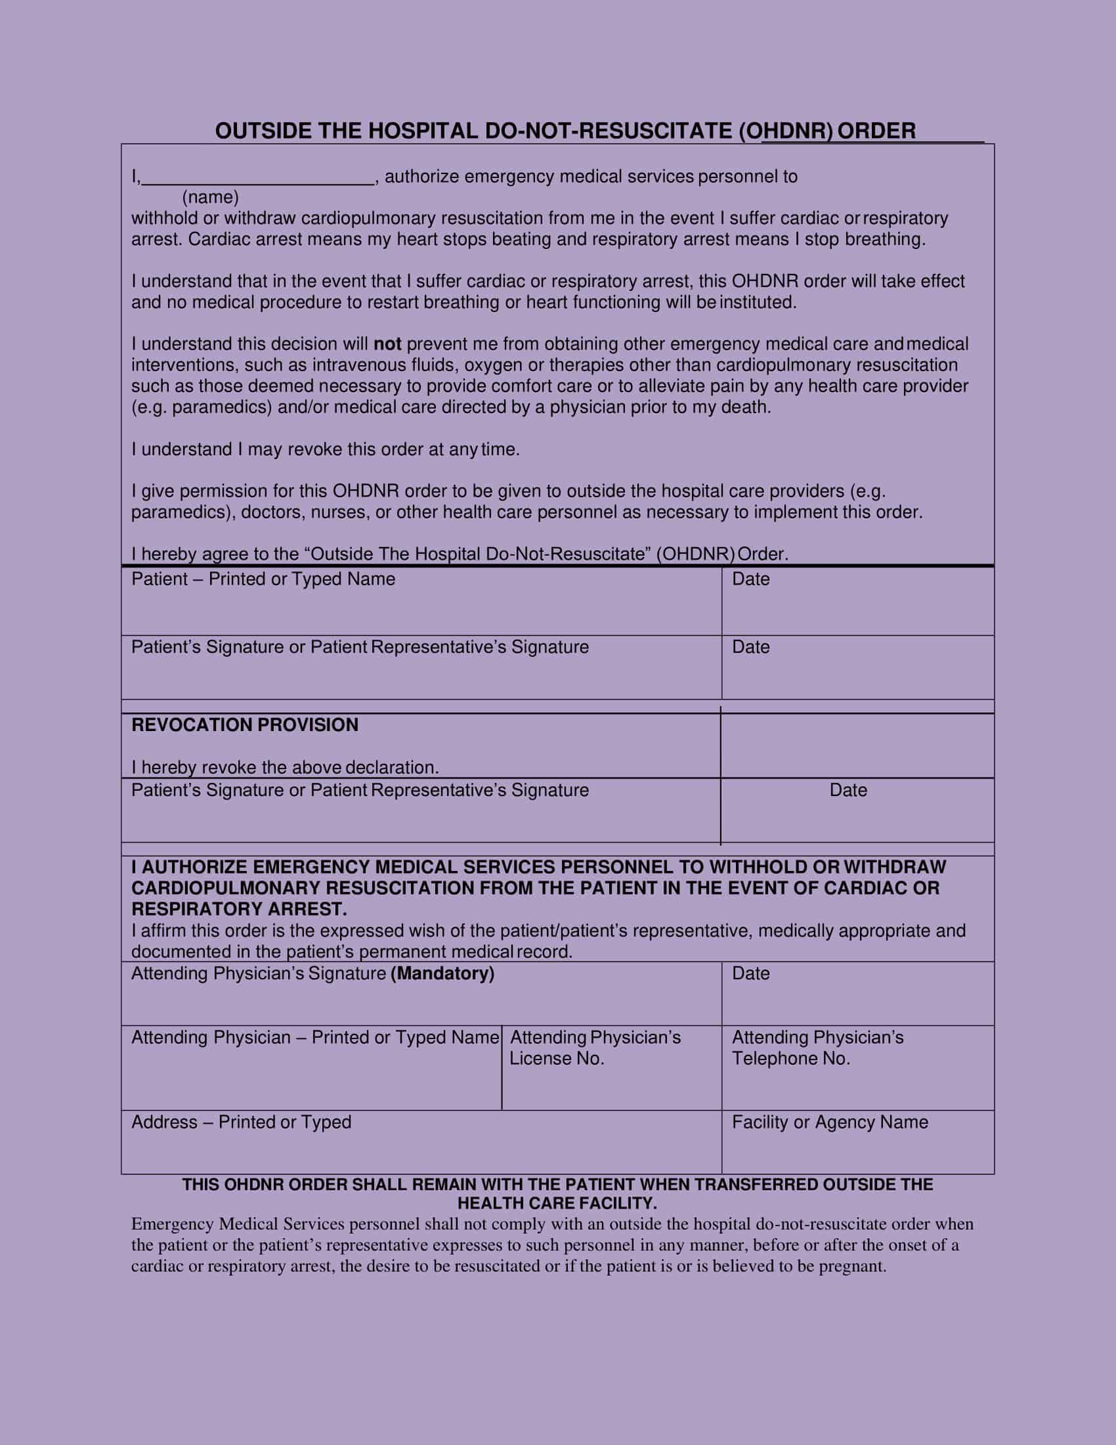
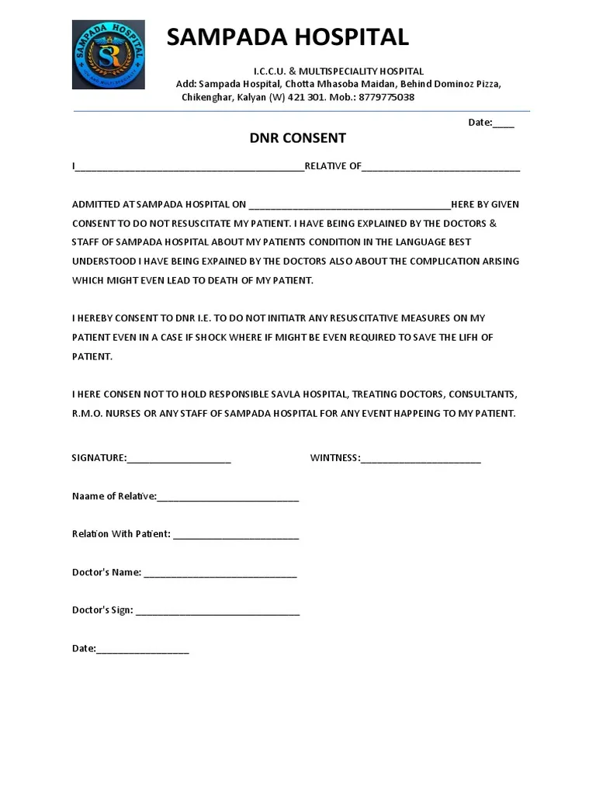
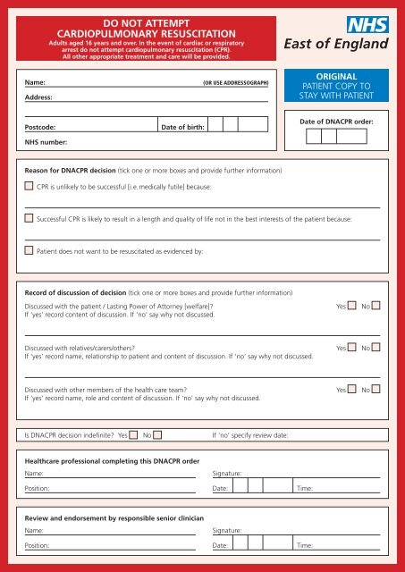
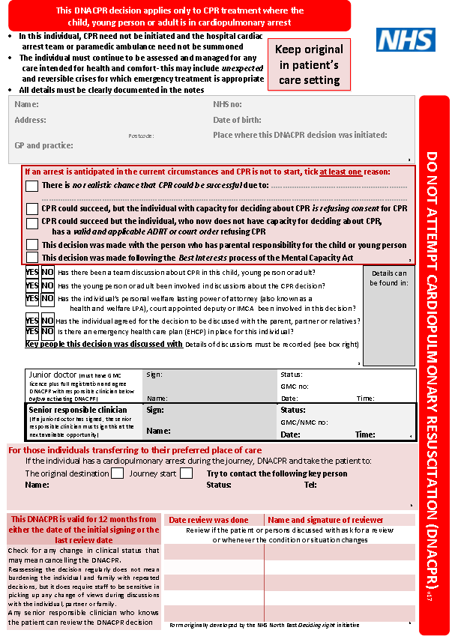
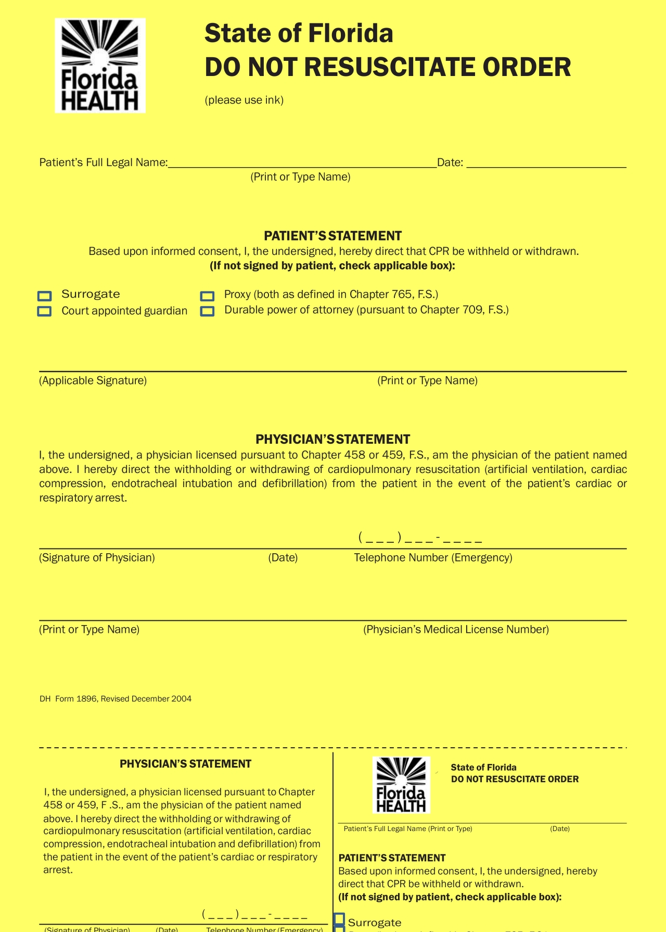
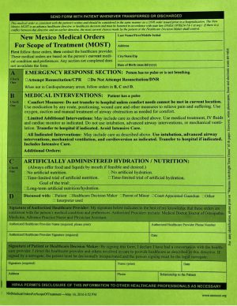
DNR forms

Slide 32
Σημεία και συμπτώματα στο τελικό στάδιο
Πόνου (~ 70 - 90%)
Αδυναμίας / καχεξίας (~ 61 - 70%)
Ξηροστομίας (~ 57%)
Ταχυκαρδιας (- 56%)
Δύσπνοιας (~ 50%)
Αϋπνίας (~ 49%)
Δυσκαταποσίας - ενυδάτωση
Δυσκοιλιότητας (~ 52%)
Κατακλίσεων
Κατάθλιψης (~ 41%)
Άγχους (~ 24 - 30%)
Συγχυτικών συνδρόμων (26 - 44%)
Φόβου απόρριψης & εγκατάλειψης
Φόβου επικείμενου θανάτου
Αυτοκτονικού ιδεασμού (~ 1.5 > υγιείς )

Slide 33

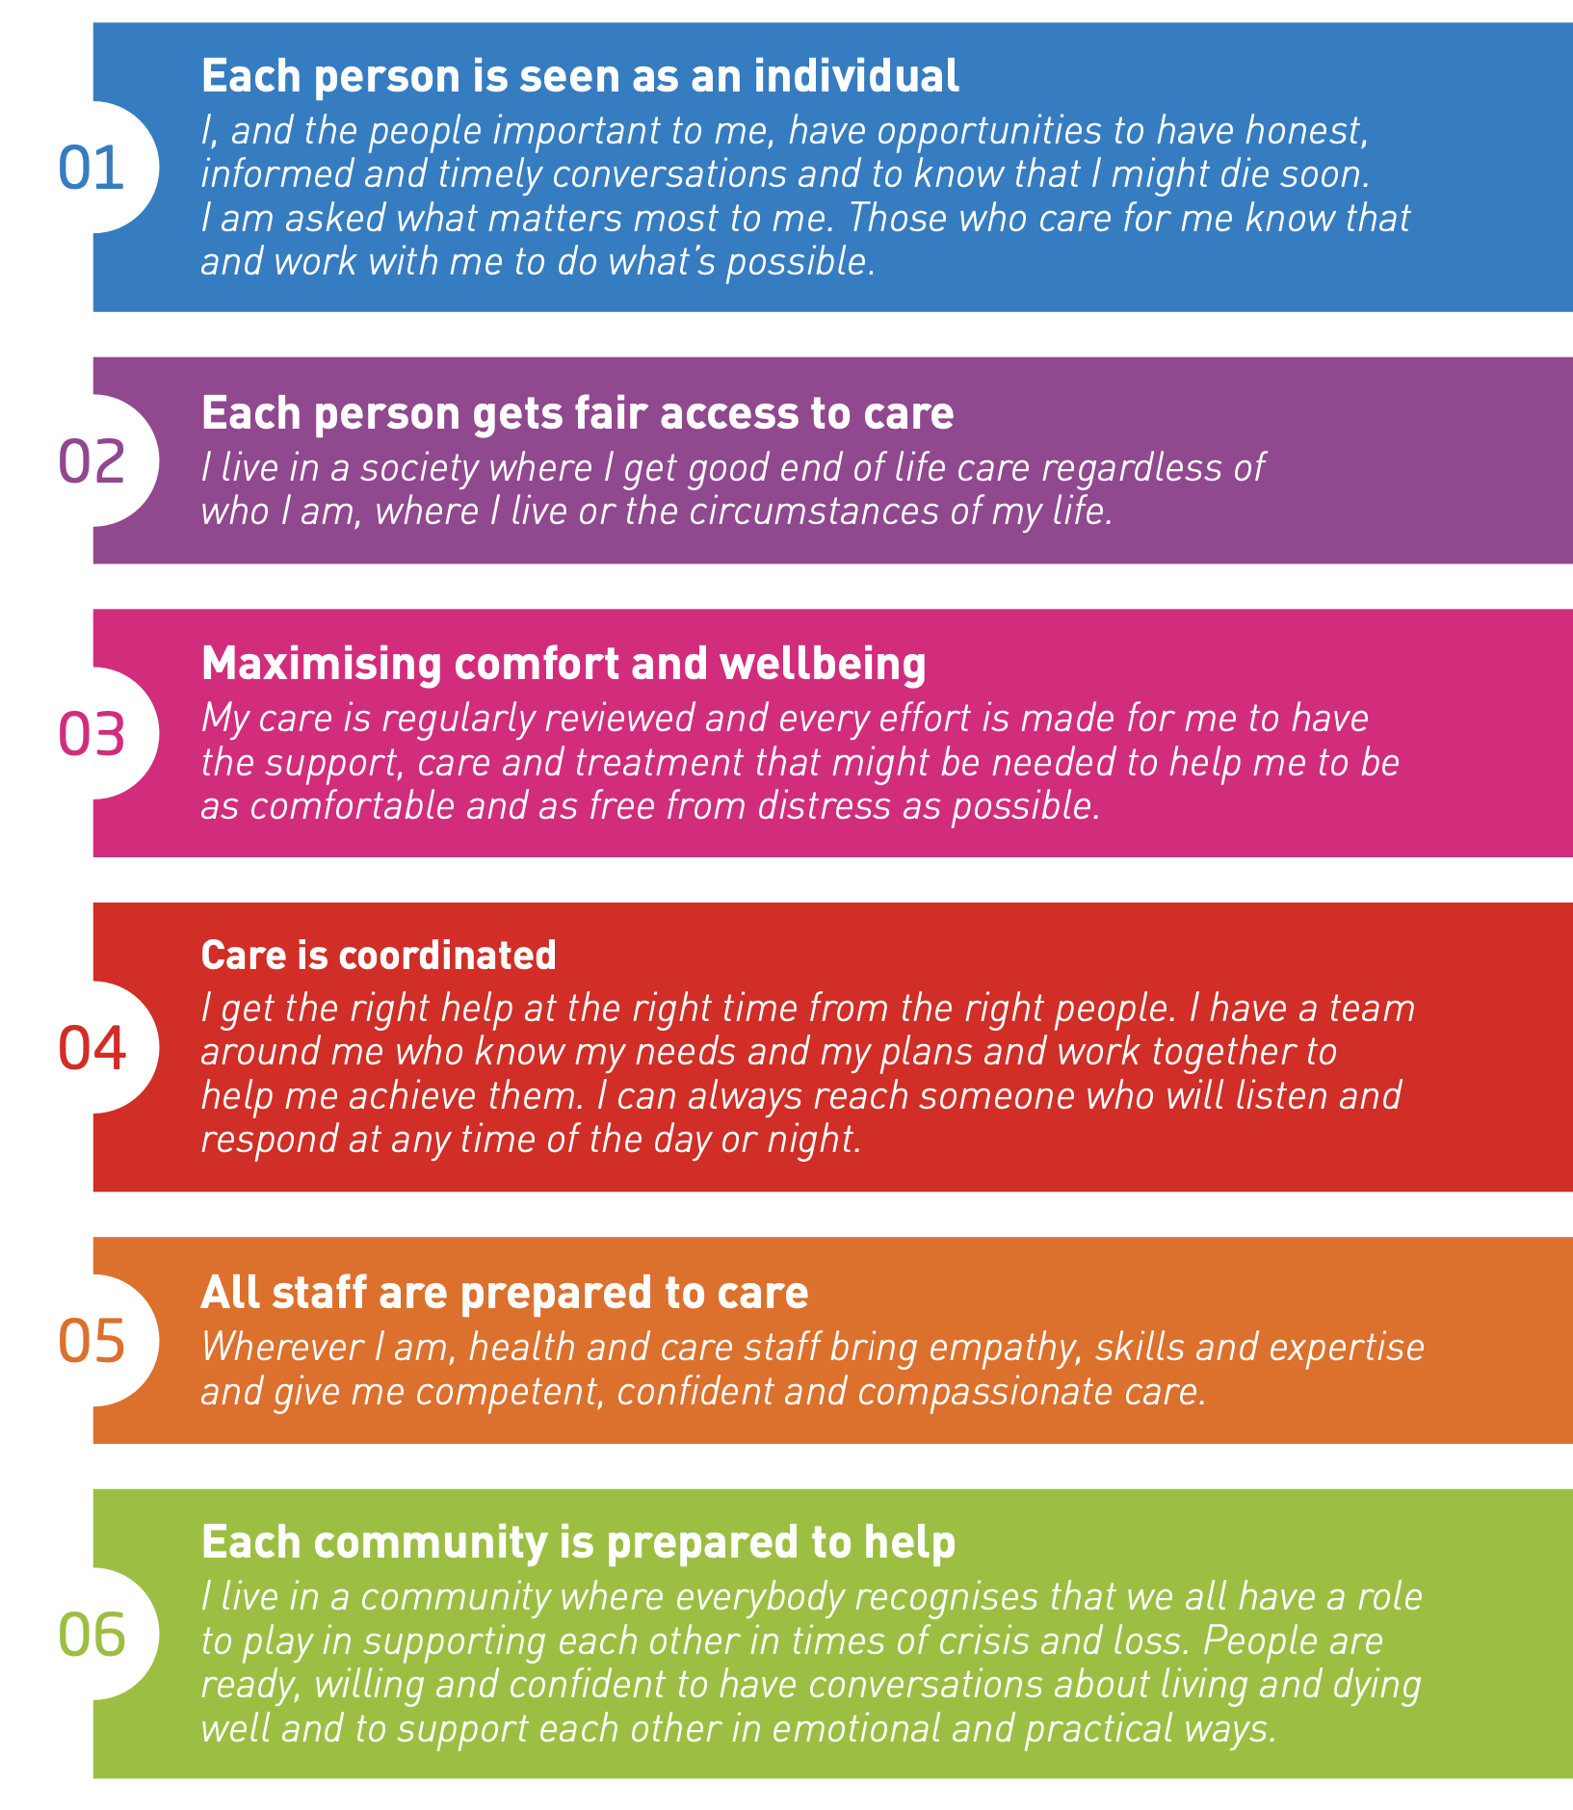

Slide 34


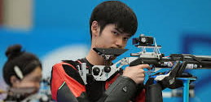


Slide 35



Slide 36

Results
Of 141 unique patients in the full sample, 54 (38.3%) were women and 123 (87.2%) were White
Of 39 unique oncologists, 8 (19.5%) were women, and 34 (82.9%) were White. The mean (SD) age for both patients and oncologists was 56.3 (10.0) years
(5%) included discussions of ACP, palliative care, treatment discontinuation, hospice care, or after-death wishes
(33%) of oncologists with at least 1 EOL discussion
(64%) included missed opportunities
23 oncologists had either a missed opportunity or actual EOL discussion; only 4 of 23 (17.4%) had both.

Slide 37
Message to take home as clinicians…

Slide 38



Palliative Care
Gained time is our success.
Death of our patient is NOT a failure.
NOT respecting patient’s dignity IS a failure

Slide 39
Message to take home as my friends…

Slide 40
Make your life line if not long..
Then as full as posible !!!!!…

