Slide 1
Επιδημιολογία συμπαγών όγκων
Εμμανουήλ Παναγιώτου, MD, MSc
Ειδικευόμενος Παθολογικής Ογκολογίας
Γ’ Παθολογική Κλινική και Ομώνυμο Εργαστήριο Ιατρικής Σχολής ΕΚΠΑ
ΓΝΝΘΑ «Η Σωτηρία»
empanagi@med.uoa.gr

Slide 2

Epidemiology — Defined
Study of the distribution and determinants of health-related states among specified populations and the application of that study to the control of health problems
Adapted from: Last JM, ed. A dictionary of epidemiology. 2nd ed. Toronto, Canada: Oxford University Press; 1988.
Notes:
SAY:
Epidemiology is defined as the “study of the distribution and determinants of health‑related states among specified populations and the application of that study to the control of health problems.”
GO to next slide.

Slide 3
Epidemiology Purposes
in Public Health Practice
Discover the agent, host, and environmental factors that affect health
Determine the relative importance of causes of illness, disability, and death
Identify those segments of the population that have the greatest risk from specific causes of ill health
Evaluate the effectiveness of health programs and services in improving population health
Notes:
SAY:
The purpose of epidemiology in public health practice is to
discover the agent, host, and environmental factors that affect health;
determine the relative importance of causes of illness, disability, and death;
identify those segments of the population that have the greatest risk from specific causes of ill health; and
evaluate the effectiveness of health programs and services in improving population health.
GO to next slide.

Slide 4

Solving Health Problems
Step 1 -
Step 1
Step 1 -
Data
collection
Surveillance; determine time, place, and person
Step 2
Step 2
Solving health problems
Assessment
Inference
Step 3
Step 3
Hypothesis
testing
Determine how and why
Step 4
Step 4
Action
Intervention
Action
Notes:
SAY:
To solve health problems, epidemiology practitioners, or epidemiologists, use a four-step scientific approach that includes
data collection,
assessment,
hypothesis testing, and
action.
When using the scientific approach, data are collected, and an initial assessment (or hypothesis) is conducted. The hypothesis is then tested, and the resulting information is used to take action.
<DIRECT participants to the boxes on the far right.>
This portion of solving health problems illustrates how the epidemiologist uses each step in the scientific approach.
First, data are collected about health problems occurring among the population through public health surveillance. The data collected include information about when the problem occurred, as well as where and who were affected (that is, time, place, and person). This is known as descriptive epidemiology, and it will be covered in greater detail later in the course.
Next, the epidemiologist establishes inferences on the basis of the collected data and draws initial conclusions on the basis of those data. From there, he or she uses the information to generate hypotheses about what might be causing the health problem.
Then, the how and why of a condition is determined by conducting tests or studies to determine if the hypothesis is accurate. This determination of how and why is known as analytic epidemiology, which will also be covered later in this course.
Finally, the epidemiologist takes action. In public health, that action is known as an intervention. We take action to intervene to prevent the condition from spreading further or to promote healthy behaviors. The epidemiologist recommends or implements some form of action at the population level (for example, a community intervention.)
<Instructor note: Add your own example of hypotheses and interventions.>
GO to next slide.

Slide 5
Epidemiology
Incidence (επίπτωση): The rate of new cases of a disease developing in a specified, at-risk population over a defined time period. It essentially measures the risk or probability of an individual developing the disease.
Prevalence (επιπολασμός): The proportion of a population found to have a condition (encompassing both new and pre-existing cases) at a specific point in time (point prevalence) or over a defined duration (period prevalence). It measures the overall burden of the disease within the population.
Case-Fatality Rate (θνητότητα): The proportion of individuals diagnosed with a specific disease who die from that disease within a given timeframe. Because the denominator is strictly limited to those who already have the condition, CFR is a measure of disease severity and prognosis.
Mortality Rate (θνησιμότητα): The rate of deaths (either from a specific cause or all-cause) occurring in the general population during a given time period. Unlike CFR, the denominator here includes the entire population at risk, regardless of whether they have the disease or not.

Slide 6
Modifiable risk factors
Tobacco & Smoking
  Pathogenesis: Exposure to hundreds of known carcinogens (e.g., polycyclic aromatic hydrocarbons, nitrosamines) leading to direct DNA adduct formation and mutagenesis.
  Key Associations: Lung, urothelial/bladder, head and neck (squamous cell), esophageal (squamous cell), and pancreatic cancers.
  Impact: Dose-dependent risk (pack-years); cessation reduces risk over time, though not immediately to baseline.
Obesity
  Pathophysiology:
    Hormonal: Increased peripheral aromatization of androgens to estrogens in adipose tissue.
    Metabolic: Chronic hyperinsulinemia and elevated IGF-1 (promotes cellular proliferation and inhibits apoptosis).
    Immunologic: Chronic, low-grade systemic inflammation.
  Obesity-Linked Cancers: Endometrial, postmenopausal breast, colorectal, renal cell, and esophageal (adenocarcinoma).
Diet/Alcohol
  High intake of processed meats (nitrates/nitrites) links to gastric and colorectal cancers
  Chronic alcohol consumption acts synergistically with tobacco (head/neck, esophageal) and increases risk for hepatocellular and breast cancers.

Slide 7
Modifiable risk factors
Oncogenic Infections(~15% of cancers worldwide)
  Pathogenesis: Driven by chronic inflammation/tissue turnover (e.g., H. pylori, HCV) or direct insertion of viral oncogenes into host DNA (e.g., HPV E6/E7 proteins inhibiting p53 and Rb).
  Key Pathogens & Associations:
    HPV (esp. strains 16, 18): Cervical, anal, and oropharyngeal squamous cell carcinomas.
    HBV / HCV: Hepatocellular carcinoma (HCC) via chronic hepatitis and cirrhosis.
    Helicobacter pylori: Gastric adenocarcinoma and gastric MALT lymphoma.
    Epstein-Barr Virus (EBV): Burkitt lymphoma, Hodgkin lymphoma, and nasopharyngeal carcinoma.

Slide 8
Environmental/Occupational exposure
Ultraviolet (UV) Radiation
  Key Associations: Skin cancers (Basal Cell Carcinoma (BCC), Squamous Cell Carcinoma (SCC), Melanoma)
Asbestos (Occupational exposure in construction, shipbuilding, older insulation)
  Key Associations:
    Bronchogenic Carcinoma: Most common malignancy associated with asbestos exposure (risk is highly synergistic with smoking).
    Malignant Mesothelioma: Most specific malignancy associated with asbestos (arises from the serous lining of the pleura or peritoneum; smoking does not increase this specific risk).
Radon Gas
  Pathogenesis: A colorless, odorless radioactive gas produced by the natural decay of uranium in soil and rock; accumulates in enclosed, poorly ventilated spaces (e.g., basements). It emits alpha particles, causing severe, hard-to-repair double-strand DNA breaks in the respiratory epithelium.
  Key Associations: Lung cancer. It is the second leading cause of lung cancer overall, and the leading cause in non-smokers. Synergistic risk with tobacco use.

Slide 9
Environmental/Occupational exposure
Ionizing Radiation
  Pathogenesis: High-energy radiation (X-rays, gamma rays) causes direct physical damage to DNA (double-strand breaks) and generates hydroxyl free radicals from tissue water, leading to indirect DNA damage. Tissues with high cellular turnover are most susceptible.
  Key Associations: Acute leukemias (except CLL), papillary thyroid carcinoma (especially with childhood exposure), breast cancer, and radiation-induced sarcomas (which often appear decades post-exposure).
Dietary/Agricultural Toxins (Aflatoxin B1)
  Pathogenesis: A potent mycotoxin produced by Aspergillus fungi, which commonly contaminate improperly stored grains, corn, and peanuts in warm, humid climates. It induces a highly specific mutation in the TP53 gene (codon 249).
  Key Associations: Hepatocellular carcinoma (HCC). The risk is exponentially magnified in patients with concurrent Hepatitis B infection.
Arsenic (Contaminated groundwater, smelting, some agricultural products)
  Pathogenesis: Acts as an endocrine disruptor, induces oxidative stress, and alters DNA methylation (epigenetic silencing of tumor suppressors).
  Key Associations: Hepatic angiosarcoma, lung cancer, and squamous cell carcinoma of the skin (classically presenting on the palms and soles).

Slide 10
Non-modifiable risk factors
Advanced Age (The single most significant overall risk factor)
  Pathogenesis: Represents the required time for the stochastic accumulation of multiple independent somatic mutations in a single cell line (clonal evolution). Additionally driven by age-related telomere shortening and a progressive decline in cellular repair mechanisms and immune surveillance
  Key Associations: The vast majority of carcinomas occur in individuals >55 years old (e.g., prostate, colon, lung).
  Notable Exceptions: Pediatric malignancies (e.g., Acute Lymphoblastic Leukemia, Neuroblastoma, Retinoblastoma) are typically driven by inherited germline mutations or errors during early embryogenesis
Biological Sex
  Estrogen Exposure: In females, early menarche, late menopause, and nulliparity increase the lifetime exposure to endogenous estrogen, raising the risk for breast and type 1 endometrial carcinomas.
  Male Predominance: Even when excluding sex-specific organs, males generally exhibit higher incidence and mortality rates for many non-sex-specific malignancies, including hepatocellular carcinoma, urothelial cancer, and renal cell carcinoma.

Slide 11
Non-modifiable risk factors
Genetics & Hereditary Cancer Syndromes (Account for ~5-10% of all cancers)
  Pathogenesis: Typically involve inherited (germline) mutations in tumor suppressor genes or DNA repair genes. They characteristically follow an autosomal dominant inheritance pattern and adhere to the "Two-Hit" Hypothesis (where the first mutation is inherited and the second is acquired somatically).
  Common Syndromes:
    Li-Fraumeni Syndrome: Germline mutation in TP53. Associated with multiple primary tumors at young ages, including Sarcomas, Breast cancer, Leukemia, and Adrenal gland (SBLA syndrome).
    Lynch Syndrome (HNPCC): Mutations in DNA mismatch repair (MMR) genes (e.g., MLH1, MSH2). High risk for colorectal, endometrial, and ovarian carcinomas.
    Familial Adenomatous Polyposis (FAP): Germline mutation in the APC tumor suppressor gene. Results in thousands of colonic polyps with a 100% progression to colorectal cancer if untreated.
    BRCA1 & BRCA2 Mutations: Defects in homologous recombination DNA repair. Strongly linked to early-onset breast, ovarian, prostate, and pancreatic cancers.

Slide 12
Social determinants of health
Environmental & Occupational Risks: Lower-income populations disproportionately reside in areas with higher industrial pollution, heavy metal contamination, and "food deserts" (limiting access to fresh, protective dietary factors).
Impact on Staging: Lower SES strongly correlates with a lack of comprehensive health insurance, leading to decreased utilization of secondary prevention (e.g., screening mammography, colonoscopy). Consequently, patients present with later-stage, symptomatic disease rather than early, localized disease.
Ethnic Disparities
  Breast Cancer: Black women historically have a similar incidence of breast cancer, but a significantly higher mortality rate. This is driven by delayed diagnosis and a higher biological prevalence of Triple-Negative Breast Cancer (TNBC).
  Prostate Cancer: Black men exhibit significantly higher incidence rates and more than double the mortality rate from prostate cancer.
  Gastric and Hepatocellular Carcinoma (HCC): Incidence is notably higher in certain Asian, Pacific Islander, and Hispanic populations, largely reflecting the global distribution of endemic oncogenic infections (H. pylori and Hepatitis B/C).

Slide 13
How do we study cancer epidemiology?
Cross-Sectional Studies ("Snapshot")
  Design: Assesses both the exposure and the disease status simultaneously at a single point in time.
  Best Used For: Determining disease prevalence and identifying associations to generate hypotheses for future studies.
  Example: A population survey assessing the current prevalence of e-cigarette use and the concurrent prevalence of oral mucosal lesions.
  Key Vulnerability: Temporal ambiguity. Because exposure and outcome are measured at the same time, you cannot definitively prove that the exposure preceded the disease (e.g., did the cancer cause weight loss, or did the diet causing weight loss also cause the cancer?).
Ecological Studies (Population-level data)
  Design: Analyzes data at the group or population level rather than the individual level. It compares aggregate statistics between different demographics or countries.
  Best Used For: Generating early hypotheses about environmental, dietary, or cultural risk factors on a global scale.
  Example: Correlating national per-capita red meat consumption with national colorectal cancer incidence rates across 50 different countries.
  Key Vulnerability: The Ecological Fallacy. Assuming that an association observed at the population level applies to individuals (e.g., just because a country eats a lot of meat and has high cancer rates does not mean the specific individuals eating the meat are the ones getting the cancer).

Slide 14
How do we study cancer epidemiology?
Case-Control Studies (Looking backward from the disease)
  Design: Subjects are selected based on the presence (Cases) or absence (Controls) of cancer. Researchers look back to assess past exposures.
  Measure: Odds Ratio (OR).
  Best Used For: Rare cancers (e.g., angiosarcoma) and cancers with very long latent periods.
  Key Vulnerability: Recall Bias (patients with cancer intensely analyze their past and over-report exposures compared to healthy controls).
Cohort Studies (Looking forward from the exposure)
  Design: Subjects are selected based on their exposure status (Exposed vs. Unexposed) and followed over time to measure the incidence of cancer.
  Measure: Relative Risk (RR).
  Best Used For: Rare exposures (e.g., specific occupational chemical spills, Chernobyl radiation workers) and establishing clear temporality.
  Key Vulnerability: Expensive, time-consuming, and highly susceptible to Loss to Follow-up Bias.

Slide 15
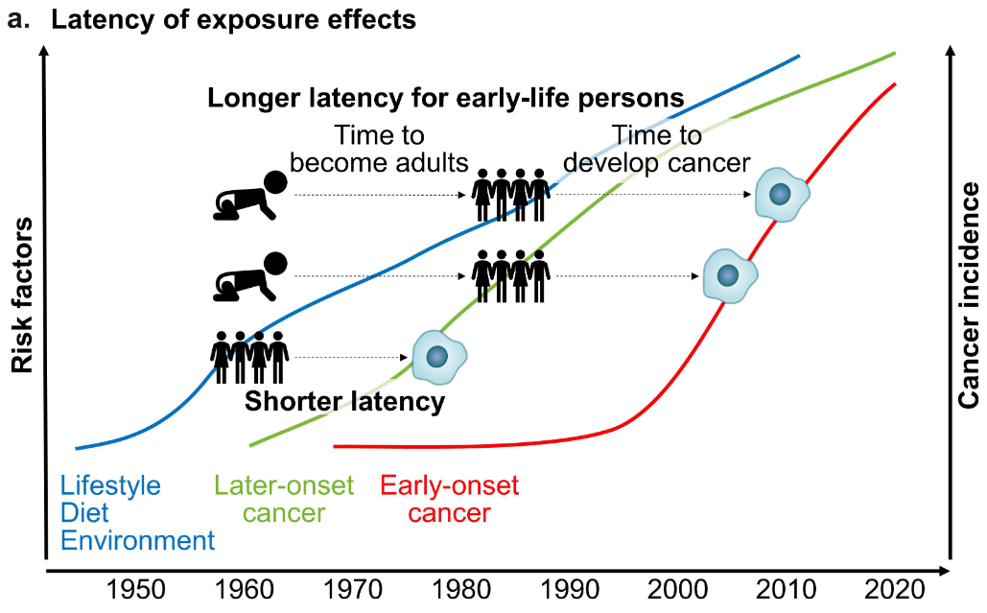
Notes:
For their latest paper, Ugai and Ogino brought together a team of investigators with expertise across 14 cancer types. They found that 12 of them were becoming more common in younger adults.
“From our data, we observed something called the birth cohort effect,” explains Ogino. “Since 1950, we found that each successive generation has a higher risk of early-onset cancer. Someone born in 1960 has a higher risk than someone born in 1950, and someone born in 1970 has a higher risk than someone born in 1960. It’s just continuing.”
Again, this is most obvious in bowel cancer. Ogino calls the disease, which is the third most common cancer and the second leading cause of cancer death worldwide, the “spearhead” for the early-onset cancer increase. In the UK, the rate of bowel cancer in the under-50s has increased by around 50% since the mid-1990s.
Now they’ve found evidence that other cancers seem to be following that trend, Ugai and Ogino think it’s important to investigate whether the causes might be related.
“Many risk factors are actually shared in many cancer types,” Ogino points out. “Obviously, the whole body is interconnected, and, with food, there’s a line from the mouth to the anus.”
Simplified schemes illustrating factors related to the rising incidence of early-onset cancers. a. Latency of exposure effects for
early-onset and later-onset cancers. Note that, for simplicity, the trajectories of the levels of risk factors and the incidence of early-
onset and later-onset cancers are illustrated as generalized curves, which cannot accurately represent those of individuals or
populations. The y axis indicates a general scale but not absolute value. The slope of each curve does not indicate any specific increasing value, but rather shows a general rising trend only. The modernization and westernization of diets, lifestyle, and environment had started to accelerate in developed countries since the mid 20th century and in developing countries since the late 20th century.3,224 Due to its shorter latency of exposure effects on middle-aged or elderly adults for the development of later- onset cancers, their incidence had started to rise in around 1950s-1960s.3,5In contrast, exposure effects on early-life individuals did not
appreciably appear until at least 3-4 decades later when those effects have been manifested as the increased incidence of early-onset
cancers. Note that, after the early-life periods, young adults continue to be exposed to (the same, similar, or varying) risk factors, which
may further contribute to the rise of early-onset cancers.

Slide 16
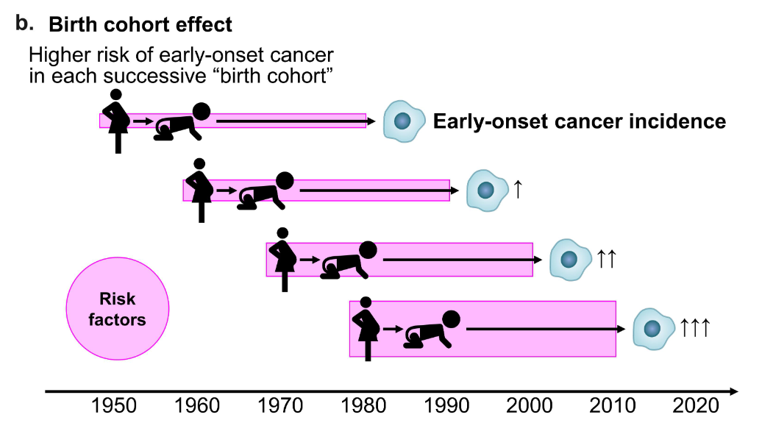
Notes:
Birth cohort effect. The term “birth cohort effect” refers to an effect that
appears differentially in each cohort of individuals starting at birth in/around similar time. Evidence suggests that each successive
newer birth cohort have higher risk of certain early-onset cancers such as colorectal cancer.3,5,225,226 This phenomenon appears to be
due to higher levels of risk factor exposure in early life in a given cohort compared to a preceding cohort. Studies have shown that
each successive birth cohort exhibited a higher risk of developing early-onset cancer.3,5,225,226 This “birth cohort effect” phenomenon
provides evidence for a potential etiological role of differential exposure effects during the life course (shown in Figure 1) in the recent
increase in early-onset cancer.

Slide 17
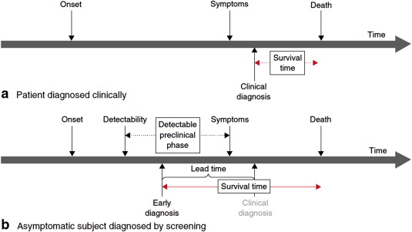
Lead-time bias
Early detection of a disease (typically through a screening program) artificially inflates the apparent survival time, even if the clinical course and actual time of death remain unchanged
The patient appears to survive longer solely because the disease was diagnosed earlier in its natural history.

Slide 18
Notes:
In 2025, a little over 2 million new cancer cases are expected to be diagnosed in the United States. Prostate cancer is the most common cancer among males (30%), followed by lung (11%) and colorectal (8%) cancers. Among females, breast (32%), lung (12%), and colorectal (7%) cancers are the most common.

Slide 19
Notes:
This slide shows long-term trends in cancer incidence rates for all sites combined by sex from 1975 to 2021. Cancer incidence trends reflect patterns in the prevalence of cancer risk factors, as well as changes in medical practices, such as cancer screening. Cancer incidence rates for 2020 are 9%-10% lower than those for 2019 because of COVID-19 pandemic disruptions that led to less screening and other elective healthcare visits, and thus less cancer detection.

Slide 20
Notes:
This slide shows trends in cancer incidence among males in the US by cancer site. Prostate cancer incidence is driven by the use of prostate-specific antigen (PSA) testing to screen for asymptomatic cancer. Rates spiked in the early 1990s because of initial widespread uptake of screening, then dropped by almost 40% from 2007 to 2014 because of a drop in screening precipitated by recommendations by the US Preventive Services Task Force against routine screening for men 75 and older in 2008 and all men in 2012. After 2014, rates have steadily increased, largely driven by increases in advanced stage disease.

Slide 21
Notes:
This slide shows trends in cancer incidence among females in the US. Breast cancer has been slowly increasing since the mid-2000s by about 0.5% per year because of increases in obesity (postmenopausal women) and continued declines in the fertility rate.

Slide 22
Notes:
This graph shows delay-adjusted incidence rates by sex and age. Sex differences in cancer risk vary markedly by age. For example, cancer rates in middle-aged women (50-64 years) are statistically equivalent to those in middle-aged men in 2021, after being 21% lower in 2007. Among people younger than 50 years, the chasm between male and female rates is widening. The incidence among women was 51% higher than men in 2002, but 82% higher in 2021.

Slide 23
Notes:
This slide shows cancer incidence rates for all cancers combined by race and ethnicity and sex. Among men, cancer rates are highest among Black men while rates in women are highest among American Indian/Alaska Native women.

Slide 24
Notes:
This slide shows the lifetime risk, or likelihood, of an average male in the US developing cancer. One of every three men, or 39.9% of men, will develop some type of cancer in his lifetime.

Slide 25
Notes:
This slide shows the lifetime risk, or likelihood, of an average female in the US developing cancer. One of every three women, 39.0%, will develop some type of cancer in her lifetime.

Slide 26
Notes:
This table shows the 5-year relative survival rate by cancer site. There have been notable improvements in survival for most cancer types due to earlier detection and/or advances in treatment. Overall cancer survival has increased from 49% in the mid-1970s to 69% for diagnoses during 2014-2020.

Slide 27
Notes:
Survival is lower in Black people compared to White people for almost every cancer type; for example, the 5-year relative survival rate for uterine corpus cancer is 63% in Black women versus 84% in White women, largely due to later stage diagnosis, more aggressive disease, and less access to high-quality treatment.

Slide 28
Notes:
In 2025, 618,120 deaths from cancer are expected in the United States. Lung cancer is the leading cause of cancer death among males (20%), followed by prostate (11%) and colorectal (9%) cancers. Among females, lung (21%), breast (14%), and pancreatic (8%) cancers are the leading causes of cancer death.

Slide 29
Notes:
This slide shows trends in cancer death rates by sex. The cancer death rate in males and females combined has declined by 34% since its peak in 1991.

Slide 30
Notes:
As a result of continuous declines in cancer mortality since 1991, there were an estimated 4.5 million fewer cancer deaths through 2022 than would have been expected if the death rate remained at its peak. This graph shows the number of averted cancer deaths in men on the left and women on the right. The blue line represents the actual number of cancer deaths recorded each year, and the red line represents the number of cancer deaths that would have been expected if cancer death rates had remained at their peak.

Slide 31
Notes:
This figure shows long-term trends in cancer death rates in males by cancer type.

Slide 32
Notes:
This figure shows long-term trends in cancer death rates for females by cancer type.

Slide 33
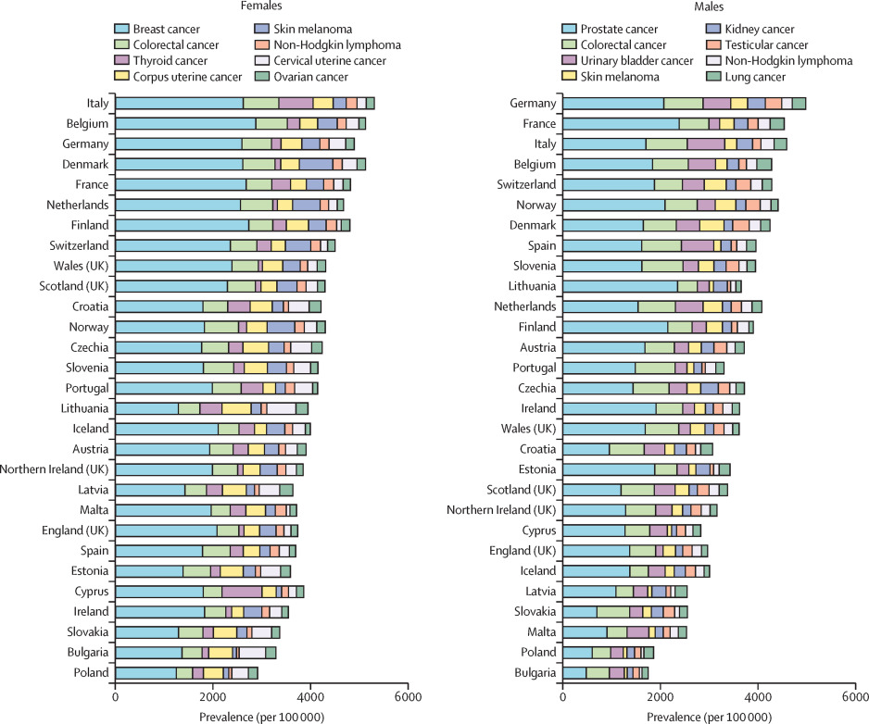
De Angelis, Roberta, et al. "Complete cancer prevalence in Europe in 2020 by disease duration and country (EUROCARE-6): a population-based study." The Lancet Oncology 25.3 (2024): 293-307.
Notes:
The complete cancer prevalence estimates differed substantially between countries. In female survivors, crude prevalence proportion was more than two times higher in the highest prevalence country versus the lowest prevalence country for all the top eight cancers: eg, breast (crude prevalences ranging from 1268 [95% CI 1246–1289] per 100 000 in Poland to 2924 [2846–3002] per 100 000 in Belgium), colorectal (339 [325–353] per 100 000 in Poland to 744 [722–766] per 100 000 in Italy), and corpus uterine cancer (249 [232–266] per 100 000 in Ireland to 609 [591–626] per 100 000 in Lithuania; figure 1; appendix pp 16–19). The differences between countries were even greater for tumours with substantial incidence dynamics and geographical variability, such as thyroid cancer (<130 cases per 100 000 in Denmark and the Netherlands, and in all countries in the Ireland and UK macro region, and >700 per 100 000 in Italy and Cyprus), skin melanoma (83 per 100 000 in Bulgaria and 700 per 100 000 in Denmark), and cervical uterine cancer (from <100 per 100 000 in Malta and Finland to >550 per 100 000 in Bulgaria and Lithuania).

Slide 34
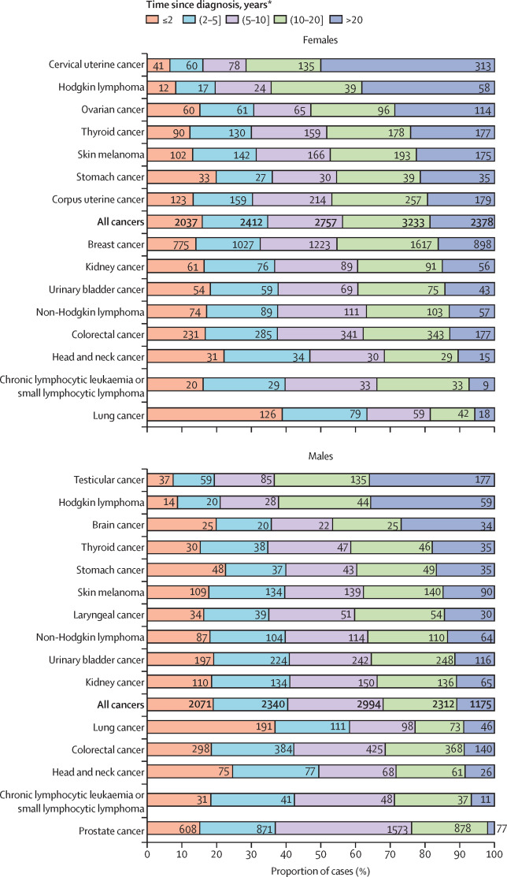
De Angelis, Roberta, et al. "Complete cancer prevalence in Europe in 2020 by disease duration and country (EUROCARE-6): a population-based study." The Lancet Oncology 25.3 (2024): 293-307.
Notes:
Cancer prognosis, median age at onset, and previous incidence time trends (decreasing vs increasing) were the main factors influencing prevalence patterns by disease duration. In 2020, 14 850 thousand (95% CI 14 681–15 018) people were estimated to be alive more than 5 years after diagnosis and 9099 thousand (8909–9288) people were estimated to be alive more than 10 years after diagnosis, representing an increasing proportion of the cancer survivor population. Overall, in early 2020, the number of female survivors in the European pool diagnosed with cancer within the past 2 years was estimated to be 2037 thousand (95% CI 1971–2104) or within the past 2–5 years was 2412 thousand (2330–2494; figure 2). Long-term survivors (ie, living with cancer for more than 5 years) accounted for 8368 thousand (65·3%) of 12 818 thousand prevalent female cases, of whom 2757 thousand (21·5%; 95% CI 2682–2832) are estimated to have been living with a diagnosis for more than 5 years to 10 years, 3233 thousand (25·2%; 3132–3334) for more than 10 years to 20 years, and 2378 thousand (18·5%; 2249–2507) for a duration longer than 20 years. Similar distributions are estimated for females diagnosed with breast cancer, colorectal cancer, corpus uterine cancer, thyroid cancer, kidney cancer, urinary bladder cancer, non-Hodgkin lymphoma, and skin melanoma. 5611 thousand (43·8%; 95% CI 5497−5726) of 12 818 thousand females were very long-term survivors (more than 10 years since diagnosis). The proportion of very long-term survivors was highest for cervical uterine cancer (447 345 [71·5%] of 625 179) and Hodgkin lymphoma (97 166 [64·3%] of 151 166), and lowest for lung cancer (60 188 [18·5%] of 324 729).

Slide 35
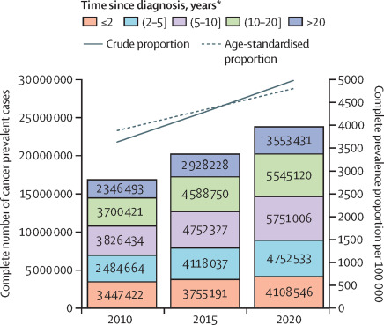
De Angelis, Roberta, et al. "Complete cancer prevalence in Europe in 2020 by disease duration and country (EUROCARE-6): a population-based study." The Lancet Oncology 25.3 (2024): 293-307.
Notes:
The estimated total number of cancer survivors in the European pool has increased on average by 3·5% per year from 2010 to 2020, from 16 805 thousand (95% CI 16 798–16 813) on Jan 1, 2010, to 23 710 thousand (23 565–23 857) on Jan 1, 2020, a relative change of 41% (figure 3). A similar increase (37%) is estimated for the crude prevalence (from 3615 cases [95% CI 3613–3617] per 100 000 to 4961 [4931–4992] per 100 000). The age-standardised prevalence is estimated to have increased less steeply (24%, from 3864 [95% CI 3862–3866] per 100 000 to 4783 [4754–4813] per 100 000), because it is not affected by demographic changes.

Slide 36
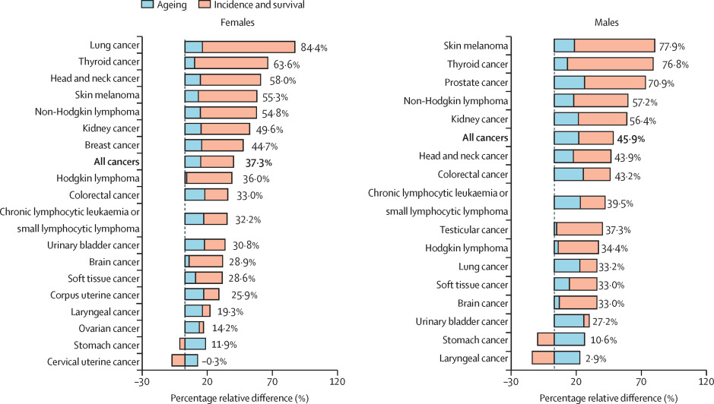
De Angelis, Roberta, et al. "Complete cancer prevalence in Europe in 2020 by disease duration and country (EUROCARE-6): a population-based study." The Lancet Oncology 25.3 (2024): 293-307.
Notes:
The impact of demographic ageing on the changes of cancer prevalence in 2010–20, compared with the dynamics of incidence and survival, is shown in figure 4 (details in the appendix p 25). The number of survivors from all cancers is predicted to increase by 45·9% in males, of which 26·9% is attributable to incidence and survival changes and 19·0% to ageing. The relative percentage increase is predicted to be lower in females (37·3%) than in males, with a smaller effect of ageing (12·2%), because of the different case-mix and lower average age at onset. The cancers with increasing incidence and survival showed the steepest relative percentage increase in the number of prevalent cases: skin melanoma (77·9% in males and 55·3% in females), female lung cancer (84·4%), thyroid cancer (76·8% in males and 63·6% in females), and prostate cancer (70·9%). For these cancer sites, incidence and survival changes had a much greater impact (2–7 times) than the ageing of the population between 2010 and 2020. For smoking-related cancers (lung, head and neck, and larynx), the increase in prevalence is estimated to be more substantial in females, in line with less favourable incidence trends in females than in males. Prevalence was estimated to decrease for cervical uterine cancer only (–0·3%), but the increase was also limited for other tumours with declining incidence, such as stomach cancer (10·6% for males and 11·9% for females) and male laryngeal cancer (2·9%). In the absence of demographic ageing, the prevalence of these cancers would decrease. Demographic changes have a minimal effect on the prevalence increase for juvenile cancers, such as testicular cancer, brain cancer, or Hodgkin lymphoma (1–4%).

Slide 37
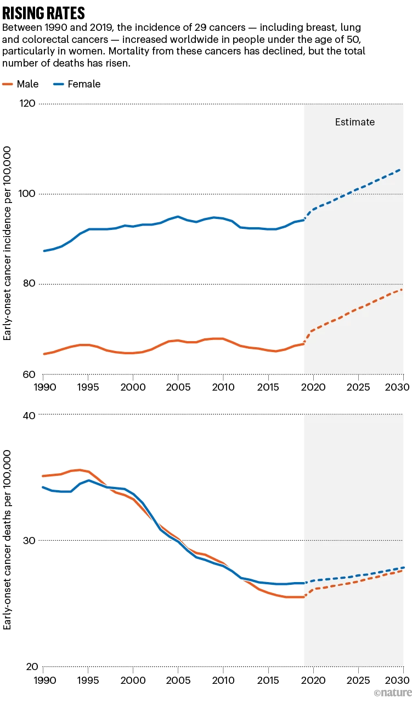
Notes:
Between 1990 and 2019, the incidence of 29 cancers – including breast, lung and colorectal cancers – has increased worldwide in people under the age of 50, particularly in women. Mortality from these cancers has declined, but the total number of deaths has risen.

Slide 38
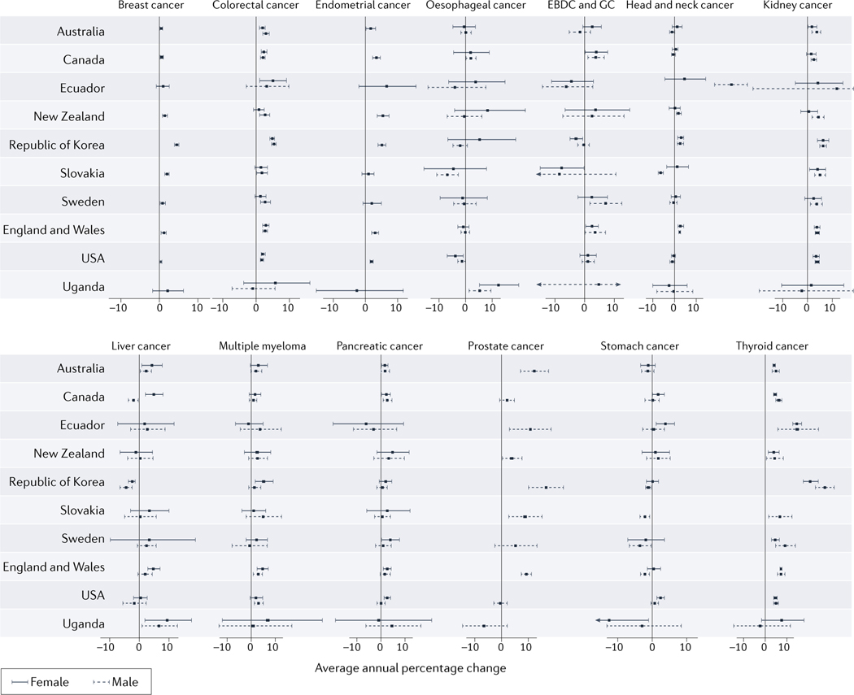
Notes:
Trends in the incidence of 14 cancer types with increasing incidences among 20–49 year-old adults during the period of 2002–2012, by country and region. Age-standardized cancer incidence data were obtained from the Global Cancer Observatory (GLOBOCAN; https://gco.iarc.fr/). Horizontal bars indicate 95% confidence interval (CIs). Data were obtained from 44 countries that provided age-standardized data on cancer incidence during 2002–2012.

