Slide 1
Head and neck cancer
Skin cancer
Ioannis Vathiotis MD, MSc, PhD
Medical Oncologist
Third Department of Internal Medicine, Sotiria Hospital for Chest Diseases, NKUA

Slide 2
Head and neck cancer

Slide 3
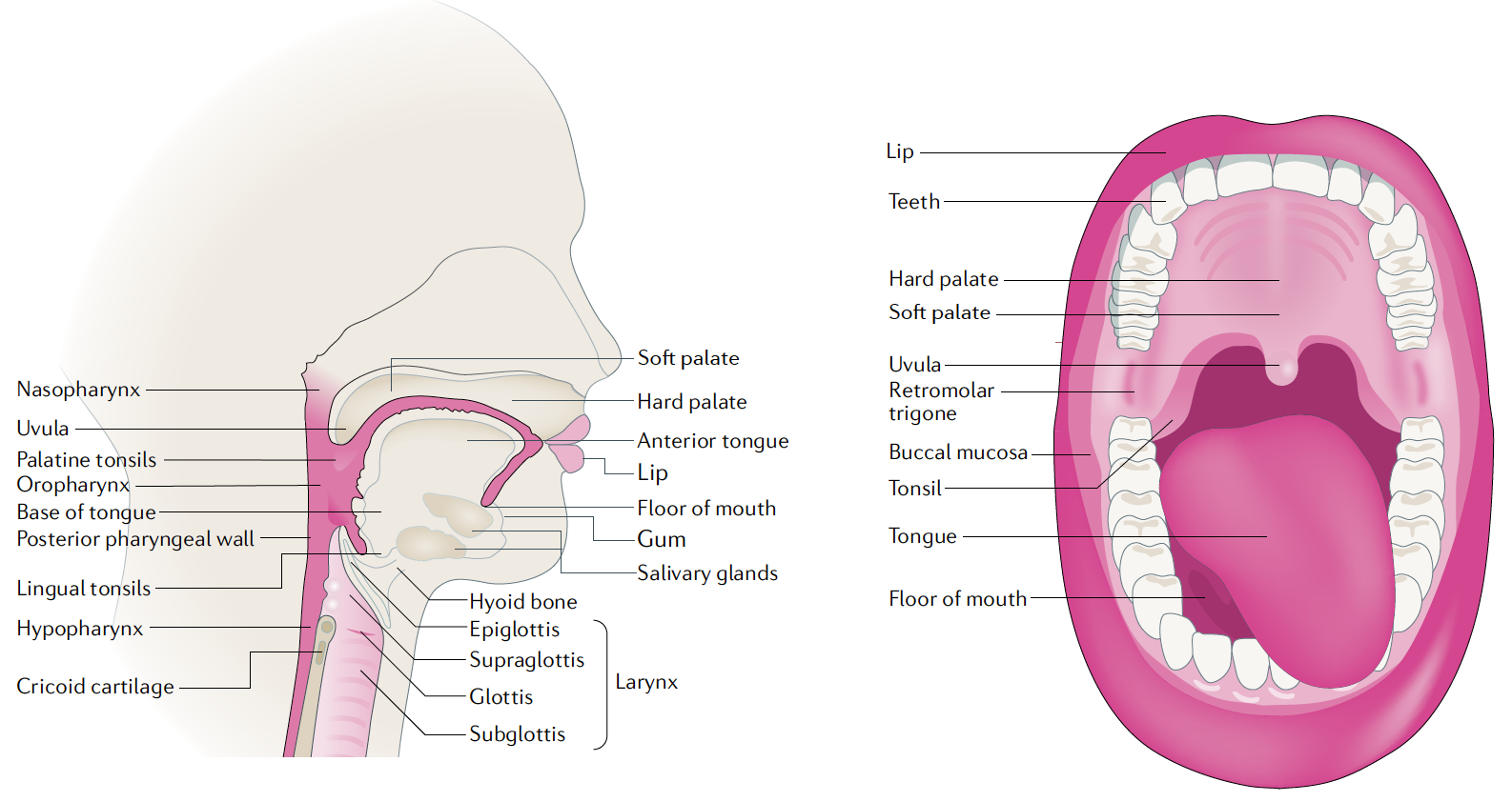
Anatomical subsites
Johnson et al. 2020

Slide 4
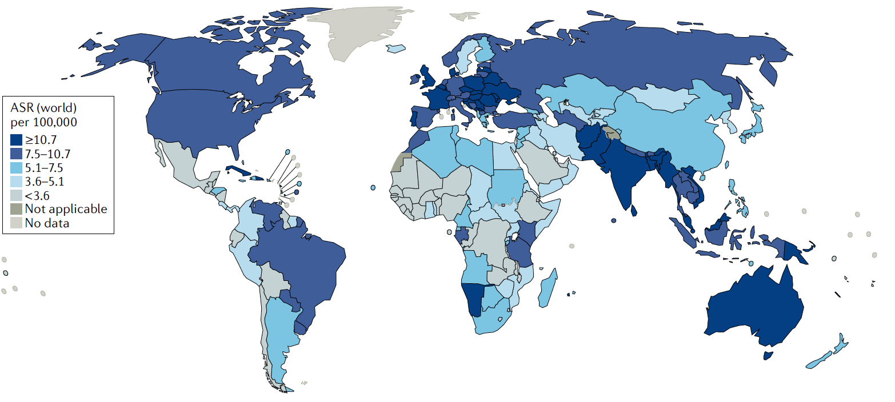
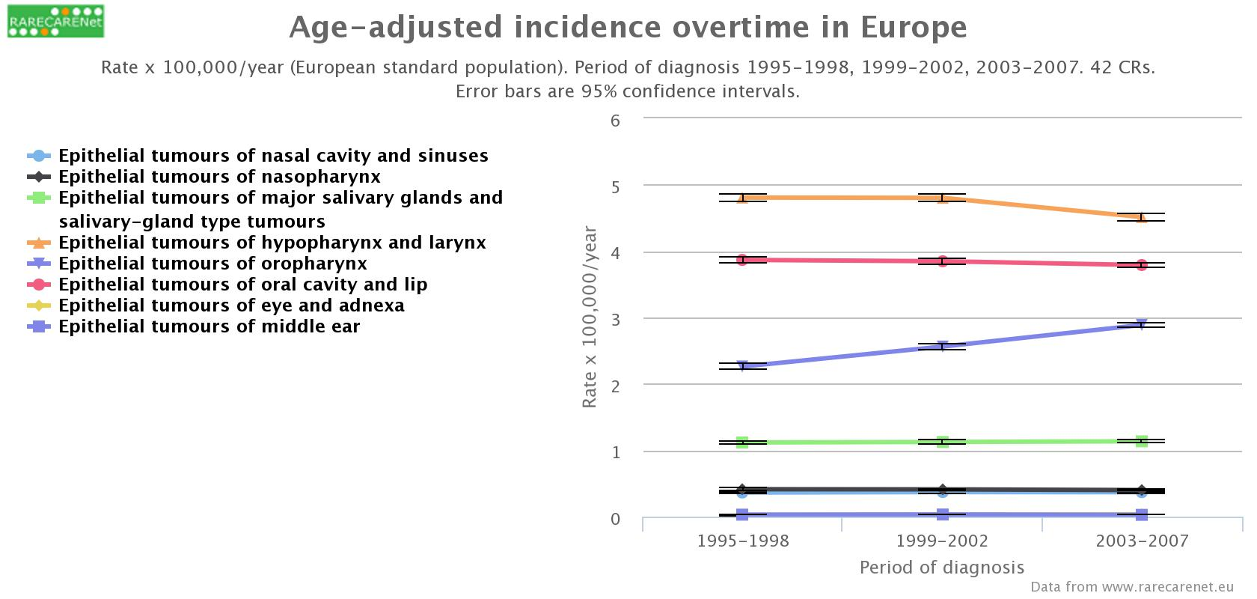
Epidemiology
Sixth most common cancer worldwide
Approximately 900,000 new cases and 400,000 deaths per year
> 1,000,000 new cases by 2030
M/F: 2-4
Median age: 66 years (HPV-)/53 years (HPV+)
5-year relative survival was 61%, 49%, 41% and 25% for laryngeal, oral cavity, oropharyngeal and hypopharyngeal SCC, respectively
Johnson et al. 2020; www.rarecancernet.eu; Gatta et al. 2017

Slide 5


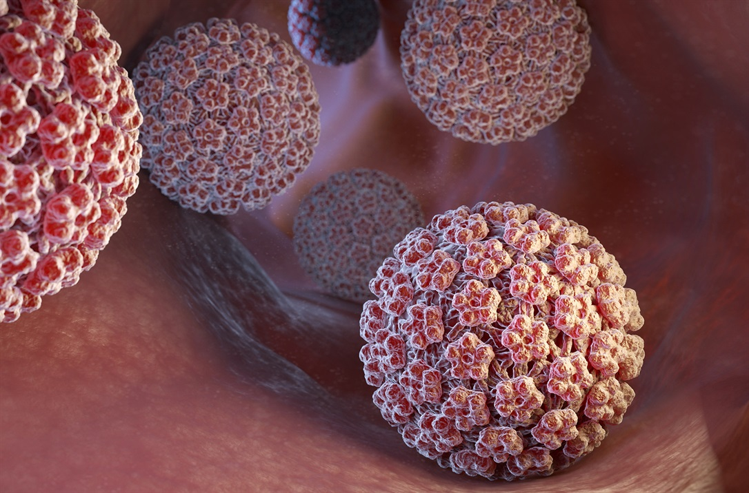

Risk factors
Tobacco
Excessive alcohol consumption
HPV (OPC), EBV (NPC)
Immunodeficiency
Areca nut or “Betel quid” (India, Taiwan, China)
Genetic factors (Fanconi anemia)
Johnson et al. 2020

Slide 6
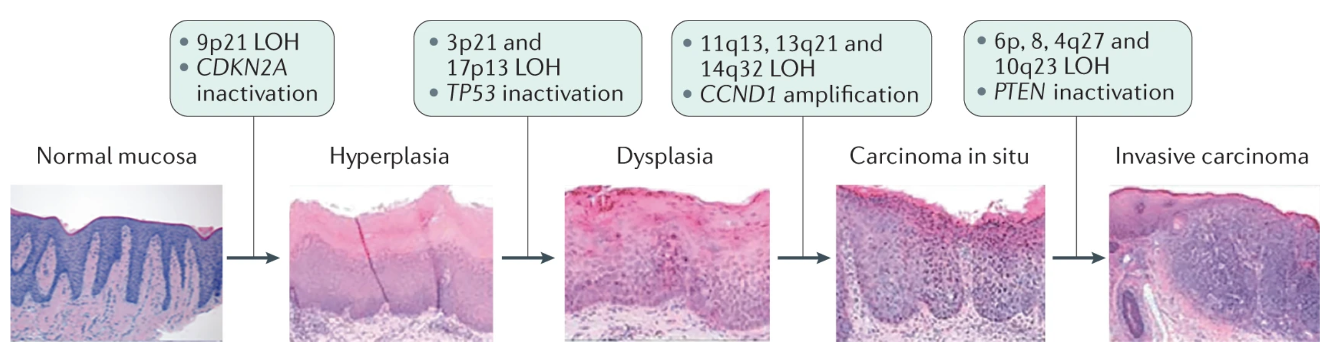
Carcinogenesis in HPV- disease
Originates from the mucosal epithelial cells that line the upper aerodigestive tract
Loss of tumor suppressor genes
Temporal sequence vs collective accumulation
“Field cancerization”: second primary tumors
Johnson et al. 2020

Slide 7
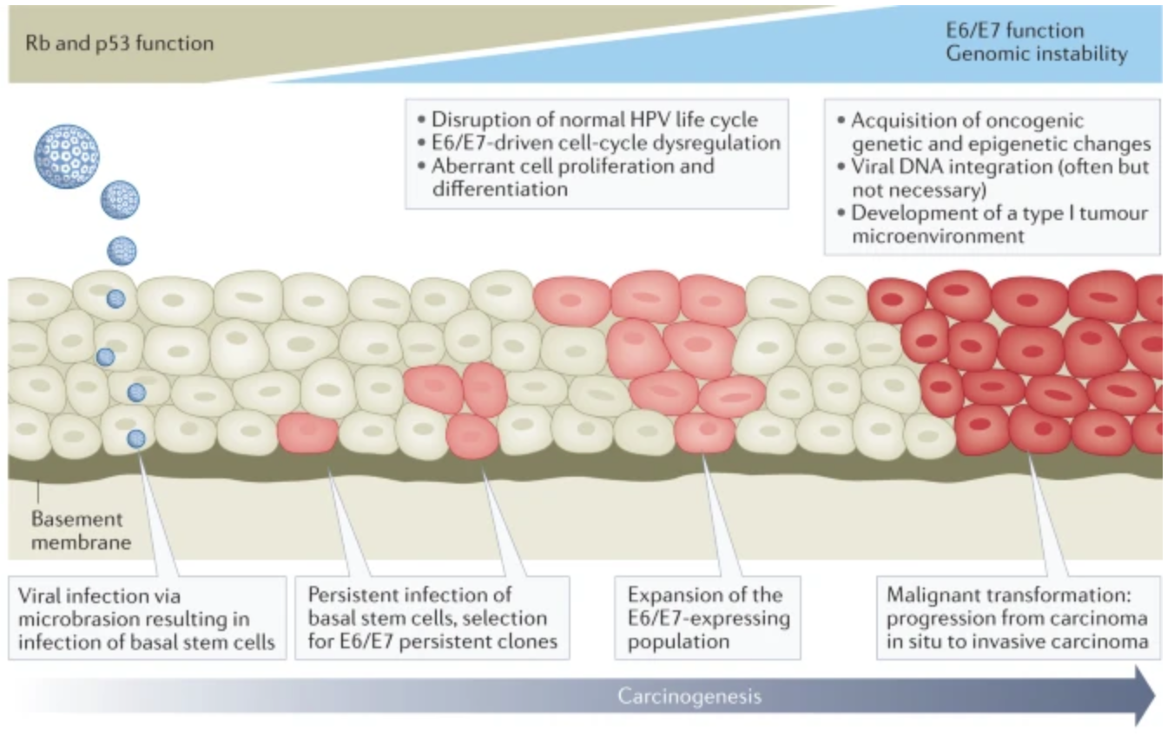
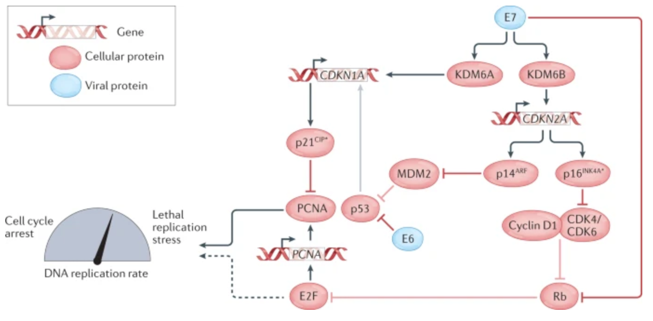
HPV-driven carcinogenesis
APOBEC-mediated editing of the viral genome clears the infection
Activation of the PI3K signaling pathway
Lechner et al. 2022

Slide 8

HPV+ oropharyngeal squamous cell carcinoma (OPSCC)
>70% of OPSCC positive for HPV
HPV-16 (85%) >> HPV-18, HPV-31, HPV-33, HPV-52
Sexually transmitted disease, strong association with the number of lifetime oral sex partners
High-income countries, young, minimal to no smoking history
In the USA, the incidence of OPSCC in men has surpassed that of cervical cancer in women
D´Souza et al. 2007; Miller et al. 2012; Gillison et al. 2006

Slide 9
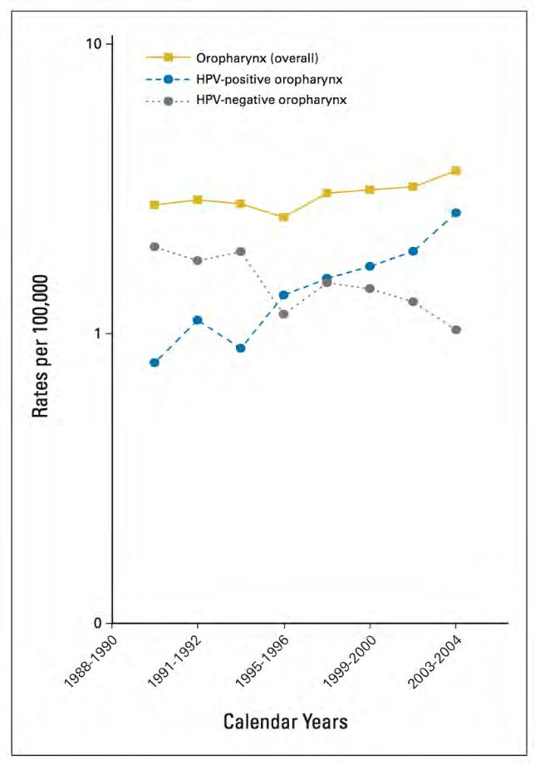
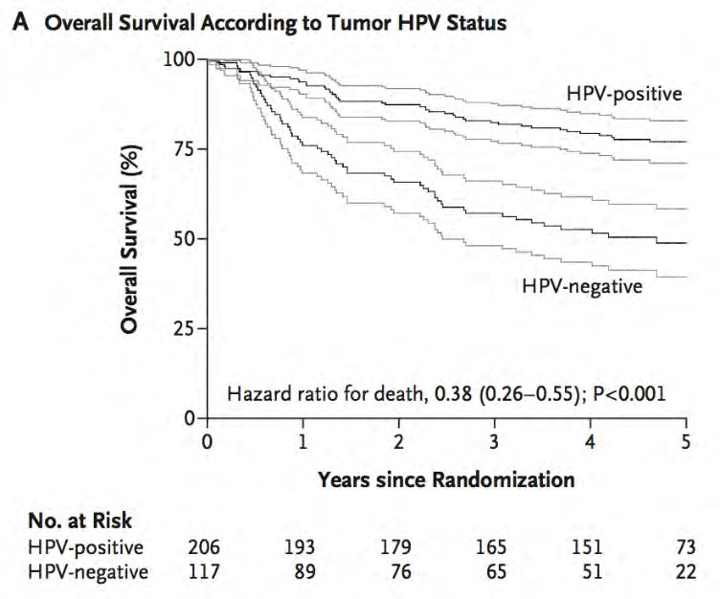
Increasing incidence and better prognosis of HPV+ OPSCC
3-year OS with CRT: 82.4%, vs. 57.1%
Carvalho et al. 2005; Chaturvedi et al. 2011; Ang et al. 2010

Slide 10
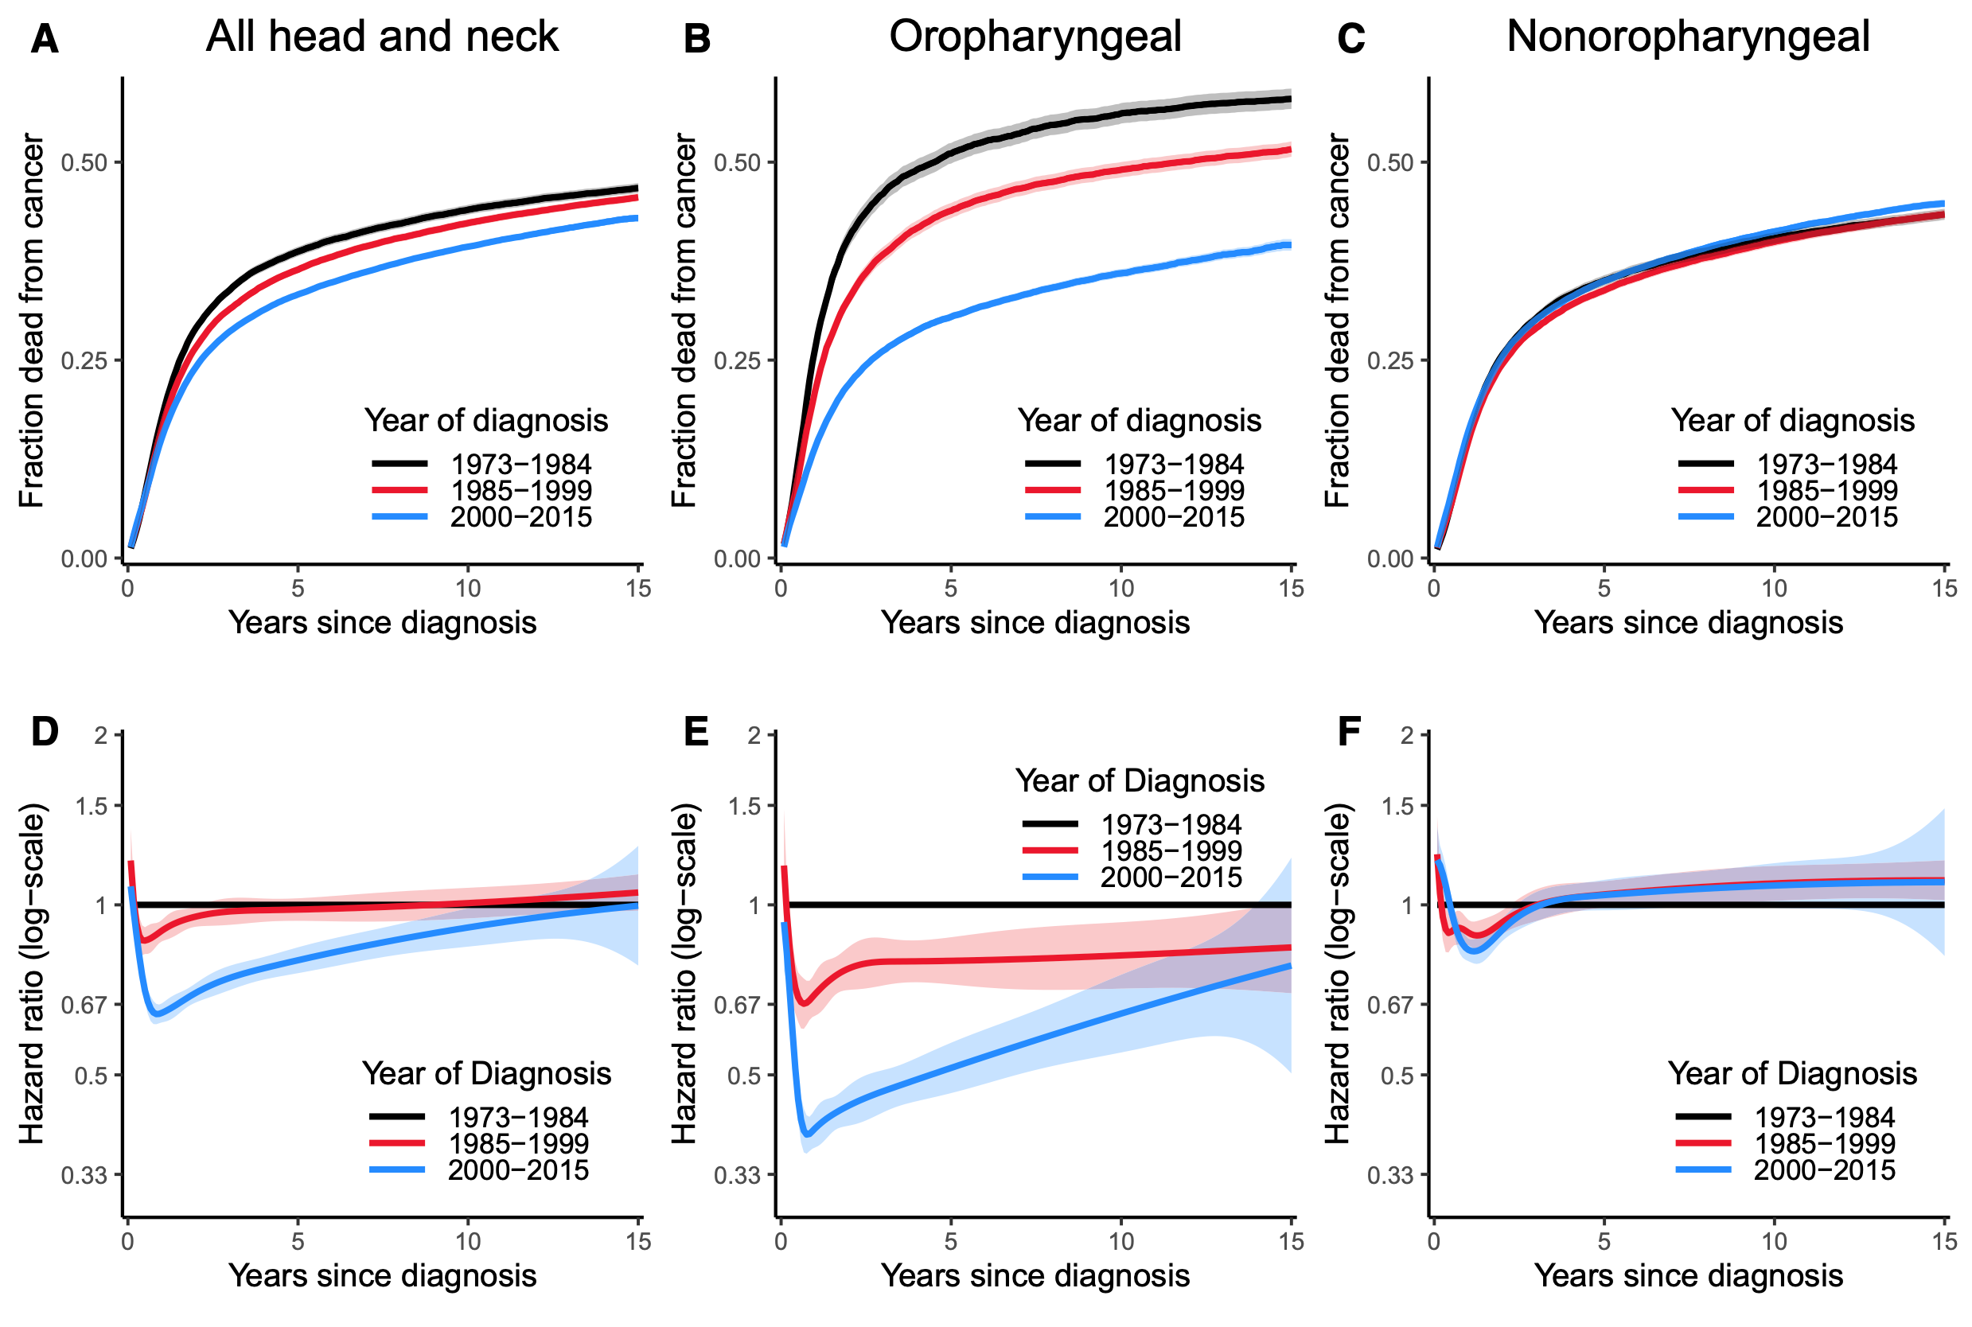
Time-varying survival effects for HNSCC
5-year OS: 55% (1992–1996) > 66% (2002–2006)
Pulte et al. 2010; Brouwer et al. 2020

Slide 11
Clinical presentation depends on the anatomical subsite and etiology
Oral cavity: Non-healing mouth sore or ulcer – early stage
HPV- Oropharynx/hypopharynx: dysphagia, odynophagia, otalgia – late stage
HPV+ Oropharynx: neck mass
Larynx: hoarseness, dyspnea
Nasopharynx: neck mass, unilateral nasal obstruction, epistaxis
Johnson et al. 2020

Slide 12
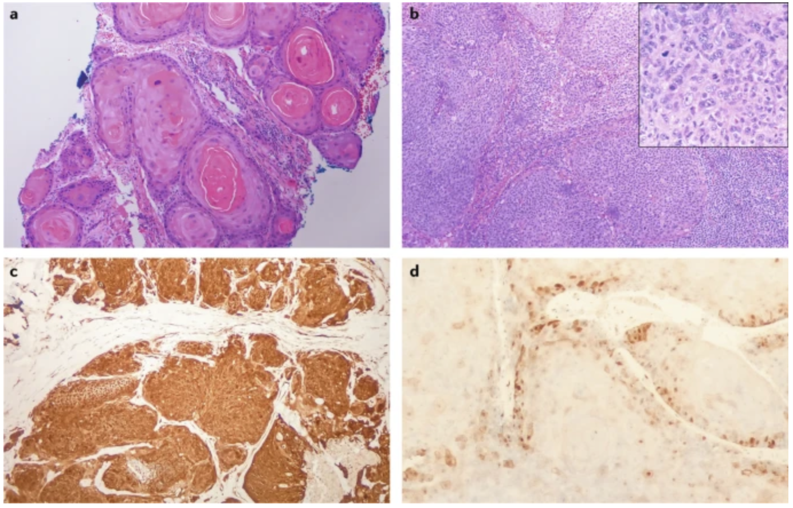
Diagnosis
Biopsy of the primary tumor and/or neck mass: FNA > excisional (non-diagnostic, unknown primary site, concurrent non-cervical lymphadenopathy)
Routine H&E is adequate for diagnosis: >90% squamous cell carcinoma
IHC for poorly differentiated/basaloid tumors: PanCK, CK5/6, p63
HPV testing for all oropharyngeal and unknown primary tumors: p16^{INK4A} (diffuse nuclear and cytoplasmic staining in >70% of tumor cells) - is not a direct measure of HPV infection, E6 and E7 mRNA (rtPCR), HPV DNA (PCR, ISH)
Johnson et al. 2020; Taberna et al. 2017

Slide 13
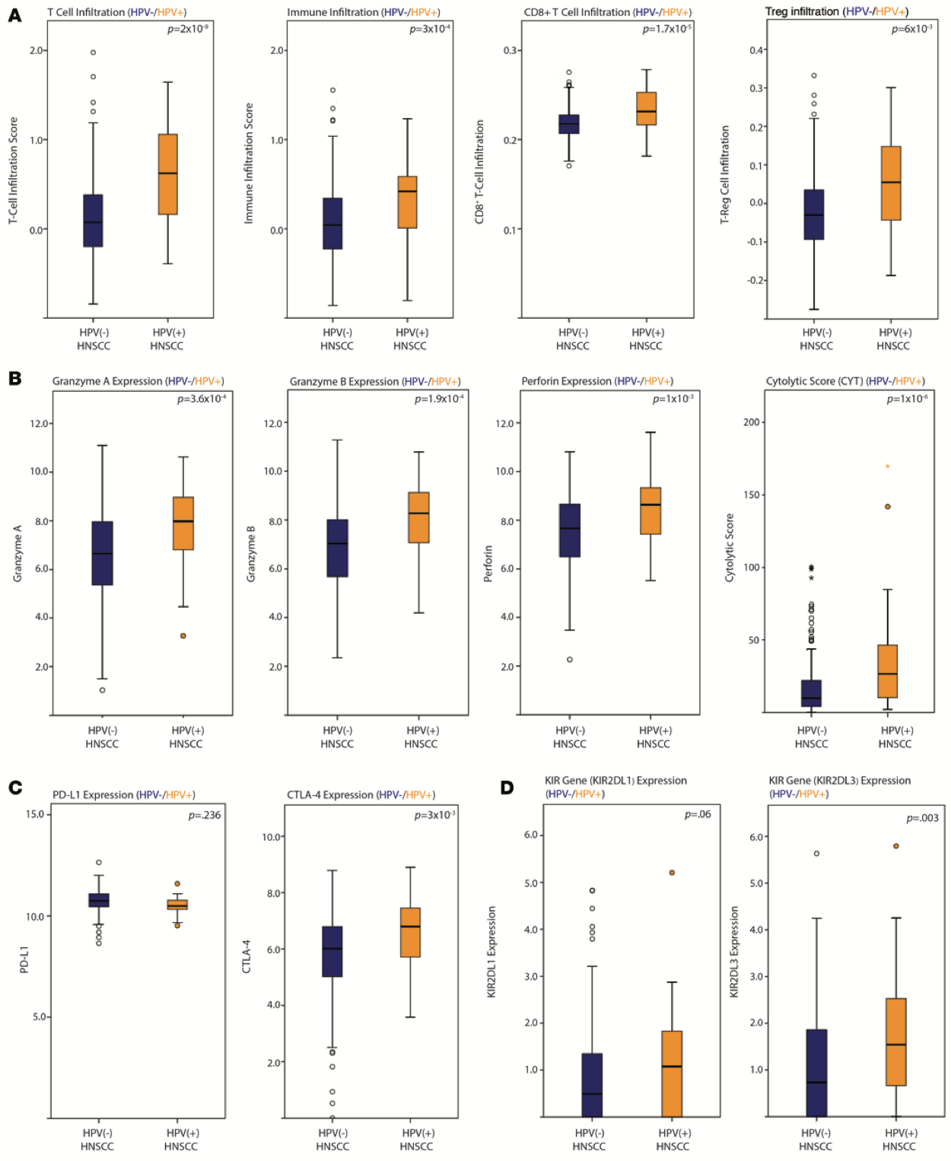
Tumor microenvironment
Highly immunosuppressive
T_{eff}, NK cells vs T_{reg}, MDSCs and M2 macrophages
Growth factors and cytokines (IL-10, TGFβ)
Decreased HLA and defects in antigen processing
Upregulation of PD-L1
Hypoxia
Oral microbiota?
Differences between HPV+ and HPV- disease
Mandal et al. 2016; Partlova et al. 2015; Ward et al. 2014

Slide 14
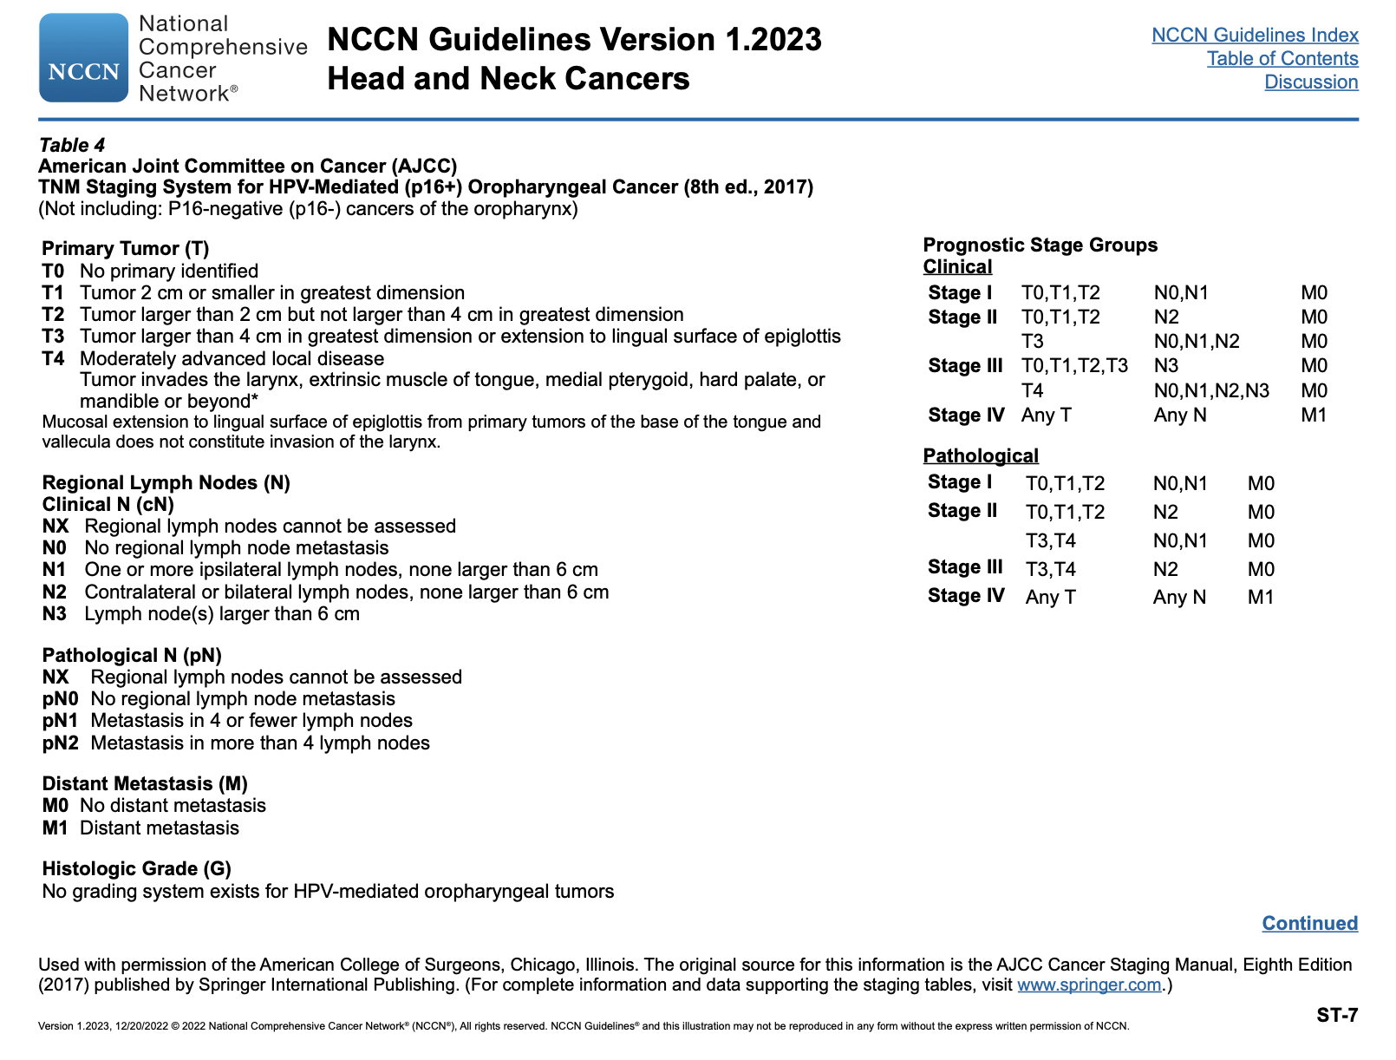
Stage and HPV status are major determinants of HNSCC prognosis
Classification of disease within each anatomical subsite
Complete head and neck exam with direct inspection of the oral cavity and fiberoptic nasopharyngolaryngoscopy, CT or MRI of the head and neck, PET-CT

Slide 15
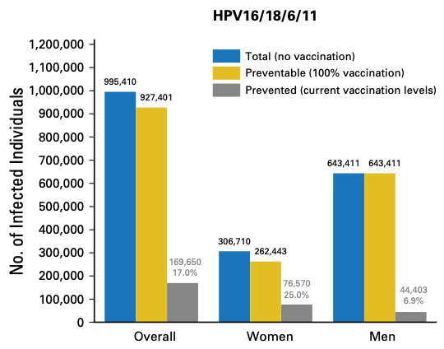
Primary prevention
Involves interventions to reduce the incidence of disease in the first place, by decreasing exposures, altering modifiable behaviors or increasing resistance in healthy people who are at risk
Tobacco cessation
Vaccination against HPV
The US CDC recommends HPV vaccination for all children and adults aged 9–26 years
The FDA approved HPV vaccination for adults aged 27–45 years who had not been adequately vaccinated earlier
Johnson et al. 2020; Chatuverdi et al. 2018

Slide 16
Secondary prevention
Refers to the early detection of latent, asymptomatic disease and subsequent interventions to halt disease progression to a harmful state; typically involves screening, such as mammography or Papanicolaou smears
HPV- HNSCC: chronic exposure to carcinogens > “field cancerization”: high risk of a second primary tumor; chemoprevention?
OPLs (leukoplakia, erythroplakia and dysplastic leukoplakia) are associated with an increased risk of HPV- HNSCC – most do not transform into invasive cancer
No validated tool exists for screening for HPV+ HNSCC
Johnson et al. 2020; Chan et al. 2017

Slide 17
Management of early-stage disease
All patients with HNSCC should be treated in high-volume centers by experienced multidisciplinary teams
The treatment approach is guided by anatomical subsite, stage, patient age/performance status/comorbidities, local expertise, functional considerations and patient wishes
Localized disease: one treatment modality vs locally advanced disease: multimodality treatment (surgery, radiation and systemic therapy) with curative intent
Pathological features indicative of increased risk of recurrence include extra-nodal extension and positive surgical margins > concurrent chemoradiotherapy with cisplatin
In the event of treatment failure after single modality radiation or surgery salvage with the alternative modality offers a high chance of cure
Johnson et al. 2020

Slide 18







































































Recurrent/metastatic disease: KEYNOTE-048
Key Eligibility Criteria
Pembrolizumab Monotherapy
SCC of the oropharynx, oral cavity, hypopharynx, or larynx
R/M disease incurable by
local therapies
ECOG PS 0 or 1
Tissue sample for PD-L1 assessmentª
Known p16 status in the
oropharynx^{b}
Pembrolizumab 200 mg Q3W
for up to 35 cycles
Pembrolizumab 200 mg + Carboplatin AUC 5 OR Cisplatin 100 mg/m² +
5-FU 1000 mg/m²/d for 4 days
for 6 cycles (each 3 wk)
Pembrolizumab 200 mg Q3W
for up to 35 cycles total
Pembrolizumab
+ Chemotherapy
R 1:1:1
Stratification Factors
PD-L1 expressionª (TPS ≥50% vs <50%)
p16 status in oropharynx
(positive vs negative)
ECOG performance status (0 vs 1)
Cetuximab 250 mg/m² Q1W^{c} + Carboplatin AUC 5 OR Cisplatin 100 mg/m² +
5-FU 1000 mg/m²/d for 4 days
for 6 cycles (each 3 wk)
EXTREME
Cetuximab 250 mg/m² Q1W
ªAssessed using the PD-L1 IHC 22C3 pharmDx assay (Agilent). TPS = tumor proportion score = % of tumor cells with membranous PD -L1 expression. ^{b}Assessed using the CINtec p16 Histology assay (Ventana); cutpoint for positivity = 70%. ^{c}Following a loading dose of 400 mg/m².
Burtness et al. 2019

Slide 19
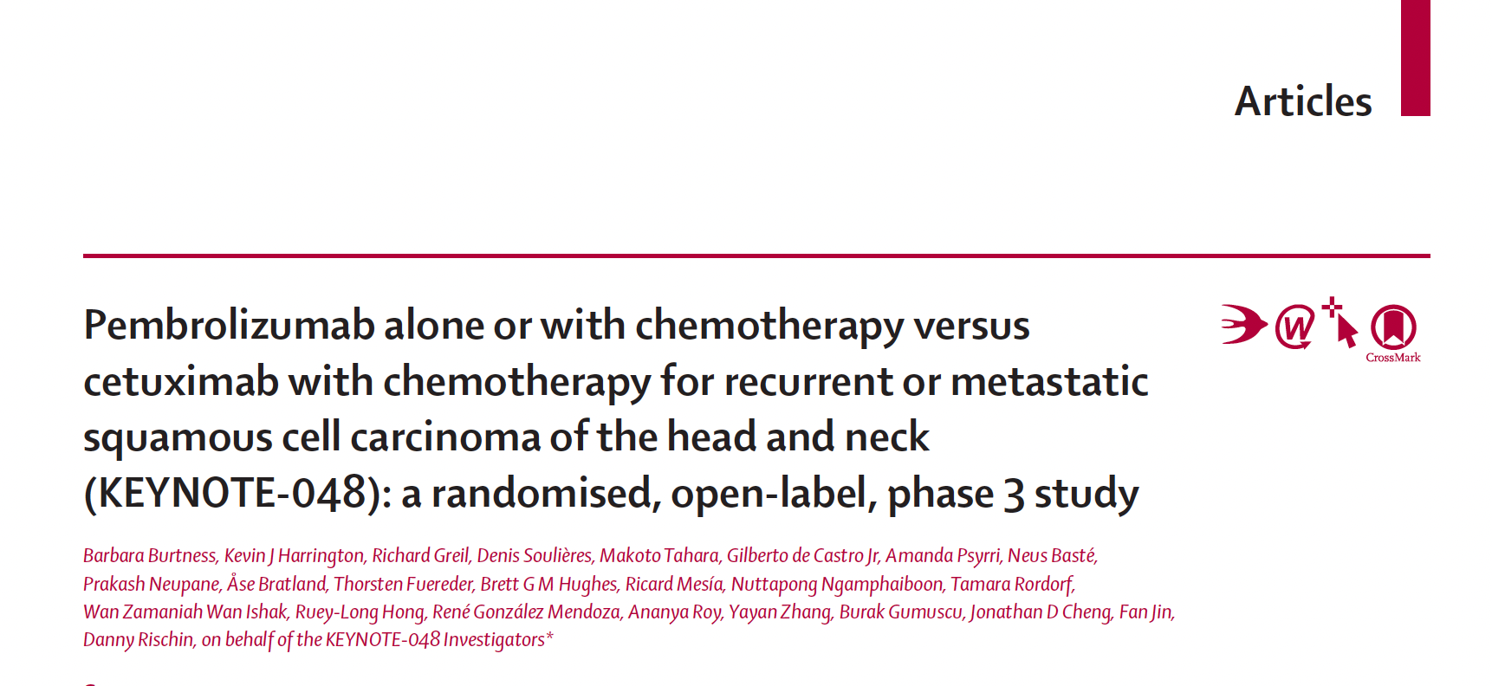
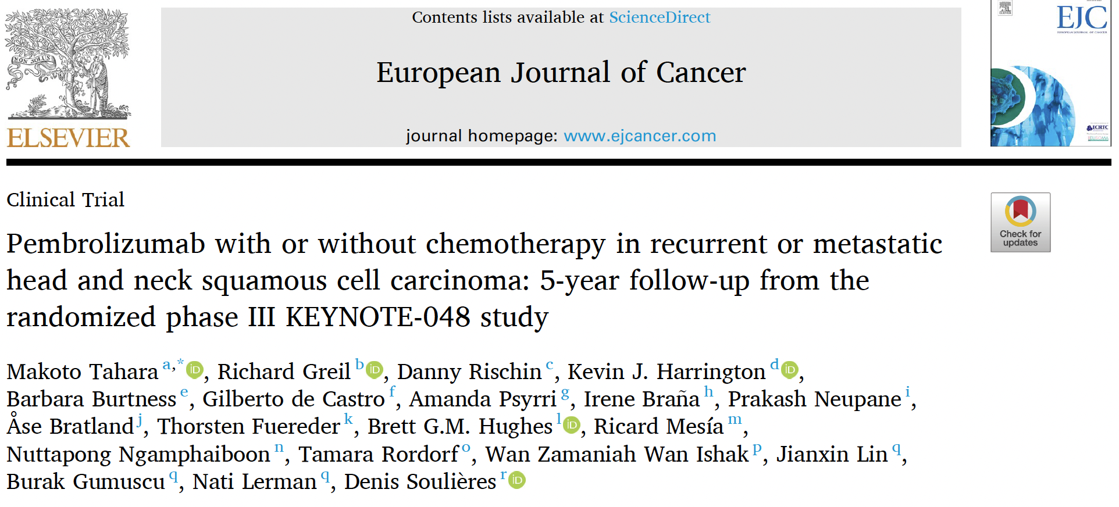
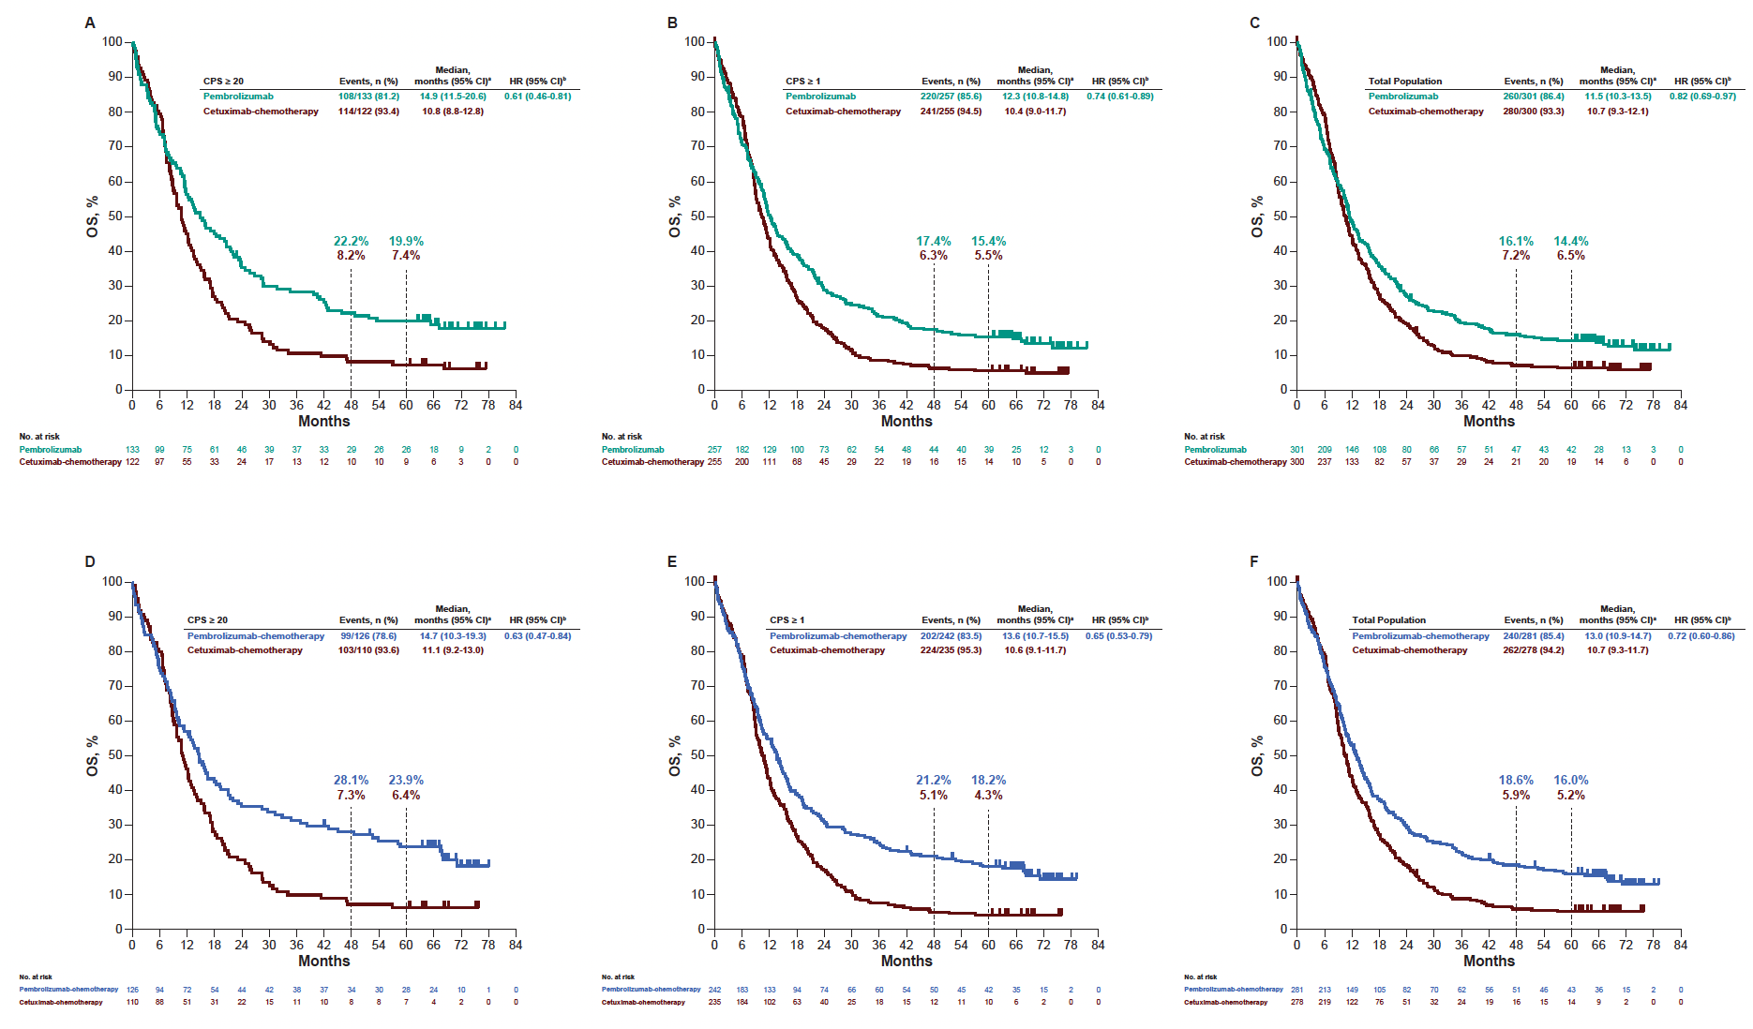
Increased PD-L1 expression associated with benefit from pembrolizumab
Early exposure to pembrolizumab might induce durable alterations in the tumor microenvironment, altering the natural history of HNSCC and sensitizing it to subsequent therapy
CPS ≥20
CPS ≥1
Total
CPS ≥20
CPS ≥1
Total
Burtness et al. 2019; Tahara et al. 2025

Slide 20
Anatomical subsites
Johnson et al. 2020

Slide 21
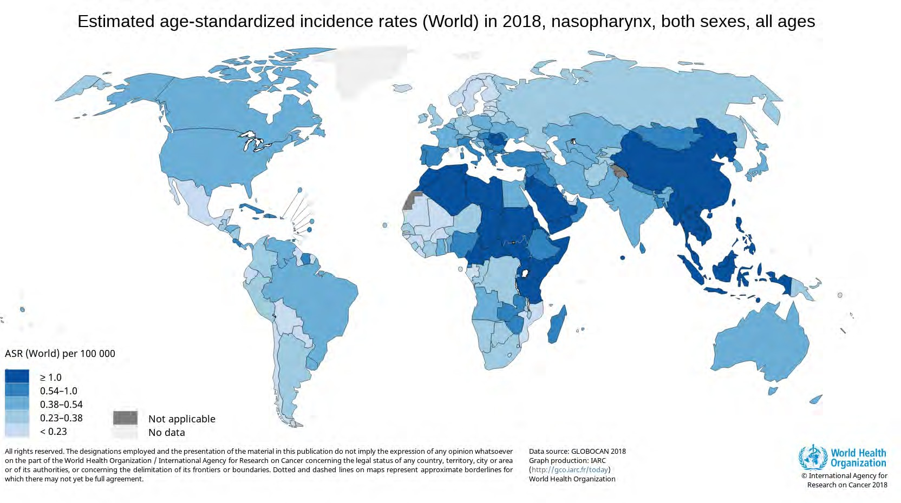
Incidence
Harbin : 1.3
Beijing : 0.8 Guangzhou: 13.9
Hongkong: 12.8
Zhongshan : 25
M/F : 2.75-3
Low incidence : EBV- High Incidence : EBV+
High among immigrant from incidence area
Penang: 10.6
Chinese: 16.1
Malay: 4.2
Indian: 1.8

Slide 22
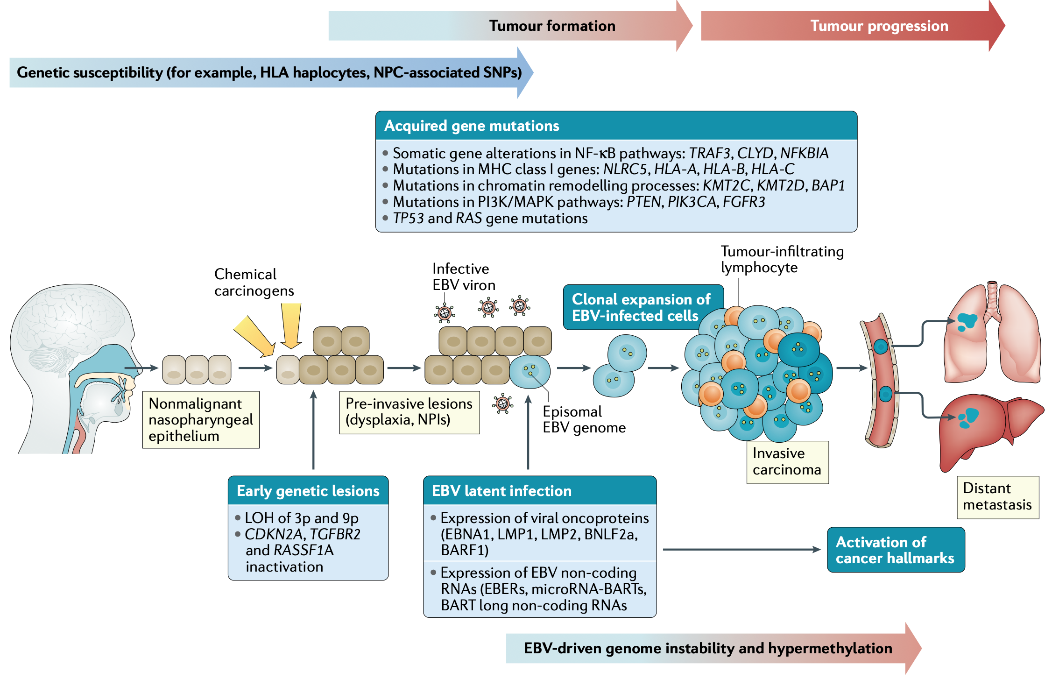
Hypothetical model of carcinogenesis
Wong et al. 2021

Slide 23
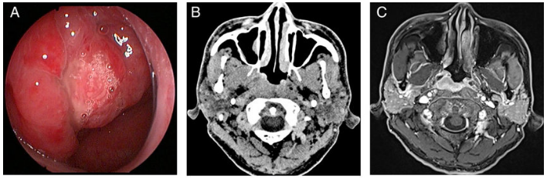
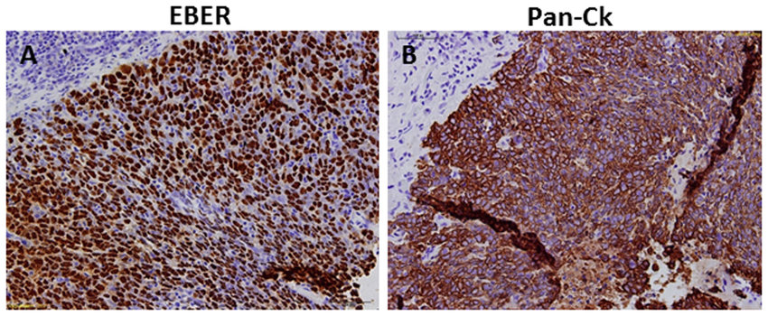
Nasopharyngeal cancer (NPC)
Diagnosis is standard H&E; EBER nearly confirmatory as > 95% are positive
Treatment is largely non-surgical based on staging (radiotherapy, chemotherapy)
Treatment of metastatic disease is based on the combination of chemotherapy with PD-1 inhibitors
Plasma EBV DNA detection may be useful for prognostication and surveillance
Chan et al. 2017

Slide 24
Anatomical subsites
Johnson et al. 2020

Slide 25
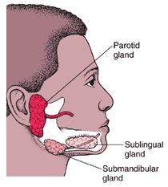
Salivary gland cancer (SGC)
3 pairs of major salivary glands/minor salivary glands
Most common site – parotid
6-8% of head and neck cancers
Incidence: 1-3/100,000/year
WHO classification, 5th ed: 24 distinct histologic subtypes

Slide 26
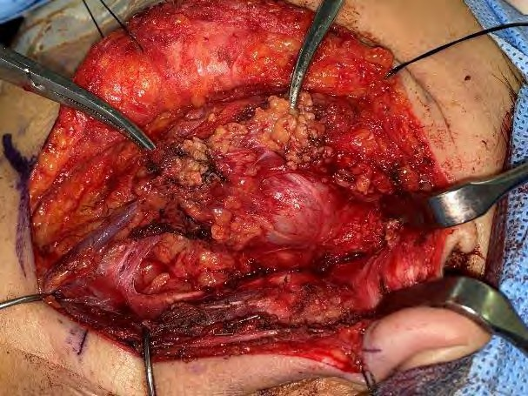
Management
Traditionally a surgical disease: surgery is both diagnostic and therapeutic
Adjuvant (chemo)radiotherapy
Most subtypes not chemosensitive
Molecular characterization > histology-driven abnormalities: opportunities for targeted therapies

Slide 27
Skin cancer (melanoma)

Slide 28
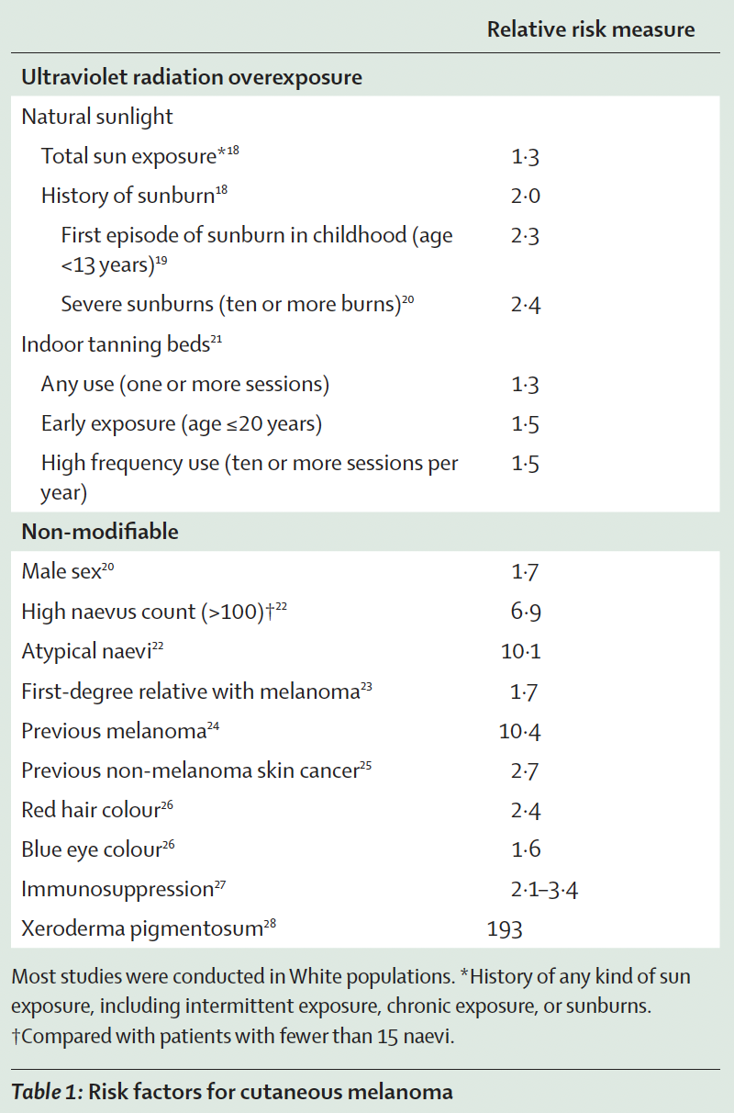
Epidemiology
Melanoma is a malignancy of melanocytes
1% of skin cancers; >80% of skin cancer deaths
Median age at diagnosis is 59 years
Subtypes: cutaneous, acral, mucosal, uveal
Kibbi et al. 2016; Rabbie et al. 2019; Bleyer et al. 2006; Long et al. 2023

Slide 29
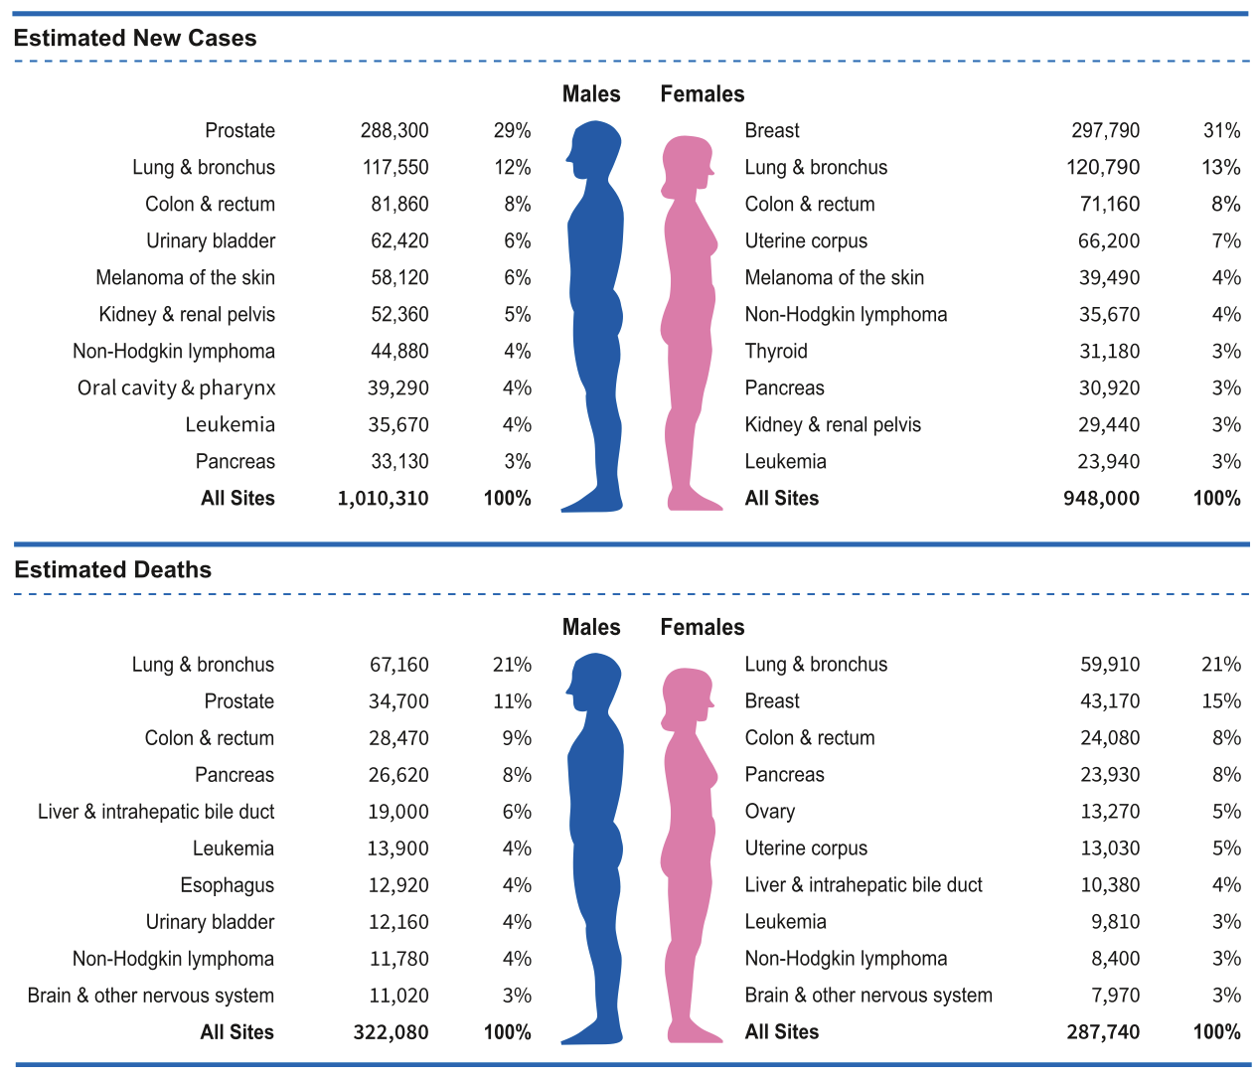
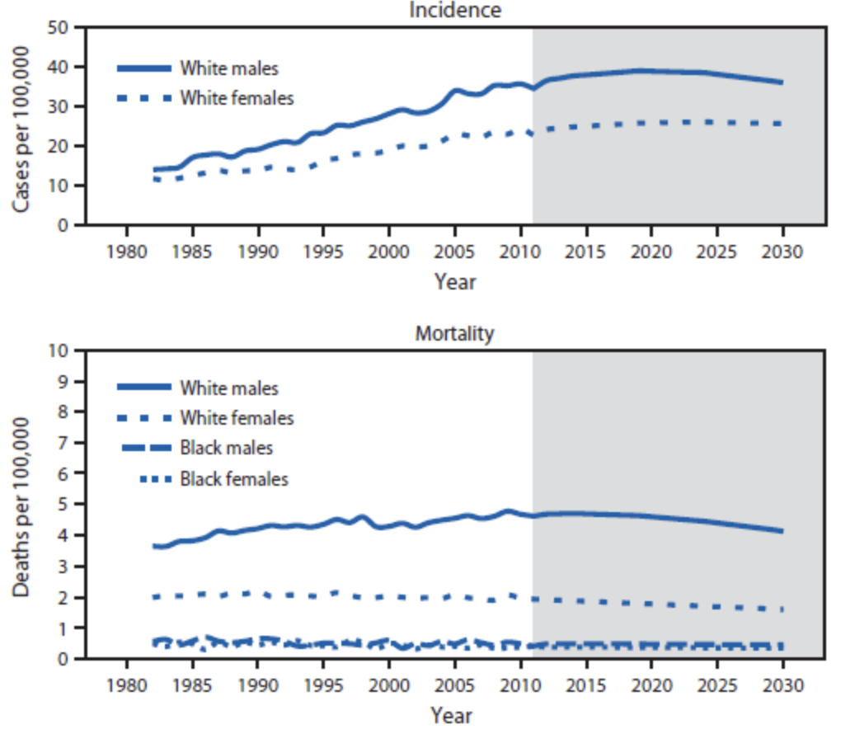
Incidence and mortality
Mediterranean 3-5/100k, Northern Europe 12-35/100k, Oceania >50/100k; systematically underestimated: in situ melanoma treated on outpatient basis
Siegel et al. 2023; Guy et al. 2015

Slide 30

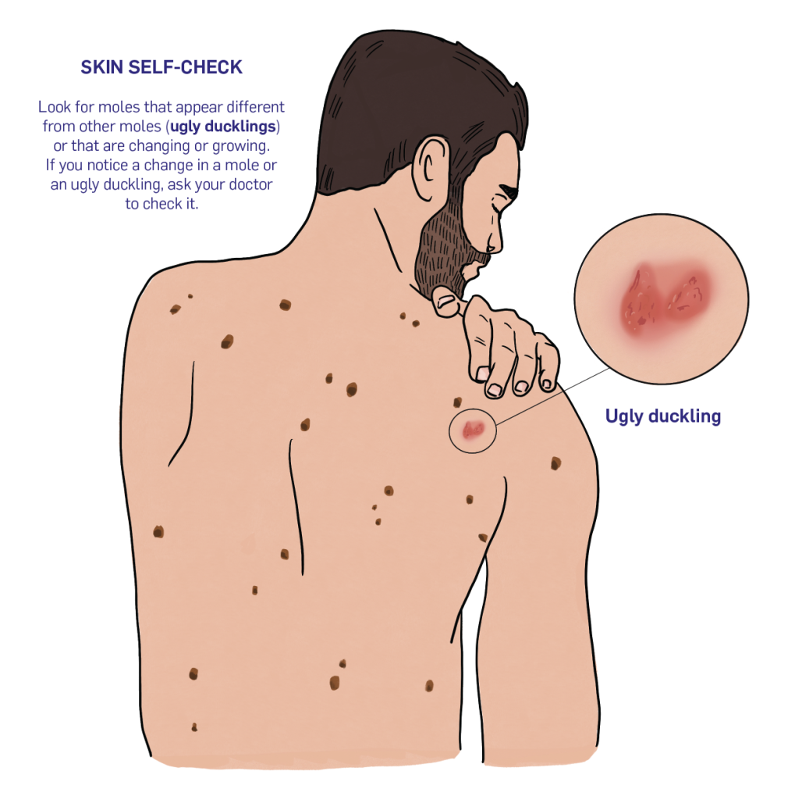
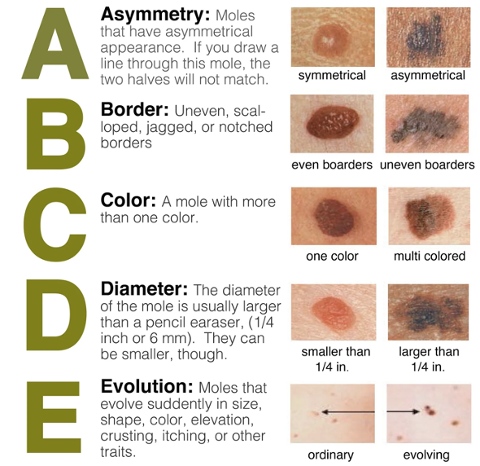
Early diagnosis
Diagnosis: excision biopsy (wide local excision with adequate margins, sentinel LN biopsy)
Grob et al. 1998

Slide 31
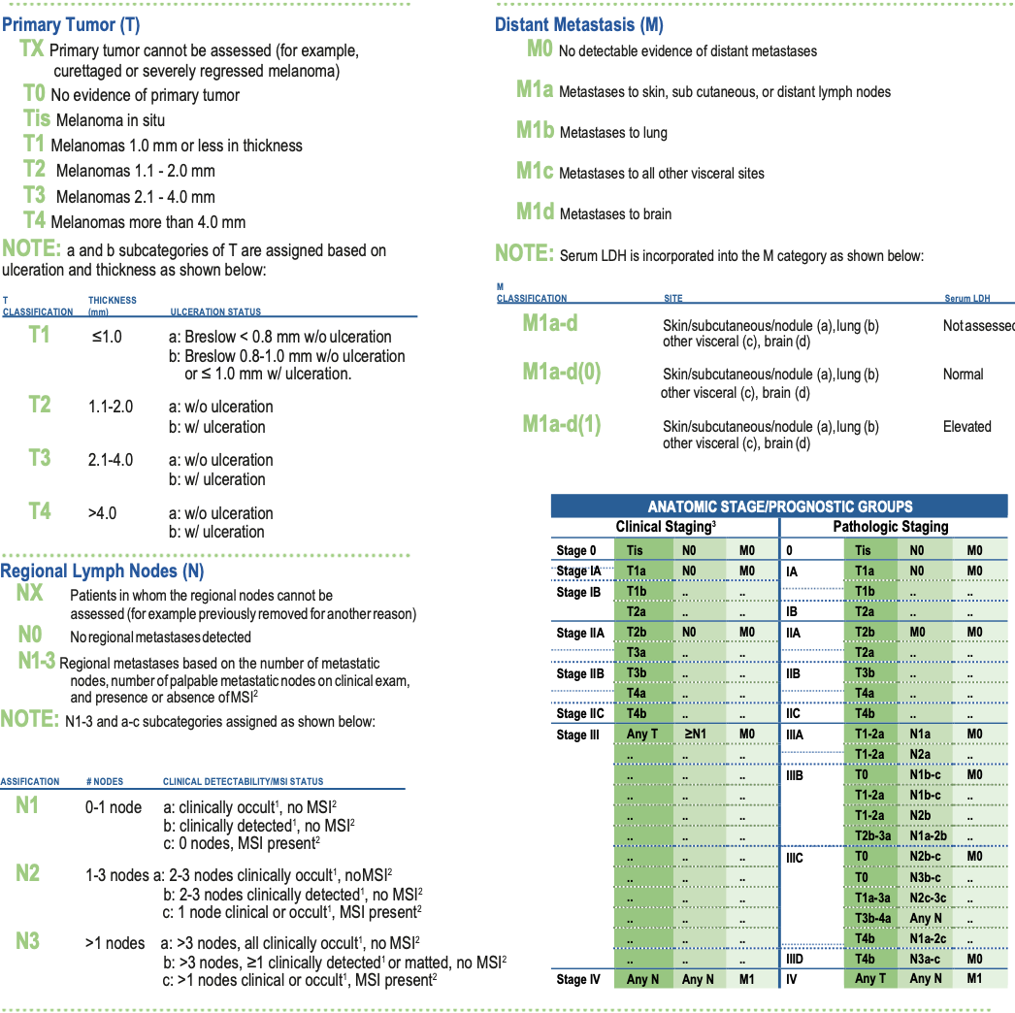
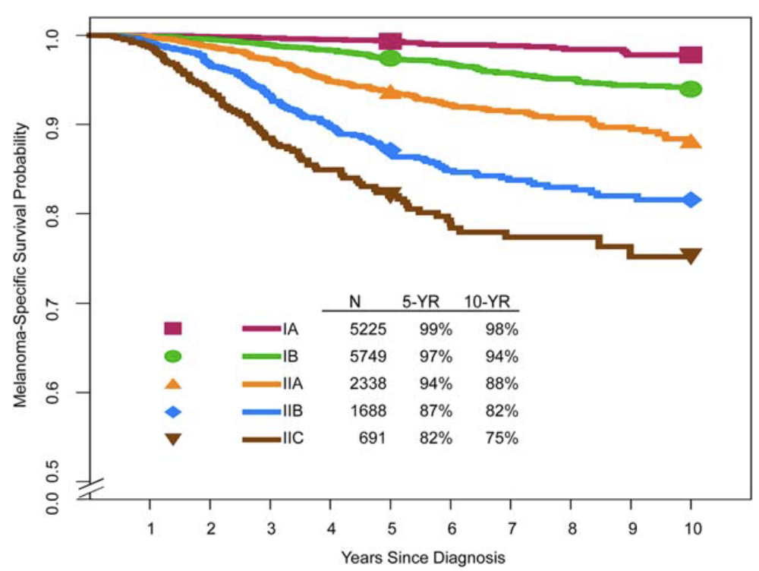
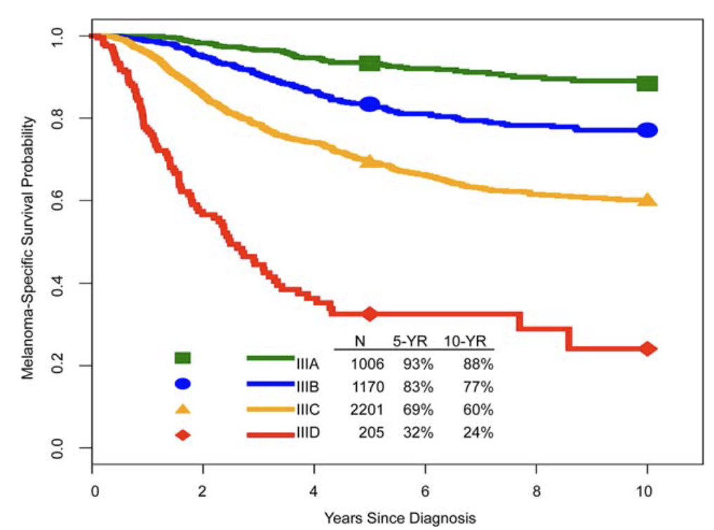
Staging
Gershenwald et al. 2017

Slide 32
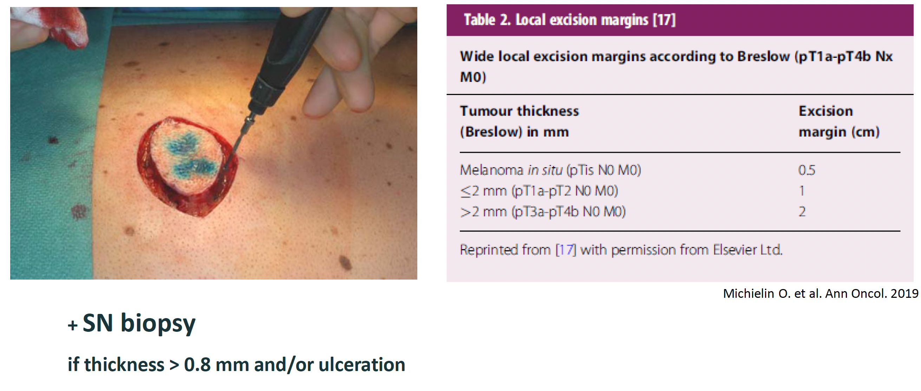
Management of local/locoregional disease
Michielin et al. 2019

Slide 33
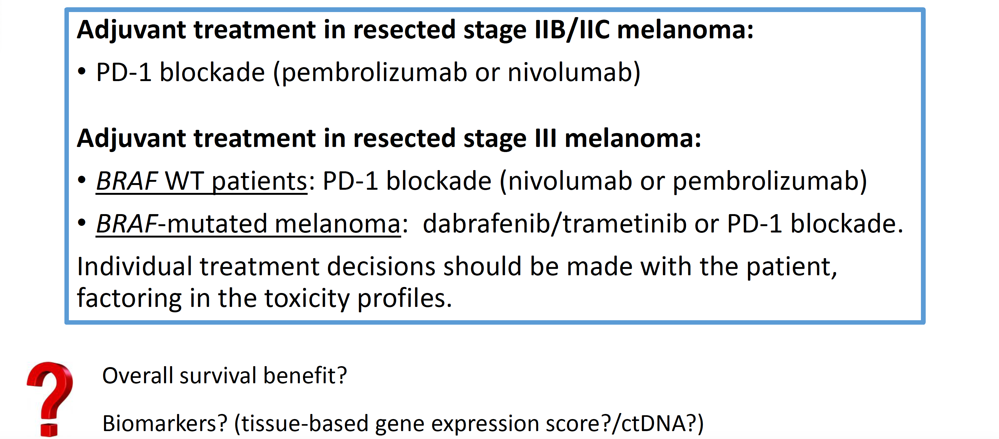
Adjuvant treatment options

Slide 34
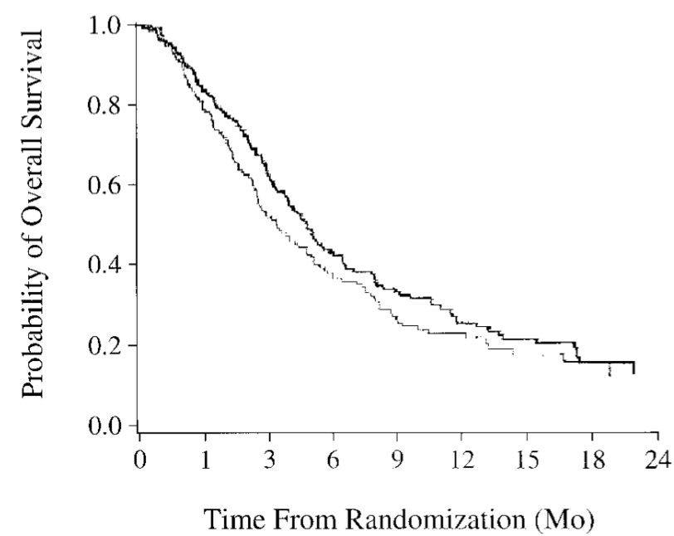

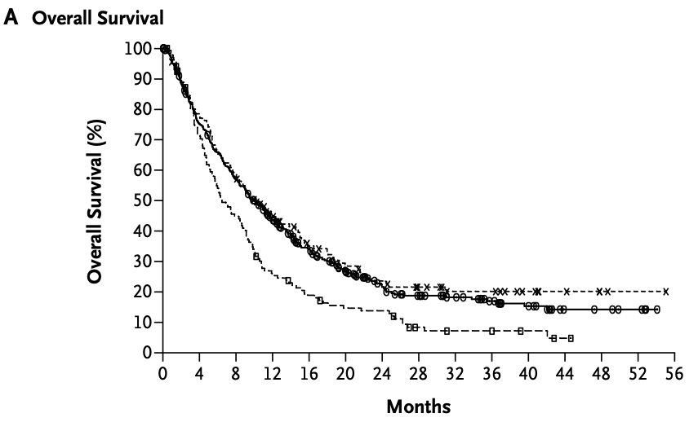
Treatment of unresectable disease
Temozolomide vs DTIC
Median OS ≃ 6 months
5-year OS ≃ 6%
Ipilimumab
Median OS 10.1 months
< 2011
2011
Middleton et al. 2000; Hodi et al. 2010

Slide 35
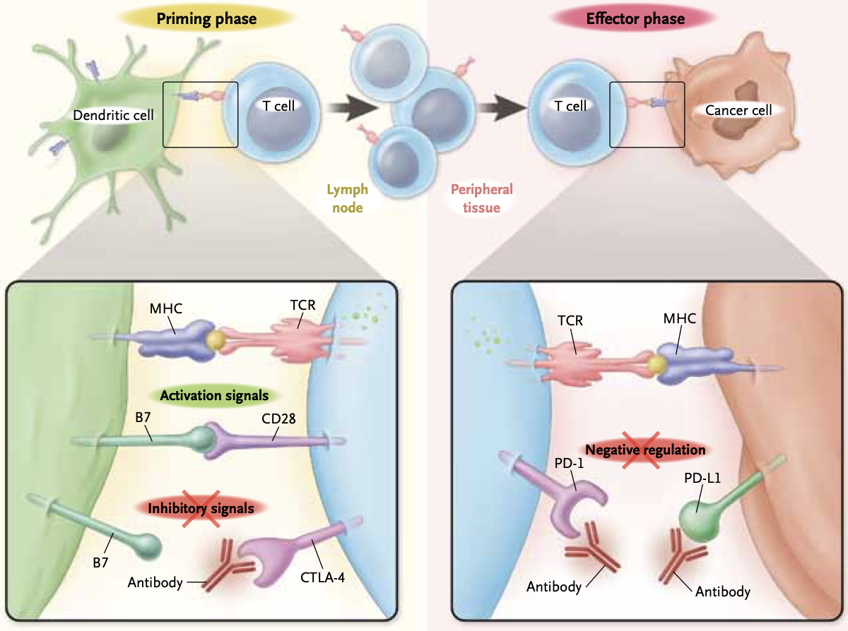
Ribas et al. 2012

Slide 36
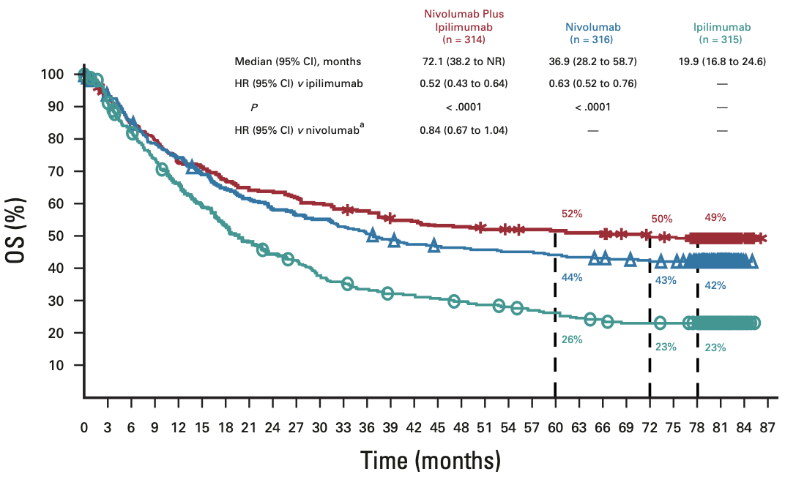
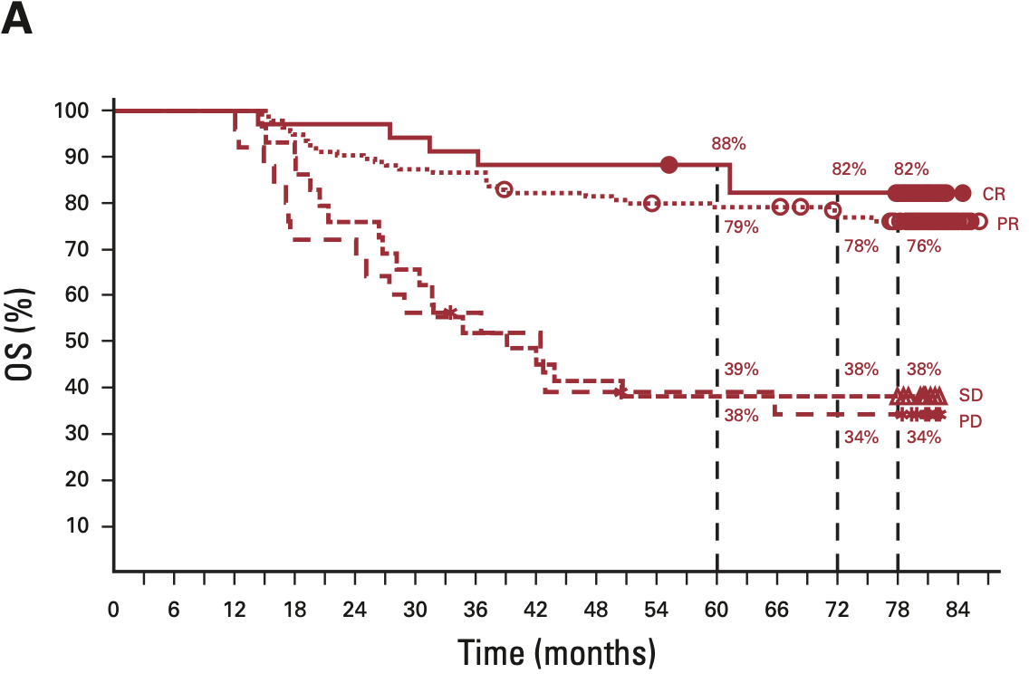
Combination immunotherapy: CheckMate067
Phase 3, Randomized 1:1:1
Primary endpoints: PFS, OS
Median OS
72.1 months Nivolumab plus Ipilimumab
36.9 months Nivolumab
19.9 months Ipilimumab
No predictive biomarkers!
Larkin et al. 2015; Larkin et al. 2019; Wolchok et al. 2022

Slide 37
Thank you

