Slide 1
Basic principles of targeted therapy
Emmanouil Panagiotou, MD, MSc, PhD(c)
Resident Physician in Medical Oncology
Third Internal Medicine Unit and Lab
Medical School, National and Kapodistrian University of Athens
empanagi@med.uoa.gr

Slide 2
Reasoning for targeted therapy
Certain molecular alterations are oncogenic drivers:
Cancer cells depend on altered genetic pathways for survival
Alterations are unique or overexpressed in cancer cells
  Less toxicity to normal cells
Targeting driver mutations may stop tumor progression

Slide 3
Differences
Chemotherapy
Targeted therapy
All rapidly dividing normal and cancerous cells
Identified because they kill cells
Cytotoxic
Specific molecular targets associated with cancer
Designed to interact with a specific target
Often cytostatic

Slide 4
Who will benefit from targeted therapy?
Biomarker:
Organ site
Histology
Gene
Genomic alteration
RNA transcript
Protein expression
Post-translational protein modification
Multigene panels

Slide 5
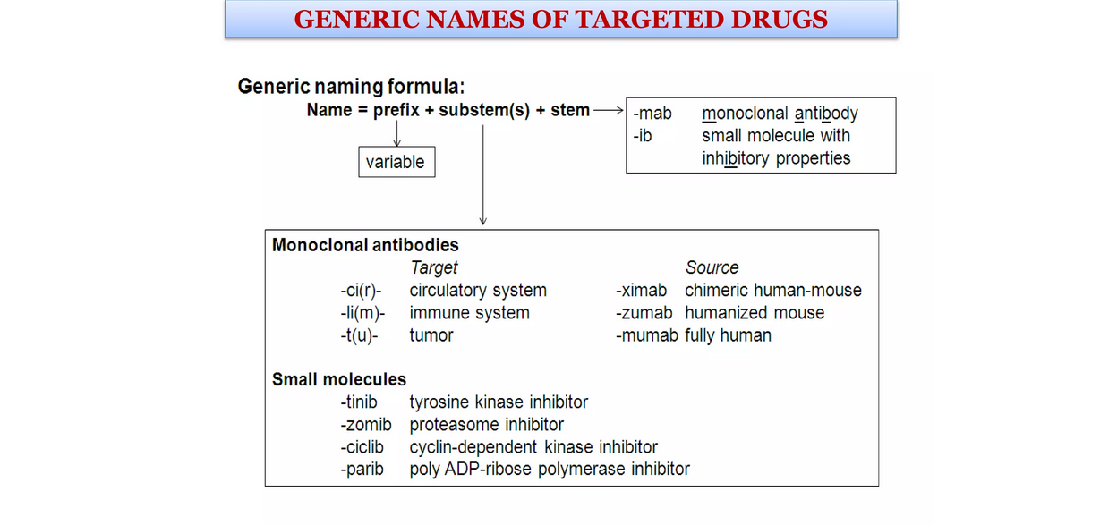

Slide 6
Types of targeted therapies
Tyrosine kinase inhibitors
Endocrine therapies
Monoclonal antibodies
Bispecific antibodies
Targeted delivery of chemotherapy
  Liposomes
  Nanoparticles
  Antibody-drug conjugates

Slide 7
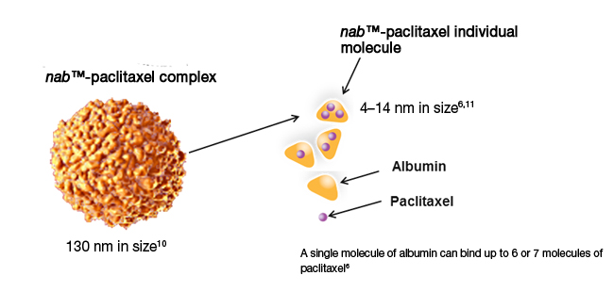
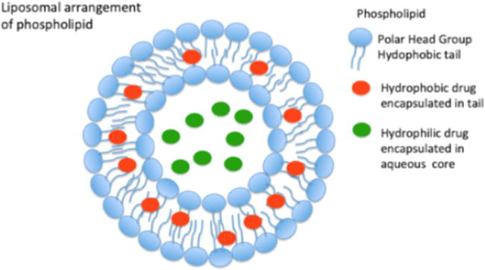
Targeted chemotherapy
Liposomal doxorubicin
Nanoparticle albumin-bound paclitaxel

Slide 8
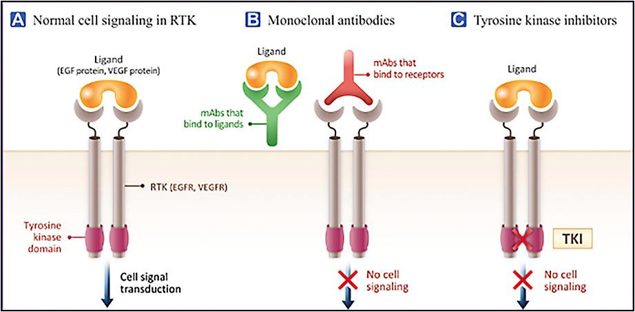

Slide 9
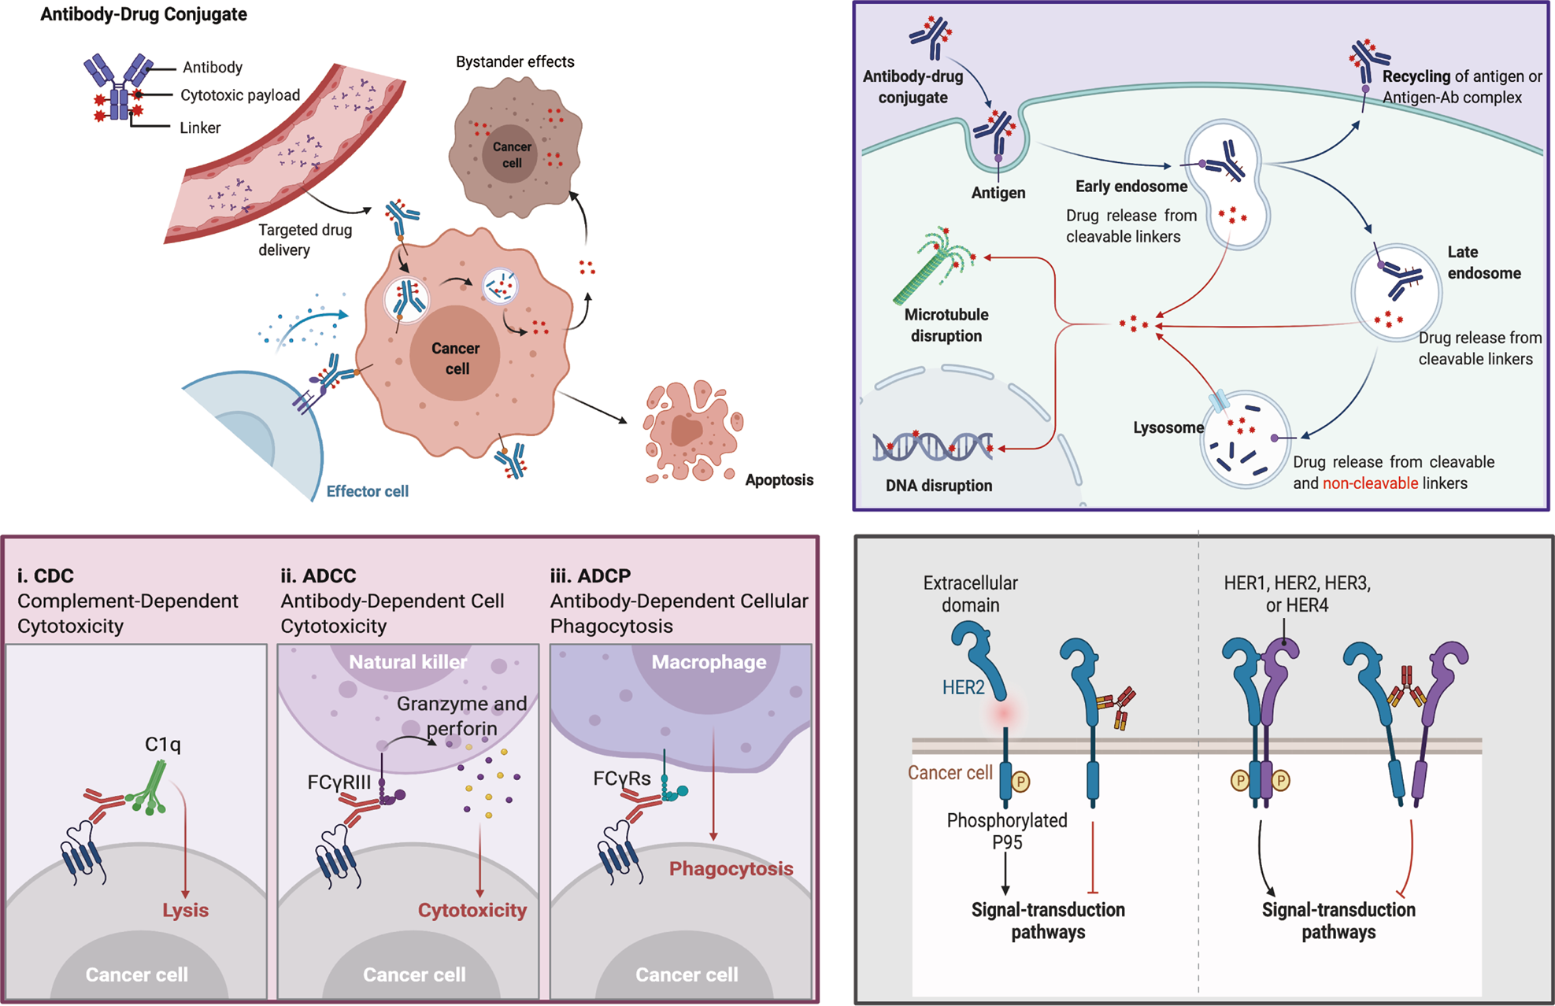

Slide 10
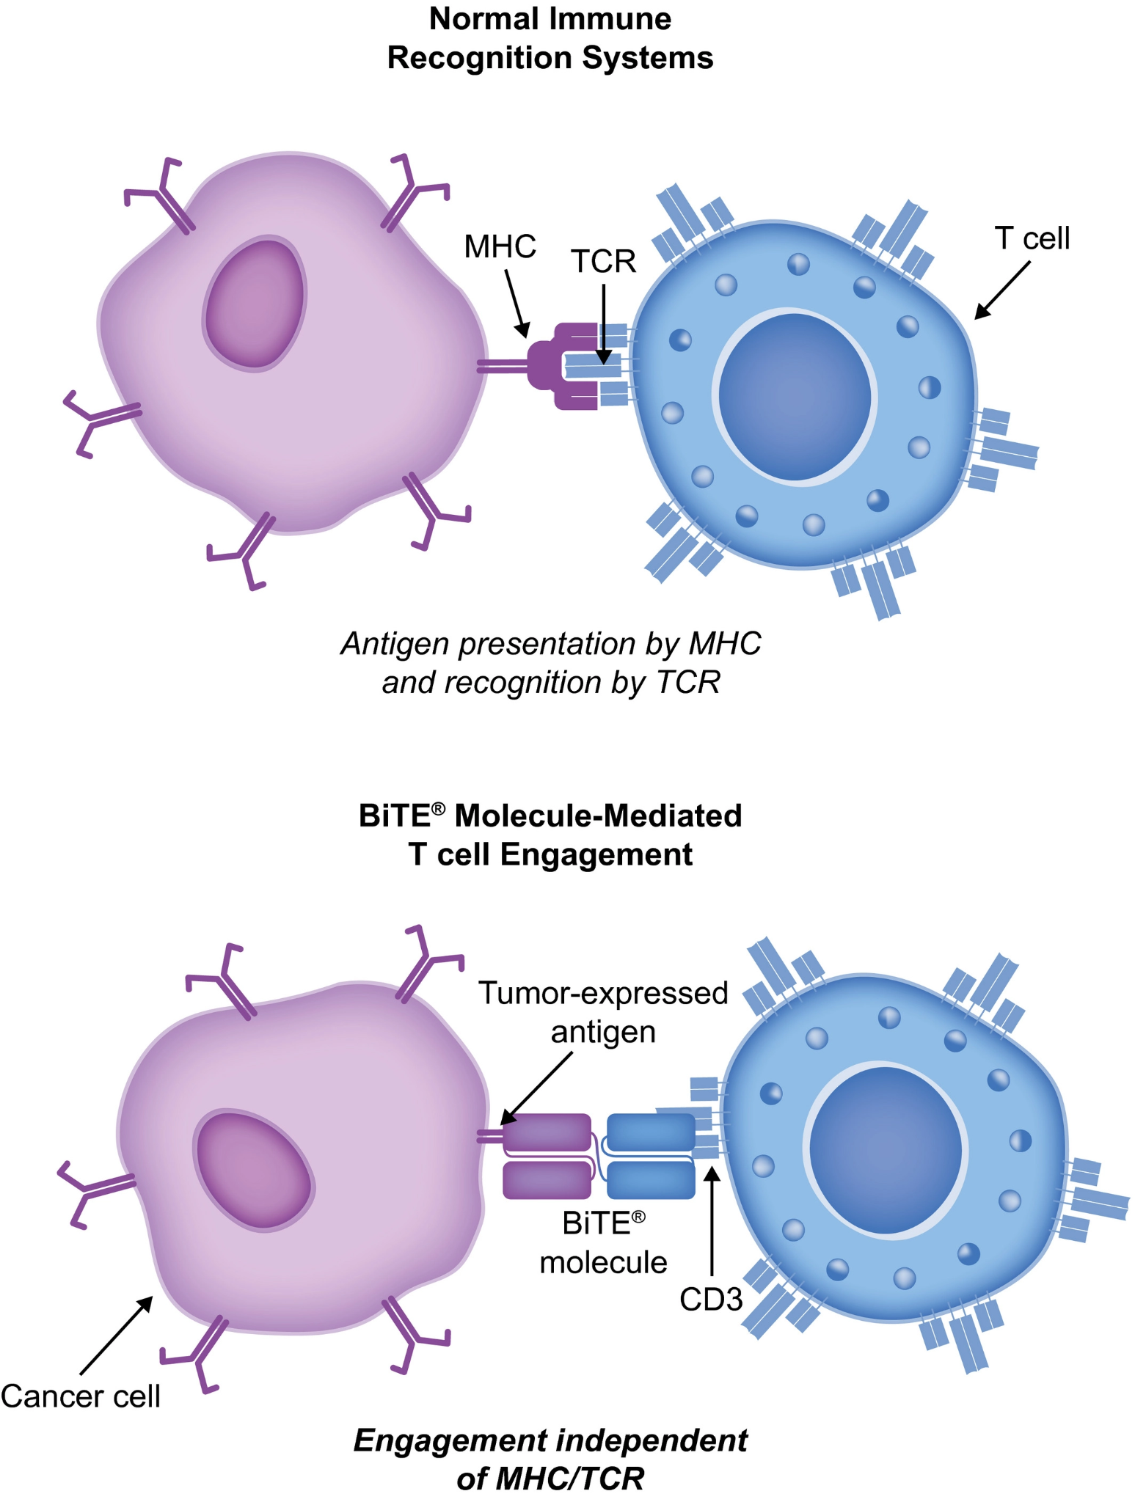

Slide 11
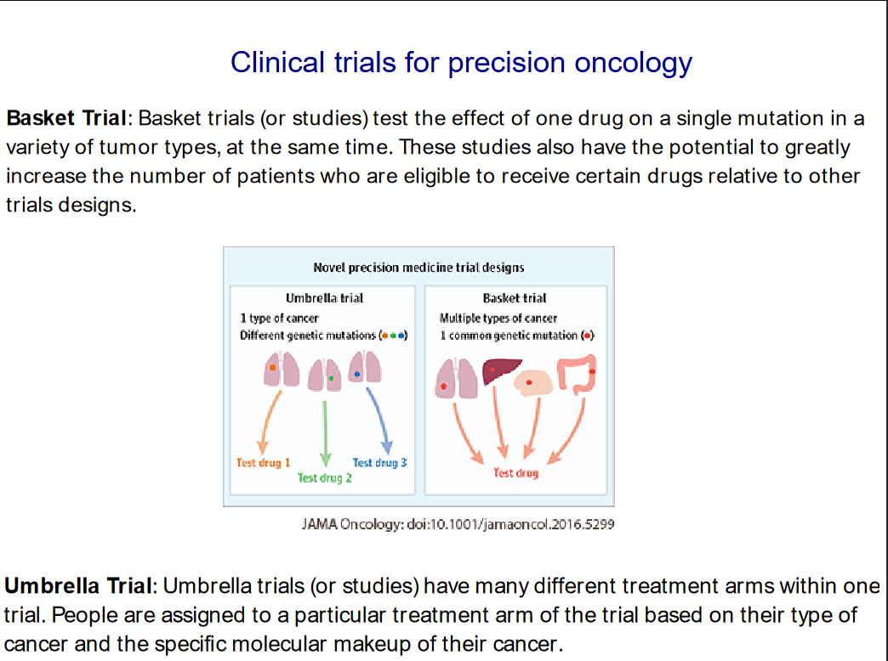

Slide 12
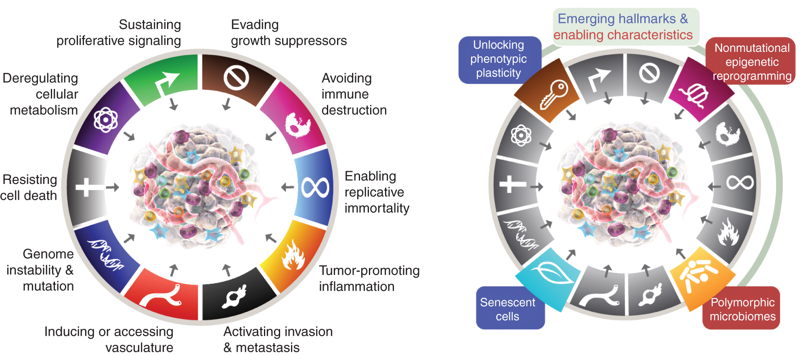

Slide 13
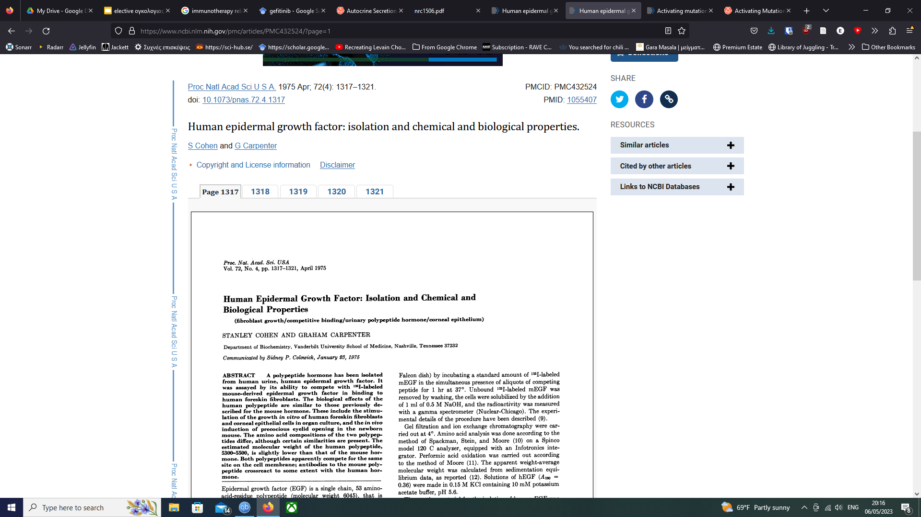
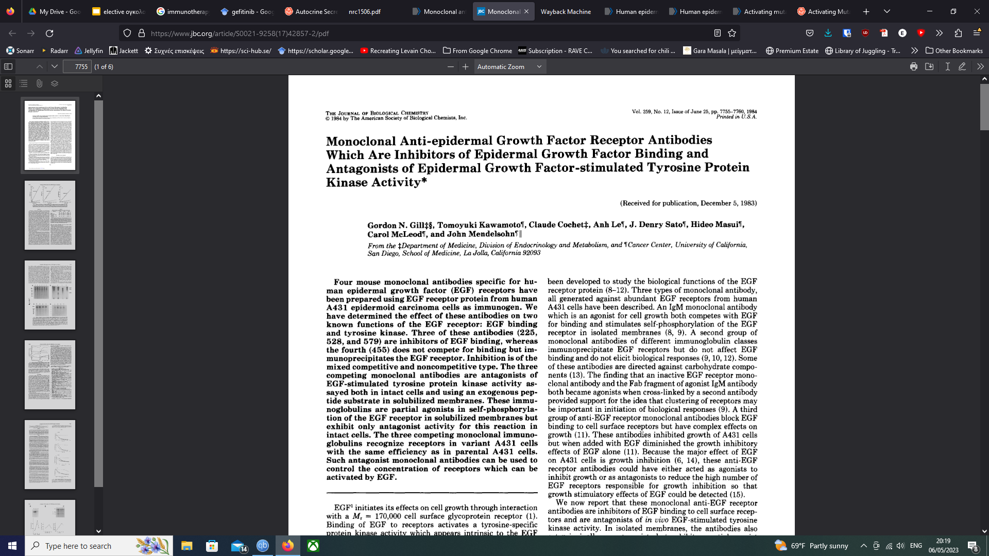
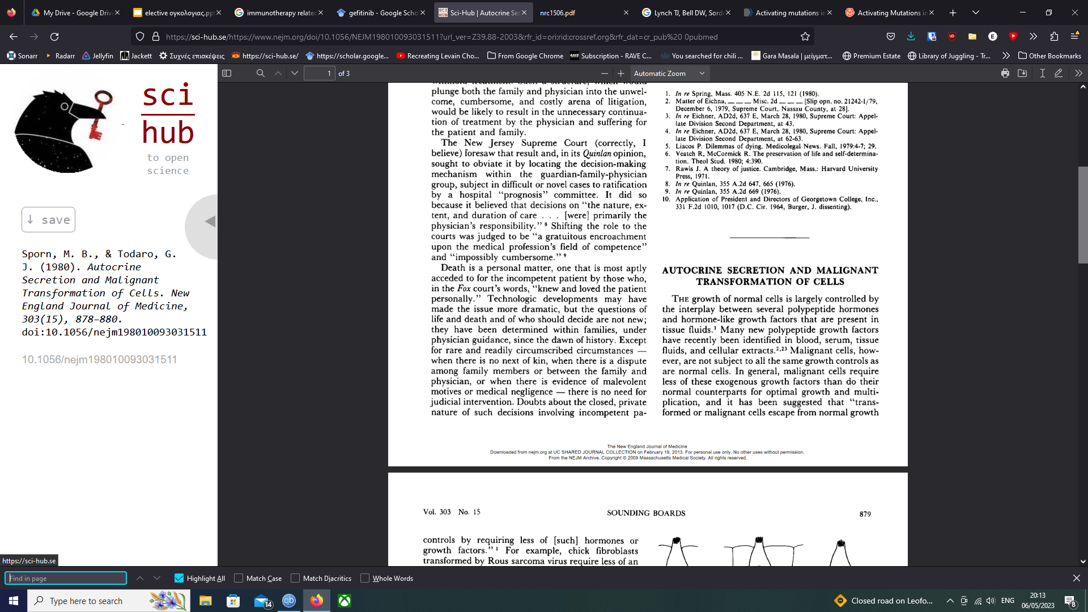
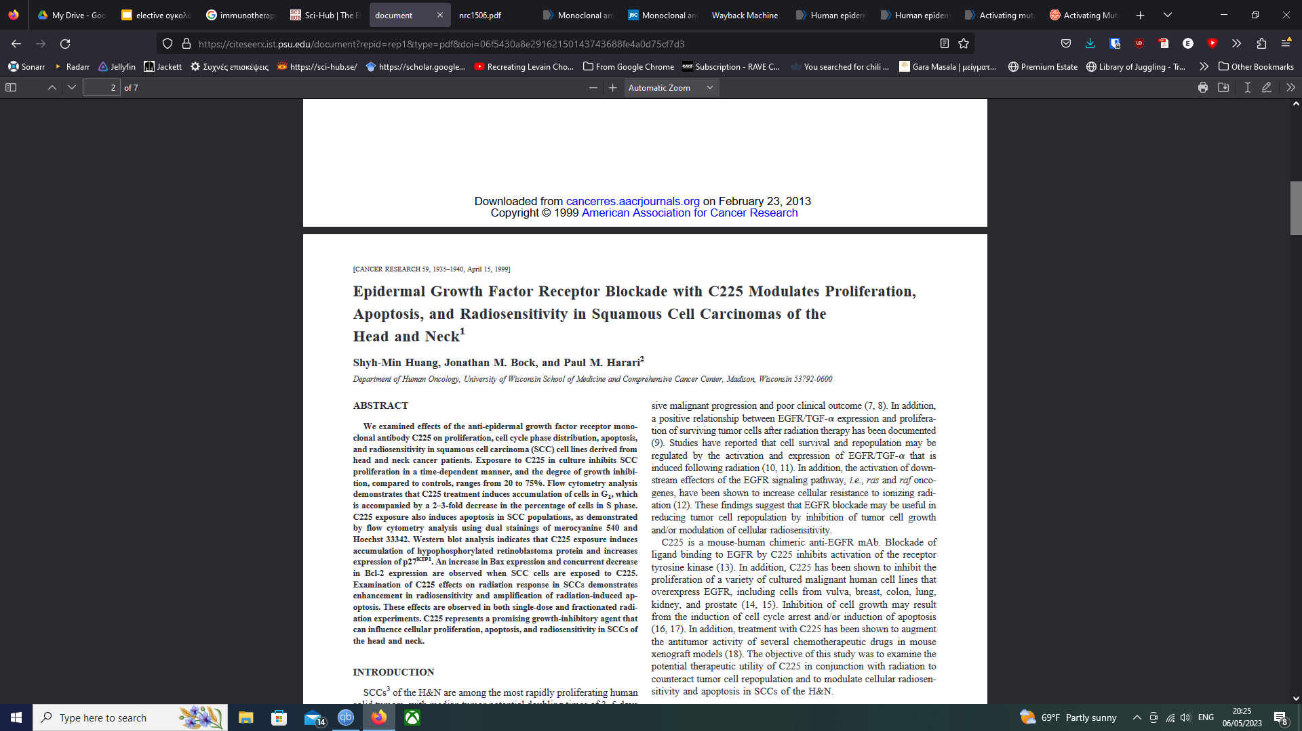
EGFR: preclinical studies

Slide 14
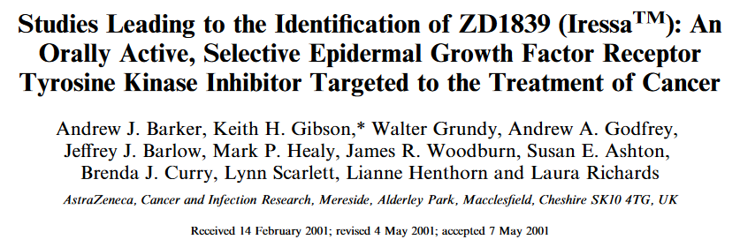
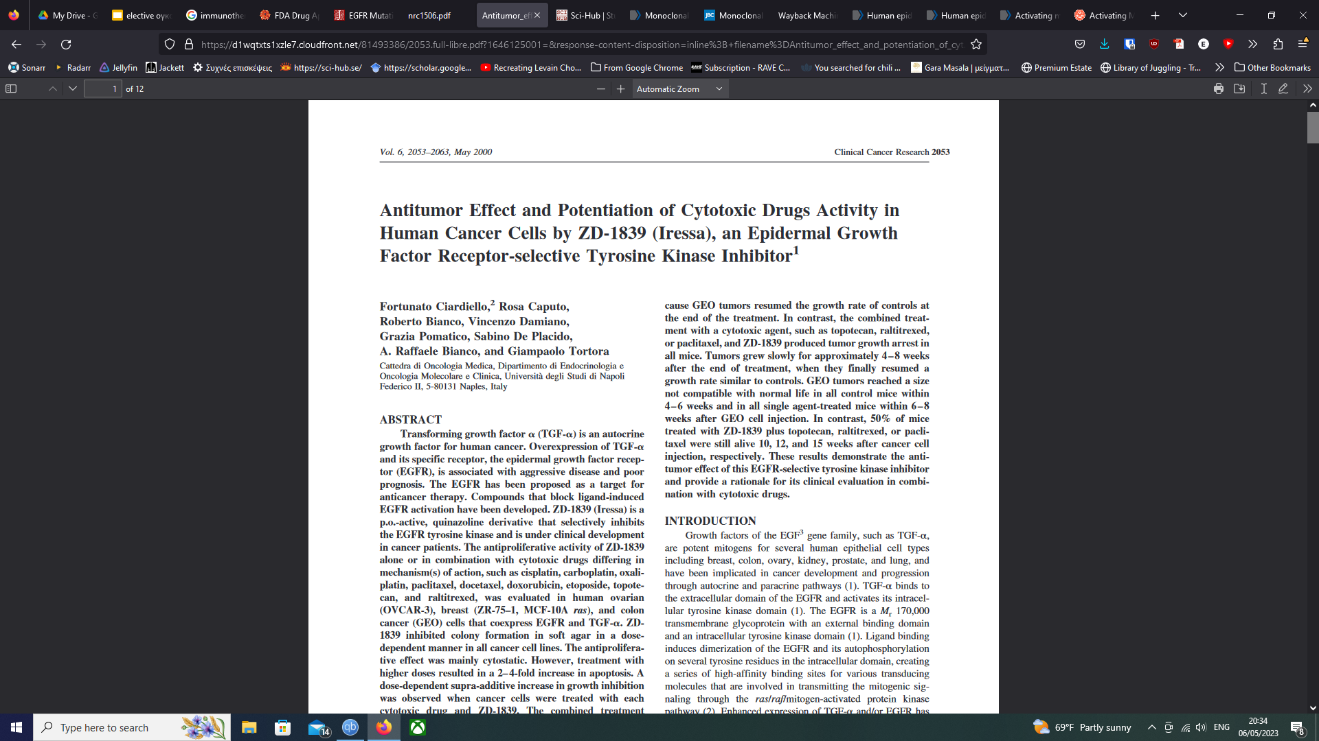
EGFR: Tyrosine kinase inhibitors

Slide 15
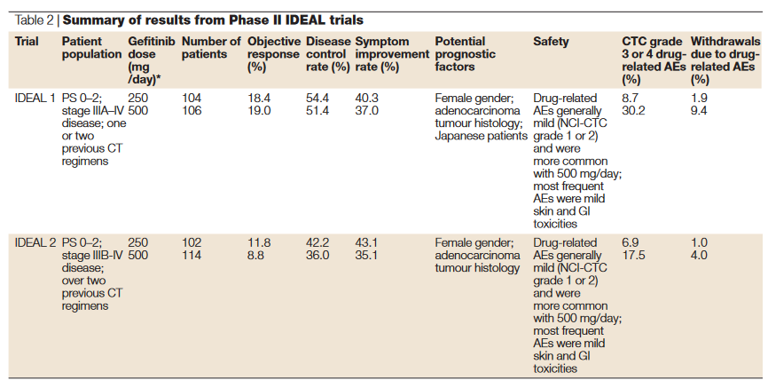
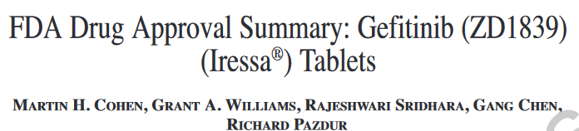

Slide 16
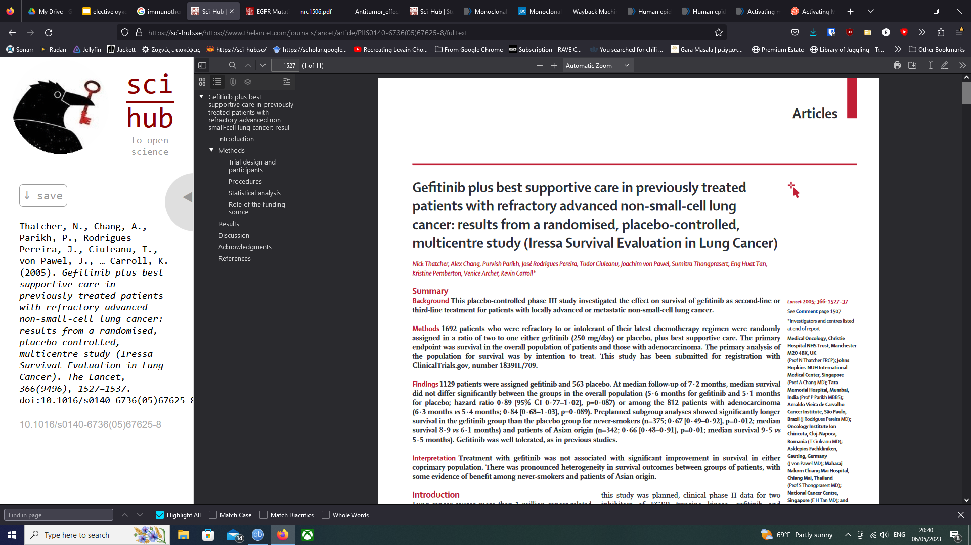
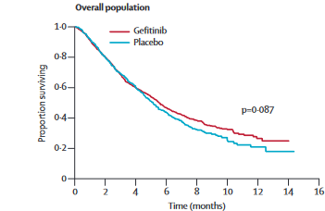
Median overall survival:
Gefitinib: 5.6 months
Placebo: 5.1 months
Hazard ratio: 0.89
[95% CI 0.77–1.02], p=0.087

Slide 17
Why didn’t it work?
Gefitinib has no activity in advanced NSCLC
  ORR: 12-18%
Suboptimal dose
  No difference between 250mg and 500mg in phase II trials
Small follow-up period
  Results did not change after longer follow-up
Only some patients benefit
Heavily pre-treated patients, non-responsive to any treatment
Methodological issues

Slide 18
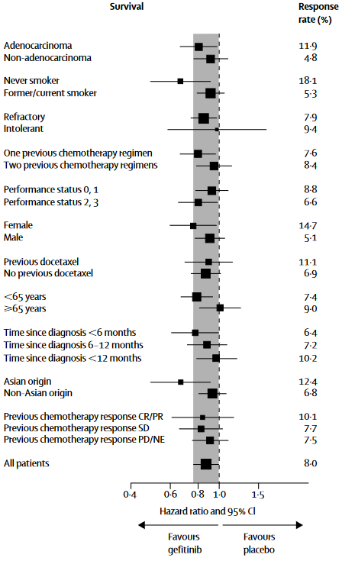

Slide 19
TARGETING EGFR IN ADVANCED NSCLC
1st line gefitinib versus chemotherapy – IPASS study
Untreated Asian
patients* with stage IIIb/IV
R
A
N
D
O
M
I
S
E
NCSLC and PS 0-2
(N = 1217)
Gefitinib 250 mg/day
(n = 609)
R
Carboplatin AUC 5-6 +
Paclitaxel 200 mg/m² q3w (n = 608)
*Never smokers or ex-light smokers.
Primary endpoint: PFS
Biomarker analysis: EGFR mutation, expression, and gene copy number
Fukuoka M, et al. ASCO 2009. Abstract 8006.

Slide 20
TARGETING EGFR IN ADVANCED NSCLC
1st line gefitinib versus chemotherapy – IPASS study
PFS: Mutated EGFR PFS: Wild-Type EGFR
100 100
Median PFS
Gefitinib (n = 132): 9.5 mos
CP (n = 129): 6.3 mos
Median PFS
Gefitinib (n = 91): 1.6 mos
CP (n = 85): 5.5 mos
80 80
Progression free (%)
Progression free (%)
60 60
40 40
20 20
HR: 2.85
P < 0.0001
HR: 0.48
P < 0.0001
0
0
0
0 | 4 | 8 | 12 | 16 | 20 | 24 |  | 4 | 8 | 12 | 16 | 20 | 24
 |  |  | Mos |  |  |  |  |  |  | Mos
Fukuoka M, et al. ASCO 2009. Abstract 8006.

Slide 21
TARGETING EGFR IN ADVANCED NSCLC
1st line gefitinib versus chemotherapy – IPASS study
OR: 2.75
P = 0.0001
OR: 0.94
P = 0.0013
OR: 1.79
P = 0.0243
OR: 0.80
P = 0.5580
OR: 1.49
P = 0.1093
OR: 1.44
P = 0.4146
80
70
60
50
40
30
20
10
0
71.2
Gefitinib
CP
58.9
51.5
47.3
44.8
ORR (%)
41.8
34
23.5
26.3
26.1
22.2
1.1
Positive Negative
EGFR Mutation
High Low
EGFR Gene Copy Number
Positive Negative
EGFR Expression
Fukuoka M, et al. ASCO 2009. Abstract 8006.

Slide 22
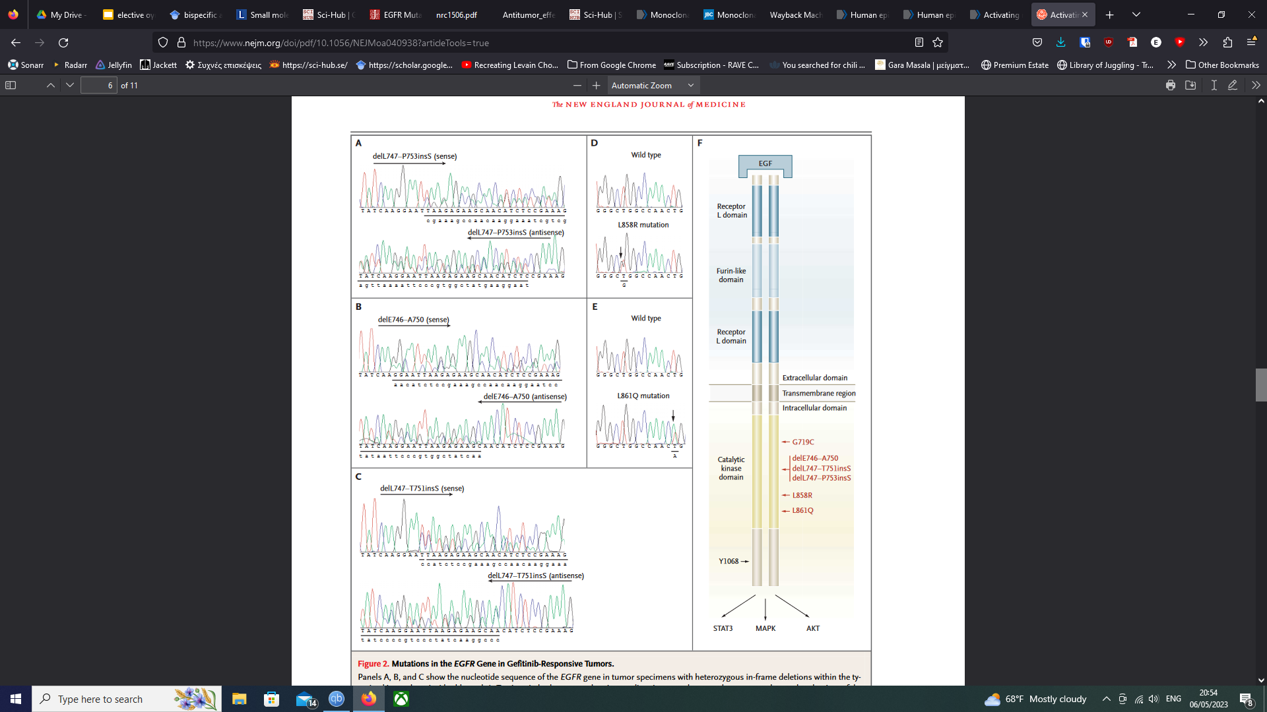
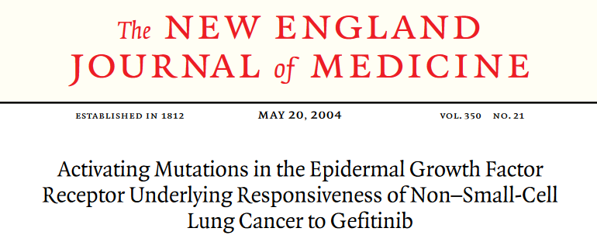

Slide 23
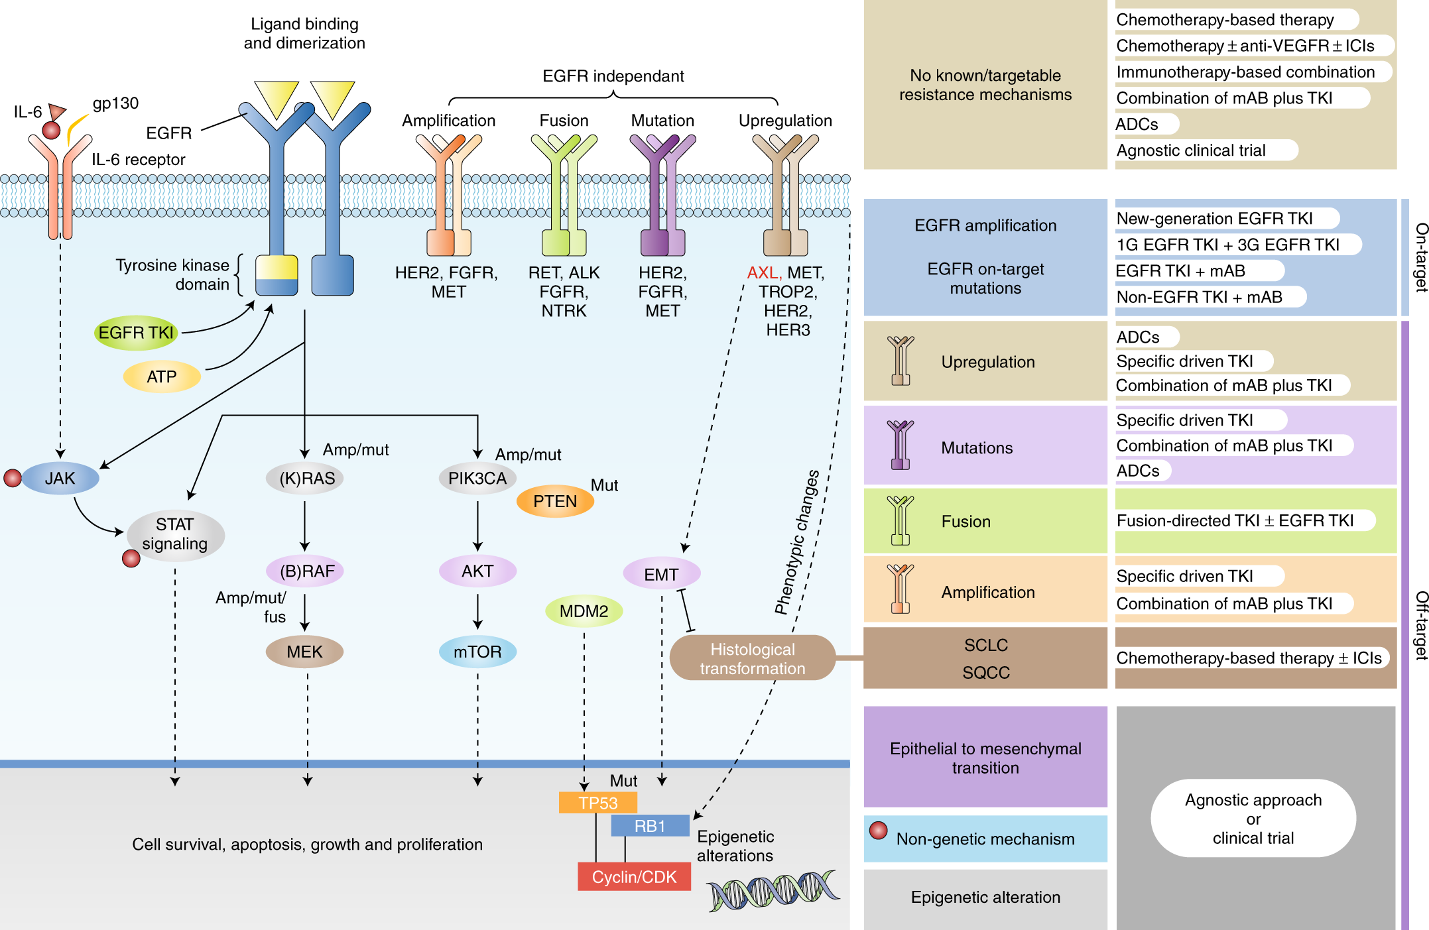

Slide 25
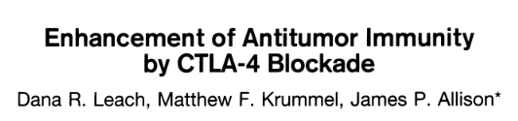
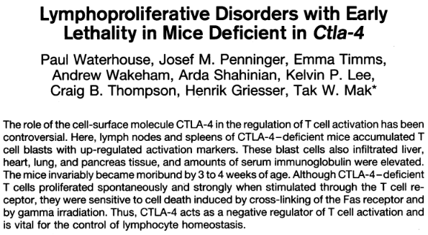
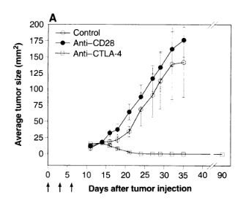
CTLA-4 is involved in antitumor immunity

Slide 26
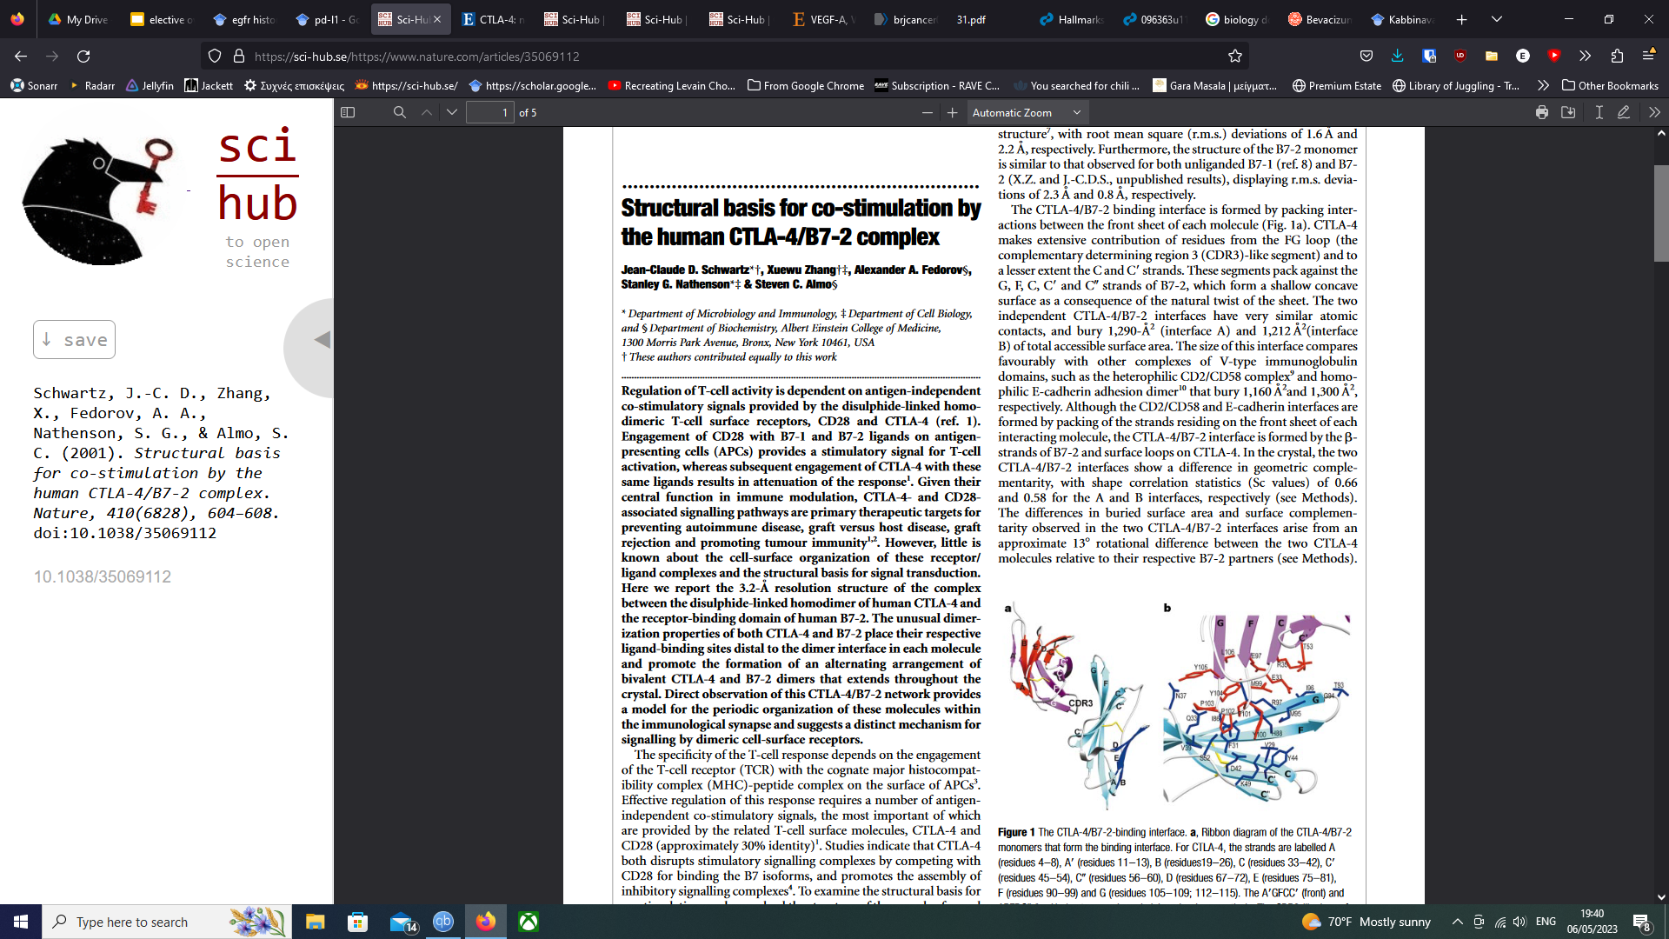
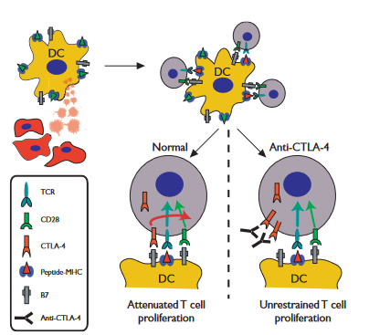
CTLA-4: Structural and functional modeling

Slide 27
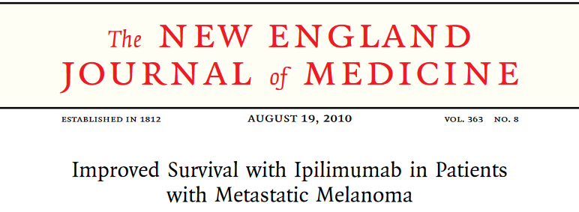
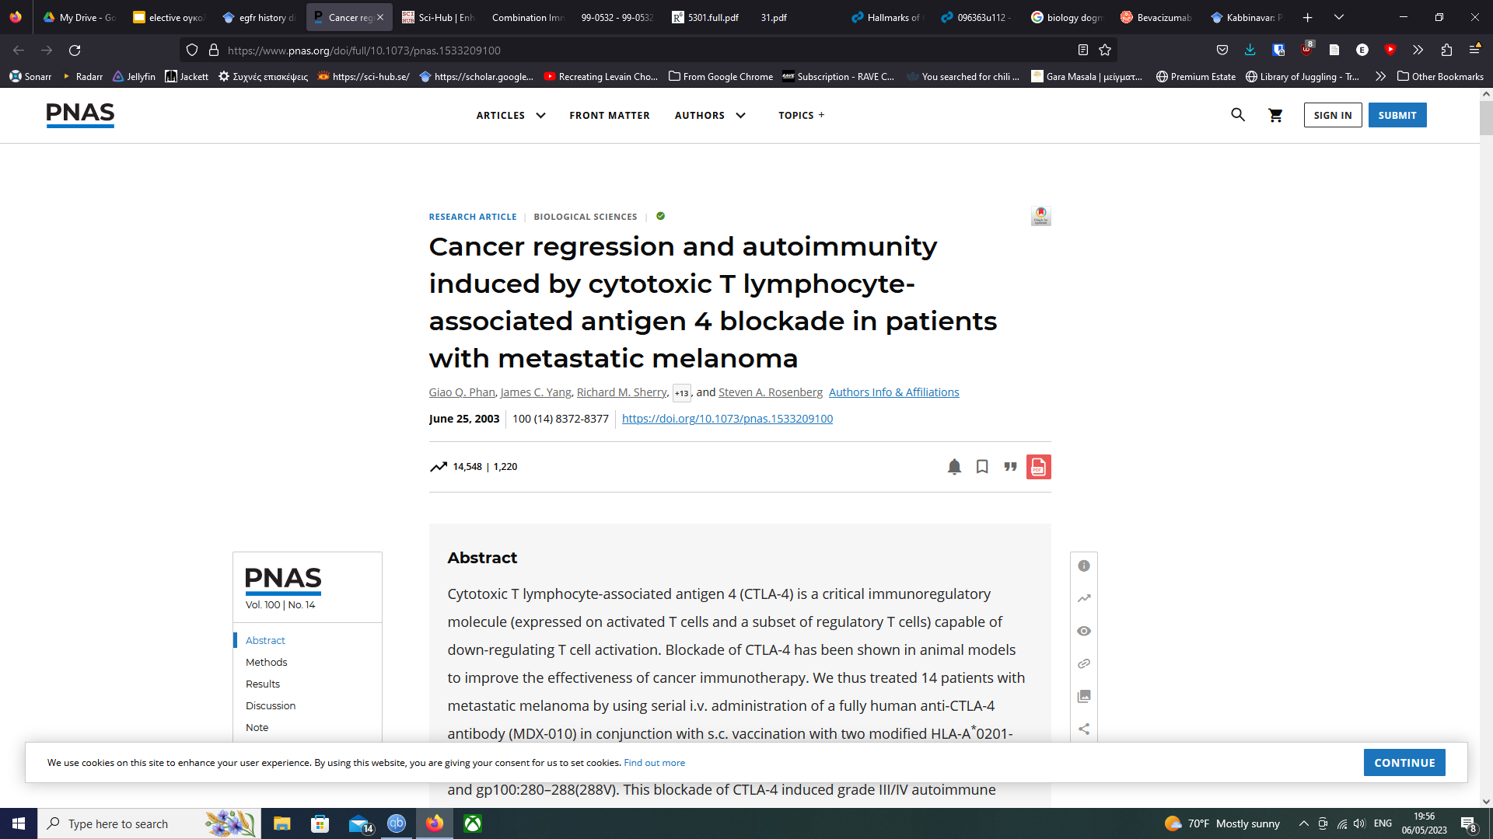
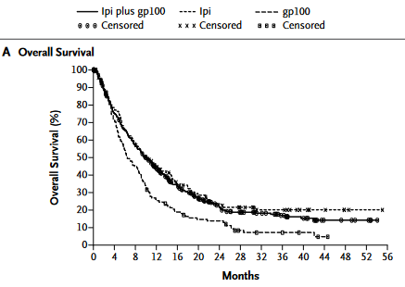
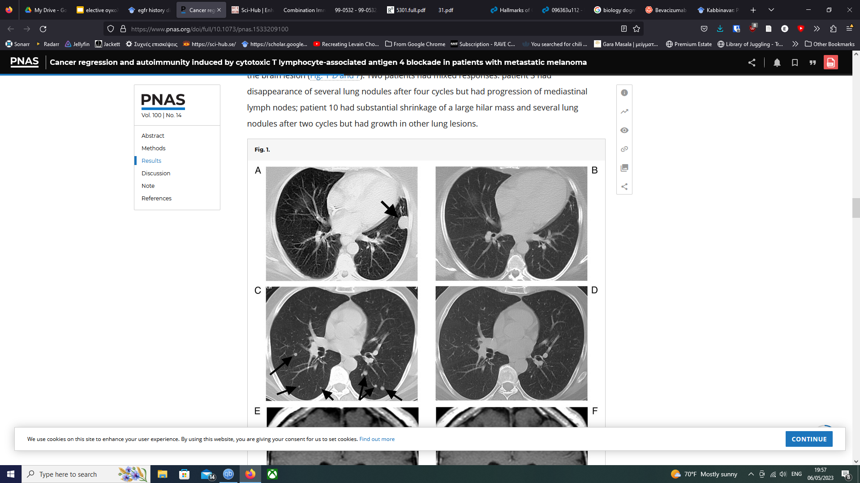
From bench to bedside

Slide 28
Combined immunotherapy: Checkmate 067
Phase 3 study in previously untreated patients with advanced melanoma
100
80
*p < 0.00001 versus IPI
60
(%)
49 %
46 %
40
42 %
39 %
20
NIVO + IPI NIVO
IPI
0
18 %
14 %
0
3
6
9
12
15
18
21
24
27
Months
 | Nivo + Ipi (n=314) | Nivo (n=316) | Ipi (n=315)
Median PFS, months (IC ₉₅) | 11.5 (8.9-16.7) | 6.9 (4.3-9.5) | 2.9 (2.8-3.4)
Wolchok JD, et al. J Clin Oncol 34, 2016 (suppl; abstr 9505). Reproduced with permission from Dr Jedd Wolchok.

Slide 29
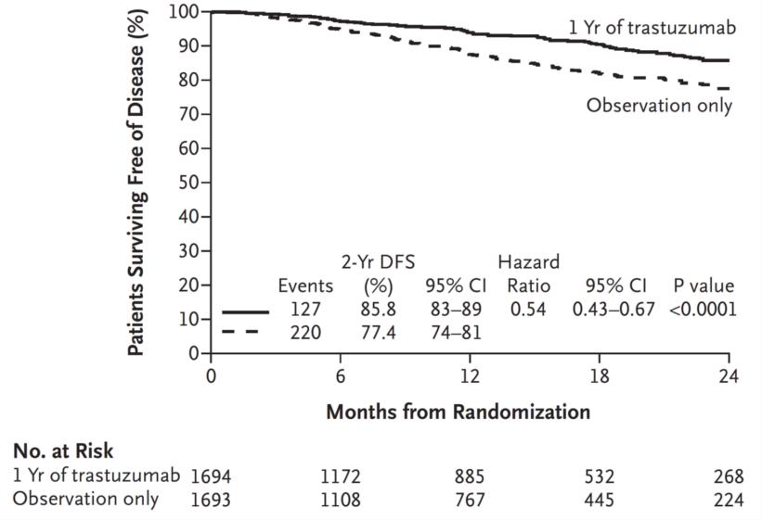
Targeted therapy may be useless in the wrong patient
HERA trial (adjuvant trastuzumab) in breast cancer
Disease-free survival¹
The right subpopulation The right drug
A huge treatment effect!
Median follow-up: 1 year
Disease-free survival HER2+ and HER2–patients
Patients 100 (%)
80
1 year trastuzumab
Observation
60
40
Events
2-year DFS
HR 95% CI p value
Simulation of HERA if conducted in unselected patients (HER2 +/–):
HER2+ : HR 0.54
HER2– : HR 0.95
20
138
170
93.4 0.88 0.71, 1.11 0.29
92.5
0
0
6 12 18
Months from randomisation
24
No. | 1646 | 1466 | 1256 | 1005 | 703
at risk | 1740 | 1567 | 1353 | 1083 | 779
Median follow-up: 1.8 years
HR, hazard ratio; CI, confidence interval
Simulation by Aparna Keshaviah, Sc.M.
SABCS 2005
1. From N Engl J Med, Piccart-Gebhart MJ. et al., Trastuzumab after Adjuvant Chemotherapy in HER2-Positive Breast Cancer, 353(16):1659–72. Copyright © 2005 Massachusetts Medical Society. Reprinted with permission from Massachusetts Medical Society.

Slide 30
Targeted therapy is different for each cancer
Drug | Tumour type | ORR
Vemurafenib | BRAFV600m metastatic melanoma | 48% | Chapman PB, et al. NEJM. 2011
Vemurafenib | BRAFV600m metastatic CRC | 5% | Kopetz S, et al. JCO 2015
Vemurafenib + cetuximab | BRAFV600m metastatic CRC | 20% | Tabernero J, et al. JCO 2014 no. 15_suppl
Dabrafenib + trametinib + panitumumab | BRAFV600m metastatic CRC | 18% | Corcoran RB, et al. ESMO 2014

Slide 31
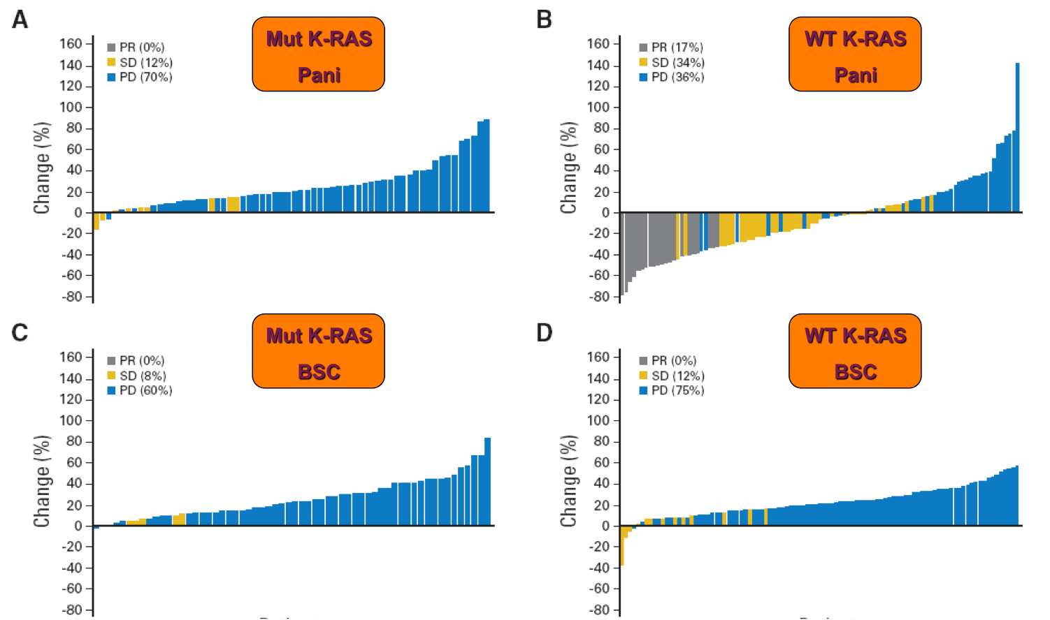
Off-target resistance: panitumumab (EGFR inhibitor) in mCRC
Amado RG, et al. J Clin Oncol 26(10), 2008:1626–34. Reprinted with permission. © 2008 American Society of
Clinical Oncology.

Slide 32
RAS status in mCRC
Predicts benefit of anti-EGFR mabs if wild-type
Avoids harm if mutated
Avoids unnecessary toxicity
Avoids unnecessary costs

Slide 33
Current problems in targeted therapy
Toxicity
No activity in certain tumor types (yet)
No CNS activity
Difficulties in assessing response

Slide 34
Mechanism-based side effects
Side effects | Agents
GI, skin | Anti-EGFR; Multi-targeted kinases
Interstitial lung disease | Gefitinib, mTor inhibitors
Hypomagnesemia, hypocalcemia | Monoclonal Antibody Anti-EGFR
Hypophosphatemia | Imatinib
Cardiac dysfunction | Trastuzumab, multi TKI, others
Bleeding, thrombosis, perforation, HTA | Anti-VEGF(R)
Proteinuria | Bevacizumab, multi TKI
Reversible posterior leukoencephalopathy syndrom | Bevacizumab, multi TKI
Hypothyroidism | Sunitinib (Sorafenib)
Auto-immune disorders | Anti-CTLA-4 monoclonal antibodies
Hematological | Sunitinib, mTor inhibitors

Slide 35
Skin AEs and cetuximab efficacy in mCRC
Grade of skin reaction (up to Week 4) | Percentage of patients | Response rate | mTTP | Median survival
0 | 14.7 | 6.3% | 1.4 months | 3.0 months
1 | 26.6 | 8.6% | 1.5 months | 6.5 months
2 | 45.4 | 27.3% | 4.2 months | 10.3 months
3 | 13.3 | 55.2% | 8.2 months | 13.7 months
Cunningham D, et al. N Engl J Med (2004).

Slide 36
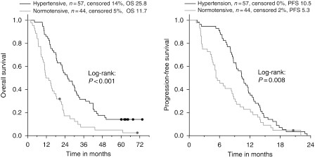
Hypertension and efficacy of bevacizumab+ChT in mCRC
Österlund P, et al. Br J Cancer 2011;104(4):599–604. Distributed under a creative common license
http://creativecommons.org/

Slide 37
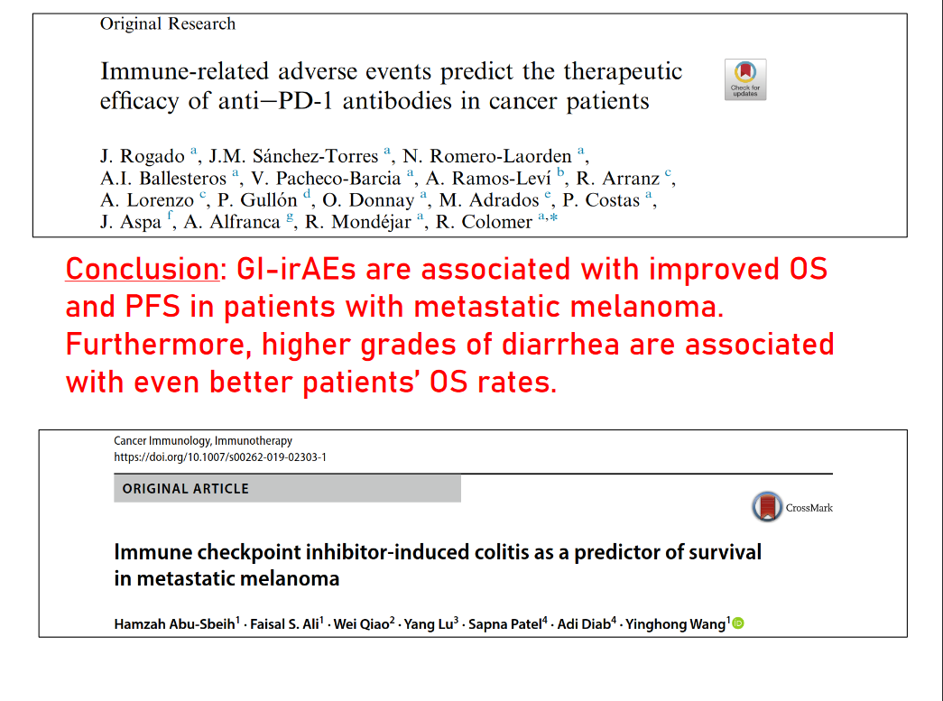

Slide 38
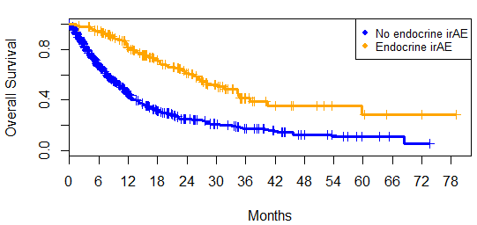
Endocrine irAEs are associated with improved survival in lung cancer
mOS:
With endocrine irAE: 31.6 months
Without endocrine irAE: 10.8 months
Hazard ratio: 0.36 (95% CI: 0.28 - 0.46, p =1.56 × 10⁻¹⁵)

Slide 39
Targeted therapy in selected tumors failed so far
The example of pancreatic cancer:
>30 randomised trials failed to show survival advantage
Absence of effective biomarkers for screening and early detection
Aggressive behaviour and resistance to the currently available chemotherapy
Inter-/intra- tumour genetic heterogeneity

Slide 40
Targeted therapy and brain metastases
Brain metastasis are more frequently seen as systemic control through targeted therapies improves
Antibodies and some small molecules do not pass the blood-brain barrier
Major clinical problem in patients with advanced breast cancer, lung cancer, melanoma and renal cell carcinoma

Slide 41
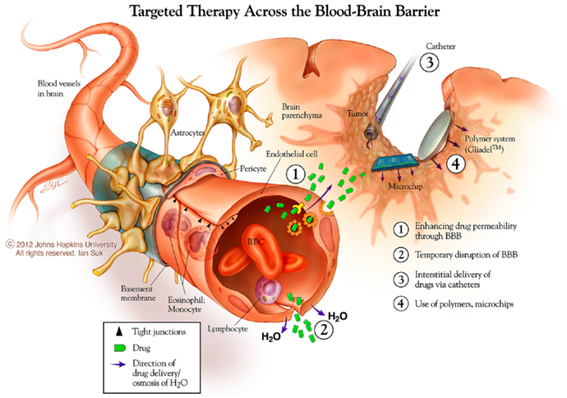

Slide 42
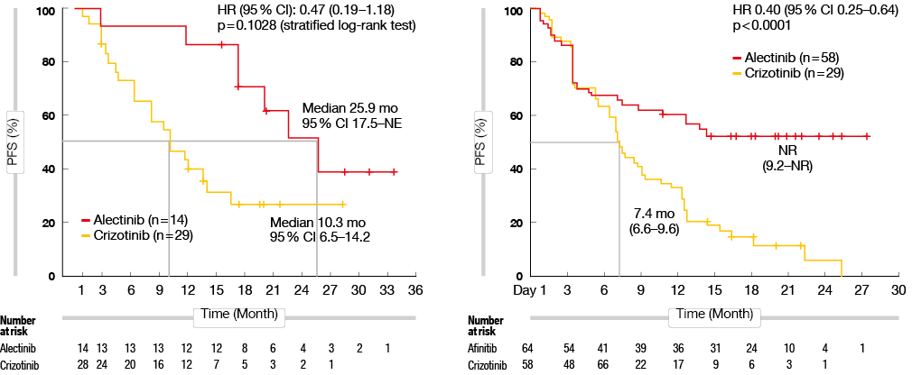
Alectinib vs. crizotinib for patients with brain metastases
(J-ALEX/ALEX)

Slide 43
Assessment of response
Standard radiological evaluation of tumour responses (RECIST) to targeted therapies could be misleading in some circumstances
Originally developed to assess response to chemotherapy
Targeted therapy:
  Prolonged disease stabilisation rather than substantial tumour regression
  Changes in tumour density
  Development of new response evaluation criteria may be needed

Slide 44
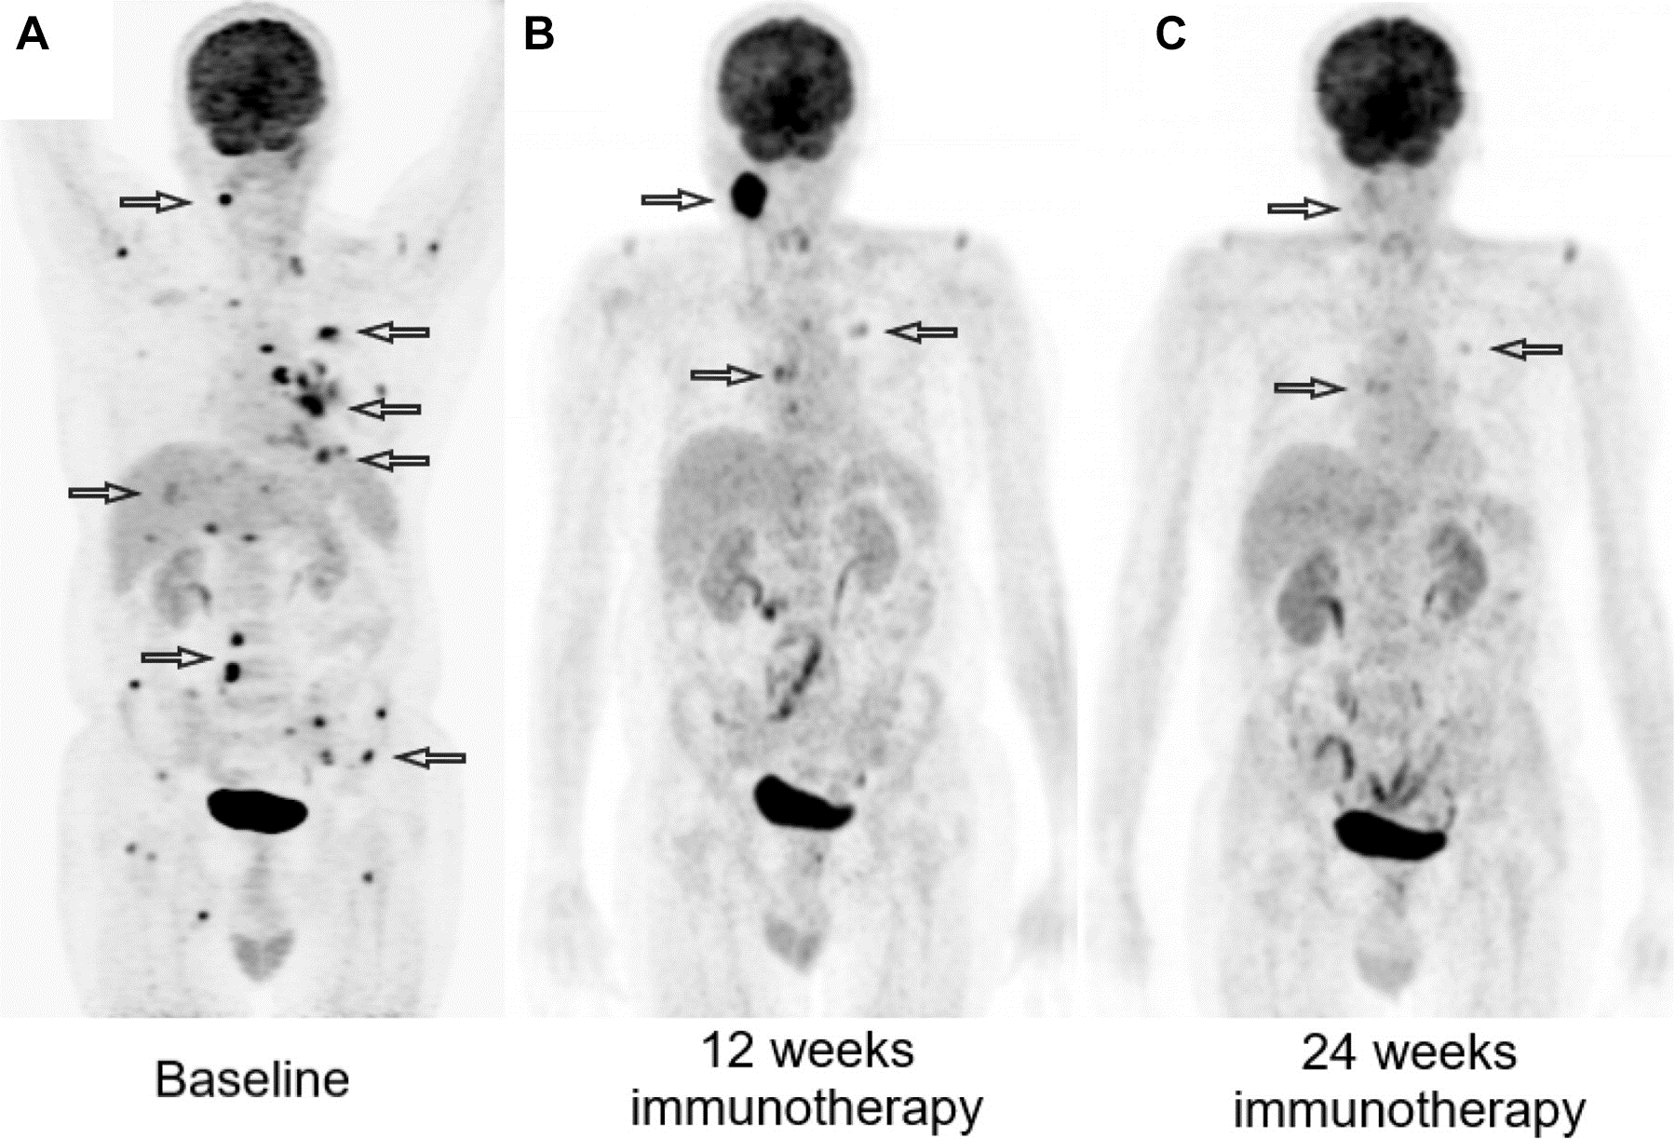
DRAWBACKS OF STANDARD RESPONSE CRITERIA
With immunotherapy: Pseudoprogression
Sorafenib treatment (400 mg b.i.d.)

Slide 45
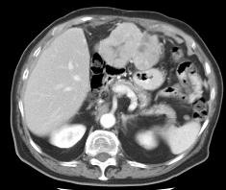
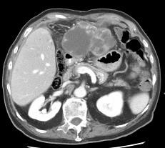
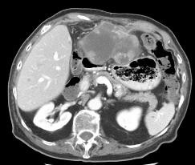
DRAWBACKS OF STANDARD RESPONSE CRITERIA
With targeted agents: tumour volume vs. tumour necrosis
Sorafenib treatment (400 mg b.i.d.)
 | Baseline | 8 weeks | 16 weeks
Tumour volume (cm³)* | 295 | 341 | 285
Tumour necrosis (%)* | 2.09 | 53.07 | 51.03
*Assessed by modified WHO criteria
Abou-Alfa G, et al. J Clin Oncol 24(26), 2006:4293–300. Reprinted with permission.
© 2006 American Society of Clinical Oncology. All rights reserved.

Slide 46
What could be done to maximise the patient’s chance of benefiting from a new targeted therapy (1)
The right target:
  Oncogenic driver
  Expressed only in tumor cells
  Targetable with existing or novel agents
The right patient:
  Clinical data
  IHC/FISH
  Genomic

Slide 47
What could be done to maximise the patient’s chance of benefiting from a new targeted therapy (2)
The right drug:
  Biologically active
  Irreversible, selective binding
  No off-target toxicity
  Crosses the blood-brain barrier
The right trial:
  Randomized
  Placebo-controlled
  Double-blind
  Representative of real-world patients
  Exploratory biomarkers

Slide 48
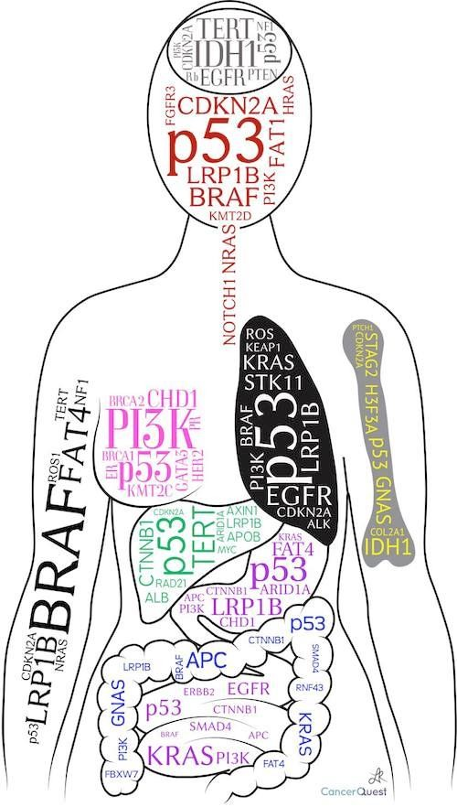
The right medicine,
for the right patient,
at the right time.

