Slide 1

Καρκίνος μαστού
Ηλίας Α. Κοττέας, M.D, Ph.D
Καθηγητής Ογκολογίας
Ογκολογική Μονάδα
Γ’ Πανεπιστημιακή Παθολογική Κλινική

Slide 2

Επιδημιολογικά δεδομένα
1^{ος} σε συχνότητα στις γυναίκες
2^{η} αιτία θανάτου από καρκίνο

Slide 3
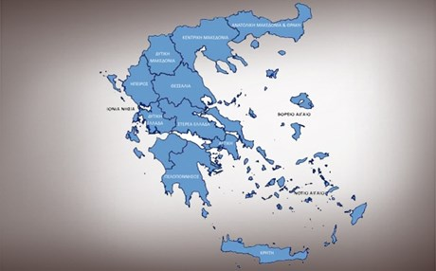
7500/έτος
Κληρονομικότητα
10%

Slide 4
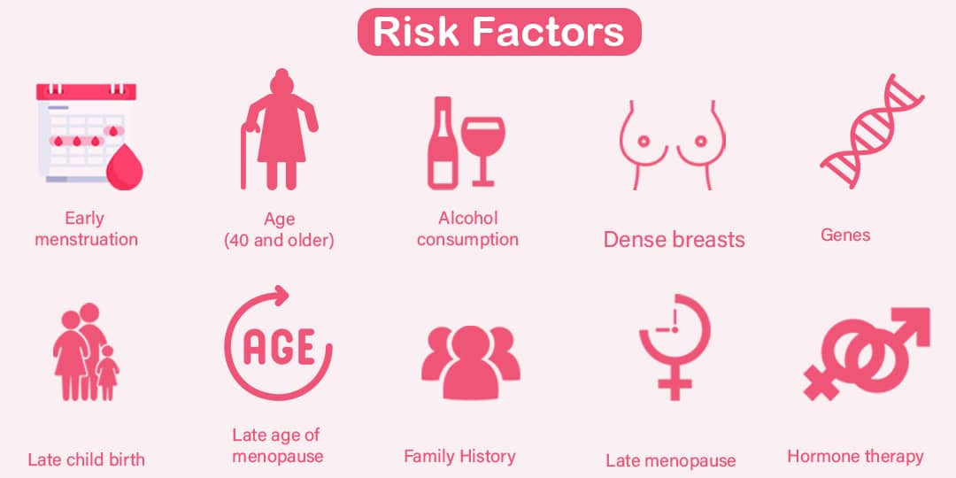

Slide 5
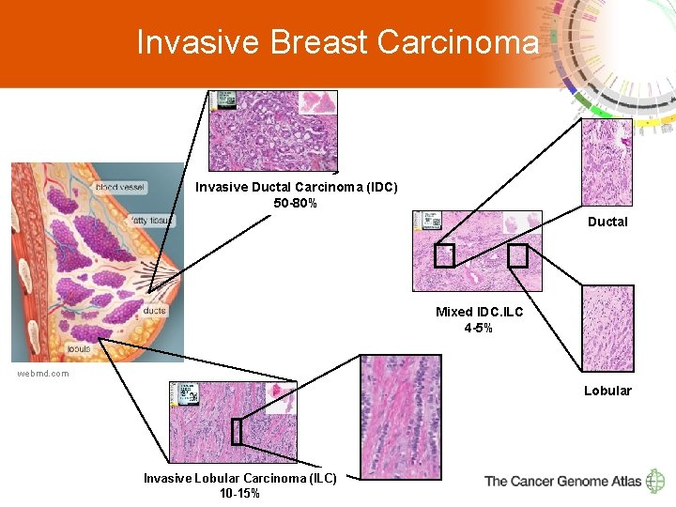

Slide 6
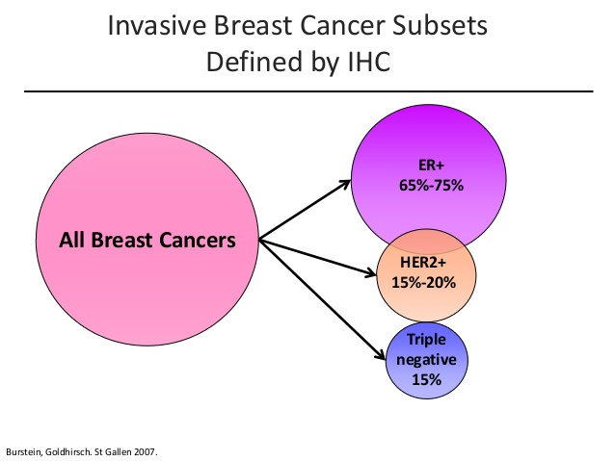

Slide 7
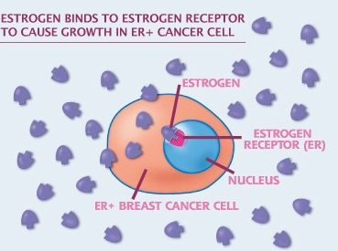

Slide 8
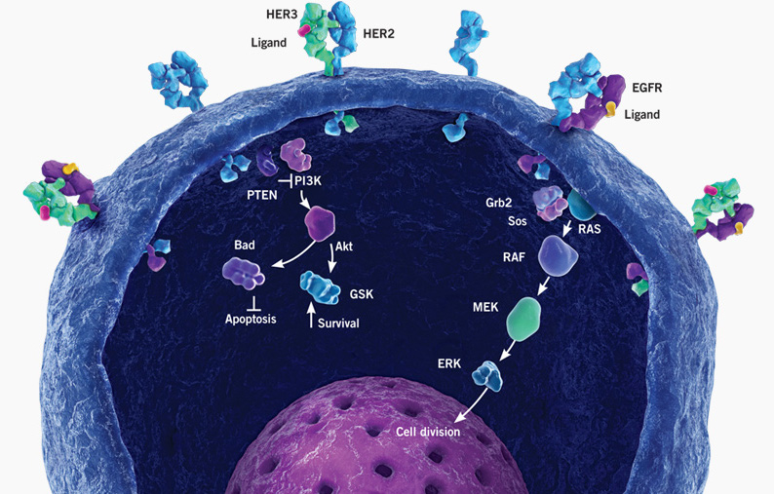
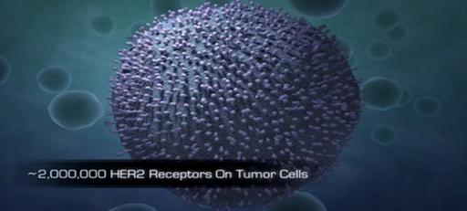
HERCEPTIN

Slide 9
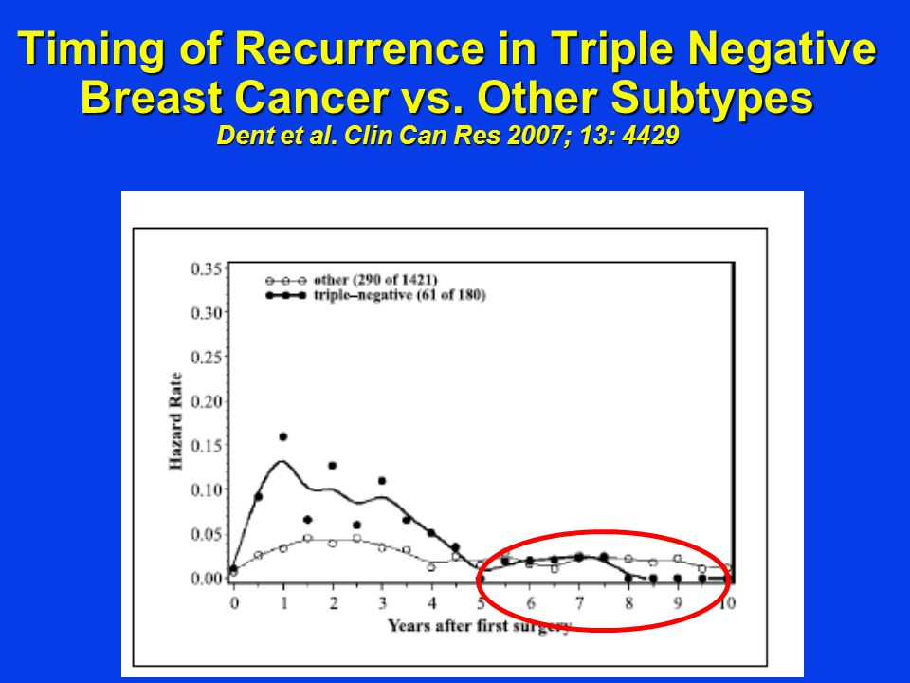
Triple negative breast cancer
Young women
Very aggressive
Early relapses
Poor prognosis
Limited treatment options (chemo only)

Slide 10
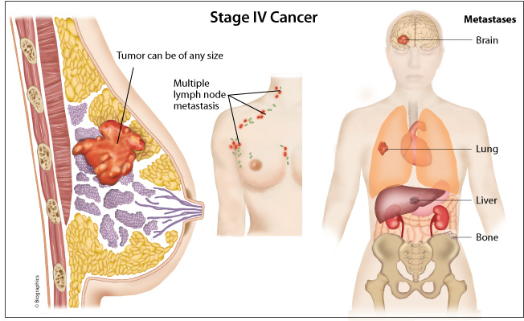

Slide 11
Stages

Slide 12
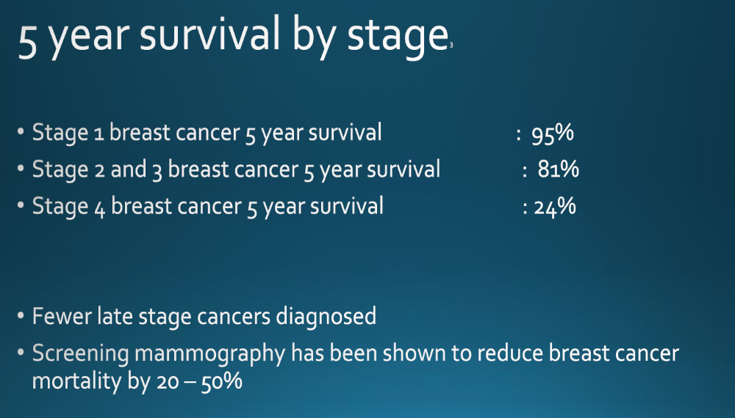

Slide 13
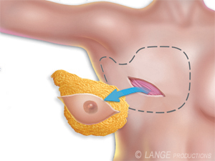
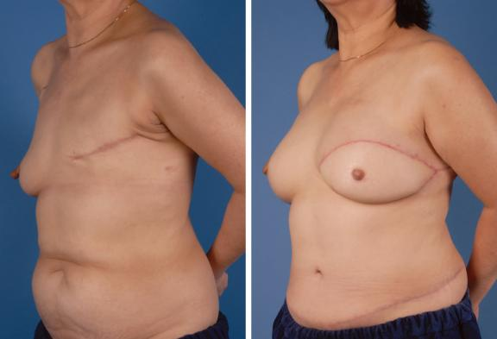
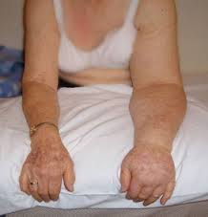
Mastectomy

Slide 14
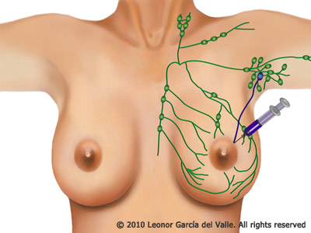
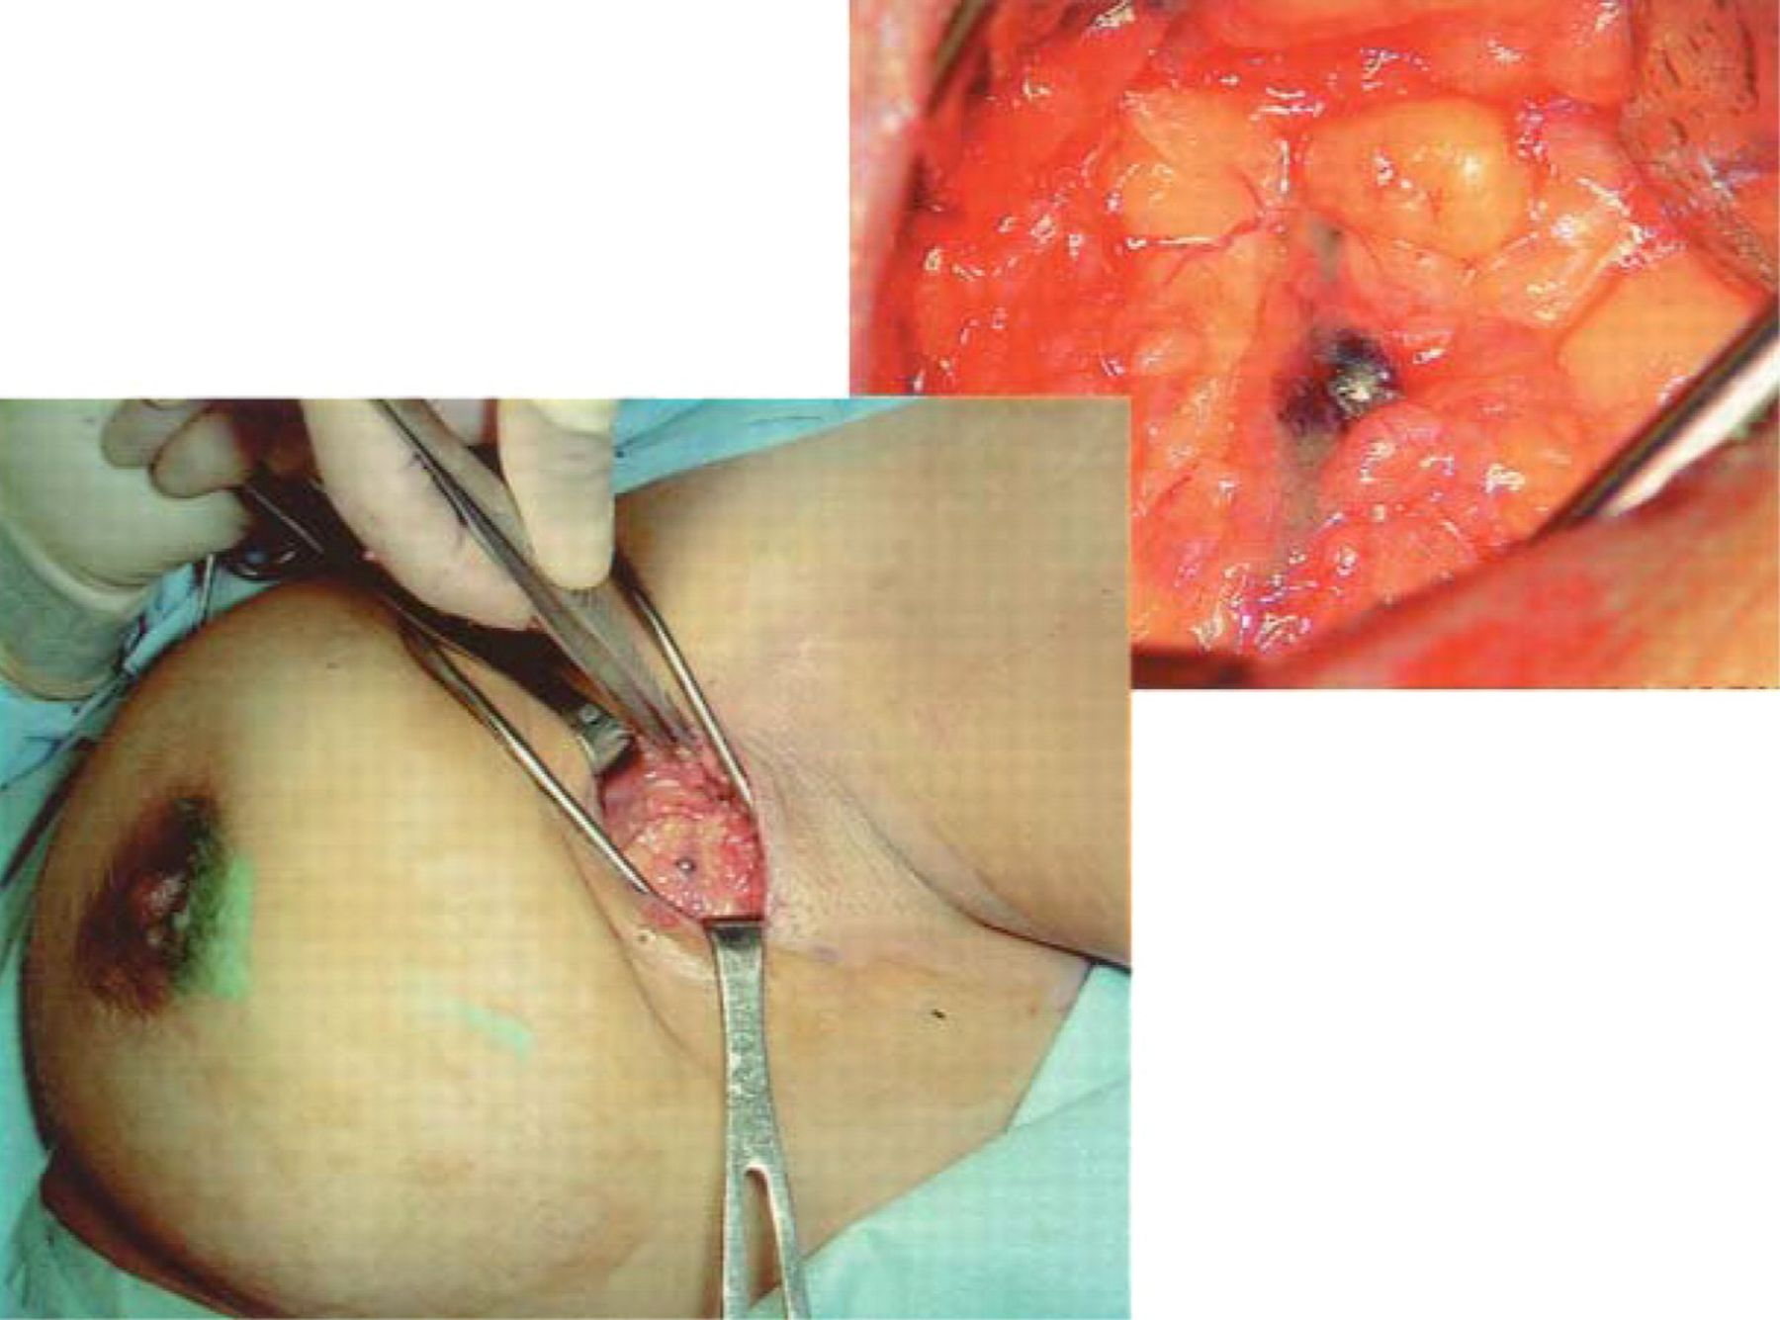
Sentinel Lymph Node Biopsy

Slide 15
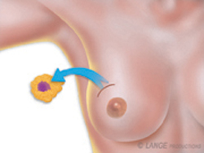
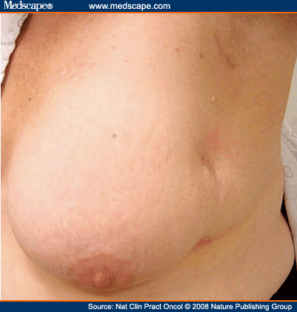
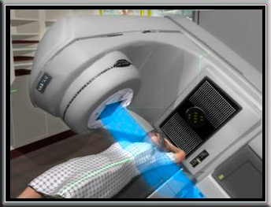
Lumpectomy

Slide 16
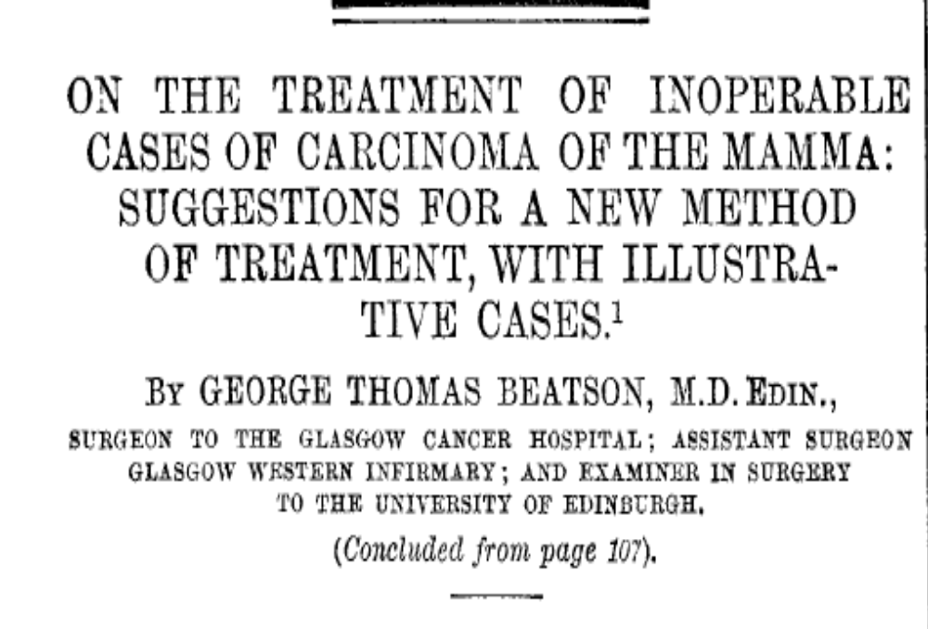
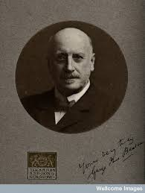
Beatson G. Lancet, 1896

Slide 17
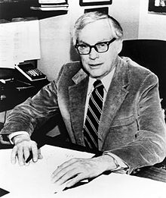
Elwood Jensen
“A lady with growth neoplastic
thought castration was just a bit drastic
She preferred that her ill could be cured with a pill
Today it’s no longer fantastic”

Slide 18
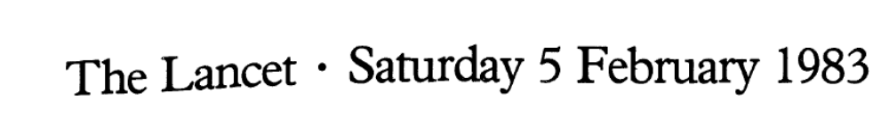
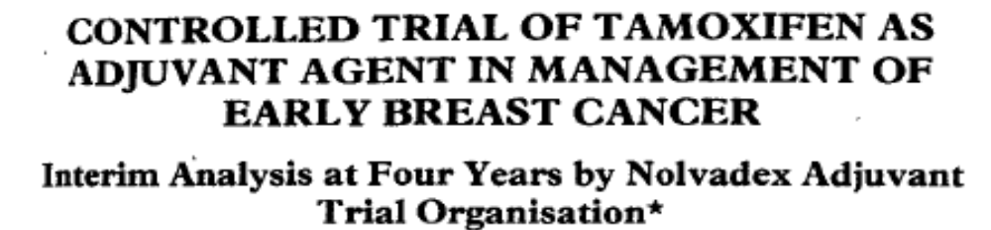
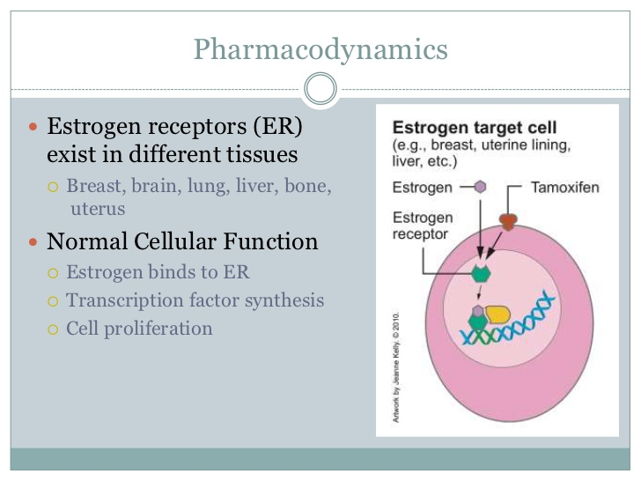
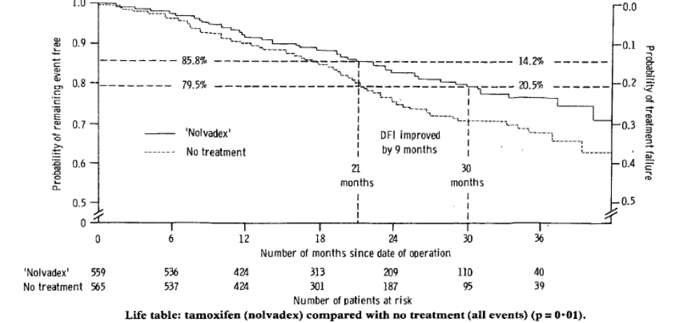

Slide 19
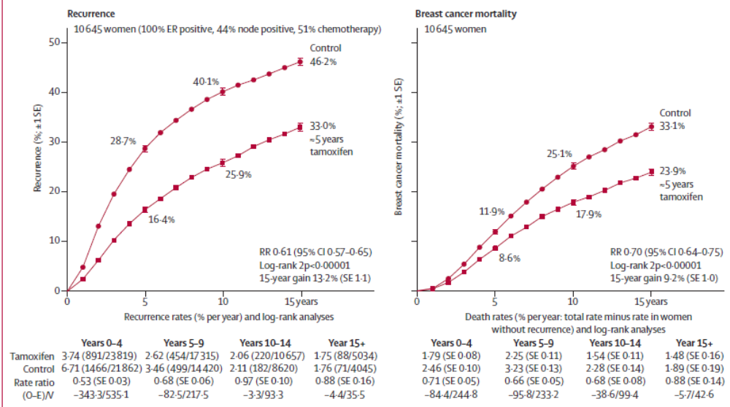
Tamoxifen: 5 years
Davies, et al. Lancet, 2011

Slide 20
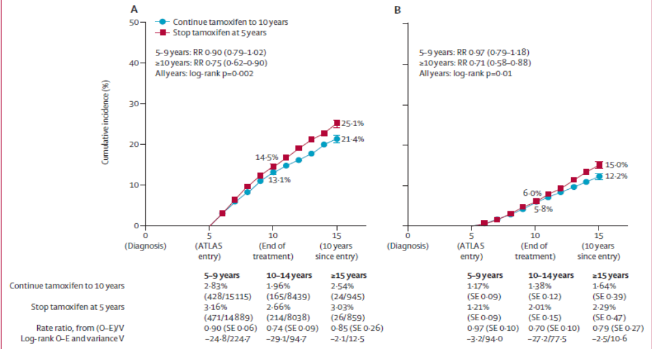
Tamoxifen: 10 years
Davies, et al. Lancet, 2013

Slide 21
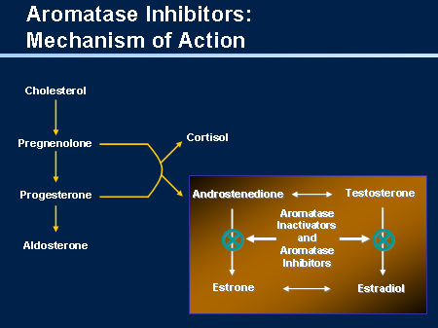
Aromatase inhibitors (Post-menopausal)
Letrozole
Anastrozole
Exemestane

Slide 22
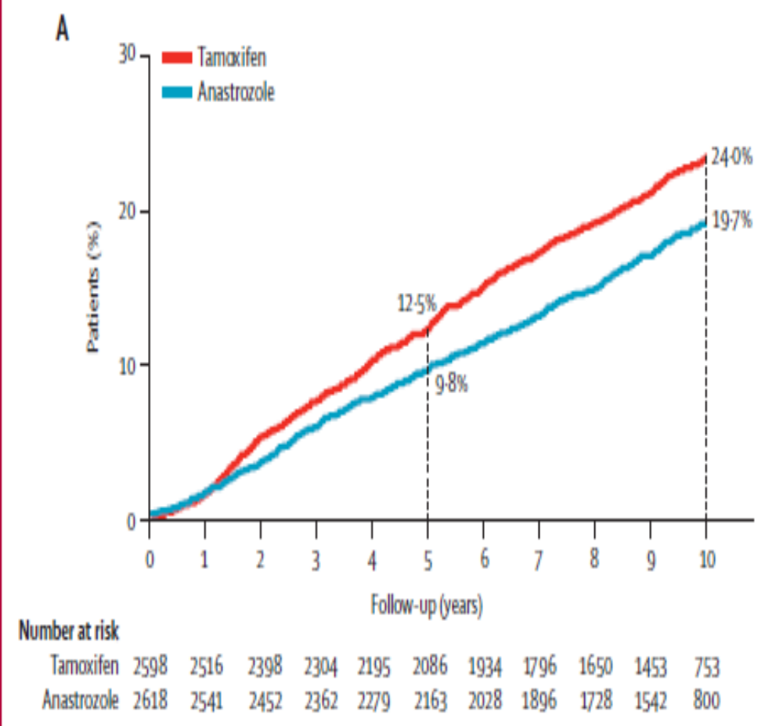
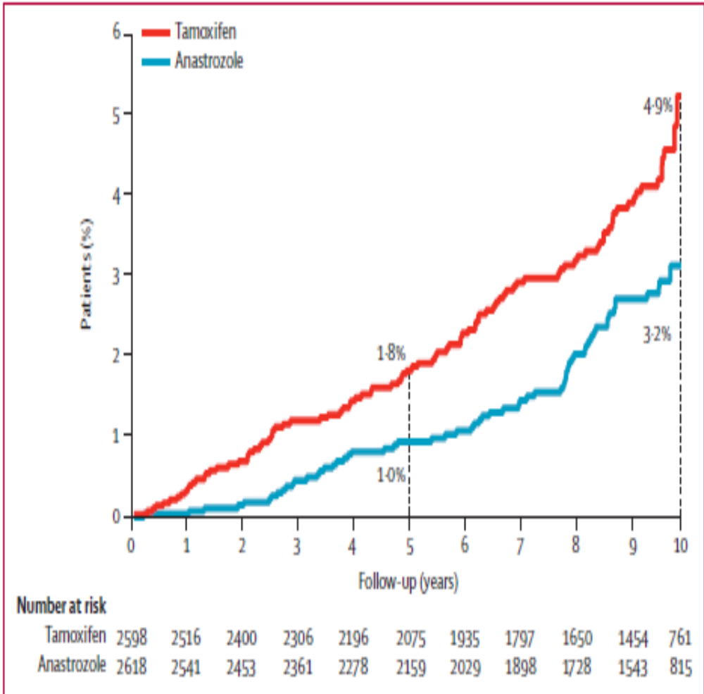
Aromatase inhibitors vs Tamoxifen (Post-menopausal)
Reccurence
Recurrence
Contralateral BC
Cuzick, et al .Lancet 2010

Slide 23
Aromatase inhibitors: 10 years
Letrozole
for 5 yrs
(n = 959)
Postmenopausal pts with ER+ breast cancer who completed 5 yrs of letrozole/Tamoxifen
(N = 1918)
Placebo
for 5 yrs
(n = 959)
Goss PE, et al. ASCO 2016. Abstract LBA1
Notes:
AI, aromatase inhibitor; CBC, contralateral breast cancer; DFS, disease-free survival; ER, estrogen receptor; PgR, progesterone receptor; QoL, quality of life.

Slide 24
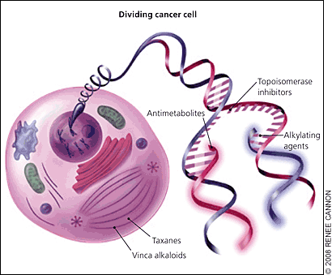
Chemotherapy
Adjuvant /Neo-adjuvant
Anthracyclines
Cyclophosphamide
Taxanes

Slide 25
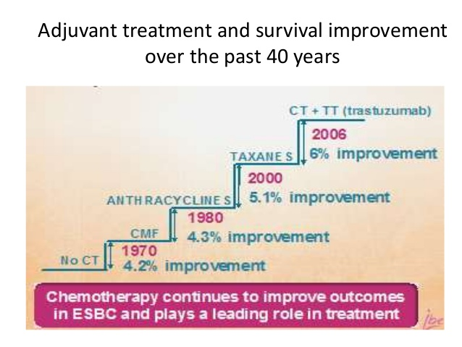
Toxicity
Benefit
Alopecia
Nausea
Diarrhea
Anemia
Neutropenia
Neuropathy
Heart failure
Leukemia

Slide 26
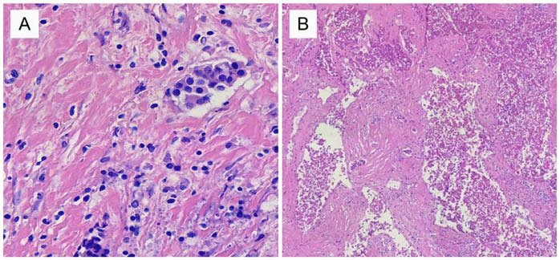
Neoadjuvant therapy (>2cm or N+)

Slide 27
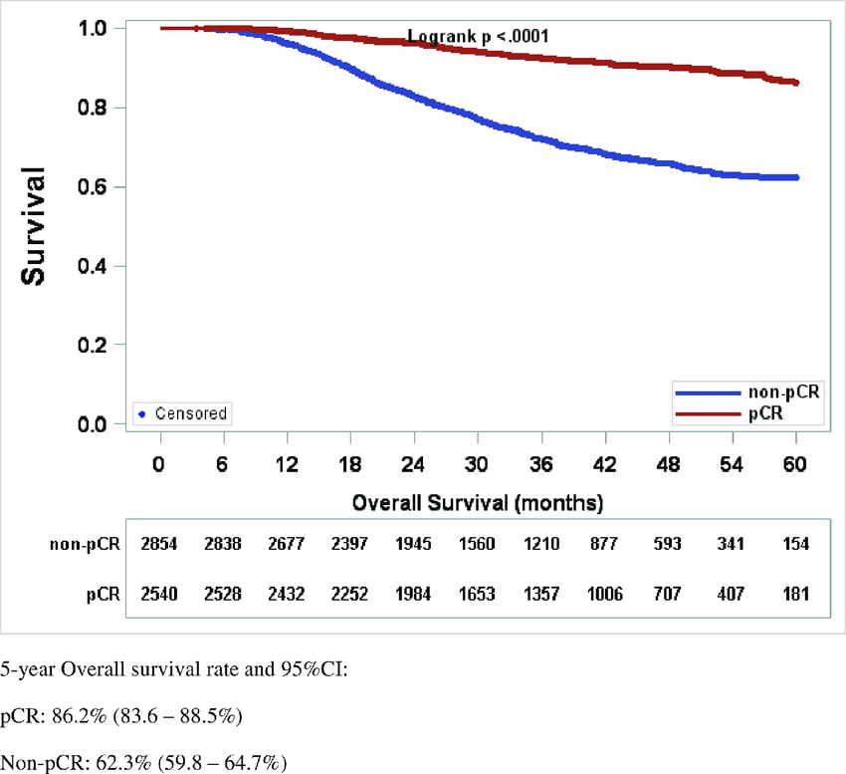
Pathologic Complete Response

Slide 28
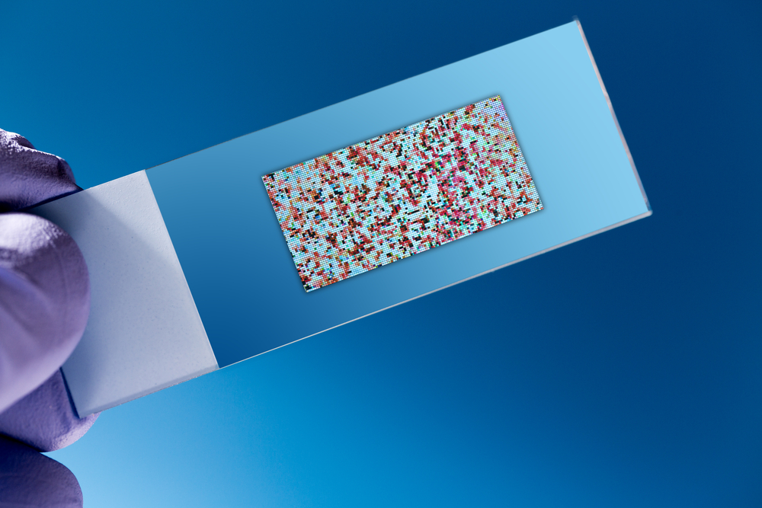
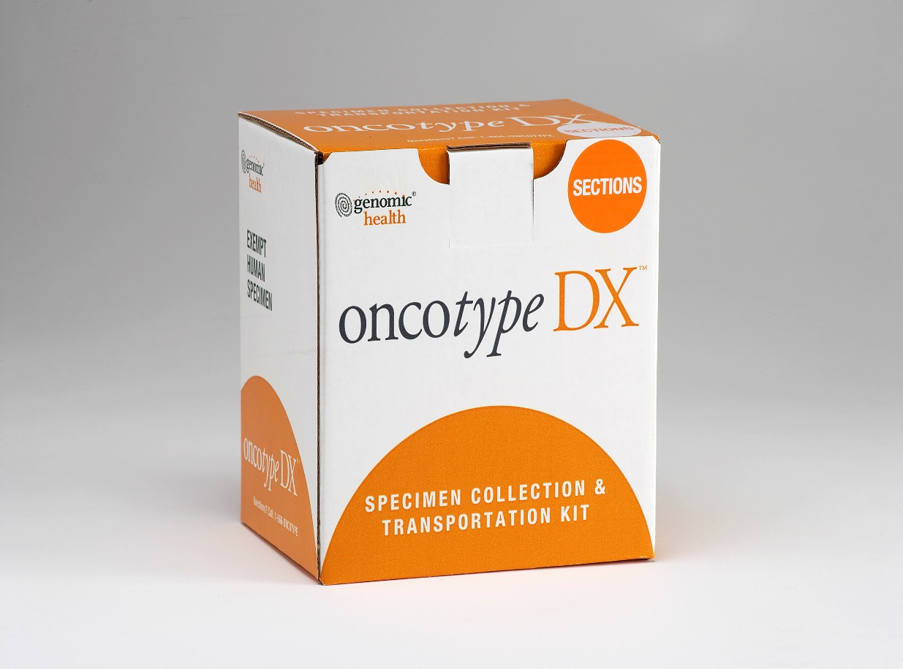
Oncotype
T1-2, Ν0/N1, ER+, HER2-

Slide 29
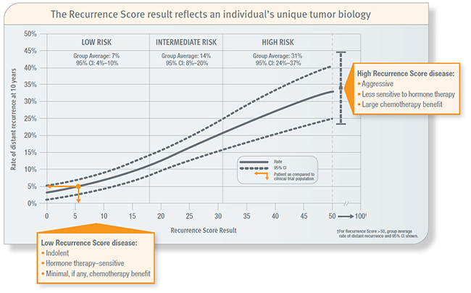
Chemotherapy
Age<50

Slide 30
Outcomes
Chemotherapy
Radiotherapy
Hormone therapy
Cure
Relapse (30%-40%)

Slide 31
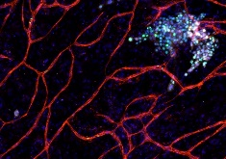
Tumor dormancy – Late relapses

Slide 32
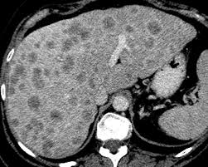
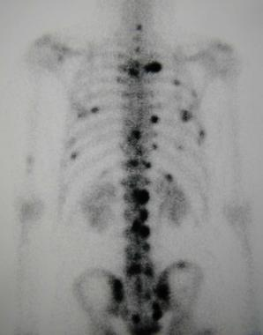
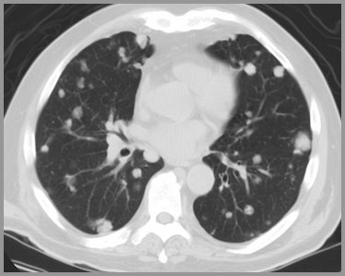
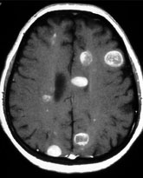
Metastatic breast cancer
Incurable

Slide 33
Metastatic ER+, HER2- breast cancer
Hormone therapy
Chemotherapy
Notes:
DES αποNCCN τις κατηγοριες 1 σε 1^{η} γραμμη

Slide 34
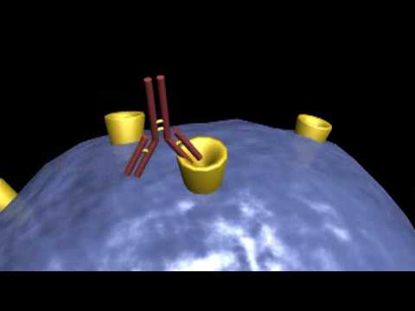

Slide 35
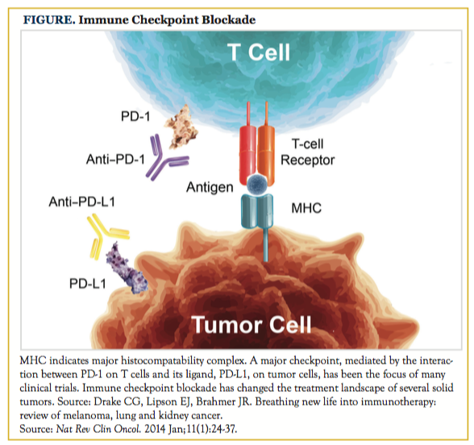

Slide 36
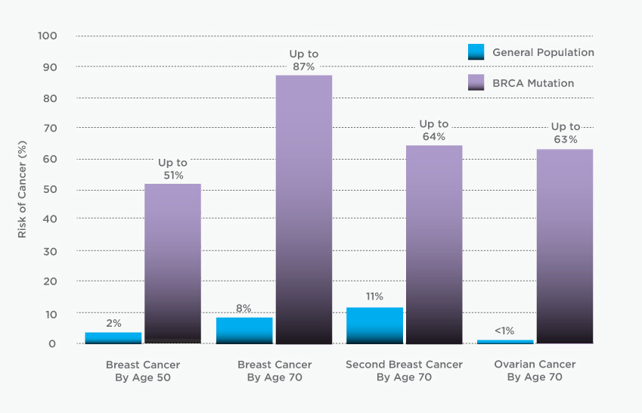
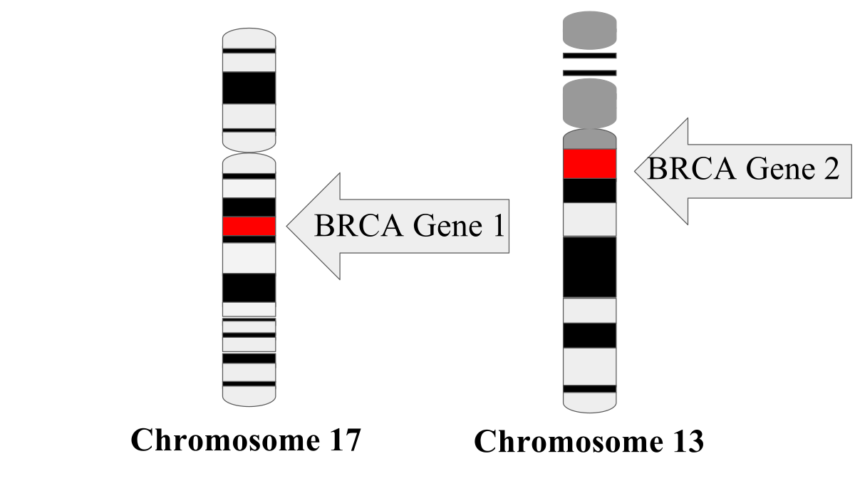
BRCA Mutations

Slide 37
