Slide 1

Καρκίνος μαστού
Ηλίας Α. Κοττέας, M.D, Ph.D
Αν. Καθηγητής ΕΚΠΑ
Ογκολογική Μονάδα
Γ’ Πανεπιστημιακή Παθολογική Κλινική

Slide 2

Επιδημιολογικά δεδομένα
1^{ος} σε συχνότητα στις γυναίκες
2^{η} αιτία θανάτου από καρκίνο

Slide 3
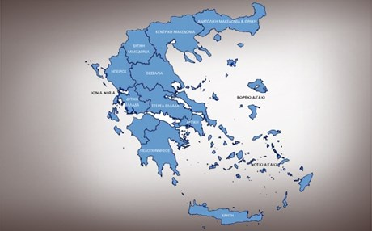
7500/έτος
Κληρονομικότητα
10%

Slide 4
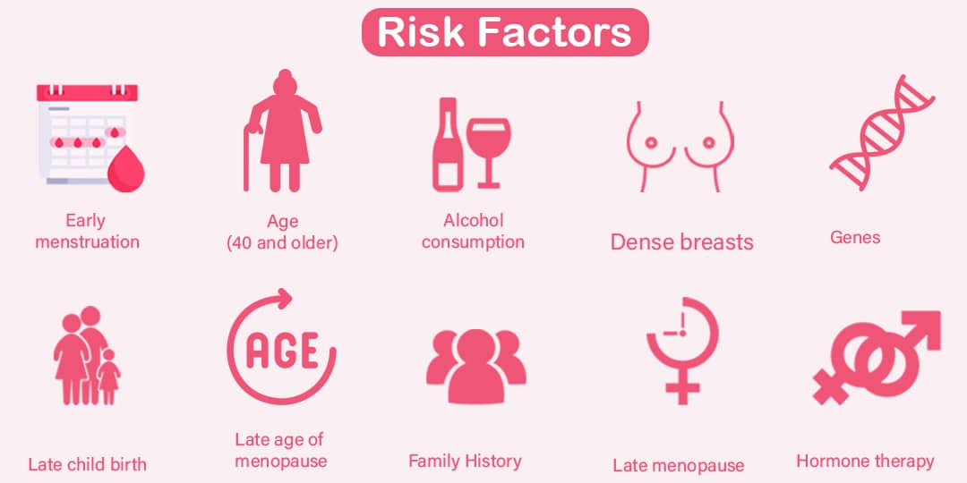

Slide 5
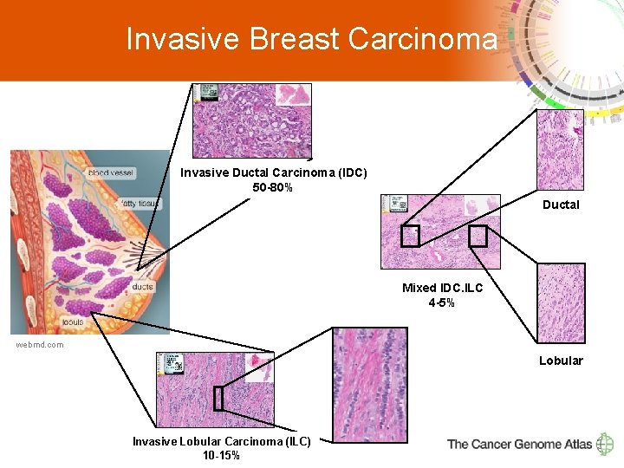

Slide 6
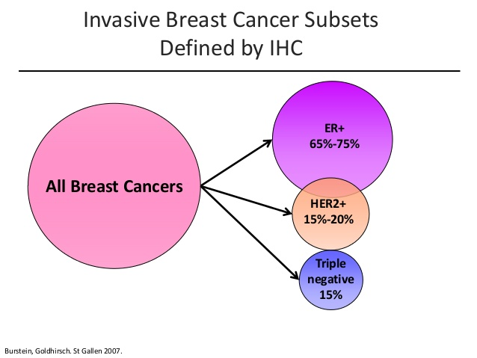

Slide 7
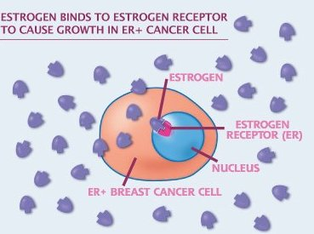

Slide 8
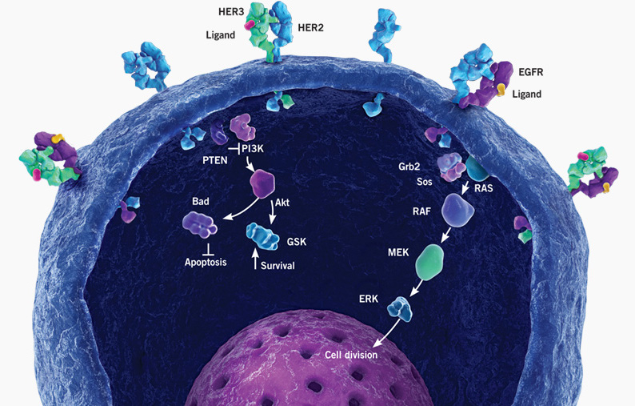
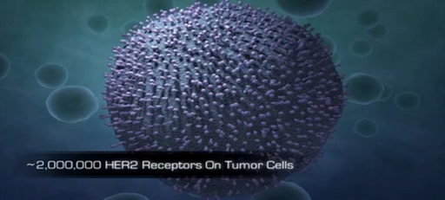
HERCEPTIN

Slide 9
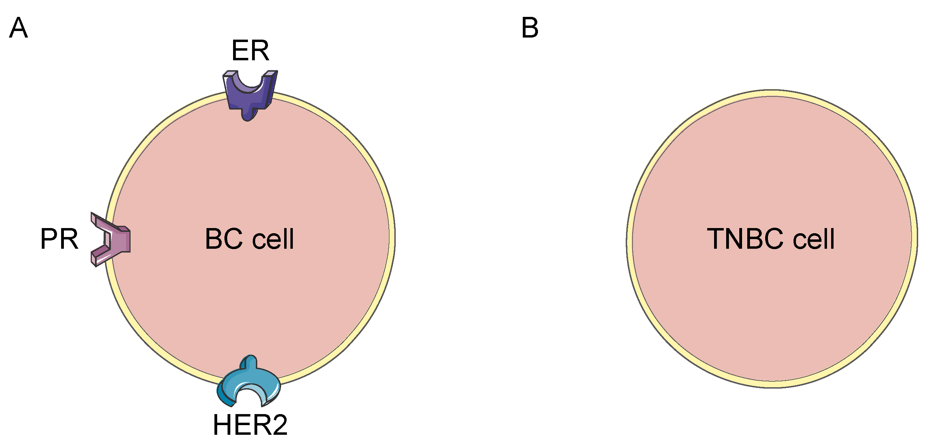

Slide 10
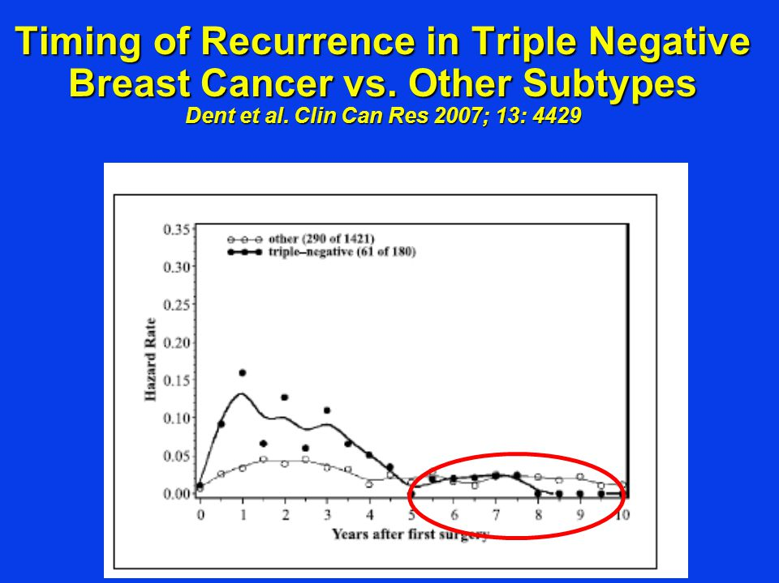
Triple negative breast cancer
Young women
Very aggressive
Early relapses
Poor prognosis
Limited treatment options (chemo only)

Slide 11
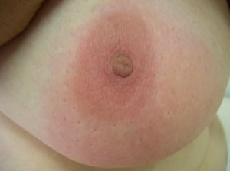
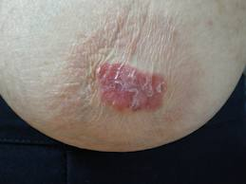
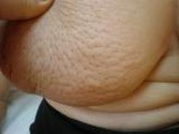
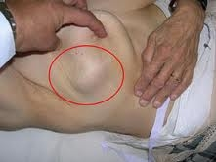
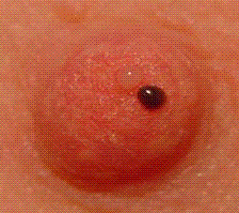
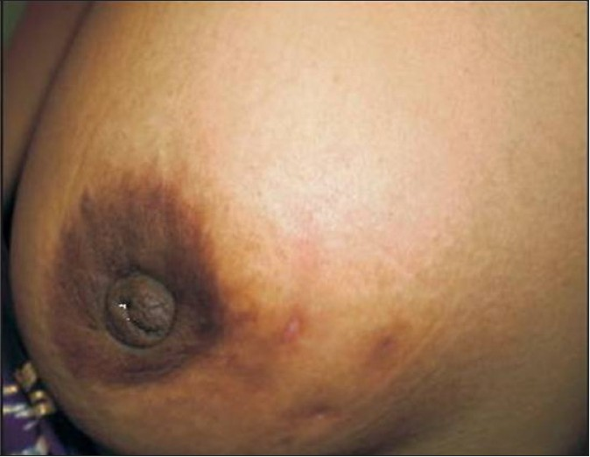

Slide 12
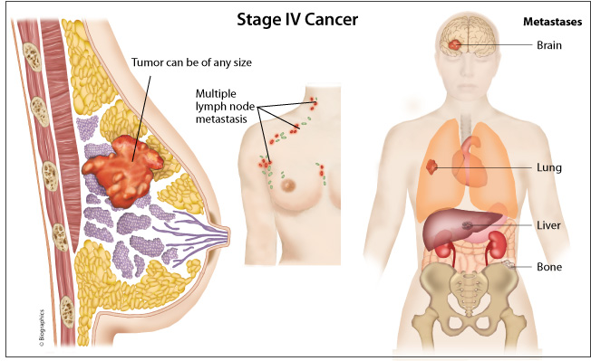

Slide 13
Stages

Slide 15
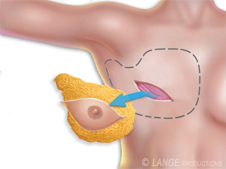
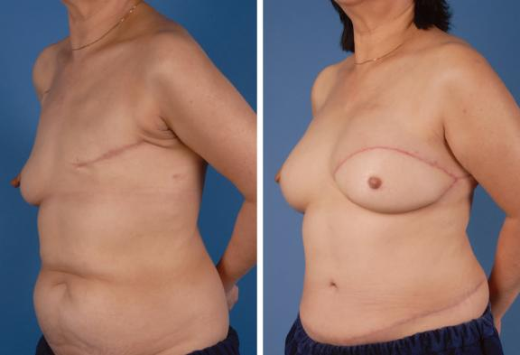
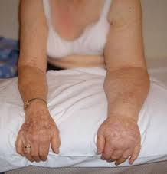
Mastectomy

Slide 16
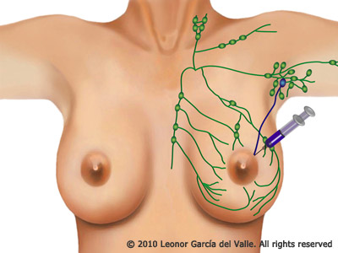
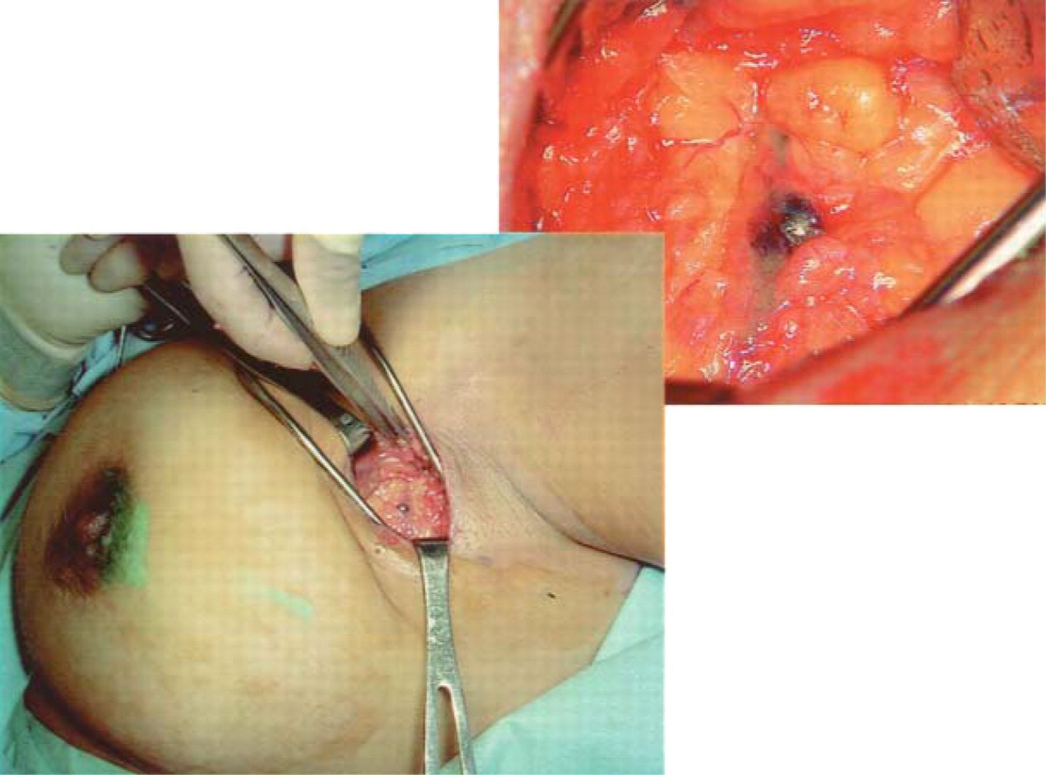
Sentinel Lymph Node Biopsy

Slide 17
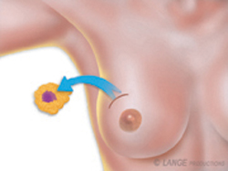
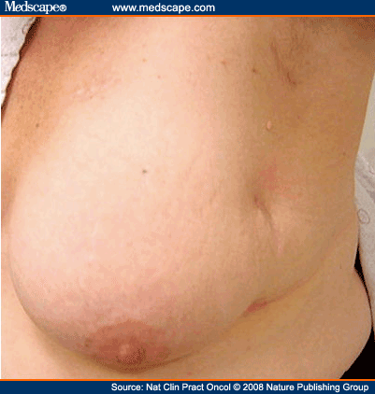
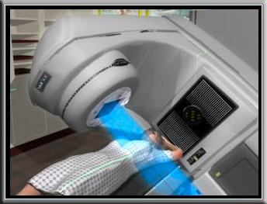
Lumpectomy

Slide 18
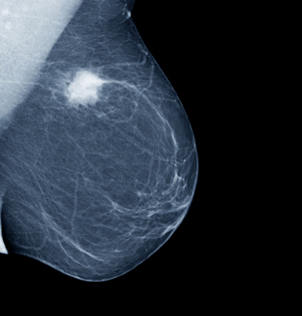
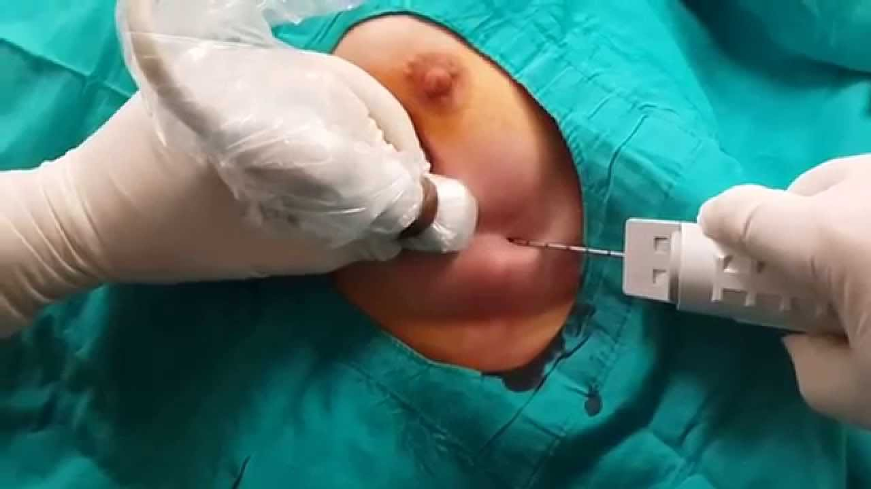
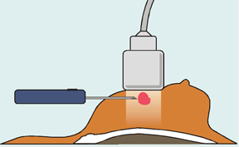

Slide 19
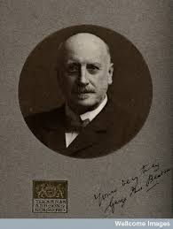
Beatson G. Lancet, 1896

Slide 20
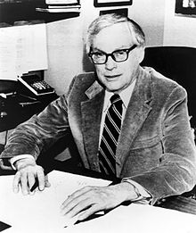
Elwood Jensen
“A lady with growth neoplastic
thought castration was just a bit drastic
She preferred that her ill could be cured with a pill
Today it’s no longer fantastic”

Slide 21
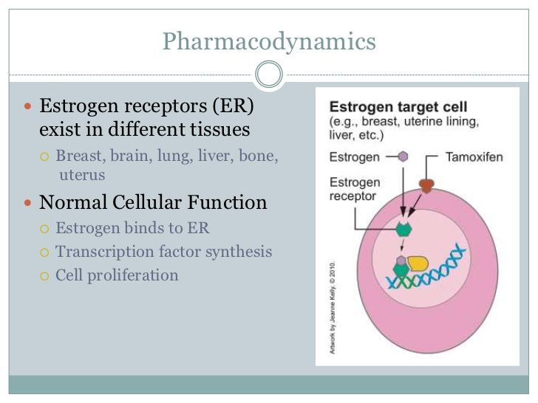

Slide 22
Tamoxifen: 5 years
Davies, et al. Lancet, 2011

Slide 23
Tamoxifen: 10 years
Davies, et al. Lancet, 2013

Slide 24
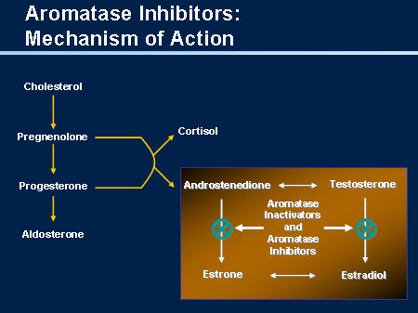
Aromatase inhibitors (Post-menopausal)
Letrozole
Anastrozole
Exemestane

Slide 25
Aromatase inhibitors vs Tamoxifen (Post-menopausal)
Reccurence
Recurrence
Contralateral BC
Cuzick, et al .Lancet 2010

Slide 26
Aromatase inhibitors: 10 years
Letrozole
for 5 yrs
(n = 959)
Postmenopausal pts with ER+ breast cancer who completed 5 yrs of letrozole/Tamoxifen
(N = 1918)
Placebo
for 5 yrs
(n = 959)
Goss PE, et al. ASCO 2016. Abstract LBA1
Notes:
AI, aromatase inhibitor; CBC, contralateral breast cancer; DFS, disease-free survival; ER, estrogen receptor; PgR, progesterone receptor; QoL, quality of life.

Slide 27
DFS and OS After Median Follow-up of 6.3 Yrs
DFS benefit of extended letrozole in all prespecified subgroups
5-yr OS: 93% vs 94% (HR: 0.97; P = NS)
DFS Outcomes | Letrozole | Placebo | HR (95% CI) | P Value
Overall 5-yr DFS, % | 95 | 91 | 0.66 (0.48-0.91) | .01
Events, n (%) | 67 (7.0) | 98 (10.2)
New contralateral breast cancers, n (%) | 13 (1.4) | 31 (3.2) |  | .007
Locoregional recurrences, n | 19 | 30
Distant recurrences, n | 42 | 53
Bone recurrences, n | 28 | 37
LN+
Young age at diagnosis
Goss PE, et al. ASCO 2016. Abstract LBA1
Notes:
AI, aromatase inhibitor; DFS, disease-free survival; NS, not significant.

Slide 28
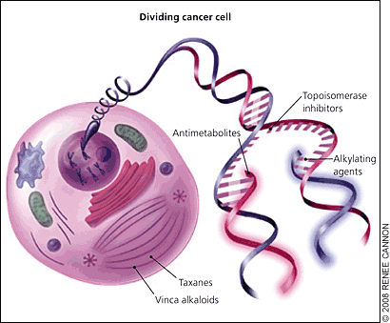
Chemotherapy
Adjuvant /Neo-adjuvant
Anthracyclines
Cyclophosphamide
Taxanes

Slide 29
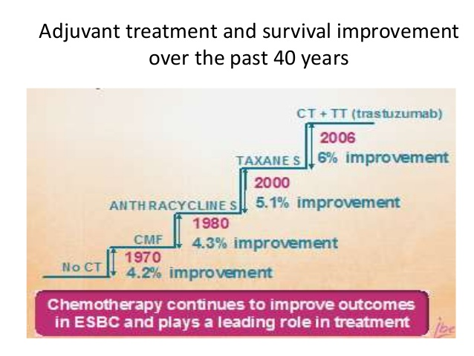
Toxicity
Benefit
Alopecia
Nausea
Diarrhea
Anemia
Neutropenia
Neuropathy
Heart failure
Leukemia

Slide 30
Chemotherapy indications
LN+
Grade III
Highly proliferative tumors
ER-
HER2+

Slide 31
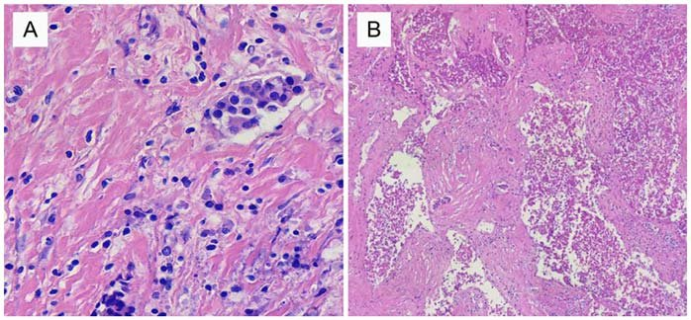
Neoadjuvant therapy (>2cm or N+)

Slide 32
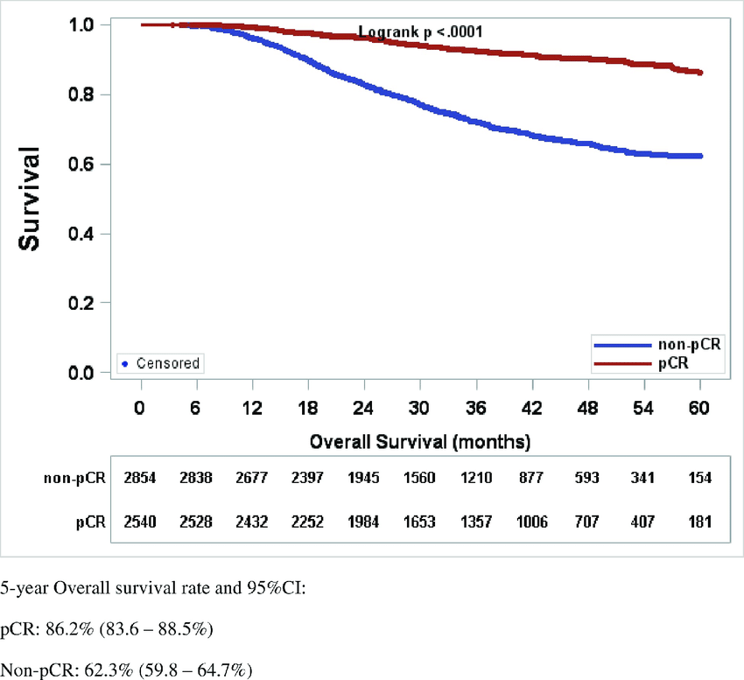
Pathologic Complete Response

Slide 33

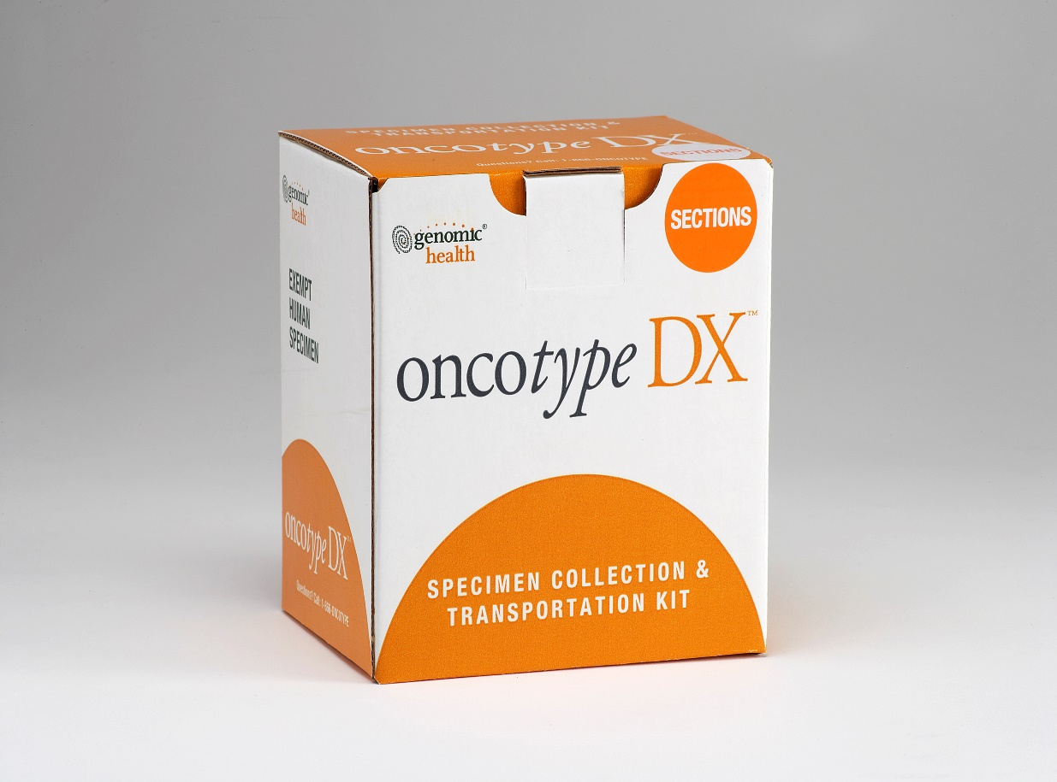
Oncotype
T1-2, Ν0/N1, ER+, HER2-

Slide 34
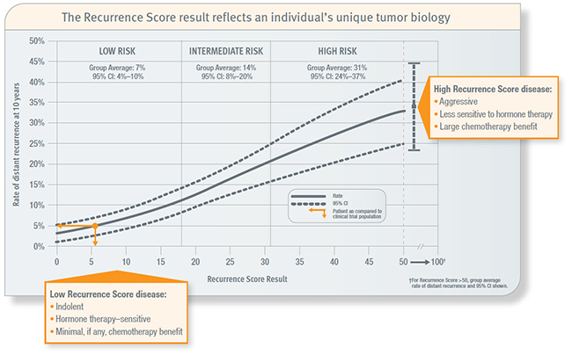
Chemotherapy
Age<50

Slide 35
Outcomes
Chemotherapy
Radiotherapy
Hormone therapy
Cure
Relapse (30%-40%)

Slide 36
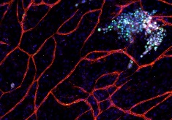
Tumor dormancy – Late relapses

Slide 37
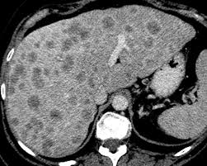
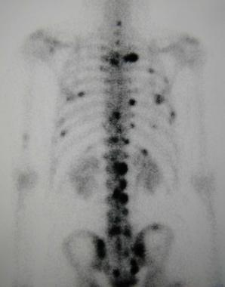
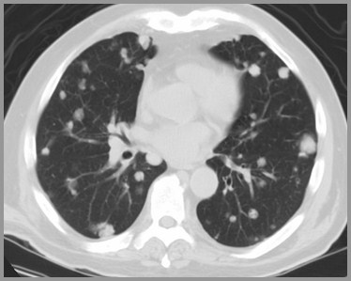
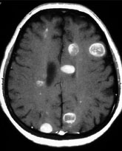
Metastatic breast cancer
Incurable

Slide 38
Metastatic ER+, HER2- breast cancer
Hormone therapy
Chemotherapy
Notes:
DES αποNCCN τις κατηγοριες 1 σε 1^{η} γραμμη

Slide 39
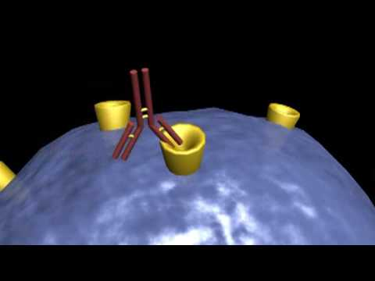

Slide 40
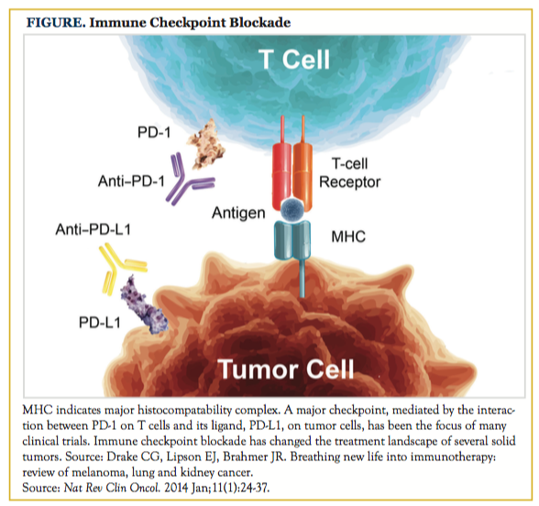

Slide 41
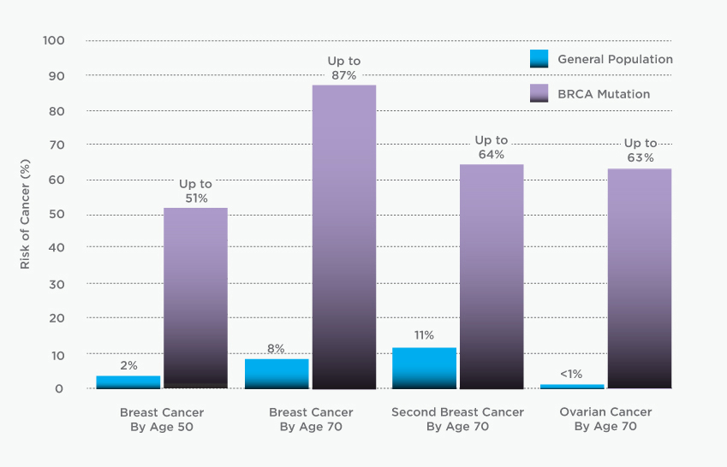
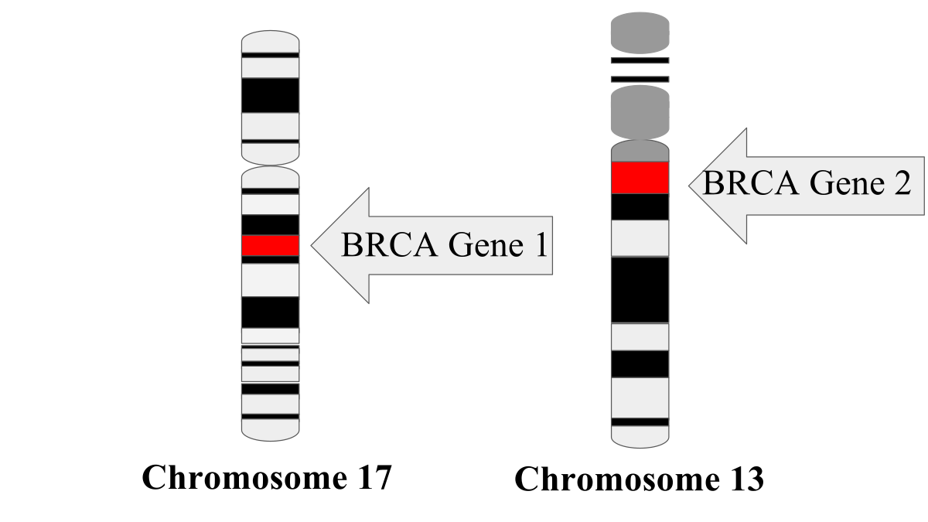
BRCA Mutations

Slide 42


Slide 43


