Slide 1
Πρόληψη αιμολυτικής νόσου με χορήγηση αντι- D ανοσοσφαιρίνης
Νικόλαος Φ. Βλάχος MD. PhD, FACOG
Καθηγητής Μαιευτικής, Γυναικολογίας και Υποβοηθούμενης Αναπαραγωγής

Slide 2
Alloimmune Hemolytic Disease Of The Fetus / Newborn:
Definition:
A condition in which the Red Cells Of The Fetus Or Newborn Are Destroyed By Maternally Derived Alloantibodies
The Antibodies arise In The Mother As The Direct Result Of A Blood Group Incompatibility Between The Mother And Fetus.
The mother becomes Iso-immunized.
In The Fetus: Erythroblastosis Fetalis
In The Newborn: HDN.

Slide 3
Antibodies That May Be Detected During Pregnancy:
Innocuous Antibodies:
Most Of These Antibody Are IgM Therefore Cannot Cross The Placental Barrier
Antibodies Capable Of Causing Significant Hemolytic Transfusion Reactions:
IgG antibodies, Their Corresponding Antigens Are Not Well Developed At Birth E.g. Lu (b), Yt (a), And VEL —
Antibodies That Are Responsible For HDN :
Anti-c, Anti-d, Anti-e, And Anti-k (Kell)

Slide 6
Genetic Expression (Rh Surface Protein Antigenicity):
Grades Of “Positively” Due To Variation In The Degree Genetic Expression Of The D Antigen.
Incomplete Expression May Result In A Weakly Positive Patient e.g. Du Variant Of Weakly Rh Positive Patient (They May Even Be Determined As Rh Negative).
A Mother With Du Rh Blood Group (Although Genetically Positive) May Become Sensitized From A D-positive Fetus Or The Other Way Around May Take Place.

Slide 8
Factors Affect The Expression Of The Rh Antigen
The Number Of Specific Rh-antigen Sites:
- The Gene Dose,
- The Relative Position Of The Alleles,
- The Presence Or Absence Of Regulator Genes.
Interaction Of Other Components Of The Rh Blood Group. Erythrocytes Of Individuals Of Genotype Cde/cde Express Less D Antigen Than Do The Erythrocytes Of Individuals Of Genotype cDE/cde.
The Exposure Of The D Antigen On The Surface Of The Red Cell Membrane.

Slide 9
Phenotype
Genotype
eCd/EcD
D positive
Antigenicity of the Rh surface protein:
genetic expression of the D allele.
Number of specific Rh antigen sites.
Interaction of components of the Rh gene complex.
Exposure of the D antigen on the surface of the red cell
e
C
d
E
c
D

Slide 10
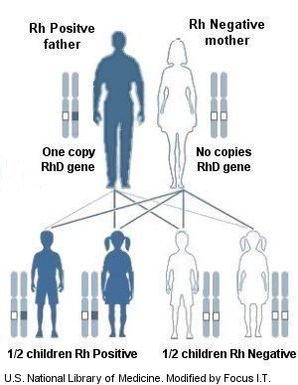
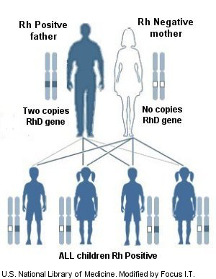

Slide 11
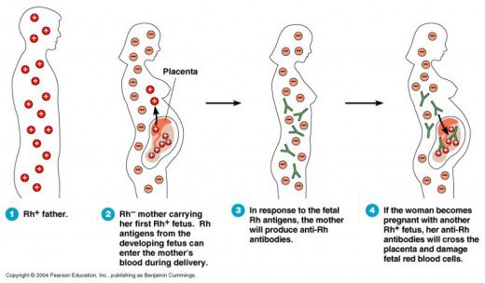
Feto-maternal blood exchange

Slide 12
1. Cleared by Macrophage
Mother
2. Plasma stem cells
Primary Response
6 wks to 6 M.
IGM.
IGM antibodies
Placental
The First Pregnancy is not Affected

Slide 13
Macroph. antigen
Presenting cell
Mother
T- helper cell
Secondary Response
Small amount
Rapid
IgG
B cell
IgG
Anti - D
Placental
Fetal Anemia

Slide 14
Mother
Macroph. Antigen
Presenting Cell
Group “O” Rh Negative
T-Hellper
Anti - A
Anti - B
B-cell
Anti-D
Placenta
B Rh positive
A Rh Positive
“O” Rh positive
Infant

Slide 15
Risk of Sensitization
Risk of sensitization depends upon 3 factors:
Volume of transplacental hemorrhage
Extent of maternal immune response
Concurrent presence of ABO incompatibility
Incidence of Iso-immunization is only 2-16% :
Rh-stimulus non-responders
Critical sensitizing volume: 0.1 ml
Difference in immunogenicity of antigen
ABO incompatibility: ABO incompatible fetal cells are cleared from the maternal circulation rapidly before they are trapped by the spleen (RES)

Slide 29
Rho(D) immune globulin is a derivative of human plasma.
Cohn cold ethanol fractionation method developed in the 1950s.
primary reason why most anti-Ds are for intramuscular use only.
Rho(D) immune globulin may trigger an allergic reaction.
although small, residual risk may remain for contamination with small viruses.
theoretical possibility of transmission of the prion responsible for Creutzfeldt–Jakob disease, or of other, unknown infectious agents.

Slide 31
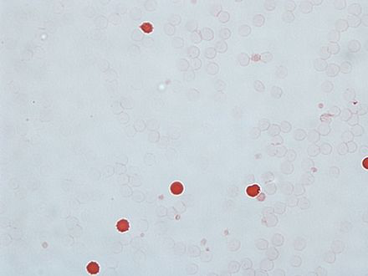
Kleinhouer-Betke test
Maternal blood is fixed on a slide with ethanol 80%
Citrate phosphate buffer to remove adult hemoglobin.
Staining with hematoxyllin–eosin
Fetal volume = number of fetal cells counted
Maternal blood volume ( 5000ml) number of maternal cells counted
One dose of Rho D ( 300mcg) ) neutralizes approximately 30 ml of fetal blood

Slide 32
Routine antenatal anti-D prophylaxis (RAADP) to all RhD-negative pregnant women, reducing the RhD immunisation incidence to 0.2–0.4%.
Arguments for introduction of noninvasive RHD screening to target prophylaxis include the limited availability of anti- D and rare but harmful effects such as virus transmission.
Exposing approximately 40% of women (who do not carry RHD-positive fetuses) to a blood product they do not need has been described as ethically unacceptable when a fetal RHD genotyping test exists.

Slide 33
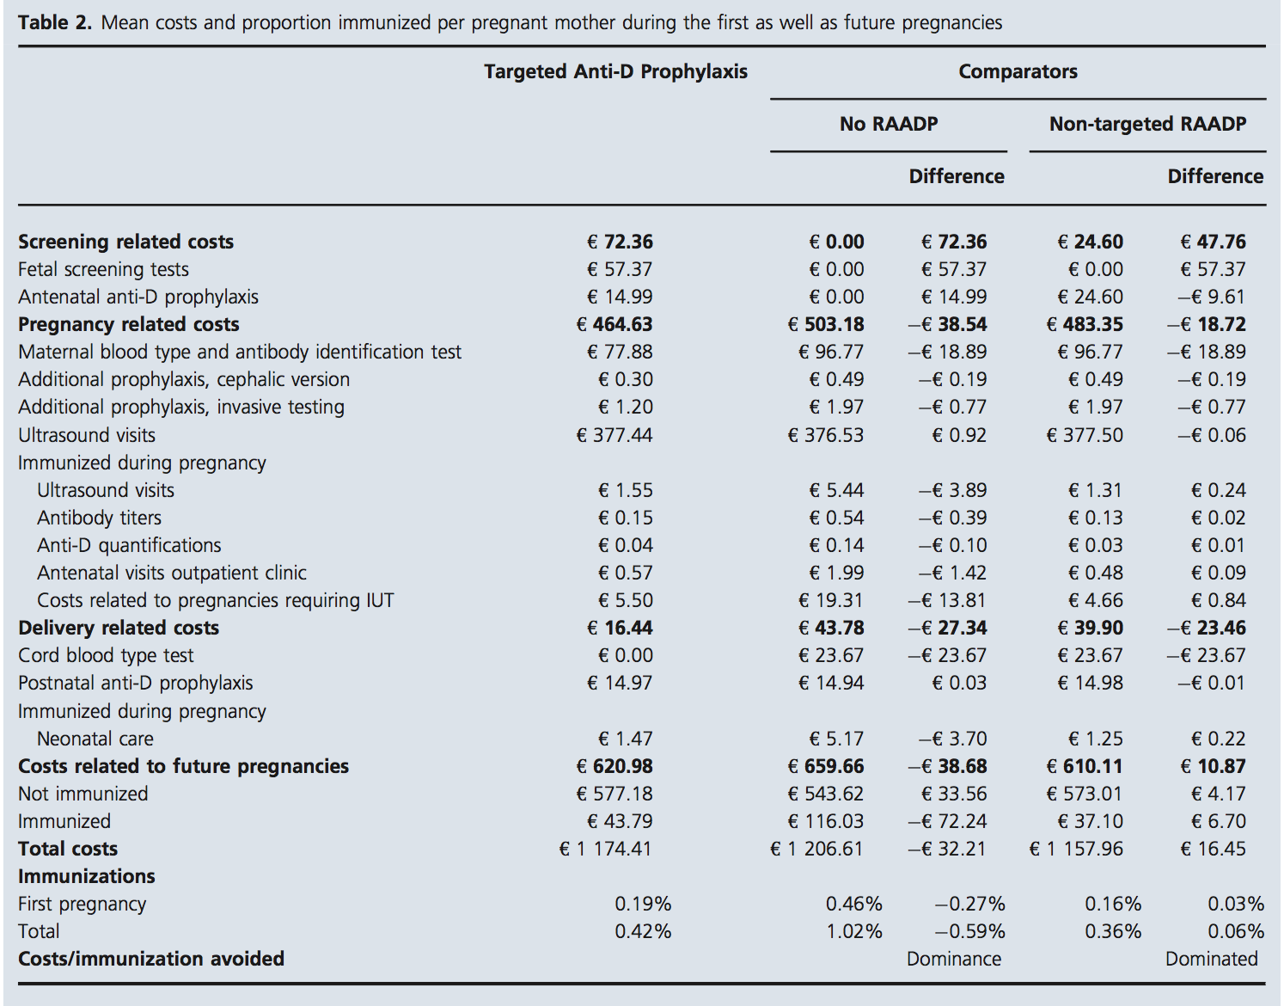

Slide 34
Assisted reproductive technologies and Rh immunization
Sperm donation
Oocyte donation
Third party reproduction.
Surrogasy

Slide 36
Dosage
Potency of Rh_{o}(D) IG is expressed in terms of international units (IU, units); potency established relative to the US, WHO, and European Pharmacopoeia Anti-D Reference Standard
Dose previously expressed in mcg; 1 mcg equals 5 units.
A single 1500-unit (300-mcg) dose of Rh_{o}(D) IG (i.e., prefilled syringes of HyperRHO S/D Full Dose, RhoGAM, or Rhophylac) contains enough anti-Rh_{o}(D) to suppress the immunization potential of 15 mL of Rh_{o}(D)-positive RBCs.
A single 250-unit (50-mcg) dose of Rh_{o}(D) IG (i.e., prefilled syringes of HyperRHO S/D Mini-Dose or MICRhoGAM) contains enough anti-Rh_{o}(D) to suppress the immunization potential of 2.5 mL of Rh_{o}(D)-positive RBCs

Slide 40
Free fetal dna to revent uncessasary anti rho-d
Rho(D) immune globulin

