Slide 1

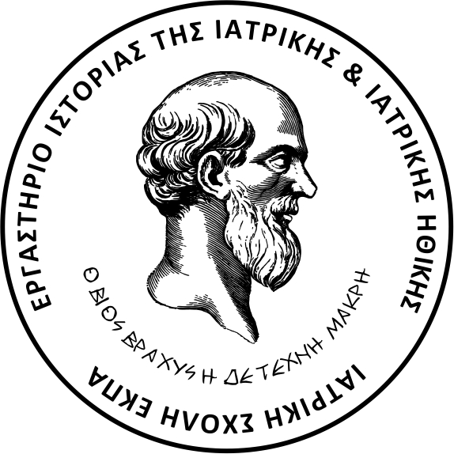
Η Ιατρική στην Αναγέννηση και η συστηματοποίηση των επιστημονικών γνώσεων
Δρ. Δημητριάδης Ιωάννης, Δερματολόγος – Αφροδισιολόγος
Ακαδημαϊκός Υπότροφος Εργαστηρίου Ιστορίας της Ιατρικής
Διευθύντρια : Καθηγήτρια Kαραμάνου Μαριάννα

Slide 2
Renaissance : 14th-16th century
The Breath of Renaissance
Knowledge developed through the scientific method: conducting experiments, collecting observations, drawing conclusions. A new technology of major importance enabled the dissemination of information: printing.
Rejection of the rigid straitjacket of Aristotelian scholasticism and freedom from the paralyzing constraints of tradition
Anatomy and surgery in the early Renaissance
Anatomy as described by Galen, based on the structure of the ape, contained as many errors as truths
A thousand years of formal prohibition on dissection - in both Christian and Arabic (Moslem) countries - made it impossible for anatomy to progress
Reform of Galenism
Humanism versus tradition
Progress in infectious pathology

Slide 3
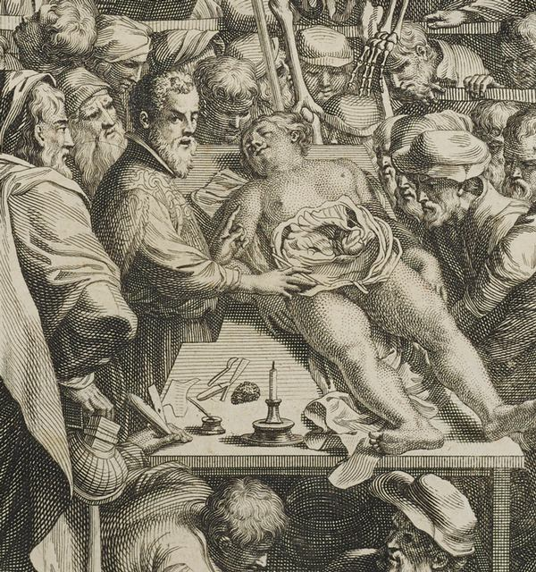
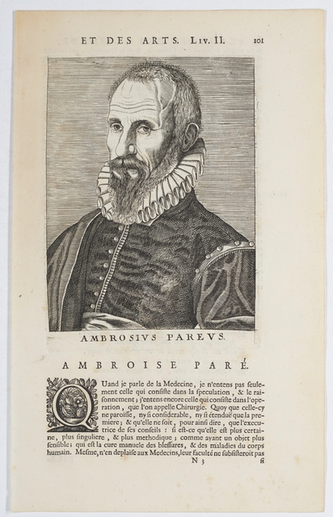
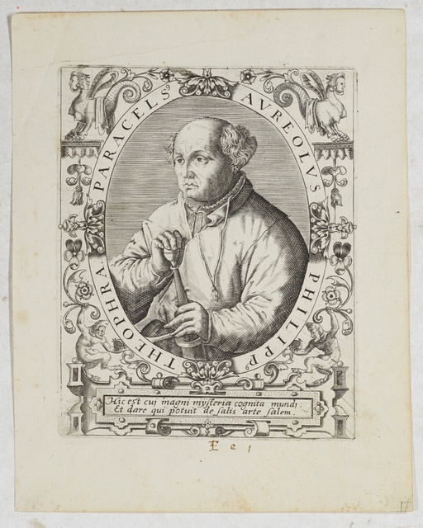

Slide 4
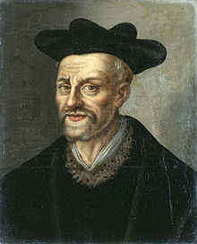
Renaissance humanism
François Rabelais (1494-1553): "By frequent anatomies (dissections), you may acquire perfect knowledge of the other world, which is the human being”

Slide 5
Anatomy, the cornerstone of the edifice Anatomy and surgery in the early Renaissance
At the dawn of the Renaissance, man still knew very little about the structure of his own body
The end of formal prohibition on dissection
Amputation also benefited from technical refinements: Guido Guidi (1509-1569) in Italy; Félix Würtz (1518-1574) in Switzerland; the German Fabrice von Hilden (1560-1634); William Clowes (1544-1604) in England.
Dissection : the problem of the scarcity of subjects to study
The dissection of human cadavers was liable to severe sanctions by civil and religious authorities
The Inquisition exercised vigilant control

Slide 6
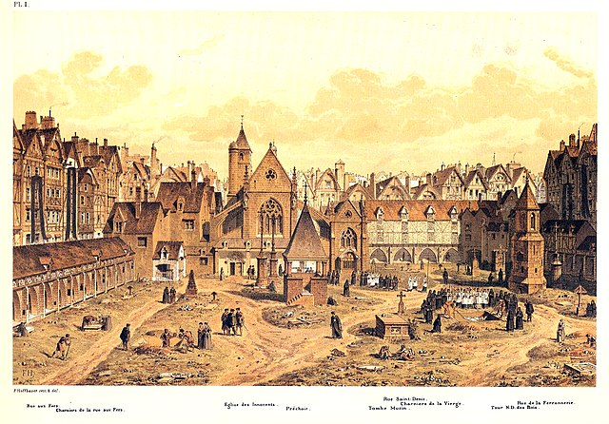
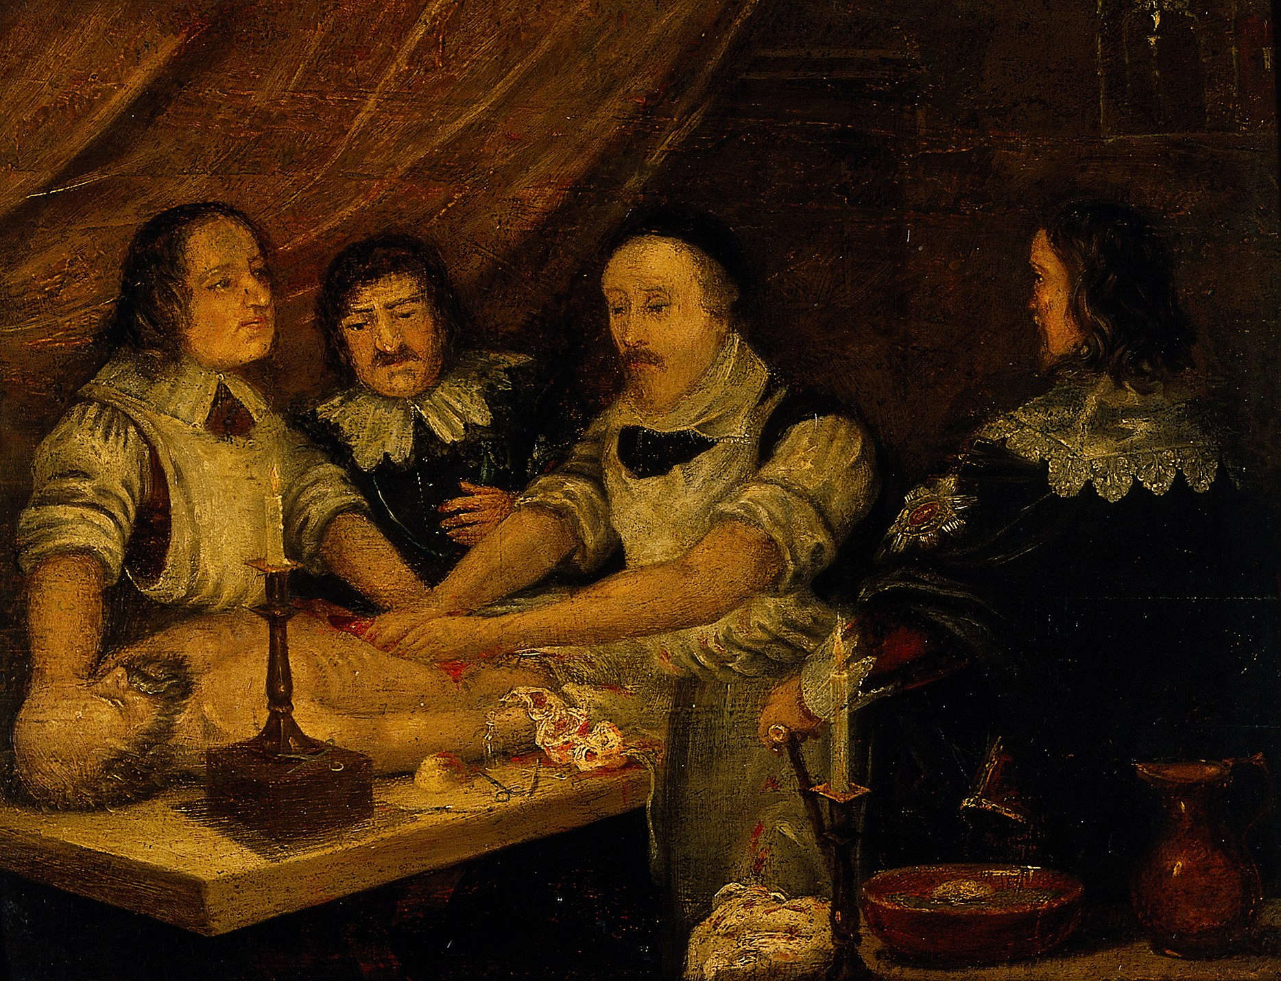
Shortage of corpses The Gibbet of Montfaucon

Slide 7
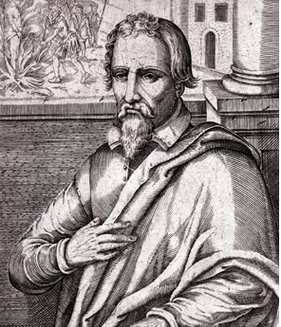
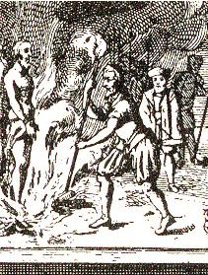
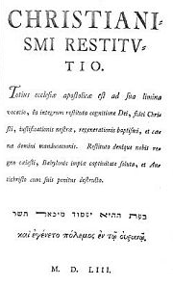
Michel Servet (1511-1553) Miguel Serveto da Villanova
1553: "Christianismi Restitutio” => small circulation
He contested Galen's dogma and asserted the impermeability of the interventricular septum in a normal heart: "This median wall does not allow any communication and does not permit the blood to pass"
Ibn Al Nafi’s work on pulmonary circulation
Before Vesalius, he overturned the theory of interventricular communication
He was led to the stake in Geneva by the Calvinists

Slide 8
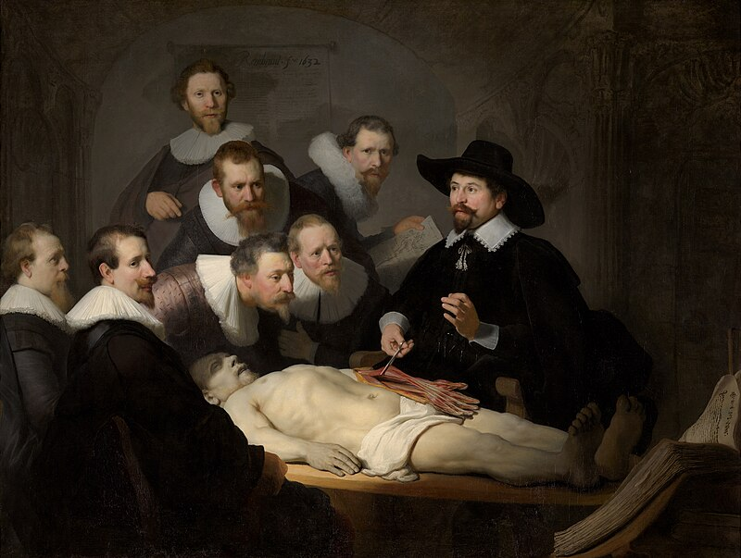
Rembrandt 1632 - The Anatomy Lesson of Dr Nicolaes Tulp

Slide 9
The systematization of scientific knowledge
The reformation of anatomy: Vesalius, Gabriel Fallope, Carpi, Eustachhio, Charles Étienne(veins of the liver) , Gonthier d’Andernach (muscles of the hand, pancreas), Salomon Albert (venous valves and urinary tracts)
Thus, by the beginning of the 16th century, the normal macroscopic configuration of the human body was accurately known, in its essential structures.
Other medical disciplines : The clinicians of the Renaissance were no match for their anatomist contemporaries.
In all the areas of the medical art, the assault on the still all-powerful Galenism was harsh and not immediately successful
Almost insignificant in other fields of clinical medicine, therapeutics and hygiene, the contribution of the Renaissance was far more substantial in infectious pathology (Fracastor)
The birth of modern psychiatry can usually be dated back to the 16th century (Félix Platter)
The great professions of physicians, surgeons and apothecaries had been individualized and organized on a European university level. Rationality and a scientific, humanistic approach were introduced into these professions

Slide 10
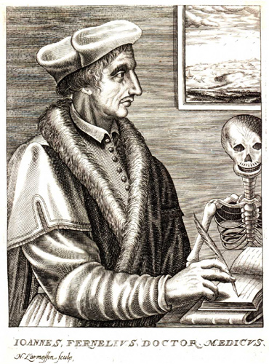
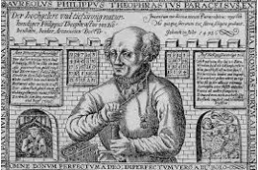
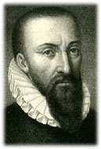
Jean François Fernel (1497-1558) vs Paracelsus (1493-1541) the reformer or Ambroise Paré (1510-1590), the great surgeon
Father of modern physiology
He succeeded in rejuvenating and revaluing Galen's work
He provided an excellent description of a case of acute perforated appendicitis in a seven-year-old girl, meticulously recording her symptoms and conducting the autopsy
“Galen, after all, is not infallible”

Slide 11
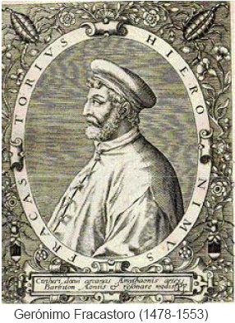
Infectious pathology - Fracastor
The contribution of the Renaissance was far more substantial in infectious pathology. Jérôme Fracastor was the main architect
He identified the fundamental role of contagion and asserted the existence of infecting micro-organisms.
In 1546, he published in Venice, "De Contagione et Contagiosis Morbis"
He indicated that contagion is an infection passing from one individual to another through "particles so small that they do not fall under the senses"; these are microbes, the "seminaria contagionis "
"Know that throughout the course of the disease, the existence of germs must never be neglected"
He describes "the great pox" and other infectious diseases: plague, smallpox, eruptive fevers, typhus, leprosy, syphilis, and tuberculosis.
"One must always remember that the most important thing is to combat the germ and oppose contagion"
As a genius precursor and a convinced "contagionist," he has been called "the Father of modern epidemiology"

Slide 12
The teaching and practice of medicine in France
All over the Middle Ages surgery is practiced by barber-surgeons.
Theoretical teaching at the Collège usually assumed by two professors was complemented by practical teaching at the hospital. Surgeons provided free treatment on the first Monday of each month in the church of Saint-Côme, then in the Collège. Pupils also attended hospital visits at the Hôtel-Dieu and the Charité, and we can see that there was already a sort of externat and internat
Students intending to practice in the suburbs of Paris or in the viscounty of Paris had to have completed five years of study, three of which were spent in hospitals. They were then “boy surgeons”, then “compagnons ”, housed, fed, heated, lit and laundered at the Hôtel-Dieu
Medical services at the Hôtel-Dieu were provided by the Faculty's Regent Doctors. They had authority over the surgeons, and for major operations such as trepanning or amputation, three doctors had to give their opinion beforehand, and one of them was present during the operation
The teaching was reformed. The most prestigious teachers were recruited. The students were even involved in the administration of their respective faculties. Tuition fees remain high. Clinical teaching is virtually non-existent. Physicians are increasingly recognized in society.

Slide 13
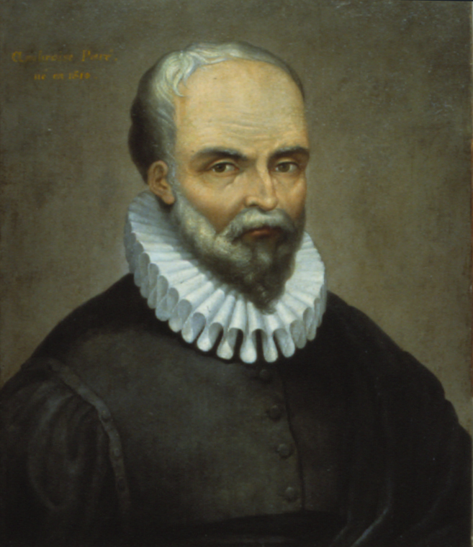
Ambroise Paré (1510-1590) the father of modern surgery and the inventor of numerous instruments
His motto was: “Labor improbus omnia vincit” (“Hard work conquers all”)
Ambroise Paré stood out from the crowd thanks to his exceptional qualities, but not without a difficult start that apparently did not destine him to achieve the renown he enjoys today.
“Je le pansay, Dieu le guarist.” (I bandaged him, God healed him).
“ I'm not asking you if you're Catholic or Protestant, rich or poor, but: what's your ailment ? ” "Je ne vous demande pas si vous êtes catholique ou protestant, riche ou pauvre, mais : quel est votre mal ?"

Slide 14
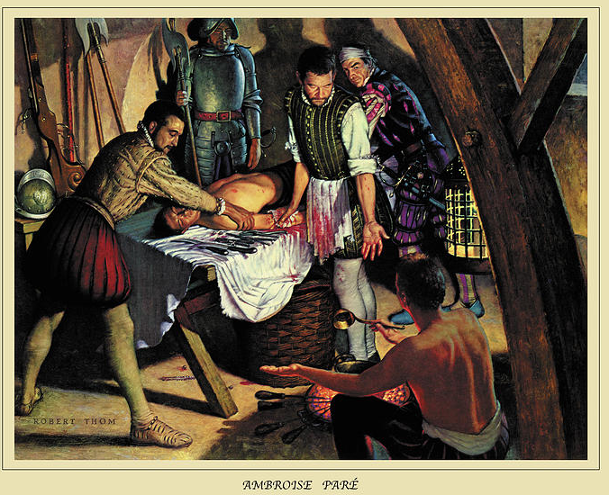
Leaving his studies behind, young Ambroise took up an apprenticeship with barber-surgeon Vitré Jean Vialot. There, he learned to wield a razor, to bleed (perform bloodletting) and to dress ulcers
His curiosity led him to Paris, to attend courses in approximately 1529. He was taught anatomy and dissection; his bedside book was a work on major surgery. In this book, we can read the four qualities the author wanted in a surgeon, and which may well have inspired Paré: “To be at once literate, expert, ingenious and highly moral.”
In 1533, he was admitted as a barber-nurse at the Hôtel-Dieu. He used to say: “It's nothing to leaf through books, to chirp, to cackle in the pulpit of surgery, if the hand doesn't put into use what reason orders.”
1536: Army surgeon during the Italian Wars - Piedmont campaign - Therapeutic innovations
In Turin, he reveals himself as a courageous innovator in the less inhumane treatment of cauterization for gunshot wounds: faced with a lack of boiling oil, he applies an ointment made from a mixture of egg yolks, rose oil, and turpentine to the wounds. From that moment on, he vows "never to burn the poor wounded so cruelly again."

Slide 15
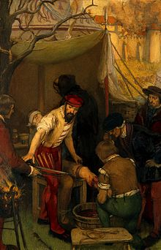
Therapeutic innovations
1545 : he publishes his first work: "The Method of Treating Wounds Caused by Arquebuses and Other Firearms; and Those Made by Arrows, Darts, and Similar Objects, as Well as Burns Specifically Caused by Gunpowder" written in French by a barber for barbers; and without the collaboration of a doctor from the Faculty. + a second work: "Summary of Obstetrics and Anatomy"
1545 : He treats Duke François de Guise for a wound caused "by a terrible lance thrust that, above the right eye, slanting toward the nose, entered and passed out the other side, between the nape and the ear," which will earn him the nickname... "the Scarred."
1552 :During the siege of Damvilliers (near Verdun), Paré performed the first thigh amputation on a gentleman. He then generalized the technique of ligating blood vessels (large veins and arteries) above the amputated part instead of using the usual cauteries (red-hot irons) => the risks of hemorrhage and pain are reduced.
1552 : During the siege of Metz, in Lorraine, the French generously assisted all the sick and dying soldiers of the Imperial camp with Ambroise Paré leading the effort. The "courtesy of Metz" became a proverbin medical ethics.

Slide 16
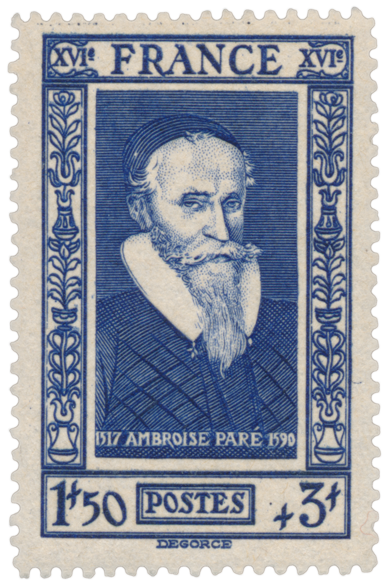
1554 : Surgeon’s Cup "in favorem Regis"
Surgeon of Kings :
In 1559, as ordinary surgeon to Henri II (1519-1559), son of François I.
In 1559, as chief surgeon to François II (1544-1560), the eldest son of Henri II.
In 1561, as surgeon to Charles IX (1550-1574), the third son of Henri II.
In 1575, as surgeon to Henri III (1551-1589), the fourth son of Henri II.
It is between Charles IX and Paré that the legendary dialogue occurred:
"- I hope you will take better care of kings than the poor?"
- "No, Sire, that is impossible."
- "And why is that?"
- "Because I treat them as kings."

Slide 17
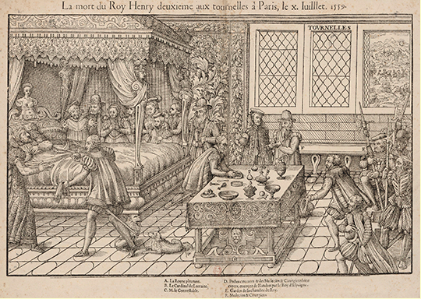
On June 30, 1559, King Henri II of France organized a tournament in front of the Hôtel des Tournelles
Henri’s injury "A large splinter struck the forehead below the right brow embedding itself in the corner of the left eye. Several fragments pierced the eye itself." After washing the wound with egg white, the doctors administered a potion made of rhubarb and chamomile.
Vésale and Paré likely met and collaborated at the bedside of King Henri II. This incident is recounted by Paré in his book titled "La méthode curative des playes et fractures de la teste humaine" (1561)
After the tournament where he was mortally wounded, the king lies dying on his bed, surrounded by the queen and the constable, while Ambroise Paré and André Vésale, the two most famous physicians of the time, discuss his case in front of a table laid out with instruments and medicines

Slide 18
1561: He broke both bones in his leg. This forced immobility provided him the opportunity to write "Dix livres de chirurgie et le magasin des instruments nécessaires à icelle" in which he included remarkable anticipations (antiseptics, trepanation, methods of bandaging). Not only did he revolutionize surgical techniques, particularly in orthopedics, but he also improved instrumentation
Psychology was not recognized as a science at the time, but Paré understood the connection between the physical and the moral. Thus, he advised Charles IX, while he was convalescing, to entertain himself by watching "the boys and girls of the village dance and sing”
1562: He was appointed chief surgeon to King Charles IX by Catherine de Médicis
1568: « Treatise on plage »
24 August 1572: Charles IX protected and saved Paré, who was perceived as a Protestant, by supposedly hiding him in his wardrobe. The king is said to have asked him to convert to Catholicism, to which the physician replied: "By the light of God, Sire, I believe you remember promising me never to command me four things: to return to my mother's womb, to be pierced in a game of battle, to leave your service, and to go to mass.”
1575: Paré became the chief surgeon to King Henri III, who succeeded Charles IX. He then suspended his travels to dedicate himself to writing his books, editing, and publishing his complete works
20 December 1590: Death. "Nothing is more certain than death, and nothing is more uncertain than the hour of death” (Henry de Mondeville)

Slide 19
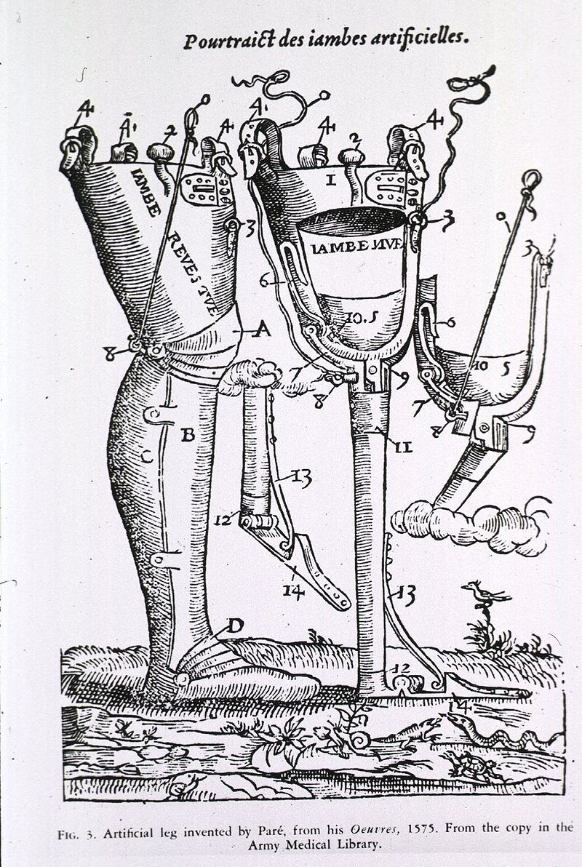
Ambroise Paré and the Faculty of Medicine in Paris had a tumultuous relationship characterized by conflict and rivalry
Since 1535 the Faculty of Medicine held absolute authority over the publication of medical works
1575 : the first edition of Paré’s first major volume incited the wrath (outrage) among the regent doctors. Paré, labeled "impudentissimus, imperitissimus, temerarius," had dared to have it printed without their authorization.
The Faculty mobilized against him, enlisting fellow surgeons who felt overshadowed by Paré's fame, and even the Provost and aldermen of Paris joined in, condemning his book as indecent and contrary to public morals, calling for it to be burned.
Paré published a "Response to the Calumnies of Certain Doctors and Surgeons Regarding His Books" to defend himself
His works laid the groundwork for modern surgical practices, and he is remembered as one of the pioneers of surgery, despite the challenges he faced from established medical authorities.
He could take pride in having risen from barber to the title of surgeon. His determination and innovations fundamentally transformed surgery, earning him a prominent place in medical history.

Slide 21
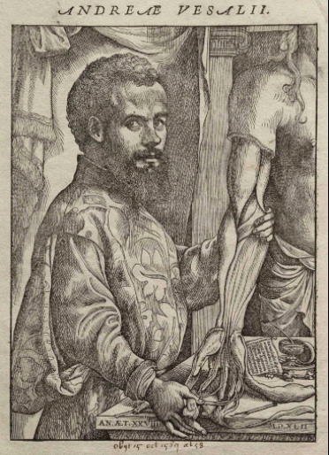
André VÉSALE, also known as Andreas Vesalius (1514-1564) Flemish physician, "Father of Modern Anatomy"
André Vésale (Andries Van Wesel in Dutch) was born near Brussels, in the Flemish Brabant, which was then a Spanish possession known as the Spanish Netherlands, under the jurisdiction of the Holy Roman Empire. He latinized his name to Vesalius, following a common practice of the time. The family home was located near the gallows, a place where executions took place.
His great-great-grandfather, Pierre Wijting (known as Van Wesel because he was from Wesel, in Lower Rhine), was the physician to Frederick III; his grandfather, also a physician and astrologer to Maximilian of Austria, taught at the University of Leuven; finally, his father, Andreas, was the apothecary to Margaret of Austria, aunt of Charles V.
“With a gaze likely detached from any sensitivity, young André made his first observations on the subtle arrangement of skin, muscles, viscera, and bones, examining the numerous corpses and skeletons cleaned by birds during his childhood”

Slide 22
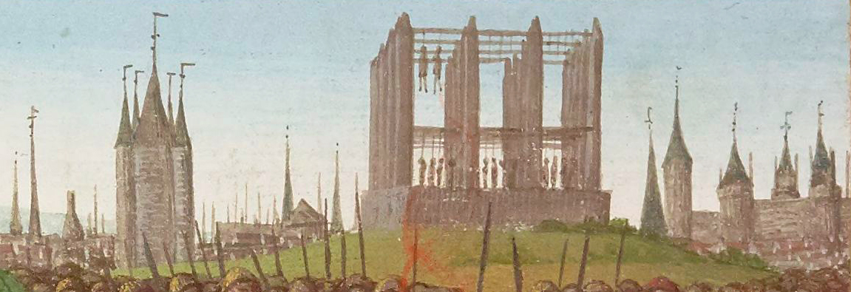
Studies
Trilingual College of Leuven (Greek, Arabic, Hebrew)
1533 : three years in Paris to study medicine. He was a student of Jacques Dubois, known as Sylvius (1478-1555), a professor of anatomy at the Royal College of Medicine, not far from the Gibbet of Montfaucon (gallows).
Vésale quickly deserted the amphitheater to roam around the Montfaucon gibbet at the gates of Paris. He collected fragments of skeletons and set out to familiarize himself with true human anatomy
Sylvius was astonished by his skill and intelligence

Slide 23
Anatomy Lesson at the University of Paris
Before the era of Vesalius, the study of anatomy primarily relied on the writings of Galen whose work had dominated medicine for centuries. Galen based his findings on dissections of monkeys and other animals, and his descriptions of human anatomy contained many inaccuracies due to this approach. Even in the 15th century, Hippocrates, Aristotle, and Galen are the absolute references.
Human dissections were rare and frequently prohibited by religious and ethical laws, which limited the precise understanding of human anatomy. As the Church's authority began to decline, dissection flourished, and knowledge of the human body expanded considerably. The dissection of human corpses was rehabilitated for the first time by the Italian University of Bologna
The function of dissection in the 14th and 15th centuries is primarily to confirm the observations recorded by the Ancients in their writings, which are read aloud by the professor
The procedure follows an order based on the speed of decomposition: first the lower abdomen, then the chest (thorax), followed by the head and finally, on the fourth day, the limbs, but never the skeleton

Slide 24
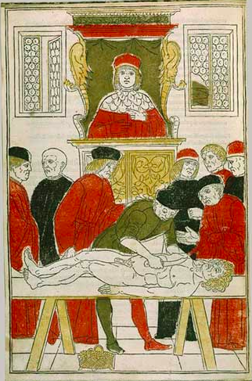
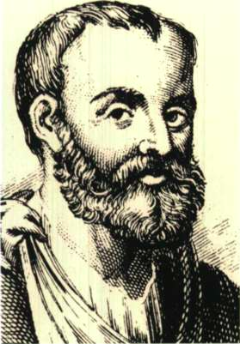
The Dissection by Johan von Ketham Fasciculus medicinae, Venice, 1491
The magister can be seen reciting the book, the ostensor (bottom right) pointing and the prosector (in the center) dissecting the flesh

Slide 25
Galenic medicine was taught as a dogma in the universities of Western Europe up until the Renaissance, and even the grossest errors of Galen were repeated without contestation.
Starting from the 15th century, the Church gradually allowed dissections, initially for legal purposes, followed by those of executed criminals and unclaimed bodies
In the 16th century, there were two distinct viewpoints regarding anatomy:
- that of the Church, which was largely hostile to dissection and hindered the progress of medicine
- that of those seeking to advance the understanding of the human body, who were thus in favor of dissection.
With the arrival of Vesalius, this approach was set to change radically. By conducting dissections himself and directly observing the human body, he was able to correct numerous errors and provide more accurate descriptions of anatomy. Thus, Vesalius paved the way for a new era of anatomical studies, grounded in observation and experimentation.

Slide 26
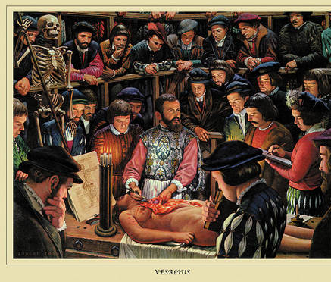
Vesalius cursus
1533 – 1536 : Paris
1537 : Thesis Leuven (Louvain)
1537 – 1546 : Padua => Professor of Anatomy
Vésale revamped the anatomy lessons and the practice of dissections, which he performed himself
1538 : lacking cadavers for his courses, he published in Venice a collection of six anatomical plates, the Tabulæ Anatomicæ Sex
1539: He secured a regular supply of bodies from the magistrate of Padua. Not only were the corpses of the executed reserved for him, but the dates of execution were also scheduled to align with his work
Vésale preferred to study bones on his own initiative by frequently visiting cemeteries. He was initially known as a "dissenter" from his predecessors, often criticized and even insulted.
Sylvius, his former professor, was one of his fiercest opponents, calling him "mad" (Vesalius => Vesanius), when the Fabrica was published in 1543

Slide 27
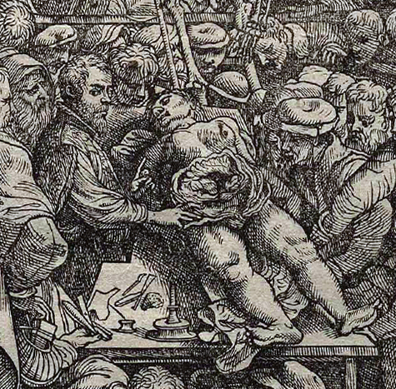
Preface of the Fabrica
"As physicians judged that only the treatment of internal ailments was within their purview and thought that knowledge of the viscera was sufficient for them, they neglected—almost as if it did not concern them—the structure of bones, muscles, nerves, veins, and arteries that irrigate the bones and muscles. To this, add that the abandonment of anatomy to barbers not only caused physicians to lose all real knowledge of the viscera, but also all skill in dissection, to the point that they no longer engaged in it. […] These [the physicians], like jays, speak of things they have never approached closely, but which they have taken from books and committed to memory, without ever looking at the described objects. The others [the barbers] are so ignorant of the languages that they cannot provide spectators with explanations about the dissected parts; they even end up lacerating the organs that the [physician] instructs them to show. The latter, having never laid hands on a dissection, is content with his commentary […]. Thus, everything is taught incorrectly."

Slide 28
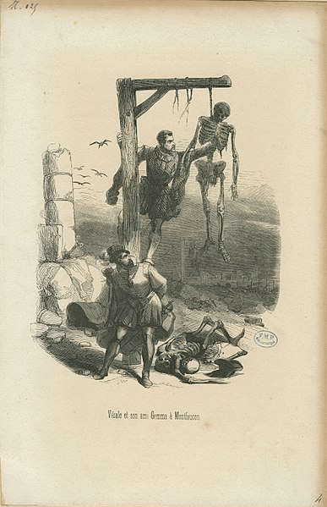
Confronted with Galen's errors, he decided to teach the reality of human anatomy. This marked the beginning of the remarkable work he undertook.
He took students to learn at the bedside of patients and encouraged them to write individual case notes. This work allowed Vésale to clearly demonstrate that the anatomical descriptions made by Galen corresponded to the bodies of monkeys, not humans.
He indeed undertook to revise, correct, or refute Galen's assertions (such as regarding the lower jaw, uterus, cardiac cavities, liver, etc.), which had been considered definitive for a millennium.
"Tabulæ anatomicæ sex" (1538) He still adheres to Galen
"De Humani Corporis Fabrica" (7 volumes), in Basel in 1543
It is the greatest treatise on anatomy since Galen. In 1543, in the first edition, Vesalius does not dare to contradict Galen

Slide 29
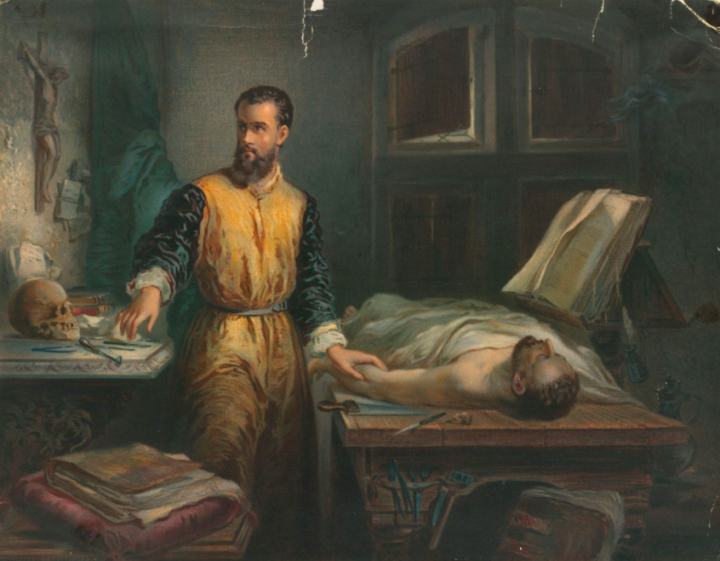

Slide 30
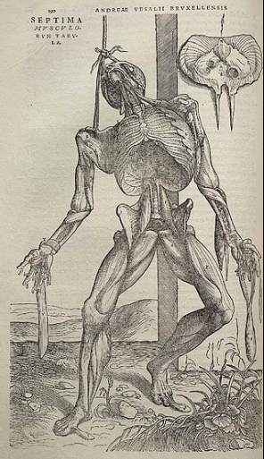
"De Humani Corporis Fabrica”, 1543 1st ed.
The first book presents a detailed overview of bones and joints
The second offers a functional conception of musculature, highlighted by the dynamic positions of the figures, strikingly lifelike and dramatically integrated into the landscape
The third book is dedicated to the arterial and venous systems
The fourth covers the spinal cord and peripheral nervous system
The fifth discusses the digestive tract, the urogenital system, and reproductive organs, concluding with a detailed description of the procedures to follow during a dissection
The sixth book studies the endothoracic organs
The seventh, after an unprecedented description of the brain and sensory organs, reiterates the rules to be followed during animal vivisection

Slide 31
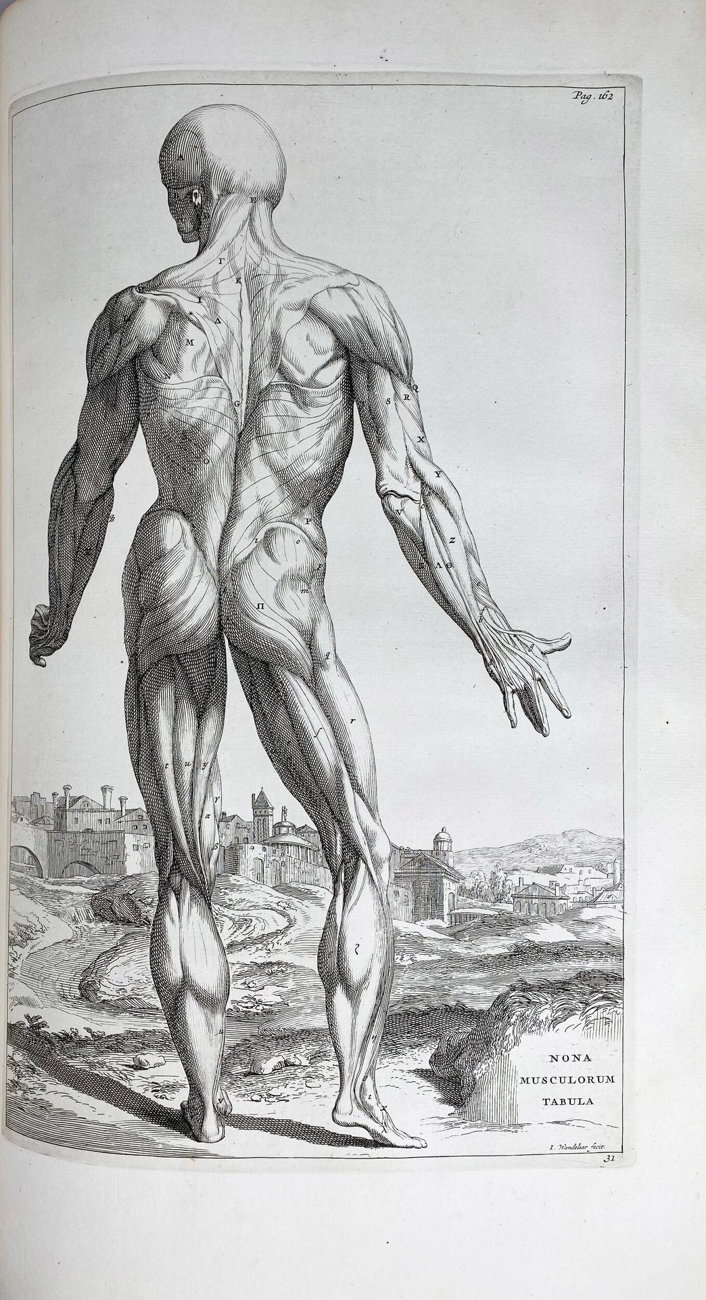
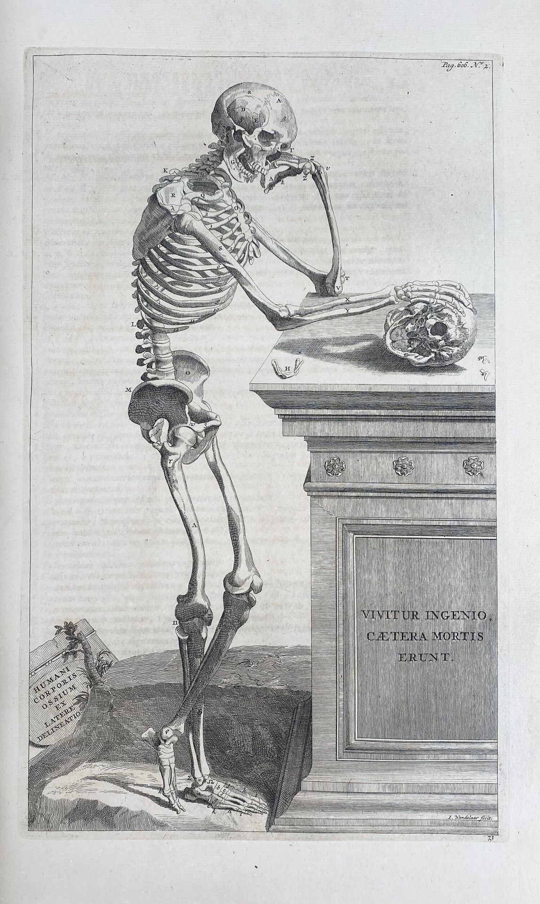

Slide 32
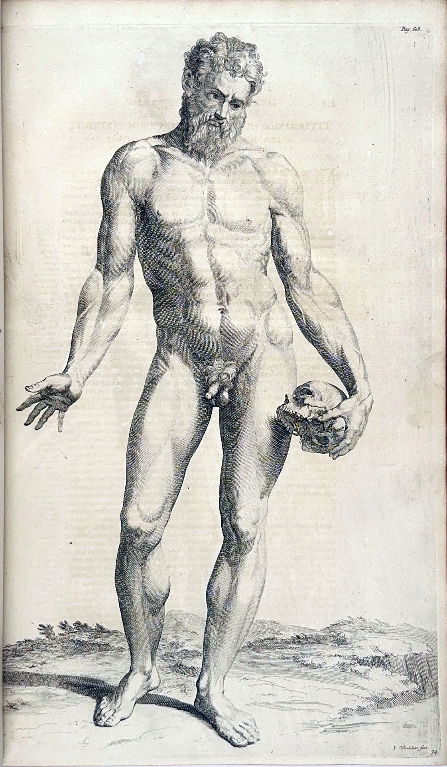
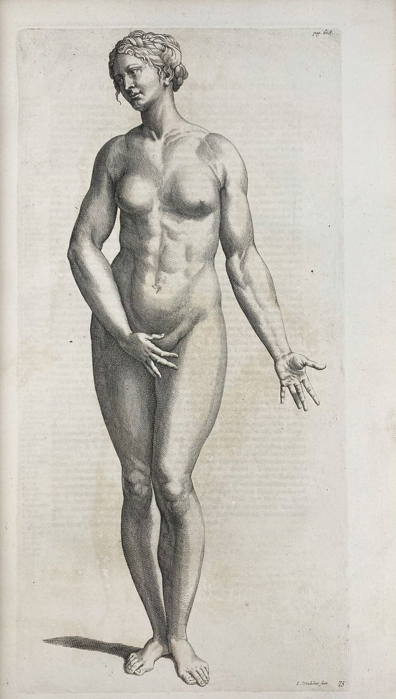

Slide 33
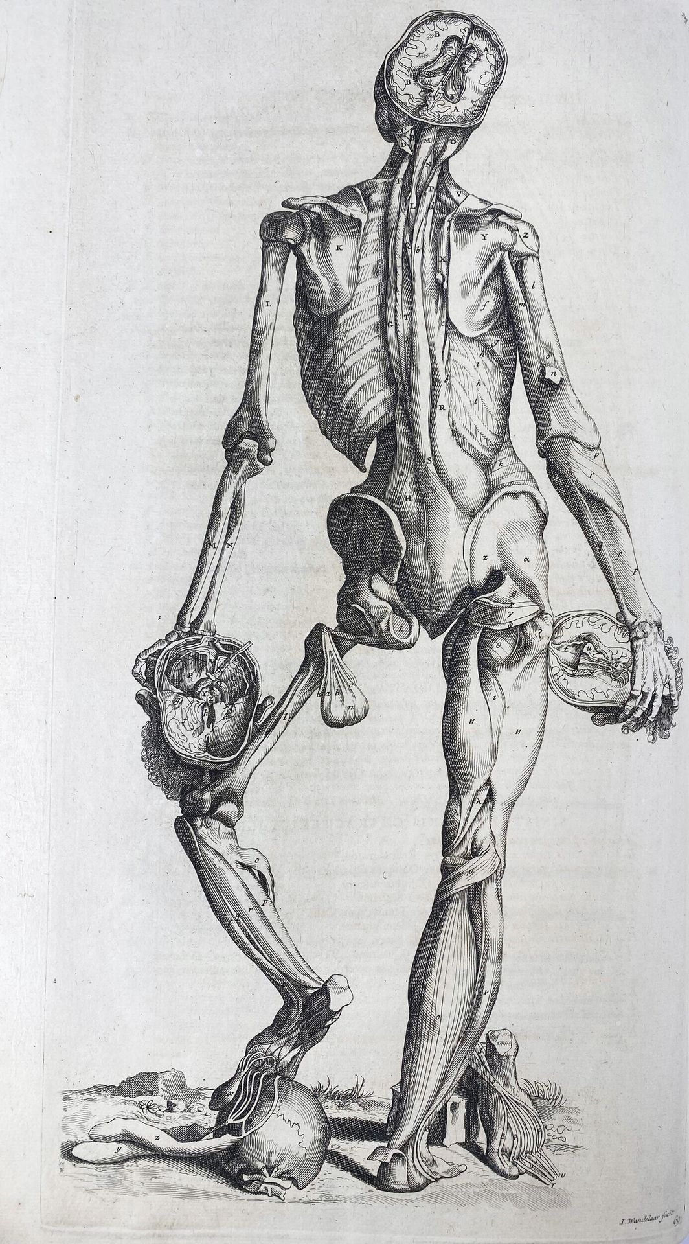

Slide 34
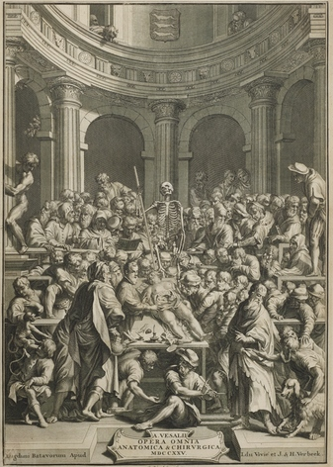

Slide 35
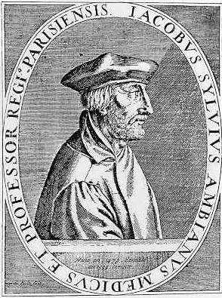
Vesalius’ Professor Jacobus Sylvius Ambianus (1489-1555) (Vesalius → « Vesanius »)
He invents the terms : mésentère, kystique, gastrique, poplité(e), sphénoïde
"Here lies Sylvius, who, in his lifetime, never gave anything for free. In death, he still laments that this line can be read for nothing."
« Ci-gît Sylvius qui, de son vivant,
ne donna jamais rien pour rien.
Mort, il se désole encore qu'on puisse lire cette ligne gratis. »

Slide 36
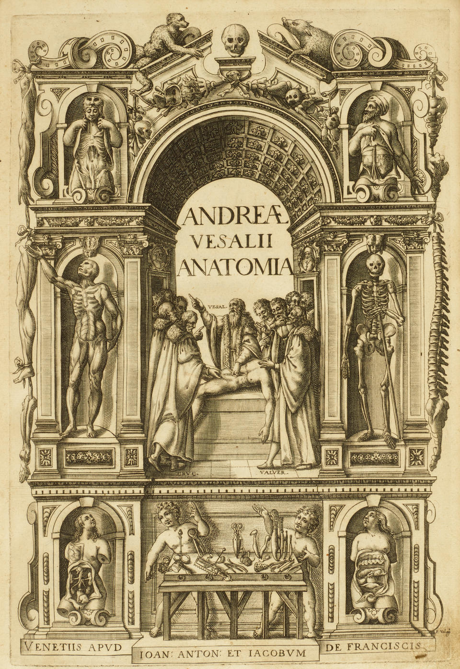
"De Humani Corporis Fabrica" 2nd ed. 1555
The first book presents a detailed overview of bones and joints
He corrected some of Galen's errors, particularly regarding blood circulation
He describes circulation in a manner similar to that of Ibn Al-Nafis (Alaa-Uddine Ali Ibn al-Hazm al-Qurashi) (1213-1288)
He refutes the galenic dogma of interventricular communication, questioning about the connection between the two ventricles of the heart : “...I still do not see how even the tiniest amount of blood could be transfused through the substance of the septum, from the right ventricle to the left...”
Restoration of the use of the nude: This led artists to take a keen interest in anatomy, becoming brilliant collaborators with scholars

Slide 37
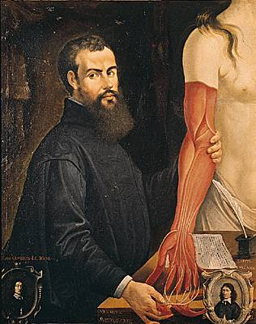
Physician at the Court of Charles V and Philip II
1543 : Vesalius becomes the personal physician to Charles V
1556 : He moves to Spain
1561 : Tribunal of the Inquisition in Madrid accuses him of : - Dissecting a living human being,
- Writing that women have the same number of teeth as men,
- Contradicting Galen,
- Disparaging physicians in the preface of the Fabrica
Condemned to the stake, Vesalius was saved by Philip II, who commuted his sentence to permanent exile and a pilgrimage to Jerusalem
While there, he received an offer to take the Chair of Anatomy at the University of Padua, which had become vacant after Fallopius's death. Shortening his pilgrimage, Vesalius organized his return from the Holy Land and boarded a pilgrim ship to Italy
During the crossing, he fell ill with a high fever, necessitating a stop at Zante, in the Ionian Sea. Vesalius was left dying on the shore and soon passed away from exhaustion somewhere along the Greek coast, around October 15, 1564

Slide 38
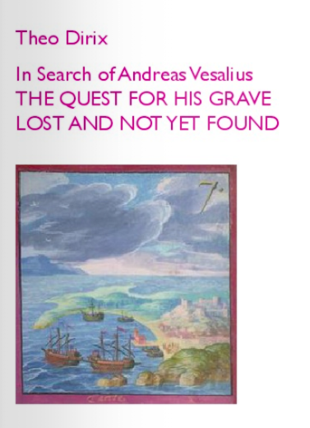
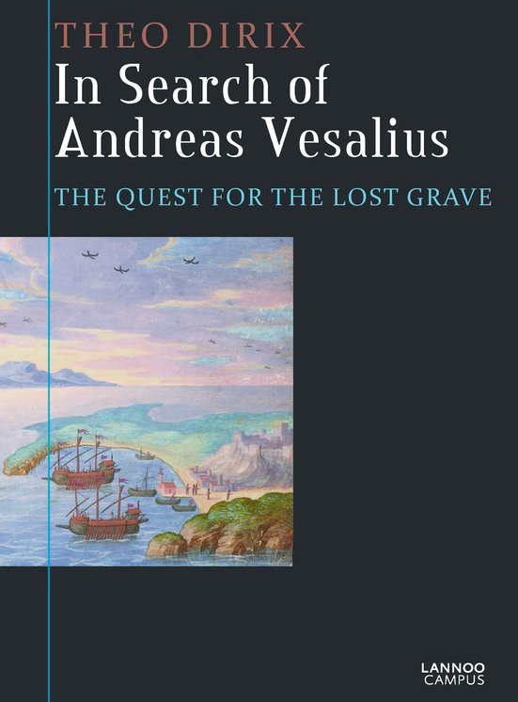

Slide 39
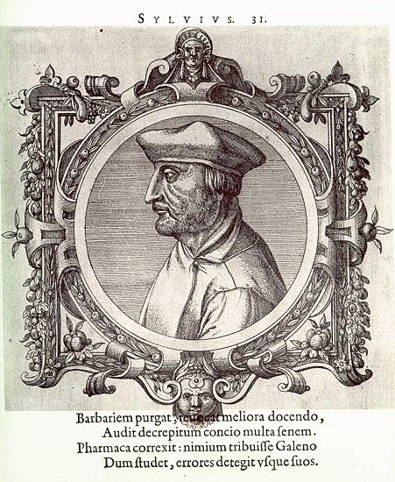
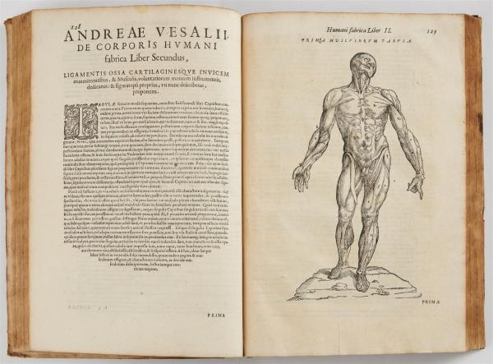
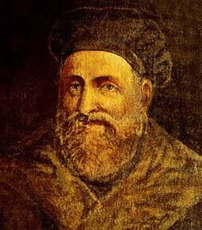

Slide 40
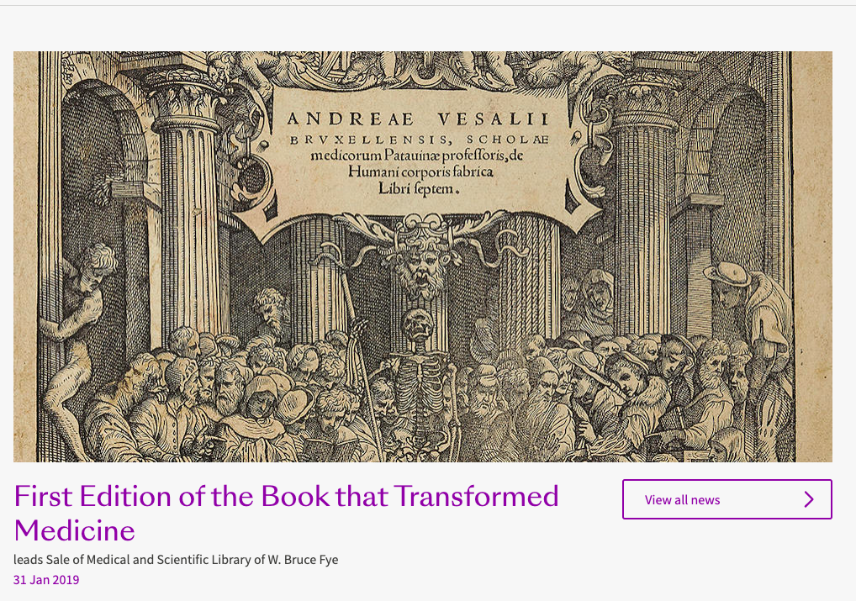
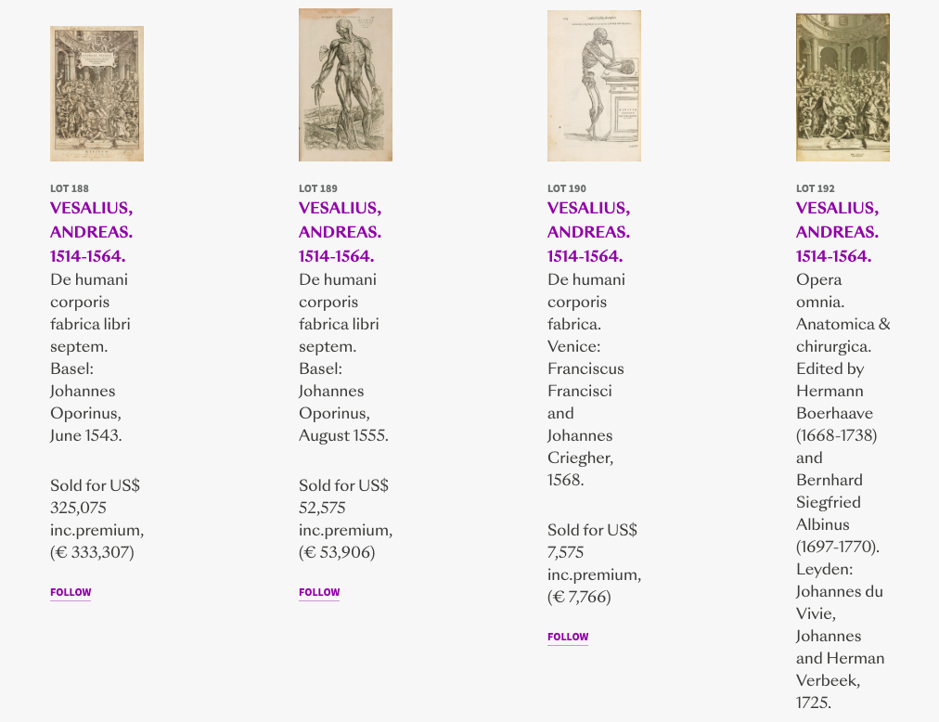

Slide 41
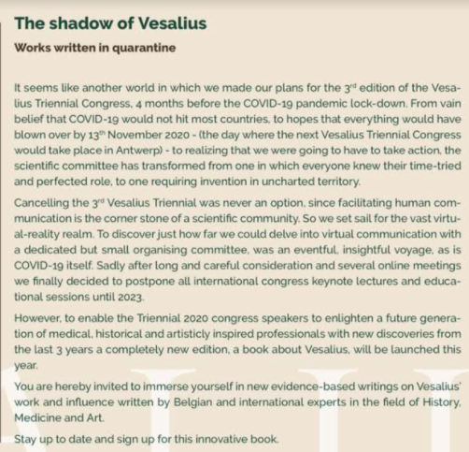
https://www.uantwerpen.be/en/conferences/vesalius-triennial/

Slide 42
PARACELSUS (1493-1541) alias Philippus Auréolus Théophratus Bombast von Hohenheim
Alternately seen as a brilliant reformer—often presented as the Luther or Danton of Renaissance medicine—or as a kind of illuminated mage (magician), tormented by occultism and theosophy, Paracelsus embodied all these facets. "If God does not help me, may the Devil assist me!" he exclaimed in moments of distress. - « Si Dieu ne m'aide, que m'aide le Diable! »
He had been emasculated in childhood by a soldier : "The nature has not woven me with much subtlety. It is not the habit of my country to use silk threads. We were not raised with figs, mead (drink of honey), or fine bread; but with cheese, milk, and oat bread: this is not what makes refined young men. What we received in our youth stays with us until the end of our days. Compared to delicate, clean people, superiorly refined, we appear coarse. And we do not understand well those raised in silk garments and by the hands of women."
He was a coarse and superstitious empiricist, an alchemist, and a public astrologer, a megalomaniac wanderer
1527: Professor of Medicine in Basel : « At the dawn of this year 1527, when Europe is shaken by immense intellectual currents, where science and knowledge are quivering under the pressure of new thoughts heralding great moments to come, I say, remaining true to my tradition and the rules I have set for myself, you should not expect from me a lesson in conformity. And now, let us together cast into the purifying fire the nonsense, bookish meditations of Galen and Avicenna !! »
« Vous n'attendez pas de moi une leçon de conformisme, et vous avez raison! Maintenant, tous ensemble allons jeter au feu purificateur, les élucubrations livresques de Galien et d'Avicenne! »

Slide 43
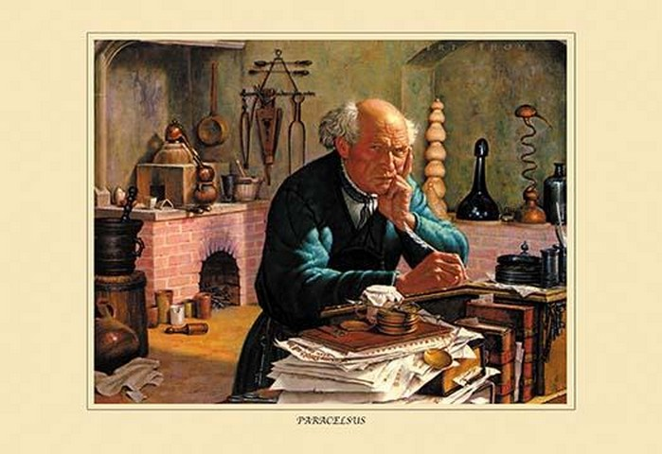

Slide 44
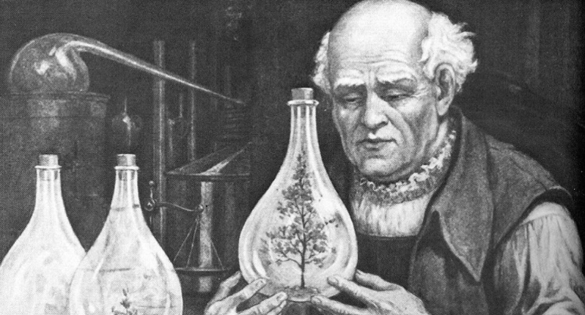
An eccentric reformer
His elevated view of his profession drove him to dedicate himself tirelessly to his patients during the plague epidemic of 1534 in Vorarlberg and Tyrol
Breaking with tradition, he taught and wrote his books in German rather than Latin, and admitted barber-surgeons into his classes
Openly rejecting Galenic tradition, Paracelsus dismissed the old belief that diseases stem from imbalances in humors, emphasizing the role of external factors. His theories form a surprising framework that combines medicine, philosophy, alchemy, occultism, and astrology.
"Very few doctors have an exact knowledge of diseases and their causes; but my books are not written like those of other doctors who have confined themselves to copying Hippocrates and Galen; I composed them based on experience, which is the greatest teacher of all things, and at the cost of unflagging labor."
He advocated for clinical teaching, already favored by the Arabs but practically ignored in Europe

Slide 45
Convinced of the importance of "alchemy" in pathology, he was the first to attempt to establish a complete system: "Man is a chemical compound; diseases are caused by some alteration of this compound: therefore, chemical medicines are needed to combat diseases."
He introduced the use of chemical compounds in medicine and provided excellent insights into many medications, including opium, mercury, arsenic, sulfur, and especially antimony (stibium). In this regard, Paracelsus is a precursor of modern chemotherapy and homeopathy.
He developed the use of non-toxic metals in medical treatments, proposing "martial" (iron) medication for anemia
He noted the anesthetic properties of ether
Cretinism = > goiter (goitre)
Founder of chemotherapy : Ηg, As, S, Sb, όπιο
Paracelsus identified silicosis and tuberculosis as occupational diseases

Slide 47
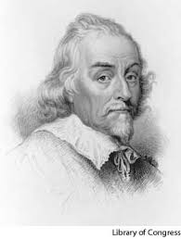

William Harvey (1578-1657)

Slide 48

Convaincu de l’importance de l’anatomie pathologique « L'examen du cadavre d'un seul homme mort à la suite d'une maladie chronique est plus utile à la médecine que la dissection de dix pendus »
Faute de cadavres, il dissèque son propre père (sœur, des nombreux amis…)
De Motu Cordis : 1628 la circulation sanguine générale selon Harvey
Méthode quantitative en médecine (72 pouls/min)

Slide 49

Benjamin Eugène Fichel (1826-1895) Guillaume Harvey prouvant la circulation du sang à Charles Ier, 1851

Slide 50



Antoni van Leeuwenhoek (1632-1723) Robert Hooke (1635-1703)

Slide 51
References
https://www.youtube.com/watch?v=maZkuO793X0
Ambroise Paré, Paracelse, André Vésale, Encyclopédie de l'Agora
La Médecine de la Renaissance du XV et du XVI siècles : https://www.medarus.org/Medecins
Drucker CB. Ambroise Paré and the birth of the gentle art of surgery. Yale J Biol Med. 2008 Dec;81(4):199-202.
Hernigou P. Ambroise Paré's life (1510-1590): part I. Int Orthop. 2013 Mar;37(3):543-7. doi: 10.1007/s00264-013-1797-5. Epub 2013 Feb 3.
Zimmerman L, Veith I. Great ideas in the history of surgery. New York: Dover; 1967. pp. 181–182.
Ghosh SK. Human cadaveric dissection: a historical account from ancient Greece to the modern era. Anat Cell Biol. 2015 Sep;48(3):153-69.
Steele L. Andreas Vesalius and his De humani corporis Fabrica libri septem. Vesalius. 2014 Summer;20(1):5-10. Jacqueline Vons : Histoire de la médecine à la Renaissance/ Textes médicaux latins, Centre d'Etudes Supérieures de la Renaissance, Université François- Rabelais de Tours- CNRS
FitzGerald G. The devil’s doctor: Paracelsus and the world of Renaissance magic and science. J Clin Invest. 2007 Mar 1;117(3):512.
Michaleas SN, Laios K, Tsoucalas G, Androutsos G. Theophrastus Bombastus Von Hohenheim (Paracelsus) (1493-1541): The eminent physician and pioneer of toxicology. Toxicol Rep. 2021 Feb 23;8:411-414.

