Slide 1
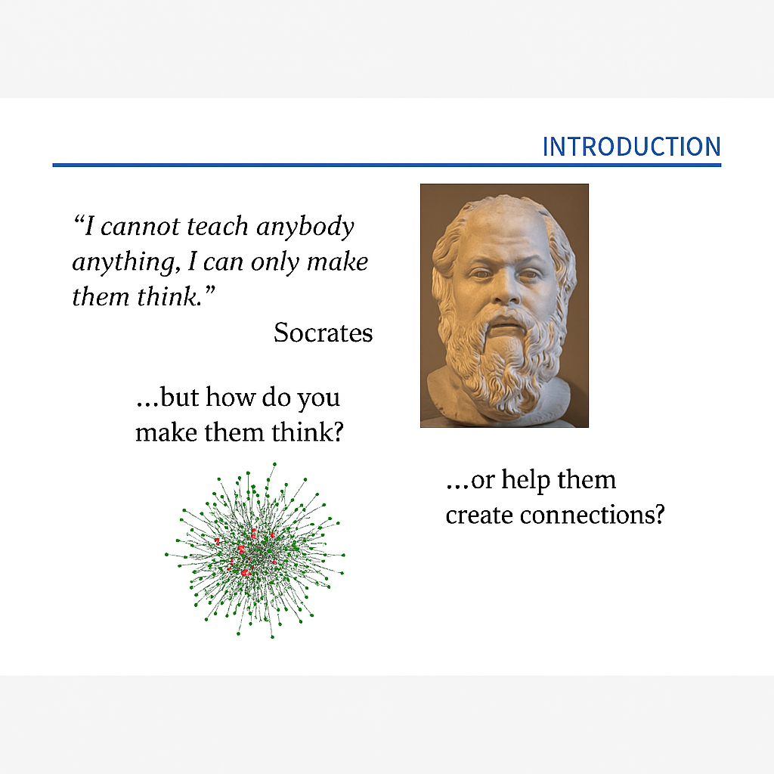

Slide 2
What to learn
What is an Ontology?
Why We Need Ontologies
What is the structure of an ontology
How to built an ontology - software tools
Main ontology repositories
Main Biomedical ontologies

Slide 3
Definitions
The definition given by Thomas R. Gruber
Ontology is: A formal specification of a conceptualization with a focus on knowledge and sharing.
Guarino defined ontology as:
A set of logical axioms intended to capture the intended meaning of a vocabulary.
Sowa's definition:
The subject of ontology is the study of the categories to which objects that exist or may exist in some domain of interest belong.
The result of such a study, called an ontology, is a catalog of the types of things that are assumed to exist in a domain of interest D from the perspective of a language L used for the purpose of discussing that domain.
According to Barry Smith:
An ontology is, in one approach, a table of categories, with each type of entity assigned to a place in a hierarchical structure.

Slide 4
The definition
In computer science, the term ontology refers to the outcome of an effort to model, in an exhaustive, meticulous, and unambiguous way, the conceptual schema of a specific domain.
An ontology is typically a hierarchical data structure that includes all the entities relevant to the domain it refers to, the relationships between them, as well as all the rules that govern their interactions within the domain.

Slide 5

  The Role of Ontologies in the Development of the Web
💻 Formal Semantics for Computers
- Ontologies define the formal meaning of information
- This enables automated processing by computers
🌍 Real-World Semantics for Humans
- Ontologies represent real-world concepts and meaning
- They allow alignment between machine-readable content and human understanding
- Based on a shared and accepted terminology

Slide 6
The problem and the need for ontologies’ development
The Most Common Reason for the Development of Ontologies
The most common reason for the development of ontologies is the sharing of information structure between humans and machines.
Importance of Ontologies in Medicine
Data Integration: Ontologies enable the integration of disparate datasets, allowing diverse health records, research databases, and clinical data to work together.
Standardization: They provide standardized terminology across different medical disciplines and regions.
Interoperability: Support for data exchange between different healthcare information systems, improving the efficiency of diagnosis and treatment.

Slide 7
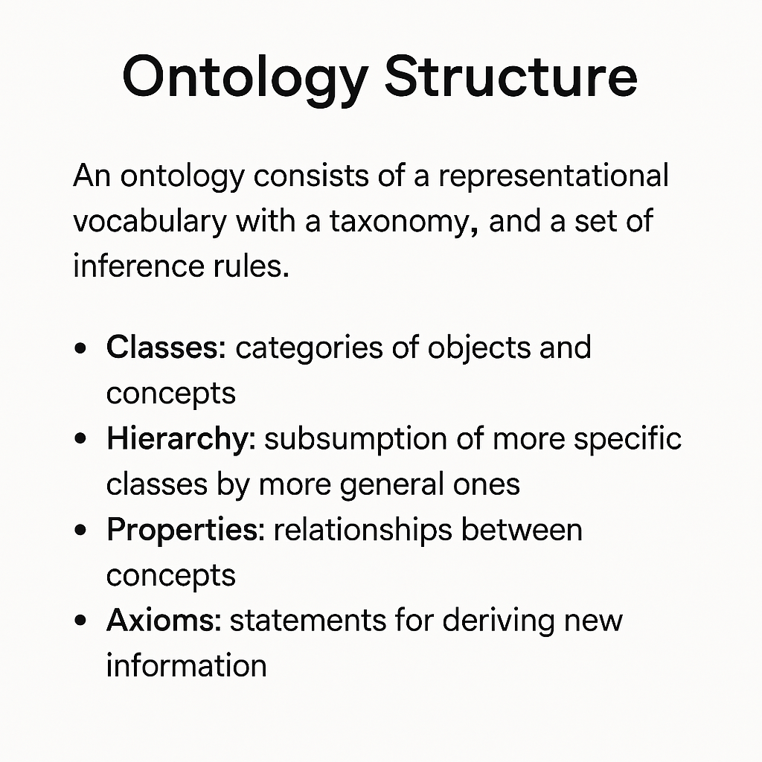

Slide 8
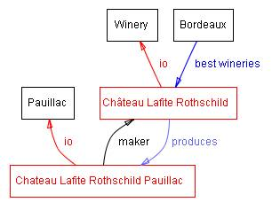
Ontology structure
Classes
Classes are the central element of most ontologies. They represent concepts in the domain. Example: Class Wine → represents all wines. A specific wine bottle → an instance of the class Wine.
Subclasses
A class may have subclasses that represent more specific concepts. Examples of subclass division for Wine: Red, white, rosé wines. Sparkling vs. non‑sparkling wines
Slots (Properties)
Slots describe attributes of classes or instances. Example (Château Lafite Rothschild Pauillac wine):Slot body → value: fullSlot maker → value: Château Lafite Rothschild wineryAt the class level, Wine may have slots for flavor, body, sugar level, maker, etc.
Some classes, instances, and relations among them in the wine domain. We used black for classes and red for instances. Direct links represent slots and internal links such as instance-of and subclass-of.
Protégé https://protege.stanford.edu/publications/ontology_development/ontology101-noy-mcguinness.html
Facets (Restrictions)
Facets impose constraints on slot values. Example: Slot body may allow only the values: light, medium, full.
Instances
Instances are concrete, real-world objects. Example: The Bordeaux wine in your glass is an instance of the class Bordeaux wine.
Relationships Between Classes
All instances of Wine (and subclasses like Pauillac) have a slot maker whose value is an instance of Winery. All instances of Winery have a slot produces, which refers to wines (instances of Wine and its subclasses).
Ontology Relationships Examples include: is_a part_of located_in

Slide 9
Ontology vs. Knowledge Base
“A formal, explicit description of concepts in a domain (classes),the properties that describe them (slots),and the constraints on those properties (facets).”An ontology + a set of instances forms a knowledge base.
Ontology vs. Knowledge Base An ontology describes concepts and their relationships. A knowledge base includes: The ontology itself Specific instances of its classes

Slide 10
Ontology construction
In practical terms, developing an ontology includes:
Conception:
defining classes in the ontology,
arranging the classes in a taxonomic (subclass–superclass) hierarchy,
defining slots and describing allowed values for these slots,
filling in the values for slots for instances.
We can then create a knowledge base by defining individual instances of these classes filling in specific slot value information and additional slot restrictions.
Integration of existing ontologies:
  Should (and how) existing ontologies (or parts of them) be used? This is generally a challenging problem.
Evaluation: "Expression of technical judgments regarding the ontologies, their associated software environment, and documentation in relation to a reference framework…" (Gomez-Perez, 1995).
Documentation: All key assumptions regarding both the basic concepts defined in the ontology and the core structural elements used to express these concepts in the ontology must be documented.

Slide 11

In order to better understand what an ontology is, let’s make one.
"Bring me a cup of tea, please"

Slide 12
What is the specific goal of our ontology?
To describe the process of making tea, in order to have it automated?
To evaluate the quality of a specific cup of tea?
To evaluate the skills of an apprentice tea-maker?
To choose the best type of cup of tea according to time and meal?
To allow tea-houses to share differently structured data?
&c…
The scope of an ontology must be precisely defined

Slide 13
What is required in order to make a cup of tea?
Ingredients: tea, water, milk or lemon, sugar…
Utensils: kettle, tea-pot, tea strainer, cup, spoon…
Actions: boiling the water, pouring the boiling water into the tea-pot, pouring the water out of the tea-pot, simmering some fresh water…
Measurements: temperature of water, duration of the infusing process…
&c…
All of these are the “things” assumed to exist in our domain of interest: “the making of a cup of tea”

Slide 14
Is there a hierarchy among these “things”?
Ingredients
Utensils
Actions
Measurements
Required
ingredients
Optional
ingredients
Kettle
Tea-pot
etc.
Boiling
the water
etc.
Temperature
of water
Duration of
the infusing
process
Tea
Water
Milk
Lemon
Sugar

Slide 15
Are we sure all of us understand these “things” the same way?
What is an “ingredient”?
Please define: …
What is a “required ingredient”?
Please define: …
What is an “optional ingredient”?
Please define: …

Slide 16
How can we describe each of these “things”?
Sugar
origin:
beet? maple? cane?
colour:
brown? white?
form:
caster? lumps? liquid? candy? granulated?
…

Slide 17
What about fructose and Aspartam?
Let’s create new classes and sub-classes:
Sweeteners
Natural
sweeteners
Diet
sweeteners
Artificial
sweeteners
Sugar
origin: …
colour: …
form: …
Fructose
Aspartam
The development of an ontology is an iterative process:
an ontology needs to be evaluated, revised, evaluated, revised, evaluated…

Slide 18
Do we really need all these refinements about sweeteners?
Not necessarily: depends on our purposes
Perhaps we might be just as happy with:
Sweeteners
type:
cane sugar, beet sugar, fructose, Aspartam…
form:
lumps, granulated…
“weightwatchingcally correct?”:
Yes or No
“There is no one correct way to model a domain — there are always viable alternatives”
(N. F. Noy & D. L. McGuinness)

Slide 19
How are these “things” interrelated?
Water
Boiling
the water
Kettle
is passive participant in →
← has passive participant
has as tool →
← is tool of
Are we sure all of us understand these relationships the same way?
What does “is passive participant in / has passive participant” mean?
Please define: …
What does “has as tool / is tool of” mean?
Please define: …

Slide 20

Did you know you knew so many things about a simple cup of tea?
Ontologies are related to the concept of knowledge representation

Slide 21
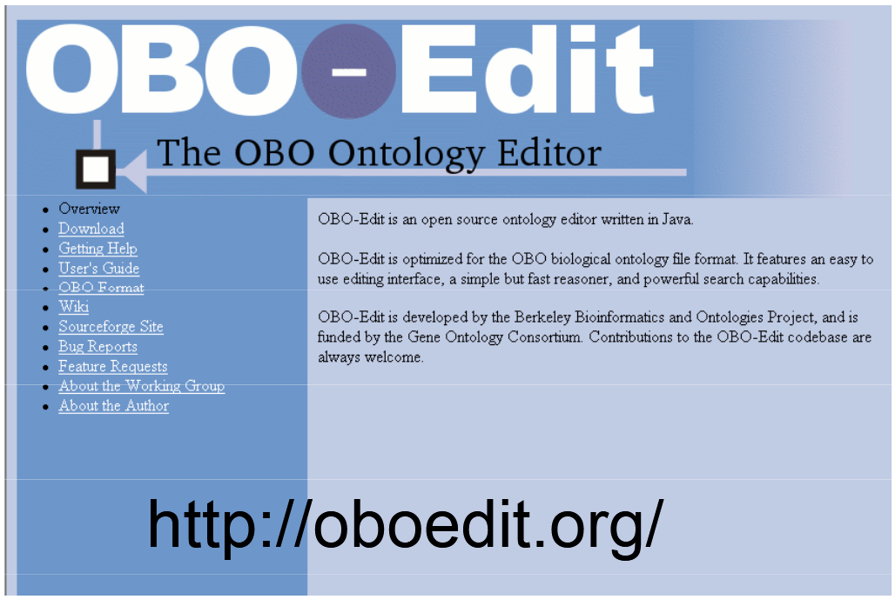
Building Ontologies: The Software

Slide 22
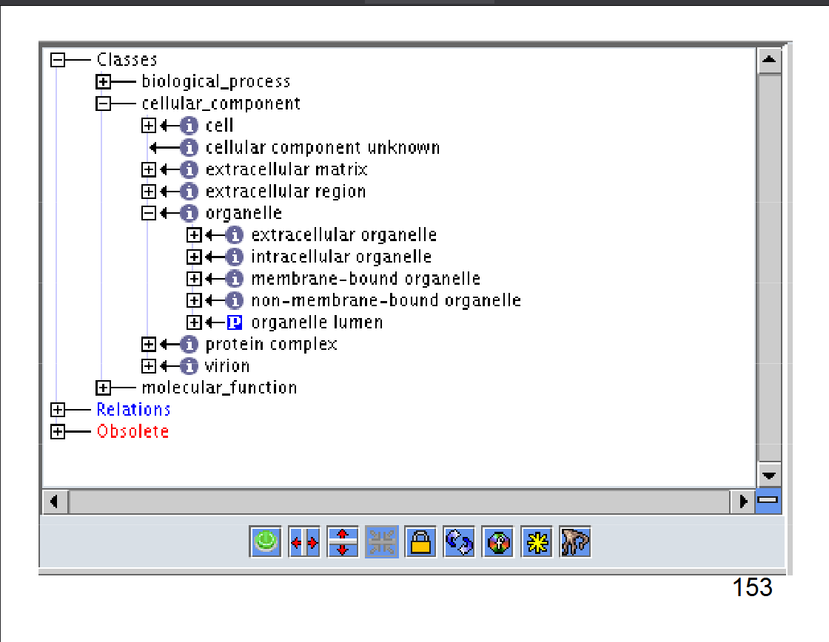

Slide 23
Protégé
Building Ontologies: The Software
Version 4.0 beta

Slide 24
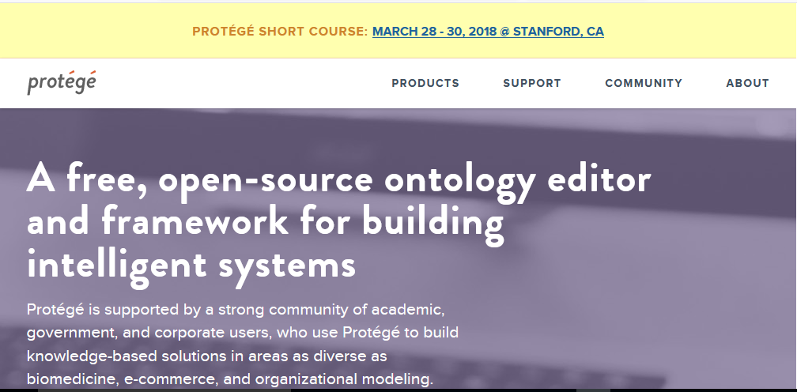
Protégé is developed by the Stanford Center for Biomedical Informatics Research (BMIR). It is the most popular tool for “knowledge engineering”. Open source standalone application with extensible architecture and plugins for more functionality
WHO has designated BMIR an official Collaborating Centre: creating the technological infrastructure for the development and dissemination of the International Classification of Diseases, the International Classification of Traditional Medicine, and other ontologies
https://protege.stanford.edu/
Notes:
Protégé is developed by the Stanford Center for Biomedical Informatics Research (BMIR). It is the most popular tool for “knowledge engineering”. Open source standalone application with extensible architecture and plugins for more functionality

Slide 25
Protégé Key Capabilities
Knowledge Modeling: It provides a graphical interface to define "classes“ (categories), "properties" (relationships like is-a or part-of), and "individuals" (specific instances)
Reasoning and Validation: It includes built-in "reasoners" (like HermiT or Pellet) that check your model for logical consistency and automatically infer new information based on existing rules.
Standard Support: It fully supports World Wide Web Consortium (W3C) standards, specifically the OWL 2 (Web Ontology Language) and RDF (Resource Description Framework).
Extensibility: The desktop version has a highly pluggable architecture, with over 100 community-developed plugins for visualization (e.g., OWLViz), data import/export, and matrix editing.

Slide 26
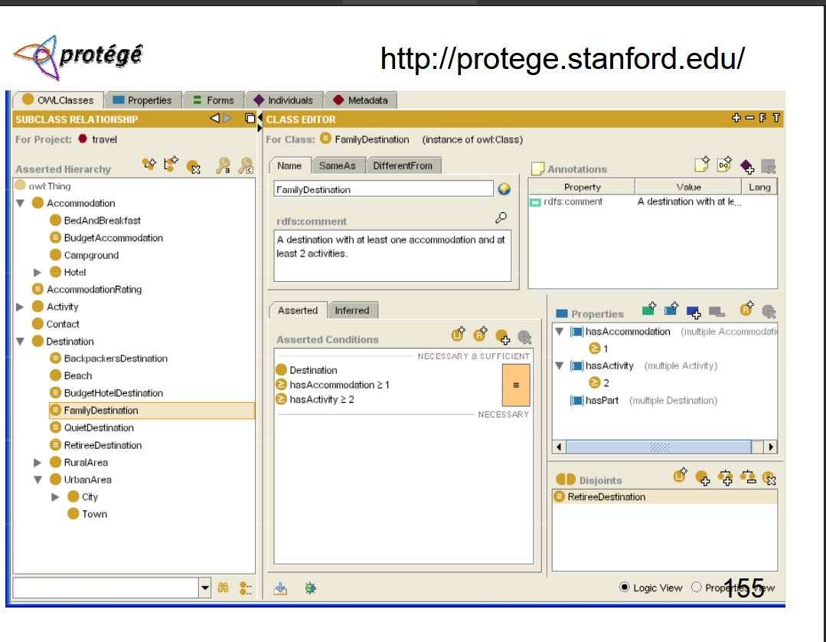

Slide 27
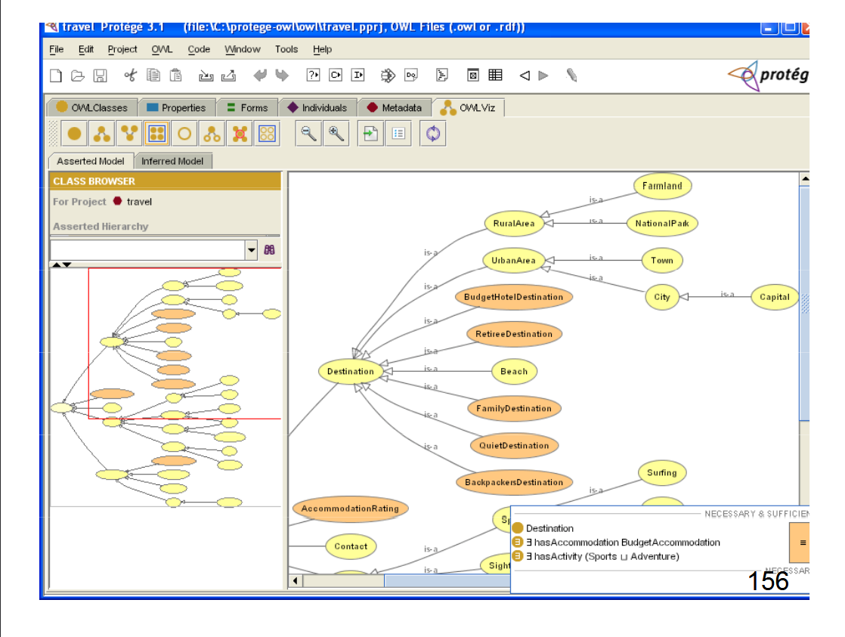

Slide 28
Ontologies in Medicine and Biomedicine
Known ontologies
OpenCyc
WordNet
OpenGalen
UMLS
SNOMED CT, FMA

Slide 29
What is UMLS?
• UMLS (Unified Medical Language System) is developed by the U.S. National Library of Medicine (NLM).
• Facilitates interoperability between health information systems.
• Provides a common framework for organizing and understanding biomedical terms.

Slide 30
Key Components of UMLS
1. Metathesaurus:
- Comprehensive database of biomedical concepts, terms, and relationships.
- Contains over 2.5 million concepts and 14 million terms.
2. Semantic Network:
- Defines relationships between biomedical concepts.
- Examples of relationships: 'causes', 'treats', 'is a'.
3. Specialist Lexicon:
- Large resource for clinical language processing.
- Supports natural language processing (NLP) applications.

Slide 31
How UMLS Works
• Integrates diverse vocabularies like ICD-10, SNOMED CT, and MeSH.
• Links medical terms across different coding systems into a unified structure.
• Improves data exchange, searching, and analysis.

Slide 32
Applications of UMLS
• Clinical Decision Support: Assists healthcare professionals in decision-making.
• Data Standardization: Ensures consistency in electronic health records (EHR).
• Research: Provides a framework to categorize biomedical knowledge for research.

Slide 33
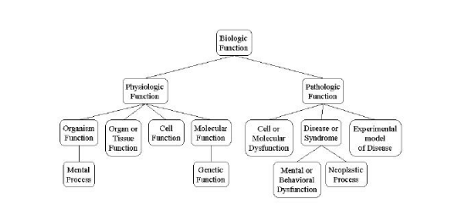
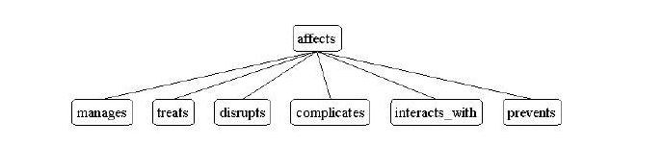
Example

Slide 34
Examples of Bio‑Ontologies
Gene Ontology (GO): Functions, processes, components
Human Disease Ontology (DOID)
Foundational Model of Anatomy (FMA)
Vaccine Ontology (VO)
Environment Ontology (EnvO)

Slide 35
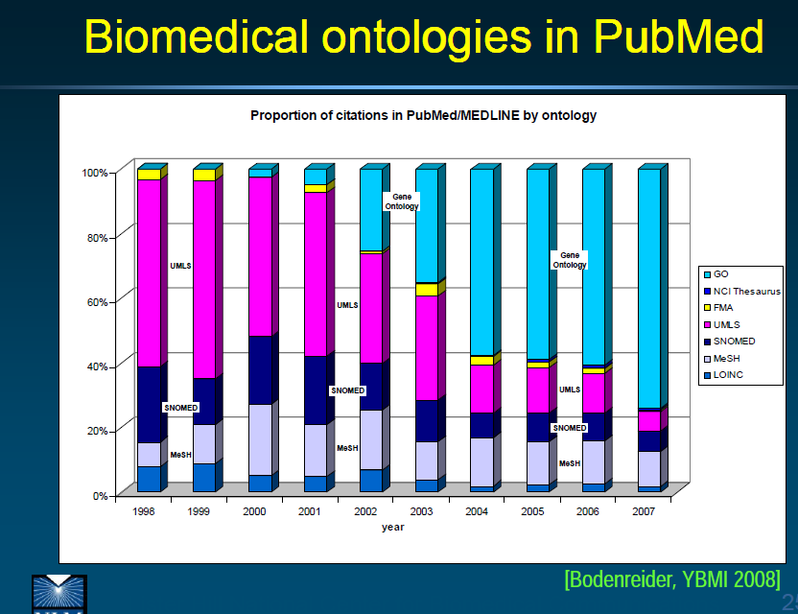
By far the most successful: GO (Gene Ontology)

Slide 36
The Gene Ontology (GO)
Supports gene annotations in genomics research
Provides controlled vocabulary for:
Biological process
Molecular function
Cellular component
Enables consistent annotation across species.
Constructed in 1998 by researchers studying the genome of three model organisms: Drosophila melanogaster (fruit fly), Mus musculus (mouse), and
Saccharomyces cerevisiae (brewers’ or bakers' yeast) developed its own flat-file (GO-)format

Slide 37
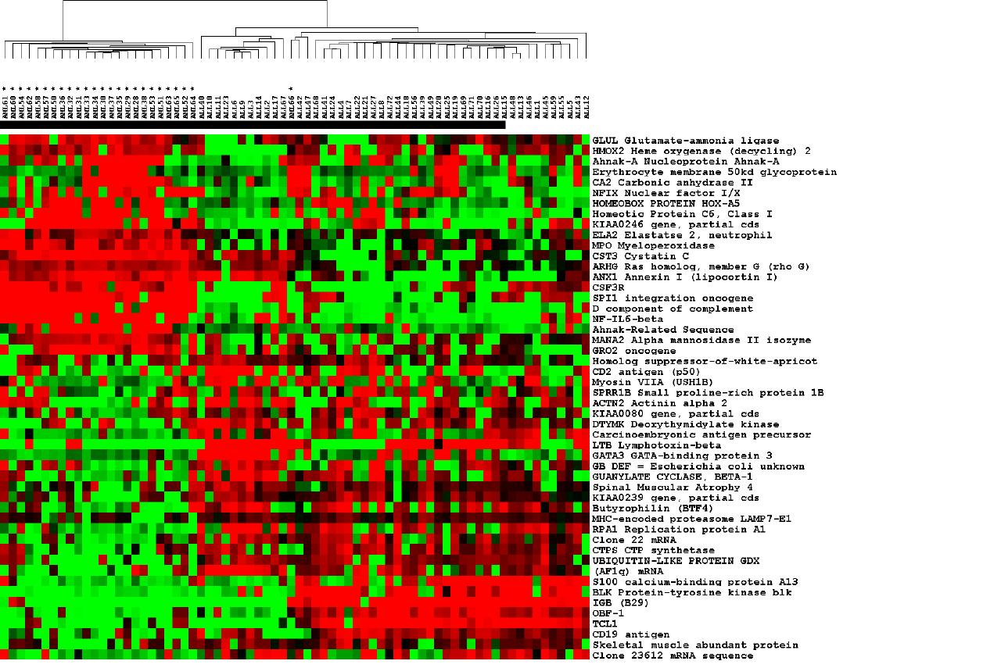
three types of data
what cellular component?
what molecular function?
what biological process?
Notes:
dir.niehs.nih.gov/ microarray/datamining/

Slide 38
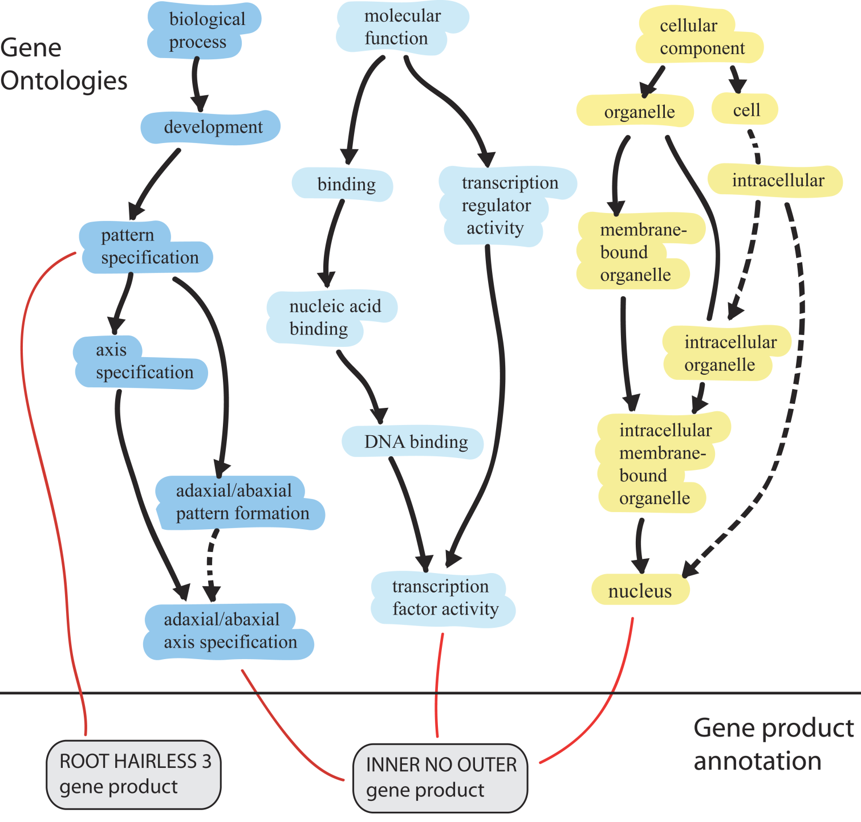
Clark et al., 2005
is_a
part_of
Notes:
The gene ontology consortium develops ontologies and makes annotation of gene products to those ontologies. The ontologies are databases containing sets of biological processes, molecular functions, and cellular components and the relationships between them. Annotators within the consortium use these ontologies to categorise gene products. During my talk today I’m going to explain about the uses of GO and give a more detailed explanation of the ontolgoies and of the system of annotation. Then Harold Drabkin is going to talk in more detail about annotation and about how you can submit annotations of your own gene products of interest.

Slide 39
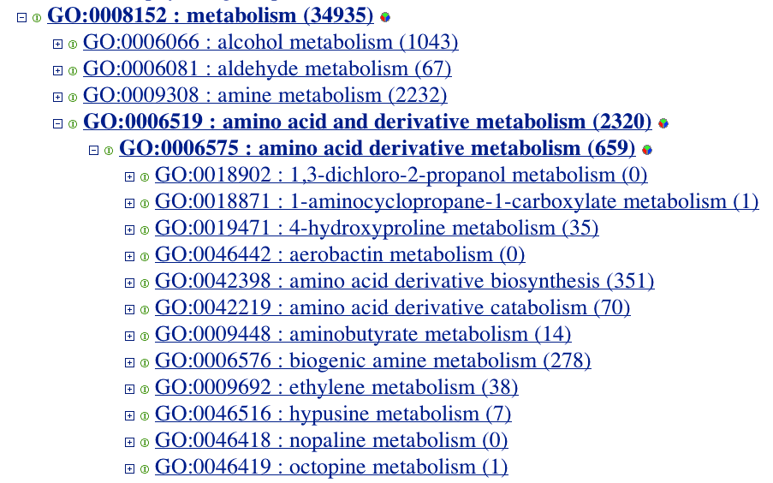

Slide 40
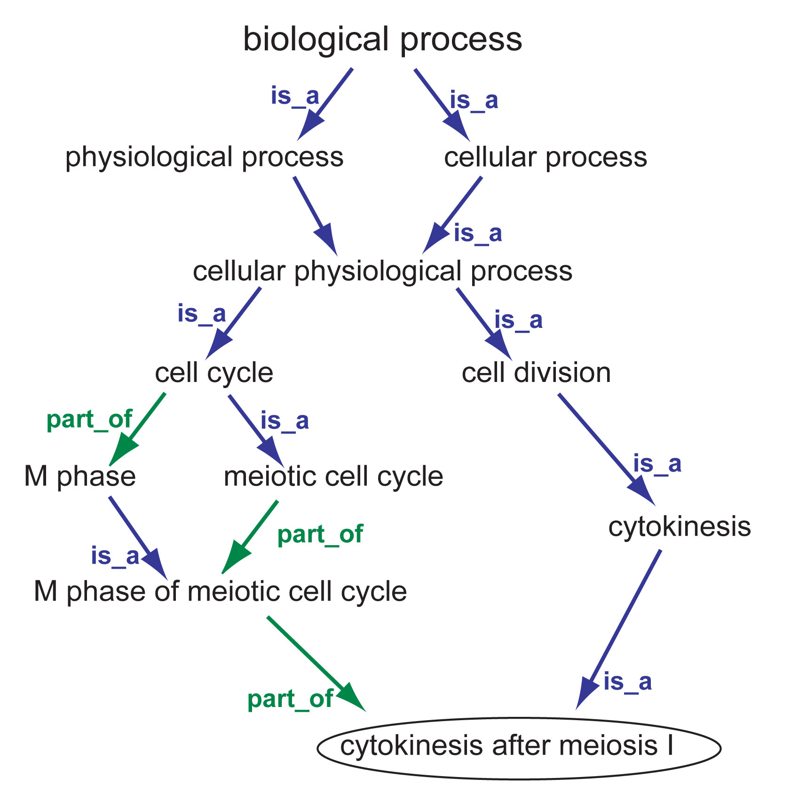
The Gene Ontology
Notes:
http://www.yeastgenome.org/help/images/cytokinesisDAGrels.jpg

Slide 41
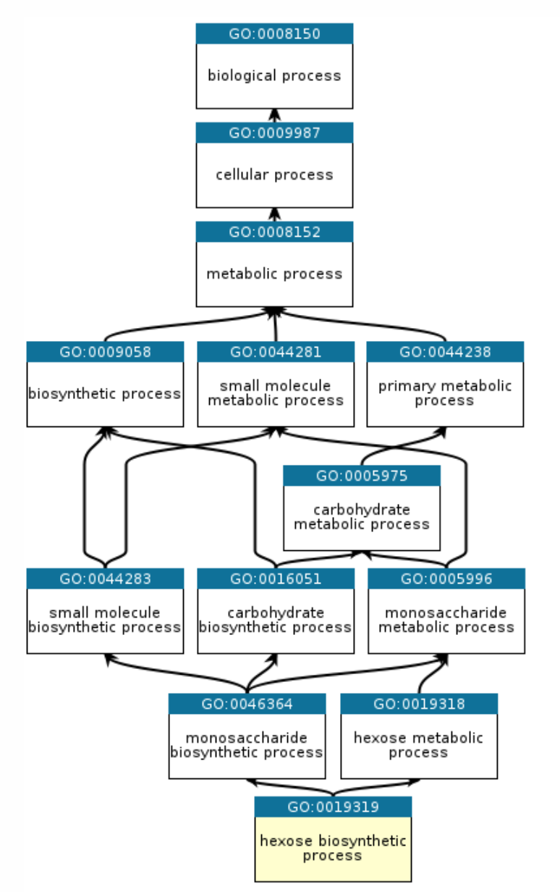

Slide 42
Gene Ontology Consortium
WormBase
Gramene
FlyBase
Rat Genome Database
DictyBase
Mouse Genome Database
The Arabidopsis Information Resource
The Zebrafish Information Network
Berkeley Drosophila Genome Project
Saccharomyces Genome Database
...

Slide 43
A strategy for translational medicine
Sjöblöm T, et al. analyzed 13,023 genes in 11 breast and 11 colorectal cancers
using functional information captured by GO identified 189 genes as being mutated at significant frequency and thus as providing targets for diagnostic and therapeutic intervention.
Science. 2006 Oct 13;314(5797):268-74.

Slide 44
Major Bio‑Ontology Repositories
OBO Foundry Collaborative suite of interoperable ontologies
Includes BFO, RO, DOID, VO, MONDO, and many more [obofoundry.org] created 2001 in Ashburner and Lewis, a shared portal for (so far) 58 ontologies http://obo.sourceforge.net
NCBO
BioPortalWorld’s largest ontology repository1,272 ontologies, 12.8M classes, tools for annotation and exploration http://www.bioontology.org/bioportal.html
Using NCBO BioPortal We can Search for ontology terms Visualize hierarchical structures Compare ontologies Use Annotator to annotate biological text

Slide 45
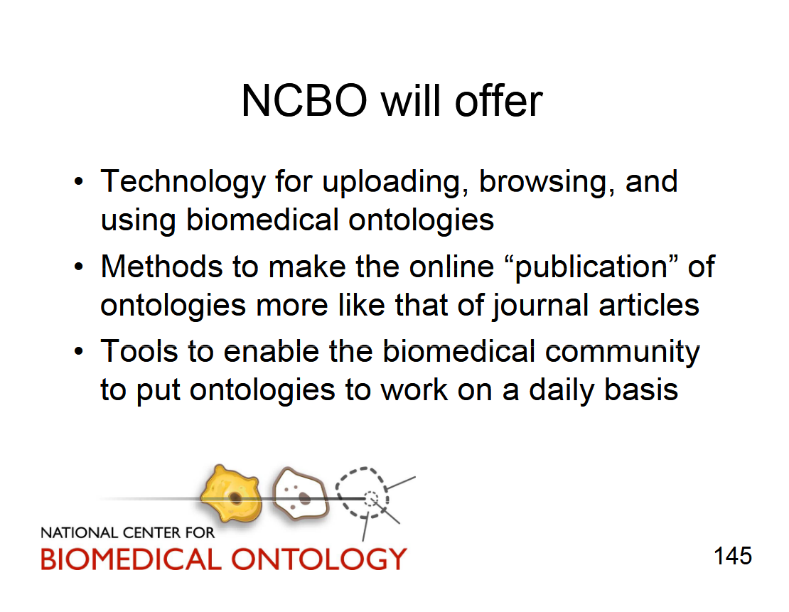

Slide 46
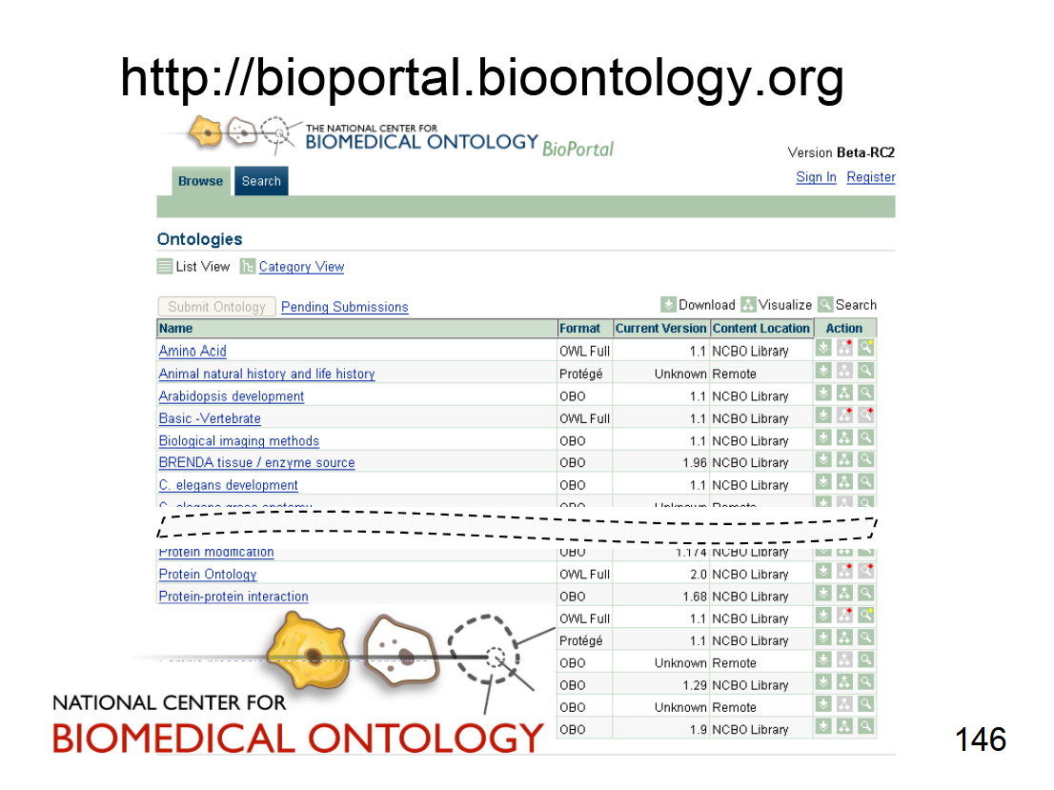

Slide 47
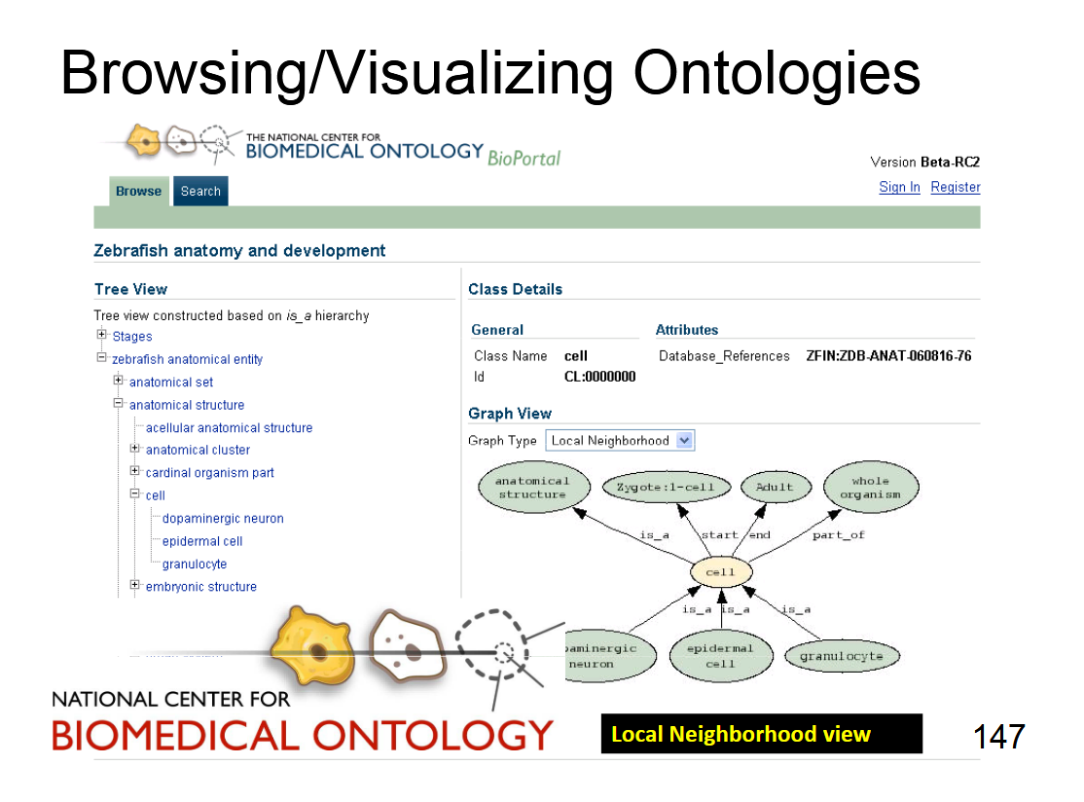

Slide 48
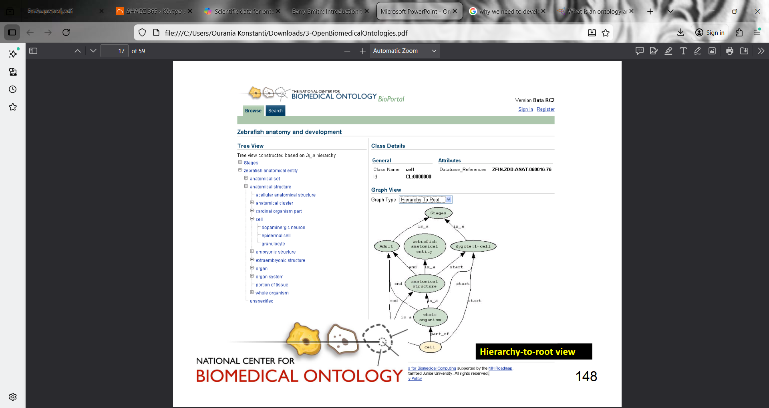

Slide 49
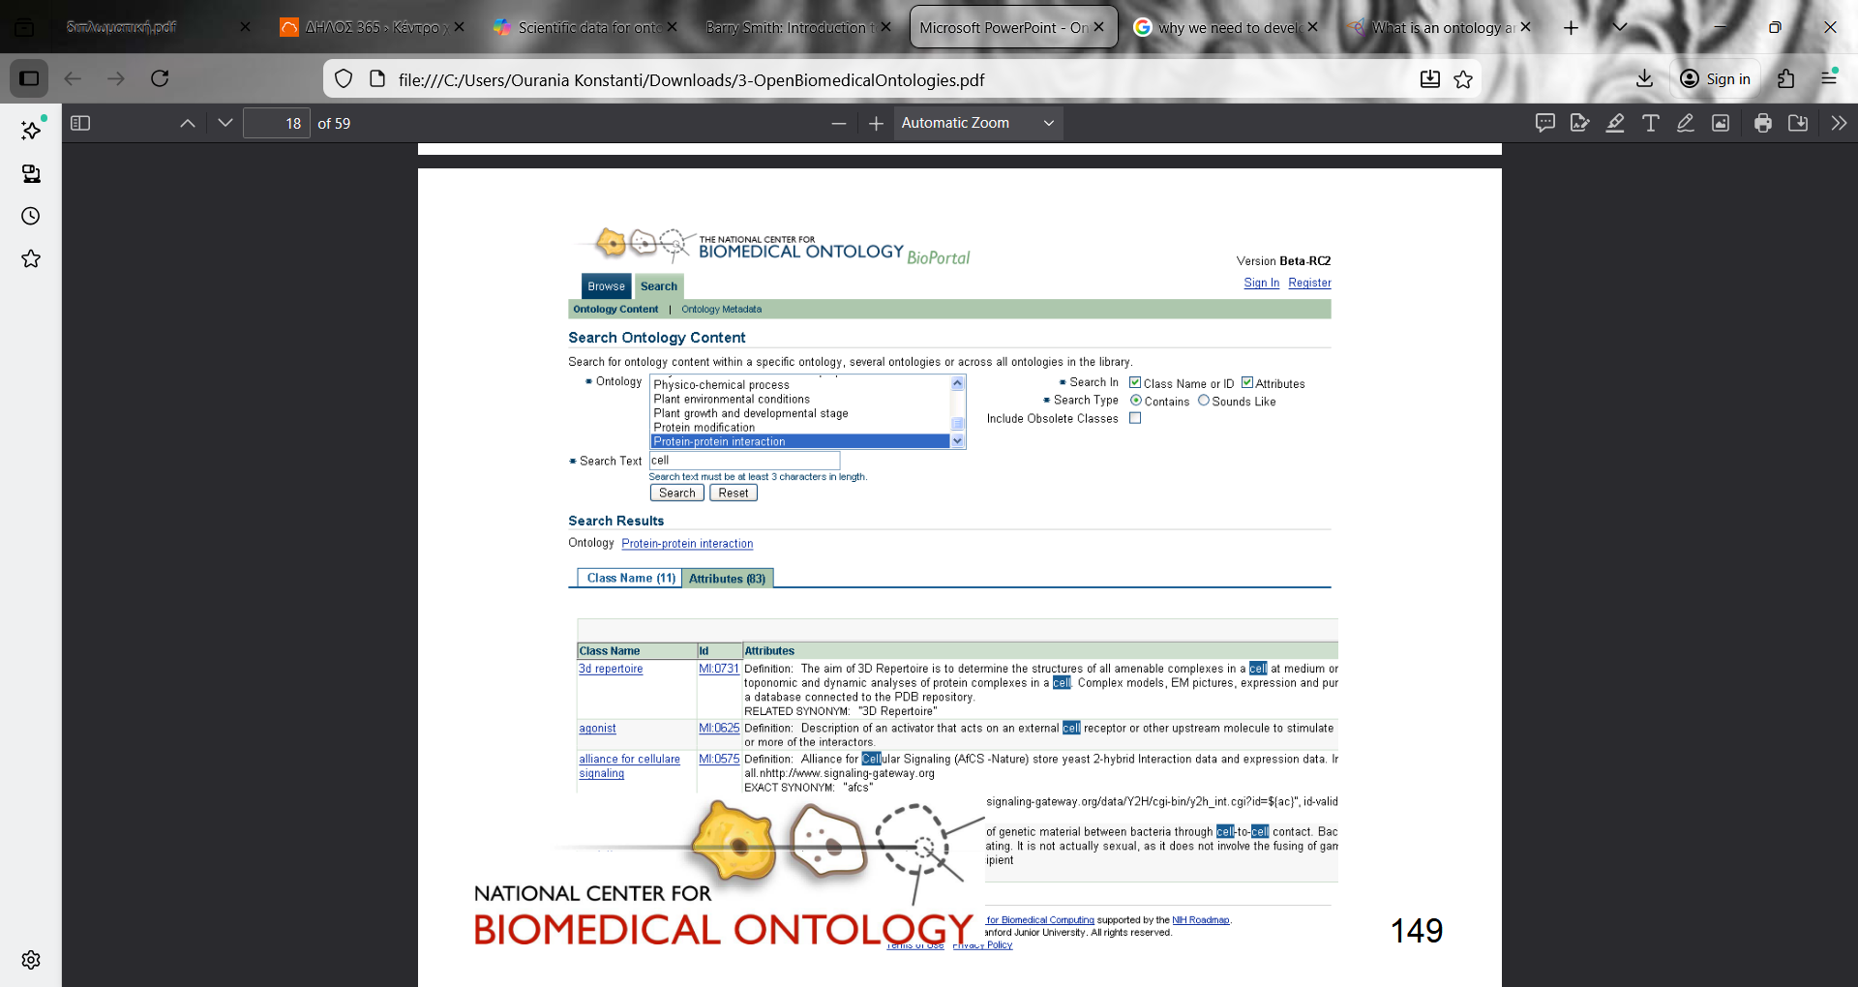

Slide 50
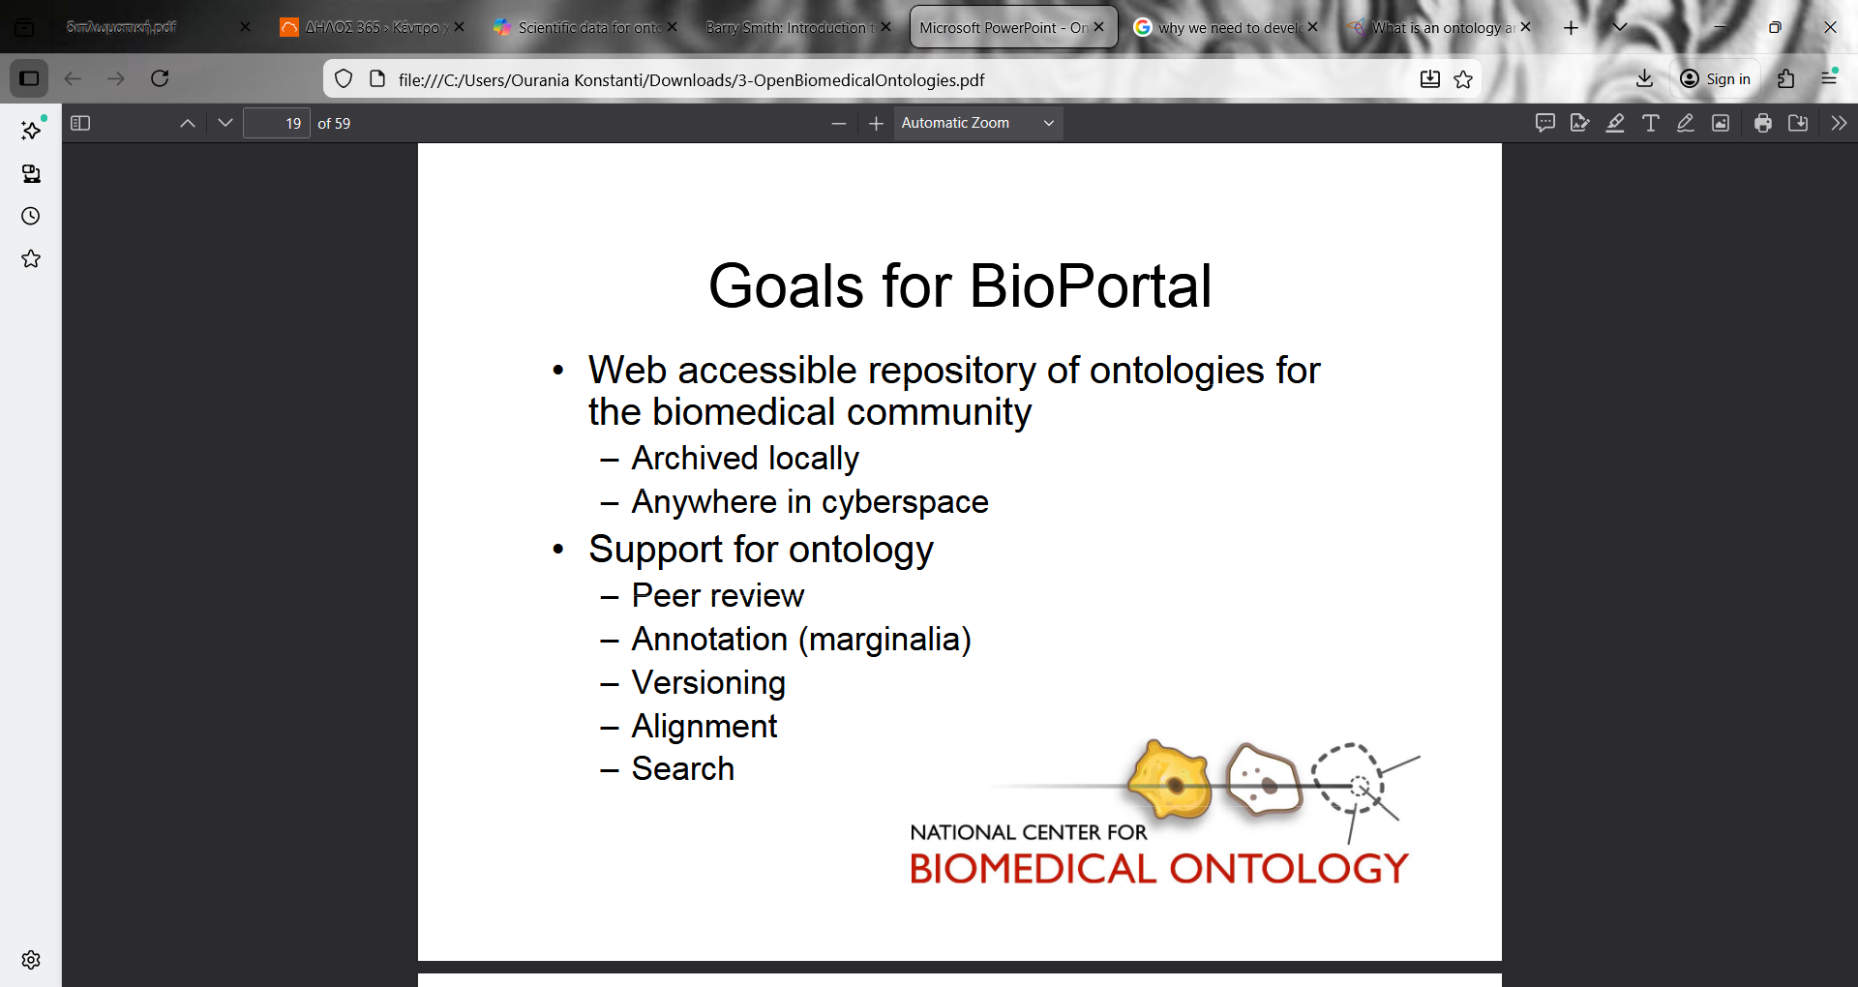

Slide 51
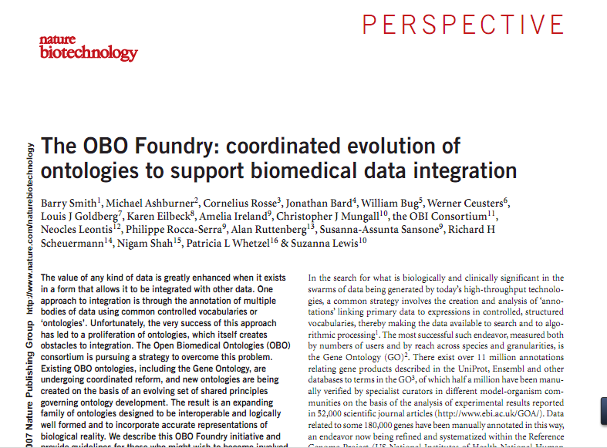

Slide 52
Ontology | Scope | URL | Custodians
Cell Ontology (CL) | cell types from prokaryotes to mammals | obo.sourceforge.net/cgi- bin/detail.cgi?cell | Jonathan Bard, Michael Ashburner, Oliver Hofman
Chemical Entities of Bio- logical Interest (ChEBI) | molecular entities | ebi.ac.uk/chebi | Paula Dematos, Rafael Alcantara
Common Anatomy Refer- ence Ontology (CARO) | anatomical structures in human and model organisms | (under development) | Melissa Haendel, Terry Hayamizu, Cornelius Rosse, David Sutherland,
Foundational Model of Anatomy (FMA) | structure of the human body | fma.biostr.washington. edu | JLV Mejino Jr., Cornelius Rosse
Functional Genomics Investigation Ontology (FuGO) | design, protocol, data instrumentation, and analysis | fugo.sf.net | FuGO Working Group
Gene Ontology (GO) | cellular components, molecular functions, biological processes | www.geneontology.org | Gene Ontology Consortium
Phenotypic Quality Ontology (PaTO) | qualities of anatomical structures | obo.sourceforge.net/cgi -bin/ detail.cgi? attribute_and_value | Michael Ashburner, Suzanna Lewis, Georgios Gkoutos
Protein Ontology (PrO) | protein types and modifications | (under development) | Protein Ontology Consortium
Relation Ontology (RO) | relations | obo.sf.net/relationship | Barry Smith, Chris Mungall
RNA Ontology (RnaO) | three-dimensional RNA structures | (under development) | RNA Ontology Consortium
Sequence Ontology (SO) | properties and features of nucleic sequences | song.sf.net | Karen Eilbeck

Slide 53
Goal of the OBO Foundry
all biomedical research data should cumulate to form a single, algorithmically processable, whole
Smith, et al. Nature Biotechnology, Nov 2007

Slide 54
OBO FOUNDRY CRITERIA
The ontology is open and available to be used by all.
The ontology is instantiated in, a common formal language and shares a common formal architecture
The developers of the ontology agree in advance to collaborate with developers of other OBO Foundry ontology where domains overlap.

Slide 55
The developers of each ontology commit to its maintenance in light of scientific advance, and to soliciting community feedback for its improvement.
They commit to working with other Foundry members to ensure that, for any particular domain, there is community convergence on a single controlled vocabulary.

Slide 56
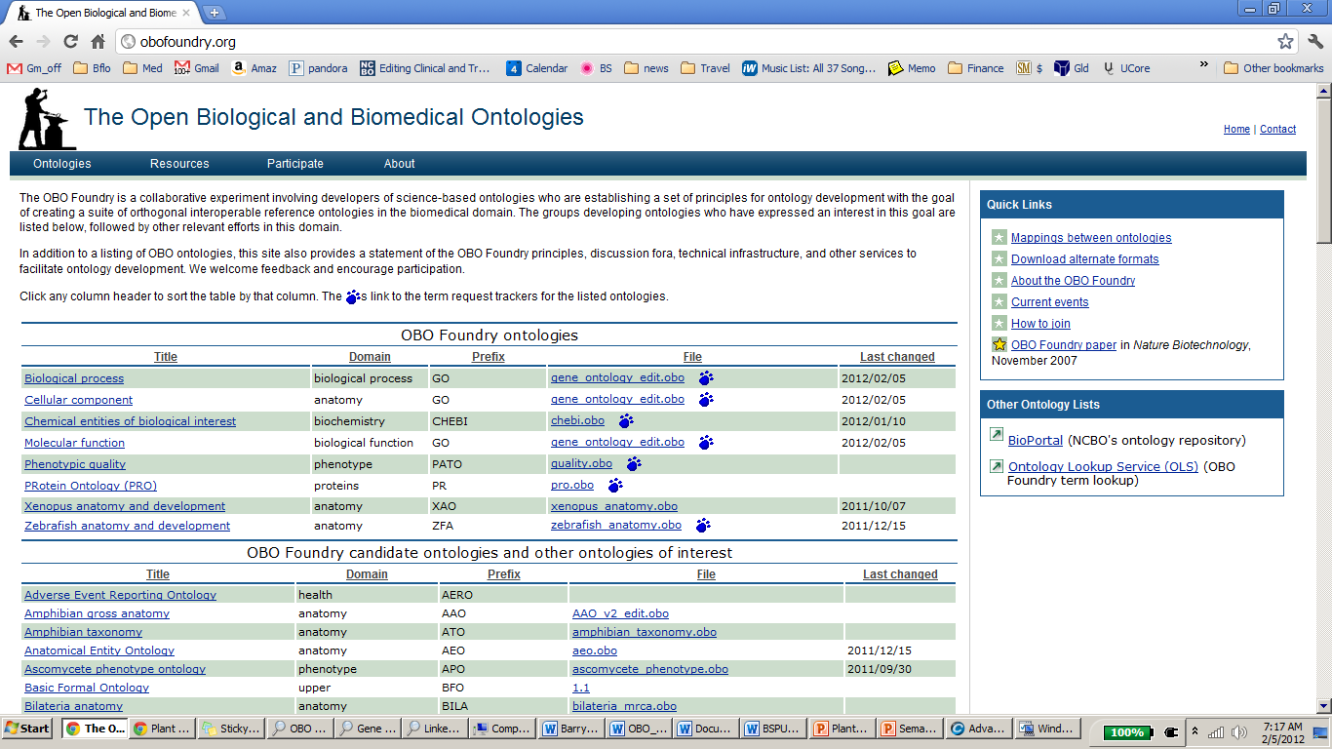

Slide 57
Current OBO Foundry Ontologies
Biological process (GO)
Cellular component (GO)
Chemical entities of biological interest
Molecular function (GO)
Phenotypic quality
PRotein Ontology (PRO)
Xenopus Anatomy and Development
Zebrafish Anatomy and Development

Slide 58
Foundry ontologies under review
Cell Ontology (CL)
Infectious Disease Ontology (IDO)
Ontology for Biomedical Investigations (OBI)
Plant Ontology (PO)

Slide 59
Ontologies under construction
  Allergy Ontology
  Environment Ontology (EnvO)
  Immunology Ontology (IDO)
  Mental Functioning Ontology (MFO)
  Emotion Ontology (MFO-EM)
  Pain Ontology
  Mental Disease Ontology (MDO)
  Neurological Disease Ontology (ND)
  Vaccine Ontology

Slide 60
Ontology is: A structured set of concepts and relationships used to describe a domain
Ontology serves: as a parallel representation of reality as it is perceived by both humans and computers.
Ontology structure includes: Classes, subclasses, Instances, Slots (properties), Facets (restrictions) and defined relationships among classes and entities.
Ontology editors: OBO-Edit and Protégé.
What the question is
What the domain and the entities hierarchy is (different aspects among researchers.
What the properties and the restrictions are
Bioontology: Gene Ontology
Biomedical ontology: UMLS
Ontology repositories: OBO Foundry, Bioportal
Ontologies Can:
Serve as repositories for organizing information
Be used as a tool for knowledge acquisition
Provide common support for knowledge classification within specific workgroups
Enable knowledge reuse in new systems
Form the foundation for constructing a knowledge representation language

