Slide 1
CONSTRUCTING ABSTRACT MATHEMATICAL KNOWLEDGE
IN CONTEXT
Tommy Dreyfus, Tel Aviv University
University of Athens
June 4, 2014

Slide 2
Thanks to my colleagues
Rina Hershkowitz
Baruch Schwarz
--
Angelika Bikner
Ivy Kidron
Anatoli Kouropatov
John Monaghan
Fatih Ozmantar
Chris Rasmussen
Gila Ron
Michal Tabach
Pessia Tsamir
Dovi Weiss
Gaye Williams
…
In this talk, “we” means various subsets of the above
Notes:
And others

Slide 3
Research supported by
Israel Science Foundation grants 973/02, 1166/05, 843/09, and 1057/12
German-Israeli Foundation for Scientific Research and Development grant 946-357.4/2006

Slide 4
An Albert Einstein Quote
“Education is what remains after one has forgotten everything one learned in school.”
The members of JHS curriculum project at the Weizmann Institute of Science (Israel) naïvely asked what students learn, and how they learn it.
Here we used the term “learn” in the sense of Einstein’s “education”: We asked what in-depth mathematical knowledge and abilities remain with the students.

Slide 5
Crucial Questions (CQs)
What do we mean by “learning”?
How can we describe / analyze (at the micro-level) the processes by which such learning takes place?
How does learning depend on context?
Notes:
These questions also provide the organization for the talk – but I’ll start by presenting an example that will allow me to illustrate the theoretical notions

Slide 6
Example: Probability
Structure of the curriculum (Grade 8)
  Part I: 1d sample space, chance bar
  Part II: 2d sample space, discrete, equi-
  probable (tabulation is possible)
  Part III: 2d binomial but not equi-probable
  (area model)
Altogether about ten lessons
Here we focus on Part II
Notes:
The example is a compromise between easy to present and ideal
Other examples can be found in the papers listed in the bibliography

Slide 7
The research population
Roni
Notes:
Six pair interviews and 7 classes.
Focus groups in 5 classes.
One of these: Roni and Yam.

Slide 8
A task sequence
Q1 Yossi and Ruti roll two regular white dice. Ruti wins when the dice show equal faces, and Yossi wins when the dice show different faces. Is the game fair?
Q2 The rules of the game are changed: Yossi wins when the dice show faces with consecutive numbers. Is the game fair now?
Q3 How many possible outcomes are there when rolling two dice?
Q4 If Yossi and Ruti play with a red and a white die, will the answers to the above Qs change ?
Notes:
This task sequence forms the beginning of part 2 – lesson 5.
Give 1-2 minutes to solve the tasks and to think about how Greek Grade 8 students might answer them.

Slide 9
Roni’s answer to Q1
R3 25 [times] this Yossi will win. And 6 times...
On the first die there will be 1 - on the second it can be any number from one to six.
R7 Each number can occur five [times], true? …
Multiply six by five.
And six times, six possibilities for Ruti.
R9 1 with 1, 2 with 2, 3 with 3, 4 with 4, 5 with 5, 6
with 6. That’s 6 out of 36 – on average. So let's
write it.
Notes:
Point to “on average” as well as to some sample space construct (36)

Slide 10
Roni’s answer to Q2
Y26 One two; two three; three four; four five; and five six. Not fair because she has more chances.
R29 Write: "The game is not fair because out of …
R31 … 11 possible outcomes, 6 times …
R33 6 times …, write in parentheses "on average",
Ruti will win, versus, versus 5 times, that
Yossi will win.
Notes:
Here the sample space from Q1 is neglected. Roni did not recognize that it is relevant here.
The boys focus now on the two compound events which are mentioned in Q2.

Slide 11
Roni’s answer to Q3
R36 So let's think about the question.
R38 Every one has six [possibilities]. 36
possibilities. Every number 6 times.

Slide 12
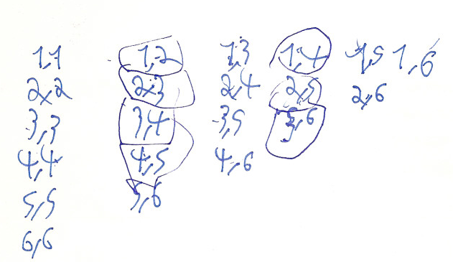
Oren and Yarden’s answer to Q3
Yarden:
O52 Don’t you write also three one?
Y53 Three one is here [points to (1,3)]
While Roni (and many others) seem to be unaware of the option of counting both, (1,3) and (3,1), Yarden (and others) are well aware and explicit about avoiding “double counting”.

Slide 13
Overview
Sample space (Q3) Fairness (Q2) | Correct (36) | Incorrect (Mostly 21) | Total
Correct (Yossi wins) | 20 | 8 | 28
Incorrect (Ruti wins) | 35 | 57 | 92
Total | 55 | 65 | 120
Out of 120 students, 43 answered inconsistently
Roni is one of 35 in the dark yellow cell
Ron, Dreyfus & Hershkowitz (2010)

Slide 14
CQ1: What do we mean by “learning”?
Abstracting (or learning) is a human activity of vertically reorganizing previous mathematical constructs within mathematics and by mathematical means so as to lead to a construct that is new to the learner
  Schwarz, Dreyfus & Hershkowitz (2009)
  Examples:
  (i) Organize the 36 events into a 6 by 6 table and see that (1,3)≠(3,1).
  (ii) Reflect on Q4 (red and white dice) and realize that (1,3)≠(3,1).
Notes:
Such learning constitutes a process of abstraction according to our definition.
I will present a theoretical framework and a model to explain this and many other processes of abstraction.
We are interested at least as much in the process of abstraction as in the product.

Slide 15
Theoretical background
The notion of vertical reorganization is taken from the Freudenthal (RME) group
Treffers & Goffree (1985)
Abstraction leads from an initial, unrefined and often vague form, which need not be consistent, to a final, elaborate, coherent construct in a two-way relationship between the concrete and the abstract - there is an “ascent to the concrete”.
Davydov (1972 / 1990)
Notes:
Vertical reorganization: within mathematics and by mathematical means, insight.
Some claim that there is little difference between our notion of abstraction and learning.
Yes but: It is deep learning.

Slide 16
CQ2
How can we describe / analyze (at the micro-level) the processes by which such learning takes place?

Slide 17
Abstraction in Context (AiC)
The main features of AiC are
  Abstraction – according to CQ1
  A priori content analysis (cognitive)
  Context (cognitive, social, cultural)
  A framework for processes of abstraction
The framework proposes
  A 3 stage view of the genesis of abstraction
  A theoretical-methodological model
Notes:
AiC has been
developed with Rina Hershkowitz and Baruch Schwarz since 1996
productive since then in collaboration with many other colleagues

Slide 18
The genesis of an abstraction
Processes of abstraction have three stages
  The need for a new construct
  The emergence of a new construct
  The consolidation of the new construct
The second stage is the central one and I will use it to introduce the model
Notes:
Examples for three stages in research by Giorgos Psycharis

Slide 19
A. The need for a new construct
This need is often provided by the design of instruction but it is relative to the context:
  The student population
  Their prior knowledge and experience
  Available tools such as computer tools
  Habits of collaboration
  …

Slide 20
Example
Conflict situations tend to provoke need.
Q2 caused open conflict in some groups.
Schwarz, Dreyfus, & Hershkowitz (2009)
Others like Roni were happy to continue with their inconsistent answers.
Q4 (colors) created conflict for some, including Roni, others still went on
Ron, Dreyfus & Hershkowitz (2010)
A computer simulation of the game showing that Yossi wins (in Q2), provoked need for almost all remaining students.
Hershkowitz, Hadas, Dreyfus & Schwarz (2007)
Notes:
From our point of view, the psychological need to solve the conflict leads a specific cognitive need for what we might call the order principle: the event (1,3) is different from the event (3,1)

Slide 21
General Epistemic Need
In other task sequences, we found that a more general epistemic need (GEN) motivates students to make progress.
Kidron, Bikner-Ahsbahs, Cramer, Dreyfus, & Gilboa (2010)
Further work on need is in progress, including
  The need for justification Harel & Kidron (2013)
  The need for definition
  Gilboa, Dreyfus, & Kidron (2011, 2013)
  The need for making sense out of formulas
Notes:
Drop if not enough time (18 min)

Slide 22
B. The emergence of a new construct
(and the dynamically nested epistemic actions model for abstraction in context)
Hershkowitz, Schwarz & Dreyfus (2001)
Dreyfus, Hershkowitz & Schwarz (2001)
Schwarz, Dreyfus & Hershkowitz (2009)
Notes:
New is new for the learner

Slide 23
Epistemic Actions
Epistemic Actions are observable mental actions related to knowledge construction
Pontecorvo & Girardet (1993)
We found the following three epistemic actions to be useful for the analysis of processes of abstraction:
  Recognizing
  Building-With
  Constructing
Notes:
Observable:
•Allow peers and teachers to react, challenge, share …
•Allow the researcher to follow processes of abstraction at the micro-analysis level

Slide 24
Recognizing (a previous construct)
The 're-cognition' of previously encountered constructs as relevant for a given mathematical situation
Notes:
‘Construct’ may refer to anything that has been constructed previously.
For example seeing the number of elements in a 2d sample space as a product is a construct.

Slide 25
Building-with (previous constructs)
The combination of constructs in order to achieve a given goal
Goals:
  solving a problem
  understanding and explaining a situation
  reflecting on a process

Slide 26
Roni’s answer to Q1
R3 25 [times] this Yossi will win. And 6 times...
On the first die there will be 1 - on the second it can be any number from one to six.
R7 Each number can occur five [times], true? …
Multiply six by five.
And six times, six possibilities for Ruti.
R9 1 with 1, 2 with 2, 3 with 3, 4 with 4, 5 with 5, 6
with 6. That’s 6 out of 36 – on average. So let's
write it.
Notes:
A simple example: The product construct: Roni has constructed his product construct when thinking about Q1.
I note that it was not required and most students did not construct it at this stage.
Roni has built-with the product construct to find the probability 6/36 in his answer to Q1.

Slide 27
Roni’s answer to Q3
R36 So let's think about the question
R38 Every one has six [possibilities]. 36
possibilities. Every number 6 times.
Notes:
and recognized it as relevant in his answer to Q3 (though not in Q2!)

Slide 28
Constructing
Is an action during which a new (to the learner) construct emerges.
Assembling and interweaving previous constructs by vertical mathematization so that a new construct emerges.
Constructs include
  Methods
  Concepts
  Strategies
The learner may but need not be fully aware of the new construct.
Process may be slow or sudden.
Notes:
The central epistemic action of abstraction.
The new construct has to be pieced together from existing elements.
Constructing refers to the first time (expressed by verbalization or action)
Awareness: Remember Yarden? He has constructed an “avoidance of double counting construct”.
Examples will follow

Slide 29
Dynamic Nesting
In processes of abstraction, the epistemic actions are dynamically nested:
  R-actions are nested in B-actions; for example in
  Y26: One two; two three; three four; four five;
  and five six. Not fair because she has more chances
  Yam recognizes events as pairs to build-with them the compound event
…

Slide 30
Dynamic Nesting (cont.)
…
Similarly, R-actions and B-actions are always nested in C-actions; in fact, (alternating) R and B actions are the building blocks of C-actions (but the whole is more than the sum of its parts)
Notes:
A C-action is the collection of all R-actions and B-actions plus what connects between these R- and B-actions and makes them into a single whole unity.
R and B (of previous constructs) precede and lead to C.

Slide 31
Dynamic Nesting (end)
C-actions at different levels may be nested in each other as in this constructions diagram:
Later, constructing
processes with more
complex diagrams
were found
(please be patient).
C₂
C₁

Slide 32
The dynamically nested RBC-model for Abstraction in Context
Theory and methodology are so closely linked that the contour lines between them become blurred.
Hershkowitz (2009)
The RBC-model may serve as a theoretical framework, or as a methodological tool, or both.
Although the model is theoretical, it largely determines the methodology
Dreyfus, Hershkowitz & Schwarz (in press)
Notes:
There is a dynamic relationship between theory and methodology
Methodological aspects and issues are discussed in a recent paper.
Here I focus on one methodological issue (a priori analysis)

Slide 33
Content analysis: Knowledge Elements
We are looking at intentional learning in school-type situations: Constructs intended by the design. We call them Knowledge Elements (KEs)
We identify them on the basis of
  a priori content analysis
  designer/teacher intentions (explicit or implicit)
  tasks given to the students
KEs give a focus to the researcher’s analysis: What constructs are we looking for?
KEs also provide a basis for analyzing students’ inconsistent behavior as in Roni’s case.
Notes:
We call them knowledge elements, for lack of a better term.

Slide 34
KEs for the probability tasks
Probability Value
Ratio
Compound Event
Sample Space
Relevant Events Completeness
Sample Space Events Completeness
Product
Relevant Event Systematic Counting
Sample Space Systematic Counting
Simple Event
Order
Pair
Notes:
Stress the ones used later:
Simple event, pair, order, …
Sample space, product, …

Slide 35
Operational definitions
For methodological reasons, KEs have general and operational definitions
The operational definition serves to decide whether a student has constructed a KE (in the present context)
Example “Order”: We shall say that students have constructed the Order element if they relate to pairs like (□,Δ) and (Δ,□) as to two distinct events.

Slide 36
Partially Correct Constructs (PaCCs)
How can the RBC-model be used to explain Roni’s inconsistent answers?
Micro-analysis of epistemic actions
Some of Roni’s constructs were absent or inadequate for solving the problems at hand.
They were only partially correct: They are PaCCs.
This allows to explain Roni’s answers.
Ron, Dreyfus, & Hershkowitz (2010)

Slide 37
Roni’s constructs
Probability Value
Q2
Q1+Q3
Ratio
Compound Event
Sample Space
Relevant Events Completeness
Sample Space Events Completeness
Product
Relevant Event Systematic Counting
Sample Space Systematic Counting
Simple Event
Order
Pair
Order is missing, at least initially
As a consequence, Simple Event, Sample Space and other constructs are PaCCs
Notes:
Roni in Q1 (pair+product) led to correct conclusion
Roni in Q2 (pair, compound event, NOT order) led to wrong conclusion
Roni’s constructs for sample space and for compound event (in the context of two dice) were PaCCs
This is a simple case hence suitable for a talk.
Gila has successfully analyzed more complex cases.

Slide 38
Constructing
Q 4 If Ruti and Yossi play with a red die and a white die, will the answers be different?
R65 What’s that? Stupid!
R71 The same but here you have one red die. Here [two white dice] if you get five, two, you can’t get again: two, five; it is considered the same. But here [red and white dice] it’s possible. If you get, say, five on the red and two on the white, maybe it’s possible five on the white and two on the red.
R79 (writes): There will be a different answer because it can be 5 on the white die and 2 on the red one; and the opposite is considered a different answer.
Notes:
Finally a first example for a constructing action
Here Roni’s PaCC is characterized by the fact that he used the Order element in some contexts but not in all appropriate contexts: He used it in too narrow a context.

Slide 39
Order is still a PaCC
Roni constructed the order element in this context (colored dice) and became aware of this construct.
However, he did not connect this awareness to the game with two white dice, and did not change his mind regarding the fairness of the game.
His construct of Order remained disconnected.

Slide 40
UnPaCCing - A whole class discussion
  R380 But let’s say there are five possibilities of consecutive numbers and six of this, of equal numbers on the dice
  …
  S420 But it’s not this, six times six, because you can get 2 and 1, and 1 and 2. That’s the same number.
  S421 But it’s not the same die. It’s another die.
  S423 It’s 21
  T425 But once it’s on the red one and once on the white one. Is that the same roll?
  R429 It’s like numbering the cubes by One and Two
From this moment on, Roni used the order element whenever it applied.
Notes:
This was in the following lesson.

Slide 41
CQ3
How does learning depend on context?

Slide 42
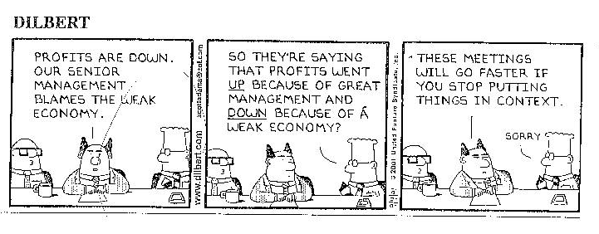
The role of context – more generally
Notes:
This illustrates the importance of context well enough – but let me mention some aspects of context that are important for processes of constructing.

Slide 43
Context
Context is important not only for PaCCs but for knowledge construction in general
In Roni’s case, the students were (on purpose) led to construct 2D probability notions in the case of two identical dimensions – a crucial contextual aspect
Design as an aspect of context
Hadas, Hershkowitz & Ron (2008)
Other aspects of context include social context, tools, and more
Notes:
Processes of abstraction take place in context.
This may sound like a contradiction in terms to some mathematicians, because abstraction is often identified with decontextualization.
We (with van Ours and others) do not make this identification
Design: There is design toward abstraction (as in HHR or in Pratt and Noss) but there is also micro-design revision based on AiC analysis (we are working on it).

Slide 44
Social context
Student pairs in a justification task (lab)
Parallel analyses according to RBC and according to a model of social interaction.
Coherence of the pair (in the sense of common motivation) supports processes of abstraction.
Coherence may include phases or separate, simultaneous of consecutive constructing actions.
Dreyfus, Hershkowitz, & Schwarz (2001)

Slide 45
Social context (continued)
We investigated small groups of students working in a classroom as they constructed shared knowledge and consolidated it.
We define ‘shared knowledge’ as a common basis of knowledge, which allows the students to continue together the constructing of further knowledge in the same topic.
Diversity of constructs: Individual flavor.
Different patterns of interactive constructing of a group’s shared knowledge were identified.
Hershkowitz, Hadas, Schwarz & Dreyfus (2007)
Notes:
Different patterns were: Two or all three together. In case of two, the third objected or joined in later.

Slide 46
Tools
Tools are a component of the context.
This is true in particular for learning tools such as dynamic geometry but also for general purpose software.

Slide 47
Computerized Tower of Bars model
How do students (grade 4) use an analog model when constructing knowledge about fraction comparison?
Need two theoretical frameworks: AiC and RME
There is a close connection between the Model-of to Model-for transition of RME and constructing actions of AiC.
The connection is empirical and theoretical
Weiss & Dreyfus (2009)
Notes:
Specifically: The Complete to whole rule for fraction comparison
Example for the close connection: Combining model-based visual reasoning with numerical reasoning during C-actions led to MO – MF transition

Slide 48
The influence of a CAS
  In another study, we analyzed the influence of a computer algebra system on construction of knowledge about bifurcations in dynamical systems.
  Kidron and Dreyfus (2010b)

Slide 49
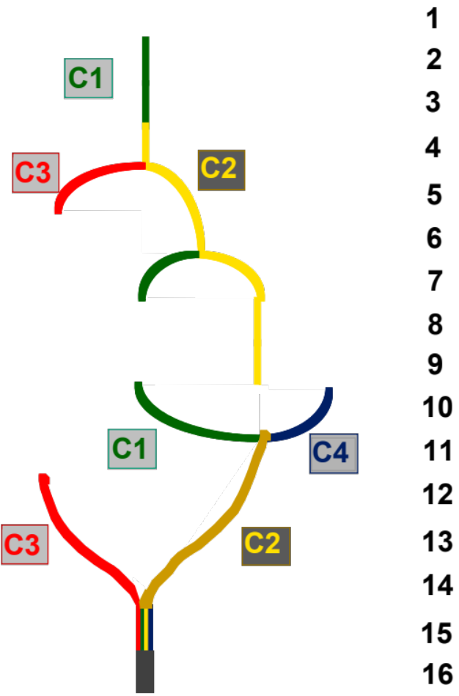
Interacting parallel constructions
  In this research, much more complex interactions of constructing actions had been found than mere nesting.
Dreyfus & Kidron, 2006
Notes:
Interruption, resumption, branching and combining of constructing actions
Branching was closely related to information provided to the learner by the CAS.

Slide 50
  The same research provided clear evidence for the analytic nature of the AiC framework, by enabling us to relate combining constructing actions to enlightenment and justification.
  Kidron and Dreyfus (2010a)

Slide 51
The scope of AiC
AiC based studies have been carried out
  from elementary school via high school and college to graduate school
  on topics including fractions, probability, algebra as a tool for justification, rate of change, functions transformations, integration, countable sets, dynamical systems, definition, justification and proof, …
  in interview situations with single learners and pairs, as well as in classrooms with focus on single learners and small groups

Slide 52
The present and near future
We are currently attempting to ‘upscale’ AiC to entire classrooms by combining it with the methodology of Documenting Collecting Activity (DCA)
Stephan and Rasmussen (2002), Rasmussen and Stephan (2008)
The aim is to coordinate research on learning at the individual, group and whole class levels in order to describe shifts of new constructs in a classroom

Slide 53
Thank you!
tommyd@post.tau.ac.il
Notes:
You may ask for
This presentation
a bibliography
specific papers
50 min

Slide 54
Possible additions
Consolidation
Nested C-actions
Unexpected constructs
Integral as accumulation and the FTC
Proving
Shifts of ideas (constructs) in classrooms
AiC and RME (networking, tools)
Structural and contextual PaCCs
Theoretical framework vs. methodological tool

Slide 55
Consolidation
Consolidation is a long-term process
Consolidation is likely to occur during problem-solving and reflection activities; constructs being recognized and built-with are being consolidated
Consolidation contributes to awareness of one’s use of the constructs and to flexible problem solving
Progressively more elaborate language is a prime indicator for consolidation

Slide 56
Example for language becoming more and more precise in consolidation
The same student (Noa) concerning the definition of a parabola
The collection of all points in the plane that are at the same distance… you understand?
If we, like, chose a line if we choose a point they will have the same distance
Why? But if each one you look at it by itself it is at the same distance from L and at the same distance from M
Yes. All the points in the plane which everyone by itself is equidistant from a given point and a given line

Slide 57
Mechanisms of consolidation
The analysis of the work of students in sequences of activities over several lessons in the probability project has allowed us to identify several mechanism of consolidation.
The most interesting of these is the consolidation of an previous construct during the process of constructing a further one, with the earlier one serving as an element in constructing the new one.
For example, in a sequence of activities in the probability project, students have been consolidating their construct of the product element during the process of constructing the order element.

Slide 58
An example for nested C-actions
The task
  All questions refer to the following two rectangles:
7 | 13
9 | 15
3 | 9
5 | 11

Slide 59
The task (continued)
  ...
  Find as many properties as you can
  ...
  Compare the sums of the diagonals (DSP)
    Will the property always hold?
  Compare the products of the diagonals (DPP)
    Will the property always hold?
  Justify your claims

Slide 60
Algebra as a tool for justification
The girls needed and used the extended distributive law for the first time – a constructing action
More generally, they have used algebra as a tool to construct this proof.
This is a new insight for them: Algebra can be used as a tool to prove some general claims.
Their knowledge about algebra and about proofs has been restructured, made more profound.
We take this to be an overarching C-action.

Slide 61
Complement – an unexpected construct
Calculating probabilities in
2D sample space, where:
  Each dimension has only two possible simple events (binomial)
  The 1D sample spaces are not necessarily equi-probable
Calculating p(both) as product
Calculating p(neither) as complement of
p(both)+p(only A)+p(only B)
both
only B
only A
neither

Slide 62
Integral as accumulation
Common approach: Two notions of integral; the connection is never established
Our proposed answer is accumulation
Thompson & Silverman 2008
We designed and tested a curriculum supporting high school students in constructing integration as a conceptual aggregate of knowledge elements from approximation via accumulation to the Fundamental Theorem of Calculus
FTC: the rate of change of the accumulation function of a given function is the given function itself.

Slide 63
FTC: examples of KEs
CAF: "Change of Accumulation Function": Changing the independent variable causes changes in the dependent value (of the given function) and in the value of its accumulation function simultaneously.
iCAF:"Infinitesimal Change of Accumulation Function“
RCAF: "Infinitesimal Rate of Change of Accumulation Function"

Slide 64
FTC: examples of KEs
FTC: For any continuous function defined on some closed interval, the derivative of its accumulation function is the given function itself.
FTC (operational): We will say that students have constructed the FTC if they express (verbally and/or graphically) that the derivative of the accumulation function of a given function is the given function itself for any value in the domain of the given function, and explain it using RCAF.

Slide 65
Conclusions
  The notion of accumulation has allowed us to design a didactical tool to support students' knowledge constructing processes on integration.
  The understanding of the FTC using this approach depends on students’ understanding of accumulation as well as on their understanding of rate of change.
  The AiC methodology allowed us to note this weak link in the chain.
  Kouropatov & Dreyfus, 2012, 2013

Slide 66
Proof image: Emergence of the idea
Moments of illumination: moments of emergence of (partial) justifications accompanied by certainty
Kidron and Dreyfus, 2010
Moments of illumination are closely related to enlightenment referring to insight into the connections underlying the statement to be justified.
Rota, 1997
[Nash] will mull over a problem and, at some point, have…a vision of the solution he was seeking…the solution did not present itself as a rigorous proof but as a bunch of intuitive threads that have to be woven together and some of the early ones present themselves visually
Nasar, 1998

Slide 67
Investigating proof image
Different case studies of learners
The justification process is a process of combining selected previous constructs, where the proof image includes a bunch of intuitive threads to be woven together and having the potential to link the selected previous constructs.
In order for the intuitive threads to be woven together, new connections between the selected previous constructs need to be established and the establishment of these connections is a process of constructing new knowledge.

Slide 68
Two components of proof image
The cognitive understanding the individual has for why the claim is true and how a proof might proceed.
  The process of selecting previous constructs and establishing links between
  The product with characteristics : logical links, personal understanding, entity, dynamicity.
The affective feeling of understanding, correctness and certainty (intuitive conviction in the sense of Fischbein).
Kidron & Dreyfus (in press)
.

Slide 69
Knowledge shifts & Knowledge agents
Ways in which knowledge is constructed and spread in the classroom: within the whole class community, groups, and individuals of the working classroom community, including the processes of shifts of constructed knowledge between and within the above social settings in the class.
AiC Meets DCA (Documenting Collective Activity)
  According to DCA, a mathematical idea or a way of reasoning becomes normative when there is empirical evidence that this idea functions in the classroom as if it were shared.
  Normative ways of reasoning emerge as learners go through collective activities.

Slide 70
What evolved in the DCA AiC coordination
A knowledge agent is a member in the classroom community or in a group, who initiates an idea, which is subsequently appropriated by another member of the classroom community. So, a shift of this idea is initiated.
Shifts of ideas (knowledge shifts) may be observed from a group to the whole class community (uploading), or within the whole class, or within a group, or from a group to another group, or from the whole class to a group (downloading).

Slide 71
AiC and RME
A dual analysis with the RBC epistemic actions of AiC and the MO-MF epistemic modes of RME puts in evidence a linkage between constructing mathematical knowledge and using models for mathematical reasoning.
The data shows that the MF mode appears in close proximity to constructing actions.
The data also shows that the MO mode is rarely used when constructing.
A closer look reveals that the MF mode appears mostly toward the end of constructing actions and that MF plays a significant role in completing constructing actions. Weiss 2012

Slide 72
Structural PaCCs
Missing-element PaCC
  e.g., Roni’s Simple Event
Incompatible-element PaCC
  e.g., Avoidance of double
  counting (Yarden)
Disconnected-element PaCC
  e.g., Roni’s Simple Event
  (after Q4)

Slide 73
Contextual PaCCs
We consider the partiality of constructs with respect to the KEs that underlie a specific learning context
Narrow-context PaCCs
  e.g. Roni’s Simple Event
  and inferred constructs
  (after Q4)
Wide-context PaCCs
  Yarden explains that (3,1) is the same as (1,3) “like in the multiplication table”

Slide 74
Theoretical framework, methodological tool, or both?
In a first stage, the model was hypothesized on the basis of the analysis a considerable amount of data.
The three epistemic actions and the dynamically nested relationships between them were hypothesized from data as the main building blocks of the model.
At the same time the epistemic actions themselves were also used as the lenses to evaluate the model based on the protocol analyses of the data. [Note the circularity.]
Such a situation holds for the first steps of validating the model as a theoretical framework and also methodological tool.

