Slide 1
Two hot topics in environmental law: climate change and environmental assessment
Prof. dr. Bernard Vanheusden
Faculty of Law, Hasselt University (Belgium)

Slide 2
Climate change

Slide 3
International level
UN Framework Convention on Climate Change (UNFCCC) (1992)
  ~ greenhouse gas (GHG) emissions
  Focused at industrialised countries
  Aim: by 2000 max. emission levels of 1990

Slide 4
International level
Kyoto Protocol (1997)
  Aim: -5,2% compared to 1990 by 2008-2012
    Greenhouse gases: Carbon dioxide (C02), Methane (CH4), Nitrous oxide (N20), Hydrofluorocarbons (HFCs), Perfluorocarbons (PFCs), Sulphur hexafluoride (SF6)
  Target per Annex I country
  Flexibility mechanisms
    Joint implementation: with other Annex I countries
    Emission trading
    Clean development mechanisms: projects in developing countries

Slide 5
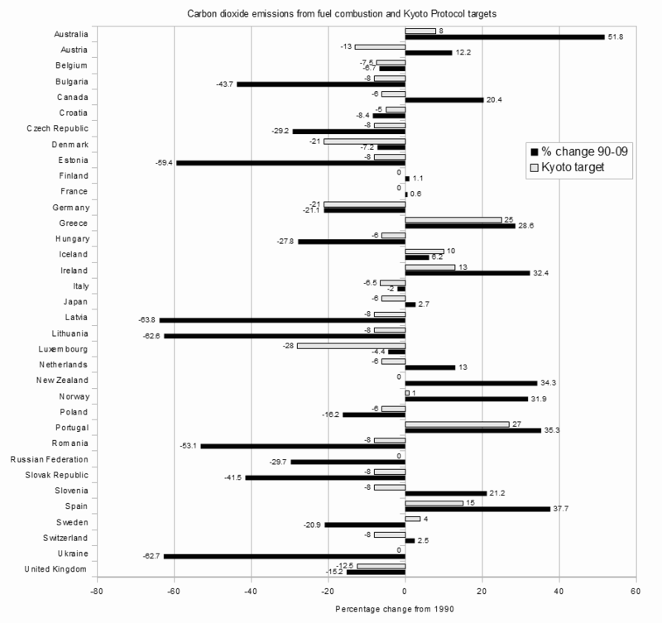
International level

Slide 6
International level
Doha Amendment (2012)
  Second commitment period 2013-2020 → not yet in force
Next?

Slide 7
International level
IPCC - Intergovernmental Panel on Climate Change (2013)
  Warming of the climate systems is unequivocal and observed changes are unprecedented on scales of decades to millennia.
  Human influence on the climate system is clear.
  Continued emissions of greenhouse gases will cause further warming and changes to the atmosphere, land and oceans in all regions of the globe.
  Limit climate change to 2°C compared to pre-industrial level

Slide 8
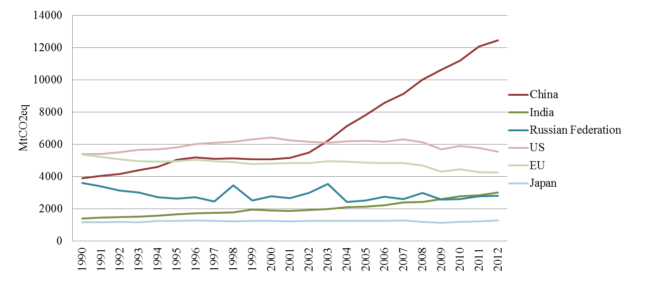
International level
Emissions of major economies, 1990-2012 (all greenhouse gases, all sources & sinks)
(Source: historical emissions data: inventories data to the UNFCCC (http://unfccc.int/national_reports/)

Slide 9
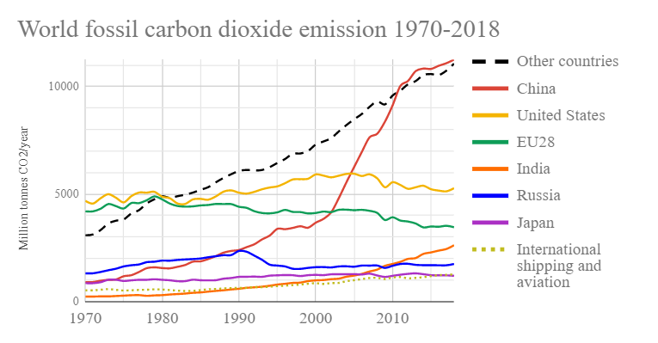
International level

Slide 10
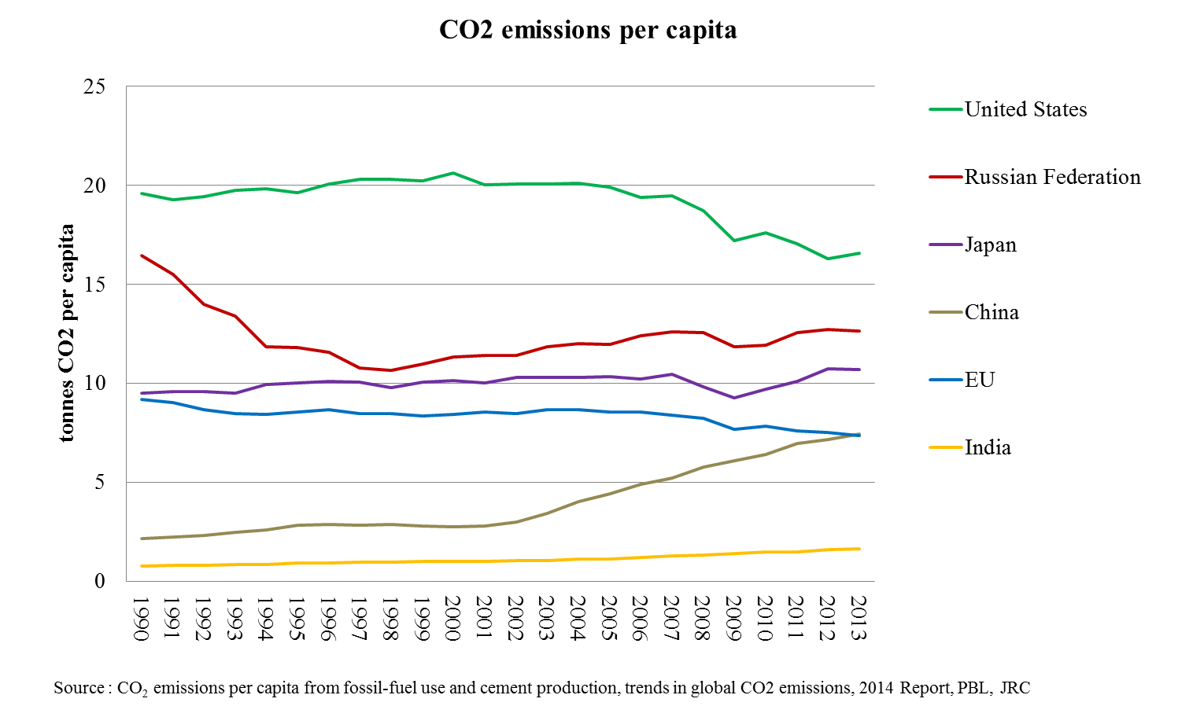
International level
C02 emissions per capita

Slide 11
International level
  2015: Paris Agreement → aim:
    (a) Holding the increase in the global average temperature to well below 2 °C above pre-industrial levels and to pursue efforts to limit the temperature increase to 1.5 °C above pre-industrial levels, recognizing that this would significantly reduce the risks and impacts of climate change;
    (b) Increasing the ability to adapt to the adverse impacts of climate change and foster climate resilience and low greenhouse gas emissions development, in a manner that does not threaten food production;
    (c) Making finance flows consistent with a pathway towards low greenhouse gas emissions and climateresilient development.

Slide 12
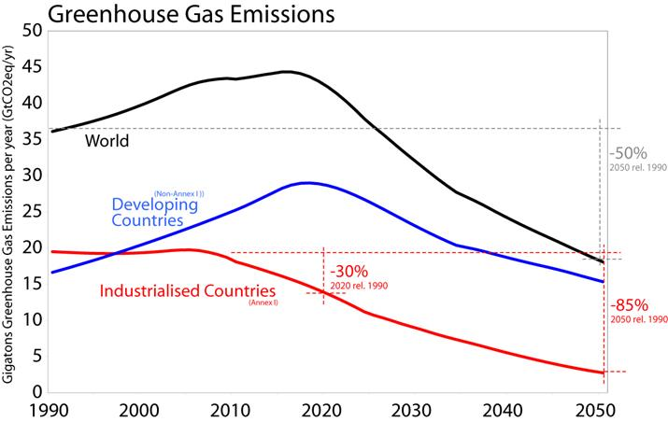
International level
A possible pathway to the below 2°C objective

Slide 13
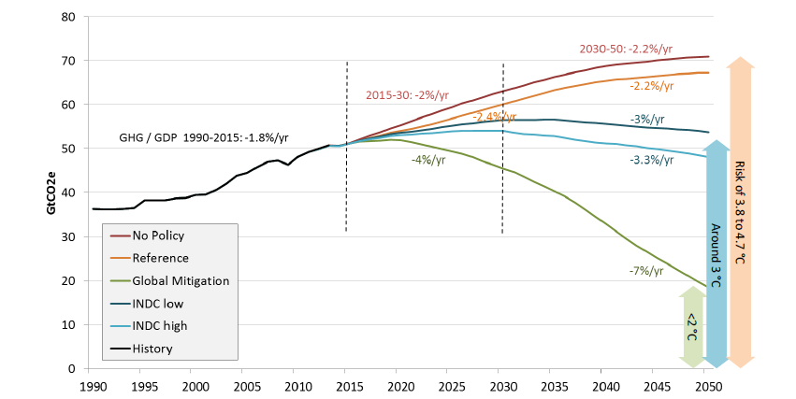
International level
World emissions and percent change in emission intensity per unit of GDP
Source: POLES – JRC Model

Slide 14
EU level
Objectives for 2020 (approved in 2007):
  20% reduction of greenhouse gas emissions
  20% renewable energy
  20% improvement in energy efficiency (energy savings)
Objectives for 2030 (approved in 2014):
  40% reduction of GHG emissions
  27% renewable energy
  27% improvement in energy efficiency

Slide 15
EU level
New objectives for 2030 (approved in June 2018)
  32% renewable energy
  32,5% improvement in energy efficiency
  → part of Clean Energy for All Europeans Package

Slide 16
Climate related legislation
Directive 2003/87 on EU emissions trading system
Directive 2009/28 on promotion of use of energy from renewable sources
  Until 30 June 2021 → afterwards: Dir. 2018/2001
  ! Permitting issues (cfr. infra)
  ! Subsidy issues
    Risk of oversubsidising (e.g. Flanders)
    Limits to free market (e.g. Alands Vindkraft (ECJ 1 July 2014))

Slide 17
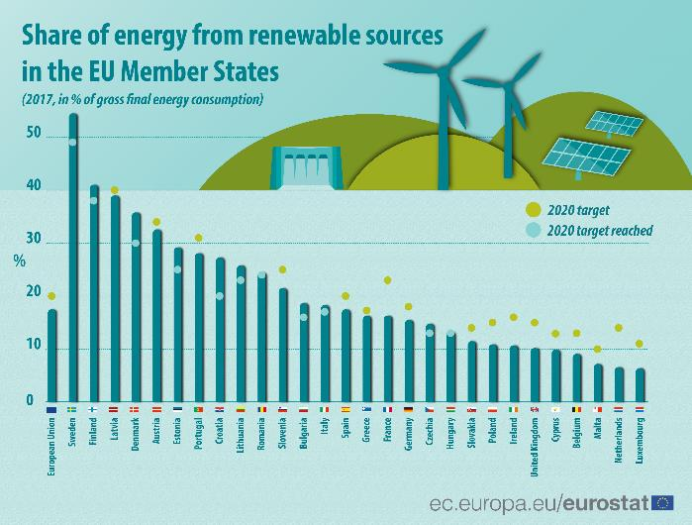
Climate related legislation

Slide 18
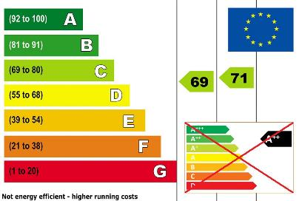
Climate related legislation
Directive 2009/31 on carbon capture and storage
Directive 2009/125 on ecodesign requirements for energy-using products
Regulation 2017/1369
on energy labelling

Slide 19
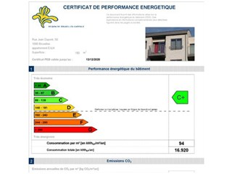
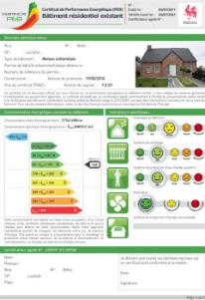
Climate related legislation
Directive 2010/31 on energy performance of buildings;
  → energy performance certificate
Directive 2012/27 on energy efficiency

Slide 20
Climate related legislation
Regulation 2018/1999 on the Governance of the Energy Union and Climate Action
  ! By 31 December 2019: integrated national energy and climate plans (for 2021-2030)

Slide 21
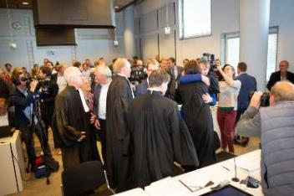
National climate cases
Urgenda case (NL)
  To push Dutch government to be more ambitious than int./EU agreements → law v science
  Successful in first instance (2015) and in appeal (2018)
  -25% GHG emissions by 2020
  ~ duty of care
  Copied in many other countries

Slide 22
National climate cases

Slide 23
Other climate cases
  Also against EU institutions → People’s Climate Case (T-330/18)
    10 families from Portugal, Germany, France, Italy, Romania, Kenya, Fiji, and the Saami Youth Association Sáminuorra
    Against Dir./Reg. on GHG reductions
    Before General Court → 8 May 2019: declared inadmissible (not individually concerned)
    Appeal before Court of Justice pending
  + New case against EU institutions filed on 4 March 2019 (T-141/19)
    To not allow for energy from forest biomass to count for renewable energy target

Slide 24

Other climate cases
  Mainly against governments, but also against companies
    E.g. Lliuya v RWE AG → Peruvian farmer sues Germany’s largest electricity producer RWE
      Seeking financial contribution towards costs of putting in place flood protections in his village in Peru
      Before German courts for emissions released in Germany, which he alleges contributed to climate change and ultimately the melting of a Peruvian glacial lake above his village

Slide 25
Environmental assessment

Slide 26
Two types of environmental assessment
Of plans and programmes
  = strategic environmental assessment (SEA)
  Dir. 2001/42/EC
  “plans and programmes, including those co-financed by the European Community, as well as any modifications to them:
    which are subject to preparation and/or adoption by an authority at national, regional or local level or which are prepared by an authority for adoption, through a legislative procedure by Parliament or Government, and
    which are required by legislative, regulatory or administrative provisions;”

Slide 27
Two types of environmental assessment
Of projects
  = environmental impact assessment (EIA)
  Dir. 2011/92/EU (codification of Dir. 85/337/EEC)
  Lists of projects in two annexes
! alternatives

Slide 28
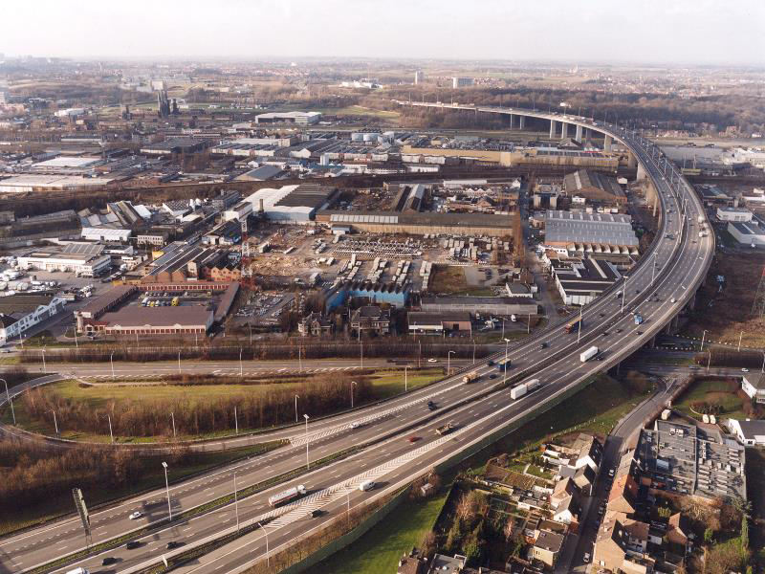
Example: Uplace

Slide 29
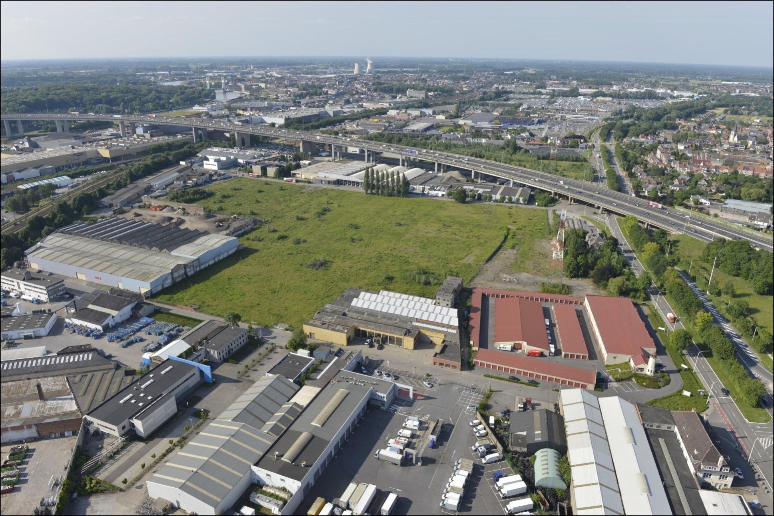
Example: Uplace

Slide 30
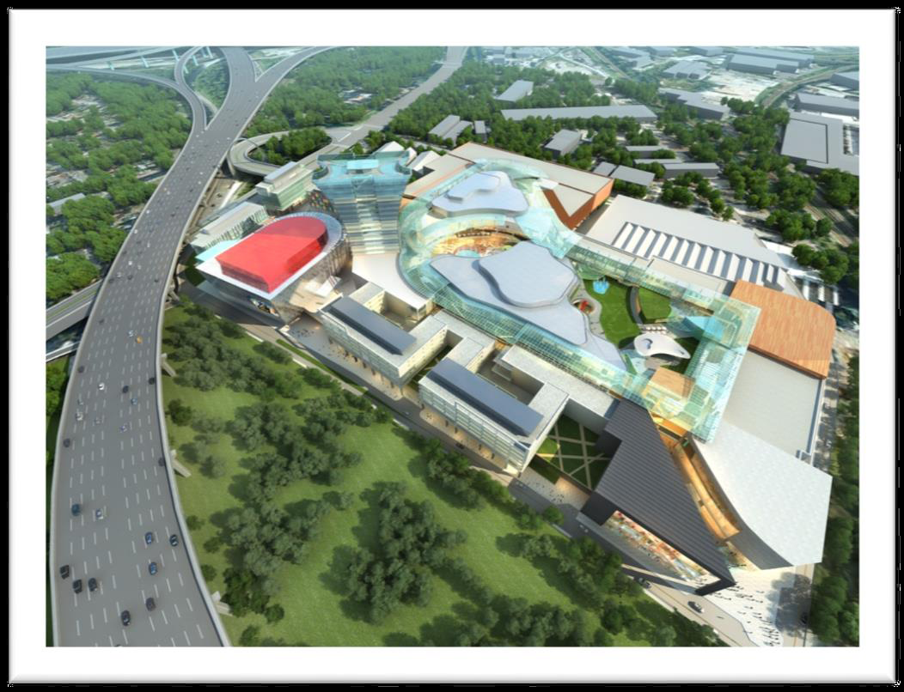
Example: Uplace

Slide 31
Example: Uplace
Project of around 600 million euros
May 2012: fully planned and permitted
  regional spatial plan approved, socio-economic permit, building permit, environmental permit
BUT: legal procedures
  2014: regional spatial plan annulled (and afterwards permits based on plan)
  Main reason: Strategic environmental assessment at plan level concludes that fine dust will increase (although environmental impact assessment at project level concludes that it will not increase)

Slide 32
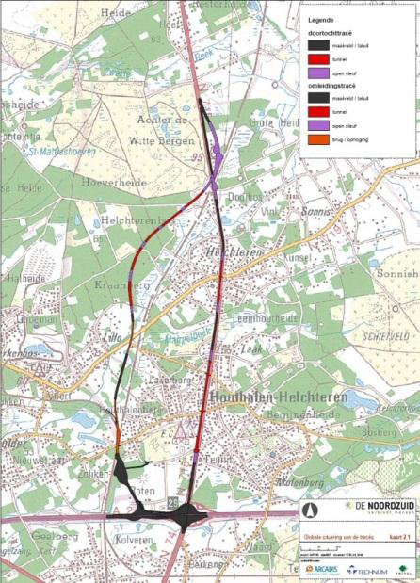
Example: North-South connection

Slide 33
Example: North-South connection
Critical point: crossing and touching of designated habitat and bird sites (Natura 2000) ~ Habitats and Birds Directives
→ ‘appropriate assessment’
  Approval in case no significant impact (potentially after conditions)
  otherwise (only in case of imperative reasons of overriding public interest and no alternative solutions): compensate
Case: incorrect approval of spatial plan

Slide 34
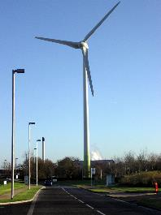
Example: wind turbines
EU environmental law sometimes ‘abused’?
  E.g. protection of bats in Belgian Council of State 4 October 2018 (nrs. 242.513 and 242.514), Wim Delvoye

Slide 35
New style cases
For a broader interpretation of EU law
  CJEU: d’Oultremont case of 2016 (C-290/15)
    ~ SEA
    “a regulatory order (…) containing various provisions on the installation of wind turbines which must be complied with when administrative consent is granted for the installation and operation of such installations comes within the notion of ‘plans and programmes’”
  CJEU: 7 June 2018 (C-671/16)
    Brussels building order is plan/programme
  → various ongoing procedures on permits for amongst others wind turbines

Slide 36
New style cases
  ! Belgian Constitutional Court 28 February 2019 (nr. 33/2019)
    Walloon Code on Spatial Planning is no plan/programme
  CJEU: Inter-Environnement case of 2019 (C-411/17)
    ~ EIA
    Extension by law of operating life of nuclear power stations is ‘project’

Slide 37
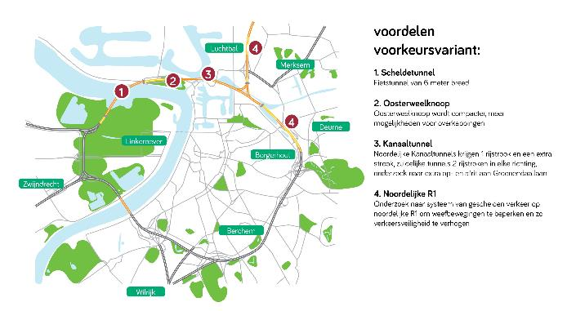
Conclusion
Government should invest much more in real public participation
  Good example: Highway around Antwerp

