Slide 1
DUE DILIGENCE
(financial & legal)
Christos Chrissanthis

Slide 2
WHAT A DUE DILLIGENCE IS ? an investigation on the target business
Financial due diligence (including tax due diligence)
Legal due diligence
Technical due diligence
Operational due diligence
Market or commercial due diligence
Environmental due diligence (a review of the market in terms of competition, macro economics, etc.)
Management due diligence

Slide 3
A legal due diligence concentrates mainly in:
Property status
Assets
Liabilities
In asset deals a due diligence is usually short (concentrating of ownership, charges over assets, but tax issues as well)
In shares’ deals the due diligence is usually more thorough.

Slide 4
WHY CARRY ON A DUE DILIGENCE ?
To confirm the legal status of the business, i.e. ownership (who is selling? etc.),
To determine a fair price for the transaction,
To identify issues to be covered by representations, warranties and indemnities in the sale contract,
To understand how the business operates and how does it produces revenue and profits (i.e. to make a business plan for the business),
To make an informed offer for the purchase of the business

Slide 5
MARKET DUE DILIGENCE
(A review of the position of the market in general as well as of the competitive position of the target company within the market)
Size of the market
Potential customers
Potential suppliers
Potential competitors
Competitive pressure
Major competitors and market shares
Macroeconomic trends
Technological developments
Regulation
Pricing trends in the market

Slide 6
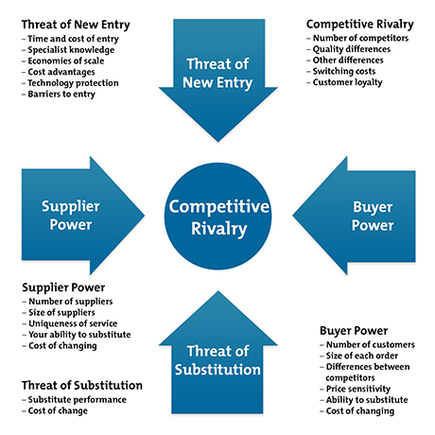
PORTER’s 5 FORCES

Slide 7
FINANCIAL & TAX DUE DILIGENCE
Confirm the accuracy and fairness of financial accounts and balance sheet
Determine the purchase price
Determine the value of the target business
Identify matters for which warranties or indemnities should be saught
Assess the volume of working capital requirements
Assist in planning post acquisition management and business plan
Confirm compliance with tax laws and regulations and tax liabilities

Slide 8
Matters to focus on in a FDD
Audited accounts – rely on annual financial accounts and auditors notes
Transactions with other group member companies
Transactions with related parties (members of the board of directors, or major shareholders)
Ageing report – money claims which are on credit (i.e. check for bad debts)
Long and short term lending, particularly in comparison to liquid assets available
Tax audits; are past financial years audited by tax authorities?
Provisions for bad debts, employees retirement benefits
10 larger creditors & 10 larger debtors

Slide 9
Outstanding debts; particularly to employees, tax authorities, social security organization and any unpaid bank cheques.
Are all transactions in “arm’s length”?
Valuation of existing investments in other companies or in stocks
Valuation of existing assets

Slide 10
LEGAL DUE DILIGENCE main purpose
Confirm property status – who is the owner from whom we can purchase
Confirm that the target company has property title over its assets
Confirm the status of any intellectual property rights
Identify issues to be covered by warranties & indemnities
Identify potential legal risks (i.e. major litigation)
Identify major contracts (suppliers / distributors / termination)
Identify legal relationships with employees
Identify legal relationships with the management

Slide 11
LEGAL DUE DILIGENCE what to check
Shares, share capital, shareholders
Capacity of the sellers to sell the business, i.e. no bankruptcy, all corporate authorization in place, etc.
Certificates from the companies’ registry, i.e. as to incorporation
Memorandum of Association – By laws
Details on parents, subsidiaries, group of companies
Insurance
Intellectual property
Legal compliance, particularly if the target is a regulated business

Slide 12
Titles over assets, particularly over land
Charges, mortgages, liens over assets
Contracts with employees, managers, suppliers, distributors, customers, lease of premises; what is usually important in connection to contracts is the termination clauses, i.e. if it is difficult or easy to terminate, or if it is difficult or easy for the other party to terminate
Pension funds and other benefits for employees
Data protection issues
General terms and conditions and consumer protection issues
Pending litigation

