Slide 1
NOVELTY
Christos Chrissanthis

Slide 2
NOVELTY CONCEPTS
NOVELTY
STATE OF THE ART
UNIVERSALITY
DISCLOSURE
ENABLEMENT

Slide 3
NOVELTY
An invention is novel (i.e., “new”) if it does not form part of the state of the art.
The "state of the art" is defined as everything made available to the public (DISCLOSURE) by means of a written or oral description, by use, or in any other way, before the date of filing of the patent application. Principle of UNIVERSALITY.
Purpose: Not to grant exclusive rights for technical knowledge which is already available.

Slide 4
ENABLEMENT
Subject-matter can only be made available to the public, and therefore be part of State of the Art, if the information given is sufficient to enable the skilled person, at the filing date and taking into account the common general knowledge in the field at that time, to practice the technical teaching which is the subject of the disclosure. ENABLING DISCLOSURE.

Slide 5
COMMON DISCLOSURES
Scientific publications
Earlier patent filings, even if rejected or expired
Products already offered in the market that incorporate inventions
Anything else that make technical knowledge available

Slide 6
Cross-references between prior-art documents
If a document (the "primary" document) refers explicitly to another document (the "secondary" document) as providing more detailed information on certain features, the teaching of the latter is to be regarded as incorporated into the primary document if this document was available to the public on the publication date of the primary document.
The relevant date for novelty purposes is the date of the primary document.

Slide 7
Novelty
Combining different disclosures
In considering novelty (as distinct from inventive step), the basic principle is that it is acceptable to combine separate disclosures existing within the same or different documents, unless such combination has specifically been suggested or is exorbitantly obvious.
So, combining different disclosures usually does not negate novelty.
However, inventive step will be lacking in such cases.

Slide 8
Implicit features or well-known equivalents
A document takes away the novelty of any claimed subject-matter derivable directly and unambiguously from that document including any features implicit to a person skilled in the art in what is expressly mentioned in the document, i.e., a disclosure of the use of rubber in circumstances where clearly its elastic properties are used, even if this is not explicitly stated, takes away the novelty of the use of an elastic material. The limitation to subject-matter "derivable directly and unambiguously" from the document is important. Thus, when considering novelty, it is not correct to interpret the teaching of a document as embracing well-known equivalents which are not disclosed in the documents; this is a matter of obviousness.

Slide 9
Implicit disclosure
The lack of novelty may be apparent from what is explicitly stated in the document itself.
Alternatively, it may be implicit in the sense that, in carrying out the teaching of the prior-art document, the skilled person would inevitably arrive at a result falling within the terms of the claim. An objection of lack of novelty of this kind is raised only where there can be no reasonable doubt as to the practical effect of the prior teaching.

Slide 10
EXCEPTIONS TO DISCLOSURE
INTERNATIONAL EXHIBITIONS – 6 months
PARIC CONVENTION PRIORITY – 12 months
ABUSE AGAINST THE APPLICANT – 6 months
SECOND (NEW) MEDICAL USES OF KNOWN MEDICAL SUBSTANCES

Slide 11
Purpose of the law
By the concept of “novelty”, the legislator seeks a balance between the exclusive rights and free competition. That is, a patent (exclusive right) is granted only for new inventions.
It also seeks a balance between the need to provide incentives (in the form of exclusive rights) for the production of new inventions and the need to disseminate technological knowledge.
With the presumption in favour of the applicant (First to File), the legislator seeks to encourage the filing of the patent as soon as possible, aiming at the dissemination of knowledge. The first to file is presumed to be the beneficiary. The first applicant to file also acquires priority in time and takes precedence over subsequent applicants. Finally, the first to file causes the invalidity of other inventions filed later for the same technical rule.

Slide 12
PENNOCK v. DIALOGUE, 1829, S.Ct.
The invention was initially kept as a trade secret and was commercially exploited. An application for granting a patent was filed at a much later date.
It was held that the law provides protection for patents for a specific period of time in order to be surrendered in common use. The practice of holding an invention initially as confidential and then seeking to benefit from the protection of the patent is not lawful because it effectively circumvents - lengthens - the limited duration of the patent. When the application of the patent was filed, the invention was no longer novel / new.

Slide 13
GAYLER v. WILDER, 1850, S.Ct.
It involved / concerned a vault mechanism.
The technical rule of the protected patent had been previously used by an individual, but only for his own private use, having kept it secret and confidential for his lifetime; upon his death, it was no longer known.
It was held that there was no disclosure and that there was novelty. The technical rule was only the private knowledge of a person, who kept it secret, and upon his death, this knowledge was lost.

Slide 14
CITY OF ELISABETH, 1878, S.Ct.
The inventor had made experimental use of the invention to confirm its effectiveness. Knowledge of this experimental use had been widely spread. The invention was related to the way of placing materials for paving roads.
It was held that even though third parties had knowledge of the invention, the element of novelty was not negated or lost because / due to the fact that this knowledge was the result of experimental use.
For the field of experimental use, please see also the later decision EMD v. GE, 2005, F.Cir.: This decision confirmed that experimental use does not catalyze the novelty of the invention, if such experimental use is objectively necessary. The decision listed thirteen factors that help diagnose whether experimental use is deemed necessary.

Slide 15
EGBERT v. LIPPMANN, 1881, S.Ct.
The case concerned a support mechanism for women's corsets (i.e., a type of underwear).
The inventor had used for many years the mechanism only on his wife's corsets. It was a purely private use, as the corset is a product that is worn under the clothes and is not visible. At one point, the inventor had also shown the invention privately to a friend. After several years, the inventor filed an application and a patent was granted. On the basis of the patent, he brought an action against the defendant, who had, in the meantime, invented a similar corset support mechanism himself.
It was held that the prior use, even if entirely private, constituted a disclosure and that the invention, when the application for patent, was filed, was no longer new. The judgment particularly criticized the lack of interest on the part of the inventor in filing the invention in time.

Slide 16
ROSAIRE v. BARIOD, 1955, FedCir.
The invention concerned a technical rule that was previously completely known to another company, which had even conducted private tests for the application of the invention, but that company had neither made use of the invention publicly, nor had it made available products incorporating it, nor did it intend to use it, nor did it keep it secret and confidential.
It was considered that there was no element of novelty.
This decision is distinguished from Gayler v. Wilder. The reason for the difference is that in Gayler v. Wilder, the person who knew the invention kept it secret and confidential, whereas in this decision, this was not the case.

Slide 17
PFAFF v. WELLS, 1998, S.Ct.
An engineer had designed a product upon request of a certain company.
He had presented it with drawings of the product and had generally completed all the necessary steps that could lead to a patent application.
The product itself had not yet been put on the market.
In the end, the patent application was filed much later.
It was held that, when the patent application was filed, the invention was no longer new.

Slide 18
ATLAS POWDER v. IRECO, 1999, Fed.Cir.
The case concerned an invention for explosives.
The description of the later patent differed from the description of the earlier patent only in that it stated that the materials of the invention must be in an adequately ventilated environment. This information, although not mentioned in the earlier patent, was absolutely necessary for the invention to apply and work and the reason it was not explicitly mentioned was that it was entirely self-evident.
It was held that the later patent was not new. The reference to the 'ventilated environment' was not sufficient to confer novelty. - See above "Doctrine of inherency".

Slide 19
IN RE KLOPFENSTEIN, 2004, Fed.Cir.
Before filing a patent application, the invention had been announced at a scientific conference, although this announcement was not published in the proceedings of the conference, nor in its official programme.
It was held that there was notification and that the condition of novelty was not met.

Slide 20
INVENTIVE STEP (NON) OBVIOUSNESS
An invention has inventive step if, having regard to the state of the art, it is not obvious to a person skilled in the Art.
The question to consider, in relation to any claim defining the invention, is whether before the filing or priority date valid for that claim, having regard to the art known at the time, it would have been obvious to the person skilled in the art to arrive at something falling within the terms of the claim. If so, the claim is not allowable for lack of inventive step. The term "obvious" means that which does not go beyond the normal progress of technology but merely follows plainly or logically from the prior art, i.e., something which does not involve the exercise of any skill or ability beyond that to be expected of the person skilled in the art.

Slide 21
TEST FOR INVENTIVE STEP
PROBLEM SOLUTION APPROACH
(i) determine the "closest prior art",
(ii) establish the "objective technical problem" to be solved,
and
(iii) considering whether or not the claimed invention, starting from the closest prior art and the objective technical problem, would have been obvious to the skilled person.

Slide 22
As to point (iii) :
Whether the skilled person would have arrived at the invention by adapting or modifying the closest prior art, because the prior art provided motivation to do so in the expectation of some improvement or advantage.
Even an implicit prompting or implicitly recognizable incentive is sufficient to show that the skilled person would have combined the elements from the prior art

Slide 23
COMBINING ELEMENTS OF PRIOR ART
In determining whether it would be obvious to combine two or more distinct disclosures, the examiner also has regard in particular to the following:
(i) whether the content of the disclosures is such as to make it likely or unlikely that the person skilled in the art, when faced with the problem solved by the invention, would combine them;
(ii) whether the disclosures, e.g. documents, come from similar, neighbouring or remote technical fields;
(iii) whether the combining of two or more parts of the same disclosure would be obvious if there is a reasonable basis for the skilled person to associate these parts with one another.

Slide 24
It would normally be obvious to combine with a prior-art document a well-known textbook or standard dictionary; this is only a special case of the general proposition that it is obvious to combine the teaching of one or more documents with the common general knowledge in the art. It would, generally speaking, also be obvious to combine two documents one of which contains a clear and unmistakable reference to the other.

Slide 25
COMBINATION v.
AGGREGATION / JUXTAPPOSITION
If the claim is merely an "aggregation or juxtaposition of
features" and not a true combination, then it is likely to be obvious.
In such a case it is enough to show that the individual features are obvious to prove that the aggregation of features does not involve an inventive step.

Slide 26
Graham vs. John Deere Co., 383 U.S. 1, 86 S. Ct. 684 (1966)
Non-obviousness is a matter of law, which is determined on the following matters of fact:
scope and content of the prior art,
the differences between the prior art and the claims at issue, and
the level of ordinary skill in the applicable art to determine the non-obviousness of a claimed invention as to prior art.

Slide 27
The Court also mentioned "secondary considerations", which could serve as evidence of non-obviousness:
1. Commercial success,
2. Long felt but unsolved needs,
3. Failure of others,
4. Unexpected results.
The Court stated that these factors "guard against slipping into use of hindsight" when making a determination of obviousness; so, they may be utilized to give light to the conditions surrounding the origin of the subject matter to be patented.

Slide 28
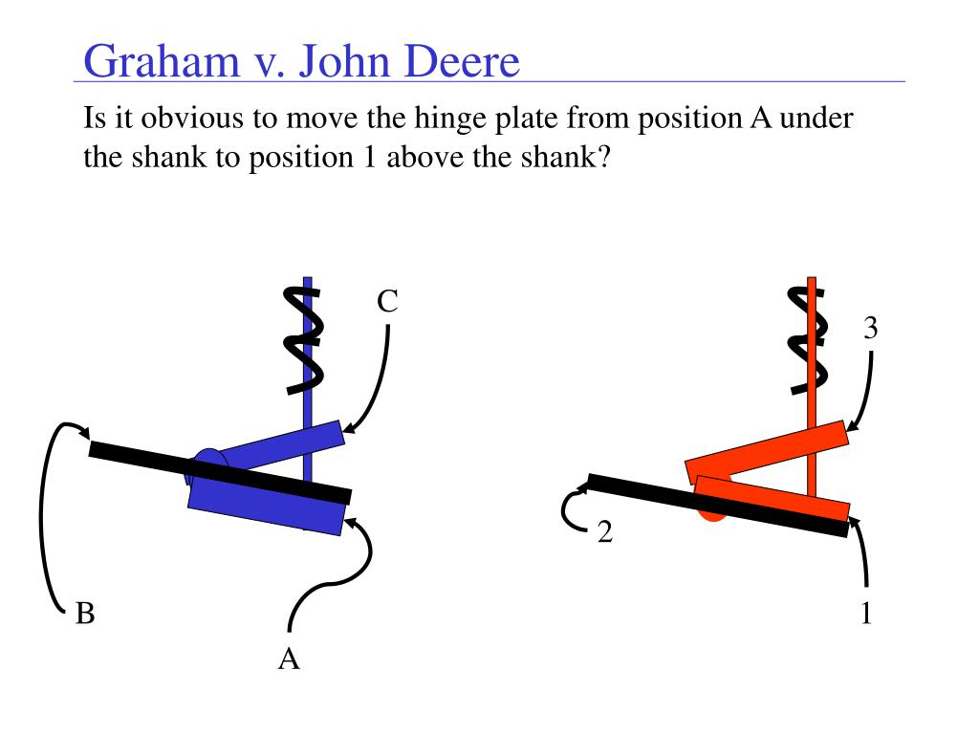
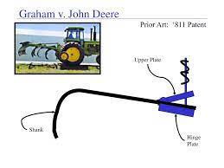

Slide 29
Iron Grip Barbell v. USA Sports (Fed. Cir. 2004)
Iron Grip owned a patent that disclosed a weight plate with three elongated openings near the periphery of the plate that function effectively as handles.
USA Sports also made a three-grip plate.
Iron Grip’s patent for plates with three built-in handles were obvious.
Various prior art showed plates with one, two and four handles. The three-grip plate fell within a range disclosed by the prior art, which raised a presumption of obviousness that was not overcome.

Slide 30
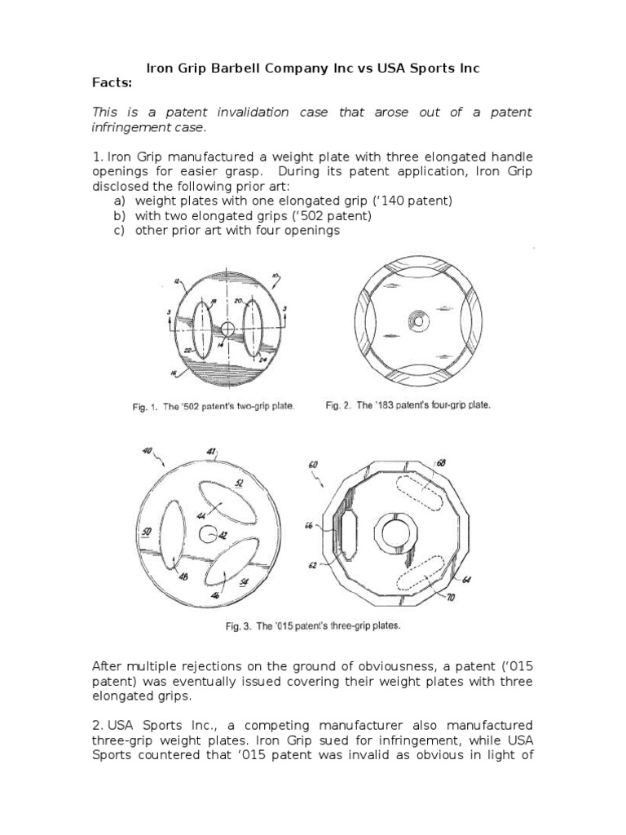

Slide 31
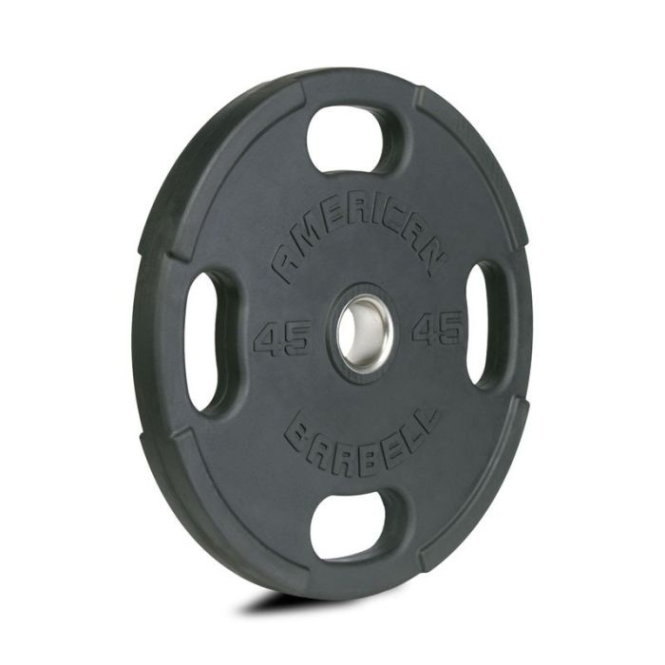
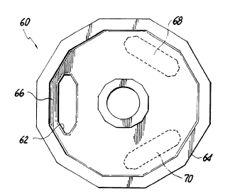

Slide 32
DAIICHI SANKYO CO., LTD. and Daiichi Sankyo, Inc. vs. APOTEX, INC. and Apotex Corp., No. 2006-1564 (decided on 12-09-2007)
Daiichi owned a patent for a method for treating bacterial ear infections by topically administering the antibiotic ofloxacin into the ear.
Apotex manufactured a generic ofloxacin ear drop.
The Court had to determine the level of person skilled in the art.
The Court found that a person skilled in the art for a pharmaceutical patent is someone engaged in developing pharmaceutical formulations and treatment methods for the ear or a specialist in ear treatments such as an otologist, otolaryngologist, or otorhinolaryngologist, who also has training in pharmaceutical formulations; thus, a general medical practitioner would not suffice.

Slide 33
KSR Int'l Co. v. Teleflex Inc. - 550 U.S. 398, 127 S. Ct. 1727 (2007)
Teleflex sued KSR, claiming that KSR had infringed on its patent for an adjustable gas-pedal system.
KSR counterargued that the patent was obvious and hence unenforceable.
District Court accepted KSR’s argument that the invention was obvious because many of its elements already existed in previous patents and a person with the ordinary skill could combine them.
Teleflex successfully appealed; the Circuit Court decided that the lower court should have applied the specific “teaching, suggestion or motivation” test that could have led a person with ordinary skill to combine two elements that already existed.
KSR successfully appealed to the Supreme Court on the basis that such approach would lead to conflicting decisions and allow obvious inventions to be patented.

Slide 34
It was held that the “teaching, suggestion or motivation” test for determining obviousness was not a mandatory one.
Teleflex's gas pedal patent was inspired by previous inventions aimed at different problems. Even though no one had combined the pre-existing adjustable gas pedal and electronic sensor technology in the precise way Teleflex's patent did, the Court held that the existence of the technology would have caused any person of ordinary skill to see the obvious benefit of combining the two. So, Teleflex's patent was obvious and therefore invalid.
It is important to note that the opinion acknowledged that a patent is not necessarily obvious because it combines two previously-existing elements; it could be of assistance to examine why a knowledgeable person would be motivated to combine those components.

Slide 35
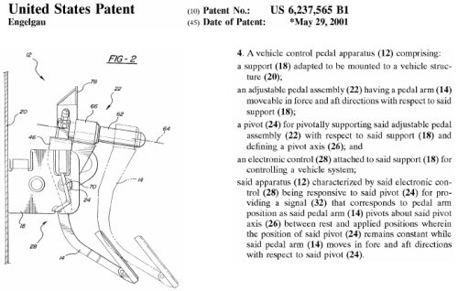
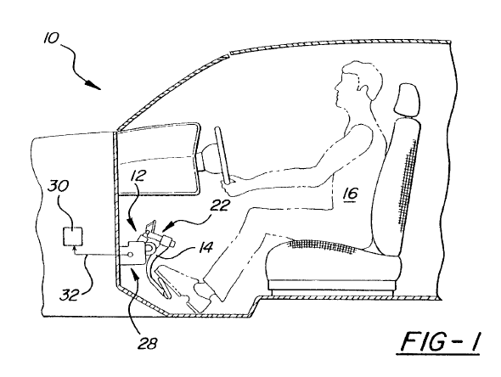

Slide 36
Stratoflex, Inc. v. Aeroquip Corp.
Aeroquip and Stratoflex were competitors in the business for polytetraflouroethylene (PTFE) tubing.
In practice, problem with leaking became more obvious due to the emergence of gaps between filler particles and the PTFE material.
Aiming to resolve it, Aeroquip developed a composite tube and obtained a patent for it (the ‘087 patent).
Stratoflex also manufactured its own version of composite tubing.
Aeroquip sued Stratoflex because it considered the use of the composite tubing amounted to patent infringement.
The district court held that several claims of the ‘087 patent were obvious in light of prior art and that Stratoflex had not infringed upon the only non-obvious claim of the ‘087 patent.
Aeroflex appealed the findings of invalidity and non-infringement.

Slide 37
The Court had to examine whether the invention set forth in the challenged claims each as a whole would have been obvious to one of ordinary skill in the art, when they were made. Consideration of differences from prior art is a tool in attempting to reach the determination of whether the claimed invention as a whole would have been obvious. The differences under discussion do not approach towards non-obviousness.
Further, evidence of “secondary considerations” should be taken into consideration in determining (non-/) obviousness issue and a nexus is required between the claimed invention and the evidence offered.
It held that the challenged claims of the patent were indeed invalid in terms of obviousness.

