Slide 1
DESIGNS
Christos Chrysanthias

Slide 2
OBJECT OF PROTECTION
OBJECT OF PROTECTION:
AESTHETIC CREATIONS
LEGISLATIVE PURPOSE:
THE PROTECTION OF THE DESIGNER AS CREATOR

Slide 3
SUBSTANTIVE CONDITIONS
NOVELTY
the criterion is the INFORMED USER (= consumer)
INDIVIDUAL CHARACTER
= personal character
criterion the overall impression it makes on the informed user
criterion the degree of freedom of the designer
EXTERNALLY VISIBLE
FUNCTIONALITY

Slide 4
COMPARISON BETWEEN DESIGNS
The comparison is made in terms of the elements that give each design its 'individual character'.
The criterion is the informed user who is careful, not the average consumer.
The degree of freedom of the designer is important.
The difference in the products to which the designs applies is not of interest.

Slide 5


EUIPO, Operations Department, Decision 18.12.2020, Indini Deutschland GmbH v. Kenzo

Slide 6
CJEU, C-101/11 INFORMED USER

Slide 7
C-281/10 INFORMED USER

Slide 8
T-84/21 freedom of the designer

Slide 9

WORLD CUP WILLI Jules Rimet Cup v. Football Association, 2008, FSR (10) 254

Slide 10
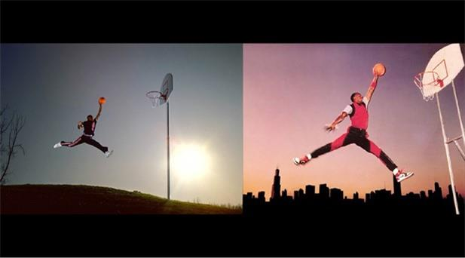
US Ct of Appeals, Ninth Circuit, Rentmeester v. Nike, No. 15-35509, Feb. 27, 2018

Slide 11
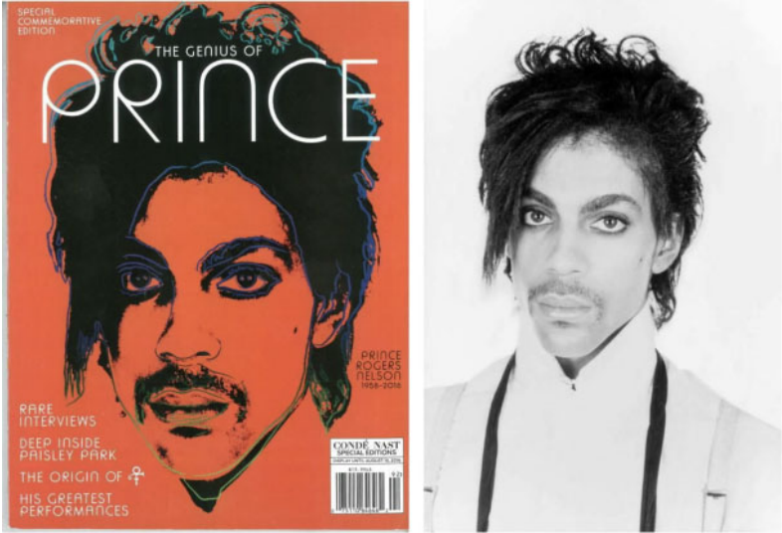
Andy Warhol v Goldsmith

Slide 12
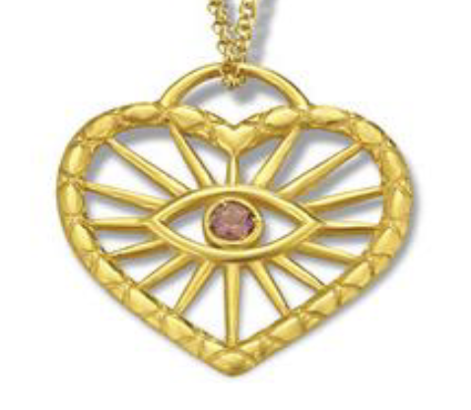
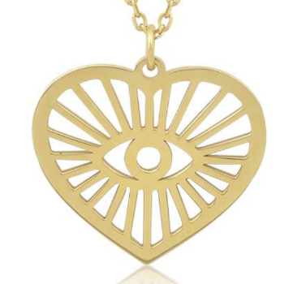
Single Member First Instance Court of Athens 2280/2022

Slide 13
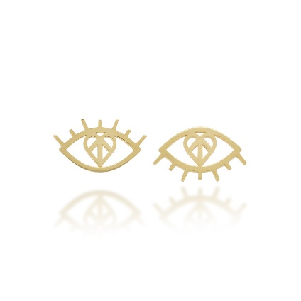

Slide 14
RELATIONSHIP BETWEEN DESIGNS AND COPYRIGHT
CJEU, C-683/17, 02.05.2019, Cofomel v G Star
Are works of applied arts protected by copyright law like other literary and artistic works?
Can the same subject-matter be protected under both design and copyright law?

Slide 15
NON-REGISTERED INDUSTRIAL PLAN
3 years of protection on the non-registered design

