Slide 1


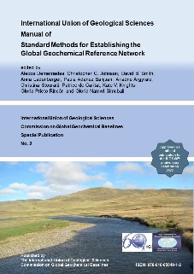
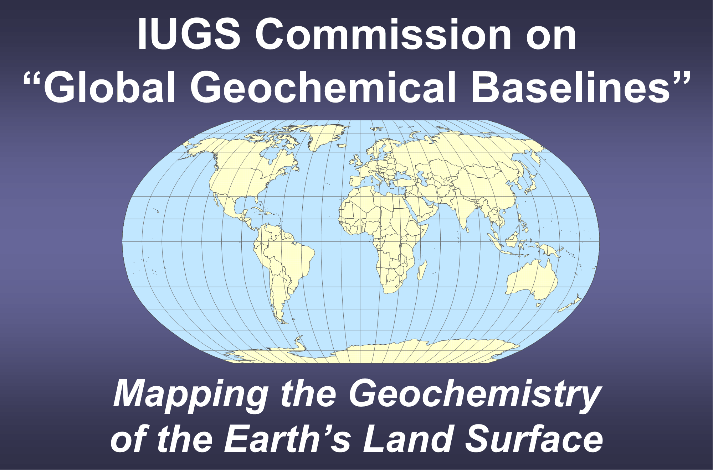
Saturday, 1st of July 2023
Short course on the applied geochemical methods described in the International Union of Geological Sciences Manual of Standard Methods for Establishing the Global Geochemical Reference Network
Management of generated data, development of databases, statistical and geostatistical processing, compositional data analysis and map plotting
Stefano Albanese
For details refer to: Tarvainen, T., Smith, S.M., Filzmoser, P., Demetriades, A., Bogatyrev, I. & Albanese, S., 2022. Data Management and Map Production. Chapter 9 In: Demetriades, A., Johnson, C.C., Smith, D.B., Ladenberger, A., Adánez Sanjuan, P., Argyraki, A., Stouraiti, C., Caritat, P. de, Knights, K.V., Prieto Rincón, G. & Simubali, G.N. (Editors), International Union of Geological Sciences Manual of Standard Methods for Establishing the Global Geochemical Reference Network. IUGS Commission on Global Geochemical Baselines, Athens, Hellenic Republic, Special Publication, 2, 457−485.
Useful materials can be found at: http://www.globalgeochemicalbaselines.eu/datafiles/file/IUGS-CGGB_Manual_Chapter-9_Data-management.zip

Slide 2
International Union of Geological Sciences
Manual of Standard Methods
for
Establishing the Global Geochemical Reference Network
Chapter 9
Data Management and Map Production
Timo Tarvainen^{1,5}, Steven M. Smith⁵, Peter Filzmoser²,
Alecos Demetriades^{3,5}, Igor Bogatyrev⁵, Stefano Albanese^{4,5}
¹ Geological Survey of Finland, Espoo, Finland
² Institute for Statistics and Probability Theory, Vienna University of Technology, Vienna, Austria
³ Institute of Geology and Mineral Exploration, Athens, Hellenic Republic
⁴ University of Napoli Federico II, Naples, Italy
⁵ IUGS Commission on Global Geochemical Baselines
It is recommended that reference to this part of the Manual should be made in the following way:
Tarvainen, T., Smith, S.M., Filzmoser, P., Demetriades, A., Bogatyrev, I. & Albanese, S., 2022. Data Management and Map Production. Chapter 9 In: Demetriades, A., Johnson, C.C., Smith, D.B., Ladenberger, A., Adánez Sanjuan, P., Argyraki, A., Stouraiti, C., Caritat, P. de, Knights, K.V., Prieto Rincón, G. & Simubali, G.N. (Editors), International Union of Geological Sciences Manual of Standard Methods for Establishing the Global Geochemical Reference Network. IUGS Commission on Global Geochemical Baselines, Athens, Hellenic Republic, Special Publication, 2, 457−485.

Slide 3
Global Terrestrial Network (GTN)
Area 160x160 km
7356 grid cells
An estimate of the number of samples that will be collected in the Global Geochemical Reference Network (GGRN) project at a density of 5 samples per GTN grid cell, and field duplicates at ≈5% of sample sites
Sample type | Rock | Topsoil | Subsoil | Humus (estimate) | Stream sediment | Stream water | Overbank sediment - top | Overbank sediment - bottom | Floodplain sediment - top | Floodplain sediment - bottom | Total: | Grand total:
Routine sample | 36,780 | 36,780 | 36,780 | 15,000 | 36,780 | 36,780 | 36,780 | 36,780 | 36,780 | 36,780 | 346,020 | 363,321
Duplicate sample | 1839 | 1839 | 1839 | 750 | 1839 | 1839 | 1839 | 1839 | 1839 | 1839 | 17,301

Slide 4
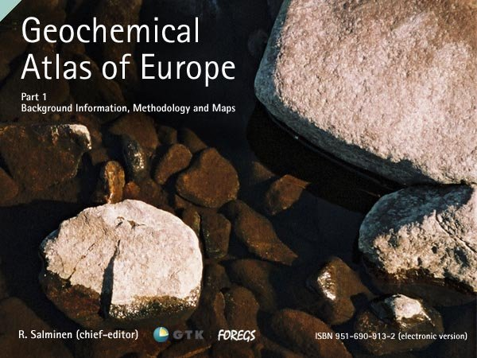
FOREGS Geochemical Atlas of Europe area and adjacent countries
The coded numbers indicate the North-South (N, S) and East-West (E, W) GTN grid cell numbering system used in the GGRN project.
The red colour lined GTN grid cell N34E03 covers Belgium, Luxembourg (Lx), France and Germany, and the green colour lined GTN grid cell N32E04 covers Switzerland (Sw), France and Germany. In the former case, Belgium is the coordinating country, and in the latter case is Switzerland.
W
E
N34E03
N32E04

Slide 5
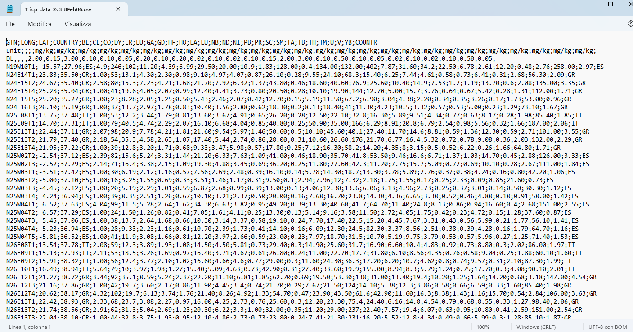
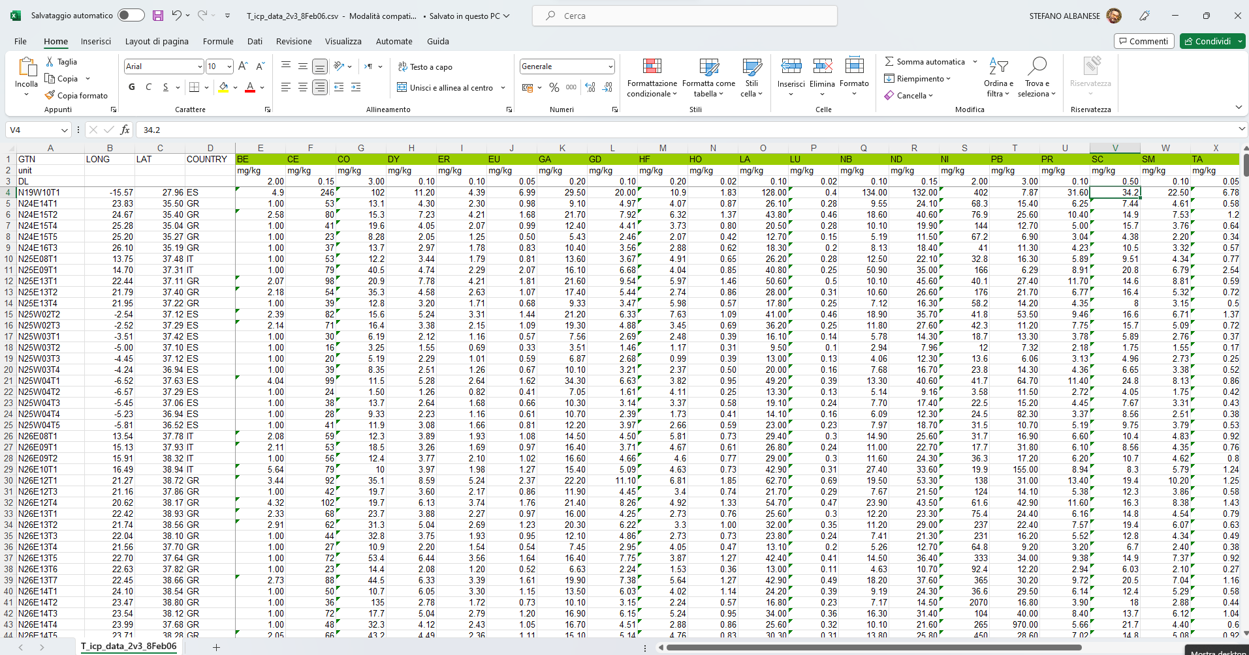

Database structure and data input
database
Analytical data
(from laboratory)
The field observations and analytical data should be combined.
Field observations
(from field)
The merged data set should be checked and validated first by the participating countries.
Coordinates
(from field)
CSV
Additional info
(from sample preparation)
All analytical data and field observations should be stored in simple text format files, such as comma-delimited files (CSV).
XLS

Slide 6
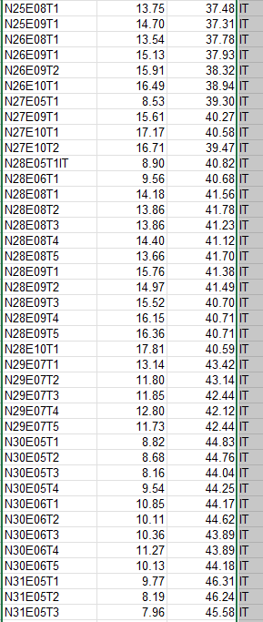
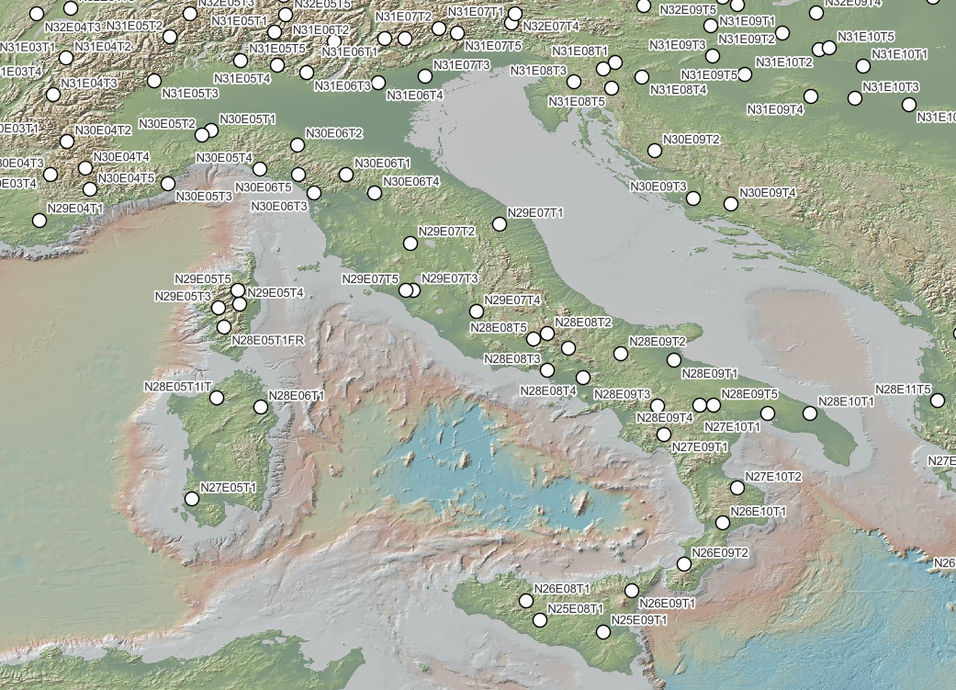
Database structure and data input [Validation of entries]
A table of coordinates of each sample type and sample site number should be compiled for each country, and a sample site map of each medium plotted, and all these thoroughly checked.

Slide 7
Preparing data for statistical elaboration and map production
CENSORED DATA
In statistics, censoring is a condition in which the value of a measurement or observation is only partially known.
Geochemical data can be “Left censored” or “Right censored”.
Left censored condition - > A concentration is below a certain value, which corresponds to the detection limit (DL) of the analytical instrument for the specific element/compound (e.g. <0.02 or -0.02)
Solution 1 - > Substitute the censored value with ½ or ¾ of the DL value
Solution 2 -> More complex statistical method based on imputation (Nearest neighbour [R package: robCompositions], Expectation/Maximum Likelihood (EM) [R package: zCompositions], Multiple regression [R package: robCompositions].
Right censored condition - > A concentration is above a certain value, which corresponds to the upper limit of the capability of the analytical instrument to “see” the concentration of a specific element/compound.
Solution 1 - > Re-analyze the sample solution after a ”controlled” dilution.
Solution 2 -> Adding a decimal number, such as 0.9999 (i.e., >20,000 mg/kg = 20,000.9999) Thus, the determinand values above the upper limit of an analytical method can be identified in the data set.

Slide 8
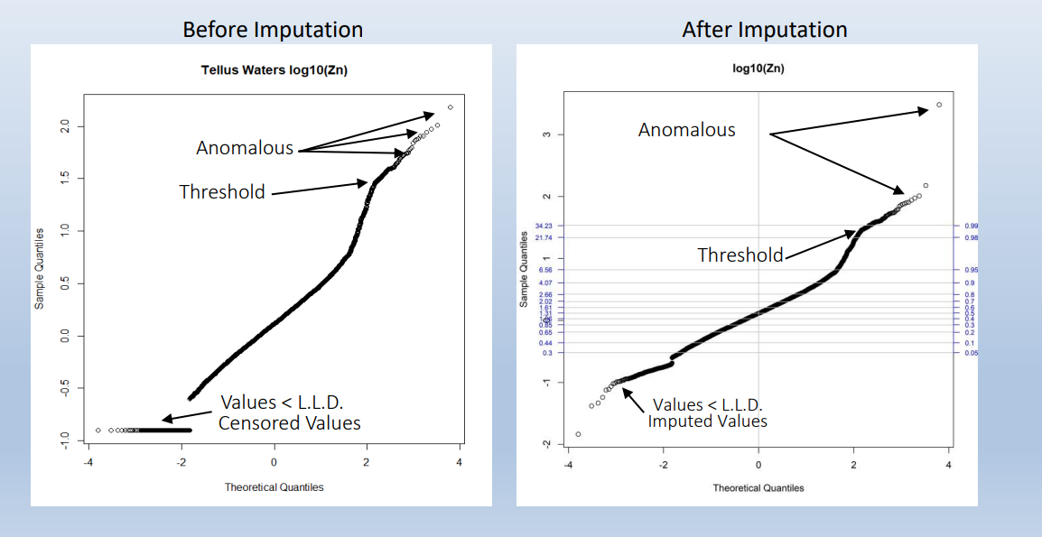
Preparing data for statistical treatment and map production
LEFT CENSORED DATA
Before imputation
After imputation
Author: E. Grunsky
Images available at: https://www.globalgeochemicalbaselines.eu/datafiles/file/03_Grunsky_%20Extracting,visualising_and_interpreting-structure-in-geochemical-data.pdf

Slide 9
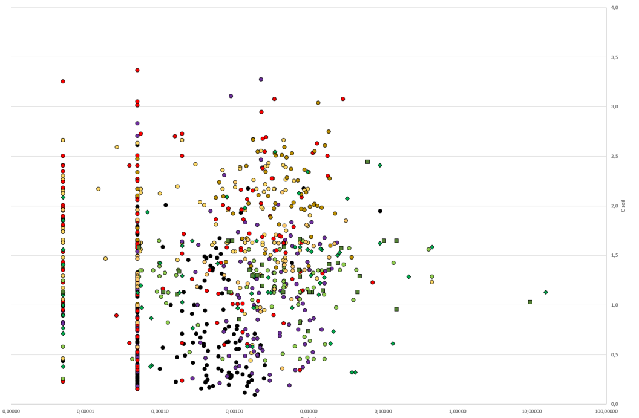
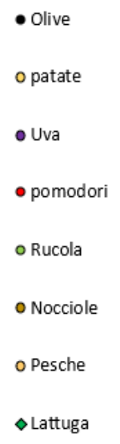
Preparing data for statistical elaboration and map production
DIFFERENT SENSITIVITY OF THE USED ANALYTICAL METHOD
The sensitivity of an analytical method could vary throughout the project because
The samples are analysed over a large time span and newer generation of instruments could have better performances.
The sensitivity of analytical methods changes resulting in lower Detection Limits (DL).
In the final dataset multiple detection limits for a single element could be present!
Solution -> In a global project, it is important to anticipate such problems and keep the analytical data in their original format and retain all values below the detection limit in the original form. During the statistical processing, the user extracts the data from the original database, and then decides how to handle multiple detection limits in the working copy of the data.
For example, if the amount of censored data for each analytical batch with different DL allow to proceed with substitution or statistical imputation one could proceed separately and then data could be joined together after treatment.
<<<
Thallium in fruit vs soil in Campania

Slide 10
Basic data tables with statistical indices
Basic statistical parameters of Zn in sample types collected in the FOREGS Geochemical Atlas of Europe project (Salminen et al., 2005). In topsoil, subsoil, stream sediment and floodplain sediment it was determined by X-ray fluorescence; in humus and stream water by ICP-MS.
Parameters | Topsoil | Subsoil | Humus | Stream water | Stream sediment | Floodplain sediment
Number of samples | 845 | 788 | 367 | 808 | 852 | 749
Order of Magnitude¹ | 3.29 | 3.31 | 3.27 | 3.54 | 3.54 | 3.99
% samples <DL | 1.78 | 4.82 | 0.0 | 0.0 | 0.0 | 0.267
 | mg/kg |  |  | μg/l | mg/kg
Detection limit (DL) | 3.00 | 3.00 | 1.00 | 0.010 | 1.00 | 1.00
Minimum | <3.00 | <3.00 | 1.00 | 0.090 | 4.00 | <1.00
2nd percentile | 3.00 | 1.50 | 6.22 | 0.473 | 16.0 | 12.0
5th percentile | 8.20 | 4.00 | 13.0 | 0.597 | 23.0 | 18.0
10th percentile | 13.0 | 13.0 | 20.0 | 0.900 | 29.0 | 25.0
25th percentile | 27.0 | 26.0 | 30.0 | 1.43 | 45.0 | 42.0
50th percentile | 52.0 | 47.0 | 45.5 | 2.61 | 71.0 | 65.0
75th percentile | 83.0 | 75.3 | 62.6 | 5.28 | 109 | 102
90th percentile | 111 | 106 | 91.4 | 9.76 | 166 | 152
95th percentile | 139 | 132 | 110 | 15.4 | 214 | 252
98th percentile | 208 | 171 | 156 | 26.8 | 421 | 457
Maximum | 2904 | 3062 | 1863 | 310 | 13,866 | 4911
MAD | 27.0 | 23.0 | 16.4 | 1.42 | 30.0 | 27.0
¹ log10 Max – log10 Min

Slide 11
Data distribution
On a Cumulative Probability plot, the concentration of the studied element is plotted along the X-axis (log-scale), while the probability of occurrence of a certain value is plotted along the Y-axis.
Cumulative probability plots
Combined plots
Floodplain sediments

Slide 12
Data distribution
A boxplot can be drawn for a single determinand, or a multiple boxplot can be plotted to compare the statistical distribution of the same determinand in different sample types (Fig. 9.3), or to compare the distribution of the same parameter determined by different analytical methods.
Boxplots
Combined plots
Topsoils

Slide 13




Map production [Open-source software solutions]
OPEN SOURCE
GIS

Slide 14
Map production
Scale
Darnley et al. (1995, Table 9-1, p.83) suggested that based on the GTN grid size of 160x160 km and an area of 25,600 km², a map scale with a 2 mm pixel size would be 1:80,000,000.
This map scale is derived from the following calculations:
1 sampling site/5120 km², which means a grid of 71.554 x 71.554 km, and the map scale is estimated by 71.554 km x 1000 m/km x 100 cm/m = 71,554,000 cm.
Hence, the optimum map scale, according to the sampling density of 1 sampling site/5120 km² is 1:71,554,000, and global geochemical maps at a nominal scale of 1:80,000,000 are feasible.

Slide 15
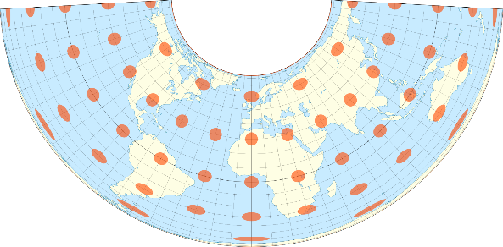
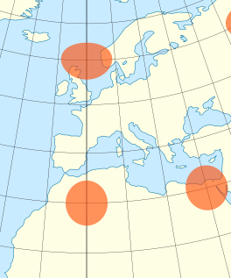
Map production
Projections
The following map projections for Global Geochemical Baselines are possible:
Albers equal-area conic projection is best suited for areas extending in an east-to-west orientation at mid-latitudes rather than north-to-south (Snyder, 1987; 1993; Snyder and Voxland, 1989).
Lambert azimuthal equal-area projection is an azimuthal projection with three aspects, i.e., polar, equatorial and oblique; it is best suited for individual territories that are symmetrically proportioned, either round or square (Snyder, 1987; 1993; Snyder and Voxland, 1989).
Van der Grinten projection is a polyconic projection, and is used for whole world maps (Snyder, 1987; 1993; Snyder and Voxland, 1989), and
Robinson projection (compromised distortion, not equal-area) is a pseudocylindrical map projection for plotting world maps (Robinson, 1974; Snyder, 1987, 1990, 1993; Snyder and Voxland, 1989).
The Albers equal-area conic projection was used for plotting the maps of the FOREGS Geochemical Atlas of Europe project (Salminen et al., 2005; Tarvainen et al., 2005).
Albers equal-area conic projection

Slide 16
Map production
The final cartographic product of all geochemical surveys, at all the scales, is a geochemical map on which the spatial distribution of a determinand is displayed.
Data can be elaborated as
discrete information (vector files)
surfaces (raster files) showing continuous patterns obtained through interpolation process
Elaborated data can be presented individually, or they can be joined togheter to offer a comprehensive view of the variable “behaviour” across the geographical space.
Point-symbol (dot) maps showing concentration values at the sample locations with data intervals set-up following statistical rules or applying reference values.
Colour-surface contour maps
Colour-surface contour maps with superimposed variable-size dots at the sample locations.
Multi-component maps (based on surfaces) displaying the simultaneous variation of a number of elements of interest, and these include ratio maps, factor analysis scores maps or colour composite RGB (Red, Green, Blue) maps.

Slide 17
Map production
Point-symbol (dot) maps [Variable-size/proportional dot map]
The dot class intervals of Zn (mg/kg) are based on minimum, the 2nd, 5th, 10th, 25th, 50th (median), 75th, 90th, 95th, 98th percentiles, and maximum.
The histogram and cumulative frequency % curve show part of the statistical distribution up to 400 mg/kg Zn.
FOREGS Geochemical Atlas of Europe (Salminen et al., 2005).

Slide 18
Map production
Point-symbol (dot) maps [EDA symbol map]
In statistics, exploratory data analysis (EDA) is an approach of analyzing data sets to summarize their main characteristics, often using statistical graphics and other data visualization methods.
Outliers (> 1.5 IQ Range))
Upper wisker (1.5 IQ Range)
3° Quartile (75° perc.)
Median (50° perc.)
1° Quartile (25° perc.)
The EDA symbol set is the original proposed by Tukey and Tukey (1981).
The central symbol set uses an accentuated symbol for the highest values
Alternative set of symbols used by the Geological Survey of Canada (GSC).
Lower wisker (1.5 IQ Range)

Slide 19
Map production
Point-symbol (dot) maps
Variable-size
vs
EDA symbol

Slide 20
Map production
Colour-surface contour maps
Spatial Autocorrelation
“[In the space] Everything is related to everything else, but near things are more related than distant things"
(Tobler‘s First Law of Geography)
Key concepts
The position of the sample the measurement of which is known is as important as the measured value.
Environmental property values at a certain scale are positively related (self-correlated).
By introducing autocorrelation some samples will be more important than others and will influence the prediction of the value of an unknown point.
Points close to each other tend to similar values, while distant points differ, on average, to a greater extent.
Geostatistics measure how similar spatially close objects are.

Slide 21
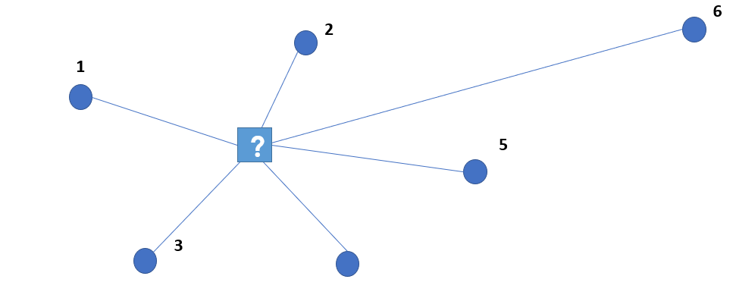
Map production
Colour-surface contour maps
Colour-surface contour geochemical maps are more difficult to construct because the point data of regional and continental-scale geochemical projects are often based on irregular sampling points, and an interpolation procedure is required to achieve a regular grid for plotting a colour-surface map.
Pixel
This means extrapolating values from the actual sampling points into unsampled space by using different interpolation methods:
Inverse distance weighting (IDW – Howarth, 1983; Reimann et al., 2008).
Moving weighted median (MWM – Gustavsson et al., 1994, 1997).
Multifractal inverse distance weighting (MIDW – Cheng, 2000; Agterberg, 2001; Lima et al., 2003).
Kriging (Matheron, 1963; Clark, 1979; Journel and Huijbreghts, 1978; Isaaks and Srivastava, 1990; Reimann et al., 2008; Filzmoser et al., 2014; Pereira and Soares, 2018; Maroufpoor et al., 2020; Demetriades, 2021).

Slide 22

Map production
Colour-surface contour maps
Interpolation is based on this general formula:
Ż (s₀) = Predicted value at unmeasured location (pixel).
Z(s_{i}) = Value at the i-esim measured location (sample).
λ_{i} = Weight given to the i-esim location (sample).
N = The total amount of measured value used to predict the value at the unmeasured location.
Exact Interpolators
The interpolated surface passes through the measurements.
Smoothing interpolators
The interpolated surface does NOT pass through the measurements. They are used when margin of uncertainty is expected on the sampled data. The resulting surfaces are chamfered.

Slide 23
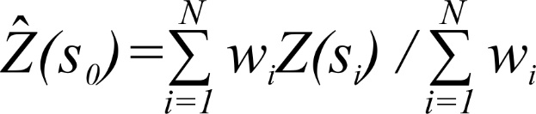
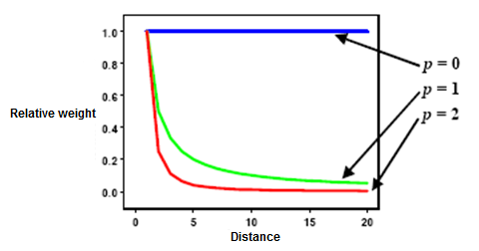
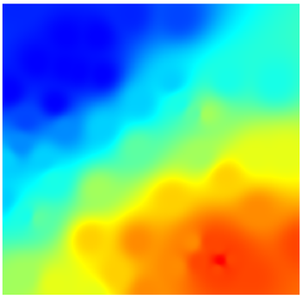
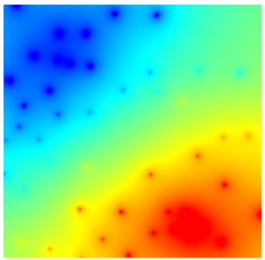
Map production
Colour-surface contour maps
Inverse distance weighting (IDW) [Exact]
In the case of IDW, the weight λ_{i} of samples depends solely on the distance (or better the inverse distance) of the known value point from the location (pixels) for which to predict the value.
Ż (s0) = Predicted value of variable at unknown point (pixel)
Z(si) = The measure of the variable at the i-th point
Wi = weight attributed to each individual observation starting from the distance of the point from the pixel to be enhanced.
N = number of observations used for the calculation of the interpolated value
w_{i =} d^{-p}
Using a power (e.g., 2, 3 or higher) emphasise the role of the distance among samples giving more relevance to closest observations.
W_{i =} d⁻¹
W_{i =} d⁻³

Slide 24
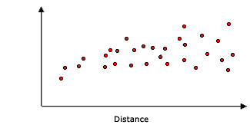
Map production
Colour-surface contour maps
Kriging [Exact]
The Kriging method is an interpolation procedure that generates an estimated surface from a discrete set of points with an assigned or known z-value.
The Kriging method is based on Matheron's (1965) regionalised variable theory in which it is assumed that variables tend to be correlated (closer sample sites are more similar to others more distant) at certain scales.
The weight λ_{i} of samples depends on the measured values, the distance of the known sample point values from the point (pixels) for which to predict the value and the spatial relationships between the measured values throughout the spatial domain covered by the data.
The spatial relationship among points is determined by the semi-variogram which allows the finding of the best function describing how the weight of sample change in space and when it becomes irrelevant.
Spherical function
Esponential function
Semivariance γ(d)
Semivariance γ(d)
Distance (d)
Distance (d)

Slide 25
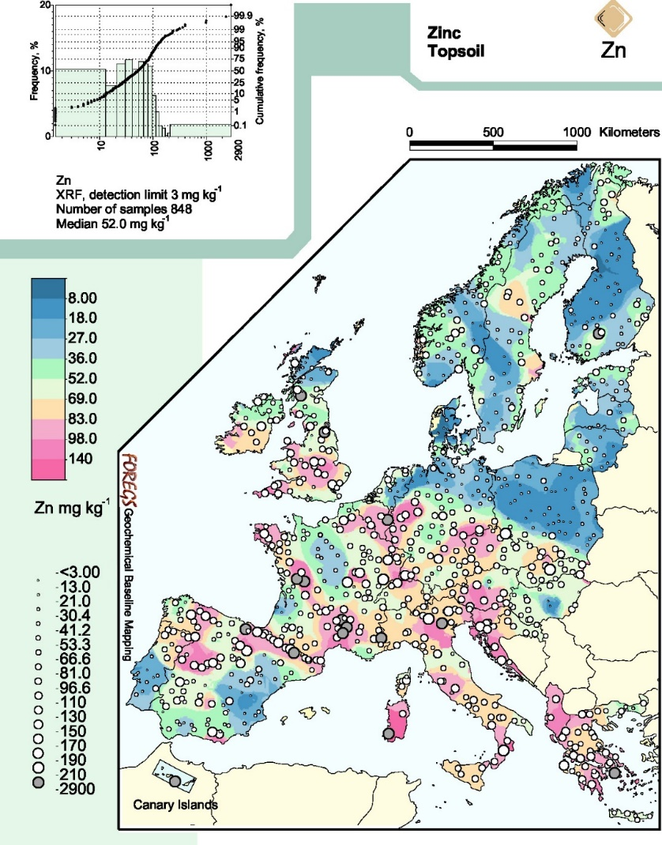
Map production
Colour-surface contour maps
Colour | RGB colour
 | 48,117,158
 | 66,148,196
 | 106,176,212
 | 158,203,224
 | 172,247,191
 | 229,248,216
 | 254,224,174
 | 245,171,204
 | 243,131,189
 | 246,103,167
«Cold colours»
Lower values
«Neutral colours»
«Hot colours»
Higher values
The 10-grade colour scale is based on the following percentiles: 5, 15, 25, 35, 50, 65, 75, 85 and 95.
FOREGS Geochemical Atlas of Europe (Salminen et al., 2005).

Slide 26
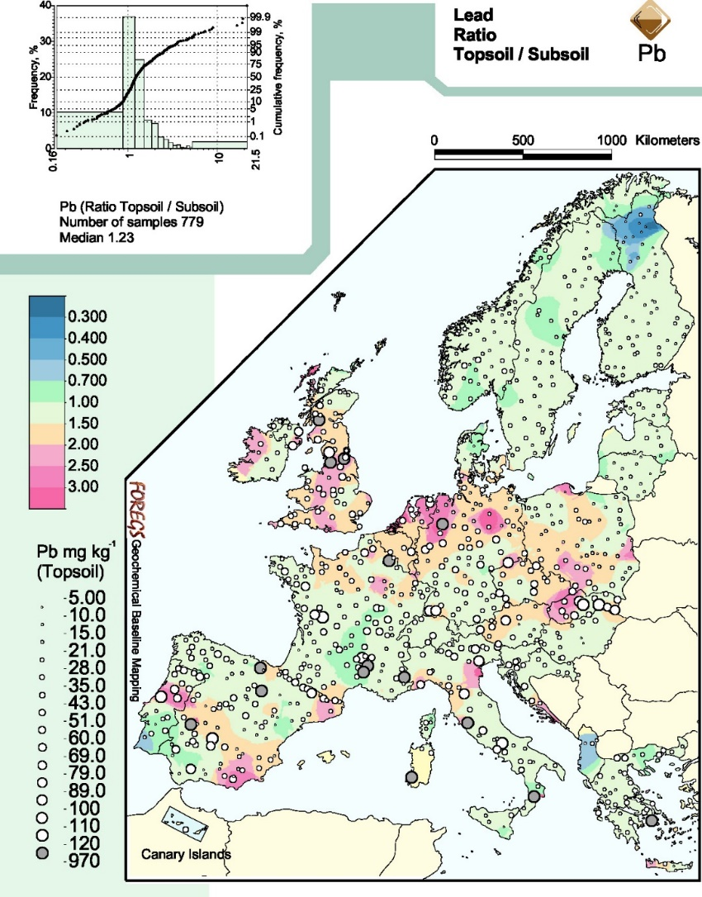
Map production
Multi-component maps
Ratio map
Topsoil/subsoil ratio colour-surface map with superimposed variable-size dots of Pb topsoil concentrations.
These maps will show any enrichment in the top compared to the bottom sample, which could be ascribed to human-induced and/or natural causes.
FOREGS Geochemical Atlas of Europe (Salminen et al., 2005).

Slide 27
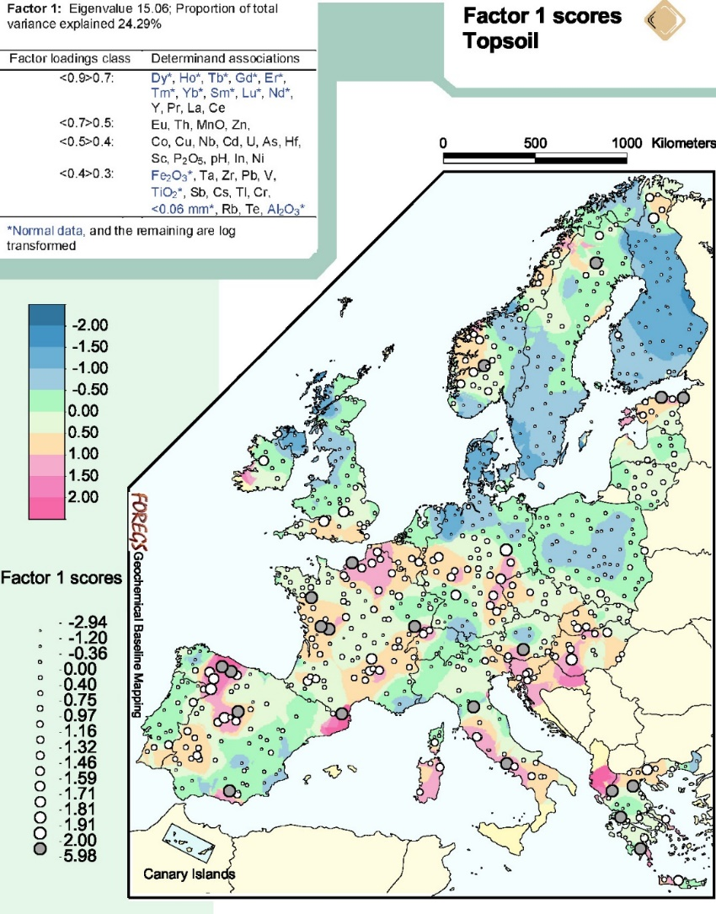
Map production
Multi-component maps
Factor score map
Colour-surface factor map with superimposed variable-size or proportional dots of Factor 1 (Varimax rotated) scores in topsoil.
FOREGS Geochemical Atlas of Europe (Salminen et al., 2005).

Slide 28
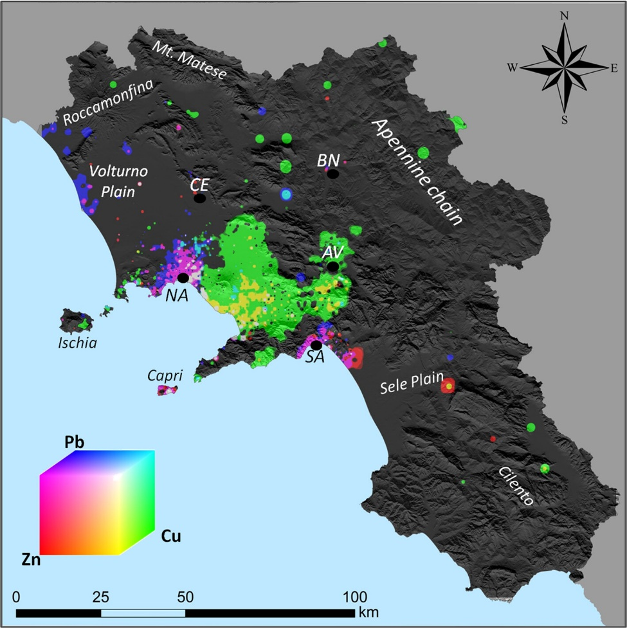


Map production
Multi-component maps
RGB composite map
Up to 3 components (surface maps of different elements) can be shown assigning to each surface a colour scale based on a primary colour (Red, Green, Blue). The resulting colour for each pixel offers a qualitative information about the relevance of an individual component at the location.
Pb, Zn
Cu
Zn, Cu
Minolfi et al., 2018

Slide 29
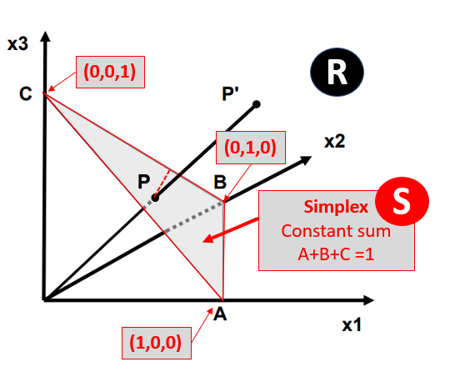
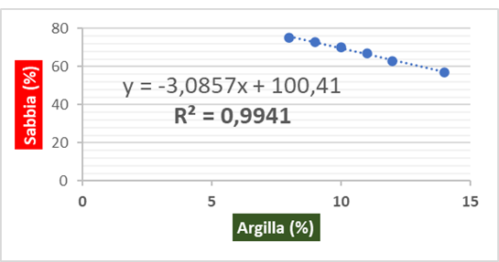
Map production
Compositional data analysis map
Geochemical data are compositional in form (CODA) because they do not contain absolute but only relative information of the whole (Aitchison, 1982, 1986, 1997).
The geochemical composition of a sample (soil, water, rock, etc.) can be seen as the projection of a vector (defined in a real space R of D dimensions equal to the number of variables) on a surface whose vertices coincide with the Cartesian axes at a unit value (Simplex).
This generate “spurious correlations” among elements since if one variable changes the others have to change too in order to remain in the simplex.
Sand
Silt
Clay

Slide 30
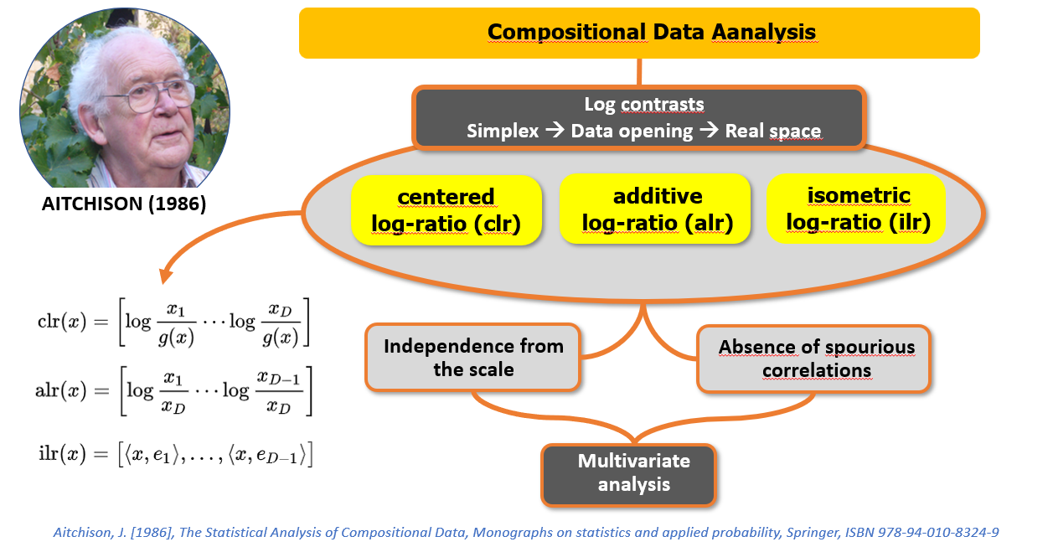
Map production
Compositional data analysis map

Slide 31
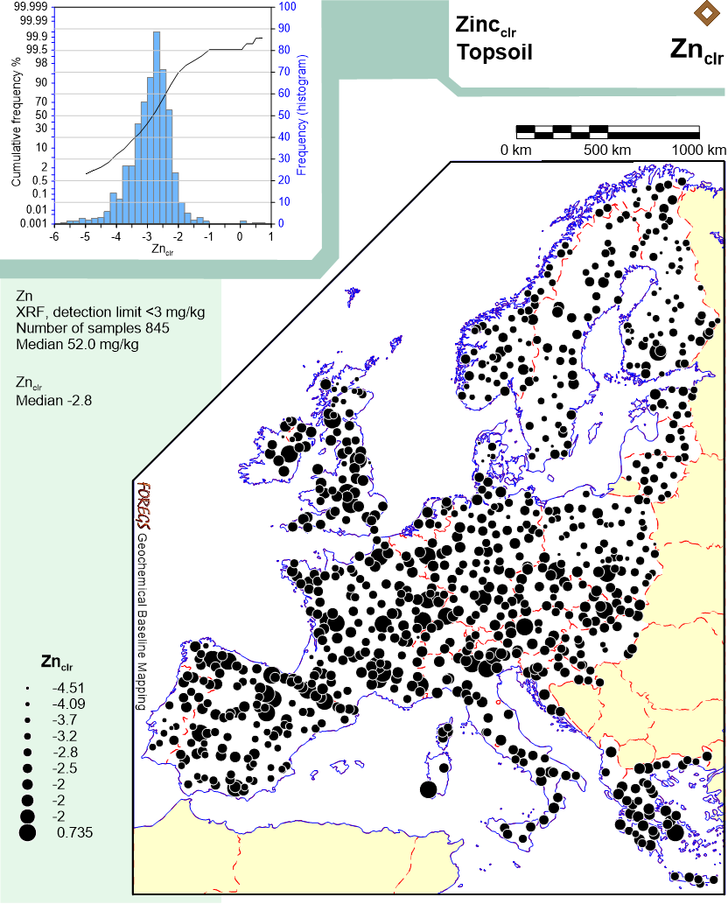
Map production
Compositional data analysis map

Slide 32
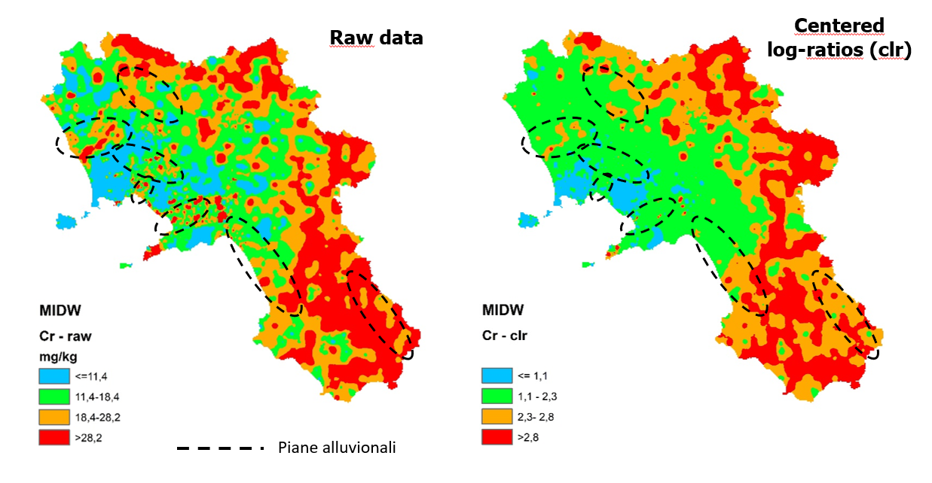
Map production
Compositional data analysis map
Examples from Campania region (Italy)

Slide 33
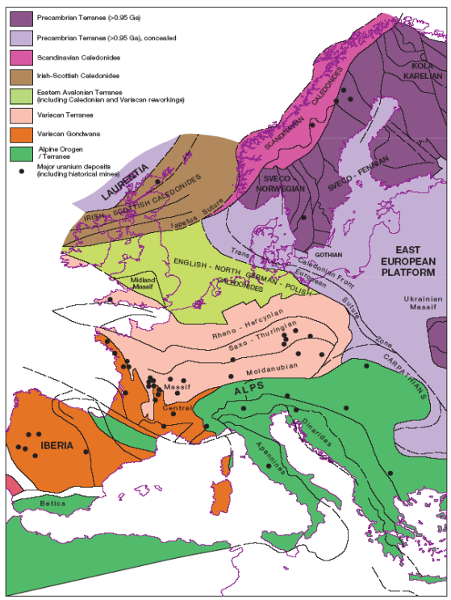
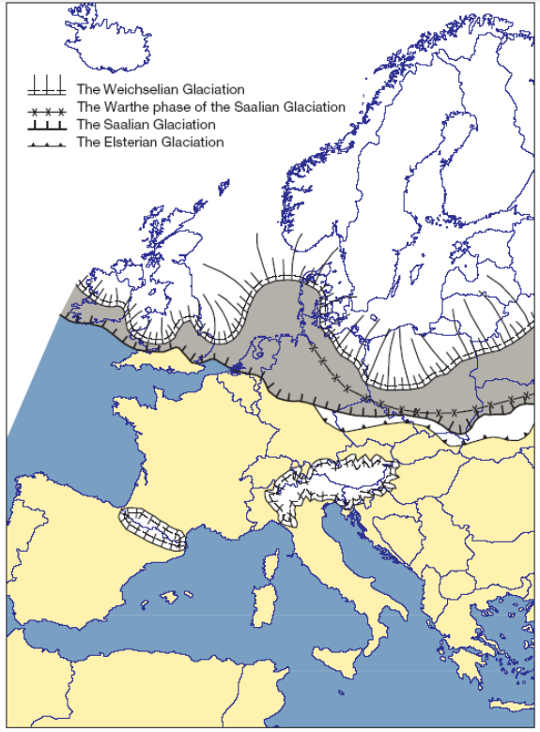
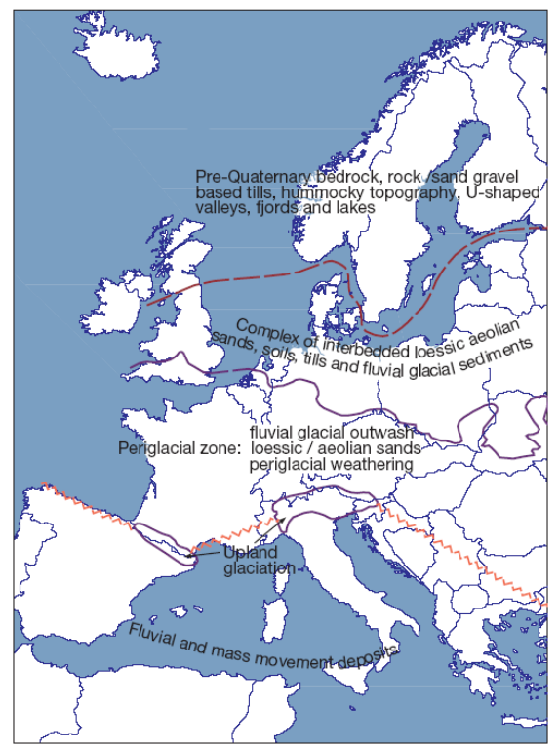
Map production
Supporting maps
The effective interpretation of the spatial distribution of determinands in samples of rock, residual soil, humus, stream water, and sediments (stream, overbank, floodplain) requires field observations and other supporting information in map form. This could include lithology, faults, mineral deposits, mineral showings, land use, rainfall (precipitation), temperature, industries, mines (active and inactive), mining wastes, and ore beneficiation wastes.

Slide 34
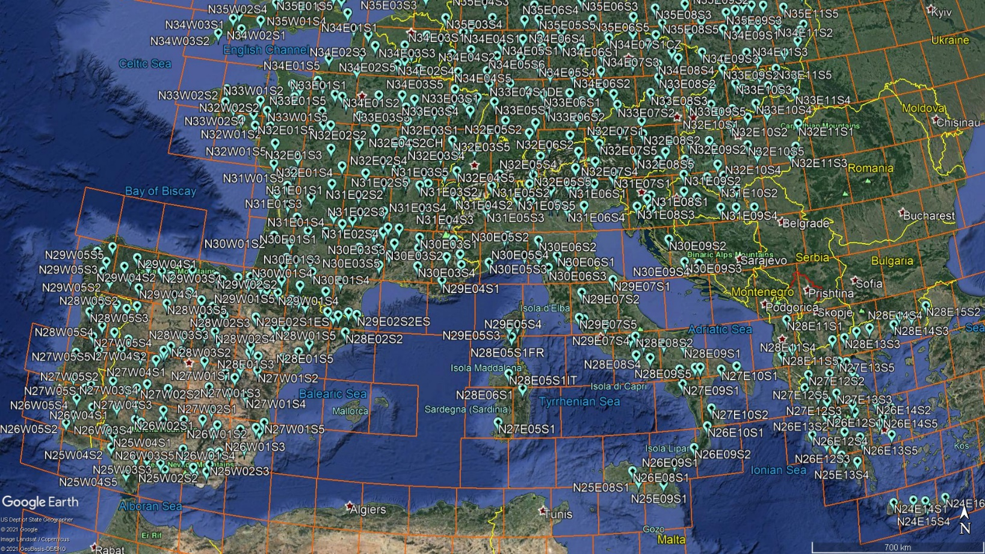
Map production
Google Earth maps
Stream sediment sample sites with their identification numbers (Salminen et al., 2005).
The orange squares are the 160x160 km GTN grid cells.

Slide 35
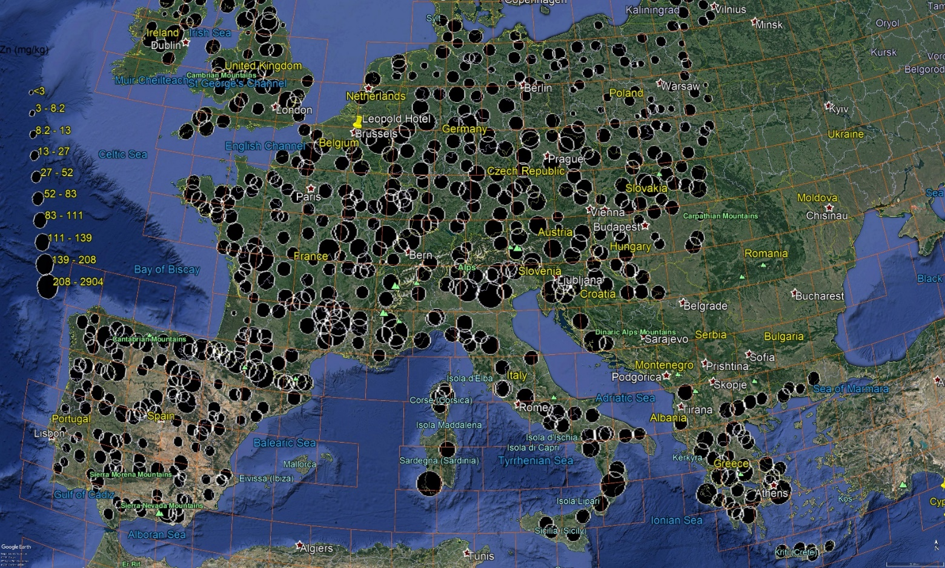
Map production
Google Earth maps
Spatial distribution of total Zn concentrations in topsoil, determined by X-ray fluorescence, FOREGS Geochemical Atlas of Europe (Salminen et al., 2005).

Slide 36
More information
Field observation archive
All observations recorded on the field observation sheets should be checked and validated prior to their entry into the database.
A hard copy record should be kept in the country of origin, and a second set in the Geological Survey of the Data Management Committee’s Chair. This is a valuable record and should be safeguarded.
Photograph archive and presentation
The photographs should be protected by their storage in the country of origin, and the Geological Survey of the Data Management Committee’s Chair.
For global access, one method could be to share the photographs trough a Google Google Earth kml containing a link as the GEMAS project was done (http://gemas.geolba.ac.at/Photos.htm).

Slide 37

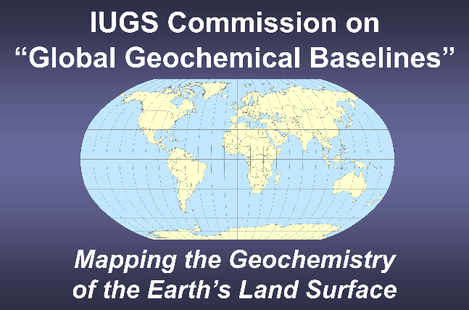
Workshop 1
Short course on applied geochemical methods described in the
International Union of Geological Sciences Manual of Standard Methods for Establishing the Global Geochemical Reference Network
1st and 2nd of July 2023
SEGH 2023
38th International Conference on Geochemistry and Health
National and Kapodistrian University of Athens
Department of Geology and Environment
Athens, Hellenic Republic

