Slide 1
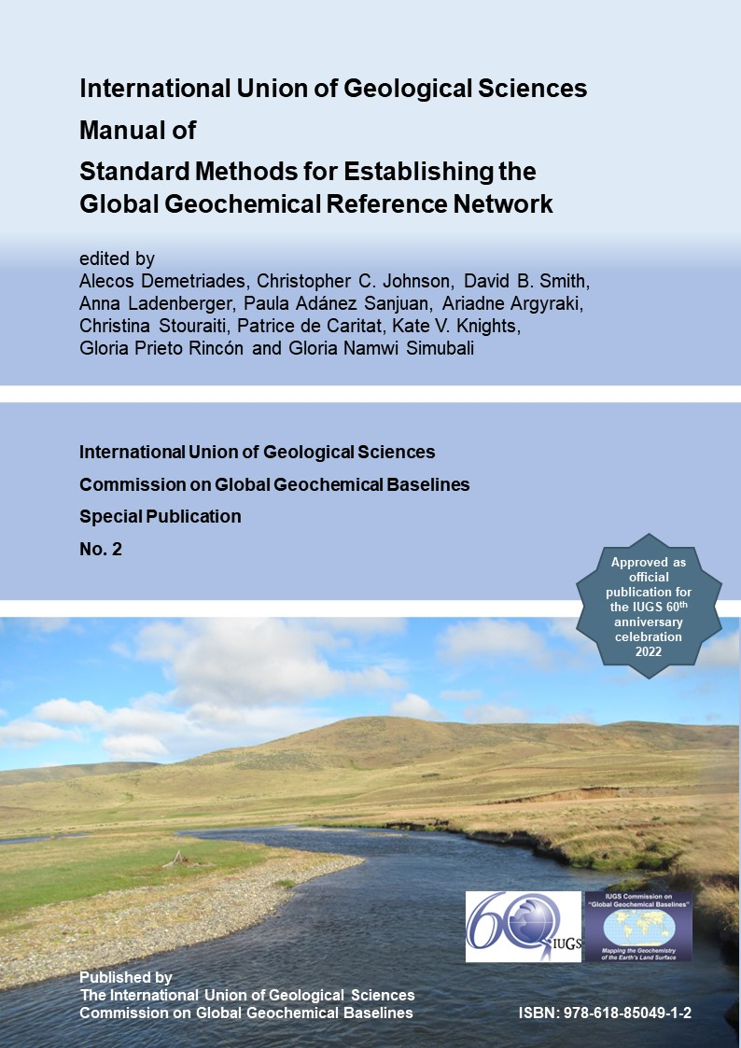



37th IGC - Workshop 21
International Union of Geological Sciences Manual of Standard Methods for Establishing the Global Geochemical Reference Network
Co-sponsored by
The International Union of Geological Sciences
and
The Association of Applied Geochemists

Slide 2


International Union of Geological Sciences
Manual of Standard Methods
for
Establishing the Global Geochemical Reference Network
Chapter 7
Quality Control Procedures
Alecos Demetriades^{1,4}, Christopher C. Johnson^{2,4}, Ariadne Argyraki^{3,4}
¹ Institute of Geology and Mineral Exploration, Athens, Hellenic Republic
² GeoElementary, Derby, United Kingdom
³ Department of Geology and Geoenvironment, National and Kapodistrian University of Athens, Hellenic Republic
⁴ IUGS Commission on Global Geochemical Baselines
It is recommended that reference to this part of the Manual should be made in the following way:
Demetriades, A., Johnson, C.C. & Argyraki, A., 2022. Quality Control Procedures. Chapter 7 In: Demetriades, A., Johnson, C.C., Smith, D.B., Ladenberger, A., Adánez Sanjuan, P., Argyraki, A., Stouraiti, C., Caritat, P. de, Knights, K.V., Prieto Rincón, G. & Simubali, G.N. (Editors), International Union of Geological Sciences Manual of Standard Methods for Establishing the Global Geochemical Reference Network. IUGS Commission on Global Geochemical Baselines, Athens, Hellenic Republic, Special Publication, 2, 387−428.

Slide 3

The Aristotelian philosophical approach demands a rational assessment of quality.
We are what we repeatedly do; excellence, then, is not an act but a habit.
‘Quality’ is subjective.
In modern times, it is most often defined as ‘fitness-for-purpose’.
Aristotle (384-322 B.C.)

Slide 4
Modern applied geochemists:
DATA + INFORMATION = KNOWLEDGE
The triangular diagram shows how quality control procedures can contribute to two levels of the equation:
DATA + INFORMATION = KNOWLEDGE
Quality control verifies the geochemical DATA set. This along with the attribution of geochemical variability and measurement of uncertainty, plus other parameters such as threshold and normal background concentration determinations (INFORMATION) contribute to the KNOWLEDGE of the geochemical baseline and an understanding of environmental status, impacts and sensitivities.
Figure 7.1 on page 391 of Manual. Plotted by Christopher C. Johnson (GeoElementary/IUGS-CGGB) with Microsoft™ PowerPoint.

Slide 5
Quality control issues
Quality control starts in the field, and continues in the laboratory during sample preparation and analysis.
Field duplicate samples: Depending on the total number of samples that will be taken in a geochemical project, field duplicate samples should be collected randomly at a rate between 3% to 10%.
Laboratory:
Analysis of field duplicate splits using a balanced ANOVA design;
Internal (including international standards) and External reference materials should be analysed at regular intervals (between 1 and 2%, depending on the method) to monitor long-term stability.

Slide 6
Sampling variability and Stability of geochemical distribution
The variability among the sample sites is very important, because it provides a measure about the stability of the geochemical map.
If the sampling variance among the sample sites is large, then the stability of the geochemical distribution displayed on the map is low.
If the sampling variance among the sample sites is small, then the stability of the geochemical distribution displayed on the map is high.

Slide 7

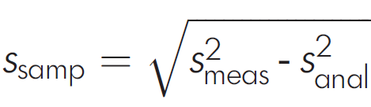
Major cause of measurement uncertainty due to sampling is the inherent in-situ heterogeneity
Distribution of the analyte in host phases - In-situ heterogeneity.
Significance of scale of observation.
Estimated by RSDsamp.
Host phases of the analyte
Expanded uncertainty: U_{meas} = 200s_{meas}/mean

Slide 8
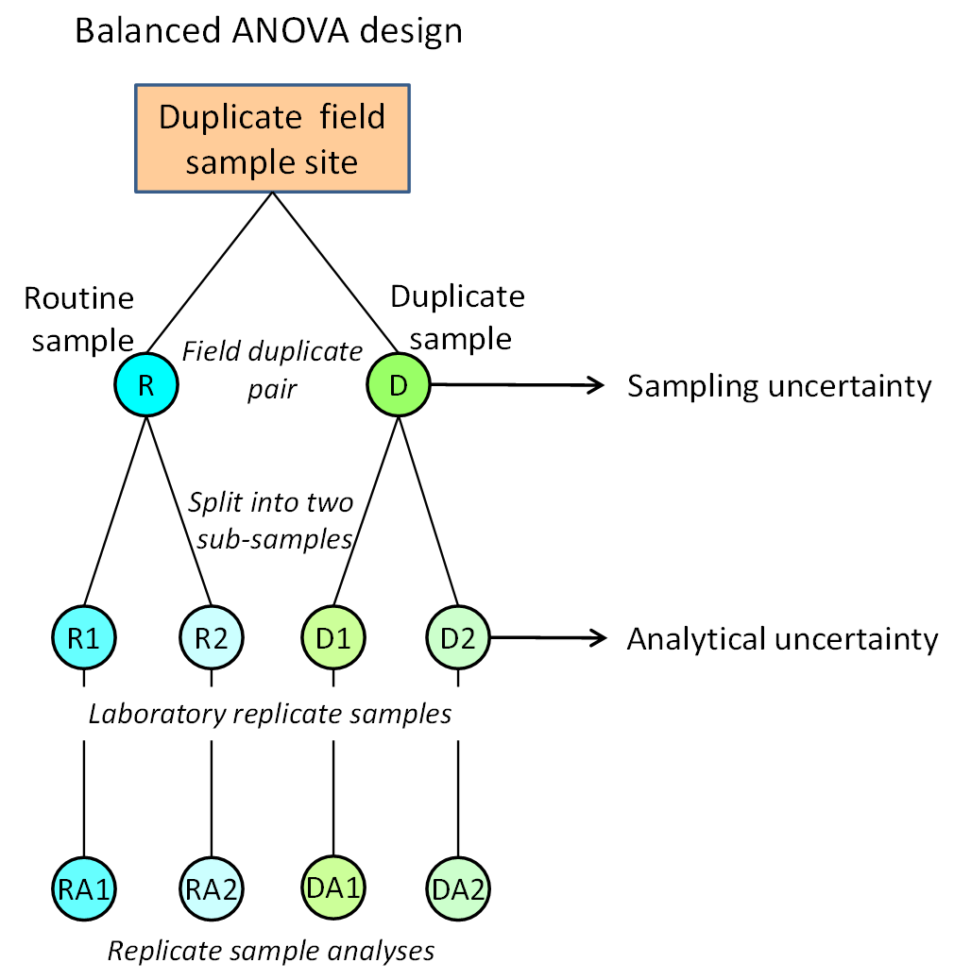
Assessment of precision
To assess the Precision of chemical analysis results relative to the variation due to sample preparation and sampling, duplicate field samples should be collected and repeat measurements made (approximately 3% to 10% of sample sites should be sampled in duplicate, depending on the total number of samples to be collected).
The field duplicate samples are prepared independently of each other and analysed randomly along with all other samples. Each field duplicate sample is analysed in replicate, as has already been described, to allow estimation of measurement uncertainty by the ANOVA statistical interpretation method.
Source: Demetriades (2011, Fig. 6.1, p.78)

Slide 9
Quantification of sources of variation (1/5)
In a Geochemical Survey, it is important to quantify all inherent errors due to different sources of variability:
Sampling (or Site)
Analytical (or Laboratory)
Spatial (or Geochemical or Natural)
ANOVA
Question:
What property are we mapping in a geochemical survey?

Slide 10
Quantification of sources of variation (2/5)
In a Geochemical Survey, it is important to quantify all inherent errors due to different sources of variability:
Sampling (or Site)
Analytical (or Laboratory)
Spatial (or Geochemical or Natural)
ANOVA
Question: What property are we mapping in a geochemical survey?
Answer: We are mapping the spatial variability of an element in a specific geological sample, of a certain grain-size, which is determined by a particular analytical method.
Conclusion: Since in a geochemical survey we are mapping the spatial variability of an element, the largest variation must be the Spatial or Geochemical variability.

Slide 11
Quantification of sources of variation (3/5)
Applied geochemists, since the 1950’s have developed different methods for the quantification of errors (A.T. Miesch, R.G. Garrett, R.J. Howarth, M. Thompson).
The most recent is by M.H. Ramsey, M. Thompson, M. Hale and A. Argyraki, who have also included estimation of measurement uncertainty of field sampling.
ISO and Eurochem have also developed methods of estimation of measurement uncertainty.
Errors can also be estimated by Geostatistics, provided that a sufficient number of samples have been collected (>50). You must be proficient, however, in Geostatistics.

Slide 12
Quantification of sources of variation (4/5)
According to Ramsey, Thompson and Hale (1992) the maximum proportions of the Sampling and Analytical variance must not exceed 20% of the Total Variance. They even stipulate the minimum conditions to be satisfied, i.e.,
Maximum Analytical variance should not exceed 4% of Total variance, and
Maximum Sampling variance should not exceed 16% of Total Variance.
Therefore, the minimum Spatial or Geochemical or Natural variance should be 80% of the Total Variance, especially if the point data will be extrapolated into unsampled space to plot coloured surface maps.

Slide 13

Unacceptable results
Quantification of sources of variation (5/5)
Acceptable results
Analytical

Slide 14
QUALITY CONTROL OF CHEMICAL ANALYSIS (QC1/30)
Upon receipt of analytical results their quality is first examined, i.e.,
Sequence diagrams plotted (sample number against analytical results in the sequence analysed) to see if there are any peculiarities (strange patterns);
Results of Standard/Reference samples extracted for their statistical treatment, and
Replicate analyses on duplicated field sample splits extracted for their statistical treatment.

Slide 15
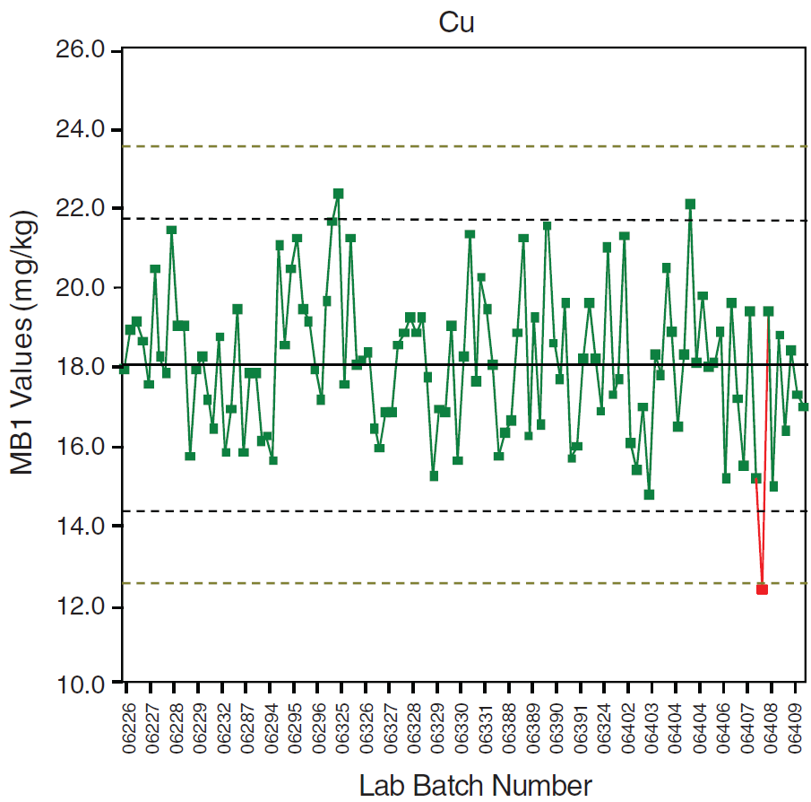
(QC2/30)
AV + 3SD
AV + 2SD
Accepted value of secondary reference material
AV - 2SD
AV - 3SD
Batch that fails QC criteria
Example of a control chart plot using QI Analyst software for the BGS Moroccan secondary reference material MB1 (after Johnson et al., 2001, Fig. 2.4, p.10). The central solid line represents the accepted value (AV) of the secondary reference material; outer black and olive colour dashed lines are at AV ± 2SD and ± 3SD, respectively. The red dot and line represent a batch that fails QC criteria.
Figure 7.2 on page 396. Source: Johnson (2011, Fig. 5.4, p.68).

Slide 16
(QC3/30)
Example of a control chart for a secondary reference material used in the EuroGeoSurveys Geochemistry Expert Group’s (EGS-GEG) URGE I project.
The central solid black line represents the accepted value (AV); outer dashed lines are at AV ±2SD and dotted lines at AV ±3SD.
The secondary reference material was used in the urban geochemical mapping projects in different European cities, the results of which are separated by solid coloured lines. In some cases, the city samples were analysed in two different batches and at different times, and dashed lines separate the two batches.
Figure 7.3 on page 396 of Manual. Plotted by Alecos Demetriades, Hellenic Institute of Geology and Mineral Exploration (IGME) and IUGS Commission on Global Geochemical Baselines (IUGS-CGGB) with Golden Software’s Grapher™ v20.

Slide 17
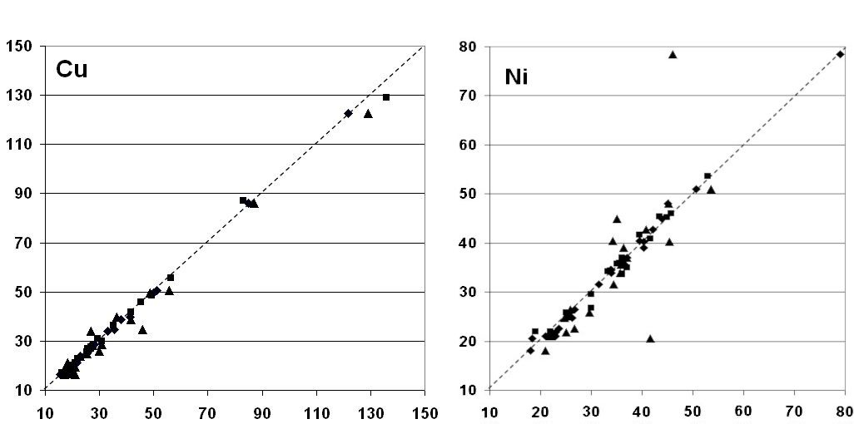
(QC4/30)
Duplicate-replicate plots for Cu and Ni for G-BASE urban soil (35-50 cm) from United Kingdom East Midlands. Axis units in mg/kg. Triangle = DUPA versus DUPB; Square= REPA versus DUPA; and Diamond = REPB versus DUPB (all x-axis versus y-axis). Notation: DUPA = Routine sample; REPA = Replicate split of routine sample; DUPB = Field duplicate sample; REPB = Replicate split of field duplicate sample.
Figure 7.4 on page 398 of Manual. Source: Johnson (2011, Fig. 5.6, p.69).

Slide 18
(QC5/30)
The reduced major axis line is the best-fit line of Y on X and X on Y, and it is used in the process of estimating the Practical Detection Limit (PDL).
The practical detection limit is estimated by the use of the project’s replicated analytical results.
For its estimation, uncensored analytical results are preferred.
If, however, uncensored results are not provided by the laboratory, the PDL procedure can still be used to verify the laboratory’s detection limits.
Figure 7.5 on page 400 of Manual. Source: Demetriades (2011, Fig. 6.2, p.82, slightly modified).

Slide 19
(QC6/30)
Variation of precision with concentration. Two examples of Be from the aqua regia GEMAS grazing land soil data set (Reimann et al., 2014) plotted with ‘IUGS-CGGB_Chapter-7_PDLPRECIS.xlsx’ Microsoft™ Excel file (see Supplementary material of Manual):
(a) With negative values (N=94 pairs), and
(b) With negative values removed (N=93 pairs).
(a) Gives a PDL at 0.072 mg/kg and an overall precision of 18.4% at the 95% confidence level, and
(b) Gives a PDL at 0.046 mg/kg and an overall precision of 24.5%
at concentrations beyond 50 mg Be/kg.
Figure 7.6 on page 402 of Manual. Plotted by Alecos Demetriades (IGME/IUGS-CGGB).

Slide 20
(QC7/30)
Cumulative probability plots of Ni indicating true detection limits for topsoil samples determined by two different analytical methods (data from the FOREGS Geochemical Atlas of Europe – Salminen et al., 2005).
Figure 7.7 on page 403 of Manual. Plotted by Alecos Demetriades (IGME/IUGS CGGB) with Golden Software’s GrapherTM v20.

Slide 21
(QC8/30)
Cumulative probability plot indicating true detection limits for samples determined by two different analytical methods. Such plots can demonstrate that the real detection limits (i.e., the point at the lower end of the cumulative distribution curve where the curve becomes horizontal) are often much lower than those cited by the analyst (the cited detection limits are marked on the plot). Recorded data for 10,000 samples from part of central and eastern England.
Figure 8.14 on page 450 of Manual (Source: Johnson et al., 2018, Fig. 5.5, p.88).

Slide 22
Cumulative probability plots indicating that the conservative laboratory lower detection limits (LDL) of hot aqua regia extractable As and Tl for the agricultural (Ap) and grazing land (Gr) soil samples of the EGS-GEG’s project of Geochemical Mapping of Agricultural and Grazing land Soil (GEMAS) of Europe, using uncensored data (Reimann et al., 2014), are higher than the true detection limits. In this case, the practical detection limit can be as low as 0.005 and 0.00009 mg/kg for As and Tl, respectively (Reimann et al., 2009).
Figure 7.8 on page 404 of Manual. Plotted by Alecos Demetriades (IGME/IUGS CGGB) with Golden Software’s GrapherTM v20.
(QC9/30)

Slide 23
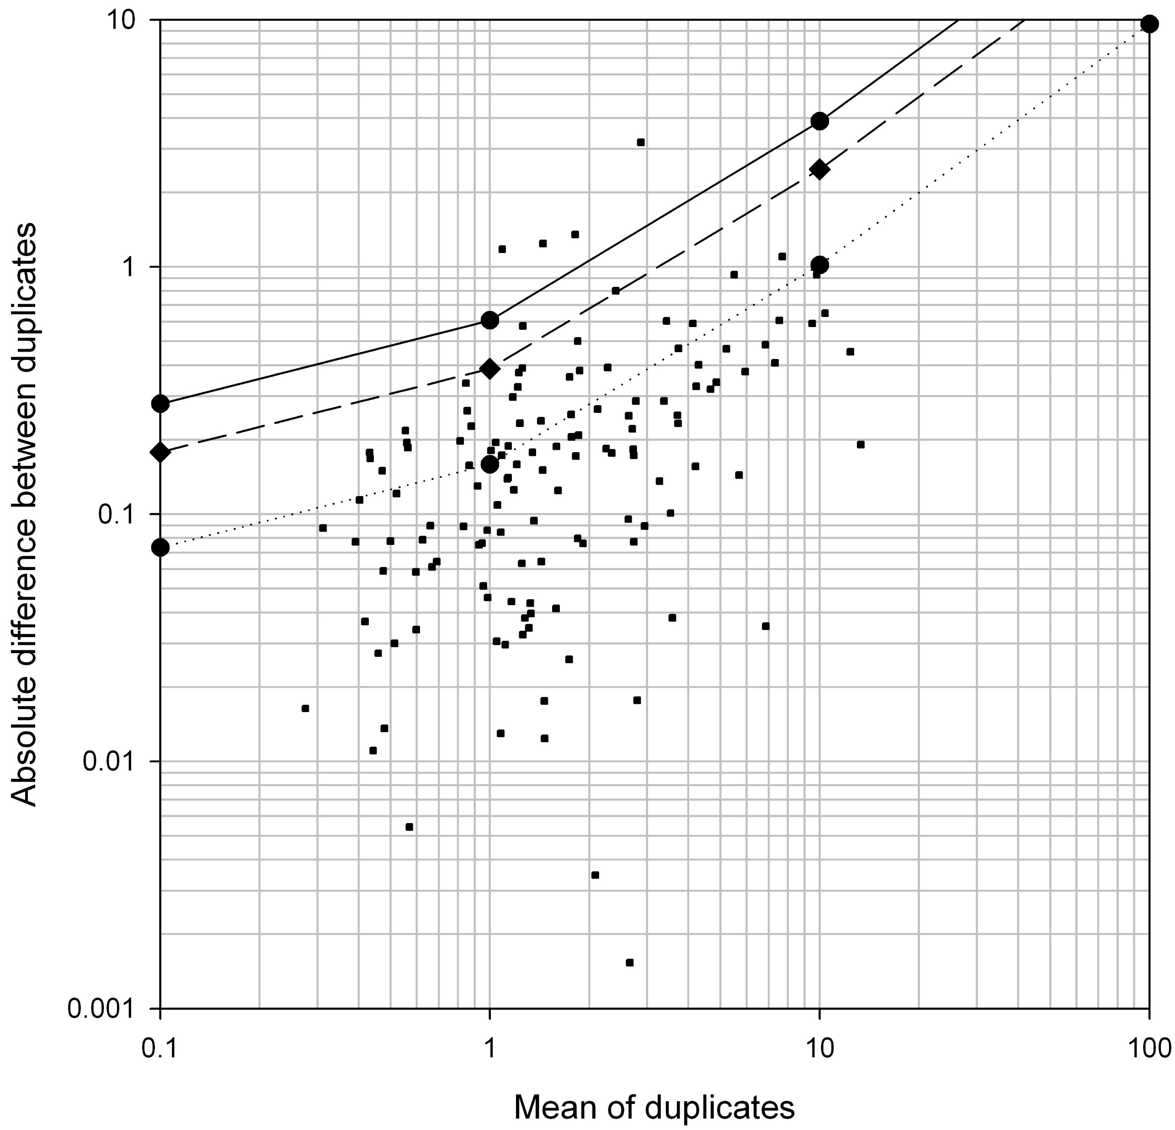
(QC10/30)
A logarithmic-scale Thompson-Howarth plot was used for visualising analytical precision.
This is a plot of G-BASE stream water duplicates for As with probabilities calculated at 0.2 μg/l detection limit using SigmaPlot v10 software by E.L. Ander (BGS).
See AMC (2002) for the rationale behind the Thompson-Howarth plot.
Solid, dashed, and dotted lines represent 99th, 90th, and 50th per cent confidence levels, respectively.
Figure 7.9 on page 405 of Manual. Source: Johnson (2011, Fig. 5.7, p.71).

Slide 24
(QC11/30)
A normal linear scale Thompson and Howarth plot was used for visualising the precision of Pb. This is a plot from the results of the Hellenic Institute of Geology and Mineral Exploration's urban soil geochemistry project at Thrakomakædónæs, a suburb of Athens.
Colour lines represent 10% and 20% precision at the 95% confidence level, and the 90th and 99th percentiles.
Figure 7.10 on page 405. Plotted by Alecos Demetriades (IGME/IUGS-CGGB) with Golden Software's Grapher™ v20.

Slide 25
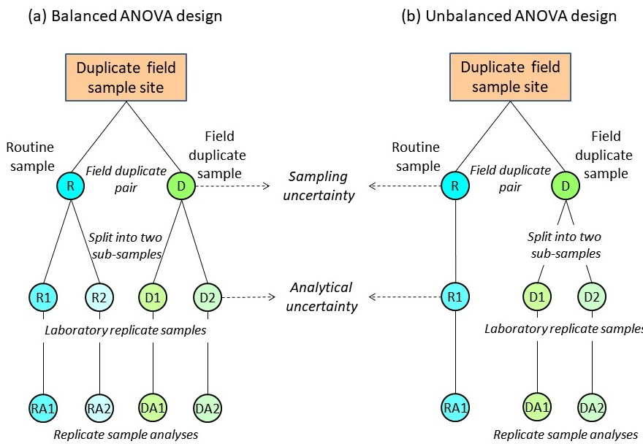
(QC12/30)
(a) Balanced and (b) unbalanced hierarchical geochemical sampling and analytical schemes for the estimation of geochemical, sampling, and analytical variance and random components of measurement uncertainty.
Figure 7.11 on page 407. Source: Demetriades et al. (2014, Fig. 6.4, p.56) slightly modified.

Slide 26
(a) Histogram of Zn distribution with fitted normal distribution curve, and
(b) Cumulative frequency plot of Zn in topsoil samples determined by XRF, FOREGS Geochemical Atlas of Europe (Salminen et al., 2005).
It is noted that most of the topsoil samples have Zn concentrations <400 mg/kg.
Figure 7.12 on page 411. Plotted by Alecos Demetriades (IGME/IUGS- CGGB) with Golden Software's GrapherTM v20.
(QC13/30)

Slide 27
Cumulative frequency curves of Zn in routine and field duplicate topsoil samples determined by XRF, FOREGS Geochemical Atlas of Europe (Salminen et al., 2005). (a) Linear graph and (b) log_{e} graph. Notation: DUPA = Routine sample; REPA = Replicate split of routine sample; DUPB = Field duplicate sample; REPB = Replicate split of field duplicate sample.
Figure 7.13 on page 412. Plotted by Alecos Demetriades (IGME & IUGS CGGB) with Golden Software's Grapher™ v20.
(QC14/30)

Slide 28
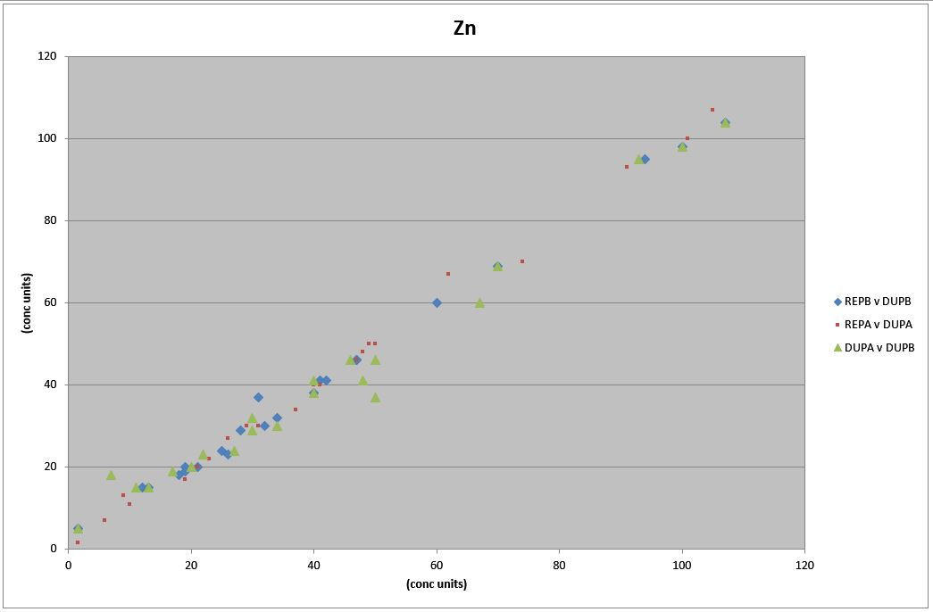
Axis concentration units in mg/kg.
(QC15/30)
Duplicate-replicate plots for Zn from FOREGS Topsoil XRF quality control data (N=23 duplicated sites).
It shows that the duplicate-replicate results are aligned close to the 1:1 gradient line.
Plotted with ‘DUPREPPLOT.xlsm’, a Microsoft™ Excel Workbook macro routine developed by Christopher C. Johnson.
Axis concentration units in mg/kg
Figure 7.14 on page 415. Plotted by Christopher C. Johnson (GeoElementary/IUGS-CGGB) with Microsoft™ Excel.
Notation:
Blue diamond = REPB versus DUPB;
Red square = REPA versus DUPA;
Green triangle = DUPA versus DUPB; and (all X-axis versus Y-axis).
DUPA = Routine sample; REPA = Replicate split of routine sample; DUPB = Field duplicate sample; REPB = Replicate split of field duplicate sample.

Slide 29
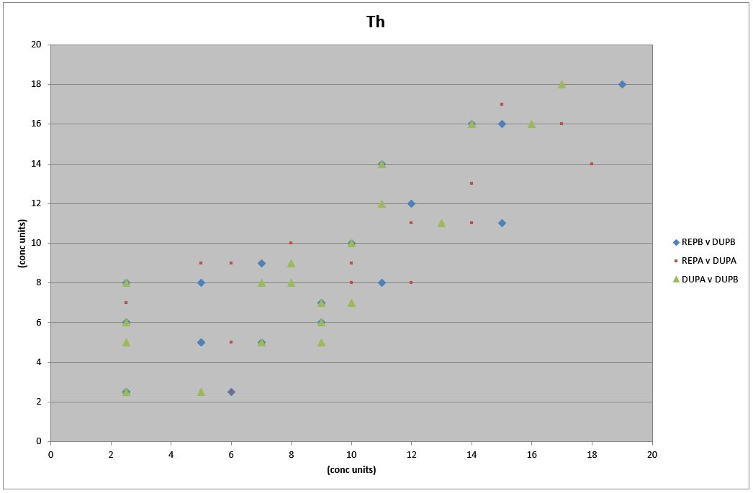
Axis concentration units in mg/kg.
(QC16/30)
Duplicate-replicate plots for Th from FOREGS Topsoil XRF quality control data (N=23 duplicated sites). It shows a wide scatter of
(i) Routine and field duplicate results (within site variability), and
(ii) Duplicate-replicate results (analytical variability).
Plotted with ‘DUPREPPLOT.xlsm’, a Microsoft™ Excel Workbook having an embedded macro routine developed by Christopher C. Johnson.
Notation: See Figure 7.14.
Figure 7.15 on page 415. Plotted by Christopher C. Johnson (GeoElementary/IUGS-CGGB) with Microsoft™ Excel.
Notation:
Blue diamond = REPB versus DUPB;
Red square = REPA versus DUPA;
Green triangle = DUPA versus DUPB; and (all X-axis versus Y-axis).
DUPA = Routine sample; REPA = Replicate split of routine sample; DUPB = Field duplicate sample; REPB = Replicate split of field duplicate sample.

Slide 30
Topsoil QC data from FOREGS project (Salminen et al., 2005).
(QC17/30)
Multiple-boxplot of major element quality control data in European topsoil (N=23 duplicated sites).
Figure 7.16 on page 419. Plotted by Alecos Demetriades (IGME/IUGS-CGGB) with Golden Software’s Grapher™ v20.

Slide 31
Topsoil QC data from FOREGS project (Salminen et al., 2005).
(QC18/30)
Multiple-boxplot of trace element quality control topsoil data (N=23 duplicated sites; Total number of sample splits, N=92)
Figure 7.17 on page 419. Plotted by Alecos Demetriades (IGME & IUGSCGGB) with Golden Software’s Grapher™ v20.

Slide 32
(QC19/30)
(a)
(b)
Multiple-boxplots of routine and field duplicate sample splits of (a) CaO and (b) Zn, FOREGS Topsoil QC data set (N=23 duplicated sites) (Salminen et al., 2005). The value of the upper whisker of all duplicate-replicate splits (N=92) is 1.63 wt% CaO, and 95 mg/kg Zn. Samples with values greater than these limits are considered outliers (see Table 7.1). Notation: DUPA = Routine sample; REPA = Replicate split of routine sample; DUPB = Field duplicate sample; REPB = Replicate split of field duplicate sample.
Figure 7.18 on page 420. Plotted by Alecos Demetriades (IGME/IUGS-CGGB) with Golden Software’s Grapher™ v20.

Slide 33
Sample Number | CaO in wt% |  |  |  |  | Zn in mg/kg
 | DUPA | REPA | DUPB | REPB |  | DUPA | REPA | DUPB | REPB
N31E05T2 | 0.655 | 0.654 | 0.683 | 0.681 |  | 67 | 62 | 60 | 60
N37W04T4 | 0.128 | 0.129 | 0.119 | 0.121 |  | 11 | 10 | 15 | 12
N32E04T5 | 0.363 | 0.363 | 0.36 | 0.355 |  | 40 | 41 | 41 | 42
N34E07T3 | 0.963 | 0.964 | 0.976 | 0.981 |  | 93 | 91 | 95 | 94
N35E01T1 | 0.896 | 0.888 | 1.01 | 0.997 |  | 40 | 40 | 38 | 40
N37W01T4 | 0.027 | 0.026 | 0.023 | 0.022 |  | 1.5 | 1.5 | 5 | 1.5
N42E10T2 | 1.29 | 1.28 | 1.26 | 1.26 |  | 20 | 21 | 20 | 19
N43E09T4 | 1.22 | 1.22 | 1.34 | 1.33 |  | 13 | 9 | 15 | 13
N34E03T3 | 0.489 | 0.489 | 0.486 | 0.484 |  | 100 | 101 | 98 | 100
N32E01T1 | 0.337 | 0.337 | 0.257 | 0.256 |  | 30 | 31 | 32 | 34
N40E10T5 | 1.38 | 1.37 | 1.63 | 1.63 |  | 48 | 48 | 41 | 41
N33E08T5 | 0.23 | 0.232 | 0.234 | 0.232 |  | 22 | 23 | 23 | 26
N42E04T5 | 0.816 | 0.818 | 0.954 | 0.961 |  | 20 | 20 | 20 | 21
N43E04T5 | 3.29 | 3.29 | 3.10 | 3.10 |  | 50 | 49 | 37 | 31
N30E06T1 | 0.275 | 0.273 | 0.289 | 0.289 |  | 46 | 47 | 46 | 47
N38E04T4 | 0.549 | 0.55 | 0.539 | 0.548 |  | 27 | 26 | 24 | 25
N28E11T1 | 1.03 | 1.02 | 0.815 | 0.829 |  | 107 | 105 | 104 | 107
N34E10T5 | 0.147 | 0.149 | 0.11 | 0.110 |  | 17 | 19 | 19 | 19
N36E08T3 | 0.142 | 0.143 | 0.303 | 0.302 |  | 7 | 6 | 18 | 18
N31E03T4 | 1.59 | 1.57 | 4.46 | 4.47 |  | 50 | 50 | 46 | 47
N33E02T3 | 25.8 | 25.9 | 28.3 | 28.5 |  | 30 | 29 | 29 | 28
N34E01T1 | 1.03 | 1.04 | 0.566 | 0.57 |  | 34 | 37 | 30 | 32
N32E10T1 | 0.953 | 0.952 | 1.02 | 1.02 |  | 70 | 74 | 69 | 70
(QC20/30)
CaO (wt%) and Zn (mg/kg) results of routine and field duplicate sample splits of FOREGS Topsoil samples (Salminen et al., 2005).
According to the results of the total number of samples (N=92), the outlying values for CaO are >1.63%, and for Zn >95 mg/kg.
The outlying values are indicated by bold red numbers.
Notation:
DUPA = Routine sample;
REPA = Replicate split of routine sample;
DUPB = Field duplicate sample;
REPB = Replicate split of field duplicate sample.

Slide 34
(QC21/30)
Output results as given by ROBCOOP4A.EXE program
The next slide shows the Classical and robust analysis of variance results of CaO from the FOREGS Topsoil XRF data set (Salminen et al., 2005).
Output as given by ROBCOOP4A.EXE program (Vassiliades, 2022). The coverage factor used in this case is 1.96 at the 95% confidence level.
Note: The output is exactly as given by the program. In practice, the results should not be quoted with more than two or three significant figures to the right of the decimal point depending on the number of integers.
Table 7.2 on page 421 of Manual (next slide).

Slide 35
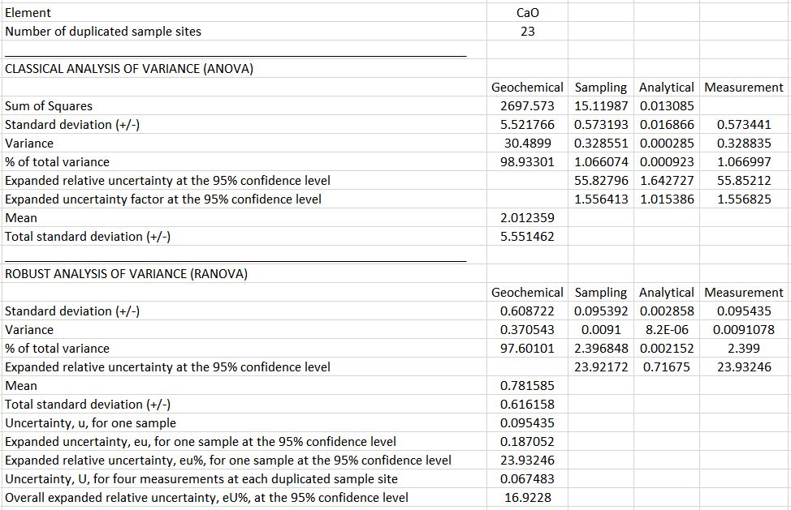
Output results of CaO as given by the ROBCOOP4A.EXE program
(QC22/30)

Slide 36
(QC23/30)
Output results as given by ROBCOOP4A.EXE program
The next slide shows the Classical and robust analysis of variance results of Zn from the FOREGS Topsoil XRF data set (Salminen et al., 2005).
Output as given by ROBCOOP4A.EXE program (Vassiliades, 2022). The coverage factor used in this case is 1.96 at the 95% confidence level.
Note: The output is exactly as given by the program. In practice, the results should not be quoted with more than two or three significant figures to the right of the decimal point depending on the number of integers.
Table 7.3 on page 421 of Manual (next slide).

Slide 37
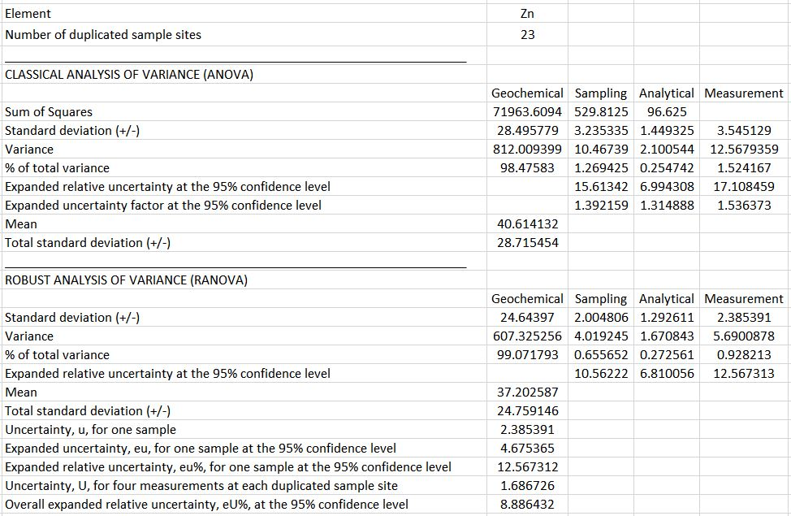
Output results of Zn as given by the ROBCOOP4A.EXE program
(QC24/30)

Slide 38
(QC25/30)
Pie charts of robust balanced ANOVA results for (a) CaO and (b) Zn in topsoil samples of the FOREGS Geochemical Atlas of Europe, determined by XRF (Salminen et al., 2005).
Figure 7.19 on page 422. Plotted by Alecos Demetriades (IGME/IUGS-CGGB) with Golden Software’s Grapher™ v20.

Slide 39
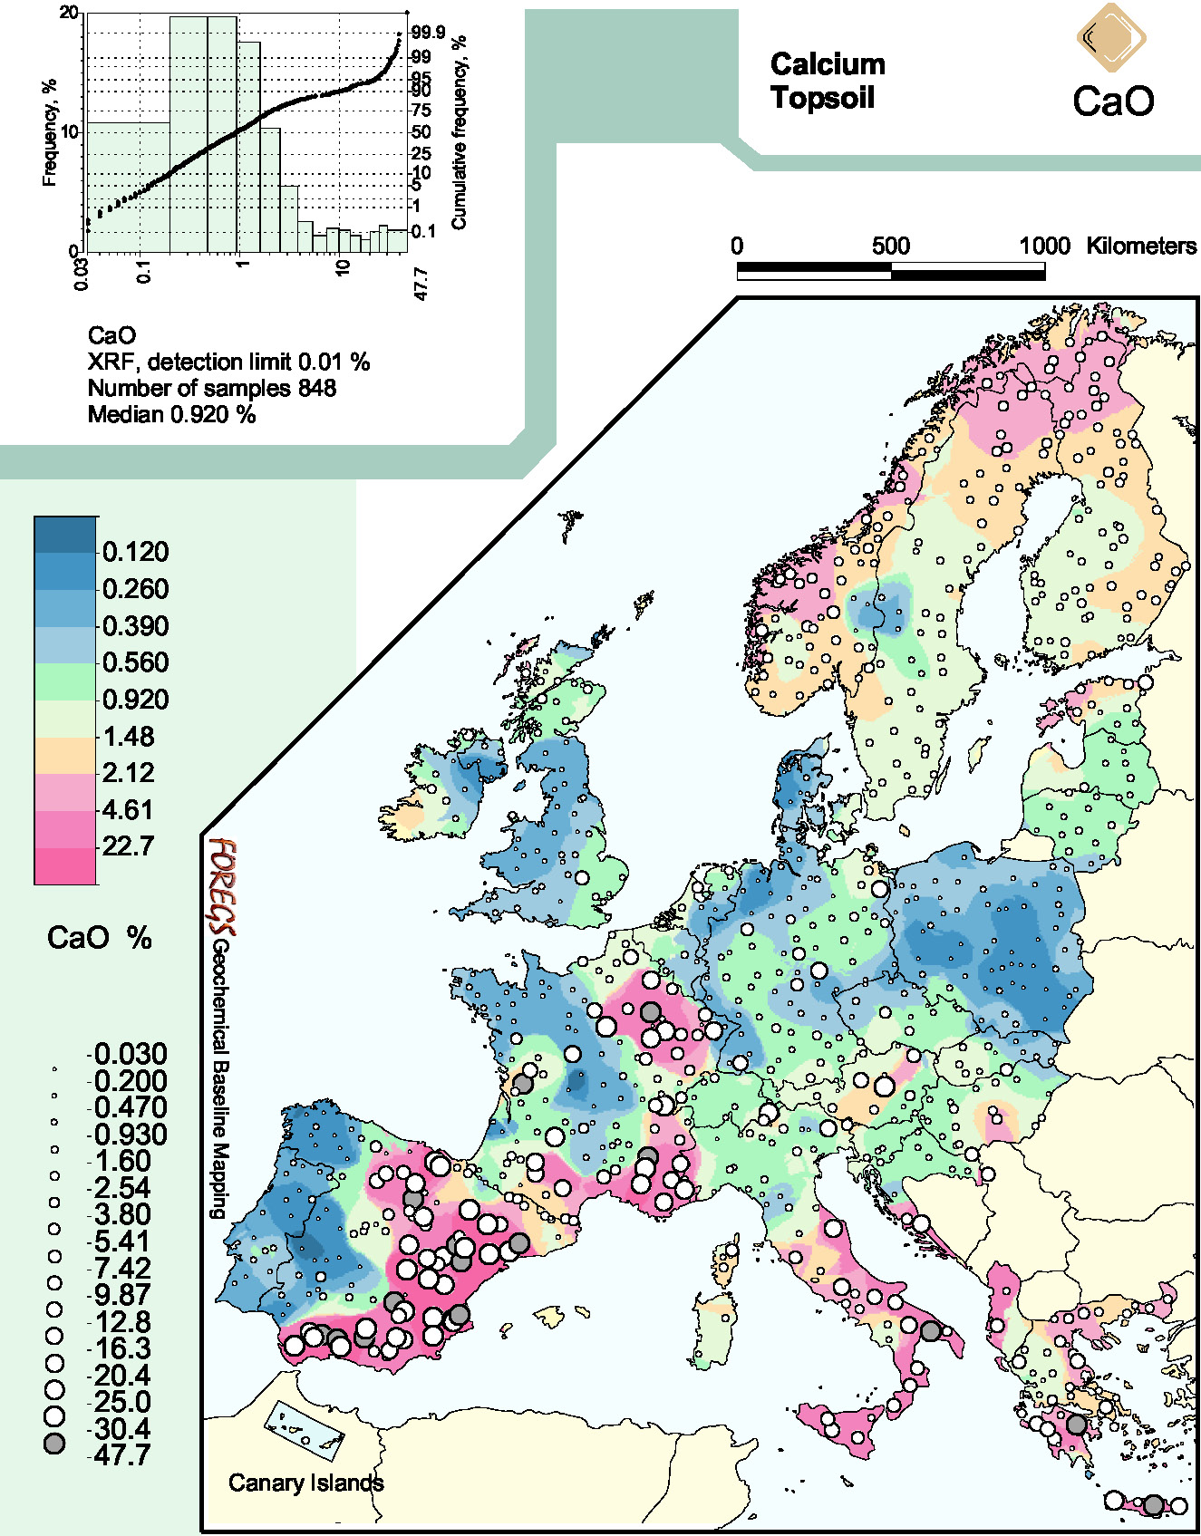
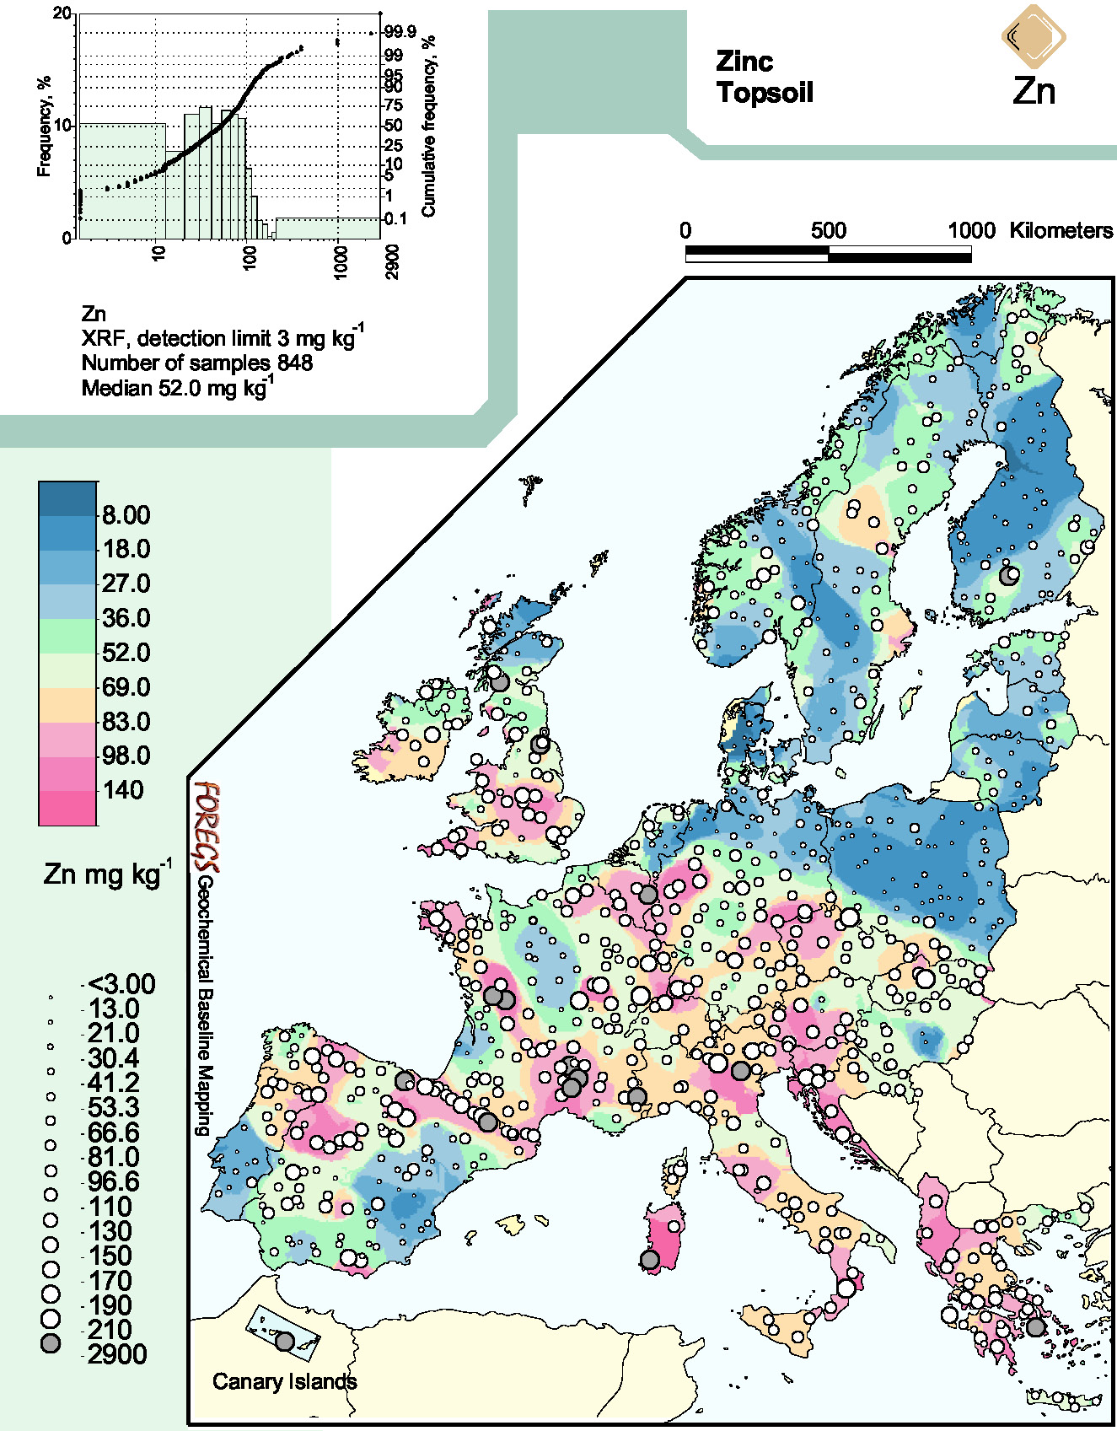
(QC26/30)
FOREGS Geochemical Atlas of Europe maps of topsoil (a) CaO and (b) Zn determined by XRF.
Figure 7.20 on page 423. Source: Salminen et al. (2005, p.158 CaO -http://weppi.gtk.fi/publ/foregsatlas/maps/Topsoil/t_xrf_cao_edit.pdf; p.513 Zn - http://weppi.gtk.fi/publ/foregsatlas/maps/Topsoil/t_xrf_zn_edit.pdf). It is noted that the number of topsoil samples analysed by XRF is 845 and not 848.

Slide 40
(QC27/30)
Calculations using the Zn concentration of 67 mg/kg in topsoil sample N31E05T2 (see Tables 7.1 and 7.3) with respect to the robust expanded relative uncertainty (U΄=±12.6%), and expanded uncertainty factor (^{F}U=1.54). The much higher UCL for the ^{F}U approach better reflects the positive skewness of the underlying logarithmic frequency distribution (see histogram and cumulative frequency curve in Fig. 7.12). The coverage factor used in this case is 1.96 at the 95% confidence level. See Table 7.5 for the calculations and Figure 7.21. Notation: LCL = Lower confidence limit; UCL = Upper confidence limit; CI = Confidence interval.
Measurement uncertainty and factor at the 95% confidence level |  | Calculation of LCL | LCL (mg/kg) | Calculation of UCL | UCL (mg/kg) | CI around measured value (mg/kg)
Robust expanded relative uncertainty (U') | 12.6% | 67 – (67*12.6%) (Equation 26) | 58.6 | 67 + (67*12.6%) (Equation 25) | 75.4 | ±8.44
Expanded uncertainty factor (^{F}U) | 1.54% | 67/1.54 (Equation 34) | 43.5 | 67*1.54 (Equation 33) | 103 | -23.5, +36
Table 7.4 on page 422 of Manual.

Slide 41
(QC28/30)
The next slide is an extract from the example used for plotting the last figure (Figure 7.21) to show the calculations presented in Table 7.4 (previous slide) with respect to the Expanded uncertainty factor (^{F}U).
The Microsoft Excel worksheet is provided in the Supplementary material (IUGS-CGGB_Chapter-7_FOREGS_Topsoil_LCL_&_UPL.xlsx). Numbers were rounded to the first decimal place <99.9 and nearest integer >100.
Next slide Table 7.5 on page 423 of Manual.

Slide 42
GTN Sample No. | Zn_{i} (mg/kg) ordered | Zn_{i} LCL (mg/kg) (Zn_{i} / ^{F}U%) | Zn_{i} UCL (mg/kg) (Zn_{i} * ^{F}U%) | E_{i} (mg/kg) (Zn_{i} * U´%) | Zn_{i} − E_{i} (mg/kg) | Zn_{i} + E_{i} (mg/kg)
 | Zn_{i} | Zn_{i} / 1.54 | Zn_{i} * 1.54 | E_{i} = Zn_{i} * 0.126
……… | ……… | ……… | ……… | ……… | ……… | ………
N42E11T3 | 114 | 74.0 | 176 | 14.4 | 99.6 | 128
N25E13T1 | 115 | 74.7 | 177 | 14.5 | 101 | 129
N38W03T3 | 117 | 76.0 | 180 | 14.7 | 102 | 132
N32E07T1 | 118 | 76.6 | 182 | 14.9 | 103 | 133
N26E13T2 | 120 | 77.9 | 185 | 15.1 | 105 | 135
N30E06T4 | 130 | 84.4 | 200 | 16.4 | 114 | 146
N33E06T1 | 141 | 91.6 | 217 | 17.8 | 123 | 159
N29W02T5 | 142 | 92.2 | 219 | 18.0 | 124 | 160
N37W01T3 | 295 | 192 | 454 | 37.2 | 258 | 332
N31W01T5 | 314 | 204 | 484 | 39.6 | 274 | 354
N26E14T4 | 358 | 232 | 551 | 45.1 | 313 | 403
N27E05T1 | 396 | 257 | 610 | 50.0 | 346 | 446
……… | ……… | ……… | ……… | ……… | ……… | ………
(QC29/30)
Table 7.5 on page 423 of Manual.

Slide 43
(QC30/30)
Composite high-low-close plot of Zn_{i} versus Zn_{i} concentrations in topsoil samples showing the upper (UCL) and lower (LCL) confidence limits estimated by the robust expanded relative uncertainty (U′) and expanded uncertainty factor (^{F}U) on the Zn_{i} concentrations.
The most notable feature is the exhibited asymmetry of the UCL and LCL on the Zn_{i} concentrations calculated with the use of the expanded uncertainty factor (^{F}U).
It is noted that the plot shows Zn concentration values up to 400 mg/kg in the abscissa and 600 mg/kg in the ordinate.
Figure 7.21 on page 424 of Manual. Plotted by Alecos Demetriades (IGME/IUGS-CGGB) with Golden Software’s GrapherTM v20.

Slide 44
Workshop 21:
International Union of Geological Sciences Manual of Standard Methods for Establishing the Global Geochemical Reference Network
Co-sponsored by
The International Union of Geological Sciences
and
The Association of Applied Geochemists
IGC 2024
37th International Geological Congress
GeoExpo. Bexco
Busan. Republic of Korea

