Slide 1

Women in Male-Dominated FIELDS
Breaking Barriers: Women in Tech, Finance & Construction
Petridou Angeliki

Slide 2

Why This Topic Matters
Women remain underrepresented in key industries
Gender gaps impact business performance
Understanding barriers helps improve equality and business outcomes

Slide 3

The Gender Imbalance: Industry Statistics
Statistics show that:
Tech: 25% of all tech roles
Finance: 46% of employees in the finance sector, only 15% occupy executive roles
Construction: 12% of the total workforce
Male Dominated Field = fewer than 25% women in the workforce

Slide 4

Key Barriers Women Face
Unequal pay and recognition
Lack of support for work–life balance
Gender bias and stereotypes in hiring and promotion

Slide 5


Women in Tech: Success & Innovation
WomenTech Network: leading global community dedicated to empowering women in technology. Its mission is to support women’s professional growth through leadership development, mentorship, networking, and education, while helping companies build more diverse and inclusive tech teams.
over 150,000 members
9,000+ global ambassadors
more than 70,000 tech leaders
across 179 countries

Slide 6


Women in Finance: Leadership & Impact
100 Women in Finance (100WF):a global organization dedicated to advancing gender equity in the finance industry. It supports women at all career stages, from students and early-career professionals to senior leaders, by connecting them to a global network of people, education, and resources.
Four Main Pillars: Focus on education, networking, impact, and visibility
Global community of board members, staff, councils, and 600+ active volunteers worldwide
Vision 30/40: 30% of women in senior roles by 2040

Slide 7
Women in Construction: Progress & Growth
NAWIC: a leading organization that supports women in construction by offering education, mentorship, networking opportunities, and initiatives that promote diversity and leadership across the industry.
6.000+ members and 120+ chapters across the United States
One of the oldest women-focused construction organization since 1953
Hosts events, training programs, awards, and professional workshops

Slide 8

Why Gender Diversity Improves Business
Diverse Perspectives
Better Decision-Making
Increased Innovation
Stronger Business Performance
Talent Attraction and Retention
Positive Workplace Culture
Companies with gender-diverse teams are up to 39% more profitable than those with low gender diversity, showing that inclusion directly boosts business performance.

Slide 9
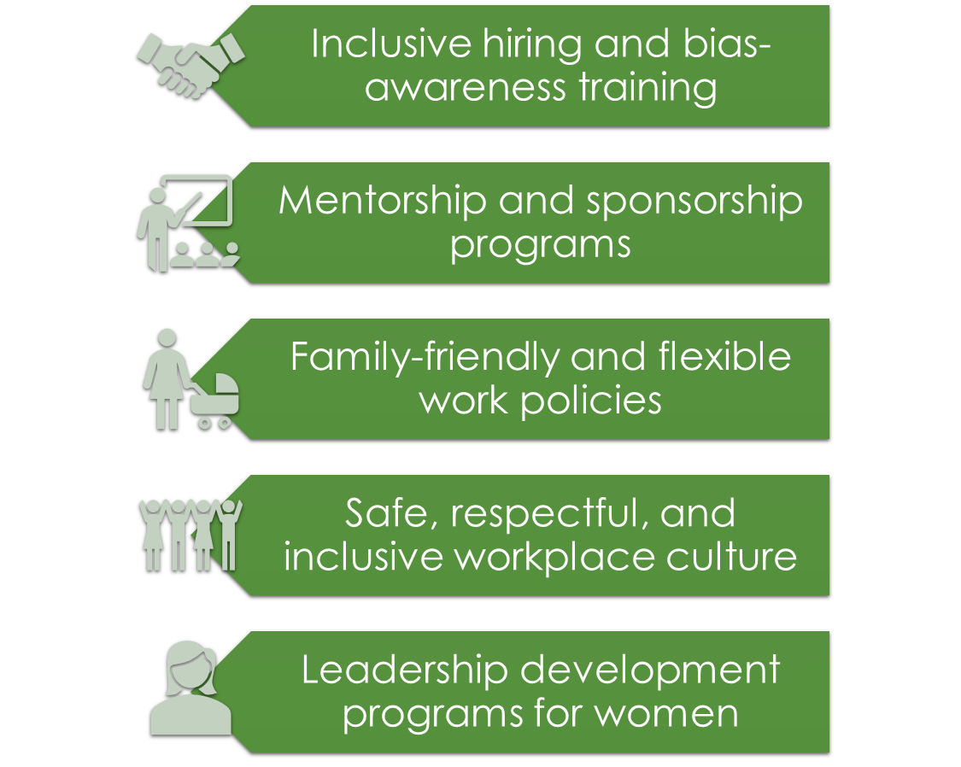

How Companies Can Make a Difference

Slide 10

Key Points & Final Thoughts
Gender diversity boosts innovation, decision-making, and profitability
Women face barriers in male-dominated industries, but progress is happening
Successful initiatives: WomenTech, 100 Women in Finance, NAWIC and many more
Investing in women is investing in business growth
"We’re raising our girls to be perfect, and we’re raising our boys to be brave. To truly innovate, we cannot leave behind half of our population. We have to be brave.“ – Reshma Saujani, Founder of Girls Who Code

Slide 11
THANK YOU FOR YOUR ATTENTION
ARE THERE ANY QUESTIONS?

