Slide 1
The Great Depression (1929-1939)
DIMITRIS MELAS

Slide 2
What was the great depression?
It was an economic crisis that started in the us in 1929 and shocked the world for a whole decade

Slide 3
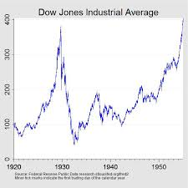
What caused it?
On October the 29th 1929 the New York stock exchange crushed

Slide 4
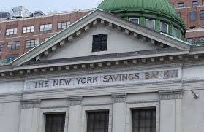
This led people to a bank run (running to get their money from the bank)

Slide 5
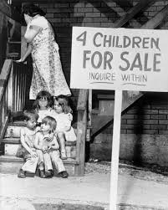
Unemployment reached 25% in the US and crushing poverty became the norm

Slide 6
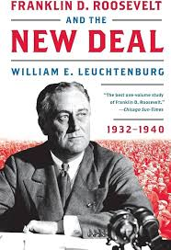
The solution
In 1932, Americans elected Franklin D. Roosevelt. He introduced the 'New Deal,' which created government jobs for people to build public works. It helped stabilize the economy and gave people hope

Slide 7
In the US 1.35 trillion usd were lost in todays money
The equivalent of 5 years of wealth produced in Greece today

Slide 8
Implications on Greece

