Slide 1
Occupational Burnout
Understanding Symptoms, Legal Status, and the European Landscape

Slide 2
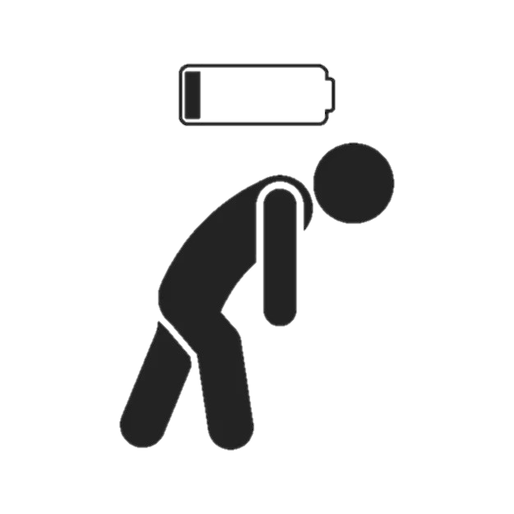
Definition & Core Dimensions
What is Burnout?
Recognized by the WHO (ICD-11) as an "occupational phenomenon" resulting from chronic work-related stress. It is directly linked to the work environment and organizational factors.
The Three Pillars:
  Physical: Exhaustion, energy depletion, chronic fatigue, sleep disorders, muscle pain.
  Emotional: Cynicism, feelings of negativism, loss of motivation, irritability.
  Cognitive & Behavioral: Reduced performance and productivity, isolation, procrastination.

Slide 3
Causes & Risk Factors (2025)
Excessive workload:
Unpaid overtime and increased work demands
External pressure:
Financial stress
Poor sleep quality
Care responsibilities (children/elderly)
Work environment factors:
Lack of control over tasks
Unclear expectations
Absence of managerial or peer support
Recovery may take weeks or months, depending on severity.
Key Strategies:
Setting clear work-life boundaries
Refusing excessive workloads
Psychotherapy (CBT)
Physical activity
Workloads adjustments

Slide 4
The Situation in Greece (2025)
Legal Status: Burnout is not yet officially recognized as a standalone "occupational disease" in Greek legislation and there is no “burnout leave”.
Regulatory Framework:
  Law 3850/2010: Mandates employers to protect workers' mental health and prevent psychosocial risks.
  Labor Code (P.D. 62/2025): Recent codification emphasizes working hour limits and employee protection.
Employee Rights: Workers can use sick leave (via psychiatric diagnosis) or exercise the Right to Disconnect. Cannot receive compensation based solely on a burnout diagnosis.

Slide 5
The European Union Landscape (2025)
Current Recognition:
  Latvia: Fully recognizes burnout as an occupational disease.
  France, Netherlands, Sweden: Use "open systems" where burnout can be recognized if a direct link to work is proven.
EU Initiatives:
  EU-OSHA (2025) Stats: 29% of EU workers report stress/anxiety and 40% face extreme time pressure.
  Quality Jobs Act (Feb 2025): A new EU strategy aimed at improving mental health at work.
  Policy Shift: Ongoing pressure for a European Directive on psychosocial risks.

Slide 6
Key Drivers & Statistics (2025)
Why is it rising?
  Economic Pressure: Cost-of-living crisis is a major stressor for younger workers (18-24).
  Gender Gap: 50% of women report burnout vs. 44% of men due to "double burden" (work & caregiving).
  Digital Fatigue: Constant connectivity leading to the erosion of work-life boundaries.

Slide 7
Prevention Strategies
For Individuals:
  Set strict boundaries and utilize the Right to Disconnect.
  Cognitive Behavioral Therapy (CBT) for stress management.
For Organizations:
  Implement "Mental Health First Aid" training.
  Redesign workloads and ensure transparent communication.
  Early detection through anonymous 2025 workplace well-being surveys.

Slide 8
Useful Links & Resources
European Agency for Safety and Health at Work: EU-OSHA
Greek Labor Inspectorate: Hellenic Labour Inspectorate
Mental Health Support: Click to Therapy - Burnout 2025 Guide

