Slide 1
AMERICAN WOMEN POETS OF THE 20TH & 21ST CENTURY
Dr. VASILEIOS N. DELIOGLANIS
CONFESSIONAL POETRY
Department of English Language and Literature, National & Kapodistrian University of Athens

Slide 2
POSTMODERNISM (1945-2000)
Socio-historical Context
Postmodern Condition
American Women Poets
The atomic bomb (Hiroshima & Nagasaki, 1945)
Jewish holocaust
Cold War
Economic affluence in US
Materialism
Capitalism
Experimental artists: innovative, pushing boundaries.
Fear, desperation, distrust, discouragement, doubt
Lack of innocence and honesty
Celebrate free spirit
Fight against conventions, conformity & socio-political
End of faith in absolute truths and master narratives
Superficiality & artificiality
Irony & playfulness
Fragmentation
Contingency & indeterminacy
Sylvia Plath
Anne Sexton
Adrienne Rich
Audre Lorde
Elizabeth Bishop
Mary Oliver
Louise Erdrich
Sandra Cisneros
Cathy Song

Slide 3
The Post-War Period (1950s)
economic affluence
progress, power and abundance
feelings of fear, doubt and desperation
Cold War - existential angst
Conservatism, social conformity, and communal patriotism
deviant groups are marginalized
Women – limited rights

Slide 4
Therapeutic; a means of self-expression
Confessional poetry a mix of: modernist experiment & intense lyrical exposure (of and against taboos)
Passage from private to public
Walt Whitman: 1st confessional poet
Confessional poetry vs. Eliotic aesthetic
No use of persona; “I”: persona
Dramatic monologs
Poem as deflection: prism effect
Poems as examples of moral courage
Alienation
Revelations / epiphany
Victory over pain and defeat
Irony, overstatement or understatement
CONFESSIONAL POETRY

Slide 5
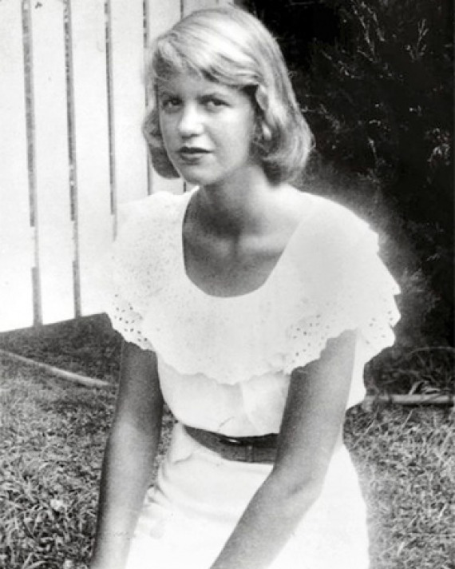
Sylvia Plath (1932-1963)

Slide 6
Sylvia Plath
Smith College and Cambridge education
unresolved psychological problems (Lapsed into episodes of severe depression)
marriage to Ted Hughes – June 1956
death of German father at 8 years and life-long depression (two prior suicide attempts, death by suicide), divorce from Hughes
Children: Freida and Nicholas
Hughes having affair with Assia Wevil, sent her into depression
The Bell Jar (1963)
Ariel (1965)

Slide 7
“Lady Lazarus” (1962)
Themes: Suffering, Violence, Death
Biographical Fallacy
Plath’s death: placed her head in the oven with her two children still in the house
Won Pulitzer Prize – 1982 for Collected Poems
Process of self-discovery
Models of authority/masculinity
Experience and insight
Historical / Social / Political Context
Emphasis on particular words / repetition
Apostrophe
Synecdoche
Alliteration
Rhyme: inconsistent / irregular
Enjambement
Line length alternates and affects the emotional impact of the poem

Slide 8
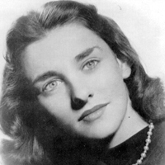
Anne Sexton (1928-1974)

Slide 9
Anne Sexton
wife, mother, and poet
mental illness / committed suicide
more autobiographical than Plath’s confessional poetry
poems appeal powerfully to the emotions
female topics: childbearing, the female body, marriage
other topics: madness and death

Slide 10
“The Truth the Dead Know” (1962)
Subjective tone
Rhyme: abab
confessional elegy on the death of her parents in 1959
Themes: death & vanity of life

