Slide 1
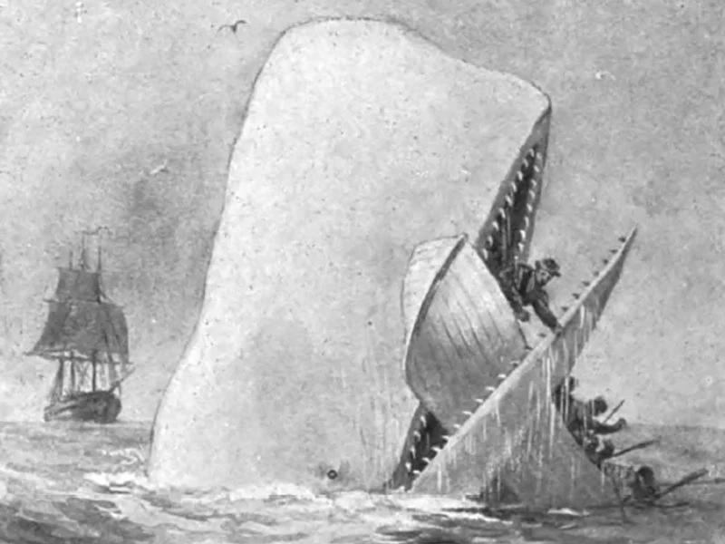
WHITEOUT
The Power of (No) Color

Slide 2
“LA LLORONA”
-“woman in white” motif (succubus; water-nymph: rusalka, lamia, siren)
-physical VS metaphysical emphasis (la familia, religion)
-Julia Kristeva (Powers of Horror): abject motherhood, patriarchal horror of incest
-function:
charter scare of complaining women (or women suffering from post-partum depression), cheating men
anxieties of the patriarchal oppressor
femininity definition (woman as angel-abject)

Slide 3
Water Symbolism
-the dual (positive-negative) symbolism of water (tears) and white color:
womb-tomb motif (the Santa Muerte cult)
woman as water-related (Tethys; Tiamat; Yemanjá): sea as amniotic fluid
-the import of rivers as time in folklore symbolism
linear vs cyclical time, reversal of time and return to virginity the womb a taboo/sign of divine power

Slide 4
MOBy-DICK (1851)
“HERMAN MELVILLE CRAZY” reaction to tale, BUT
-knowledge and use of the power of exotic folklore to embellish actual incident
-“a whale of a tale” literally
Biblical references
Ahab as Miltonic Satan (pointless vengeance against natural wonder, hatred of incomprehensible creation and mystery of God’s prerogative)
Whaler’s harpoon as Satan’s pitchfork; lameness as being spiritually “off-balance”
Sea as the vast, fertile, savage and marvelous “continent”, a metonymy for the divine
Moby Dick (godlike) traits:
abnormally white
gigantic
ubiquitous” (mysterious pathways)
“immortal”
marked, crooked, corkscrewed, humpback, wrinkled forehead ferocious, wrathful
“all evil” of the world (acc. to Ahab)

Slide 5
Meaning of White
The importance of white beasts
White Dog, Stallion, Bull, Stag, Buffalo, Swan
the (super) natural American land/sea
veil of incomprehensible miraculousness (sacred beast)
horror vacui

Slide 6
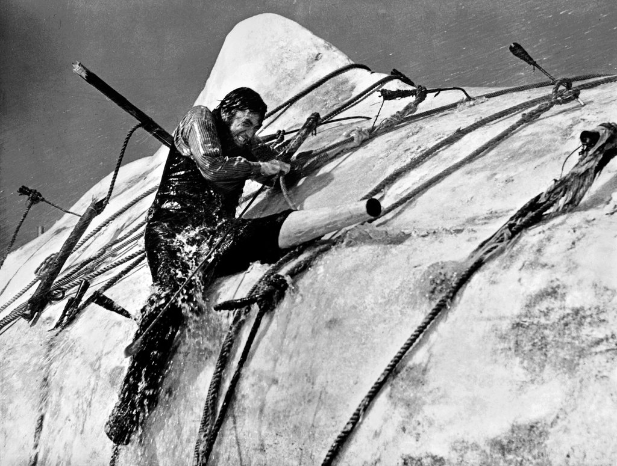
Gregory Peck as Ahab in 1958 John Huston’s Moby-Dick

Slide 7
The hunt for (White) flesh
The hunt for white flesh
-Ahab’s missing leg: castrated Oedipal son
-sea as “Mother Womb/Tomb” (rocking and sinking boat)
-whale as Abject Feminine (feeds and terrifies)
-ending: incest punished—death in amniotic whirlpool, tied to umbilical harpoon-rope

