Slide 1
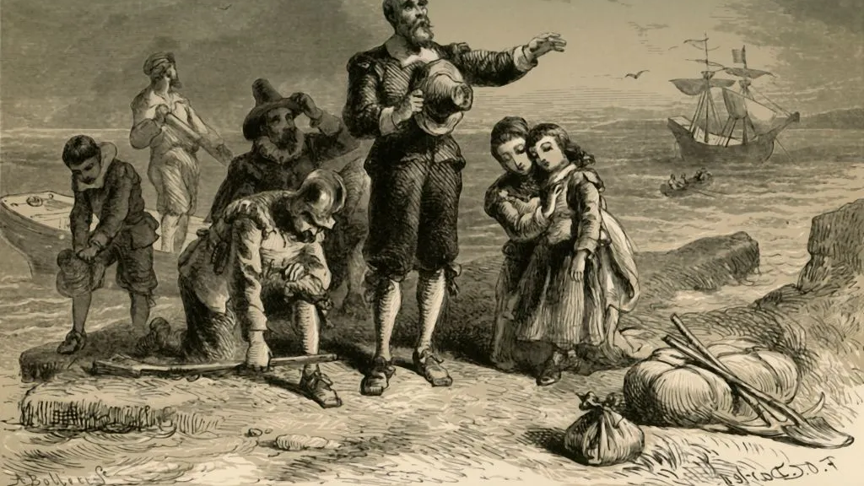
The puritan origins of america
Or, How to Make a Myth out of Oneself

Slide 2
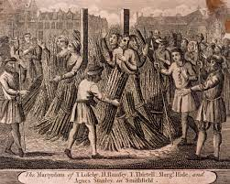
Historical context
The Puritans’ view of themselves in Europe: a. religious persecution
b. temptations for the youth
c. corrupt aristocracy
d. removed from own country anyway (Israelite exile in Egypt)→ Atlantic crossing as Israel in the desert, America as “New Canaan”
e. bourgeois merchants and skilled workers—had funds to immigrate

Slide 3
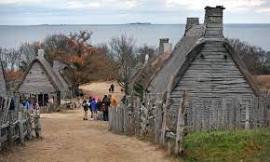
Plymouth Plantation
November 11, 1620: Mayflower lands on Plymouth Rock; the Mayflower Compact
European separatism: “Pilgrims”, the “saints”, the “Elect”, the “New Israel”, the “Chosen People”
Goodie, Goodman, American Adam
New Jerusalem, City on a Hill
Puritan work ethic
Teleology, predestination, saving grace, typology
Thanksgiving (1621)
The “Devil’s Territory”; the Salem Witch trials
Hellfire & brimstone sermons (Jonathan Edwards, 1700s brief revival)
→self-fabulization
Strict theocracy and prejudice later reviled—Nathaniel Hawthorne

Slide 4
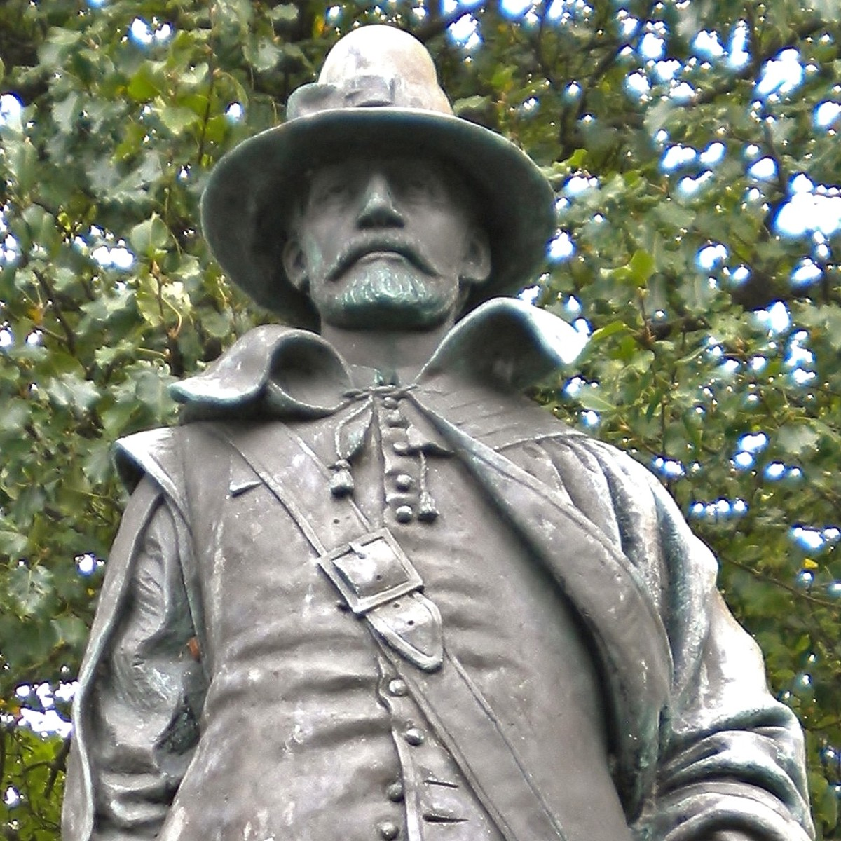
WILLIAM BRADFORD (1590-1657)
First governor of Massachusetts Bay (Plymouth) colony
Of Plymouth Plantation retrospective “journal” (1630-50)
I. The Crossing of the Atlantic:
Myth of corrupt, sinful Europe
Politico-religious community (VS Elizabethan England); bourgeois tradesmen
God as director/ punishes wicked, rewards good
Fabulistic/teleological elements (events, vocabulary)
II. The New Eden/ Devil’s Territory
Native relations: prejudice VS reality VS teleology (corn as manna, Squanto and Samoset as “angels”)
First Thanksgiving—ritual, epic on-the-go
Why did Puritanism become prevalent, if they weren’t the majority of the settlers in America (100 colonists, 50 dead from 1621 plague)?

Slide 5
COTTON MATHER (1663-1728)
Son of Increase Mather and grandson of John Cotton; last of old-line Puritan celebrities; gifted scholar/historian
Magnalia Christi Americana (1702): a “historical” account of the settlement of the New World
“The Wonders of the Invisible World”
The Salem Witch trials (Feb. 1692-March 1693):
Tituba as scapegoat
mass hysteria
150 arrested, 19 hung+ 6 tortured to death
judgment unofficially questioned (Mather as “revisionist” via textuality)

Slide 6
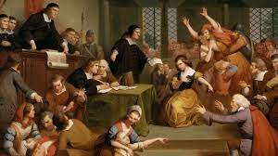
The Trial of Martha Carrier
paranormal events for “facts”
accusers were neighbors, wanted her land
WHY SUCH DEVIL PARANOIA AMONG THE “SAINTS”?

