Slide 1
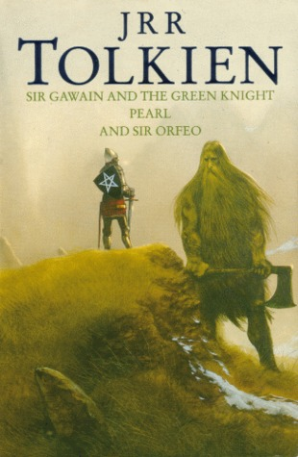
SIR GAWAIN AND THE GREEN KNIGHT
Knighthood inside and out

Slide 2
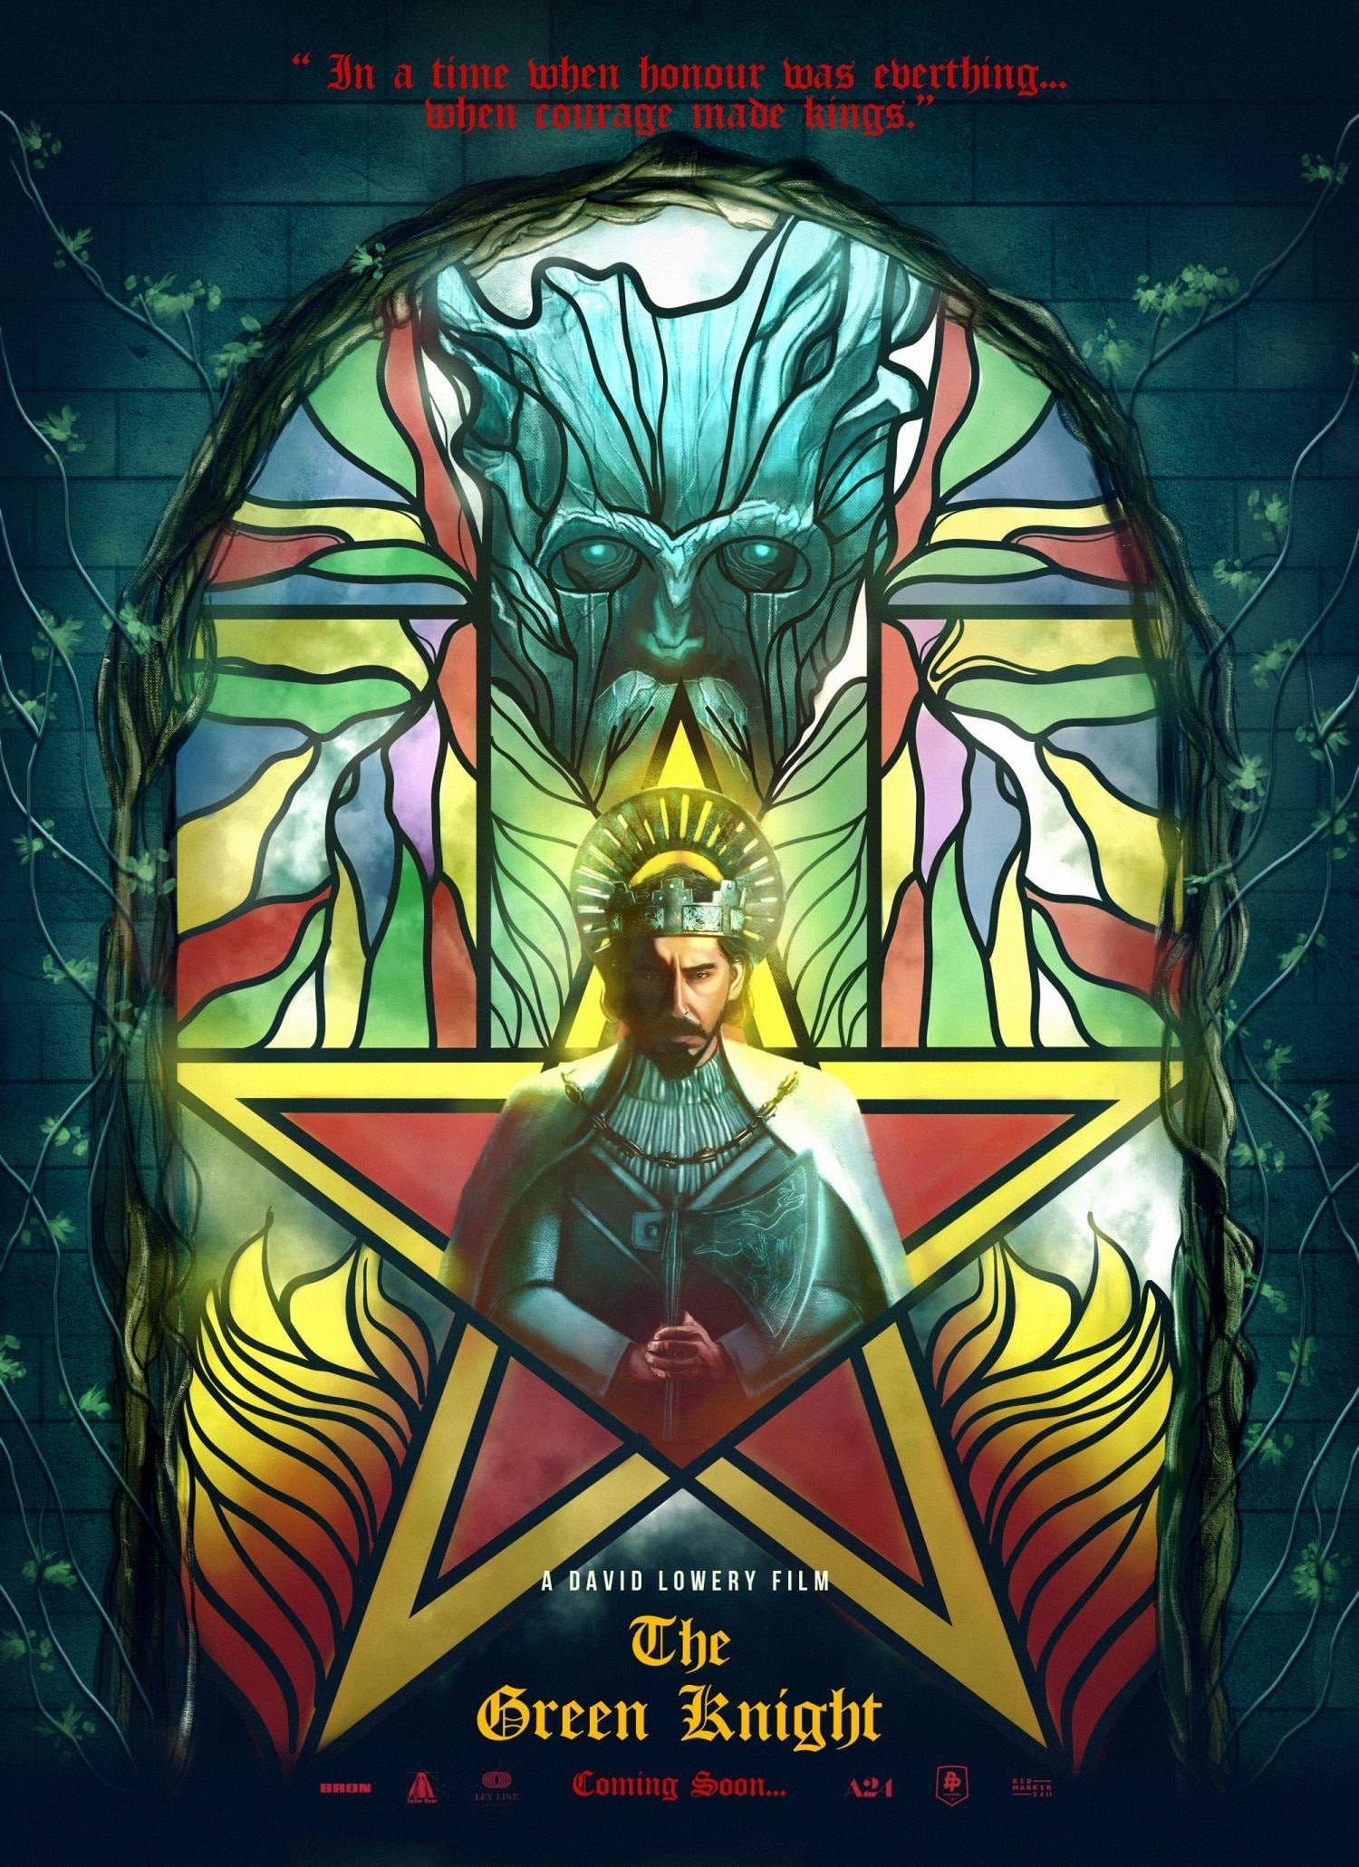
Written c.1375 (by Pearl poet?)
“The finest Arthurian romance in English” (Norton, 156)
Popularity of medieval romances: exotic adventures + love trysts (often explicit!)
Origin in 12th-century tales
“Alliterative Revival” 2530 ll. variant of the “Beheading Game” lay: alliteration + “bob and wheel” (short line followed by rhyming quatrain) ending of each stanza
Optional: watch the event commemorating Tolkien’s lecture on “SGatGN” at https://www.youtube.com/watch?v=Q4c_bKoTM0k

Slide 3
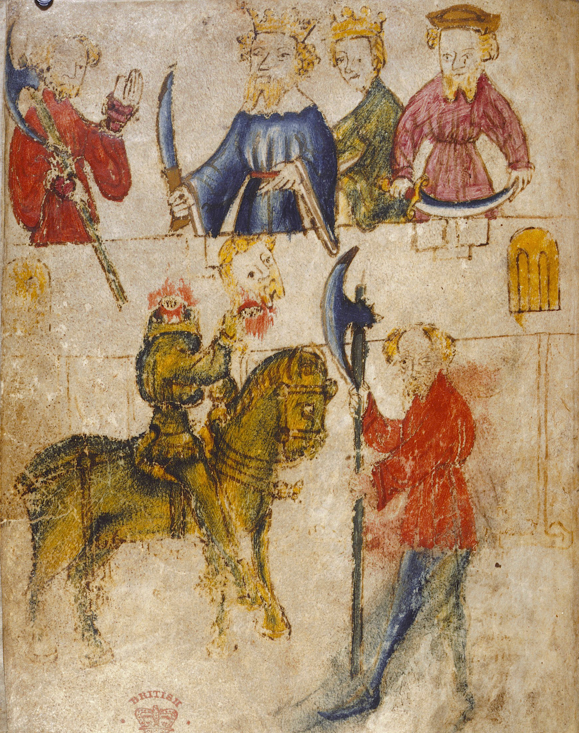
Sir Gawain, ll. 1-1125:
Poem starts with genealogy from Troy—import of royal bloodlines
Pretense of orality (ll. 30-32)—why?
Plot

Slide 4
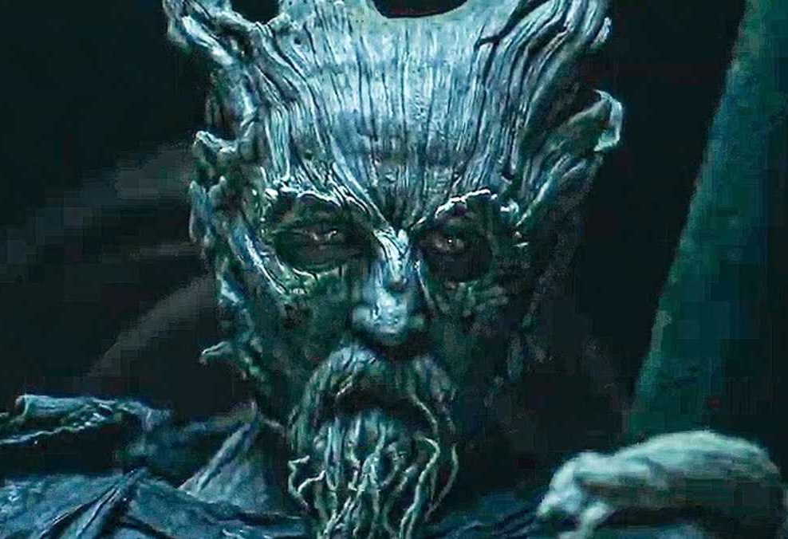
Symbolic elements
-setting and time—New Year’s Day -the castle hall (locus amoenus) vs the forest/countryside (streams, mountains) -colors (Bercilak’s and Gawain’s) -Gawain as a solar hero -Holly sprig and ax -Gawain taking up the challenge as “most unworthy” (l. 354) -the beheading game

Slide 5
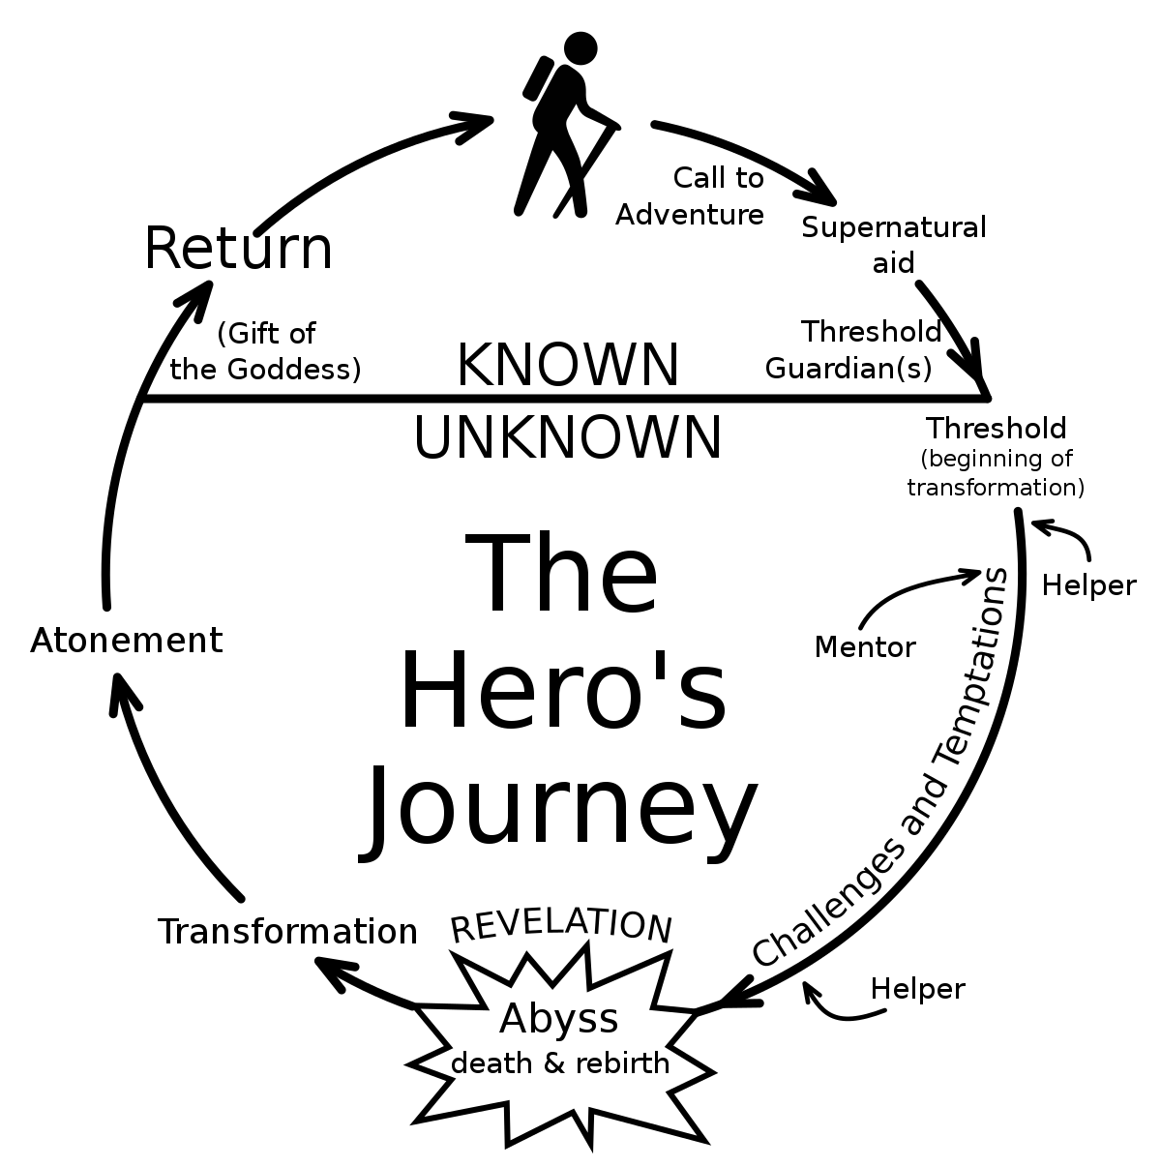
The Knight’s/ Hero’s Quest Joseph Campbell’s Heroic Quest Cycle (from The Hero with a Thousand Faces, 1949) -Based on Lord Raglan’s idea of the monomyth (24 traits)

Slide 6
-The pentagel (pentalpha, pentacle): 5x physical, religious, courtly, knightly
→Chivalry and trawthe (“troth”/”truth”)
-The forest castle and the two ladies
-The second exchange game Gawain undertakes blindly

