Slide 1
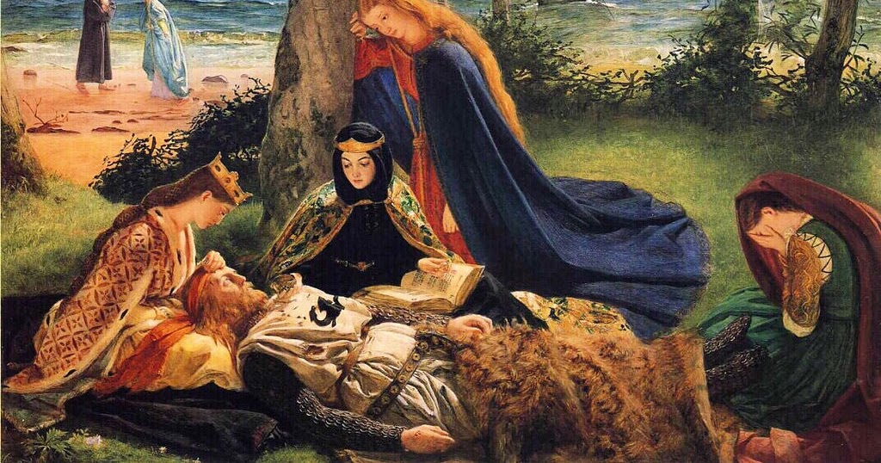
Le Morte D’Arthur
Part II
by Sir Thomas Malory

Slide 2
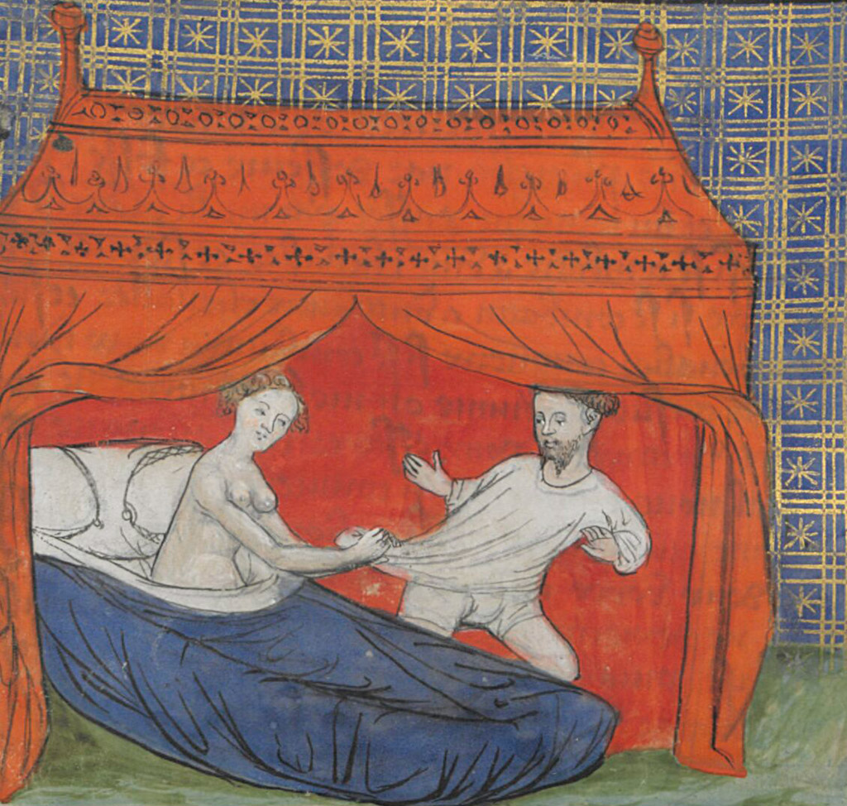
HIEROS GAMOS
Book 11, chapters I-X;
Siege Perilous and dragon’s lair prophecy of
Galahad (lion), son of Launcelot (leopard): what is higher than knightly might and virtue?
“Boiling” naked Elaine (daughter of Nimue?!) redeemed by Launcelot=metaphor?
Vision of Holy Ghost and Sangreal in King Pelles’s castle (Corbenic):
  horn/cauldron of plenty;
  experience linked to Launcelot’s sexual union with Elaine
  Launcelot’s own desires versus divine fate: symbolic of oath of knighthood, his earth-bound existence

Slide 3
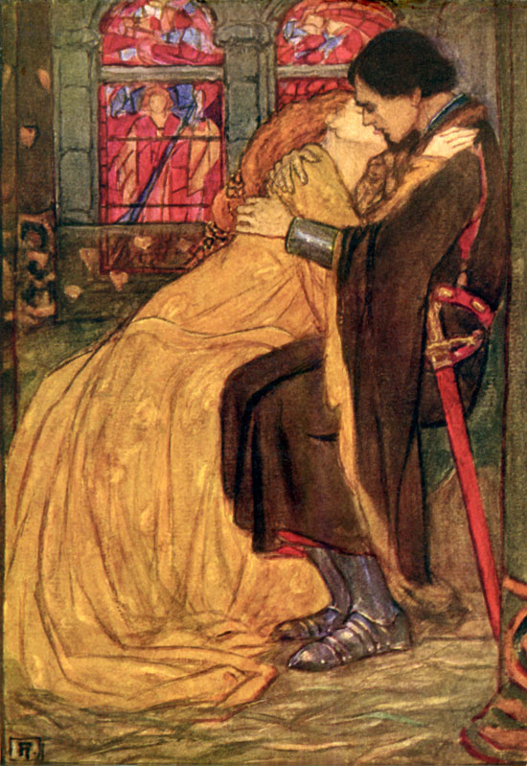
Launcelot & the ladies
Launcelot’s trouble with women→
prisoner of Morgan Le Fay
in trouble with the jealous queen
raped twice through enchantment
naked in the thorns and running off mad for two years because of Elaine’s enchantments
Book 12, ch. IV-VI
Lancelot ends up a kept fool, reunited by chance with Elaine, healed by Sangreal
Self-exiled for shame to Joyous Isle as Le Chevaler Mal Fet
What is the meaning of such adventures?

Slide 4
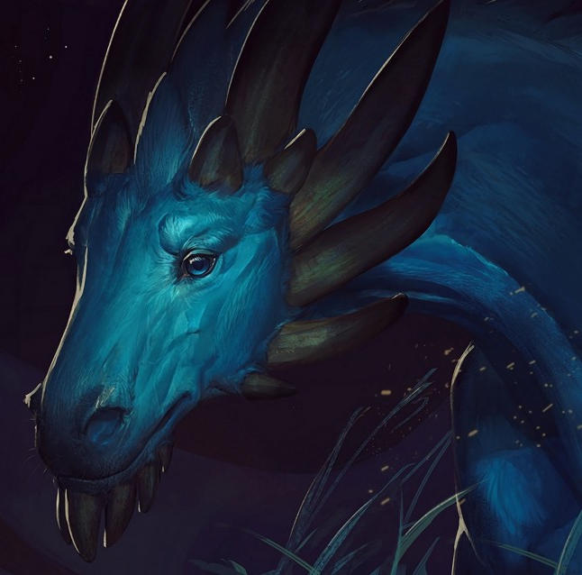
The VISION OF SIR BORS
wounded by the flaming spear (of Longinus)
-wounded again by a volley of arrows and crossbow tips (quarrels)
-slaying of lion
-battle of “horrible” leopard (Launcelot) and dragon with “Arthurian” gold writ on his forehead
-dragon then devoured by his 100-drake spawn
-old harpist with two adders around his neck
-procession of four children and old man holding “Spear of Vengeance”
-silver altar and hovering silver-bright sword that blinds Sir Bors momentarily (not worthy)
→ meaning?

Slide 5
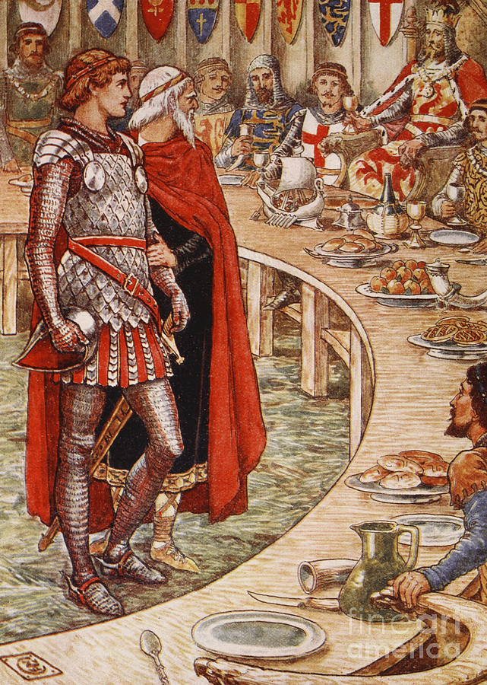
The rise as the fall
Book 13, ch.1-VIII
Galahad raised in a nunnery, made knight by his own father
(unknowingly), at the request of a damosel of King Pelles’ castle
Sword in the stone AND sword in lake (here river) miracles repeated
together on a Pentecost for the Knight who will find the Sangreal
→ Arthur’s replacement, or heavenly parallel?
Are the KoRT’s reactions to Galahad’s miracles same as when Arthur
accomplished his feats?
Galahad’s sword—Balin’s brother-killing sword—Spear of Longinus (causes unhealable wounds)
Damosels as bearers/messengers of the Sangraal
Miracle of Camelot, c/c to Pentecost Epiphany: knights must depart and scatter for Grail Quest
→dissolution of Camelot (like Lancelot, the best of earth, but not enough)

Slide 6
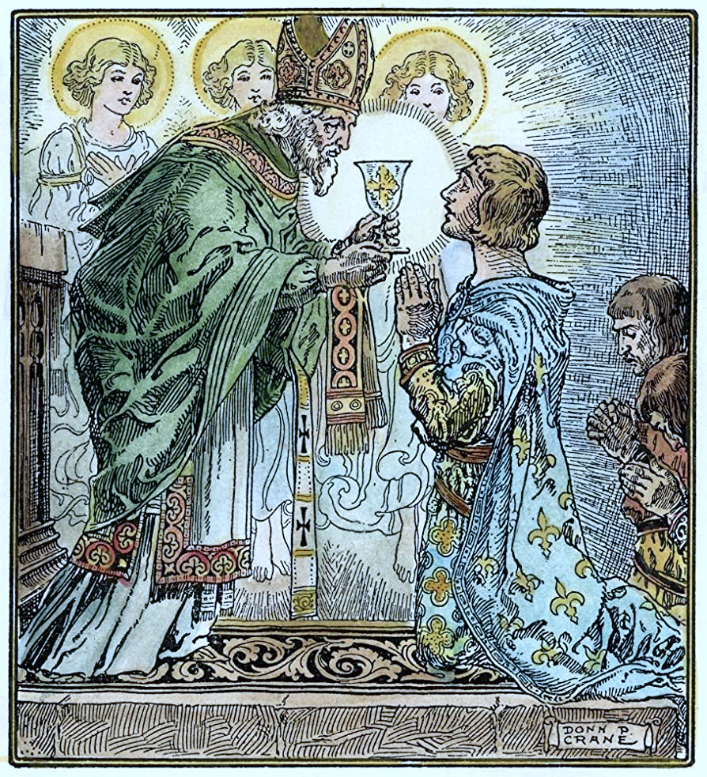
The holy grail/sangraal
Book 17, ch. XVIII-XXIII
Galahad heals king Mordrains of blindness and old age—king is delivered.
Forest Perilous miracles: well of lechery loses flames at Galahad’s virgin touch
Subterranean tomb of Simeon in Land of Gore; Galahad passes—and extinguishes—ring of Purgatory fire; second delivery of Grail guardian.
Miracle of the restored sword; literal transubstantiation and mass by Joseph of Arimathea (vision of Jesus as transcendental signified)

Slide 7
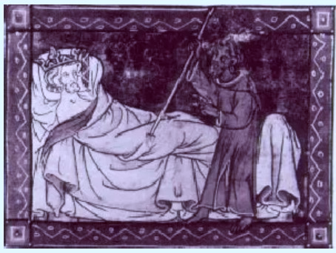
The maimed (fisher) king
Healing of the Maimed (Fisher) king
Bearing of Sangreal to city of Sarras by three knighs on ship with Percivale’s dead sister; healing of cripple; burial of Percivale’s sister;
Belly of the beast (prison); king Estorause shriven and delivered;
Galahad king of Estorause, makes Holly Vessel (golden box that houses silver tabernacle and Sangreal); Galahad delivered along with Sangreal and Spear.

Slide 8
Uncivil war
Book 18, ch.I
Foreshadowing of Camelot’s undoing through Agravaine and Mordred’s gossip of Lancelot and Guenever’s adultery
Book 20, ch. I-X, XXI-XXII
Agravaine and Mordred betray Lancelot and the Queen—division and strife (in the guise of piety)
Switch to dialogue from narrative: lyrical over epic
The castle made out of love and shame, Joyous Garde, now a refuge for the queen and Lancelot.
Arthur’s reaction when he hears of Launcelot being caught with his queen, and escaping
Gawaine’s reaction when he hears Launcelot has slain his brother too (along with two of his sons before)
→political over private priorities
Slaughter among the KoRT; unwitting death of innocents, Gareth and Gaheris (plot device; symbolic)
Gawaine against Launcelot.
Another siege for the adulterous love of a woman.

Slide 9
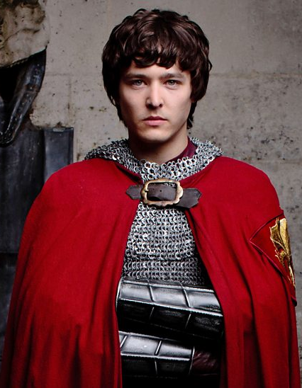
From oedipal to political
Book 21, ch. I-VII
Mordred a usurper of his father’s throne, wife→ twice cursed
Failure of Mordred to break siege of Guenever’s Tower-of-London sanctum—symbolic of?
Mordred’s use of fake news and populism to sway Englishmen—Malory’s indictment
Gawaine’s last noble act: death-bed letter of reconciliation with Launcelot
Miracle dream of Gawaine’s ghost
Adder as inescapable destiny
True death: all KoRT slain before the King’s eyes
Arthur killing Mordred: why didn’t he wait, as advised?

Slide 10
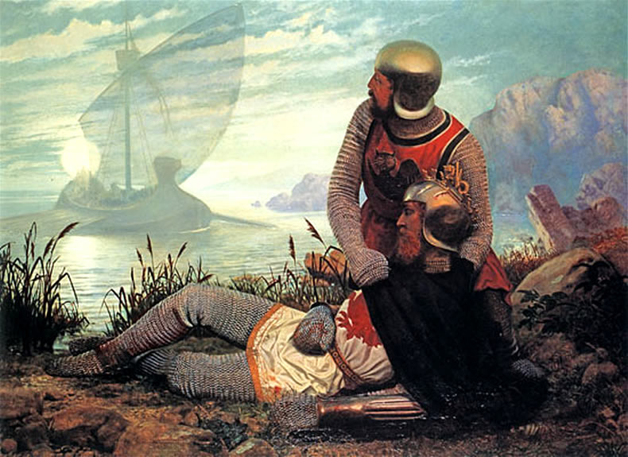
The downfall
(and rise again?)
Grim image of pilferers after battle—utter dissolution
Last knight disobeys king’s deathbed wish twice for greed—delay deadly for the king
The barge of magical queens (Morgan as beneficent)
King buried in chapel by hermit/Bishop of Canterbury, watched over by last knight turned hermit
Ch. VII “Yet some men say…”: Arthur becomes legend.

